Slide 1
ATCA availability and shelves procurement

Slide 2
Outlook
ATCA availability/market (reminder of nVent’s presentation of May 2023)
ATCA procurement framework at CERN (also a reminder)

Slide 3
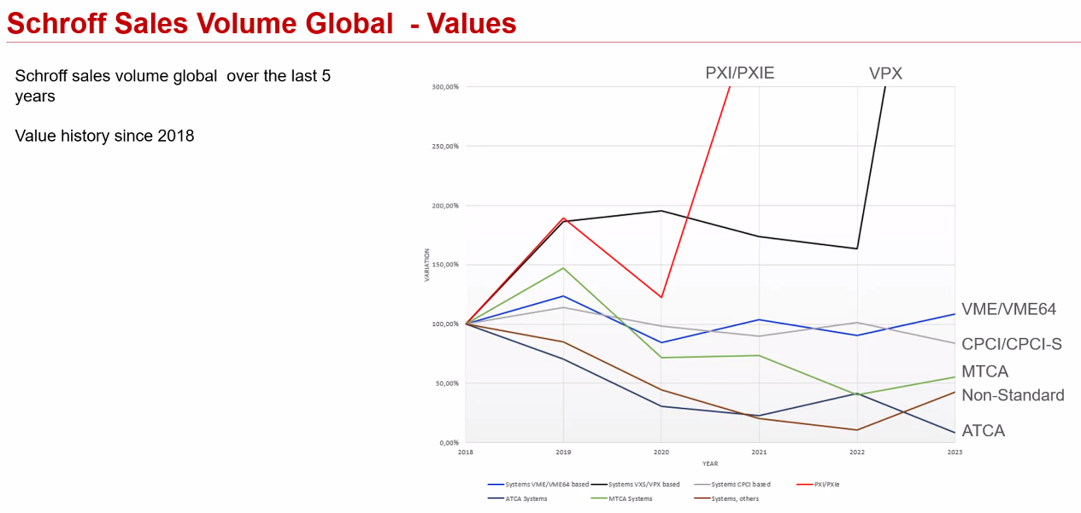
ATCA availability
ATCA market situation and nVent product roadmap – nVent presentation of May 2023 during the 18th ATCA IG
Screenshot from Ralf Waldt’s nVent presentation @ 18th xTCA Interest Group Meeting, May 23

Slide 4
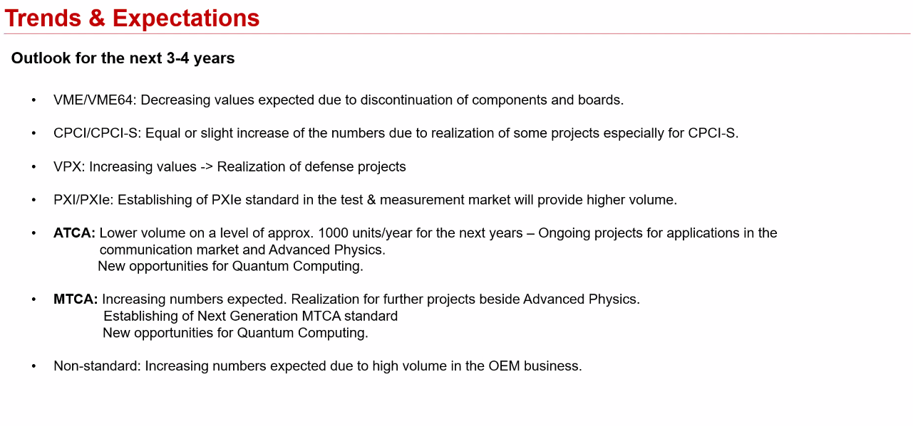
ATCA availability
ATCA market situation and nVent product roadmap – nVent presentation of May 2023 during the 18th ATCA IG
Screenshot from Ralf Waldt’s nVent presentation @ 18th xTCA Interest Group Meeting, May 23

Slide 5
ATCA availability
ATCA market situation and nVent product roadmap – nVent presentation of May 2023 during the 18th ATCA IG
Two interesting questions:
Which standard is telecom using now?
« Telecom is using OCP => Dedicated standard, not running well. Now telecom is going into server solutions, in accordance with OCP standard, SW as a service. No dedicated HW anymore. »
Will ATCA disappear?
« ATCA is now quite low but stable, so Schroff intends to keep this active for the coming years. In addition, quantum computing needs a lot of power, modularity, high precision clocks and low latency.
QC then often go to PXI, MTCA and ATCA and some manufacturers already went to ATCA. QC is growing market. »

Slide 6
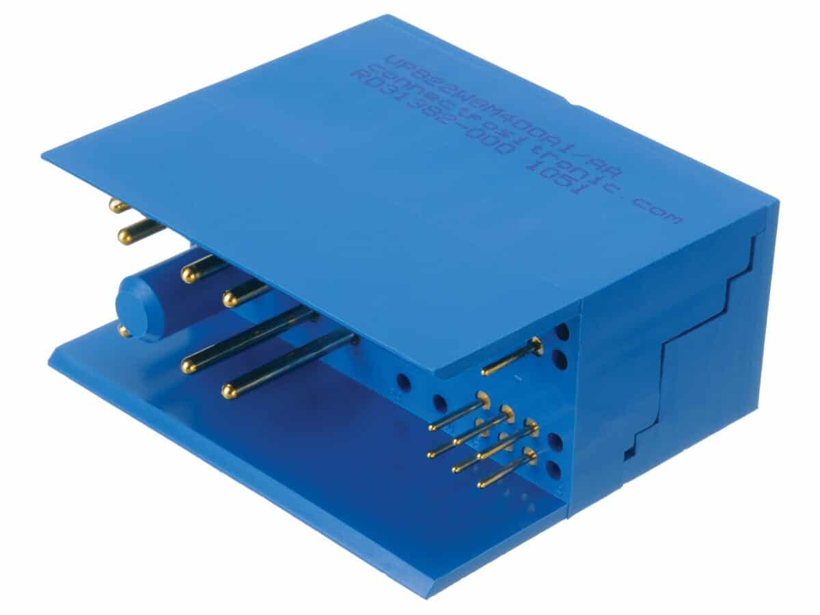
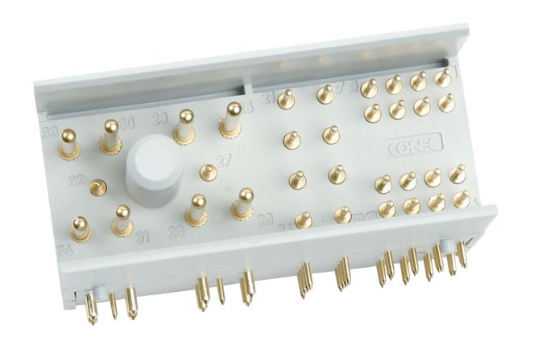
ATCA availability
Focus on the ATCA connector availability – nVent reply date August 30 2023
  Concerning connector type I:
  We assume that the volume of this type of connector will decrease because fewer and fewer applications are being implemented. Some connector manufacturers will focus on the automotive sector because they expect volume business there.
  As shown in our presentation during the ATCA session this year we have also recognized that the numbers for the ATCA decline. There is still business but on a lower level in the communication business and we see coming up interest for ATCA in the Quantum Computing.
  We have received messages from TE and from EPT that they will cancel this type of the ATCA power connector (male, female is continued) which are used for the plug-in units. There are still some manufactures who are providing the ATCA power connector Z1 male version:
    Nextron/Leanpac: https://www.nextrongroup.com/products/connector/Power_Connectors/ATCA_series?Gender_%26_Mounting_Angle=Male+Right+Angle&Number_of_pin=34
    Conec: https://conec.com/catalog/en/atca%20messerl.%2034p%20l%C3%B6tstift%2090%C2%B0-16649.html
    Positronic: https://www.connectpositronic.com/series/vpb/

Slide 7
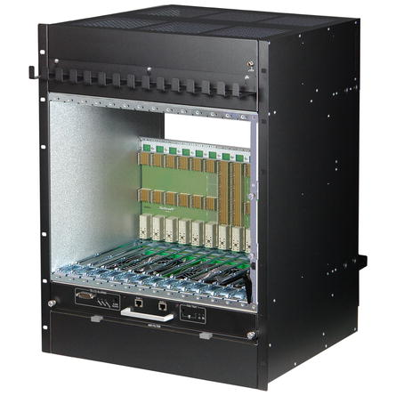

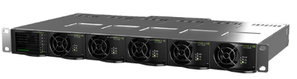

Procurement and maintenance framework - Reminder
Target
      Total estimated needs
        ATLAS: 100 - 130 units
        CMS: 100 - 130 units
      Technical requirements: No change compared to the original price enquiry for limited quantities.
  Total estimated : 250 shelves
  Blanket purchase contracts
  For both, ATCA shelves and AC-DC rectifier units
  Covering procurement and maintenance over long term
ATCA shelf
14 ATCA slots w. RTM
Vertical (or Horizontal) cooling
DS or FM topology
40G backplane (100G optional TBC)
Bussed IPMB (Radial upon request)
1 Shelf man. Included (PP ShMM 700)
- 48Vdc rectifier system
Up to 18 kW max output pwr
(w. expansion unit)
9 kW with N+1 redund. (one 1U unit)
Based on 5 pwr bricks
Single bulk power output
Ctrl module (SNMP over eth.)

Slide 8
Procurement framework for ATCA shelf and -48V rectifier - Reminder
Orders so far on contract B1660 | # | Topology
Mar 24 | 2 | Bussed
Oct 23 | 7 | Bussed
Dec 22 | 88 | Bussed
July 22 | 5 | 69 bussed, 19 radial
Apr 22 | 7 | Bussed
Dec 21 | 6 | Bussed
Total | 115
Main contractual conditions
Delivery lead-time: 10 weeks from ordering date *
Warranty duration: 2 years from delivery date
Long term maintenance:
  Fixed repair prices for every type of equipment (independent from the failure reason)
  Subject to a 3 months repair warranty
  Fixed verification prices for every type of equipment
  Mostly applied in case of «no fault found»
Faulty equipment: «fault report» to be registered in the DB prior to equipment return at the ePool reception
  Subject to budget code registration. But DAI is issued only if equipment is out of warranty
  * Revised to up to 6 months for the Eltek AC-DC !
Link to the technical DB for the procurement requests: https://aisdb.cern.ch/pls/htmldb_aisdb_prod/f?p=117

Slide 9
Thanks for your attention
Any question?

Slide 10
Backup/Spare slides

Slide 11
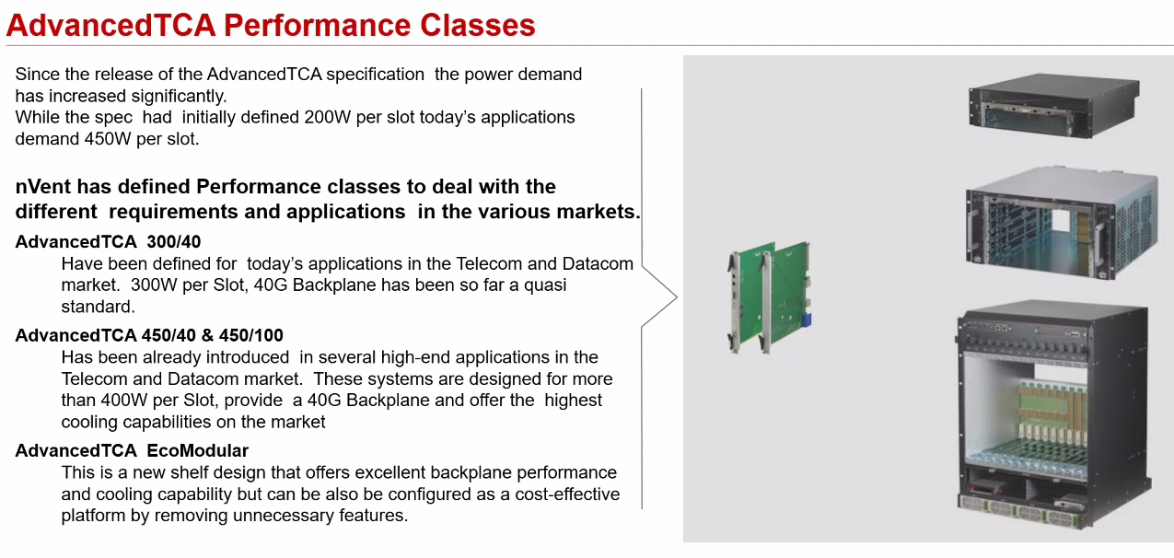
ATCA availability
ATCA market situation and nVent product roadmap – nVent presentation of May 2023 during the 18th ATCA IG
Screenshot from Ralf Waldt’s nVent presentation @ 18th xTCA Interest Group Meeting, May 23

Slide 12
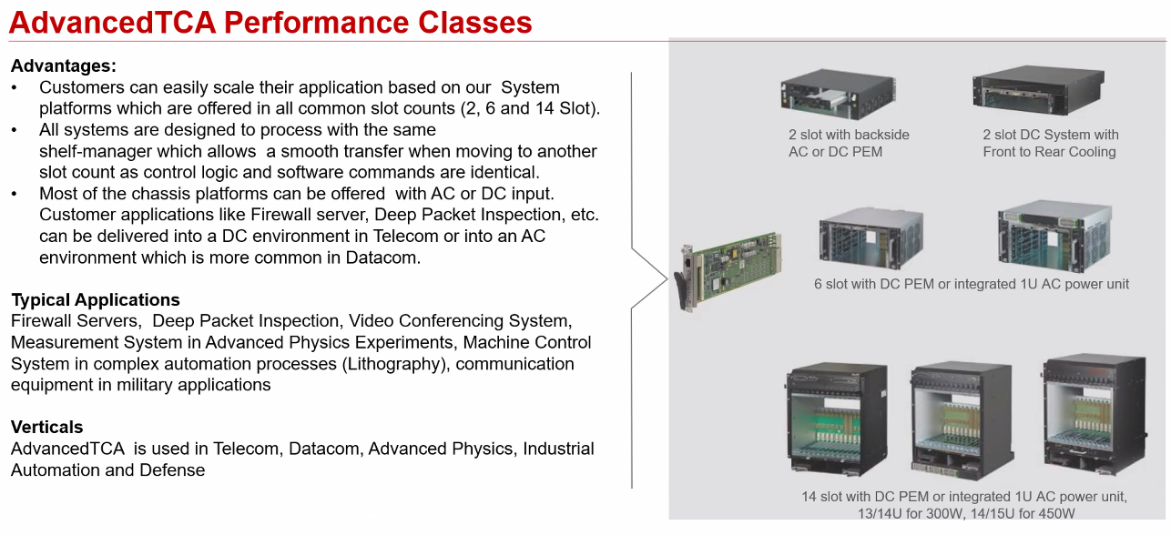
ATCA availability
ATCA market situation and nVent product roadmap – nVent presentation of May 2023 during the 18th ATCA IG
Screenshot from Ralf Waldt’s nVent presentation @ 18th xTCA Interest Group Meeting, May 23

