Slide 1
Numerical estimation of optimal eco-friendly gas mixtures in gas-based tracking and timing detectors
Dario Stocco
HVL-CERN Collaboration Meeting, Winter 2024
2024-02-14

Slide 2
Project Objective
Research Goal
Numerical prediction of performance of the trigger RPC setup using various alternative eco-friendly gas mixtures. Identify optimal mixtures and validate them through lab-scale experiments.
Systematic parameter-space scan
Garfield++
Novel cross-sections of eco-gases
Gas mixture selection
Detector performance
Proposed alternative gas mixture
Quantify performance

Slide 3
Content
R134a cross-section set update
  Standard mixture swarm parameter measurements
  Ion mobility measurements
Electric Network Pipeline
  (BSc Thesis) Signal analysis by Patrick Zimmermann
  Multiconductor transmission line
  Coax cable attenuation
  Digitizer sampling
RPC Simulation
  Results
Outlook and Conclusion

Slide 4
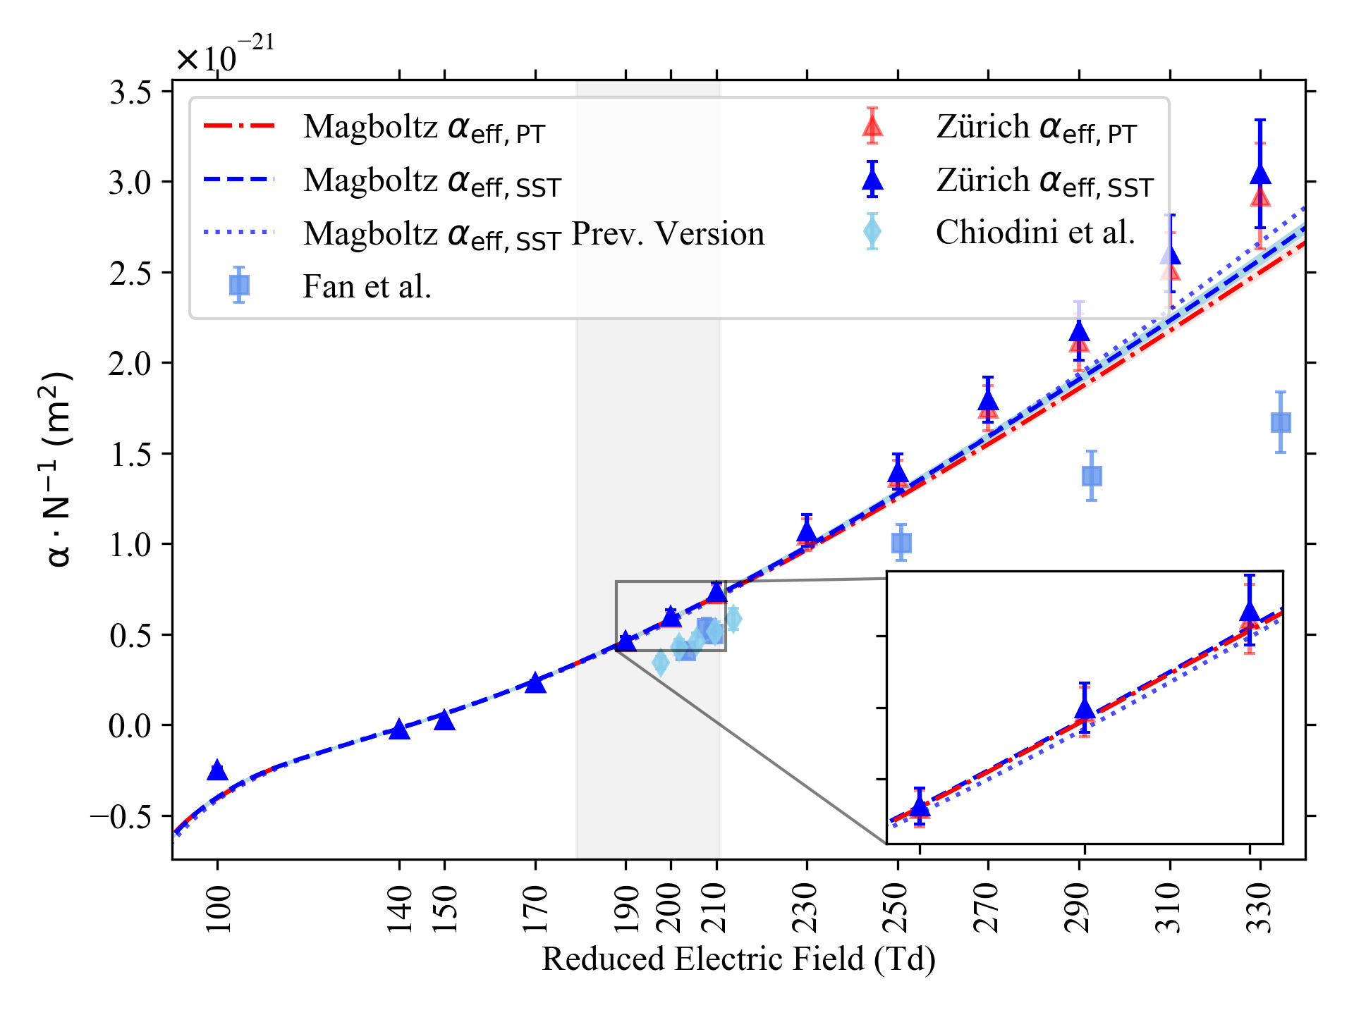
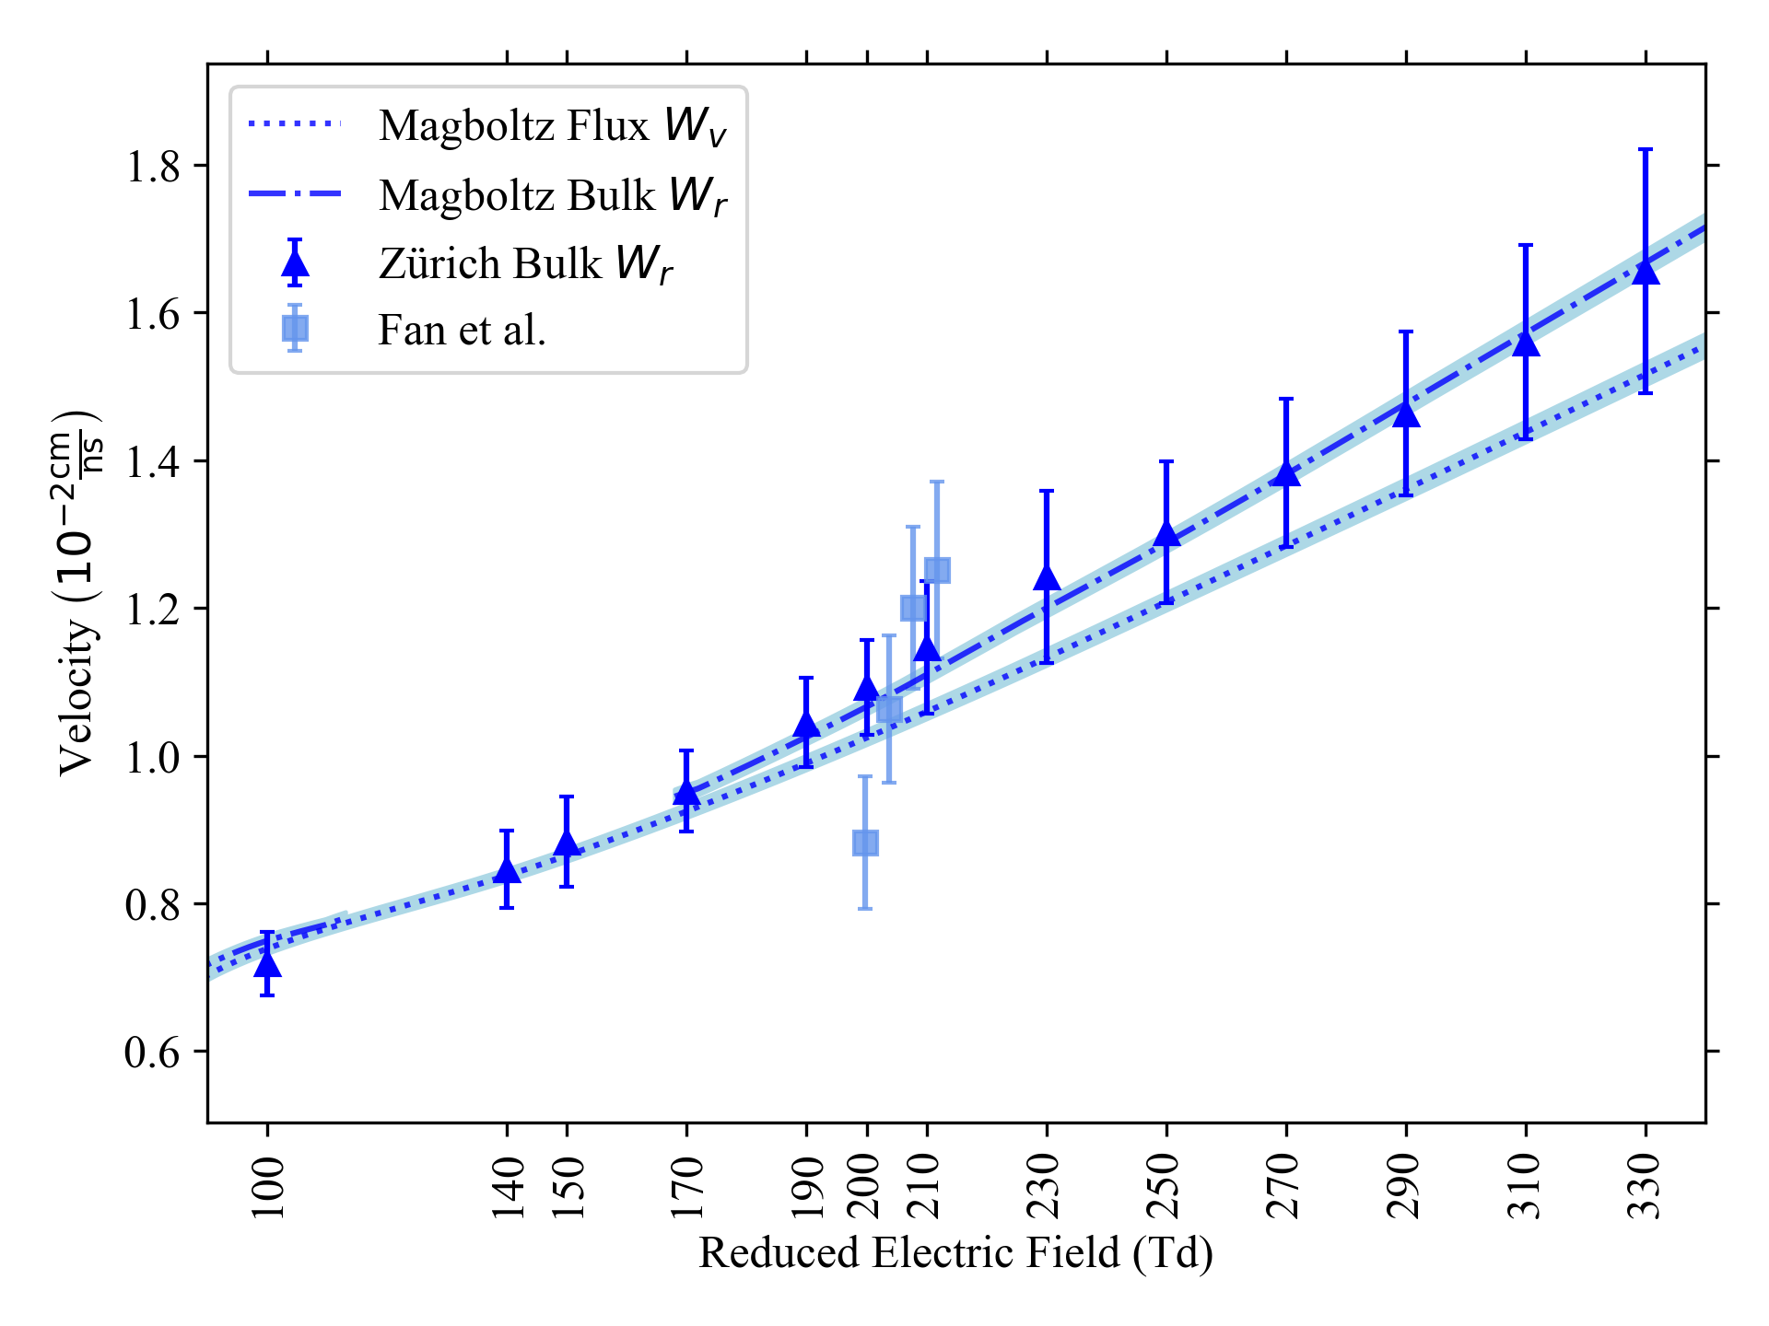
R134a Update:
Standard Mixture PT Measurement
[1] G. Chiodini, et al., Nucl. Instr. and Meth. A 602 (2009) 757-760
[2] X. Fan, et al., Nucl. Instr. And Meth. A 1024 (2022), 166124
Figure: First Townsend coefficient in SST and PT picture compared to literature values.
Figure: Flux and bulk drift velocities compared to literature values.

Slide 5
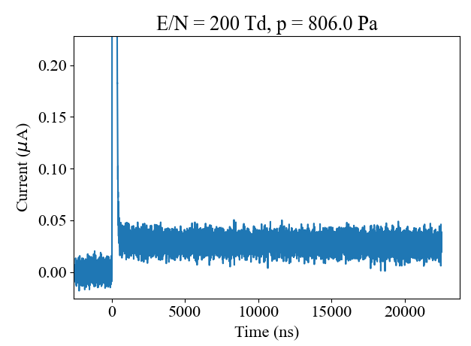
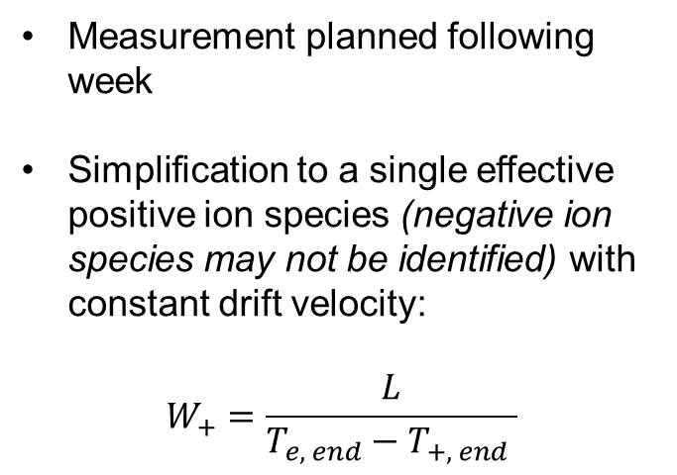


R134a Update:
Standard Mixture Ion Mobility
Measurement planned following week
Simplification to a single effective positive ion species (negative ion species may not be identified) with constant drift velocity:
$$W_{+}=\frac{L}{T_{e, end}−T_{+, end} }$$
$$T_{e, end}$$
$$T_{+, end}$$
Figure: Recorded PT signal. Fast electron signal starting at 0 ns and following consequent ion signal with duration longer than 20 us.

Slide 6
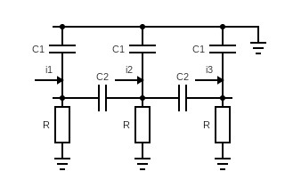
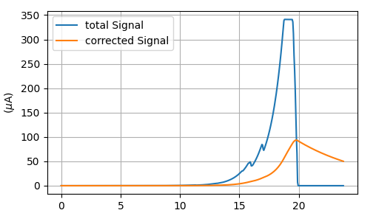
Electric Network
What we have seen last collaboration meeting:
Figure: Network describing the RPC setup, with currents i1..3 generated by the simulation [0].
Figure: Typical simulated signals. Without (blue) and with (orange) network.
Did not explain structure of recorded wave-form
Time-over-threshold estimation has been too large compared to measurements

Slide 7
Bachelor Thesis: Classification & Quantitative Analysis of RPC Signals
Research Goal
Wave-pattern classification of the recorded signals from RPCs and subsequent quantitative analysis of specific structure occurrence.
Python code developed to automatically classify each wave-form + its analysis
  Based on the structure of the signal peaks

Slide 8
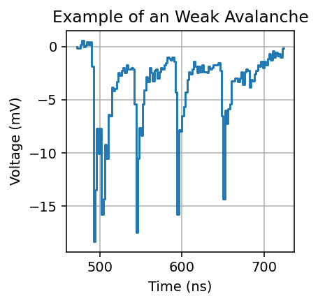
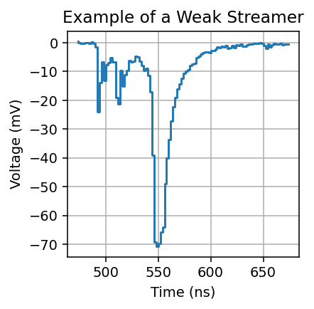
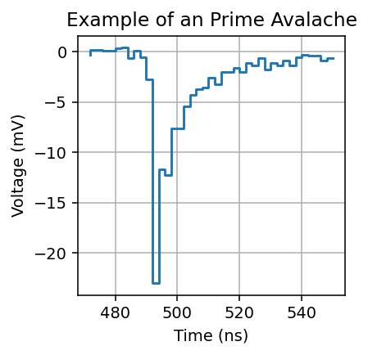
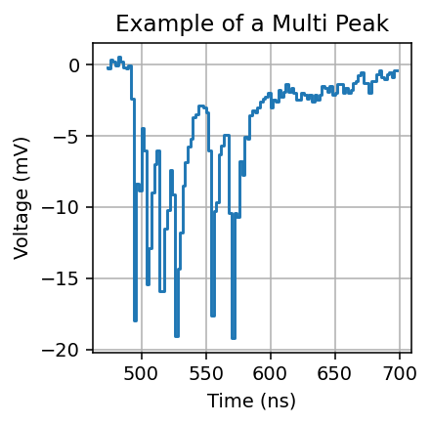
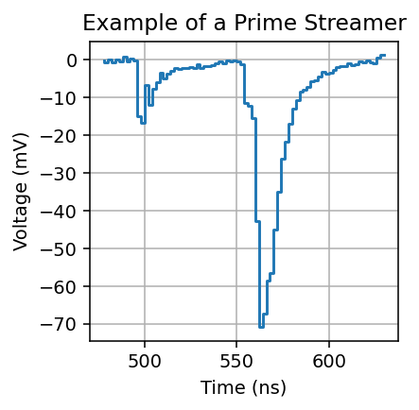
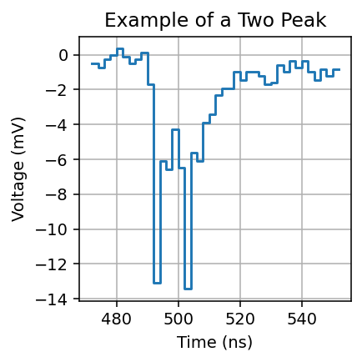
Chosen Classification

Slide 9
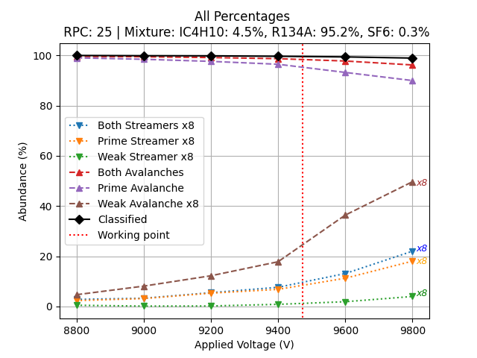
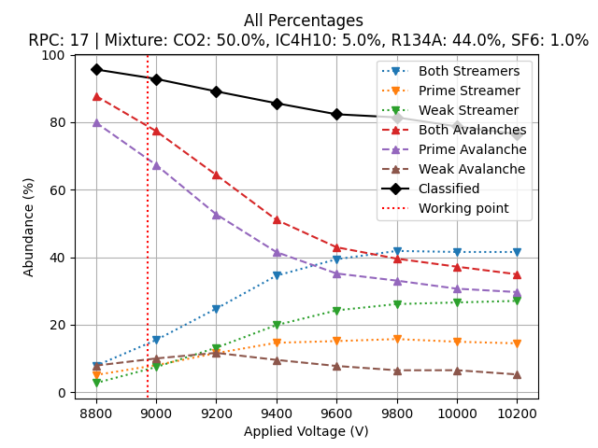
Classification based Abundance
Figure: Abundance in standard mixture
Figure: Abundance in CO2 + std mix
Nice demonstration in the CO2 based mixture of:
  Non-classifiable signals increase with HV (see black line)
  Prime streamer crosses weak streamer i.e. disturbances increase faster

Slide 10
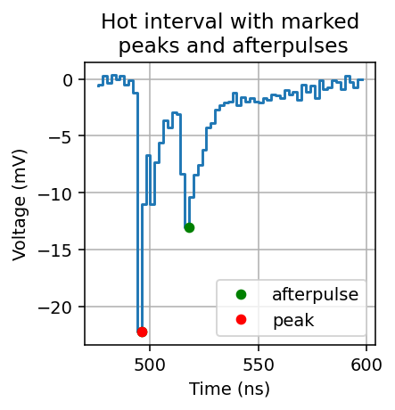
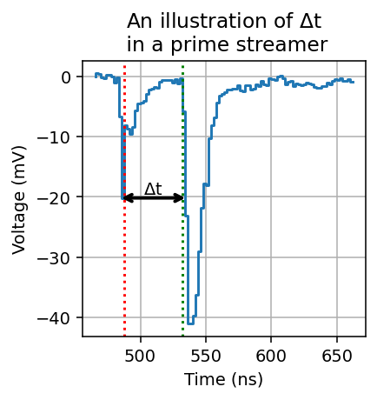


Wave Pattern Characteristic:
Qualitative Analysis
$$P_{1}$$
$$P_{2}$$
Figure: Exemplary illustration of after-pulses, relative height of peaks and streamer development time.

Slide 11
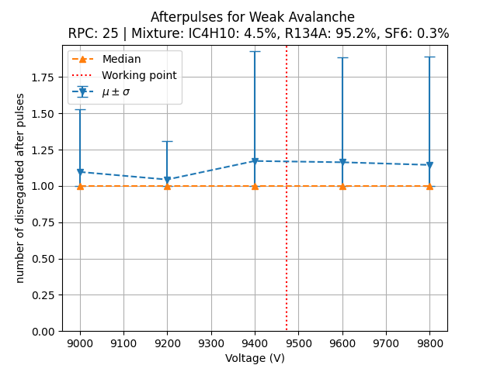
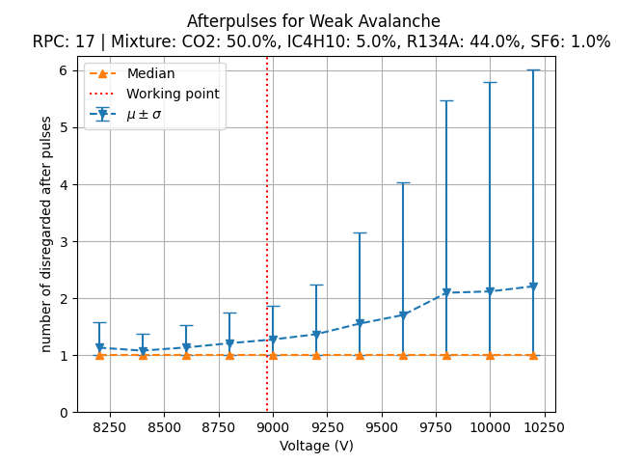
Analysis of After-Pulses from type “Weak Avalanche”
Figure: Number of after-pulses in standard mixture
Figure: Number of after-pulses in CO2 + std mix
Again, in CO2 based mixture, nice demonstration that disturbances from additional pulses increase
  Deviation from “beautiful” single-avalanche picture

Slide 12
Conclusion BSc-Project
Developed a simple automated peak-based algorithm to classify the wave-patterns according to six different classes/sub-classes
Observed that the disturbances from the single avalanche and or typical streamer signal increase above working point especially for CO2 based mixtures
Consequences for the RPC simulation:
  Does the first signal pulse (which we can simulate) already generate a large enough signal to trigger the detector?
  Which signal-pattern contribute to the ‘Streamer-like’ probability estimate, and can we predict it accurately with the avalanche-to-streamer transition model?

Slide 13
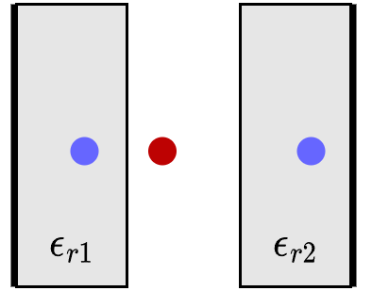
Updated Electric Network:
Garfield++ Displacement Currents
Multiconductor Transmission Line
Coax Cable
Digitizer Read-Out
Garfield++ detailed RPC + Strips
Lippmann’s Space-Charge Routine respecting our geometry:

Slide 14
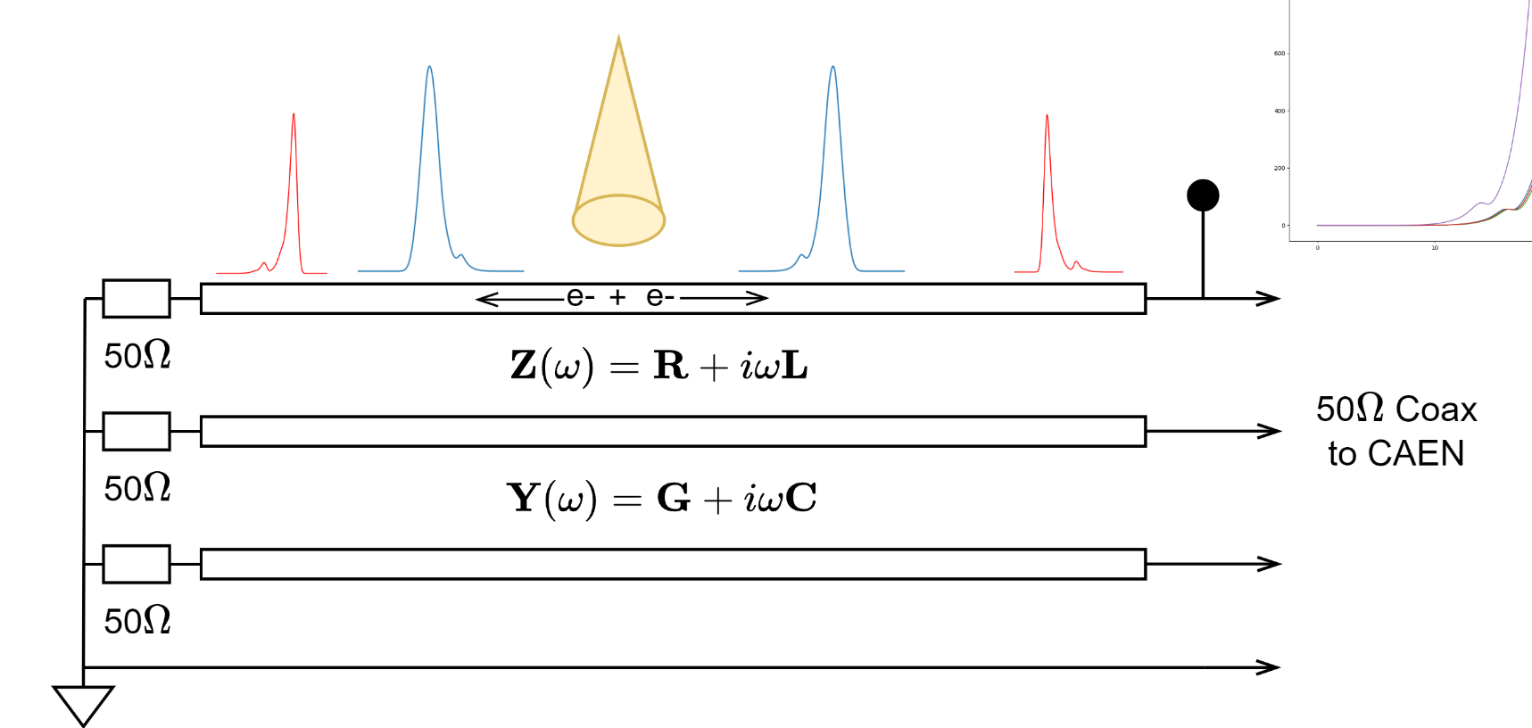
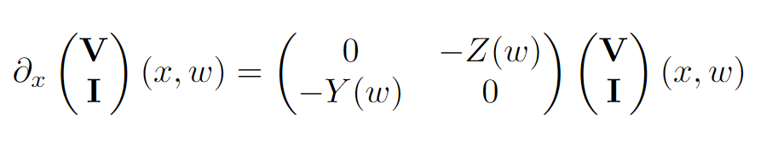

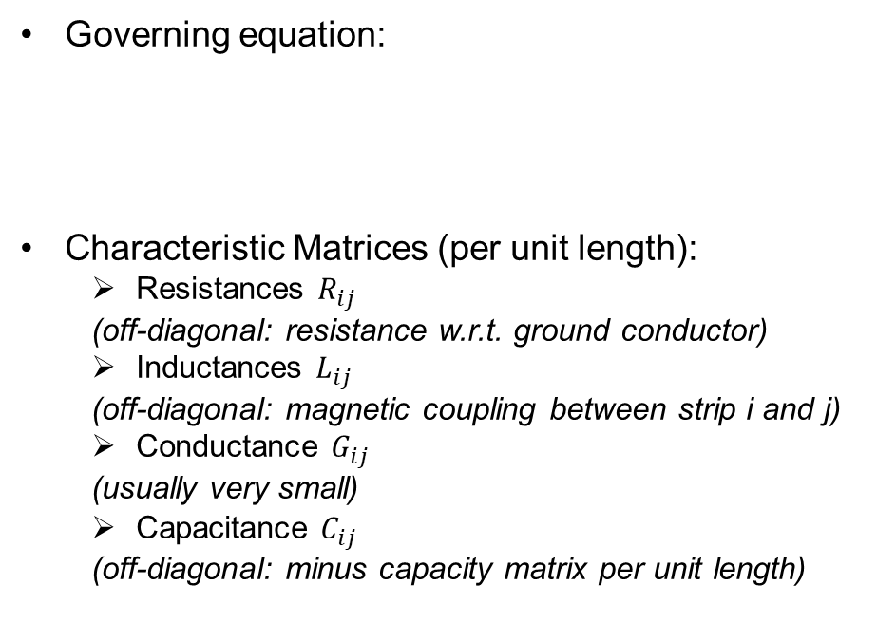
Multiconductor Transmission Line
GF++
MTL
Coax
Digi
Governing equation:
Characteristic Matrices (per unit length):
  Resistances $R_{ij}$
  (off-diagonal: resistance w.r.t. ground conductor)
  Inductances $L_{ij}$
  (off-diagonal: magnetic coupling between strip i and j)
  Conductance $G_{ij}$
  (usually very small)
  Capacitance $C_{ij}$
  (off-diagonal: minus capacity matrix per unit length)
$$V_{R, tot }(t)$$
Figure: RPC multi strip-line transmission network terminated with 50 Ohm resistors.

Slide 15
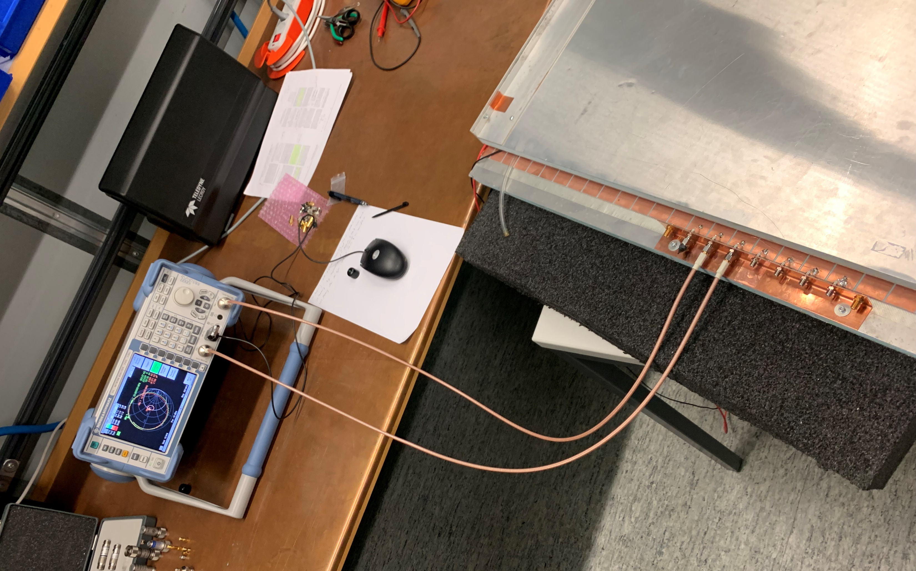
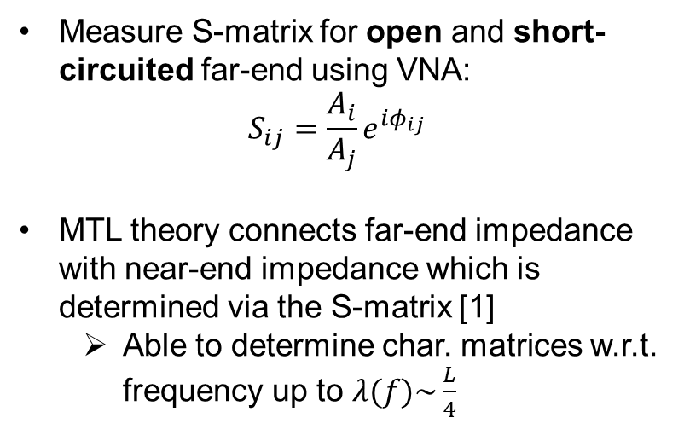
Measurement of Characteristic Matrices
GF++
MTL
Coax
Digi
Measure S-matrix for open and short-circuited far-end using VNA:
$$S_{ij}=\frac{A_{i}}{A_{j}}e^{iφ_{ij}}$$
MTL theory connects far-end impedance with near-end impedance which is determined via the S-matrix [1]
  Able to determine char. matrices w.r.t. frequency up to $λ(f)\sim \frac{L}{4}$
[1] J. van der Merwe et al., IEEE Transactions on Electromagnetic Compatibility, vol. 40, no. 3, pp. 249-256, Aug. 1998, doi: 10.1109/15.709423
Figure: Measurement Setup with custom SMA adapter.

Slide 16
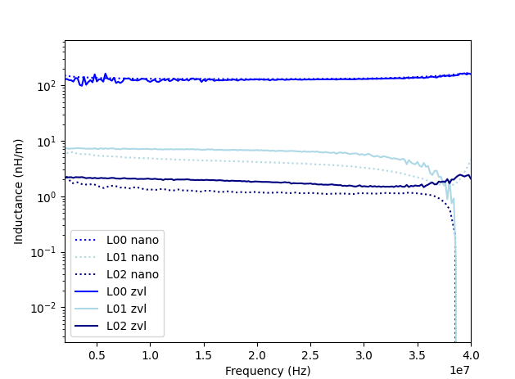
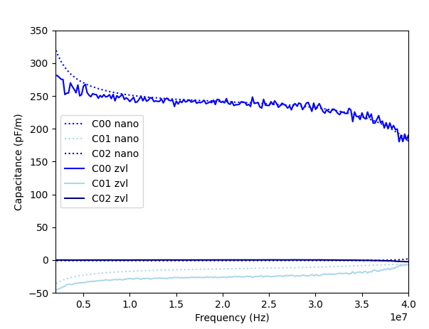

Results $L \& C$
GF++
MTL
Coax
Digi
Figure: First row of inductance matrix up to 40 MHz from two different measurement devices (R&D zvl3 & nanoVna).
Figure: First row of capacitance matrix up to 40 MHz from two different measurement devices (R&D zvl3 & nanoVna).

Slide 17
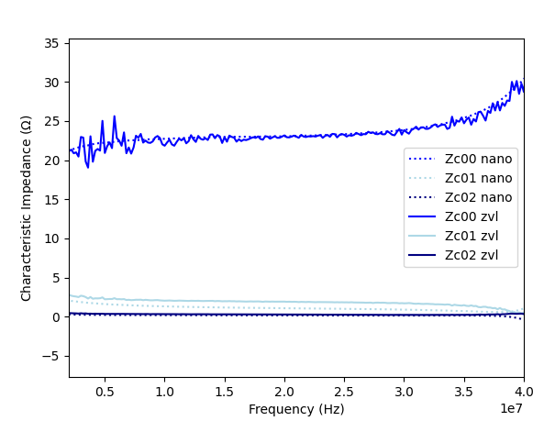

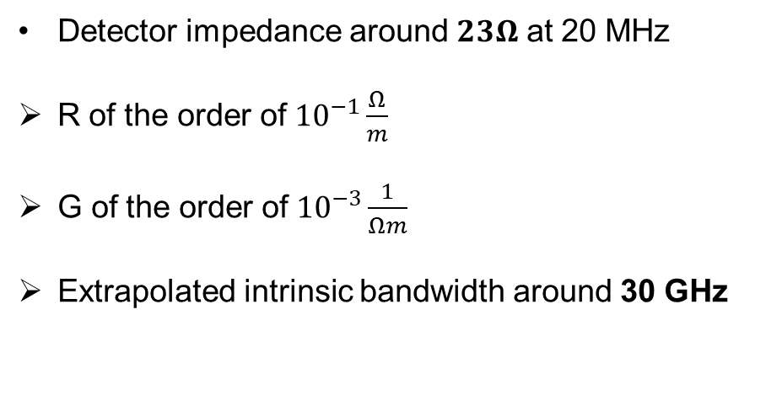
Results $Z_{C}$
GF++
MTL
Coax
Digi
Detector impedance around $23Ω$ at 20 MHz
R of the order of ${10}^{−1}\frac{Ω}{m}$
G of the order of ${10}^{−3}\frac{1}{Ωm}$
Extrapolated intrinsic bandwidth around 30 GHz
Figure: First row of characteristic impedance matrix up to 40 MHz from two different measurement devices (R&S ZVL3 & nanoVna).

Slide 18
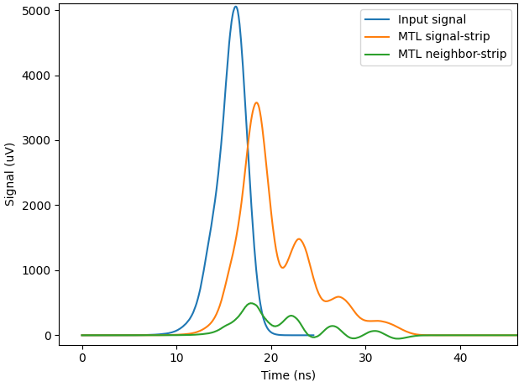
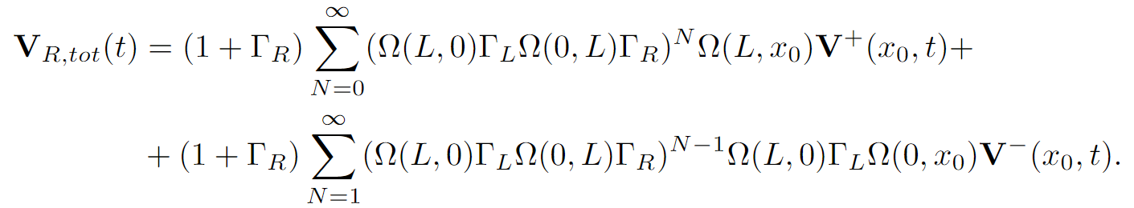

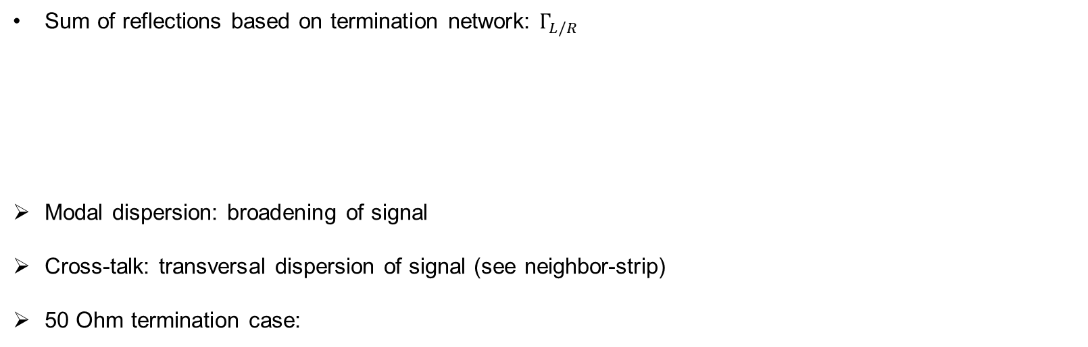
Solution to loss-less MTL + Example
GF++
MTL
Coax
Digi
Sum of reflections based on termination network: $Γ_{L/R}$
Modal dispersion: broadening of signal
Cross-talk: transversal dispersion of signal (see neighbor-strip)
50 Ohm termination case:
$$T=\frac{1+0.37}{2}⋅\frac{23Ω }{50Ω }≈29\%$$
Figure: Three conductor line applied to blue input signal leading to distorted signals at end of RPC.

Slide 19
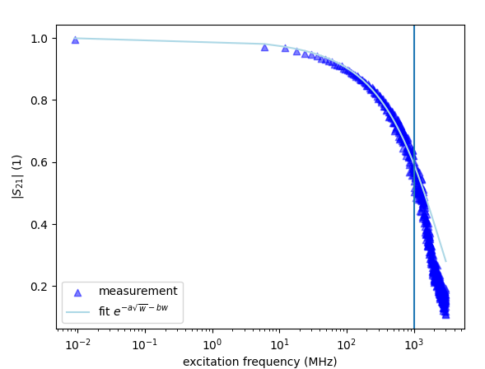
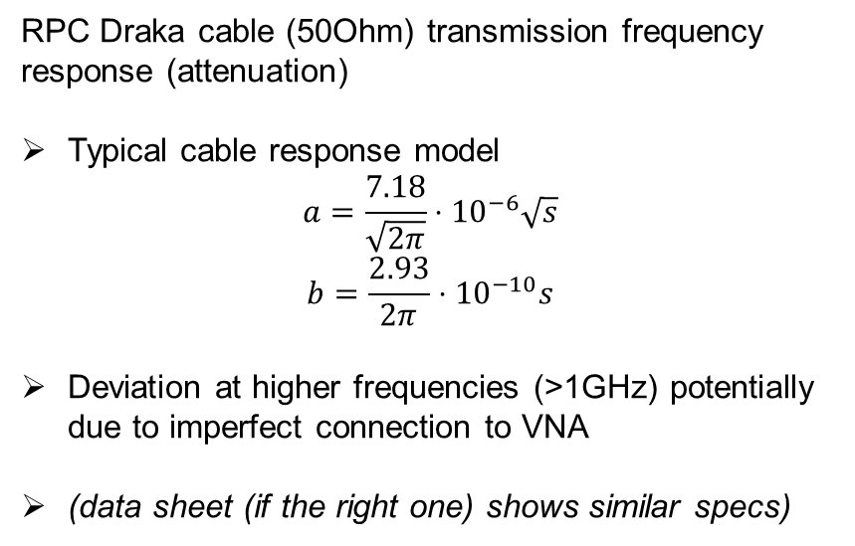
Coax Cable
GF++
MTL
Coax
Digi
RPC Draka cable (50Ohm) transmission frequency response (attenuation)
Typical cable response model
$$a=\frac{7.18}{\sqrt{2π}}⋅{10}^{−6}\sqrt{s}$$
$$b=\frac{2.93}{2π}⋅{10}^{−10}s$$
Deviation at higher frequencies (>1GHz) potentially due to imperfect connection to VNA
(data sheet (if the right one) shows similar specs)
Figure: Measured cable attenuation of typical CA50 Draka cable with length ~3.2m.

Slide 20
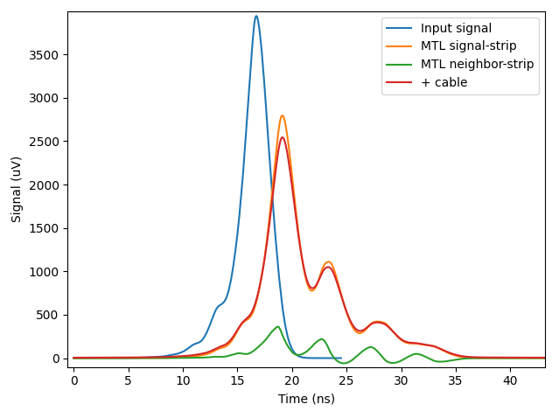
Coax Cable Attenuation Example
GF++
MTL
Coax
Digi
Low-pass filter signature further reduces signal amplitude
  i.e. alters efficiency curve
Figure: three conductor + cable attenuation applied to blue input signal leading to distorted signals at end of RPC.

Slide 21
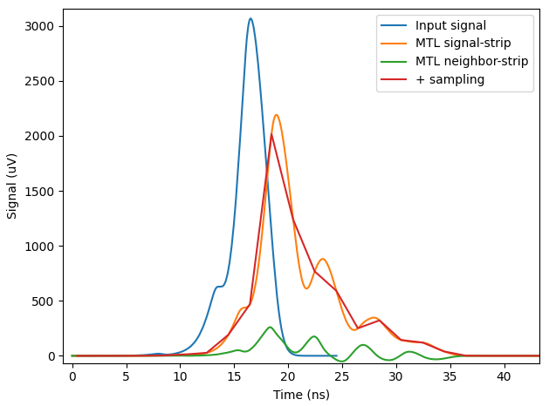
Digitizer Read-Out Example
GF++
MTL
Coax
Digi
CAEN v1730 Digitizer: 3db@250MHz, 2ns
2ns sampling interesting for shorter signals i.e. at higher HV (higher velocities)
May reduce the signal peak significantly
  i.e. alters efficiency curve
Figure: three conductor + 2ns sampling applied to blue input signal leading to distorted signals at end of RPC.

Slide 22
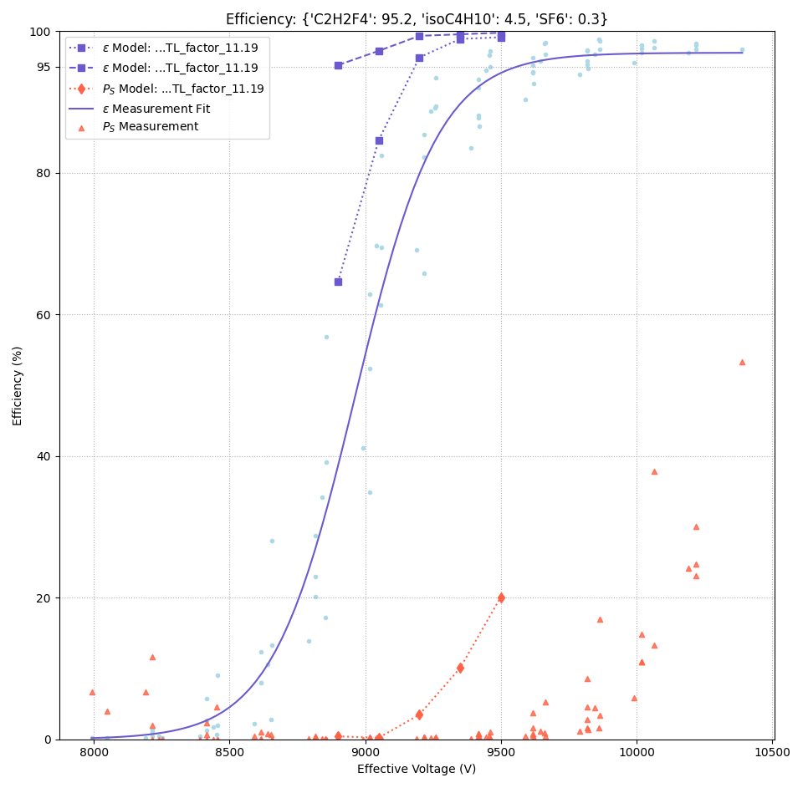
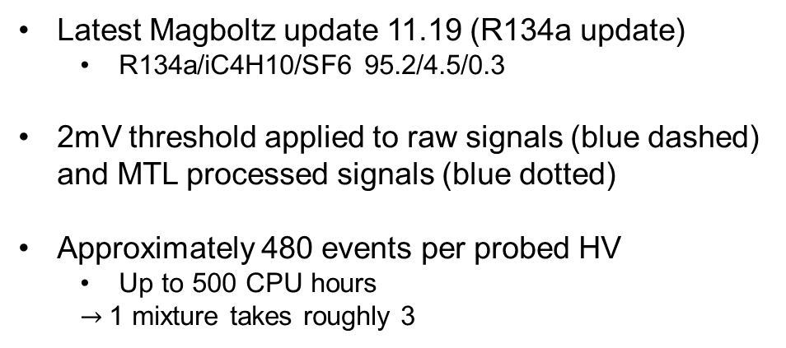
Effects of Network on RPC Simulation
GF++
MTL
Coax
Digi
Latest Magboltz update 11.19 (R134a update)
  R134a/iC4H10/SF6 95.2/4.5/0.3
2mV threshold applied to raw signals (blue dashed) and MTL processed signals (blue dotted)
Approximately 480 events per probed HV
  Up to 500 CPU hours
  $→$1 mixture takes roughly 3
Figure: Standard mixture efficiency curve with voltage threshold of 2mV and with MTL network.

Slide 23
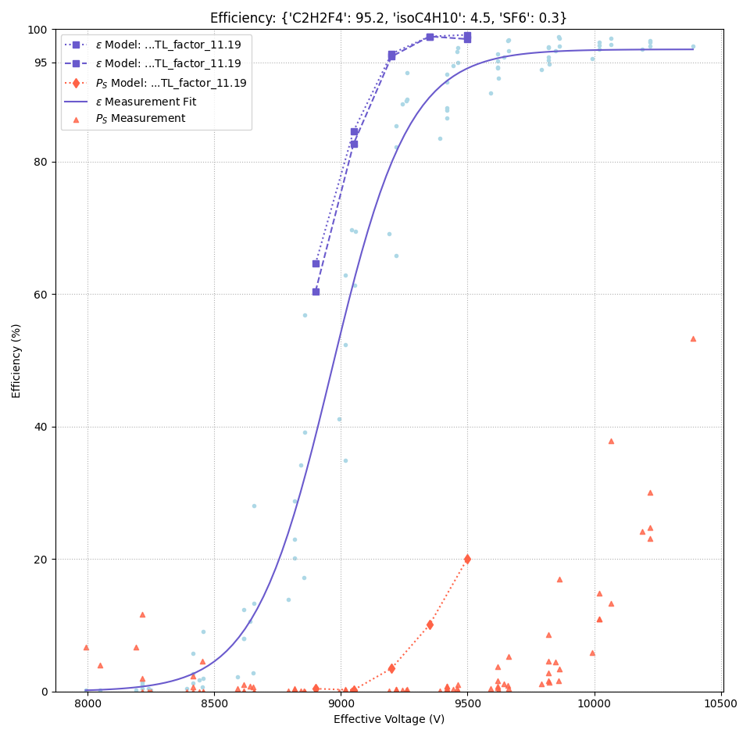
Effects of Network on RPC Simulation
GF++
MTL
Coax
Digi
2mV threshold applied to MTL signals (blue dotted) and MTL + Coax signals (blue dashed)
Does not reach 100% efficiency immediately
Strange tipping forms
  Low statistics?
Figure: Standard mixture efficiency curve with voltage threshold of 2mV and with MTL + Coax network.

Slide 24

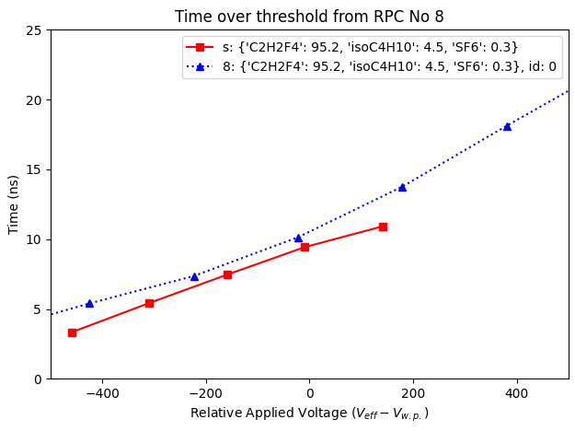
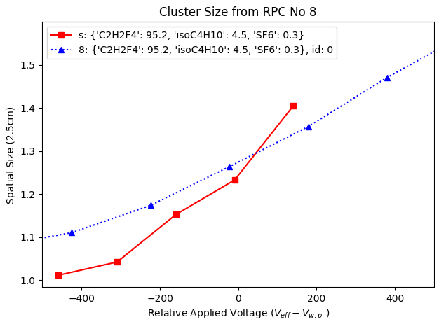
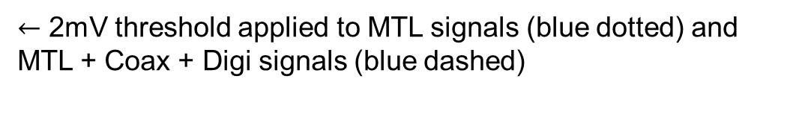
Effects of Network on RPC Simulation
GF++
MTL
Coax
Digi
Figure: Standard mixture mean time over threshold and mean cluster size of pure avalanches w.r.t. working point with MTL + Coax + Digi network.
$←$ 2mV threshold applied to MTL signals (blue dotted) and MTL + Coax + Digi signals (blue dashed)
Figure: Standard mixture efficiency curve with voltage threshold of 2mV and with MTL + Coax + Digi network.

Slide 25
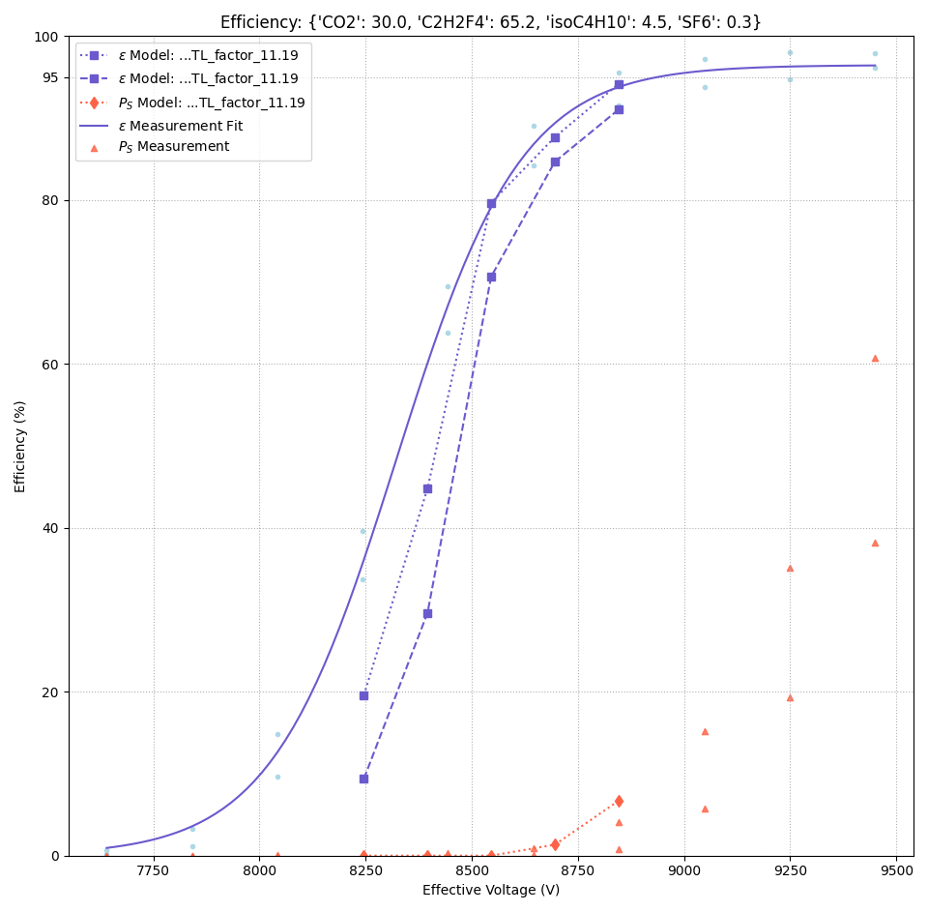
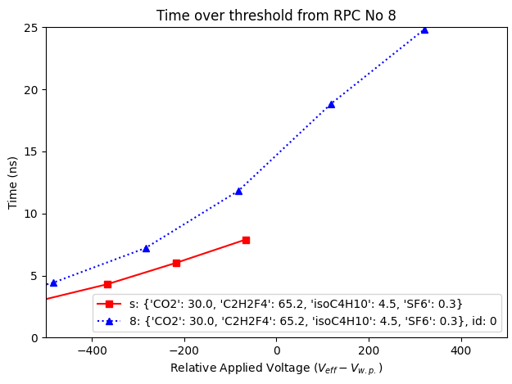
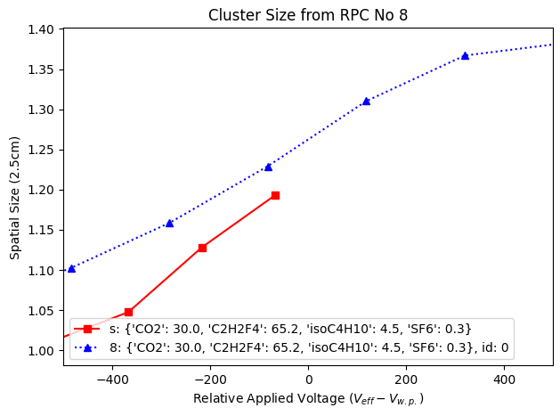
CO2 (30%) based Standard Mixture
GF++
MTL
Coax
Digi
Figure: CO2 + std mix mean time over threshold and mean cluster size of pure avalanches w.r.t. working point with MTL + Coax + Digi network.
$←$ 2mV threshold applied to MTL signals (blue dotted) and MTL + Coax + Digi signals (blue dashed)
Figure: CO2 + std mix efficiency curve with voltage threshold of 2mV and with MTL + Coax + Digi network.

Slide 26
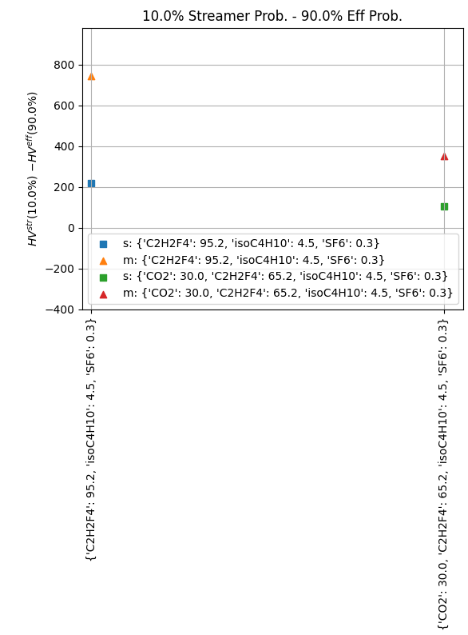
Mixture Performance: Curve-Width
Efficiency- to streamer probability curve width to account for immediate performance
Simulation predicts the measured trend reliably

Slide 27
Conclusion
Purely physics motivated electric network (no fine-tuning!)
  made of three components: MTL, Coax, Digitizer Sampling
  Strange tipping from Coax attenuation + sampling
Model overestimates efficiency knee in standard mixture
  Aging effects?
  Time delayed weighting field or wrong permittivity model of dielectrics?
  Mirror charges from Eigenfield?
Validation of RPC simulation still in progress but
  Will start optimization procedure based on current simulation output
  Focus on relative trends validation including the avalanche-to-streamer-like transition model

Slide 28
Outlook
Sensitivity analysis of avalanche-to-streamer-like transition model
  Help of student doing her bachelor thesis
  Direct: How does the transition behave under swarm-parameter variations?
  Indirect: Can we reliably predict relative trends of efficiency- and streamer probability curve using the model?
Start of optimization approach focus on comparing relative trends
1. “Cost Function”
  Determine useful variables to determine mixture performance
    Separation width etc.
  Calibration to validation points
2. Optimization Approach
  Random search algorithm
  Bayesian optimization approaches to steer into ‘good’ directions (expensive cost functions)

Slide 29
Questions
How big is the area muons are passing the RPC in Gif++ and where is it located above the RPC?
How do I know with which angle the muon passed the RPC from the raw data you gave me?
Does the digitizer first attenuate than sample or is the sampling yielding the 250MHz(3dB) attenuation?

Slide 30
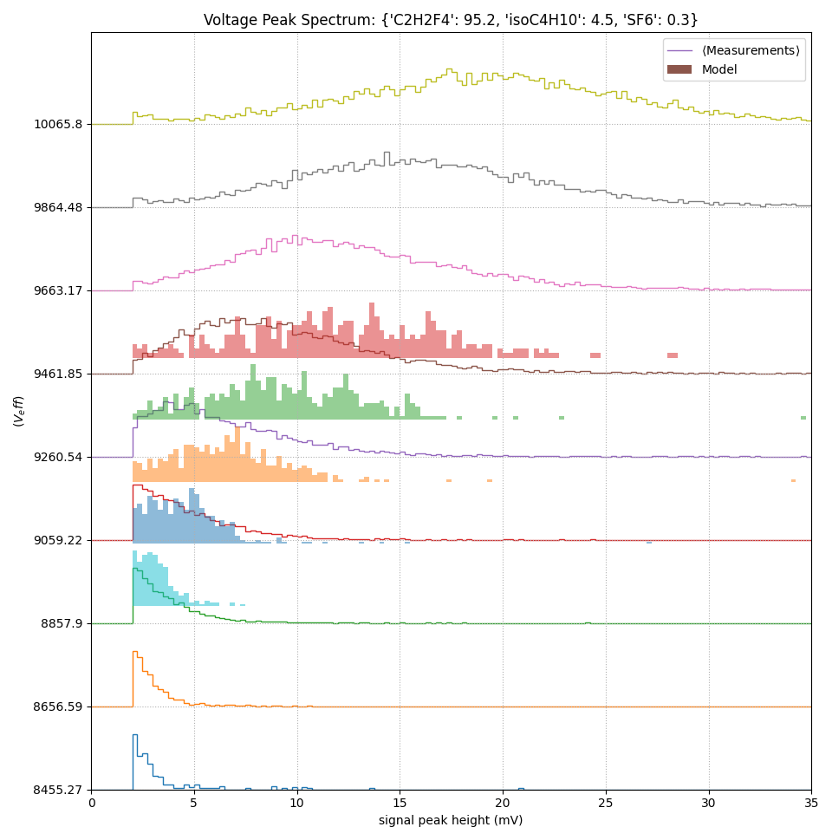
Voltage Peak Spectrum Comparison
GF++
MTL
Coax
Digi

Slide 31
Comments
Space-charge effects reduces efficiency up to 30%
It doesn’t matter how detailed we simulate if it extends previous theory

