Slide 1
Micromegas Detectors in CAST
Theodoros Vafeiadis
DT Science-Techno Meeting
23 June 2011

Slide 2
Outline
Micromegas Detectors
Micromegas Detectors in CAST
Improvements – Background
Event Selection
Cast Detector Lab

Slide 3
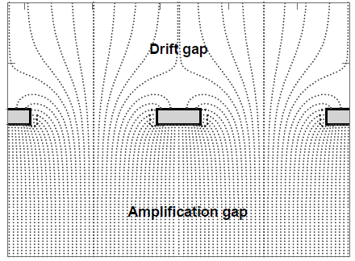

The Micromegas Detector
Gaseous detector with two regions
Conversion region
Primary ionization
Charge drift
Amplification region
Charge multiplication
Readout layout
Separated by a Micromesh
Very strong and uniform electric field
Drift field
Typical 10²⁻³ V/cm
Mesh
Amplification field
Typical 10⁴⁻⁵ V/cm
Y Strips
X Strips
192 X Strips
192 Y Strips

Slide 4
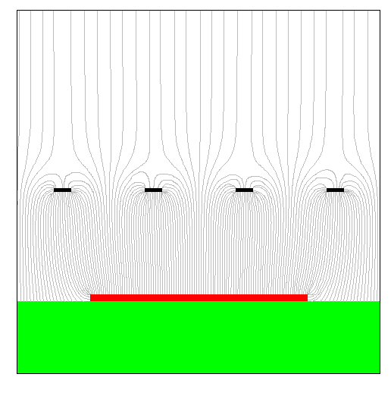
Trigger and Readout
Amplifier + Shaper
FI/O
Mesh signal
MATACQ
Discriminator
Trigger
Timing Signals
Sequencer
strips signal
Data ready
Gassiplex card
CRAM
Clear

Slide 5
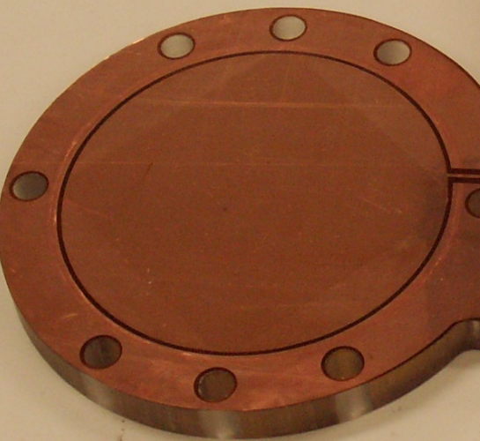
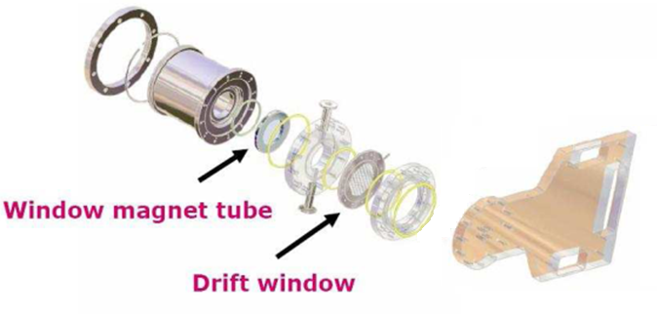
Micromegas Detectors in CAST
  Classic technology (CAST Phase I & CAST Phase II ⁴He run)
  Bulk technology (CAST Phase II ³He run)
  Microbulk technology (CAST Phase II ³He run - present)
Differential pumping window
Drift window

Slide 6
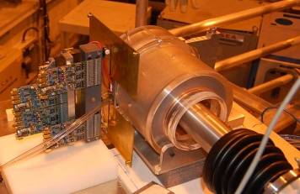
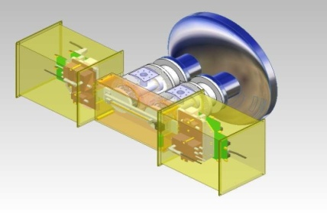
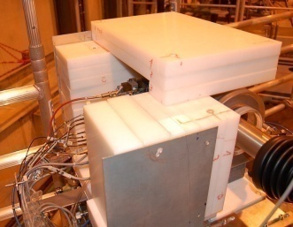
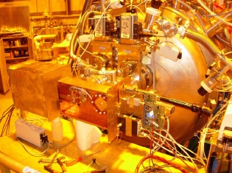
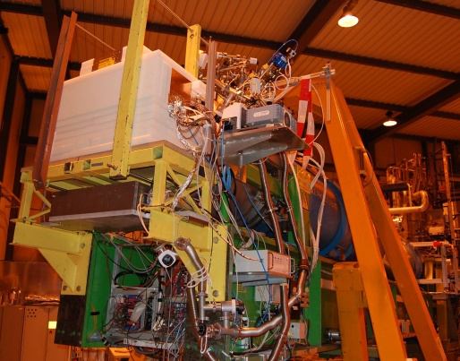
Improvements
In line improvements
Sunset side:
Both detectors are μM
Very good shielding!!
The μM Sunrise line has been redesigned for introducing Shielding.

Slide 7
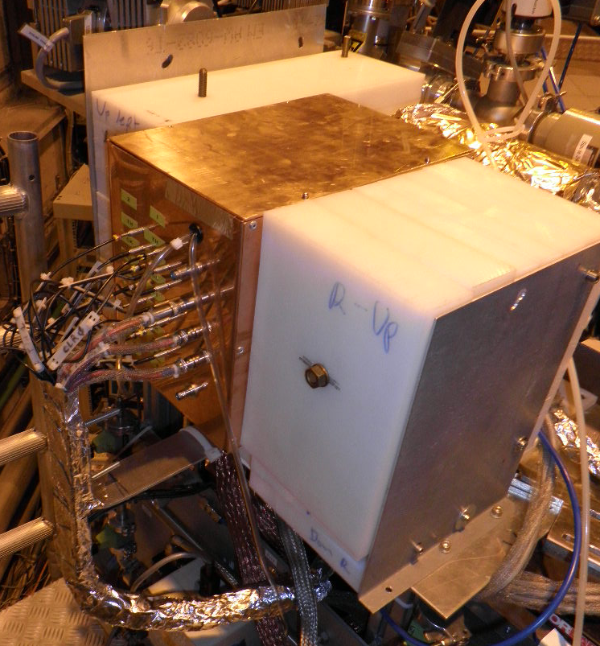
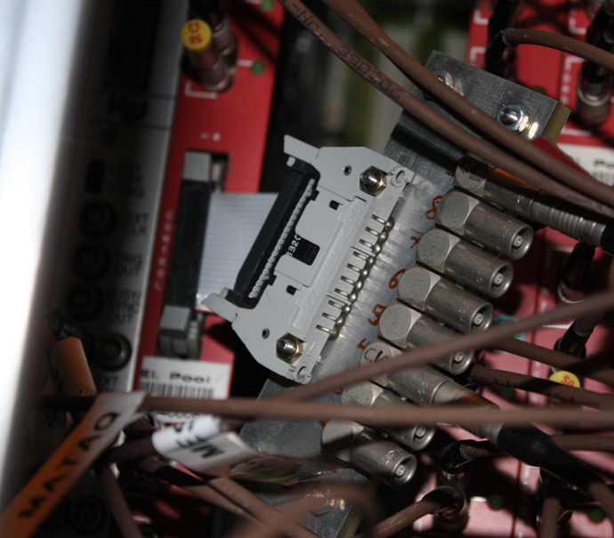
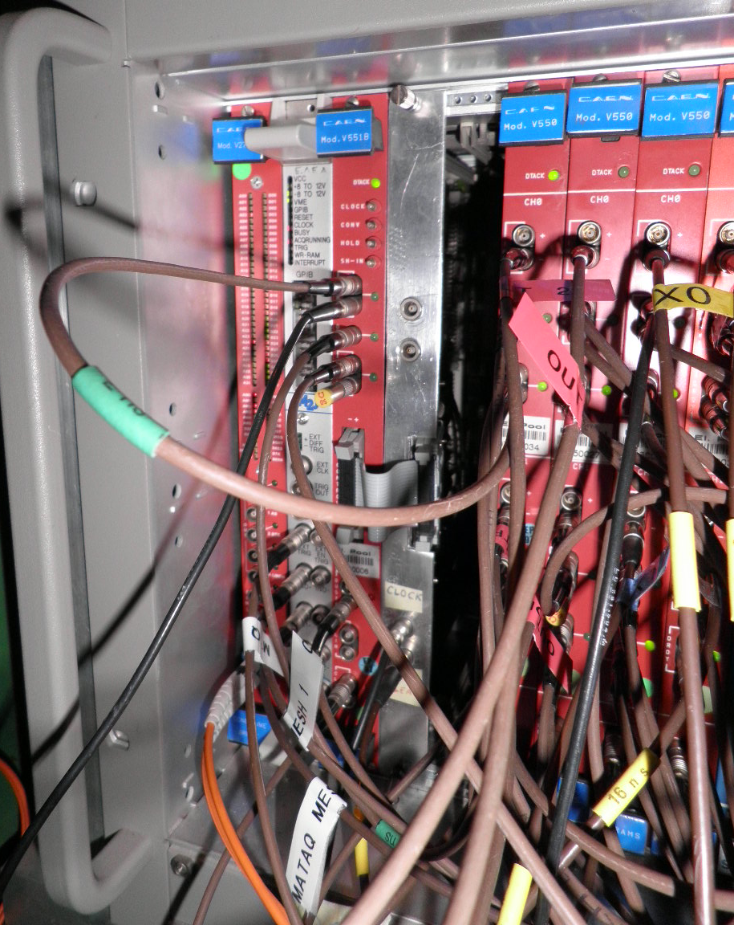
Intervention mid April 2010

Slide 8
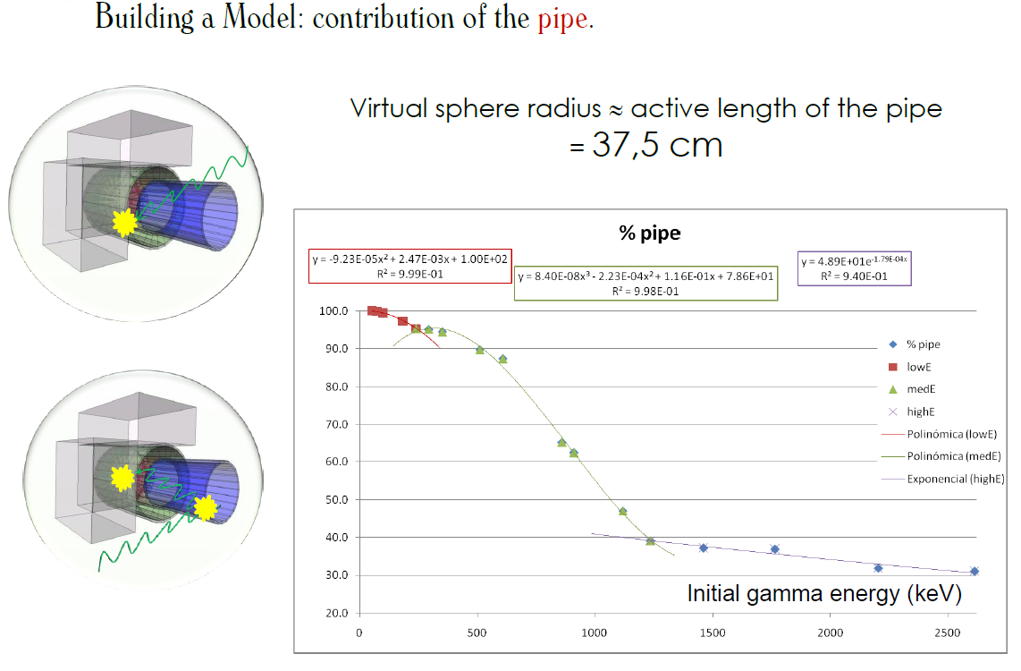
Simulation Studies
Detector
Shielding
Total contribution for all the Energies from the pipe : 50%

Slide 9
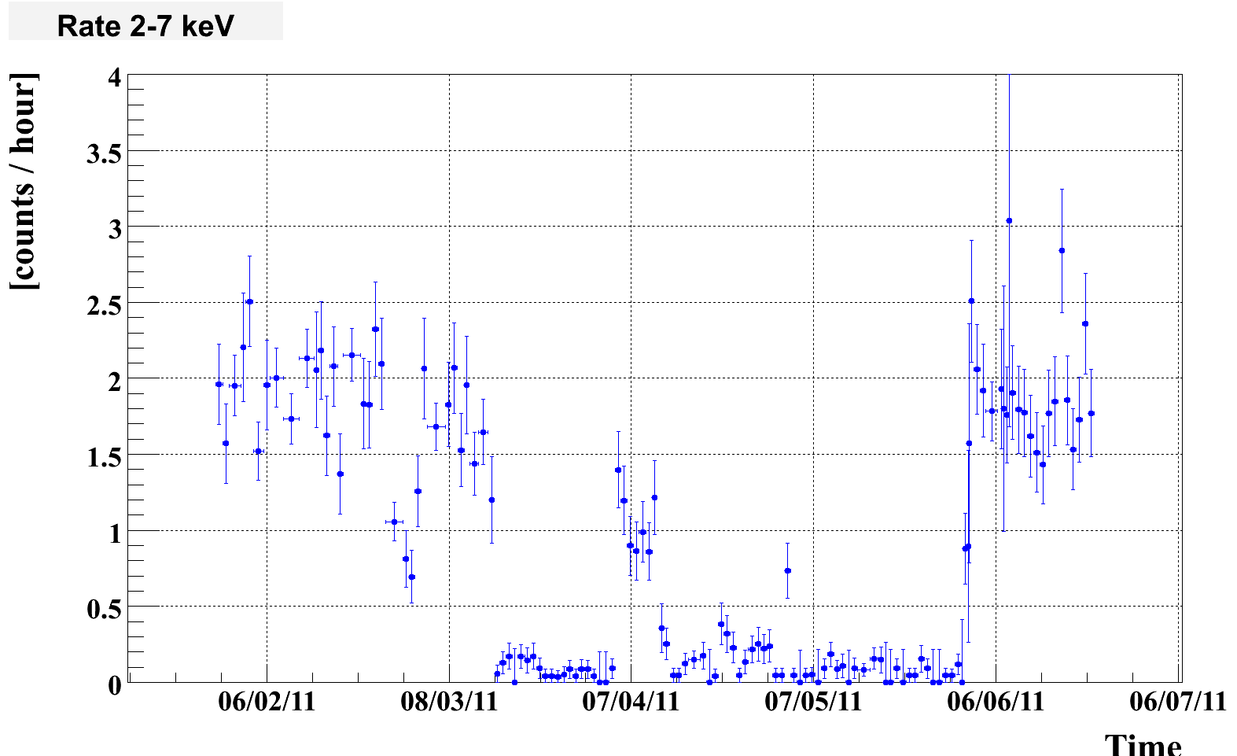
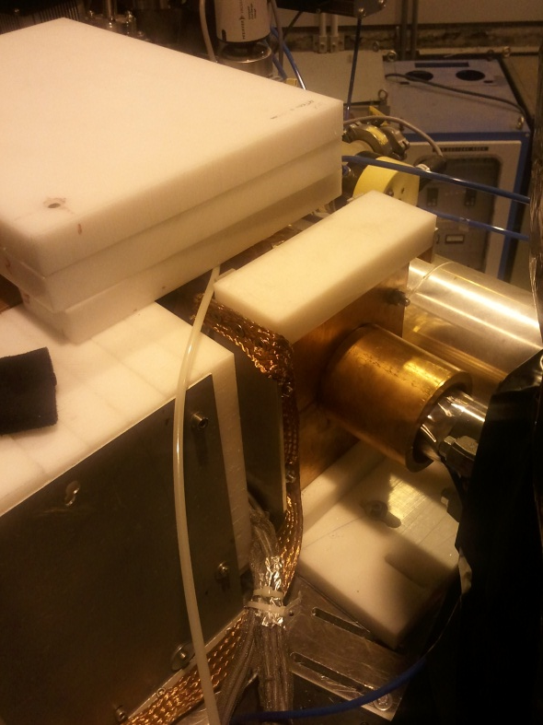
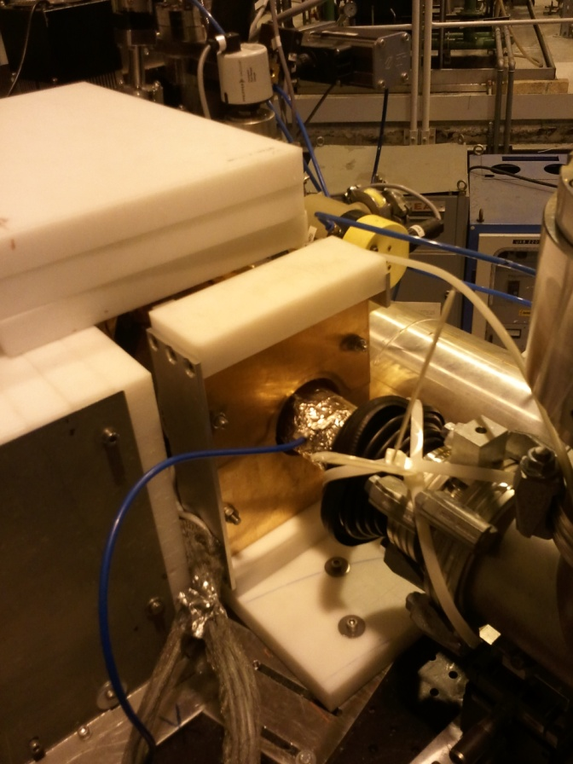
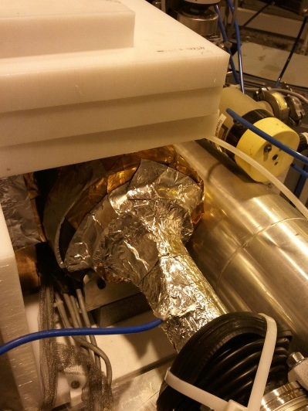
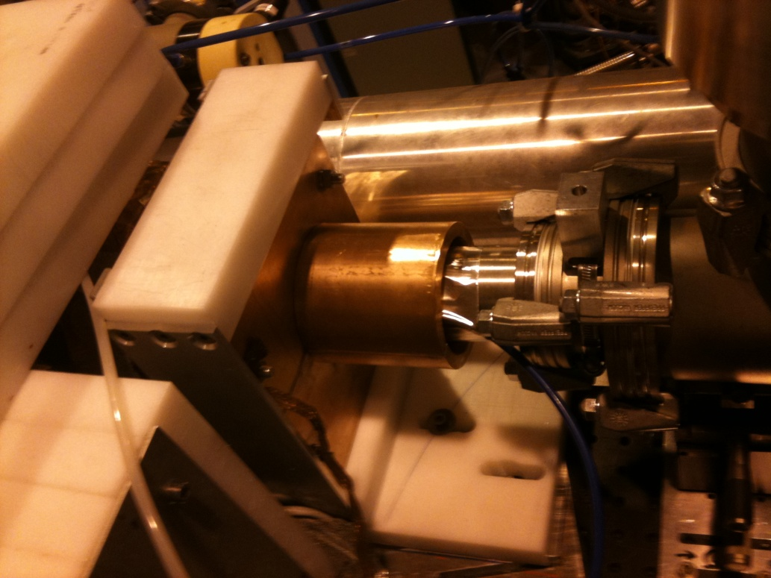
Intervention February 2011
New front shielding
PRELIMINARY
Intervention
??
Step 3
No Front Shielding
Step 1
Step 2

Slide 10
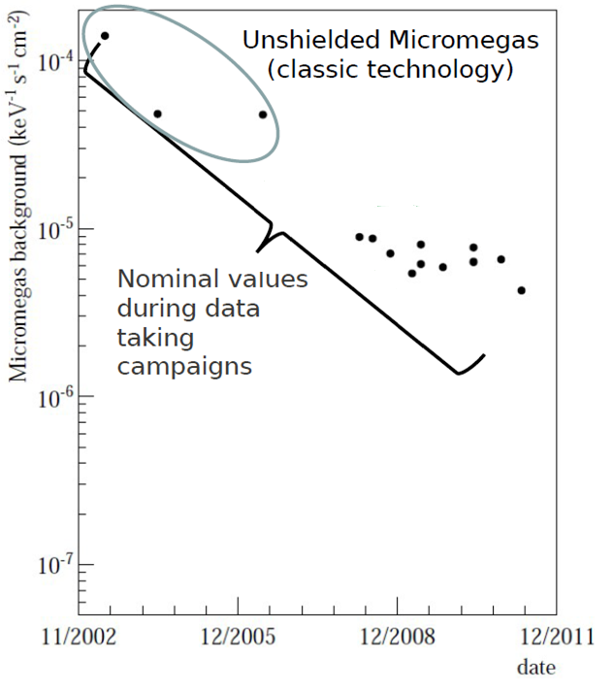

PRELIMINARY
Shielded Micromegas
(bulk and microbulk technology)
2010 & 2011 (until now)
4π Shielding
in Canfranc Underground Lab
1-4 counts/day
ULB
~1count/day

Slide 11
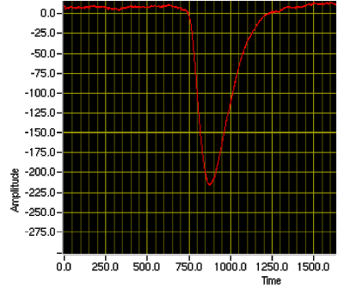
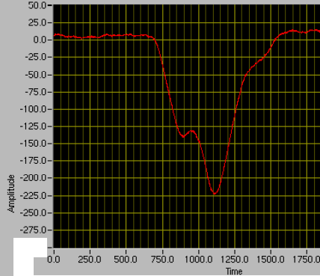
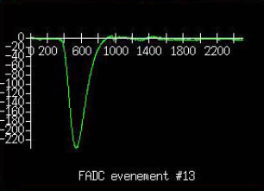
Event selection
Electronics trigger Threshold : <1keV
Daily calibration with ⁵⁵Fe source (X-Ray signal characteristics)
X-Rays :
Short risetime and pulse width for the analogue signal
Charge in one cluster of few strips per axis
⁵⁵Fe

Slide 12
Event selection
Event Selection : distinguish the X-Ray signals from the background (mainly cosmic)
Time information of the charge measured on the mesh (risetime, width, amplitude, pulse integral)
Space information of the charge on the strips (multiplicity, width, topology of clusters)
Three different types of cut selection:
  Sequential
  Multivariate analysis
  Neural networks
  Data reduction:
  Better than 3 orders of magnitude!

Slide 13
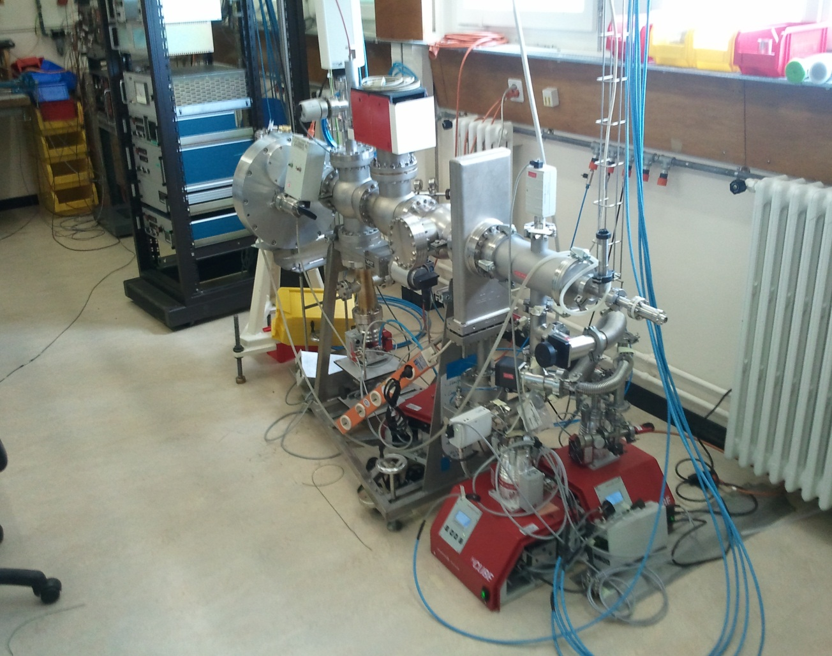
Cast Detector Lab
Need to Calibrate detectors for the whole energy range of interest (2-7 keV)
X-ray tube:
Designed built and
tested in Max-Planck
institute

Slide 14
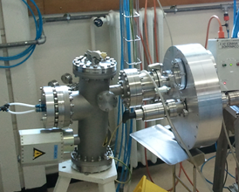
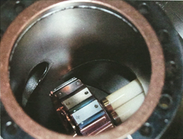
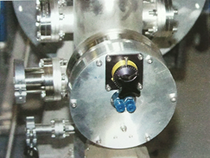
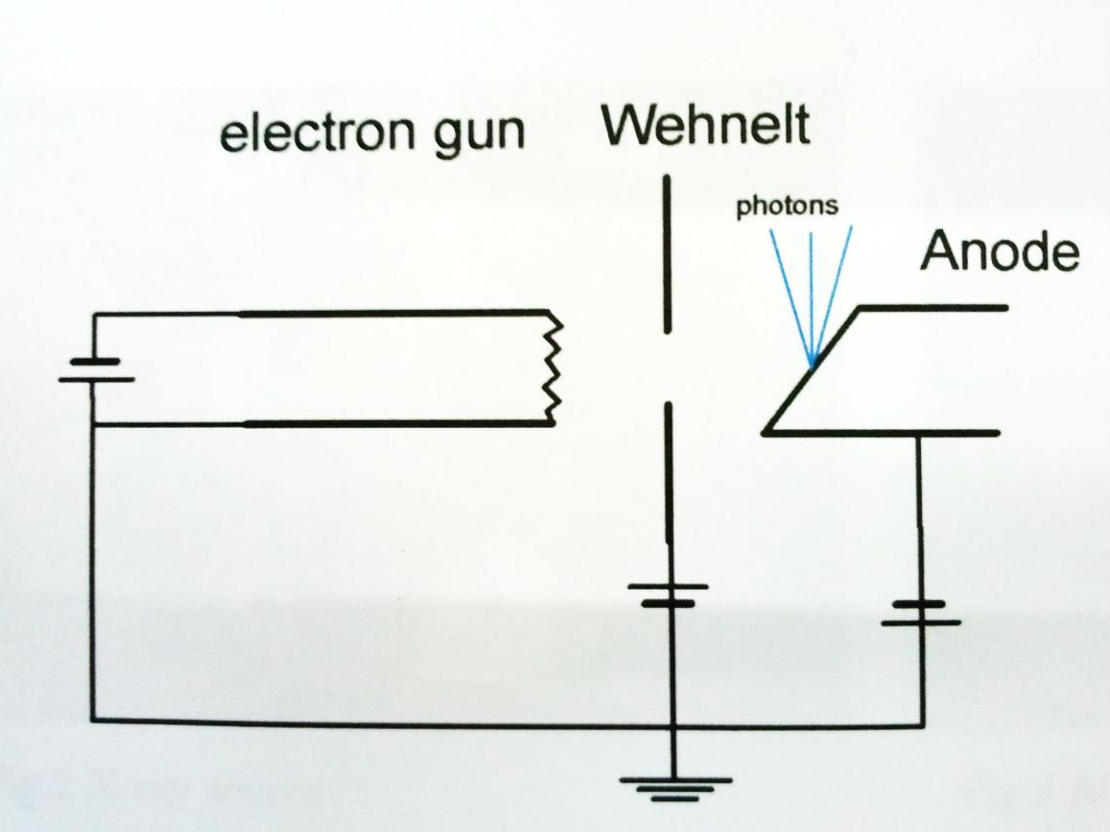
X-ray tube : details
Emission lines:
0.28keV < E < 17.4keV

Slide 15
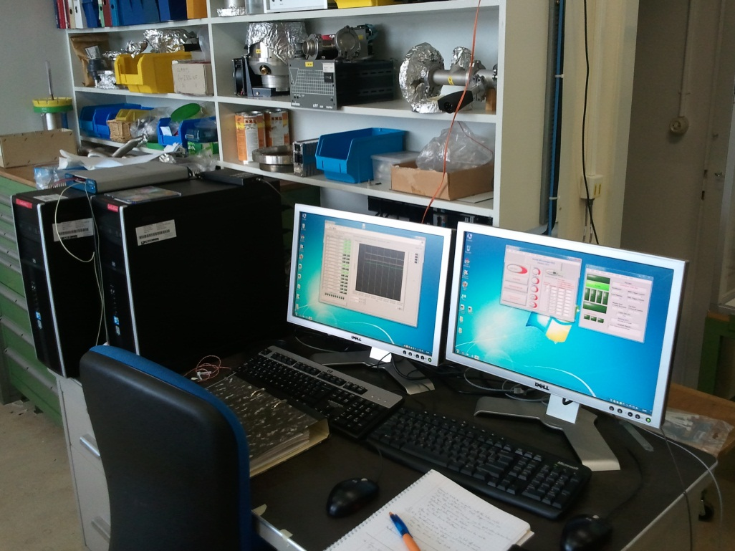
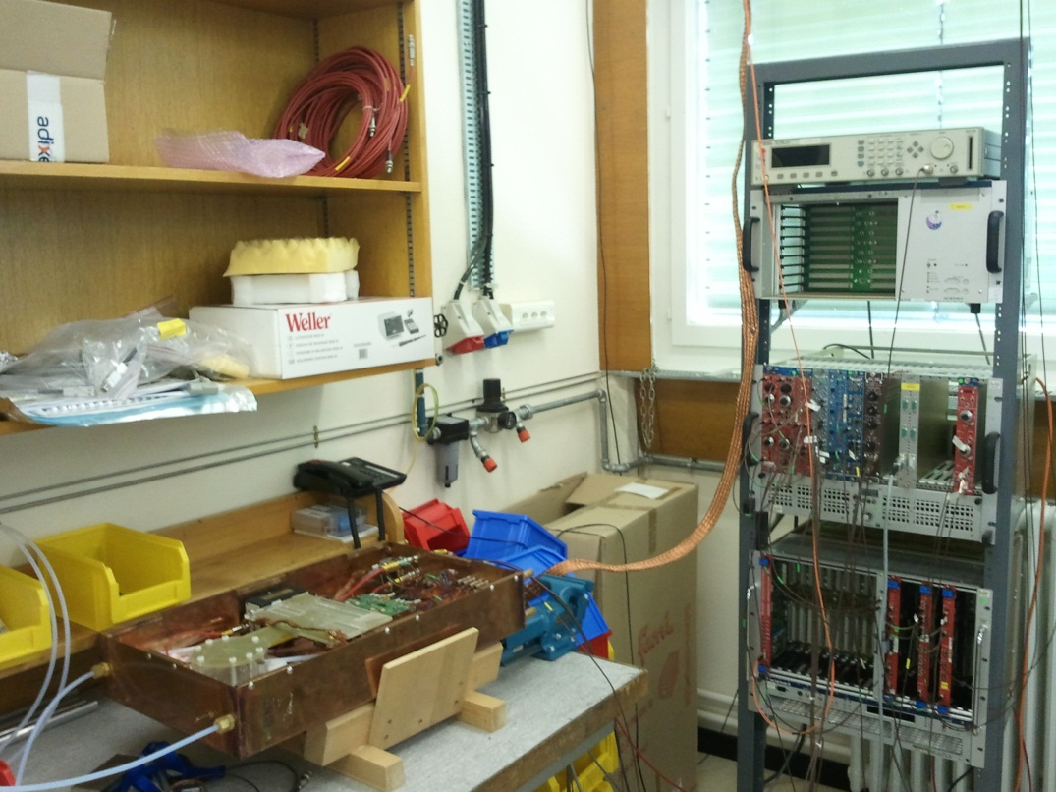
Labview Based:
Slow Control
Data Acquisition
Radon Detector
Ready on bench calibration setup
Will be fully tested next week
Ready to mount a detector on the X-ray tube by end of July??????

Slide 16
Thank you

Slide 17
Micromegas Detectors in CAST
  Classic technology
  The pillars are attached to the mesh. A supporting ring or frame is adjusting the mesh on top of the readout plane
  Typical dimensions: mesh thickness 5 μm, gap 50 μm
  Bulk technology
  The pillars are attached to a woven mesh and to the readout plane
  Typical dimensions: mesh thickness 30 μm, gap 100 μm
  Microbulk technology
  The pillars are constructed by chemical process of a kapton foil, that is attached to the mesh and to the readout plane
  Typical dimensions: mesh thickness 5 μm, gap 25 or 50 μm

Slide 18
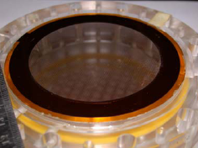
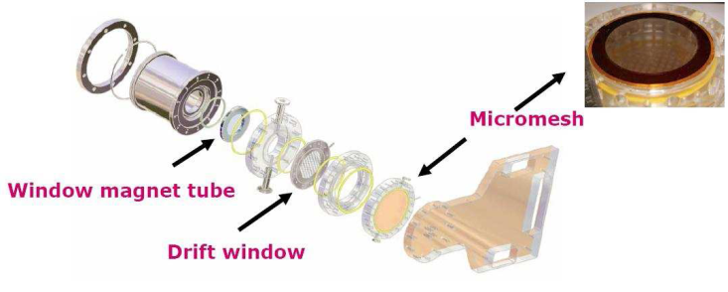
Micromegas Detectors in CAST
CAST Phase I & CAST Phase II ⁴He run
Conventional technology Micromegas - not shielded. (Sunrise side)
  Typical dimensions: mesh thickness 5 μm, gap 50 μm
Readout :192 x 192 strips, 350 μm pitch
Gas mixture: 95% Ar, 5% Isobutane @ 1 bar (flamable)
  The pillars are attached to the mesh or the readout plane. A supporting ring or frame is adjusting the mesh on top of the readout plane
  All “Micromegas advantages” (material selection, spatial resolution, field uniformity, stability…)
  Good energy resolution (mesh quality)
  Mesh can be replaced easily
  Mesh not attached + support frame:
  Resolution limitations
  Dimension limitations / large detectors
  Large scale production
  Curved surfaces
X-Ray detection Threshold: ~0.6keV
Background 4.8×10⁻⁵ events keV⁻¹s⁻¹cm⁻²

Slide 19
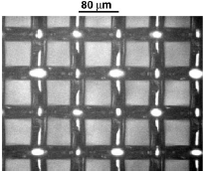
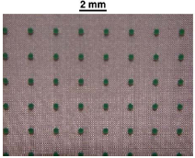
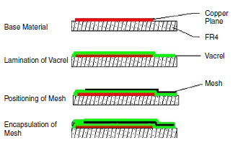
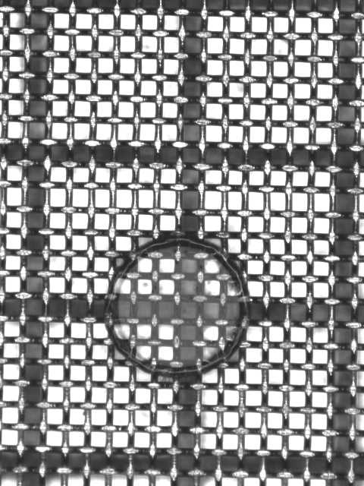
Micromegas Detectors in CAST
CAST Phase II ³He run
two new types of MICROMEGAS technologies : Bulk and Microbulk
Bulk
Stainless steel woven mesh of 30 mm thickness is placed on top of the readout strips by insulating pillars
Woven Inox mesh 30 µm
vacrel 128 µm
Advantages:
Uniformity, Reachable resolution (~18 FWHM, due to the thickness of the mesh), very robust, low noise due to lower capacity, easy to construct
Disadvantages:
higher risetime, sensitive to pressure variations in the CAST operating conditions, stability in the same conditions.
Readout pads

Slide 20
Micromegas Detectors in CAST
  Microbulk
  High accuracy photo-chemical & photo-lithography techniques on copper-clad Kapton foils
  All the advantages of a bulk micromegas + enhanced performance.
  Uniformity
  Clean materials
  Very flexible structure
  Stability at long term runs
  Less sensibility to pressure variations
  Energy resolution (<13% FWHM @ 6 keV)
  Low intrinsic background & better particle recognition
  Low mass detector
  Disadvantages
  Higher electronic noise due to higher capacity
  Complexity of the fabrication process
  Fragility / mesh can not be replaced
Micromesh
5µm copper
Kapton 50 µm
Readout pads
best option versus the Bulk technology for the CAST experiment.

Slide 21
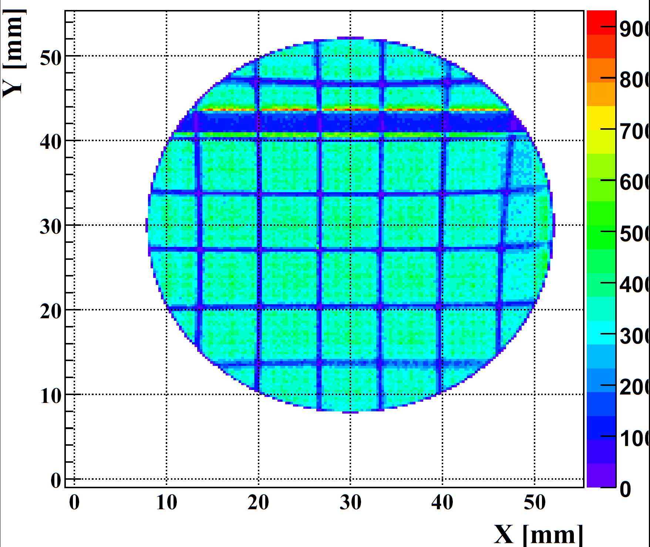
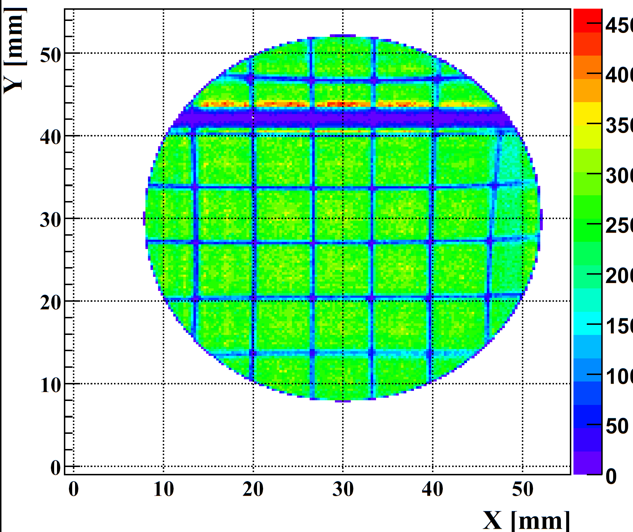
Event selection
before
cuts
after
cuts

