Slide 1
Safety and Chemical Disposal Protocol For DUNE FC Production
Brad Brown

Slide 2
Outline
Safety training done through EHS
Safety concerns for field cage construction and quality control
Safety practices and using PPE
Proper disposal of chemicals and inventory management

Slide 3
Required Safety Training
CHEM200 – Communication and Waste Management (50min)
LSR100 – Laser Safety (45min)
OCC100 – Respiratory Protection (30min)
Radiation Safety Training (2-3hrs)
Respirator Fit Test (15min)
Site Specific Training

Slide 4

Required Safety Training Cont.
Go to the UTA CEMS website and login with your UTA email and password
Click “view available courses” then click “start online training”
If needed, click “view certificates” to download a pdf
In- person trainings can be scheduled with:
  Resp. Fit Test, Elisabeth Rowlett – rowlett@uta.edu
  Rad. Safety Training, Laura Warren – lwarren@uta.edu

Slide 5
Safety Concerns for FC Production
Dropping heavy objects on feet
Bodily harm related to using the crane to move heavy objects
Chemicals in eyes or on skin
Cuts and Abrasions
Breathing in fiberglass dust and other particulates
Asphyxiation
Cryogenic burns

Slide 6
General Safety Guidelines
Always work with at least one other group member, never alone
If you have any doubts, always ask before starting a task
Communicate clearly when you are starting a hazardous process
Know the location of the first aid kit, fire extinguisher, and wash stations
Know who to contact in the case of an emergency

Slide 7


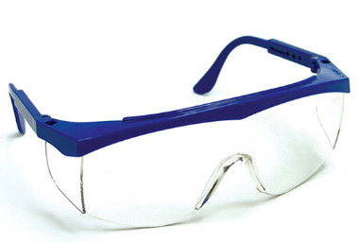
Construction Safety
Steel-toe shoes/boots will be worn at all times
Safety glasses should be worn at all time
In general, hard hats should be worn at all times, but especially when
  Working with the assembly table
  Using the crane
  Moving large items like I-Beams

Slide 8
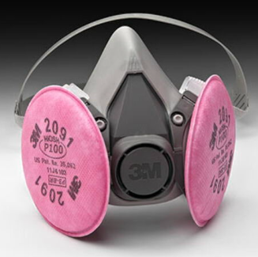



Sanding, Gluing, and Deburring Safety
N95 masks or a respirator with a P100 filter should be worn when sanding
  Can not be shared
  Respirators must be cleaned regularly
  N95 should be disposed of if damaged or used for longer than 8 hours
Thick work gloves to be worn when sanding with nitrile gloves underneath
Nitrile gloves when working with epoxy and varnish
Lab coats to protect any other exposed skin/clothes

Slide 9

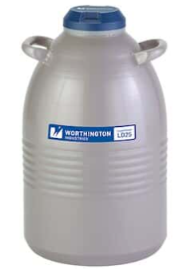
Liquid Nitrogen Safety
Always work in pairs and in well ventilated areas
Wear the gloves designed for working with LN2 (do not submerge in LN2)
Cover as much skin as possible (pants, long sleeves, lab coat)
Only dispense needed amounts of LN2 into a dewar and never above 80% capacity
Never completely seal a dewar containing LN2
Lower items slowly into the dewar to prevent splashing

Slide 10
Chemical Inventory and Disposal
All chemicals should be barcoded and logged in CEMS
Empty containers can not simply be thrown away but need to be removed from the CEMS system first. Eric and I have the ability to do this.
If an item can not go in regular garbage it must be tagged for hazardous waste and a request to EHS for pickup must be sent
These tags and liquid waste container can be obtained from CPB Stockroom

Slide 11
Future Work
Make known where various items will be stored
Define crane safety procedure
Determine what mask/filter type is needed for “dirty work” (Resp. Haz. Asmt.?)
Pull SDS and determine if further precautions are needed for various chemicals

Slide 12
Questions?

