Slide 1

Vertical Drift Field Cage(FD) QA/QC Procedure
Samriddha Chakraborty

Slide 2
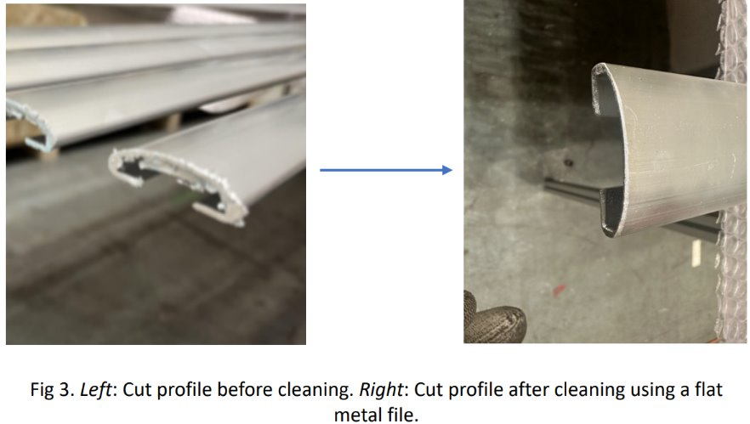
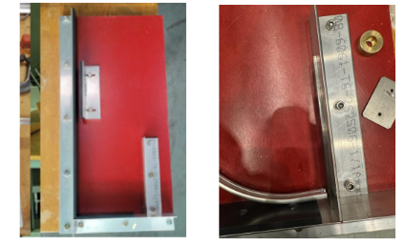
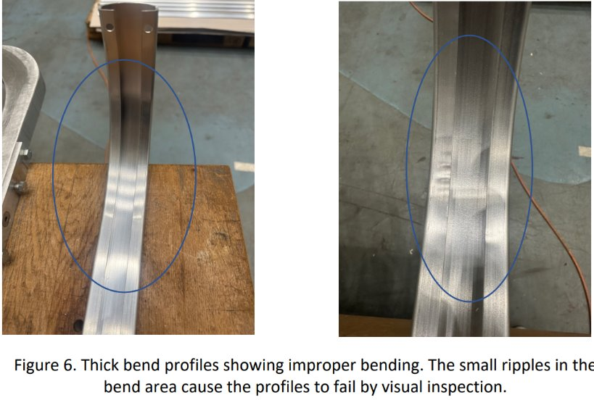
QA/QC Procedure of Aluminum Profiles:
We need to make sure there are no rough surfaces on the already cut profiles. If there is, we will use flat metal plates to get rid of it.
Make sure profiles are bent properly. There are no bumps or waves.
We will use Quality control tool to ensure the proper bending of profiles to 90degrees.

Slide 3
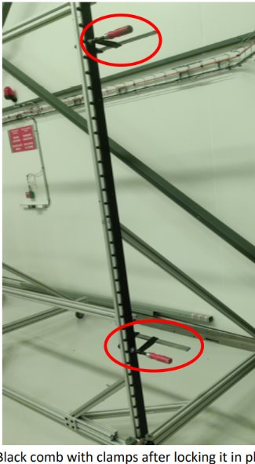
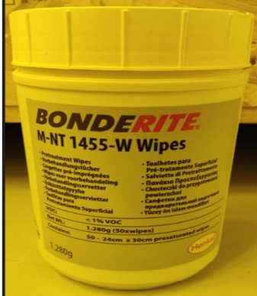
QA/QC of Black Combs for Vertical Assembly Table
After installing the black combs, we need to make sure that the comb is straight and in contact with VAT and also unbent. We will use clamp with the black clamps to make sure it's firmly hold.
We need to make sure Aluminum profiles are properly wiped with kimwipes and alcohol and properly coated with Bonderite before we load them to the VAT.

Slide 4

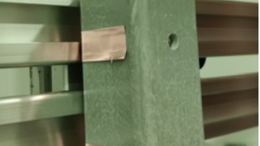
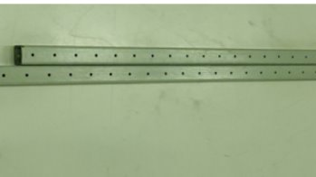
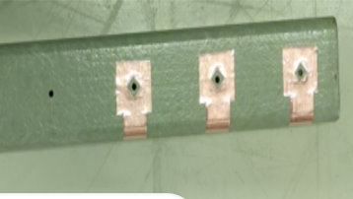
BOX BEAMS

Slide 5
QA/QC PROCEDURE OF BOX BEAMS
SETUP:
We need to make sure Box beams are straight. There should be no bent beams.
There should be no bump or rough surfaces on the box beams.
The copper holes on the box beams should be dust free to prevent any disturbance on the electrical contact. We can use a brush to clean the wholes to keep it dust-free.
Then we will check box beams are properly placed and locked and they are in continuous contact with the black teeth of the comb and the aluminum profiles at the back.

Slide 6
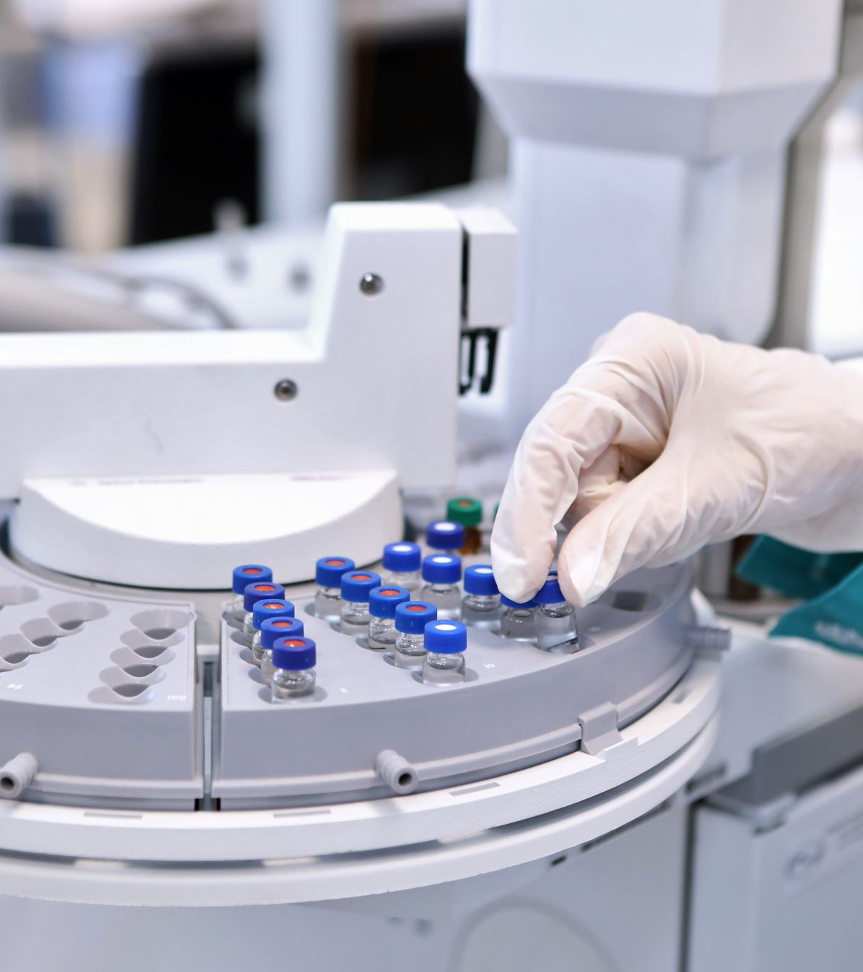
Dimension Inspection of the parts
Length
Distance
Hole Position
Hole Diameters

Slide 7
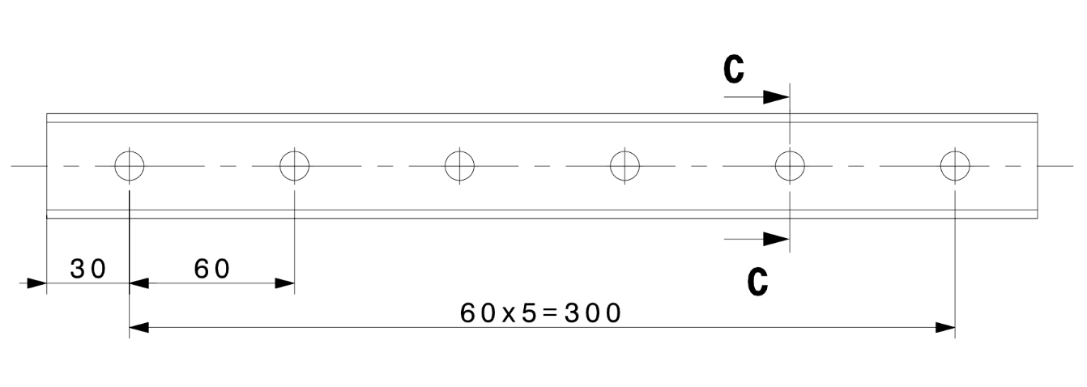
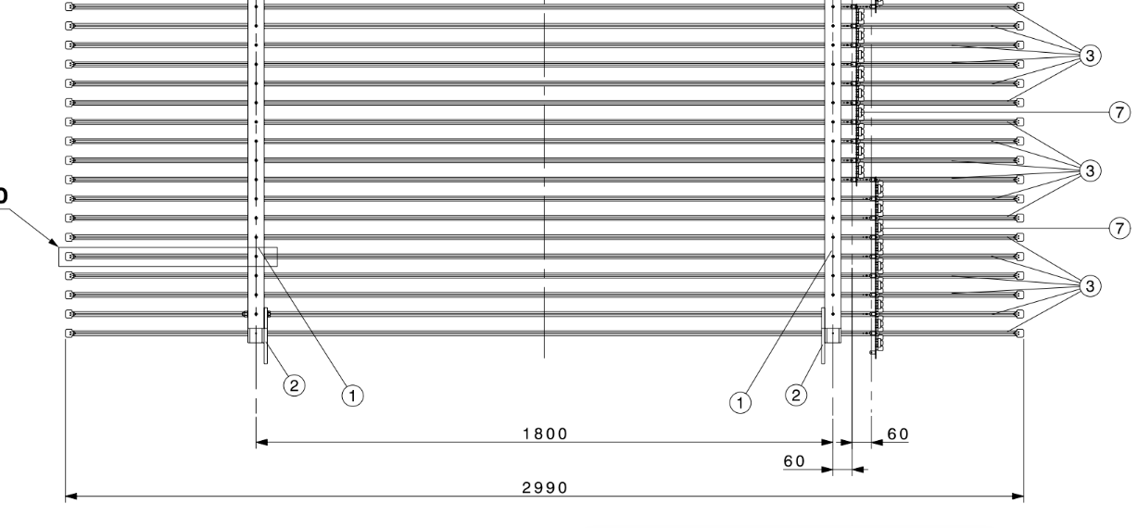
DIMENSION CHECKING :
We need to make sure the distance between the front end and the first whole is 30mm.
Then the gap length between each wholes should be 60mm
We need to make sure the gap length between two box beams are 1800mm
We need to make sure the distance between two divider boards are 60mm.

Slide 8
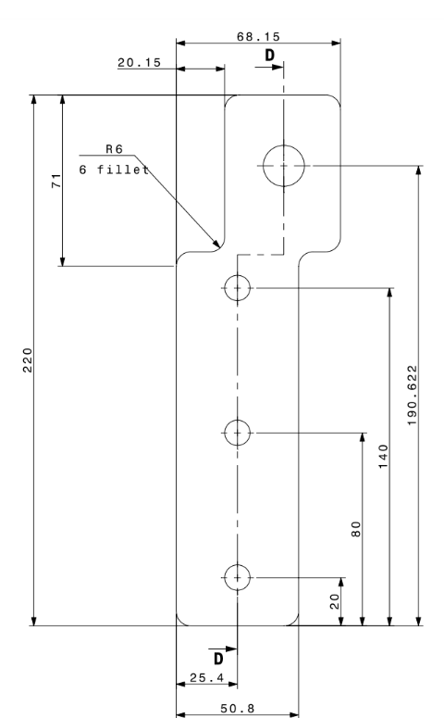
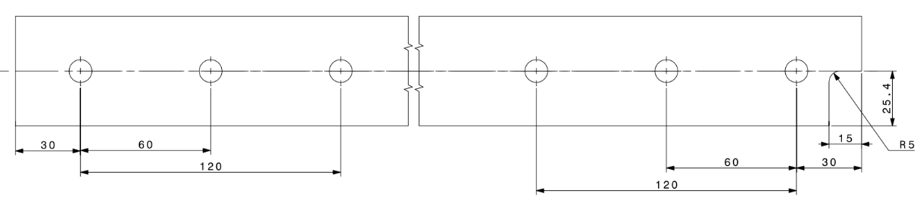
Make sure the Rounded interior corner is smooth without any bumps. If there are bumps, we will need to get rid of it through sanding.

Slide 9
Future Goals:
Study the Engineering drawings more thoroughly
1
Finish the Data Set 1 and Data Set 2 scanning
2
Gather the screenshots of all the interesting events and the events that are identified as 8.
3

Slide 10

THE END
- THANK YOU
Samriddha Chakraborty

