Slide 1
Horizontal Drift QA/QC Fiber Reinforced Plastic (FRP) Parts Preparation & Gluing Procedure
Sam Blanchard

Slide 2
Part Preparation and Cleaning

Slide 3
Initial Visual Inspection
Perform the following visual inspection of the material for the following defects
- Category 1 defects (severe)
- Category 2 defects (problematic if large)

Slide 4
Category 1 Defects
Cracks
Fractures
Delamination (separation of two or more layers)
Dry Fiber (lack of resin fill out)
Burns or Thermal Decomposition
Under-cured (dull or bleached surfaces)
Wrinkles
Curve

Slide 5
Category 2 Defects
Crater / Shrink Marks
Craze (fine network of cracks)
Chips (can’t be more than 10 mm in length or width)
Saw Burn (should be covered by resin / epoxy)
Grooving (ok if material thickness reduction is less than 10% and the groove’s width is less than 3 mm)
Die Parting Line (within 0.5 mm and no loose fibers)

Slide 6
Category 2 Defects (continued)
Porosity - Internal and Surface Voids (ok if does not affect structural integrity)
Resin Rich Area (ok)
Roving Knot (ok)
Scale (ok if not sharp edges)
Scuffing (ok if less than 30 cm long and 19 mm wide)
Discoloration (ok)

Slide 7
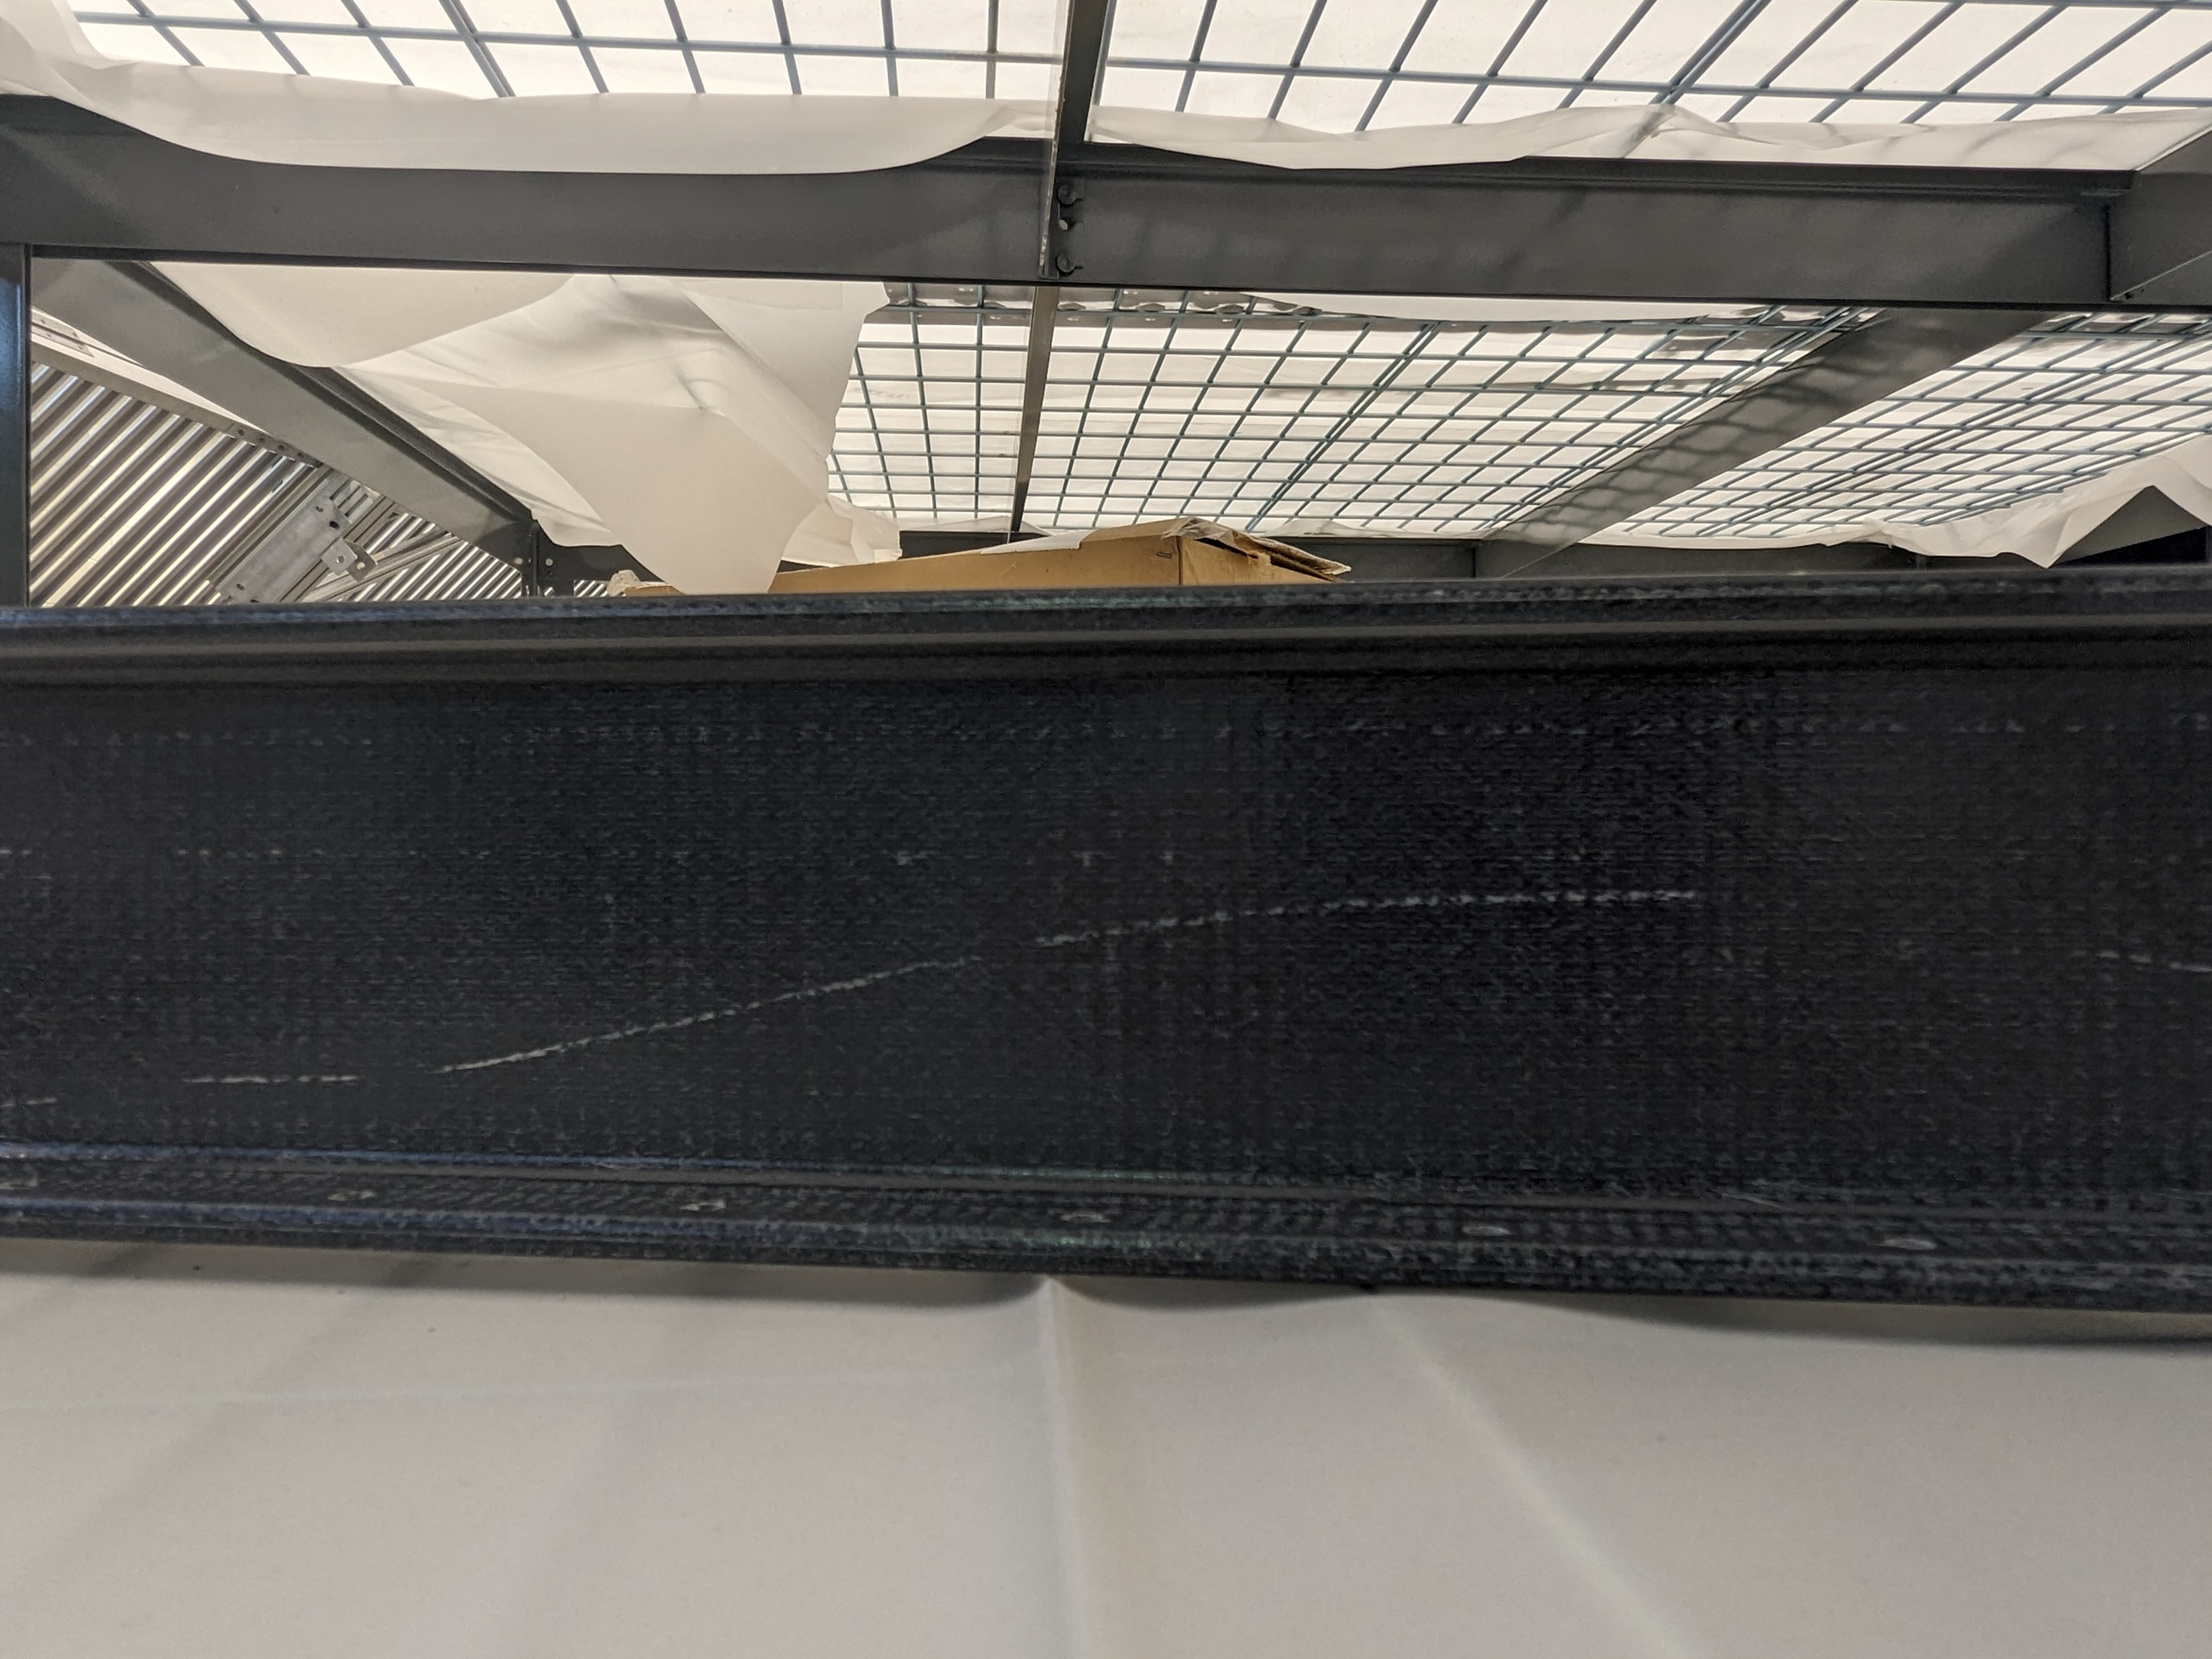
Scratches

Slide 8
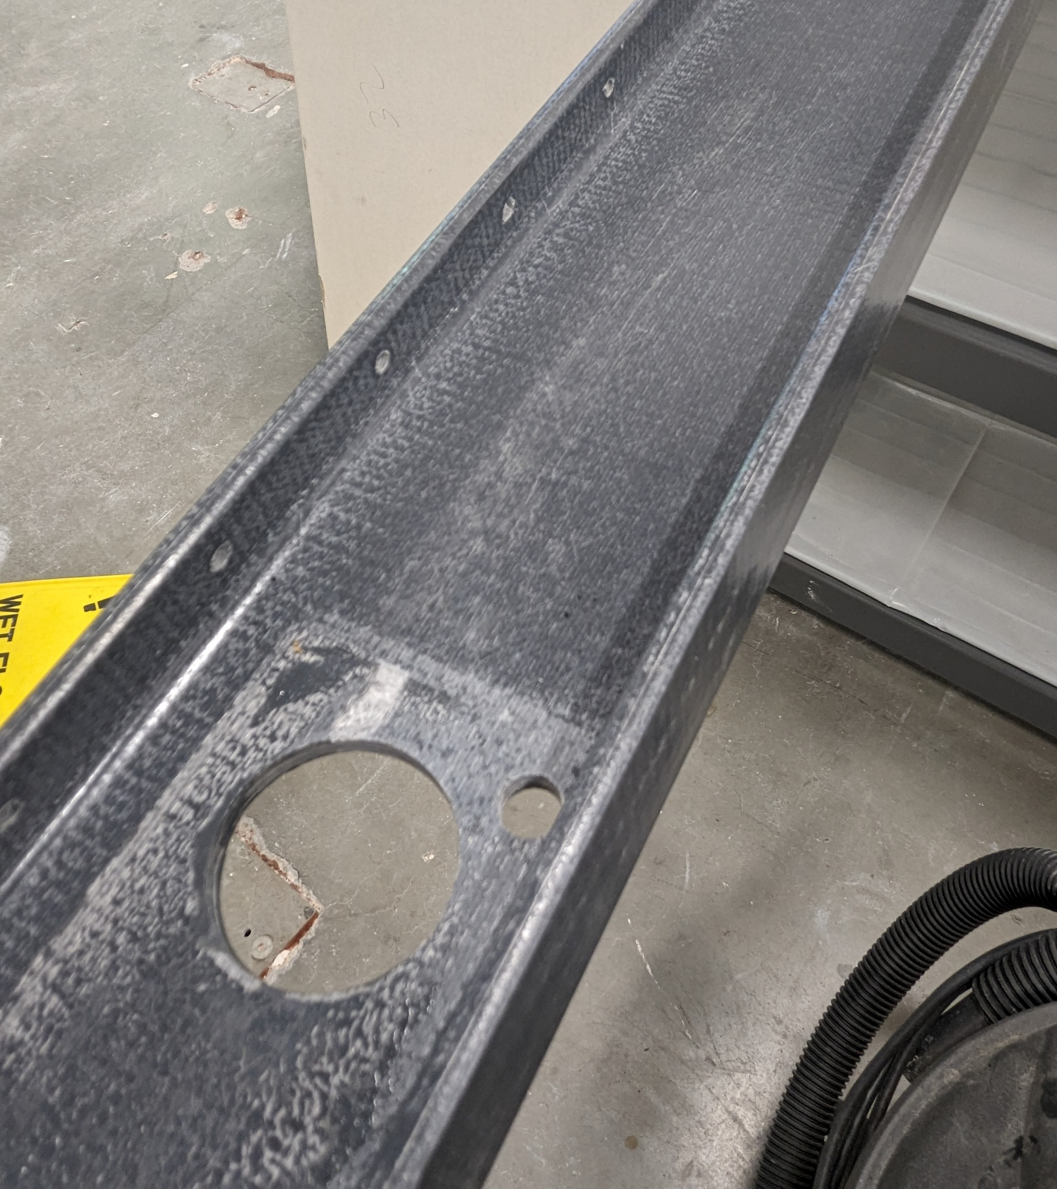
Scuffing

Slide 9
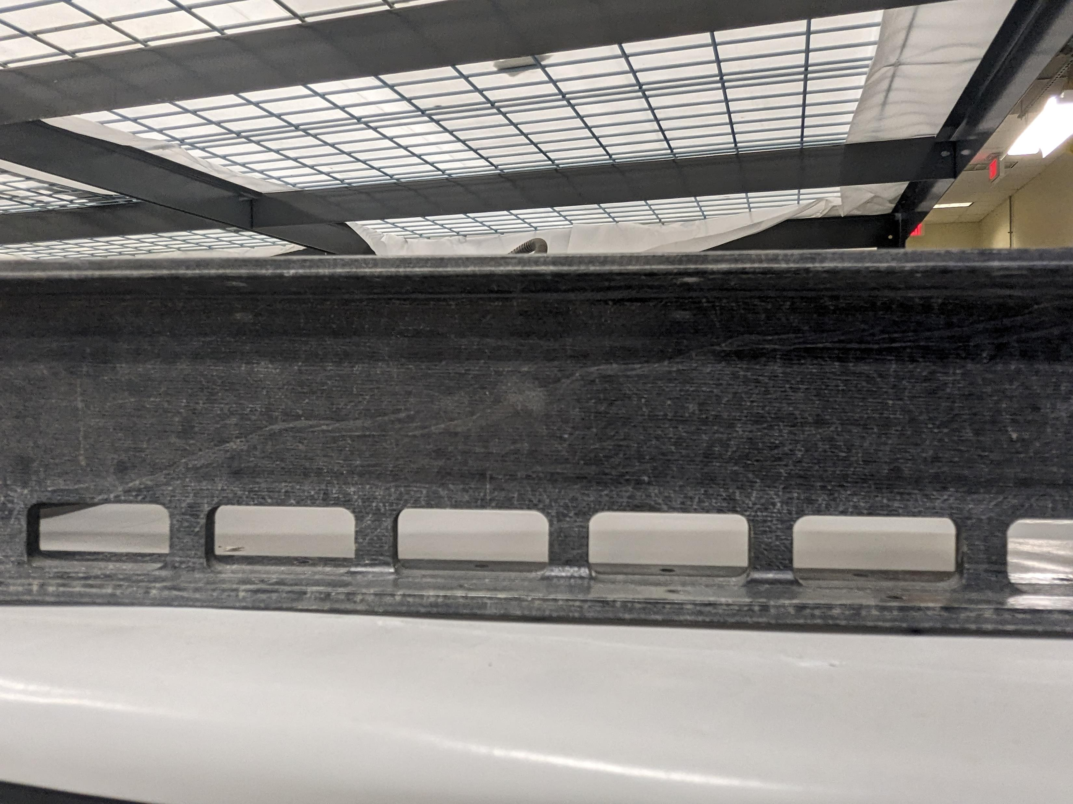
Craze and Scuffing

Slide 10
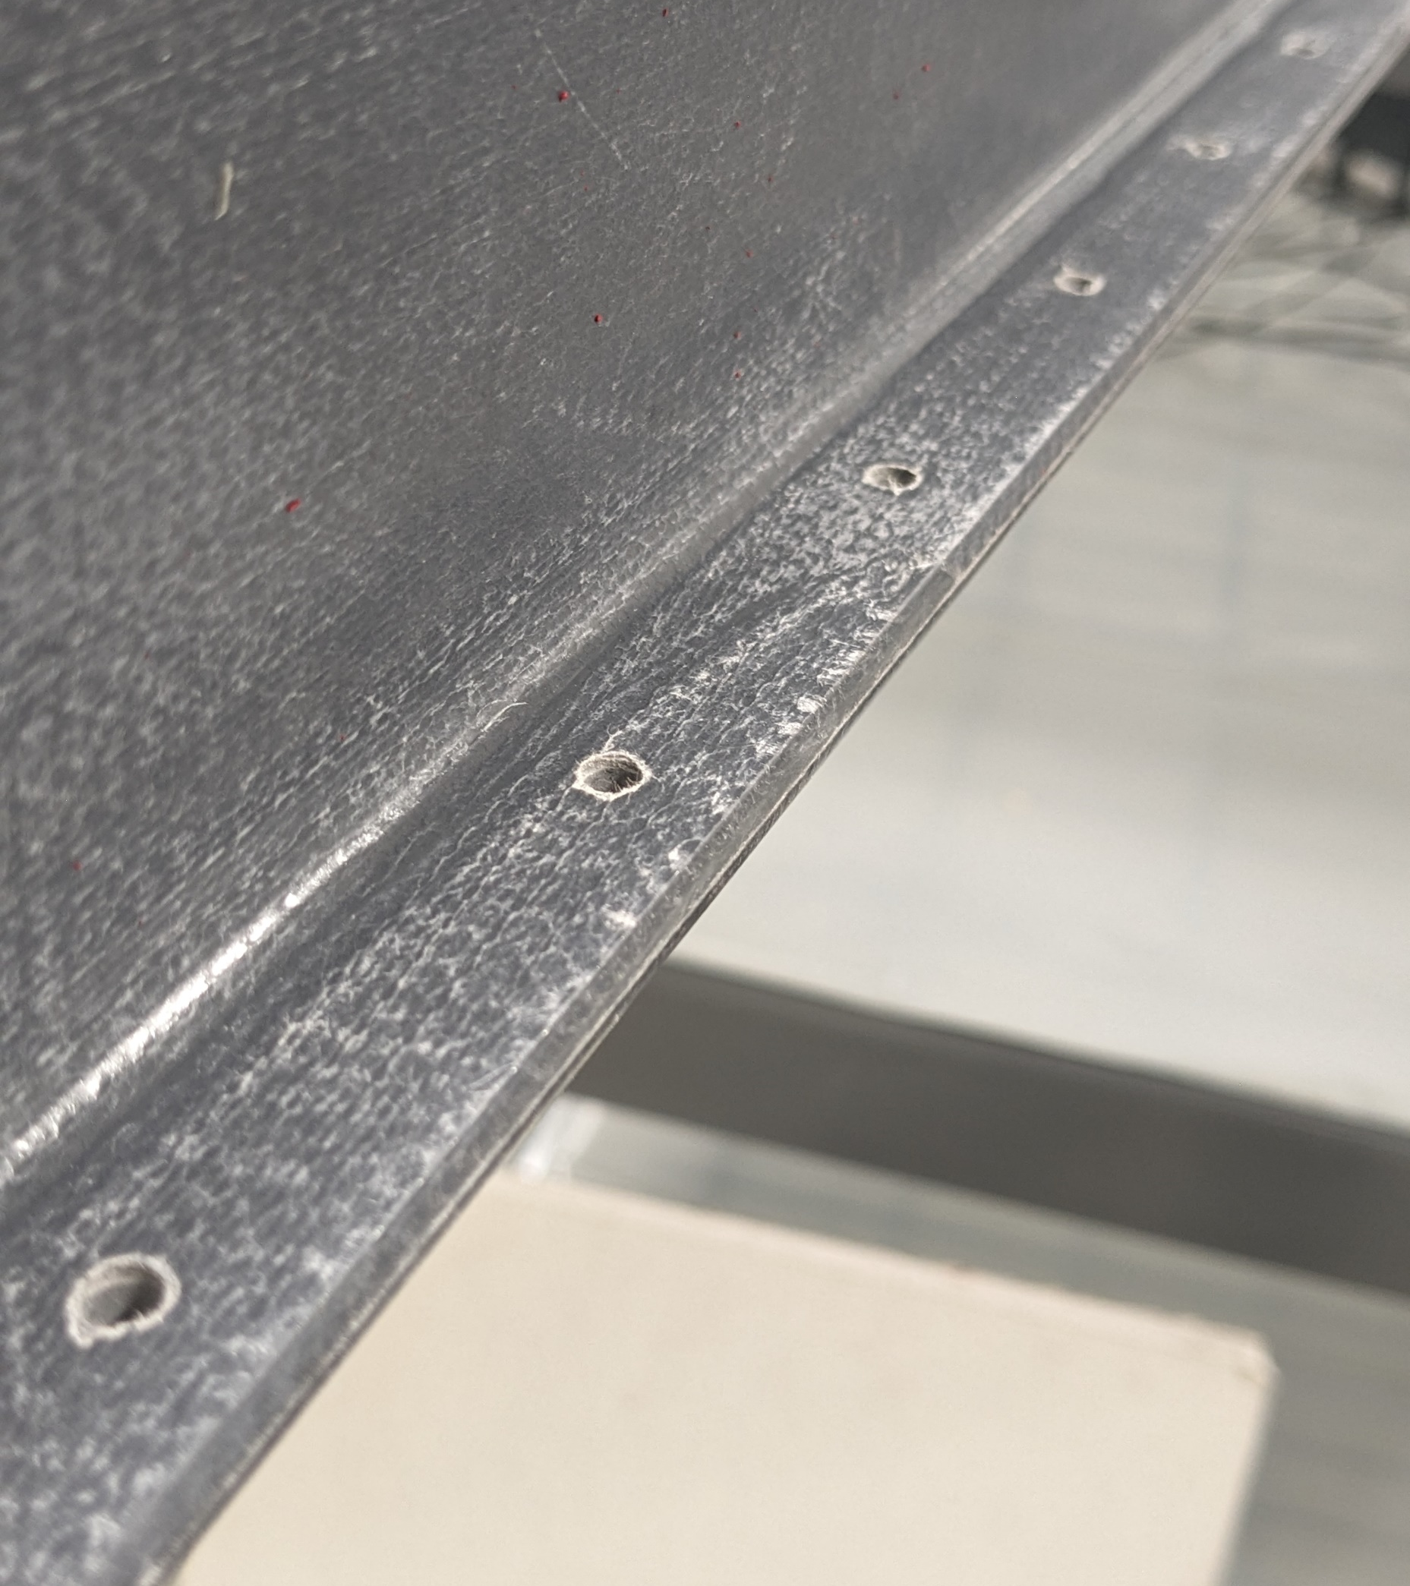
Needs to be Deburred, Small Scuffing

Slide 11
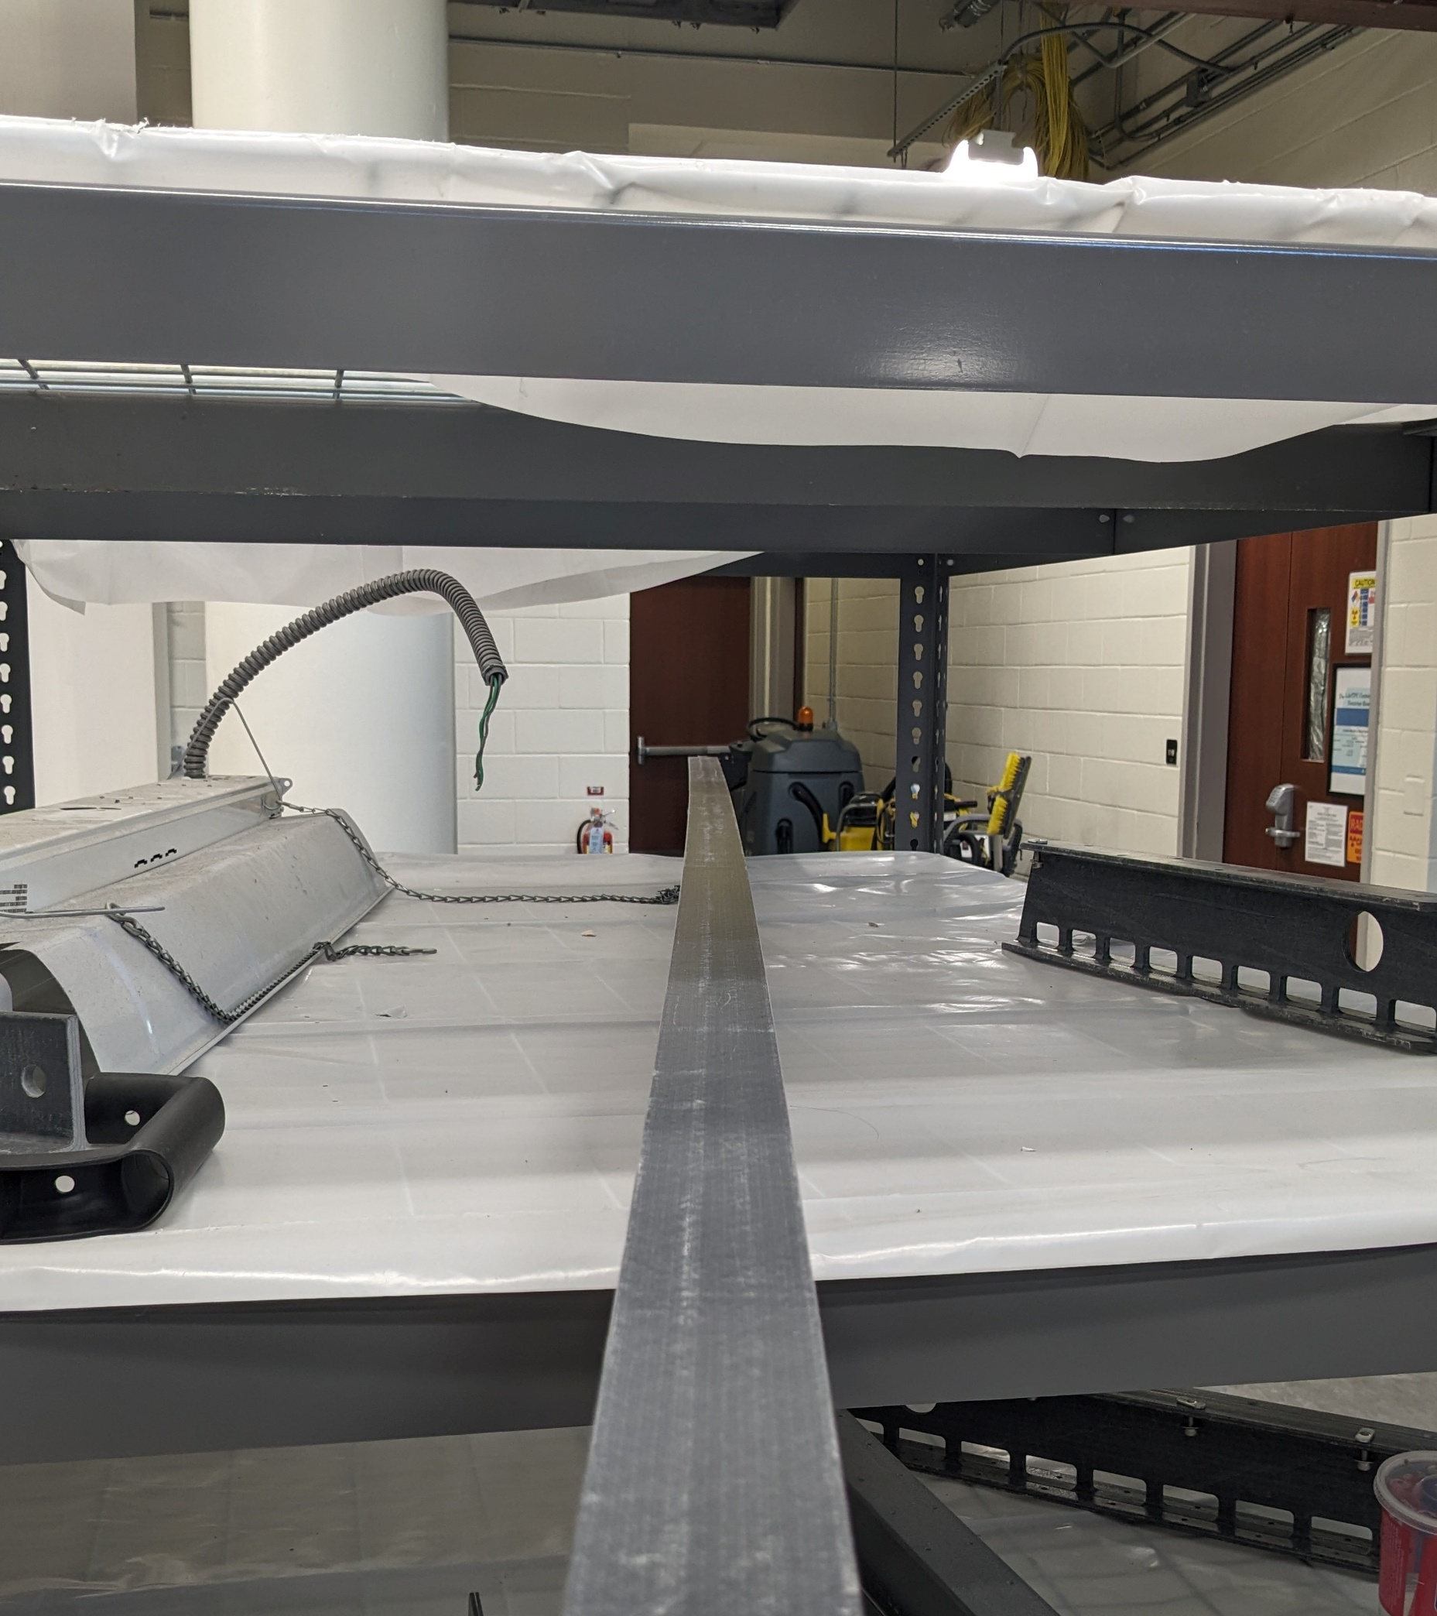
Curves Too Much

Slide 12
Deburring, Defibering, Sanding, Coating, and Cleaning of FRP Parts
    1. Debur machined holes and slots with the deburring tool to remove large remaining pieces of the FRP from all parts
    2. Defiber using sandpaper. Use 1500 grit wet.
    3. Clean the processed FRP part with clear “simple green” solution followed by de-ionized water, using the Kimwipe(s). Make sure that no lint is left over after the wiping.
    4. Move the cleaned parts into the semi-clean area and dry them in air on a drying rack for 24 hours to remove all moisture.

Slide 13
Deburring, Defibering, Sanding, Coating, and Cleaning of FRP Parts (cont.)
    5. Glue two reinforcement plates to either side of the main I-beams according to the drawing and the gluing procedure attached to this presentation. Let the glue cure level to keep the plates in place.
    6. Apply epoxy coating as uniformly as possible on all machined surfaces, excluding holes smaller than 1cm in diameter. Apply coating using gloves and your finger to surface defects on latch and main I-beam. Wipe excess coating material off the beams. Inspect the coating quality to ensure uniform application of the coat.
    7. Let the coating dry and cure for at least 24 hours in the semi-clean area.
    8. After 24 hours of curing, move the processed I-beams and latch beams to the semi-clean storage rack.

Slide 14

Measuring

Slide 15
Dimensional Inspection of the I-Beams, Latch Beams, and Reinforcement Plates
• Perform a thorough visual inspection before taking measurements (Failed visual inspection will be noted).
• Dimension types inspected.
- Length
- Straightness
- Flatness
- Hole Position
- Hole Diameters

Slide 16
Critical Dimensions
Critical dimensions – The distances between the adjacent slip-nut holes, diameter of hole B, the distance from edge I to hole B for Main I Beams, and diameter of hole B for the Reinforcement plates - must be verified within 0.010 in (0.25 mm).
- Jigs that adhere to the tolerances above are developed for a rapid quality control the critical dimensions of all FRP parts. Parts will be labeled pass or fail. Failed parts will be rejected. Passed parts will be inspected closer for qualifying them.

Slide 17
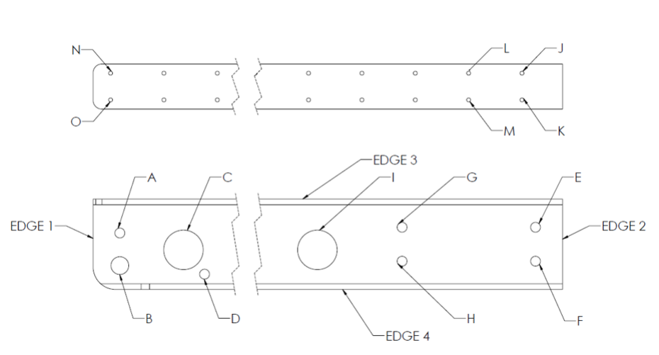
Critical Dimension

Slide 18
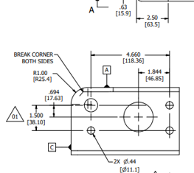
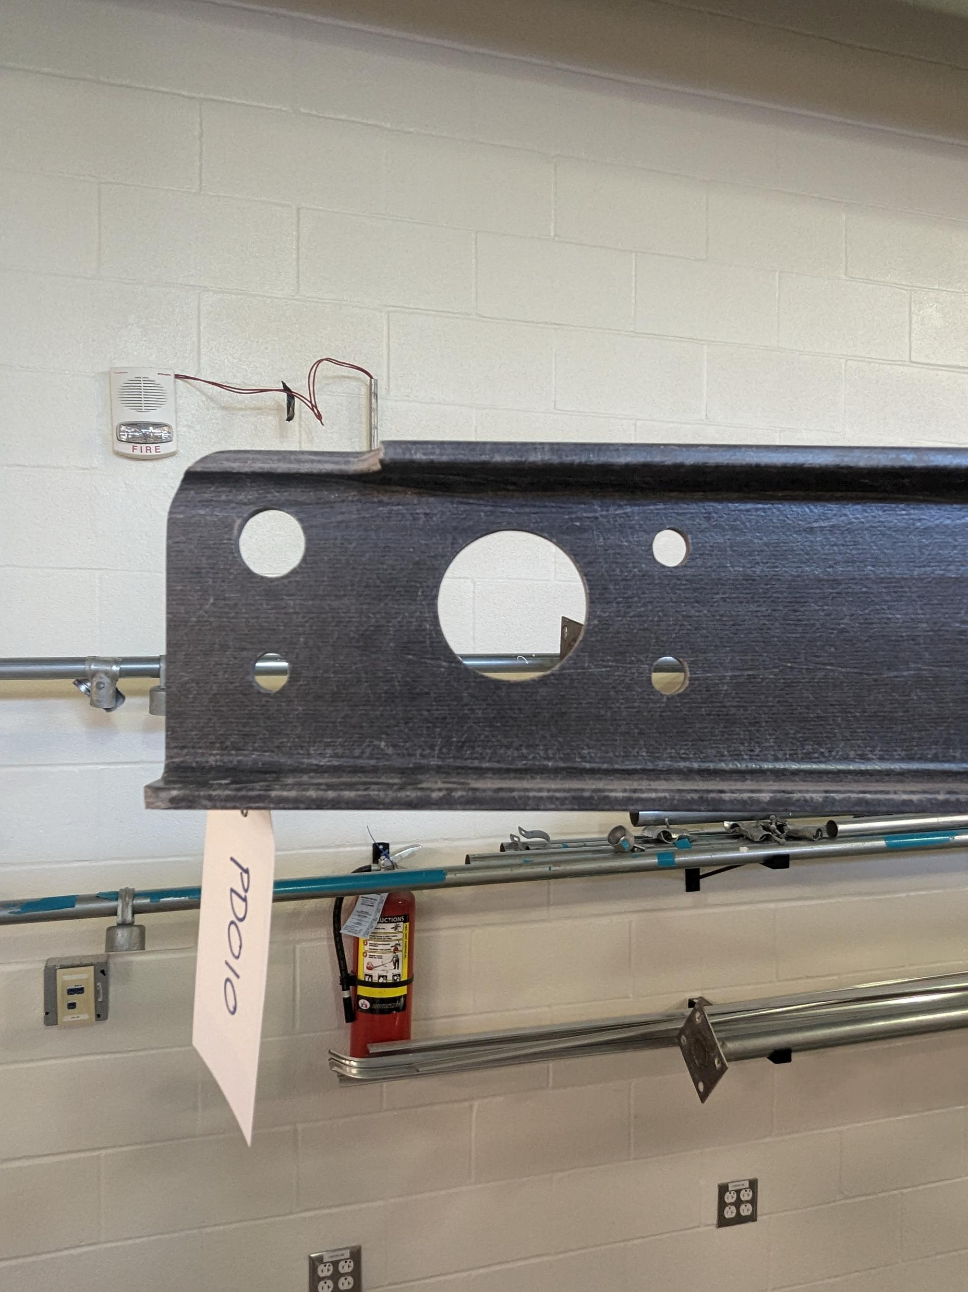
Most Important Section of I-Beam

Slide 19
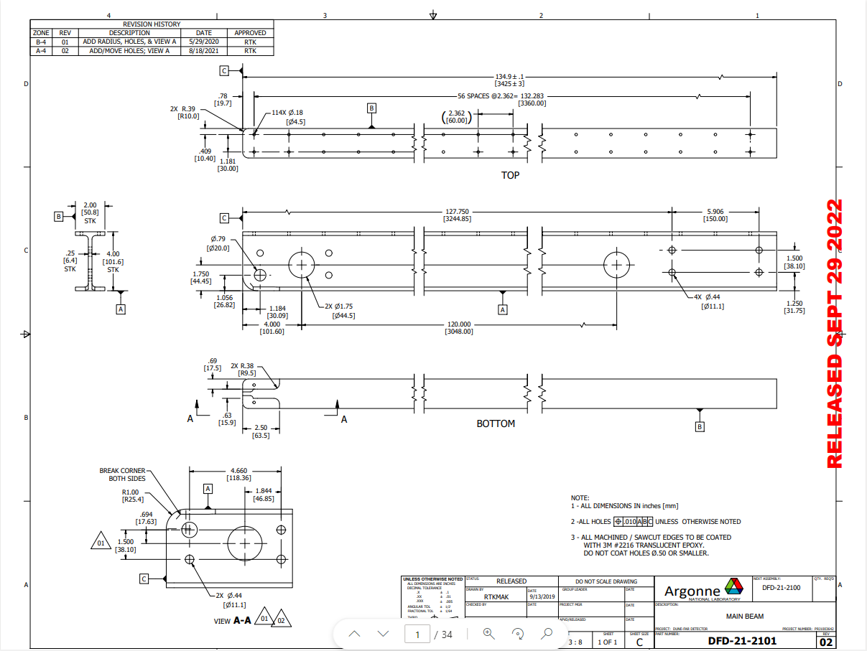

Slide 20
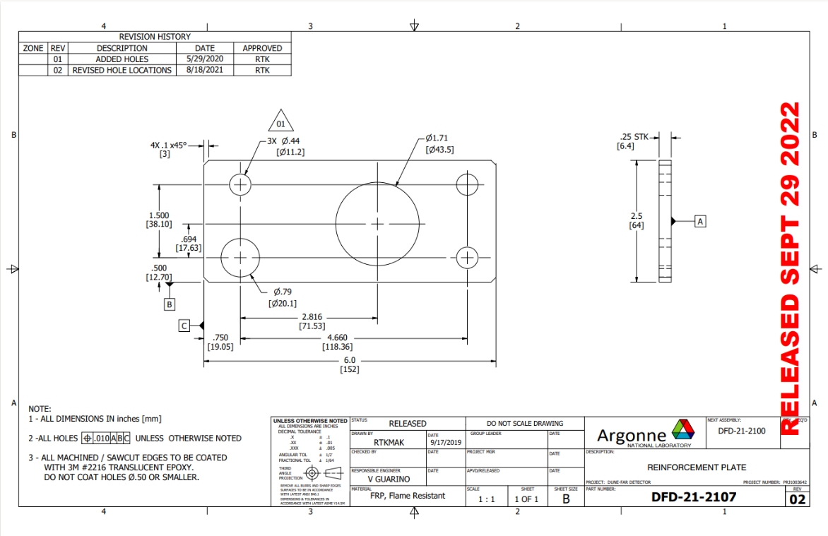

Slide 21
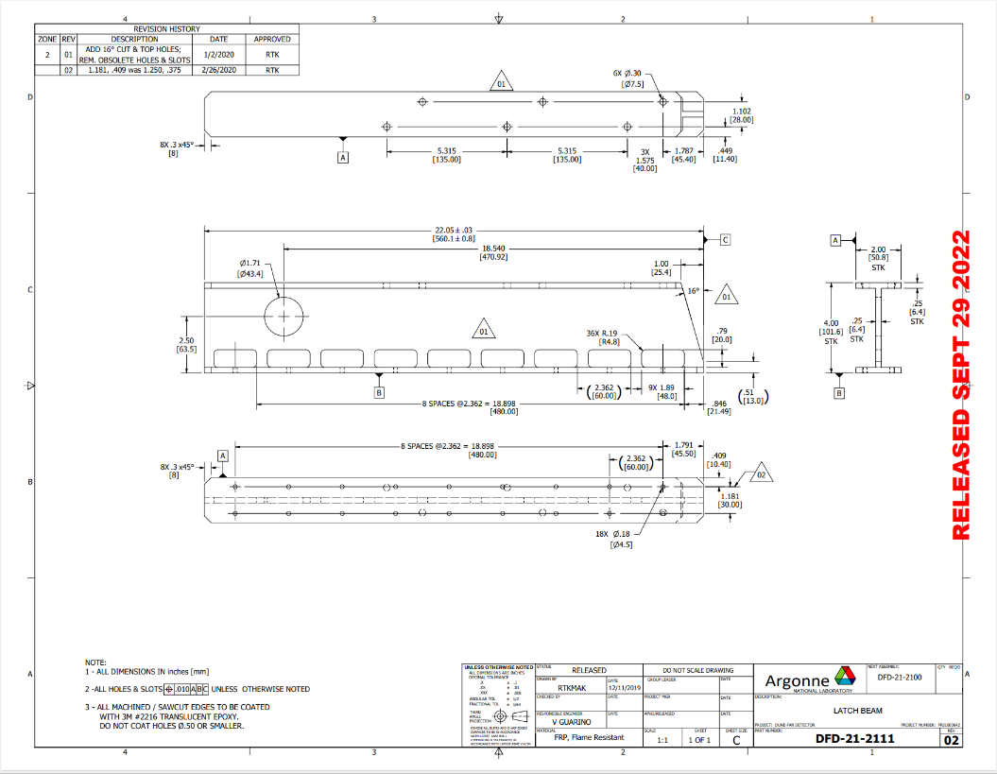

Slide 22
Basic Tolerancing of Parts
All tolerances in the drawings follow a rule unless otherwise specified.
(all measurements in inches)
.X ± 0.1
.XX ± 0.01
.XXX ± 0.005
There is one exception in the drawings
All positions of holes must be ± 0.01 of their specified dimension in relation to edges A,B, and C

Slide 23
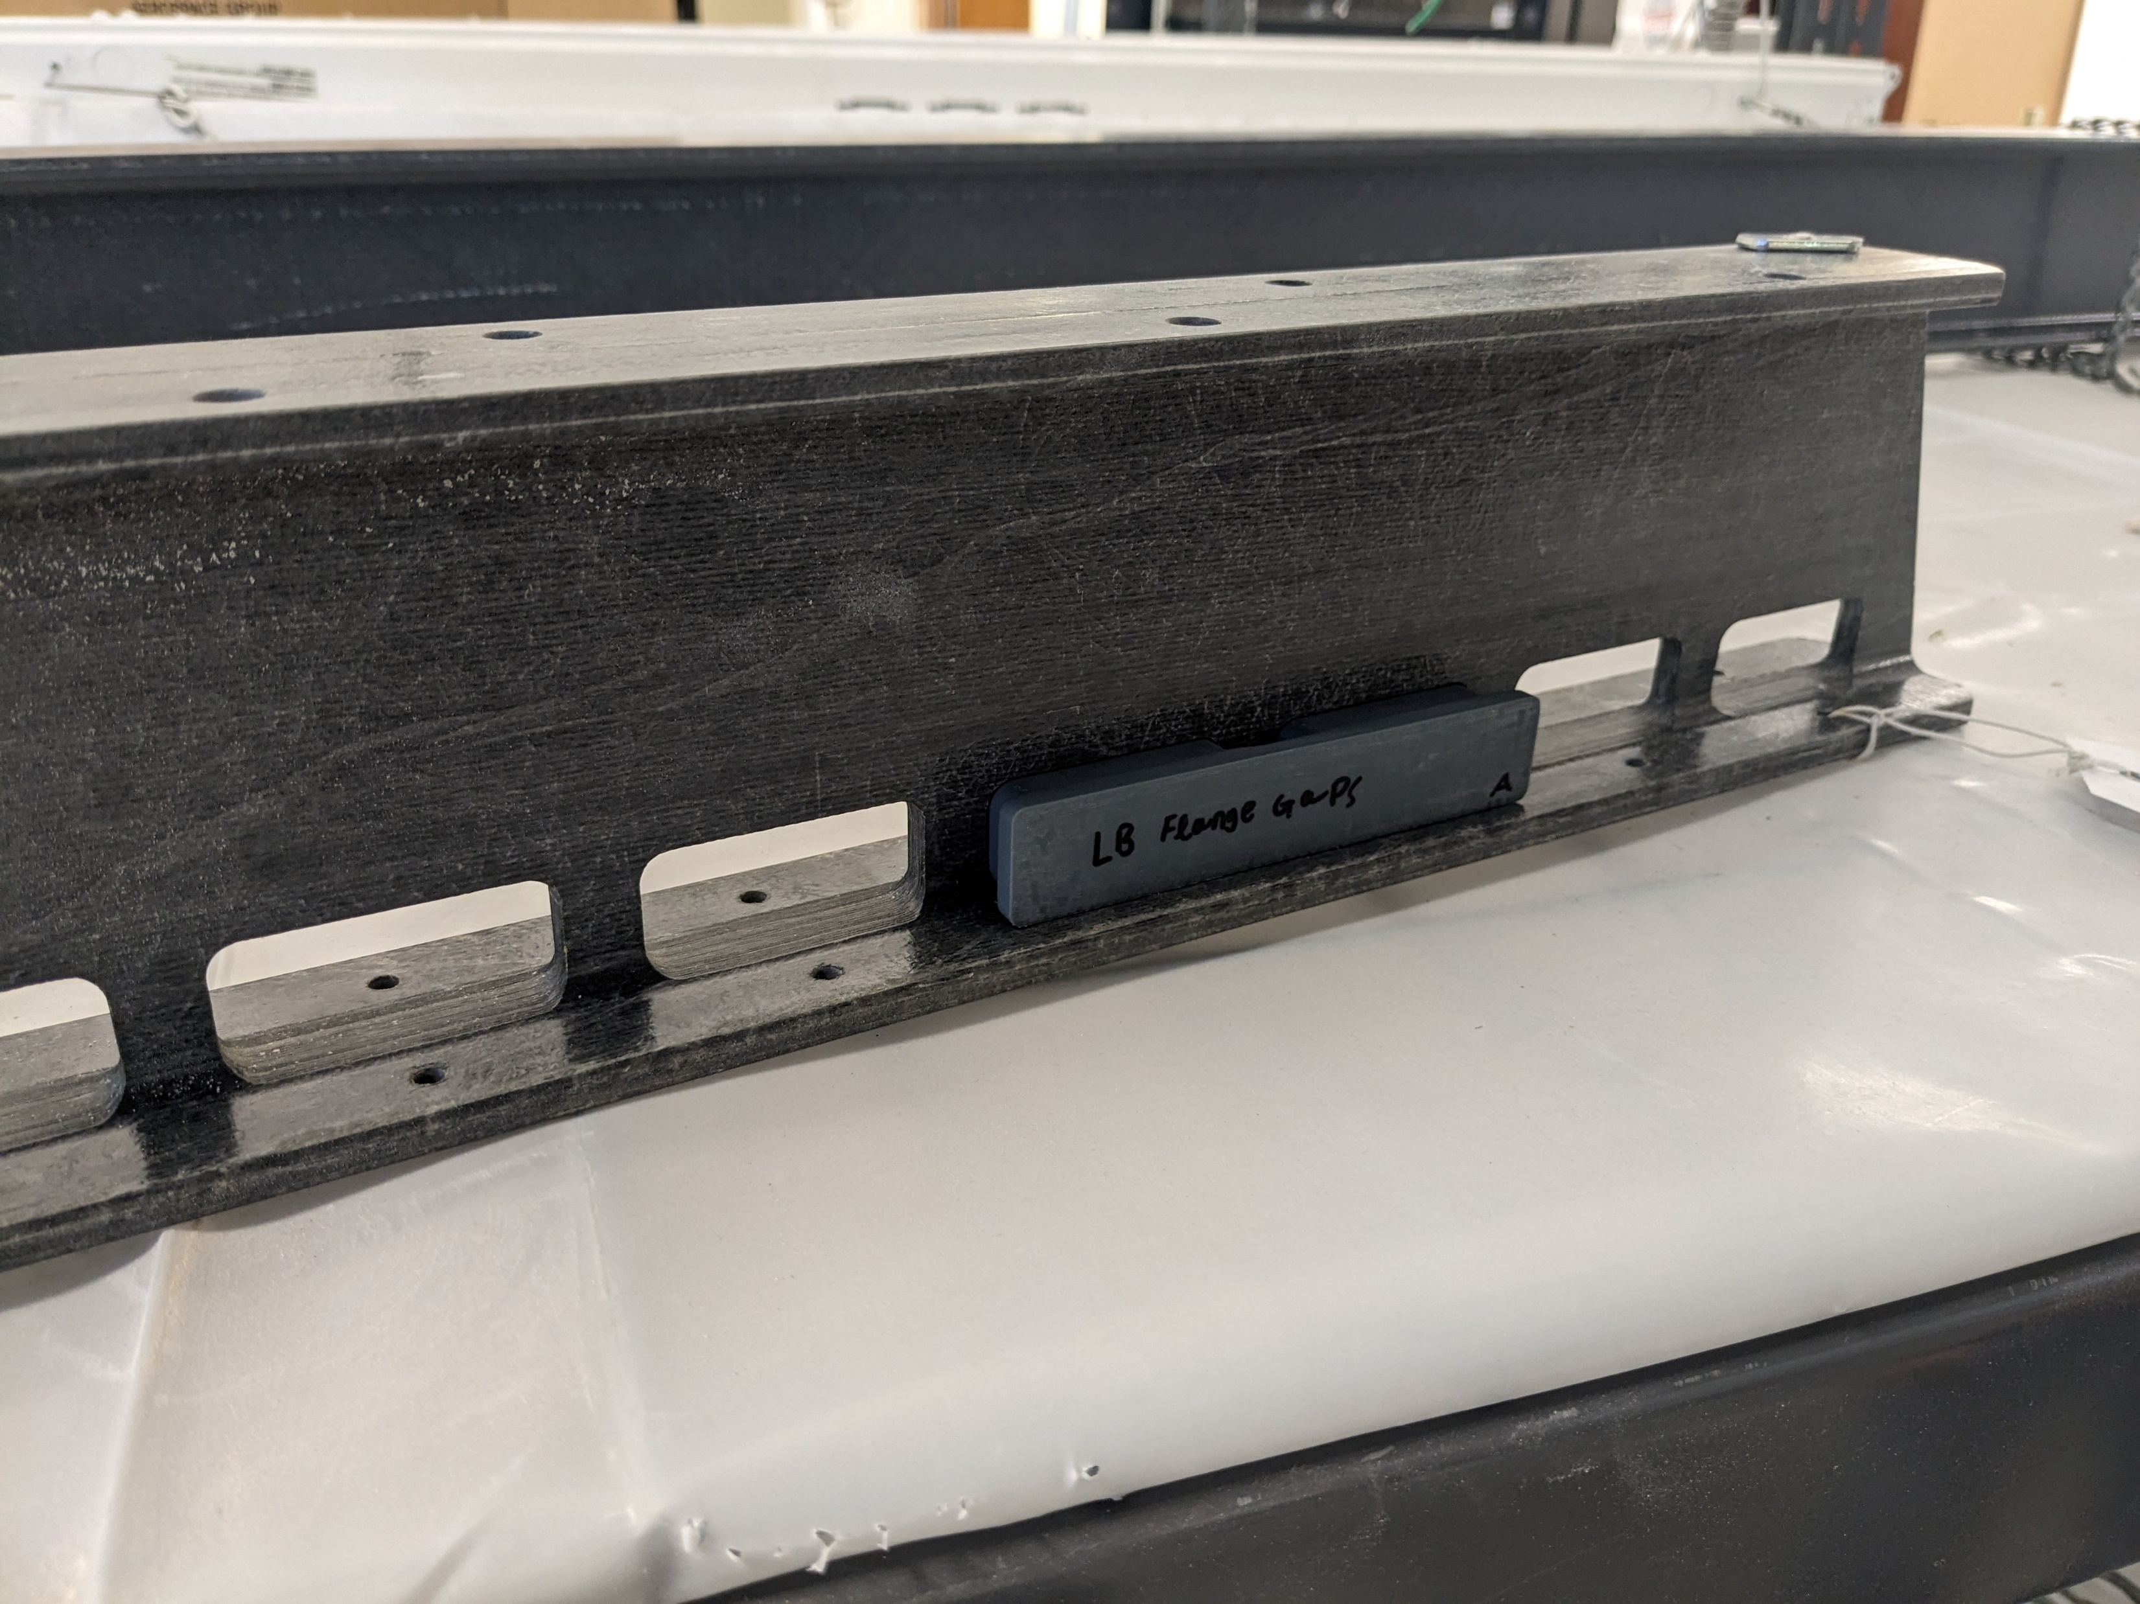
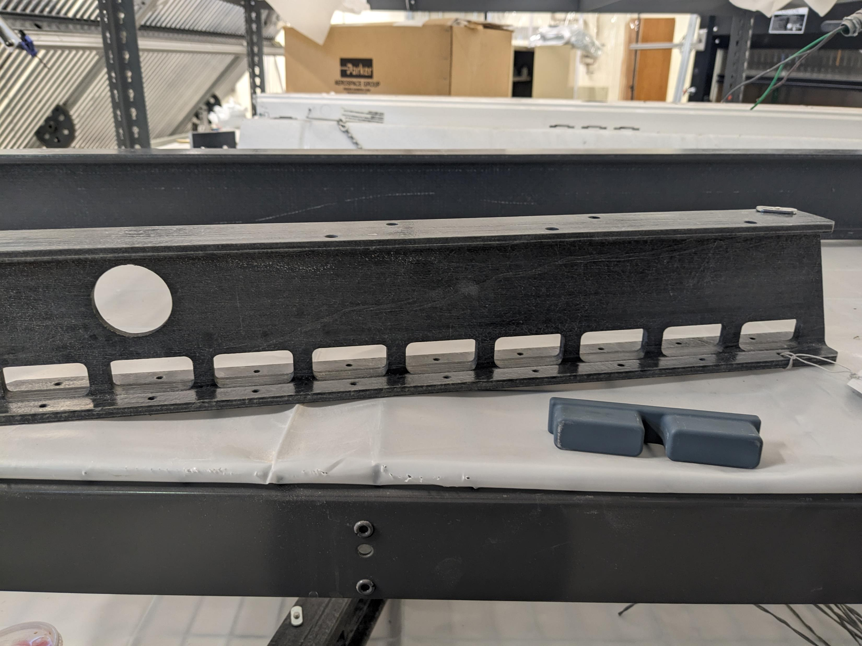
Using Jigs

Slide 24

Gluing Procedure for Reinforcement Plate

Slide 25
Materials
• FRP Reinforcement Plates
• 3M #2216 Translucent Epoxy
• Silicone Brush and Knife
• C-clamps or Vice Grips
• PPE: Latex Gloves, Coat, Glasses

Slide 26
Reinforcement Plate Preparation
• Make sure Reinforcement Plates are sanded properly (edges need to be filleted)
o Left and Right Reinforcement Plates should be clearly distinguishable.
o Clean, wash, and dry with Kim Wipes.
o Pair reinforcement plates with I-beam (2 reinforcement plates for each main I-beam).
o Wait 24 hours to dry.

Slide 27

Procedure
Place I beam in the vertical position

Slide 28
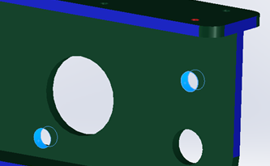
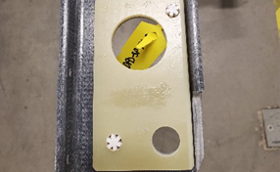
Procedure
• Insert two alignment pegs into alignment holes.

Slide 29
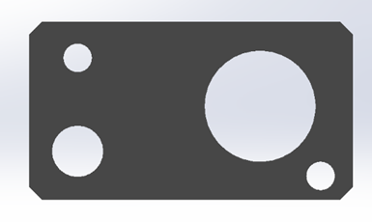
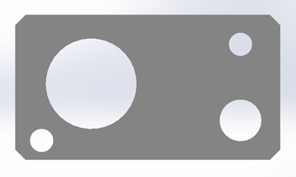
Procedure
• Apply glue onto inner surface of plates using the brush as evenly as possible.
o Left Reinforcement Plate inner surface
o Right Reinforcement Plate inner surface

Slide 30
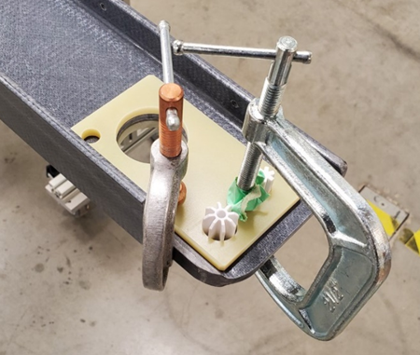
Procedure
• Carefully place plates onto I-beam using the alignment pegs as guides.
• Clamp the plates in place.

Slide 31
Procedure
Excess glue seeping out from the plates should be scraped off immediately.
Wait 1 minute and remove the alignment pegs.
Remove C-clamps after two hours for sufficient level of curing.
Move I Beam to storage rack

Slide 32
Applying Epoxy Coat
  After the glue has sufficiently cured, the last step is to apply the epoxy coat.
  Using a disposable latex glove and your finger to spread the glue, apply epoxy coating as uniformly as possible on all machined surfaces, excluding holes smaller than 1cm in diameter.
  Wipe excess coating material off the beams. Inspect the coating quality to ensure uniform application.
  After finishing the coating, let it cure for at least 24 hours in a semi-clean area.
  Once curing is complete, move the part to the semi-clean storage room.

Slide 33

Conclusion
QA/QC consists of –
Checking parts for initial damage
Checking the dimensions of parts
Gluing reinforcement plates
Applying an epoxy coat

Slide 34
END

