Slide 1
FD1-HD and FD2-VD FC workshop
Feb. 17, 2024
2nd DUNE FC Workshop
Jaehoon Yu
University of Texas at Arlington

Slide 2
Workshop Fundamentals
Goals : To set up the production factory for large scale FC parts processing and to train all group members with module QC and assembly procedure
Tasks to complete in the workshop
  Complete the factory set up
  Understand the scope and tasks involved in the project
  Go through the module assembly procedure hands-on and finish constructing one HDFC module
  Hands-on training of the module parts QC procedure and exercise recording them into the QC iPADs

Slide 3
Neutrino fundamentals – 1
Postulated in 1930 to explain the nuclear β-decay and detected experimentally in 1956 (1995 Nobel)
Fundamental particles of matter in the current Standard Model of Particle Physics
  Makes up a quarter of the whole particle table in TSM as massless particles
  Have three flavors – electron (ν_{e} – 2002 Nobel), muon (ν_{μ} – 1988 Nobel) , and tau (ν_{τ}) types
  Charge neutral and only interact via the weak force ➔ do not interact often in matter

Slide 4
Neutrino fundamentals – 2
Large numbers of low E neutrinos (ν_{e}) produced in the Sun (2002 Nobel) and in reactors
  ➔ 65x10⁹ ν_{e} /s/cm² (FFT: how many passes throughout your body/sec?)
Neutrino flavor oscillation (change their flavors in flight!) discovered & confirmed throughout late 1990 and early 2000 (2015 Nobel)
  Happens because flavor and mass eigenstates differ (oscillation probability dependent on L/E_{ν})
  Neutrinos have mass! ➔ SM in BIG trouble!

Slide 5
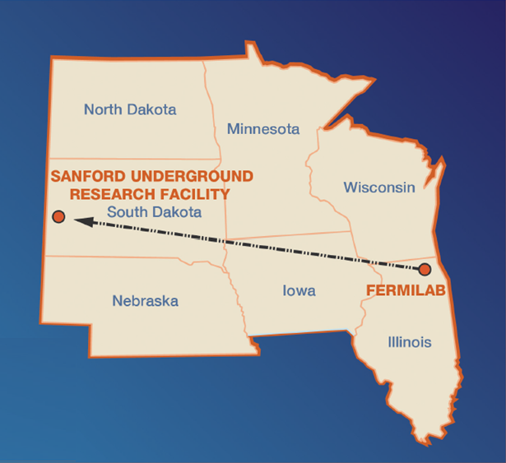
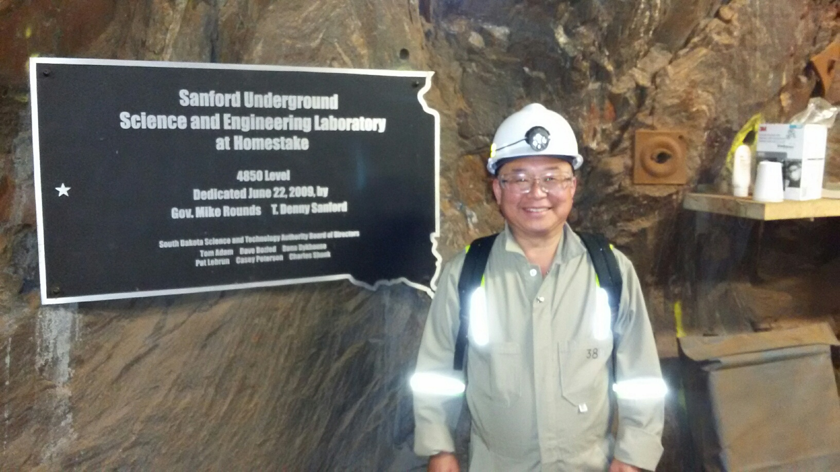
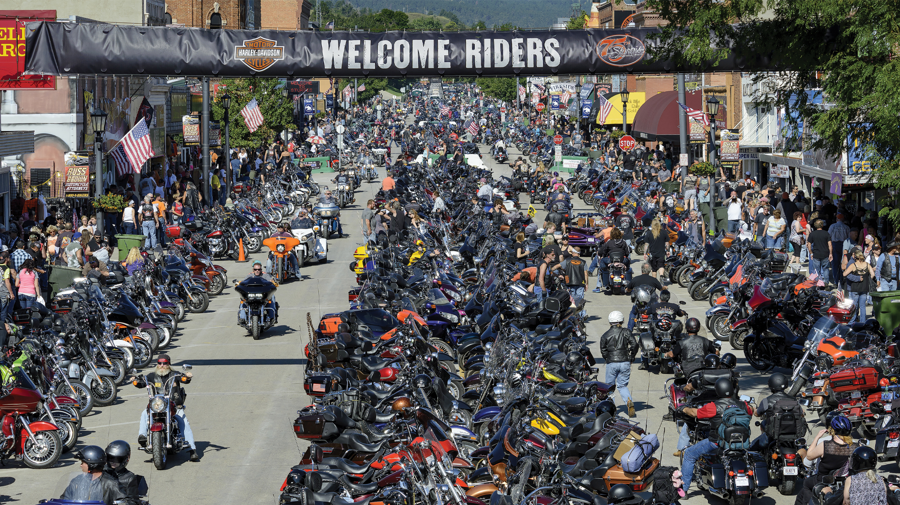
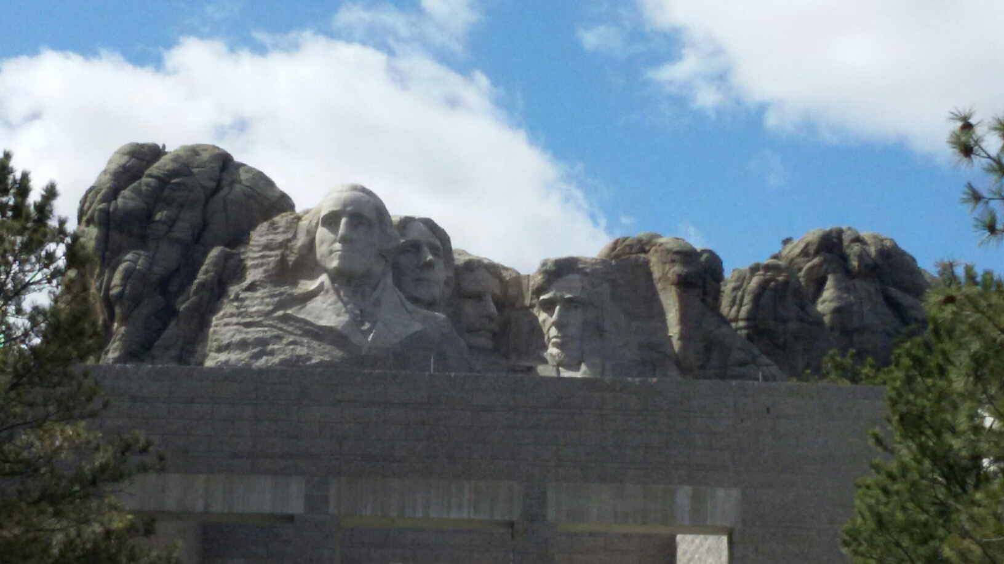
The Next Big Thing - DUNE Experiment
Stands for Deep Under Ground Neutrino Experiment
US flagship long baseline (1300km) ν experiment
  1500m underground in an old South Dakota gold mine
Yes, you are right, again!
That Sturgis is right next door!
Yes, you are right! Mount Rushmore!!
2002 Nobel Winning solar ν detection by Ray Davis
Many DM experimentsNew
DUNE area excavation completed on Jan. 25, 2024
Experiment infra work begun

Slide 6
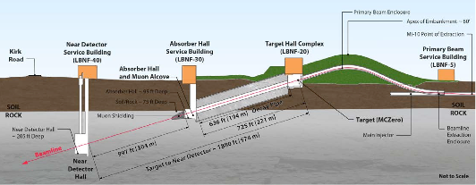
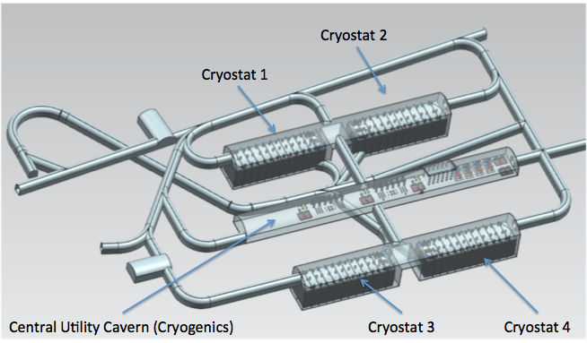
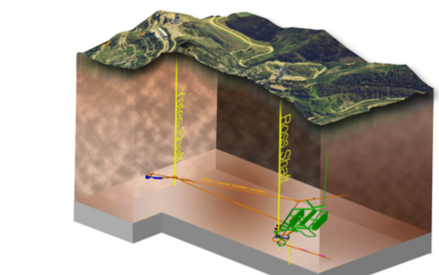
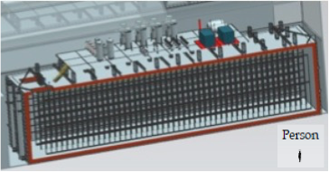
Anatomy of DUNE
LBNF ν Beam
Broadband ν from 60 – 120GeV p
P_{Beam} :1.2MW →2.4MW
Tgt
1300km (800 miles)
570m
ND
4 caverns for
M_{t}~ 70kt LAr
(>85% complete)
M_{A}~ 17kt LAr
LBNF Far Detector Site, SURF
1500m underground
18m
18m
66m

Slide 7
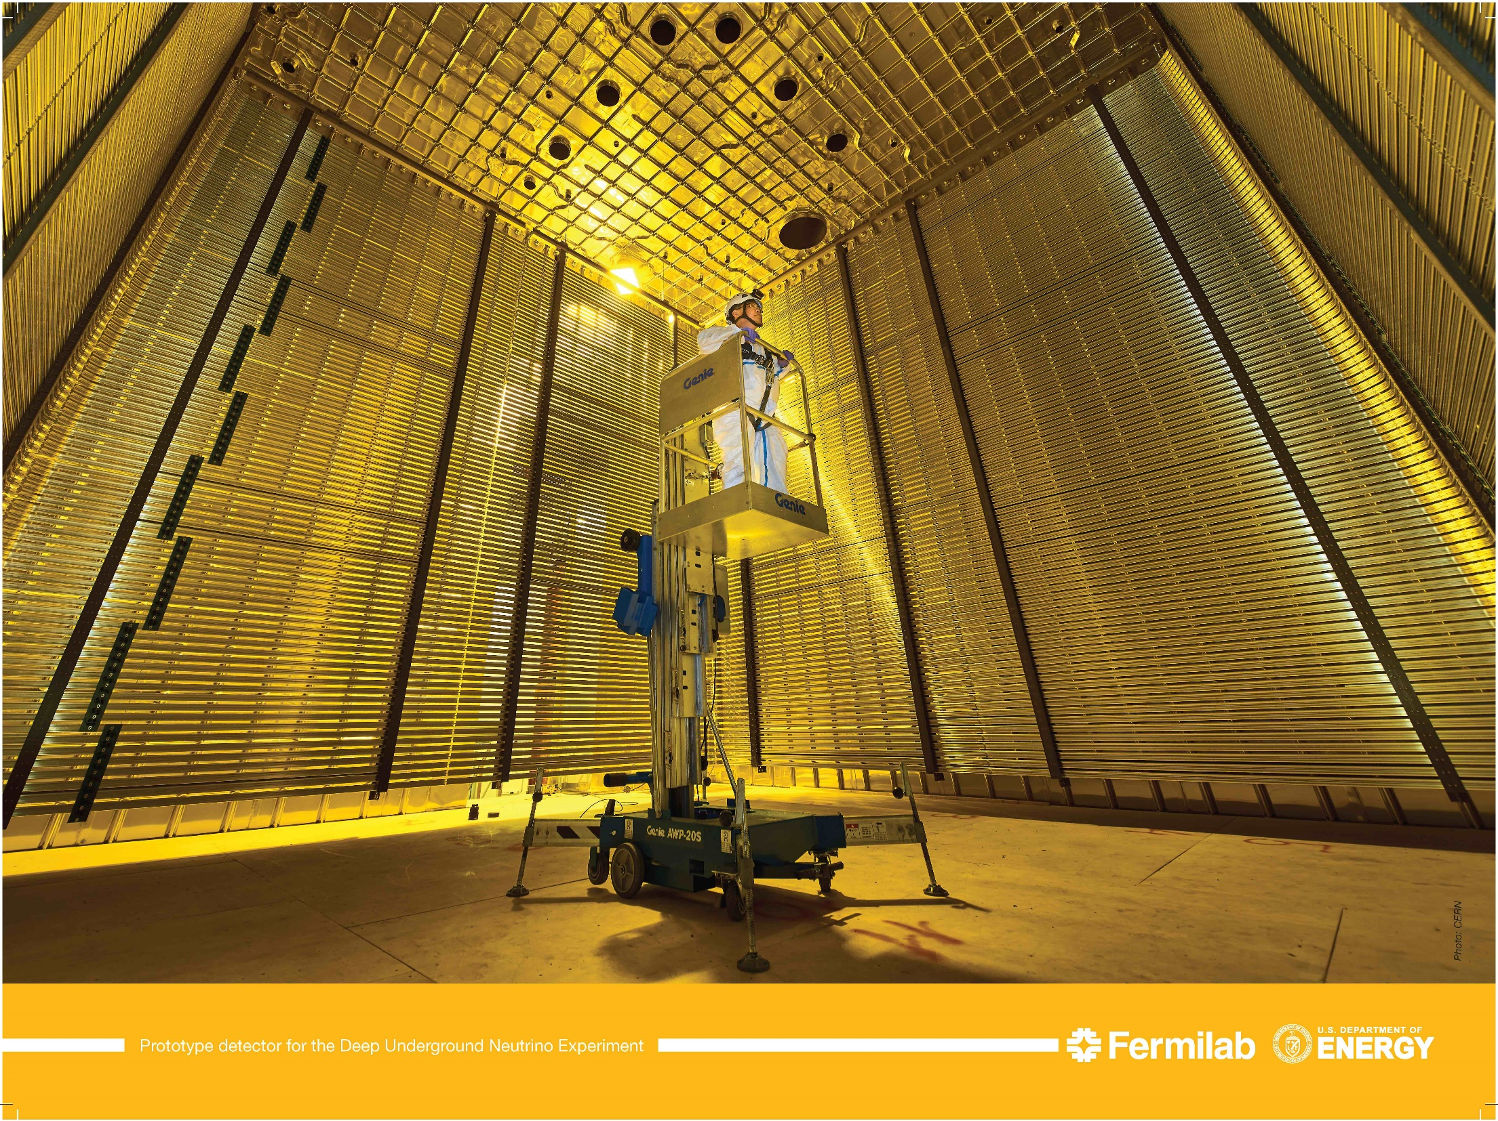
UTA-Built Prototype Field Cage @ CERN 2018
6m
6m
6m
V_{PD}=1/30 V_{FD}

Slide 8
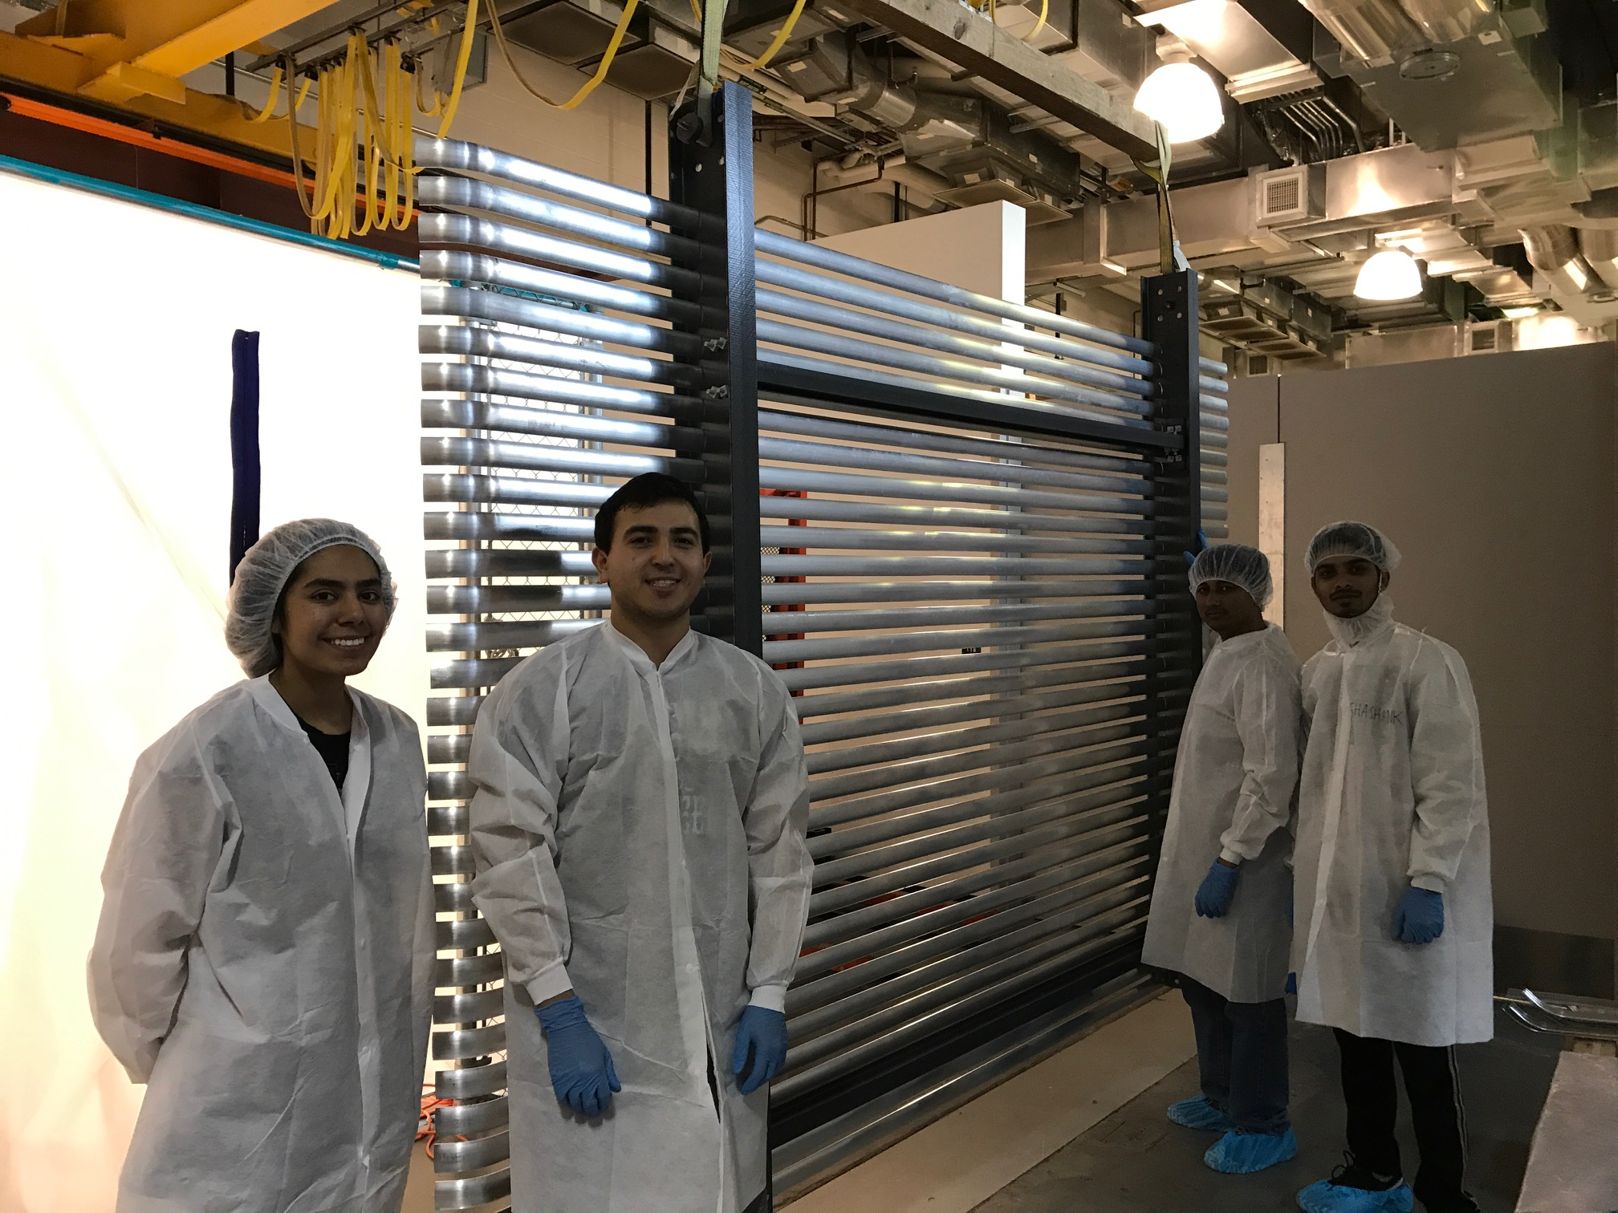
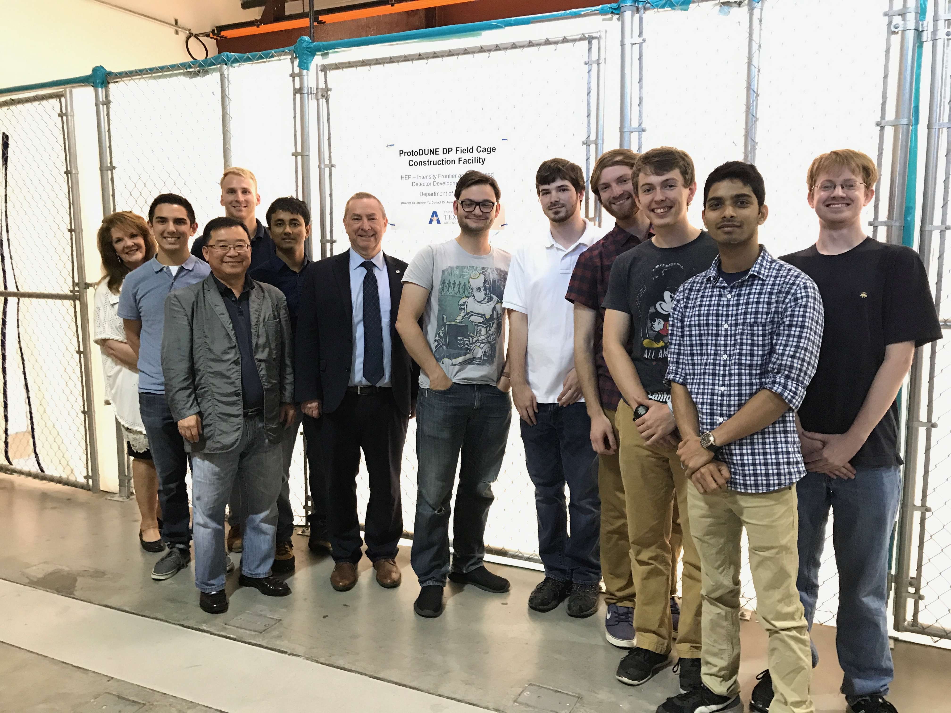
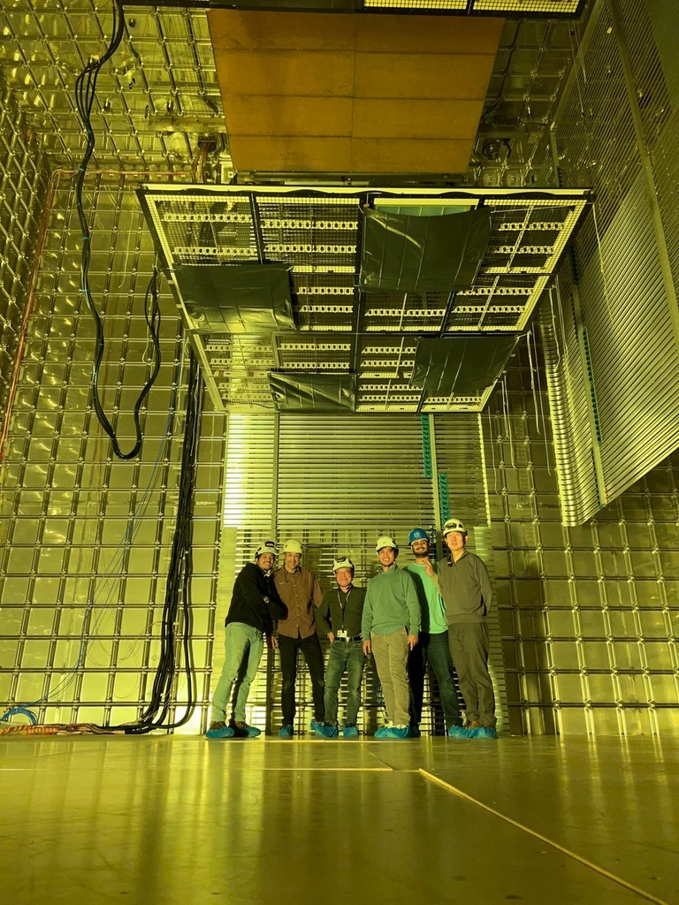
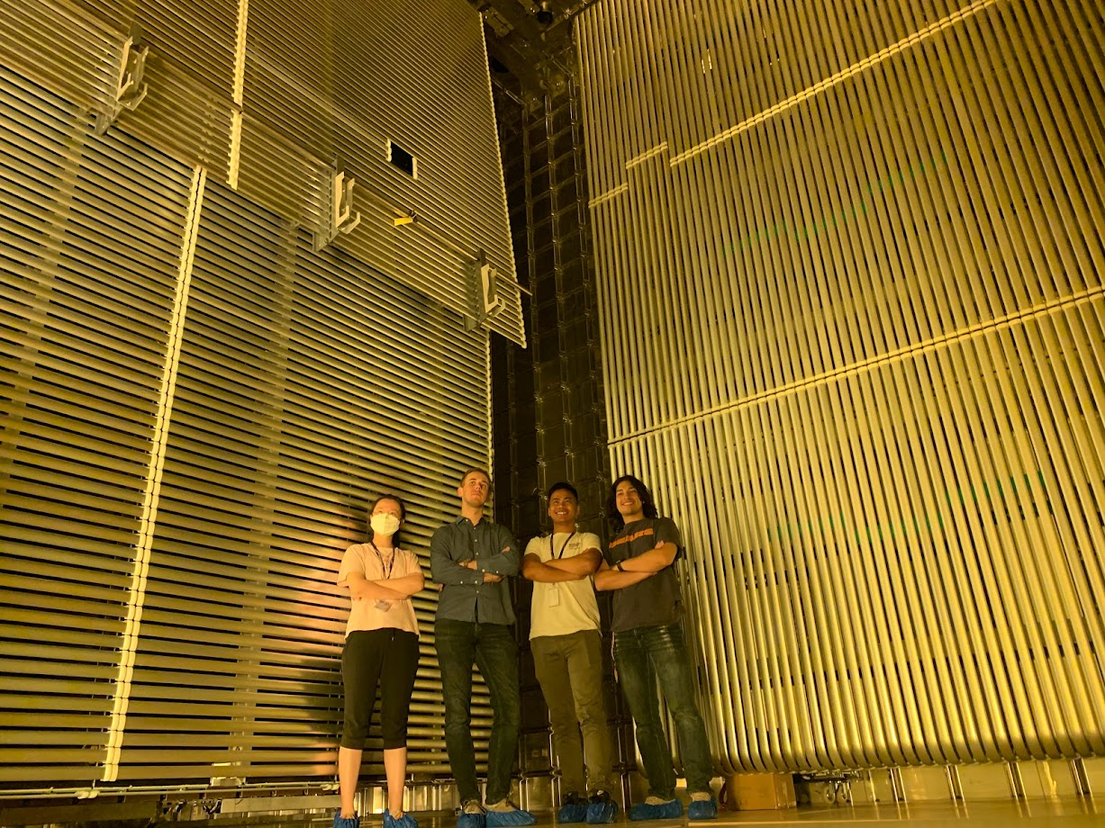
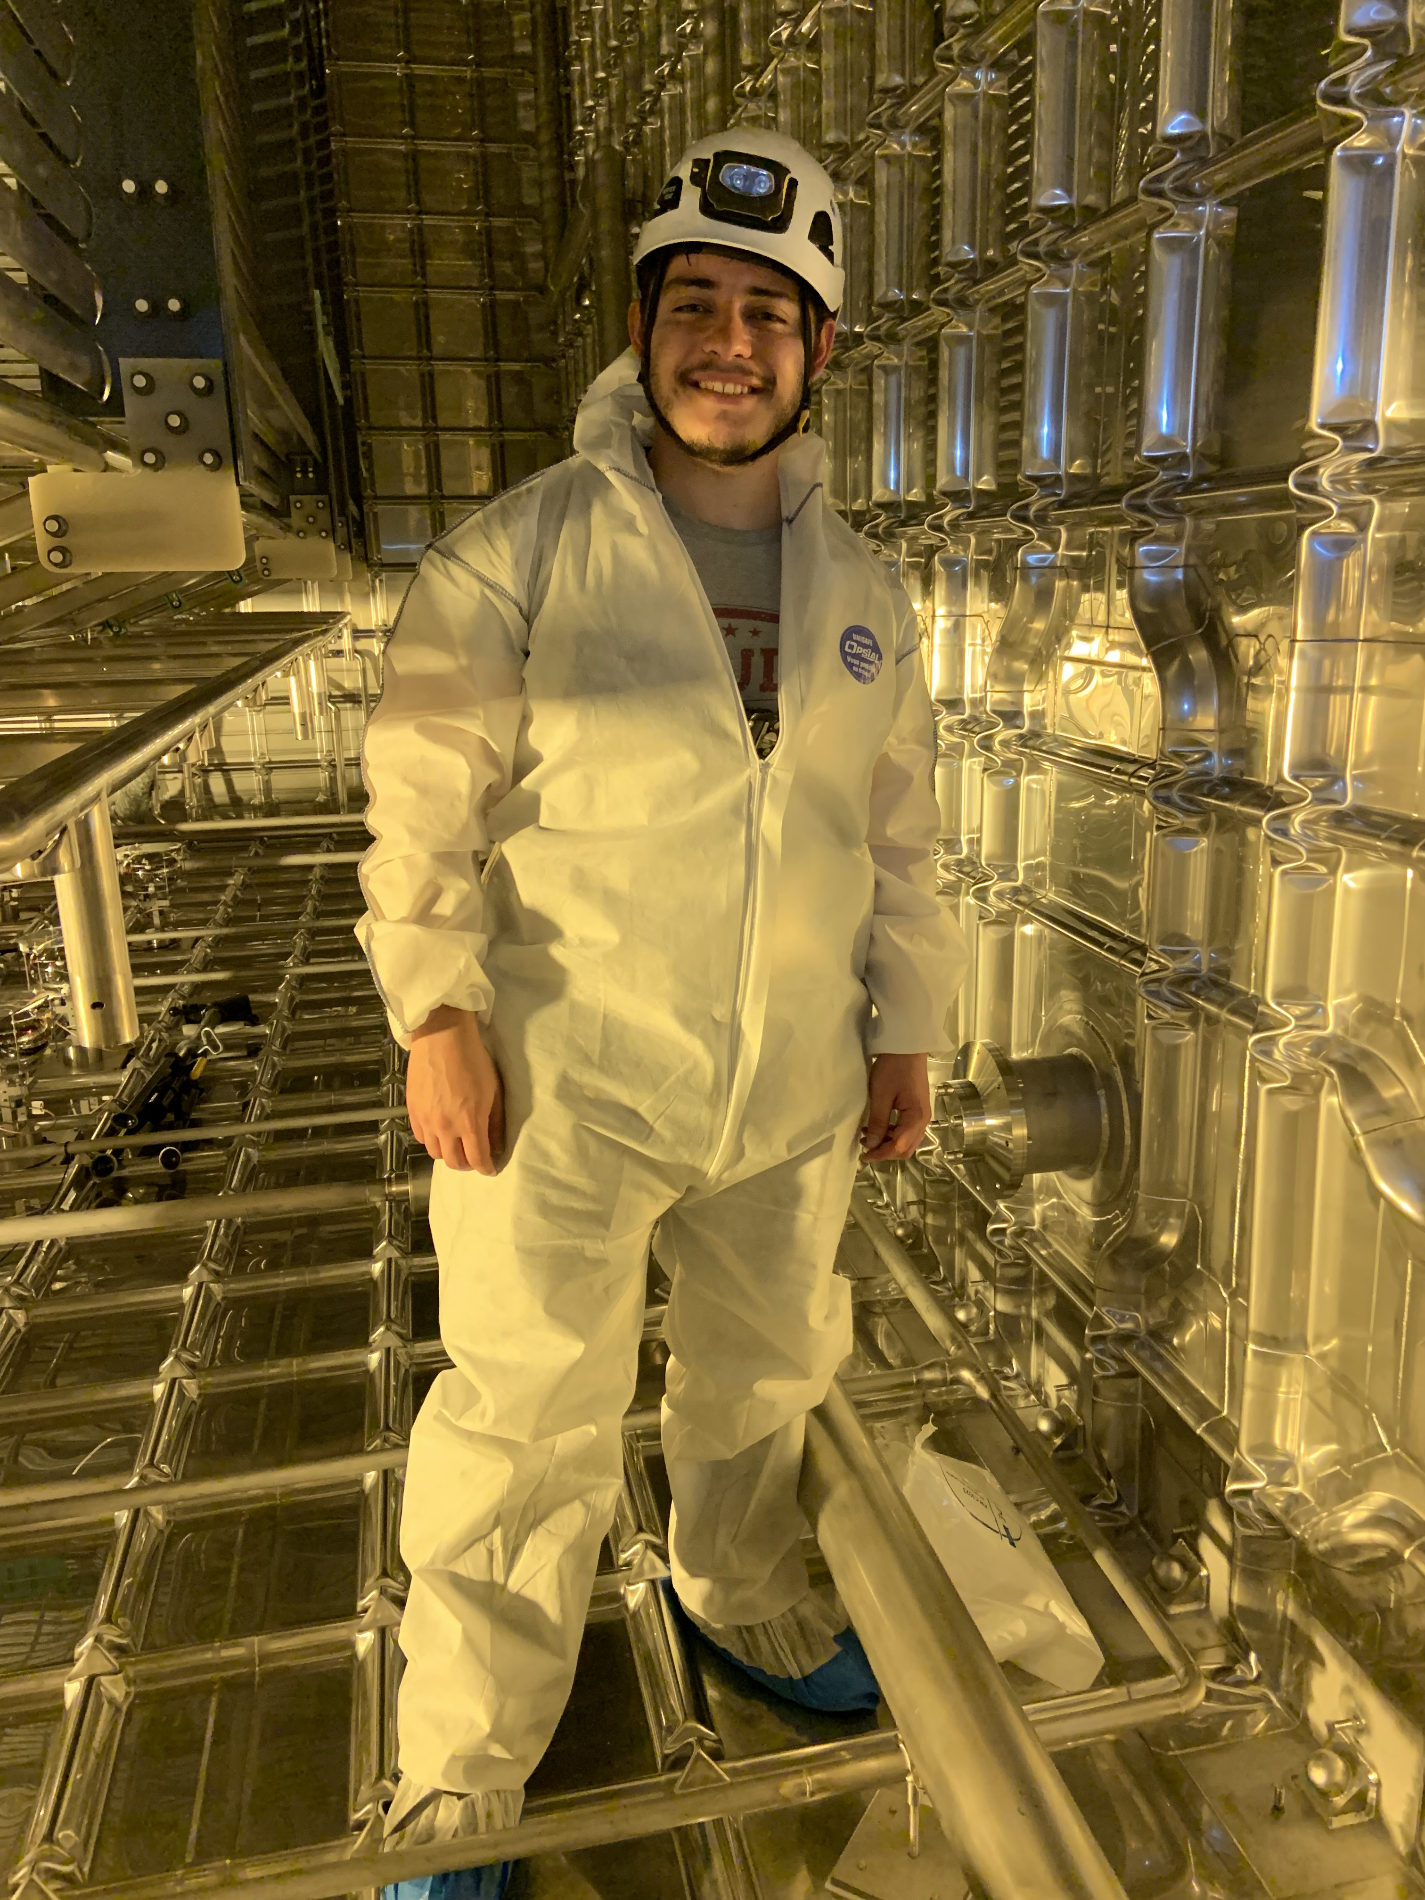
The UTA Field Cage Team 2017
Gajendra Gurung & Eric Garcia @ CERN, June 2022
Hector Carranza @ CERN, 2019
Eric Garcia, Gajendra Gurung & Atharva Dange @ CERN, March 2023

Slide 9
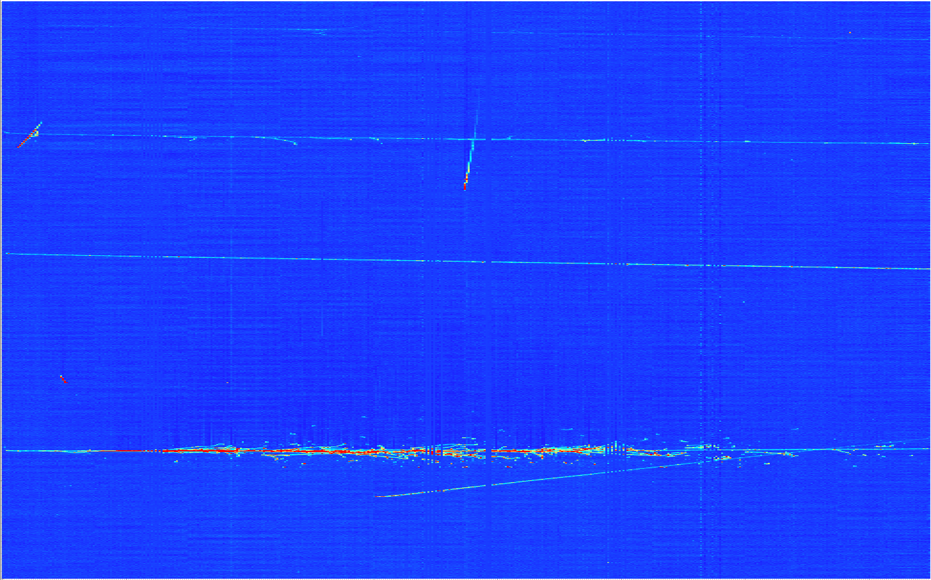
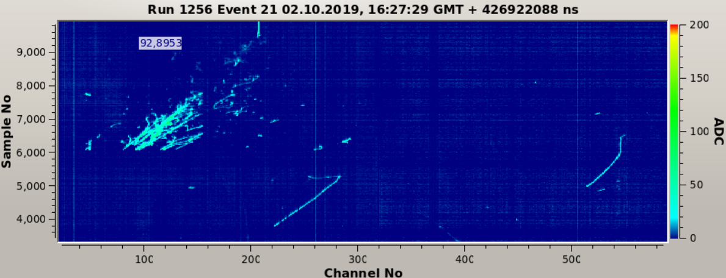
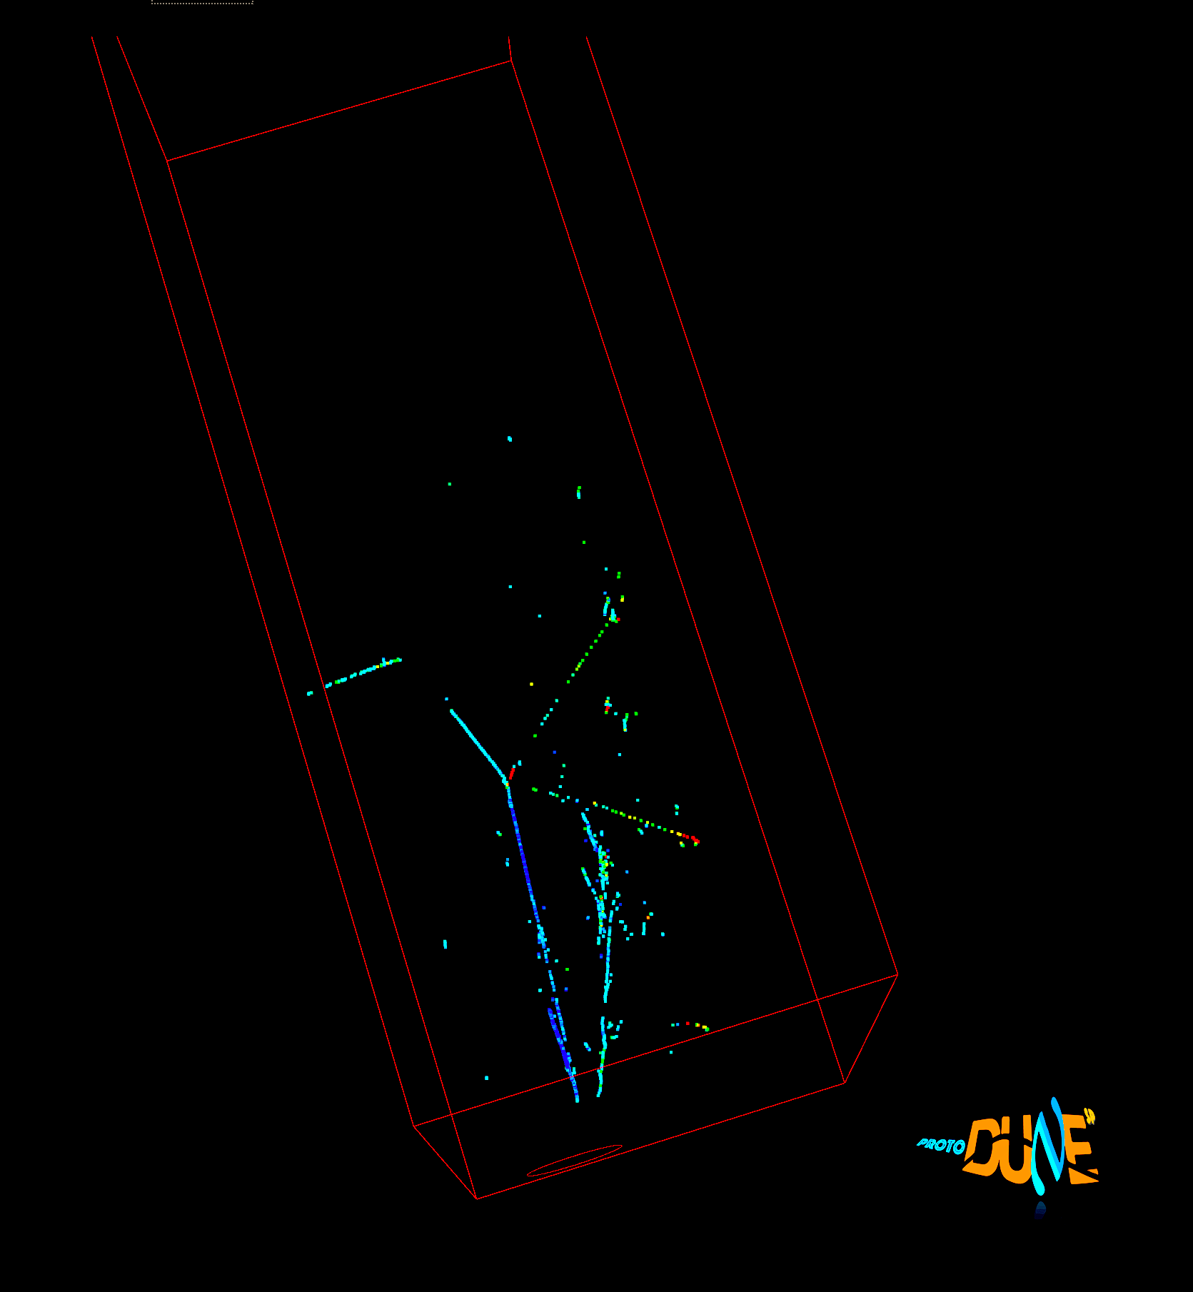
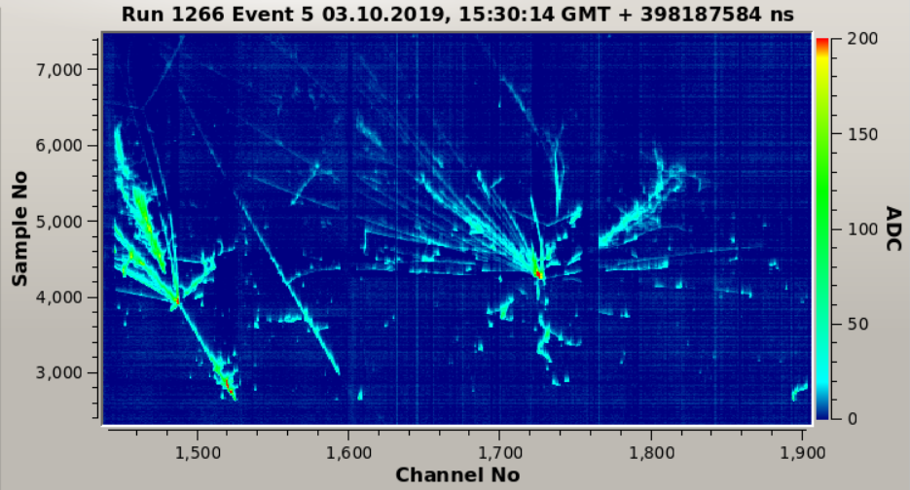
Images in DUNE LAr-TPC Prototypes
Throughgoing μ
Electromagnetic shower + two muon decays
E_{LEM} = 31 kV/cm
µ decay
EM shower
P = 1010 mbar
Multiple hadronic interactions in a shower
Run 4696, Ev 103:
2 EM showers and a pion interaction
E_{LEM} = 32 kV/cm
P = 1010 mbar

Slide 10
Latest news on DUNE
DUNE far detector cavern excavation completed Jan. 25
  Experimental infrastructure construction begun
Both ProtoDUNE HD cryostats closed, purge begins now ➔ LAr fill to start in March ➔ Filled and ready for beam May 24
  ProtoDUNE VD cryostat still open for a last minute PDS work
FD2 VD installation mechanical mock-up testing in this summer at CERN
  Mock-up mechanical structure to be completed end of June
  Two teams of two members need to be at CERN, mid June for module assembly and Mid July for installation work
UTA is expected to undergo 2 production readiness reviews (PRR) in Nov. and Dec. for FD2 VD and FD1 HD (UMN)
  Need to procure parts for all tooling and build them
  Exercise and adhere to the QC procedure & Module Assembly

Slide 11
LArTPC HVS Overview
HVS provides a uniform E field to the active volume for the ionization electrons to drift to anodes
Consists of three primary components
  HV Delivery
    HV PS
    HV Cable
    HV Ripple Filter
    HV Feedthrough
    HV Extender (VD only)
  HV Distribution
    Cathode Plane
    HV Divider Boards
    Field Cage
  HV Return and Monitoring
    HV Return
    HV Monitoring
warm
cold

Slide 12
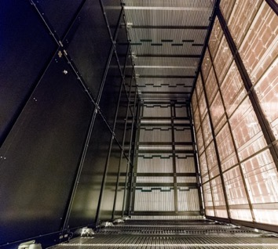
HVS Consortium Scope - FD1-HD TPC
Design, fabricate, test and assemble:
  100 CPA resistive panels forming two cathode arrays (1400m²)
  100 top + 100 bottom field cage modules, 48 End Wall field cage modules (1728m²)
  2 sets of HV power supplies, cables, ripple filters, and feedthroughs
  Digitizers for HVPS and ground plane monitoring
  Cameras for HV monitoring
Top Field Cage, TFC
Parts prep: 2025 – late 2025
Installation: 2026 – 2027 @SURF
End Wall Field Cage, EWFC
Cathode Plane Assembly, CPA
12m
TFC
E
58m
E
E
APA
E
Bottom Field Cage, BFC
Compared to
ProtoDUNE HD:
CPA: 33x
T/B FC: 17x
EW FC: 4x
CPA
Drift ~3.6mx4
EWFC
14m
BFC

Slide 13
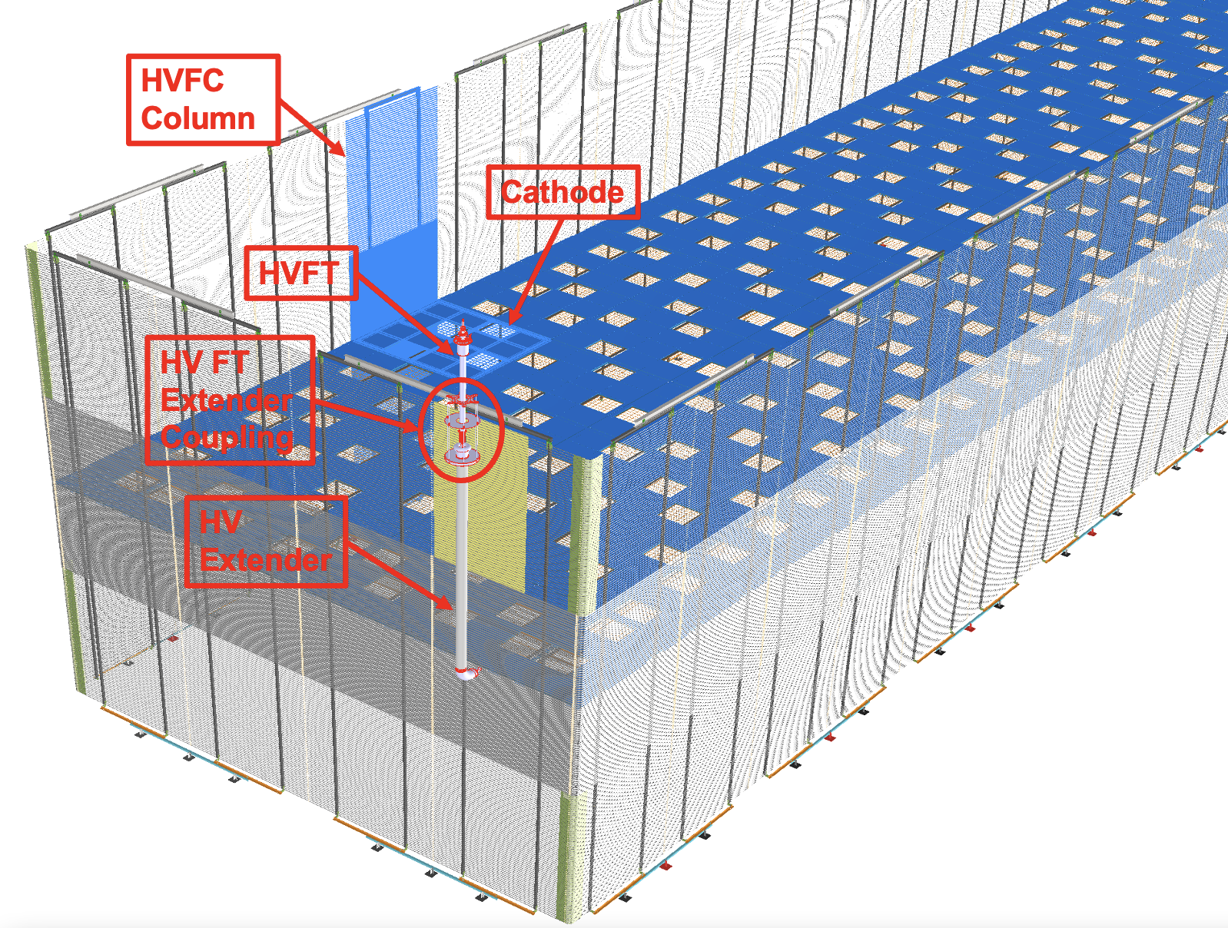
HVS Consortium Scope - FD2-VD TPC
Design, fabricate, test and assemble:
  80 Full Unit Cathode Planes (780m²) with embedded PD
  192 field cage modules – 160 Long Wall and 32 End Wall modules (~1781m²)
  One set of HV power supply, cable, ripple filter, and feedthrough
  Digitizers for HVPS and current monitoring
  Cameras for HV monitoring
E
70% Optical Transparency
E
13m
Drift 2x6.5m
2.5m
Long Wall Field Cage
60m
End Wall Field Cage
13m
Parts prep: Mid 2025 – late 2026
Installation: 2027 – 2028@SURF

Slide 14
Field Cage & the Scope of the Work
FC surrounds the active volume and help provide a uniform E field
The Scope: Construct the field cage (FC) for the FD1-HD and FD2-VD, integrate it into the HVS
Teams
  FD1-HD: UT Arlington, U. of Minnesota, LSU and CERN
  FD2-VD: UT Arlington, William & Mary and CERN
This entails to
  Procure all the FC parts and devise the necessary tools
    CERN is responsible for design and the aluminum profile electrodes
    UTA is responsible for FRP and other parts
  QC the FC parts
  Package and ship QCed parts to SURF at least 6mo prior to the start of the construction
  Assemble FC modules, including the HVDB mounting underground at SURF
  Install FC into FD1-HD (Mar. 2027 – Dec. 2027) and FD2-HD (Feb. 2028 – June 2028)
  Commission the HV system

Slide 15
Parts for UTA to Process – FD1-HD
Process parts for 100 BFC w/ 10% spare & deliver by 11/1/26
Parts and numbers to process
  For BFC Modules
    FRP I-beams: 2/BFC + 10% spare ➔ 200+20 = 220
    FRP Latch Beams: 2/BFC + 10% spare ➔ 200+20 = 220
    G10 Reinforcement plates: 4/BFC + 10% spare ➔ 400+40 =440
    BFC Lifting Bar: 1/BFC + 2% spare ➔ 100+2 ➔ 102
    Lifting Plates: 2/FC ➔ 8 total (already in hand)
    All necessary hardware : screws, lock washers, flat washers, nuts
  Tooling
    2 FC assembly tables : One to be shipped to SURF
    Any tools for installation
Galaxy cluster collision ➔ the blue shows the total mass concentration mostly dark matter

Slide 16
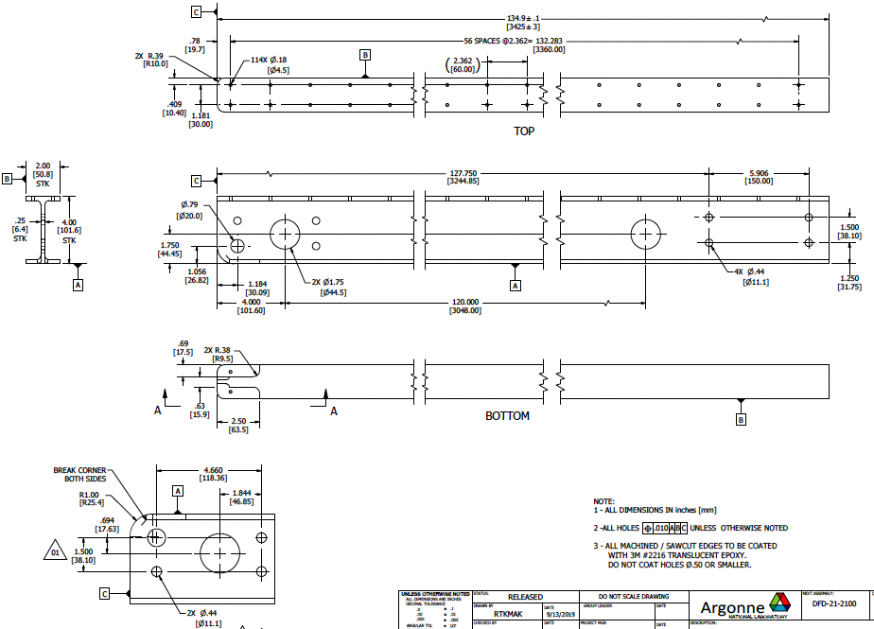
FD1-HD I – Beam (process 220)

Slide 17
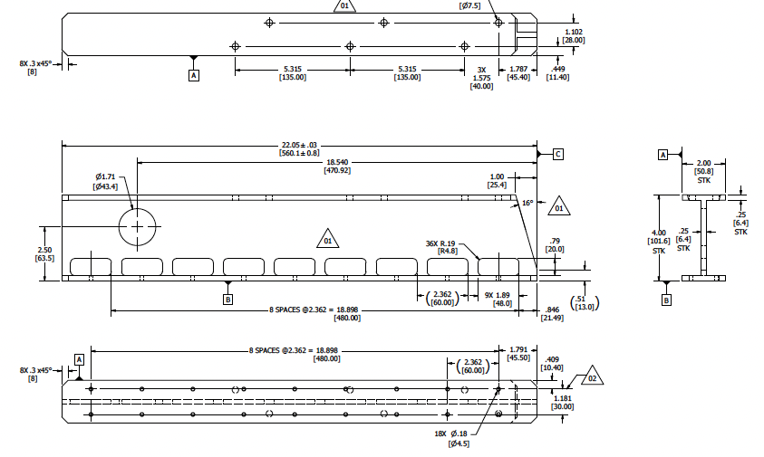
FD1-HD Latch – Beam (process 220)

Slide 18
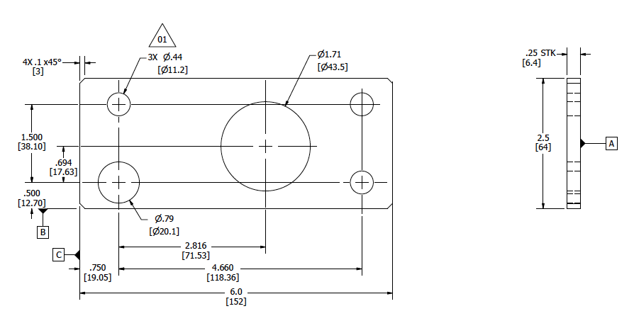
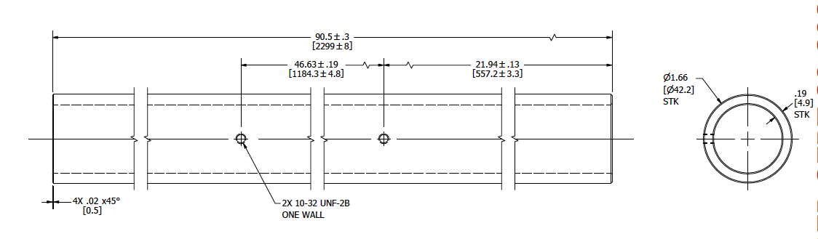
FD1-HD Reinforcement Plates (process 440) & Lift Bars (make 102)

Slide 19
Parts for UTA to Process – FD2-VD
Process parts for 192 FC w/ 10% spare & deliver by 9/1/27 ➔ 2*3 different types of modules, long wall/end wall * top/middle/bottom
Parts and numbers to process
  FC Module
    FRP Box-beams: 2/FC + 10% spare ➔ 384 + 38 = 422
    FRP Box beam insert for inter-module connection :2/FC+10% spare ➔ 384+38
    Bottom stabilizers : 2/FC column + 10% spare: 2*48*1.1=106
    Top stabilizers: 2/FC column + 10% spare: 2*48*1.1=106
    Top yoke: 1/FC column + 10% spare: 1*48*1.1=53
    Top SM I-beams: 1/SM + 10% spare: 1*24*1.1=26
    All necessary hardware: screws, lock washers, flat washers, nuts, etc
  Tooling
    2 profile bending tools: stay at UTA
    3 FC assembly stands : Two to be shipped to SURF, 1 at UTA
    28 FC Storage carts: all to be shipped to SURF
    3 scaffolding structure for module assembly: 2 to be shipped to SURF
    4 installation tripods: all to SURF
    1 gantry crane for completed module lifting and insertion into the storage cart
    4 module installation carts: all to SURF

Slide 20
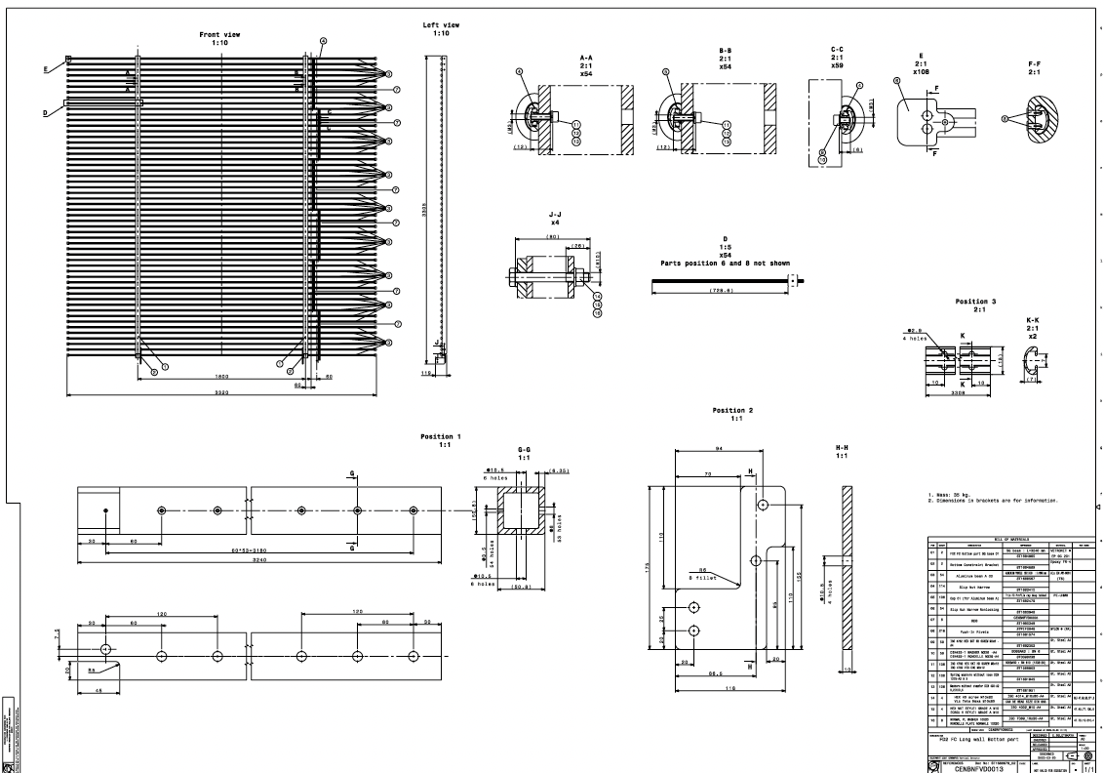
FD2-VD Long-wall Bottom Module (48)

Slide 21
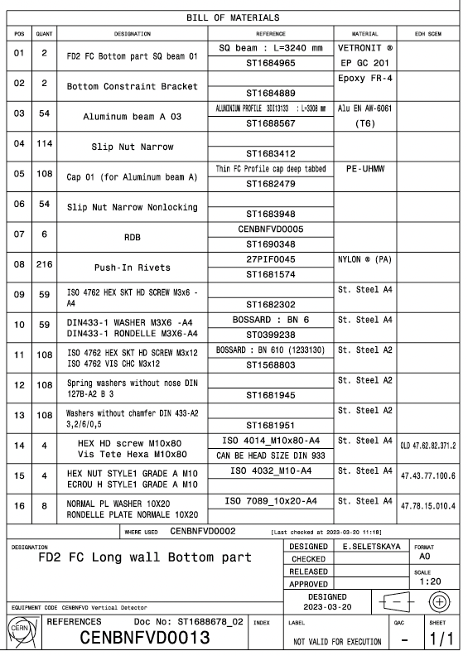
FD2-VD Parts List – Long Bottom FC

Slide 22
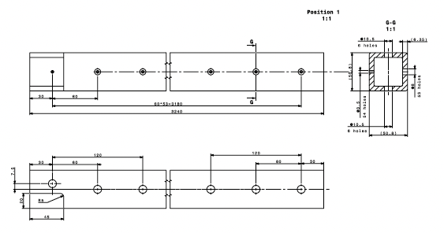
FD2-VD Box Beams (process 422)

Slide 23
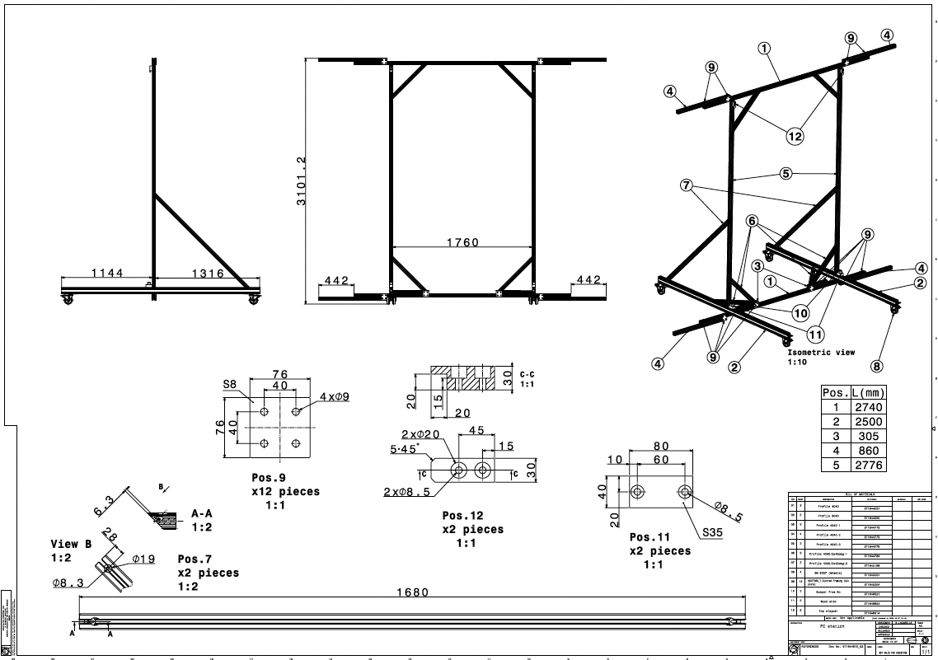
FD2-VD Assembly Stand (make 3)

Slide 24
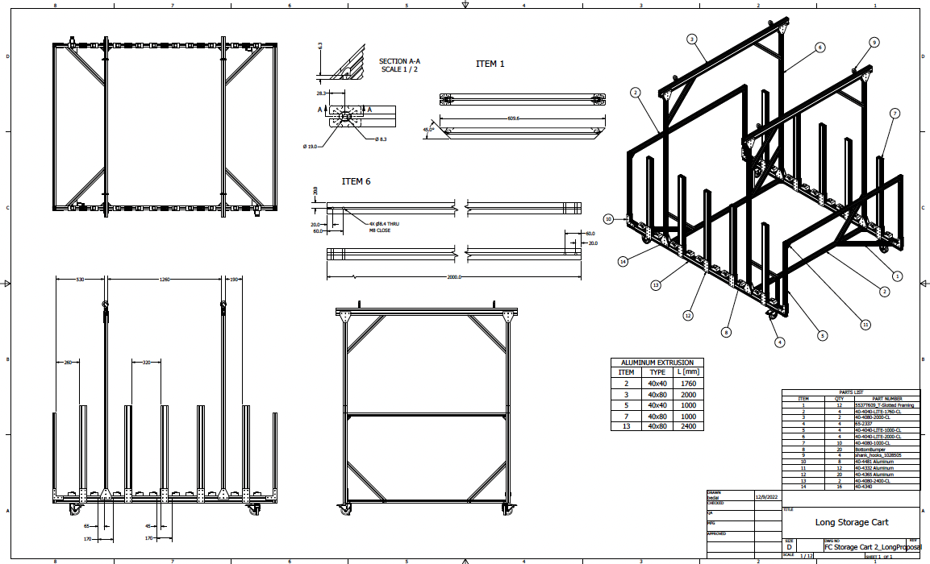
FD2-VD FC Storage Cart (make 28)

Slide 25
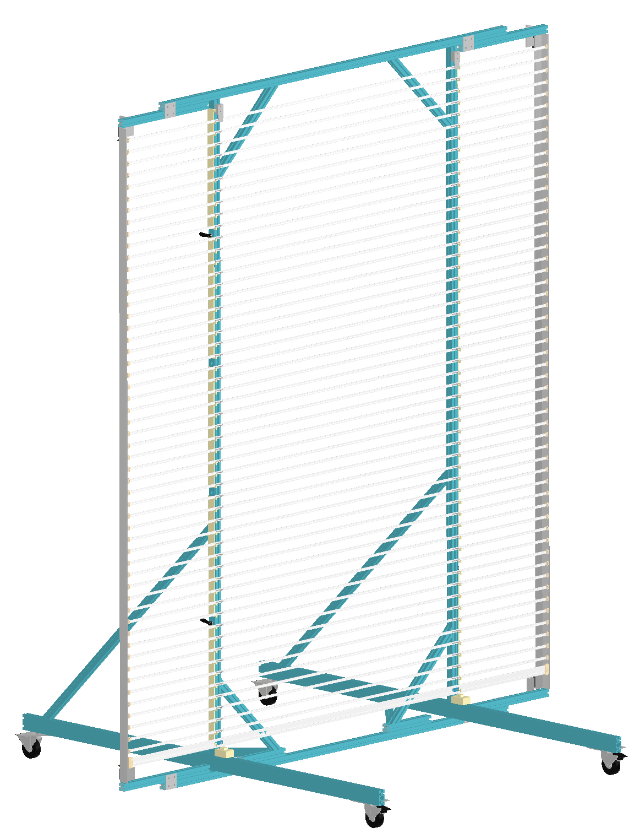
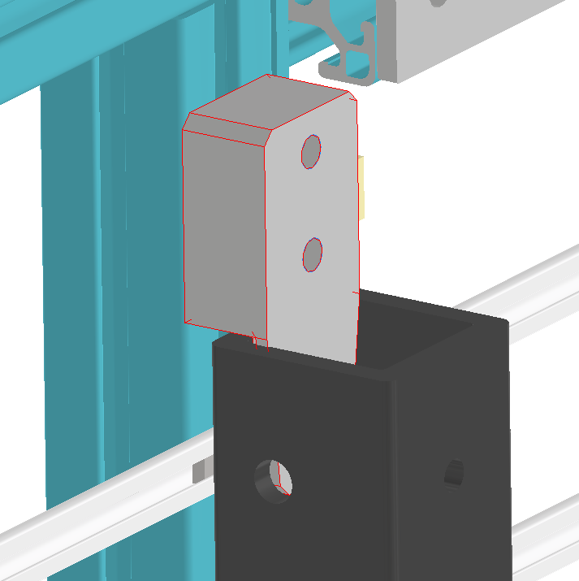
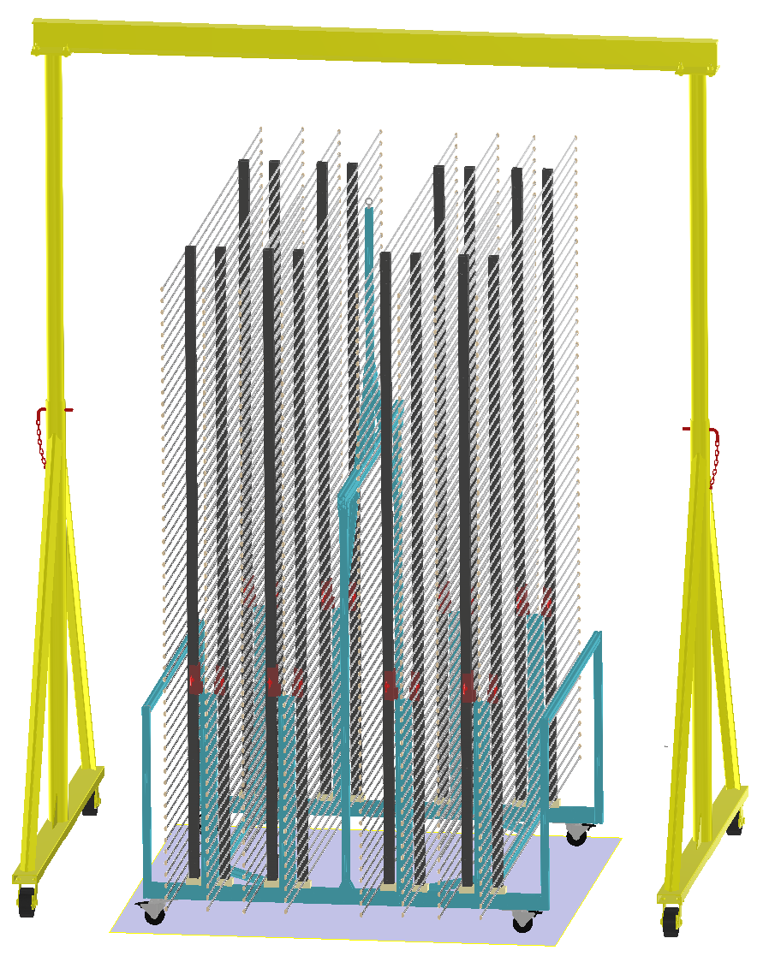
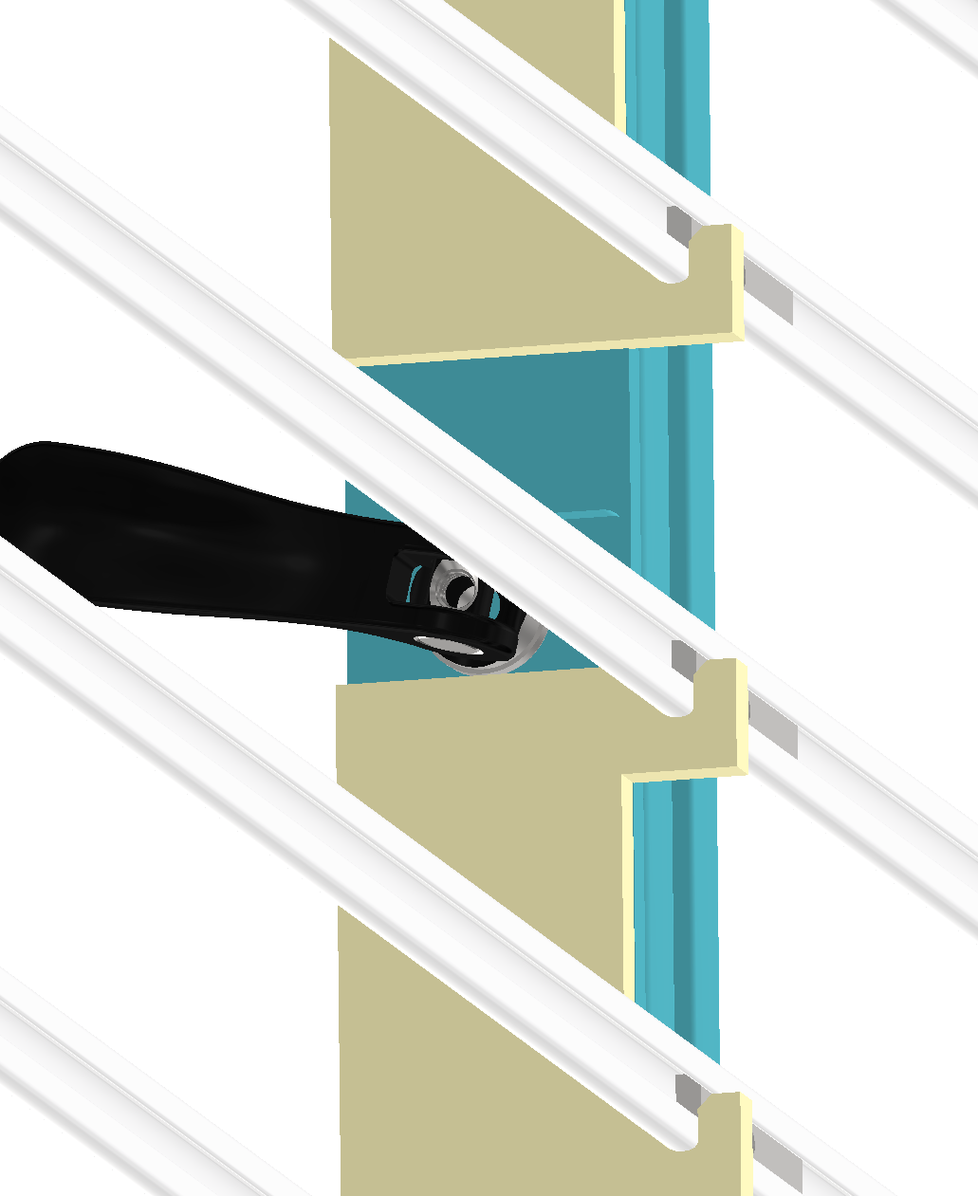
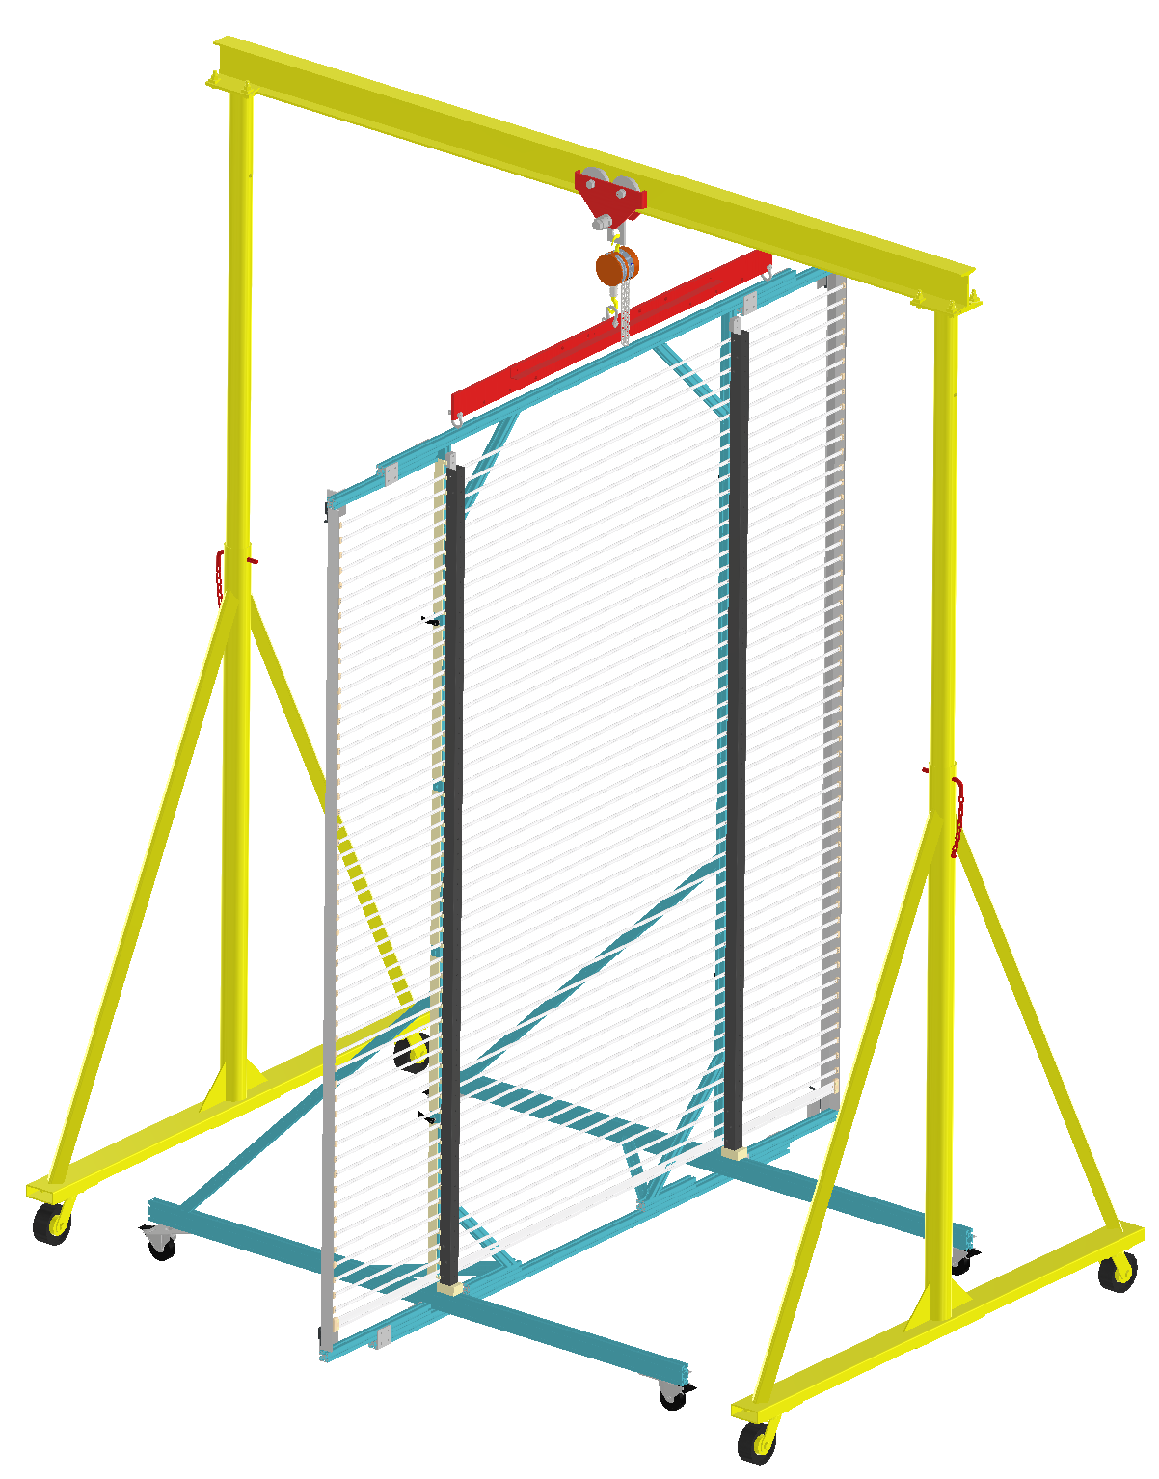
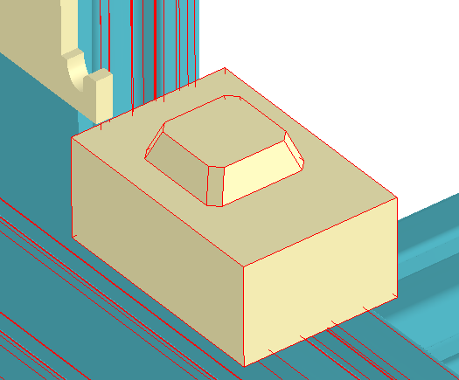

Slide 26
What do we need to do?
Exercise, learn and adhere to the QA/QC procedures
Procure all FRP and other parts
Construct all tools for module assembly and installation
Train for profile bending
Train and get used to the different types of parts
Exercise the parts preparations, along with the QA/QC procedure and the use of the QA/QC tool
Construct the HD and VD assembly tables and exercise module constructions for training
Exercise the 3D printing of the thin profile caps and the necessary QA/QC jigs
Prepare for production readiness review (PRR) for both HD and VD parts production

Slide 27
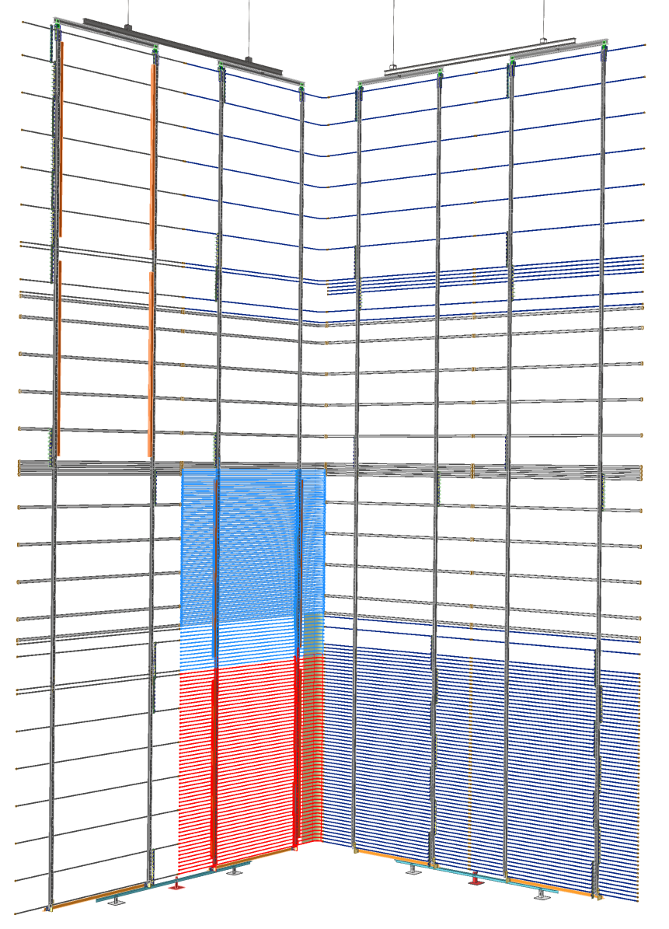
Field Cage Installation Test Configuration
LWSM
EWSM
Two dummy LW modules with fiber conduits, and top profiles to demonstrate new fiber connection scheme
4 FC support flanges with lift rods
Six dummy EW modules with subset of profiles:
Demonstrating cathode connection
Demonstrating row 3 to row 4 interconnects
Make cathode/HV bus connections
Two full(?) LW modules with fiber conduits to demonstrate old fiber connection scheme.
Time and motion study on assembly speed.
Two full EW modules to demonstrate final FC closing
(one split in 2 half modules?)
Remaining LW modules are dummies with sparce profiles

Slide 28
What do we need to build for Mock-up?
Process and QC
  FRP Box beams: 2*16 + spare = 40
    TFC Box beams: 2*4 + spare = 10
    MFC Box beams: 2*8 + spare = 20
    BFC Box beams: 2*4 + spare = 10
  FRP Box beam inserts: 3*2*4 + 10% =24 + 2 =26
BNL or CERN will purchase and prepare
  Al FC Column box beam top connector: 2*4 + 10% = 8+2
  SS FC Column yoke connector: 1*4 + 10% = 4+1
  TFC support plates: 2*2*4+spare = 20
  BFC constraining bracket: 1*2*4+spare = 10
  Steel Bottom stabilizer structure : 1*4 = 4
  Module installation cart: 1

Slide 29
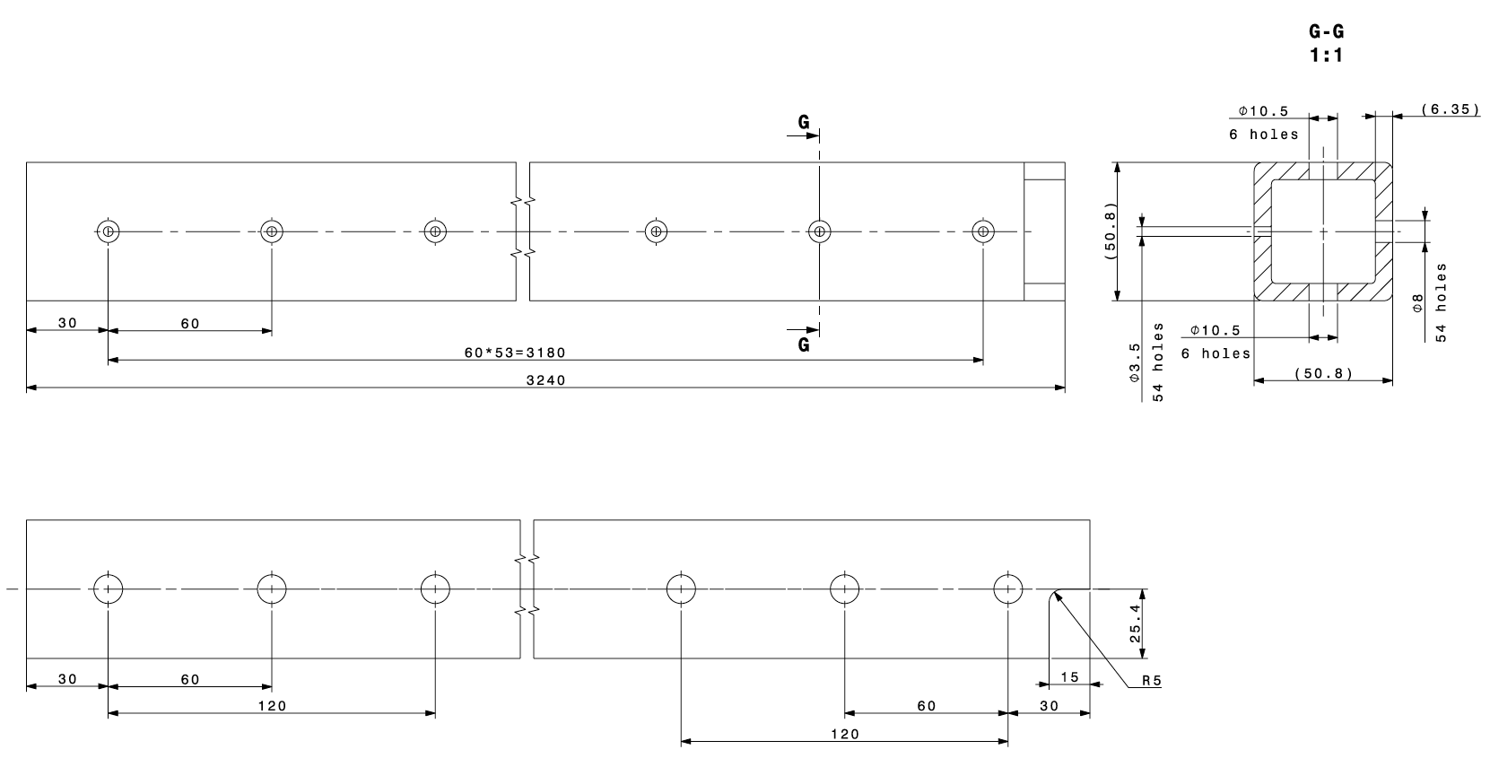
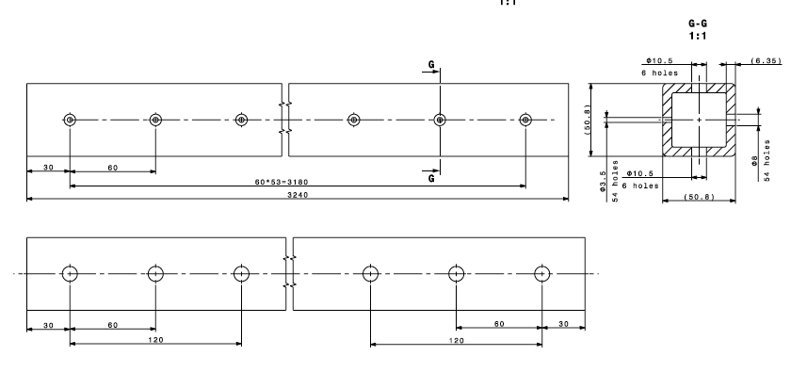
VD Top and Mid FC Module Parts
TFC FRP Box beams (2*4+spare=8+2)
MFC FRP Box beams (4*4+spare=16+4)

Slide 30
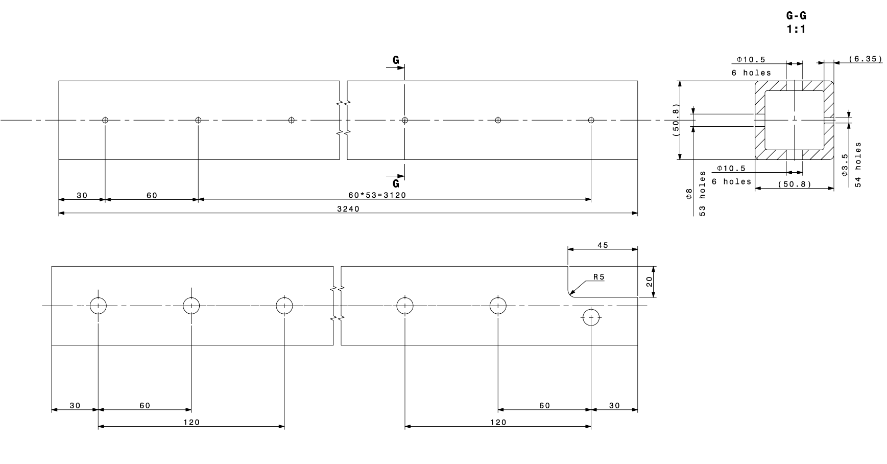
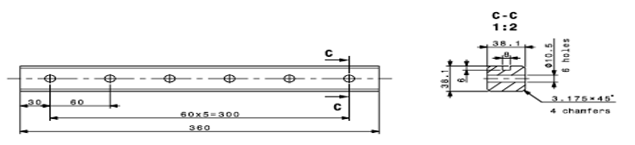
VD Bottom FC Module Parts
BFC FRP Box beams (2*4+spare=8+2)
FRP Insert (14)

Slide 31
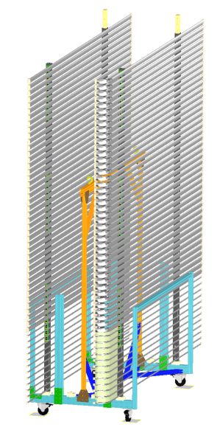
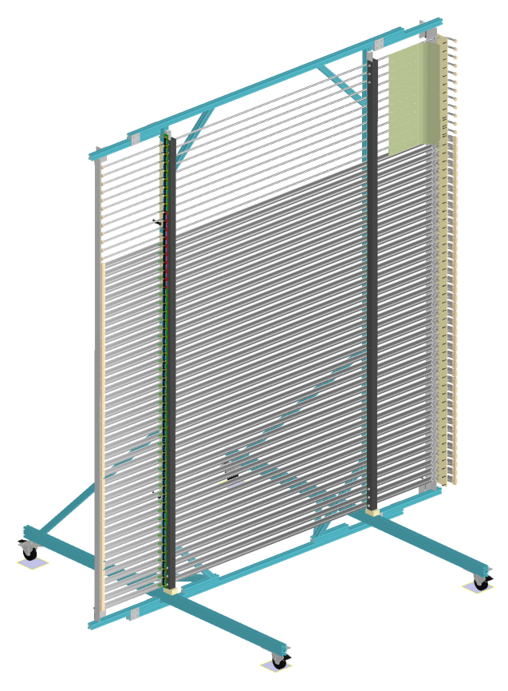
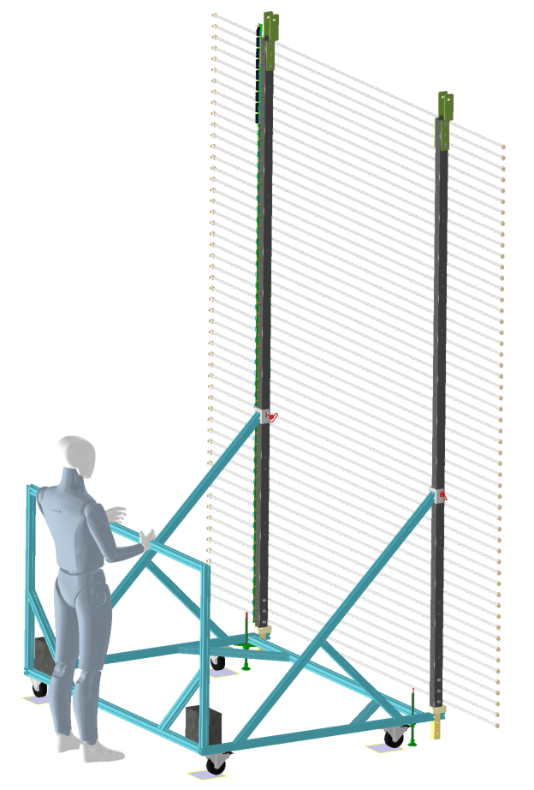
VD Field Cage Tools
2 storage carts
Available @ CERN with minor updates
One installation cart ➔ UTA to build one and ship to CERN
One assembly station
Modified NP02 version @ CERN

Slide 32
Group’s 3E Motto
Demand Yourself Excellence!
Demand Each Other Excellence!
Help Each Other Become Excellent!

