Slide 1
EMWSD / Wakis
Electromagnetic and Wake Solver Development
Meeting #19
Elena de la Fuente, Carlo Zannini, Lorenzo Giacomel, Giovanni Iadarola

Slide 2
Outline
Where are we?
Main improvements in the code
Beam injection & Absorbing boundary conditions (ABC)
1st Benchmark with CST: PEC pillbox
Conclusions & Next steps

Slide 3
Outline
Where are we?
Main improvements in the code
Beam injection & Absorbing boundary conditions (ABC)
1st Benchmark with CST: PEC pillbox
Conclusions & Next steps

Slide 4


Wake solver milestones:
PhD %
1st year
2nd year
3rd year
Jul ‘24
Jul ‘25
Jul ‘26
Jul ‘27
meetings #17, #18
In progress
To Do
0. Wake potential and impedance
4. Beam injection $J_{z}$
7. Frequency-dependent materials
1. FIT Maxwell Equations in 3D
5. Materials: $ε, μ, σ$
8. …
2. PEC, Periodic, PMC boundaries
6. Open boundaries: PML
3. Embedded Boundaries: geometry import from .stl files
xx. Automatic testing

Slide 5
Outline
Where are we?
Main improvements in the code
Beam injection & Absorbing boundary conditions (ABC)
1st Benchmark with CST: PEC pillbox
Conclusions & Next steps

Slide 6

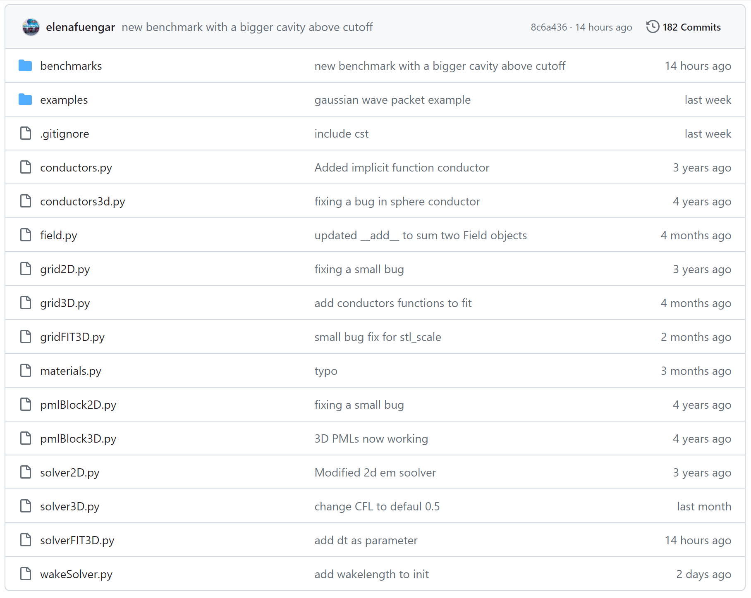
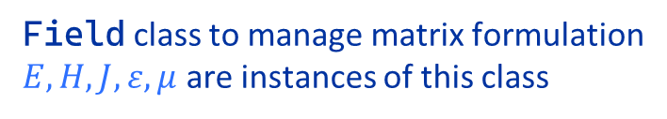
PyFIT GitHub overview
Benchmarks vs CST, WarpX …
Examples & university tests:
Plane wave propagation
Gaussian wavepacket propagation
Cubic Resonator
Field class to manage matrix formulation
$E, H, J, ε, μ$ are instances of this class
FIT EM Solver
GridFIT3D class in charge of STL importer and grid definition
Pre-defined materials library (vacuum, dielectric, PEC)
FDTD EM solver
by Lorenzo
SolverFIT3D class that solves Maxwell equations
Wake Solver
Wakis code is refactored into class WakeSolver
Should we turn this into a package already?

Slide 7
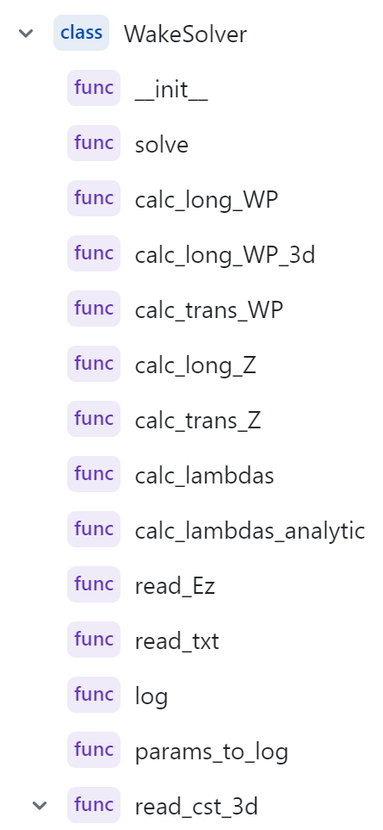
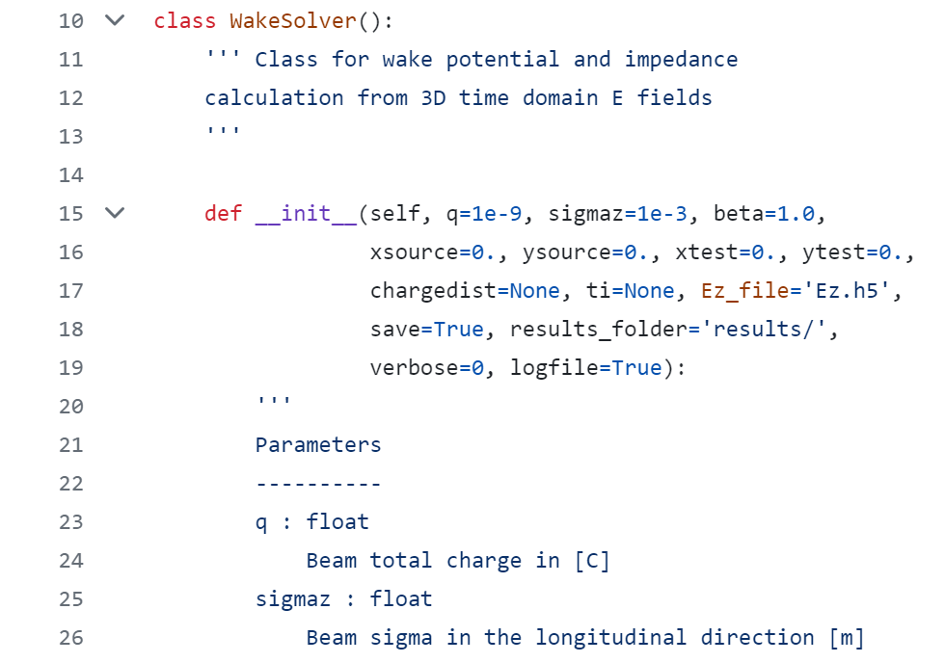
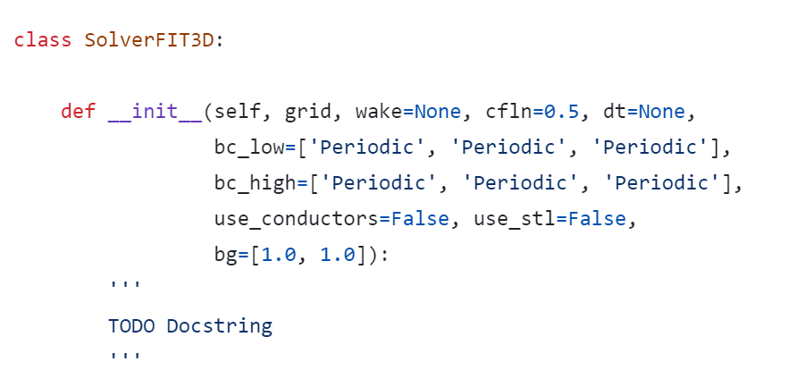
Merging wakis with PyFIT
Should PyFIT become the wakis package instead?
Moved all the relevant functions from wakis to the WakeSolver class
WakeSolver instance is passed as a parameter to SolverFIT3D to perform Wakefield simulations
It’s kept optional since it is not needed to perform just EM time domain simulations

Slide 8
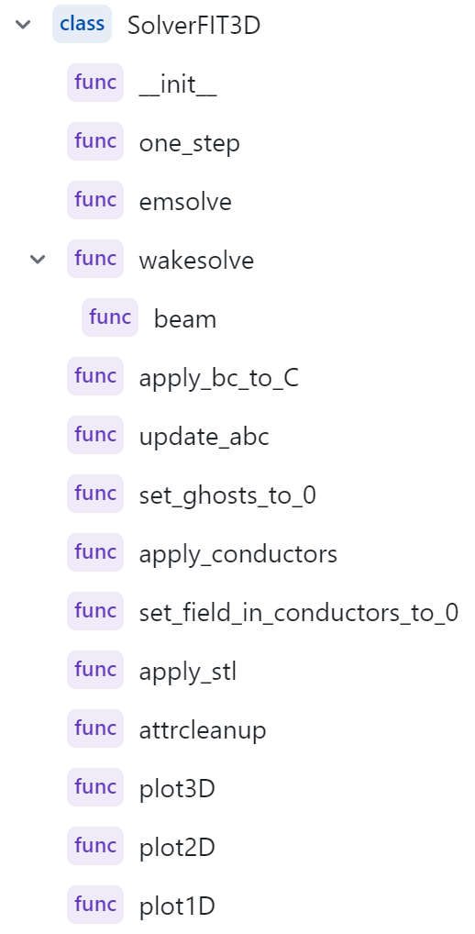
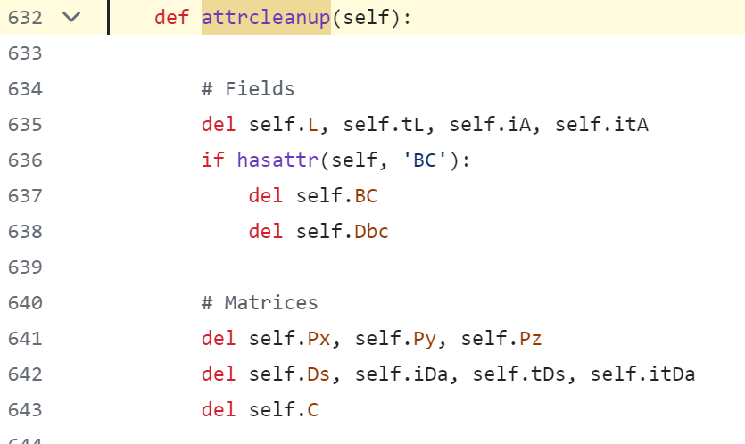
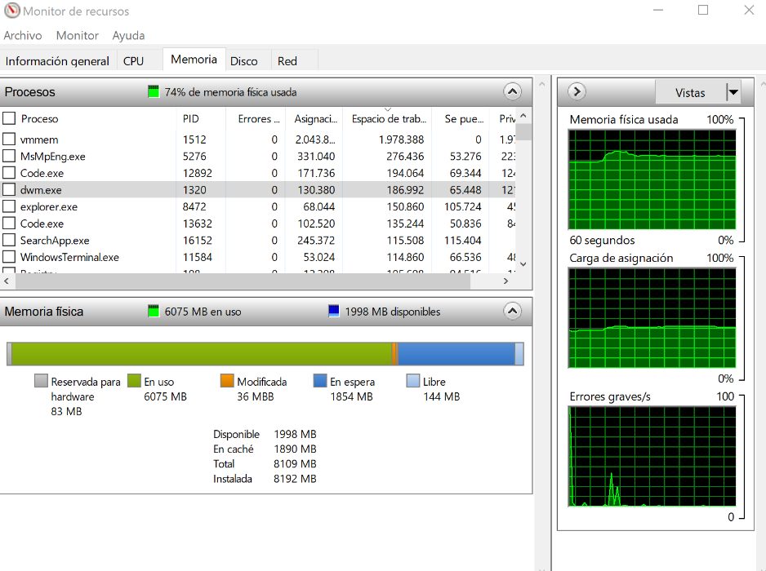
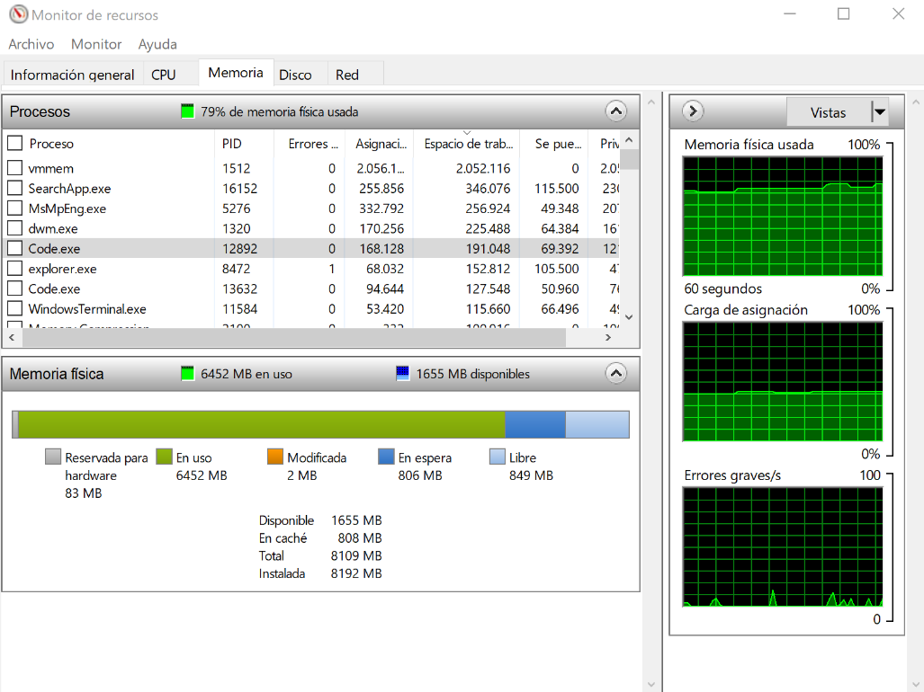
SolverFIT3D development (I): memory optimization
Deletes from memory the matrices that will not be used for the timestepping routine:
Improves memory allocation by 60%
Increases speed performance by 5%

Slide 9
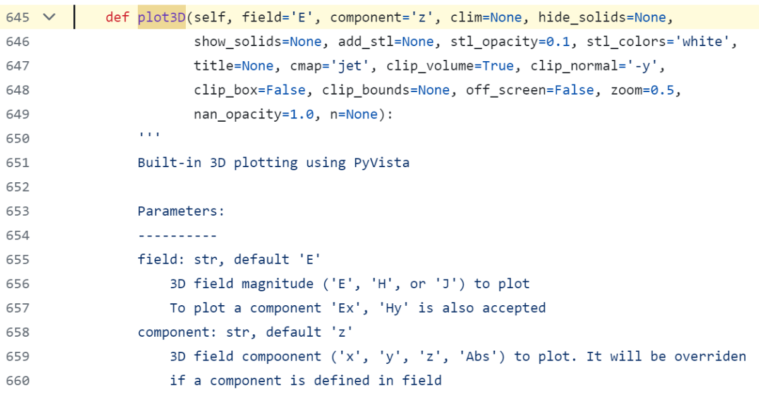
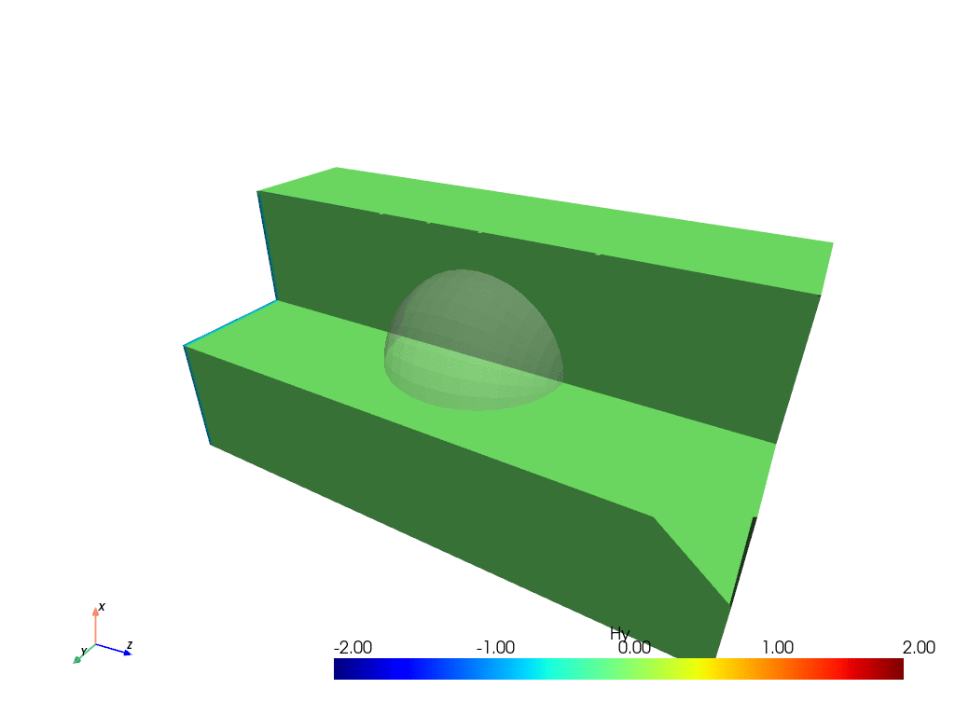
SolverFIT3D development (II): 1D, 2D, 3D plotting
Using PyVista (vtk based) functions.
Plots can also be interactive:
clip_volume or clip_normal flags when off_screen =True
Plot3D example:
examples/script_planewave_fit.py
A planewave interacting with a dielectric sphere (University test)

Slide 10
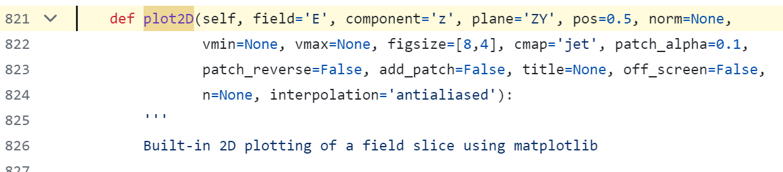
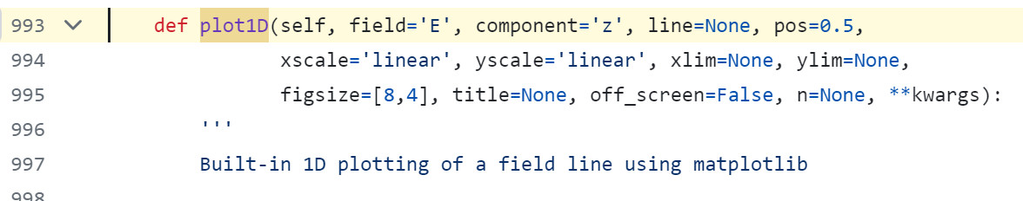
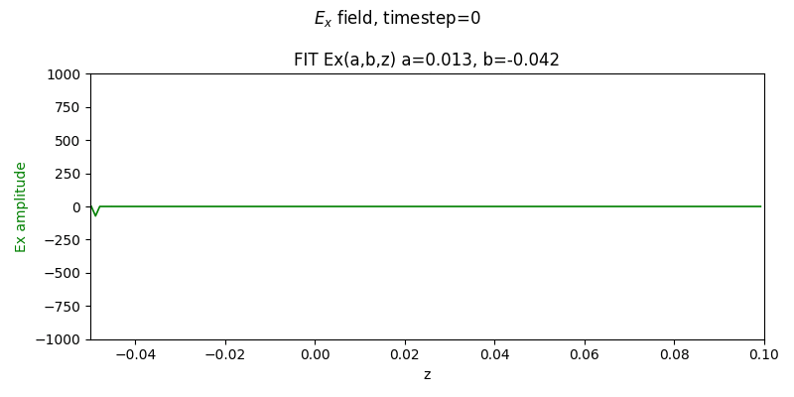
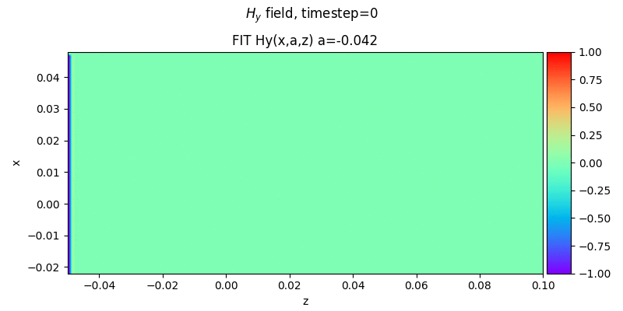
SolverFIT3D development (II): 1D, 2D, 3D plotting
Matplotlib based coutourf (2D) and line plot (1D)
Plot2D and 1D example:
examples/script_planewave_fit.py
A planewave propagating through vacuum being repflected at the PEC boundary

Slide 11
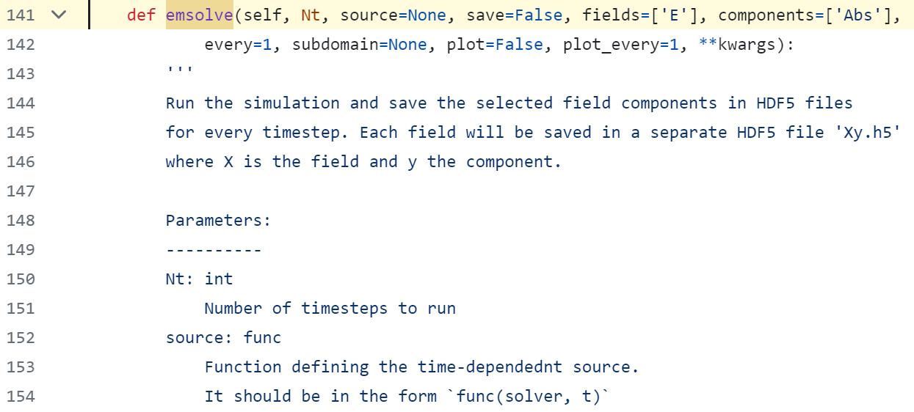
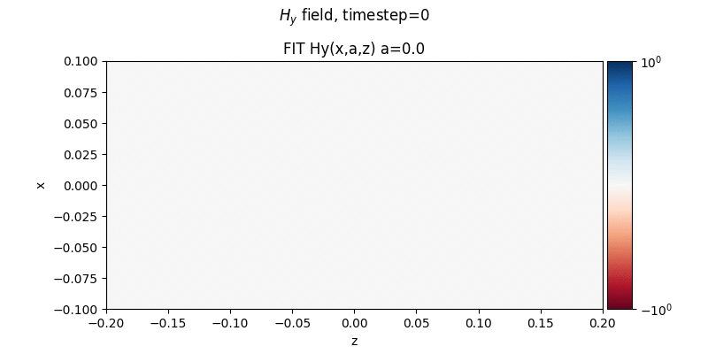
SolverFIT3D development (IV): EM solve
Runs Electromagnetic time domain simulation given an initial condition or source
EM solve example:
examples/script_wavepacket_fit.py
A gaussian wavepacket propagating through vacuum domain (University test)

Slide 12
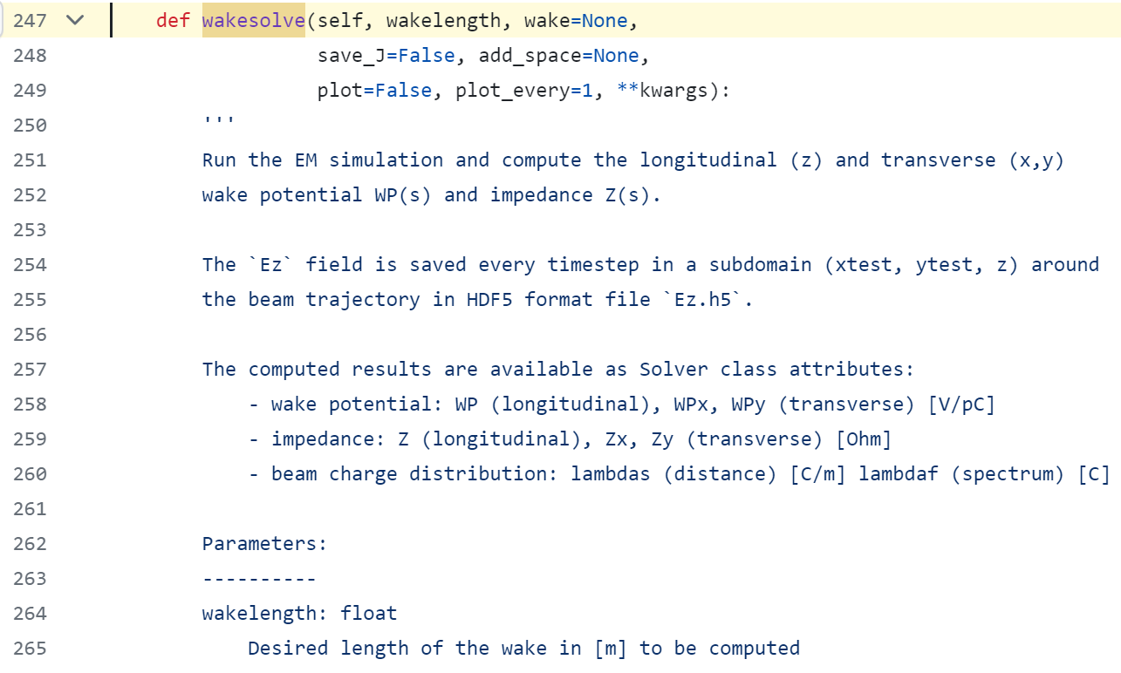
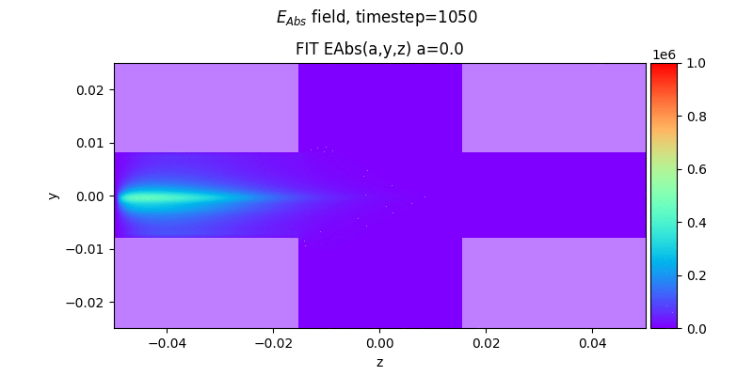
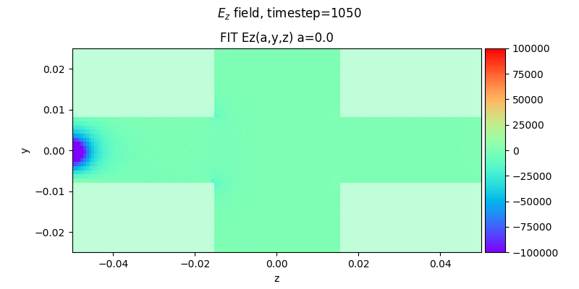
SolverFIT3D development (V): Wake solve
Runs Wakefield time domain simulation given a wakelength.
Beam source injected is defined by WakeSolver object.
Computes wake potential and impedance by saving Ez field every timestep and using the routines in WakeSolver class (needs h5py)
Wake solve example:
examples/script_cubcavity_fit.py
A gaussian beam traversing a PEC cubic pillbox cavity

Slide 13
Outline
Where are we?
Main improvements in the code
Beam injection & Absorbing boundary conditions (ABC)
1st Benchmark with CST: PEC pillbox
Conclusions & Next steps

Slide 14
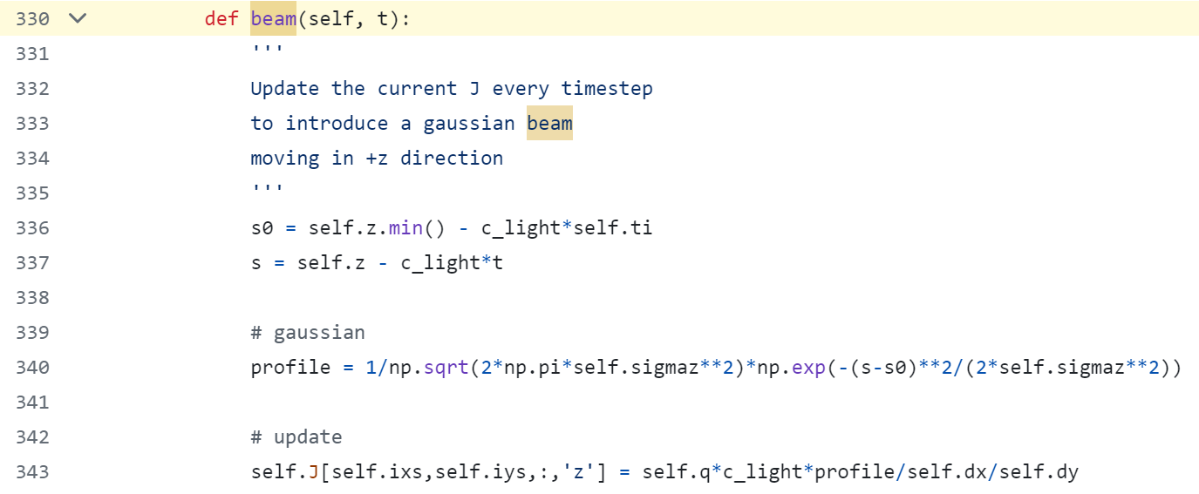
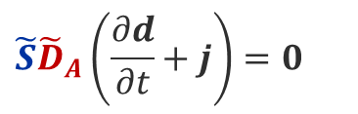

Beam injection
The particle beam is injected as a linear current with a gaussian profile defined by the beam size $σ_{z}$ and charge $q$
Every timestep, the field $J_{z}$ is updated at $x_{source}$, $y_{source}$ for all the cells in $z$
The beam injection produces a big $E_{z}$ field perturbation at z- and z+, due to violation of the continuity equation (Gauss law)
FIT
$${\tilde{S}\tilde{D}}_{A}\left(\frac{∂d}{∂t}+j\right)=0$$
Not included in update equations… Should we correct it / enforce it?
$$∯_{∂V}^{ }{D⋅dA=\iiint_{V}^{ }{ρ dV}}$$

Slide 15
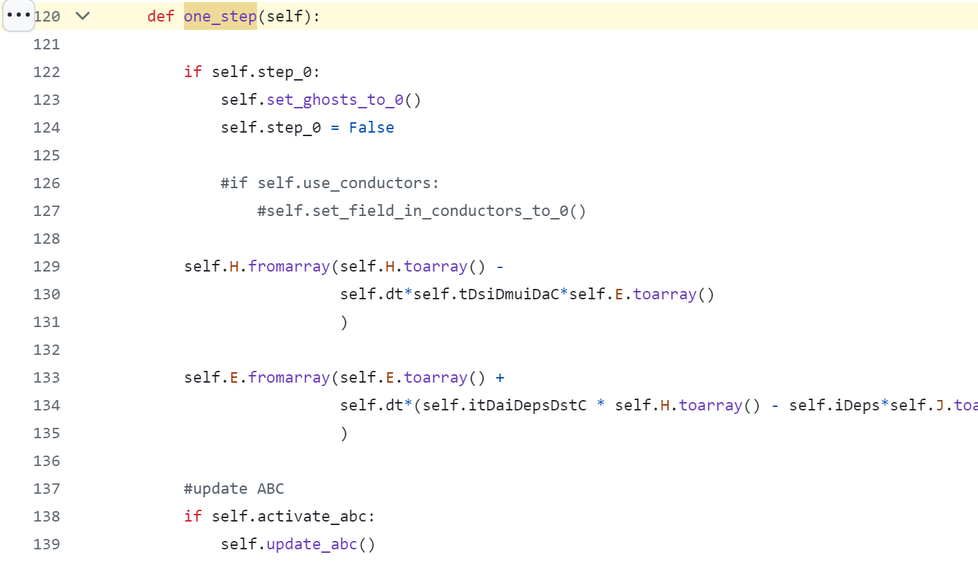
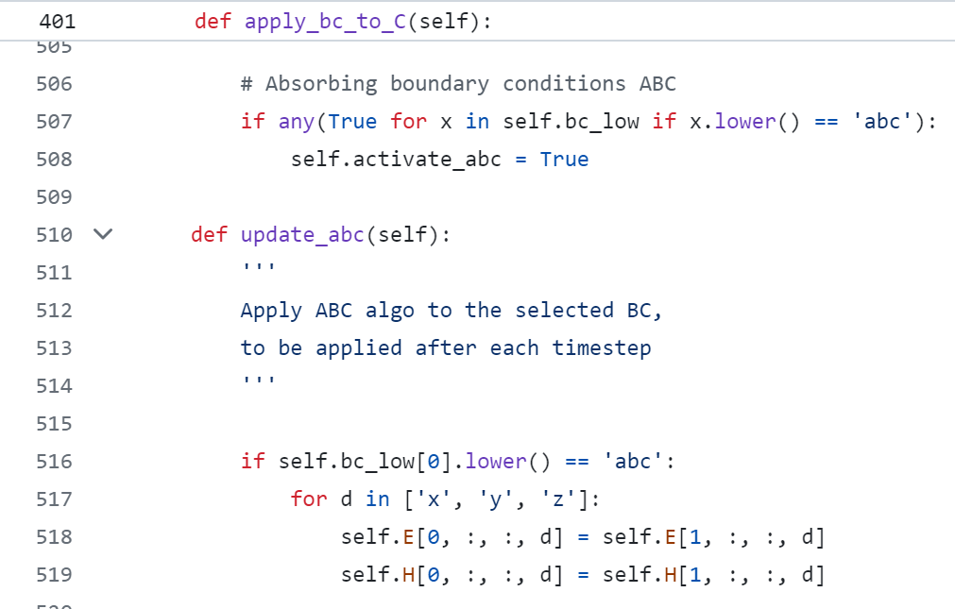
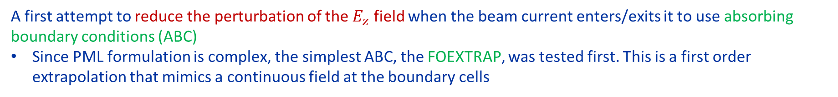
Absorbing boundaries
A first attempt to reduce the perturbation of the $E_{z}$ field when the beam current enters/exits it to use absorbing boundary conditions (ABC)
Since PML formulation is complex, the simplest ABC, the FOEXTRAP, was tested first. This is a first order extrapolation that mimics a continuous field at the boundary cells
It has to be updated every timestep
Same for all 6 boundaries (low and high, x, y, z)

Slide 16
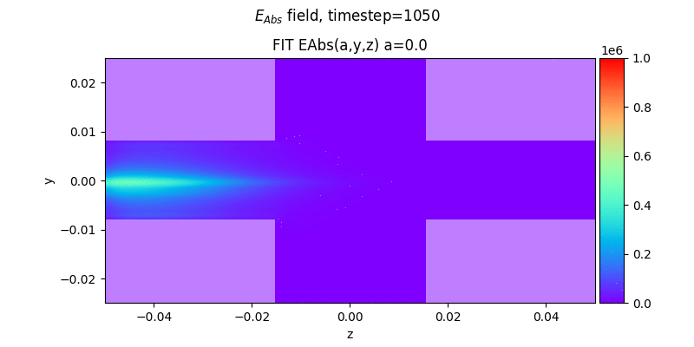
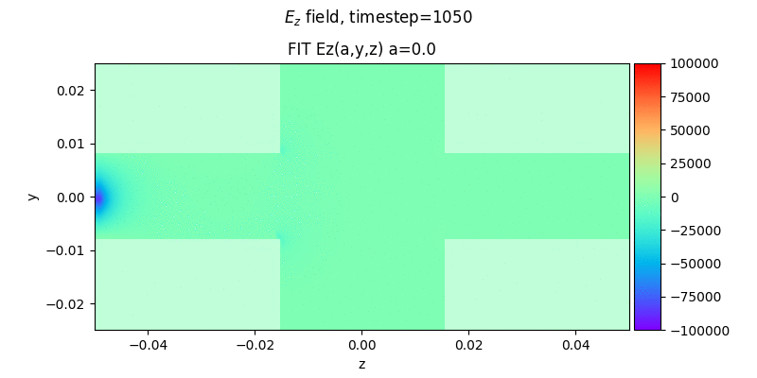

Absorbing boundaries (II)
The effect of this simple ABC is clearly visible at the edges of the domain:
ABC gives a smaller perturbation amplitude but it oscillates from negative to positive
ABC
PEC

Slide 17
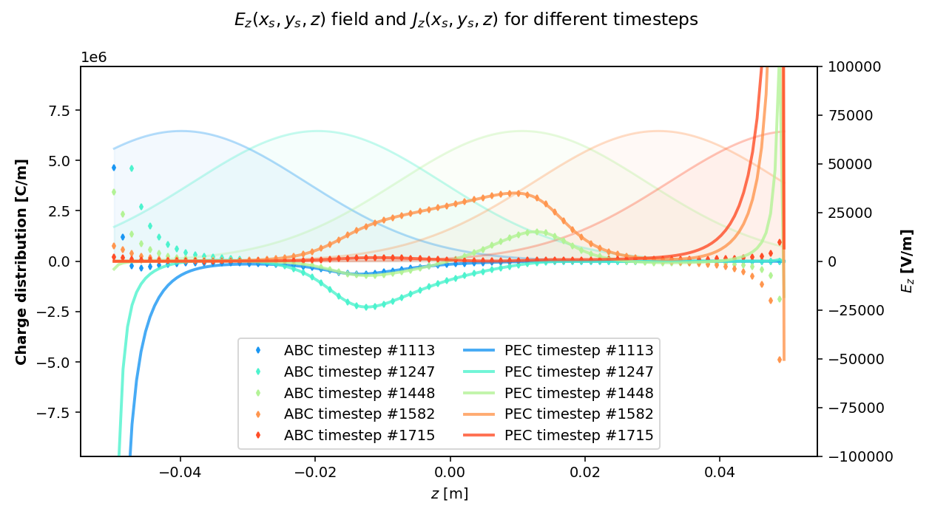

Absorbing boundaries (III)
Order of magnitude reduction of the amplitude of the perturbation, specially at z+.
Line charge current per timestep $J_{z}$

Slide 18
Outline
Where are we?
Main improvements in the code
Beam injection & Absorbing boundary conditions (ABC)
1st Benchmark with CST: PEC pillbox
Conclusions & Next steps

Slide 19
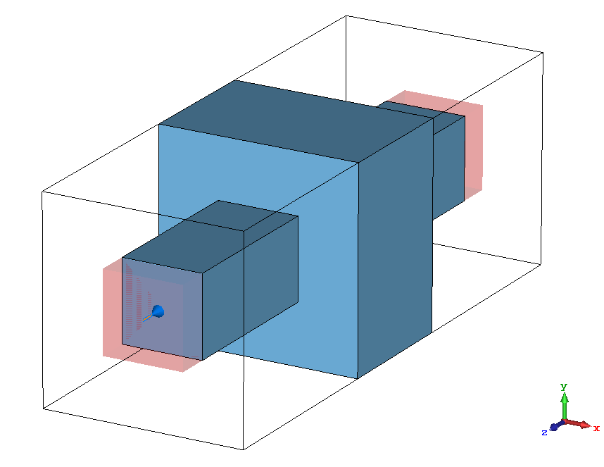
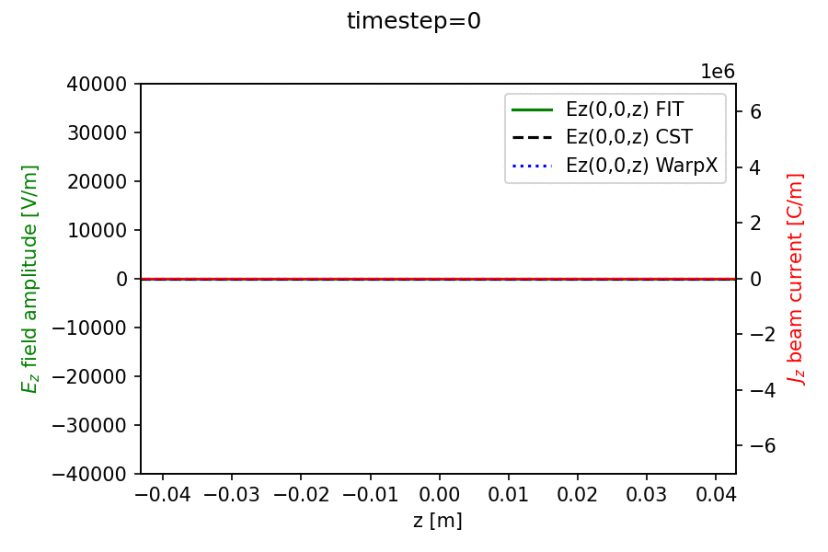

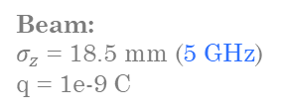

Pillbox Cavity (bellow cutoff): FIT vs WarpX vs CST
Geometry:
$L_{cav}$= 30 mm
$h_{cav}$= 50 mm
$w_{cav}$ = 50 mm
$L_{pipe}$ = 100 mm
$h_{pipe}$= 15 mm
$w_{pipe}$ = 15 mm
Simulation time: for 1m Wakelength (8760 timesteps)
CST: 42s, 16 threads, in `abpimp60g01`
FIT: 3m40s , single core in `abpimp60g01`, 5m20s in lxplus
WarpX: 42m to 1h 23m, single core in lxplus
  (high variability due to load of lxplus node…)
Beam:
$σ_{z}$ = 18.5 mm (5 GHz)
q = 1e-9 C
Mesh:
nx, ny, nz = 50, 50, 150
total: 375000 cells
Cutoff frequency: $\sim 10$ GHz
FIT: ABC
CST/WarpX: PML
Remarks:
Some error comes from the CST field export, since it does not respect the sampling when it’s too close to the simulation timestep.
WarpX reflections are higher on z-, lower on z+, but are present longer in the domain -> FIT performs slightly better.
Jz and Ez along z axis

Slide 20
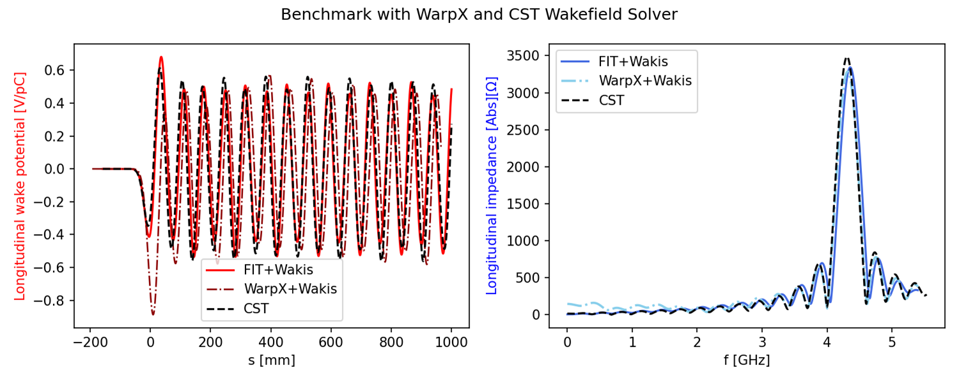
Pillbox Cavity (bellow cutoff): FIT vs WarpX vs CST
Geometry:
$L_{cav}$= 30 mm
$h_{cav}$= 50 mm
$w_{cav}$ = 50 mm
$L_{pipe}$ = 100 mm
$h_{pipe}$= 15 mm
$w_{pipe}$ = 15 mm
Beam:
$σ_{z}$ = 18.5 mm (5 GHz)
q = 1e-9 C
*Calculation performed removing 10 cells at z+ and z- of the FIT domain to reduce the beam injection perturbation
Remarks: WarpX agreement worsens when not using the extended pipe model (pipe+50mm) see CEI-030823
Mesh:
nx, ny, nz = 50, 50, 150
total: 375000 cells
Cutoff frequency: $\sim 10$ GHz
FIT: ABC
CST/WarpX: PML
Related to beam injection as seen with the goniometer in WarpX

Slide 21
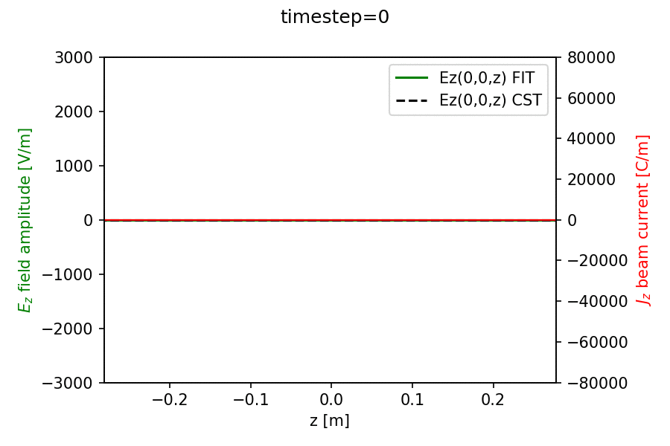

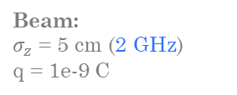

Pillbox Cavity (above cutoff): FIT vs CST
Geometry:
$L_{cav}$= 20 cm
$h_{cav}$= 30 cm
$w_{cav}$ = 30 cm
$L_{pipe}$ = 70 cm
$h_{pipe}$= 12 cm
$w_{pipe}$ = 12 cm
Simulation time: for 10m Wakelength (10340 timesteps)
CST: 52s, 16 threads, in `abpimp60g01`
FIT: 4m50s , single core in `abpimp60g01`
Beam:
$σ_{z}$ = 5 cm (2 GHz)
q = 1e-9 C
Mesh:
nx, ny, nz = 51, 51, 104
total: 270,504 cells
20 cells/wavelength
Cutoff frequency: $\sim 1.25$ GHz
FIT: ABC
CST/WarpX: PML
Remarks:
Main pattern is there, contaminated by the high relfections from the boundaries for the modes above cutoff
Jz and Ez along z axis

Slide 22
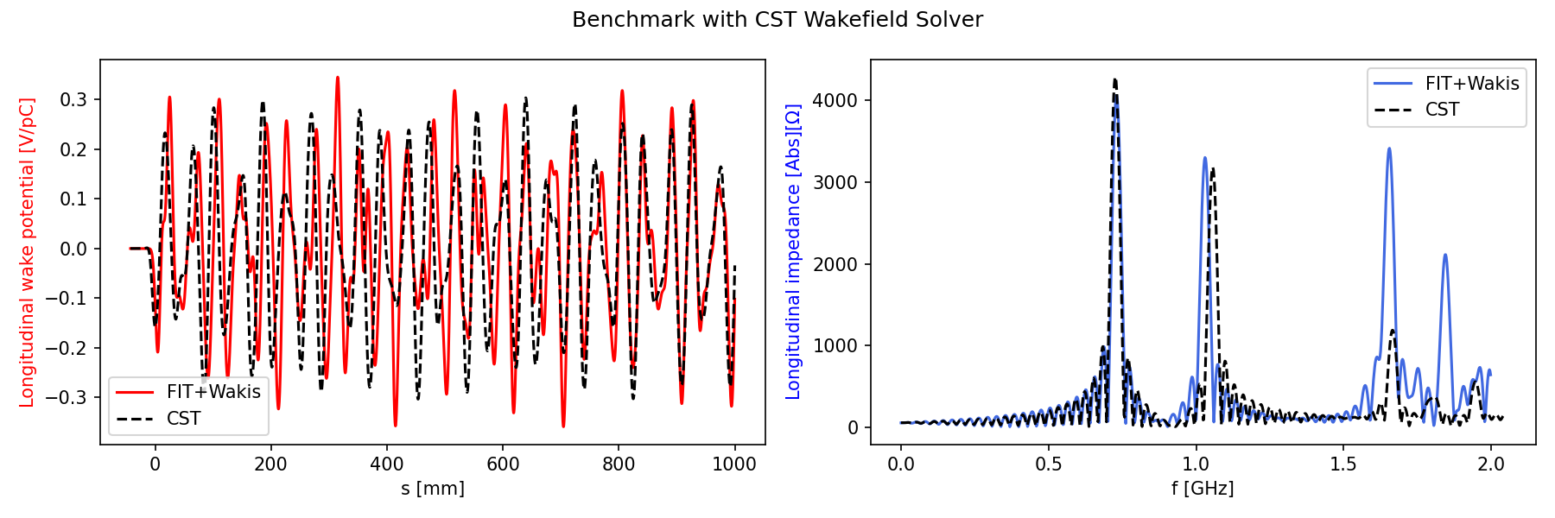

Pillbox Cavity (above cutoff): FIT vs CST
Geometry:
$L_{cav}$= 20 cm
$h_{cav}$= 30 cm
$w_{cav}$ = 30 cm
$L_{pipe}$ = 70 cm
$h_{pipe}$= 12 cm
$w_{pipe}$ = 12 cm
*Calculation performed removing 10 cells at z+ and z- of the FIT domain to reduce the beam injection perturbation
Remarks: the agreement worsens the closer to cutoff frequency. The modes above cuttof present an artificial amplitude (not propagating) –> Need for PML
Beam:
$σ_{z}$ = 5 cm (2 GHz)
q = 1e-9 C
Mesh:
nx, ny, nz = 51, 51, 104
total: 270,504 cells
20 cells/wavelength
Cutoff frequency: $\sim 1.25$ GHz
FIT: ABC
CST/WarpX: PML

Slide 23
Outline
Where are we?
Main improvements in the code
Beam injection & Absorbing boundary conditions (ABC)
1st Benchmark with CST: PEC pillbox
Conclusions & Next steps

Slide 24
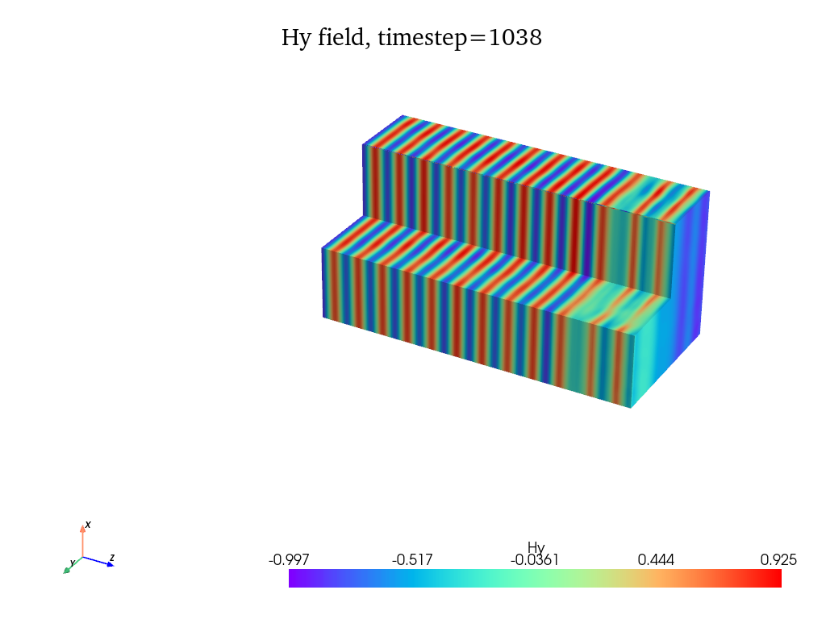
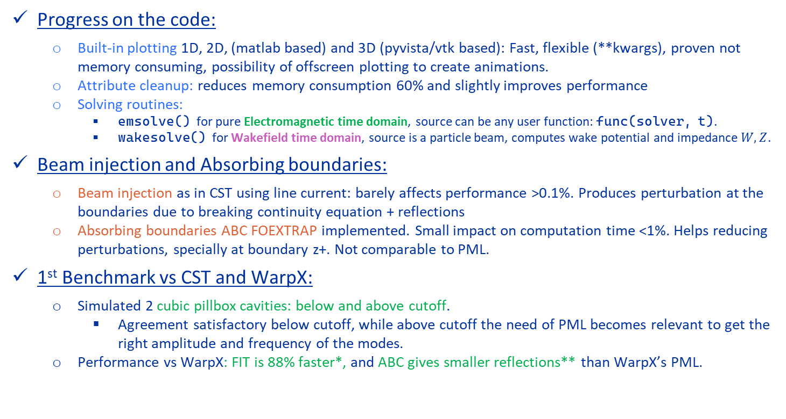
Conclusions
Progress on the code:
  Built-in plotting 1D, 2D, (matlab based) and 3D (pyvista/vtk based): Fast, flexible (**kwargs), proven not memory consuming, possibility of offscreen plotting to create animations.
  Attribute cleanup: reduces memory consumption 60% and slightly improves performance
  Solving routines:
    emsolve() for pure Electromagnetic time domain, source can be any user function: func(solver, t).
    wakesolve() for Wakefield time domain, source is a particle beam, computes wake potential and impedance $W, Z$.
Beam injection and Absorbing boundaries:
  Beam injection as in CST using line current: barely affects performance >0.1%. Produces perturbation at the boundaries due to breaking continuity equation + reflections
  Absorbing boundaries ABC FOEXTRAP implemented. Small impact on computation time <1%. Helps reducing perturbations, specially at boundary z+. Not comparable to PML.
1st Benchmark vs CST and WarpX:
  Simulated 2 cubic pillbox cavities: below and above cutoff.
    Agreement satisfactory below cutoff, while above cutoff the need of PML becomes relevant to get the right amplitude and frequency of the modes.
  Performance vs WarpX: FIT is 88% faster*, and ABC gives smaller reflections** than WarpX’s PML.
Example 3D built-in plot of planewave in vacuum
Safe to say we are in a better position with FITWakis Feb 2024 compared to July 2023 WarpX+Wakis ? ☺
*comparison on lxplus (same node). Workload variability may impact WarpX’s time
**probably due to beam injection with 10^6 macroparticles perturbations not being absorbed by PML

Slide 25
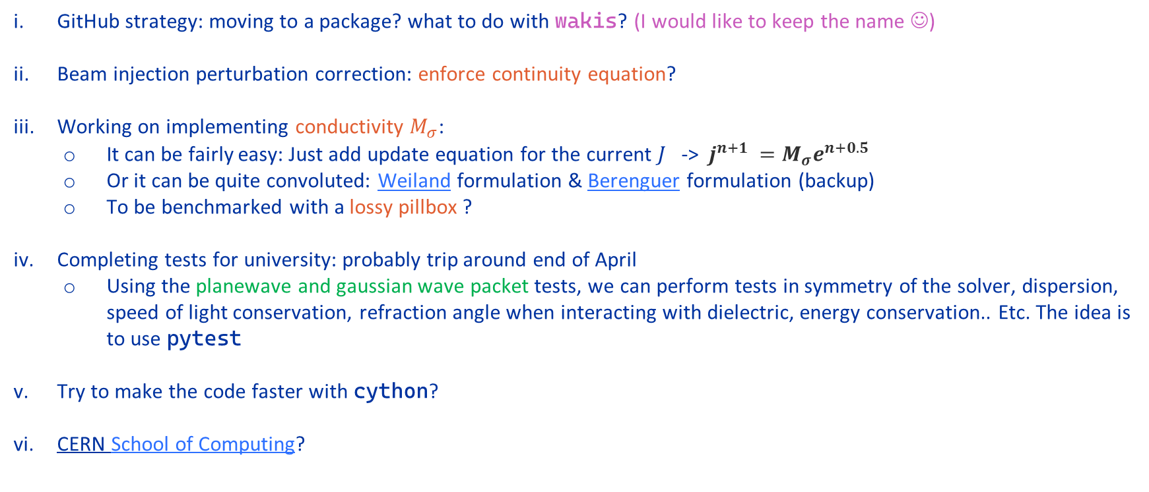
Next steps / Questions
GitHub strategy: moving to a package? what to do with wakis? (I would like to keep the name ☺)
Beam injection perturbation correction: enforce continuity equation?
Working on implementing conductivity $M_{σ}$:
  It can be fairly easy: Just add update equation for the current $J$ -> $j^{n+1 }=M_{σ}e^{n+0.5}$
  Or it can be quite convoluted: Weiland formulation & Berenguer formulation (backup)
  To be benchmarked with a lossy pillbox ?
Completing tests for university: probably trip around end of April
  Using the planewave and gaussian wave packet tests, we can perform tests in symmetry of the solver, dispersion, speed of light conservation, refraction angle when interacting with dielectric, energy conservation.. Etc. The idea is to use pytest
Try to make the code faster with cython?
CERN School of Computing?

Slide 26
Thank you ☺ !!!
Electromagnetic and Wake Solver Development
meeting #19
Elena de la Fuente García (BE–ABP–CEI)

Slide 27
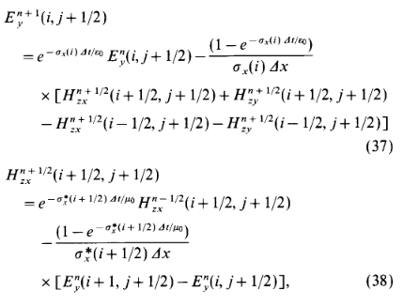
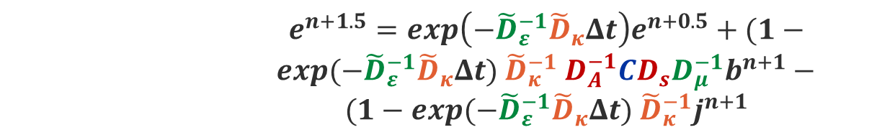
Berenguer PML vs Weiland update equations
        $e^{n+1.5}=exp\left(−{\tilde{D}}_{ε}^{−1}{\tilde{D}}_{κ}Δt\right)e^{n+0.5}+(1−exp(−{\tilde{D}}_{ε}^{−1}{\tilde{D}}_{κ}Δt)$ ${\tilde{D}}_{κ}^{−1}$ $D_{A}^{−1}CD_{s}D_{μ}^{−1}b^{n+1}−$
        $(1−exp(−{\tilde{D}}_{ε}^{−1}{\tilde{D}}_{κ}Δt)$ ${\tilde{D}}_{κ}^{−1}j^{n+1}$
$$h^{n+1}=h^{n}−Δt{ {\tilde{D}}_{s}D_{μ}^{−1}D}_{A}^{−1}Ce^{n+0.5}$$

Slide 28
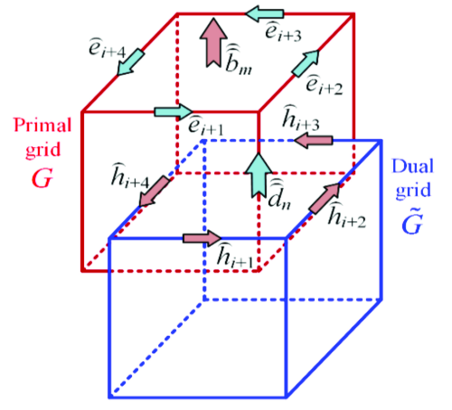
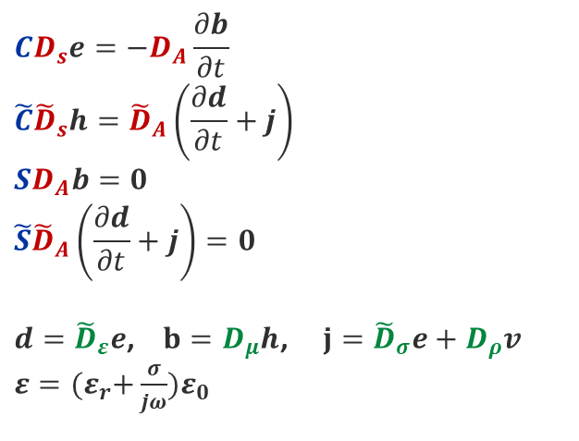
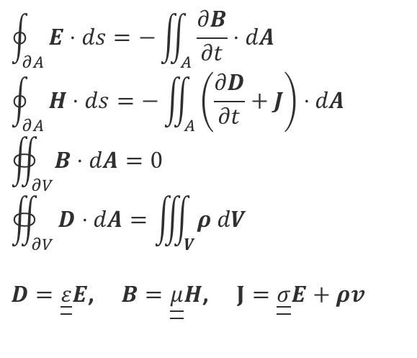
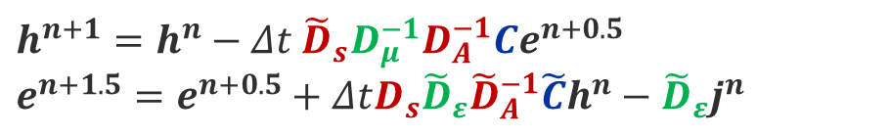
FIT theory: Grid Maxwell Equations
FIT
Grid Maxwell Equations
$$\oint_{∂A}^{ }{E⋅ds=−\iint_{A}^{ }{\frac{∂B}{∂t}⋅dA}}$$
$$\oint_{∂A}^{ }{H⋅ds=−\iint_{A}^{ }{\left(\frac{∂D}{∂t}+J\right)⋅dA}}$$
$$∯_{∂V}^{ }{B⋅dA}=0$$
$$∯_{∂V}^{ }{D⋅dA=\iiint_{V}^{ }{ρ dV}}$$
$D=\underline{\underline{ε}}E$, $B=\underline{\underline{μ}}H$, $J=\underline{\underline{σ}}E+ρv$
$$CD_{s}e=−D_{A}\frac{∂b}{∂t}$$
$$\tilde{C}{\tilde{D}}_{s}h={\tilde{D}}_{A}\left(\frac{∂d}{∂t}+j\right)$$
$$SD_{A}b=0$$
$${\tilde{S}\tilde{D}}_{A}\left(\frac{∂d}{∂t}+j\right)=0$$
$d={\tilde{D}}_{ε}e$, $b=D_{μ}h$, $j={\tilde{D}}_{σ}e+D_{ρ}v$ $ε={(ε}_{r}+\frac{σ}{jω})ε_{0}$
Operators
Spatial matrixes
Material properties
$$h^{n+1}=h^{n}−Δt{ {\tilde{D}}_{s}D_{μ}^{−1}D}_{A}^{−1}Ce^{n+0.5}$$
$$e^{n+1.5}=e^{n+0.5}+ΔtD_{s}{\tilde{D}}_{ε}{\tilde{D}}_{A}^{−1}\tilde{C}h^{n}−{\tilde{D}}_{ε}j^{n}$$
We need to build all these matrices and then apply these equations every timestep !
What we care about:
Update equations

