Slide 1



Updates on counter-rotating muon beams in the high-energy acceleration chain
9th Meeting of Task 6.1 MuCol Design Study
10/6/2024
F. Batsch, L. Thiele, S. Albright, D. Amorim, R. Calaga, H. Damerau, A. Grudiev, I. Karpov,…

Slide 2

Outline
General aspects of counterrotating bunches
Simulations with FM wakefields from CR
Cavity voltage modulations (more in L. Thiele’s presentation)
Changes of the momentum compaction factor
Summary

Slide 3
General situation
5
crossing point
In the RLAs, the co-propagating bunches are separated by odd multiples of π
In the RCSs, the bunches are counterrotating (CR)
In the standing wave cavities, the bunches must pass with a relative offset of multiples of 2π
The positioning of the bunch crossing points with respect to the RF stations is an important assumption as it defines the intensity effects affecting the other bunch, the HOM power scales with I²
→ Bunch crossing points in the middle of the arcs optimal
6
4
7
Example with 8 RF stations
3
8
2
crossing point
1

Slide 4
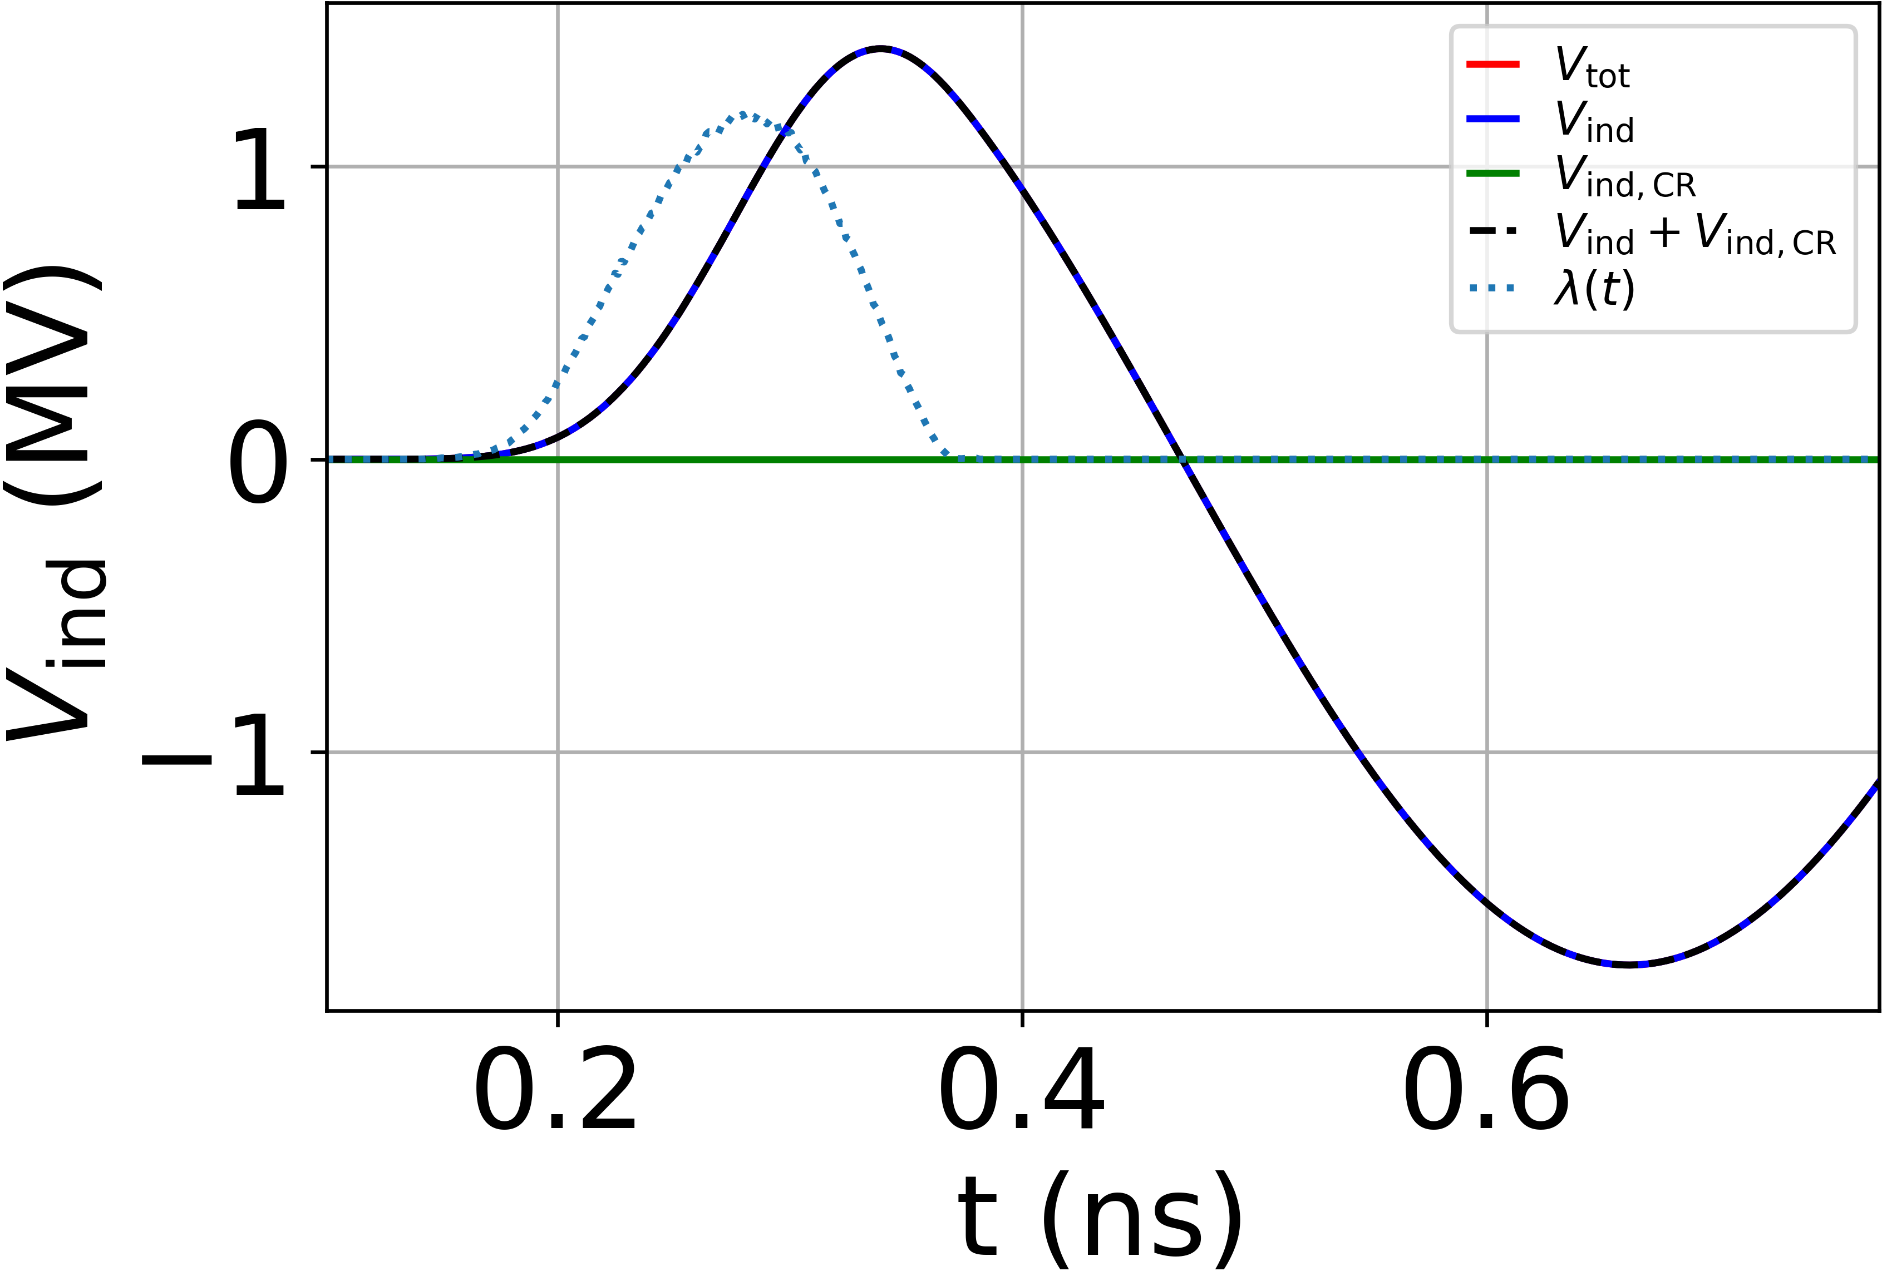
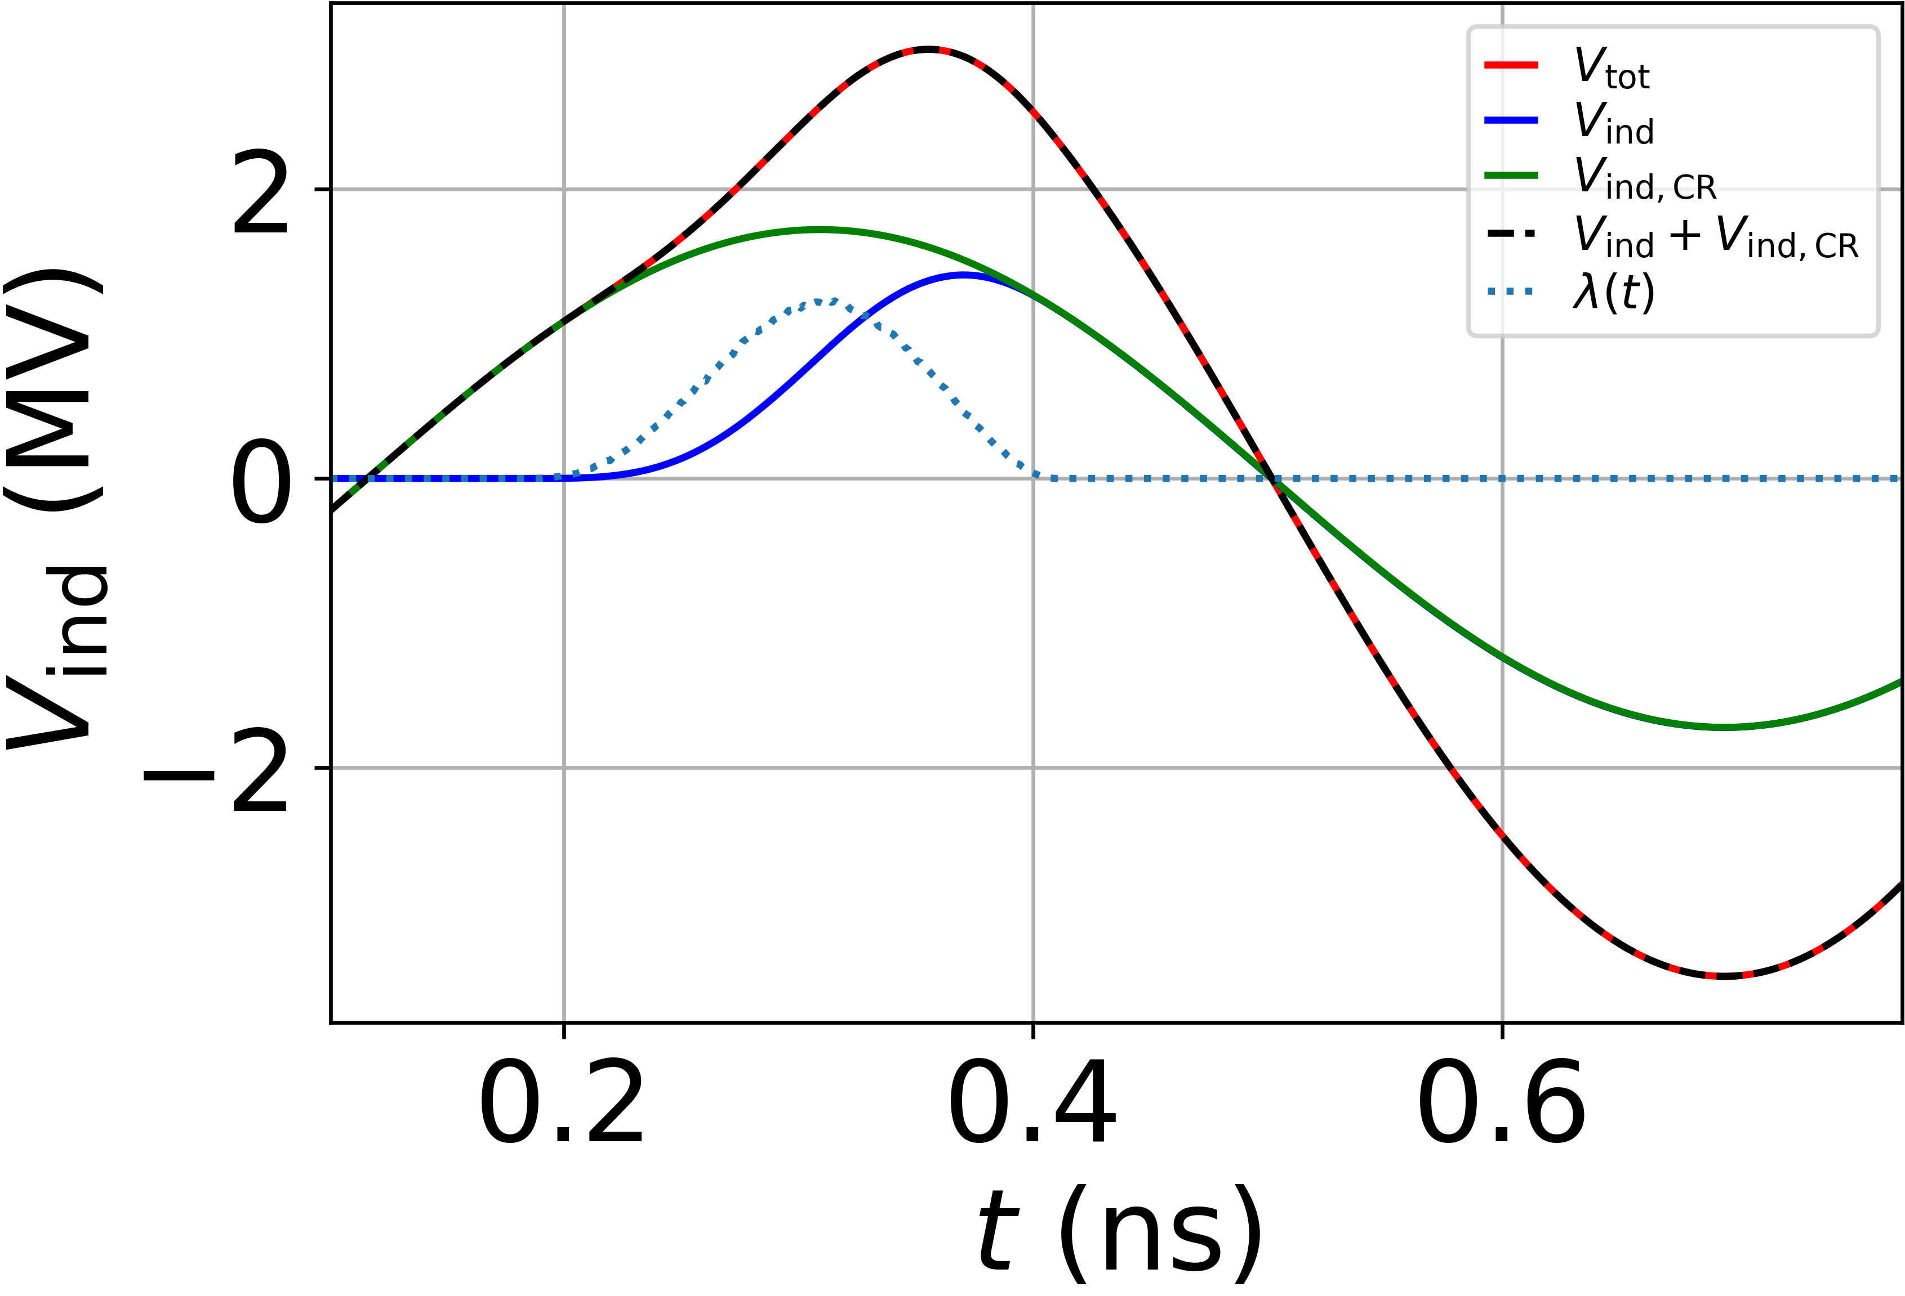
Wakefields of the CR bunch
5
crossing point
Use of ‘standard’ cavity and RCS parameters
Re-use the intensity effect calculations for multi-turn effects for one bunch in BLonD
Calculate in addition wakefields at the time of the passage of the CR bunch in the future
Apply it to the other beam at the moment of passage
6
4
7
Example with 8 RF stations
3
Induced voltages in RF station 1:
Induced voltages in RF station 5:
8
2
crossing point
1

Slide 5
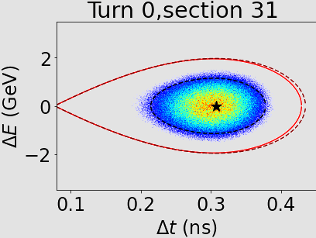
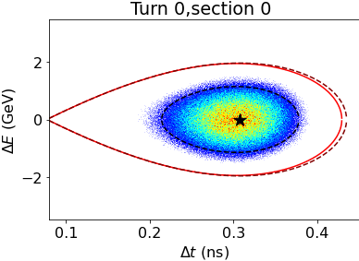
Simulation example
Exemplary longitudinal phase spaces for µ⁻ and µ⁺ bunch for 32 RF stations:
RCS1
µ⁻
µ⁺

Slide 6
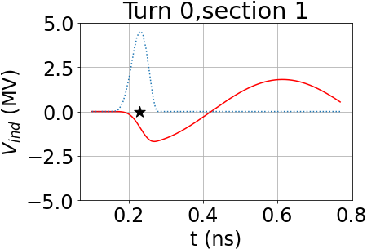
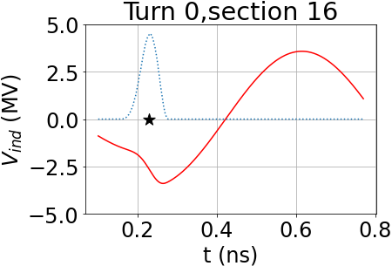

Simulation results
For the fundamental mode (FM), and a relative phase offset of $0$, the fundamental mode wakefields from the CR bunch are therefore also in phase and build up:
Induced voltage per cavity
RCS1

Slide 7
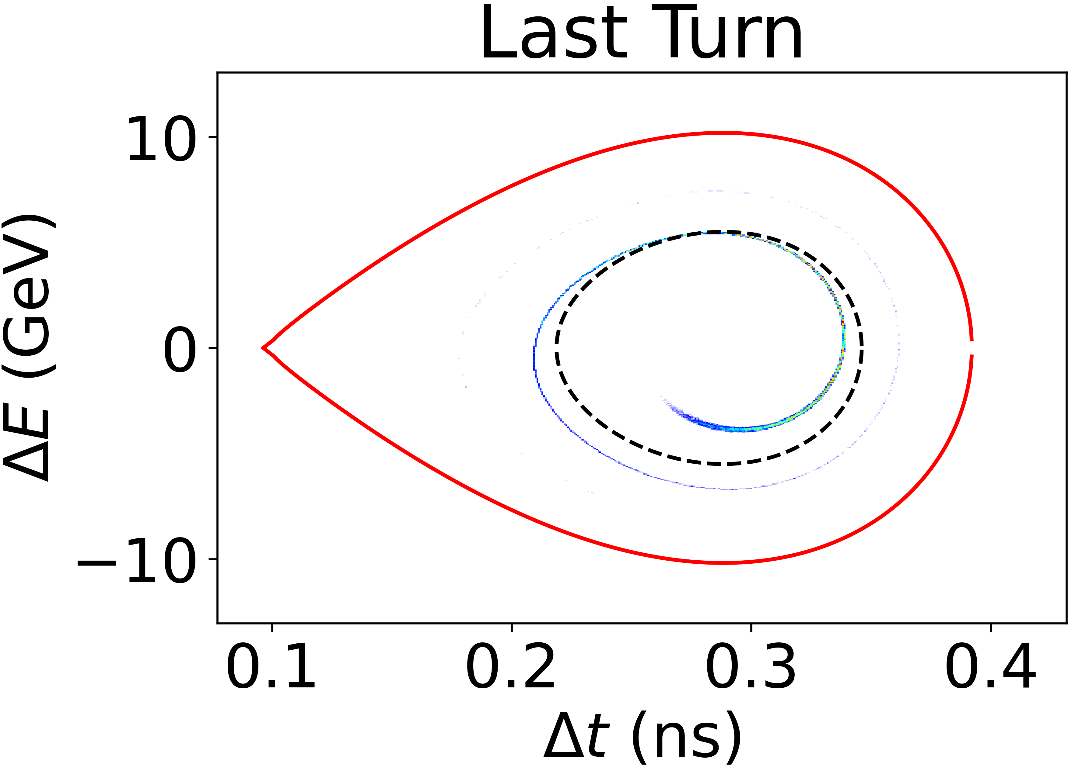
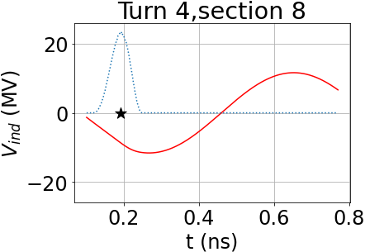
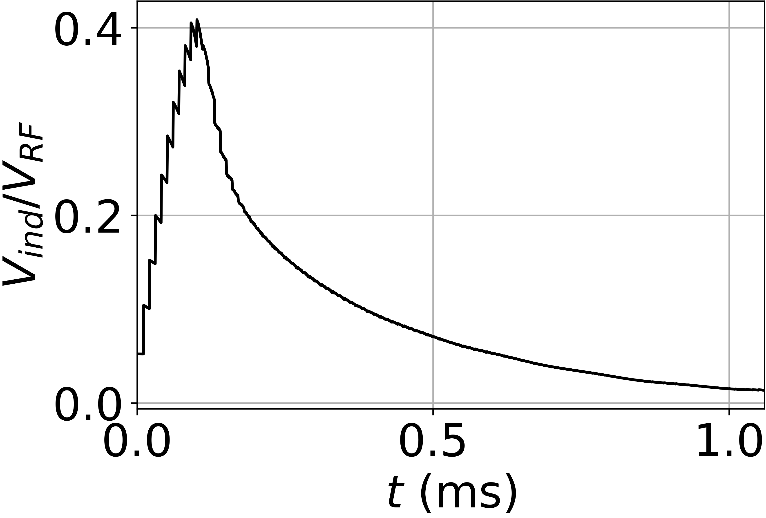

Simulation results (1)
Induced voltages of ~1MV per cavity and turn build up. Example of RCS2:
$n_{RF}=32$
$φ_{s}=45°$
$α_{p}=0.00032$ (value from Lisa Soubirou)
Only fundamental mode, multi-turn and CR intensity effects, no HOMs
→ No sufficient beam loading compensation, bunch lost
Longitudinal phase space
Induced voltage per cavity

Slide 8
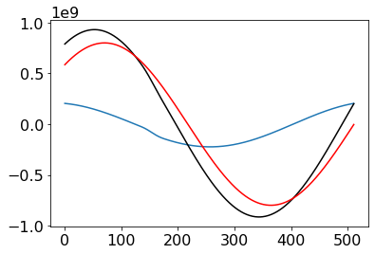
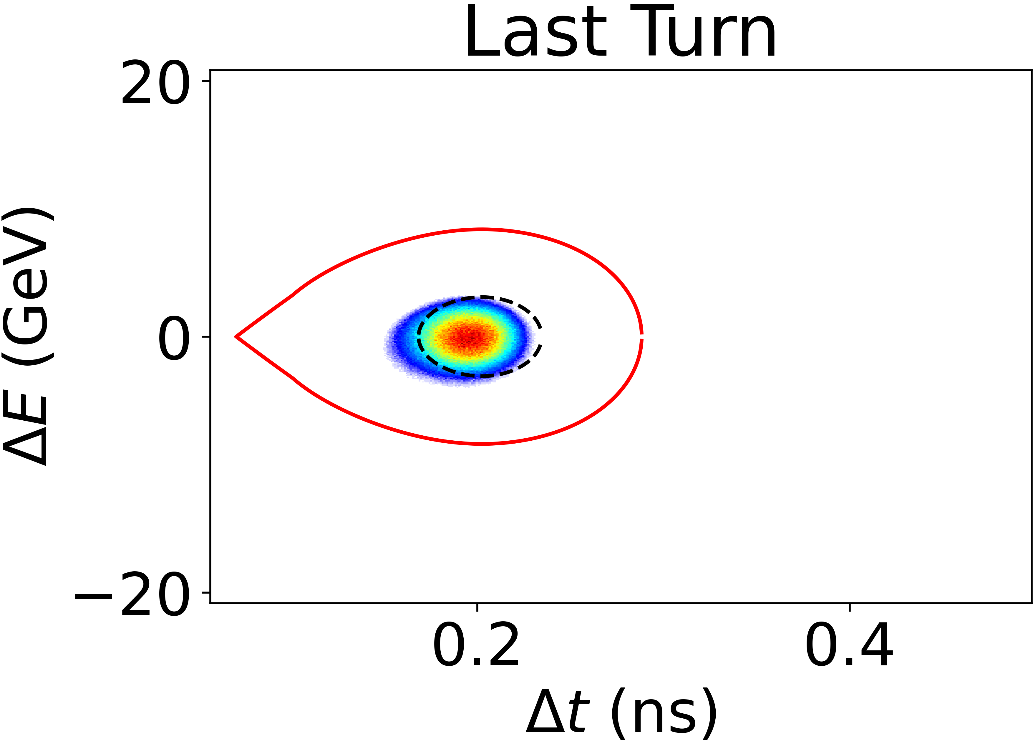
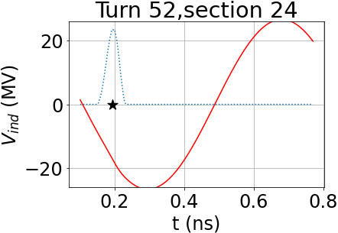
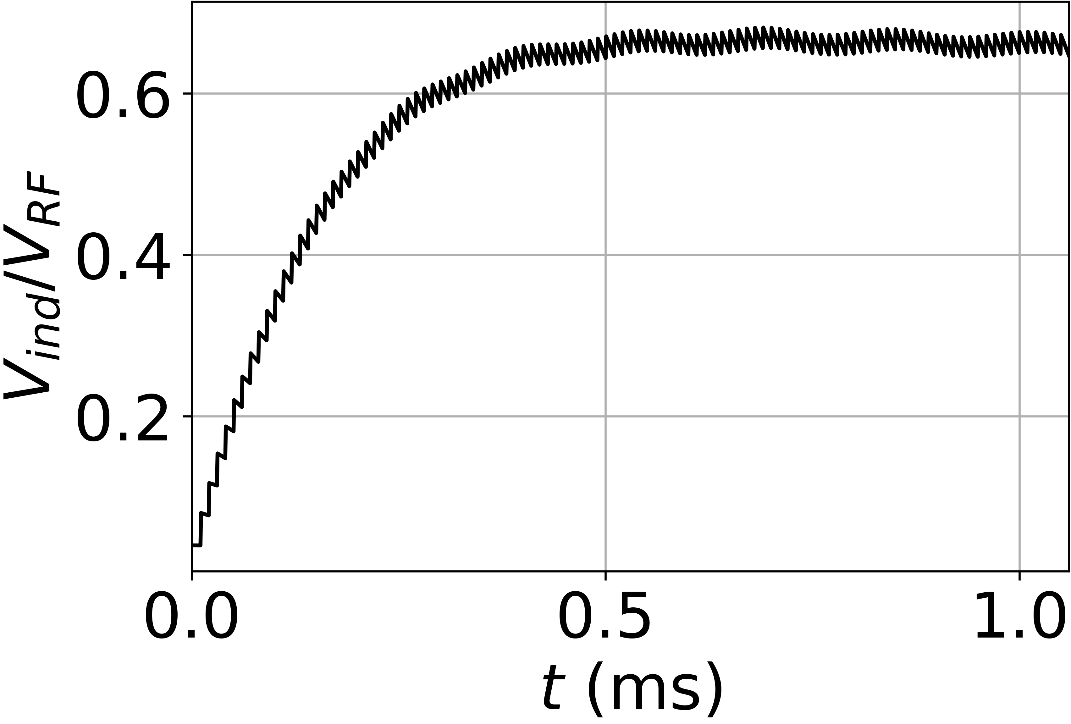

Simulation results (2)
Providing more voltage by decreasing the synchronous phase:
$φ_{s}=33°$ (30% more total RF voltage)
Other parameters unchanged
→ Bunch is transported, the fast synchrotron motion mitigates the beam loading
RF voltage
Ind. Voltage FM
Sum
Ind. Voltage [V]
Longitudinal phase space
Induced voltage per cavity
Time step

Slide 9
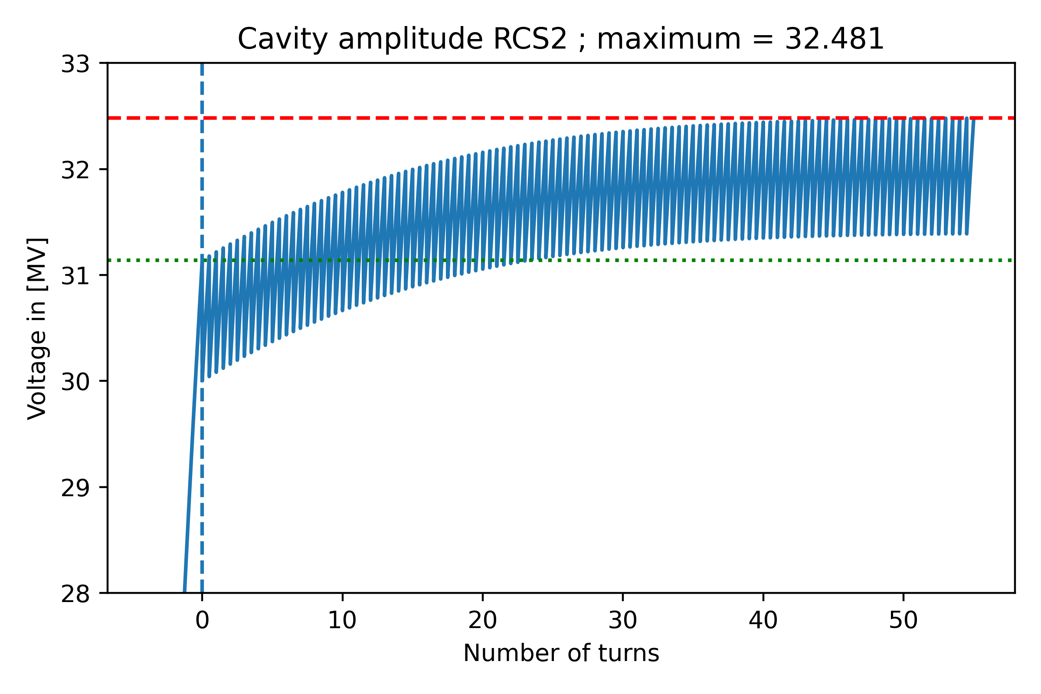
Beam loading compensation
The linac acceleration scheme together with beam loading leads to a non-constant cavity voltage
→ Study effect in BLonD with cavity voltage calculated by L. Thiele, see his presentation
Cavity amplitude in RCS2
L. Thiele

Slide 10
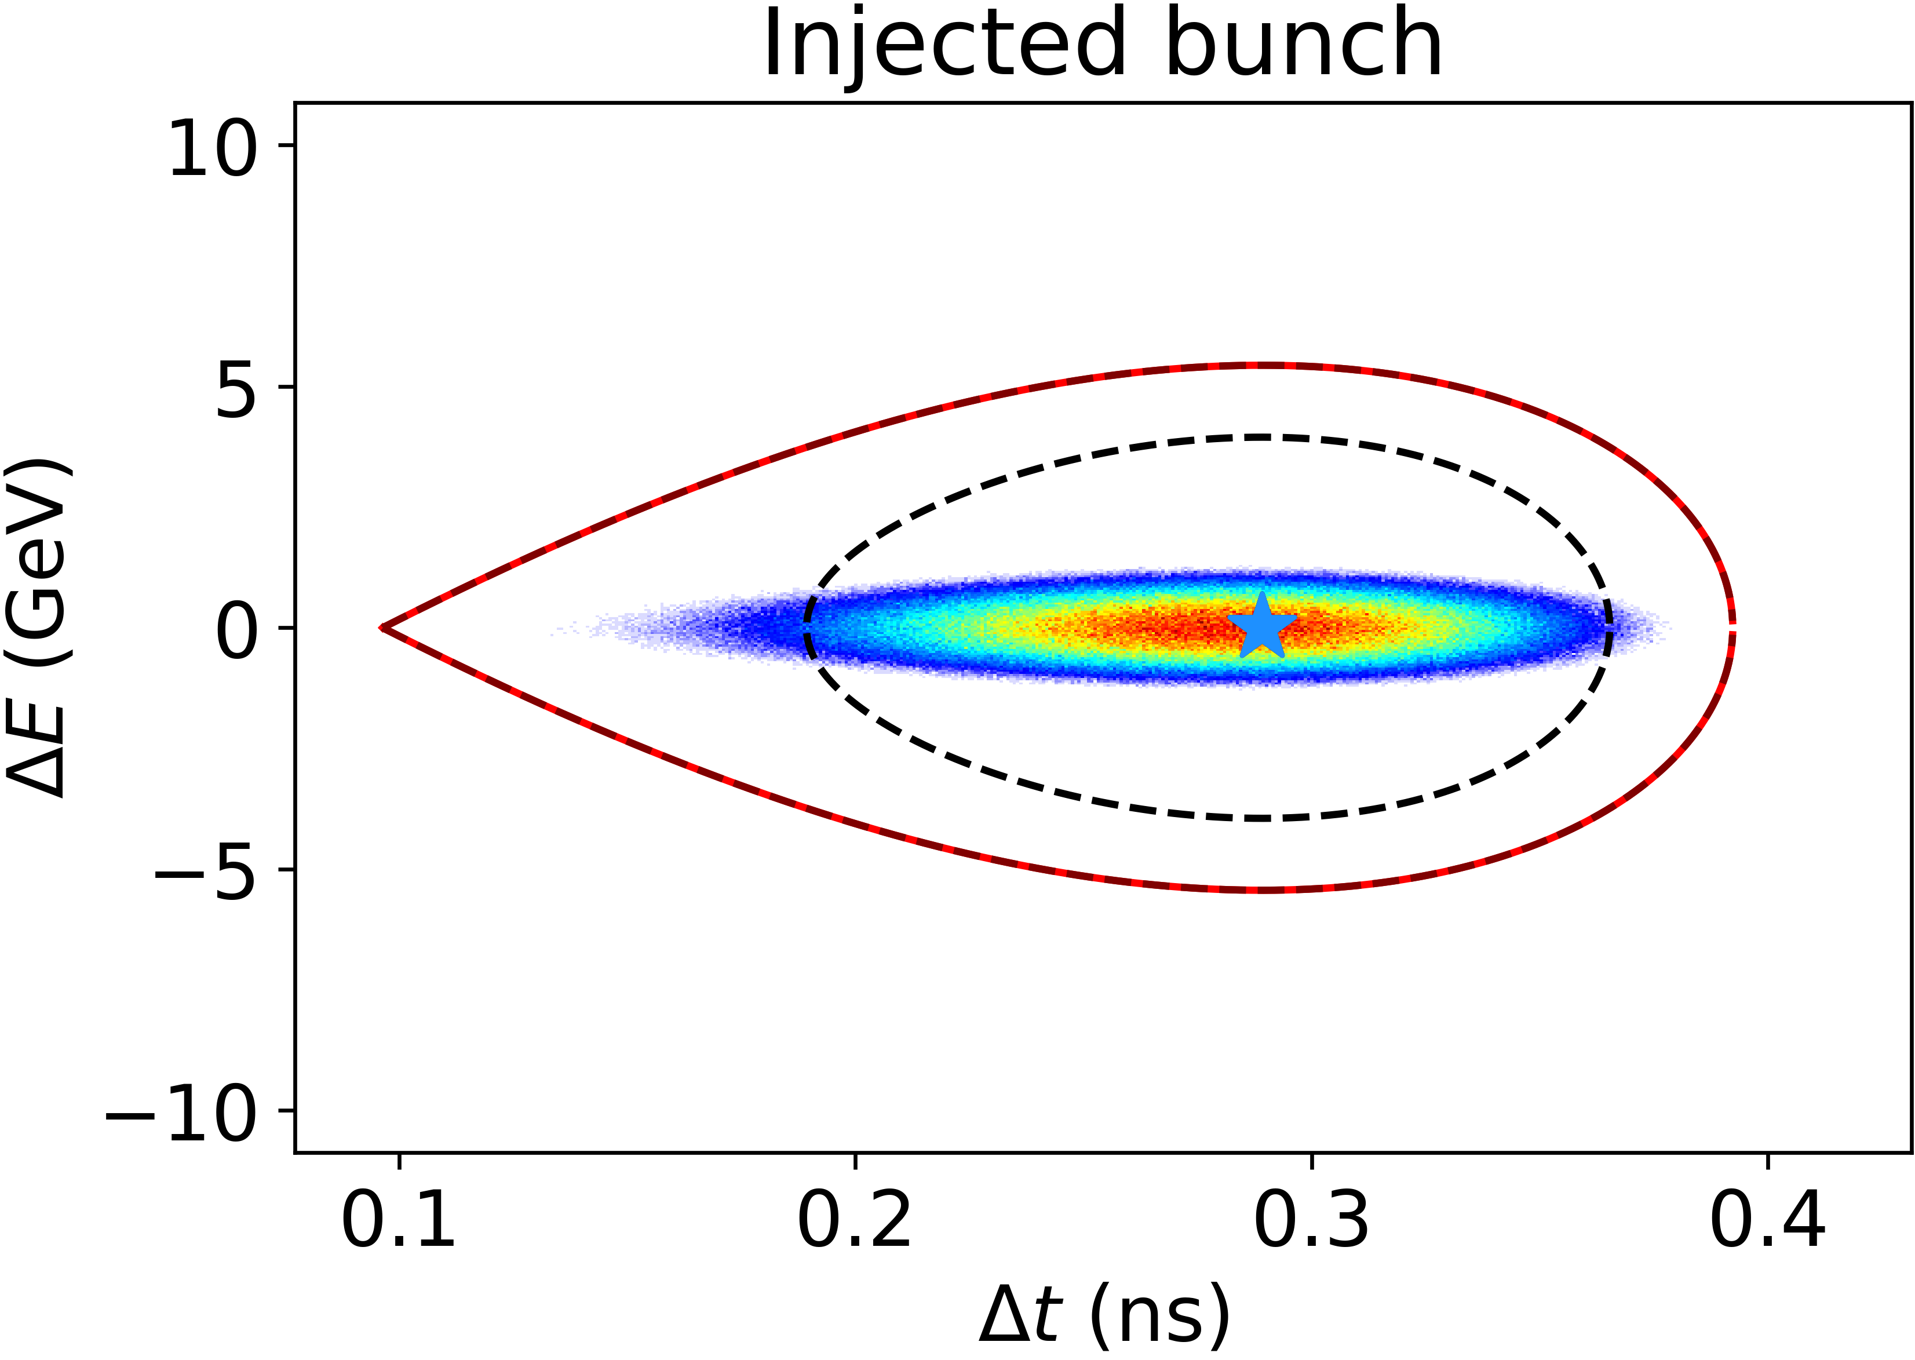
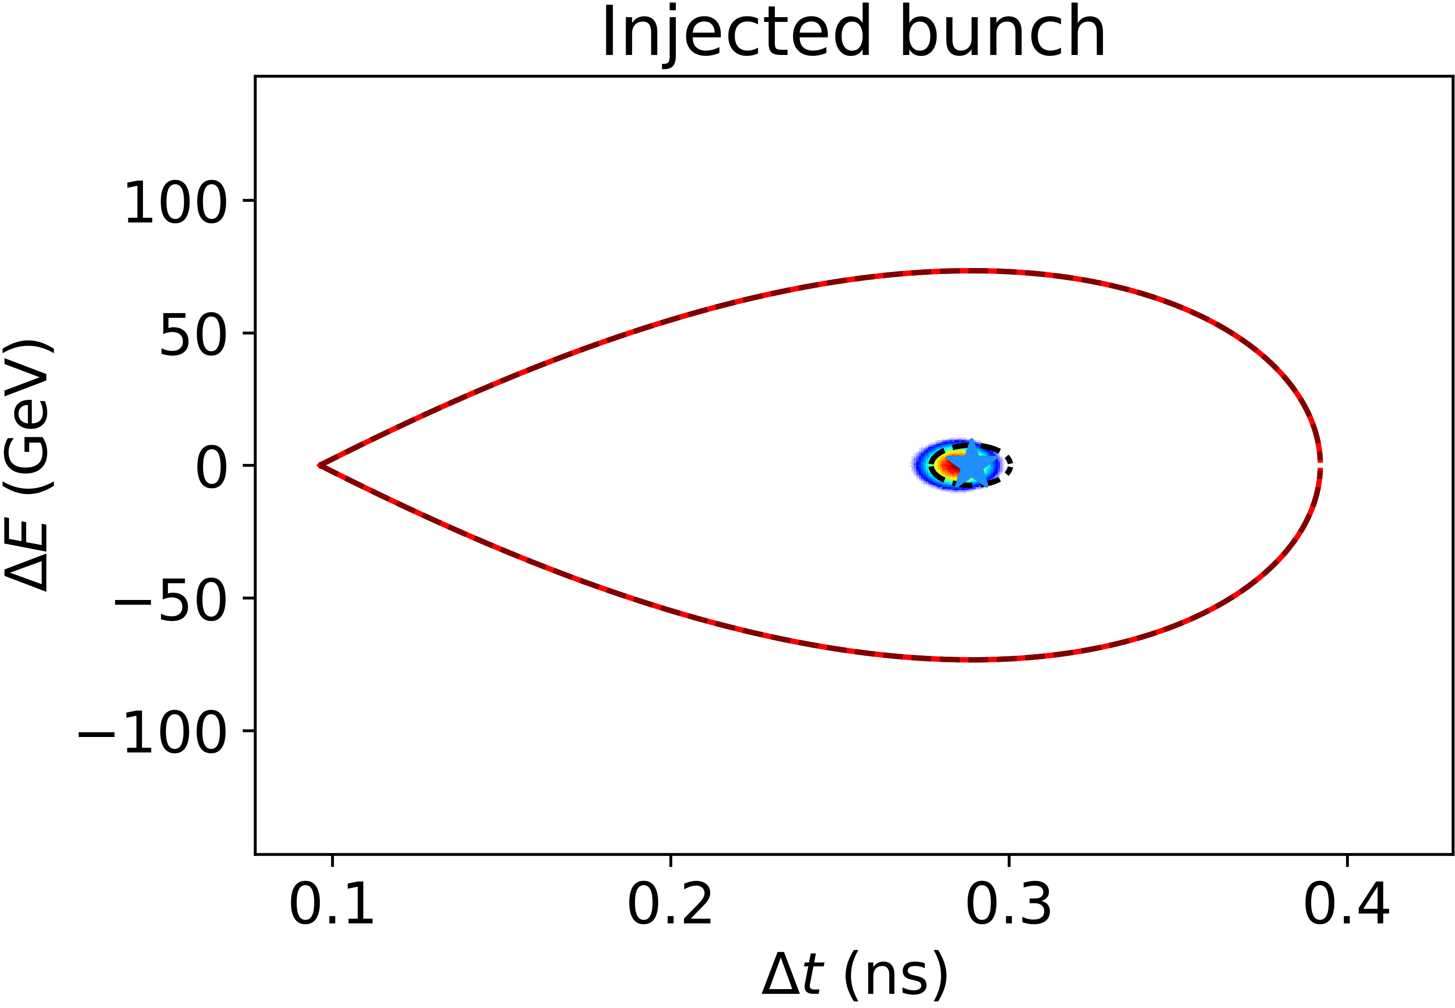

Changes of the transition gamma
The transition gamma was proposed to be changed:
RCS1: from 20 to 79 → 15 times smaller momentum compaction factor $α_{p}$
RCS4: 8 times larger transition gamma, 62.5 times smaller $α_{p}$
Large effects on RF, RF bucket, beam dynamics, bunch length, etc.
Probably strong mismatch in RCS1, extreme changes of the RF bucket in RCS4
This also affects the transverse studies
RCS1, mismatched bunch
RCS4, matched but excessive RF bucket

Slide 11
Summary
The induced voltages of the counterrotating beams build up due to their relative phase offset of 0 (2nπ)
→ Careful placement/alignment of cavities required, as done for LEP (see paper, section 4.1)
Providing larger RF voltages seems to allow for beam loading compensation
Modulation of the cavity voltage from the CR bunch under study
Changes in the momentum compaction factor might have large consequences on the longitudinal and transverse design and will be topic of a dedicated meeting end of June

Slide 12
Outlook
CERN summer student from July to August (01/07-30/08):
Longitudinal beam dynamics simulations for a hybrid RCS demonstrator facility
Design for 0.1-3 GeV, assuming a fixed ramp rate of 3 kT/s
From 8th WP6.1 Meeting:
Moderately-sized hybrid (e⁻) RCS demonstrator to be constructed and commissioned from 2030 to 2033
Several purposes:
Test of hybrid RCSs and its beam dynamics
Evaluate fast ramping of magnets
Serve as an injector for an electron storage ring
Option to ramp only one half of the magnets and keep the others at a fixed field to simulate a hybrid scheme

Slide 13


