Slide 1

Transient beam loading in the RCS chain
Leonard Thiele (University of Rostock, CERN), Fabian Batsch
S. Albright, R. Calaga, H. Damerau, A. Grudiev, I. Karpov, U. van Rienen

Slide 2
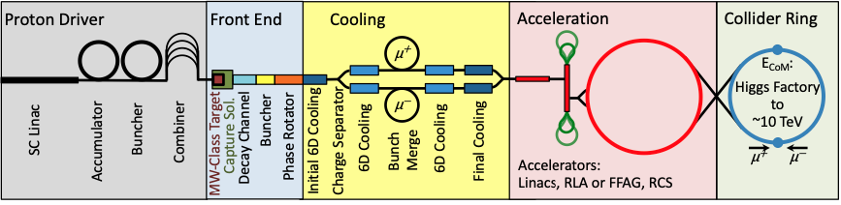

Content
Introduction to beam loading in RF cavities
Transient beam loading in the muon collider
Simulation of cavity voltage and phase during acceleration
Changed RF power requirements
Summary and outlook

Slide 3
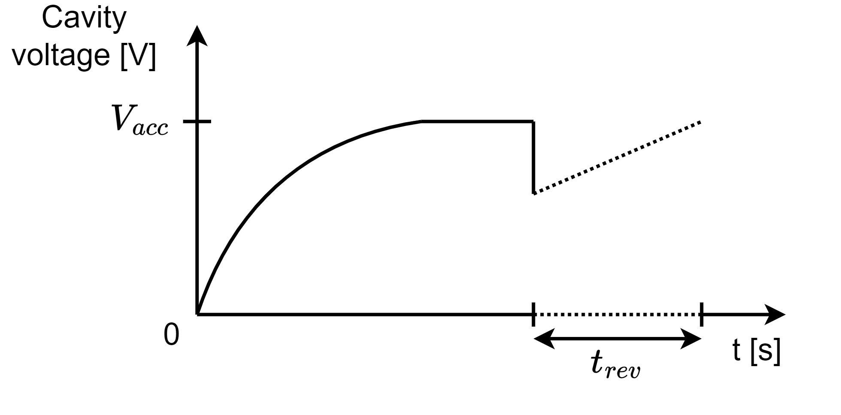
Introduction to beam loading in RF cavities
After filling the cavity with a certain generator current, a voltage will build up.
The bunch passage will then decrease this voltage as parts of the energy are transferred to the bunch.
This effect has to be compensated for, as otherwise, the bunch encounters less voltage on the next passage → Beam loading compensation.
The input power for the ideal compensation can be computed from an equivalent circuit model [1] J. Tückmantel, CERN-ATS-Note-2011-002 TECH.

Slide 4
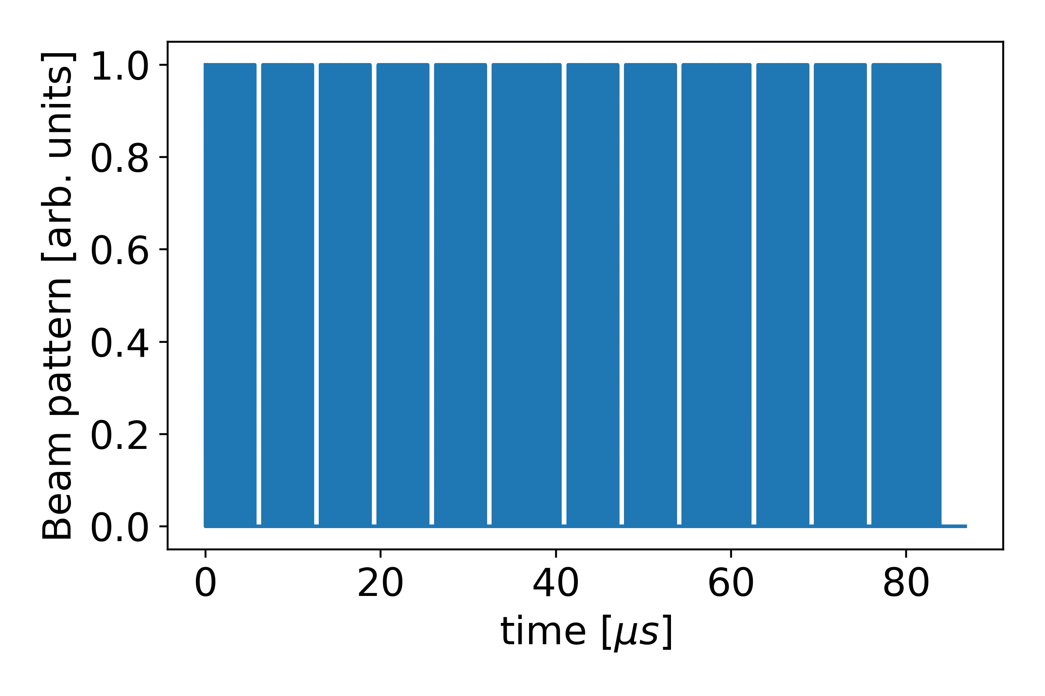
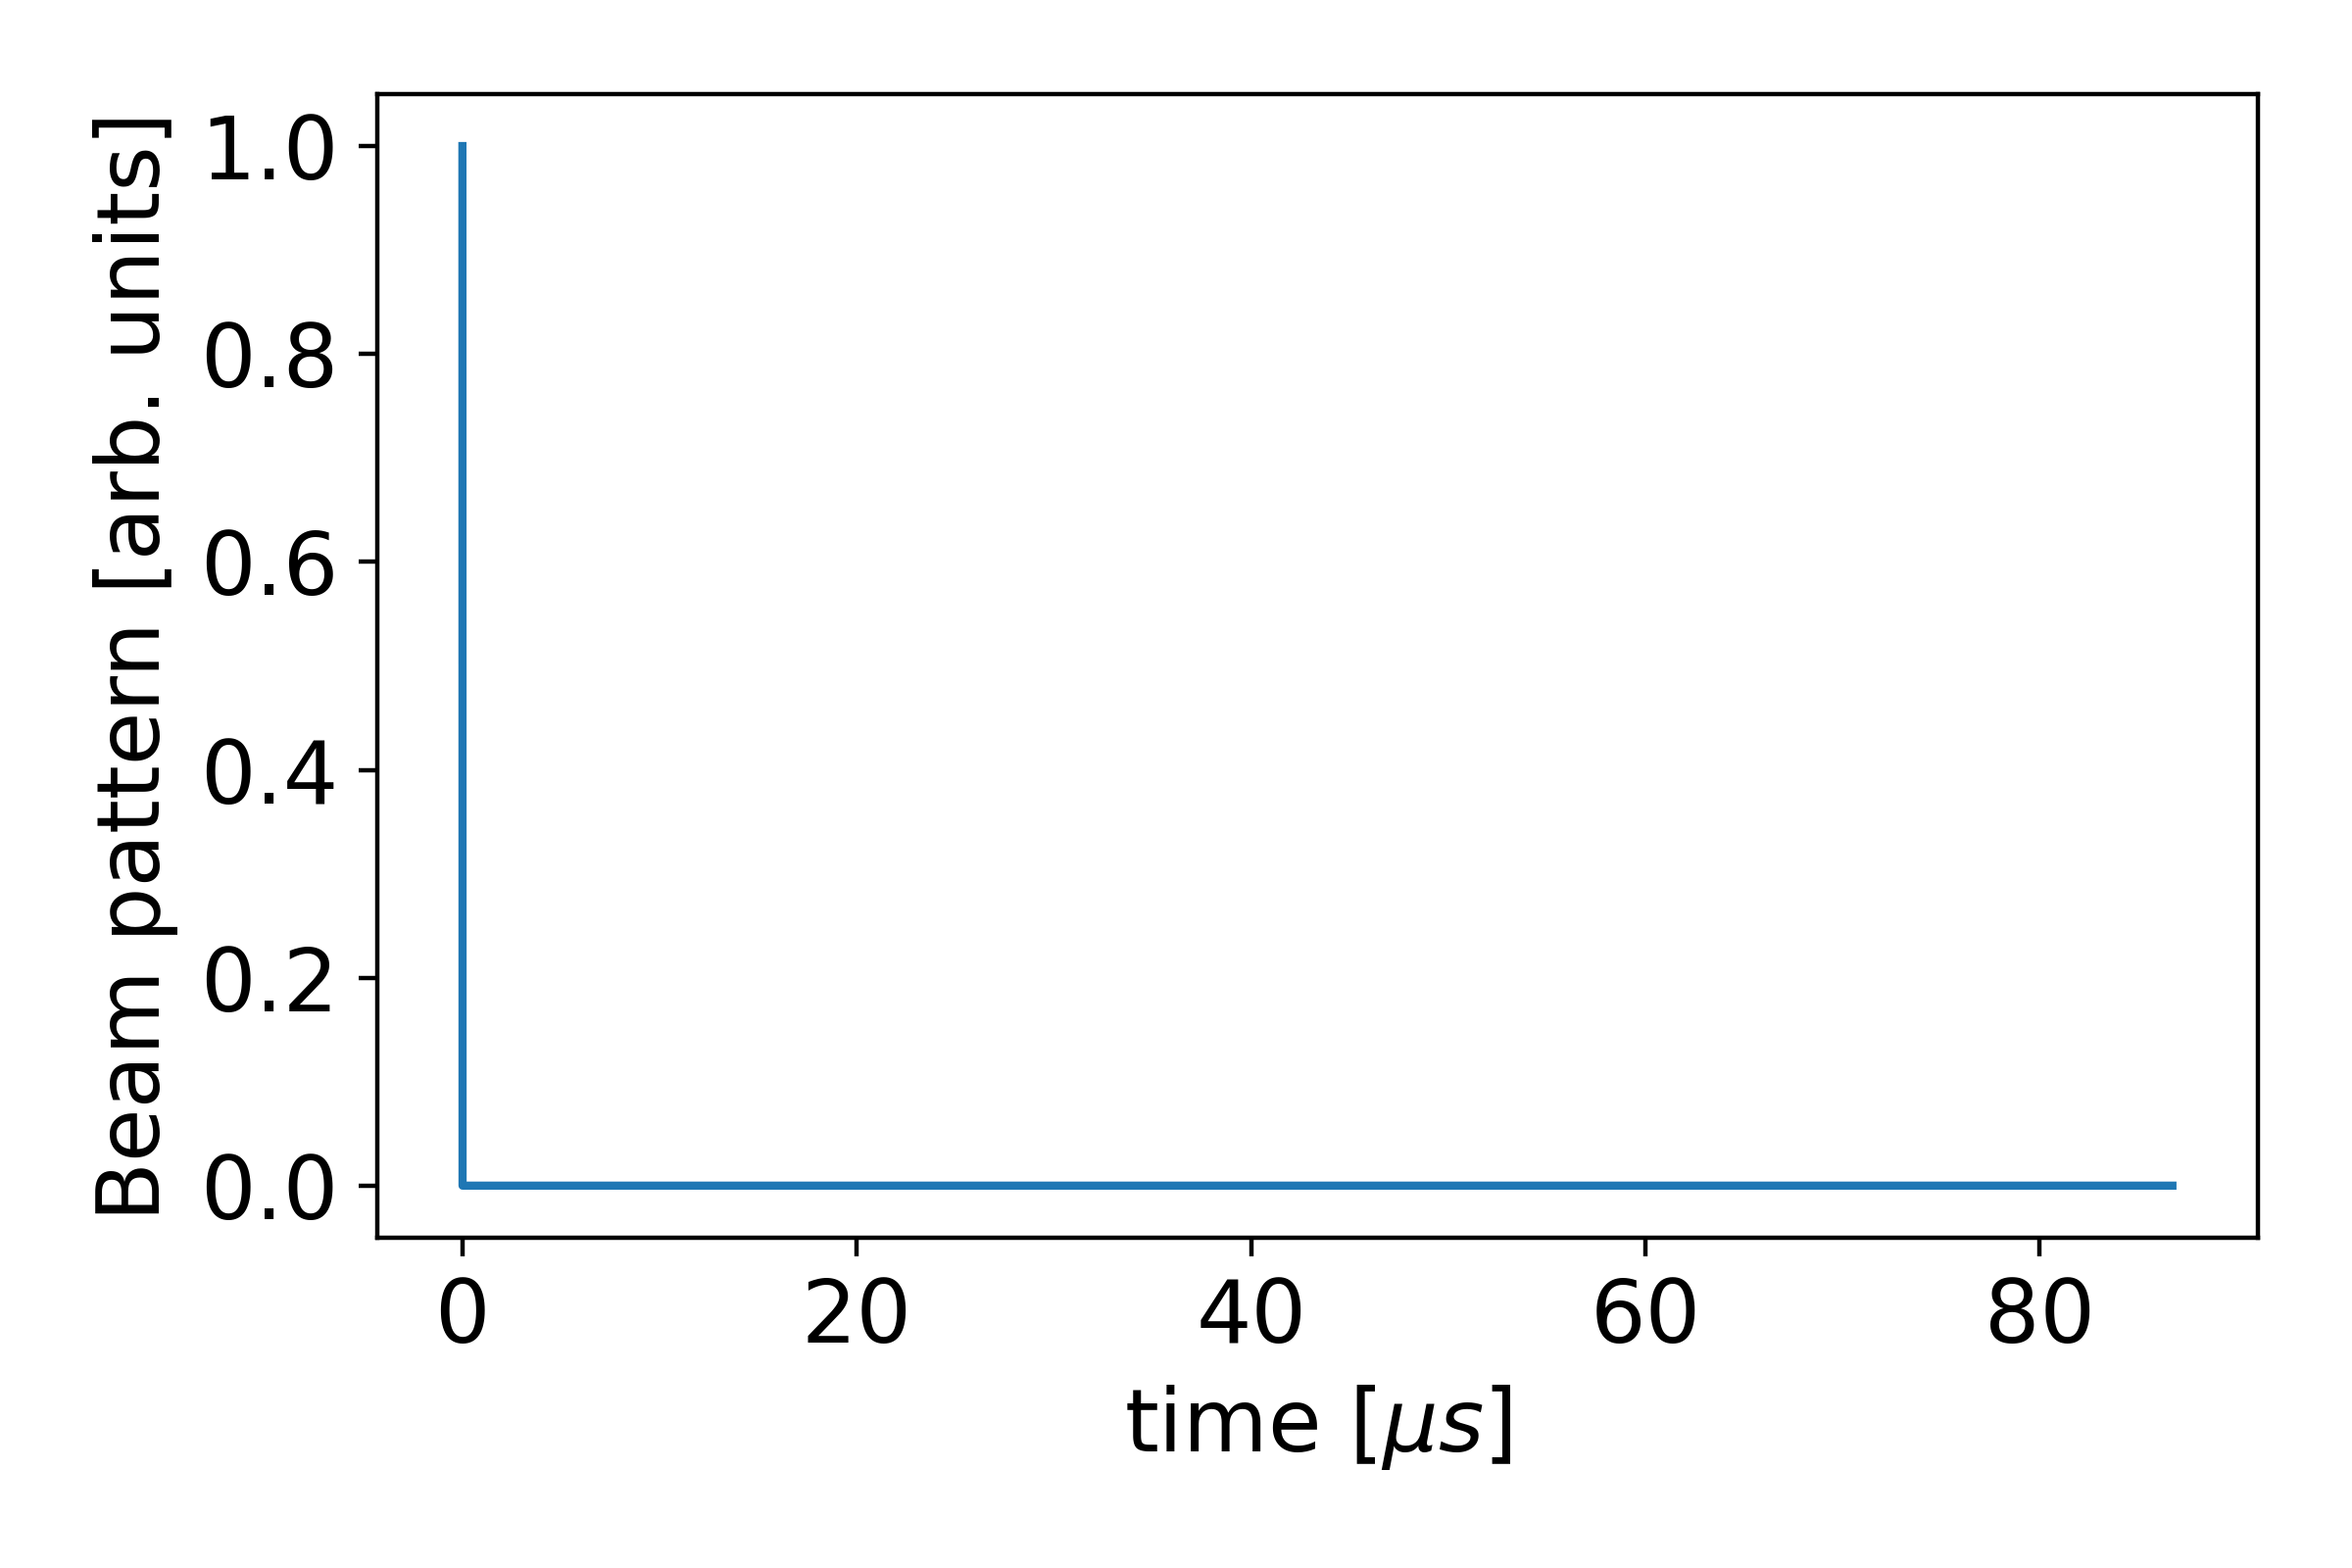
Transient beam loading in the Muon Collider
In the Muon Collider, the entire beam charge is concentrated in 2 bunches, leaving the rest of the ring empty.
  The ratio between maximum beam current and average beam current is high.
  Transient beam loading will impact the voltage noticeably.
If the counter-rotating beam then encounters a lower voltage, the energy gain will be smaller, resulting in a lower muon transmission.
← LHC-like bunch pattern
MuCol bunch pattern →

Slide 5
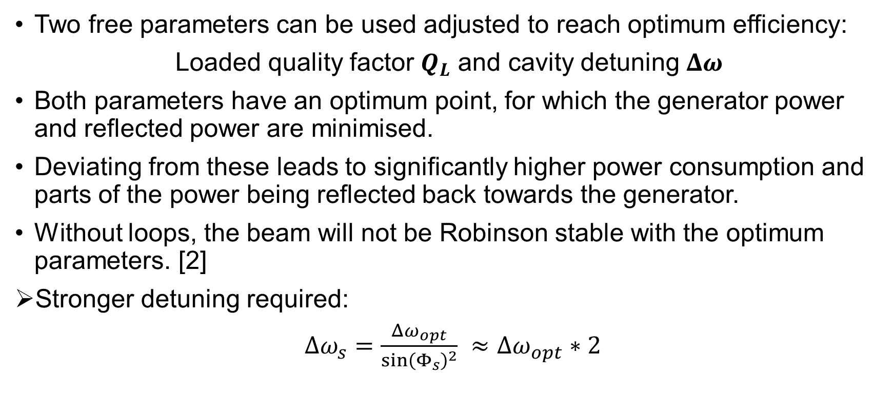
Beam loading compensation
Two free parameters can be used adjusted to reach optimum efficiency:
Loaded quality factor $Q_{L}$ and cavity detuning $Δω$
Both parameters have an optimum point, for which the generator power and reflected power are minimised.
Deviating from these leads to significantly higher power consumption and parts of the power being reflected back towards the generator.
Without loops, the beam will not be Robinson stable with the optimum parameters. [2]
Stronger detuning required:
$Δω_{s}=\frac{Δω_{opt}}{\sin{{\left(Φ_{s}\right)}^{2}}} ≈Δω_{opt}∗2$

Slide 6
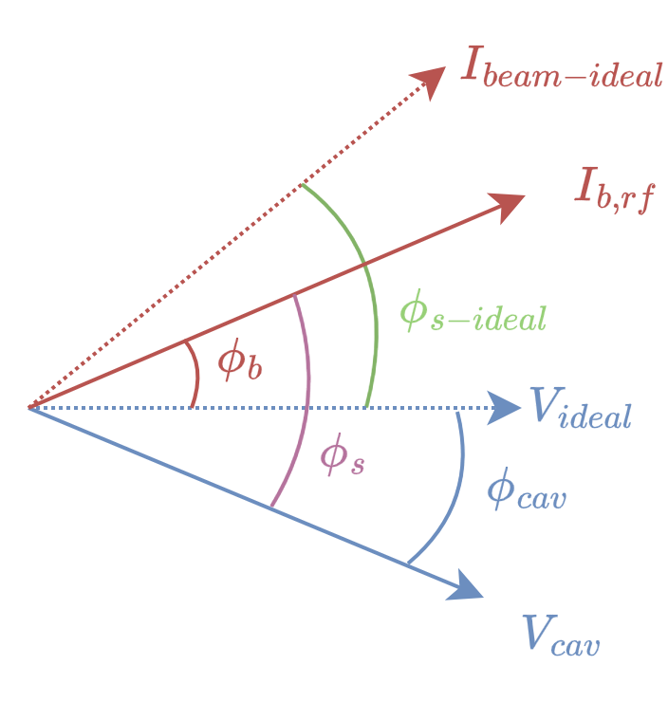
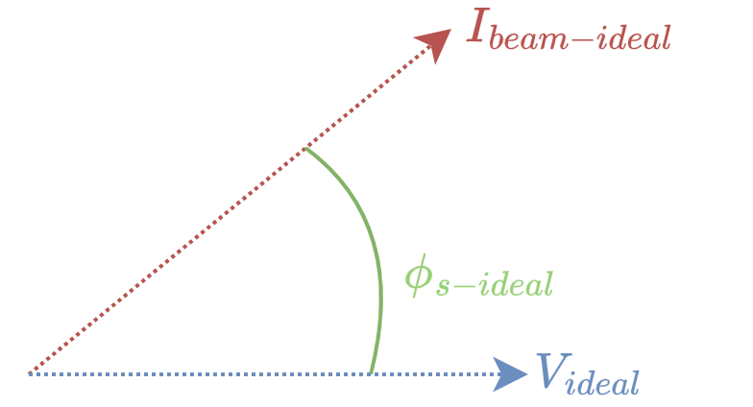
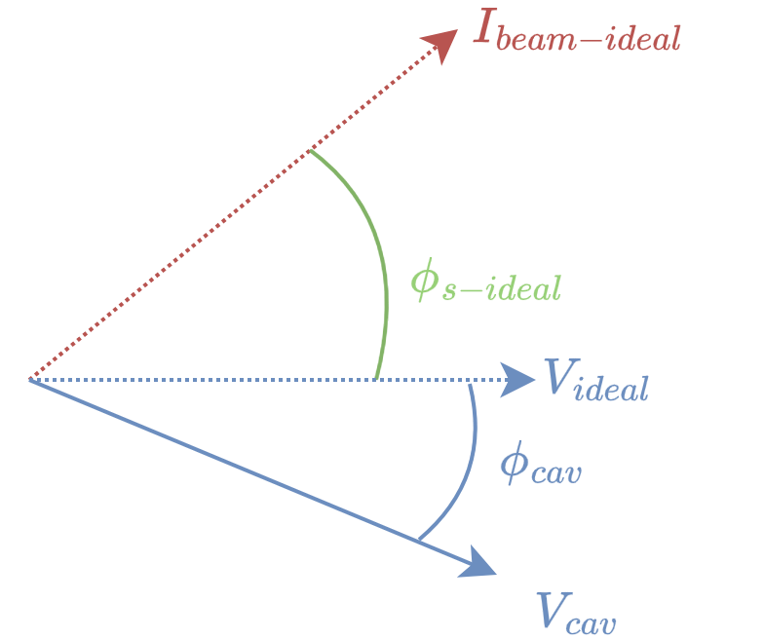
Assumptions to simulate transient beam loading
Due to the short acceleration time, the cavity voltage and cavity phase are allowed to be altered by the beam without a controller loop present.
The phase at which the beam passes to get the desired energy gain will, therefore, also change.
The generator current is assumed to be constant.

Slide 7
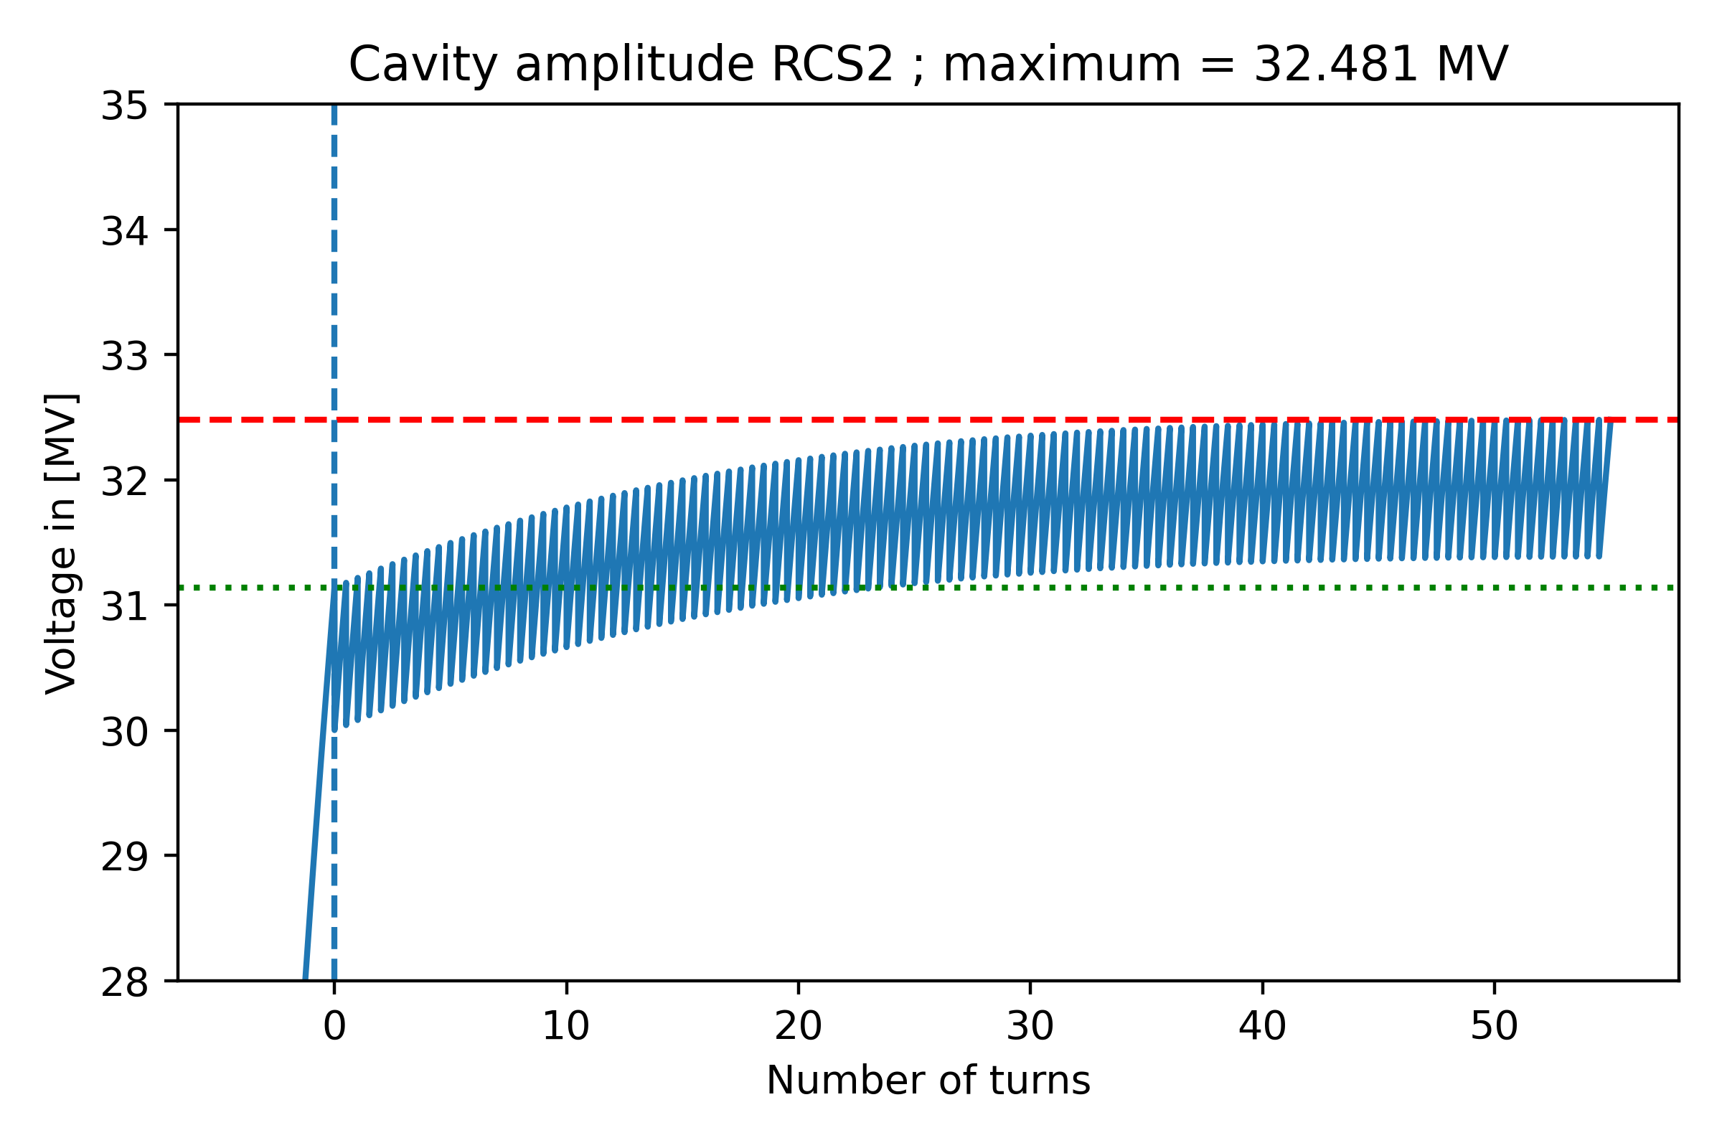
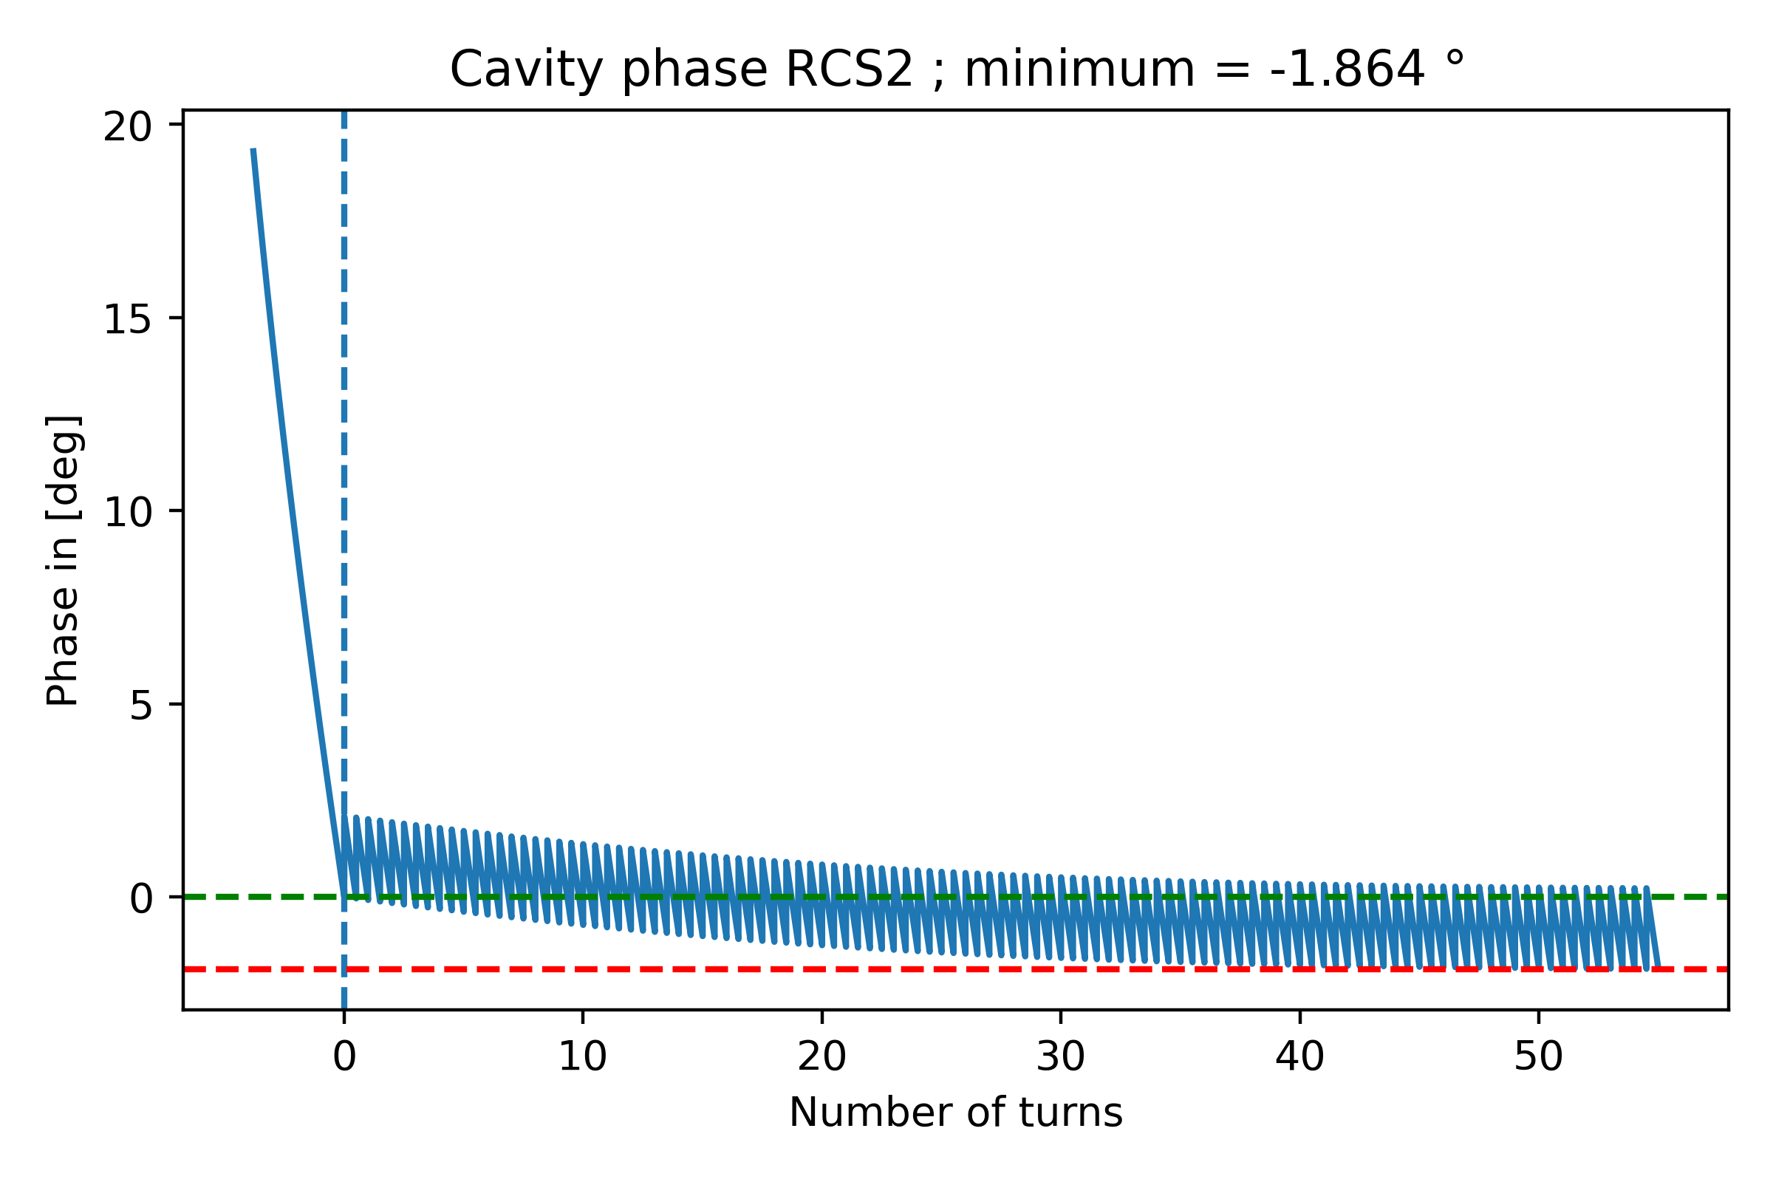
Cavity voltage amplitude/phase modulation during the acceleration
All plots with stronger detuning and optimal loaded quality factor $Q_{L}$.
Implementation follows the description in [2] I. Karpov, “Transient beam loading and rf power evaluation for future circular colliders”

Slide 8
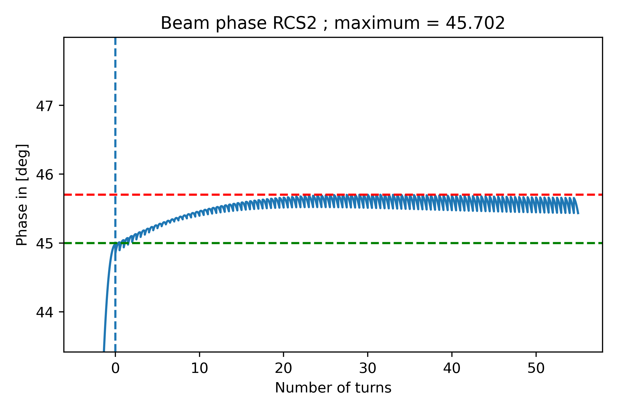
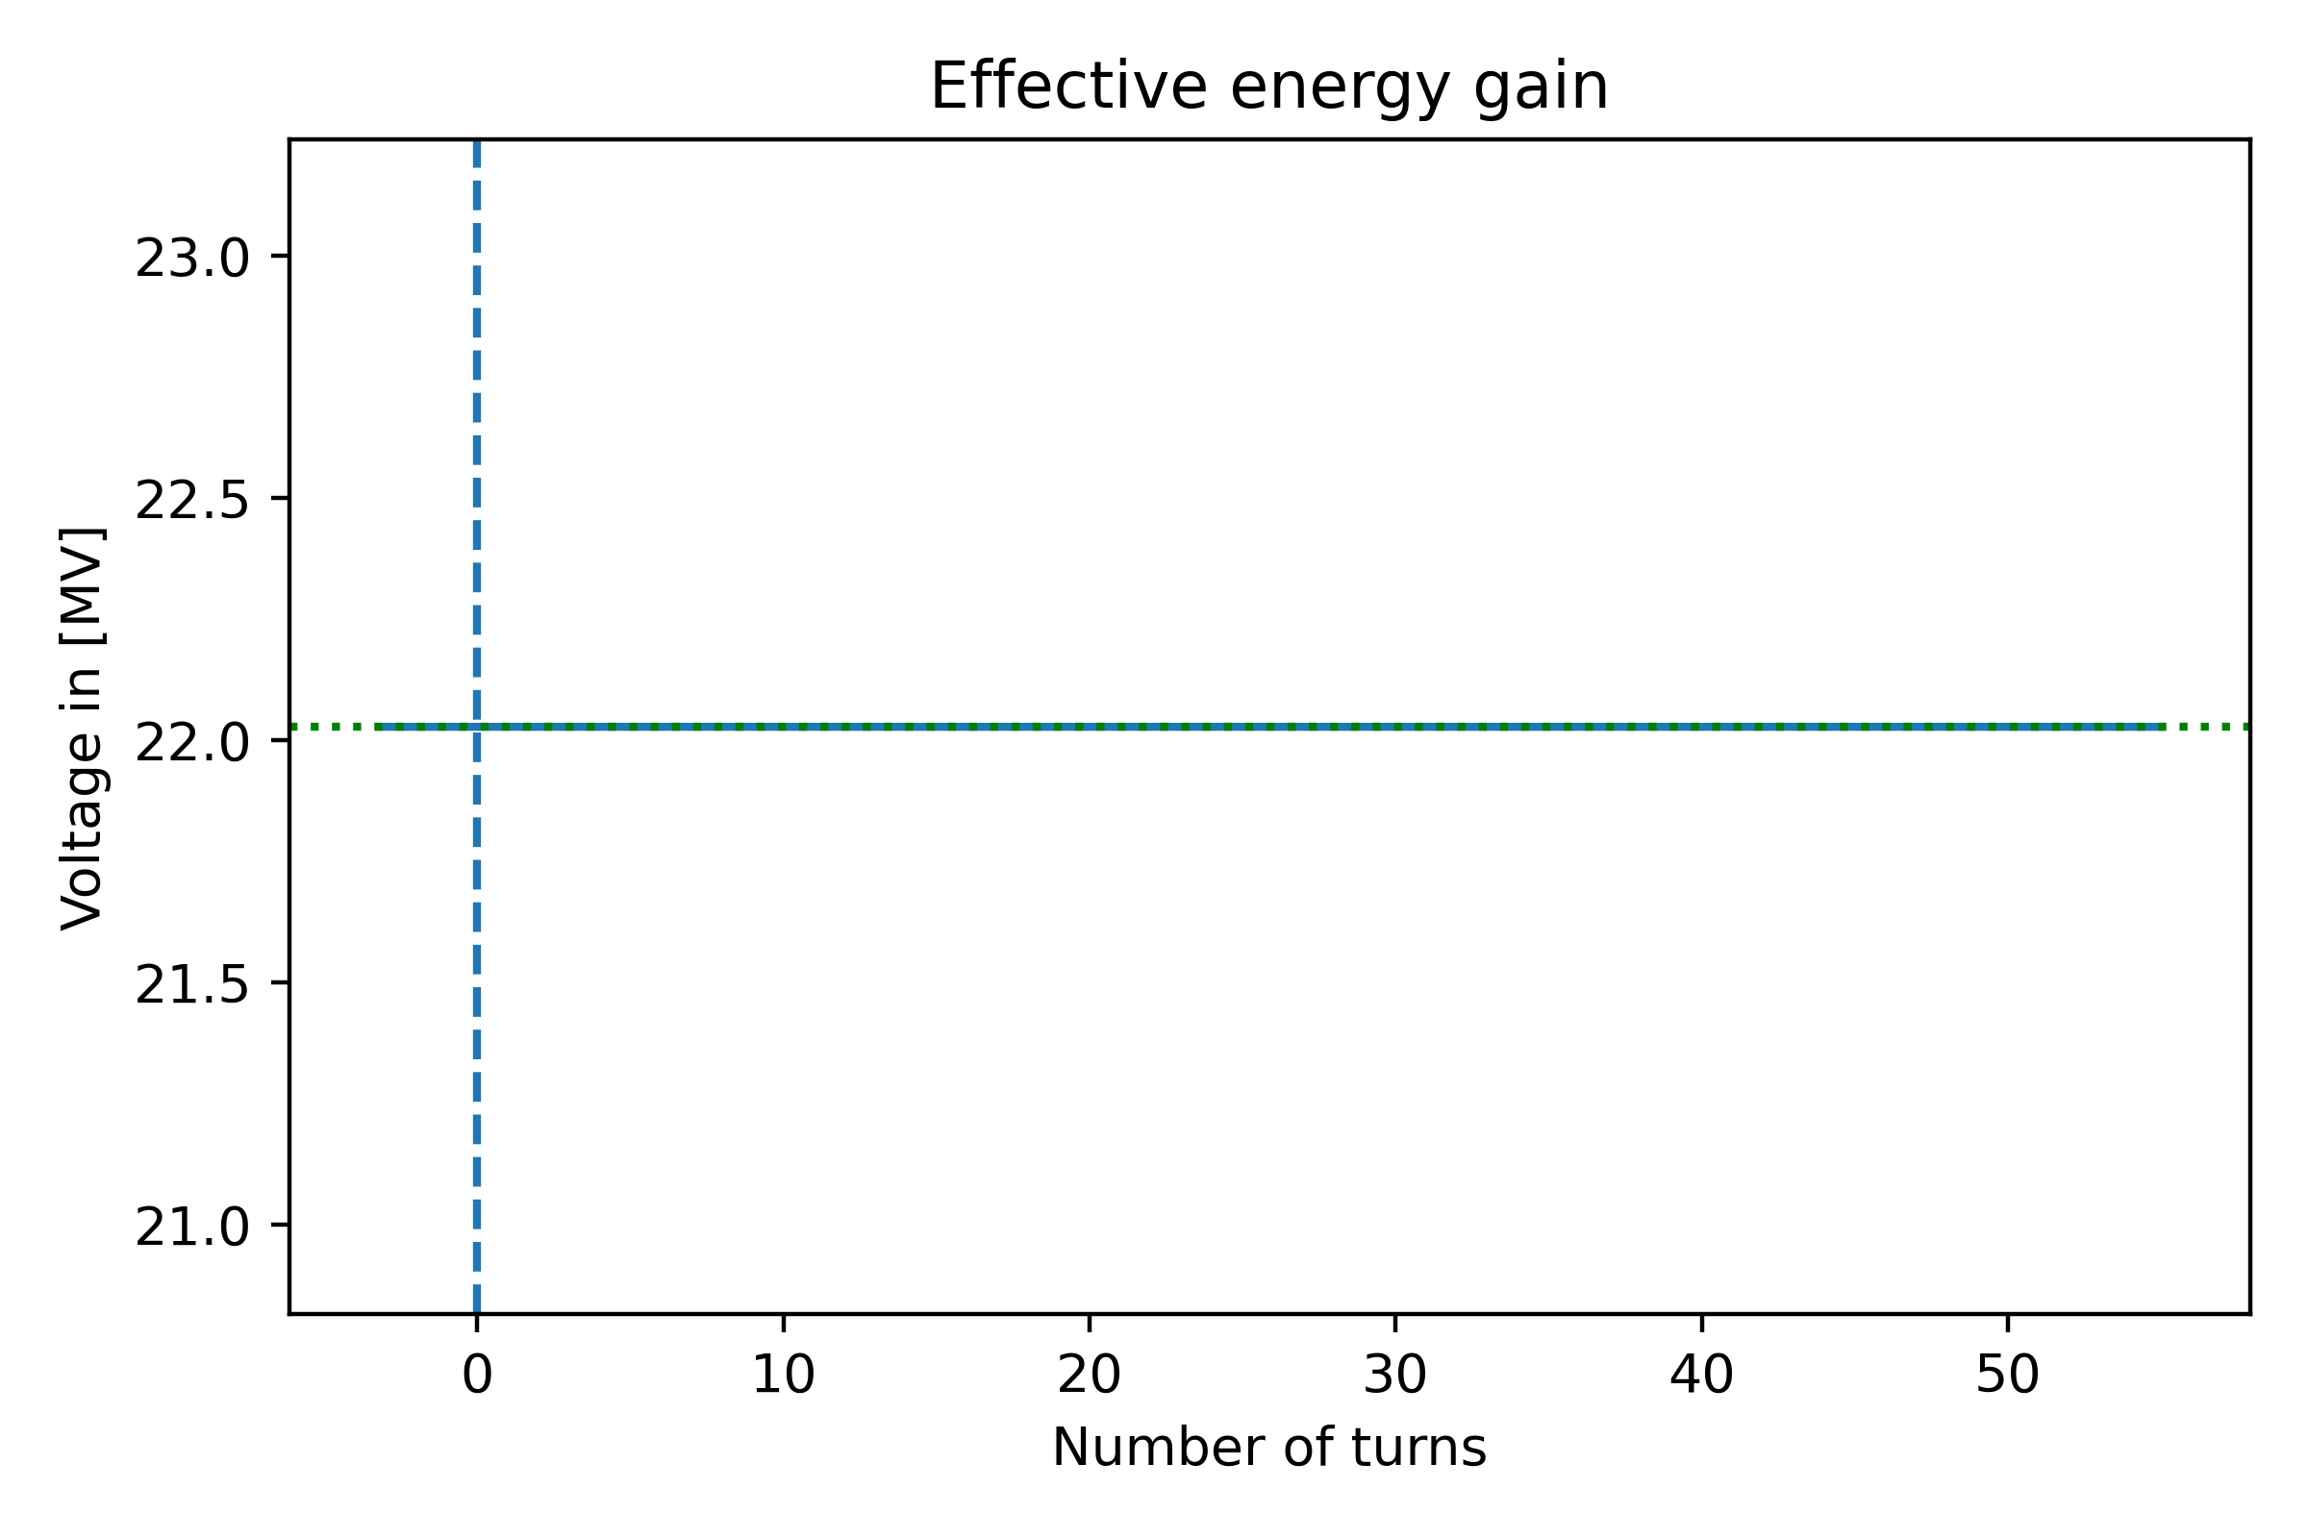

Beam phase modulation during the acceleration
Beam phase is given in electron machine convention
Phase is modulated, to get the correct energy gain, considering the change in cavity phase and voltage.

Slide 9
RF parameters in the high-energy chain
Cavity powering “stable” detuning
 | Unit | RCS1 | RCS2 | RCS3 | RCS4
Duty factor | [%] | 0.21 | 0.59 | 1.26 | 3.52
Optimum cavity detuning | [kHz] | -0.64 | -0.58 | -0.3 | -0.08
Stable cavity detuning | [kHz] | -1.29 | -1.16 | -0.59 | -0.16
FPC peak power | [kW] | 954 | 860 | 435 | 120
FPC peak power | [kW] | 1191 | 1072 | 543 | 151
Average wall plug power (incl. klystron eff.) | [MW] | 2.7 | 3.7 | 6 | 25
Average wall plug power (incl. klystron eff.) | [MW] | 3.3 | 4.7 | 7.2 | 31
Number of klystrons | - | 96 | 45 | 31 | 47
Number of klystrons | - | 112 | 52 | 40 | 58
Parameters with optimum detuning
Parameters with stronger detuning

Slide 10
Summary
Usage of non-optimal cavity detuning leads to higher power consumption.
The phase at which the beam sees the correct voltage changes during the acceleration.
The transient beam loading simulation shows that the cavity voltage reaches its equilibrium above the current baseline of 30 MV/m.
  This indicates, that a higher surface field would be present during the acceleration.
  Try to adjust RCS parameters in order to change the equilibrium voltage.

Slide 11
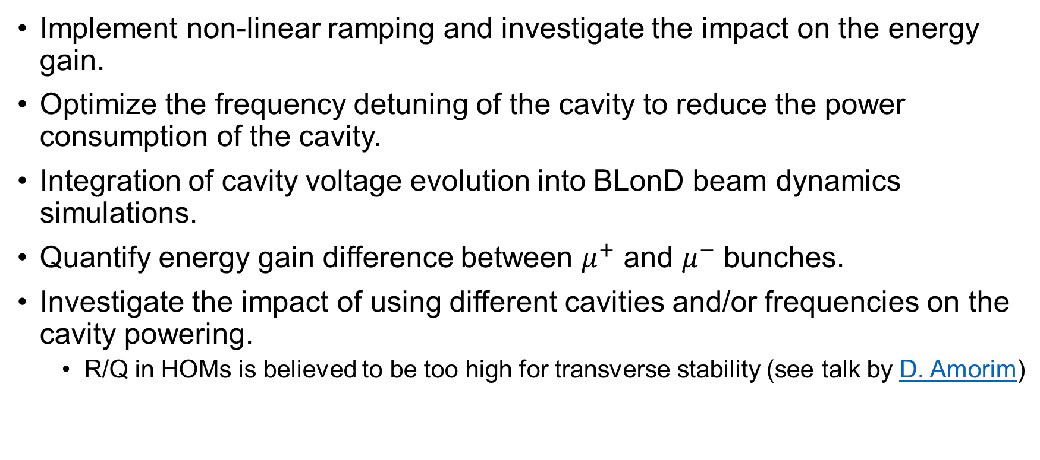
Outlook
Implement non-linear ramping and investigate the impact on the energy gain.
Optimize the frequency detuning of the cavity to reduce the power consumption of the cavity.
Integration of cavity voltage evolution into BLonD beam dynamics simulations.
Quantify energy gain difference between $μ^{+}$ and $μ^{−}$ bunches.
Investigate the impact of using different cavities and/or frequencies on the cavity powering.
  R/Q in HOMs is believed to be too high for transverse stability (see talk by D. Amorim)

Slide 13
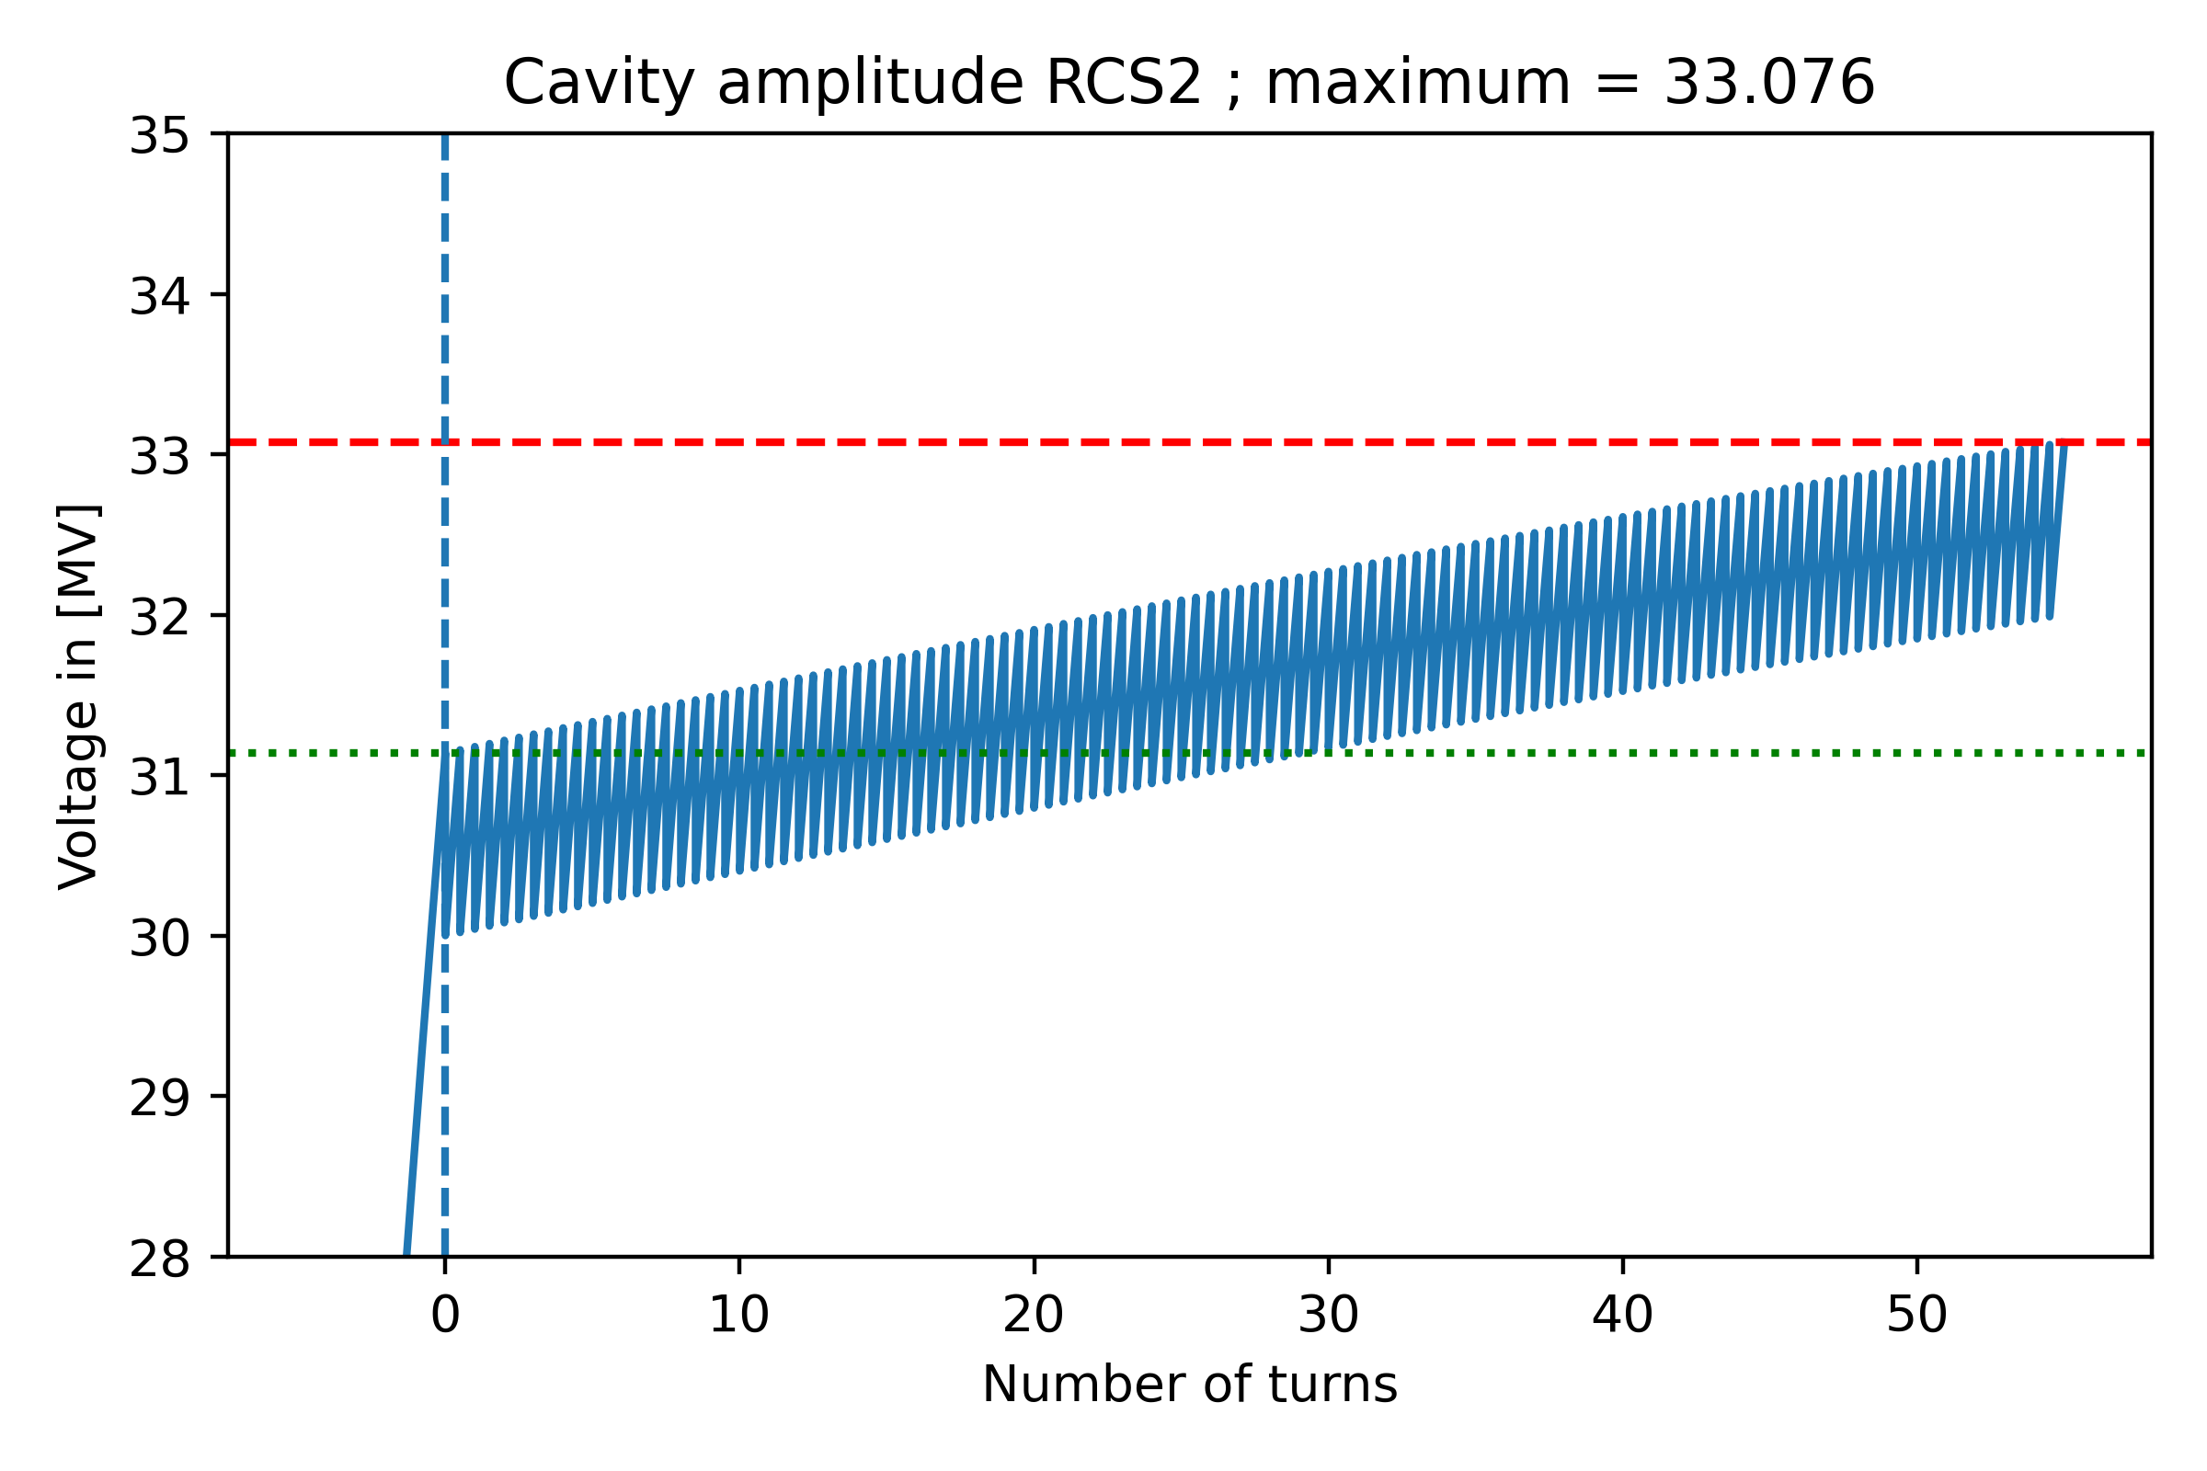
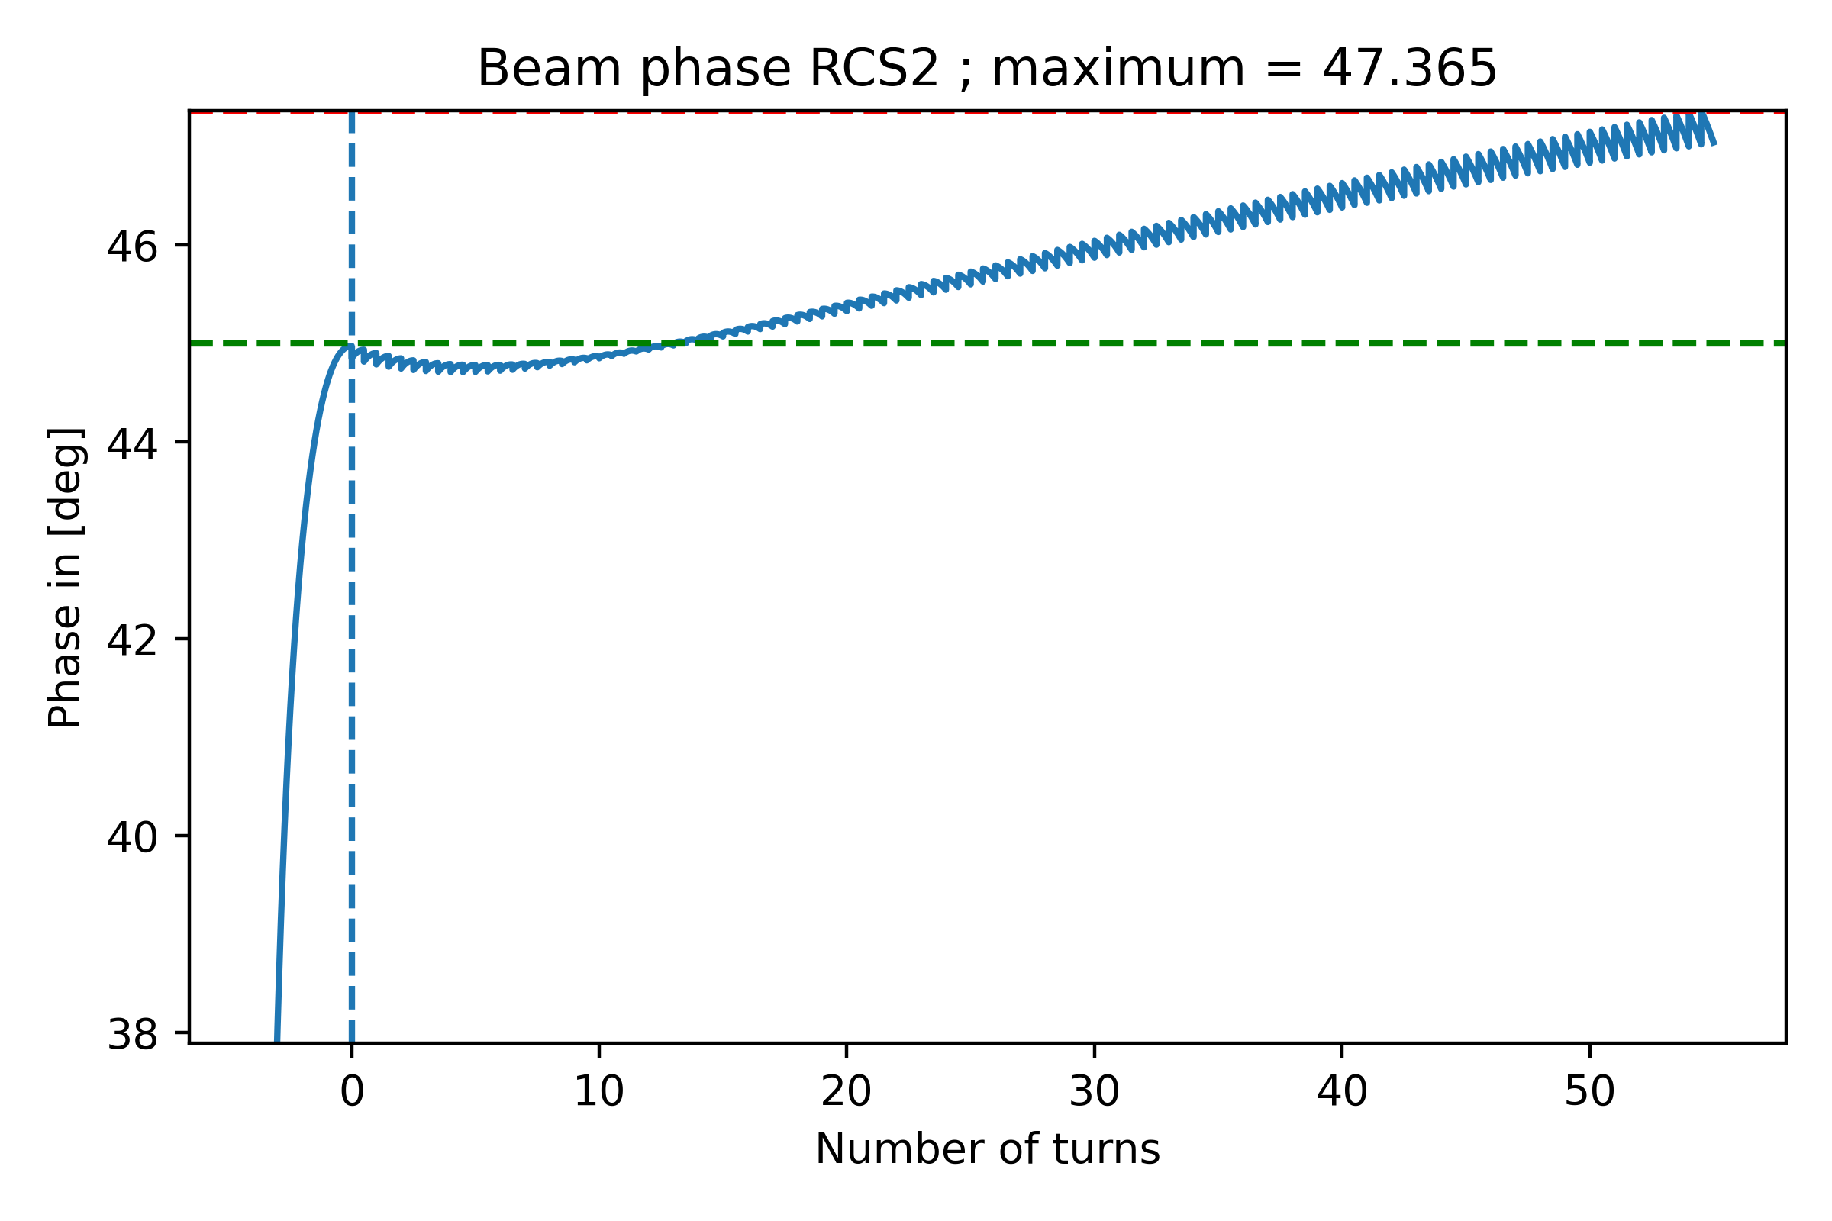
Cavity voltage with optimal detuning
Cavity amplitude is continuously rising, not reaching equilibrium within the simulation time
Acceleration is not stable in this regime

Slide 14
RF parameters in the high-energy chain
Cavity powering “stable” detuning
 | Unit | RCS1 | RCS2 | RCS3 | RCS4
Beam acceleration time | [ms] | 0.34 | 1.10 | 2.36 | 6.42
Cavity filling time | [ms] | 0.25 | 0.27 | 0.54 | 1.94
RF pulse length | [ms] | 0.59 | 1.37 | 2.90 | 8.36
Duty factor | [%] | 0.21 | 0.59 | 1.26 | 3.52
Cavity detuning | [kHz] | -1.294 | -1.164 | -0.590 | -0.164
FPC peak power | [kW] | 1191 | 1072 | 543 | 151
Total peak RF power (incl. power distribution losses) | [MW] | 1630 | 794 | 575 | 891
Average wall plug power (incl. klystron eff.) | [MW] | 3.3 | 4.7 | 7.2 | 31
Number of klystrons | - | 112 | 52 | 40 | 58
Cavities per klystron | - | 6 | 7 | 13 | 50

Slide 15
RF parameters in the high-energy chain
Cavity powering – optimum detuning
 | Unit | RCS1 | RCS2 | RCS3 | RCS4
Beam acceleration time | [ms] | 0.34 | 1.10 | 2.36 | 6.42
Cavity filling time | [ms] | 0.25 | 0.27 | 0.54 | 1.94
RF pulse length | [ms] | 0.59 | 1.37 | 2.90 | 8.36
Duty factor | [%] | 0.21 | 0.59 | 1.26 | 3.52
Cavity detuning | [kHz] | -0.64 | -0.58 | -0.3 | -0.082
FPC peak power | [kW] | 954 | 860 | 435 | 120
Total peak RF power (incl. power distribution losses) | [MW] | 1304 | 629 | 466 | 717
Average wall plug power (incl. klystron eff.) | [MW] | 2.7 | 3.7 | 6 | 25
Number of klystrons | - | 96 | 45 | 31 | 47
Cavities per klystron | - | 7 | 8 | 17 | 62

Slide 16
References
[1]: Cavity-Beam-Transmitter Interaction Formula Collection with Derivation: http://cds.cern.ch/record/1323893/files/CERN-ATS-Note-2011-002%20TECH.pdf
[2]: I. Karpov, Transient beam loading and rf power evaluation for future circular colliders https://journals.aps.org/prab/abstract/10.1103/PhysRevAccelBeams.22.081002

