Slide 1
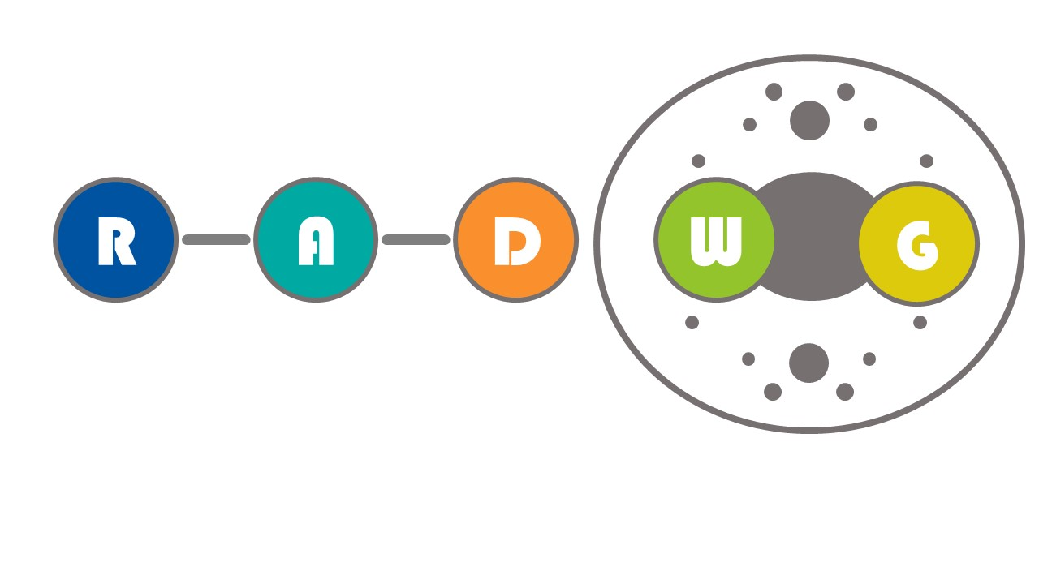
RADWG Meeting February 2024
Salvatore Danzeca BE-CEM-EPR
Manoel Barros Marin SY-BI-BP
on behalf of the RADWG

Slide 2
AGENDA
Introduction
BE-CEM-EPR Radiation Test Service: Status, Activities, Results & Planning by Rudy Ferraro
CHARM Facility Status by Salvatore Fiore
Radiation Tolerant Wireless Solutions: Current status and future perspective by Salvatore Danzeca
Potential radiation-tolerant candidates among commercial SFPs/QSFPs by Manoel Barros Marin

Slide 3
CTTB and CTSB request to the RADWG
Goal: Show the actual status of the radiation tolerant productions for LS3
Goal: Show the current and future possibilities of radiation tolerant wireless networks

Slide 4
THANK YOU

