Slide 1
CHARM user planning 2024
Salvatore Fiore
BE-CEM-EPR

Slide 2
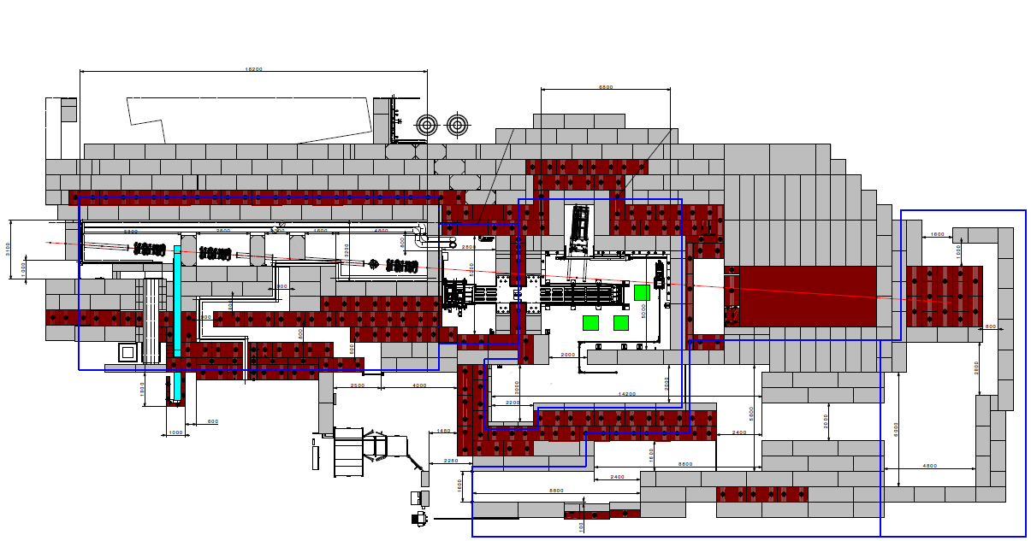
East Area Irradiation Facilites
  Primary beam line from PS (T08): 24 GeV/c proton beam
  CHARM irradiation area is placed downstream to IRRAD on the T8 line
PS p+
24 GeV/c
~400ms spill
DUMP
IRRAD
ENTRANCE
CHARM

Slide 3
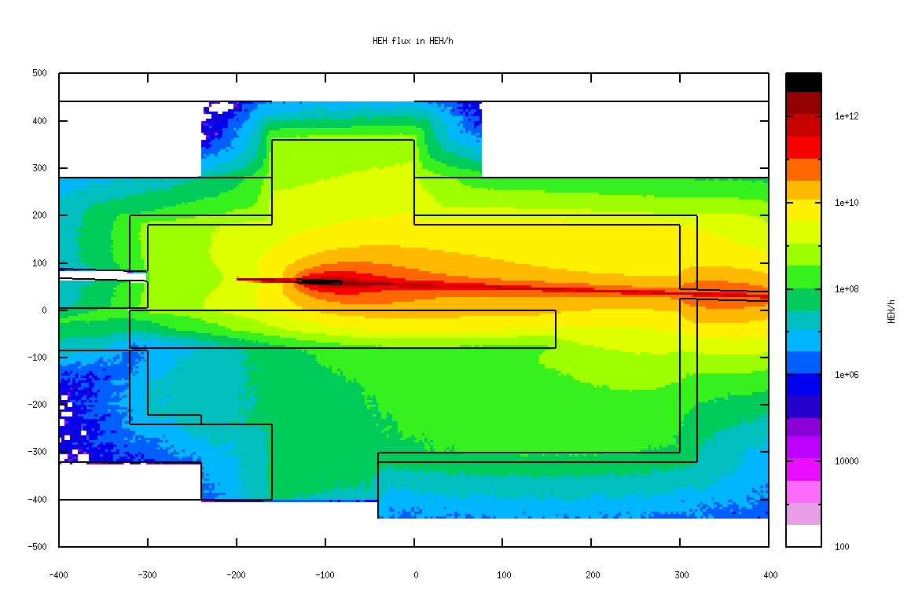
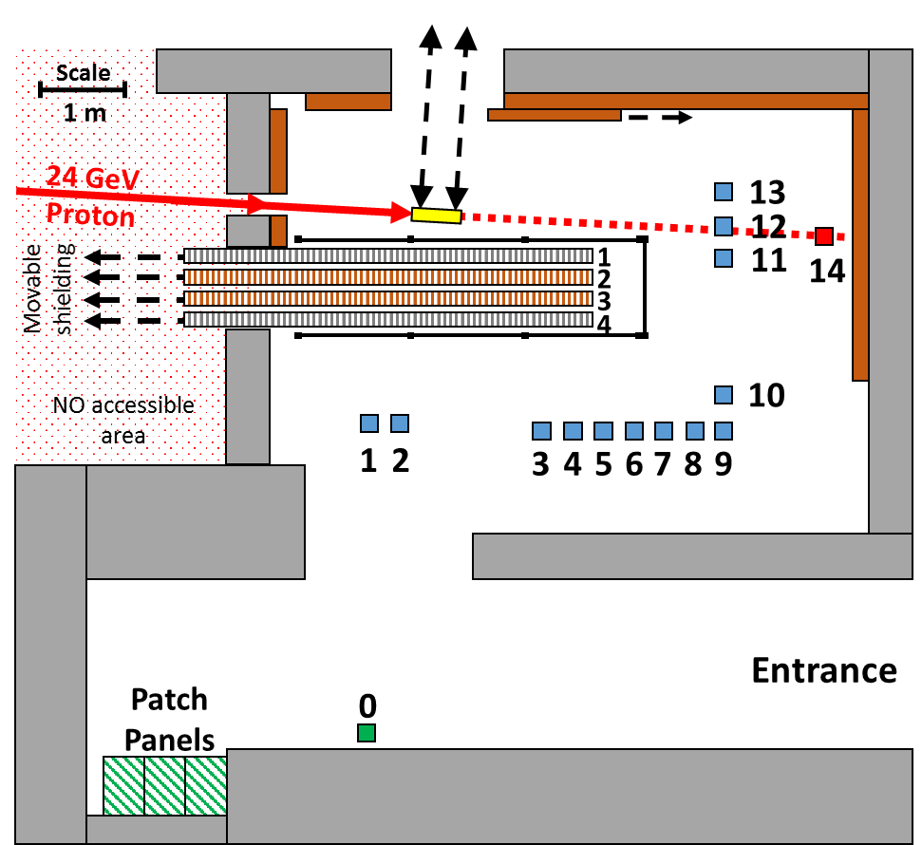
Irradiation Room
PRIMARY PROTONS IMPINGE THE TARGET: A SECONDARY RADIATION FIELD IS CREATED
3 KEY ELEMENTS:
Target
Movable Shielding
Positions
Target
Concrete
5mt
Iron
6mt
Conveyer
Montrac

Slide 4
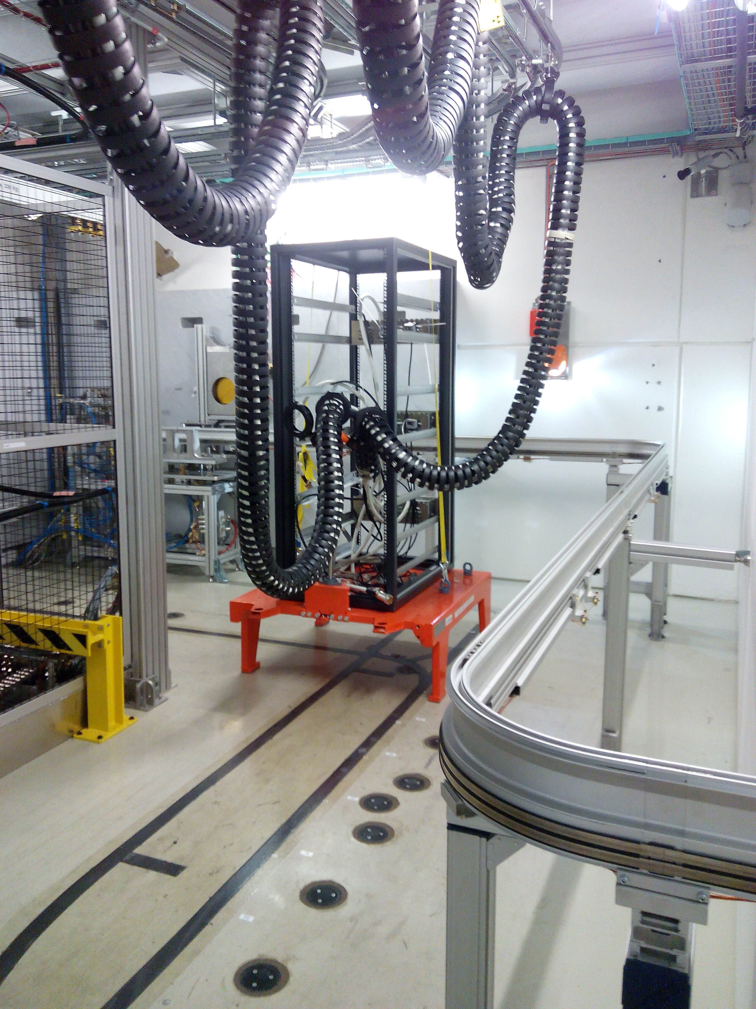
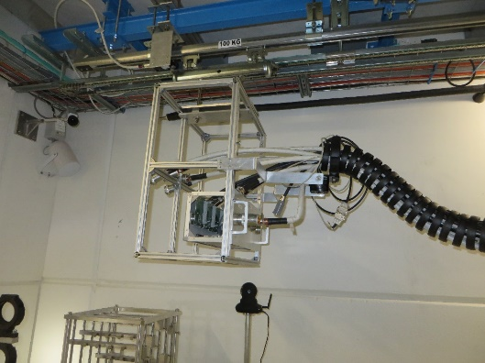
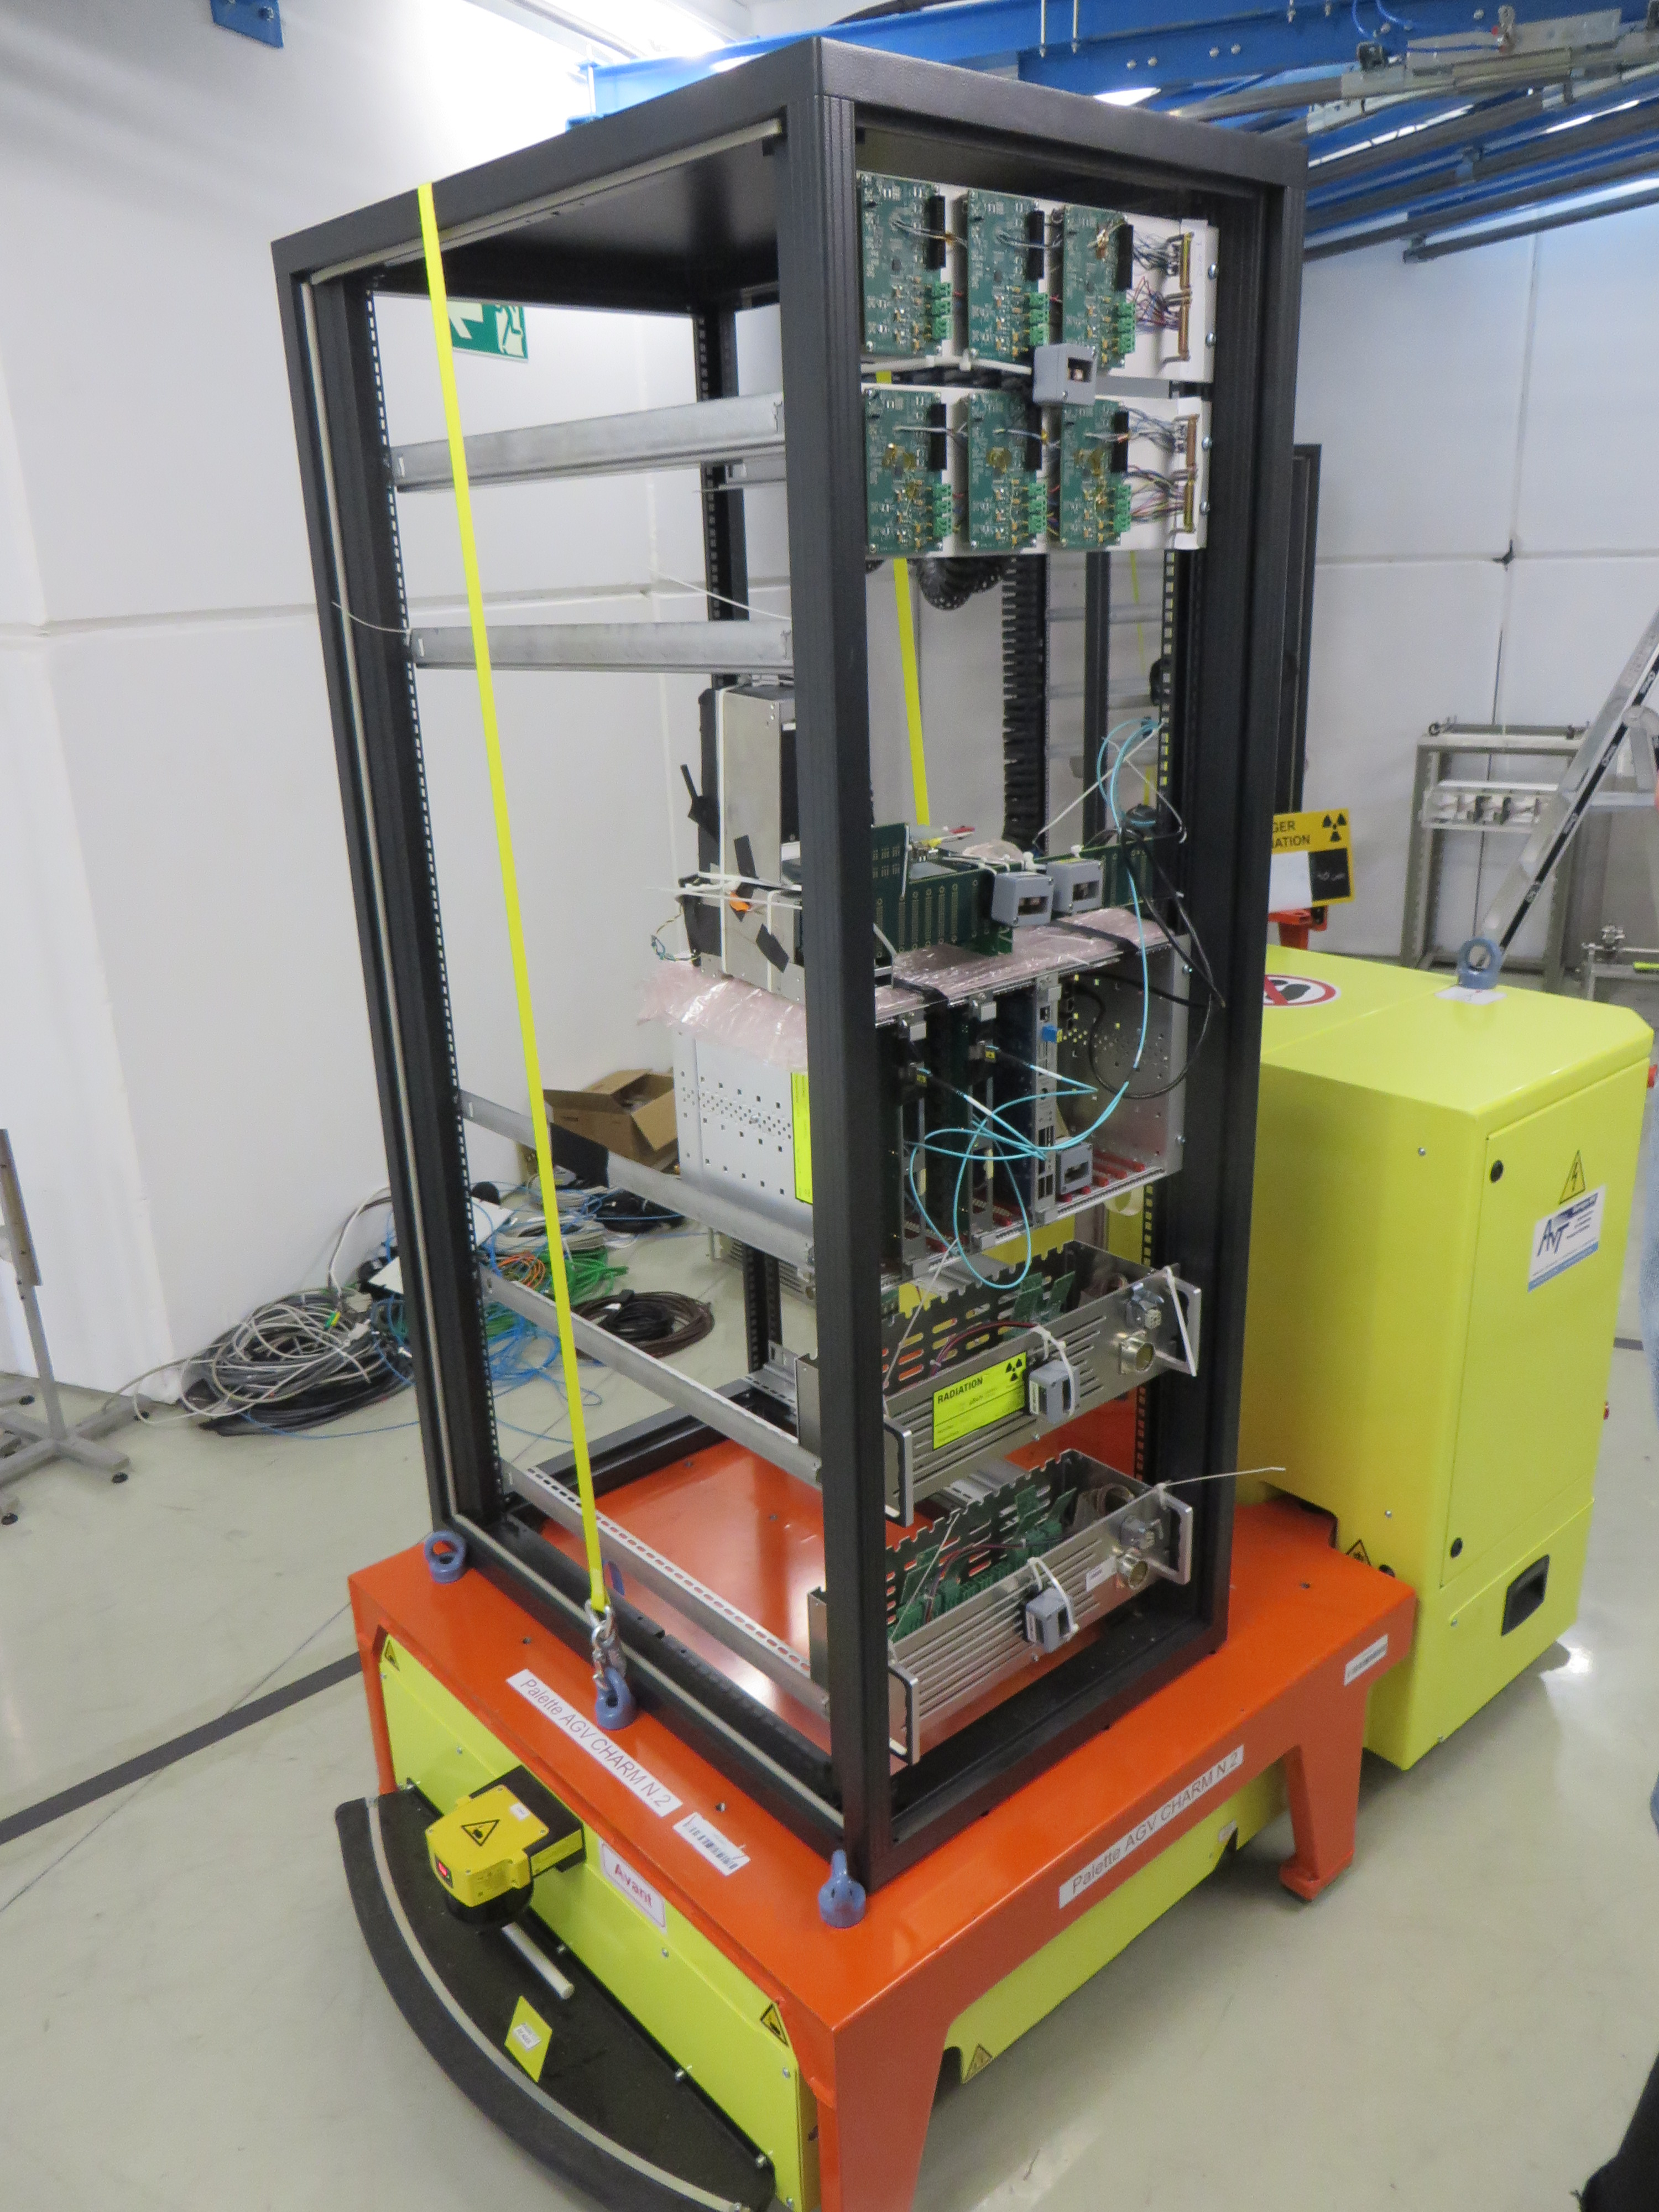
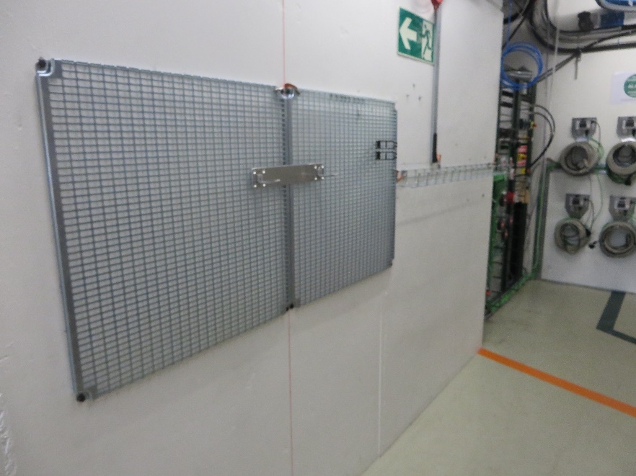
Irradiation Room
OVERHEAD
RACK
RACK
G0

Slide 5
Users and reference radiation levels per week
In CHARM we can host several users in parallel testing:
The CHARM rack can host up to 2 users
  Up to 500 Gy, 1.8E12 HEH/cm², 3E12 1-MEVeq n /cm², 5E11 Th n /cm² , per week
G0 (grillage close to partch panel) up to 3 users depending on size
  Up to 25 Gy, 7E11 HEH/cm², 2E12 1-MEVeq n /cm², 5E11 Th n /cm² , per week
Overhead up to 1 user
  Up to 100 Gy, 1E12 HEH/cm², 1.5E12 1-MEVeq n /cm², 5E11 Th n /cm² , per week

Slide 6
Operations: Planning and constraints
Constraints:
  Safety/RP : Reduce at maximum the exposure of users and operators to ionizing radiation
  Organize the accesses to reduce at maximum the overhead
  Deliver the radiation levels requested by the users + environment fitting
Operational constraints
  Upstream IRRAD facility operations follow-up
  CHIMERA/HEARTS (EU Project) → ions in the last 2 weeks of PS EA beam
  RP WEEK
  No more than 2 users in the test rack + EPR activities (dosimetry and testing)
  Additional users in G0 or Overhead, not on the rack

Slide 7
Weekly Ops
  CHARM irradiation time is divided in Slots: 1 Slot is one week
  Access is ONLY on Wednesday: profiting of the PS MD
  CHARM Target is removed from the beam in accordance with RP recommendation: 24 hours before the access.
  The preparation room allows users to test in advance their setup
    Wednesday -> One-shot installation -> If the setup is not working the user won’t test
  Users are requested to test their equipment in the preparation room one week in advance wrt to their installation

Slide 8
Protons to PS EA and CHARM
Relevant dates:
March 18: protons to EA
June 12-15 Injectors Technical Stop
October 14/16 end of protons to EA

Slide 9
CHARM calendar for 2024
Starting from 2024 we adopt the standard week numbering:
A test scheduled for Wxx is foreseen to start on Wednesday of Wxx
Dry run starts on Wednesday W(xx-1)
The first user week is W14
The last user week is W41
W24 is Injectors TS
W38 is dedicated to RP

Slide 10
2024 schedule booking
36 test requests so far, with different radiation level goals, through the web-form (still incoming requests)
First calendar version is ready, users being asked for confirmation
45/52 rack slots already filled
86% occupancy
EPR tests for Radiation Test
Service not included: several
test per week

Slide 11
Current CHARM occupancy, as of today
week # | 14 | 15 | 16 | 17 | 18 | 19 | 20 | 21 | 22 | 23 | 24 | 25 | 26 | 27
from Wednesday | 03-Apr | 10-Apr | 17-Apr | 24-Apr | 01-May | 08-May | 15-May | 22-May | 29-May | 05-Jun | 12-Jun | 19-Jun | 26-Jun | 03-Jul
to Tuesday | 09-Apr | 16-Apr | 23-Apr | 30-Apr | 07-May | 14-May | 21-May | 28-May | 04-Jun | 11-Jun | 18-Jun | 25-Jun | 02-Jul | 09-Jul
Rack | full | full | half | full | full | full | full | full | full | full | ITS | full | full | full
G0 | full | full | full | free | half | free | free | half | half | half | ITS | free | free | free
week # | 28 | 29 | 30 | 31 | 32 | 33 | 34 | 35 | 36 | 37 | 38 | 39 | 40 | 41
from Wednesday | 10-Jul | 17-Jul | 24-Jul | 31-Jul | 07-Aug | 14-Aug | 21-Aug | 28-Aug | 04-Sep | 11-Sep | 18-Sep | 25-Sep | 02-Oct | 09-Oct
to Tuesday | 16-Jul | 23-Jul | 30-Jul | 06-Aug | 13-Aug | 20-Aug | 27-Aug | 03-Sep | 10-Sep | 17-Sep | 24-Sep | 01-Oct | 08-Oct | 15-Oct
Rack | full | full | full | full | full | full | full | half | half | half | RP week | half | half | half
G0 | half | half | half | free | free | free | free | free | free | free | RP week | free | free | free

Slide 12
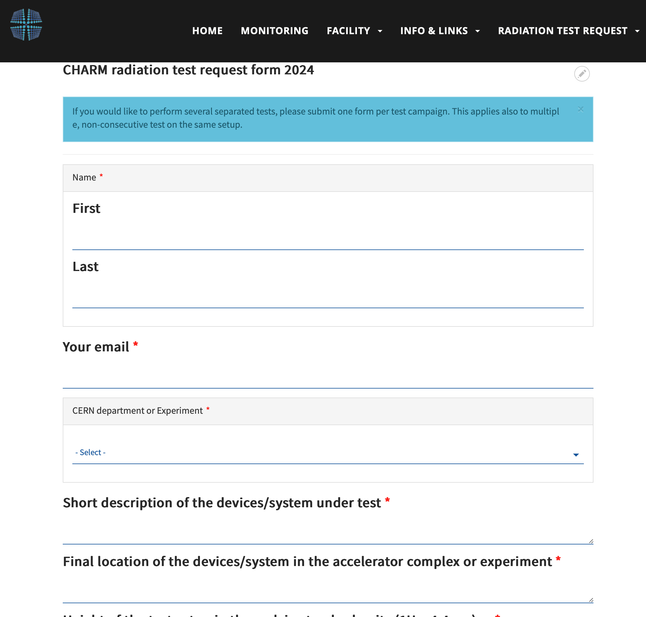
Conclusions
PS EA beam to CHARM for 26 usable weeks
CHARM users calendar for 2024 being finalised
Currently 86% of the rack slots are full. Safety and logistics constraints
All the requests have to be sent through https://cern.ch/charm

Slide 13
Thank you for your attention!

