Slide 1
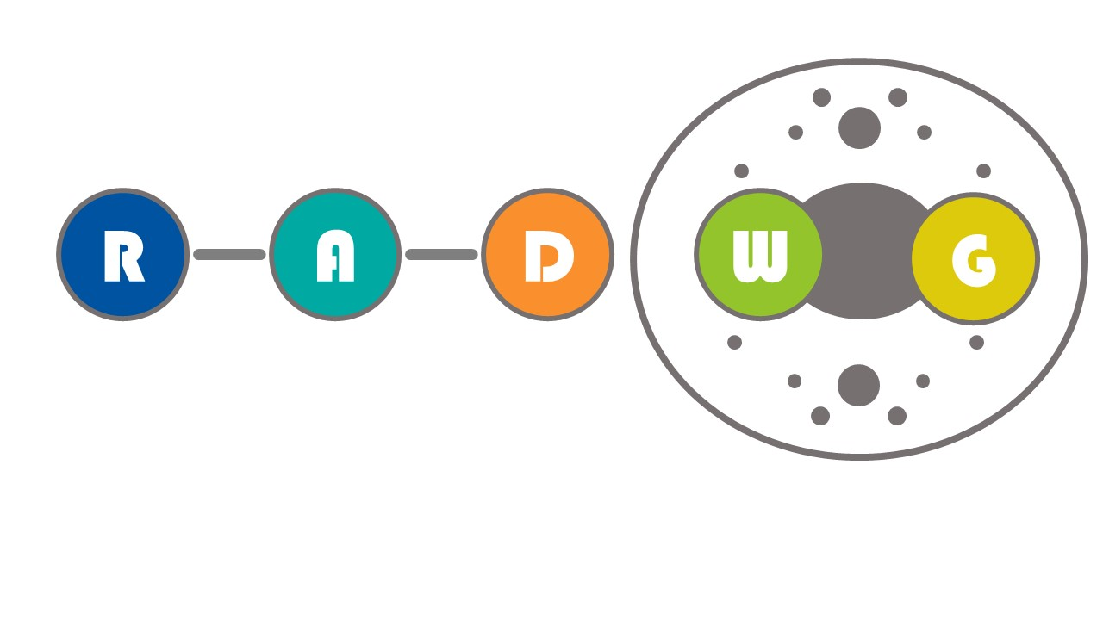
RADWG Workshop
COTS SFP/QSFP radiation test
M. Barros Marin*, A. Boccardi, S. Can Ozdogan, S. Danzeca, R. Ferraro, A. Scialdone

Slide 2
Outline
Introduction
Radiation test
Summary & Outlook

Slide 3
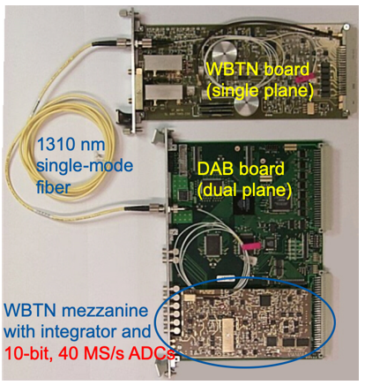
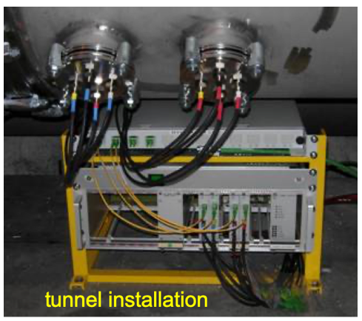
Introduction
Current LHC BPM system

Slide 4
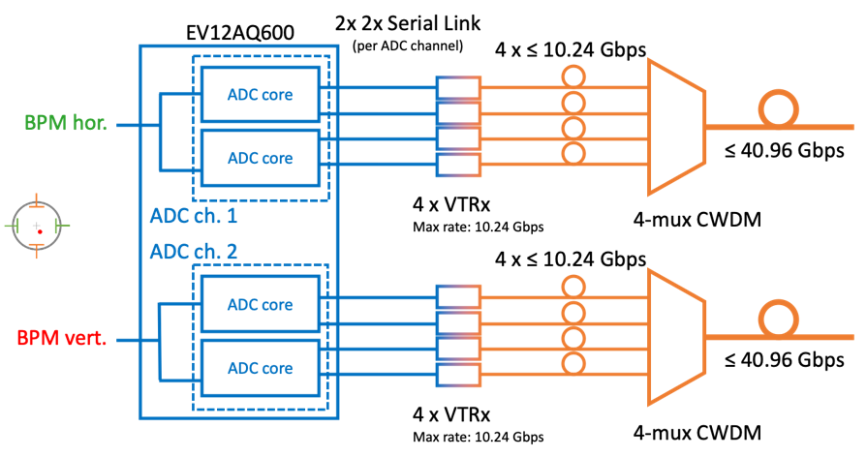

Introduction
LHC BPM consolidation project
RadTol ADC
Back-End
RadTol Optical Tx
(or 2-mux?)
RadTol Optical Tx
(or 2-mux?)

Slide 5
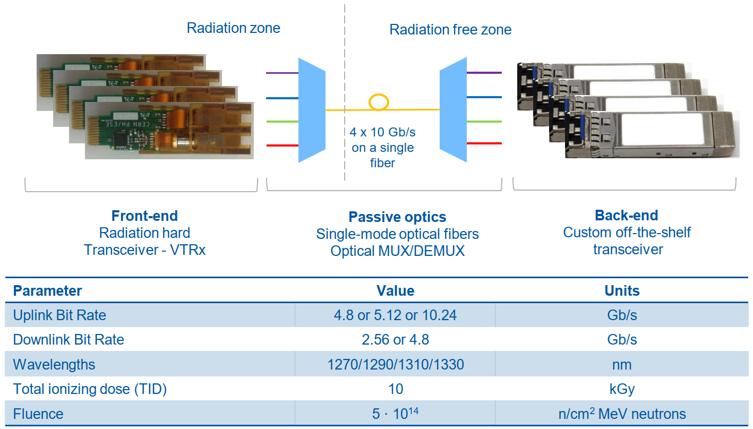


Introduction
Option 1 : CWDM SM-VTTx

Slide 6
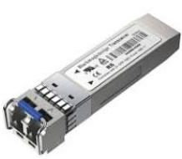
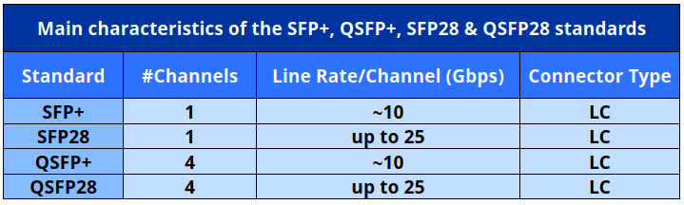
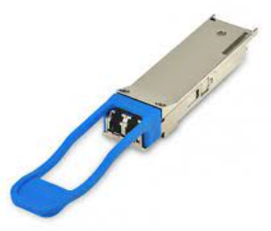
Introduction
Option 2 (due to components availability issues): SFP/QSFP
SFP
QSFP

Slide 7
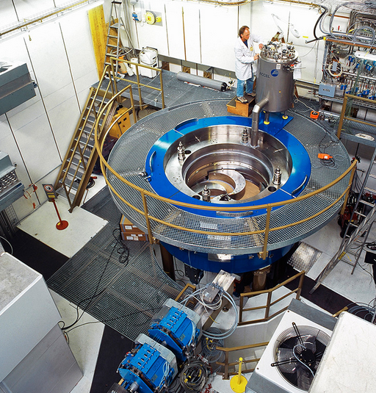

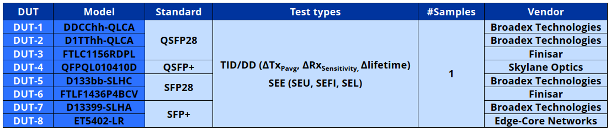
Radiation test
COmpact MEdical Therapy cyclotron
(COMET)
Radiation test @ PSI (November 2022)
  Cumulative effects test
  Single-Event Effects (SEE) test

Slide 8
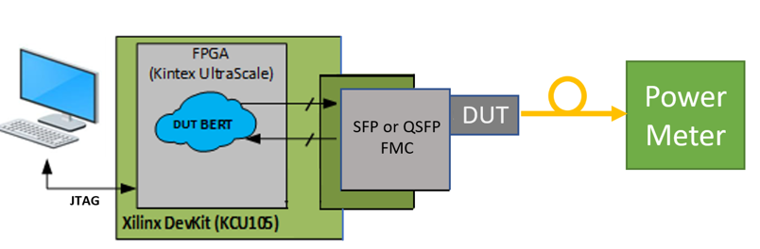
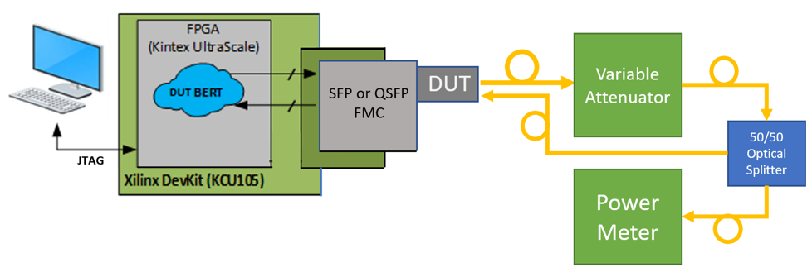
Radiation test
Cumulative effects test block diagram
Tx Pavg (dBm) measurement
Rx sensitivity (dBm) (BER@1e-12)
measurement

Slide 9
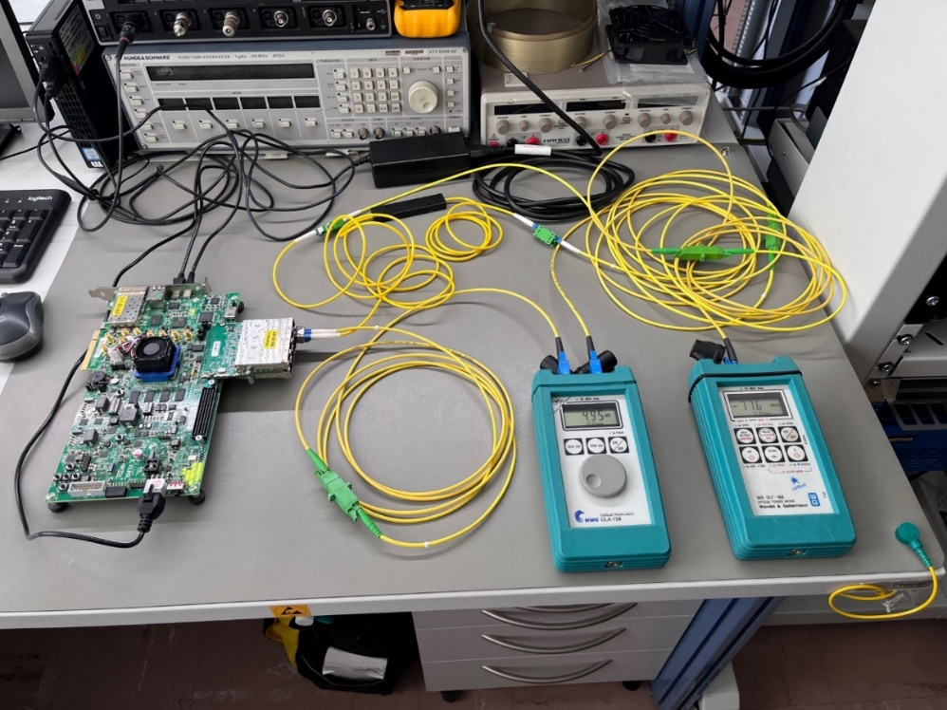
Radiation test
Cumulative effects test implementation

Slide 10
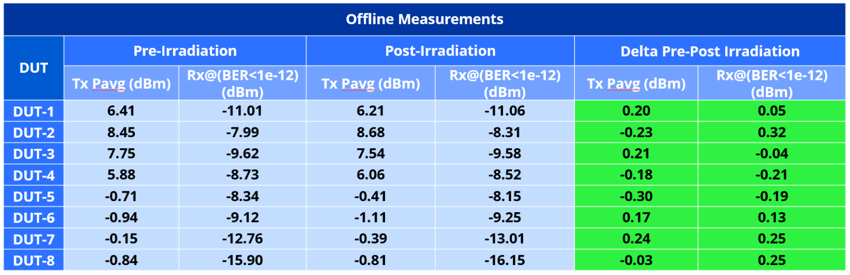
Radiation test
TID test results

Slide 11
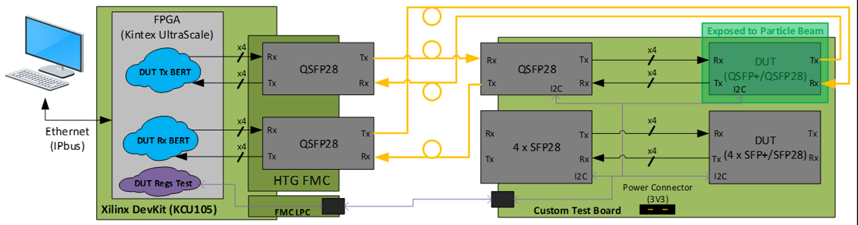
Radiation test
SEE test block diagram

Slide 12
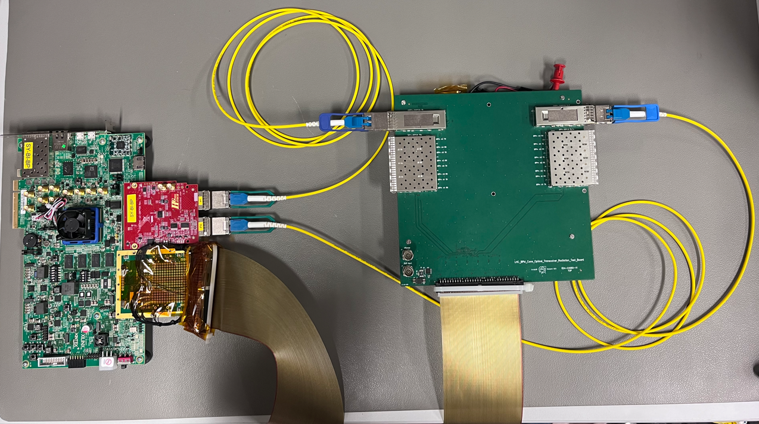
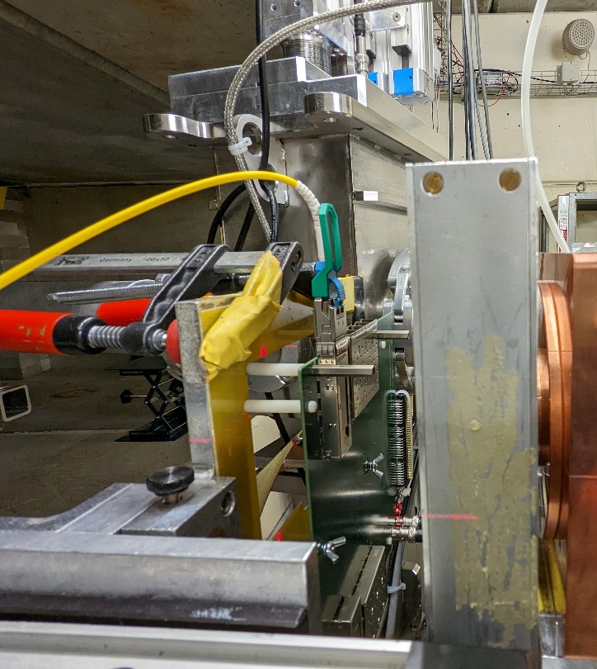
Radiation test
SEE test implementation
DUT

Slide 13
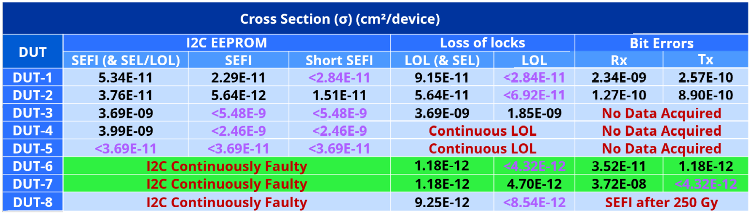
Radiation test
SEE test results

Slide 14
Summary & Outlook
The LHC BPM system reliability compromised after ~20 years of operation
LHC BPM Consolidation effort ongoing
Baseline for the Optical Tx: CWDM SM-VTTx
COTS optical transceivers as back-up option due to procurement issues
COTS optical transceivers tested at PSI -> 2 DUT passed the test
JINST paper and test report available to the community soon

Slide 15
Any Question?

