Slide 1
Status of the 2024 RP optics
[LHC optics with Reversed Polarity of the inner triplet in IR1]
S. Fartoukh
Acknowledgements: R. Bruce, I. Efthymiopoulos, M. Solfaroli, G. Sterbini
Motivation
RP vs. nominal optics in IR1(5)
2024 optics readiness
  Protons
  Ions
  VdM
A word on the wire
Summary and outlook

Slide 2
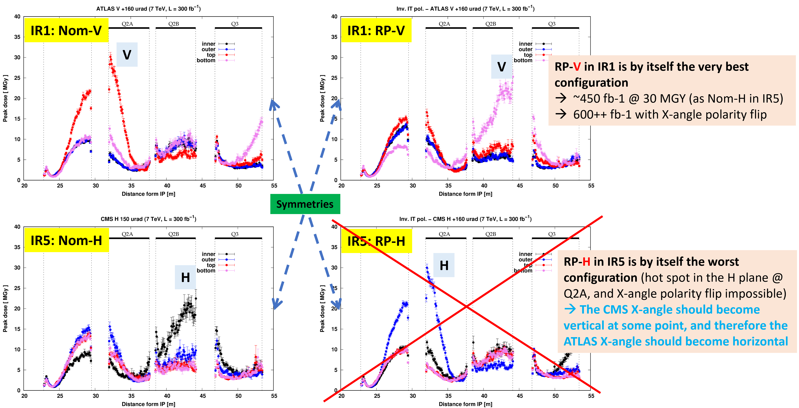
Motivations
See JAP2023 and
Chamonix2024
Mitigate the radiation to the triplet .and. D1, starting with IR1 in 2024
The configuration RP-V/Nominal-H for ATLAS/CMS has been agreed to for the 2024 pp Run.
Still 30 cm round optics, no X-angle rotation, positive X-angle in ATLAS but IT polarity reverted in IR1
The other two 2024 cycles (ions and VdM) are impacted with the Reversed IT polarity in Pt1.

Slide 3
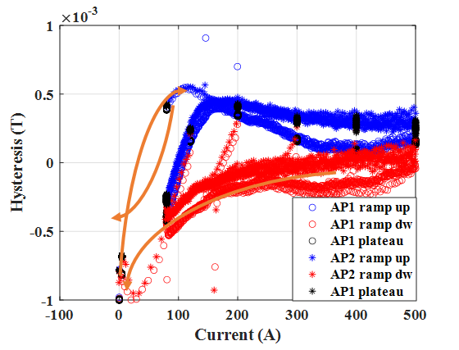
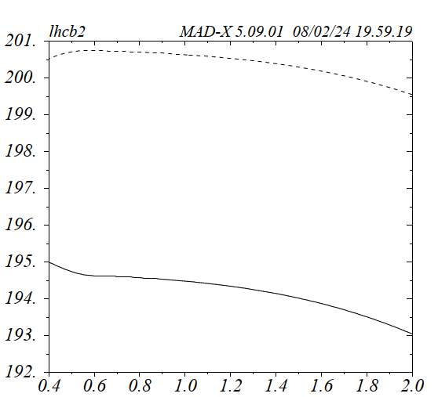
Main features and implications
RP optics vs. nominal optics
Illustration by L. Fiscarelli
- Q4 is OFF (to recover the nominal polarity of the
LHC quads as of Q5).
→ Q4 degaussing procedure put in place
- The IT polarity is reversed in Pt 1 (the 3 circuits
RQX, RTQX2 and RTQX1)
→ The IR1 triplet polarity scheme is now similar to IR2 & IR8
Due to the missing Q4, an unusual gradient unbalance
(~6 T/m) is needed between Q1/3 (up to 195 T/m max) and
Q2 (up to 201 T/m max), but all MQX’s at ~nom. or below.
To accommodate this unbalance, the IPNO of RQX circuit has been reduced below nominal, while increased by 30 A above ultimate for the RTQX2 circuits (Pt1 only).
Q2
Gradient [T/m] @ 6.8 TeV
Q1& Q3
Pre-squeezed β*[m]

Slide 4
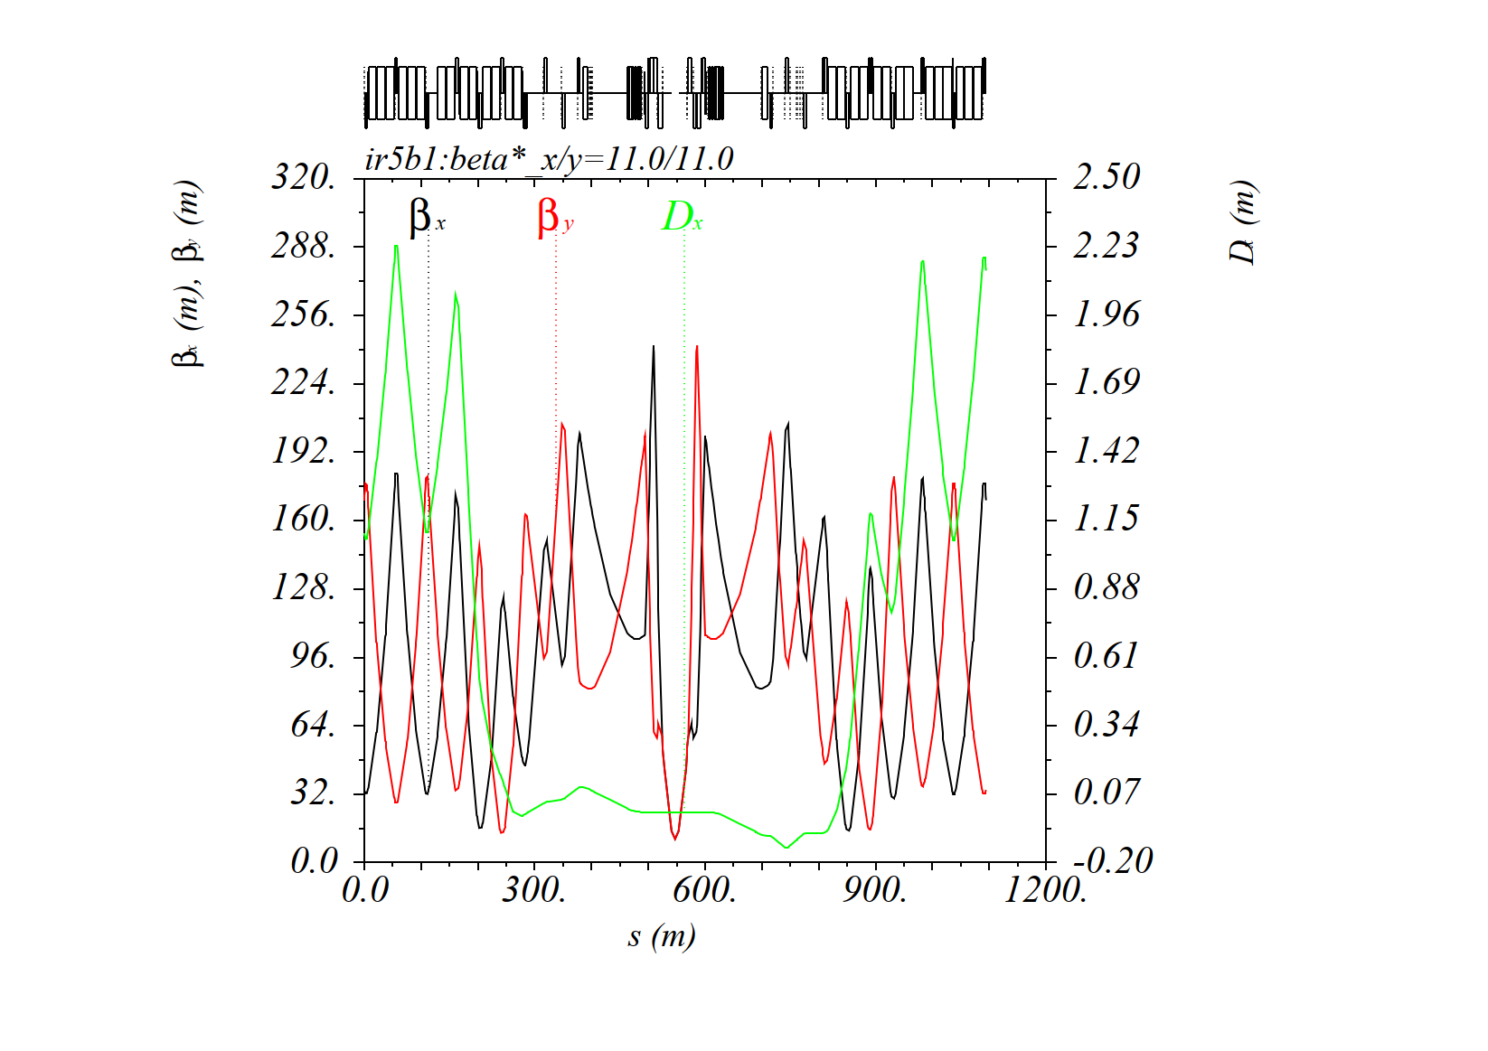
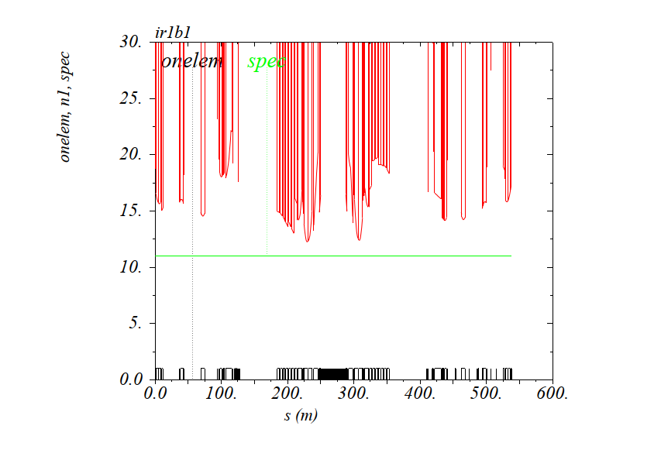
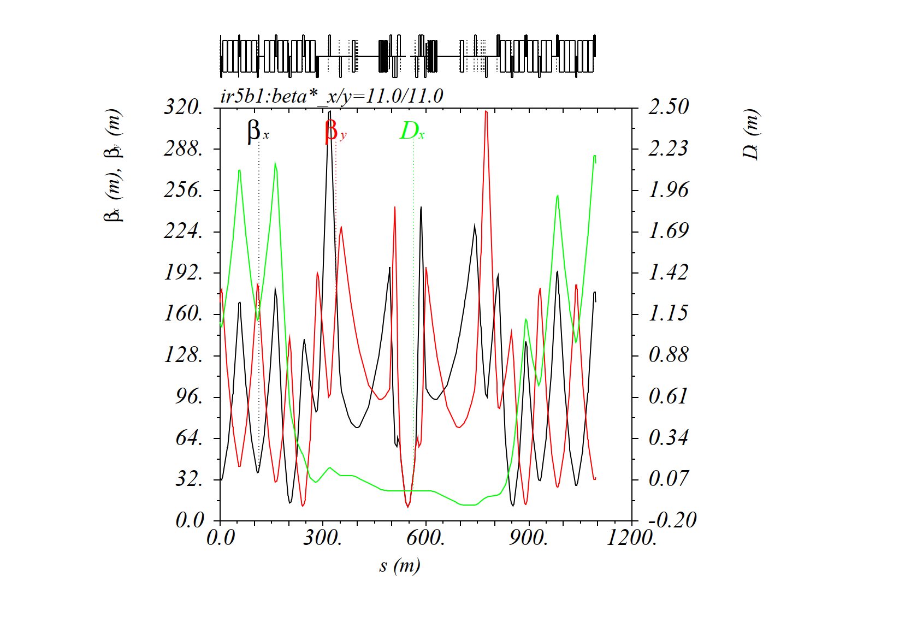
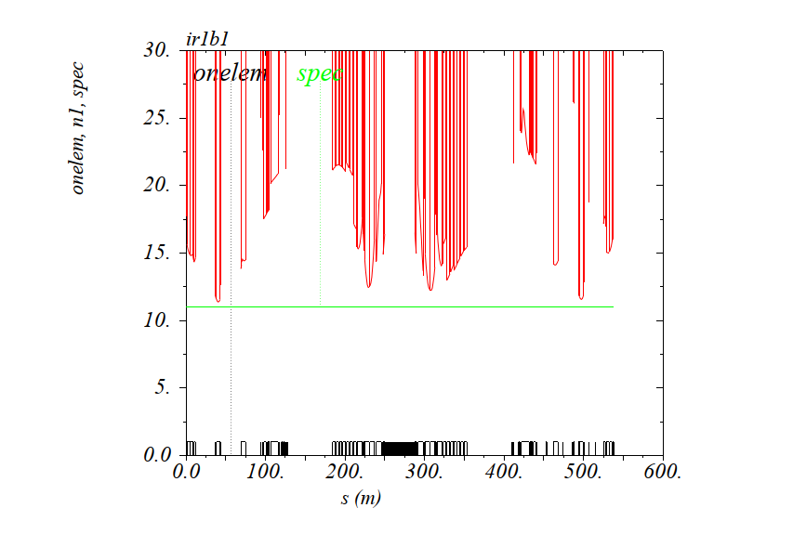
The IR1 injection optics features higher β’s @ Q6, but OK for aperture
Nominal IR1-beam1
11 σ
RP IR1-beam1
11 σ
Q6

Slide 5
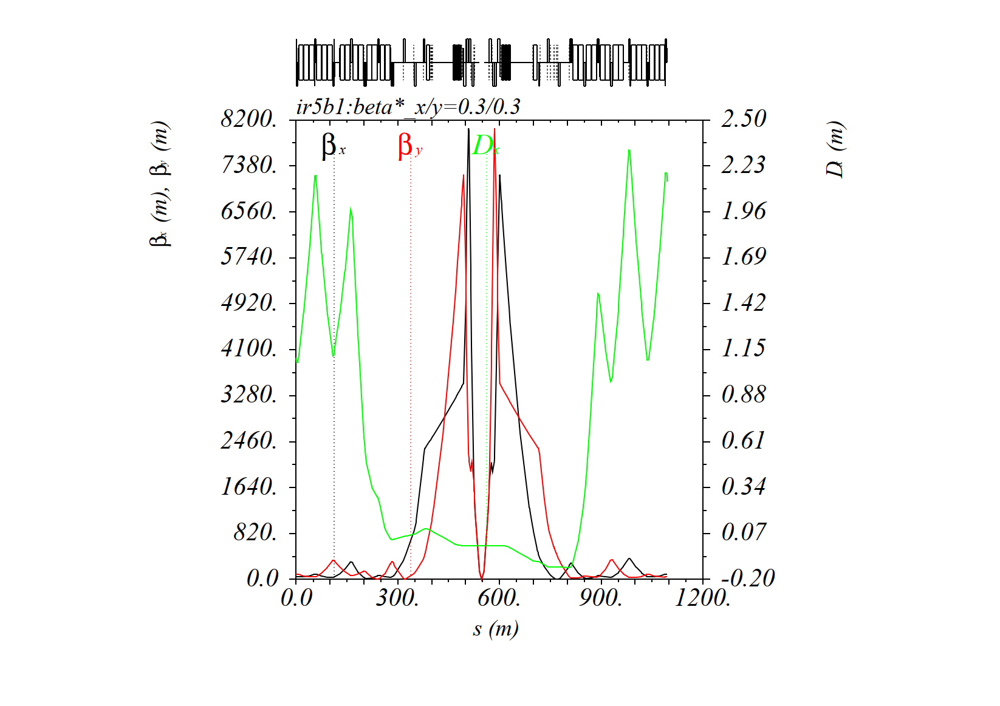
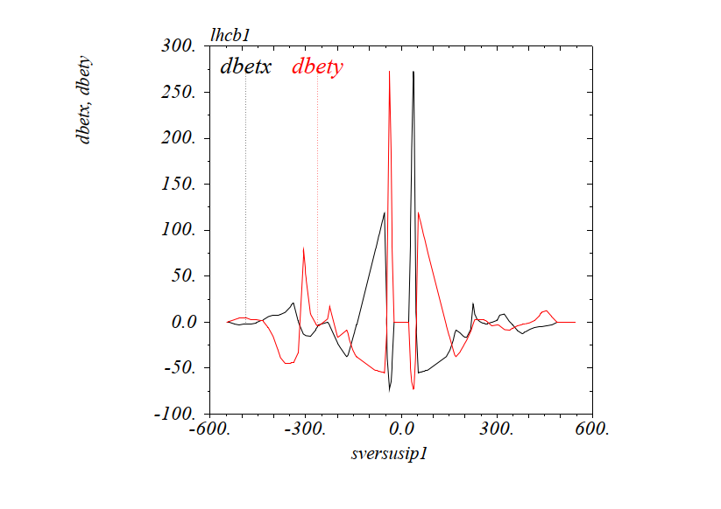
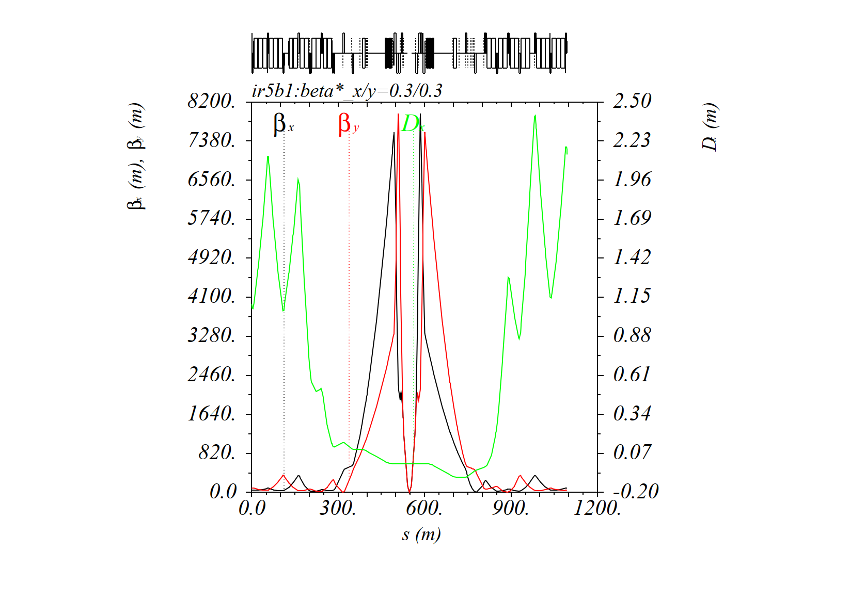
The collision optics is very similar as of ~Q5 on the out-going beam side
Nominal 30 cm
Δβ/β [%] from 2023 to 2024 in IR1 (beam1)
Q4 is ON
RP 30 cm (with Q4 off)
Q6
Q4 is OFF
Q4
Q5

Slide 6
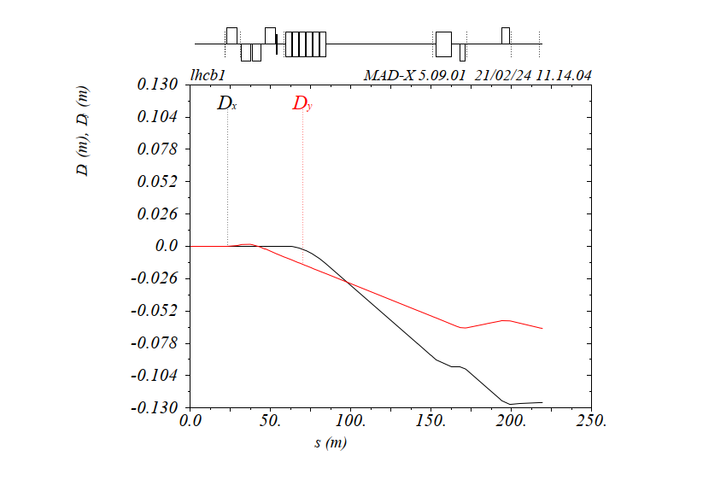
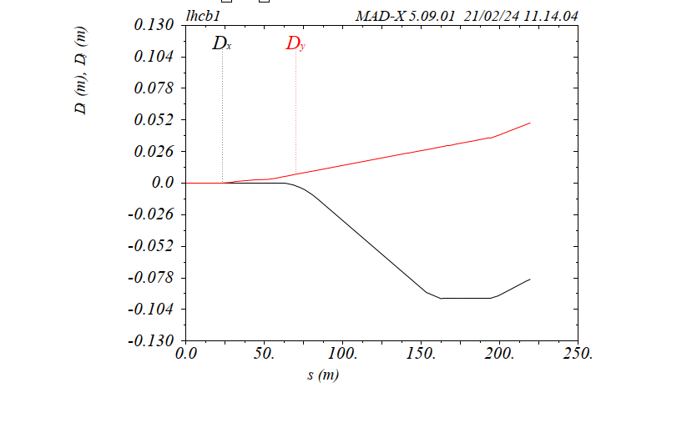
.. But the H dispersion is significantly reduced at the XRP and TCL6 (and the
vertical dispersion changes sign with the polarity switch of the ATLAS X-angle)
Already optimized since first RP optics versions, and CANNOT be optimized further w/o risk on the overall optics flexibility (too small gradients for Q5 & Q6).
Dx @ XRP and TCL6 still higher than in IR5, in particular no danger for QPS in the DS for ~ 2mm TCL6 gap (see also F. Cerruti @ Chamonix2024).
Possible impact on background to FASER may however need mitigation (TBC), by operating with a TCL6 gap as low as 1.25 mm at β*=30 cm & levelling needed in this case from 1.6 mm down to 1.25 mm for β*=120-60 cm (being looked at by the coll. team → see F. Van der Veken @ CollWG).
XRP
2023
D_{x} = -12.5 cm
@ TCL6
D_{x}=-8 cm
@ TCL6
2024

Slide 7
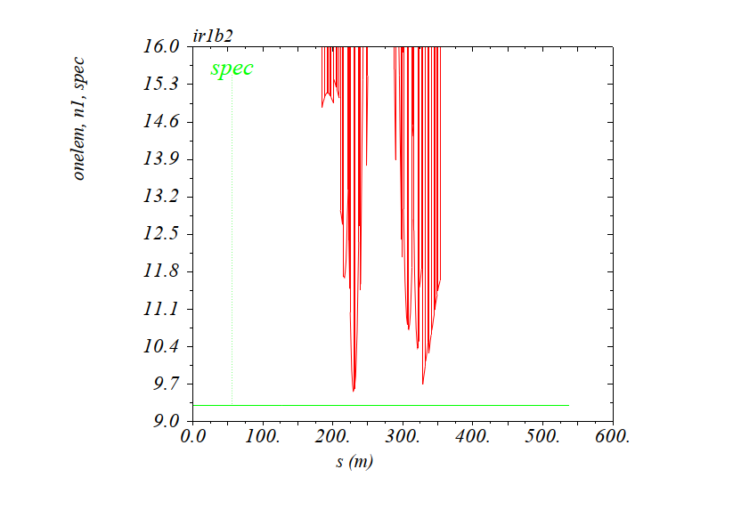
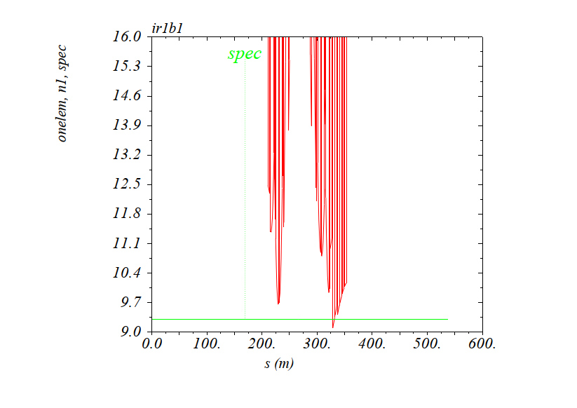
The triplet aperture is slightly improved, but the IR bottleneck is degraded by 0.47 σ, displaced from the IT to the first D1 module [vertical plane, outgoing beam side]
→ A comparison Nom-Beam2 with RP-beam1 (or conversely) is convenient
Nominal Beam2
RP Beam1
9.56 σ @ Q2.L5
9.66 σ @ Q2.L5
9.09 σ
A possible cure is to run the last matched point (32.5 cm→ 30 cm) at constant
TCT gap in mm (as in 2018 for the segment 30-27-25 cm)

Slide 8
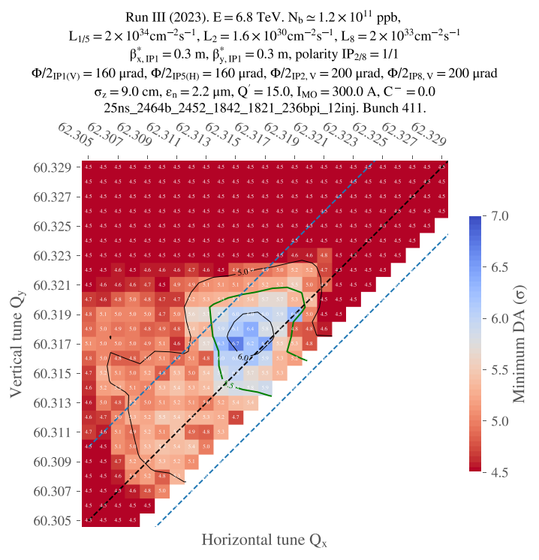
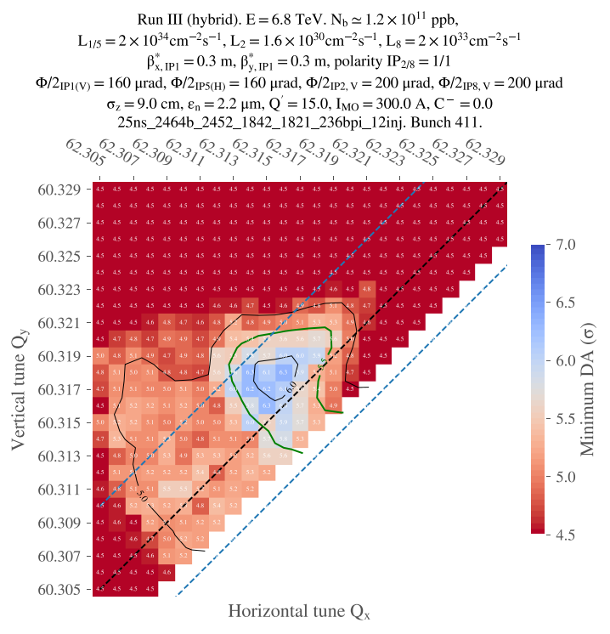
Cannot be more transparent for the dynamic aperture in collision
[same WP (.313/.318) for 5.5 σ DA at a distance ΔQ~5 ×10⁻⁴ w.r.t. the coupling resonance]
2023 @ 30 cm
2024 @ 30 cm
Courtesy of C. Droin

Slide 9
Protons
2024 optics readiness
The sequence of optics is ready, from injection down to 30 cm
/afs/cern.ch/eng/lhc/optics/runIII/RunIII_dev/Proton_2024
.. With smallest possible changes w.r.t. 2023
Same number of optics, and same matched point (within 3 exception in the ramp)
No change a priori in 2024 for the timing table of the ramp (TBC).
Change of IPQ functions and IP-knob coefficient only in IR1 (+ slight rematching of sextupoles and on_disp knob.
Crossing angle constant set to 160 μrad during levelling (motivated by the significant degradation of effective cross-section observed in 2023).
Possible extension of the levelling down to 20 cm, available (round optics)
→ On-going discussion of how to exploit it, e.g. via controlled decay of the lumi at the BB limit instead of natural decay [levelling against a moving target PU(b*,X)]

Slide 10
Ions
The sequence of optics is ready, from injection down to 50/50/50/150 cm at IP1/2/5/8
/afs/cern.ch/eng/lhc/optics/runIII/RunIII_dev/ION_2024
.. With smallest possible changes w.r.t. 2023
Same number of optics, and same matched points.
Embedding the full squeeze in the ramp is still under discussion (but should be feasible if needed).
Change of IPQ functions and IP-knob coefficient only in IR1 (+ slight rematching of sextupoles and on_disp knob).
Possible extension of the levelling down to 40 cm at IP1/5, available (if needed).
MDs to test smaller β* at IP8 (~ 1 m) are under discussion, but the optics is neither available, nor for the 2024 baseline.

Slide 11
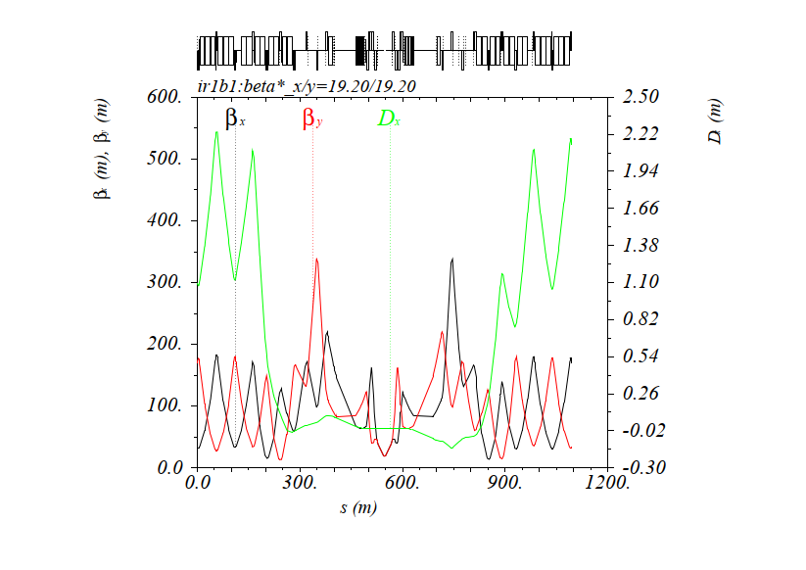
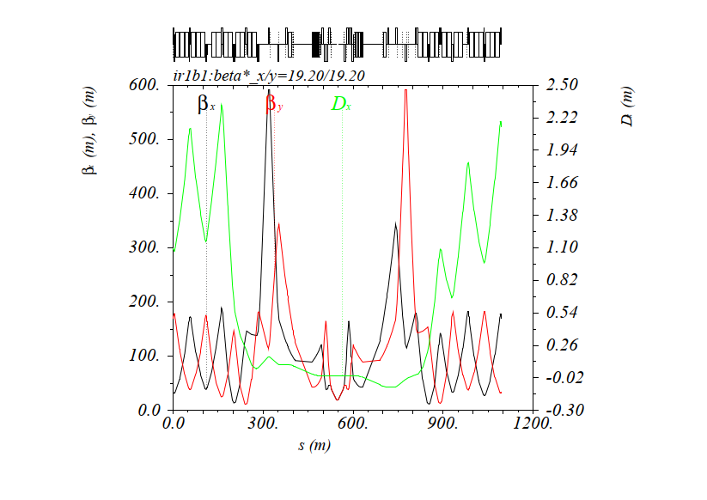
VdM
Courtesy of I. Efthymiopoulos
The sequence of optics is ready, from injection up to 19.2/19.2/19.2/24.0 m at IP1/2/5/8
/afs/cern.ch/eng/lhc/optics/runIII/RunIII_dev/VdM_2024
Same number of optics, and same matched points→ Same timing table for the combined ramp and de-squeeze (TBC).
Change of IPQ functions and IP-knob coefficients only in IR1 (+ slight rematching of sextupoles), with IT1 gradient well within the new RQX & RTQX2 operational currents of Pt1.
As for injection optics, higher beta’s at Q6 in collision @ 19.2 m (but still much less than e.g. for the 2023 run at 90 m)
Nominal VdM optics
@ 19.2 m
RP VdM optics
@ 19.2 m

Slide 12
Wire
Courtesy of G. Sterbini
With Q4 off, the correction of the linear imperfections induced by the wire needs to be revisited in Pt1.
A definite cure to this redundant discussion might be
- to have 2 matched points @ 30 cm with the wire OFF/ON (60 cm pre- squeezed IR1/5 optics rematched with 30 cm wire settings, at cst IT and L/R phase → no impact on the telescope for any β*)
- to continue the telescopic lumi levelling 30 cm → 24(20) cm with the rematched IPQ-IR1/5 settings (and nominal telescope)
- to give up this 30-20 cm segment in case the wire breaks during the year
(or to revalidate after a TS a new 30-20 cm segment with the wire OFF).
Under discussion (if no appropriate simplified solution is found for IR1)

Slide 13
Summary & Outlook
All optics are ready and are being scrutinized by the various teams.
In the end, these are just settings which have been built up to try to please all the parties with the best possible compromises.

