Slide 1
Optics commissioning schedule and plans
T. Persson
on behalf of the OMC-team

Slide 2
Reminder of the cycle
Injection
The overall plan is to keep the local corrections in the other IPs and then remove the rest
The correction strategy very similar to 2023 in terms of global corrections, when they come in etc.
Ramp to 4 TeV
Ramp from 4TeV to 6.8TeV (tele-index from 1 to 0.5)
Pre-squeeze to 1.2 m (constant tele-index)
Tune change
Adjust
β* levelling from 1.2m to 60 cm
β* levelling from 60cm-30 (25cm??)cm

Slide 3
Preliminary planning
Linear injection optics (1 long shift)
  Local coupling IP1
  Beta-beat (phase-beat)
  Total phase correction
  Potentially vertical dispersion
Measure down to 30 cm without crossing angles, if possible down to the minimum beta* for the year
  Check and correct energy to early 2022
    Either remove the Q4 correction in IR5 and adjust energy (used to balance the energy) OR make the B1 and B2 Q4 correction equal and adjust the energy. Slight preference for the second.
  Local correction in IR1
  B4 correction for IR1 (in particular if the tune signal is bad)

Slide 4
Preliminary planning (cont)
4. Measure from flattop with local incorporated (after orbit + xing)
  Measure at 2m, 1.2m, 60cm
  Global Corrections at 1.2m, 60cm
5. Measure continued squeeze (Most likely two fills)
  Measurement in the ramp
  Sextupole correction in IP1
  Global correction 30cm and 20cm
6. Final checks
  Final validations
  b6 and a4

Slide 5
Additional measurement (not in order)
The nonlinear at injection benefits from at least 1 preferably 2 shifts but can be slotted in at a convenient moment
  Spool pieces settup
  Potential sextupole correction
  Validate MO response
Potential additional things:
  K-mod for IR4
Amplitude detuning at flattop

Slide 6
Things to remember
TCT-MKD phase advance
  Do we have any tolerances on this?
Correction strategy as in 2023
  We don’t use q4-q6 for the global corrections

Slide 7
Things already done
I added so we can use the 2024 optics in beta-beat (OMC worked out of the box)
We have tested the GUI
  Some issues with extracting knobs and MQTs
    Joschua is following this up
NL GUI (not used since 2022) fails to run and extract any data.
  Fixed some issues (variables no longer available on nxcals, similar pyspark issue as GUI)
  Still issues with extraction times, differing from 2022 test cases, prevents running any cleaning.
  Possible issue with the pytimber implementation, but worked fine in 2022, Josch followed up.
  Response matrix still needs to be updated to 2024 optics

Slide 8
When will we measure?
There is a very preliminary schedule on the LBOC website
  Should only be seen as an idea
    Things will change for sure
    Depending on availability, machine performance, what we see etc.
The official start is on the 11th of March
  Good chance we can start already on the 9th of March
  As always the busiest time is at the beginning
To preserve the tradition, we will probably be requested to measure VdM/ions over easter!

Slide 9
What can we say about the local corrections?
Difficult to say because we don’t know how local the corrections are
The difference in absolute strength of the magnets is less than 2% for the triplet magnets
 | SbS | APJ | Powering 2023 Without correction
MQXA1.L1/K1 | 1.23E-5 | - | -8.72E-3
MQXA1.R1/K1 | -1.23E-5 | - | 8.72E-3
MQXB2.L1/K1 | 4.1E-6 | 1.15E-5 | -8.74E-3
MQXB2.R1/K1 | -7.0E-6 | -8.7E-6 | 8.74E-3
MQXA3.L1/K1 | 1.22E-5 | 1.94E-5 | -8.77E-3
MQXA3.R1/K1 | -1.22E-5 | -2.88E-5 | 8.77E-3
All corrections make the magnets weaker (both SbS and APJ)
  The best guess would be to make the magnets weaker by the same amount
  However, we need to measure -> Will be very interesting to understand the underlying errors!

Slide 10
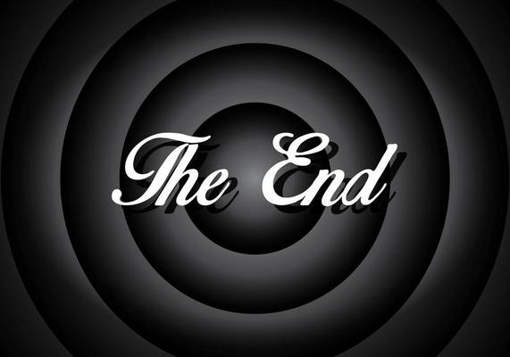
Or rather not even the beginning of the beam commissioning…

Slide 11
INJ 0.5 shift local coupling
2 shifts global corrections, check total phase & NL optics (we assume we will need some new global corrs since changing betas around Q4 etc which are used in global corrs)
TOP energy: 1 shift virgin machine (flat orbit)
1 shift implement/check local corrections (flat orbit)
1 shift b4 correction at EoS (flat orbit)
----------------------------------------------------------------------- orbit settup by OP?
1 shift local validation / global corr at EoS (xing)
1 shift FT-EoS check/implement global corrs
1 shift beta* checks through squeeze
0.5 shift IP4 optics checks
0.5 shift coupling correction through squeeze
2 shift NL (a3,b3,a4,b6)
0.5 shift detuning at flattop (request from xavier)
0.5 shift ramp optics validation

