Slide 1
SPS survey
LNO-section meeting
26/2/2024
Riccardo De Maria
Federica Murgia
https://codimd.web.cern.ch/WPMcLXhnQBKsFWxIJmM8Dg

Slide 2
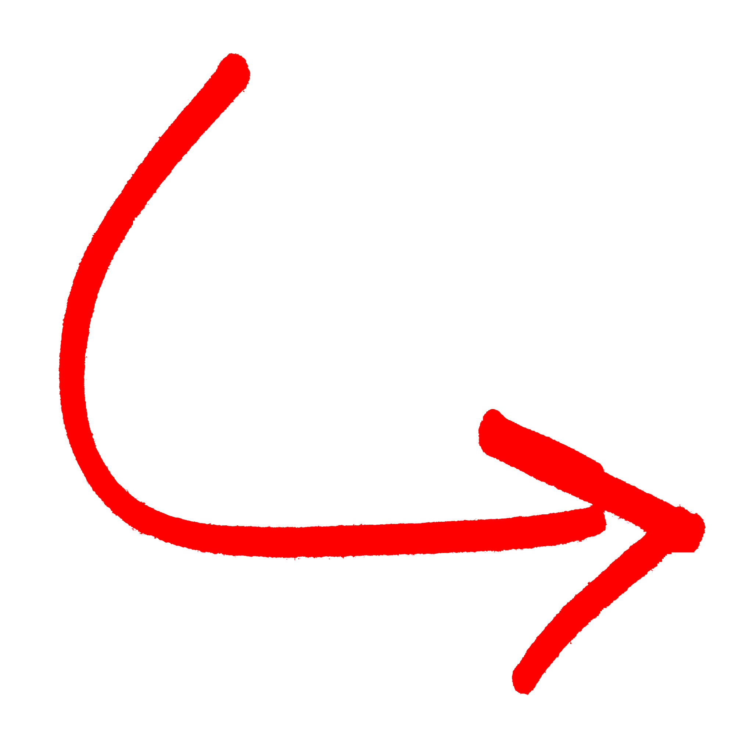

Why E2A?
LS2 presented a significant challenge for
alignment activities
numerous recurring issues related to procedures, tolerances, priorities, etc were identified by the various teams involved.
Engineering to Alignment (E2A)
The long-term objective of the project is to optimize time and resources required for installation and alignment for the entire complex workflow, while also modernizing and standardizing the process.
SPS survey 26/2/2024
Notes:
BE-ABP BE-CSS BE-EA BE-GM BE-OP EN-ACE EN-MME SY-ABT TE-VSC

Slide 3
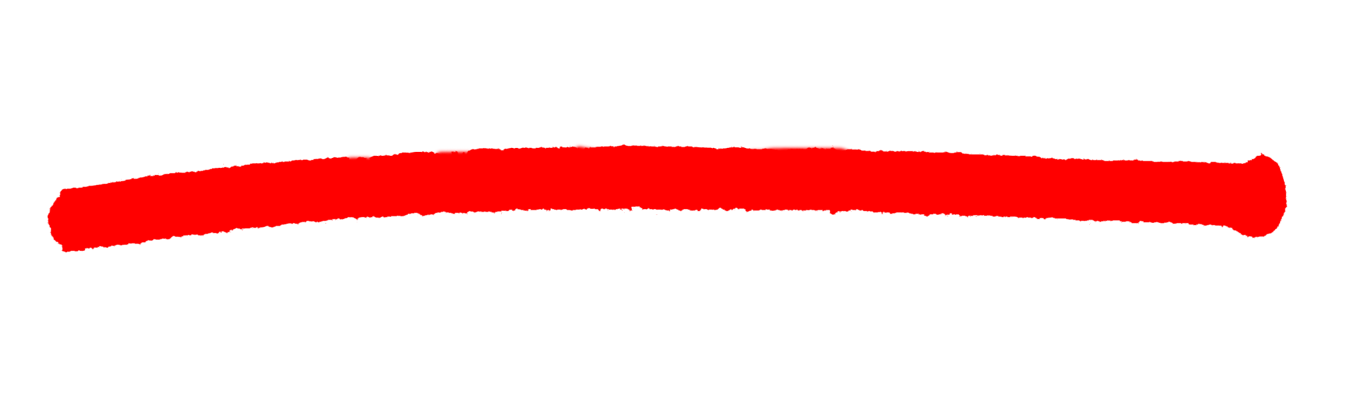
E2A
E2A is composed by 9WP, as BE-ABP we are involved in most of them,
In particular on:
Computation of equipment positions and orientations in CCS coordinates from data in LDB
MAD-X sequence and aperture validation tools
Establish data consistency between different databases
There are important discrepancies between the data stored in the different databases (e.g. LDB, optics repository, survey DB). Furthermore, data shown on the layout drawings is also not necessarily consistent with the DBs, as they are often based on old AutoCAD drawings.
SPS survey 26/2/2024

Slide 4
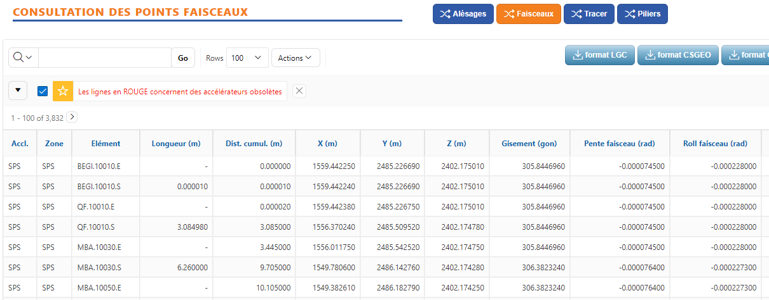
SPS DBs
GEODE
Layout DB
We are referring to it as the source that reflects the machine as it is
cern.ch/geode
SPS survey 26/2/2024

Slide 5
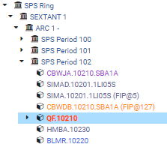

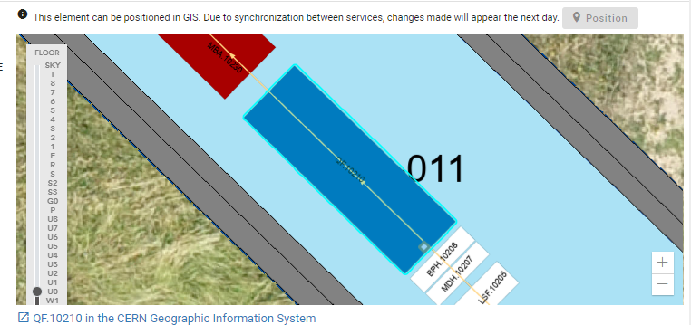
SPS DBs
GEODE
Layout DB
We want to use it as the one that mirrors the machine in its
real design for future reference and for integrate it with MAD-X
Part of the exercise is also to identify issues on the DB and check for data consistency
(e.g. magnet: mechanical length, magnetic length, optic length)
layout.cern.ch
SPS survey 26/2/2024

Slide 6
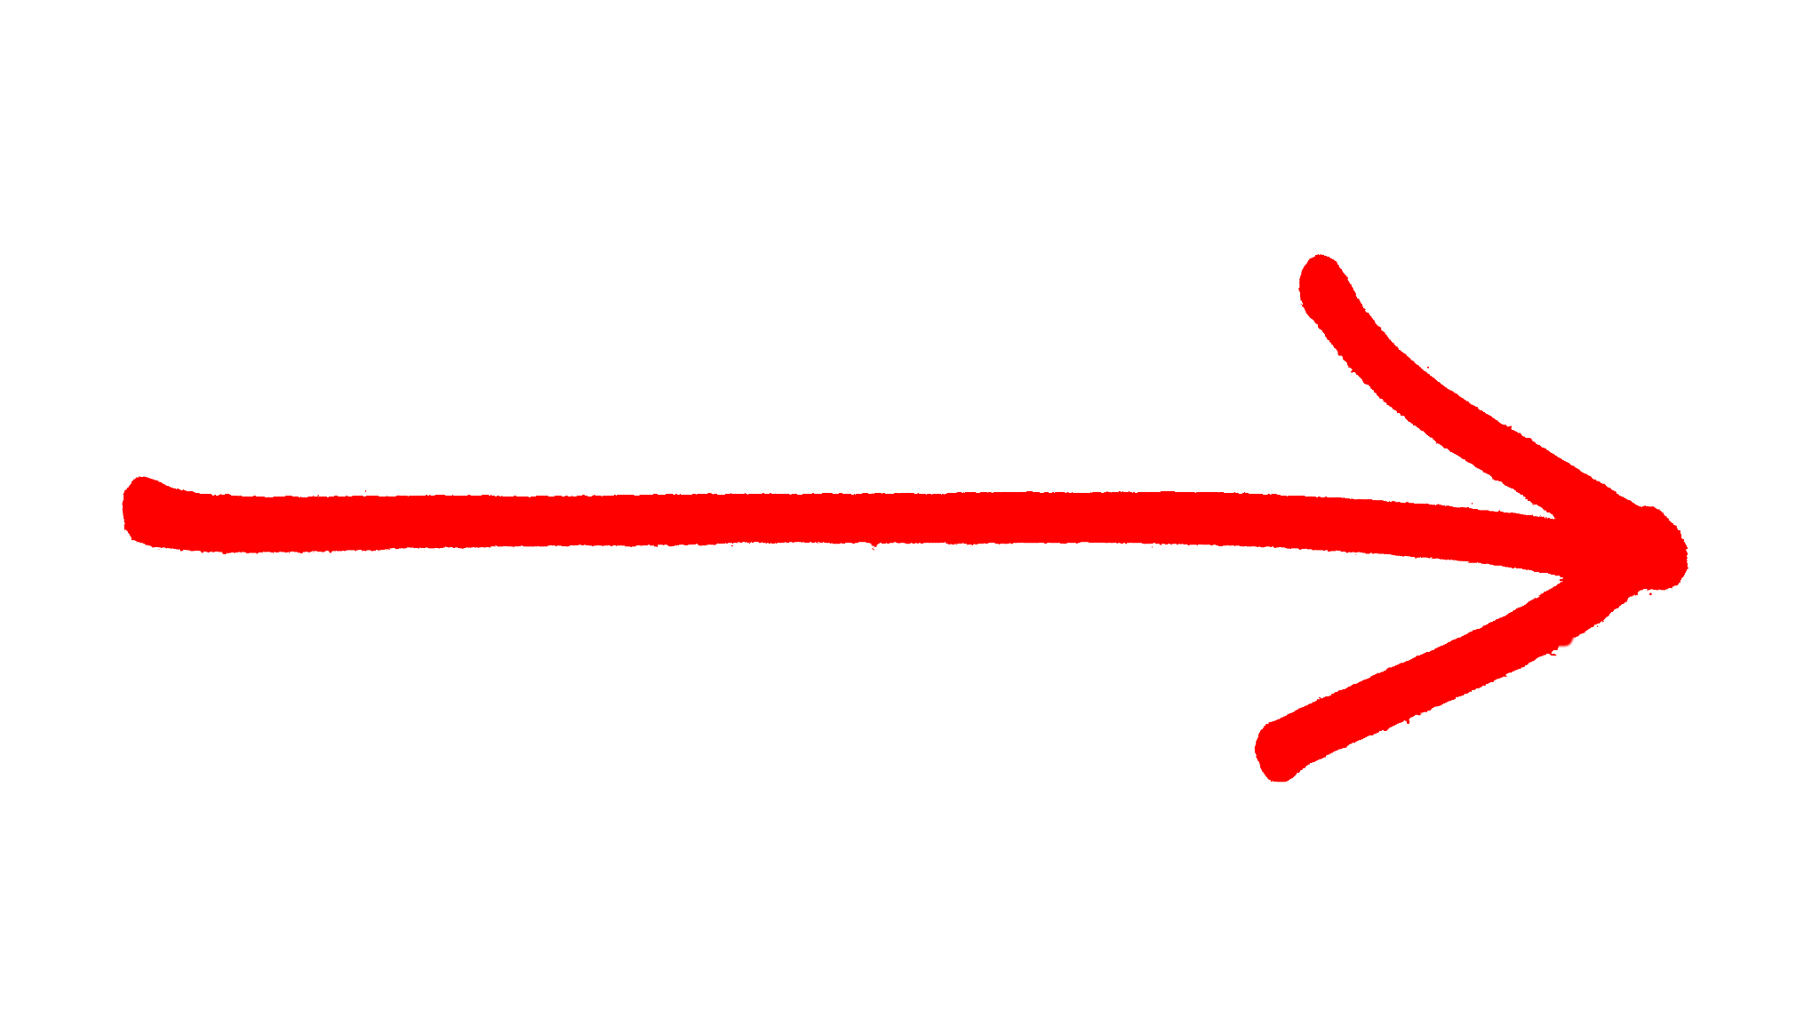
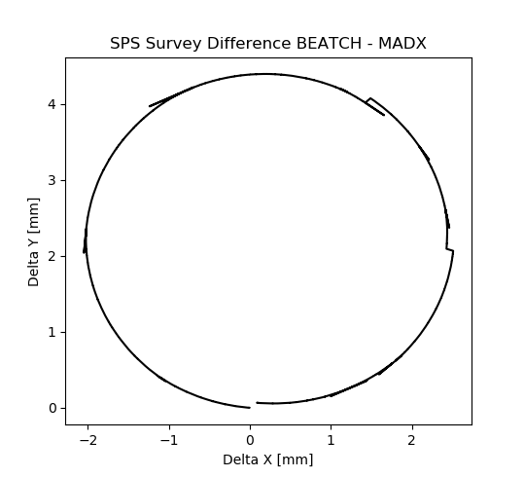

SPS reference geometry
Layout DB
MAD-X vs GEODE
GEODE reference geometry can not be reproduced by MAD-X
GEODE SPS geometry
slightly larger than
MAD-X SPS geometry
SPS survey 26/2/2024

Slide 7
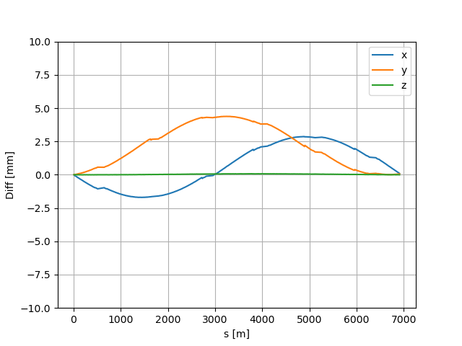
SPS reference geometry
The geometry difference is reflected as a global discrepancy in all coordinates
Almost machine plane → X, Y
Almost vertical → Z
Displacement of 4 mm in the machine planes
SPS survey 26/2/2024

Slide 8
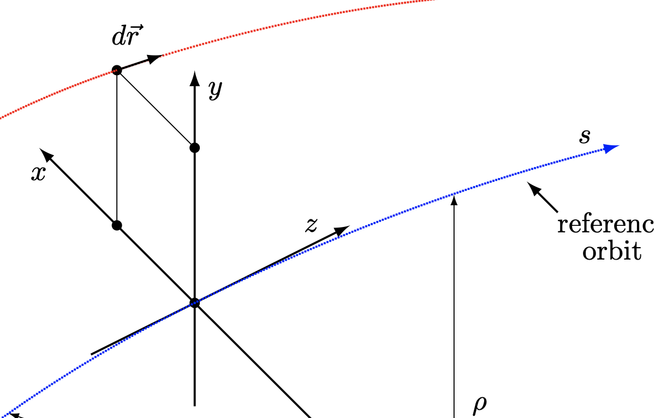
SPS reference geometry
The difference in geometry comes from a miscalculation on the particle trajectory path called as S (reference orbit) or DCUM (cumulate distance)
*For this first analysis we are taking into account just the 744 SPS dipoles
SPS survey 26/2/2024

Slide 9
SPS reference geometry
The input in GEODE is the distance between the elements faces.
Real Path length
The length in MAD-X can be arc or straight, but S is always the accumulate path length.
This is why the GEODE SPS circumference is larger.
SPS survey 26/2/2024

Slide 10


SPS reference geometry
MBB/MBA | Length [m]*
Lchord [m] | 6.26
Larc [m] | 6.2600186
Diff [m] | 18.6e-6
Real Path length
Machine | Length [m]
Design machine length | 6911.5038 (Design circumference 11/7 PS)
GEODE sum of length | 6911.50381
GEODE real machine length | 6911.50381+744*18.6e-6= =6911.50381+0.0138384= 6911.517648 (Non conform circumference)
*In the SPS machine, both MBA and MBB have the same magnetic length. The length is referred to the magnetic one (LDB)
SPS survey 26/2/2024
Notes:
Reference orbit of the particle

Slide 11
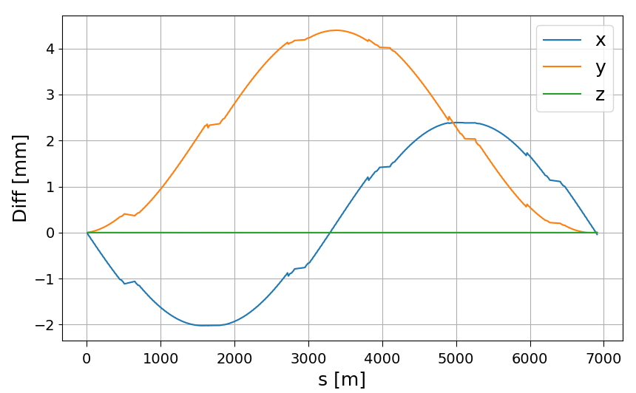
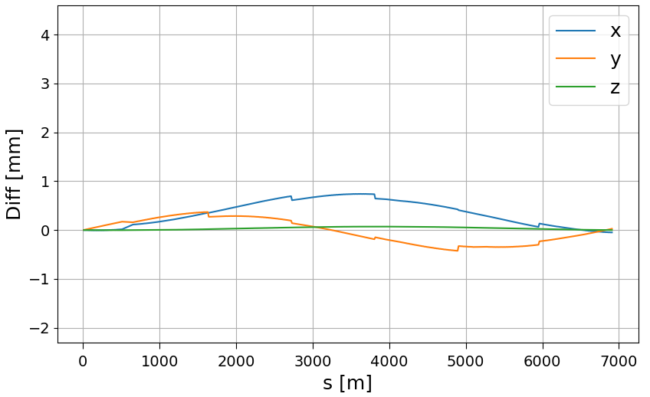
SPS survey
After correcting the 18.6um value, the displacement between GEODE and MAD-X decreased significantly.
Before
After
Taking into account just the SPS dipoles
SPS survey 26/2/2024

Slide 12
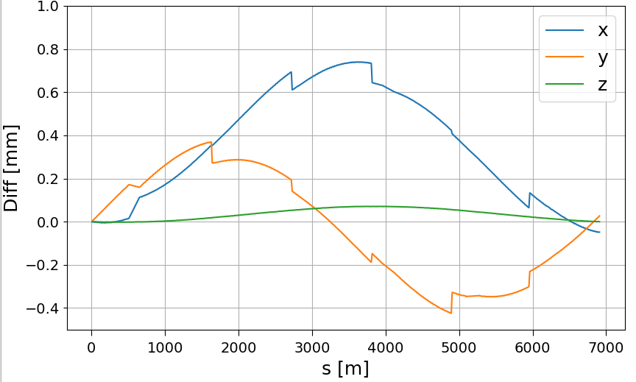
SPS survey
After correcting the 18.6um value, the displacement between GEODE and MAD-X decreased significantly.
Zooming
The displacement on the machine planes x and y decrease from almost 4mm to less than 1mm
Taking into account just the SPS dipoles
SPS survey 26/2/2024

Slide 13
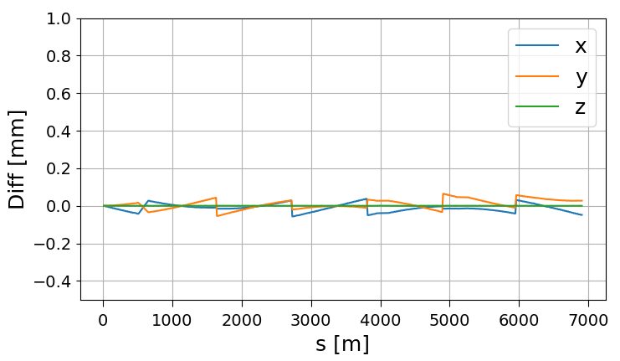
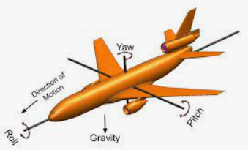
SPS survey
By adjusting the rotational angles of the SPS start, we were able to further reduce the differences between GEODE and MAD-X.
Δθ= 335 [μrad] Yaw
Δɸ= 12 [μrad] Pitch
Δψ= 31 [μrad] Roll
Before
After
SPS survey 26/2/2024

Slide 14
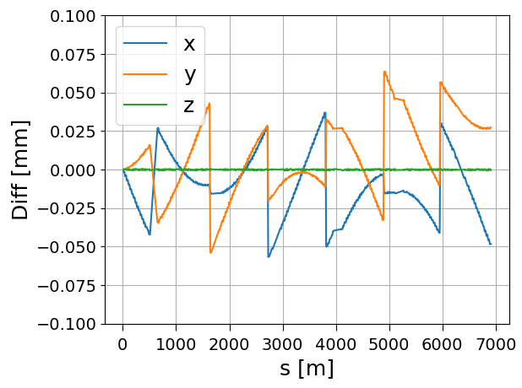
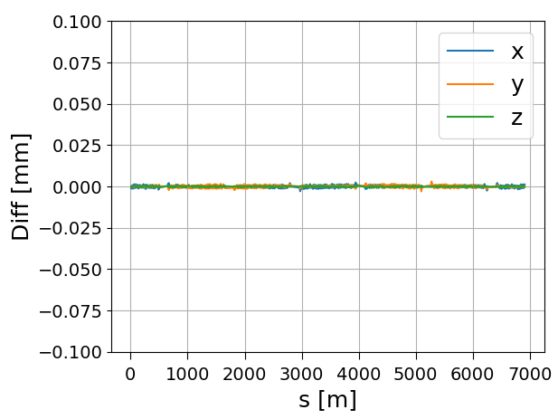
SPS survey
Additional empirical adjustments:
18.6um -> 19.34um between MBs
Adjust distance between straights
Before
After
SPS survey 26/2/2024

Slide 15
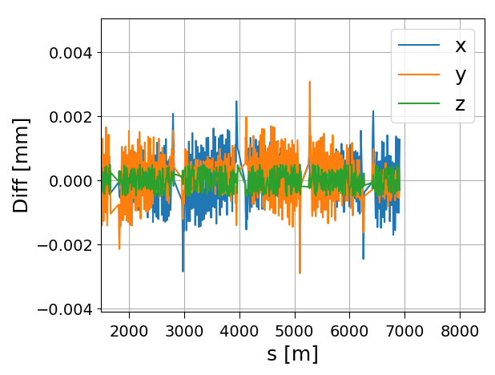
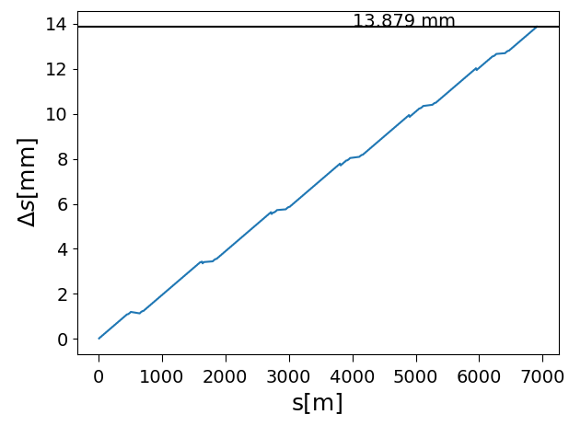
SPS survey
Doing some additional empirical adjustment to certain dipoles and correctors by a few micrometers (10-100) enabled us to achieve a discrepancy of under 5um in all machine planes.
GEODE and MAD-X (dipoles) geometries are now matching!
SPS survey 26/2/2024

Slide 16



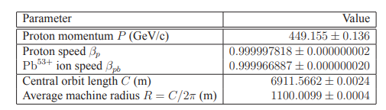
SPS energy mystery
Nominal length: 6911.5038 m
With present corrections: 6911.5177 m
Still ~49 mm missing
https://jwenning.web.cern.ch/documents/SPS/Notes/sps_ecal02.pdf
SPS survey 26/2/2024

Slide 17
Conclusion :
With the corrections:
Moved the machine trajectory by almost 13.8 mm by increasing distance between dipoles
Changing the starting direction
Small adjustment of the straights length
The GEODE and MAD-X models are matching with a reasonable discrepancy of 1um for the MB
Next steps:
Check other elements: quadrupoles, sextupoles, correctors, BPMs, rest of the equipment.
SPS survey 26/2/2024

Slide 18
Thanks for the attention!
Questions ?
SPS survey 15/2/2024

Slide 19
Backup slides
SPS survey 15/2/2024

Slide 20
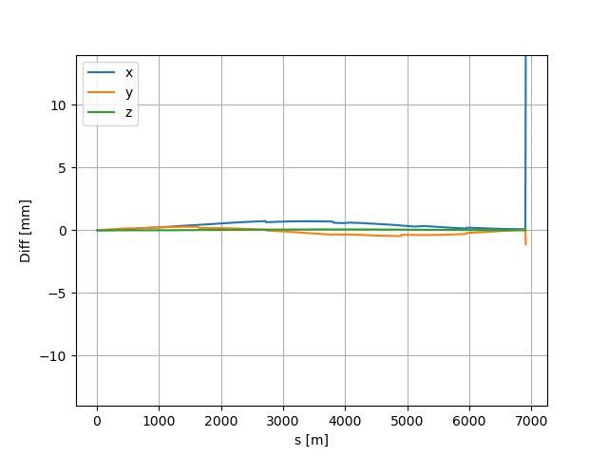
SPS survey [old]
After correcting the 18.6um value, the displacement between GEODE and MAD-X decreased significantly.
Before
After
Taking into account just the SPS dipoles
SPS survey 26/2/2024

Slide 21
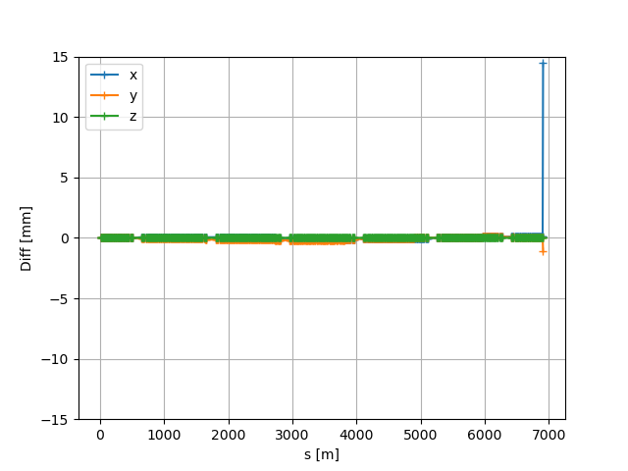
SPS survey
There is a peak at the end of the SPS geometry
This peak appears when I corrected the machine length
18.6um*744
SPS survey 26/2/2024

Slide 22
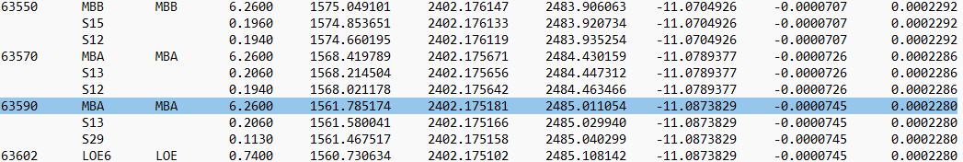
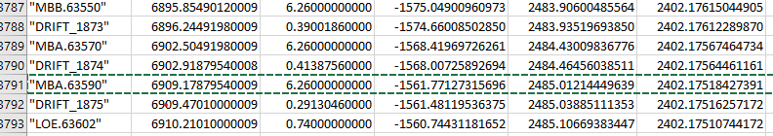
SPS survey
In correspondence of the peak there is a dipole:
X -1561.771273+ | Y 2402.175184-
1561.758174= | 2402.175181=
0.013901 | 0.000003
GEODE
particle trajectory
S=√(0.013901^2+0.00003^2)=0.013901 mm
MAD-X
SPS survey 26/2/2024

Slide 23
SPS survey
In correspondence of the peak there is a dipole:
X -1561.771273+ | Y 2402.175184-
1561.758174= | 2402.175181=
0.013901 | 0.000003
GEODE
particle trajectory
S=√(0.013901^2+0.00003^2)=0.013901 mm
MAD-X
SPS survey 26/2/2024

Slide 24
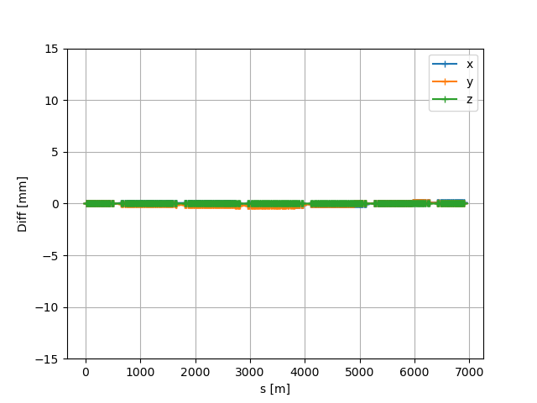
SPS survey
63570
63590
-13 mm
Peak solved!
Moving this dipole of almost 13mm we are forcing the machine to “return” at the initial GEODE end-point
13.9[mm] ~ 18.6e-6 [m]*744
SPS survey 26/2/2024

Slide 25
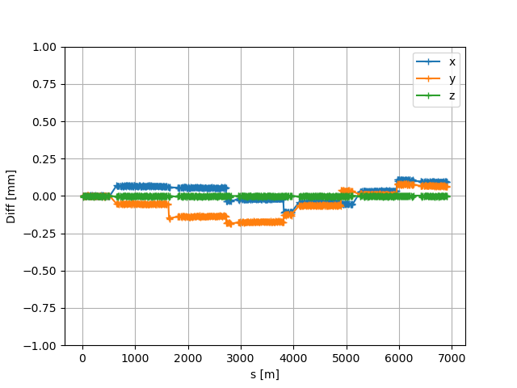
SPS survey
Zooming
The displacement on the machine planes x and y decrease to less 0.25mm
SPS survey 26/2/2024

Slide 26
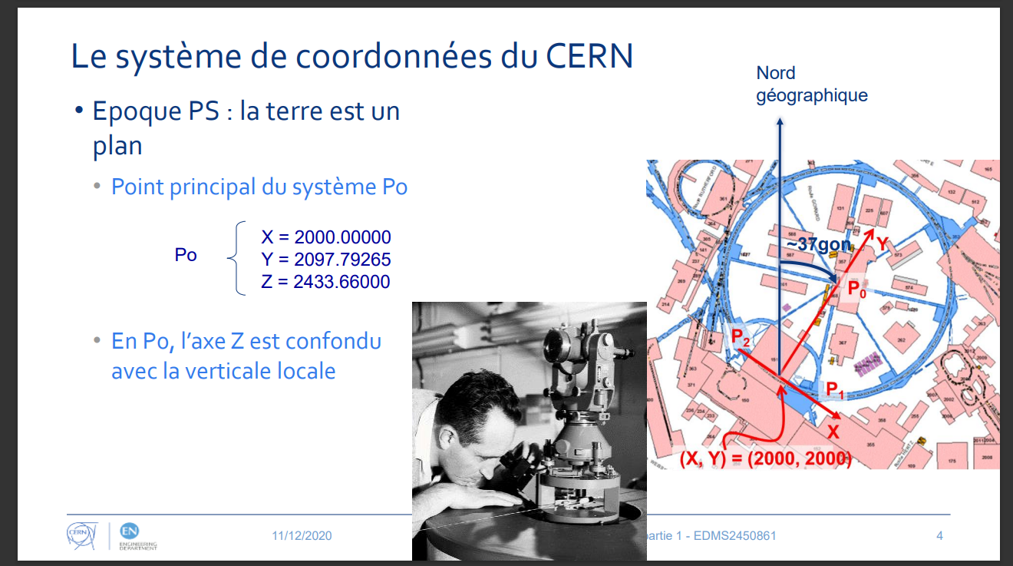

Slide 27
BEATCH=Nominal MAD-X
MAD-X corrected
Real Path length
~13.8mm
SPS survey 15/2/2024

Slide 28
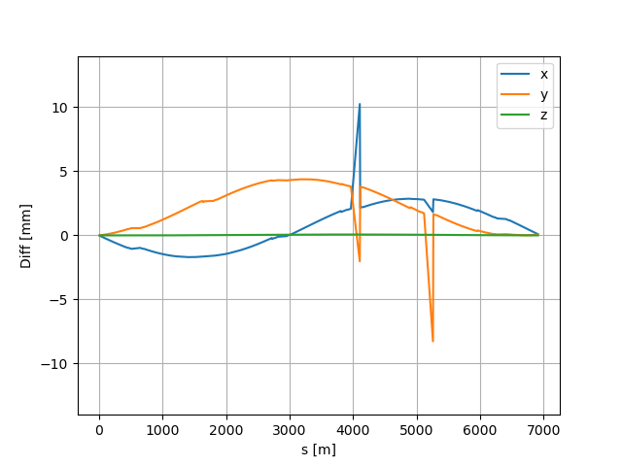
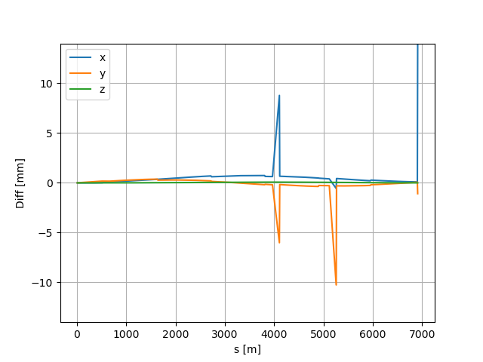
After correcting the 18.6um value, the displacement between BEATCH and MAD-X decreased significantly. Checking only MBA, MBB for time being.
Before
After
Peaks still remain but x and y decrease
Taking into account just the SPS dipoles
SPS survey 15/2/2024

Slide 29
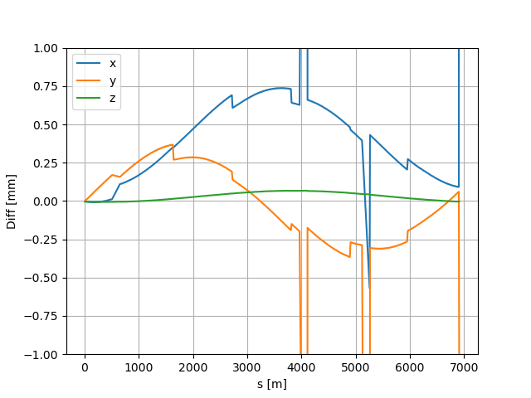
Zooming…
Displacement decrease from ~4 mm to less than 1mm in all the coordinates
Peak still remains and needs to be further investigated
SPS survey 15/2/2024

Slide 30
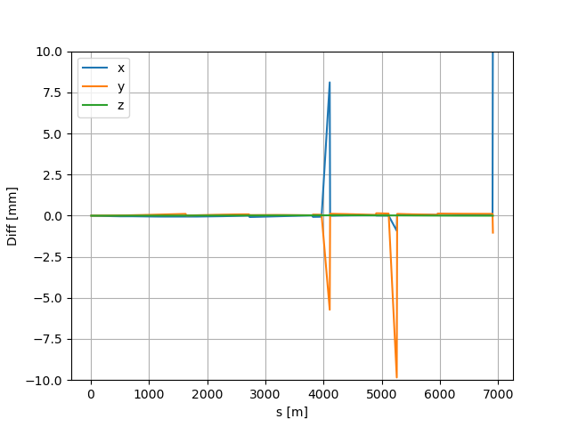
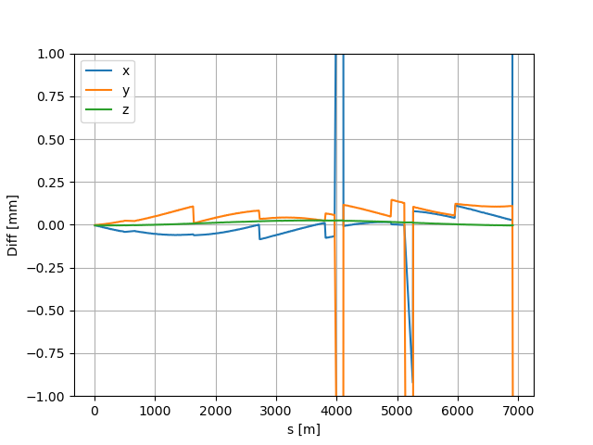
By adjusting the rotational angles of the SPS start, we were able to further reduce the differences between BEATCH and MAD-X.
Before
After
Zooming…
theta= 0.310e-6 [rad] Yaw
phi= 0.010e-6 [rad] Pitch
psi= 0.018e-6 [rad] Roll
SPS survey 15/2/2024

Slide 31
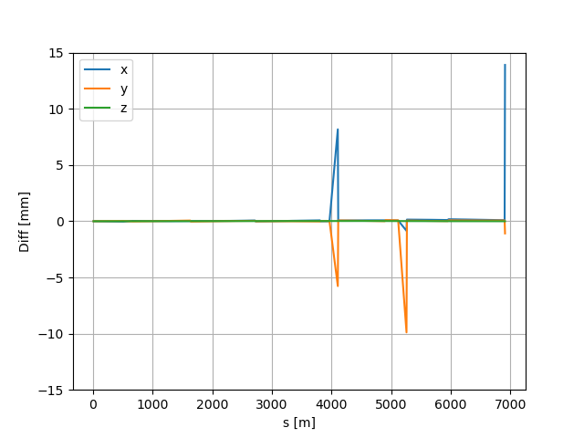
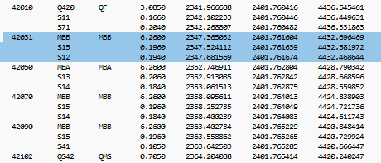
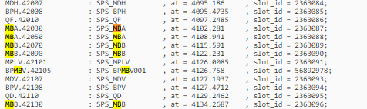
Time to investigate the peaks.
BEATCH
LDB
The first peak is around 4100 m
SPS survey 15/2/2024

Slide 32
The MBB 42031 in the BEATCH file appears to be no longer present in any of our databases. Both GEODE and LDB report an MBA in this position.
BEATCH
However, in the case of the SPS, the dipoles share identical lengths and angles, so they cannot be the reason behind the peak.
LDB
SPS survey 15/2/2024

Slide 33
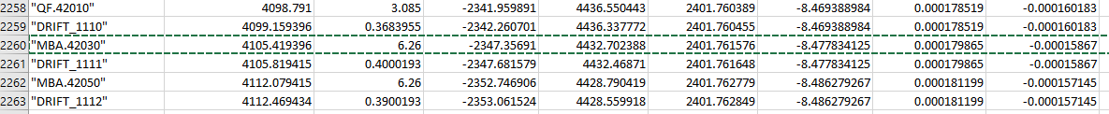
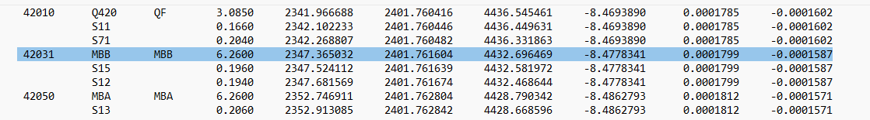
Comparing the data from the MAD-X and BEATCH
MAD-X
BEATCH
X -2347.356910+ | Y 4432.702388-
2347.365032= | 4432.696469=
0.008122 | 0.005919
SPS survey 15/2/2024

Slide 34
X -2347.356910+ | Y 4432.702388-
2347.365032= | 4432.696469=
0.008122 | 0.005919
MAD-X
BEATCH
Since we're dealing with the reference orbit
(moving our elements on the the particle trajectory S), this variance manifests as a 10mm shift of the MBA in MAD-X
√(0.008122^2+0.0057919^2)=0.01004995 mm
SPS survey 15/2/2024

Slide 35
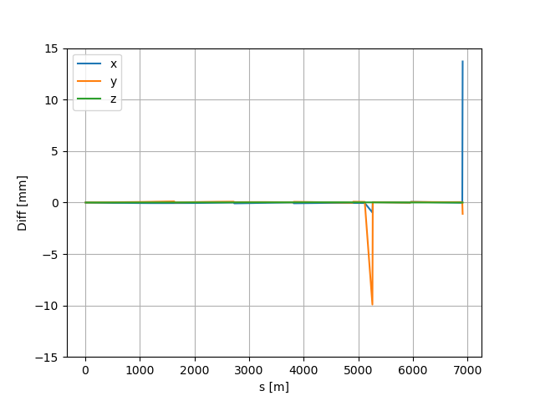
Moving the MBA of 10 mm in S
42010
42030
42050
-10 mm
First peak solved!
SPS survey 15/2/2024

Slide 36
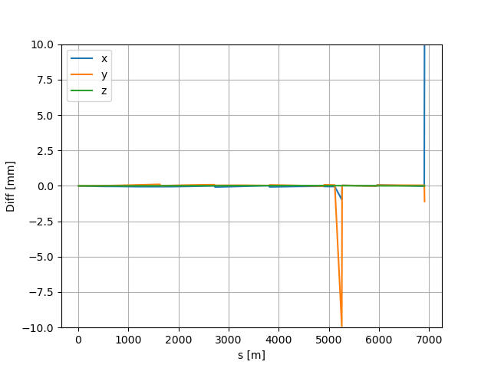
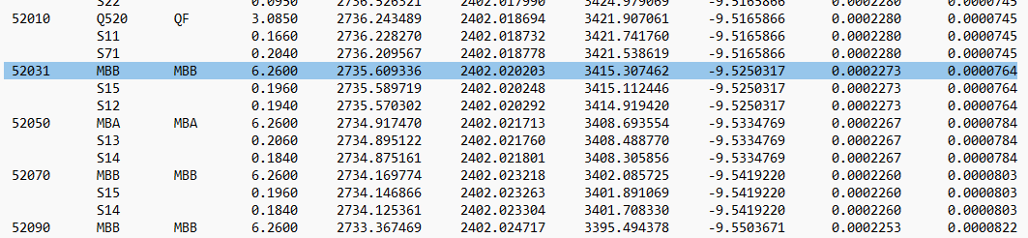
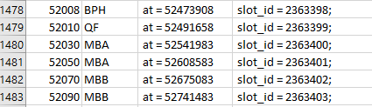
Time to investigate the second peak
BEATCH
LDB
Peak around 5200 m
SPS survey 15/2/2024

Slide 37
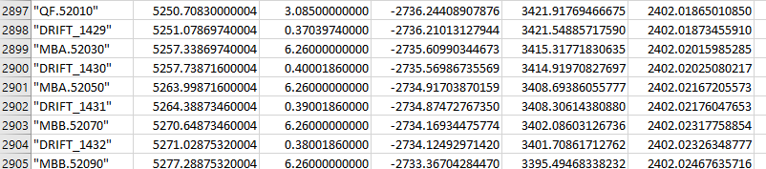
Comparing the data from the MAD-X and BEATCH
MAD-X
X -2735.609903+ | Y 3415.3177183-
2735.609336= | 3415.307462=
0.000567 | 0.0102563
BEATCH
√(0.000567^2+0.0102563^2)=0.010272 mm
in the the particle trajectory S
SPS survey 15/2/2024

Slide 38
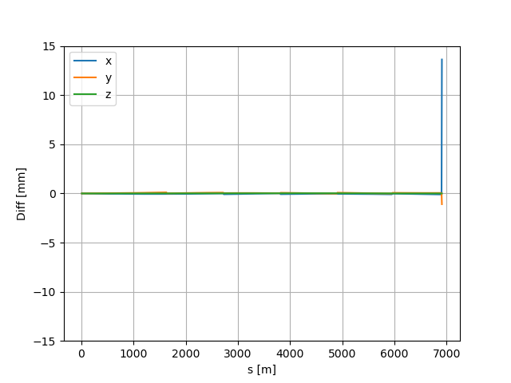
Moving the MBA of 10 mm
52010
52030
52050
-10 mm
Second peak solved!
SPS survey 15/2/2024

Slide 39
Time to investigate the theard peak
BEATCH
MAD-X
Peak around 6900 m
Last dipole in the sequence
SPS survey 15/2/2024

Slide 40
Time to investigate the theard peak
BEATCH
X -1561.771273+ | Y 2402.175184-
1561.758174= | 2402.175181=
0.013901 | 0.000003
MAD-X
√(0.013901^2+0.00003^2)=0.013901 mm
*In this case I didn’t notice differences in name between beatch file and the LDB as before
SPS survey 15/2/2024

Slide 41
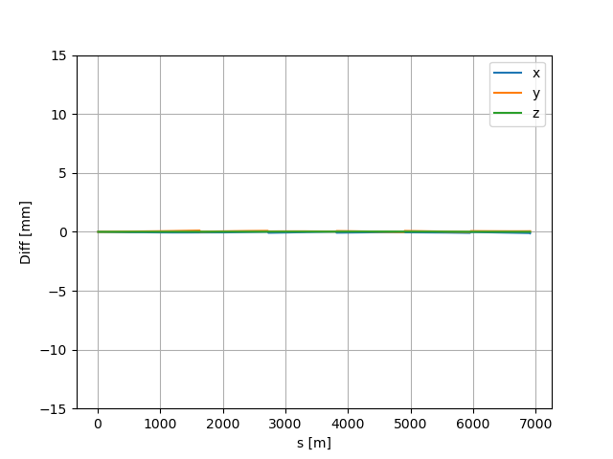
Moving the last MBA in the sequence
63570
63590
-13 mm
Peak solved!
Moving this dipole of almost 13mm we are forcing the machine to “return” at the initial BEATCH end-point
13.9[mm] ~ 18.6e-6 [m]*744
SPS survey 15/2/2024

Slide 42
dsmb=18.6e-6
#dsmb=19.33e-6
#dsmb=19.2e-6
mad = Madx()
mad.call("job_survey.madx")
eps = {
"mba": dsmb,
"mbb": dsmb,
"mdh.11607": -85e-6,
"mdv.21507": -98e-6,
"mba.22030": 13e-6+dsmb,
"mdv.31307": -100e-6,
"mba.32030": 14e-6+dsmb,
"mdv.41107": -100e-6,
"mba.42030": 10.014e-3 + dsmb,
"mba.42050": -10.000e-3 + dsmb,
"mdv.50907": -100e-6,
"mba.52030": 10.014e-3 + dsmb,
"mba.52050": -10e-3 + dsmb,
"mdh.60607": -100e-6,
"mba.62030": 33e-6,
"mba.63590": -4.630e-3 + dsmb, # 4.77
}
x0 = [-3e-6, 4e-6, 2e-6]
# x0 = [-3.000e-6, 2.500e-6, 2.700e-6]
dir0 = [0.3350e-6, 0.012e-6, +0.031e-6]
dir0 = [0.330e-6, 0.012e-6, +0.031e-6]
# dir0 = [0.0e-6, 0.0e-6, +0.0e-6]
name,dx,dy,dz = mksurvey(mad, eps, x0, dir0, "surveydiff4.png", 0.01)
plt.show()

