Slide 1
- Sensitivity tables including CEPC
- Benchmark of commissioning simulations with errors and corrections: AT vs MADX vs MADX-PTC
S.Liuzzo (ESRF), T.Charles (ANSTO), E.Musa (DESY), R.Tomas (CERN), I.Agapov (DESY)

Slide 2
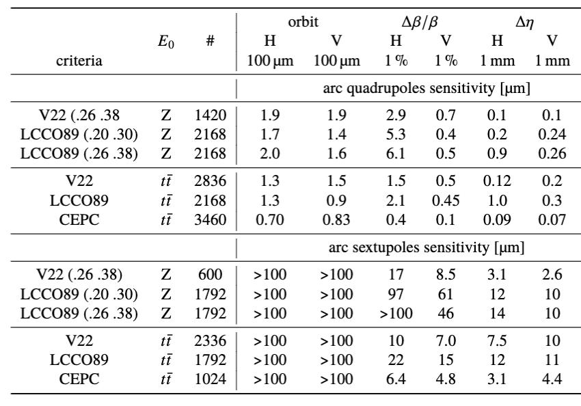
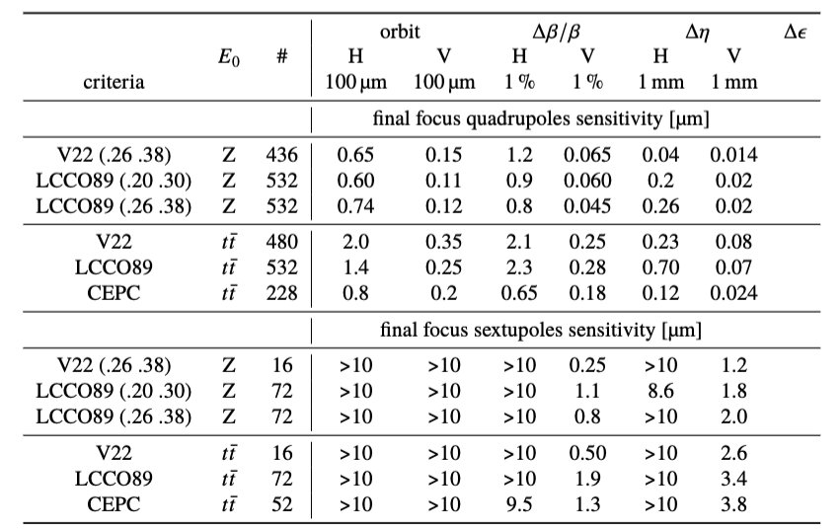
Sensitivity tables for V22, LCCO89 and CEPC_hlat_wcor
For CEPC the magnets in the FF are selected as those with *IR* in their name (easy for many tuning studies, would be nice if adopted also for FCC optics)
ALL MAGNETS ARE UNIFIED, NO “SLICES”.
For LCCO FF-Sext = NOT(S[FD][12])
In terms of sensitivities @ttbar, for most parameter (not all), LCCO > V22 > CEPC

Slide 3
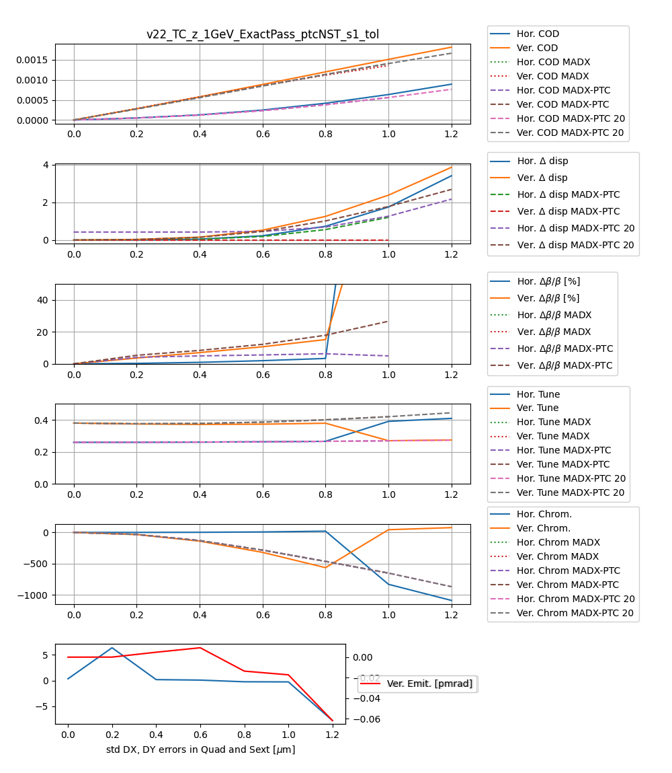
Benchmark of effect of errors in AT, MADX, MADX-PTC
Use lattice provided by T.Charles @ttbar (but Energy = 1GeV, no synchrotron radiation). Assure errors are identical for all codes: AT, MADX, MADX-PTC.
MADX-PTC (4 slices, exact) is closer to AT (as expected). Still there is a discrepancy.
Reason for discrepancy not yet understood.

Slide 4
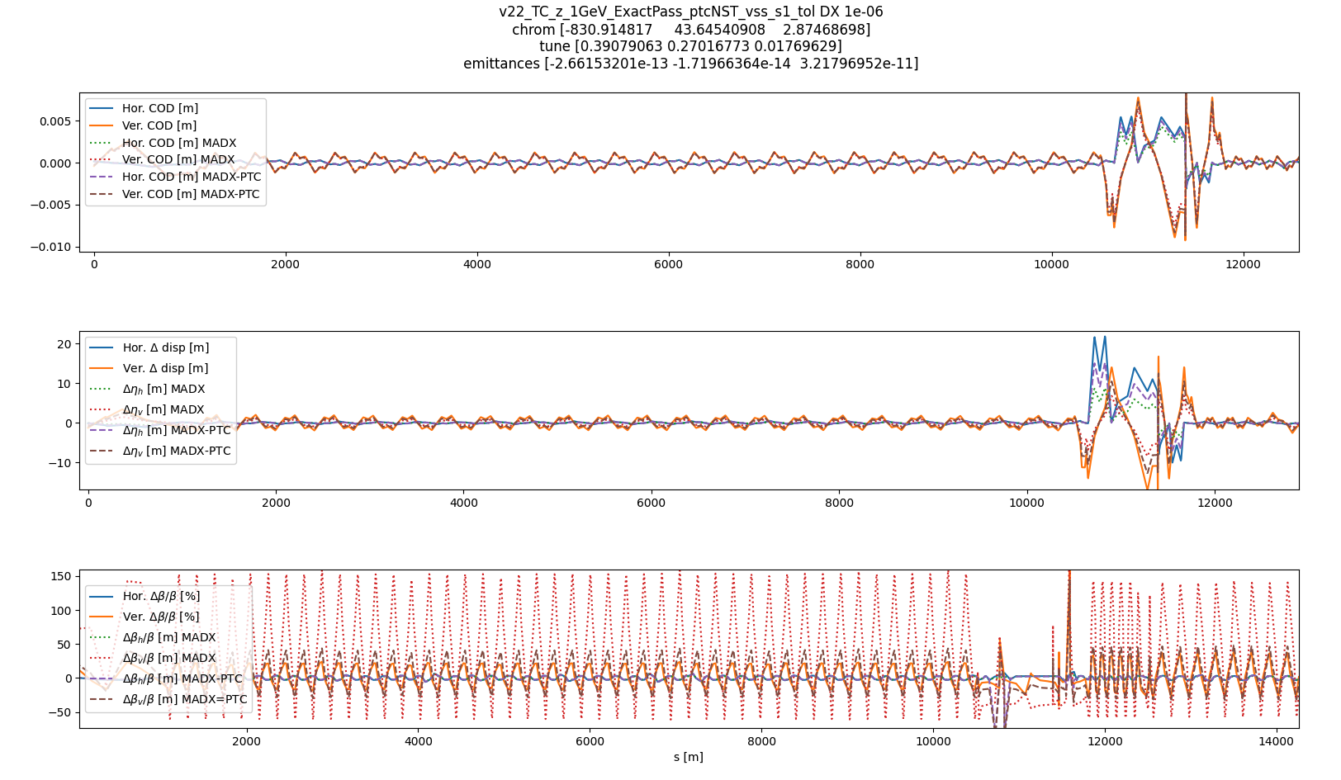
OPTICS WITH ERRORS ALONG S AT ALL LOCATIONS
For orbit and dispersion most of the difference is from the FF, and then it recovers. May be the exact integrators make the difference (is the exact flag in PTC set to true? for AT this is the case). MADX-PTC is closer to AT than MADX.
For beta-beating horizontal AT matches to horizontal MADX-PTC and MADX. For the vertical the MADX-PTC is closer to the AT values than MADX.
It is may be not a dramatic difference and it is limited to the IP. Would you continue to investigate or we keep it as a know-difference and continue? To minimize this effect we could forget about MADX for the future and keep only MADX-PTC for the comparisons.

Slide 5
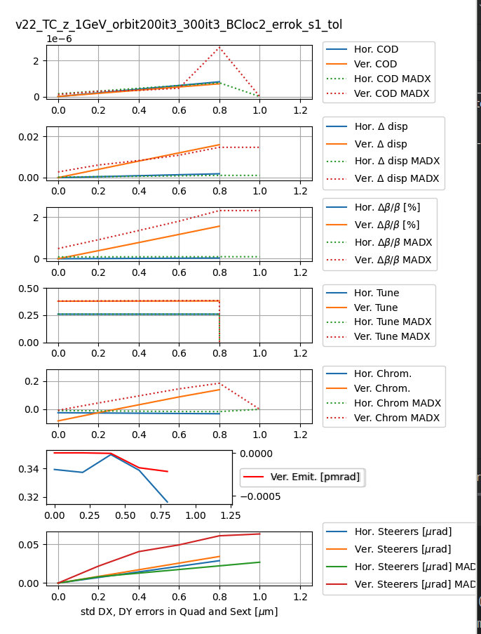
Effect of orbit correction
Use lattice provided by T.Charles @ttbar (but Energy = 1GeV, no synchrotron radiation). Assure errors are identical for all codes: AT, MADX, MADX-PTC. Assure BPM and correctors have same size and location.
We could obtain similar optics after orbit correction. Initial optics corrected by AT are larger than those given by MADX-PTC for the same initial errors. MADX-CORRECT command does not give direct access to orbit correction parameters in order to fix them for the comparison.
MADX-PTC 3xV, 2xH “COND=1, SNGVAL=50”
AT 3x H-V 300s.v. , 3x H-V 1000 s.v.

Slide 6
Next steps
The terms of the next tuning simulations to compare could be (get maximum tolerated alignment errors by AT and by MADX-PTC):
use AT or MADX-PTC (MADX gives too large initial beam optics parameters discrepancy)
if any, erase all existing correction (steerers, quadrupoles, sextupoles, etc.) (NO error ramp. We can skip this step in a next case of comparison.)
set one seed of 10 um errors in all quadrupoles sextupoles (the ones that we have been using now for comparisons, scaled to 10um).
Sextupoles OFF
find closed orbit (beam threading) (else we are stuck at 0.8-1 um rms errors)
Sextupoles ON
find closed orbit (beam threading) (else we are stuck at 0.8-1 um rms errors)
if orbit is not found, reduce initial errors by ~25% (ex 7.5um)
correct orbit (as in previous slide)
correct tunes (which magnets to use?)
correct chroma (which magnets to use?)
(optional, as there are too many parameters to agree upon) correct optics
evaluate orbit, dispersion, beta vs s (usual files twiss_1p0um*)
evaluate rms orbit, dispersion, beta, tunes, chroma, emittances, steerers, quad. corr., sext. corr. (usual file optics_param_ptc* + quad + sext rms)
(optional) evaluate x-y DA @ FRF.1
(optional) evaluate dpp-x DA @ FRF.1
Compare the values in the points 10, 11,(12), (13) AT vs MADX-PTC
If all parameters are ok (DA negligibly affected, beta-beating ~1% etc..) then repeat all above steps with x2 errors.
This procedure should converge to a value of errors above which correction fails. It will show if the two codes really diverge and when this happens.
If there is no divergence we can skip step 2 and study the un-realistic case of error ramp. This will tell us the potential tolerance, if we can make the tuning procedure capable of reaching it.

Slide 7
Conclusions
Sensitivities @ ttbar: LCCO > V22 > CEPC
Comparison of codes (AT, MADX, MADX-PTC) with errors and correction to understand tolerance estimates discrepancy:
  Optics with alignment errors (identical element by element for all codes):
    orbit, dispersion, chroma in AT > MADX-PTC > MADX (to be excluded from future comparisons)
    Beat-beating, ver. tune MADX-PTC > AT
    Discrepancy mostly in the Final Focus region
    Could use transfer line optics to detect if the discrepancy starts at a specific location
  Optics with alignment errors and orbit correction:
    No success in setting identical parameters for orbit correction. Nevertheless, both codes can converge to similar orbit residuals. AT starts with larger orbit-rms and gets finally lower steerers rms.
    Without beam threading, for the seed of errors studied, 0.8um is the maximum rms at which both codes find a closed orbit.
    NEXT step: extended tuning procedure with beam threading, tunes and chroma to get tolerated values. Same procedure, same correction parameters, for all codes.
    Presently no source of discrepancy has been found.

Slide 8
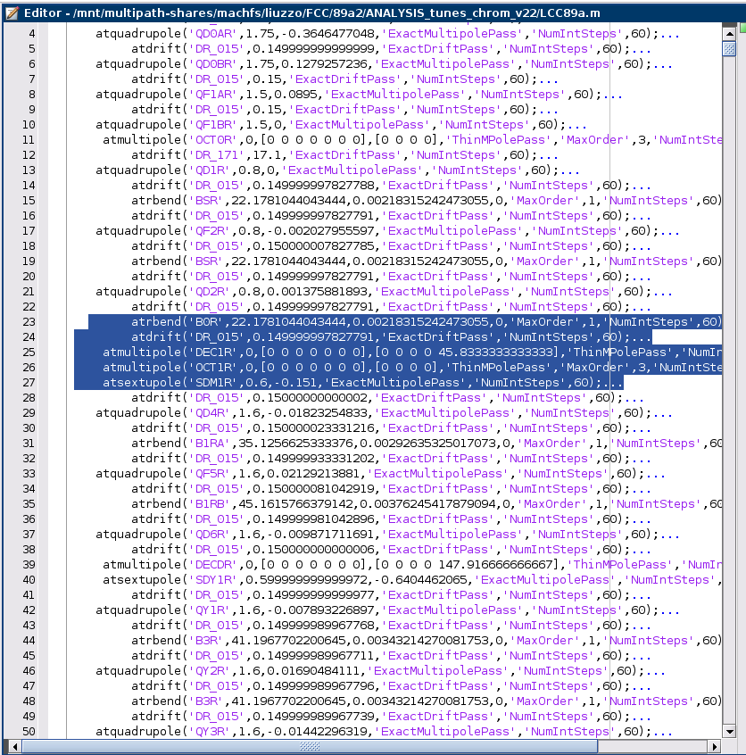
Sample from AT lattice. All elements are unified. NO SLICES

