Slide 1
Tuning studies with MADX
Tessa Charles
charlest@ansto.gov.au

Slide 2
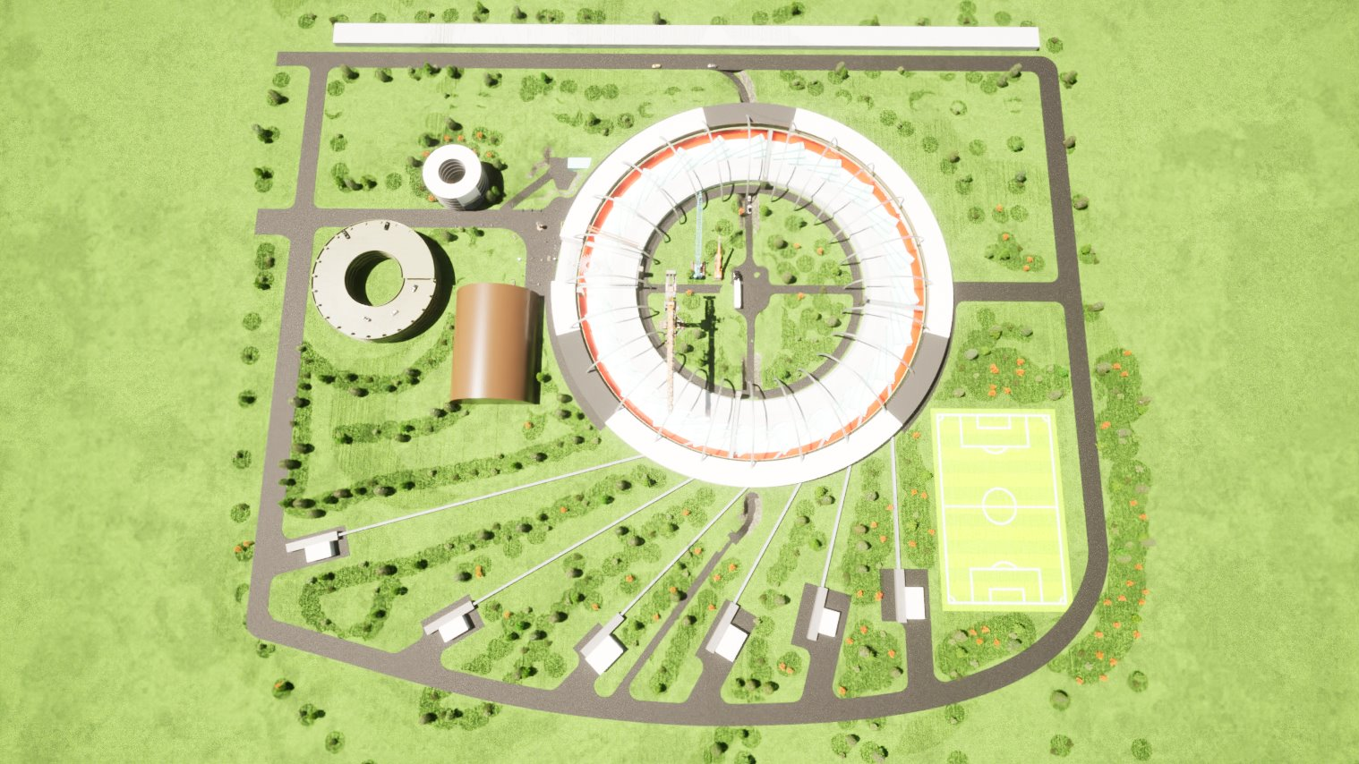
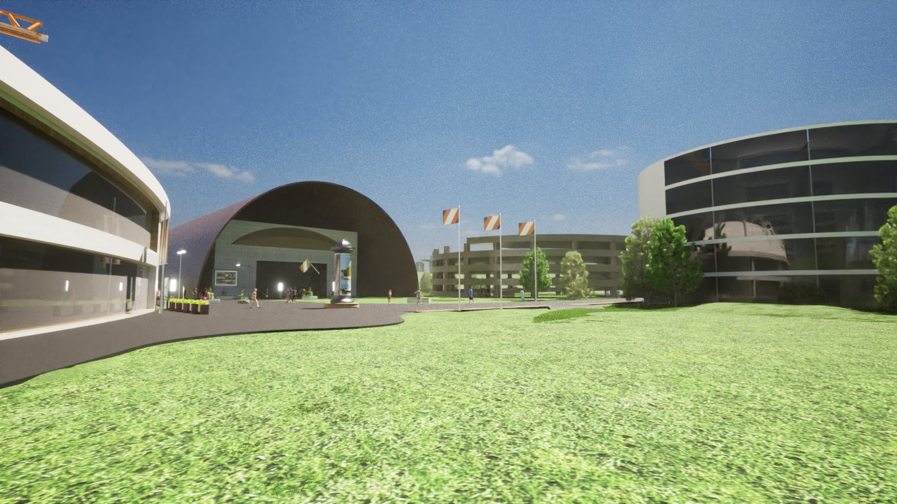
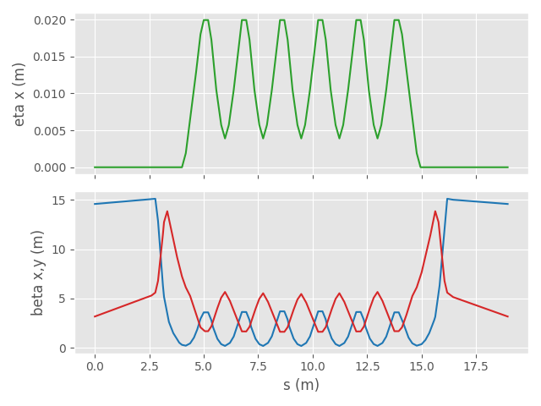
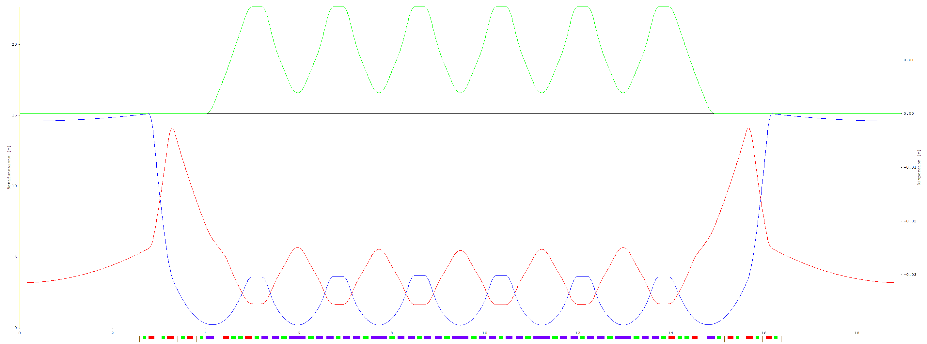
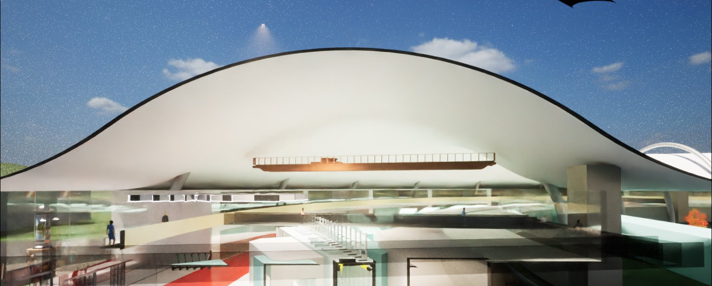
Australian Synchrotron & AS2.0
A greenfield, 4th gen light source proposal
CDR in early stages of being developed
Parameter | Value | units
Emittance​ | 50​ | pm​
alphaC​ | 0.56​ | xE-4​
dE/turn​ | 785​ | keV​
Circumference​ | 454.8​ | m
Touschek​ | 5.173​ | h​
Qx​ | 70.25​ | ​
Qy​ | 20.81​ | ​
ChX​ | -151​ | ​
ChY​ | -76​ | ​
Straights​ | 5​ | m​
Bore radius​ | 12.5​ | mm​
Max Dipole​ | 1.048​ | T​
Max Quad​ | 110​ | T/m​
Max Sext​ | 10 000​ | T/m2​
Facility Layout
βx
Foyer and Admin Buildings
βy
Building Cross Section

Slide 3
Adding extra elements
Which elements, where?
Correctors (L = 0.2 m) before all quads. (Except, currently, QC1*, QC2*, QC0*, QRF*)
BPMs (L=0) before all quads
Trim quads and skew quads at every sextupole (inc. SY* sextupoles)
Naming conventions currently used (Can be changed if anyone has feedback)
BPMs: BPM.QD1.1
Correctors: MCB.QD1.1
Skew quads: MQS.SD20.1
Trim quads: MQT.SD20.1
Other naming issue:
RF quads at different RF stations have identical name. This could be problematic if using these quads for tune correction. I can rename them, but I don’t want to introduce inconsistent naming.
First 3 consistent with what’s at:
/eos/project/a/acc-models/public/fcc/fccee/V22/t
Notes:
Long dipoles

Slide 4
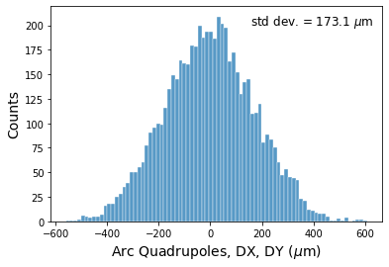
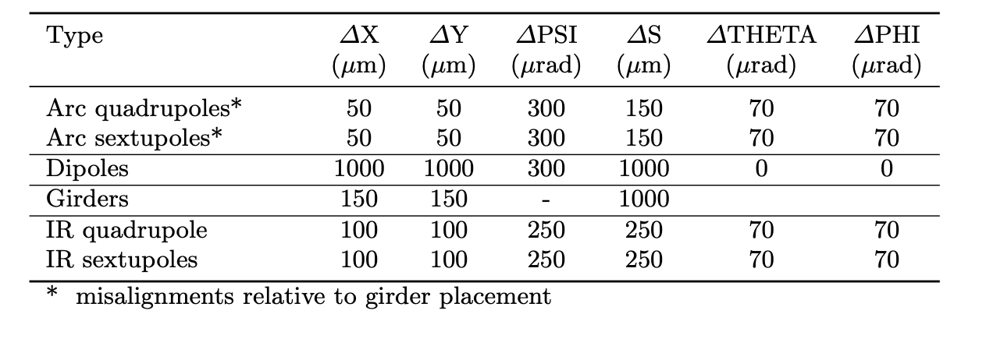
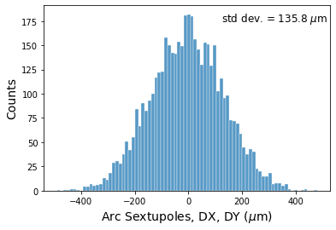
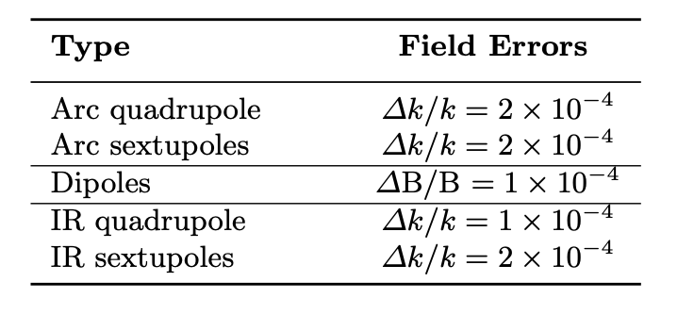
Emittance tuning results, ttbar
Note: BPM errors not included

Slide 5
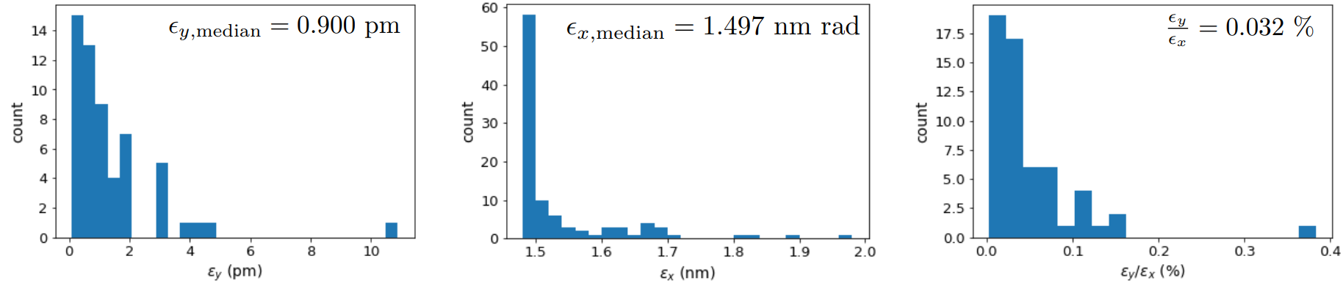
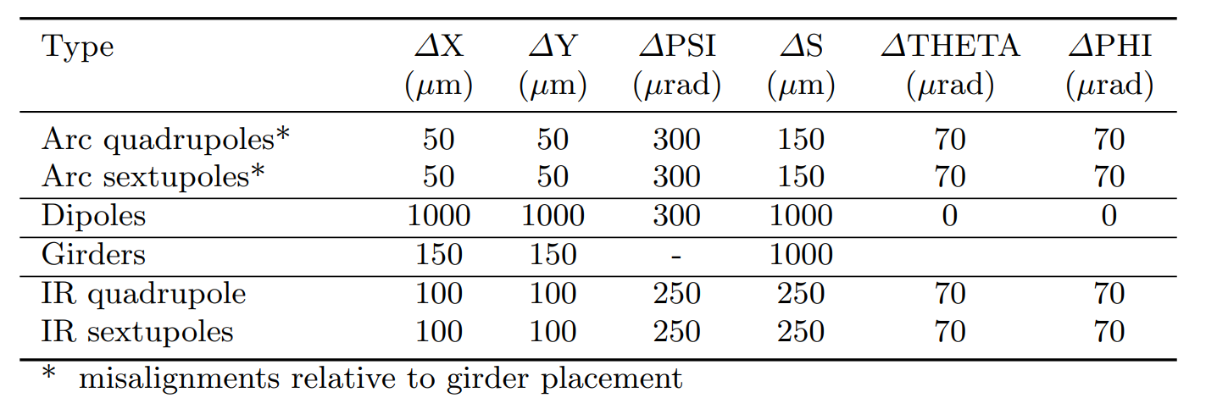
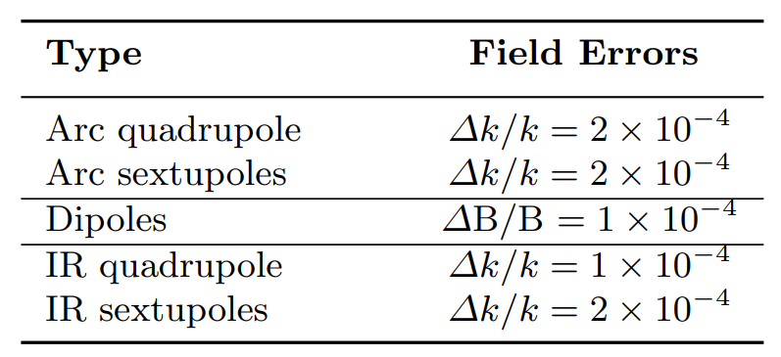
Emittance tuning results, ttbar
Note: BPM errors not included
Oide ttbar lattice
Note:
Despite linear optics appearing good, DA is still very limited.
Further work needed, and tighter tolerances most likely needed.
Notes:
$\epsilon_{x, \textrm{median}} = 1.510$ \textrm{ nm rad }

Slide 6
Emittance tuning results, ttbar
Note: BPM errors not included
Note:
Despite linear optics appearing good, DA is still very limited.
Further work needed, and tighter tolerances most likely needed.
Notes:
$\epsilon_{x, \textrm{median}} = 1.510$ \textrm{ nm rad }

Slide 7
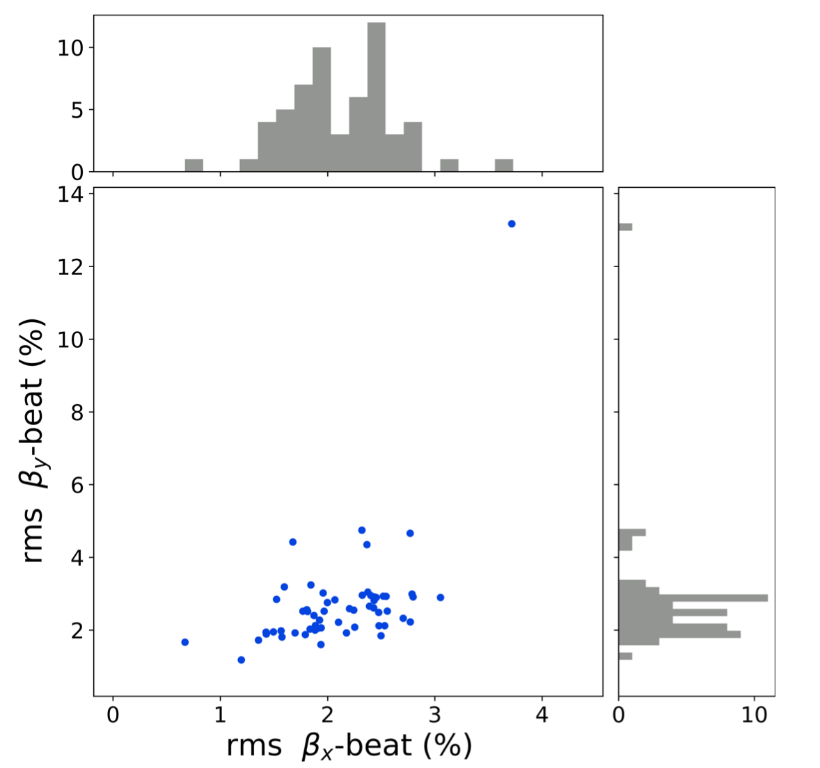
Emittance tuning results, ttbar
Note: BPM errors not included
Note:
Despite linear optics appearing good, DA is still very limited.
Further work needed, and tighter tolerances most likely needed.

Slide 8
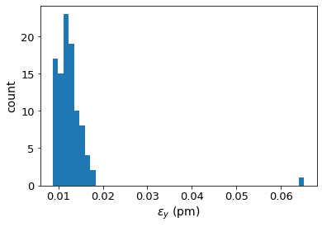
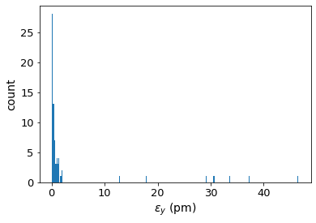
Impact of COD
In this example, most properties of the machine are well-corrected, except for chromaticity.
Before chromaticity correction:
After Chromaticity correction:
Chromaticity correction
And a large proportion of seeds start to fail

Slide 9
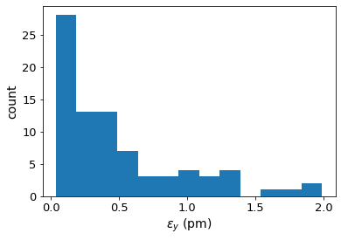
Impact of COD
In this example, most properties of the machine are well-corrected, except for chromaticity.
Before chromaticity correction:
After Chromaticity correction:
Chromaticity correction
Highest 8 emittances removed, to better view lower end of distribution.
And a large proportion of seeds start to fail
Chromaticity correction corrects chromaticity well, but increases coupling.
Of course, an iterative procedure is necessary, but nevertheless this massive increase in hor. emittance was despite a fairly small COD (see nest slide)

Slide 10
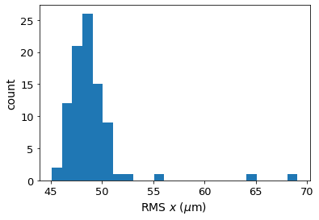
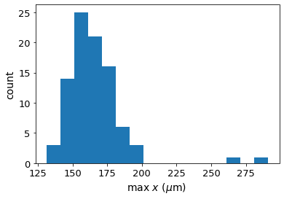
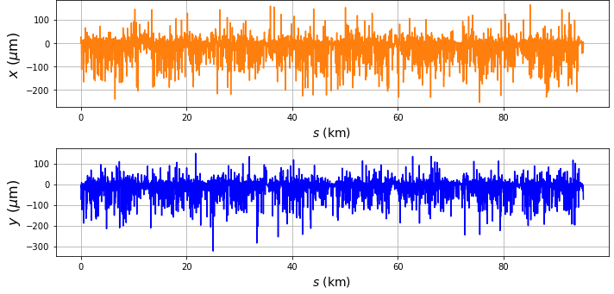
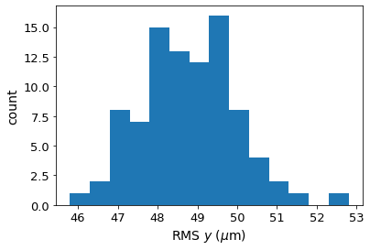
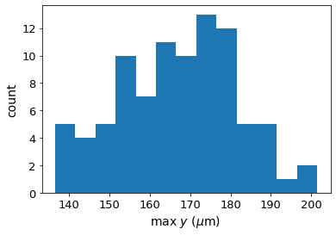
Impact of COD
Below is the orbit for the example of chromaticity correction.
Improved orbit correction would help, but it’s already good (~48 um RMS in x and y).
Also BPM error were not yet included, so COD likely to be worse
RMS horizontal orbit and max orbit distortion, after corrections (BPM errors not included):
Notes:
Why does this happen? Chromaticity corr changes sextupole strengths.
Improved orbit correction would help, but it’s already good.

Slide 11
Next steps
Applying corrections to Z lattice (in collab with Simone Liuzzo and Elaf Musa)
DA calculations (for ttbar and Z lattice)
Explore synergies with the Australian Synchrotron and AS2.0

Slide 12
Thank you

Slide 13
Misalignments and field errors

Slide 14
Assigning girder misalignments
sextupoles/ quadrupoles
girder
girder
(not to scale)
dipole
dipole
  - 2 independent DX and DY misalignments for each end of the girder, and which can be used to calculate DTHETA and DPHI.

