Slide 2
Working Group:
Training and Career Development
Stefan Roiser (CERN)
Andy Yates (EMBL)

Slide 3
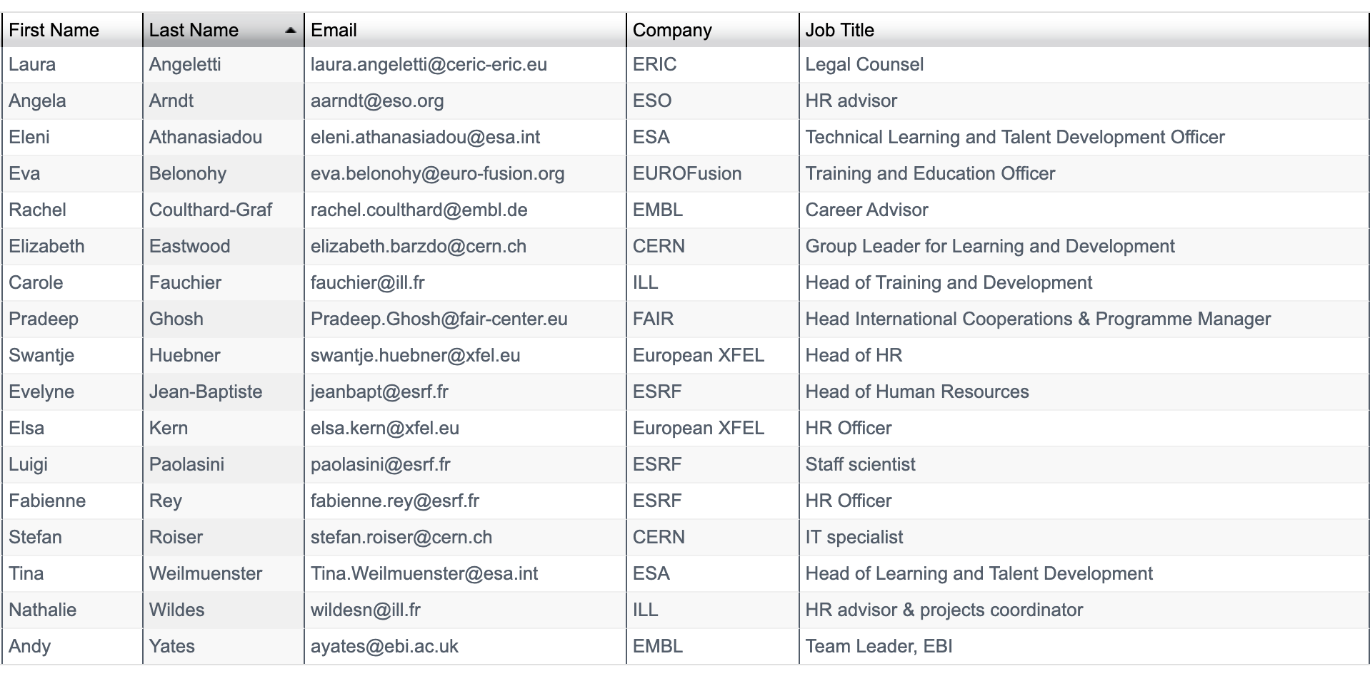
Working Group Members

Slide 4
Activities from 2024
Presentations and information exchange on “competency models and benchmark jobs” during WG meetings
  EMBL, CERN, EUROfusion and presented
  ESA will present their competency framework in the new year
Workshop on “Effective Knowledge Capture”
  Organised by Eva Belonohy/EUROfusion
  4-7th June https://indico.euro-fusion.org/e/EIROforumKnowledgeManagementWorkshop
  Presentations from EIROforum members and external organisations including NASA and IAEA
  All materials available from the above site
Notes:
NASA: National Aeronautics and Space Administration
IAEA: International Atomic Energy Agency

Slide 5
Additional efforts
Feedback from the April DG meeting flagged new areas to concentrate upon
  DOE Oppenheimer Leadership Network presented to the working group
  Direct relevance is limited but provides useful insights
New guests of the WG
  ERIC and FAIR contacts have been established
  Will present themselves at 12th December meeting
  Eumetsat has shown interest and will follow-up
Notes:
NASA: National Aeronautics and Space Administration
IAEA: International Atomic Energy Agency

Slide 6
Planned activities for 2025 for discussion
Benchmark jobs white paper
Oppenheimer leadership network in EIROforum context
Similar workshop to Knowledge Management planned around “Producing Visual Training material” for February 2025
Need to redouble efforts on synergies in training across EIROforum members and WG guests
Requiring more effort/activation energy
  EIROforum wide catalog across EIROs and leverage on EVERSE EU project (Stefan Roiser Dec 2024)
  Setup of a EIROforum leadership network similar to Oppenheimer (yes/no decision needed)
Proposal to move our meetings to monthly and 1hr to increase engagement

Slide 7

Thank you
Andy Yates (EMBL)
Working Group Co-chair

