Slide 1
Is Cyber Security
IPv6-Ready?
HEPiXX – Vancouver, BC
Bob Cowles
October, 2011

Slide 2

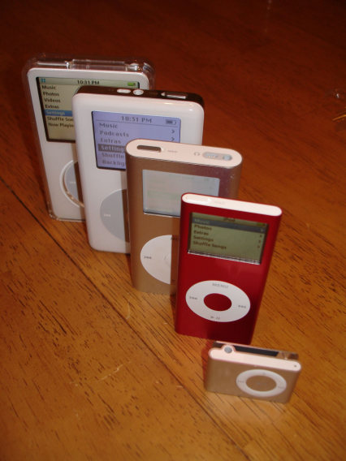
Quiz: What Happened to IPv5
Lost in space?
Born out of TCP?
Replaced by the iPod?
Protocols are even numbers?

Slide 3
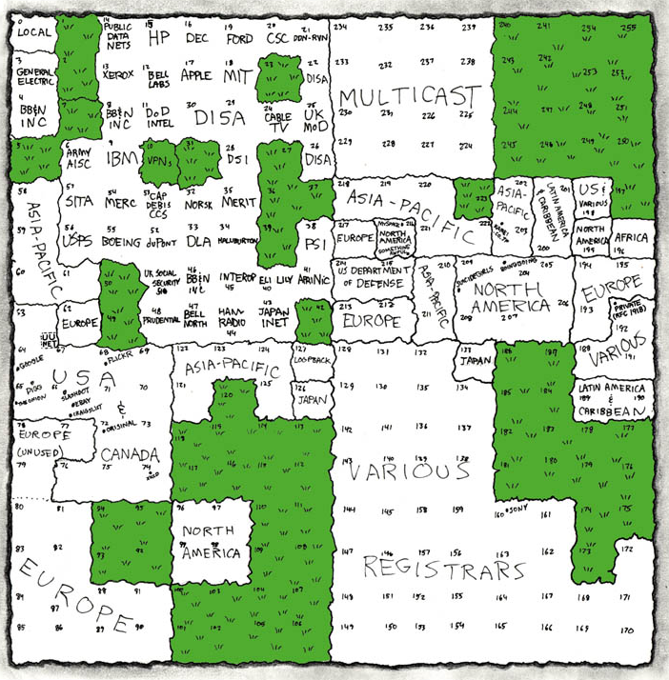
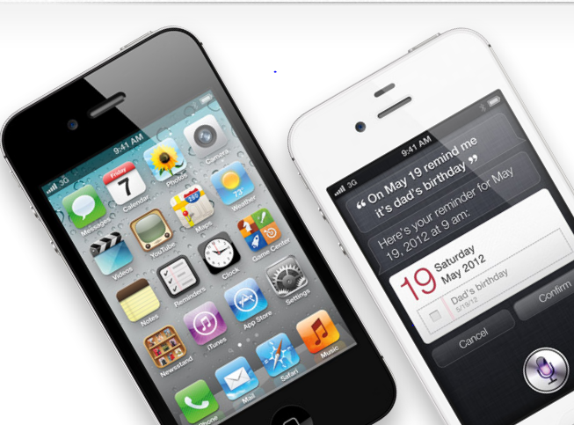
What happened to IPv4?

Slide 4

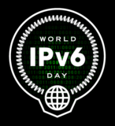
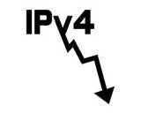
IPv6 Concepts Quiz (six-foo)
Minimum MTU?
You can get a logo if you are IPv6 ______?
NIST guidelines for secure config 800-___
Number of address bits router examines?
2001:0db8:76ff:0000:dab4:0000:0000:da8c
What are ::1/128? fe80::/10? fd00::/8? 2000::/3?
ff02::1, ff02::2, ff02::fb ?
Maximum jumbo packet size?
# of IPv6 addresses for a host on the internet?

Slide 5
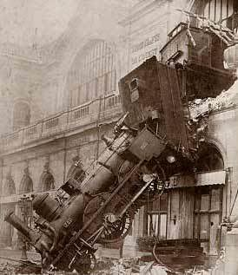
Are there Security Issues?
Architecture
Design
Implementation
Configuration
Operation
Co-Existence with IPv4
Tools

Slide 6

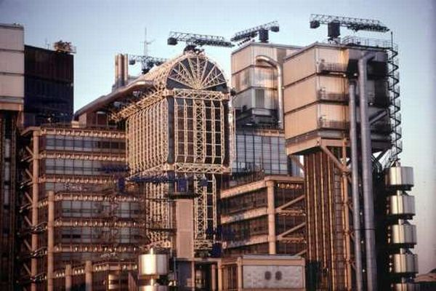

Architecture
Multicast, IPsec, ICMPv6 required
IP addresses impossible to remember
  dead:beef
  bebe
Address mapping is now many to1 to many
Fragmentation left to hosts

Slide 7
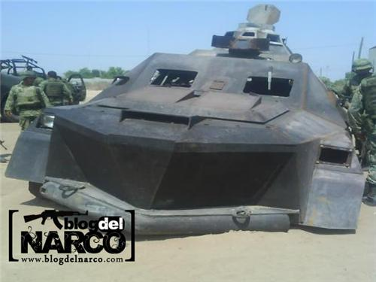
Design
Routing Headers bring back source routing
Too many things are suggestions and not strictly enforced
  TCP can adjust MSS to prevent fragmentation
  Order of Extension Headers
Unused fields can be covert channels
Mobility IP

Slide 8

Implementation
Implementations are still partial
  E.g. centos firewall accepts IPv6 – does nothing
IPv4 errors will be repeated
Error conditions will be undetected or handled in different ways
Inconsistencies in specs are still being discovered
SEcure Neighbor Discovery (SEND) not widely implemented – required for adequate security
  Protects RA/RS and ND
  RFC3971

Slide 9


Configuration
Many additional or different issues to consider
Explosion of IP addresses per host
Considerations in subnet and IP address assignment
  Non-obvious vs. easy to guess?
  Based on MAC vs. privacy
Use routing headers? IP mobility? DHCP?

Slide 10

Operation
Everything has to be tested in detail
  Devices IPv6-Ready but associated firmware is not available (e. g. printers)
Host option controls
  Autoconfig vs DHCPv6
  Mobile IP
  IP address changing
  Use of routing headers
  Response to mDNS
  Response to Neighbor Solicitations/Advertisements

Slide 11


Co-Existence with IPv4
Dual stacks add complexity
Ability to send packets over two different protocols (evade packet inspection)
Tunnels – 6-to-4, Teredo (shipworm)
Interactions not fully understood but wiill be exploited
Windows – can turn off IPv6 but not restore via registry entry

Slide 12

Tools
Some new tools, some old tools with new options
  traceroute6 (unix), tracert -6 (windows)
  tcpdump extended with new options and functionality (e. g. “protochain to parse extension headers)
  wireshark, nmap is OK, snort is not ready
Passive asset discovery easier than active

Slide 13


Security?
Attention to configuration guidelines
  http://www.nsa.gov/ia/_files/routers/I33-002R-06.pdf
  http://csrc.nist.gov/publications/nistpubs/800-119/sp800-119.pdf
Plan transition carefully – use experiences already published as guidelines
  Join mailing lists, working groups
Test, test
  Everything works that is supposed to work
  Nothing works that isn’t supposed to work

Slide 14
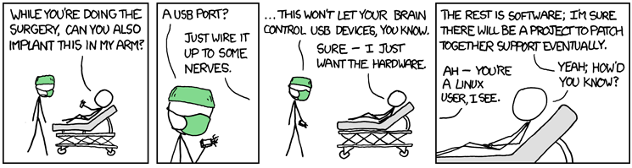
Get Prepared!
Ethernet?
Courtesy of xkdc.com

Slide 15

Liftoff!

