Slide 1

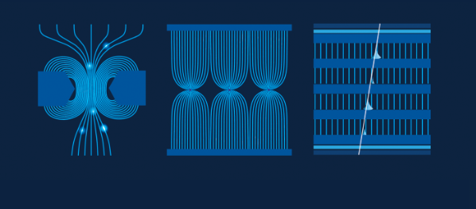

MPGD technologies 1
Micro Pattern Gaseous Detectors
Esther Ferrer Ribas
CEA/IRFU

Slide 2
MPGD technologies 1
Outline
Birth of Micro Pattern Gaseous Detectors (MPGD)
Gas Electron Multipliers
Micromegas
Micro Resistive Well
Applications

Slide 3
Birth of Micro Pattern Gaseous Detectors
In the 90’s advances in microelectronics and photolithographic technology on flexible and standard PCB substrates favored the invention
Pitch size of a few hundred microns, an order of magnitude improvement in granularity over wire chambers
First Micro Pattern Gaseous Detector (MPGD): Micro-strip Gas Counter (MSGC) Oed, 1988

Slide 4
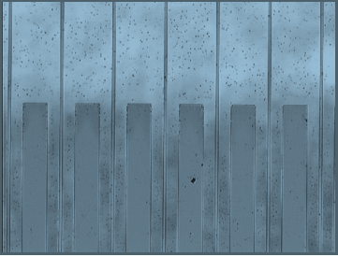
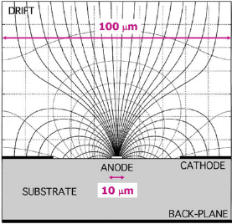
MSGC
Performance
Intrinsic high-rate capability (>10⁶ Hz/mm²),
excellent spatial resolution (down to 30 μm),
multiparticle resolution (∼500 μm),
single photo-electron time resolution in the ns-range,
large sensitive area and dynamic range.
Limitations:
Destructive sparks,
time-dependent gain shifts (substrate polarization and charging up),
deterioration during sustained irradiation (“aging”).
Credit: Sauli « Gaseous Radiation Detectors »

Slide 5

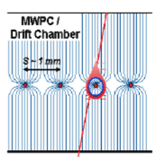
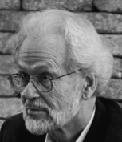
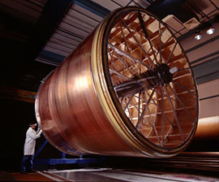
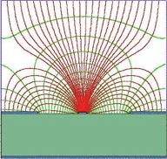
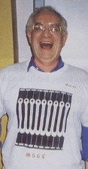
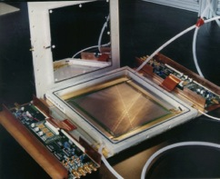

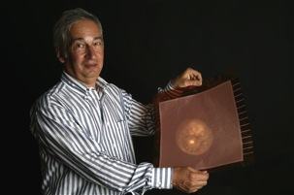
Birth of MPGD
MWPC
Multi-Wire Proportional Chamber
G. Charpak et al., 1968
TPC
Time Projection Chamber
D. R. Nygren et al., 1974
MPGD
MSGC
Micro-Strip Gas Chamber
A. Oed, 1988
CATHODE
ANODE
CATHODE
200 µm
GEM
Gas Electron Multiplier
F. Sauli, 1997
MICROMEGAS
MICRO-MEsh GAseous Structure
I. Giomataris et al., 1996

Slide 6
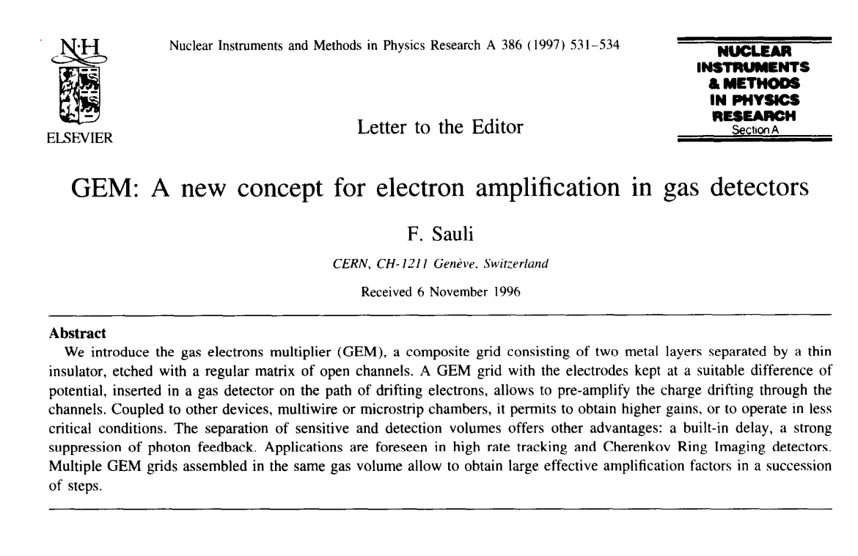
Gas Electron Multiplier (GEM)

Slide 7
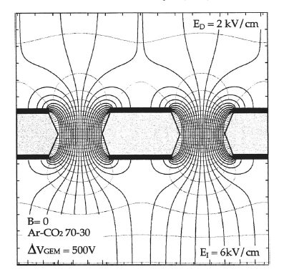
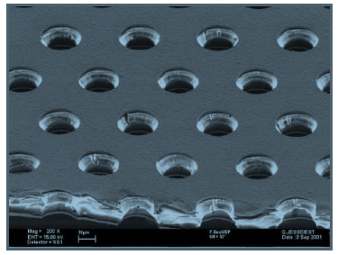
GEM
A thin, metal-clad polymer foil chemically perforated by a high density of holes, typically 100/mm²
Large ΔV between the two sides of the foil creates a high field
Electrons released in the upper region, drift towards the holes acquiring enough energy to provoke ionisations
Large fraction of electrons are transferred into the lower section

Slide 8
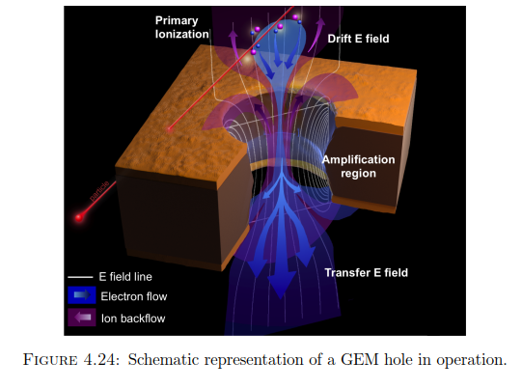
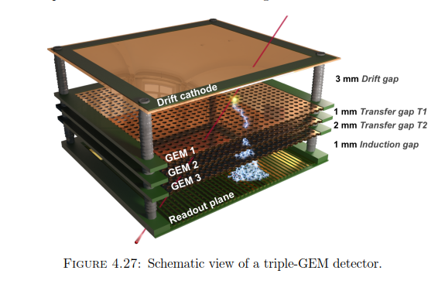
GEM
Full decoupling of amplification stage (GEM) and readout stage (PCB, anode)
Amplification and readout structures can be optimized independently
“Study of long-term sustained operation of gaseous detectors for the high rate environment in CMS”, J. Merlin,
CERN PHD theses, https://cds.cern.ch/record/2155685/files/CERN-THESIS-2016-041.pdf

Slide 9
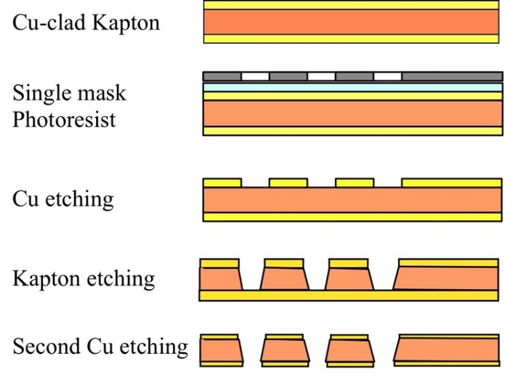
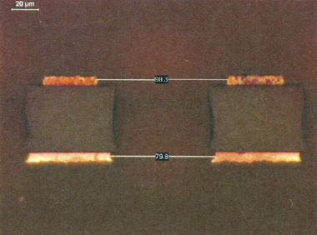
Manufacturing of GEM: single mask
Large size detectors
« MPGD manufacturing » by Rui de Oliveira on 3/12
From F. Sauli RD51 school 2023

Slide 10
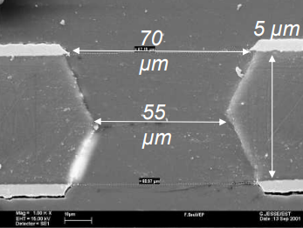
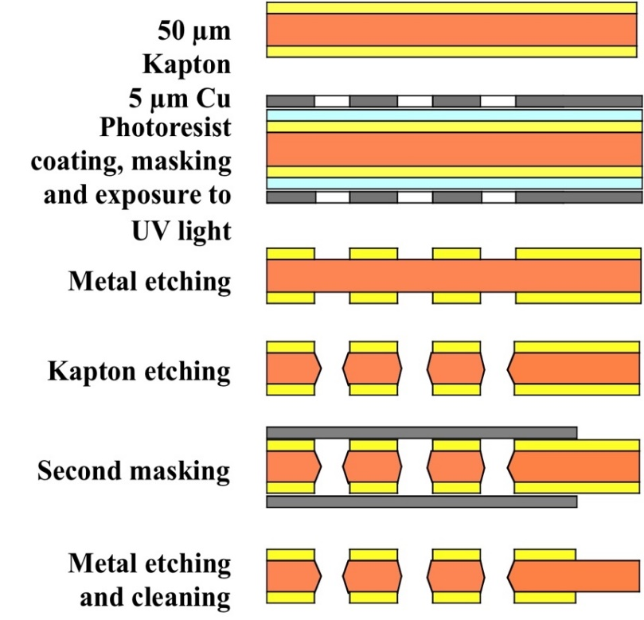
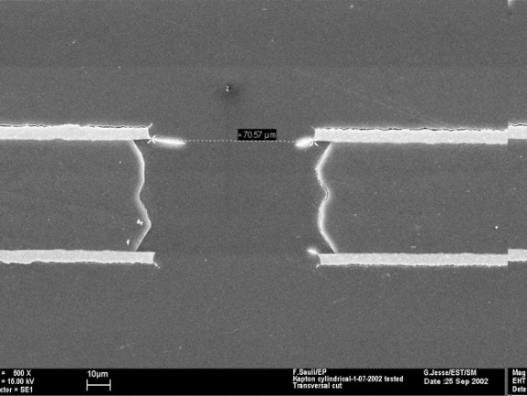
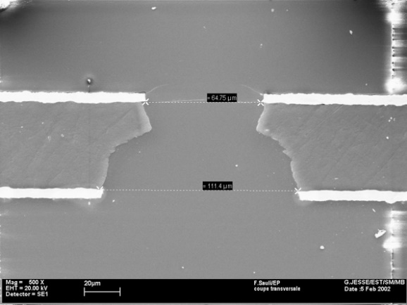
Manufacturing of GEM: double mask
From F. Sauli RD51 school 2023
STANDARD
Double-Conical
Hourglass
CYLINDRICAL
CONICAL
« MPGD manufacturing » by Rui de Oliveira on 3/12

Slide 11
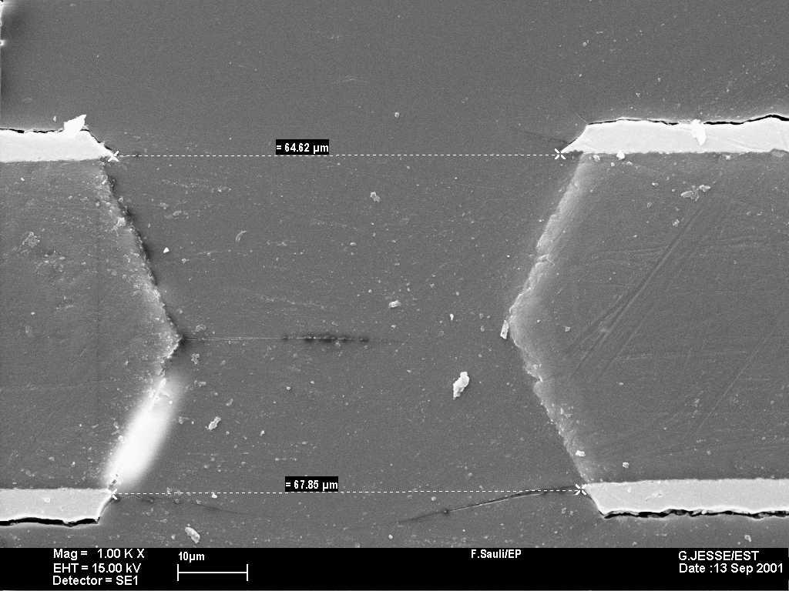
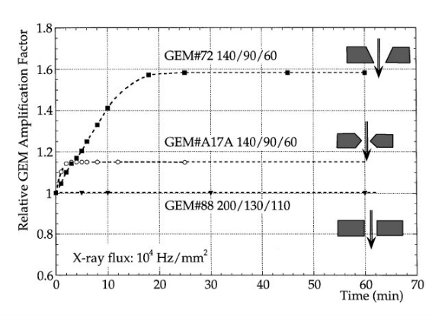
Manufacturing of GEM: double mask
Shape of the holes influence performance
Trade off: high gains/charging up effects
Standard: patch for discharge longer/reaching higher gains but more insulator so more charging up
STANDARD
Double-Conical
Hourglass
CYLINDRICAL
CONICAL
From F. Sauli RD51 school 2023

Slide 12
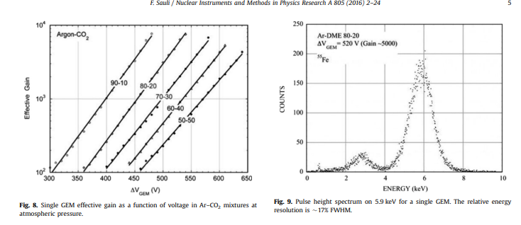
Performance in single GEM

Slide 13
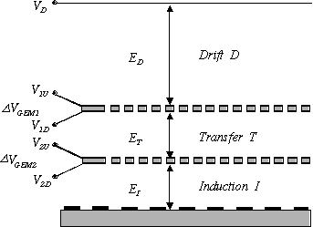
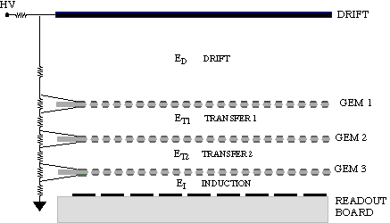
Multi-GEM
Cascade of GEM electrodes
Allows attaining higher gain with each GEM at lower voltage
Discharges disfavoured
S. Bachmann et al, Nucl. Instr. and Meth. A479 (2002)294
Notes:
Use of three GEM electrodes and an anode separated by 2mm gaps.
A scheme to distributed the apropriated voltage to all electrodes
The detector gain is characterised with an Fe source.
The maximum safe operating voltage is found and then with an alpha source Radon
Amount of moisture in the gas should be kept below 50 ppm

Slide 14
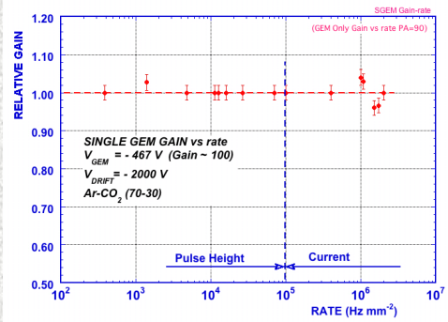
GEM Rate capability
5.9 keV X-rays:
> 2.10⁶ mm⁻²
J. Benlloch et al, IEEE NS-45(1998)234

Slide 15
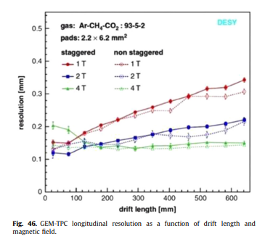
GEM spatial resolution
F. Sauli, NIM A 805 (2016) 2-24
Notes:
Staggered: pads in every second row are shifted by half pitch

Slide 16
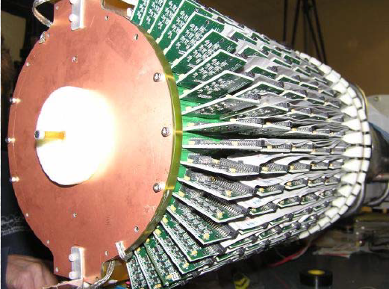
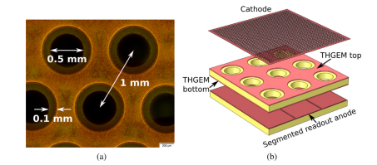
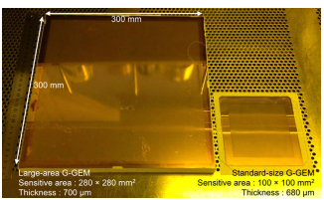
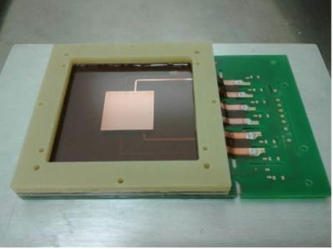
GEM family
Cylindrical GEM
THICKGEM/LEM
S. Bressler et al. , Progress Particle and Nuclear Physics 130 (2023) 104029
GEMPix: a triple GEM structure read by 50 micron pixels
GLASSGEM
F. Murtas, JINST (2014) 9 C01058
Y. Mitsuya et al., NIM A 795 (2015) 156-159
Notes:
Depending on the insulator substrate kapton, pcb, or glass. You can hace standard gem, thick gem also called Large electron multiplier.
You can curve them an obtained a cylindrical GEM or if you coupled GEM electodes to a Medipix chip o Timepix you will have a GEMPIX which is an extremely pixelated structure

Slide 17
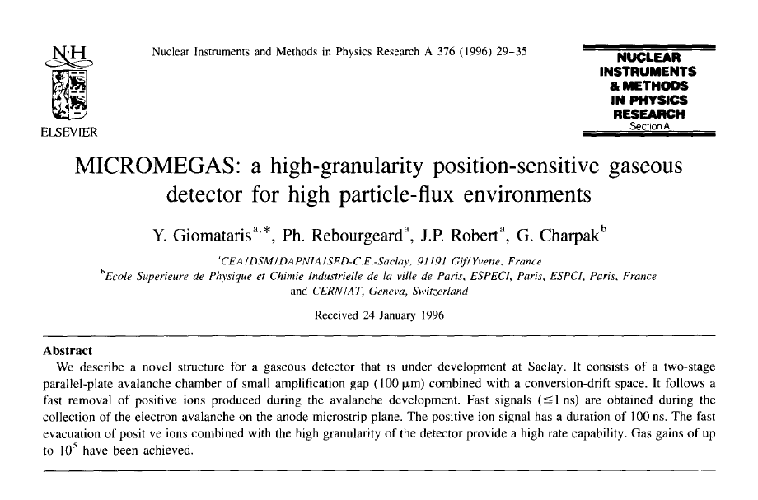
Micromegas

Slide 18
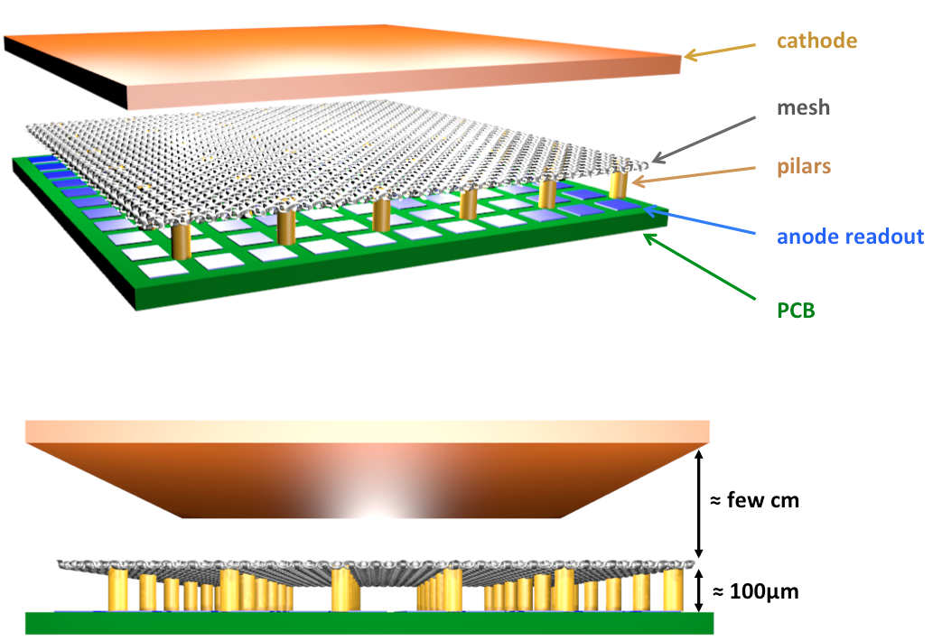
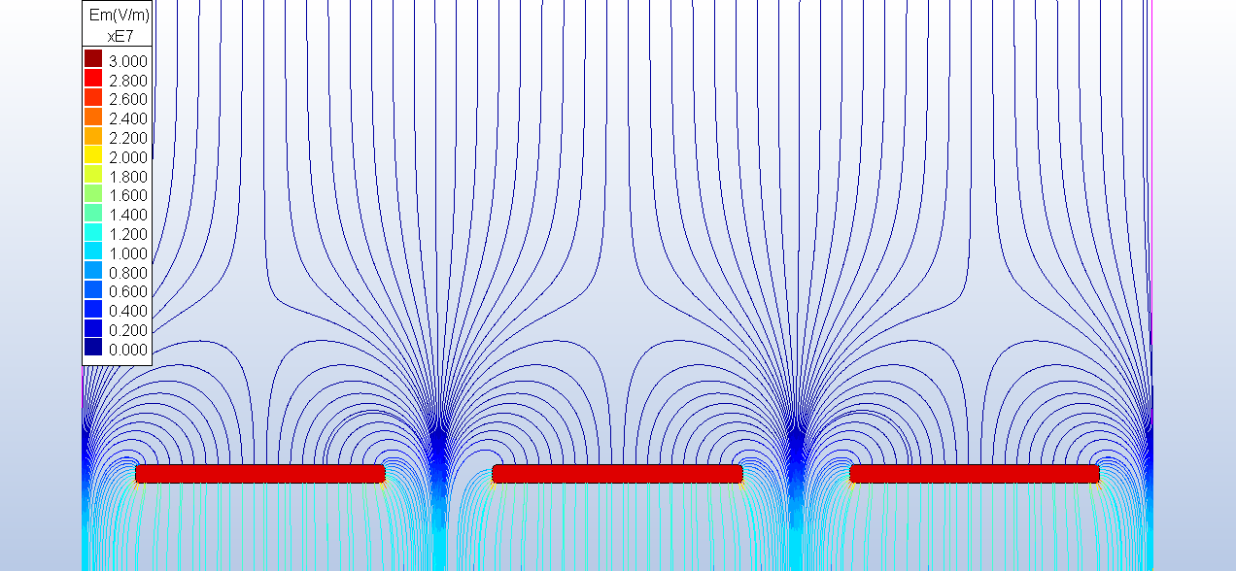
Micromegas

Slide 19
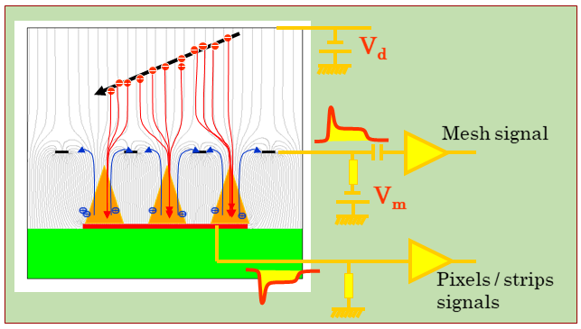
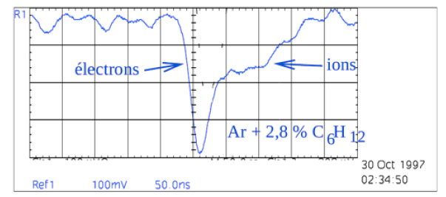
Micromegas
Multiplication takes place in high E field (~ 40 kV/cm) between the anode and the mesh
  High gain (up to 10⁵ or more)
  Single stage of amplification
    Fast signals (< 1 ns)
    Fast & natural ion collection
    Low ion backflow to the drift region
    Short recovery time (~150 ns)
    → High-rate capability (>MHz)
Signal is induced by both electron & ion movement towards the anode / micromesh
  Thin amplification gap (50-150 µm) →
    Small imperfections → no gain variations

Slide 20
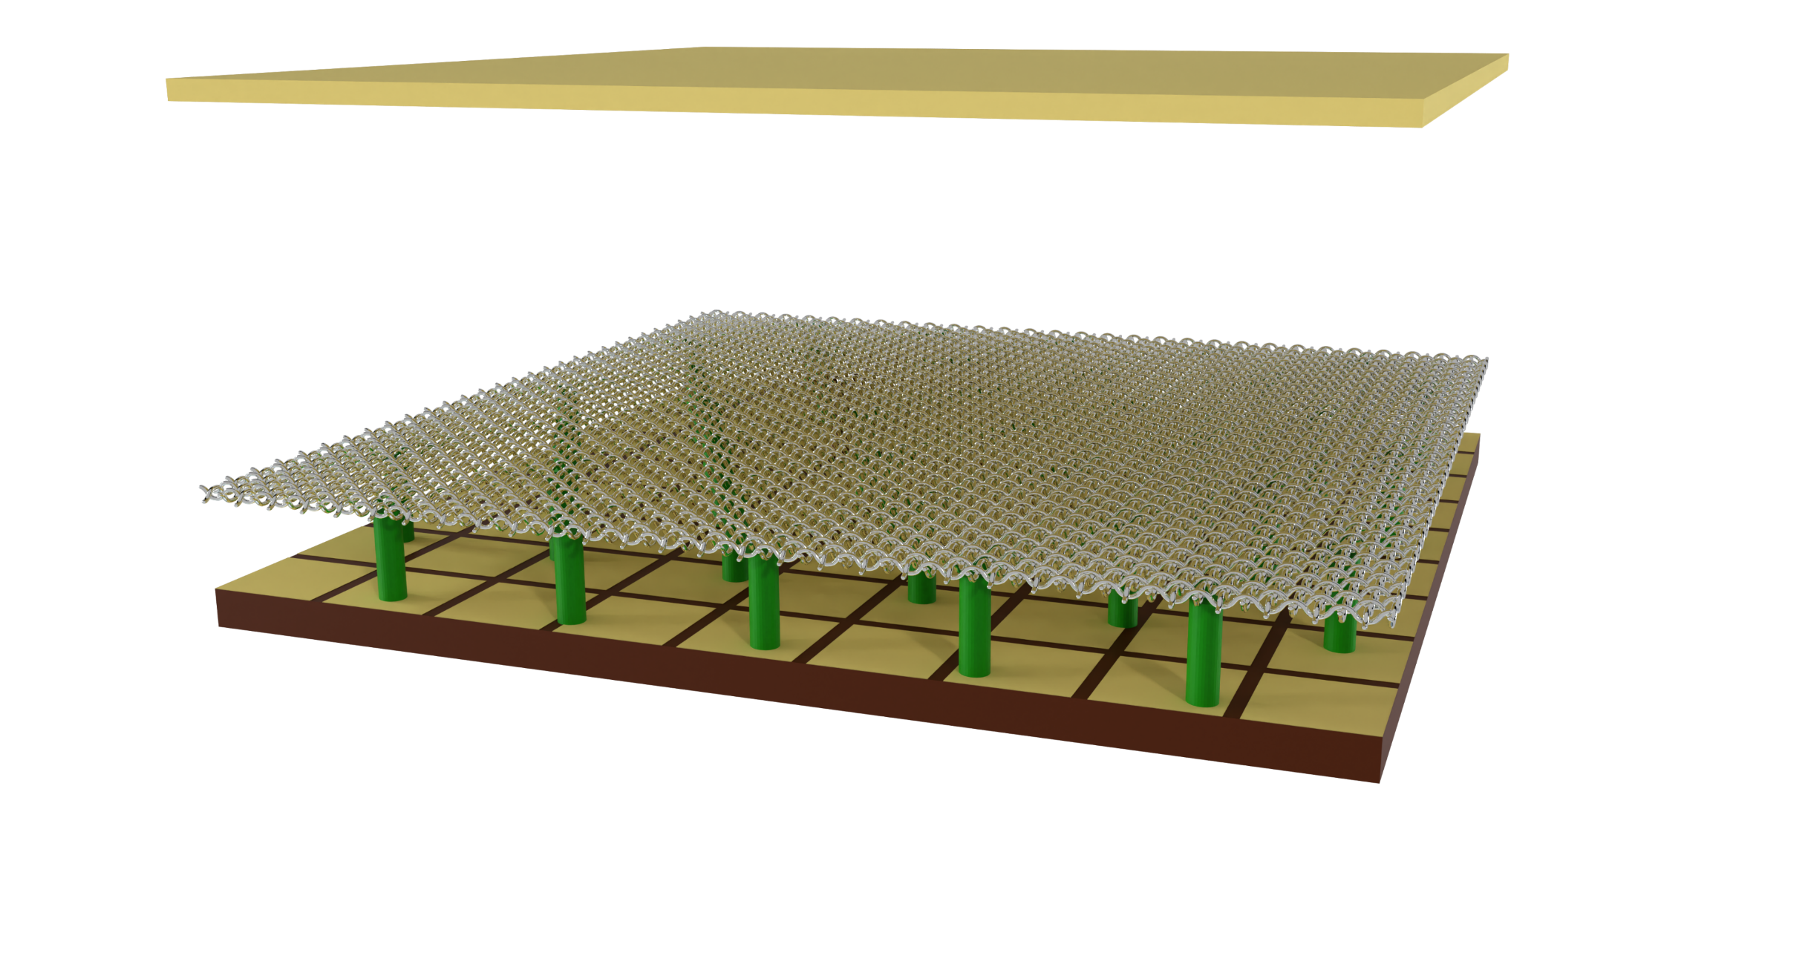
Micromegas
A. Cools PhD animation
Incident particle
Cathode
+
-
~ mm
Mesh
Anode
~ 100 µm
Pillars
Readout pads

Slide 21
Micromegas
A. Cools PhD animation
Incident particle
+
-
E
E ≈ 70 V/cm

Slide 22
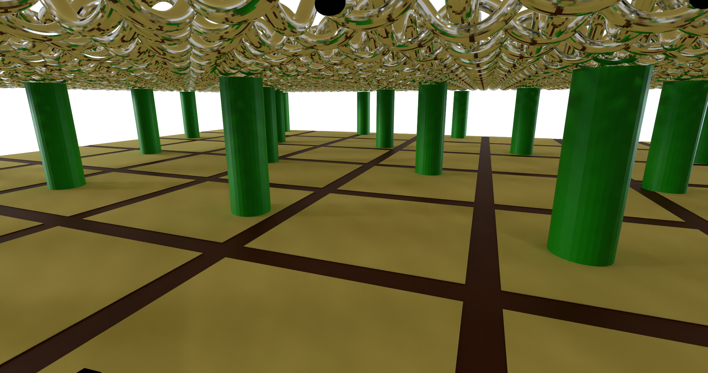
Micromegas
A. Cools PhD animation
e⁻
E ≈ 50 kV/cm
Electronics

Slide 23
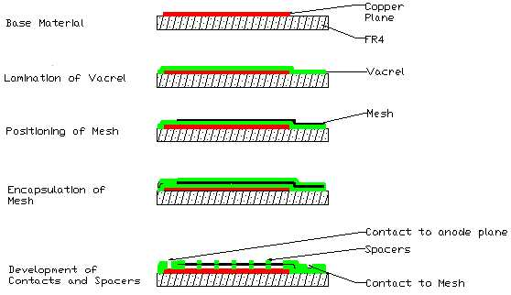
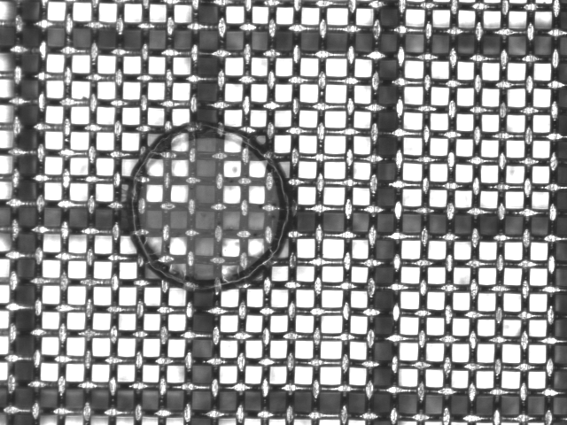
Manufacturing of Micromegas
I. Giomataris et al., NIM. A 560 (2006) 405-40

Slide 24
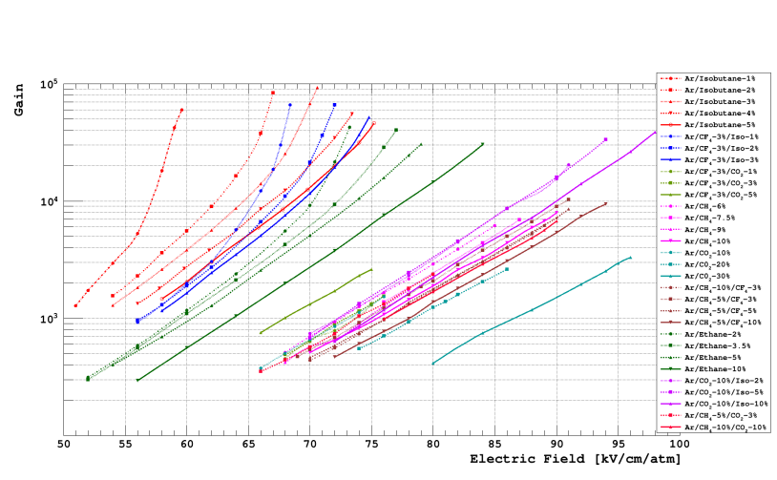
Micromegas Gain
David Attié, “Gaseous tracking detectors for academic and societal applications”, Habilitation à diriger des recherches, October 2022

Slide 25
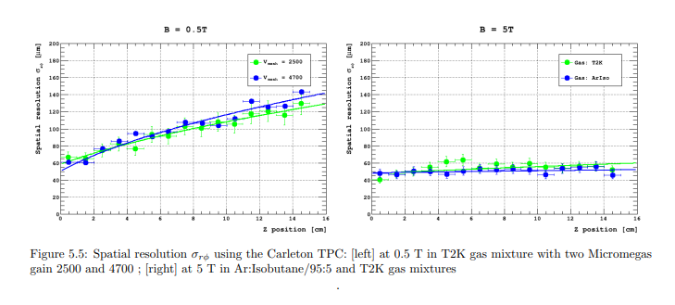
Micromegas spatial resolution
David Attié, “Gaseous tracking detectors for academic and societal applications”, Habilitation à diriger des recherches, Octobre 2022

Slide 26
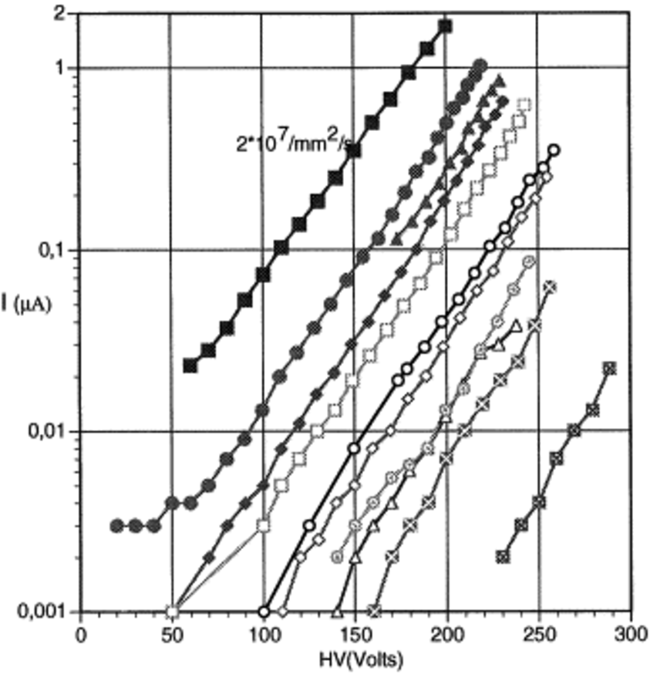
Micromegas rate capability
Current increases with the flux
All curves parallel
Gain independent of the rate
No saturation is observed
G. Charpak et al. NIMA 1998 412 47-60
10 MeV protons
Particle fluxes from 4×10² up to 2×10⁷particles mm⁻²s⁻¹
Ar + 5% isobutane

Slide 27
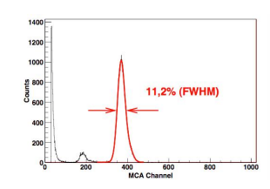
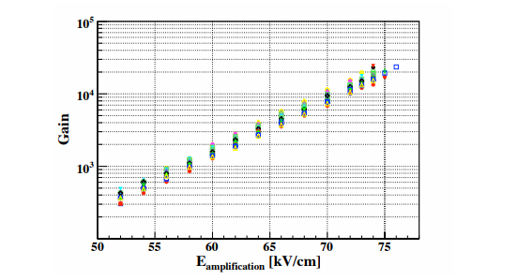
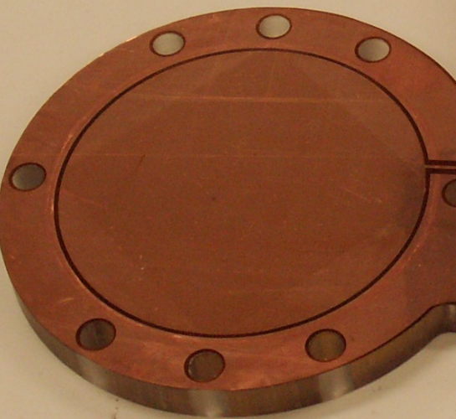
Microbulk
Pitch 100 µm,
Holes 30 µm
Micromesh
5 µm copper
Kapton 50 µm
Readout pads
S. Andriamonje et al. JINST 2010 5 P02001

Slide 28
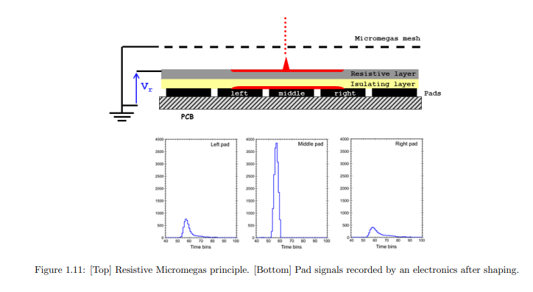
Resistive Micromegas
Resistive coating:
  Charge dispersion
  Spark protection
A. Bellerive et al., eConf C050318 (2005) 0829
David Attié, HDR, October 2022

Slide 29
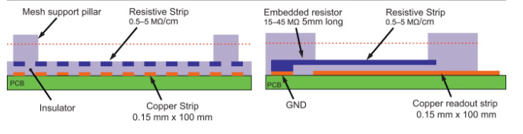
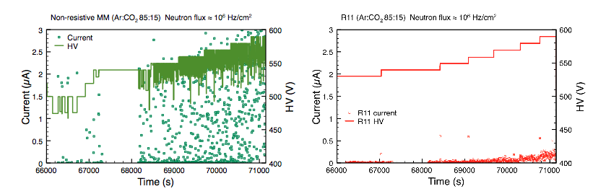
Resistive strips Micromegas
T. Alexopoulos et al., NIM 1 640 (2011) 110-118

Slide 30

Resistive Micromegas
From R. De Oliveira
RD51 MPGD School 2023
M. Alviggi et al., e-print:2411.1702

Slide 31

Thermal Bonded Micromegas
Stretching of the mesh
Pre-setting the spacers on the anode
Setting the borders for the mesh fixation
Stacking the mesh
Thermal bonding using a hot roller
Complete view after full assembly
J. Feng et al 2021 NIM A 989 (2021) 16958

Slide 32




Thermal Bonded Micromegas
G. Liang et al 2011 Chinese Phys. C 35 163
Z. Zhang et al 2014 JINST 9 C10028
J. Feng et al 2021 NIM A 989 (2021) 16958

Slide 33




Micromegas family
XY Microbulk (2012)
Piggyback (20213)
Standard
1996
Bulk
2003
Ingrid
2005
Microbulk
2006
Thermal Bonded
2011
Mesh
Readout plane
TWO mechanical entities
INTEGRATED:
ONE single entity
Type of mesh
Any
type
30 µm
Stainless steel
1 µm
Aluminium
5 µm
Copper
30 µm
Stainless steel
Advantages
Demontability
Large Surface
Robust
Industrial manufacturing process (PCB)
Excellent energy resolution
Single electron efficiency
Intrinsically Flexible
Low mass
Radiopure
Easy mass production without the need for etching
High gains

Slide 34

µ-Rwell
The µRWELL is composed of a µ-RWELL PCB + Cathode
µRWELL PCB : amplification stage coupled to the readout PCB through a resistive layer
Resistive layer: Diamond-Like-Carbon with a resistivity 20-100 MOhm/square

Slide 35

µ-Rwell Low rate: Single resistive layer
Based on GEM fabrication techniques. Micromegas like amplification and signal formation
2D current evacuation based on a single resistive layer
Grounding around the active area
For large area: problem the path of the current depends on position=> detector inhomogeneity
Limited rate capability < 100 kHz/cm²
Single resistive layer (2014-1017)
G. Bencivenni et al, 2019 JINST 14 P05014

Slide 36



µ-Rwell high rate
Double resistive layer
Silver grid
M. Poli Lener, MPGD 2022
PEP (Patterning-Etching-Plating)
Very good performance
Complex manufacturing due to the double matrix of vias
Good performance
2D evacuation scheme by a conductive grid (screen printed or etched)
Alignment of the conductive grid pattern with the amplification pattern difficult
Single DLC layer
DLC grounding from top by kapton etching and plating
No alignment problems
Scalable to large sizes

Slide 37






µ-Rwell high rate
G. Bencivenni et al, NIM A 1069 (2024) 169725
PEP Groove
PEP Dot

Slide 38

µ-Rwell high rate
G. Bencivenni et al,
NIM A 1069 (2024) 169725

Slide 39
MPGD Applications

Slide 40

MPGD @ CERN experiments
M. Titov
Gaseous detector lecture
at the ICFA school 2023
(Not up-to-date)

Slide 41

MPGD @ nuclear physics
RD51 MPGD School 2023 M. Cortesi

Slide 42

MPGD neutrino physics
M. Titov
Gaseous detector lecture
at the ICFA school 2023
(Not up-to-date)

Slide 43

MPGD @ rare event detection
M. Titov
Gaseous detector lecture
at the ICFA school 2023
(Not up-to-date)

Slide 44
Two chosen applications

Slide 45




Charge and optical readout
Charge readout
Frontend and backend electronics
Optical readout
Optical readout of MicroPattern Gaseous detectors (MPGDs) relies on recording scintillation light emitted during electron avalanche multiplication
Scintillation spectrum of gas mixtures with CF₄ is well suited for readout with CCD or CMOS imaging sensors
High spatial resolution can be obtained
45

Slide 46
Charge and optical readout
Charge readout
Frontend and backend electronics
Optical readout
Use of camera (large number of pixels, use of lens for large field of view)
Easy handling of the data (light intensity matrix)
Online imaging thanks to very low data processing and light integration approach
46

Slide 47

X-ray fluorescence with optically read-out GEM
Materials are excited by X-rays
Characteristic X-ray emisson is produced
X-ray fluorescence ➔identification of different materials in an image
Recorded light proportional to the energy of the incident particle
F.M. Brunbauer et al 2018 JINST 13 T02006

Slide 48

X-ray fluorecence with optically read-out GEM
F.M. Brunbauer et al. 2018 JINST 13 T02006

Slide 49


Beta imaging with Glass Micromegas
Context: oncological research
Drugs labelled with tritium 3H
Drug efficiency➔measurement of 3H activity

Slide 50


Beta imaging with Glass Micromegas
A. Cools PhD 2024 Université Paris-Saclay
Camera
Cathode
Micromegas
³H glucose
β
20 cm
e⁻
6 mm
Light
Mesh
ITO
Glass
Sample holder
Camera
³H concentration ↔ Sample activity (Bq)
Assess the activity measurement sensitivity and dynamic range → Activities: 0.1 Bq, 1 Bq and 10 Bq
50

Slide 51



Beta imaging with Micromegas
Light intensity profile over time
5 s exposure time frames for 1h acquisition
Gain ~ 10⁴
A. Cools et al NIMA (2023)1048 167910

Slide 52
Summary
MPGDs, GEM and Micromegas, are mature technologies
Thin amplification region (~100 μm), well separated from conversion / drift region
Fast collection of positive ions (~100 ns)
Fast signals (~ ns)
High gain (~10⁵)
High spatial resolution (~30 μm)
High rate capability (~MHz/mm²)
Low ion backflow (~ 1%)
More robust than wires
Better ageing / radiation hardness
Large area scalability
Fabrication simplicity / lower cost
Versatility (tracking, TPC, imaging)

Slide 53
Summary
MPGDs today: GEM, Micromegas and µRWell
Versatile, adaptable ➔ wide range of applications
  High Energy Physics
  Nuclear Physics
  Rare event detection
  Neutrino physics
  Polarimetry
  Applications beyond fundamental research: Muon tommography, Medical Physics, Neutron detection
Talks by P. Iengo, M. Cortesi, J. Bortfeld

Slide 54
Perspectives
Challenging R&D
  Optical readout
  High rates/Ageing
  Large areas
R&D for future colliders: Future Cicular collider (FCC),Cicular electron positron collider (CEPC), Electron Ion Collider (EIC)…
  Trackers
  Muon detectors
RD51 MPGD School 2023 E. Oliveri
Talk D. Gonzalez

Slide 55
Thanks!
Acknowledgements
D. Attié, F. Jeanneau, Y. Giomataris, E. Oliveri,
T .Papaevangelou, F. Sauli, M. Titov, M. Vandenbroucke

Slide 56
Further reading
F. Sauli and A. Sharma, «Micro-patern Gaseous Detectors», Ann.Rev.Nucl.Part.Sci. 49 (1999) 341-388
Y. Giomataris, “Development and prospects of the new gaseous detector Micromegas”, NIM A 419 (1998) 239-250
F. Sauli, “The gas electron multiplier (GEM): Operating principles and applications”, NIM A 805 (2016) 2-24
S. Bressler, «The Thick Gas Electron Multiplier and its derivatives: Physics, technologies and applications, Progress Particle and Nuclear Physics 130 (2023) 104029
D. Attié et al., « Current Status and Future Developments of Micromegas Detectors for Physics and Applications”, Appl.Sciences 11 (2021) 12, 5362
Gaseous Radiation Detectors, Fundamental and Applications, Fabio Sauli, Cambridge Monographs on Particle Physics, Nuclear Physics and Cosmology, Cambridge University Press
Micro-Pattern Gaseous Detectors: Principles of Operation and Applications, Fabio Sauli, World Scientific

Slide 57
Spare

Slide 58
GEM Properties
High Rate Capability ➔ MHz/mm² (MIP - Minimum Ionizing Particles, 2MeV cm² /g)
High Gain ➔Up to 10⁵ -10⁶
High Space Resolution➔ <100 μm
Good Time Resolution ➔In general few ns , sub-ns in specific configuration
Good Energy Resolution➔10-20% FWHM @ soft X-Ray (6 KeV)
Excellent Radiation Hardness
Good Ageing Properties
Ion Backflow Reduction ➔ ~% level, below % in particular configurations
Large size
Low material budget
Low cost

Slide 59
Micromegas properties
High gain ( >10⁴)
Good energy (11% @ 6 keV) and time resolution (< 1 ns)
Good spatial resolution (~100 µm)
Reduced ion feedback < 1%
Radiation hardness (10⁶ p/cm²)
Fast ion collection→ operation at high flux
Good Ageing Properties
Large size
Low material budget
Low cost
Cope with sparks: resistive coating

Slide 60


Ingrid
M. Chefdeville et al., Nucl. Instr. Meth. Phys. Res. A 556, 490 (2006)
H. van der Graaf, Nucl. Instr. Meth. Phys. Res. A 580, 1023 (2007)
Mesh is directly built on the silicon pixel readout chip
High gain and small pixel size allow single electron detection
High resitive silicon oxide layer protection against discharges

Slide 61





Hybrid Implementation: GEM + Micromegas

Slide 62







GEM Implementations
COMPASS
TOTEM
KLOE-2
HBD for PHENIX
BONUS RADIAL TPC
ALICE TPC UPGRADE
LHCB
Notes:
COMPASS 30 x 30 cm2 with 2D readout
TOTEM TWO-ARMS FORWARD TRACKER IN CMS
Cylindrical Inner tracker for the Kloe 2 experiment
BONUS radial TPC at the CLAS experiment at JLAB

Slide 63










Micromegas Implementations
COMPASS
CLAS12
T2K
CAST
NTOF
ATLAS-NSW
ACTAR-TPC
ATLAS-NSW
MINOS
ND280 upgrade High-Angle TPCs

