Slide 1




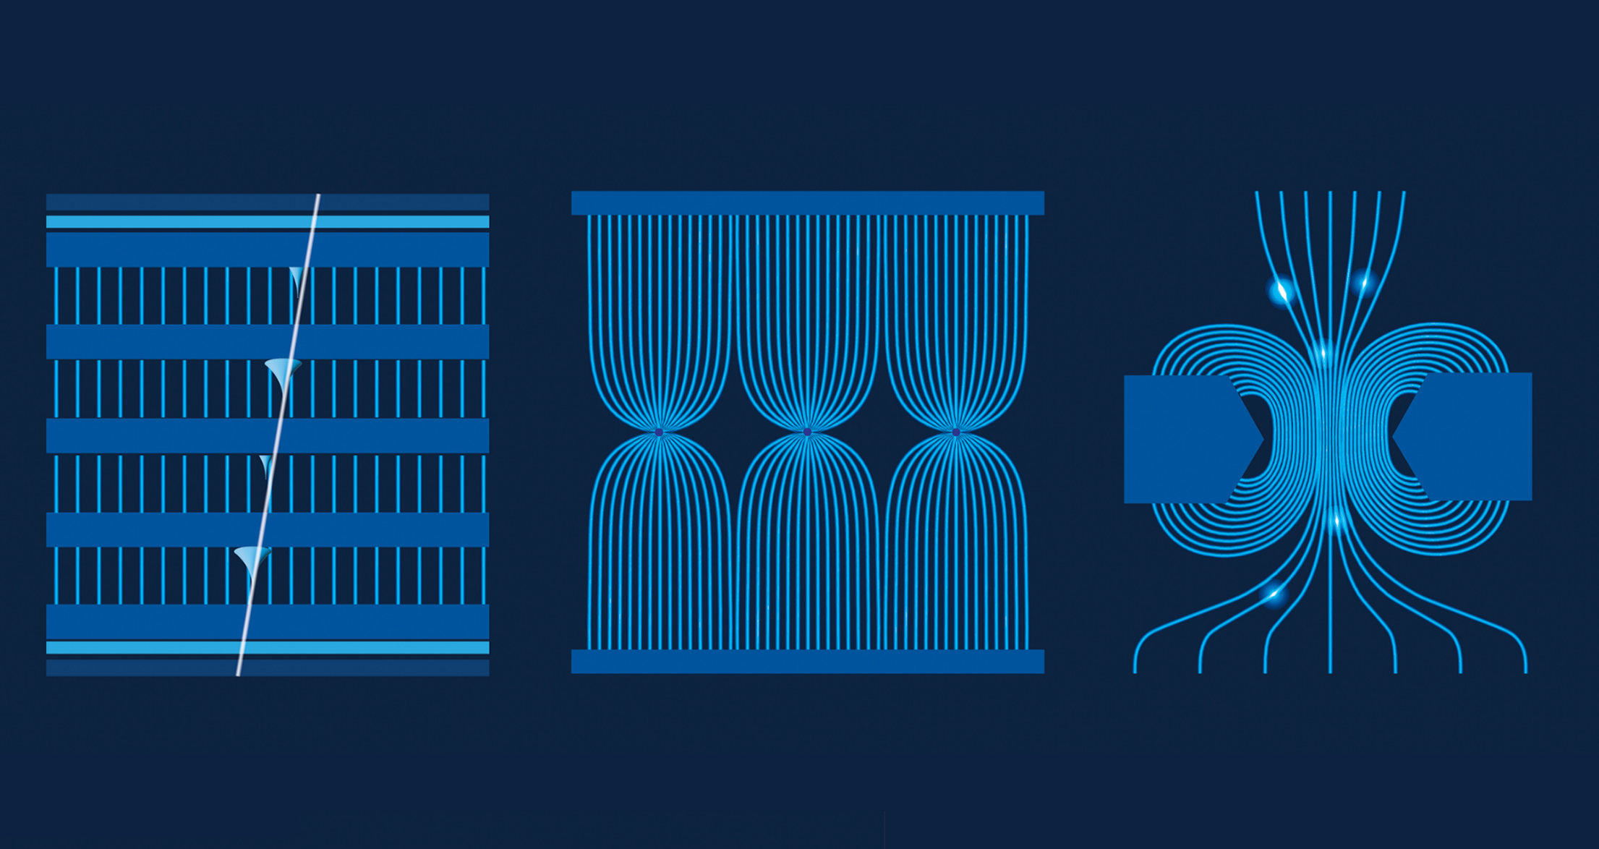
Gas properties and mixtures
Marcello Abbrescia
University and INFN Bari, Italy
DRD1 gaseous detector school
CERN, November 27 – December 6, 2024

Slide 2
Basics
The gas (or gas mixture) is the «core» of any gaseous detector
It is where (almost) everything happens
Its properties contribute to determine the shape, amplitude and duration of the signals generated → The performance of the detector
Aging processes in gaseous detectors strongly depend on the nature of the gas mixture used
How do we choose the «best» gas mixture?

Slide 3
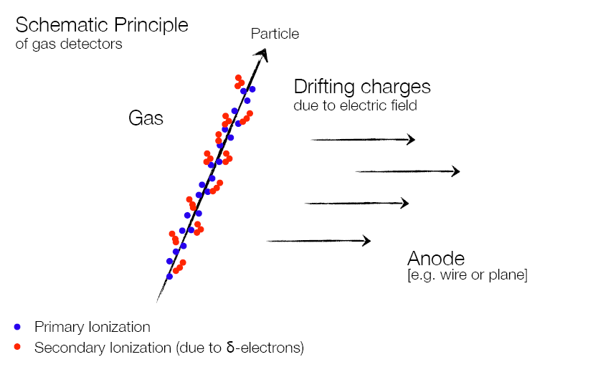
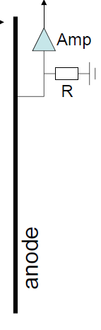
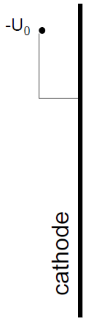
Working principle of gaseous detectors
Drift and amplification
due to electric field
Detection of an impinging particle takes place because this ionizes the gas, generating ion-electron pairs.

Slide 4
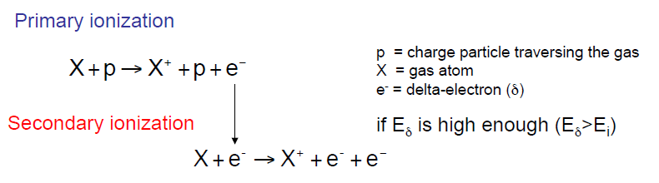
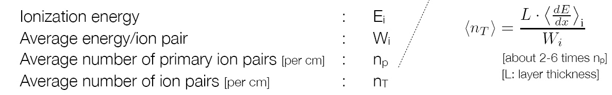
Ionization
I₀
Not the whole energy lost by the impinging particle goes in ionization processes; a part (roughly half) goes in excitation of the gas molecules.
→ The average energy W_{i} needed to create an ion-electron pair is ≈ 2-3 I₀
Interest in maximizing ionization processes

Slide 5


Statistics of ion-electron pair production
Primary ionization events are independent and therefore follow Poisson statistics.
- Each time an impinging particle crosses a layer of gas, it has a certain probability to produce a certain number of primary electrons
- If n_{P} is the average number of primary electrons (ions), the probability P(k) to have k electrons (ions) is:
Therefore there is always a finite probability to produce no electron-ion pairs:
In the other cases the impinging particle is not revealed
Intrinsic inefficiency of the detector
Note: of course n_{P} is proportional to the gas layer thickness and the energy loss
→ Limit on the thickness of the gas volumes that can be used.

Slide 6
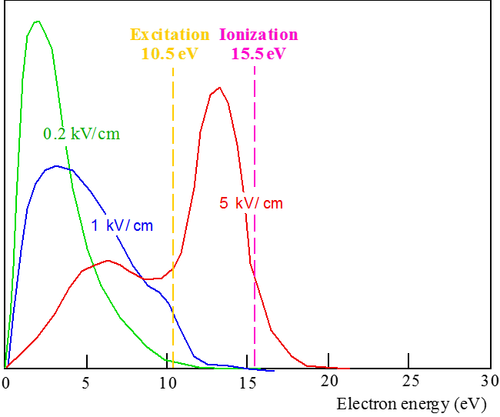
High E fields: excitation and ionization
- When an applied electric field exceeds few kV/cm,
more and more electrons can reach enough energy
to produce excitation and ionization.
- The plot shows the energy distribution in Ar for three different values of the electric field, compared to the energy needed for excitation and ionization
Multiplication processes

Slide 7
Multiplication processes
In gaseous detectors typically few tens of ion/electron pairs are produced by a MIP in few mm of gas;
To be compared to ≈24.000 hole/electron pairs produced in 300 μm of Si.
Multiplication processes (a la Townsend) are fundamental in gaseous detectors
Because there’s no hope to distinguish the signal generated by few tens of electrons from all sources of noise
All these considerations leads to the necessity of optimizing (namely enhancing as much as possible) primary and secondary ionization in gaseous detectors.

Slide 9
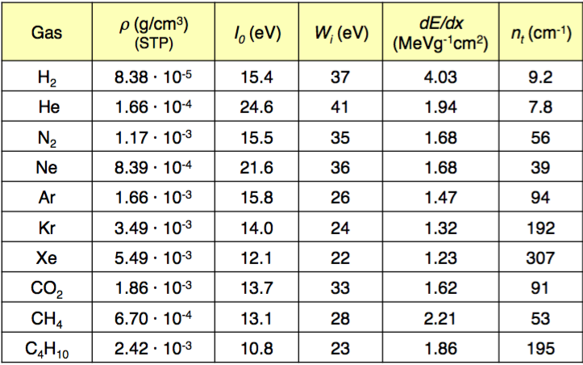
Choice of the gas filling
Noble gases are preferentially used due to the absence of vibrational and rotational states ➔ionization dominates.
(Polyatomic gas have non-ionizing de-excitation modes available)
Possible electron multiplication at low electric field
Choose cheap noble gases with low ionization potential
Expensive and rare

Slide 10
Choice of the gas filling
Noble gases are characterized by the largest I₀/W_{i} ratio
In principle noble gases with large Z should be preferred, because of their large dimensions, leading to larger n_{t}/cm
→ Kr and Xe would be ideal choices, but their drawback is their cost
→ Rn is radio active
Hence Ar was (and still is) a very popular choice
In principle one could release the requirement on I₀/W_{i} in the case of large molecules, characterized by large n_{t}/cm
Large hydrocarbons would be suitable
→ But they are flammable

Slide 11
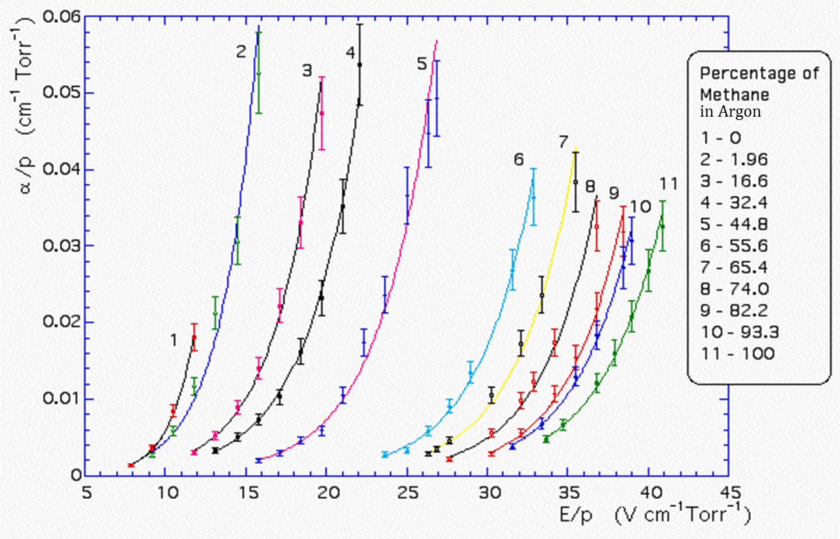
First Townsend coefficient for Ar/CH₄ mixtures
The first Townsend coefficient represents the average number of pairs produced per unit length by an electron drifting in the gas

Slide 12
Not only ionization…
From: F. Sauli, Gaseous radiation detectors: Fundamentals and Applications, Cambridge University Press, 2014

Slide 13
Penning effect
When using gas mixtures, Penning effect can take place, if the excitation potential on one species is larger than ionization potential of the other.
A* + B → A + B⁺ + e
Ar excitation and ionization energy levels

Slide 14
Penning effect
Additional ion-electron pairs are produced, increasing the «effective» ionization coefficient, especially during multiplication processes.
From the original paper by Penning et al., 1940
Ionization coefficient of Ne/Ar mixtures larger than ionization coefficients both of Ar and Ne

Slide 15
Penning effect: complications
Gain in an gaseous ionization counter, filled with Ar/isopentane mixture.
Two effects:
Increase of the gain due to Penning effect for low concentration of iso-pentane
Decrease of the gain for larger concentrations due to electron cooling by iso-pentane

Slide 16
Choice of the gas filling
If only a noble gas is used to fill the counter, it can operate at
relatively low gains (M ≈ 10³ - 10⁴) before entering the permanent discharge regime
When the avalanche forms, excited Ar atoms are created, which can return to the ground state only emitting UV photons
- The energy of these photons can be sometimes larger than the energy needed to extract electrons from the cathode walls (7.7 eV for copper)
- Photoelectrons can be extracted from the walls, which cause farther ionization of the gas
Possible spurious delayed pulses due to ions neutralizing on the cathode
- Ar+ ions reaching the cathode are neutralized
The neutral Ar atom is sometimes produced in an excited state, decays emitting UV photons → An additional electron can also be extracted from the wall
Both processes induce spurious delayed pulses

Slide 17
Emission spectra from various gases
Emission spectra of the noble gases typically fall in the UV region

Slide 18
Radiation trapping
Photons emitted by radiative decay to ground of excited noble gas atoms have a high probability of being re-absorbed and subsequently re-emitted by the noble gas: radiation trapping.
Eventually, after many absorption/emission cycles, the photons are absorbed by the walls of the gaseous detector (or a quencher gas molecule).
Excited states may effectively have a long lifetime

Slide 19
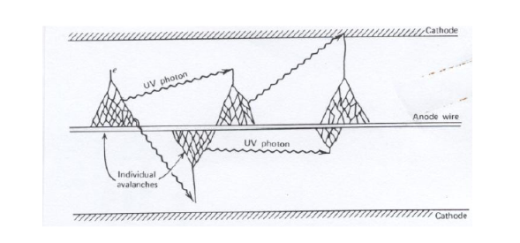
Geiger-Muller counters
Filling gases: He, Ne or Ar
High electric fields
Gains of the o(10¹⁰)
Entire gas volume is involved
Loss of information on space
Loss of information on energy
Simple, easy to use, cheap, suitable for measuring radiation counts
Sometimes optimization of gas mixtures is easy… ☺

Slide 20
Use of quencher gases
The problem of UV photons is solved by adding to noble gas percentages of other polyatomic gases, usually called "quenchers"
Gas quencher molecules have non-radiative (rotational and vibrational) mode and can absorb UV photons in a wide energy range.
- CH₄ absorbs photons between 7.9 and 14.5 eV
- Other polyatomic gases used are freons, CO₂, BF₃, C₄H₁₀, etc.
Polyatomic gases dissipate energy by elastic collisions
- Some of these gases can dissociate, and/or form solid or liquid polymers which can deposit on the electrodes, altering their properties
Malter effect, where the E field close to the electrode is distorted, causing undesired discharges
Aging effects (one of the main issues in all particle detectors)
Even small quantities of quencher allow to operate these detectors up to gain of 10⁶ without discharges.

Slide 21
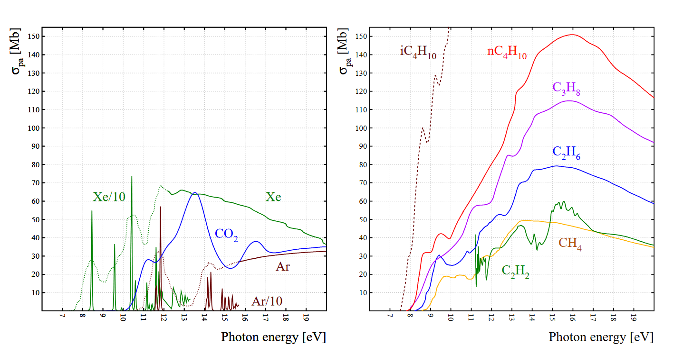
Quenching by UV absorption
Photo-absorption cross sections for various gases and for the principal hydro-carbons
→ They extend down to 7-8 eV

Slide 22
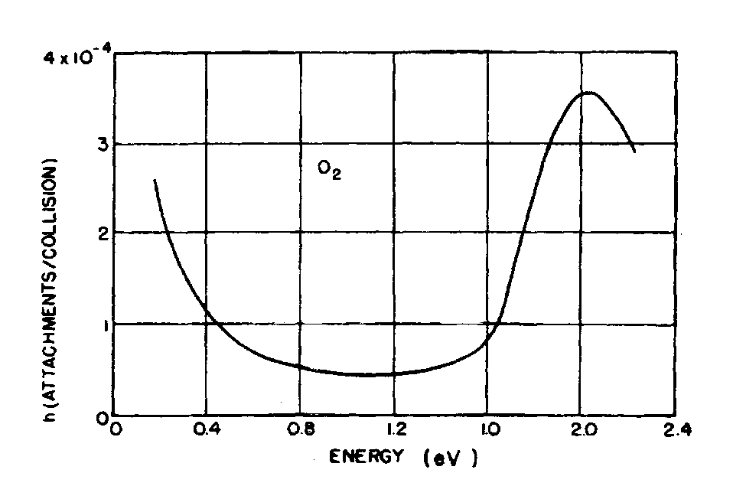
Electronegative gases
- Some gases, like O₂, Cl₂, H₂O vapour, etc., are characterized by a high probability to capture drifting electrons and form negative ions;
- The net effect is reducing the total number of drifting electrons → electronegative gases
- The probability of capture per collision (or per unit length)
is called "attachment coefficient"
The attachment coefficient strongly depends on electron energy .
Attachment coefficient of electrons in Oxigen, vs. electron kinetic energy

Slide 23
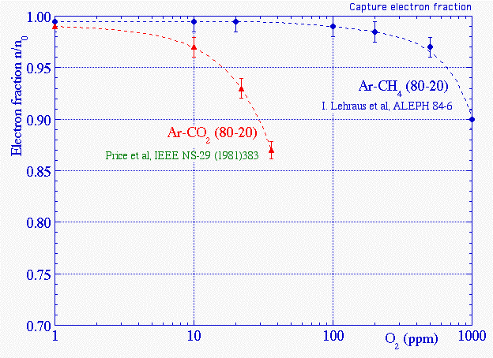
Effects of electronegative gases
Fraction of electrons surviving after a drift of 20 cm in two gas mixtures, as a function of the contamination of O₂, under the action of E = 200 V/cm

Slide 24
Use of quencher gases
Also electronegative gases are used as quenchers, like many freons (CF₃Br), ethyl-bromide (C₂H₅Br), etc. which help operate detectors at high gain without discharges.
- They are characterized by an electron capture mean free path that is less than typical anode-cathode distance (≈ 1 cm) and larger than avalanche size (few μm)
These gases capture electrons possibly extracted at the cathode forming negative ions, preventing the formation of spurios delayed avalanches
Sometimes quenchers, in particular various kinds of freon, can dissociate resulting in simpler molecules, sometimes harmful to the detector, like HF → aging

Slide 25
«Classical» gas mixtures
Popular gas mixtures in use for a wide variety of gaseous detectors were ternary:
Noble gases (typically Ar) to enhance primary, secondary ionization and Towsend avalanches in the gas
→ enhance the signal produced
→ Reduce the intrisic inefficiency
→ They do not dissociate in pollutants
Small fractions of hydrocarbons (CH₄ or i-C₄H₁₀), or CO₂, and/or fractions of some kind of Freon
When no simulation were available the «best» gas mixture for a certain detector was chosen by making, literally, hundreds of tests
Simulations have made life easier to particle detector physicists

Slide 26


Slide 27
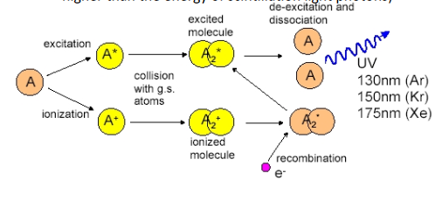
Exploiting ligth emission
Charged particles leave trails of excited molecules
Certain gases release part of this excitation energy producing visible or UV photons
This can be exploited if the gases are transparent to these photons

Slide 28
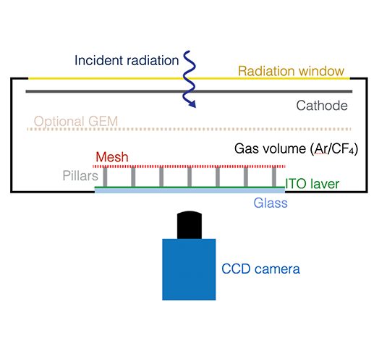
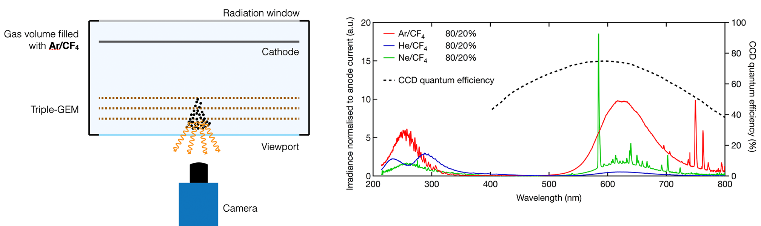
Gaseous detectors with optical readout
Energy carried away by scintillation light is small: < 1% of dE/dx
Up to 10⁴ photons per MeV of dE/dx
→ use the scintillation ligtht produced during the avalanche multiplication processes
Typically Micro Pattern Gaseous Detectors (MPGDs) are used coupled with CCD or CMOS cameras.

Slide 29
Exploiting ligth emission
Spectrum of the noble gases is typically in the UV region.
Maximum sensitivity of photosensors is typically for visible light.
→ Need to use wavelength shifters
→ Add suitable gases to noble gases
Broad spectrum from CF₄
Sharp peaks from noble gases

Slide 30
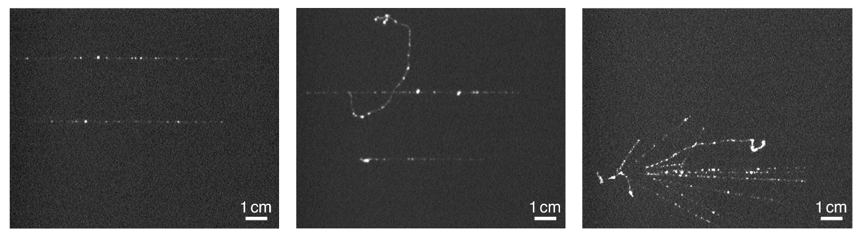
Images from optical readout GDs
Muon tracks
Muon + δ ray
Hadronic shower
Scintillation light decay time:
≈ 10 μs for noble gases → suitable for typical CCD integration time
10-1000 ns in inorganic scintillatos
2 ns for fast organic scintillator
First particle detectors were «imaging» detectors
→ Intuitive and direct visualization of what happens

Slide 31
Electron Drift velocity
Ionization probabilty (and gain) are not the only parameters to be optimized in gaseous detectors.
Drift velocity is typically related to time resolution in GDs.
- In RPC, where the whole volume is active for multiplication processes:
In wire chambers and most MPGDs time resolution is related to fluctuations in the drift time toward the amplification region.
- CF₄ is added to Ar to improve time resolution
In general:
I_{ind} = q_{e} v_{d} E_{w} → the signal amplitude is proportional to drift velocity

Slide 32
Drift velocity in Ar/CO₂
Drift velocities computed by Magboltz at Ar/CO2 at 3 bar
Adding even small percentages of a gas to another can change the drift velocity dramatically
CO₂ added to Ar makes the drift velocity of the mixture max larger
In general, mixtures characterized by large drift velocities are preferred: «fast» gas mixtures

Slide 33
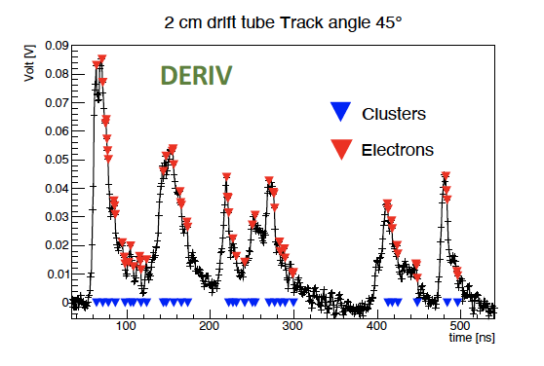
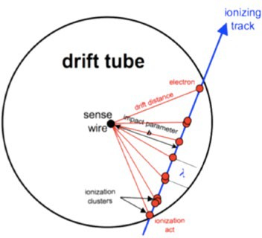
«Slow» gas mixtures: the cluster counting technique
Principle: In He based gas mixtures the signals from each ionization act can be spread in time to few ns.
By counting the number of ionization acts per unit length (dN/dx), it is possible to identify the particles (P.Id.) with a better resolution w.r.t the dE/dx method.
Landau distribution of dE/dx, originated by the mixing of primary and secondary ionizations, has large fluctuations and limits separation power of PID → primary ionization is a Poisson process, has small fluctuations
dE/dx: truncated mean cut (70-80%), with a 2m track at 1 atm give σ ≈ 4.3%
dN_{cl}/dx: for He/iC₄H₁₀=90/10 and a 2m track gives σ_{dNcl/dx} /(dN_{cl}/dx) < 2.0%

Slide 34
Diffusion coefficients for Ar/CO₂
Transversal diffusion related, typically, to spatial resolution
Longitudinal diffusione related, sometimes, to time resolution
→ In drift tube (or TPC) it can affect spatial resolution as well
Transversal and longitudinal diffusion should be optimized together with other parameters (gain, drift velocity).
Calculated by Magbolts for Ar/CO₂ at 3 bar

Slide 35
Diffusion of electrons and ions in gases
While diffusing, electrons and ions do not have an easy life.
Possible interaction of positive ions:
- Neutralization with a negative charge carrier (either an electron or a negative ion)
- Neutralization after the extraction of an electron from the walls of the detector
- Charge transfer
- to a molecule of its own gas (A⁺ + A --> A + A⁺)
- to a molecule of another gas with lower ionization potential (A⁺ + B --> A + B⁺)
Possible interactions of electrons:
- Neutralization with a positive ion (e + A+ --> A)
- Attachment to a molecule with negative electron affinity (e + A --> A-)
- This attachment probability is negligible for noble gases and hydrogen
- Oxigen is a gas with strong electronegative affinity
- The attachment coefficient depends strong on the electric field (if any)
- Absorption in the walls of the detector

Slide 36
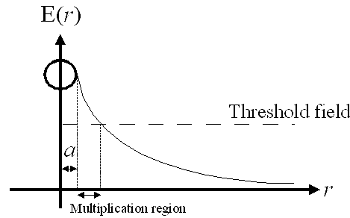
Changing of paradygm
Until 1980s most succesfully gaseous detectors were cylindrical
→ yes, MWPCs are «cylindrical»
Drift and multiplication region separated from each other
→ quite good spatial resolution
→ relatively poor devices for time resolution
Δt
Using a parallel plate geometry was considered difficult
→Detectors unstable and with limited lifetime
Once that a discharge started the whole energy stored in the electrodes was dissipated
Detectors had to be externally triggered

Slide 37
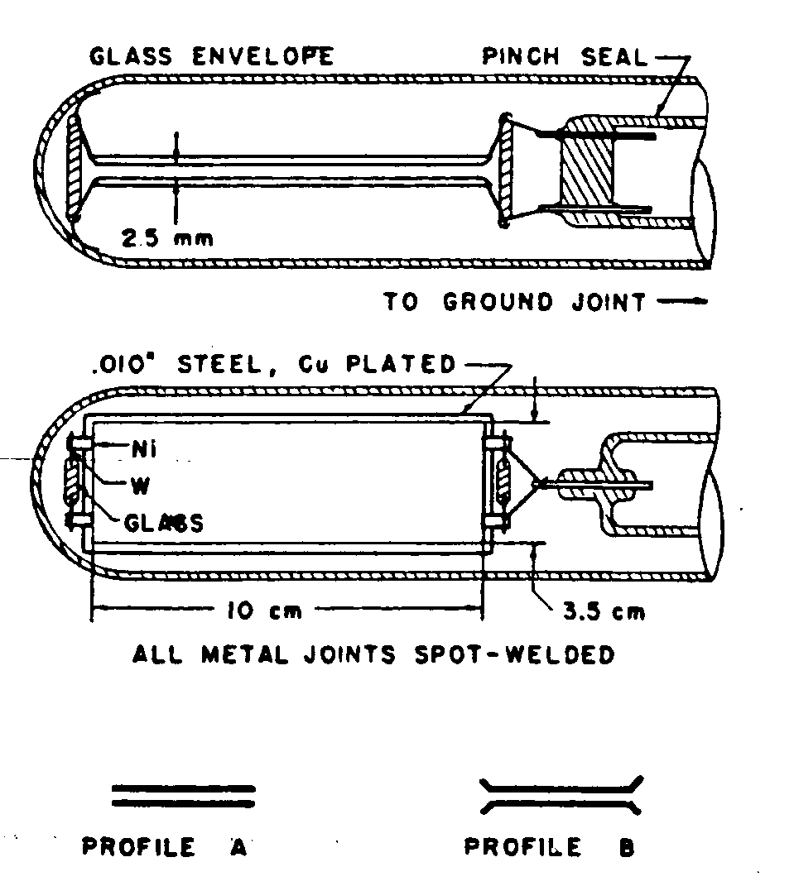
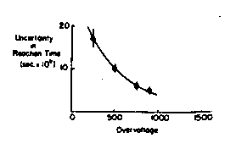
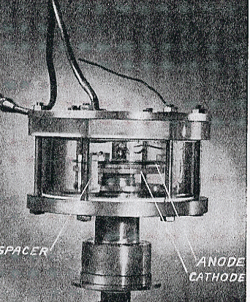
Changing of paradygm
Time resolution ≈ 1 ns
Keuffel PPCs (1949)
Madansky and PIDD PPCs

Slide 38
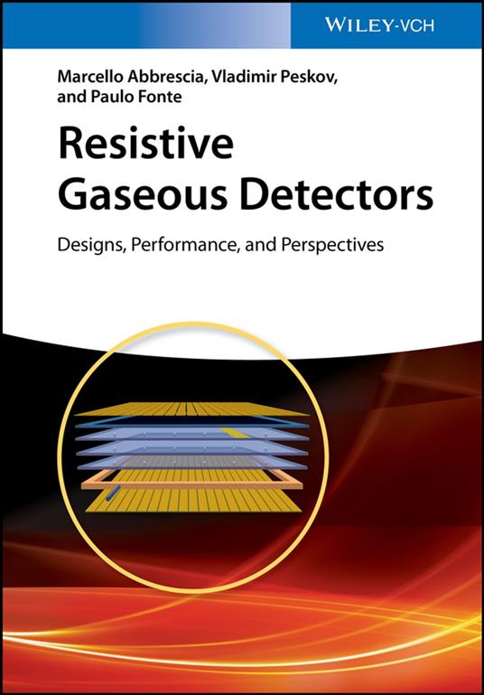

Including resistive elements in gaseous detectors
Resistive electrodes allow auto-quenching mechanisms due to the switching off of the LOCAL electric field
Limitation of rate capability
Including resistive elements in gaseous detectors was (and is) a major breakthrough in GD R&D
RPCs succesfully operated with Ar/iC₄H₁₀/CF₃Br mixtures

Slide 39
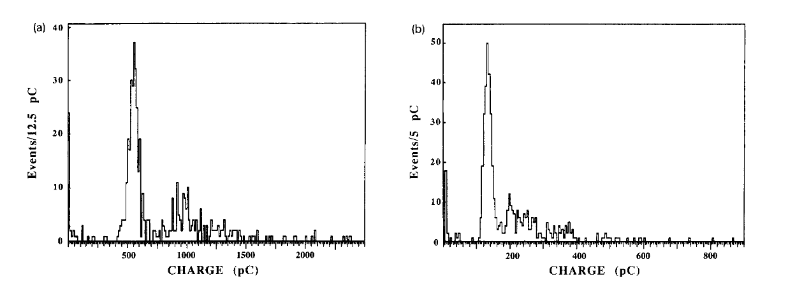
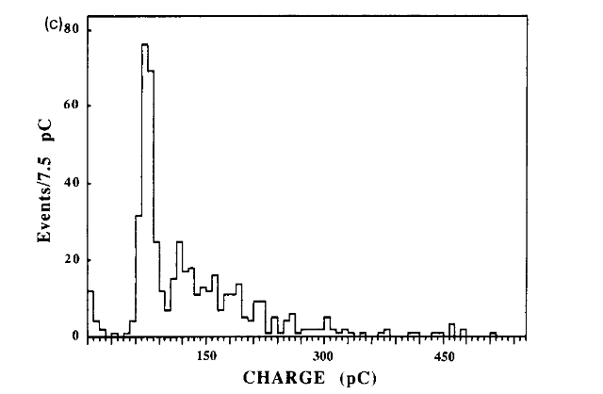
Trasferring amplification to front-end electronics
R. Cardarelli et al., Performance of a Resistive Plate Chamber operating with pure CF3Br, NIMA 333(1993), 399-403
0% CF₃Br
4% CF₃Br
Sometime large gains (charge) are not acceptable:
RPCs operated in streamer mode were NOT suitable for LHC experiments because of their too low rate capability
The solution was to increase the fraction of quencher gases and transfer part of the needed amplification to the front-end electronics
8% CF₃Br

Slide 40
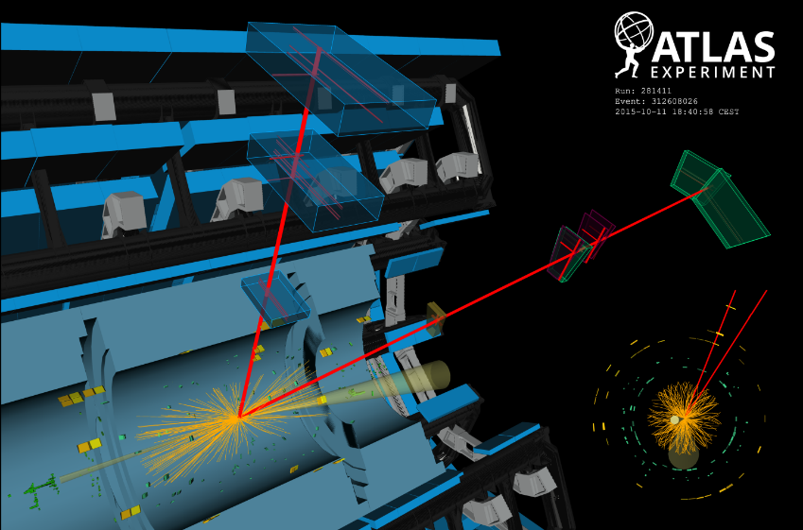
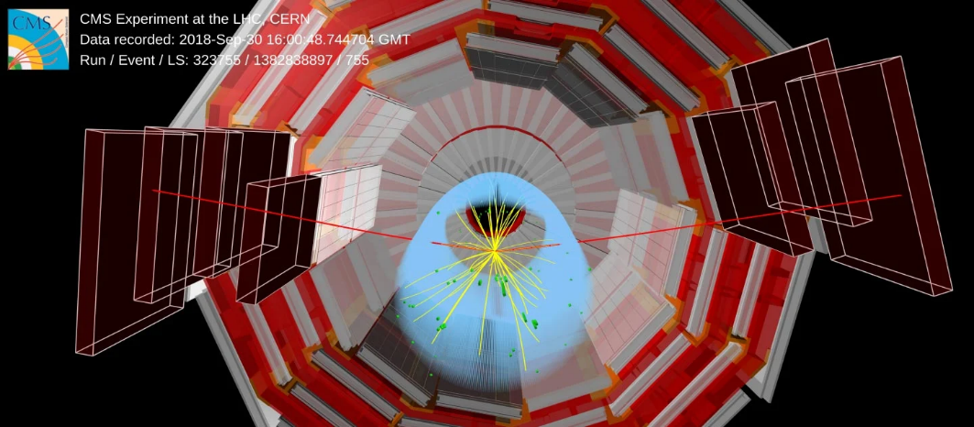
Passage from streamer to avalanche mode in RPCs
The use of CF₃Br enriched mixtures allowed an increase of the rate capability of more than one order of magnitude
Allowed the use of RPCs in muon systems of the LHC experiments
How a gas mixture can change your life…
Later on, it was found that CF₃Br was harmful for the ozone layer, and was banned from production and use.
It was replaced by C₂H₂F4, a gas largely used in refrigerating systems
RPCs gas mixtures are nowdays almost completely made out of C₂H₂F₄.

Slide 41

Twenty years later (not by Alexandre Dumas) → …

Slide 42
The problem of GreenHouse Gases
- Not only CO₂ contributes to the greehouse effect. There are other gases (and families of gases) that contribute: H₂0, CH₄, CFC, HCFC, NO_{x}, SO_{x}
To compare various gases, the Global Warming Potential was introduced:
it is a measure of how much energy the emission of 1 ton of a gas will absorb over a given period of time, relative to the emission of 1 ton of carbon dioxide (CO₂).
The larger the GWP, the more that a given gas warms the Earth compared to CO₂ over that time period.
The time period usually used for GWPs is 100 years(*).
(*) Some gases, once arrived in the high atmosphere, dissociate, producing by-products that may or may NOT be greenhouse gases: therefore the lifetime a a gas species MUST be considered when computing its GWP

Slide 43
GWP for various gases
The Relative instantaneous radiative forcing, is independent of the lifetime of the gas in the atmoshpere.
The GWP take also into account the lifetime of the gas in the atmoshpere.

Slide 44
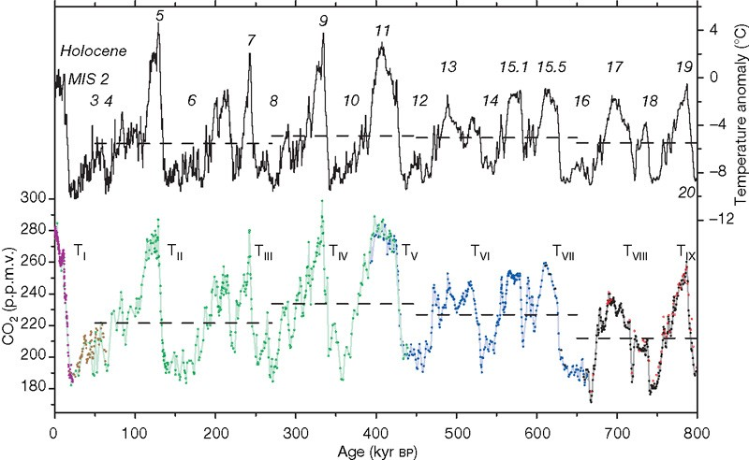
Temperature and CO₂ concentration: last 800.000 years
Temperature
CO₂ concentration < 300 ppm
CO₂ concentration
Lüthi, D., et al. High-resolution carbon dioxide concentration record 650,000–800,000 years before present. Nature 453, 379–382 (2008). https://doi.org/10.1038/nature06949

Slide 45
Use of Greenhous gases in HEP
GHGs are used in several gaseous particle detectors due to their characteristics suitable for optimal detector performance AND long term operation
30 years ago we had to get rid of Ozone Depletion gases
There was not the feeling about GHGs → many detectors were designed from the beginning to be used with GHGs

Slide 46
The use of GHGs at the LHC experiments
- 40% GHG emissions from Run 1 to Run 2 excluding from the calculations ATLAS and CMS RPC systems
- ATLAS and CMS RPC systems: +35% increase of GHG emissions due to development of new leaks

Slide 47

Replacement of GHGs with eco-friendly gases
We need to replace:
  C₂H₂F₄ = R134a = TFE mainly used in RPCs
  SF₆ mainly used in RPCs
  CF₄ used in CSCs, GEMs, RICH, etc.
with more ecological gases, namely with a much lower Global Warming Potential.
Difficult problem: gases are the core of gas-filled detectors.
We also need:
  to get the same performance
  not to change the electronics and HV (for existing systems)
It’s not a problem concerning just the RPC community
HEP experiments, present and future, last several (dozens) of year
→ A good performance must be mantained for an adequate period of time
→ Aging tests are needed as well.
Of course we can also re-circulate
the gases used, after purifying them,
and reduce leaks

Slide 48
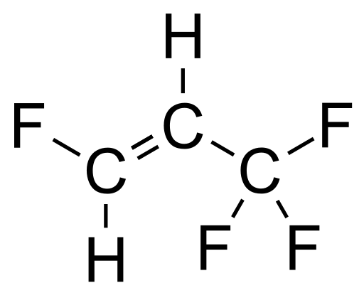
The importance of collaborative effort
All high energy experiments (ALICE, ATLAS, CMS, LHCb, etc.) and the CERN gas group (CERN EP-DT) started, already several years ago, an intense R&D program to find suitable gas mixtures.
Practically all research trendlines concentrate around the idea of replacing:
C₂H₂F₄ (GWP=1430)→ C₃H₂F₄ze (GWP=4)
+ CO₂ (GWP=1) or He
EEE
C₃H₂F₄ (here indicated as HFO for short) is the molecule most similar to TFE but with low GWP
CO₂ (or He) are essentially added to reduce the operating voltage.
The RPC EcoGas@GIF++ is a Collaboration transversal to ALICE, ATLAS, CERN EP-DT, CMS, and LHCb willing to put together expertise and resources in order to test potential candidates of eco-friendly gas mixtures with different detectors and electronics.

Slide 49
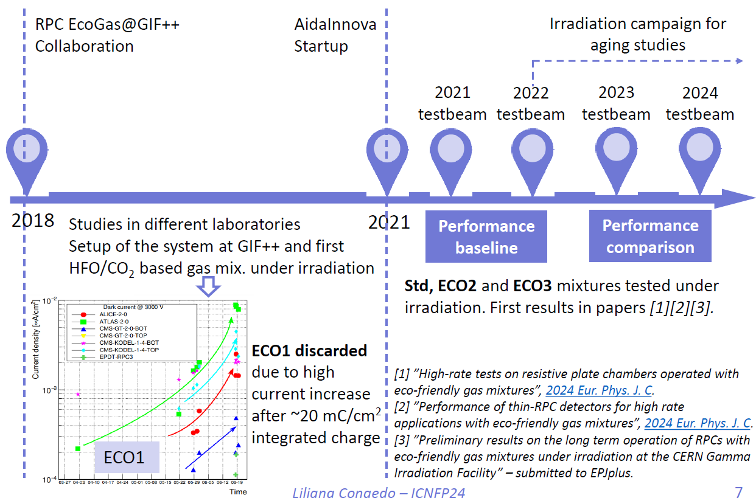
The RPC ECOGas@GIF++ timeline
Assessment of the possibility of using HFO in place of TFE
→ ECO1, ECO2 and ECO3
The RPC EcoGas@GIF++ is a collaboration transversal to ALICE, ATLAS, CERN EP-DT, CMS, and LHCb willing to put togethere expertise and resources in order to test different detectors and electronics, in the same conditions and 2-3 potential candidates of eco-friendly gas mixtures.

Slide 50
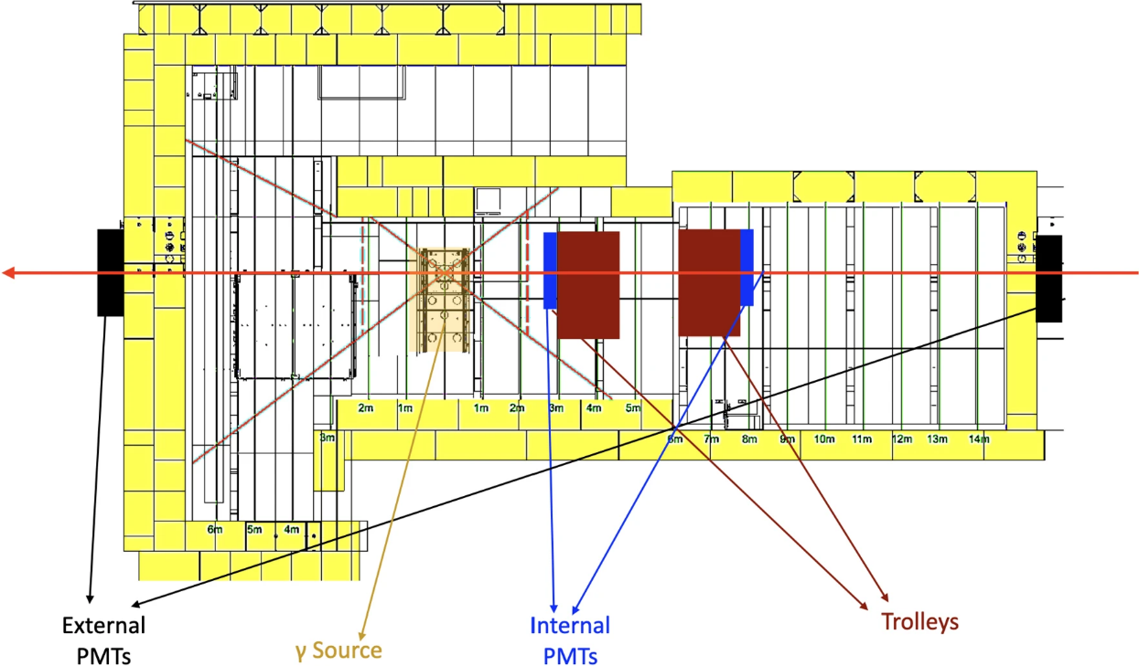
Experimental set-up @GIF++
Three gas mixtures identified, with various concentrations of HFO and CO₂.
Attention focussed on ECO2 and ECO3 because of the good stability and performance demonstrated in home-labs tests.
Aging tests performed at GIF++
12.5 TBq 137Cs source
to generate background (high rate)
to accelerate aging processes
100 GeV muon beam
to measure detector performance

Slide 51
Detectors @ GIF++
Various detectors, mounted on two trolleys, equipped with various electronics.
→ Help in disentagling common observed effect from effects specific of ONE detector
Trolley 1
The results presented here refer particularly to the detectors equipped with TDC
Trolley 3

Slide 52
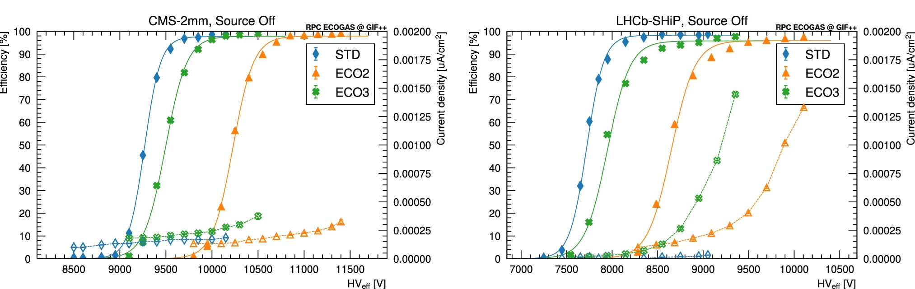
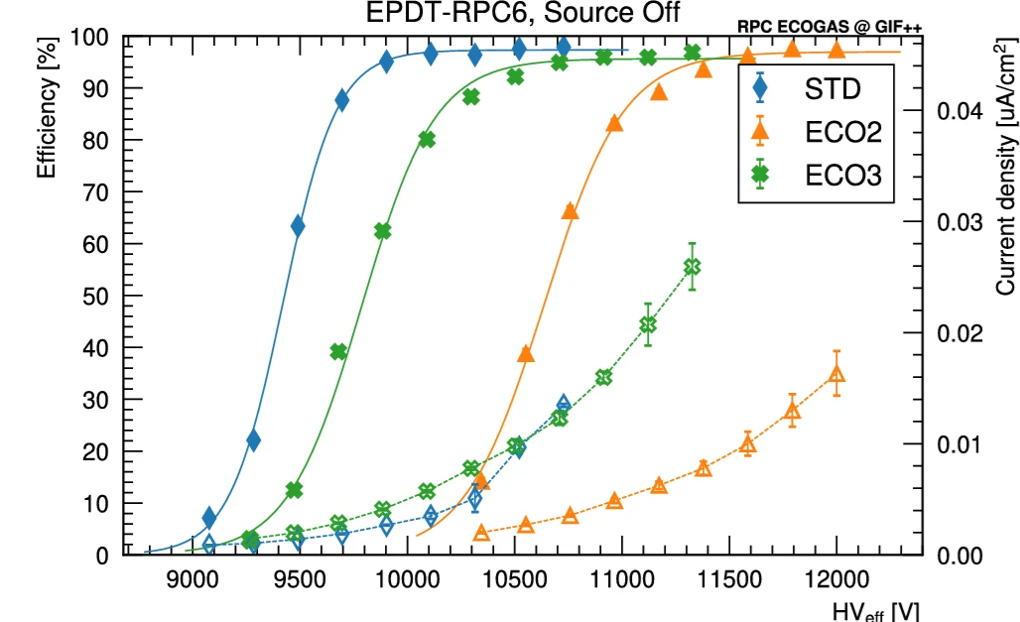
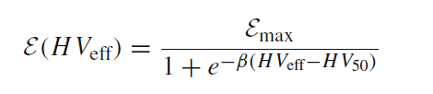
Determination of baseline perfomance
Source OFF, 2021 data
Fit of efficiency curves with a sigmoid:
Efficiency at plateau basically similar for STD, ECO2 and ECO3 > 95%
Efficiency curves shifted at higher voltages depending on fraction of HFO
→ WP(ECO2) > WP(ECO3) > WP(STD)

Slide 53
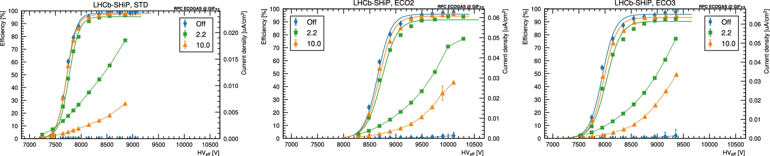
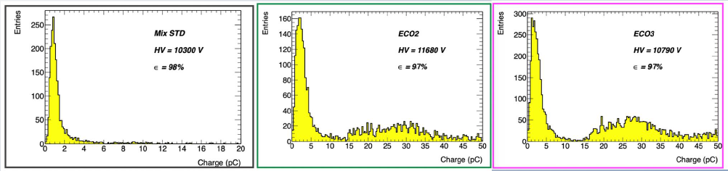
Efficiency and counting rate with irradiation
Source ON, 2021 data
LHCb/SHiP (SG 1.6 mm)
STD
ECO2
EC03
Efficiency > 90% at the highest rate for all detectors
ATLAS 2021 (digitizer)
With ECO2 and ECO3 the presence of larger charge events (not streamers) observed

Slide 54
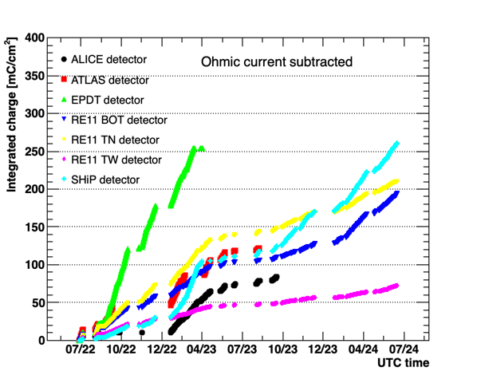
Aging and causes for aging in RPCs
Generally, the charge integrated along a certain elapsed time is considered the most important factor for aging in RPCs;
The targets of integrated charge are different for various experiment: for instance, for ALICE is ≈ 100 mC/cm², for CMS is ≈ 1 C/cm² CMS, including a safety factor of 3.
2023 t.b.
2024 t.b.
Start of the irradiation
54

Slide 55
Further considerations about aging
Caveat: The importance of the integrated charge derives from the fact that production of HF was measured to be proportional to the integrated charge
Direct damage of the detector
However, HFO typically dissociates producing TriFluoroAcetic acid
How TFA causes aging in RPCs and affects their performance on the long term is still to be investigated.
Aging is also caused by irradiation itself
→ Chemical modifications in the HPL electrodes
Aging is also caused by time itself
→ e.g. changed in HPL resistivity because of drying up.
55

Slide 56
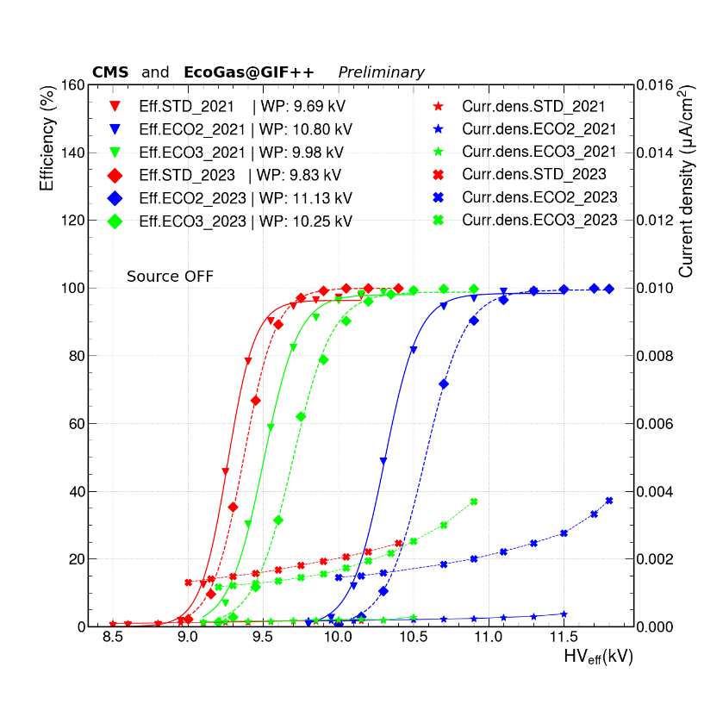
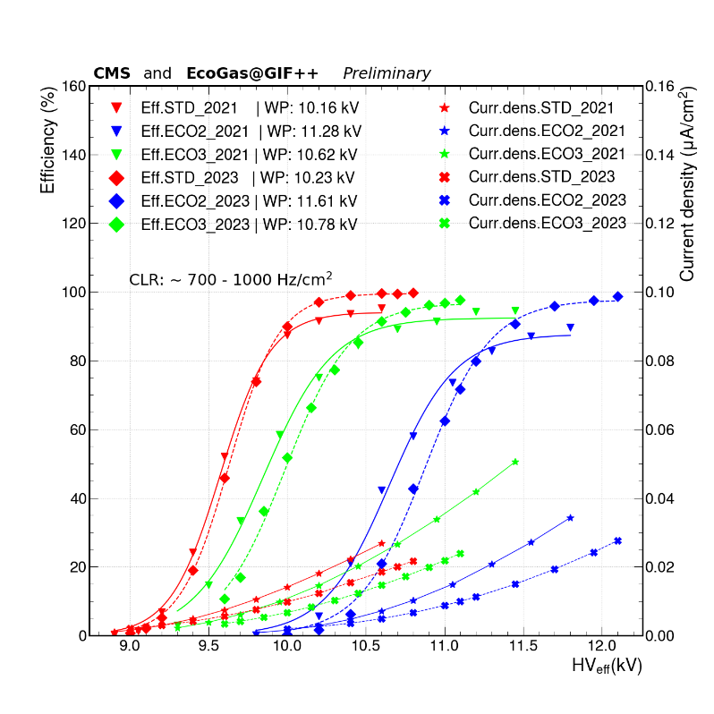
Efficiency before and after irradiation campaign
ALICE, comparison 2022 – 2023
SOURCE OFF
STD
ECO2
CMS (double gap), comparison 2021 – 2023
SOURCE OFF
SOURCE ON
≈ 0.7-1 kHz/cm²
56

Slide 57
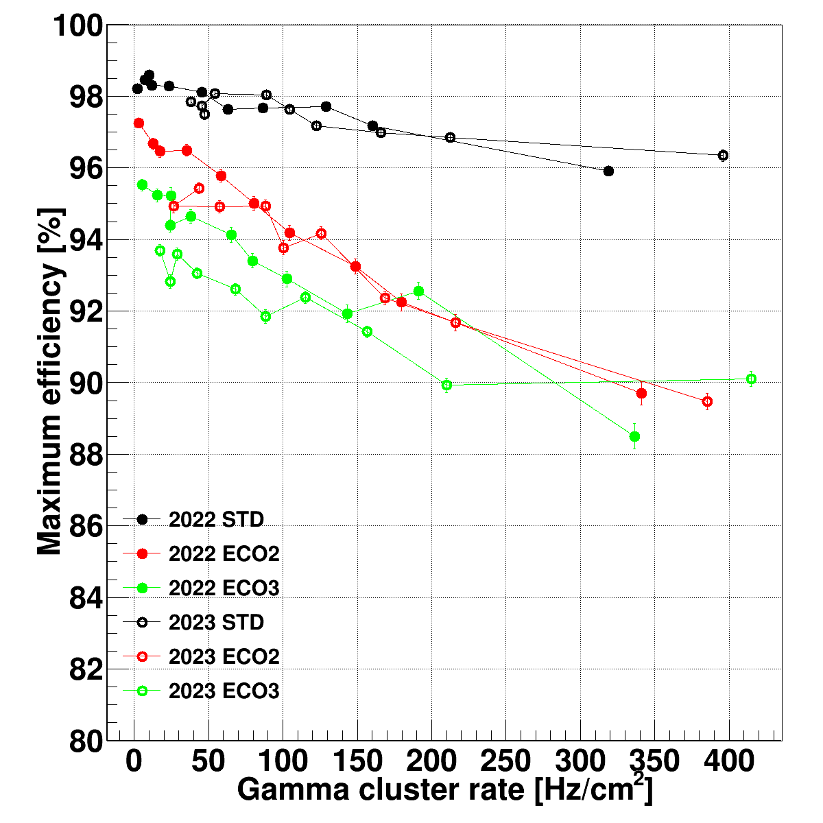
Plateau efficiency before and after irradiation
Comparison 2022-2023 data
ALICE
LHCb/SHiP RPC
The usual decrease of plateau efficiency with rate (or dose) is observed.
Nevertheless, there seems NOT to be any efficiency degradation in the time lapse 2022-23
57

Slide 58
The other piece of the puzzle
The replacement of TFE is just part of the problem; in ECO2 and ECO3 the residual GWP is almost ALL due to the presence of SF6.
Gas mixture replacement is generally done at constant number of gas volumes
→ CO2e is the parameter to consider when evaluating the reduction of the impact on greenhouse effects
Mixture | GWP (100 y) | CO2e (g/l)
Standard | 1485 | 6824
ECO2 | 475 | 1522
ECO3 | 527 | 1529
With ECO2 and ECO3 achieved a reduction of 4 times the CO2e wrt. STD
The residual CO2e is ALL due to SF6
→ Need to find replacement for SF₆, with low GWP and CO₂e, which could reduce the fraction of large charge events when in combination with HFO.

Slide 59
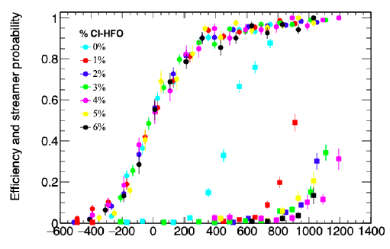
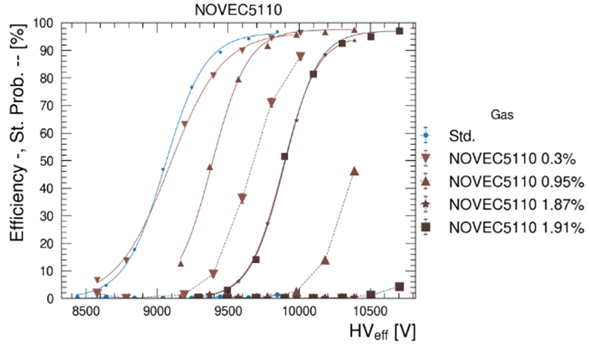

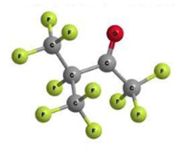
Looking for replacements for SF₆
One proposed solution is
Chloro-trifluoropopene C₃H₂ClF₃ (HFO1233zd)
Avalanche/streamer separation (“useful” plateau) larger than 400V
G.Proto et al, 2022 JINST 17 P05005
B. Mandelli, Possible alternatives to SF6 for Resistive Plate Chambers RPC2022
NOVEC 5110
GWP < 1
Atm. lifetime = 15 days
Application in industry

Slide 60

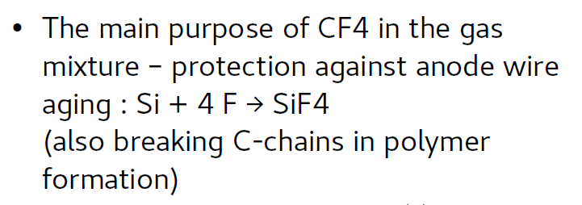
What about CF₄?
Used in CSCs and GEMs
For instance, gas mixture used in CSCs of CMS:
Used in GEMs basically to increase drift velocity → better time resolution. Anyhow without CF₄ time resolutions still within requirements,
Main ideas:
Reduce (or eliminate) CF₄
HFO to replace CF₄, but this implies an increased HV → more studies needed
60

Slide 61
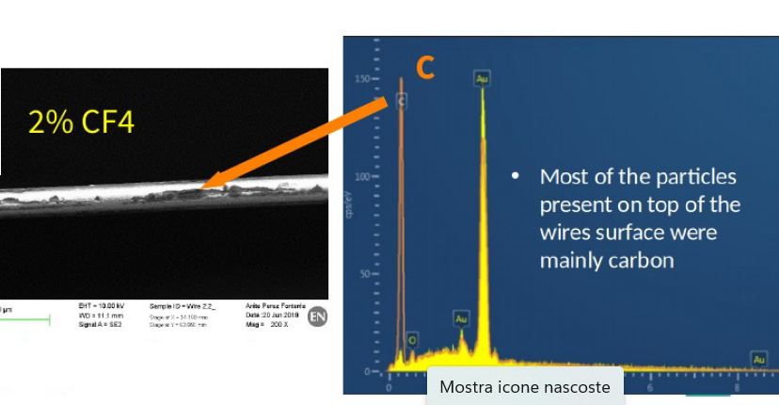
Reduction of CF₄ in CSC
No significant degradation seen, in terms of performance, in all longevity tests
However cathode modifications were seen in all cases.
Anode surface depositions are seen with 0 and 2% CF4 even with naked eye.
61

Slide 62
Replacement of CF₄ with HFO1234ze
Just 1000V increase in the operating voltage, good efficiency, reasonable plateau length
No gain reduction up to 1 C/cm, but significant increase in the dark current in first irradiation tests

Slide 63


Conclusions
There are no conclusions!
  Activities are in full steam, there is a LOT to do!
  Join in, be part of the party!
Interpretation of the effects observed not trivial
Collaborative effors of paramount importance at this stage.
The gaseous detector community is on the eve of its ecological transition

