Slide 1
Manufacturing techniques for PCB and Detectors:
Base materials
Photolithography
Multilayer structures
Drilling/milling
Plating
Test
Example of productions
Tuesday December 3, 2024

Slide 2
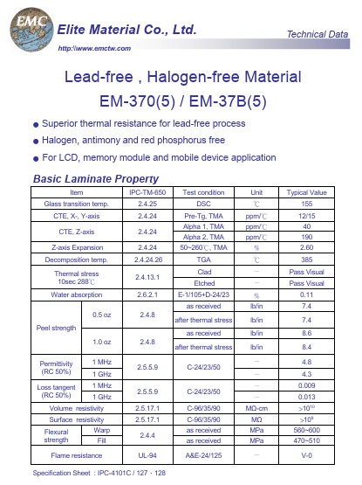
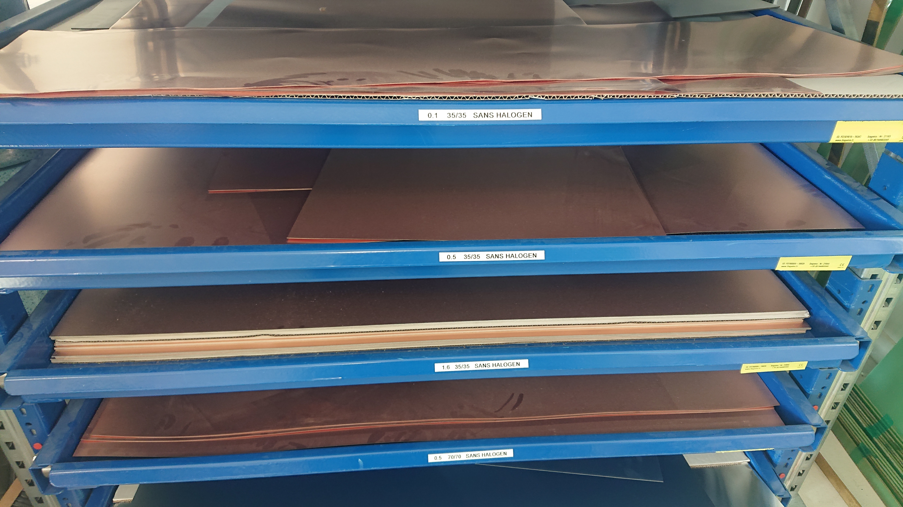
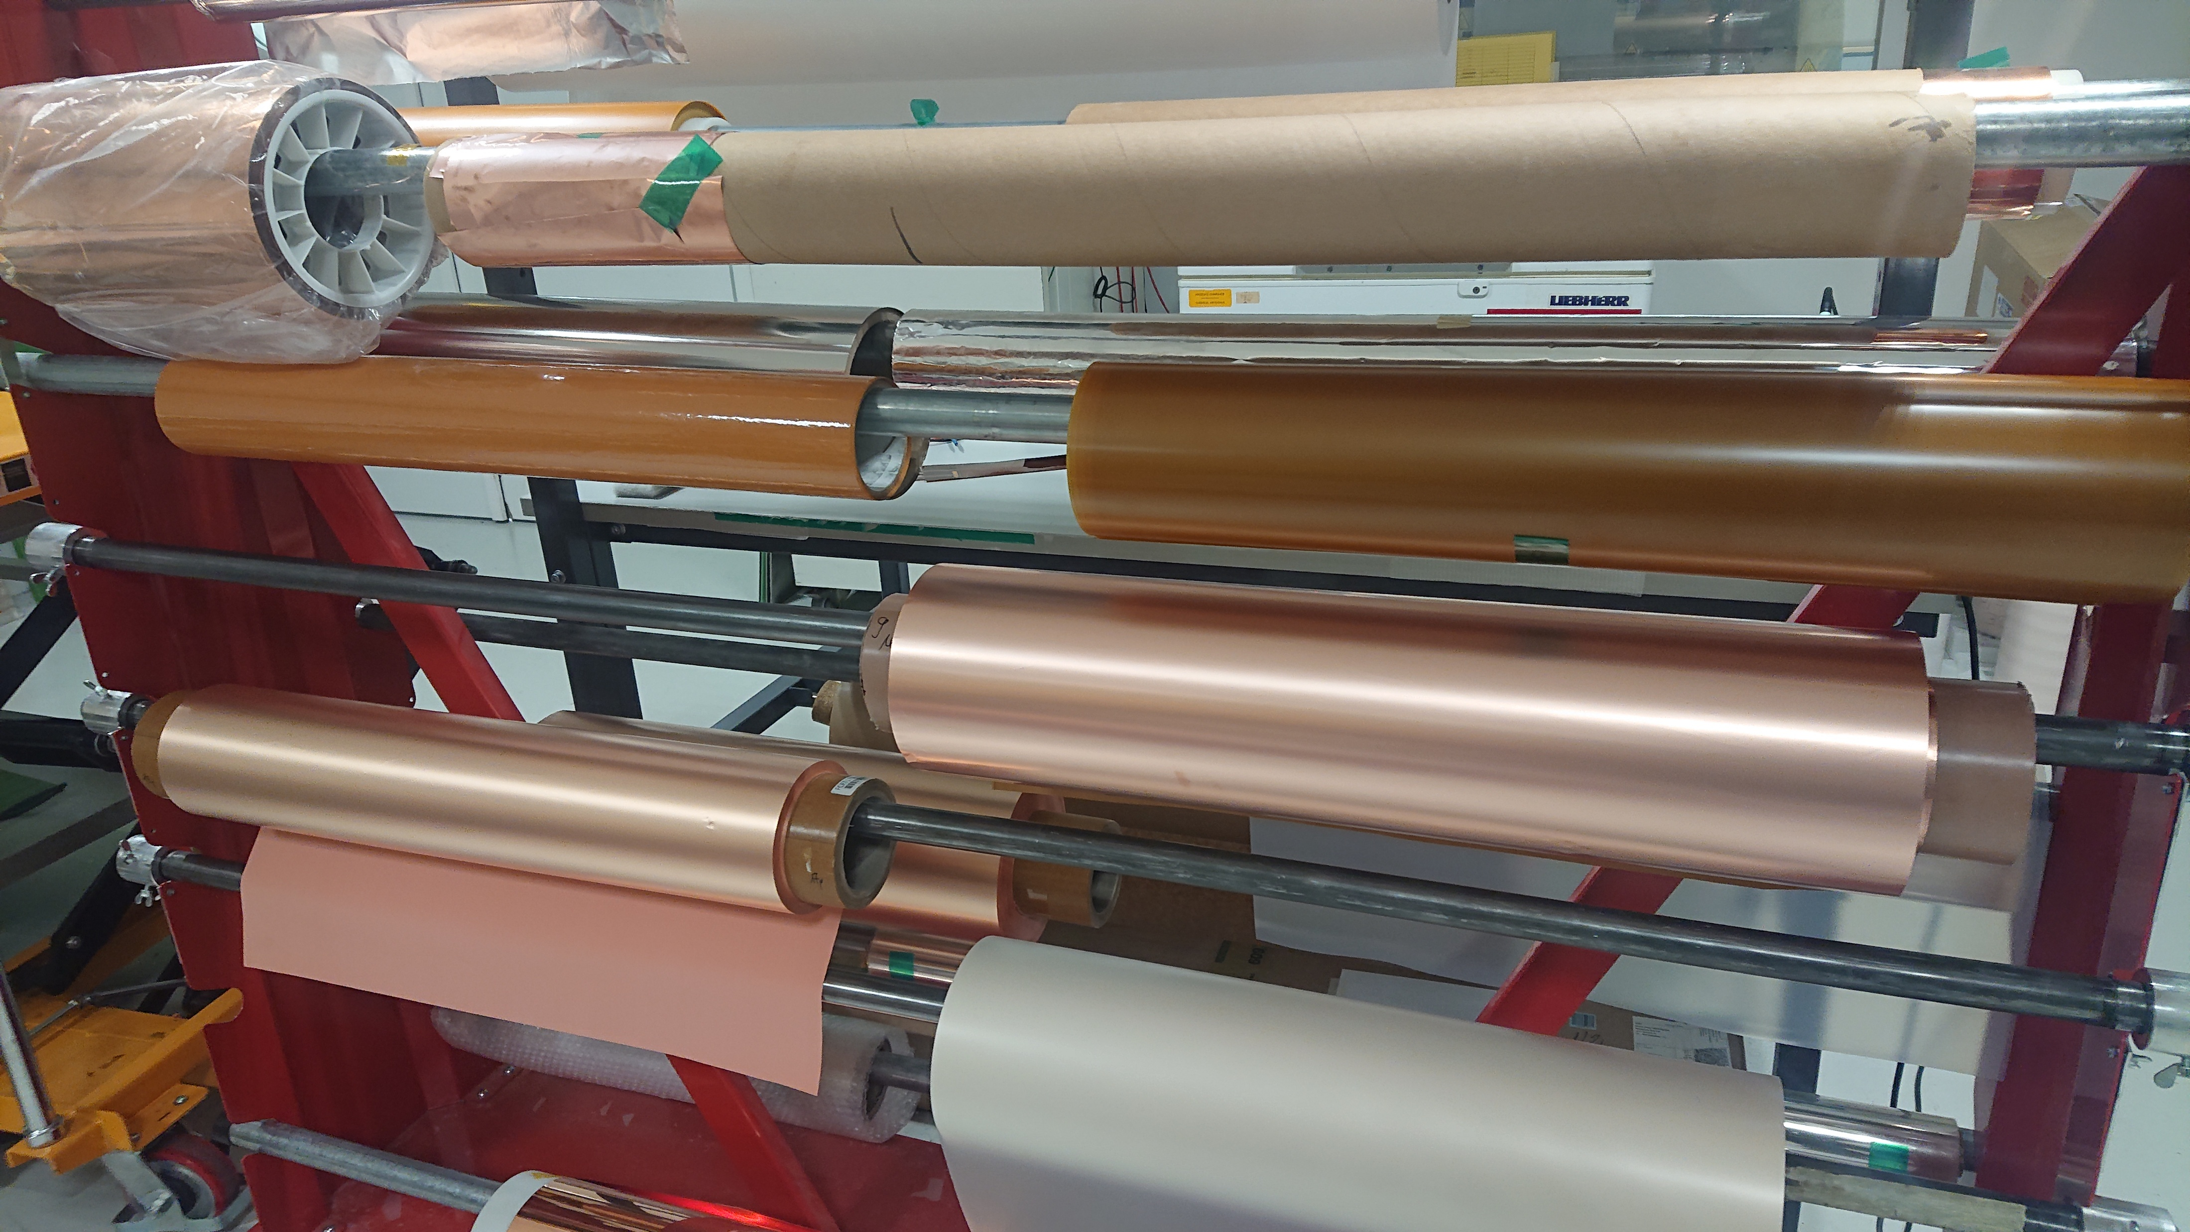
Rigid /Flex materials
Rigid
Glass epoxy
  G10 , FR4, High TG, Low loss , low Dk , anti CAF , low CTE etc..
Aramid Epoxy
  Low CTE
Glass polyimide
  G30 ,High temperature , high reliability
Glass Teflon , ceramic Teflon
  High frequencies
Bakelite
  Low cost
Flex
Polyimide
  General flex application
  Low intrinsic radiation
  Low outgassing
LCP , PEEK
  High reliability flex application
  low moisture absorption , low outgassing
  High frequencies
PET , PEN
  Low cost
Example of data sheet

Slide 3
Photolithography
Basic process steps
Photo-imageable materials
Resist deposition
Masks
Resist exposure
Resist development

Slide 4
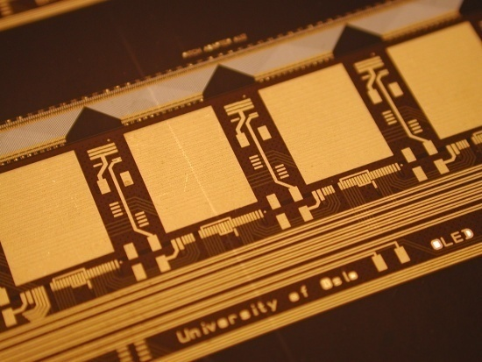
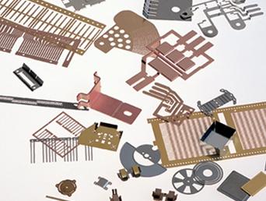
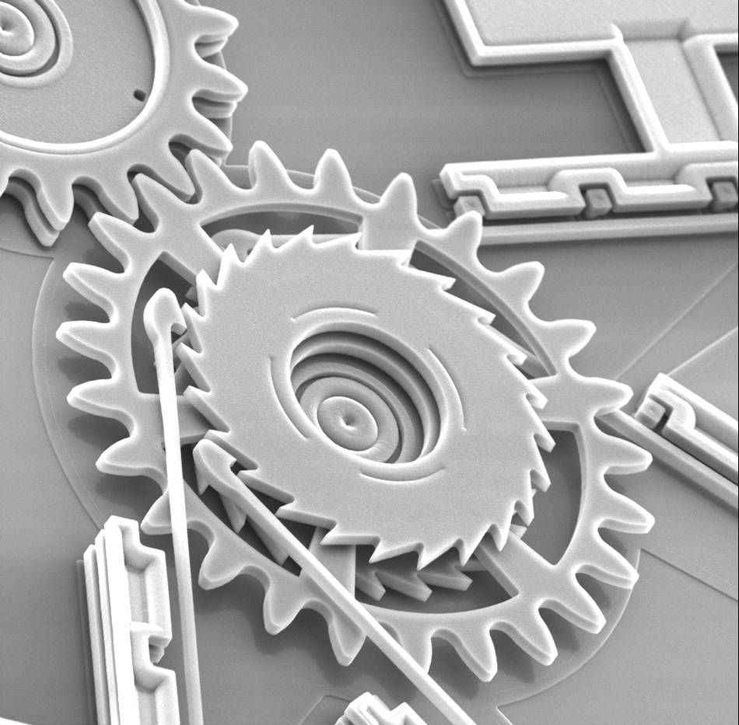
Photolithography basics (substrative)
copper
dielectric
Base material with copper
Photoresist deposition
UV exposure through a mask
Resist development (negative resist)
Copper Etching
Resist Stripping

Slide 5
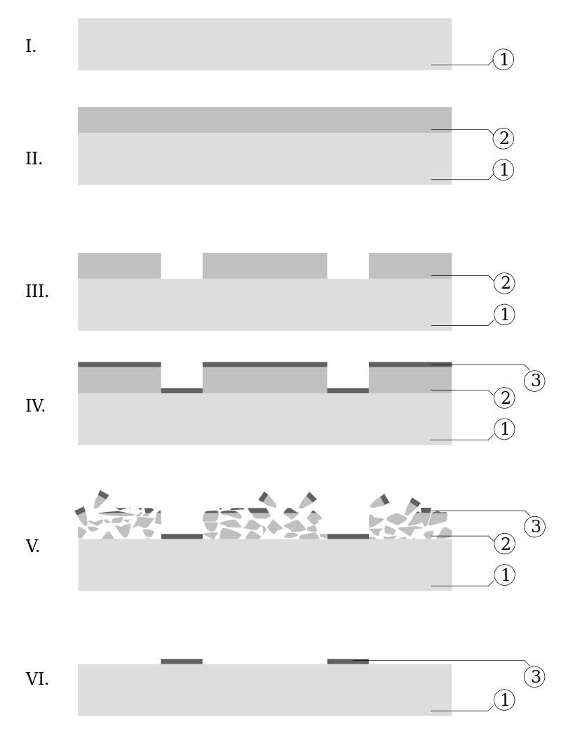
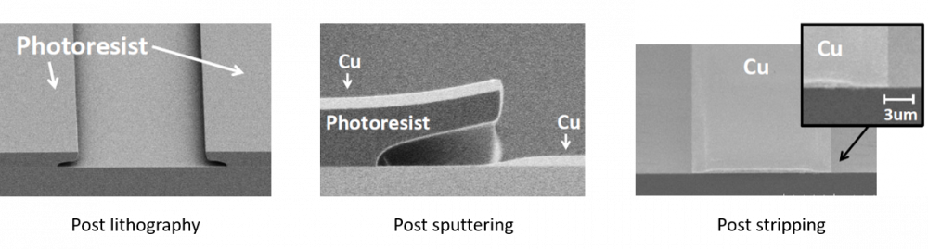
Lift Off patterning (additive)

Slide 6
Photo-imageable materials
Liquid resist (sacrificial)
  Pattern lines
  Thickness : 1um to 5um
  L/S: sub micro-meter
Solid resist (sacrificial)
  Pattern lines
  Thickness: 15um to 200um
  L/S : 20-30um
Solder-mask (not sacrificial)
  Protect external lines on rigid boards
  Typical thickness : 30um
  L/S: 50um
Photo-imageable Cover-layer (not sacrificial)
  Protect lines on flexible boards
  Thickness 30um
  L/S: 50um
Legend inks (not sacrificial)
Liquid Polyimide (usually not sacrificial)
  Make 3D shapes , protect Chips
  Thickness :from 1 to 30um
  L/S : 20um
Liquid Epoxy (usually not sacrificial)
  Make 3D shapes , used for MEMs , Gridpix
  Thickness :1 to 100um
  L/S: 20um

Slide 7
Resist deposition
liquid
-Spinning - semiconductor production
-Dip coating - fine lines for PCBs or 3D objects
-Curtain coating - solder mask deposition
-Spray – solder mask- cover layer
-Screen printing - solder mask deposition
Solid
-Dry film lamination- PCB production

Slide 8
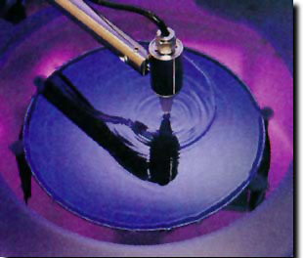
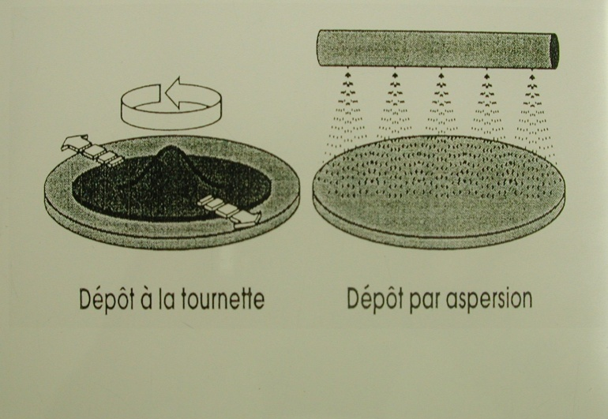
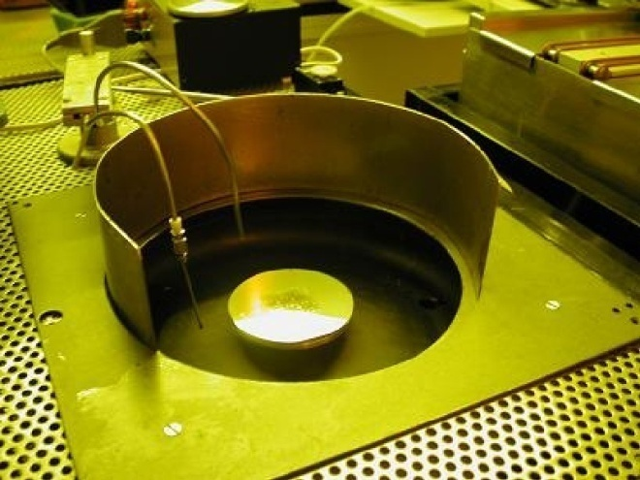
Spin Coating
Spin
Spin & spray
Deposition by centrifugation
Uniform thickness
Ultra-thin : down to 1 μm thickness
Excellent repeatability
Clean room mandatory

Slide 9
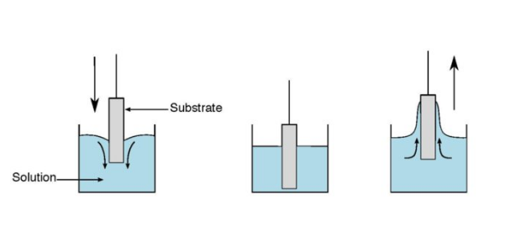
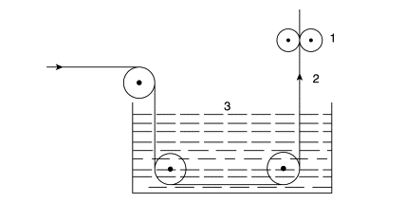
Dip Coating
tank with liquid resist
vertical dryer
base material
Rigid board deep
-Simple
-Difficult to maintain repeatability
-Thin depositions
-Fine patterns
Continuous flex mass production
-Good repeatability
-Fast deposition
-Perfect uniformity

Slide 10
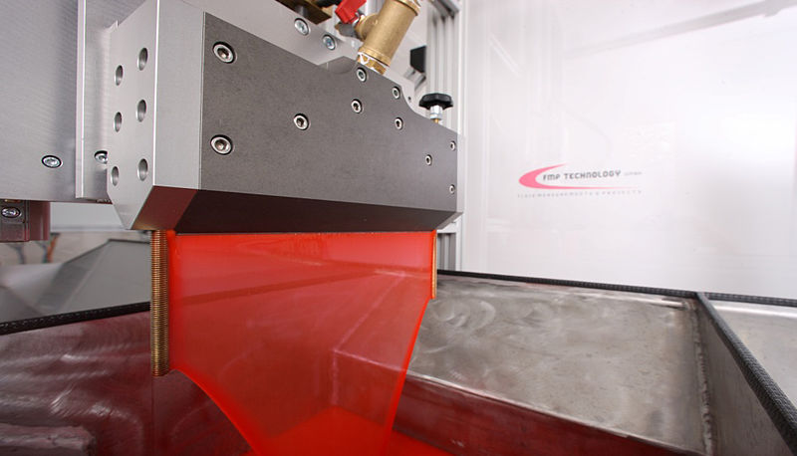
Curtain coating
Reservoir with
Liquid resist
Resist layer
PCB 2
PCB 1
Good for solder-mask deposition
-fast deposition
-but thickness not accurate

Slide 11
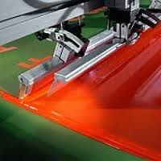
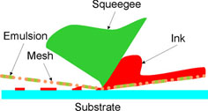
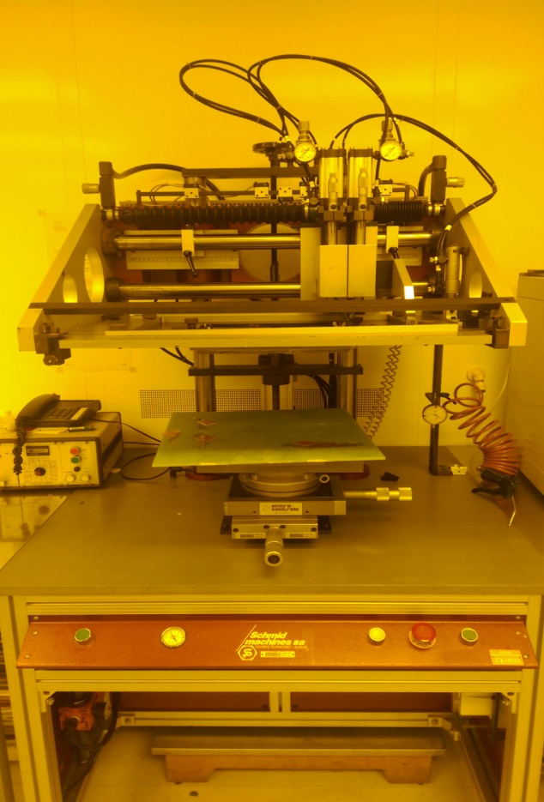
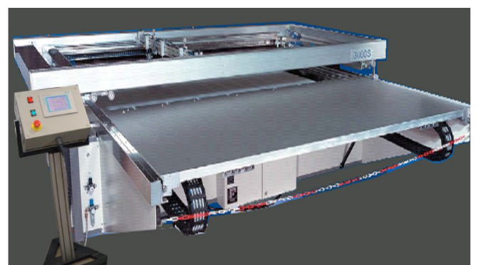
Screen printing
Good for solder-mask deposition
-fast deposition
-thickness not really accurate
-direct pattern printing
CERN precise machine
20cm x20cm deposition
CERN Semi automatic machine 1.5m x 2m
General purpose

Slide 12
Hot roll lamination
Hot rubber roll
PCB
Dry process
Medium class clean room
Large size
Precise thickness
Easy to process
Down to 20μm line/space
Not compatible with 3D shapes
Solid photoresist
Hot rubber roll
Solid photoresist roll

Slide 13
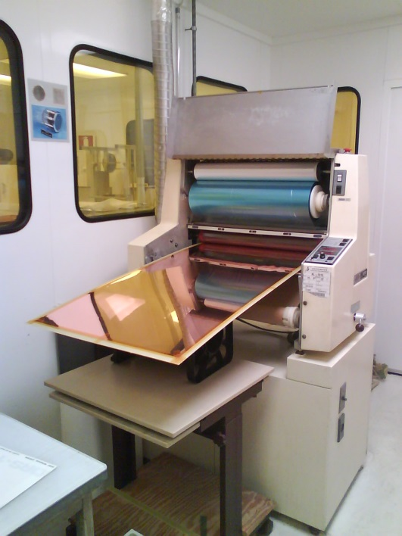
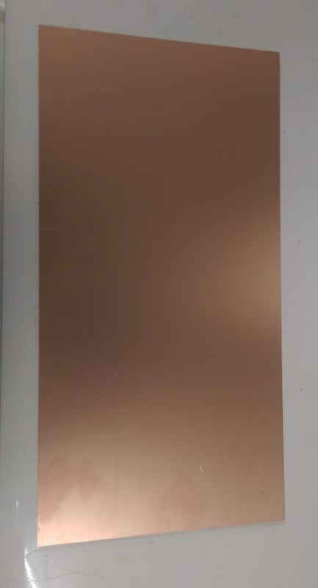
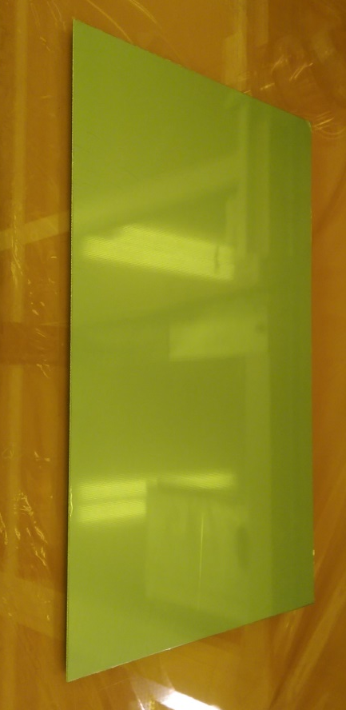
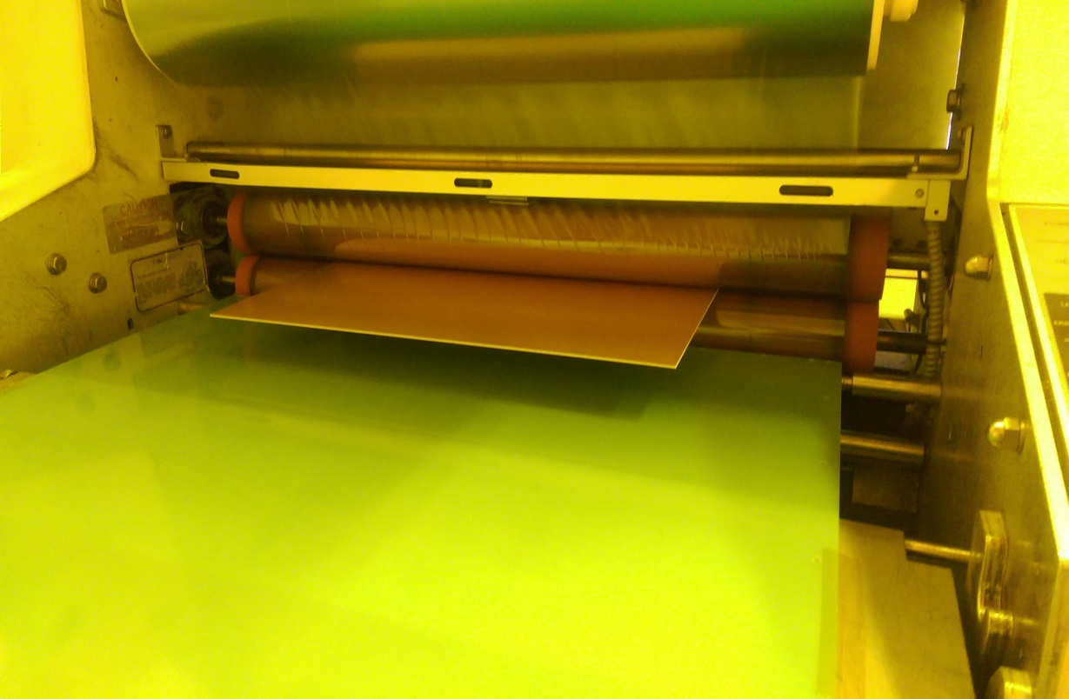
Hot roll lamination deposition
Cu/Glass-Epoxy/Cu plate
Or flex
Plate + Photoresist
Resist deposition by Lamination

Slide 14
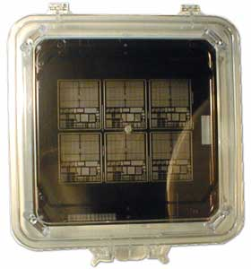
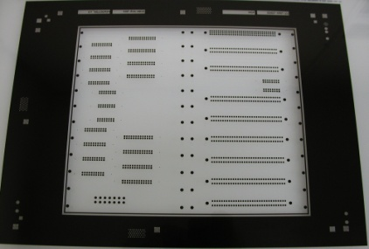
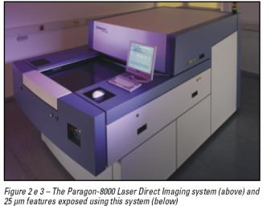
Masks
Precise mask : few mm of Glass or Quartz
-Chromium on thick soda lime glass
  -Sub-micron resolution
  -up to 1m x 0.6m (15 000 CHF for a 1m x 0.6m mask)
Polyester mask : 100um thick
  -Minimum line and space around 20um
  -up to 2m x 1.5m (400 CHF for 2m x 1.5m mask)
Laser direct imaging : no mask
  -Minimum 20um line and space
  -up to 80cm x 60cm

Slide 15
Photolithography problems
Light diffusion
Light absorption
Light diffraction

Slide 16
light diffusion problem
Diffuse UV light
Ex: a neon tube
Collimated (polarized) UV light

Slide 17
light absorption problem
Thin layers ok
Problem with thick layers

Slide 18
light diffraction problem
Diffraction in glass or polyester
Less with quartz
Problems appear with small pattern
below the um

Slide 19
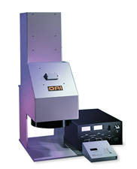
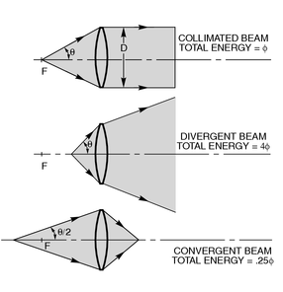
Collimated UV lamps
Precise large size lens up to 12 inches
-Perfect Collimated light
-Low local energy → absorption problem → only thin resist
-Diffraction→ quartz mask
-Working size : 20 cm diameter
-Good enough for 1um line and space

Slide 20
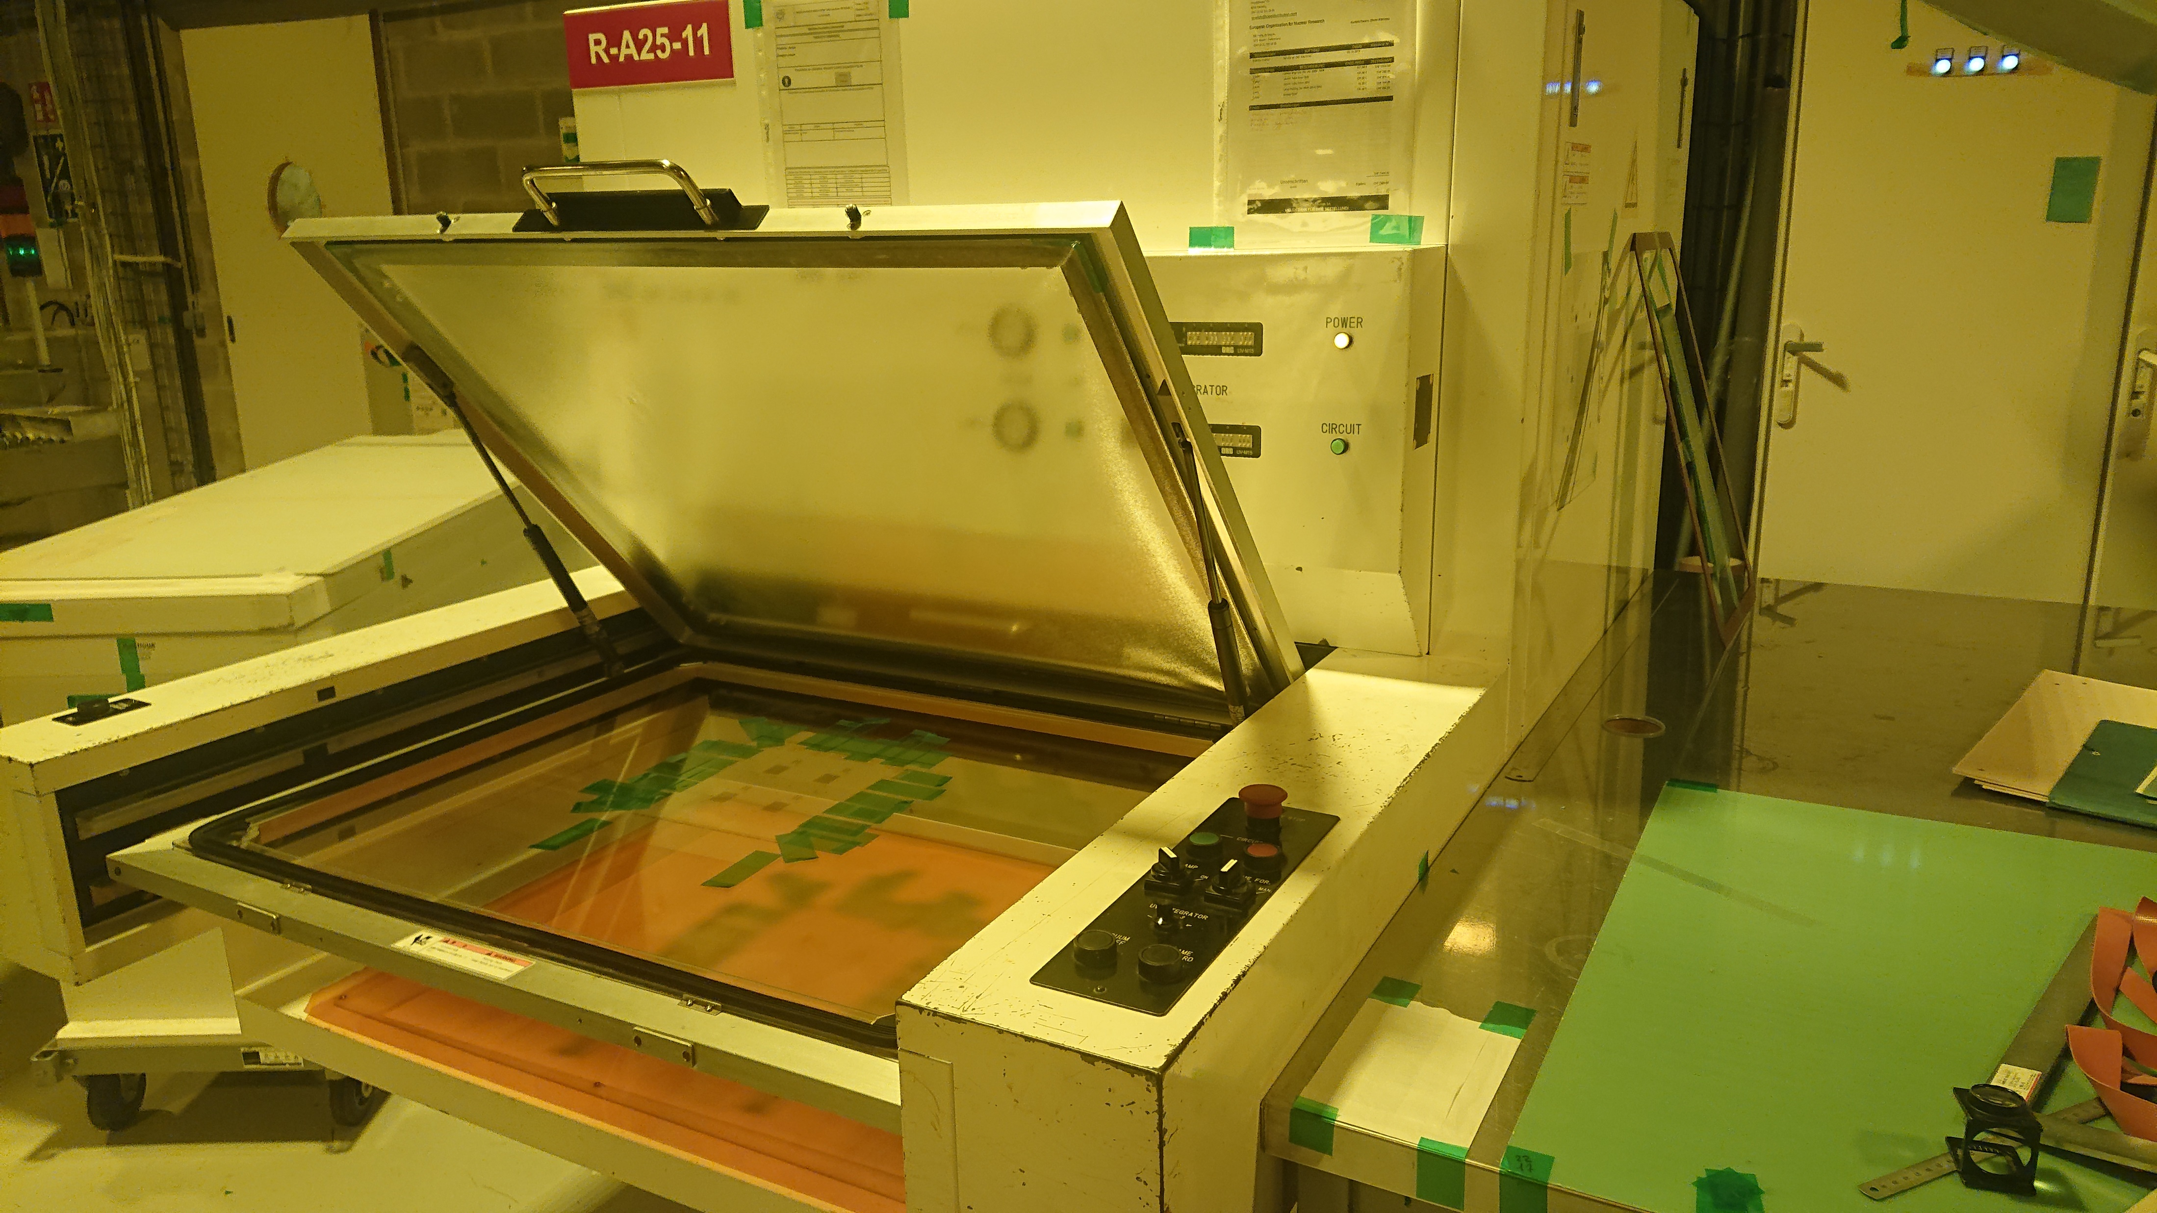
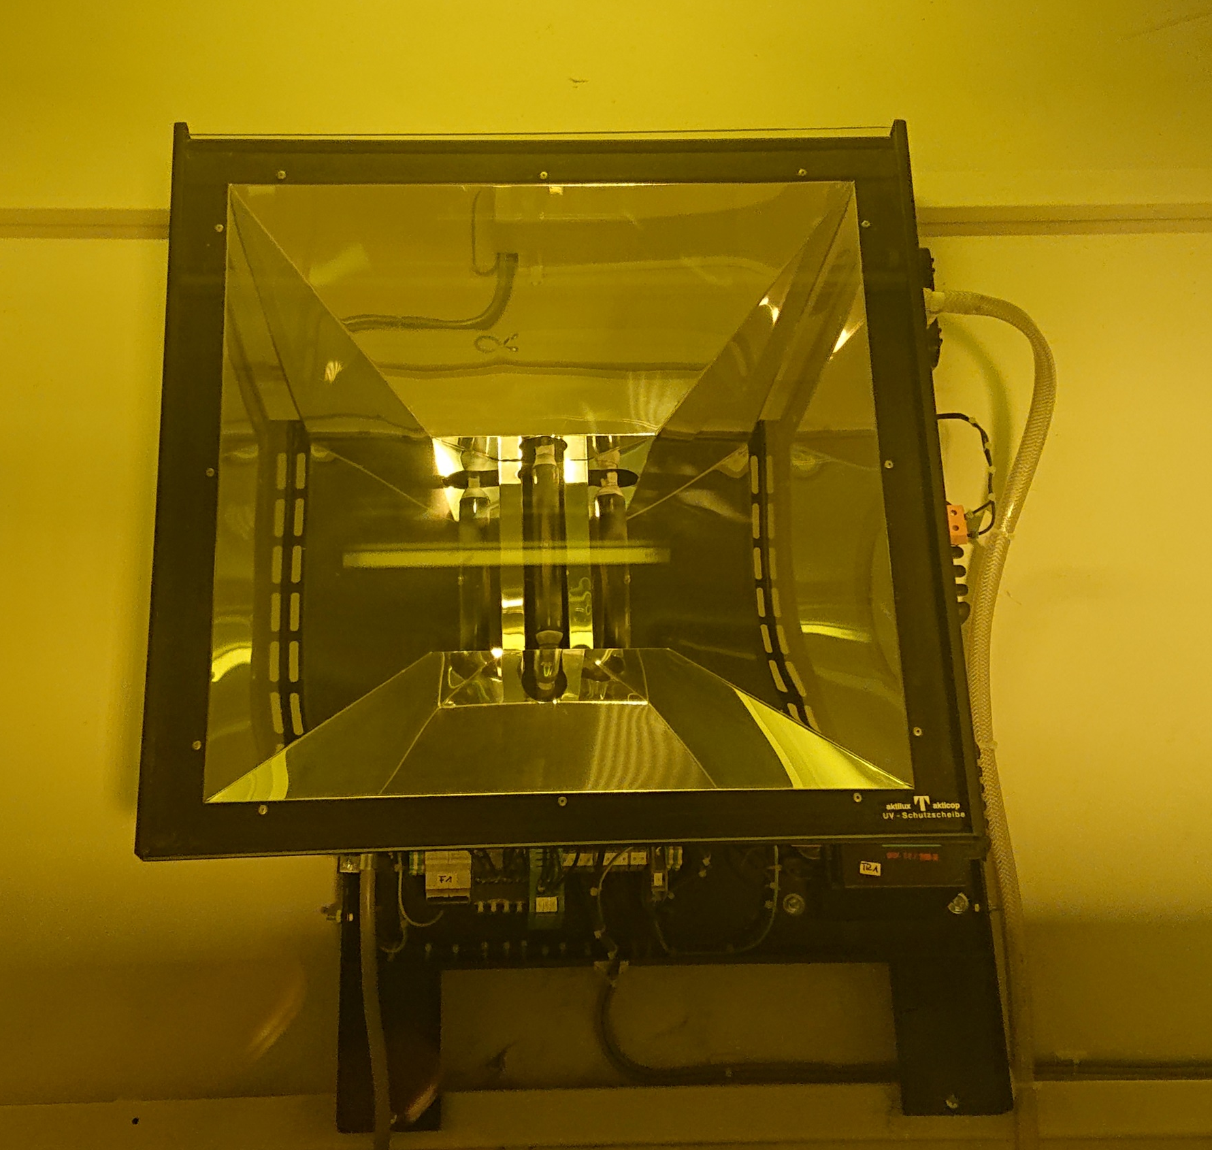
Classical UV exposure machine for PCB production
-Semi Collimated light
-Low local energy → absorption pb
-Diffraction → thin polyester mask
-Working size up to 2.5m x 1.5m
-Good enough for 30um line and space
Two UV bulbs
Stack up:
-Polyester foil
-Mask → manual alignment
-PCB with resist to be patterned
-Glass plate (Chassis)
Vacuum Drawer (open)
Sliding in the machine.
Deflectors to
Improve collimation
UV bulbs

Slide 21
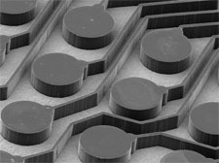
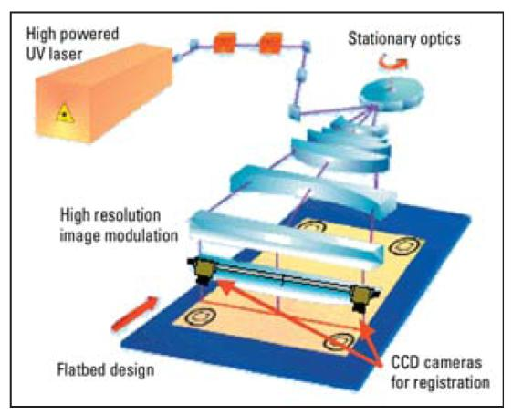
LDI: laser Direct Imaging
-Collimated light
-High local energy better for
absorption but not perfect
-No mask→ no diffraction
-Working size 80cm x 70cm
-Good enough for 20um line and space
X Y steps: 0.5 μm to 2 μm
(depending on machine type)
LDI

Slide 22
Cheap way to avoid light absorption with thick patterns (above 100um)
Resist lamination
+ UV exposure
After development
That’s how the Micromegas pillars
are produced.
Second Resist lamination
+ second UV exposure

Slide 23
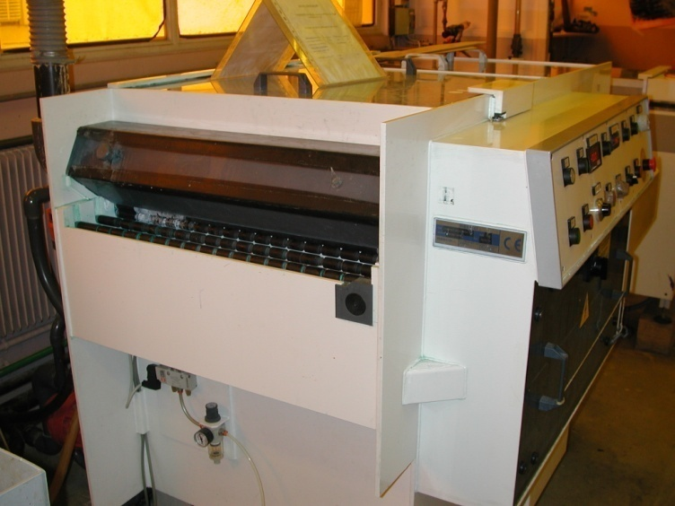
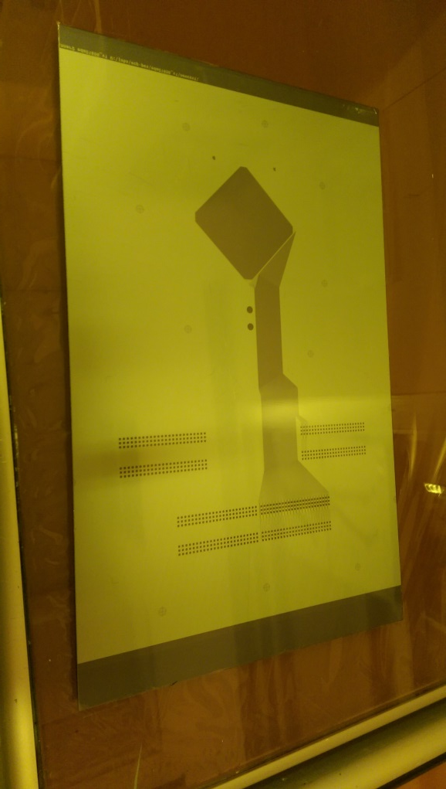
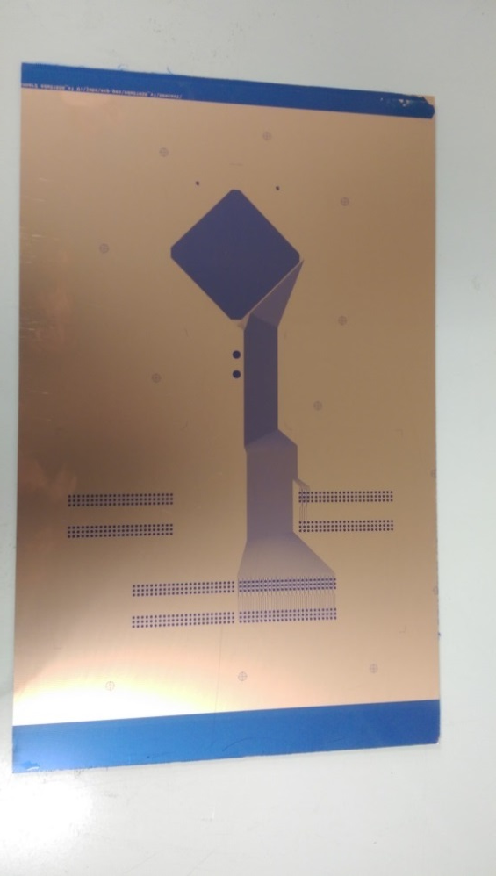
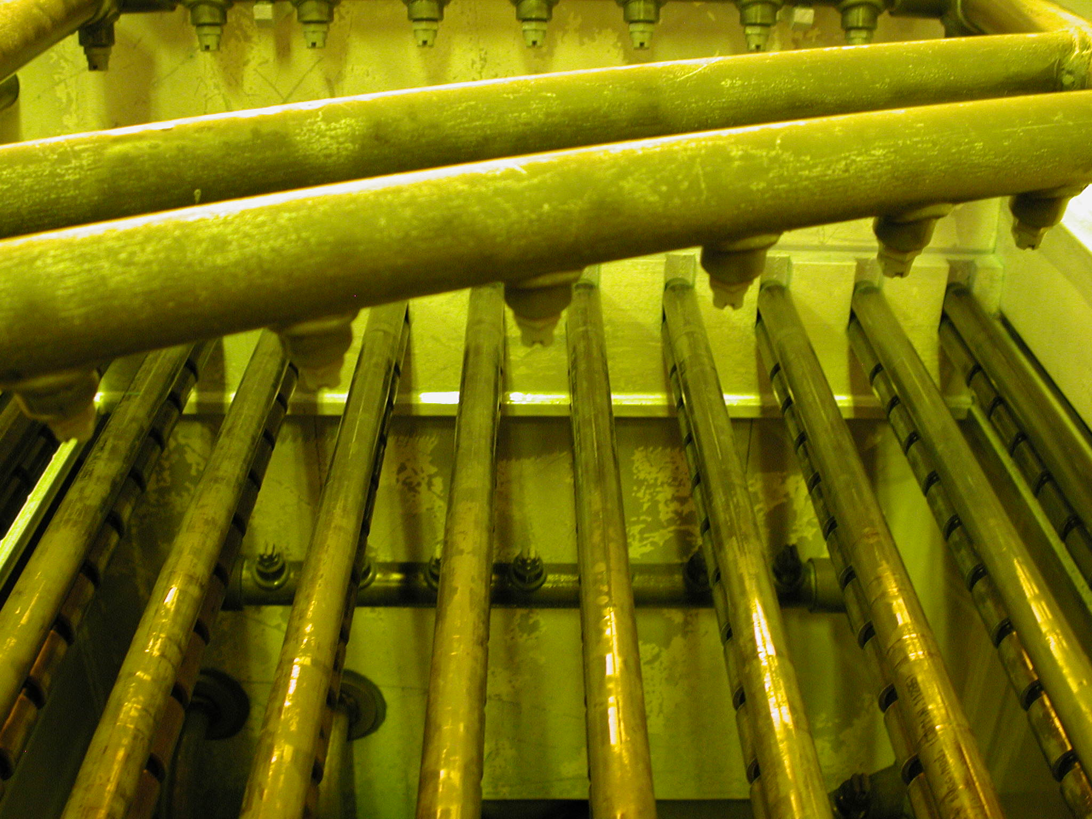
Wet development
After Exposure:
UV exposure change
slightly the resist color.
The UV light have initiated
a crosslink in the polymer
After Development:
All the areas exposed to UV
stays.
Everywhere else the resist
is dissolved.
Sodium carbonate
NA2CO3 development
With spray nozzles

Slide 24
Etching
Wet etching
Anisotropic /isotropic
Laser ablation
Electroforming to reach high aspect ratio patterns
Resist stripping

Slide 25
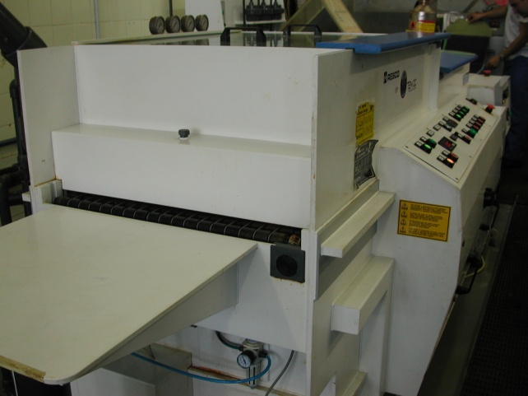
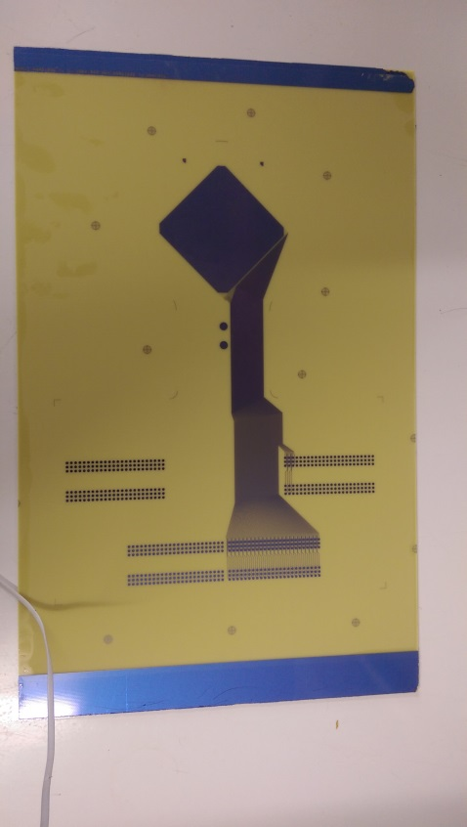

Wet spray Etching
Resist Image
Wet spray horizontal etching
Some examples of chemistries:
-Ferric Perchloride for: Copper/SS/Aluminium
-Phosphoric/sulphuric/Fluoridric acid for: Niobium
-Fluoridric acid for: Titanium
-Potassium Ferrocyanide for: Tungsten
-Iode/Iodine for: Gold
-Iron nitrate for: Silver
-etc.. etc..
After Etching

Slide 26
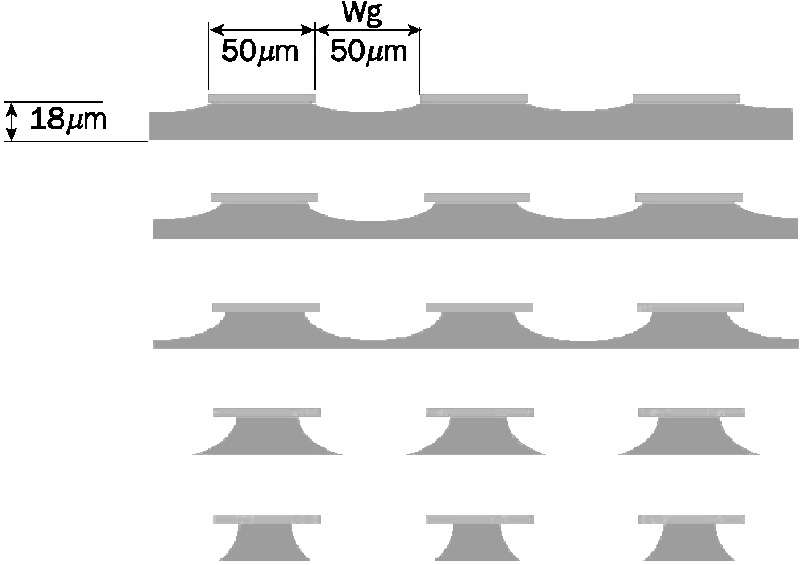
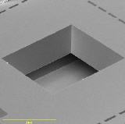
Wet etch , anisotropic or isotropic ?
Wet etching is isotropic for nearly all materials
Some exceptions
  Silicon etching is anisotropic due to its crystalline structure
  Polyimide etching can also be anisotropic
Patterned silicon
Minimum line spacing → 3 to 4 time
the metal thickness.
Big limitation for thick layers !
Anisotropic etching

Slide 27
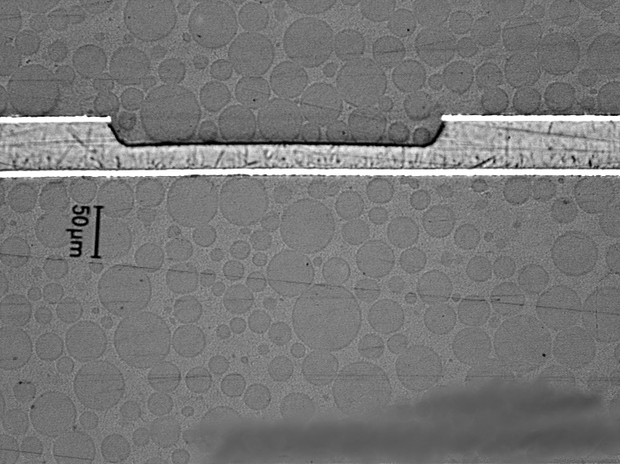
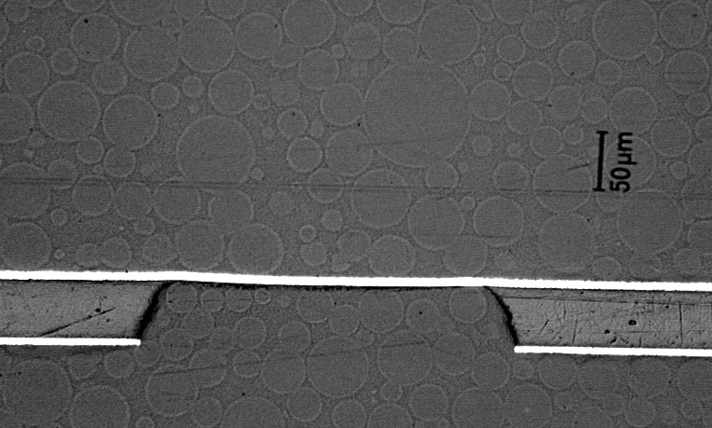
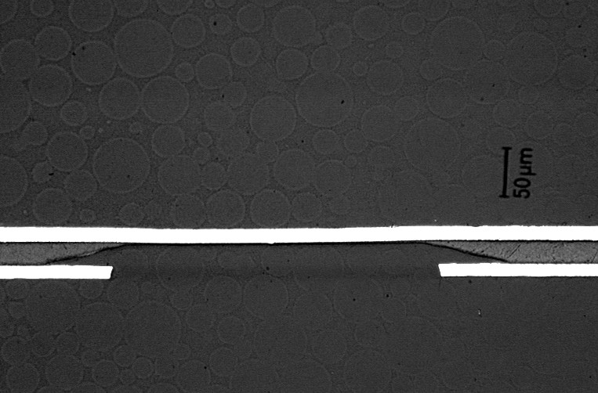
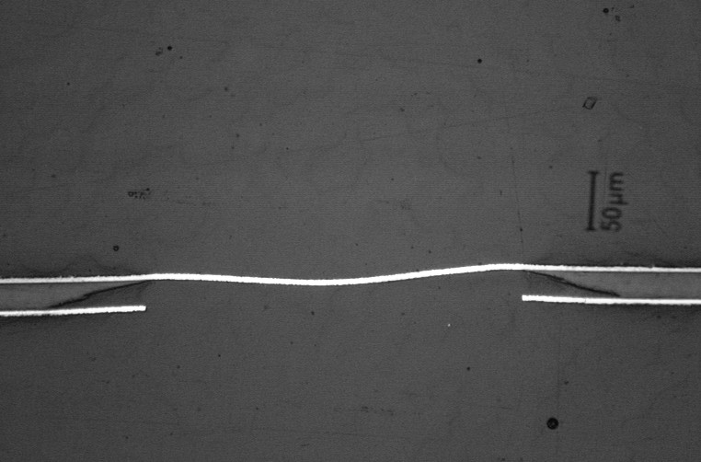
Polyimide wet etching , isotropic and anisotropic
First type of polyimide:
Perfect anisotropic etching
No under etch
Perfect to make small holes
OK
OK
Second type of polyimide:
Fully isotropic etching
Not satisfactory
Les than 10% of PIs available on the market have an anisotropic behavior.
bad
bad

Slide 28
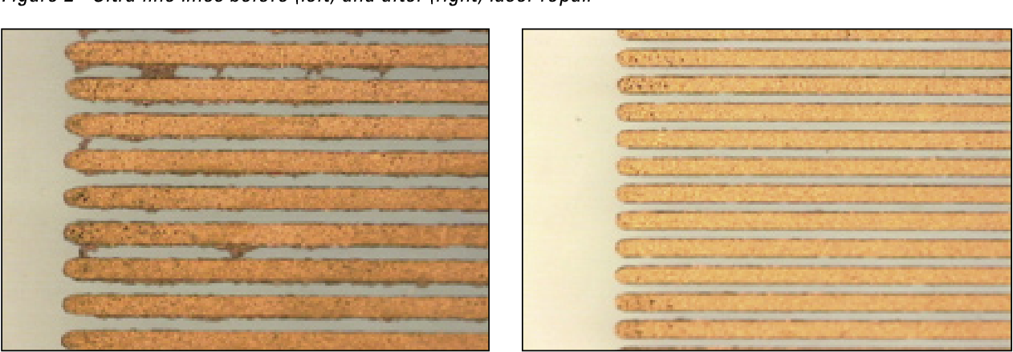
Laser etching
-Laser direct patterning is anisotropic , but not commonly used to make lines in PCBs.
-But lasers are nice for repairs .
Full of shorts
Cleaned up
Seems simple but the process to get this result is highly complex , only lasers can achieve this result.

Slide 29
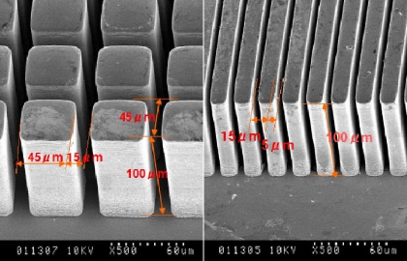
Electroforming to beat wet etching isotropy

Slide 30
Electroforming to beat wet etching isotropy
Thick resist
Electro plating
Resist stripping
Seed layer removal
by wet etching

Slide 31
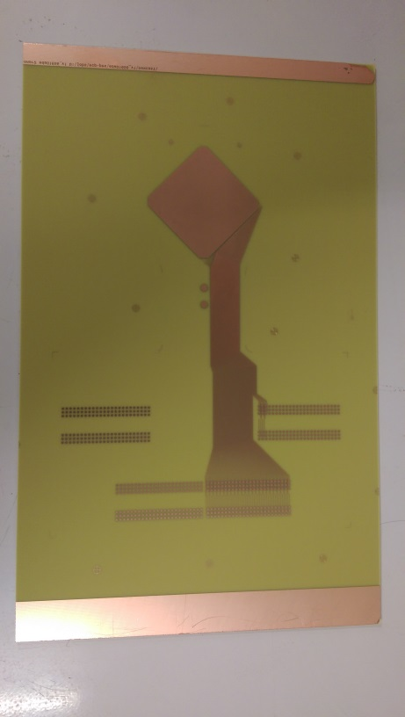
After wet etching → wet resist Stripping
Stripping with:
NAOH
KOH
Solvents
After copper Etching
After stripping

Slide 32
Multilayer structures
Parallel layers production
  Produce all the layers in parallel
  Stack and glue them
  Drill and plate the full stack
Sequential build-up
  Produce layer 1
  Glue layer 2 on top
  Drill and plate layer 2
  Pattern layer 2
  Etc..
Mix structure
  Core done with parallel production (power supplies)
  Sequential build up for high density interconnect

Slide 33
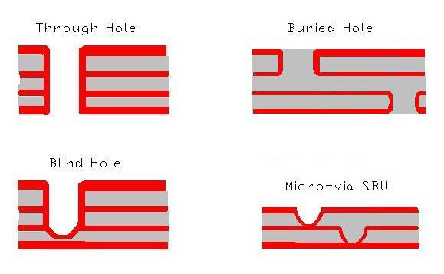
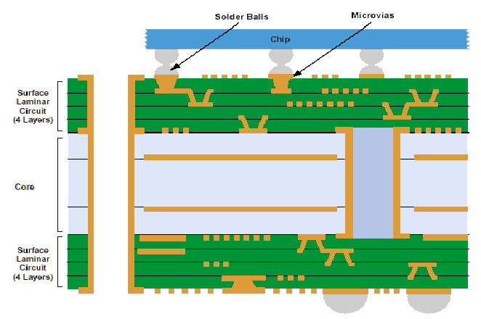
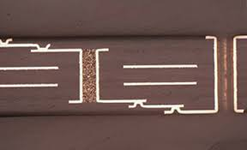
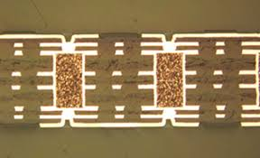
Different interconnection strategies and corresponding holes
Staggered micro vias, buried and through holes
Buried holes and stacked micro vias

Slide 34
Gluing
pressure
Thick Stainless steel
Layer 1
Stack under vacuum
And then heat the stack
glue
Layer 2
Thick Stainless steel
Metallic guiding pins
pressure
Mechanical or pressurized Air

Slide 35

Glue
Liquid
  Difficult to apply , impossible to clean , thicknesses not accurate
  Impossible to remove bubbles
Prepregs
  Woven glass impregnated with a bi-stage glue
  Few um precision thickness
Cast
  Thin solid bi-stage glue layer without glass fiber
  Epoxy, epoxy-acrylic
  Few um precision thickness
Bond-ply
  Polyimide foil with a cast layer on both sides
  Polyimide foil with a thin thermoplastic polyimide layer on both sides

Slide 36


Curing cycle
PrePreg
Cast

Slide 37


Gluing equipment
Isostatic press
-Vacuum chamber
-5 heating platens , 4 daylights
-Mechanical Hydraulic pressure (170 Tons)
-Plate size 600mm x 700mm
-Presses with 3m x 1.5m platens exist
-Only used for flat circuits
-Perfect for mass production
Autoclave
-The parts to be glued are in a vacuum bag
-Pressure comes from compressed air (7 Bars)
-STD size 2m x 1m
-Machine with a length of 20m are existing
-Long cycles
-3D objects
-Need more handling than Isostatic

Slide 38
Problem : nothing is flat
Thick stainless-steel plate
PCB
glue
PCB
Thick stainless-steel plate

Slide 39
Problem : nothing is flat
Thick stainless-steel plate
PCB
glue
PCB
Thick stainless-steel plate
Machine platens →+/-150um error
SS plates →+/- 50um
PCB →+/- 10% of the thickness
Prepreg , Glues →+/-10um

Slide 40

Problem : nothing is flat
Thick stainless-steel plate
PCB
glue
PCB
Thick stainless-steel plate
Machine platens →+/-150um error
SS plates →+/- 50um
PCB →+/- 10% of the thickness
Prepreg , Glues →+/-20um
Introduction of conformal layers to correct
all the errors

Slide 41

Release and conformal layers
Release sheets
  Pacotane
  Pacolon → high temp
Planarity correction
  Pacopads→ 200um correction
  Thermal activation
  Pacoterms→ 1mm correction
  Mechanical activation
Hermetic layer
  Pacovia→ Stop the glue flowing from buried holes
  Thermal activation
Typical 4-layer Rigid PCB stack
Typical 4-layer Flex stack

Slide 42


And not forget to prepare metals before gluing
Copper before and after treatment
1/Detergent Cleaner
2/Pre-conditioning
3/Micro structuring Chemistry
4/DI water Rinse
5/Dry

Slide 43
Drilling / Milling
Mechanical
Chemical
Laser
Plasma
Sand blast

Slide 44


Mechanical drilling
At CERN
Minimum tool diameter : 0.15mm
Spindle 180 000 RPM
Max rate 3Holes/s
1.4m x 0.6m drilling area
CERN Machine
In industry
Up to 4m x 2m drilling area
Max rate up to 10 holes/s
Min tool diameter 0.05mm
Spindle 300 000 RPM
Tool store
Spindle
Dust
exhaust
Optical
camera
Xray Camera

Slide 45



Mechanical Milling
Tool store
Spindle 80 000 RPM
0.5mm min milling tool

Slide 46



Chemical drilling → GEM
Base material : Polyimide 50um + 5um on both sides
Double mask
Single mask
Base material
Hole patterning in Cu
Polyimide etch
Bottom electro etch
Second Polyimide Etch
Limited to 40cm x 40cm due to:
  The masks alignment precision
  And Glass mask cost
Limited to 2m x 60cm due to:
  Base material
  Equipment

Slide 47



Laser or plasma drilling
CO2 laser
UV laser
RIE Plasma
DRIE Plasma
Punching
Thin spiral cut
-Many possible base Materials.
-Holes perfectly clean.
-Small patterns
-30um holes
-Not competitive with Wet drilling
-Many possible base Materials.
-Can drill both metals and polymers
-20um holes
-Not selective enough
-Not yet competitive with Wet drilling
-Moderate machine cost .
-Holes perfectly clean
-50um holes
-Not uniform on large size.
-Etching too Isotropic
-Perfect cylindrical holes.
-Holes perfectly clean
-Ultra precise patterns
-20um holes
-Complex process
-limitation on size : dia 20cm max.

Slide 48

Sand blast drilling
-Anisotropic drilling
-Can drill nearly all materials
-Smooth walls
-Millimetric scale holes

Slide 49
Wet plating
Black hole
Electroplating
Electroless plating
Vacuum plating

Slide 50
Hole plating →Black hole
Drilled PCB
Carbon full coverage
Remove the carbon on copper
Electrolytic copper plating

Slide 51

Dielectric treatment before copper plating
1/Deasmear line:
  Remove material burnt during drilling
  Come back to fresh dielectric
  Sequence:
    1/ Sweller
    2/ Potassium permanganate etching
    3/ Neutralizer
2/Carbon line:
  Deposition of Nano Carbon on dielectric
  Sequence
    1/ Detergent cleaning
    2/ Nano carbon full coverage
    3/ Micro etch to remove carbon on copper

Slide 52



Electro plating
Anode
Basket with copper balls
CU
NI
Au
Copper plating Bath
2m x 0.6m panels
Cathode
Filter/pump

Slide 53


Electro-less plating
Protect copper from oxidation
- Ease the components soldering
- Allow Aluminum or Gold wire Bonding
ENIG : Electroless nickel (5um) , Immersion Gold (0.07um)
ENEPIG: Electroless nickel , electroless Palladium , Immersion Gold
Ag: Chemical silver less than 1um
Tin: Chemical Tin
Immersion Au
Electroless Ni

Slide 54





Vacuum deposition
Cr
Cu
Al
Ti
Nb
B4C
DLC
ITO
Pulsed DC Magnetron vacuum
deposition machine
Drum unloading
after processing
70cm targets

Slide 55
Tests
QC
AOI
Flying probe tester
XRF

Slide 56

QC
IPC standard define the parameters
to check and set 3 levels of quality.
Class 1: Consumer products
-It can fail without consequences
-exchange sometimes not necessary
→ radio , toy , microphone etc..
Class 2: Industrial products
-uninterrupted service is desired
-exchange is not critical.
→ CNC machines, Heat pumps etc..
Class 3: High reliability
-No possibility to exchange the product
without serious problems.
→ Airplanes, trains , cars
→ President microphone.

Slide 57



3 examples of parameters to be checked.
There are more than 150 parameters to check in IPC-A-600.

Slide 58



Automatic Optical Inspection (AOI)
Compare the scanned image with the CAD file
Minimum track or space 20um
Minimum detectable defect around 5 um ( pixel 2.5um)
Cannot detect defect in holes
Short circuit
Open
Bonding pad

Slide 59


Electrical test
Control netlist integrity
Including PTH connections
Conductive / dielectric mode
Capacitive mode
Flying probe

Slide 60


XRF , X Ray Fluorescence
Can measure different metals nature and thicknesses
Used for ENIG and ENEPIG control

Slide 61
Production examples

Slide 62




Inner Trackers → Low Mass Aluminium circuits
ALICE inner tracker BUS (5 Aluminum layers)
Double-sided flex for ILC Vertex sensor
ATLAS IBL Low Mass 8 layers
ALICE inner tracker

Slide 63



Magnets calibration → ultra precise field sensors
Multi-layer coils :
-1.5m long
-up to 40 layers
-30um maximum registration error
-Line and space down to 50um/50um
-Printed Coils are 10 time more accurate than
wounded structures

Slide 64


LHC machine protection
Others:
-Heating foils
-High power resistors
-Optical targets compatible with UHV
-etc..
Stainless steel or SS/Cu mix Quench Heaters
Long flexes up to 15m x 0.6m

Slide 65


HDI CMS strip detectors
Front end Asics
Rigid flex
Glass pitch adaptor
Silicon strip detector
Size in the range of 10cm x 20cm

Slide 66


PCB for CMS Pre-shower

Slide 67



Full Aluminium flex with embedded silicon detector (R&D)
Top
bottom
Thinned chip 50um
100um thick end device
Full aluminium
No bonding

Slide 68





CMS GEM Single Mask
Microscopic view
Single mask GEM
CMS experiment
Cross section
GE1/1 → 400 GEM (1.3m x 0.5m) made at CERN
GE2/1→ 1000 GEM (1.3m x 0.5m) CERN/Korea
GEM producers' capabilities:
-CERN MPT : 500m2/year
-Mecaro Korea : 250m2/year
Triple GEM stack
GE1/1 Muon detector
CMS nose

Slide 69



And many more
Other detectors with GEM single mask technique
CMS ME0 → 1000 GEMs
KLOE – Cylindrical Detector
ALICE TPC → 700 GEM
-BM@N in Dubna (1.6m x 0.5m)
-SBS tracker Jefferson lab
-CBM at Fair
-BESIII China
-SOLID
-BONUS 12
-P-RAD
-S-Phenix TPC
-COMPASS upgrade
-GEM for nuclear physics TPCs
-ESS for neutron detectors
-and lot of small GEMs for academic purpose

Slide 70



BULK and Floating mesh Micromegas detectors
BULK Micromegas
Floating mesh Micromegas

Slide 71







BULK Micromegas detectors
T2K TPC ,J.Beucher
1.8m x 0.8m plane
With 12 detectors
ILC DHCAL , M.Chefdeville
1m x 1m plane
With 6 detectors
Early ATLAS NSW R&D
Joerg Wotschack
1.5m x 0.5m plane
Single panel
CLAS 12
Cylindrical Micromegas bulk
Thin substrate
33 sectors , 12cm diameter detector
2.5mm dead space for sectorizing
1mm hole for HV connection

Slide 72
Introduction of resistive layers in floating MM
50um Kapton + resistive strips
PCB + readout strips
25um solid Glue
High temp Gluing
mesh
Pillars creation

Slide 73

Atlas NSW
Close to 2000 Micromegas detectors produced with modules sizes up to 2m x 0.5m
PCBs with pillars built at ELTOS (IT) and ELVIA (FR)
Panels construction and detector Assy :
-Dubna
-INFN Frascati
-CEA Saclay
-LMU Munich
MPT participated to the R&D and was also involved in the mass production with industry
-Specification
-Companies selection
-Technology transfer

Slide 74

Resistive MM structures
Medium-rate detectors 100kHz/cm2
Side evacuation of the charges
High-rate detectors 10Mhz/cm2
Charge evacuation inside active area
2013
2015
Screen printed resistive strips (ATLAS NSW)
2 layers with screen printed pads
or
or
2015
2020
full DLC layer
2 DLC layers without patterns

Slide 75
Micro Resistive well detectors
After gluing
Polyimide coated foil: copper top , DLC bottom
Prepreg
Chemical drilling ( GEM process)
Any PCB or flex with any kind of R/O structure
X/Y , UVW , Pads, Capacitive sharing etc..

Slide 76


Medium rate µRwell
Lateral evacuation of charges
High rate uRwell
Charge evacuation in the active area
PEP→ Pattern Etch Plate
1 DLC layer
Evacuation line
The DLC is connected by plated grooves or plated holes from the top layer
SG→ Silver Grid
10cm x 10cm µRwell detector
The DLC is connected to copper lines directly on the DLC layer

Slide 77




uRwell examples
Frascati R&D
1D PEP uRwell
Active area:
40cm x 5cm
Frascati R&D
1D PEP uRwell
Active area:
30cm x 30cm
CLAS12 R&D
2D PEP uRwell
Active area:
150cm x 50cm
CLAS12 uRwell
rolled in an oven
for E-cleaning

Slide 78
Thank you for your attention

