Slide 1
Gaseous Detector Applied to Fundamental Research Beyond HEP
Marco Cortesi
Detector System, Group Leader
cortesi@frib.msu.edu
2 December 2024

Slide 2


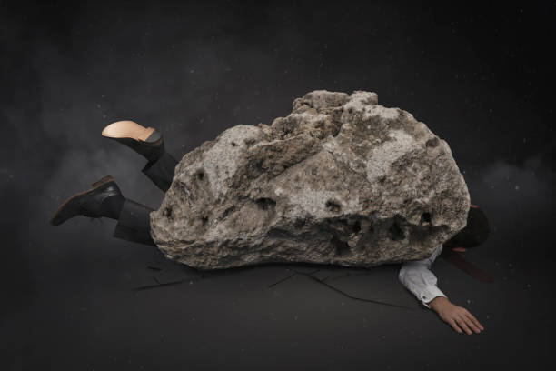

Preamble: Constraints, Limitations, and Assumptions
During preparation
After slides has been completed
Goal
Reality
Warning: the task has a massive scope!
➔ Constrain: Time Boundary!
➔ Limitation: Personal (limited) experience is the basis for the materials here presented!
➔ Assumption: I most probably miss something important!

Slide 3


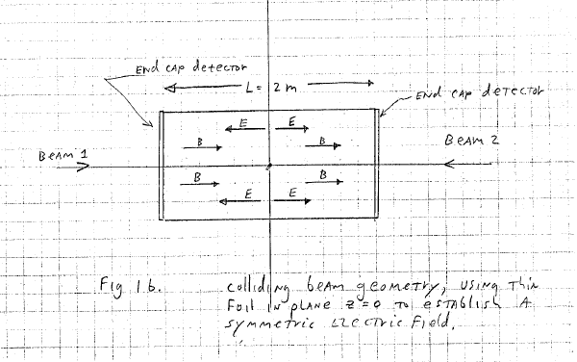
“Speculative & Ambitious” Program Outline
General intro: requirements of gaseous detectors applied to other field than HEP
  Example HEP vs LENP etc.
Examples of application to LENP/HENP
  RIBs physics, gaseous detector for PID in fixed-target spectrograph
  Inverse kinematic nuclear reactions study: TPCs and Active target mode of operation
    -) physics, technology, challenges, ... (low pressure operation, pure elemental gas, etc.)
    -) Examples of Active-Target TPCs
  TPC for Fission Fragment Studies
  R&D project with MPGDs for EIC
Rare Event Search Applications & Neutrino Physics
  Exotic decays with MPGD-TPC (Dark Decay, X17 boson, etc..)
  Directional TPC (Negative-ion OTPC)
  Cryogenic detector: mostly exotic ideas

Slide 4
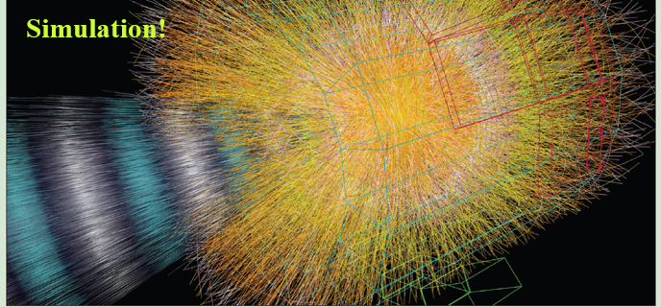
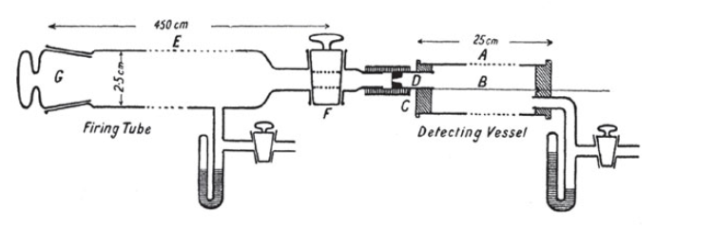
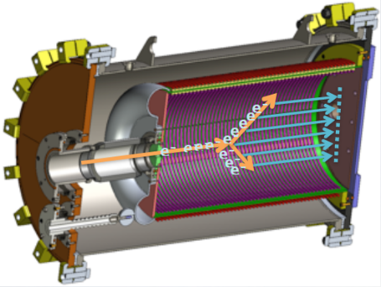
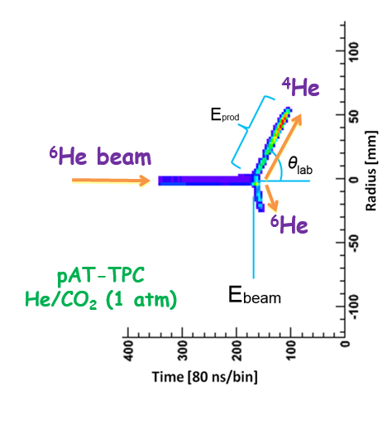
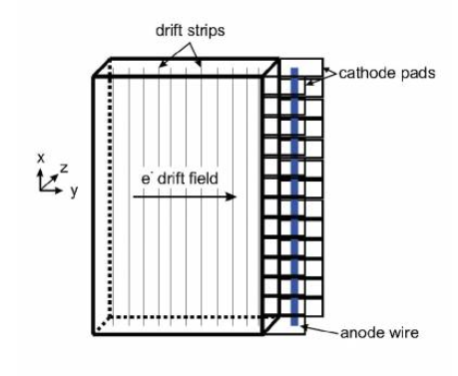
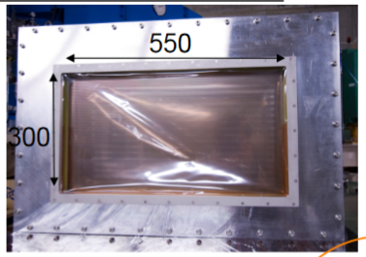
Nuclear physics and gaseous detectors
First gaseous detect ever build:
Rutherford & Geiger alpha particle counter (1908)
High-E Particle Physics
-) High gain (MIPs, Photons, etc.)
-) High Multiplicity
-) Specificity
-) High rate
-) Large & complex
-) IBF → mostly from the gas avalanche readout
-) …
Used in early fundamental research on alpha particles.
“Single-wire” Cathode image Readout for Drift Chamber (CRDC) still used today
e.g., S800 CRDC @ FRIB/NSCL
BELLE central drift chamber
SHARAQ CRD @ RiKEN
Tracking MAGNEX Spectrometer ………
Low-E Nuclear Physics
-) Modest gain (heavy charged particles)
-) Low Multiplicity
-) Versatility (one setup many experiments)
→ large dynamic range (different pressure)
→ active target mode (pure elemental gas)
-) Low/moderate rate
-) Small setup, simple
-) IBF → mostly from the beam particles
-) …
X = pulse height analysis
Y = drift time
pAT-TPC (NSCL) ➔ few tracks per event!

Slide 5
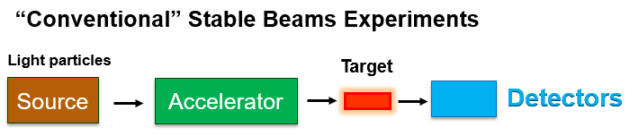
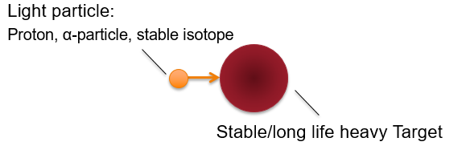
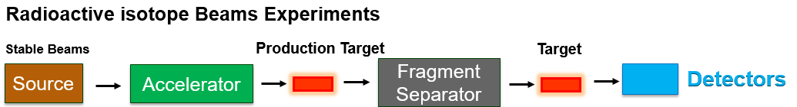
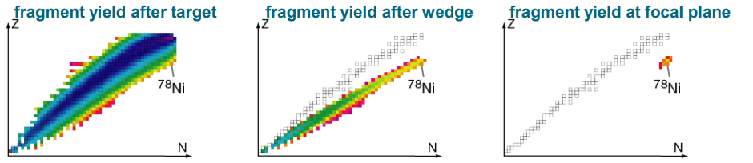
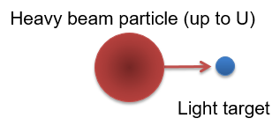
Low-Energy Nuclear Physics with Rare Isotope Beams (RIBs)
Direct Kinematic
Stable Target
PID
Significant advances in rare isotope beam production technology (accelerators and fragment separators) have been achieved in the last decades, crucial for the exploration of the nuclear chart.
The paradigm shift has led to significant change in detectors requirements
RIBs
PID
Inverse Kinematic
Experiment with very different energy regime are possible (Fast beams, slow “reaccelerated” beams, and stopped beams)!

Slide 6
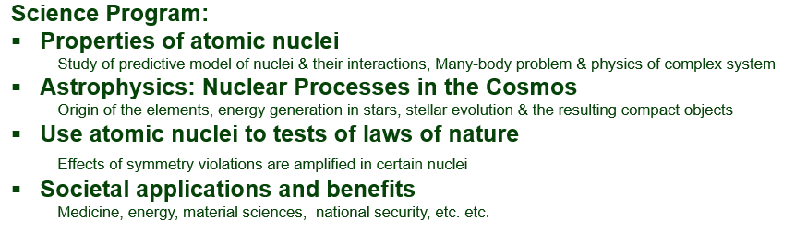
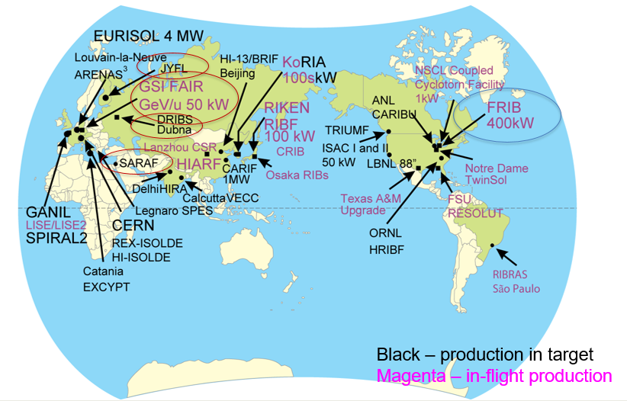
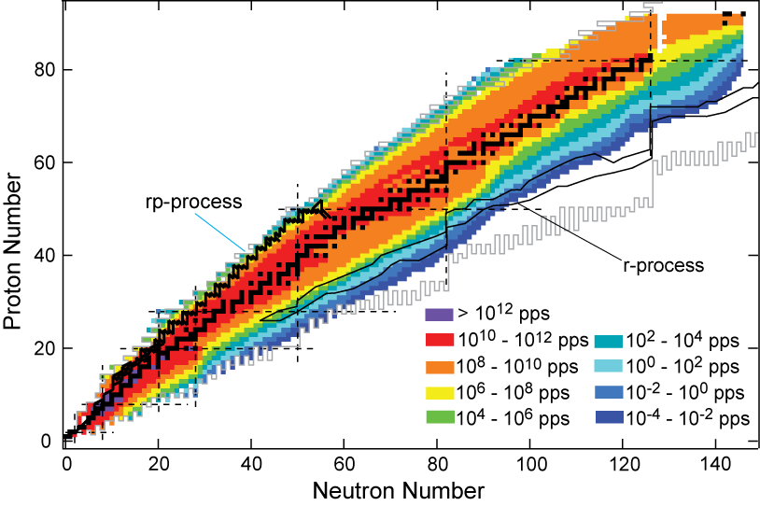
World view & reach of Modern Rare Isotope Facilities
Next generation facilities will produce more than 4500 isotope available for study
➔about 80% of the isotopes predicted to exist in the universe
Main Gaseous Detector Applications:
-) Active Target TPC with fast & slow beams
-) Study (PID) of exotic decay with stopped beams
-) Fission Fragment tracking (fission reaction studies)
-) Focal-plane tracking for fast beam in spectrometers
-) Beam diagnostics/tuning

Slide 7
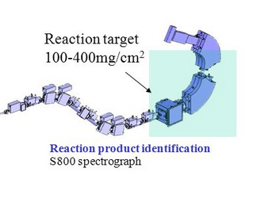
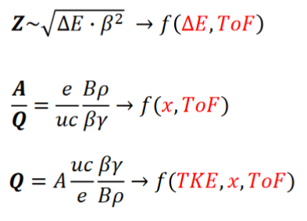
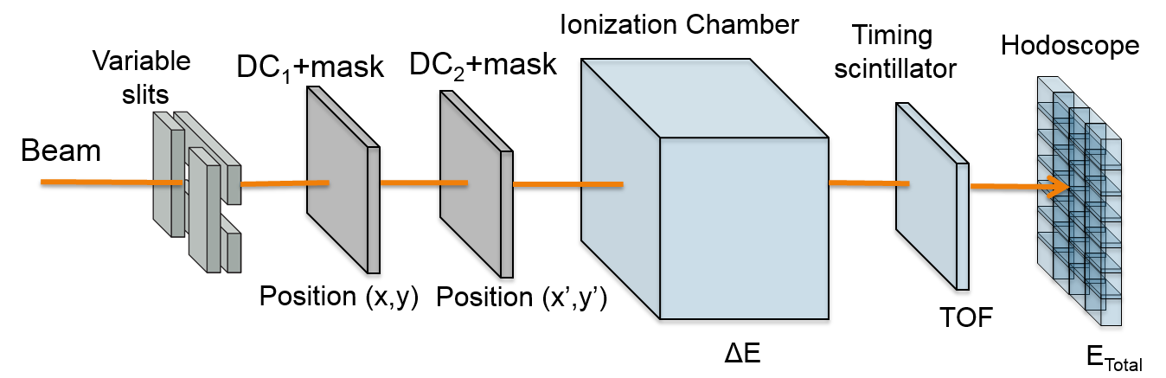
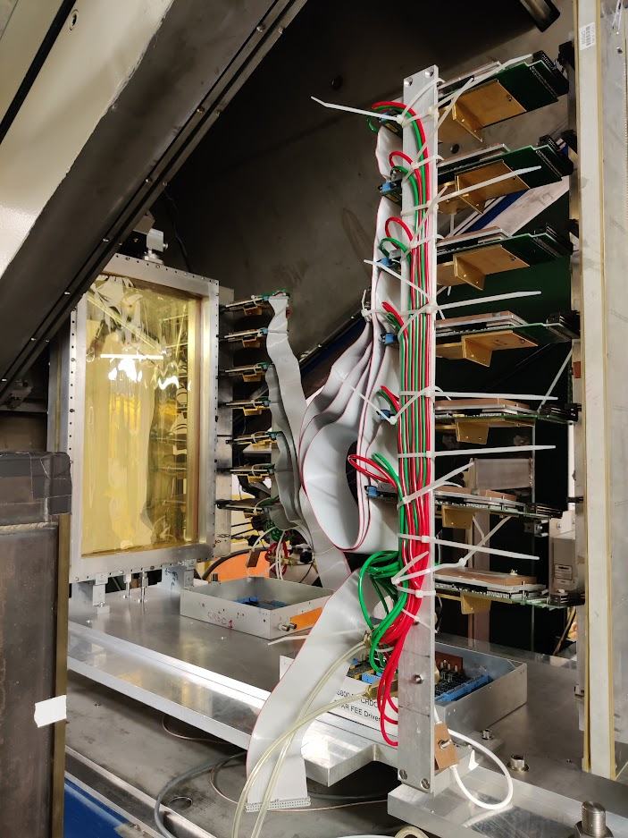
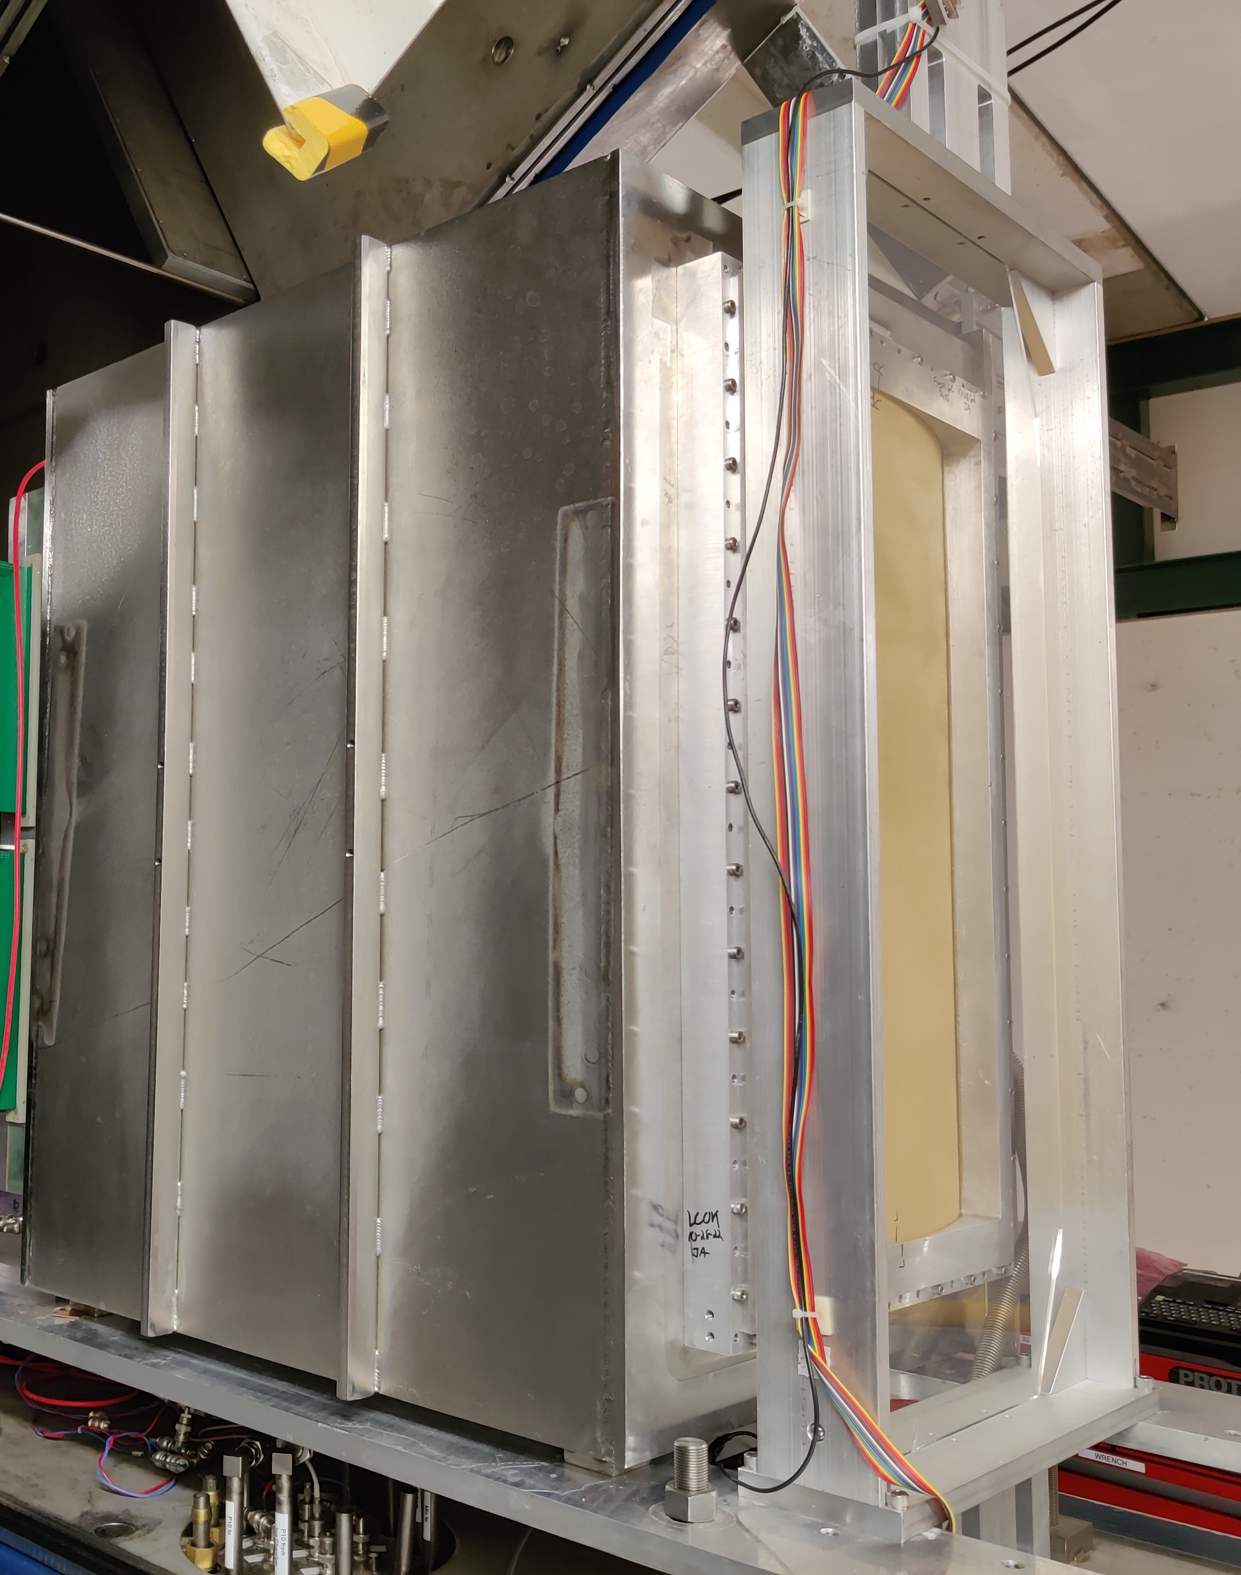
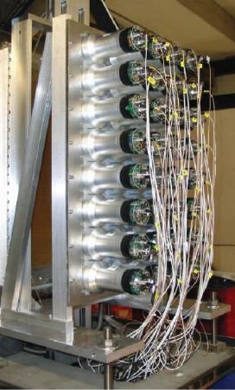
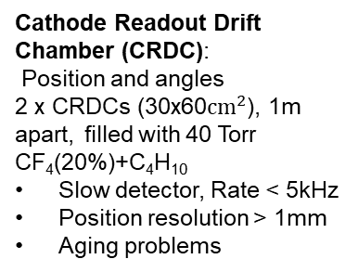

Gaseous detectors for PID in RIBs spectrometers (FRIB S800)
PID: Bρ-dE-ToF
Focal Plane detector system for heavy-ion PID
$$A/Z= 2$$
Ionization chamber: ΔE/E
32 fragile thin foils
Energy resolution
ΔE/E ≈ 1.2% (A≈100)
Plastic Scintillator:
Time resolution ~450ps
Hodoscope:
Hydroscopic CsI crystals
TKE resolution 0.85%
Cathode Readout Drift Chamber (CRDC):
Position and angles
2 x CRDCs (30x60${cm}^{2}$), 1m apart, filled with 40 Torr CF₄(20%)+C₄H₁₀
Slow detector, Rate < 5kHz
Position resolution > 1mm
Aging problems
Gaseous detector used for Tracking and dE/E measurements:
-) Good tracking & PID capability for heavy ions → low energy/angular straggling needed→ low material budget (low pressure operation)
-) Large area coverage → low cost with good performance

Slide 8
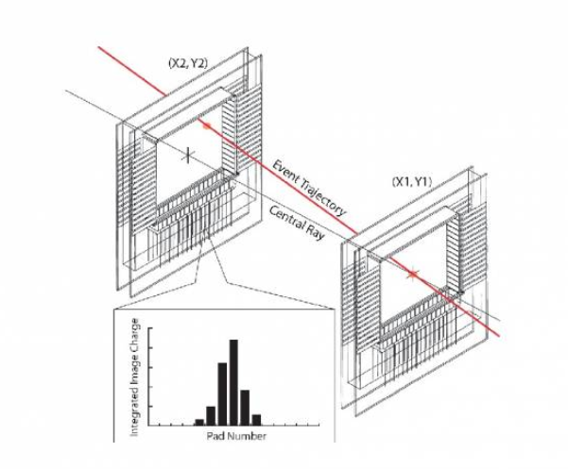
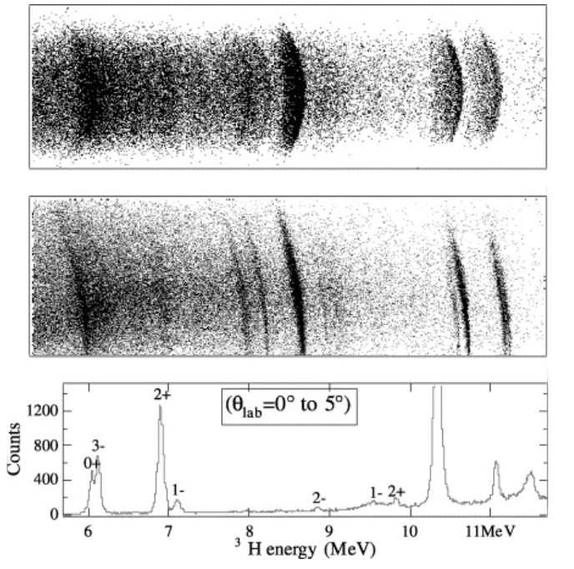
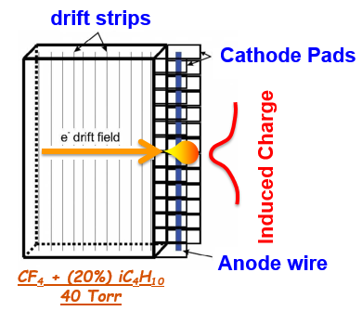
Cathode Image Drift Chamber (CRDC)
Energy versus scattering angle from the reaction ¹²C(⁷Li,³H)¹⁶O
Raw data
Single-wire readout
1 meter
Rigidity-corrected data
Position resolution ➔ 0.5 mm
Tracking resolution ➔ < 2 mrad

Slide 9
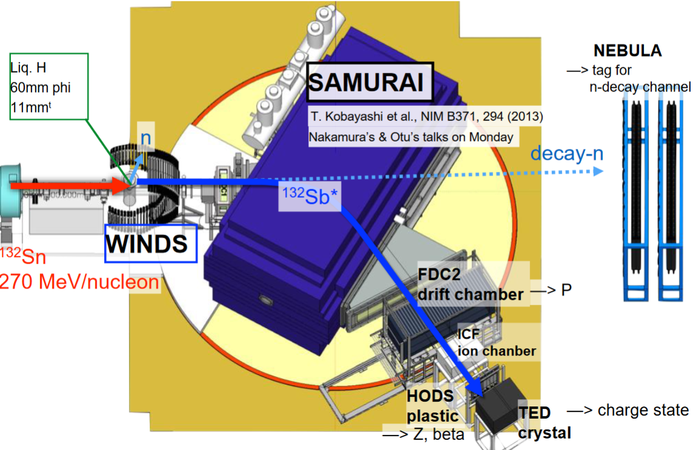
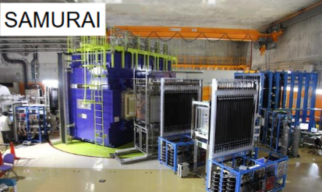
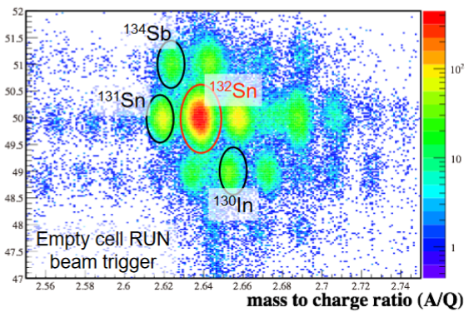
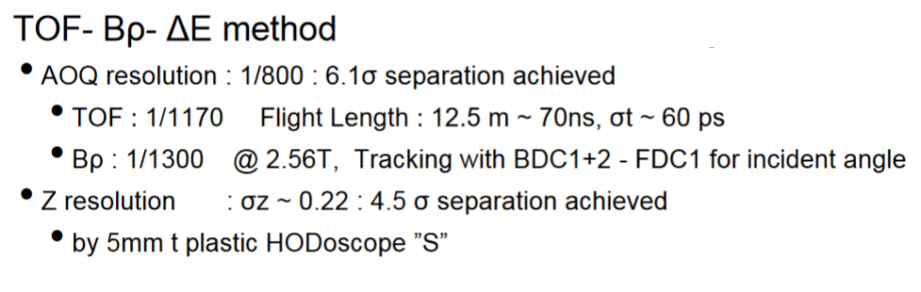
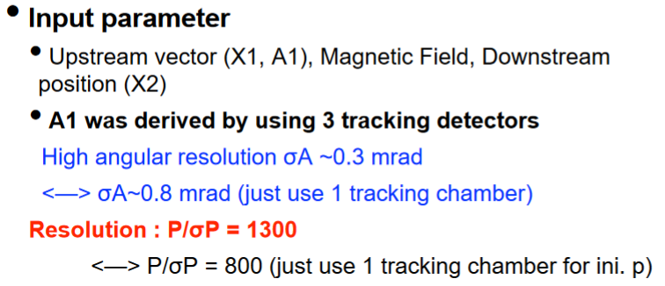
PID with the SAMURAI spectrometer (RIKEN)
Z
A/Q

Slide 10
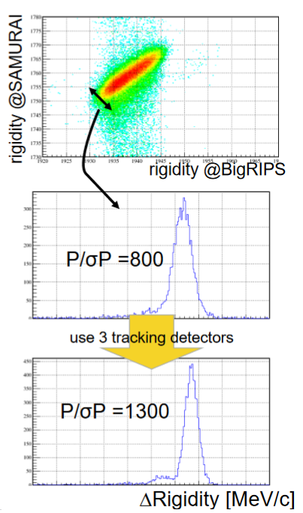
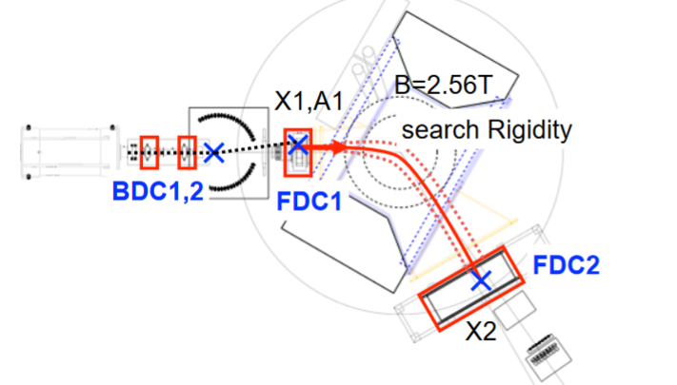
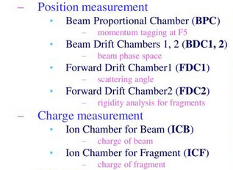
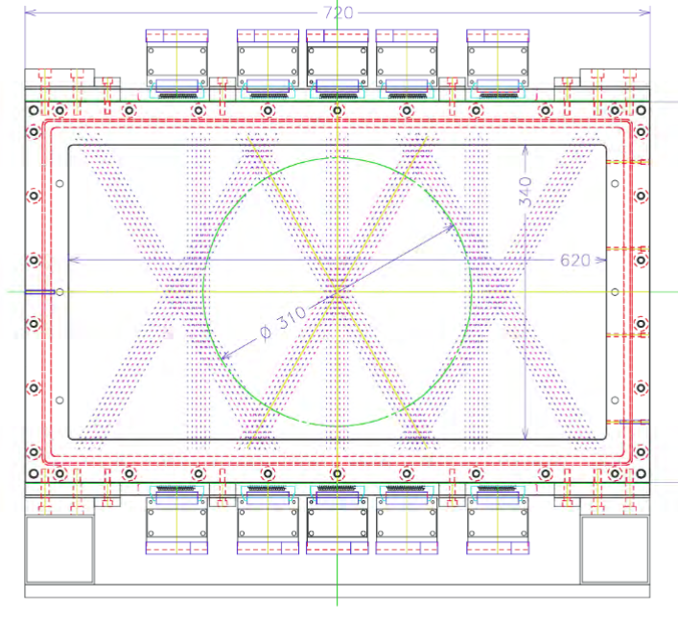
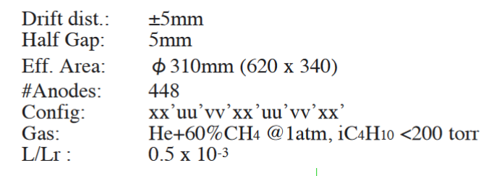
RIKEN Forwards Drift Chamber (FDC)
Tracking system
Gaseous Detectors
Before the target
Before the Dipole
After the Dipole
uu
Low-pressure MWPC-based readout
xx
vv

Slide 11
Inverse Kinematic with gaseous detector targets
Goal: Study of inverse-kinematic nuclear reactions with resolutions equal to the one achieved in direct kinematics with high-resolution spectrometers + higher efficiency & thicker targets
Direct Kinematic
-) Thin Targets (low luminosity, low straggling, good ΔE/E)
-) Thick Targets (high luminosity, high straggling, poor ΔE/E)
-) Small acceptance angle
-) Low energy event trapped in the target
Projectile
Solid “heavy” target
Particle identification
Inverse Kinematic (AT-TPC) → gas is simultaneously the target and the tracking medium
Gaseous avalanche readout
  -) 4π acceptance of reaction products
  -) Energy loss like thin target = excellent ΔE/E
  -) Very high effective thickness ➔ high luminosity
  -) Detection efficiency ~100% (+ low energy events < 200 keV)
  -) Event-by-event reconstruction in 3 dimensions
  -) Different target pressure ➔ Large dynamic range
Heavy, short-lived projectile
Gaseous “light” target

Slide 12
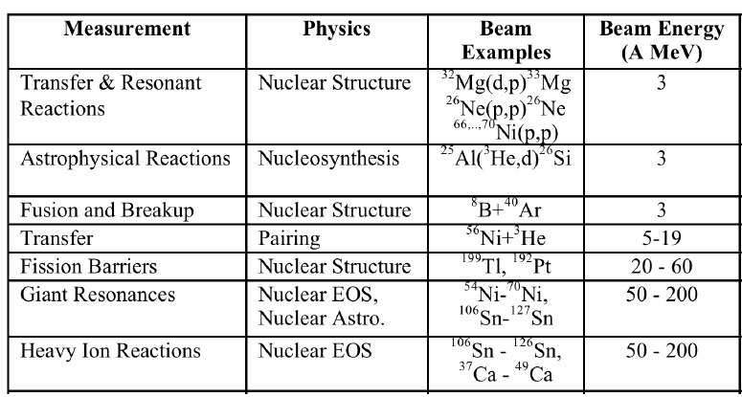
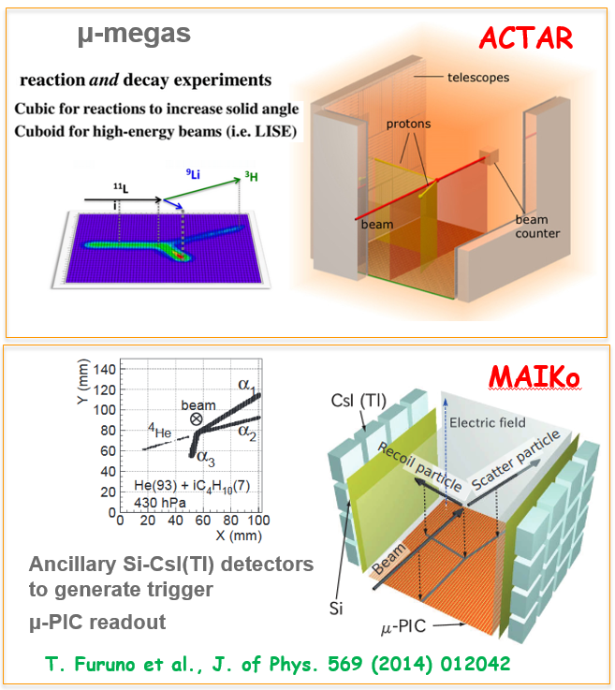

TPC operated in active target mode ➔ MPGDs
Science program with AT-TPCs
Same goal, different paths:
-) geometry:
→ Cylindrical vs cubicle
-) Gas avalanche readout:
→ Micromegas
→ Hole-Types (GEM, …)
→ μ-PIC
→ Hybrid …..
-) Coupled to Ancillary detector
→ Isomer tagging
→ Triggering
→ Particle identification
→ Neutron detection
-) With/Without magnetic field
Suzuki et al., NIM A, 691 39 (2012)
Micromegas +
M-THGEM
and many more ….
Cylindrical geometry
Readout > 10k pads

Slide 13
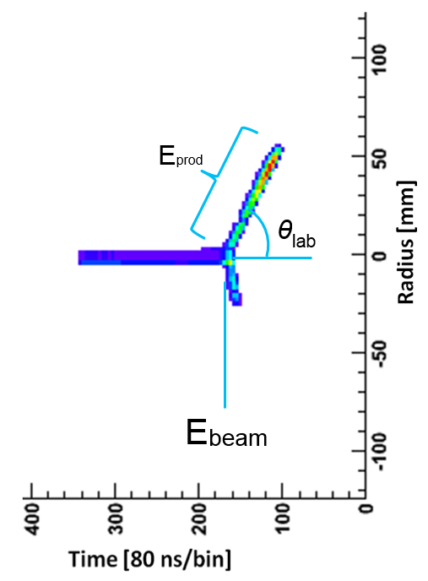
Inverse Kinematic: what is needed
What we measure:
Beam
→ (3D) track
→ Energy (E_{beam}) at the reaction point known from vertex determination
→ excitation function reconstruction
Reaction Products
→ Angle θlab
→ Energy, Eprod (Bragg curve, range, curvature in a magnetic field)
Cross Sections: dσ/dΩ(E,θ)
What we need:
Detector with excellent Position (< 1 mm) & Energy resolution (a few %)
⁴He
⁶He beam
⁶He
pAT-TPC
He/CO₂ (1 atm)

Slide 14
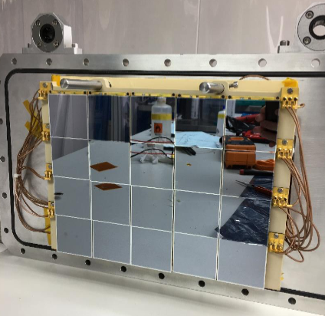
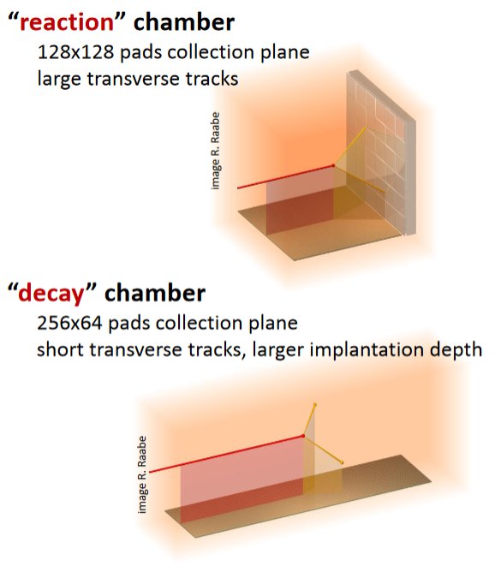
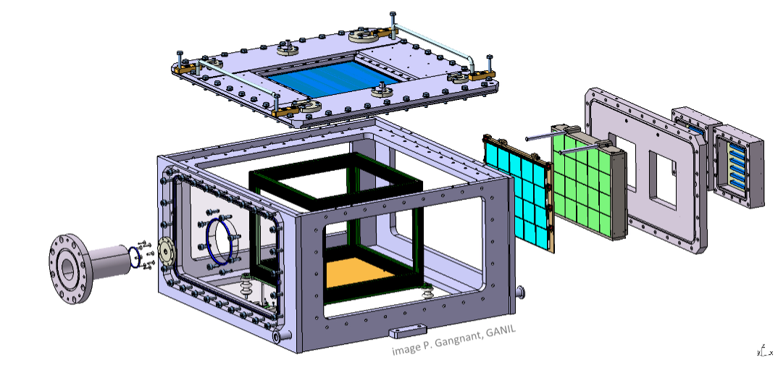
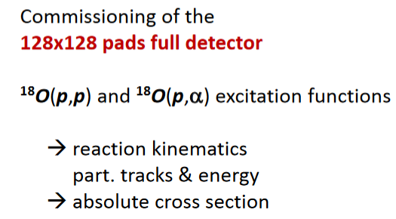
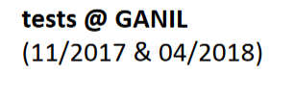
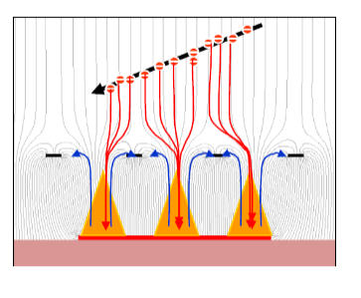
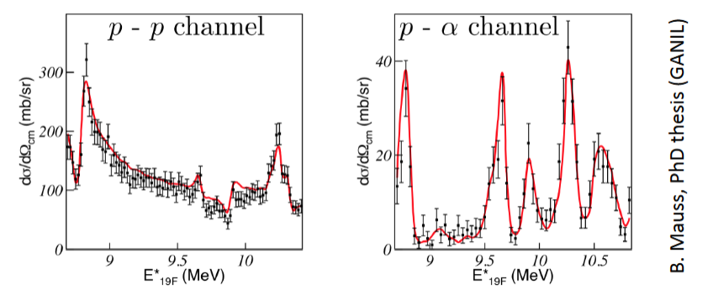
ACtive TARget and Time Projection Chamber (ACTAR TPC)
TPC designed to include additional detectors (e.g. Si-PIN):
• tracking of particles escaping the drift region
→ reaction studies and active target mode
• additional position and energy information
→used also for commissioning
Two operational modes:
ACTAR mechanical design
(iC₄H₁₀) gas at 100 mbar
Bulk micromegas
220 um avalanche gap
(also possibility to use GEM)
B. Mauss et al., NIM A 940 (2019), 498-504.

Slide 15
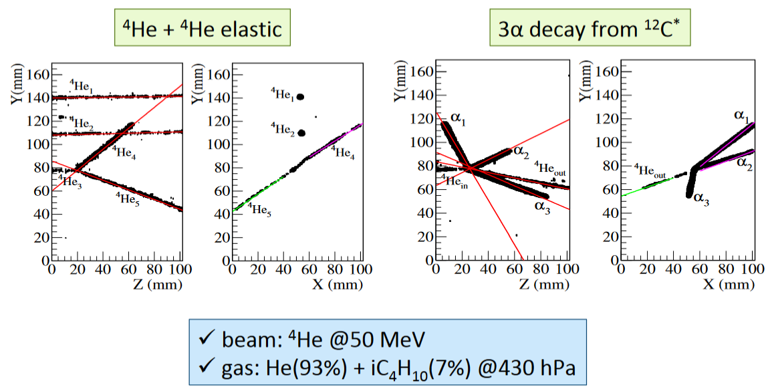
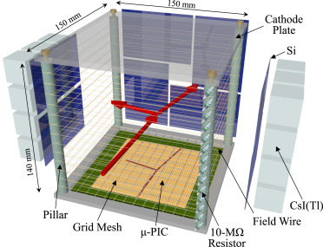
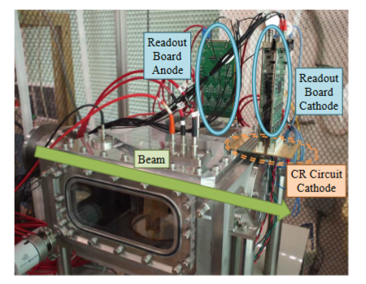
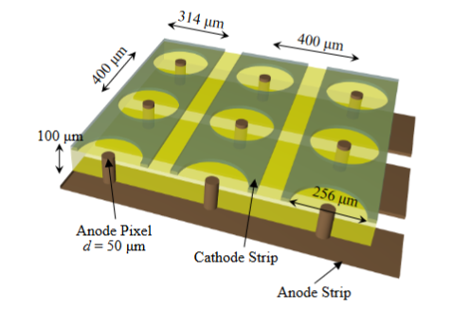

Mu(μ)-PIC based Active target for Inverse Kinematics (MAIKo)
T. Furuno et al., NIM A 908 (2018), 215-224.
Ancillary Si-CsI(Tl) detectors used to generate trigger
And measure Energy of particle escaping the volume

Slide 16






Active-Target TPC @ Facility for Rare Isotope Beams (FRIB)
pAT-TPC
Active volume 25 liters
(L = 50 cm, Ø = 25 cm)
Cylindrical pad plane (1,000 pads)
Cylindrical configuration:
Use with solenoid
➔ Magnetic field for PID
Problem:
Need to suppressed beam!
➔ Smart-ZAP
Full scale AT-TPC
‣ Active volume 200 liters
(L = 100 cm, Ø = 50 cm)
‣ 10,240 triangular pads
‣ Placed inside 4 Tesla solenoid
M-THGEM
Position-sensitive
micromegas pad
AT-TPC Readout pad → GET electronics
Position-sensitive MM
Gain Provided mainly by M-THGEM
Position-sensitive MM for track encoding
Field Cage
Cortesi et. al. EPJ Web of Conferences 174, 01007 (2018)
Ayyad et al. Eur. Phys. J. A (2018) 54: 181

Slide 17











AT-TPC project @ FRIB
E20009 → pure D₂ (760 Torr)
¹⁰Be(d,p)¹¹Be
Spokesperson: Daniel Bazin
More Tracks
D. Bazin Courtesy
SOLARIS (up to 4 Tesla)
The cinnamon roll: 8 MeV p (5 m range)
E20020 → pure He (700 Torr)
4 α decay of ¹⁶O
Spokesperson: Clementine Santamaria
The big Kraken: 5 α-particle tracks

Slide 18






TPC for Neutron Induced Fission Fragment Tracking Experiments
Motivation: Study and improve cross section ratio systematics
NIFFTE: two-chamber MICROMEGAS TPC ➔ precision cross section measurements of neutron-induced fission
Position-sensitive MM board with 2976 pad (2 mm wide)
range
n
²⁵²Cf fission
N Beam
Energy (ADC)
Fixed target
α-particle
Gas: 95% argon, 5% isobutane

Slide 19







MM-THGEM for Fission Fragment experiments
Goal: Understand Fusion-Fission and quasi-Fission reaction mechanisms → production of super-heavy elements
CFFD (NSCL)
Heavy-ion Imaging system:
Velocity vector
→ Mass/Angle distribution
PPAC-based tracking system
MM-THGEM imaging detector prototype (10x10 cm²)
Fission events
E_{sum}
Performance:
-) Spatial Resolution < 0.5 mm (σ)
-) Time resolution ~ 1 ns (σ)
Isobutane (7 Torr)
Time (ns)
²⁵²Cf (sf)
10x10 cm²
Requirements:
-) Large area, low pressure
-) Resolution < 1 mm (FWHM)
-) Modest rates (up to a few kHz)

Slide 20





TPC for exotic decays studies: Neutron lifetime puzzle & Dark decay
Motivation: Free neutron lifetime measured in beam and in bottle are ~4σ away!
Different observables measuring different decay modes?
Beam
Fornal and Grisntein
PRL 120, 191801(2018)
Possible explanation (Fornal and Grinstein):
-) the neutron decay to a dark matter particle
➔ 3 different decay mechanisms could be possible
-) A branching ratio of ~1% would explain the n lifetime puzzle
Bottle
Suggestion: Dark decay also possible in halo nuclei (weakly bound n) ➔ S_{n}<1.572 MeV
Possible candidates: ⁶He, ¹¹Li, ¹¹Be, ¹⁵C, and ¹⁷C
➔ branching ratio upper limit of 10⁻⁴ depending on the dark particle mass.
¹¹Be → ¹⁰Be (β-delay proton emission + dark decay)
➔ measured using AMS with a branching ratio of 8.3(9) ·10⁻⁶
Pfutzner, PRC 97, 042501 (2018)

Slide 21






Dark decay Scenarios
Scenario 1
Tang et al., Phys Rev Lett 121 (2018), 022505
X
Scenario 2
X
Sun et al., Phys. Rev. C
97 (2018), 052501
Scenario 3
(?)
Fornal and Grisntein, PRL 120, 191801(2018)

Slide 22




First observation of a β⁻ delay proton emission!
MPGD-based TPC readout for dark decay search
Micromegas + M-THGEM
Example of tracks from a
beta(minus)-delay alpha emission
Y. Ayyad (NSCL) et al., Phys. Rev. Lett. 123, 082501
He:CO₂
pAT-TPC → tracking of particles with two order of magnitude difference in specific ionization density
¹¹Be
⁷Li track
β- track
^{390 keV/u}
Beta-delayed proton decay of 11Be explained by an exotic near-threshold resonance that favors proton decay
➔ No room for dark decay!
α-particle track
Calorimetry is not enough for PID!
E. Lopez-Saavedra et al., PRL 129 (2022), 012502
β background
and proton
region
PID based on analysis of dE
⁷Li*
Proton
⁷Li
α* and ⁷Li
α
α and ⁷Li
(¹¹Be → ¹⁰Be + p) branching ratio results (10⁻⁵- 10⁻⁶) compatible with AMS ¹¹Be → ¹⁰Be value (8.3·10⁻⁶).

Slide 23





Applications to exotic decays: The X17 Boson
P. Schlüter et al, Physics Reports 75 (1981), pp 327-392.
-) Photo-production in ⁸Be* via p+⁷Li
-) Fraction of the photons converted into e+e- by IPC
-) Measure angular distribution of the e+e- pair

Slide 24


Decay and Internal Pair Creation (IPC): ATOMKI’s Anomaly
A.J. Krasznahorkay et al., Phys. Rev. Lett. 116 (2016) 042501
A.J. Krasznahorkay et al, J. Phys.: Conf. Ser. 1643 (2020) 012001

Slide 25





Example of X17 search with MPGD tracking
X17 spectrometer at CTU
Track recognition with machine learning techniques
1) Unusual E×B configuration:
➔ Physics reconstruction under development from simulated tracks
Proposed Detector concept ➔ Three detectors:
1) Timepix3 → angle measurement
2) MWPC → angle and scattering measurement
3) MPGD-TPC → energy measurement and PID
TPC readout based on 3 GEM foils
A.F.V. Cortez et al., NIMA 1047, February 2023, 167858

Slide 26






TPC with solid target for X17 boson search
Target:
-) 400 μg/cm Lithium Hydroxide (LiOH)
-) 10 μg/cm Lithium Fluoride (LiF)
Courtesy Y. Ayyad (AT-TPC collaboration)
e-
e+
p
e-
Beam 1 μA
protons 1 MeV
e+
M-THGEM+Micromegas
Single Beta
Gas filling: P10 @ 1 atm
TwinSol – Notre Dame University (Indiana)

Slide 27





Studying smaller and smaller things…
21 century nuclear science ➔ probe the nuclear matter in all its forms and explore their potential for applications
Build powerful microscope using particle accelerators
$Resolution \sim λ= \frac{h}{2π}$ $\frac{1}{p}$
Fixed Target Particle
Accelerator experiment ➔ λ_{electron} ≈ 0.062 fm (20 GeV)
Resolution ≈ 0.1 fm
Optical microscope ➔ λ_{photons} ~ 380-740 nm
Resolution > 200 nm
Example: In the 1960s Experiments at SLAC established the quark model and our modern view of particle physics “the Standard Model”
Electron microscope ➔ λ_{electron} = 2.5 pm (200 keV)
Resolution > 0.1 nm (limited by objective lens system)

Slide 28





Electron Ion Collider (EIC)
EIC science program:
-) Precision 3D imaging of protons and nuclei
-) Solving the proton spin puzzle
-) Search for saturation
-) Quark and gluon confinement
-) Quarks and gluons in nuclei
At least one large-acceptance detector that can capture most of the particles scattering from the collisions in all directions and at wide range of energies.
Polarized electron-proton/light ion & electron-Nucleus collider
Many baseline EIC detector designs involved various gaseous detectors technologies for tracking in the central as well as end cap region
NNPSS at U. of Tennessee, Lecture on Electron Ion Collider, Abhay Deshpand

Slide 29



EIC detector and tracking requirements
Tracking detectors provide:
➢ Space point coordinates and trajectory of charged particles → Vertex
➢ Momentum measurements in magnetic (B) field
➢ Angle measurements
➢ Measurements of primary and secondary vertices
➢ Multitrack separation
➢ Particle identification (if possible)
➢ Low material budget to minimize scattering and secondary interactions.
p/A
e
MPGD readout
MPGD R&D
Selected tracking detector technologies:
Hybrid tracking detector design: Monolithic Active Pixel Sensor (MAPS, ITS3) based silicon vertex/tracking subsystem, the MPGD tracking subsystem and the AC-LGAD outer tracker, which also serves as the ToF detector.
Electron – photon separation: charged particles leave a track while the photon interact at most once
Central Detector Layout

Slide 30






MPGD for tracking/Vertex
Barrel Main Tracker
Hermetic coverage, close to 4π acceptance
  pseudorapidity range up to +/-1
  Large area detectors
Low material budget on the level of 3-5% of X/X₀ for the central tracker region
  Gaseous detectors
Spatial resolution below 100 μm
Example of proposed concept: GEM for gas amplification
Readout based on μRWELL and capacitive coupling
Minimization of ion back flow with quad-GEM (ALICE TPC)

Slide 31






EIC Focused R&D projects
Sourav Tarafdar, MPGD as tracker for EIC. CPAD workshop Stanford 2023

Slide 32


Directional Detection
Directional Recoil Detectors
  enable 3D track reconstruction for vector directionality
  reconstruction of incident particle directionality
Many science applications (at different energy scale)
Example of Detector performance requirements:
(if targeting solar neutrinos & m_{DM}= ~10 GeV)
Event-level recoil directionality
  angular resolution ≤ 30 degrees
  excellent head/tail sensitivity
• Rejection of internal electron backgrounds
  by factor >= 10$5$ for 1000 m³ detector
• All of above down to E_{recoil} ~ 5 keV
• Energy resolution ~ 10% at 5.9 keV
• Timing resolution ~ 0.5 h
Gas TPC ➔ time-resolved recoil imaging, enabling broad physics program beyond DM cost-effective: non-cryogenic and easily scalable to large volumes
S. Vahsen et al Annu. Rev. Nucl. Part. Sci. 2021. 71 189-224

Slide 33





Directional DM search using NI-OTPC
➔ Optical TPC readout and negative ion drift for directional nuclear recoil detection: Low-pressure, direction-sensitive TPC
Example: Dark Matter Search
Detection of T/H direction
Experimental approach:
Target (He, CF₄) + Highly electronegative gas (CS_{2,} SF_{6, …})
Measure spatial ionization
distribution resulting from
nuclear recoils
5.9 MeV α-particles
Conventional OTPC
NI-OTPC
D. Loomba (UNM)

Slide 34







Directional DM search via Migdal Effect
➔ Use Migdal Effect in DM search to extend the sensitivity to low mass region (m_{DM} < 1 GeV).
-) Low-pressure gas: 50 Torr of CF₄
→ extended particle track
-) TPC Signal amplification
→ NI low diffusion for high resolution
-) Optical Readout
→ High SNR
-) Electron and nuclear recoil tracks
→ Directionality (common vertex)
Glass-THGEM as gas avalanche light multiplier
How it works: OTPC to record the two simultaneously tracks, from the Migdal electron & the nuclear recoil, both originating from the same vertex
Simulation of DM events
Trigger
(z-axis)
From P. Majewski (STFC)
DM
DM
DM
DM
DM
DM
Localization
(x,y axes)
DM

Slide 35




The Cryogenic Frontier for Rare Event Search
Read-out elements of cryogenic noble liquid detectors → Rear event detectors (n, DM) & Medical Physics (PET)
  Detecting the scintillation light produced in the noble liquids
  Options of scintillator light and ionization charge detection by a same detector!
with windows
Windowless (2-phases)
Operated in Cryogenic Liquid
S.Duval et al., JINST 6 (2011) P04007
Bondar et al., NIMA 556 (2006) 273
& Rubbia group ETHz - LArTPC

Slide 36

Noble liquid radiation medium as detector
A. Breskin, FRIB seminar 2023

Slide 37


Dual-phase liquid noble-gas TPC
A. Breskin, FRIB seminar 2023
A. Breskin, FRIB seminar 2023

Slide 38





LArTPC for Dune
DUNE originally considered two LArTPC technologies: Single-Phase and Dual-Phase

Slide 39




Proto-DUNE TPC
Single vs Dual

Slide 40















MPGD: cryogenic R&D (Concept Gallery)
Periale et al, IEEE TNS 52 (2005) 927
A.Buzulutskov et al, IEEE TNS 50 (2003) 2491;
A.Bondar et al, NIMA 524 (2004) 130
A.Rubbia, J. Phys. Conf. Ser. 39 (2006) 129
S. Duval et al, JINST 6 (2011) P04007
A.Bondar et al, NIMA 556 (2006) 273
Y.L.Ju et al, Cryogenics 47 (2007) 81
S. Duval et al, JINST 4 (2009) P12008
Lightfoot et al, JINST 4 (2009) P04002
A.Buzulutskov, A.Bondar, JINST 1 (2006) P08006
A. Bondar et al, JINST 5 (2010) P08002
A.Buzulutskov et al, EPL 94 (2011) 52001
A.Bondar et al, JINST 3 (2008) P07001
D.Akimov et al, JINST 4 (2009) P06010
M.Gai et al, Eprint arxiv:0706.1106 (2007)
D.Akimov, NIMA 628 (2011) 50

Slide 41


Bubble-assisted Liquid Hole Multiplier LHM
A. Breskin, FRIB seminar 2023

Slide 42
Summary
General intro Gaseous Detector applied fields beyond HEP
  Example of requirements HEP vs LENP
Application to HENP/LENP
  R&D project with MPGD for EIC
  Active Target TPC, inverse kinematic nuclear reactions study
    -) physics, technology, challenges, ...(Operation pure elemental gas)
    -) Examples of Active Target TPC project
  Fission Fragment imaging system
Rare Event Search Applications & Neutrino Physics
  Exotic decays with MPGD-TPC (Dark Decay, X17 boson, etc..)
  Directional TPC (Negative-ion OTPC)
  Cryogenic detector: mostly exotic ideas

