Slide 1
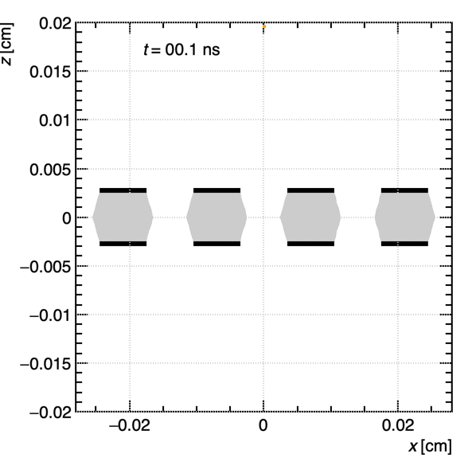
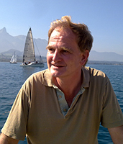
Gaseous Detector Simulation
& Physics Modelling
Djunes Janssens – CERN
Riccardo Farinelli – INFN sezione di Bologna
Dario Stocco – ETH Zurich
Piet Verwilligen - INFN sezione di Bari
inspired and grown up by many lectures of Rob Veenhof

Slide 2
DRD1 School: Simulation Outline
First Lecture: the basics P.V. Today
  0. Introduction – Garfield++
  1. Energy Loss – Primary Ionization
  2. Electric Fields in the detector
  3. Charged particle transport
Second Lecture: advanced topics D.J. Monday
  4. Gas Gain & fluctuations
  5. Signal induction & Capacitive coupling
  6. Current limitations and Perspectives
Hands-on Exercises:
  SIM1: several simple exercises on the individual topics above
  SIM2: full exercise: simulation of RPC or Resistive Micromegas

Slide 3
First Lecture detector simulation basics

Slide 4
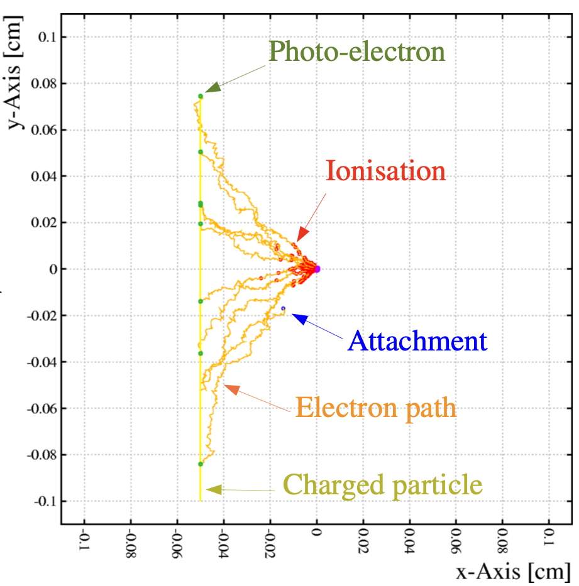


0. Intro: All steps: from $μ$to signal
Your Detector (GND)
Primary Ionization
Energy loss - gas
Cluster distribution
1
Your
gas
2
Your Detector
Geometry
Electric Fields
Anode Wire (-HV)
Charge transport
Drift & diffusion
Gas cross-sections
3
4
Charge Amplification
Townsend avalanche
Avalanche fluctuations
5
Signal Induction
Ramo-Shockley theorem
Signal processing
$$μ$$

Slide 5

0. Intro: All steps: from $μ$to signal
Your Detector (GND)
Primary Ionization
Theory: F.Sauli, today
Simulation: P.V. , today
1
Your
gas
2
Your Detector
Theory: Many Lectures
Simulation: P.V, today
Anode Wire (-HV)
Charge transport
Theory: F.Sauli, today
Simulation: P.V., today
3
4
Charge Amplification
Theory: F.Sauli, today
Simul: D.Janssens, Monday
Plot © Rob Veenhof
5
Signal Induction
Theory: W.Riegler, Friday
Simulation: D.Janssens, Monday
$$μ$$

Slide 6
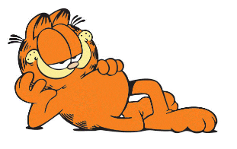
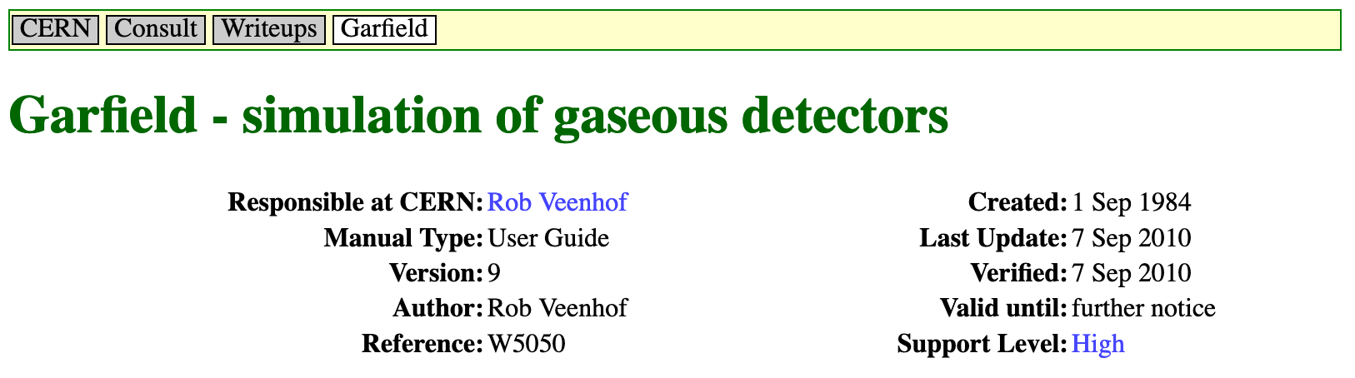
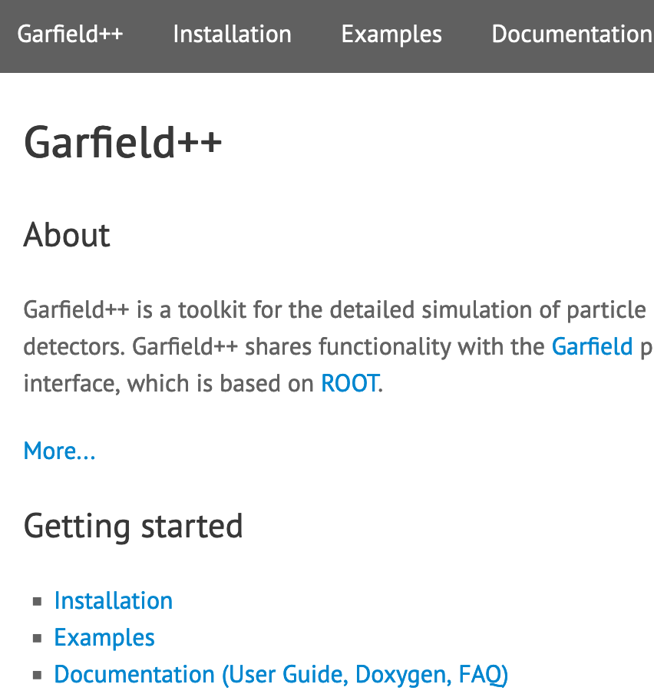
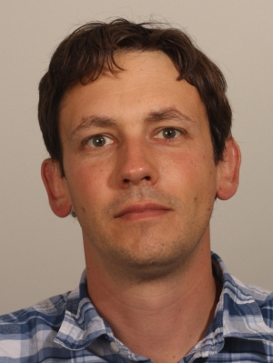
0. Intro: Garfield & Garfield++
Garfield = Open-source toolkit for detailed simulation of charge transport and signals in particle detectors
  Developed by Rob Veenhof as Summer Student in 1984
  Fortran77, continuously devel’ed & expanded 1984 - 2010
Garfield++ = New program written in C++ by Rob Veenhof and Heinrich Schindler (then PhD student)
  Implemented most functionallity (not all!) from garfield
  Can now simulate also semiconductor devices
https://garfield.web.cern.ch/garfield/
https://garfieldpp.web.cern.ch/garfieldpp/
https://cds.cern.ch/record/1500583

Slide 7
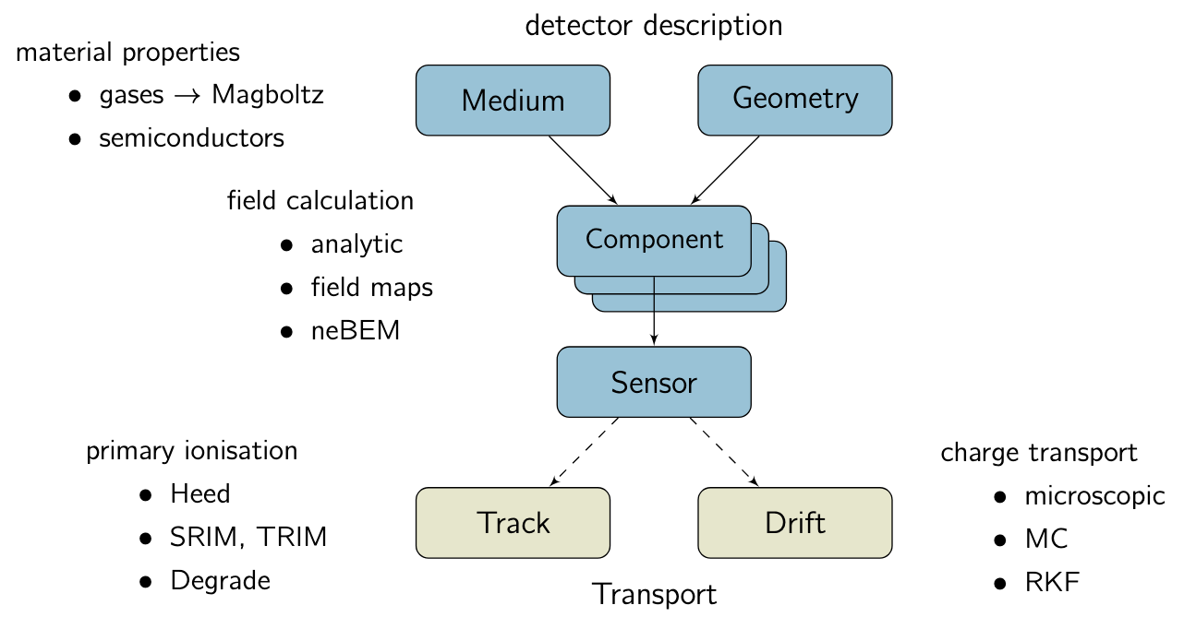
0. Intro: Garfield++ Structure
Schematic © H.Schindler
https://garfield.web.cern.ch/garfield/
https://garfieldpp.web.cern.ch/garfieldpp/
https://cds.cern.ch/record/1500583

Slide 8

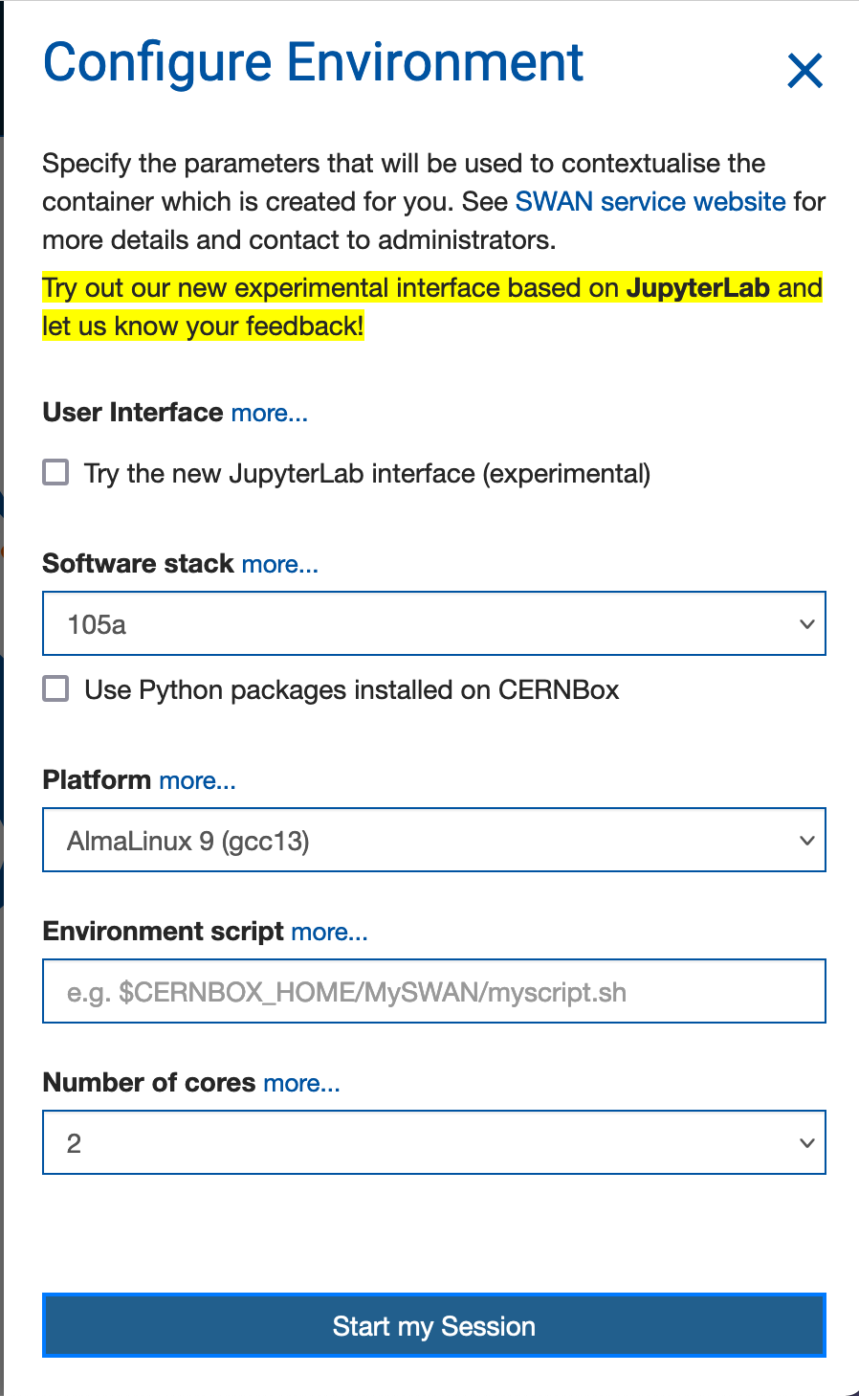
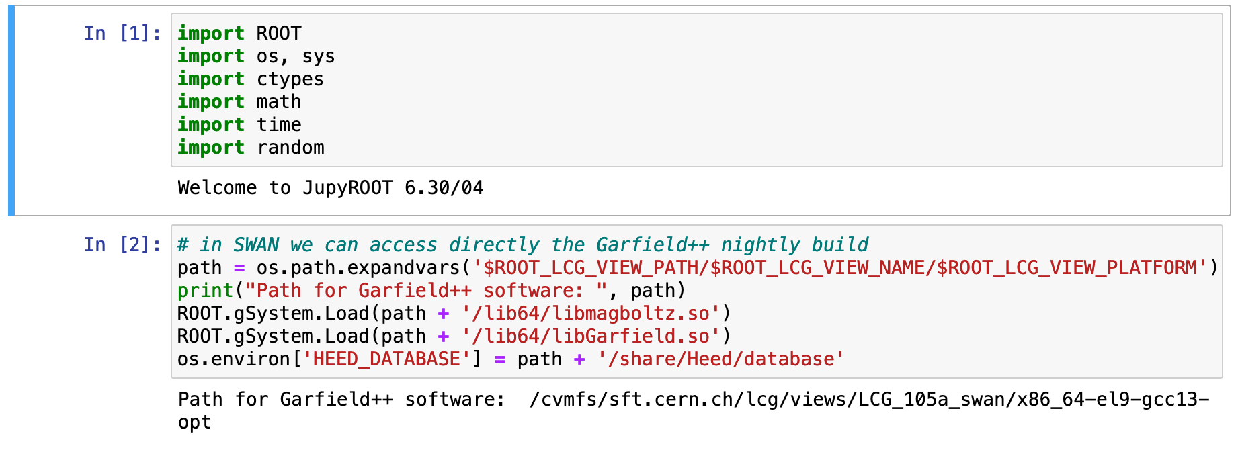
0. Intro: Garfield++ Structure
Quickest way to start using Garfield++: SWAN
  Jupyter notebook using python programming language
  For who has a CERN computing account
  We access directly the latest (nightly) build of Garfield++
  go to https://swan-k8s.cern.ch
  An example is/will be attached to the indico page
Alt: on LXPlus or installed on a Linux Virt.Machine
The minimum needed:
Import ROOT
Import OS and System commands
Import C++ type objects
Load the path to
the nightly build
Load the paths
of Garfield Libs

Slide 9
0. Intro: What is not (yet) modelled?
Your Detector (GND)
Primary Ionization
HEED assumes zero Energy loss
Interactions in detector material
1
Your
gas
2
Your Detector
Non-smooth surfaces
Error on Electric Field calc
Anode Wire (-HV)
Charge transport
Correct drift velocity for ions
3
Charge Amplification
A correct limit to max charge amplification
Emission of UV-photons from excited states
Smooth transition from Micr.Trk to Swarm
Plot © Rob Veenhof
5
Signal Induction
New: effects of Resistive materials
Transmission line effects
$$μ$$

Slide 10
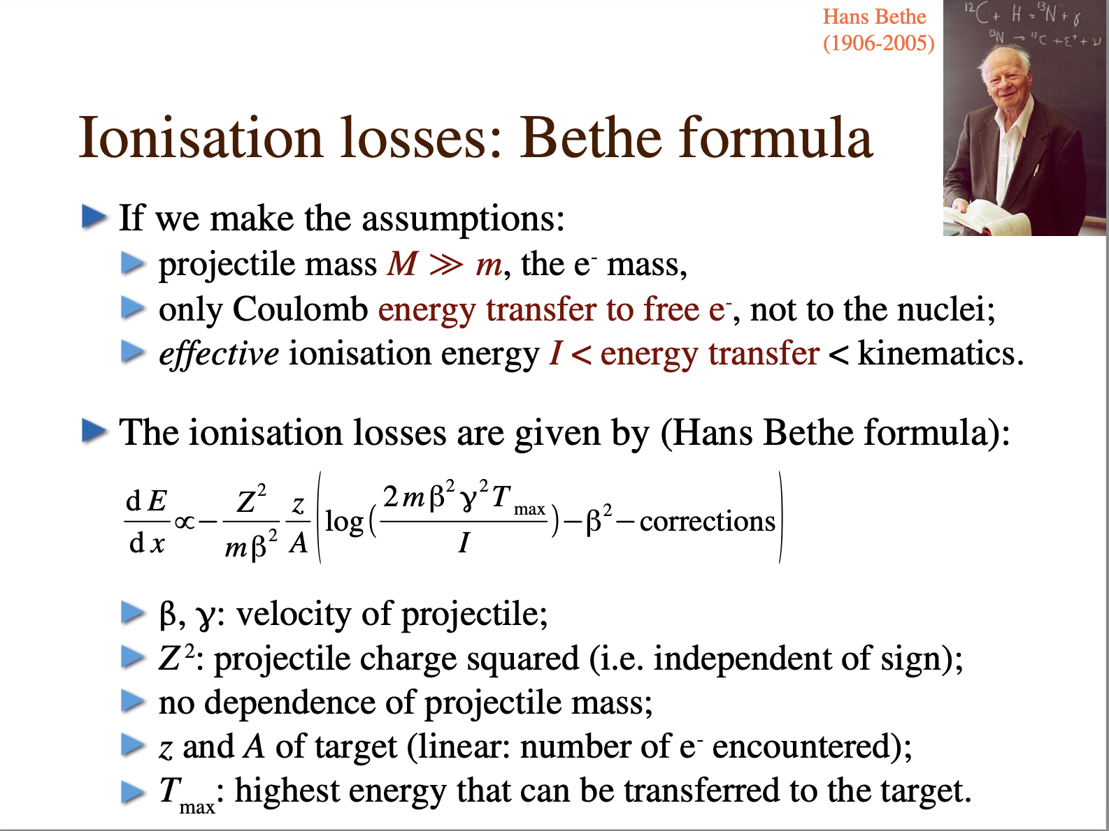
1. Interaction of particles with Matter
Bethe-Bloch
  For charged particles
  Tells us only about E-loss
  Not about distribution along the primary track
Slide © Rob Veenhof
Interaction of relativistic charged particles
  Described in “Photo-Absorption Ionisation (& Relaxation) PAI(R)
    GEANT4 uses PAI, HEED (interfaced to Garfield++) implements PAIR
Interaction of slow, heavy charged particles
  Stopping and Range of Ions in Matter (SRIM)
Interaction of neutral particles
  Interaction of Photons (HEED) & Neutrons (GEANT – not covered)

Slide 11

1. Interaction of particles w/ matter
1 mm
≪1 mm
$$γ$$
*
e⁻
Charged particle
Ar atom
Slide © Rob Veenhof

Slide 12
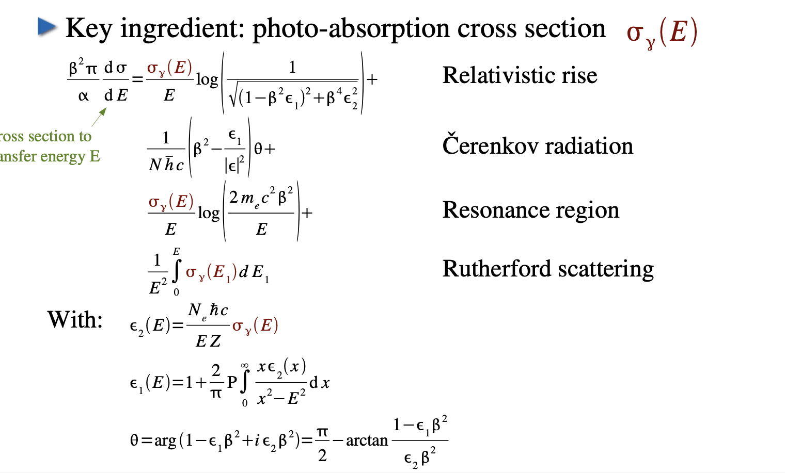
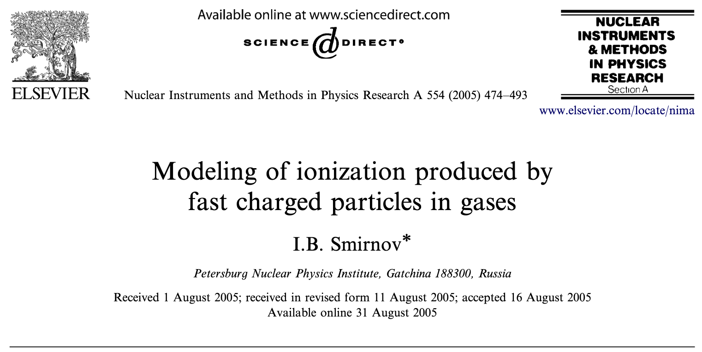
1. formulae PAI(R) model
PAIR model implemented in HEED
Cross section to transfer energy E
I.B. Smirnov, Nucl.Instr.Meth.A 554 (2005) 474
Slide © Rob Veenhof
Slide © Rob Veenhof

Slide 13
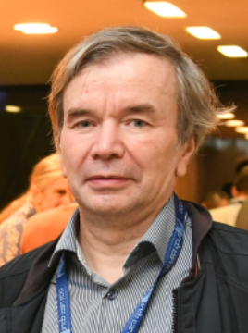
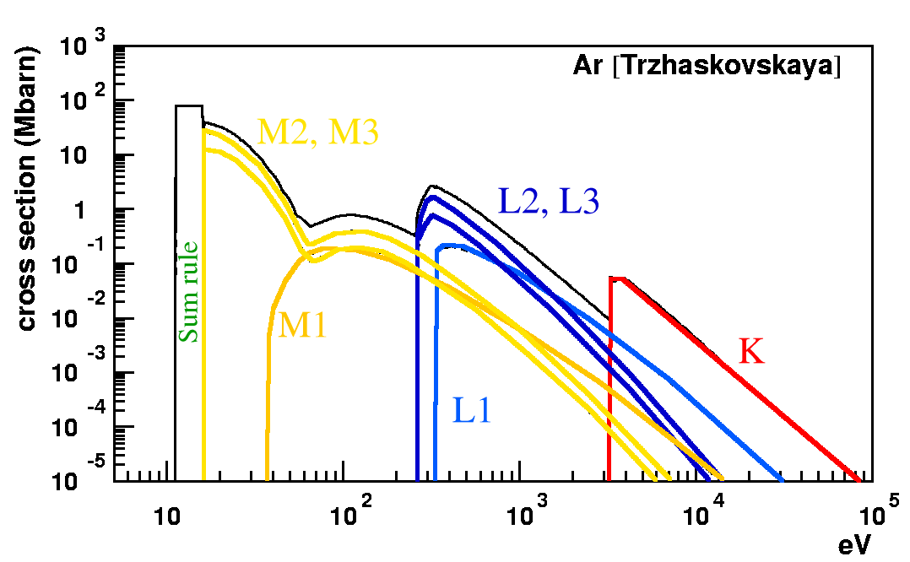

1. Photo-absorption in argon
Argon has 3 shells, hence 3 groups of lines:
Spin-orbit splitting
K = 1s
L1 = 2s
L2 = 2p 1/2
L3 = 2p 3/2
M1 = 3s
M2 = 3p 1/2
M3 = 3p 3/2
Plot © Igor B. Smirnov - Slide © Rob Veenhof
{
{
Lamb shift

Slide 14
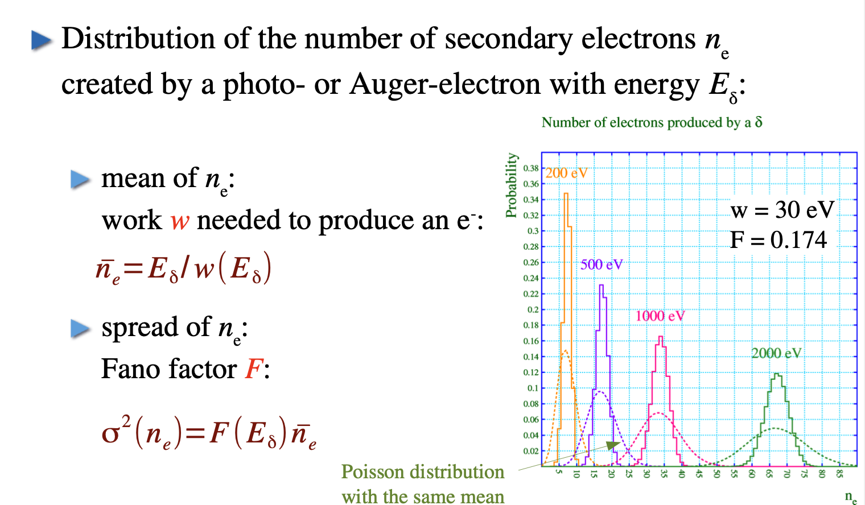
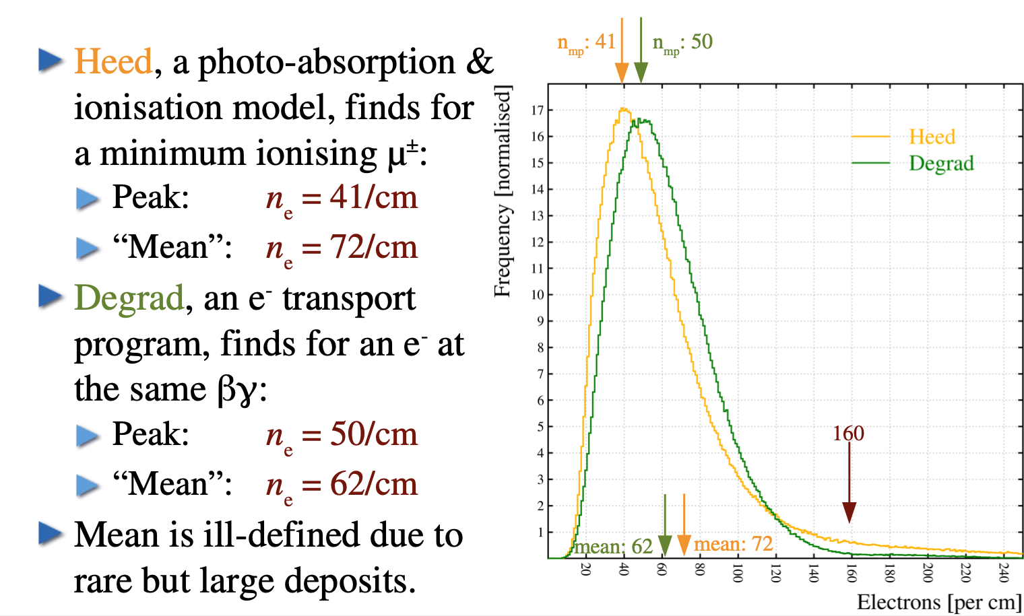
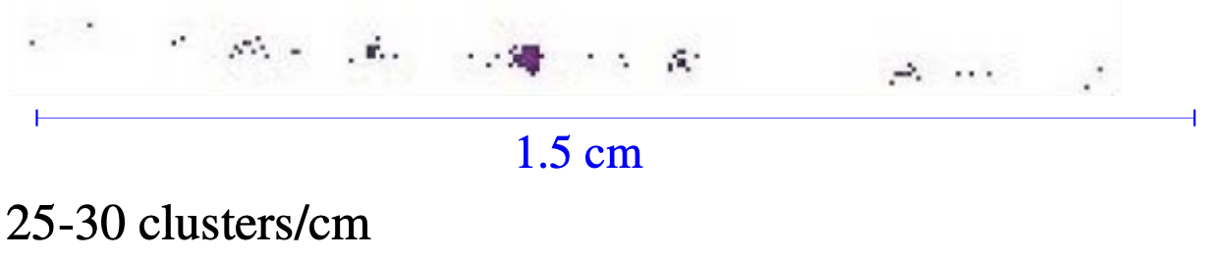
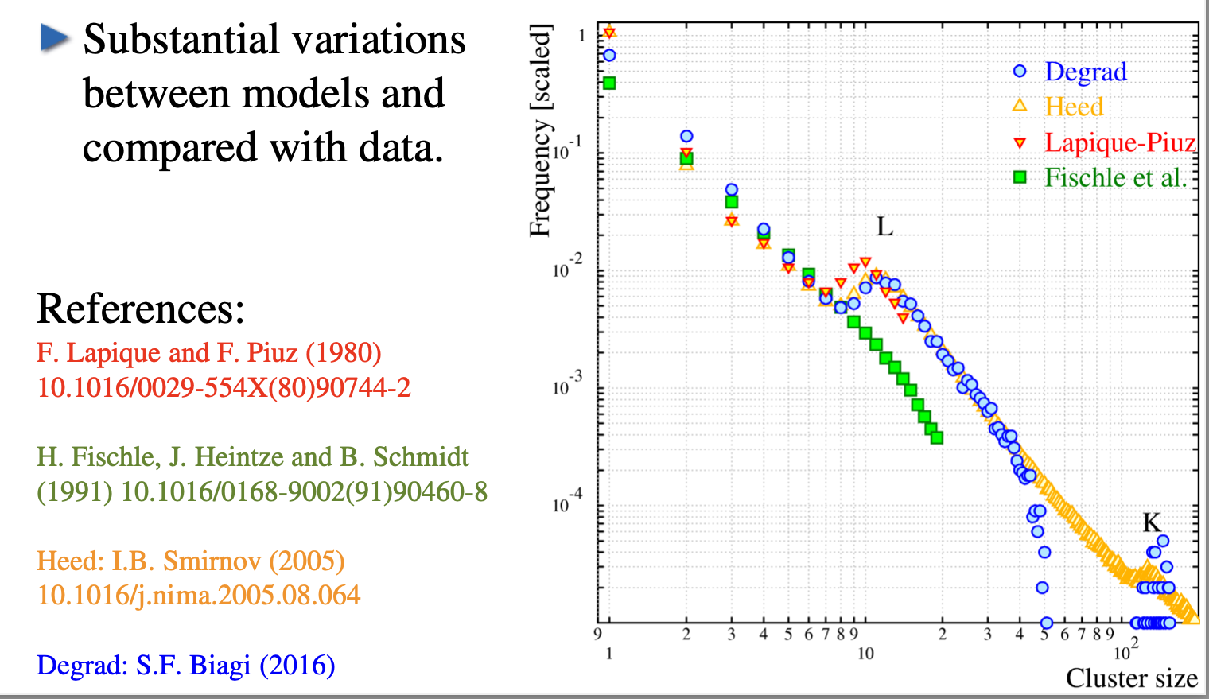
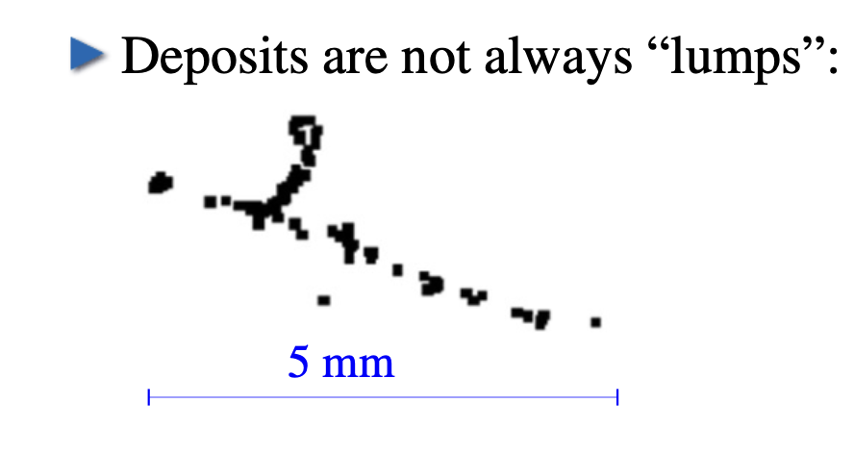

1. Primary Interactions / Clusters
Ionisation electrons deposited in Ar
  dE/dx divided by ionisation potential (IP):
  160e-/cm
  Heed: 72 e-/cm – Degrad 62 e-/cm
On average need more energy than binding energy to ionize an electron
  Some energy goes into excitations (W)
  Not all energy is used (F)
Energy is liberated in primary clusters
  Not evenly spaced – not even exponential
1.5cm – clusters in T2K gas
(Ar:CF₄:iC₄H₁₀ 95:3:2)
$δ$ electrons
Slides © Rob Veenhof

Slide 15
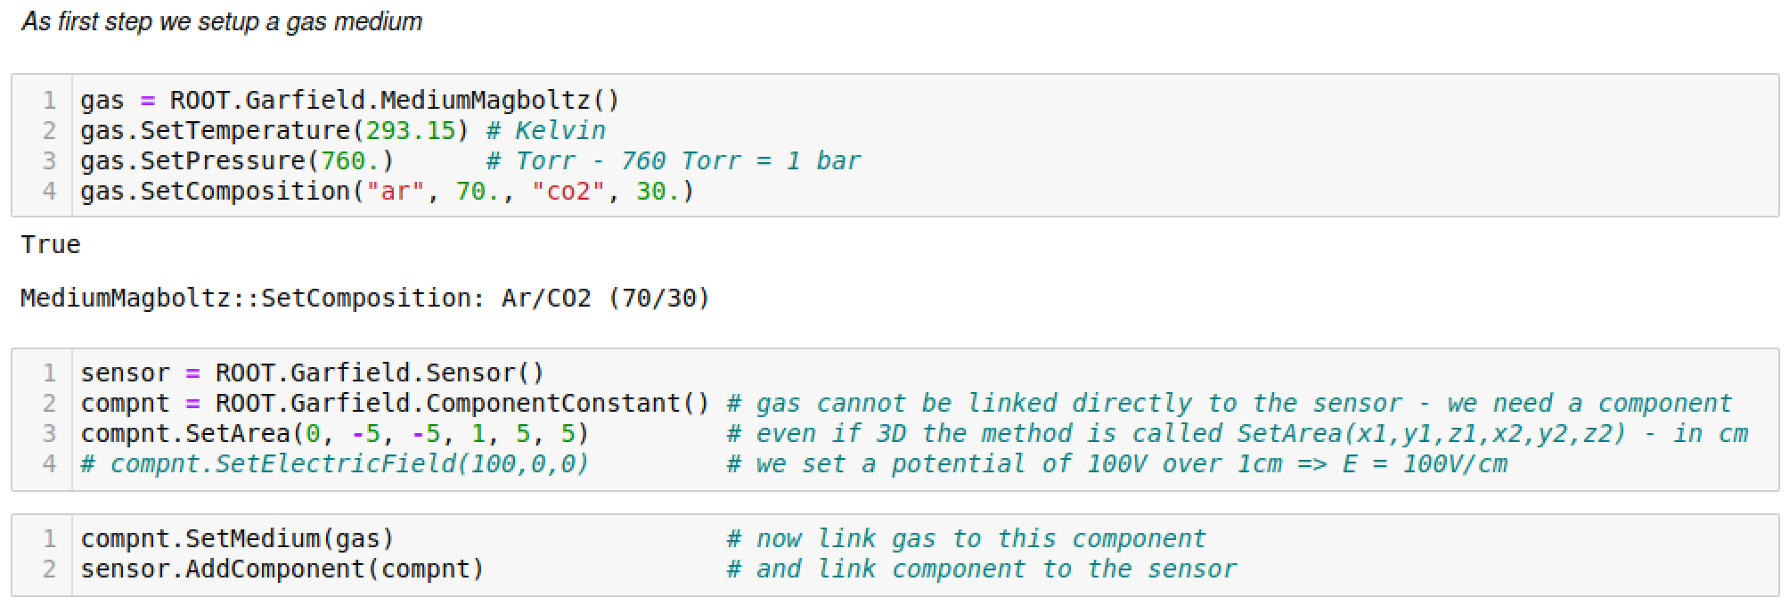
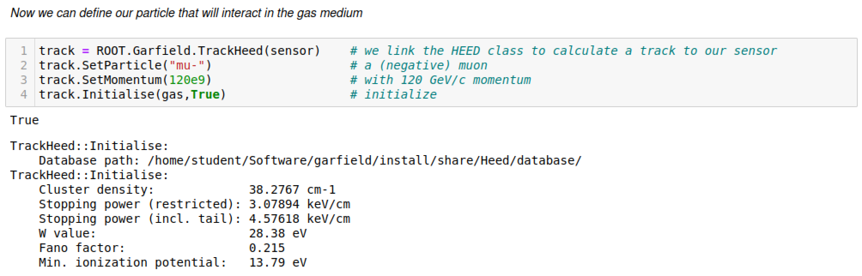



1. Interaction of a Charged Particle
10 cm
10 cm
$$y$$
$$x$$
1 cm
$$z$$
Heed calculated, based on particle and the gas medium:
N_{cls}/cm = 38 cm⁻¹
dE/dx = 4.58 keV/cm
W = 28.38 eV per e-ion pair

Slide 16
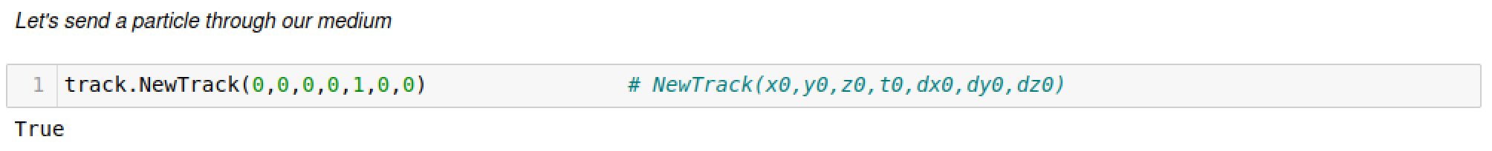
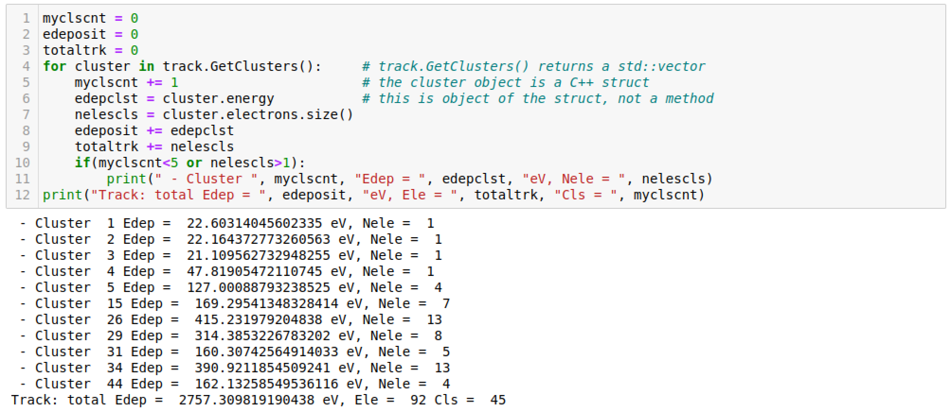
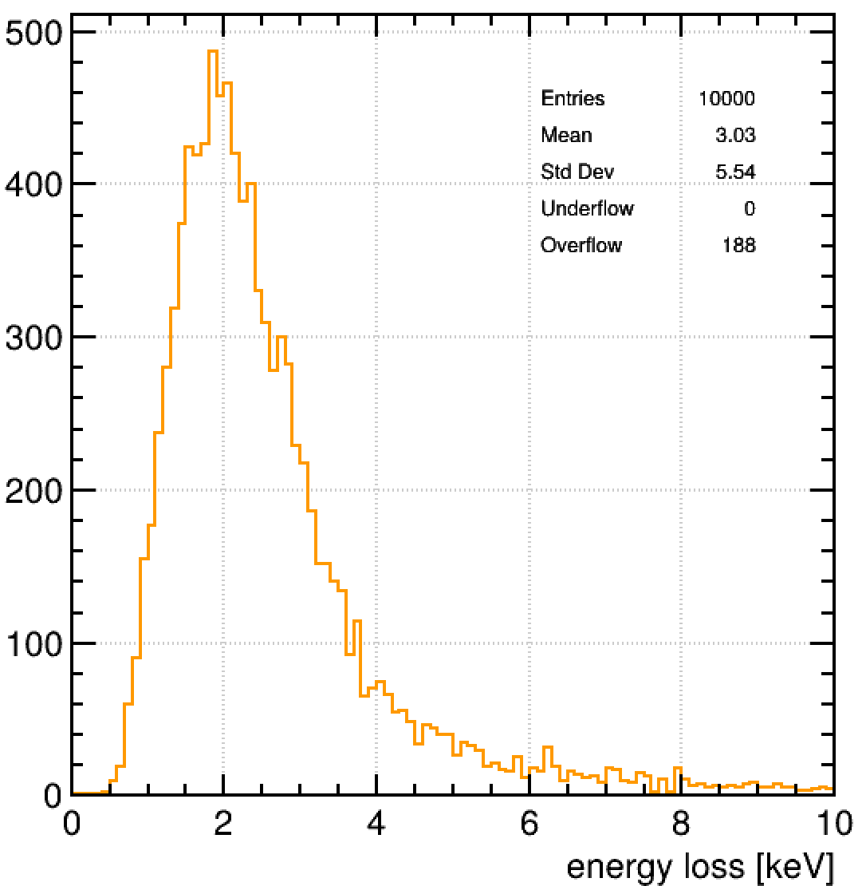
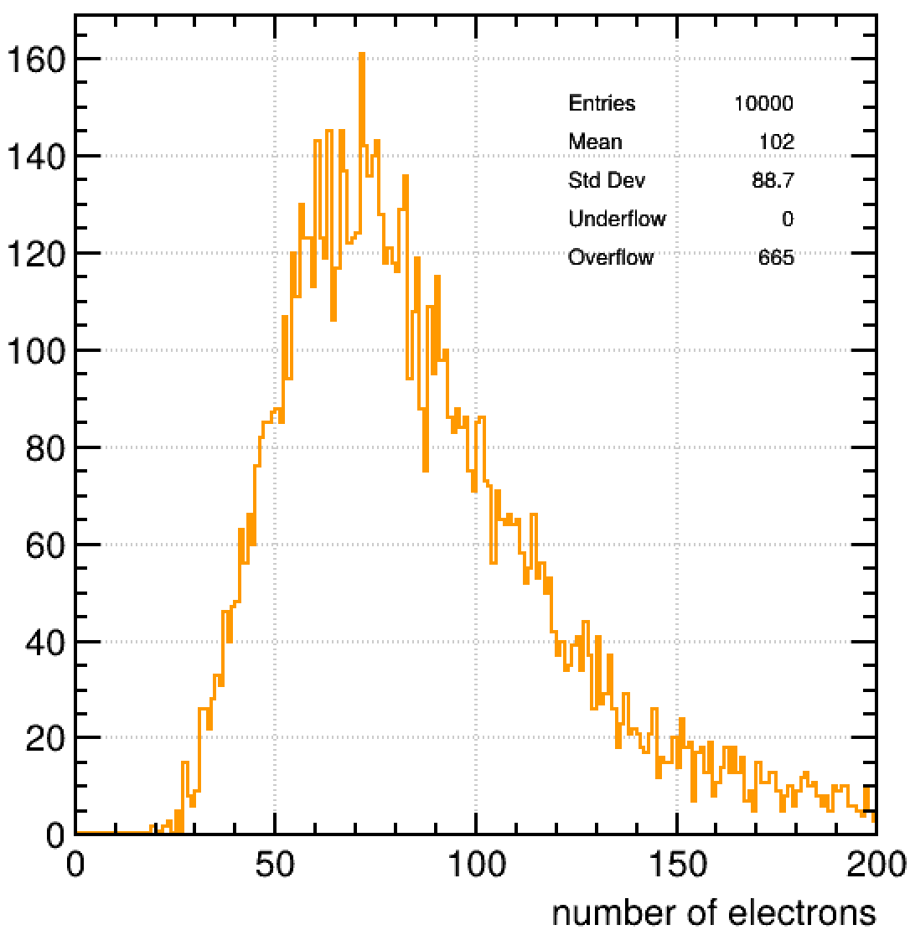
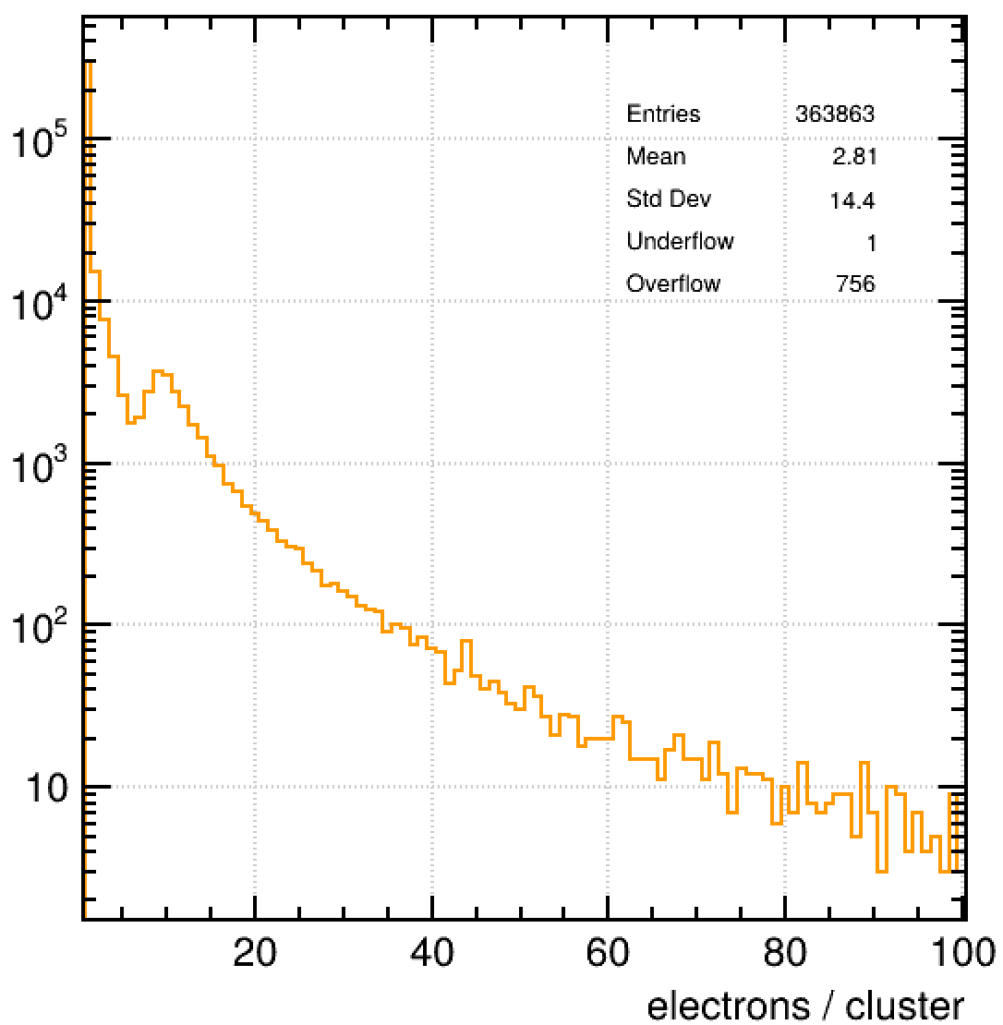

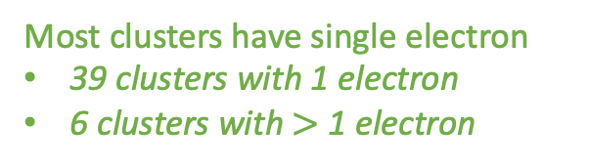
1. Interaction of a Charged Particle
$$μ$$
$$y$$
$$x$$
$$z$$
Most clusters have single electron
39 clusters with 1 electron
6 clusters with $>$ 1 electron
Non-gaussian tails
Structures in the cluster size
mpv
dE/dx (unrestr)
dE/dx (restr)

Slide 17
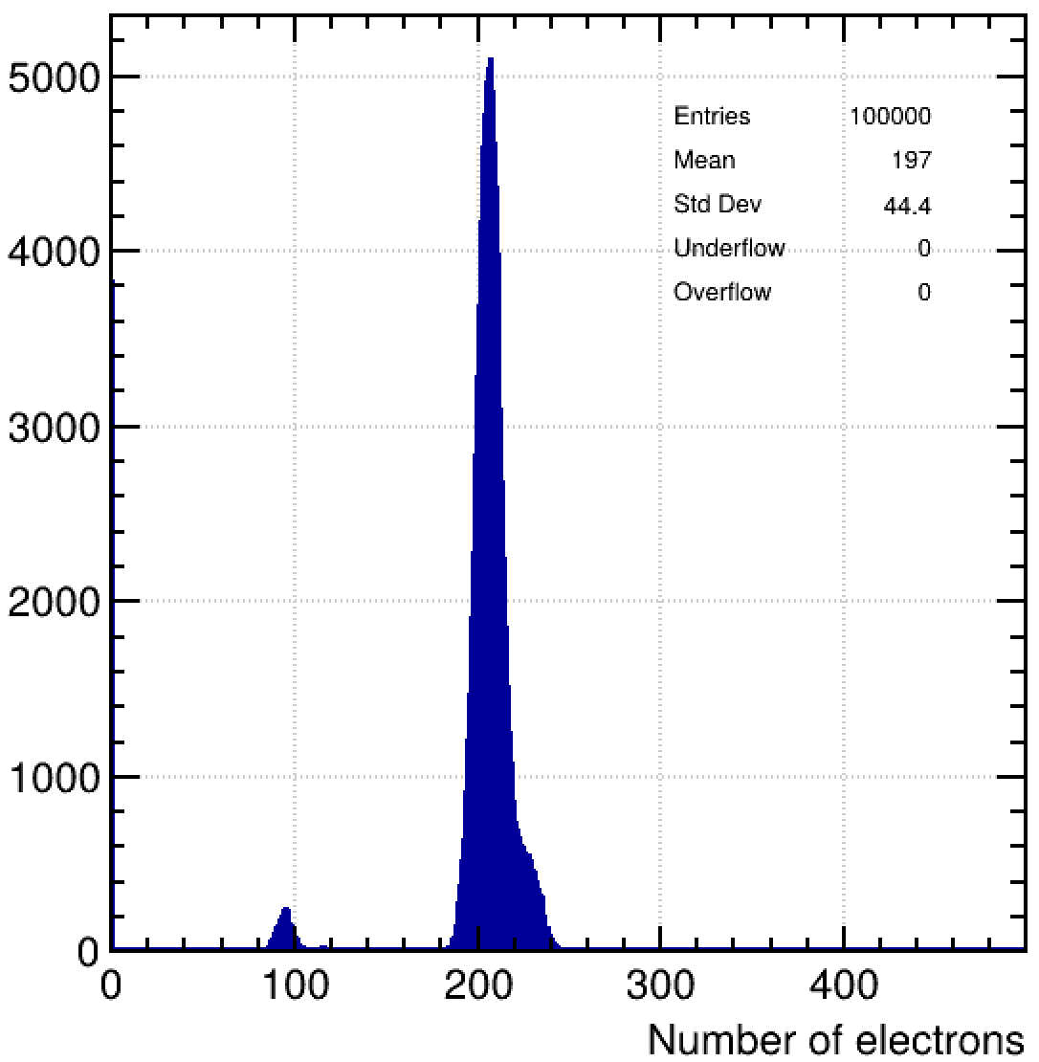
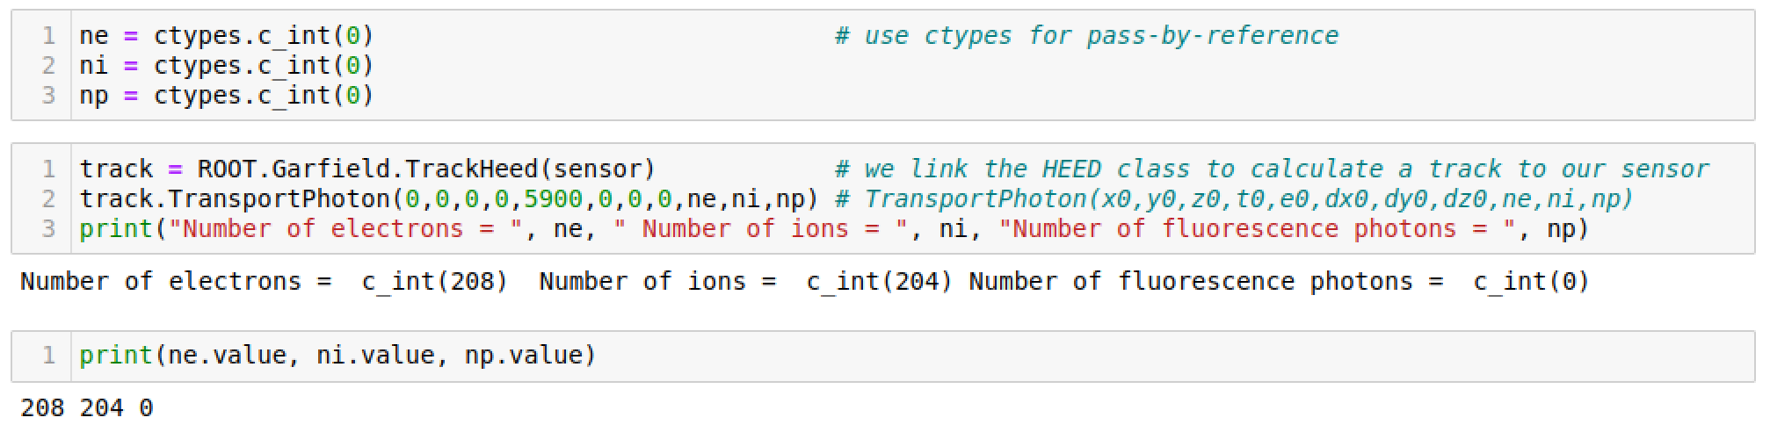
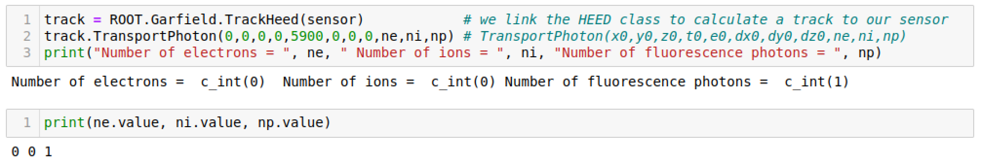
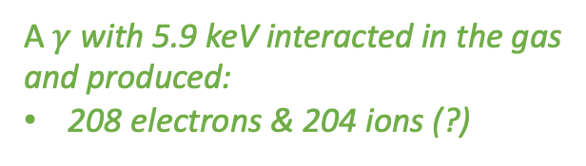
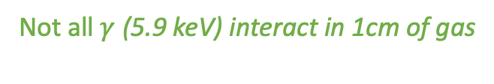
1. Interaction of a Photon / X-ray
Garfieldpp is C++ code
Need c++ objects for pass - by - reference
A $γ$ with 5.9 keV interacted in the gas
and produced:
208 electrons & 204 ions (?)
The call “ne” gives you back
the ctypes object
“ne.value” gives you the value
Not all $γ$ (5.9 keV) interact in 1cm of gas

Slide 18
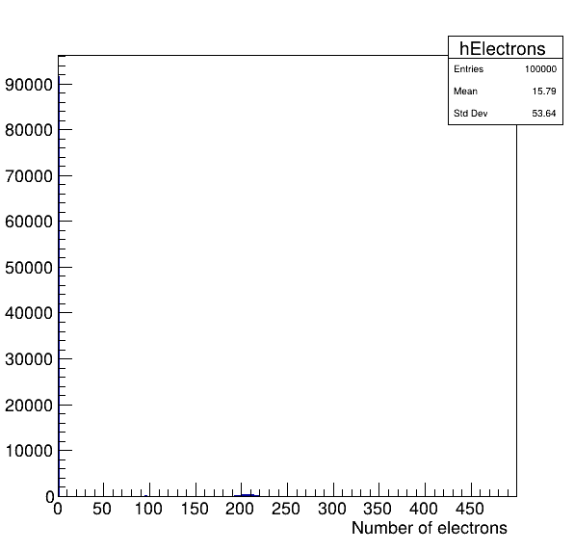

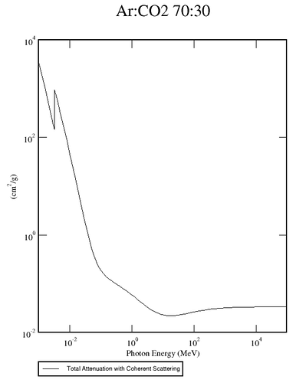
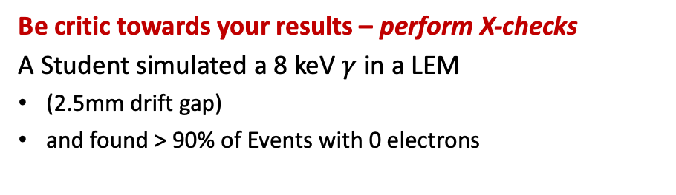
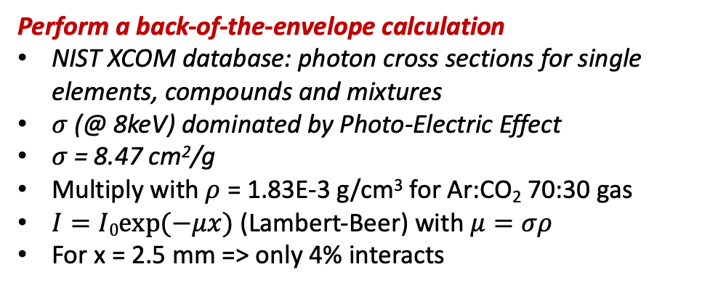
1. Interaction of a Photon / X-ray
Be critic towards your results – perform X-checks
A Student simulated a 8 keV $γ$ in a LEM
(2.5mm drift gap)
and found > 90% of Events with 0 electrons
> 90% of Evts
5.9 keV
peak
Perform a back-of-the-envelope calculation
NIST XCOM database: photon cross sections for single elements, compounds and mixtures
$σ$ (@ 8keV) dominated by Photo-Electric Effect
$σ$ = 8.47 cm²/g
Multiply with $ρ$ = 1.83E-3 g/cm³ for Ar:CO₂ 70:30 gas
$I=I0exp⁡(−μx)$ (Lambert-Beer) with $μ=σρ$
For x = 2.5 mm => only 4% interacts
https://physics.nist.gov/PhysRefData/Xcom/html/xcom1.html

Slide 19

2. Electric Fields & Det Geometry
Closed expressions, “analytic method”:
  almost all 2d structures of wires, planes + periodicities;
  dielectrics and space/surface charge are laborious;
  fast and precise, if applicable.
Finite element method:
  2d and 3d structures, with or without dielectrics;
  several major intrinsic shortcomings.
Integral equations or Boundary element methods:
  equally comprehensive without the intrinsic flaws;
  technically challenging and emerging;
  consumes more CPU time than FEM, but catching up.
Finite differences:
  used for iterative, time-dependent calculations.
Implemented in Garfield
OK for parallel plate & wire detectors
ANSYS, COMSOL,
ELMER
Needed for MPGDs
NeBEM
Slide © Rob Veenhof

Slide 20
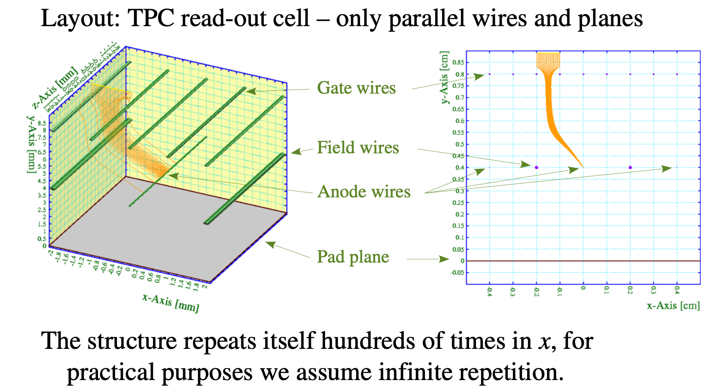
2. Analytic Fields in 2D - example
Garfield++ Examples:
https://garfieldpp.web.cern.ch/garfieldpp/examples/analytic/
https://garfieldpp.web.cern.ch/garfieldpp/examples/alicetpc/
Slide © Rob Veenhof

Slide 21
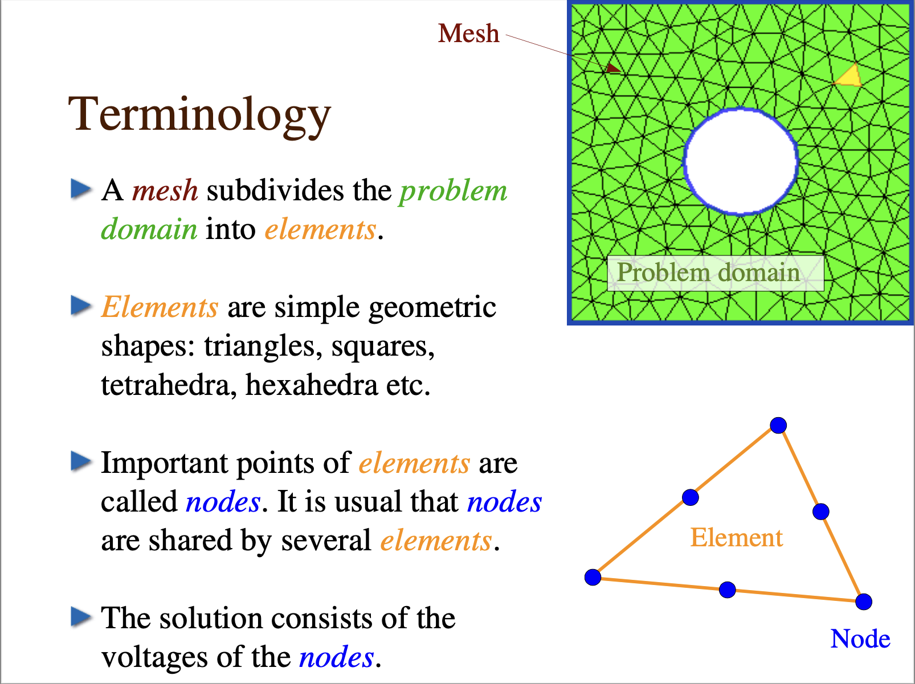
2. Finite Element Method
Slide © Rob Veenhof

Slide 22
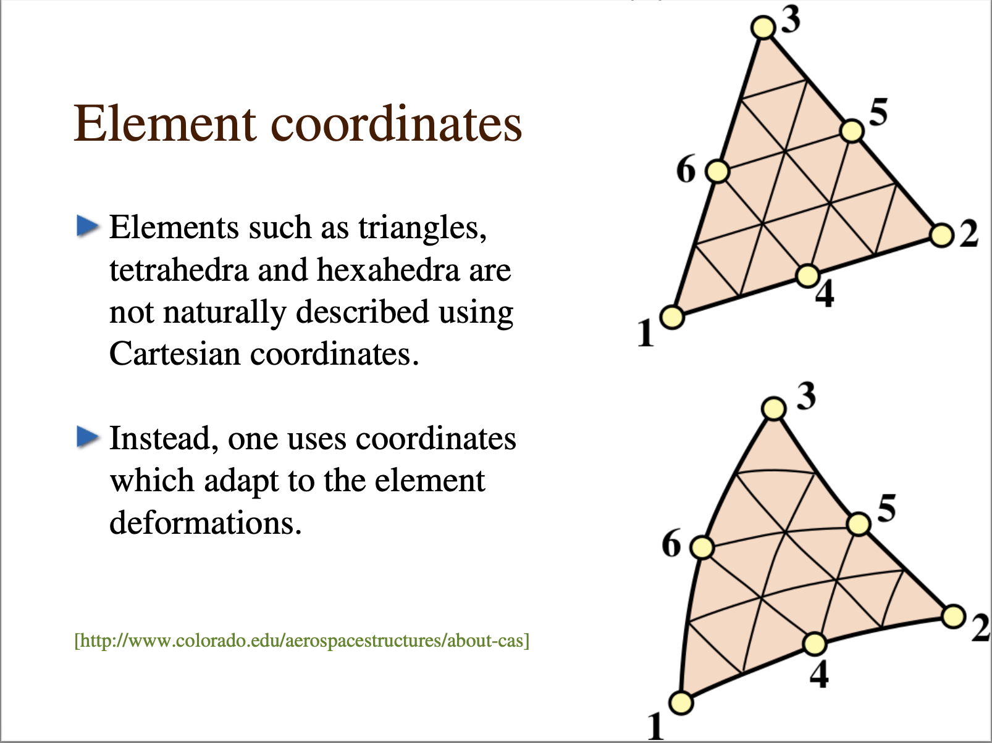
2. Finite Element Method
Slide © Rob Veenhof

Slide 23
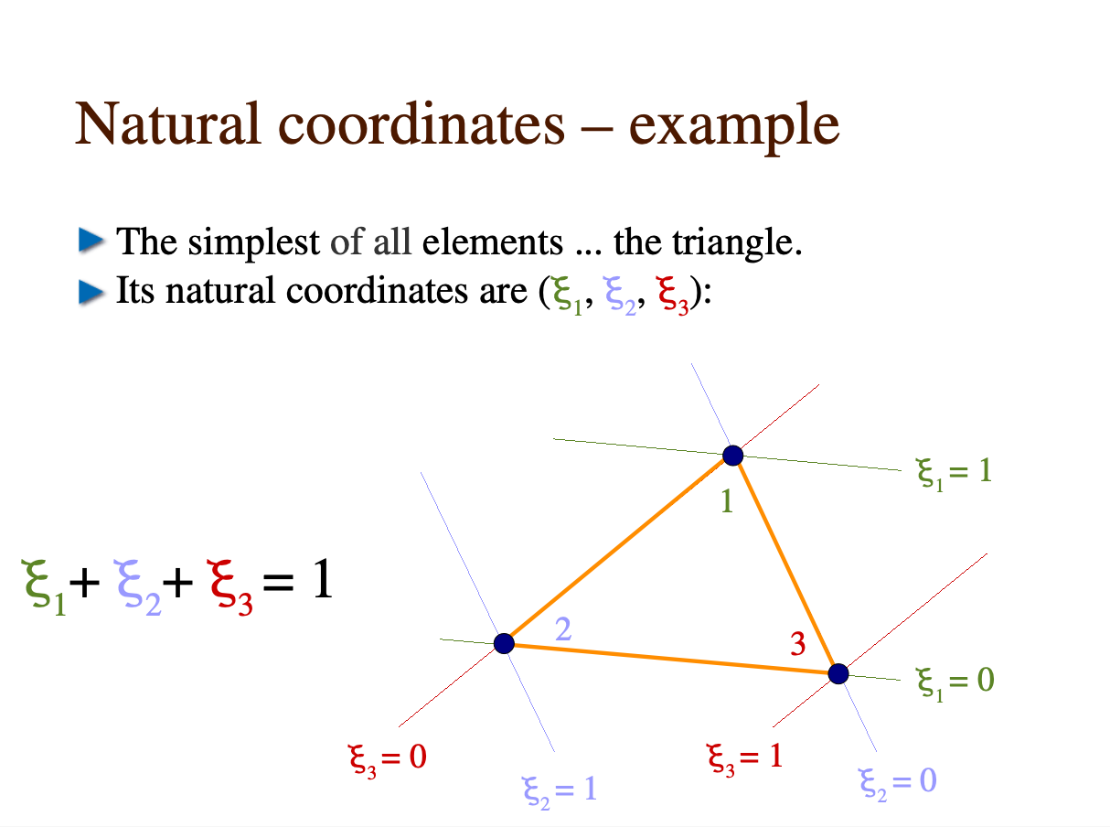
2. Finite Element Method
Slide © Rob Veenhof

Slide 24
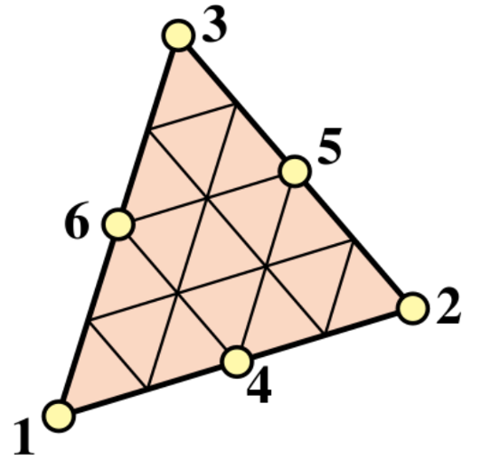
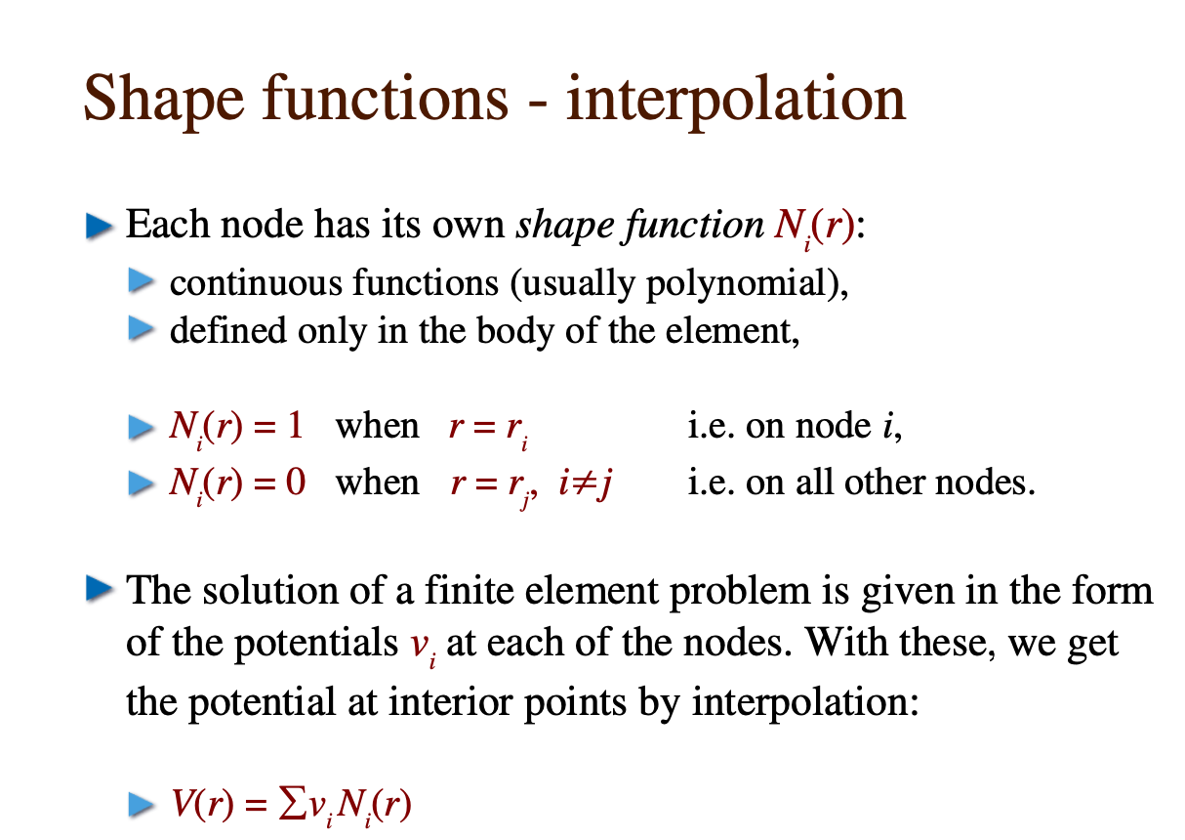
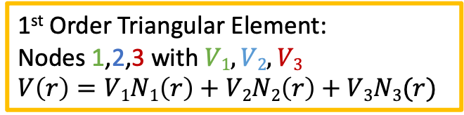



2. Finite Element Method
$$V1$$
$$V2$$
Example:
1st Order Triangular Element:
Nodes 1,2,3 with $V1,V2,V3$
$V\left(r\right)=V1N1\left(r\right)+V2N2\left(r\right)+V3N3(r)$
Slide © Rob Veenhof
$$V3$$

Slide 25
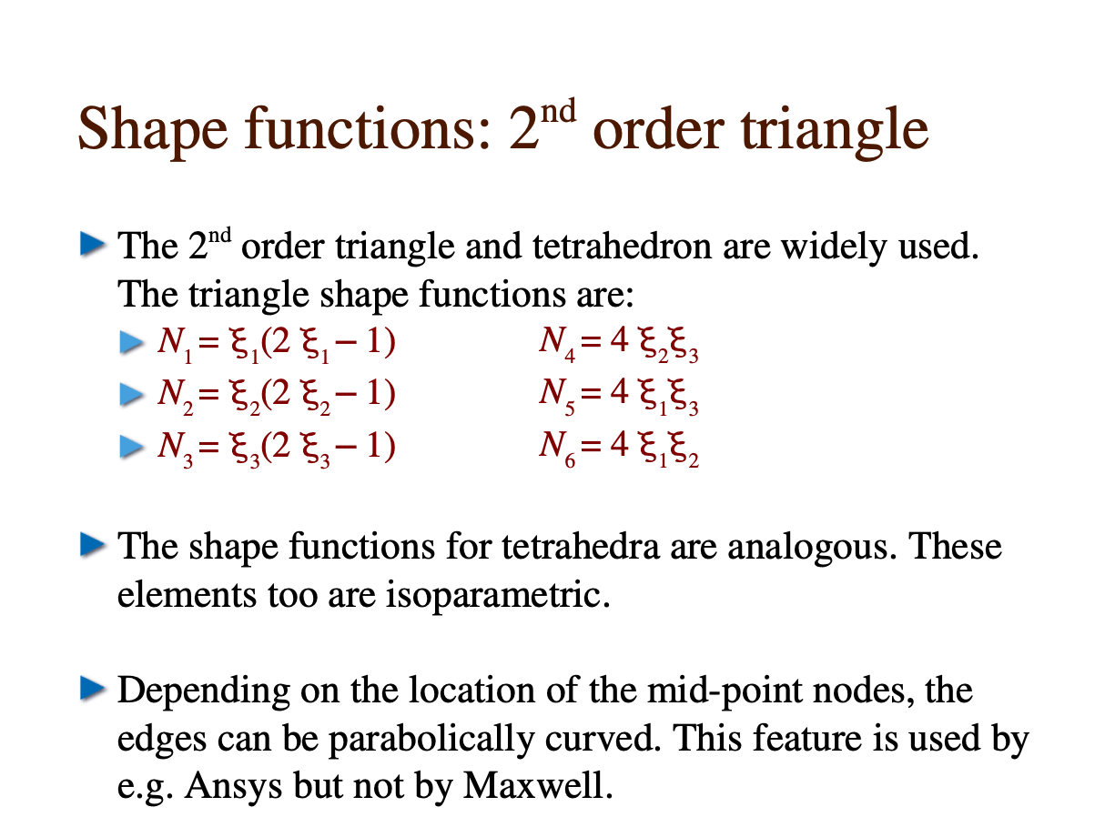
2. Finite Element Method
Slide © Rob Veenhof

Slide 26
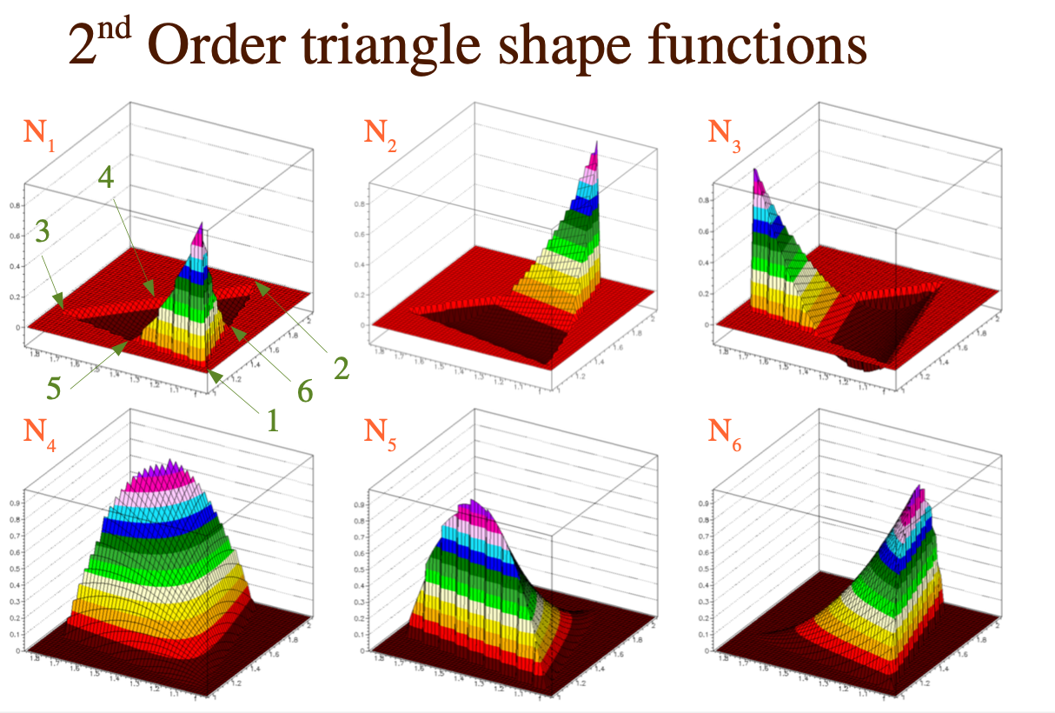
2. Finite Element Method
Slide © Rob Veenhof

Slide 27
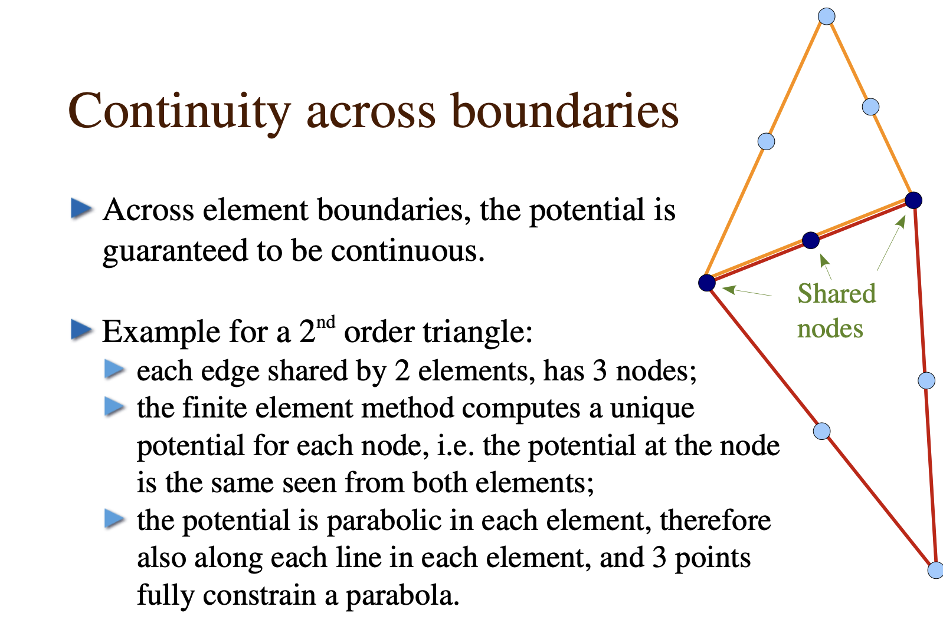
2. Finite Element Method
Slide © Rob Veenhof

Slide 28
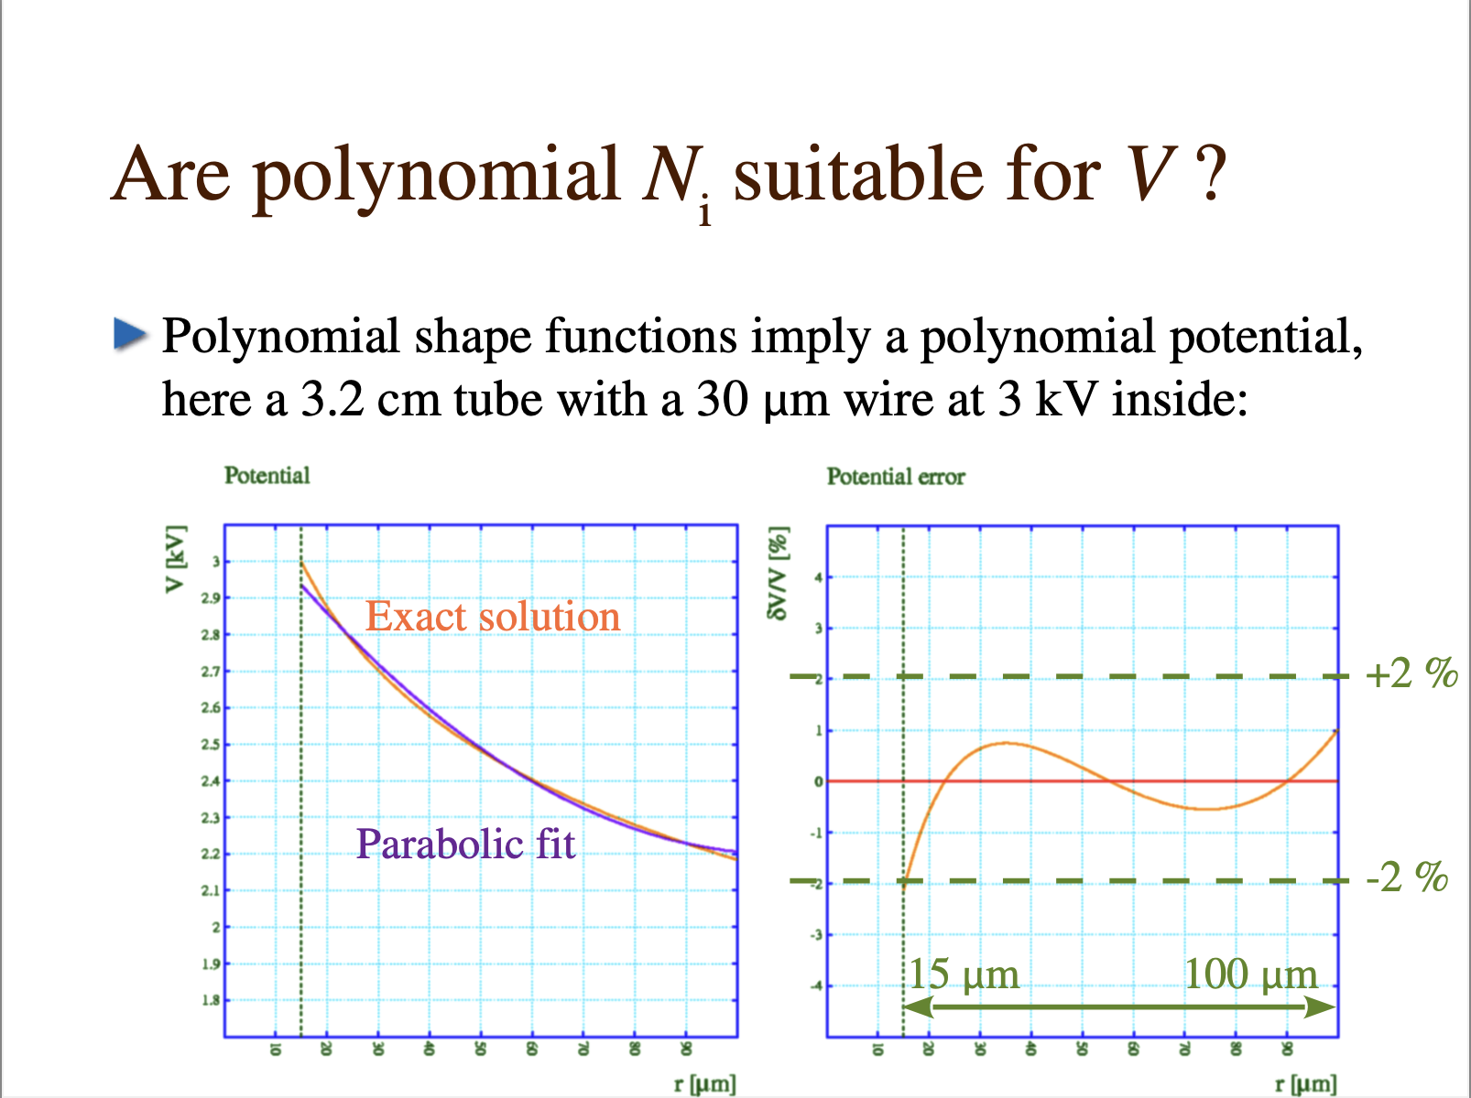
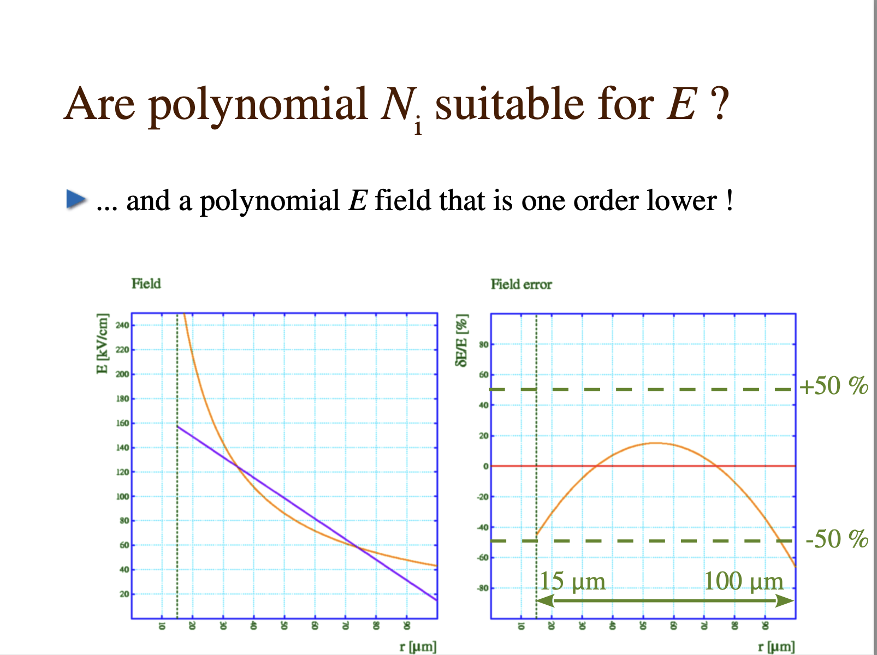
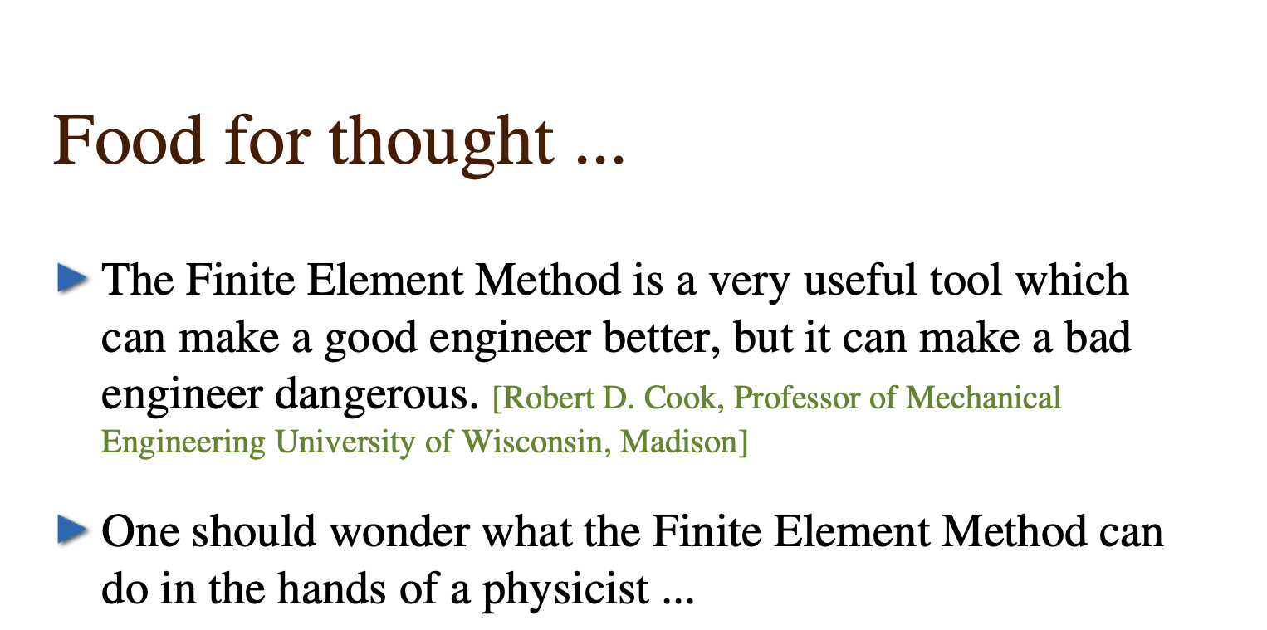

2. Finite Element Method
Slide © Rob Veenhof

Slide 29

2. Finite Element Method
Slide © Rob Veenhof

Slide 30


2. Boundary Element Method
Alternative approach:
  No discretization of the domain (as in FEM)
  But discretization of the boundaries (BEM)
BEMS first applied around 1977 … about 20 years later than FEM (1955)
In ad 3D detector
  Elements are 2D surface panels located on the boundaries
  Potentials on Electrodes => Charges on the boundary elements
  Charge on a boundary => Electric Field calculated using Green’s functions
  Field in domain is superposition of fields induced by all boundary elements
  No discontinuities in the problem domain – but discontinuities on boundaries
However … method is numerically challenging, time-consuming
neBEM: nearly-exact Boundary Element Method
  Nearly-exact refers to how singularities in vicinity of boundaries are addressed
  Open source, developed by our DRD1 colleagues in Saha Institute (Kolkata, IN)
neBEM integrated in Garfield++
  Developments still ongoing to speed up the code
Slide © Rob Veenhof
Garfield++ Examples:
https://garfieldpp.web.cern.ch/garfieldpp/examples/nebem/
S.Mukhodpadhyay & N.Majumdar, Computation of 3D MEMS electrostatics using a nearly exact BEM solver EABE 30 (8), 687-696, 2006

Slide 31




2. Electric Fields & Det Geometry
3 materials: Gas, Cu, Kapton
8758 elements
14066 nodes
14066 potentials, same as nodes
Dimensions of the Elementary Cell
Index of the Materials:
0 = Cupper ($εr=∞$, $ρ$= 0)
1 = Gas ($εr=1$)
2 = Kapton ($εr=4$)

Slide 32



2. Electric Fields & Det Geometry
3 materials: Gas, Cu, Kapton
8758 elements
14066 nodes
14066 potentials, same as nodes
Dimensions of the Elementary Cell
Index of the Materials:
0 = Cupper ($εr=∞$, $ρ$= 0)
1 = Gas ($εr=1$)
2 = Kapton ($εr=4$)

Slide 33

3. Charged Particle Transport
Overview
Recall:
We have a charged particle that produces primary ionization along its track
We need to have this primary ionization moving (and in most cases to amplify it) to detect
  Therefore we apply electrical fields in our detector
  Now need to know how these particles move in the electric Field
Lorentz: $F=q \left(E+v × B\right)$
Newton: $F=m \ddot{r}$
Equation of motion: $r\left(x,v,t\right)=f(x,E,B)$
But this is a macroscopic approach … we need to add gas

Slide 34



3. Charged Particle Transport
Intro: the mean free path in argon
We know (e.g. from literature) that:
  Diameter (Van der Waals) r ≈ 1.9 10⁻⁸ cm
  Cross section of 1 atom: $σ$ ≈ 1.5 10⁻¹⁶ cm²
  Atoms per volume: n₀ ≈ 2.7 10¹⁹ atoms/cm³ (Loschmidt)
  Average distance: 1/$∛$n₀ ≈ 3 nm
Mean free path for an electron ?
  An electron hits all atoms of which the centre
  is less than a cross section σ radius from its path;
  over a distance L, the electron hits n₀ σ L atoms;
  mean free path = distance over which it hits 1 atom;
  $λ$_{e} = 1/(σ n₀) ≈ 2.5 $μ$m
  much larger than
    3 nm distance between atoms in gas, and
    140-600 pm typical gas molecule diameters.
Slide © Rob Veenhof

Slide 35
3. Charged Particle Transport
Intro: MPGDs and Mean free path
Recall:
  Mean free path of electrons in Ar: 2.5 µm,
Compare with:
  Micromegas mesh pitch: 63.5 µm
  GEM polyimide thickness: 50 µm
  Micromegas wire thickness: 18 µm
  GEM conductor thickness: 5 µm
Hence:
  mean free path approaches small structural elements;
  such devices should be treated at a molecular level.
Slide © Rob Veenhof
Notes:
… the devices are large compared with the characteristic dimensions of the detector.
This is not the case in MPGDs: -

Slide 36





3. Charged Particle Transport
Boltzmann equation
The Boltzmann equation describes the evolution of
the distribution function f (energy or velocity distribution) in 6D phase-space: $f(x,v)$ is function of position and velocity
  $\frac{∂f}{∂t}+v∙∇f+\frac{e}{m}\left(E+v×B\right)$ $∙∇f$ = 0
$$S=k log⁡W$$
1935: solution by expansion of f with Legendre polynoms
$f\left(x,v\right)=f0\left(x,v\right)+\frac{ε}{v}f1\left(x,v\right)$
With $f0$ the random distribution and $f1$ the electron drift
From 1960: numerical solutions with first computers
  Skullerud – Null-collision tech. 1968
  Fraser & Mathieson 1986, E-fields
  Steve Biagi 1998, E & B-fields

Slide 37


3. Charged Particle Transport
Magboltz
Magboltz solves transport equations in presence of E- and B-fields
Program written in Fortran
  http://cern.ch/magboltz
  Integrated (through wrapper) in Garfield++
  You need to update manually with new versions
It uses electron-atom cross-sections
  Internal database, published on LXCAT
  Measurements -> cross section
Precision of the cross-sections:
  Total cross section: 1%
  Ionisation 2%
  Excitation 5-10%
Magboltz calculates transport params
  Townsend Coefficient
  Attachment Coefficient
  Drift velocity
  Diffusion Tensor
  Average electron energy
cern.ch/magboltz
S.F. Biagi – Nucl. Instr Meth A 421 (1999)

Slide 38

3. Charged Particle Transport
Ar:CO₂
2-10 % CO₂
CO₂ makes the gas faster, dramatically.
Calculated by Magboltz for Ar/CO₂ at 3 bar. (Note where the arrow is !)
0.1-1 % CO₂
20-100 % CO₂
Pure Ar
Slide © Rob Veenhof

Slide 39


3. Charged Particle Transport
CO₂ vibrational modes
CO₂ is linear:
  O – C – O
Vibration modes are numbered V(ijk)
  i: symmetric,
  j: bending,
  k: anti-symmetric.
Total cross section
V(010)
V(001)
Vibration sum
V(100)
Slide © Rob Veenhof

Slide 40


3. Charged Particle Transport
Electrons in Ar:CO₂ mixtures at E = 1kV/cm
0 % CO₂
E
10 % CO₂
Slide © Rob Veenhof
Starting point
Starting point

Slide 41


3. Charged Particle Transport
Electrons in Ar:CO₂ mixtures at E = 1kV/cm
90 % CO₂
100 % CO₂
Slide © Rob Veenhof
Starting point
Starting point

Slide 42

3. Charged Particle Transport
Ar:CO₂
Slide © Rob Veenhof

Slide 43



3. Charged Particle Transport visualize Ar and CO₂ cross sections with Garfield++
Conversion factors:
1Mbarn = 10⁻¹⁸ cm²
Argon
Carbon dioxide
Elastic
Sum of vibrations
Elastic
Inelastic
Ionization
Ionization
Excitation

Slide 44







3. Charged Particle Transport visualize Electron Velocity & Diffusion with Garfield++

Slide 45

3. Charged Particle Transport
Garfield++ has 3 different Transport Algorithms
  Runge-Kutta-Fehlberg (RKF) Integration – numerical method to solve ODEs
  Monte-Carlo
  Microscopic Tracking
First 2 methods calculate the electron trajectory, using as input the Transport Parameters ($α$,$η$, $vd$, $DL$,$DT$)
  These parameters need to be provided as a gasfile (map/table),
  in function of E-field, B-field and angle between E & B field
  This gasfile can be calcuted in Garfield++ using Magboltz
3rd method uses the electron-Atom scattering cross sections
  Cross-sections taken from Magboltz and hard-coded in Garfield
  Need manual update each time a gas is updated by Steve
Different methods have different level of precision, resources,..
  Wire-based detectors: OK to use RKF integration
  Micro-Pattern detectors: need to use Microscopic Tracking
  Parallel plate: use Microscopic Tracking up to O(100) electrons

Slide 46




3. Charged Particle Transport
Illustration of Runge Kutta Fehlberg
This time we do not define the gas ourself on the spot, but we load a gasfile
Temperature and Pressure predefined
Ar:CO₂ 80:20 – varying E-field, B = 0T
This is the core … we define an object
DriftLineRKF and we pass the sensor
Now we define some helper objects
Visualize the geometry (ViewFEMesh)
Visualize the trajectories (ViewDrift)
Now we define some starting points
Equally distribute 101 points in [ –pitch/2 +pitch/2]
We launch an electron at t0=0ns
for each starting point x
Combine Geometry view & Trajectory view & plot

Slide 47



3. Charged Particle Transport
Illustration of Monte Carlo Integration
This time we do not define the gas ourself on the spot, but we load a gasfile
Temperature and Pressure predefined
Ar:CO₂ 80:20 – varying E-field, B = 0T
This is the core … we define an object
AvalancheMC and we pass the sensor
Now we define some helper objects
Visualize the geometry (ViewFEMesh)
Visualize the trajectories (ViewDrift)
We launch an electron at t0=0ns
for each starting point x
Combine Geometry view & Trajectory view & plot

Slide 48




3. Charged Particle Transport
Illustration of Microscopic Tracking
For Microscopic Tracking we need access
to the electron-Atom cross sections
And we do not need the Transport Params
This is the core … we define an object
AvalancheMicroscopic & pass the sensor
Now we define some helper objects
Visualize the geometry (ViewFEMesh)
Visualize the trajectories (ViewDrift)
We launch an electron
at position x0, y0, z0 and t0=0ns
With energy e0, and direction dx0, dy0, dz0
Combine Geometry view & Trajectory view & plot

Slide 49
3. Charged Particle Transport
Ion transport
Ions are produced in primary ionization and in avalanches, in same quantities
GEMs get their signal mostly from moving electrons
Wire chambers, Micromegas, uRWELL get most of their signal from the motion of the ions
Therefore important to know:
  Which ions are moving?
  How fast are they moving?
  Do they diffuse?

Slide 50



3. Charged Particle Transport
Ion transport
Ions are > 1000 times more massive than electrons
  This reflect in their drift velocity that is ~ 1000 x slower
We define the Ion mobility as $μ=vd/E$
Ion Mobilities are well known for the noble gases
In Ar:CO₂: Ar+ dominates in the ionization
(but CO₂+ dominates in Ne:CO₂)
However:
  Formation of dimers: ${Ar}^{+}+Ar →{Ar}_{2}^{+}$
  Charge exchange: ${Ar}^{+}+CO2 →{Ar+CO}_{2}^{+}$
  Cluster formation: ${CO}_{2}^{+}+ 2 CO2 →{CO}_{2}^{+}∘CO2+CO2$
    Formation time: 7ps – decay time 5ns … long-lived cluster
This is not fully implemented in the simulation
  Instead of ${CO}_{2}^{+}∘(CO2$)_{n} mobility in Ar:CO₂ mix, we use Ar⁺ in Ar
  Correct within 10-15% … but for other mixtures this is far worse …
  Simulation provides Ar+ in Ar, Ne+ in Ne, He+ in He and few others …
  Lot’s of room for improvement, especially if correct signal shape is important
Figures © Rob Veenhof

Slide 51


4. Charge Amplification
Townsend coeff $α$: probability per unit length that an electron creates an additional electron
  $dn\left(x\right)=n\left(x\right)α\left(x\right)dx$ => $n\left(x\right)=n\left(0\right)exp⁡(\int_{0}^{x}{α\left(x^{′}\right)dx′)}$
Once field is high enough
electron picks up energy > IP
  Electron can ionize an atom in collision
  Liberated electrons sense the strong field and can ionize further
Implemented in all Electron Transport classes
  Runge-Kutta-Fehlberg (e-, ion+)
  Avalanche MC (e-)
  Microscopic Tracking (e-)
Ar:CO₂ 3 bar
(e.g. ATLAS MDT)

Slide 52
Second Lecture see you Monday!

Slide 53
Questions?
Stupid questions do not exist

Slide 54
References

Slide 55
References & Acknowledgements
References:
RD51 Simulation School 2011 https://indico.cern.ch/event/110634/
RD51 Open Lectures 2017 https://indico.cern.ch/event/676702/
RD51 Open Lectures 2021 https://indico.cern.ch/event/911950/
Acknowledgements
  To Rob, who taught many of us simulation
  And all – major and minor contributors- who have developed Garfield++ code and who have developed the exercises over
  the past 14++ years

Slide 56
Third Lecture hands-on exercises

Slide 57
Hands-On Exercises
We have prepared a Linux Virtual Machine
  Xubuntu 24.04 LTS – ROOT and Garfield++ preinstalled
  You can download the VM at the following location:
  https://cernbox.cern.ch/s/2GwgQCBQ0TSMnMc
  You need to download Oracle Virtual Box to open it
  Username: “student” – Password: “password”
The Linux VM contains also the Hands-On exercises
  /home/student/DRD1-School-2024

Slide 58
Hands-On Exercises
Introductory Simulation Lab
  3-5 Simple exercises, dedicated to:
    Detector setup, electric field
    Primary Ionization
    Avalanche Multiplication
    Signal Induction
    Influence of resistivity on signal induction
Advanced Simulation Lab
  1-2 big (full) exercises – in group – with strong help …
    Signal in Resistive Place Chambers
    Signal in Resistive Micromegas

Slide 59



Your Friends:
Your best friends: the Holy Trinity: The Manual, The Source Code, The Examples
Maybe also your tutors - we will do our best ☺
https://garfieldpp.web.cern.ch/garfieldpp/documentation/UserGuide.pdf
https://gitlab.cern.ch/garfield/garfieldpp/-/tree/master/
https://garfieldpp.web.cern.ch/garfieldpp/documentation/

Slide 60
For Master / PhD students with lxplus account
https://garfieldpp.web.cern.ch/garfieldpp/getting-started/
Instructions for bash shell:
  Login (lxplus 8)
    ssh <username>@lxplus8.cern.ch
  Pickup latest (nightly) built of Garfield++
    source /cvmfs/sft.cern.ch/lcg/views/dev3/latest/x86_64-el8-gcc11-opt/setup.sh
    source /cvmfs/sft.cern.ch/lcg/views/
    dev3/latest/x86_64-el8-gcc11-opt/share/
    Garfield/setupGarfield.sh
    export GARFIELD_HOME=$GARFIELD_INSTALL
  Pick-up an example C++ file, compile and execute it
    cp -r $GARFIELD_HOME/Examples/Gem .
    mkdir Gem/build; cd Gem/build
    cmake ..
    make
    ./gem

