Slide 1
(M)RPC for HEP
I.Laktineh
Lyon University-IP2I

Slide 2
Outline
(M)RPC: a few words on their history
(M)RPC why for?
Trigger& muon detectors
RPC in L3, BABAR and learnt experiences
RPC@OPERA
RPC@LHC (CMS, ATLAS and ALICE): performances and issues
ToF
MRPC@ALICE
MRPC@CBM
Calorimeters
RPC@future colliders

Slide 3
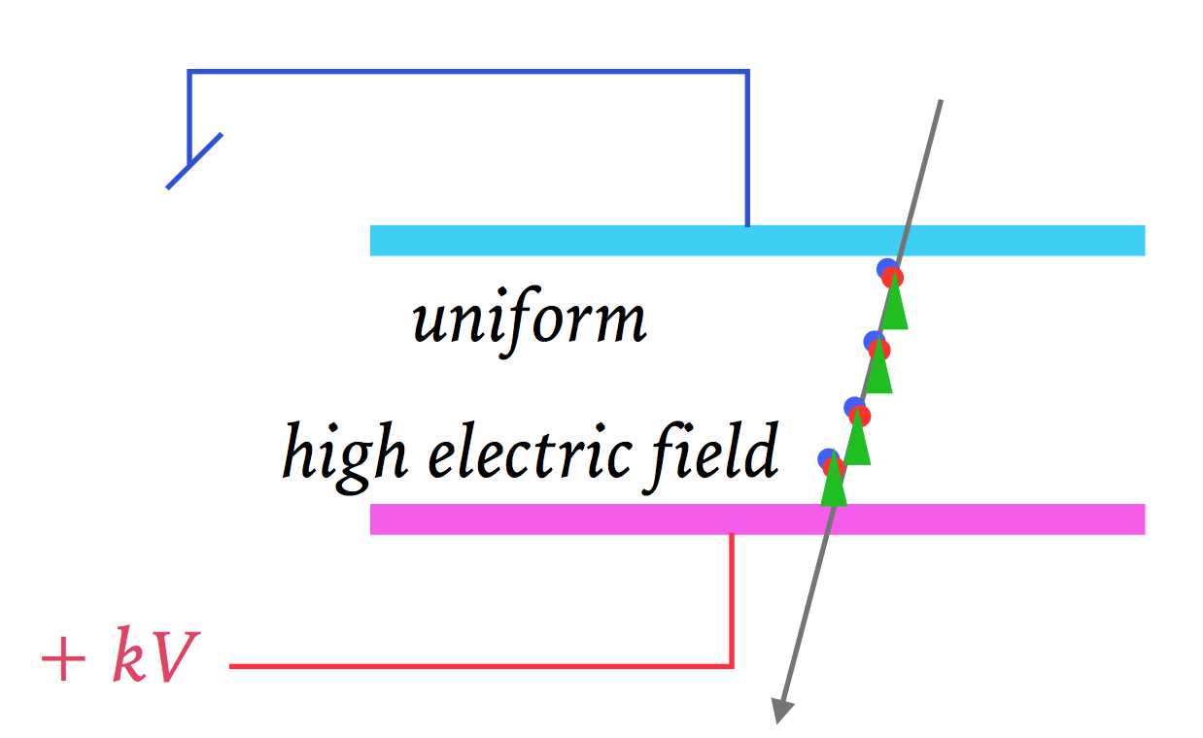
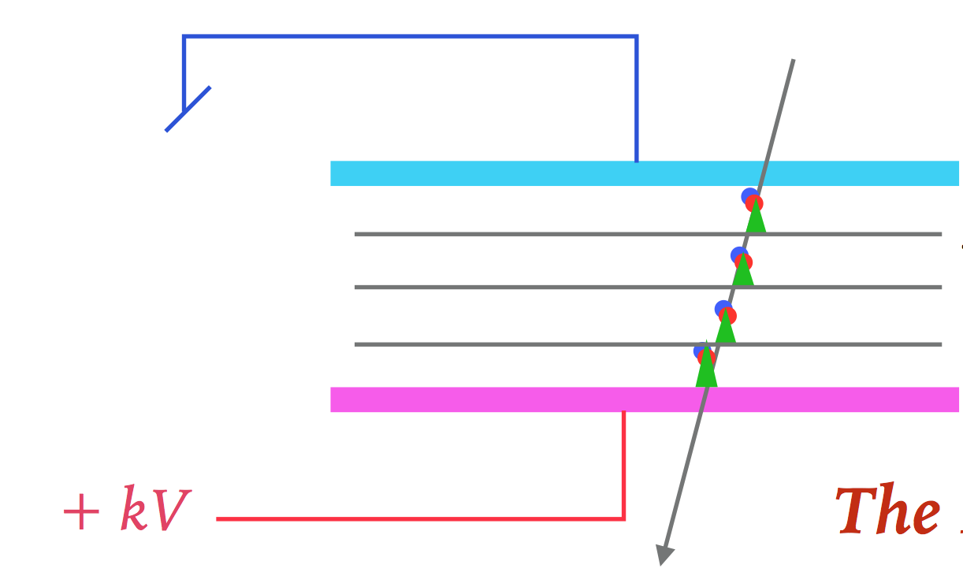
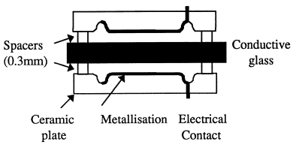
-Parallel/Resistive Plate Chambers
Single-gap
One electrode in metal and one resistive(glass) Pestov 1971
Two resistive electrodes (HPL) Santonico-Caldarelli 1981
Protection against sparks due to the “high” resistivity of the electrode
This leads to reduced rate capabilities (charge evacuation time)
Multigap
Several thin gas gaps. Thin plates in glass (Williams et al) in 1996.
tRPC: metal-glass RPC based on very thin gas gap proposed by
P. Fonte et al (1999)

Slide 4
Why (M)RPC are good for HEP?
Provide a very good detection tool in terms of spatial (a few mm down to a few hundreds of µm ) and more in time measurement precision
Provide an excellent detection tool for time measurement (resolutions less than a few ns for RPC and down to tens of ps for MRPC (< 80 ps in Alice ToF)).
Provide large detection area (6000 m² for CMS and 7000 m² for Atlas) at low cost ( a few hundreds of CHF/m²)
Could be easily built using available materials (Bakelite, glass, ceramics)
The relatively large charge ( > tens of fC up to 100 pc) that (M)RPC provide, greatly simplifies the the readout electronics.
Due to these excellent features, (M) RPC have played an important role in HEP experiments.
More than 40 years after their invention, they are still being used but also proposed for future colliders.
(M)RPC have being improved since their invention and succeeded to succeeded to overcome many encountered problems.

Slide 5
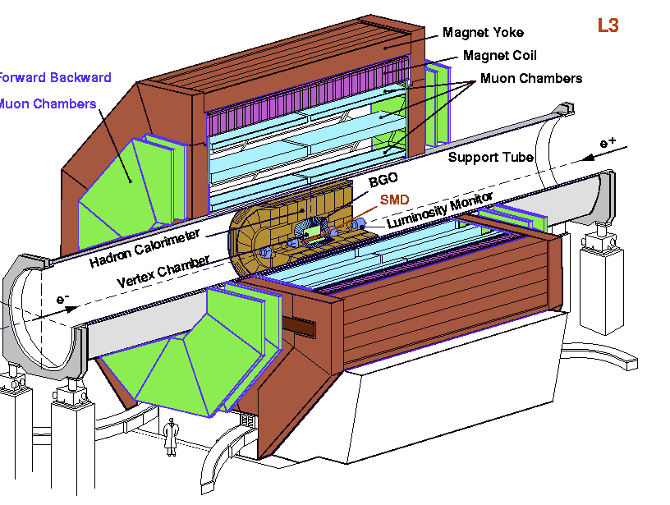
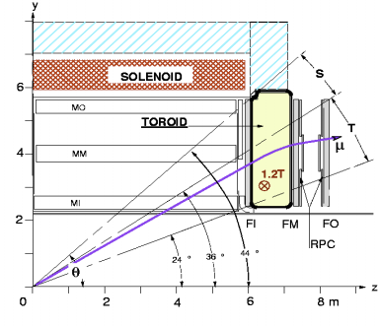
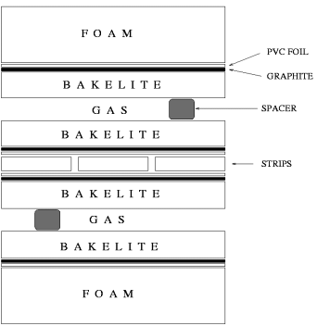
RPC@L3
The first large HEP experiment that used RPC as a muon detector and included them into its Trigger system was L3, one of the 4 LEP experiments (ALEPH, DELPHI, L3, OPAL).
Total of 192 bi-gap (300 m2) RPC, 6144 strip channels, 768 TDC channels
2mm gas gap between two electrodes of 2 mm each made of HPL (ρ =2.10¹¹ Ω cm)
The RPC were operated in streamer mode ( high charge no need for amplifier)
(94-95): Ar (58%), Iso (38%), Freon/CF3Br (4%)
(96-00): Ar (59%), Iso (35%), Tetrafluoroethane (6%)

Slide 6
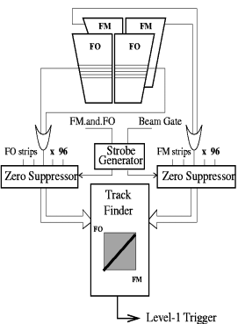
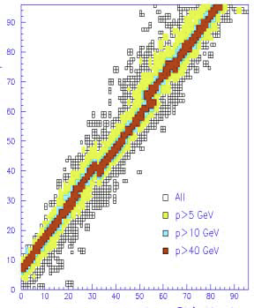
RPC@L3
L3 RPC-trigger scheme
96 x 96 strips of the two RPC layers
Muons from vertex fire few strips
The number of width indicate their momenta
Trigger time: 1.5 µs
Trigger rate O(1) Hz

Slide 7
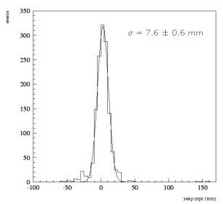
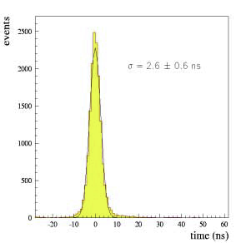
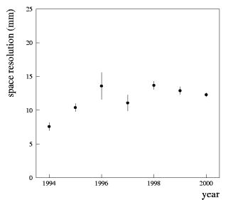
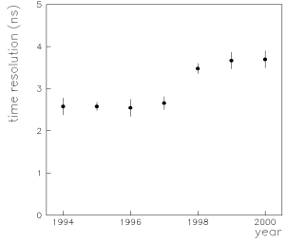
L3 RPC spatial resolution
L3 RPC time resolution

Slide 8
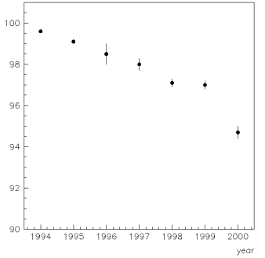
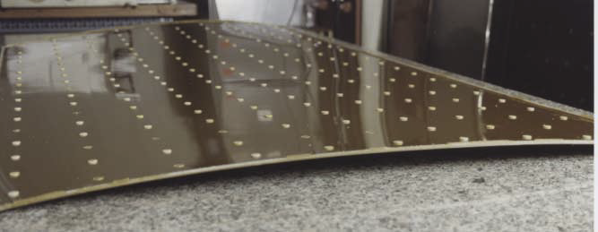

RPC@L3
Global efficiency
But no other big issues were found
Efficiency drop explained:
Gas leak
Electronics failure
Impact of gas change (HV working point)
Some hardware related issues like mechanical stress

Slide 9
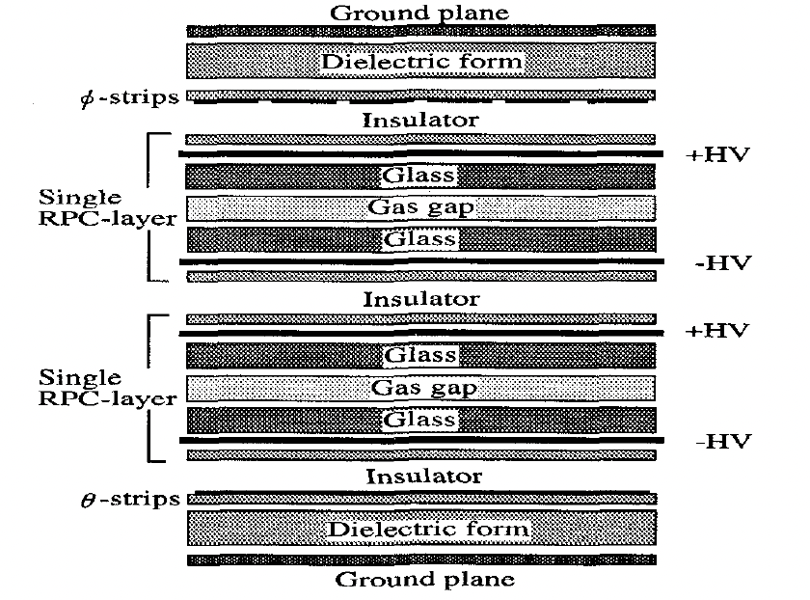
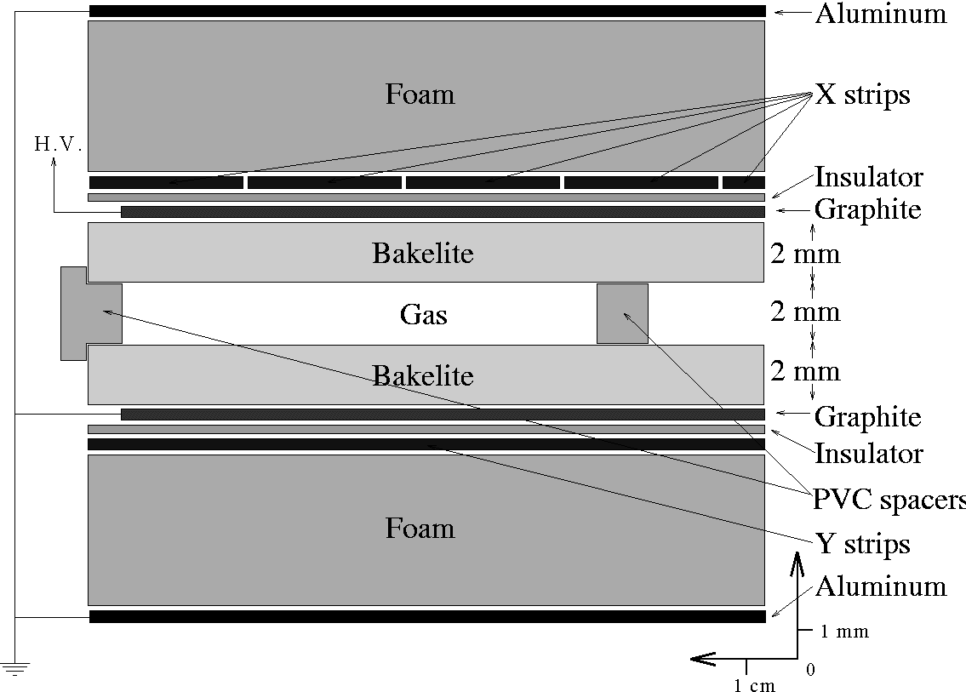
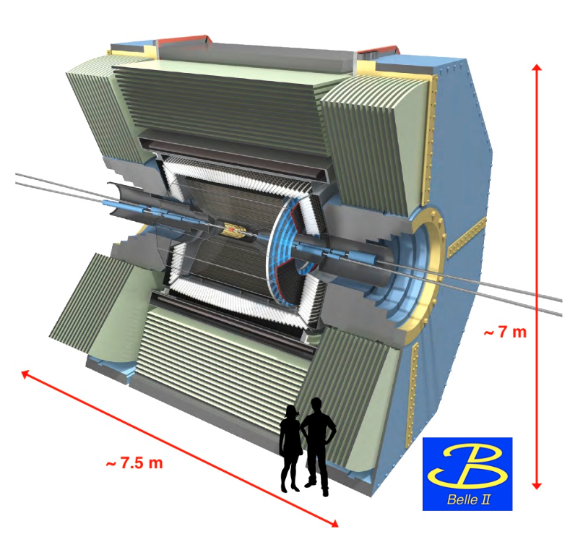
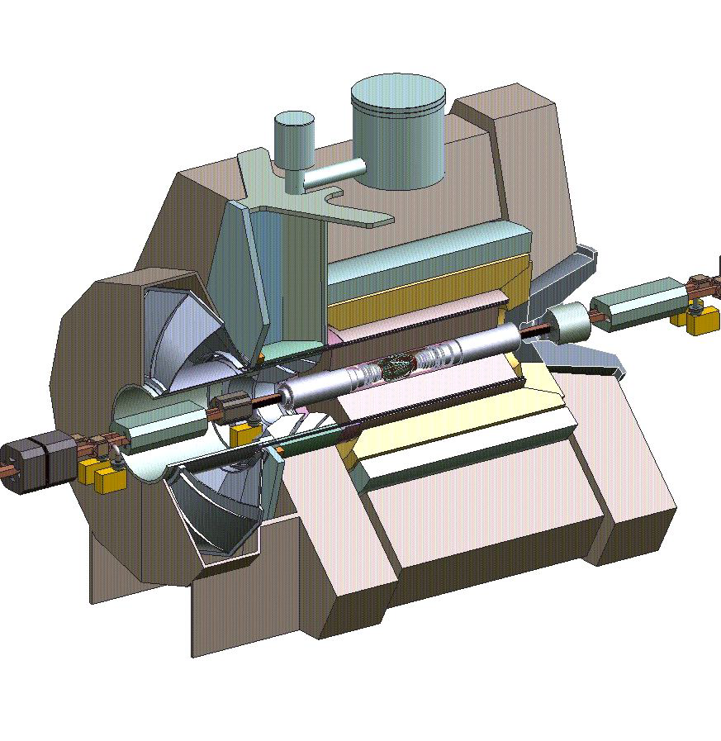
RPC@BaBar&Belle
Two b-factory experiments (e⁺ e⁻) that were built to study b physics and more generally the CKM quark matrix
Both used RPC as muon detectors
BaBar opted for HPL-based RPC, Belle selected glass-based ones
Both operated RPC in the streamer mode
Both have met some problems operating the RPC
2-gap GRPC
1-gap RPC
RPC
RPC
Few thousands of m² in each

Slide 10
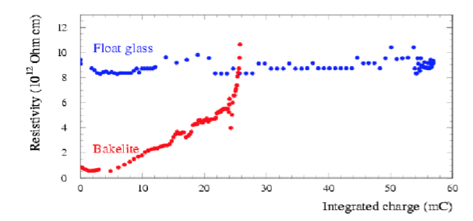
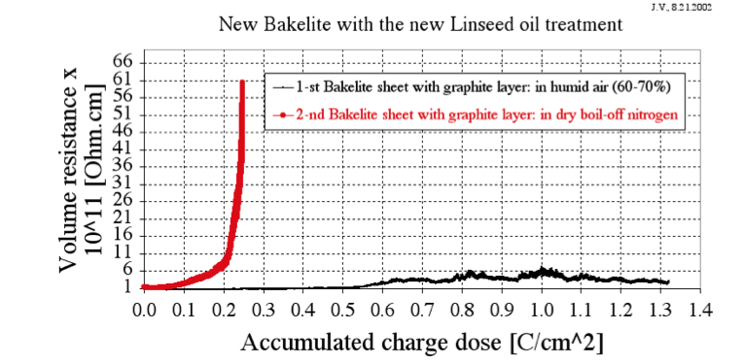
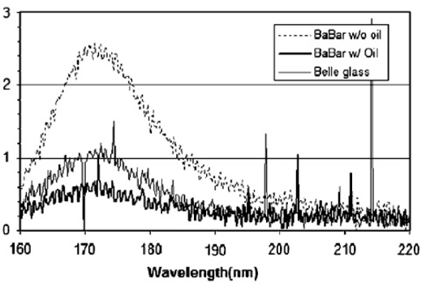
RPC@BaBar&Belle
HPL surface quality is not perfect. To avoid point-related discharges, Linseed oil was proposed to varnish the surface and render it smoother. It also better protect again UV.
HPL resistivity increases with time. Wet gas mixture (about 50% humidity) was found to maintain the initial HPL resistivity.
Glass has a much smoother surface but it is fragile and has 1 to 2 orders of magnitude of higher resistivity than HPL leading to lower rate capabilities.
Glass is more prone to HF attack in presence of humidity in the gas and therefore humidity is prohibited.
C.Lu NIMA 602 761-765
A.Tonazzo, IEEE2002

Slide 11
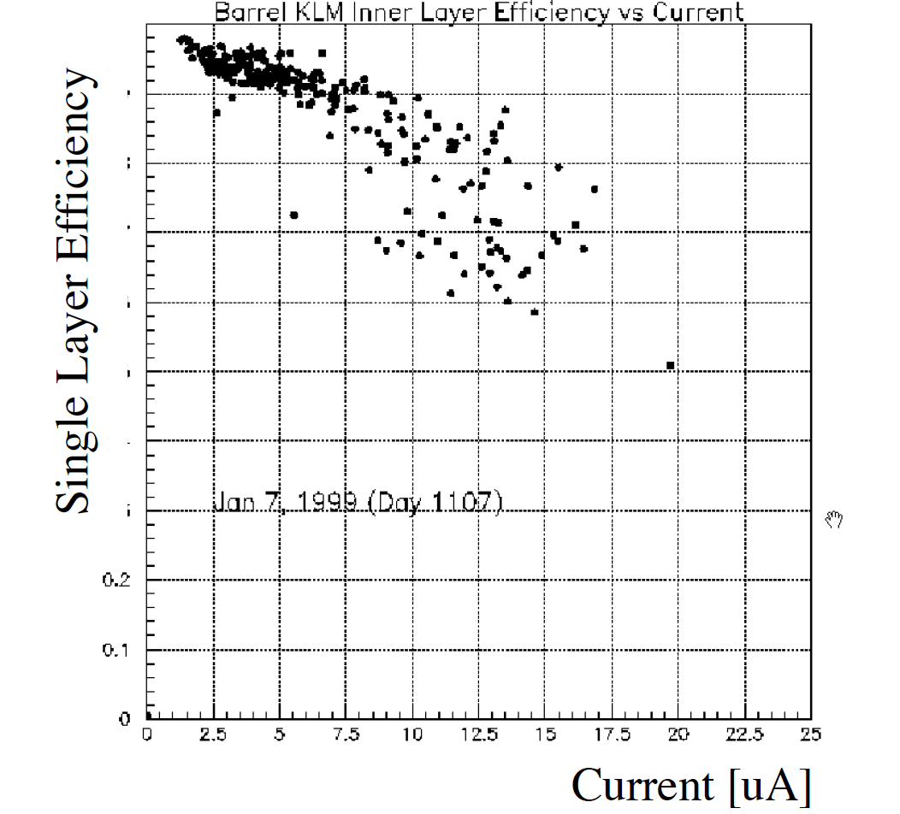
Belle RPC issue
The problem of high dark current appears a few months after the installation with a drop of efficiency
The problem was traced to the presence of water vapor in the gaps. The vapor came from the gas plastic tubes
The tubes were replaced by copper one and after a purge with ammoniac the RPC retrieved their excellent behavior after

Slide 12
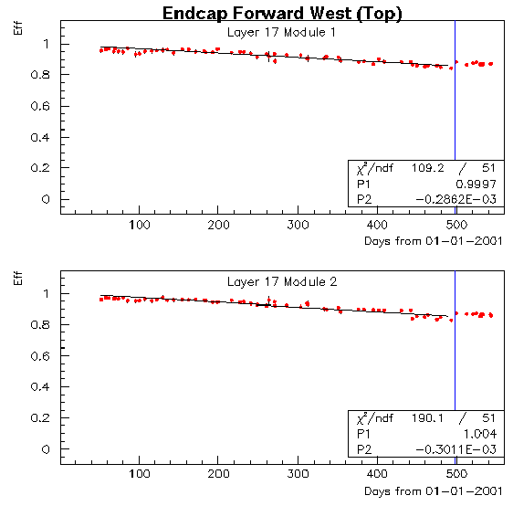
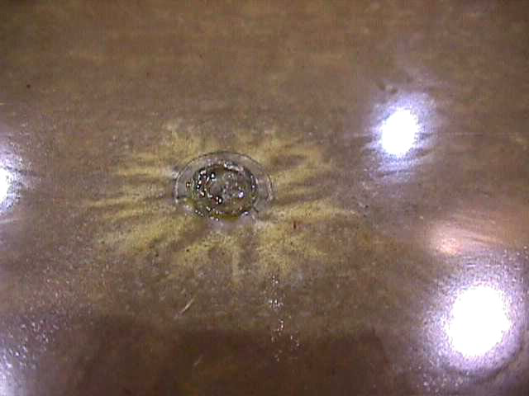
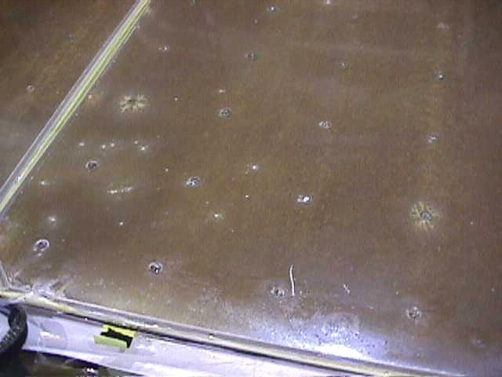
BaBar RPC issue
Continuous loss of efficiency in RPCs placed in the higher particle rate region (a few Hz/cm²)
Oiling method (one layer with bad polmyrisation) was found to be the cause. Replacing the solvent used with the Linseed was shown to improve the quality.
In addition, the oil resistivity was found to decrease while this of the Bakelite increased with time leading to efficiency drop → Using water vapor fixed the problem.
BaBar RPC were operated in the streamer mode ((48:4:48) argon, isobutane and forane (C2H2F4))

Slide 13
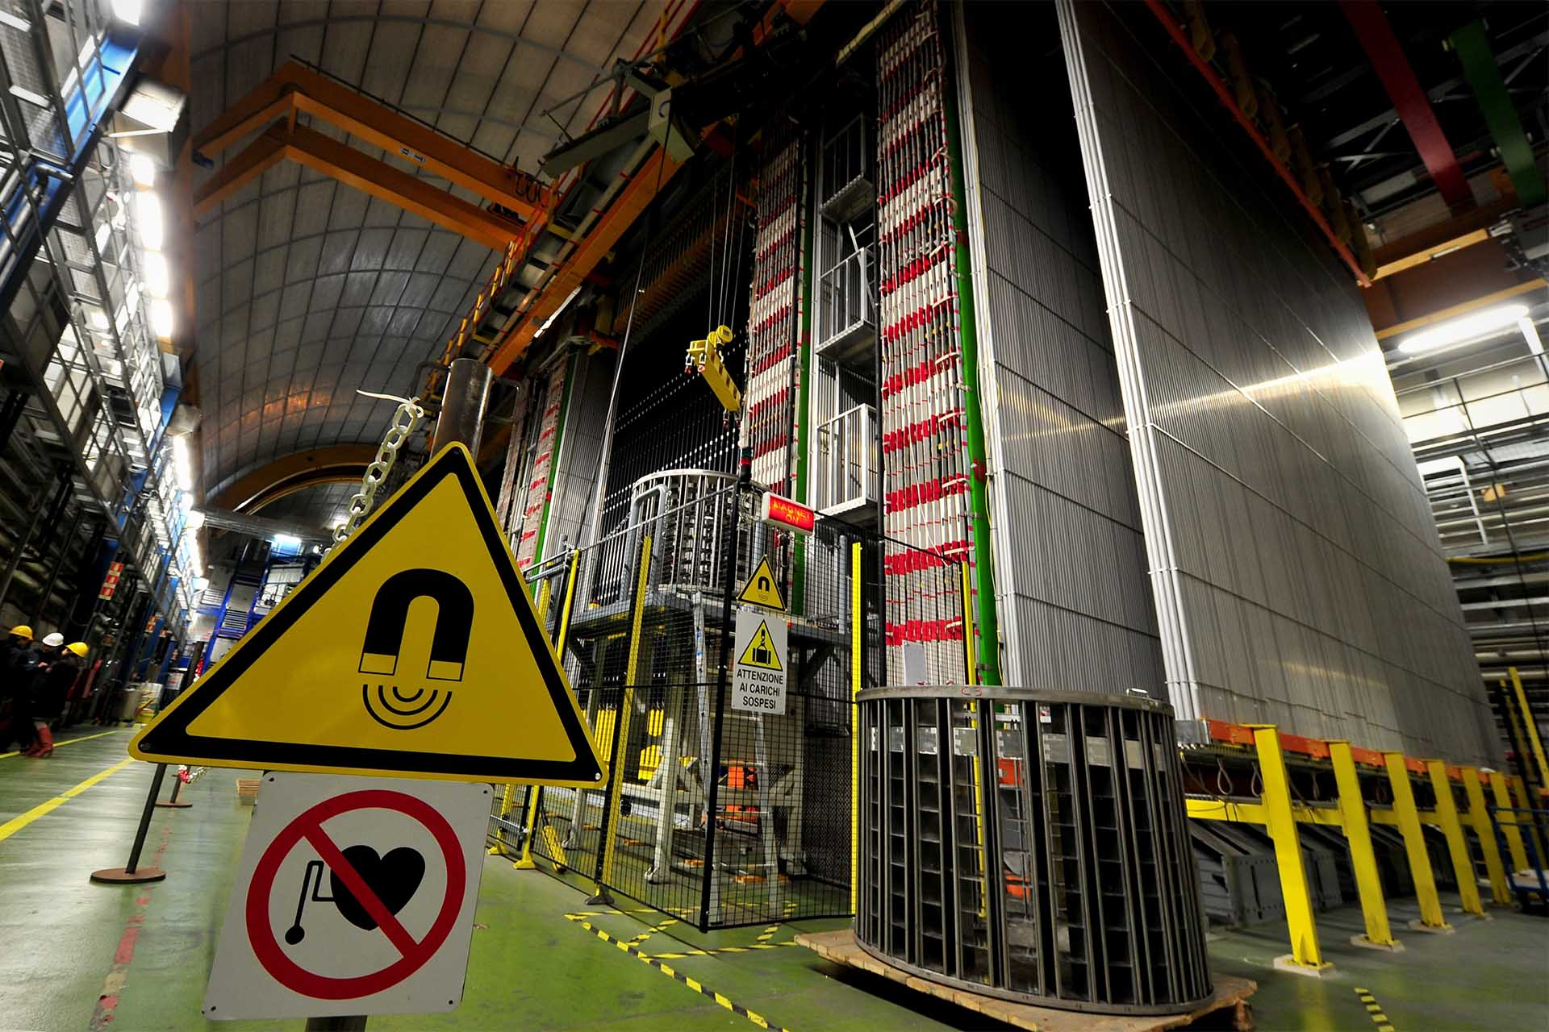
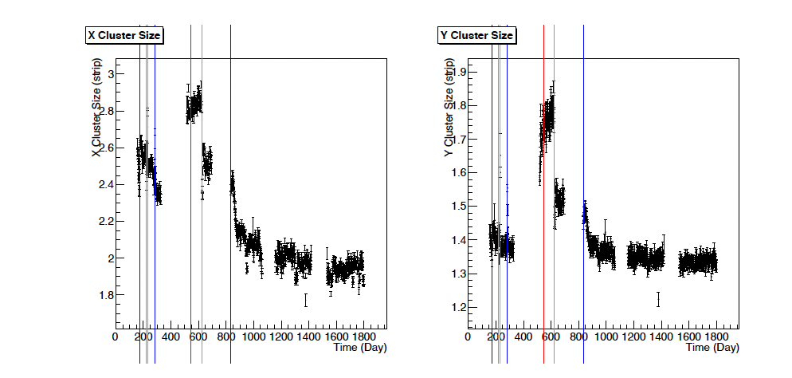
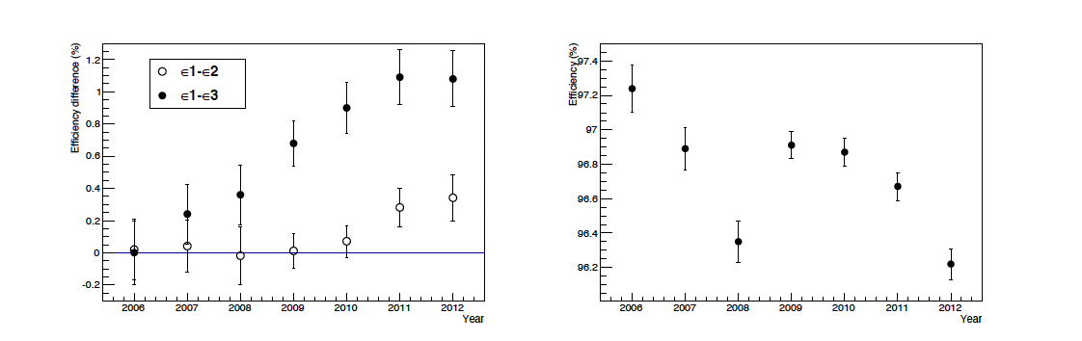
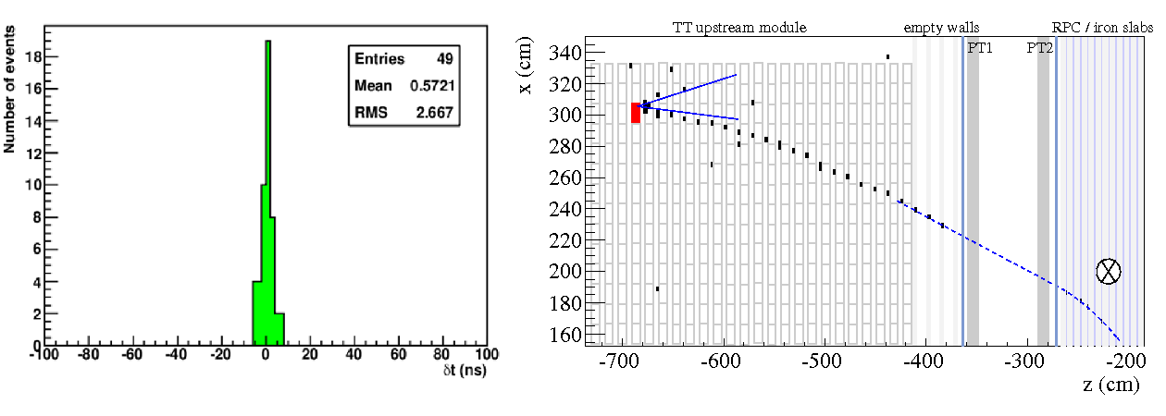
RPC@OPERA
OPERA was a long baseline oscillation experiment that was conceived to demonstrate the oscillation of ν_{m}→ν_{t}
with the appearance of a tau.
The experiment was placed in GranSasso.
The main detector was Emulsion Cloud Chambers (ECC) but
RPC were used in muon spectrometer (iron dipole magnet) with the goal to construct the muons issue from neutrino interactions
3000 m² of HPL-based single gap RPC were built and read out using x-y strips (except two (XPC) with U-V to eliminate ambiguities)
Time measurement using TDC performed on XCP and 7 of the 22 RPC of each module.
SF6 was added to the gas mixture for the first time
Ar/C2H2F4/i−C4H10/SF6 with volume ratios 75.4/20.0/4.0/0.6

Slide 14
RPC@LHC
The problems encountered at BaBar have led to huge efforts to make the RPC that were proposed for LHC experiment to be as robust as possible.
Two important improvements were made and allowed the success of RPC in ATLAS, CMS and ALICE
Oiling process of HPL-based RPC modified
Streamer→ Avalanche mode

Slide 15
Streamer versus avalanche mode
ATLAS Muon TDR
Avalanche signal
Streamer signal
The average charge produced in Streamer mode is much higher than the one in Avalanche mode. A few hundreds pC to be compared to few tens pC.
CMS&ATLAS were first to adopt the avalanche mode before to be joined by ALICE later on

Slide 16
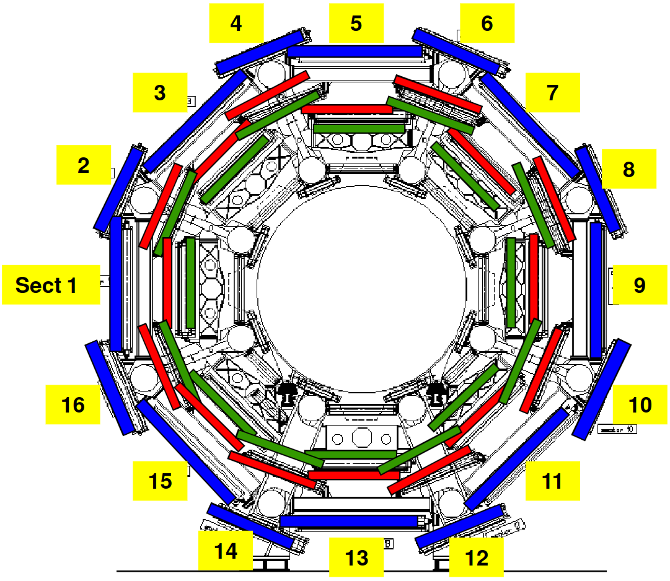
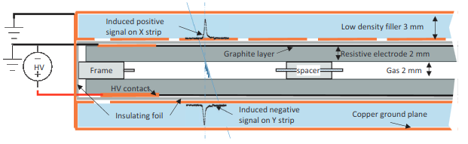
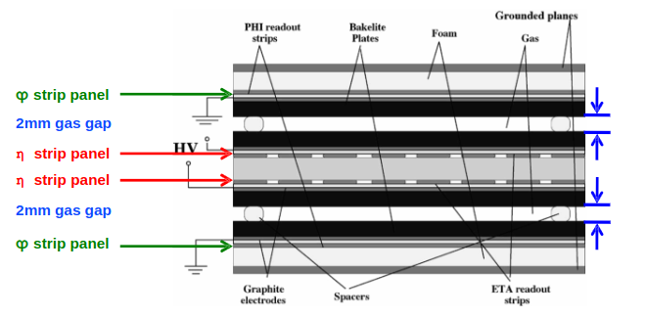
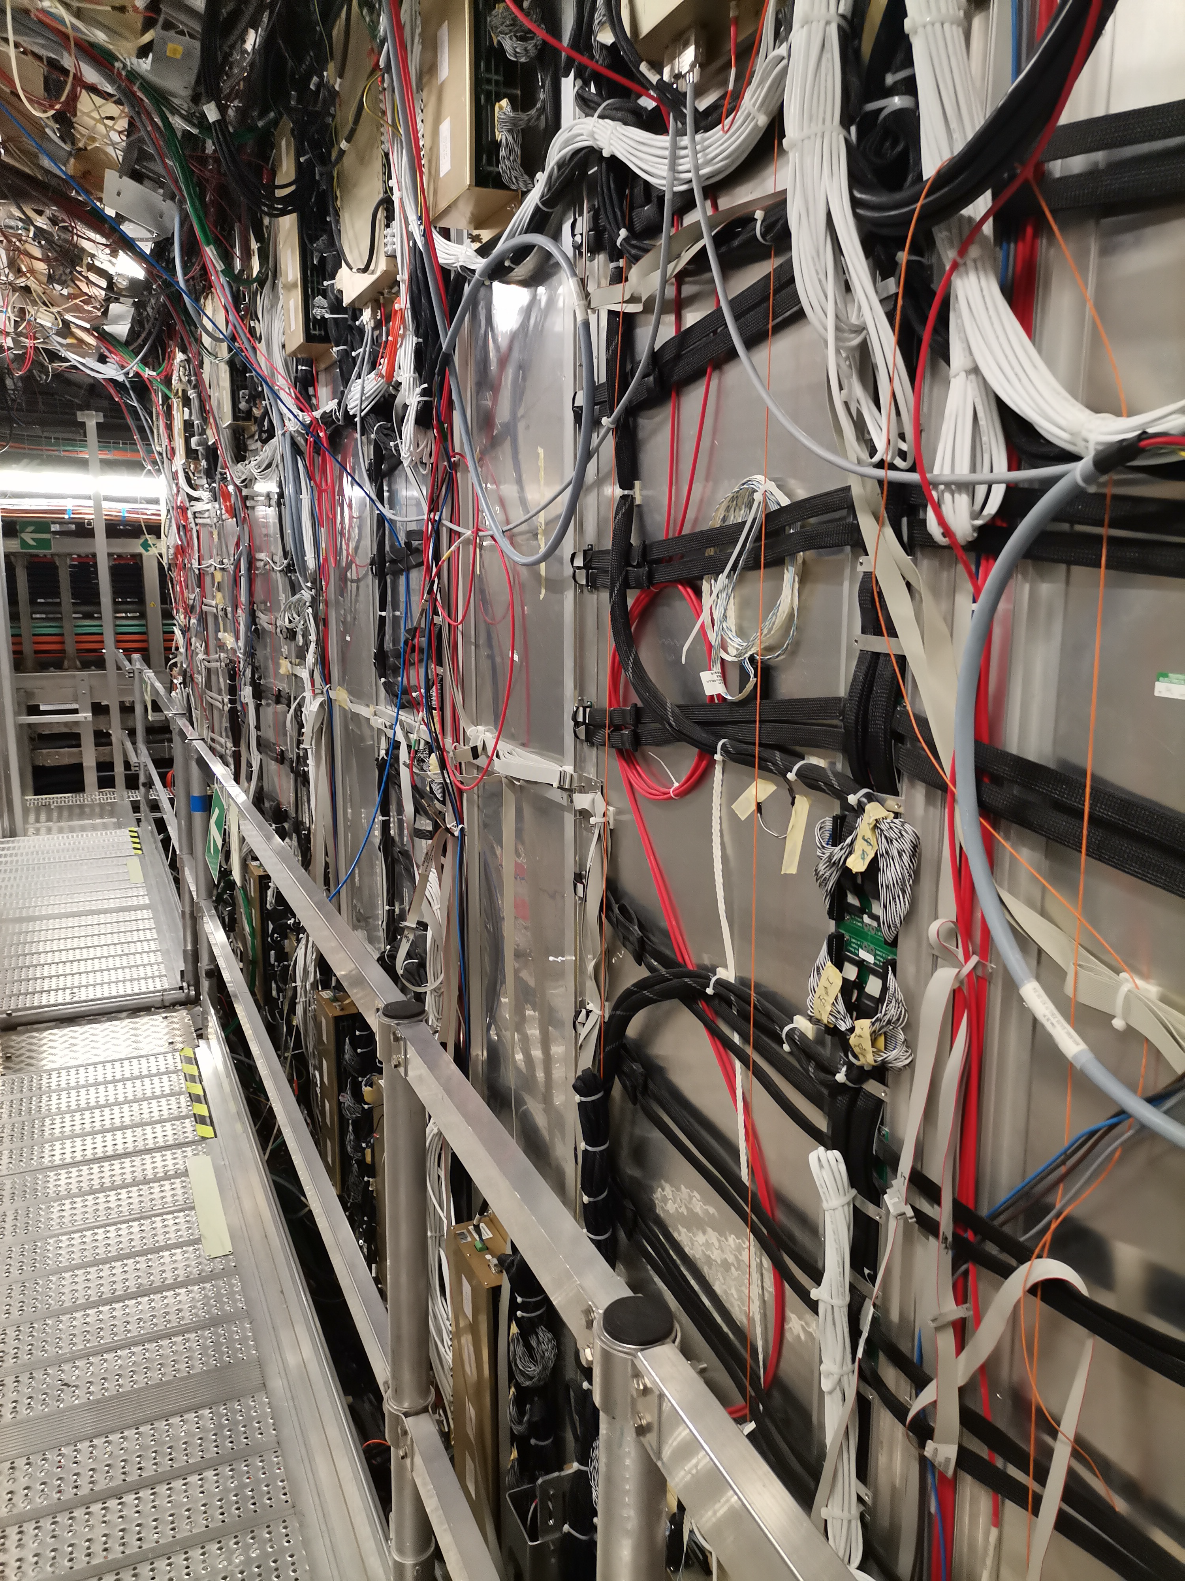
RPC@ATLAS
Single gap with pickup strips on both sides
(two orientations to determine x and y)
About 7000 m² operated in avalanche mode using the following gas mixture
C2H4F4 94.7%, C4H10 5%, SF6 0.3%
which is referred to as the standard gas mixture

Slide 17
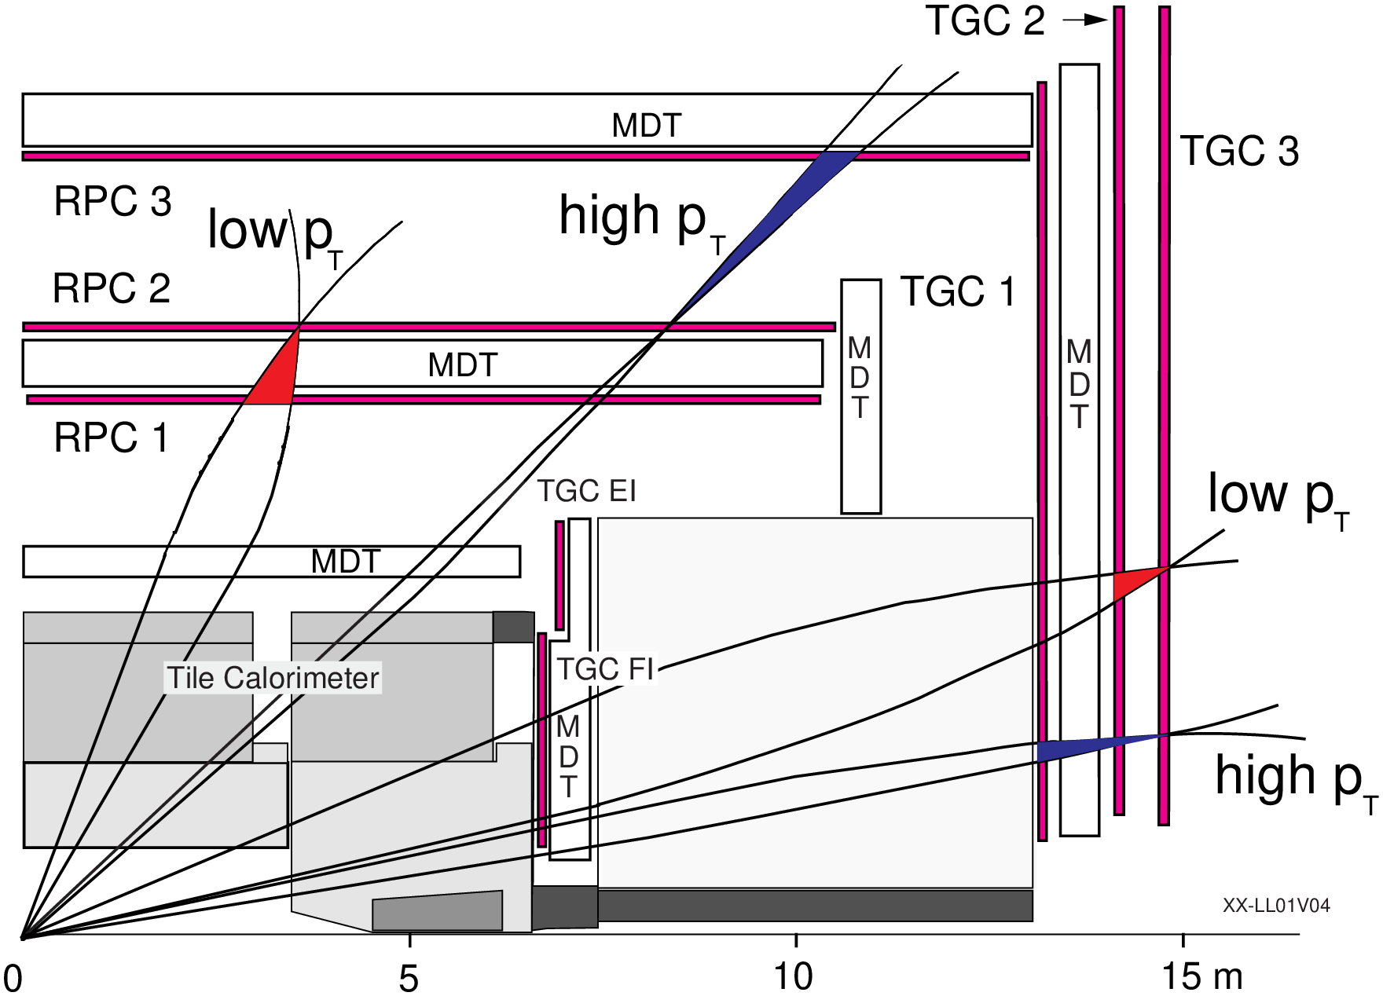
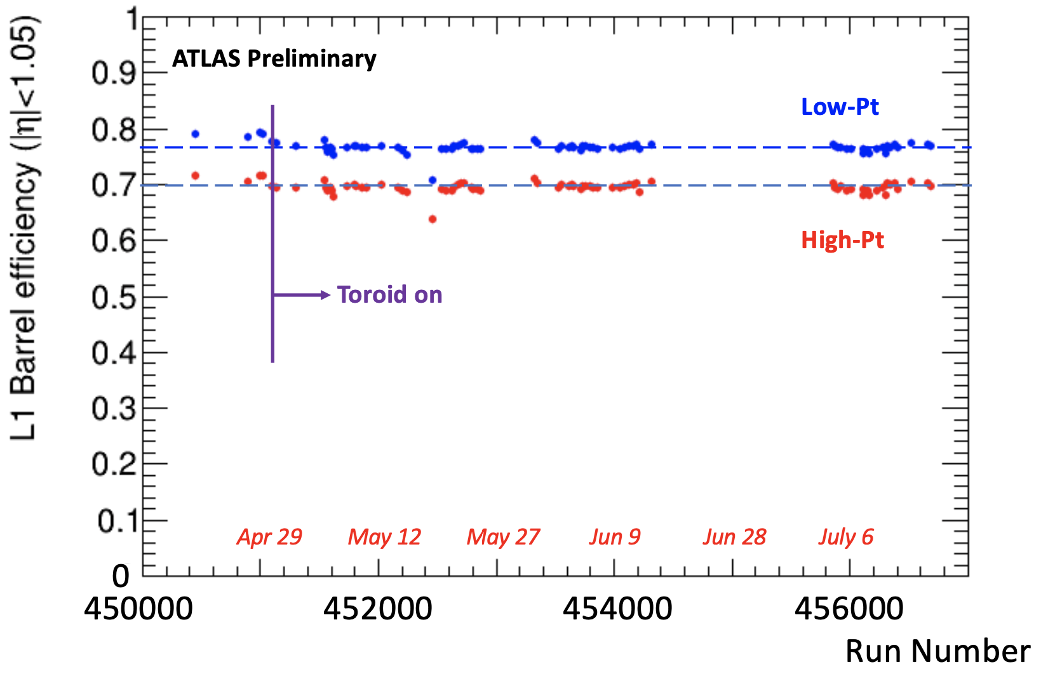
RPC@ATLAS
RPC is an important detector in ATLS for muon detection and for the ATLS trigger (LV1)
Low-pT trigger: RPC2 & RPC1 (3/4)
High-pT trigger: Low-pT & RPC3
Trigger was modified in 2023 (2/4) to take
into account the drop of a few RPC chambers due to HV /leak problems
2023

Slide 18
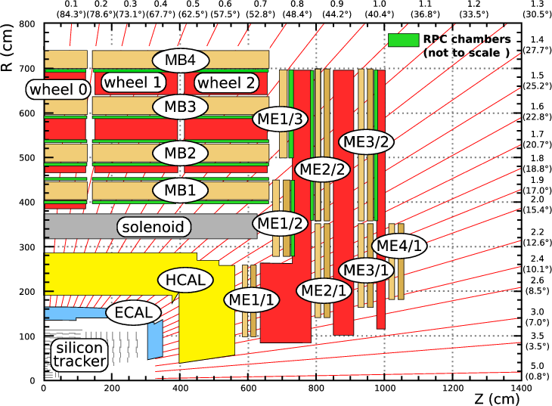
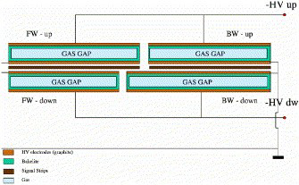
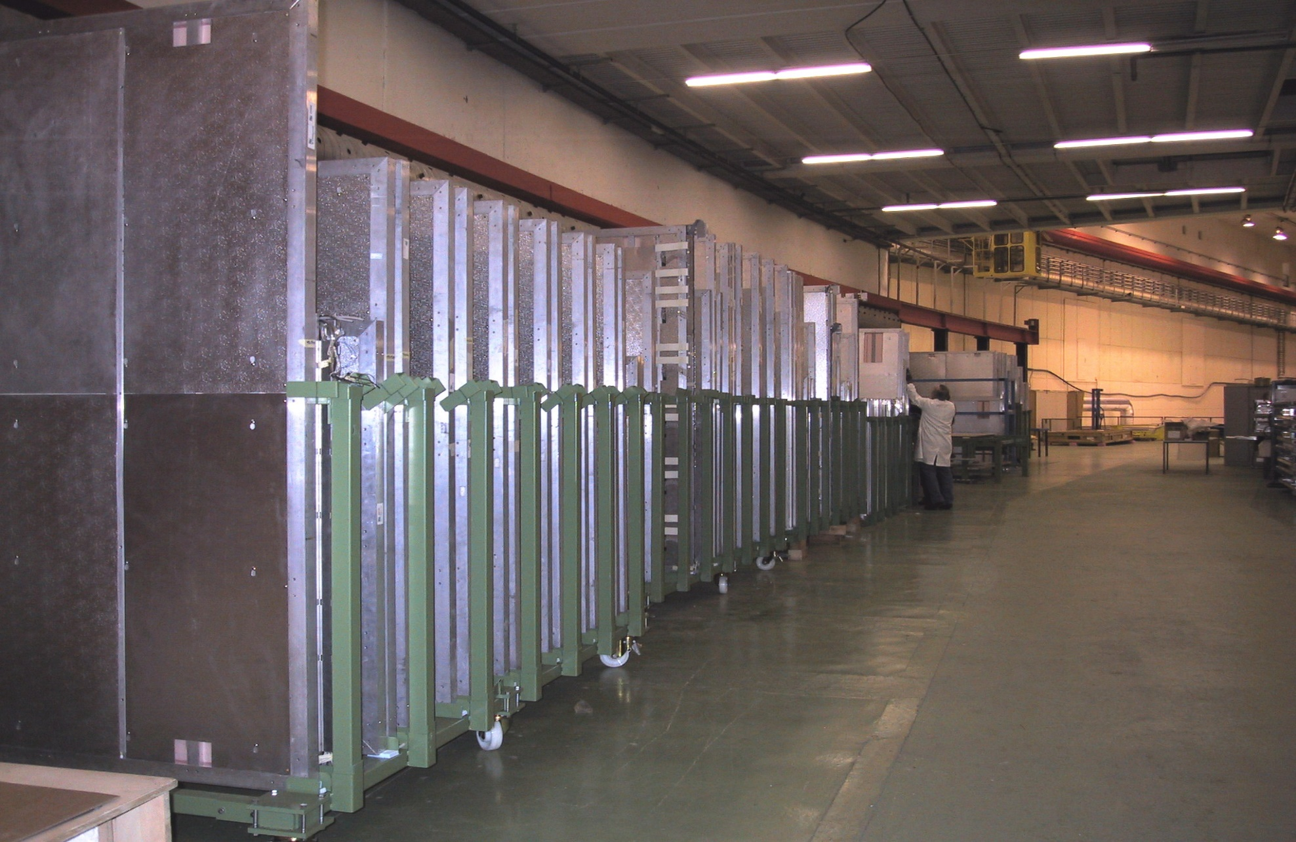
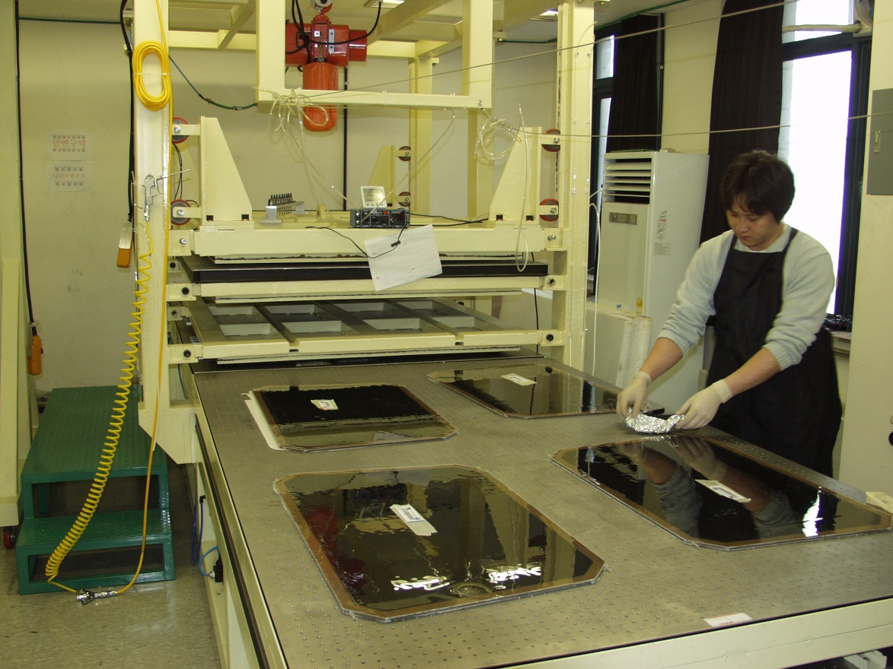
RPC@CMS
RPC are built with two gaps separated by pickup strip panels in between in one direction; They are used in the CMS muon system in both barrel and endcaps (6000 m²)
The structure of the CMS gaps is similar to those of ATLAS
PET layer
Graphite painting
2mm Bak.
2mm gas gap
2mm Bak.
Graphite painting
PET layer

Slide 19
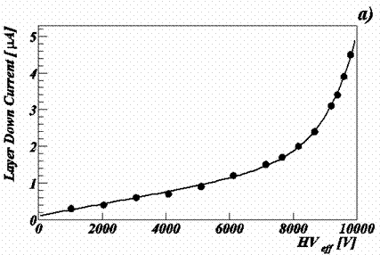
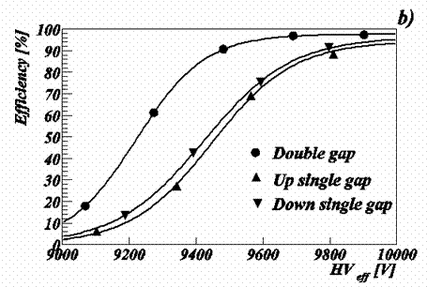
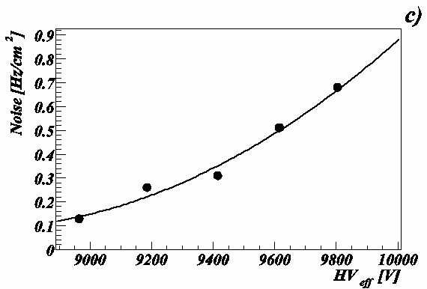
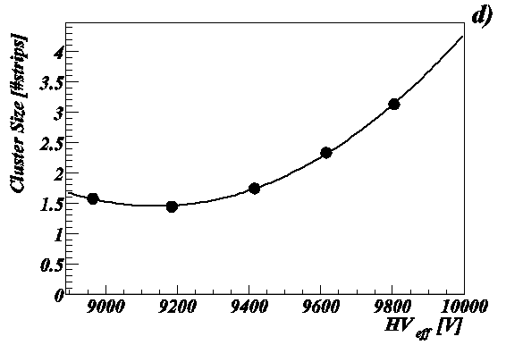
RPC@CMS
Double-gap CMS RPC allows reaching full efficiency at HV between 9.4 and 9.8 kV

Slide 20
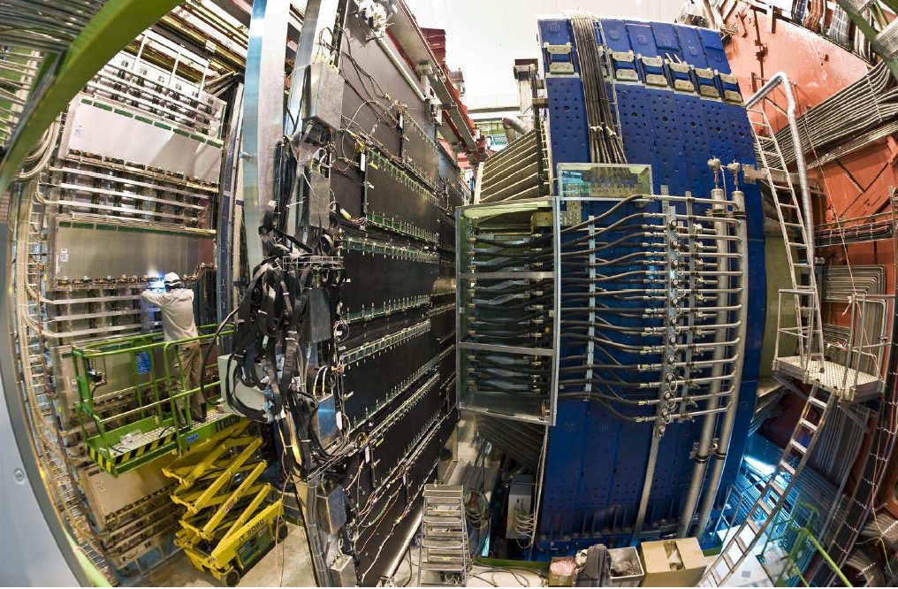
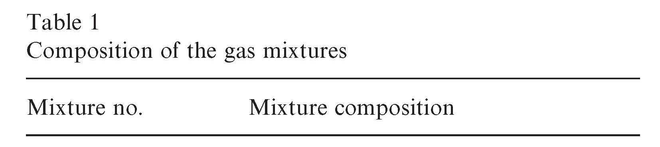
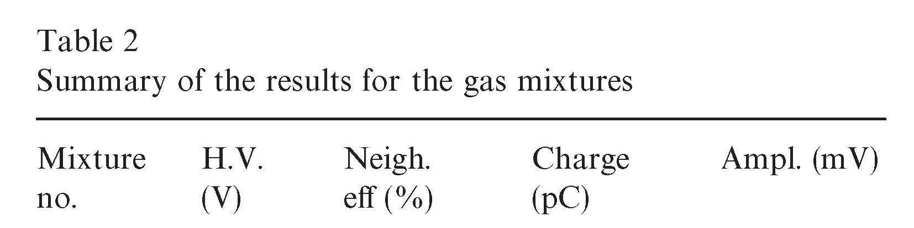
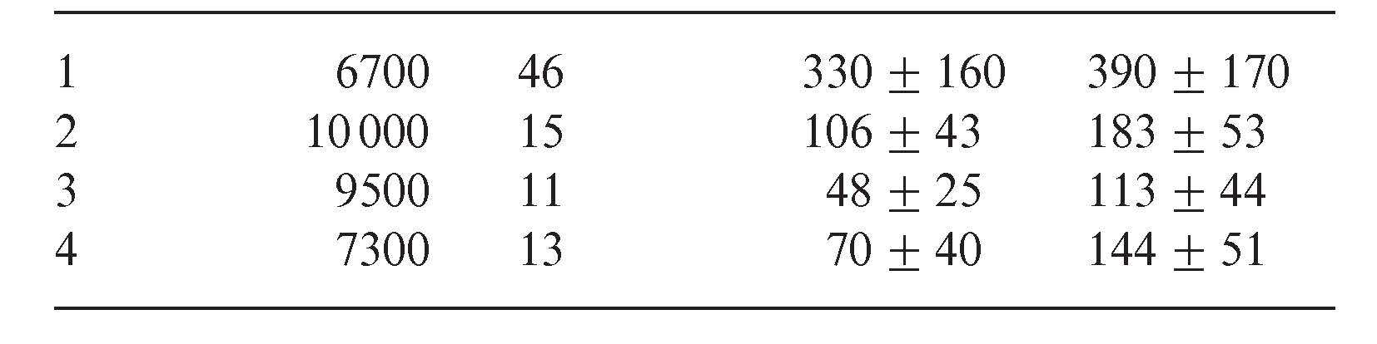
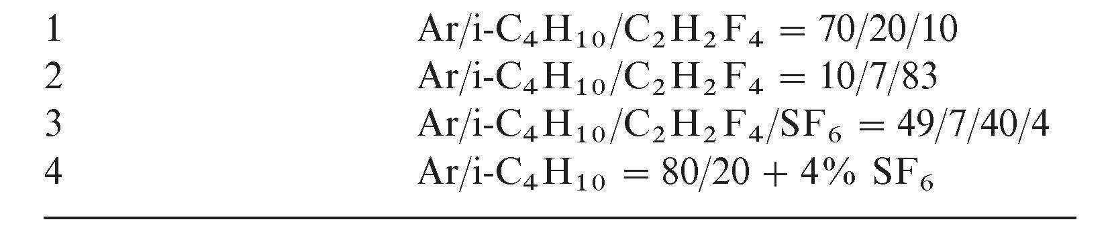
RPC@ALICE
ALICE is one of the 4 LHC experiments that is dedicated to the
study of quark-gluon plasma.
RPC are used for muon detection (J/ψ) decay and
spectrometer trigger
The highest expected rate was of 50 Hz/cm²
-> this justified why to operate RPC in streamer mode
ALICE RPC groups proposed to use SF6 (used in insulation and
quenching of electric arcs) to lower the charge of the streamer > This was then adopted by the other experiments even in the avalanche mode

Slide 21
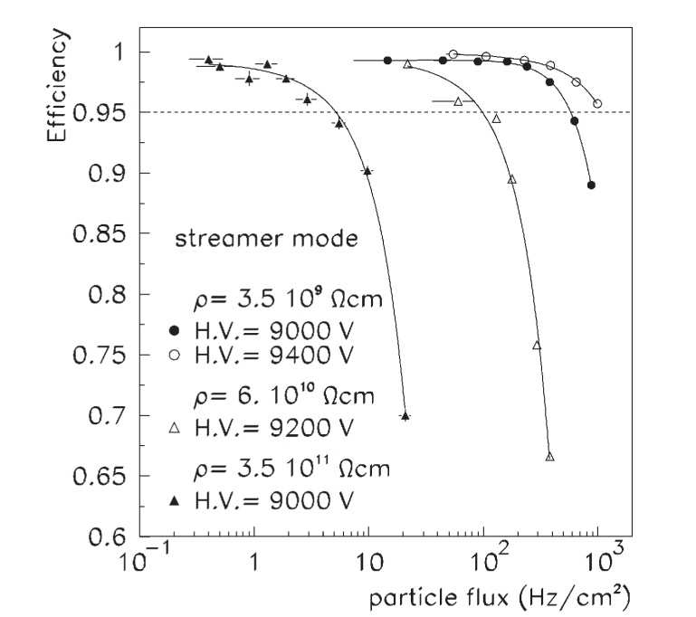

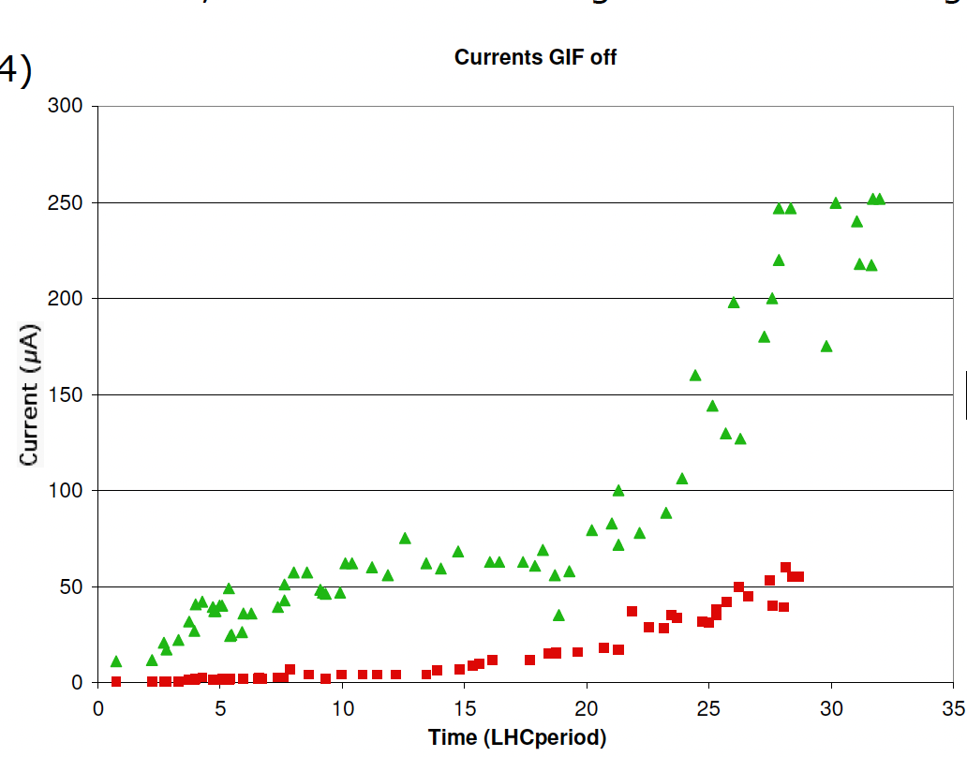
RPC@ALICE
ALICE was the first to propose low resistivity material
such that phenolic Bakelite 3.5 10⁹ Ω.cm
(10¹⁰ -10¹² Ω.cm for “common” Bakelite)
to increase the RPC rate capability
Oiling process with two thin oil layers rather
than one was found to protect RPC against damage caused by HF.
Having a third oil layer did not bring further improvement.

Slide 22

RPC&HL-LHC
CMS & ATLAS have decided to upgrade their RPC systems to improve its performances and to cope with the high rate expected at the high η region as well as the pileup of about 200
Atlas will add 306 RPC detectors (472 m²) in the BI region
Increasing the trigger acceptance from 78% to 92-96% and improving on the time resolution (0.4 ns for the new RPC using new electronics)
New RPC are triplets
Each RPC is made of 3 singlets
Each singlet is 1mm gas gap
Each singlet is readout by two strip panels in η direction
The triplets are placed in a Faraday cage

Slide 23





RPC&HL-LHC
CMS will upgrade the present RPC system by replacing the BackEnd electronics to exploit the precise the time information of its RPC detectors
CMS will also equip two stations of the high η region of the Endcaps with
a new generation RPC (2/2/2 → 1.4/1.4/1.4) with new electronics
readout scheme
Delay line technique applied successfully to RPC leading to excellent spatial resolution by measuring the time difference
of the signal arrival on both ends
of η oriented strips
σΔT ~ 150 ps → ση ~ 1.5 cm

Slide 24



MRPC@ALICE
ALICE collaboration has adopted the MRPC as ToF detector to identify particles based on their time of flight.
They are placed 3.7 m from the IP
The MRPC are 2x5-gap (250 µm each) with 400/550 µm internal/external glass plates
There are 1638 MRPC of 120 cm x7.5 cm each→ 150 m²
The MRPC read out in a differential way to reduce the jitters and improve the timing
18 super modules

Slide 25




MRPC
Better time resolution
Less charge and thus higher rate
Harp (study of hadron production) at CERN was the first to use them

Slide 26





MRPC@ALICE
MRPC were also successfully used in nuclear physics experiments (HADES)
They will also equip the ToF wall of the CBM@Fair using new resistive glass (10¹¹ Ω.cm) to reach high rate capabilities (> 50 kHz/cm²)

Slide 27










ToF@CBM
CBM will study the nuclear matter at large density to study:
partonic phases, chiral symmetry, hyper-nuclei production,
charm production and propagation in rich baryon matter
ToF detector is an essential one in the CBM.It will be made of
MRPC that can reach 80 ps (full system) time resolution
while withstanding very high rate at the center.
New doped glass was developed by Tsinghua University with ρ = 10¹⁰ Ω.cm
Peak Rate 10 MHz for Au+Au
8-10 gaps

Slide 28


RPC high rate detection capability
Rate capability of the RPC is related to the voltage drop in the resistive plate: ΔV = I R = q ρ d Φ
To have RPC with increased rate capability one should reduce:
  electrode resistivity ρ: as low as the RPC principle still stands (> 10⁹ Ωcm)
  → low-resistivity HPL or doped glass (Tsinghua glass)
  electrode thickness d: depends on electrode material
  easy for glass, possible for HPL
  produced charge q : depends on gas mixture and number of gaps
  The less the charge produced, faster the eviction : beneficial also for chamber aging but this necessitates to increase FE electronics sensitivity

Slide 29




(M)RPC for calorimetry
RPC were proposed to equip sampling HCAL for future collider experiments as a highly segmented active area (PFA-based calorimetry).
Two large prototypes (DHCAL/SDHCAL)were built and exposed to beam tests. The results show the powerful of RPC for such applications (high efficiency and high granularity with no spark issues)
The electronics readout system in both is embedded on RPC of 1m x 1m large and 3mm thick. In the SDHCAL multi-threshold readout was adopted

Slide 30





(M)RPC for calorimetry
MRPC are being proposed to replace RPC to exploit the time resolution they provide.
4 or 5 gap RPC are expected to provide better than 150 ps time resolution so they can be exploited to better separate close-by hadronic showers and discriminate the delayed neutrons
Without neutrons

Slide 31
Development trends for HEP (M)RPC
Replace greenhouse (TFE, SF6) gases by eco-friendly ones (HFO, NOVEC…)
Reduce leakage by adopting new structure (sealing,..etc)
Reduce the electrode resistivity to achieve higher rate
Reduce avalanche charge --> higher rate and less aging → develop new generation of electronics ( as for MPGD)
Increase uniformity → needed for better energy reconstruction in calorimeters and less uncertainties in timing

Slide 32
(M)RPC were, are and will be widely used in HEP experiments
They present excellent features and in particular their timing and cost-effectiveness
They are muon detectors, ToF detectors and active layers for HCAL
(M)RPC are also used in many no HEP applications such as muon tomography and medical applications but this requires another lecture in the future….

