Slide 1

EP-DT
Detector Technologies
Gas Systems for
Large Particle Detector systems
R. Guida
CERN EP-DT Gas Systems Team

Slide 2
Outline
Introduction
Large Gas Systems: the example of the LHC experiments
Gas systems description:
  Construction
  Building blocks
  Controls software
  Modules
Gas systems performances:
  Operation, maintenance, consolidations, upgrade, …
Conclusions

Slide 3
Large Gas Systems: the LHC approach
The basic function of the gas system is to mix the different gas components in the appropriate proportion and to distribute the mixture to the individual chambers.
31 gas systems (about 300 racks) delivering the required mixture to the particle detectors of all LHC experiments.
5: single pass gas systems; 14: closed loop gas system;
5: detector flushing systems; 7: gas recuperation systems.
LHC Point 1 ATLAS | LHC Point 2 ALICE | LHC Point 5 CMS | LHC Point 8 LHCb
MDT | CPV | CSC | MWPC
MM | HMPID | DT | RICH1
RPC | MCH | GEM | RICH2
TGC | MID | RPC | SciFi flushing
TRT | TOF | ID flushing | C₄F₁₀ recuperation
ID flushing | TPC | CF₄ recuperation | CF₄ recuperation
TRT CO₂ Cooling | TRD | R134a recuperation | UT flushing
nC₅H₁₂ recuperation | Xe recuperation
Xe recuperation
Gas mixture is the sensitive medium where the charge multiplication is producing the signal.
Correct and stable mixture composition are basic requirements for good and stable long-term operation of all detectors.

Slide 4
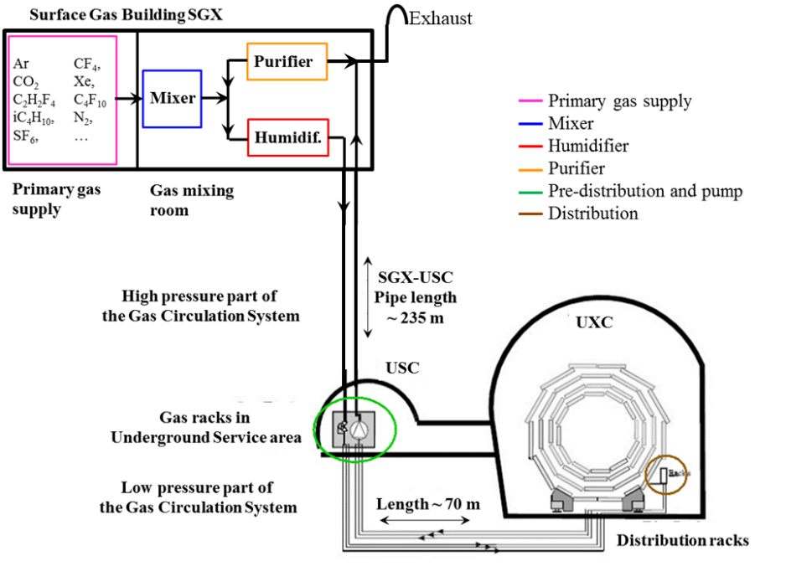
Gas systems for LHC experiments
Gas systems extend from the surface building to service balcony on the experiment following a route few hundred meters long.
Primary gas supply point is located in surface building
Gas system distributed in three levels:
  Surface (SG)
  Gas Service room (USC)
  experimental cavern (UXC)
Large detector volume (from m³ to several 100 m³) and
use of expensive gas components:
→
The majority is operated in closed loop gas circulation with a recirculation fraction higher than 90-95 %.
The gas systems were built according to a common standard allowing minimization of manpower and costs for maintenance and operation.

Slide 5
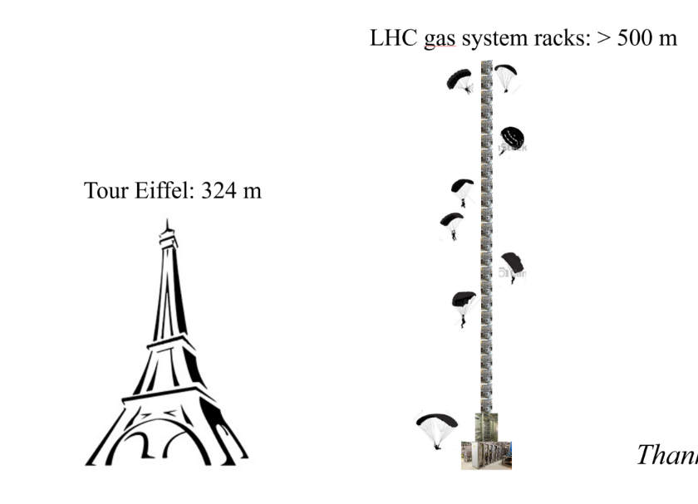
Gas systems for LHC experiments
Reliability
  LHC experiments are operational 24/24 7/7
  Gas systems must be available all time
Automation
  Large and complex infrastructure
  Resources for operation
  Repeatability of conditions.
Stability
  Detector performance are strictly related with stable conditions (mixture composition, pressures, flows, …)
Few numbers:
Construction started in 2000
Operational since 2005-2006
30 gas systems detectors at the LHC experiments
300 Universal Euroracks → x2 height of Eiffel Tower
60 PLCs
150 MFCs
4000 flow meters in distribution racks
~ 70 gas analyzers and 6 gas chromatographers
Per gas system:
  ~ 2-3 km pipes
  > 1000 connectors and 500 welds
  ~ 40 Pressure sensors
  ~ 10 Regulation valves
  < 0.1 l/day leak rate
Team: EP-DT Gas Systems project and BE-ICS

Slide 6
Requirements and Quality Assurance
Gas systems (as detectors) are subject to severe requirements on material & gas for safe detector operation:
Mainly (if needed only) stainless steel pipe and components
Need to validate the gas system components (ageing test setup)
Documentation for QA and easy operation/maintenance follow up
Monitoring of gas system operation
Monitor of supply gases and mixture composition
Evaluation of operational cost
Flexible design to accommodate detector requirements/upgrades
Careful evaluation of
  resources for operation
  resources for maintenance activity
  Stability required
  Balance requirements vs safety (as much as possible)

Slide 7
Gas system layouts: 1 - open mode
Basic gas system: Open mode operation
Gas mixture prepared and sent to the detector.
  → advantages: very simple to build and operate. No particular need of monitoring impurities.
  disadvantage: mixture is vented after being used, i.e. potential source of high gas consumption and high emissions
GAS MIXER
DETECTOR
EXHAUST
High gas consumption for a large detector system of several m3 can implies quickly not sustainable costs:
Mixture cost can range from 1 CHF/m3 (Ar/CO2) to more than 100 CHF/m3 (Ar/CO2/CF4).
RPC mixture is exactly in the middle (about 50 CHF/m3).
Typical flow 10 m3/h for about 300 days/year
Gas cost can range from 72 kCHF (Ar/CO2) up to 7.2 MCHF for (Ar/CO2/CF4)
In addition, sometimes: use of greenhouse gases
  Open mode cannot be the solution

Slide 8
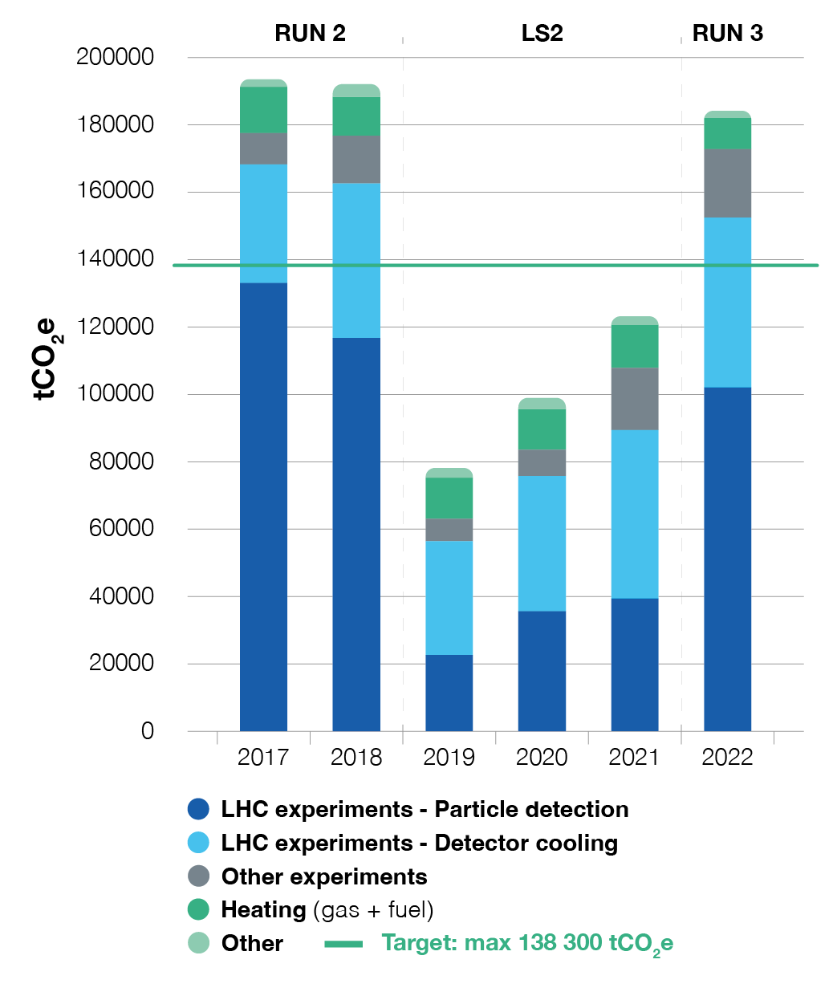
F-gas emissions
CERN Environment Report 2019-2020
2021: CERN’s Year of Environmental Awareness.
CERN Environment workshop: 12 and 13 October 2022
CERN Environment Report 2021-2022
CERN and the Environment Town Hall (2024, Nov. 8th)
Emissions from particle detection
Horizon 2025:
Target emission by end of Run3:
-28% wrt 2018 (end Run2)
Horizon 2030:
-50% wrt 2018 (end Run2)

Slide 9
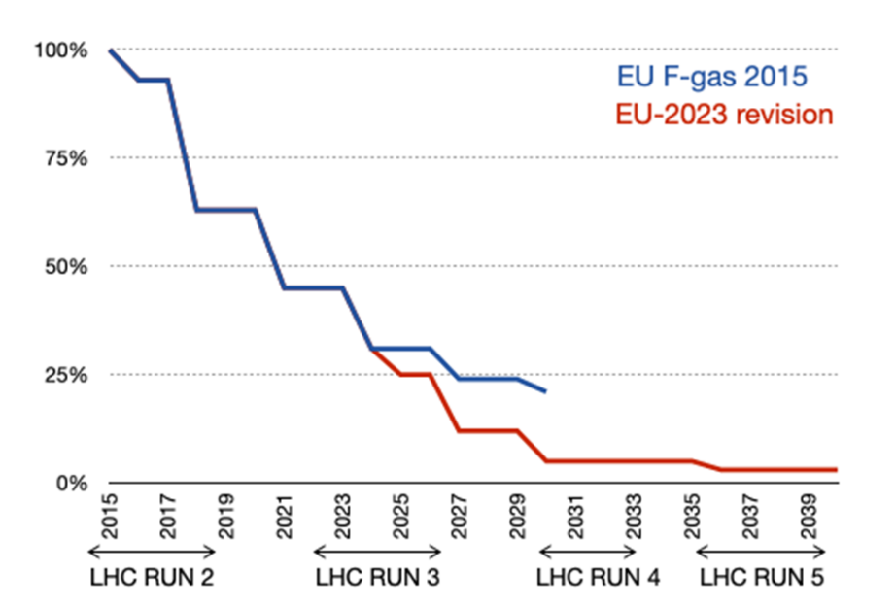
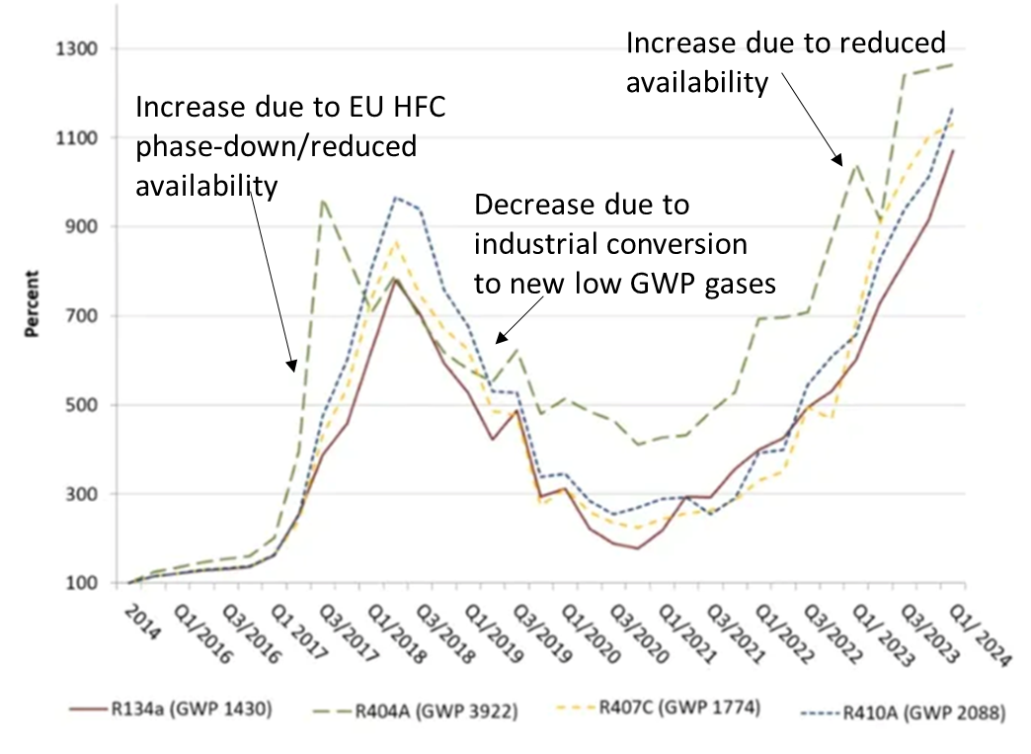
Greenhouse gas regulation
CERN has adopted an F-gas policy which is in line with the content of “F-gas regulations”
For reference, the key principles of EU517/2014 are:
Limiting the total amount of the most important F-gases that can be sold from 2015 onwards. By 2030, it limits the use to 1/5 of 2014 sales
Banning the use of F-gases in new equipment where less harmful alternatives are available
Preventing emissions of F-gases from existing equipment by requiring checks, proper servicing and recovery of gases
The new EU Regulation (2023) calls for the total elimination of HFCs by 2050
Also important to consider new regulations concerning PFAS

Slide 10
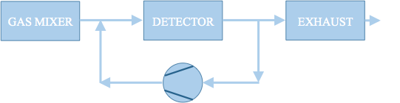
Gas system layouts: 2 – gas mixture recirculation
All gas systems are designed to recirculate the gas mixture: average 90% gas recirculation → 90% reduction of consumption/emissions
Advantages:
- Reduction of gas consumption
Disadvantages:
- Complex systems
- Constant monitoring (hardware and mixture composition)
- Use of gas purifying techniques
The remaining 10% is what we started to address from LS1. It is needed to compensate for:
  Leaks at detector: 85 % (mainly ATLAS and CMS RPC systems)
  15% N₂ intake (CMS-CSC, LHCb-RICH1, LHCb-RICH2)
Two remaining open mode systems upgraded to gas re-circulations from Run1 to Run2
  → For both detector systems: Original investment was totally paid back by gas cost saving during few years of operation
and laboratory setups

Slide 11
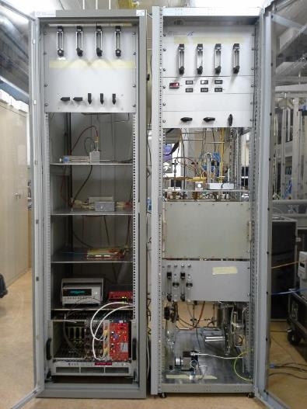
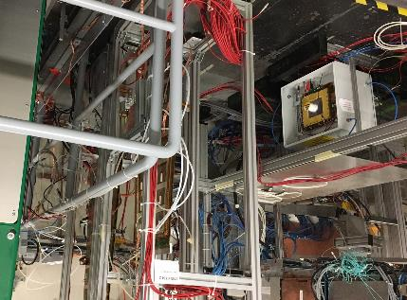
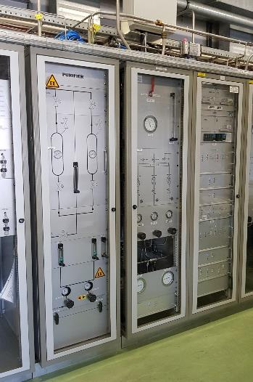
Gas Mixture Recirculation: LHCb-GEM example
Mixture: CF₄ 40%, Ar 45%, CO₂ 15%
Detector volume: ~ 50 liters (but very high flow needed by the detector)
→ R&D for operation of large GEM detector systems with gas recirculation
From Run1 to Run2:
90% GHG reduction
2013: Development of small gas recirculation systems for R&D
Started test in lab with radioactive source (GEM never operated in recirculation before)
2016-…:
Validation continued at CERN Gamma Irradiation Facility
2016-…:
LHCb-GEM upgraded to gas recirculation
Gas mixture purification studies
"A portable gas recirculation unit" JINST 12 T10002
Original investment already largely paid back by gas cost saving during operation
LHCb-GEM detector operation became more stable thanks to less frequent replacement of CF₄ cylinders

Slide 12
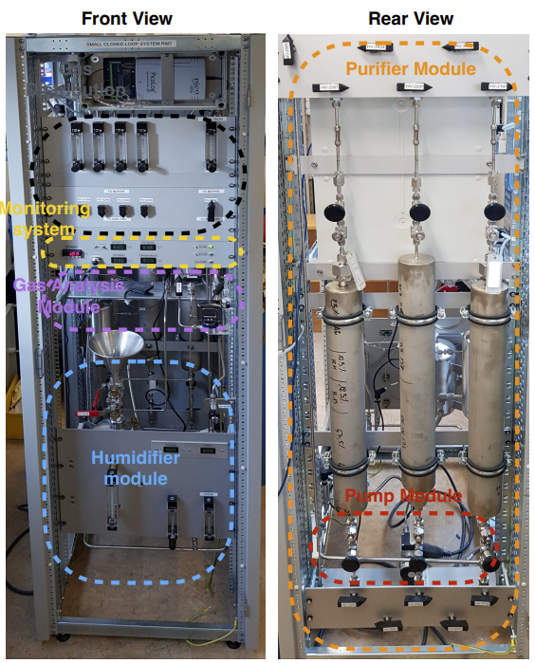
Gas Mixture Recirculation: “Lab size” gas systems
Sometimes lab test are using relatively high gas quantity if compared with large LHC systems:
example from GIF++ tests (RPC, CSC, GEM), test beam activities (CALICE RPC-SDHCAL), EEE telescope, …
Development of Recirculation system for laboratory applications
2013: Development of "A portable gas recirculation unit" JINST 12 T10002
~10 detectors
~100-200 l/h
One single rack can contain the full system
Control system based on simple PLC
Monitoring system based on Grafana
Possible to have some parameters controlled remotely
Few sensors
Five gas systems already produced and in use
20-30 kCHF

Slide 13
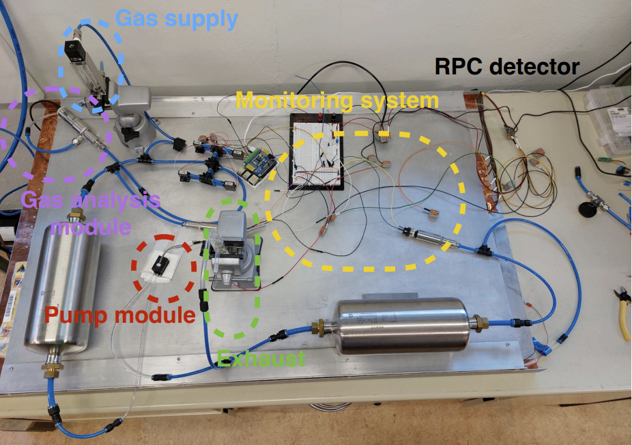
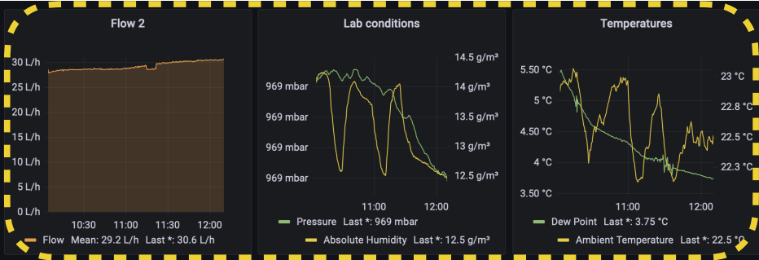
Gas Mixture Recirculation: “Lab size” gas systems
Development of Recirculation system for ~1-2 detectors – 20-30 l/h
2019: Development of Gas recirculation systems for RPC detectors: from LHC experiments to laboratory set-ups - RPC2022
It should fit in a small box
Monitoring system based on RaspBerry PI and Grafana
Manual (optional remote) control
Limited number of electronic sensors
Very cheap components
few kCHF

Slide 14
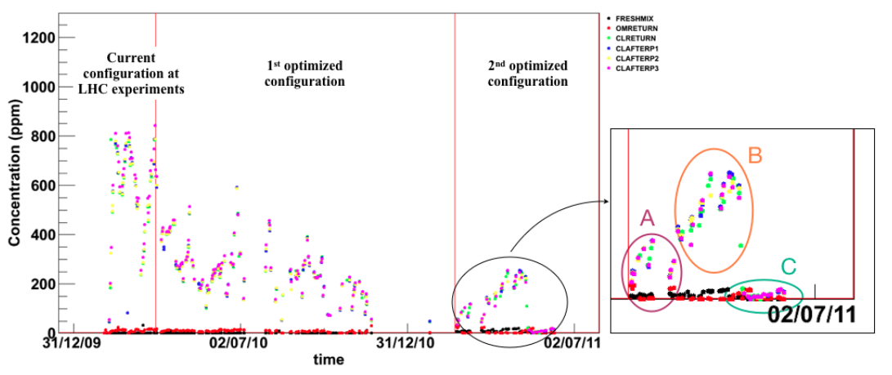
Beyond gas recirculation: why?
Not always the recirculation fraction can be increased easily: two examples
Detector operation validated for ageing up to 90%
  What about recirculating more? (example RPC: only short test performed in the past (2011) up to 97-99%)
N2 intake by diffusion (example: CMS-CSC detector)
RPC: Gas recirculation and impurities in past test
Higher recirculation fraction:
97%
99%
94%
https://pos.sissa.it/159/029/pdf

Slide 15
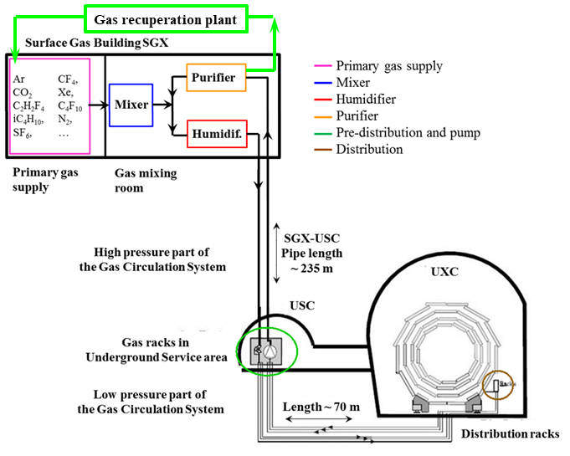
Gas systems and recuperation
Possibility to recuperate a single gas component from exhausted mixture
Many LHC gas systems already with gas recuperation
Advantages:
- Further reduction of gas consumption
Disadvantages:
- Higher level of complexity
- Dedicated R&D
- Gas mixture monitoring fundamental
Ongoing R&D aims in testing the feasibility for new recuperation systems:
  SF₆ for ALICE-RPC, ATLAS-RPC, CMS-RPC, ALICE-TOF
and substantial improvements of existing systems:
  R134a for ALICE-RPC, ATLAS-RPC, CMS-RPC, ALICE-TOF
  CF₄ for CMS-CSC, LHCb-RICH2
  C₄F₁₀ for LHCb-RICH1
Recuperation will be effective only if leaks at detector level will be reduced
R134a recuperation can drastically decrease GHG consumption
R&D costs for first R134a recuperation system can be potentially paid back with one year of operation

Slide 16
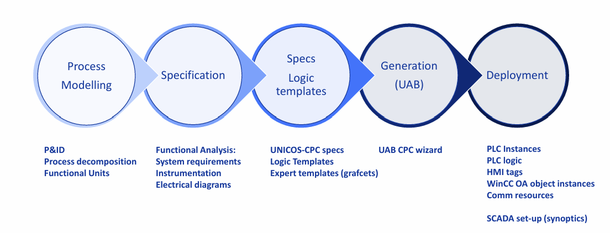
Gas Systems: from design to operation
From CERN, Beams Department, UNICOS Team

Slide 17
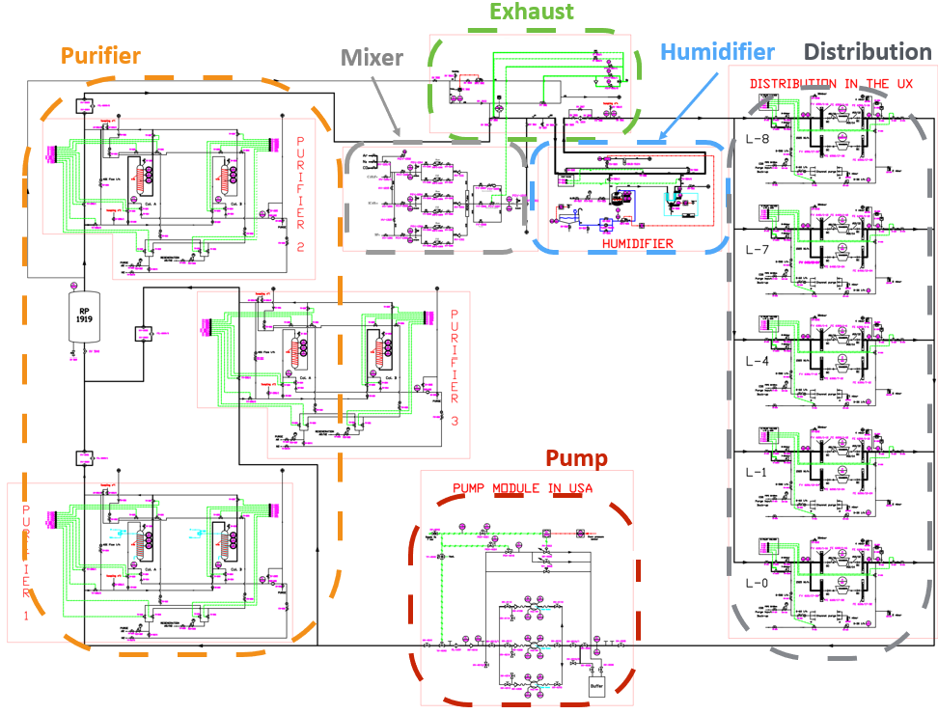
Gas Systems: design phase - identifying functional units
Piping and Instrumentation Diagram (P&ID or PID):
it is a detailed diagram in the process industry which shows process equipment together with the instrumentation and control devices.
P&ID and modules:
identifying functional units. Example:

Slide 18
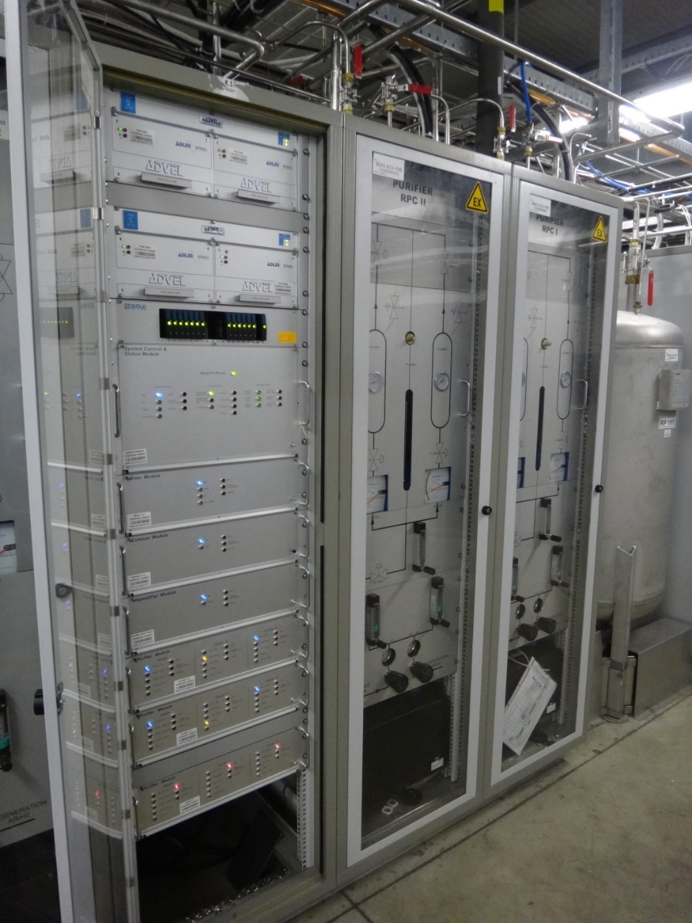
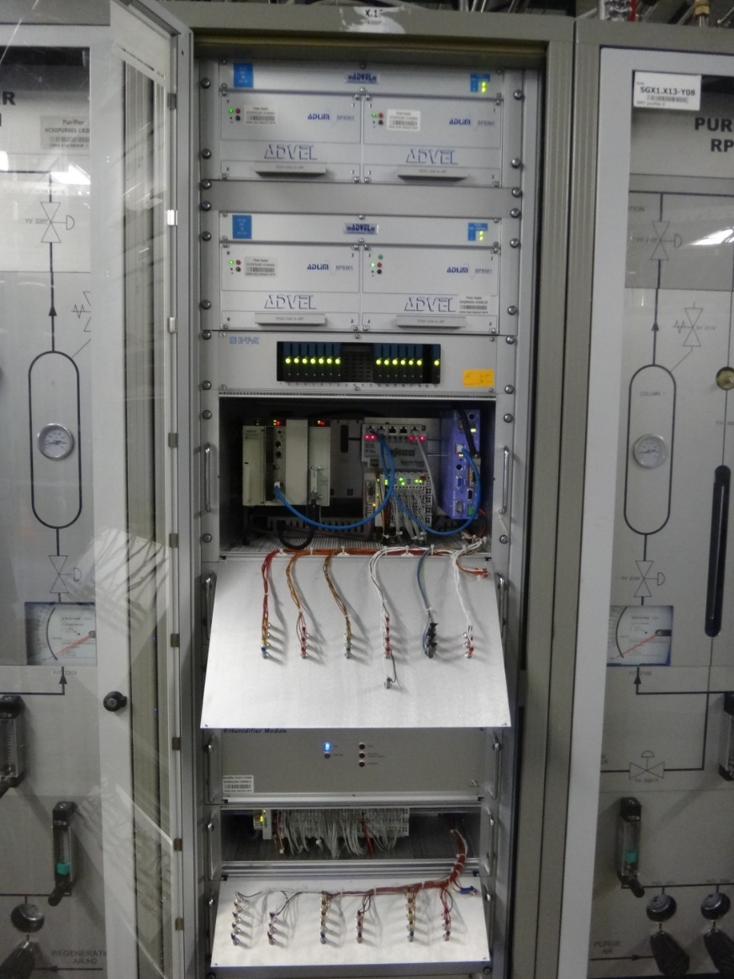
Gas Systems: design phase - functional units
Gas systems are made of several modules (building blocks): mixer, pre-distribution, distribution, circulation pump, purifier, humidifier, membrane, liquefier, gas analysis, etc.
Functional modules are equal between different gas systems, but they can be configured to satisfy the specific needs of all particle detector.
Implementation: control rack and crates (flexible during installation phase and max modularity for large systems)
Control rack
Control crate
(PLCs)
Modules crates
Profibus connection to control crate

Slide 19
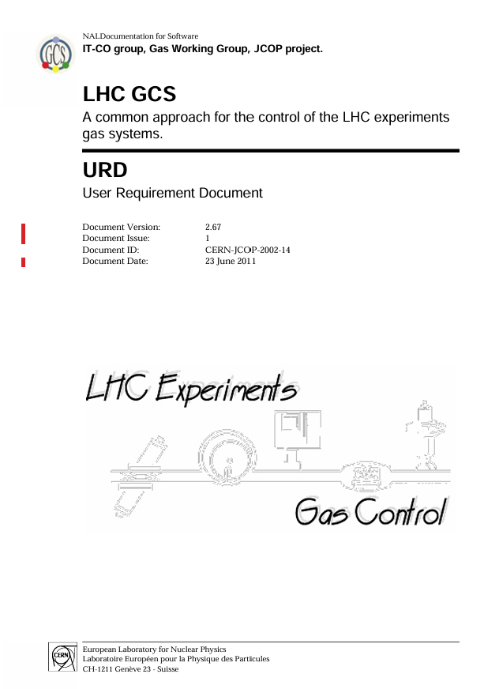
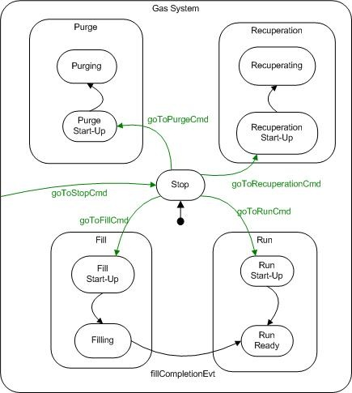
Gas Systems: from P&ID to controls
Functional analysis:
a document describing the automatic behaviour of the process
Logic Templates
Expert Templates (grafcets)
https://cernbox.cern.ch/s/DZmA2Uymugv0Ud4
About 500 pages where are defined:
Objects (units, actuator, controller)
Operational states
Interlocks (Full stop, Temporary stop, start interlock)
Alarm
User command
Computed variables

Slide 20
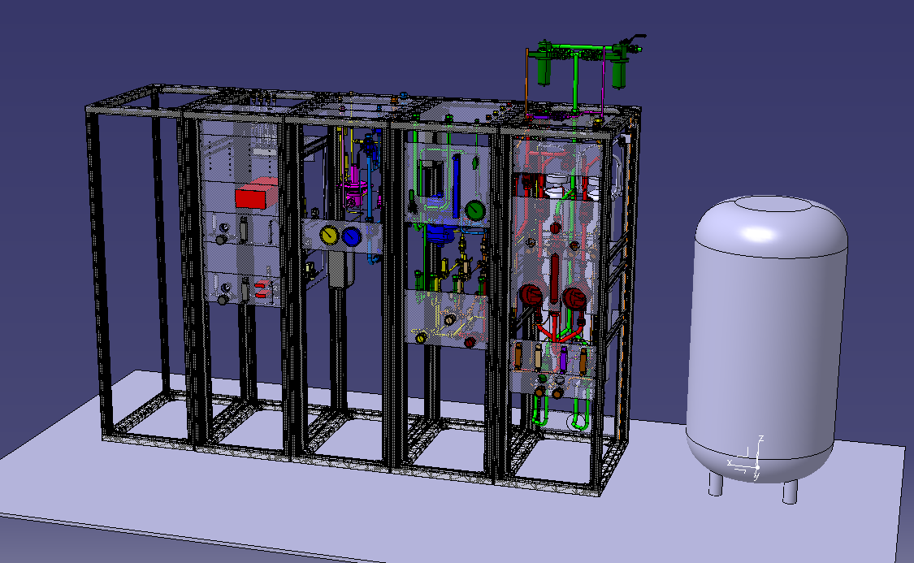
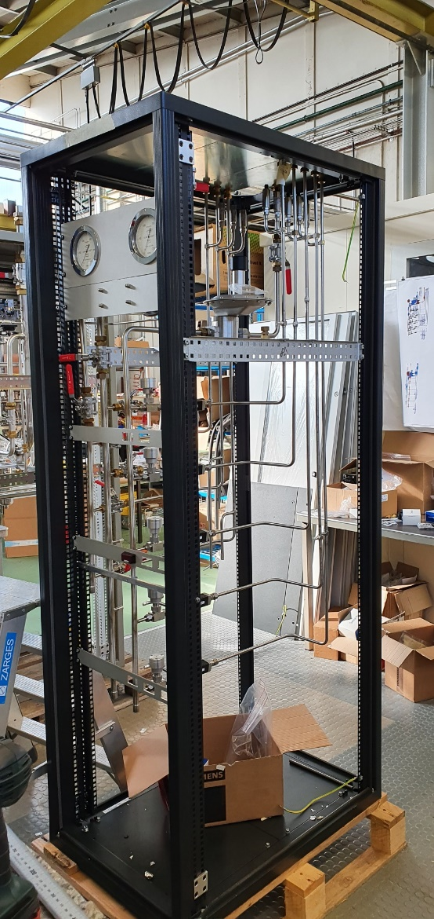
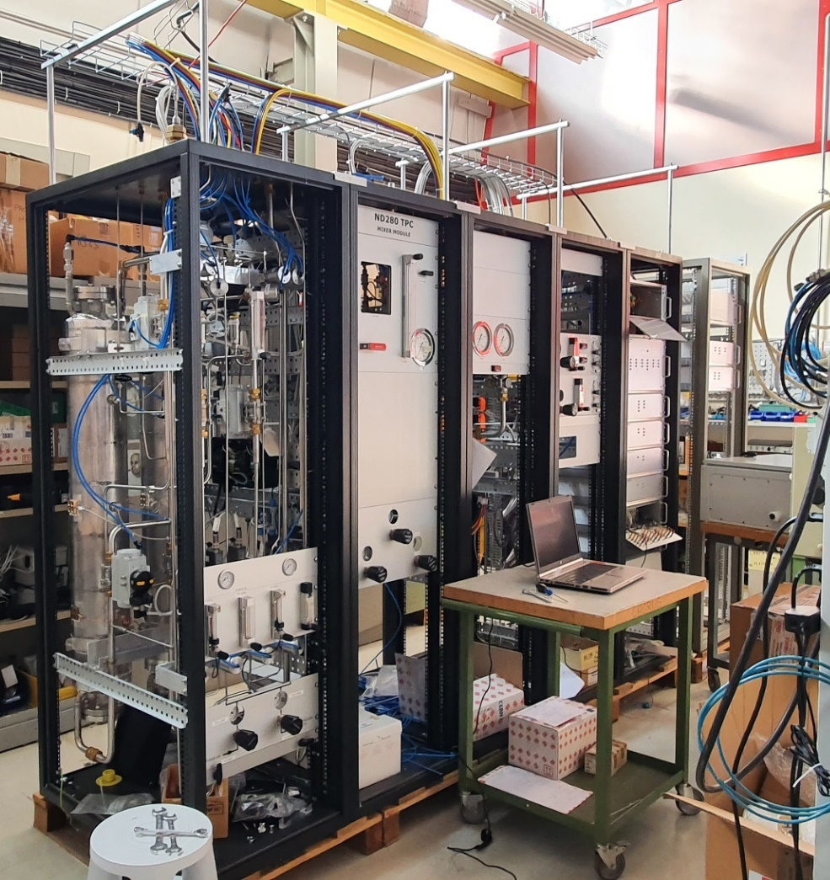
Gas Systems: from P&ID to construction
3D view of gas systems modules
in the surface gas building
Assembly
Gas systems modules
In the workshop for QC

Slide 21
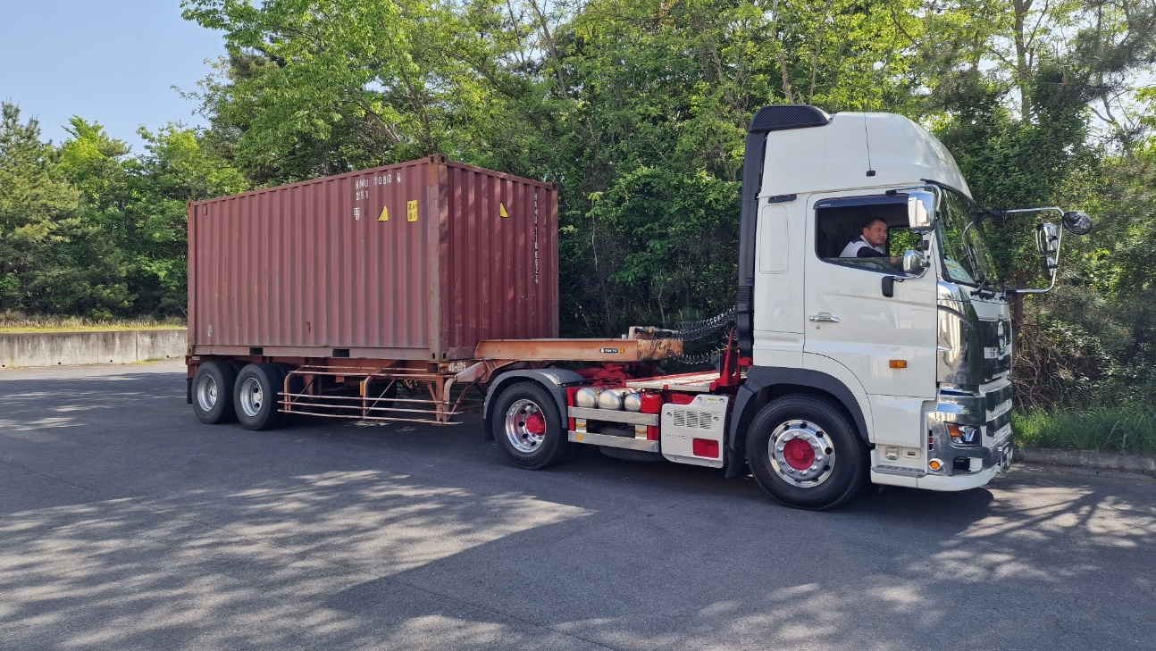
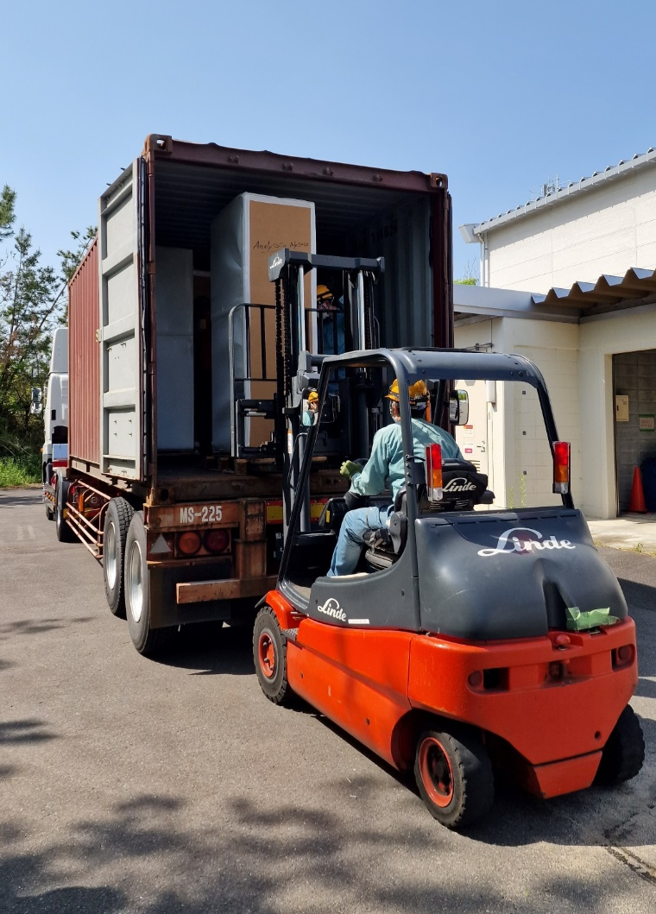
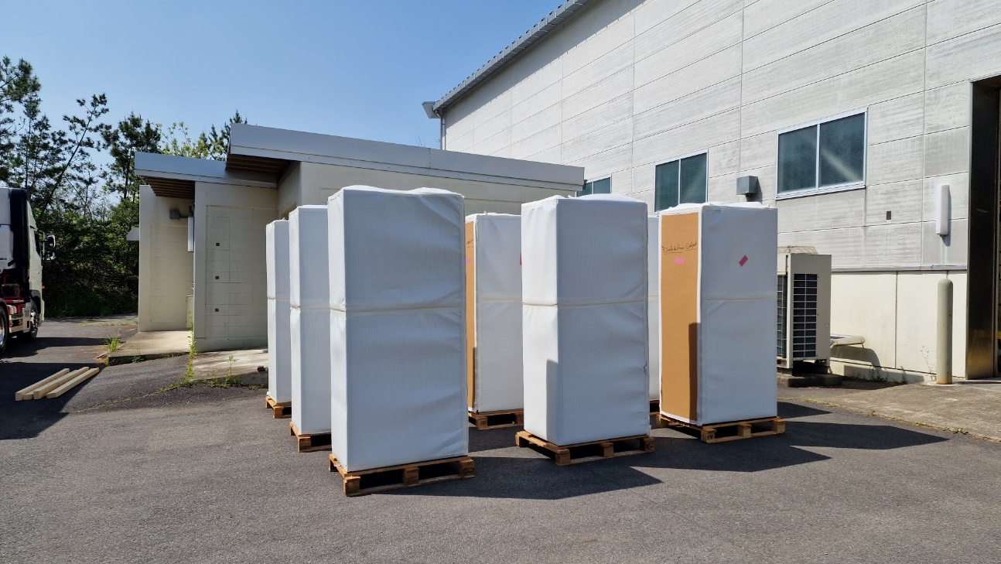
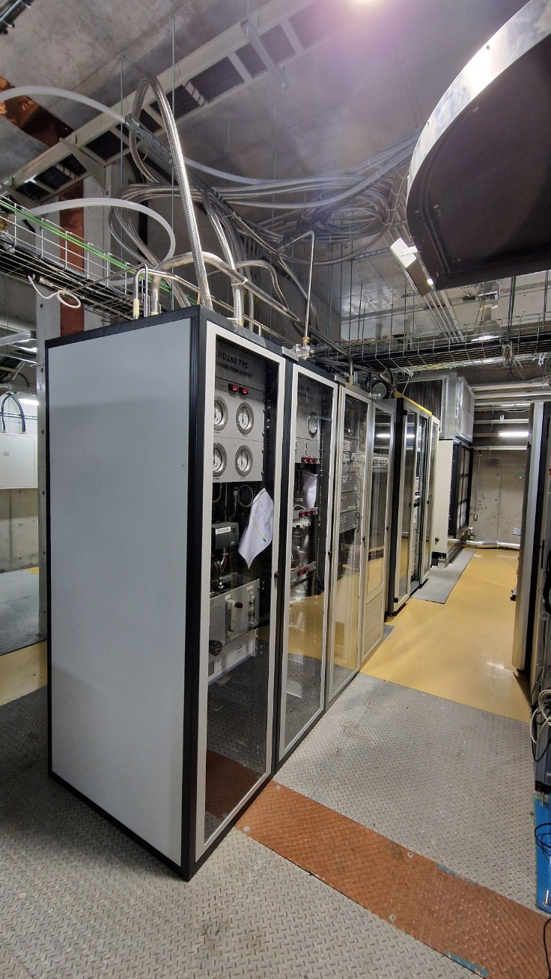
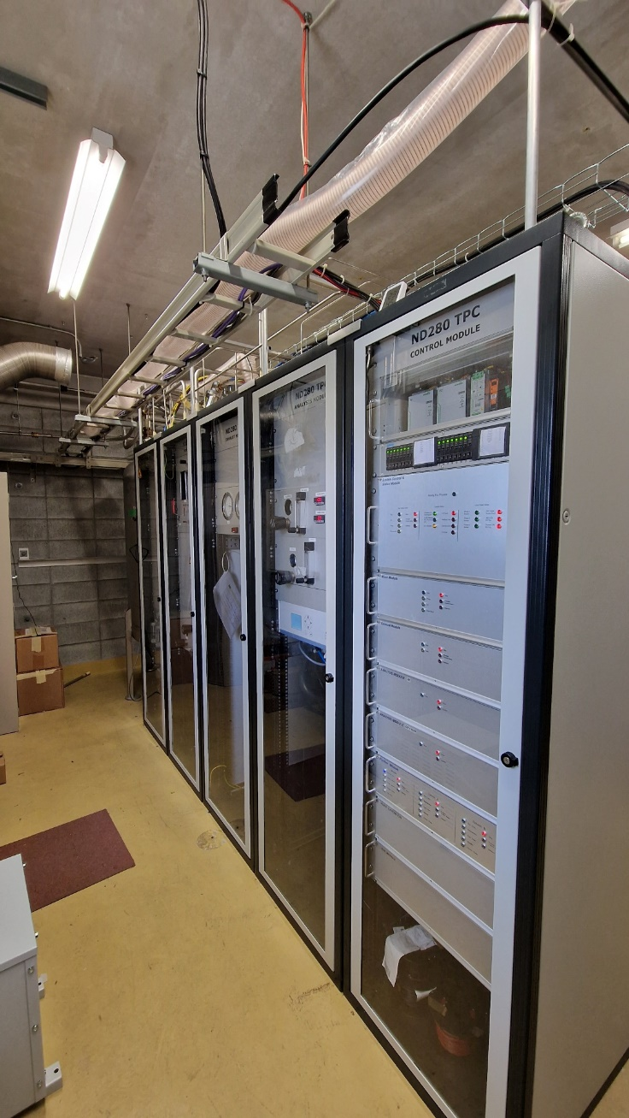
Gas Systems: installation and commissioning
Arrival
Unboxing
Installed

Slide 22
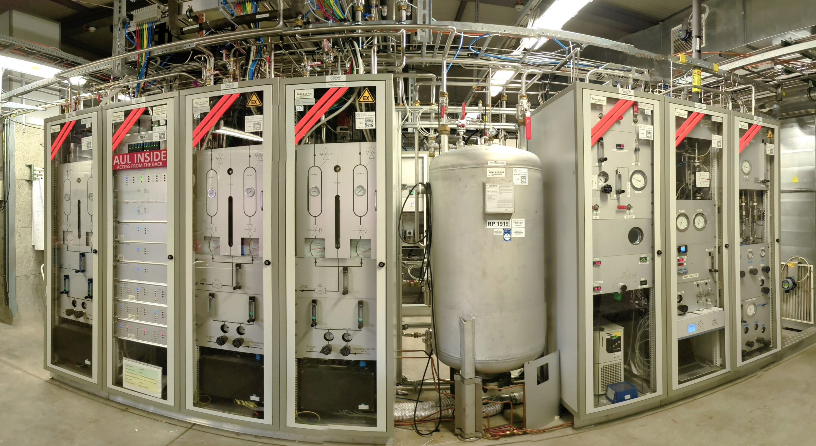
Gas system construction: modularity
Gas systems modules in surface building. In the following each module will be briefly discussed
Controls module
Purifier 2
High pressure buffer
Analysis
Purifier 1
Purifier 3
Humidifier
Mixer

Slide 23
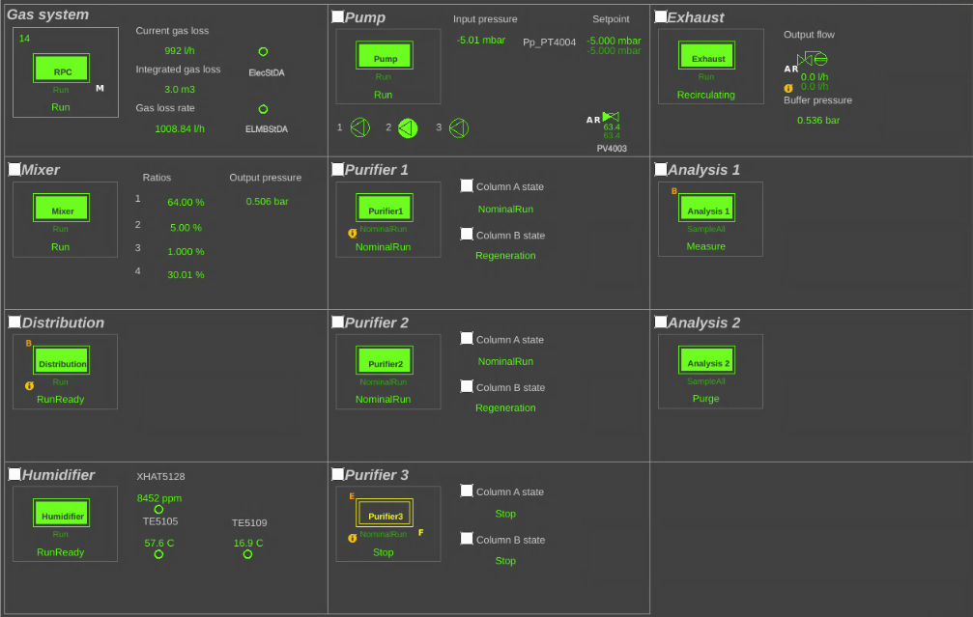
Gas system construction: modularity
View from software controls
Each rectangle is a Functional module

Slide 24
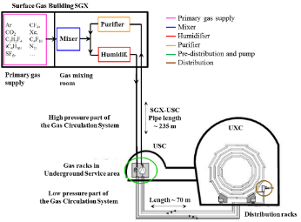
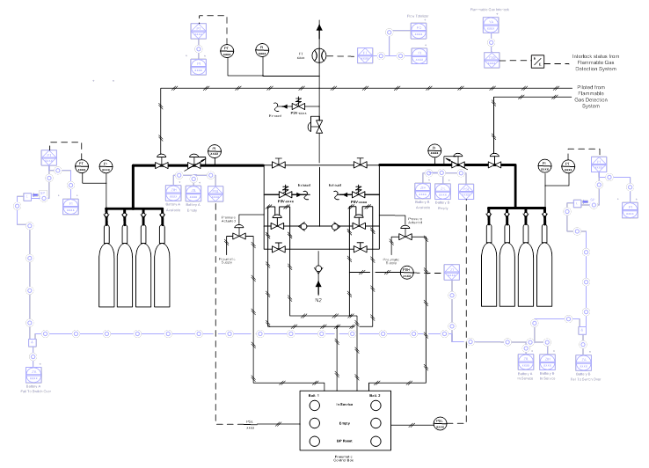
Primary Gas Supply monitoring system
Monitoring for :
  Ensuring reliability: make sure standby battery is availability
  Gas flow for each gas supply
  Gas quality (via analysis devices) before in service operation
Operational Warnings and Alarms:
  Battery failed to change over
  Low pressure/weight in active supply
  High flow demand
  Flammable gas interlock active
  I/O faults
  H₂O levels in analysed gas too high
  O₂ levels in analysed gas too high
  Backup gas supply not enabled
  Dewar full but not in service
Implemented in collaboration with BE-EA

Slide 25
Mixer module
Standard Mixer module can have up to 4 input lines (gas and liquid).
Primary task: provide the sub-detector with a suitable gas mixture during run.
Different needs for filling or purging (i.e. high flow or different mixture)
Mixture injection regulated according to detector need:
  Correction for atmospheric pressure change (majority of detector are operated at constant relative pressure, i.e. the quantity of gas in the detector follow the atmospheric pressure changes → mixture need to be stored)
  Mixture replacement in the detector
  Recuperation efficiency or leak rate
Warning/Alarms :
  Gas supply pressures
  Flow not stable/reliable
  Flow regulation (Mixing ratio)

Slide 26
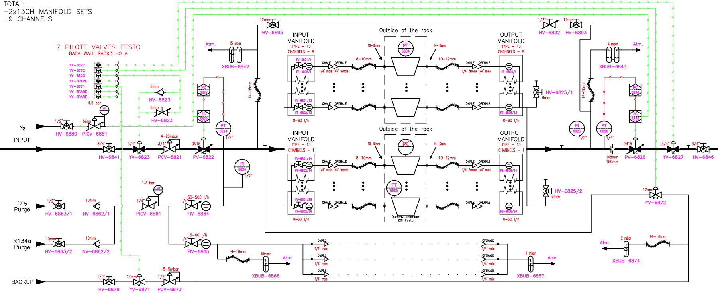
Distribution module
Distribution modules are directly connected to the detectors.
Before the distribution modules the loop pressure is between 0.5 to 1 barg.
At the input of the distribution, it is decreased to the required value for the detectors (typically ~mbarg)

Slide 27
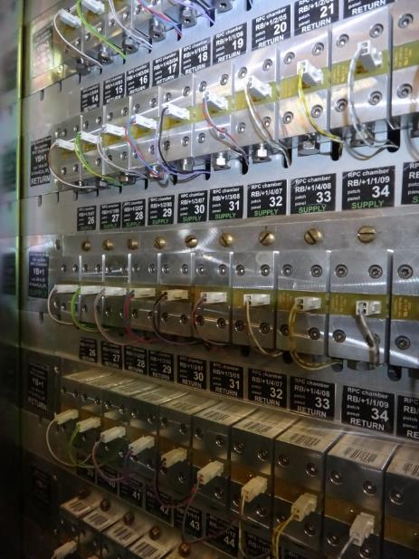
Distribution module
In the distribution modules are present supply and return manifolds where each channel is directly connected to one or more detectors
Flow-meters are measuring the supply and return flow for each channel
Needle valves allows to tune the desired flow per channel

Slide 28
Distribution module
The pressure at the chamber level is regulated by the output regulation valve
The regulation loop can use different pressure sensors:
Chambers level (PTxx04)
Rack level (PTxx26)
Other reference (PTxx25)

Slide 29
Distribution module
A fully mechanical system is present to inject a premixed mixture of a main mixture component to minimize the air intake during a stop of the gas systems

Slide 30
Distribution module
Software alarms/interlocks are implemented on each sensor to protect the detectors if pressure/flow are outside desired range
In addition, mechanical protection bubblers are there as last protection in case of any PLC/software failure

Slide 31
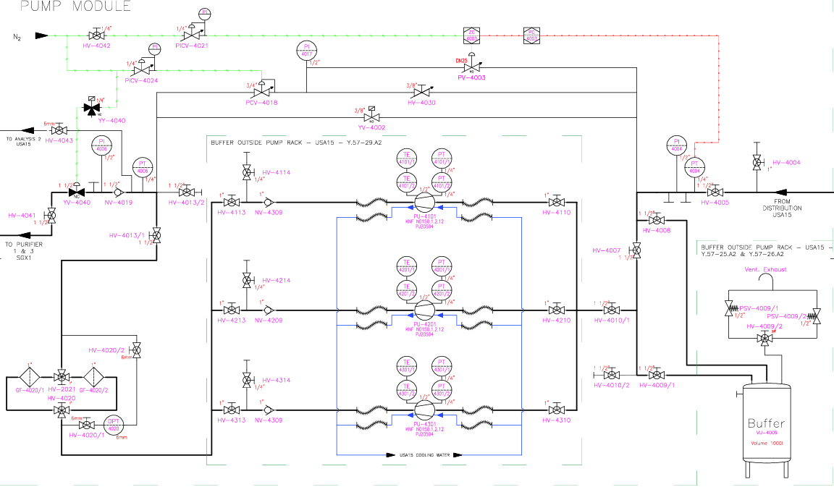
Pump module
It ensures gas mixture circulation
Different pumps used: membrane pump (single or double heads), piston pump
The gas flow through the module is tuned with three bypass loops:
YV4002 – an on/off valve to facilitate the start-up of the module/system
HV4030 – a manual coarse regulation
PV4003 – an automated valve for fine tuning regulation

Slide 32
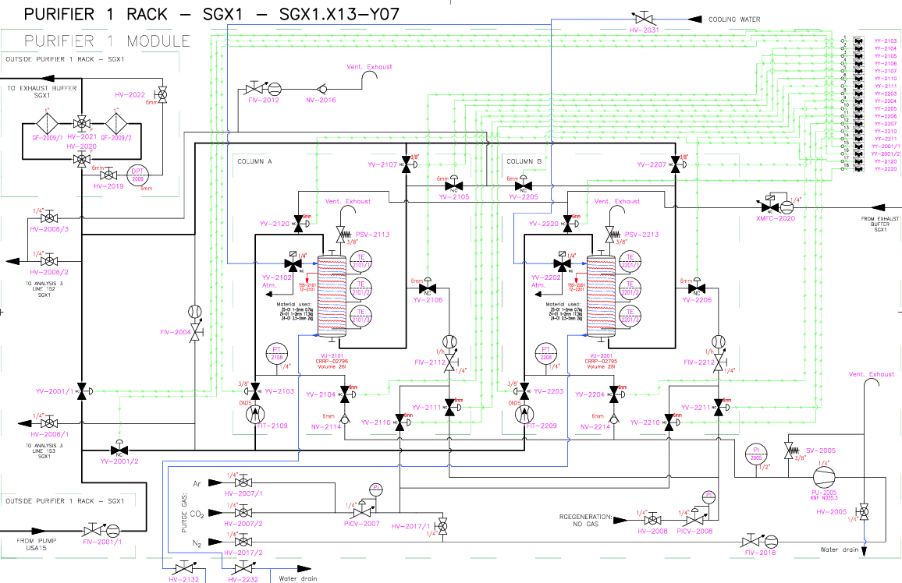
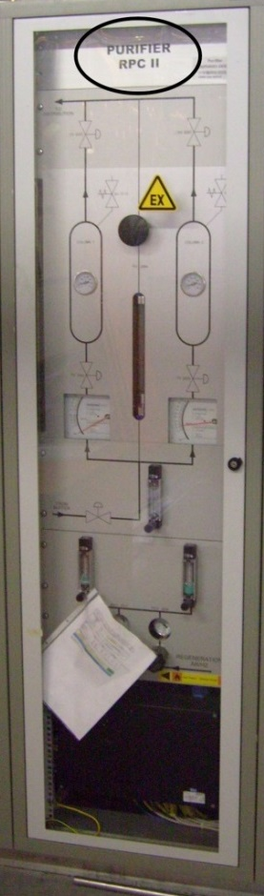
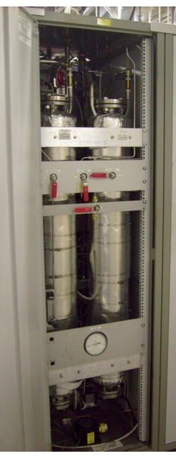
Purifier module
One of the most complex modules
Used to remove O₂, H₂O and more from mixture
Fully automated cycle
2 x 24 l columns filled with suited absorber:
  Molecular sieves
  Metallic catalysts
  others

Slide 33
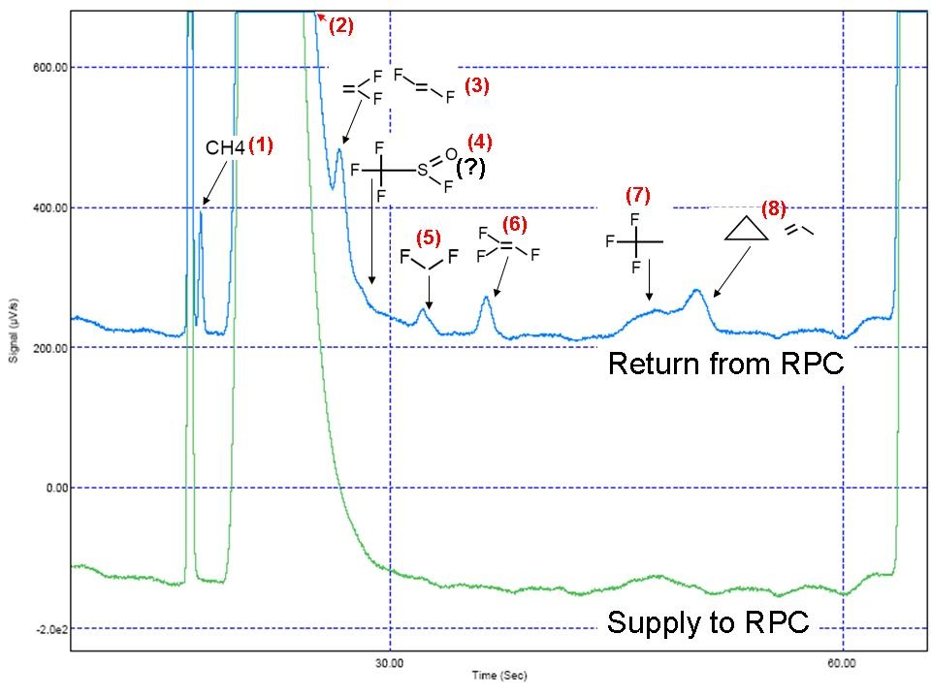
Purifier module
Why is it a complex modules?
Need to identify the impurity/es and to find a suitable material for the absorption
The material should also have a reasonable absorption capacity
It should be possibility to be regenerated onsite
The gas volume needed for the conditioning should be reasonable
 | Conditioning (volume change) | Main component filtered | Saturation for main component filtered (g (O₂/H₂O)/kg) | (1) CH₄ | (3) C₂H₂F₂ | (5) CH₂F₂ | (6) C₂HF₃ | (7) C₂H₃F₃ | (8) C₃H₆
MS3A | 3 | H₂O | 140 | Unch. | Unch. | Unch. | Unch. | Unch. | Unch.
MS4A | 10 | H₂O | 170 | Unch. | Unch. | Rem. | Unch. | Rem. | Rem.
MS5A | 50 | H₂O | 130 | Unch. | Back after 1000 vol change | Rem. | Rem. | Rem. | Rem.
Cu R11 | 20 | O₂/H₂O | 5/50 | Unch. | Unch. | Unch. | Rem. | Rem. | ~Rem.
Cu/Zn R12 | 20 | O₂/H₂O | 5/50 | Unch. | Enhanced | Unch. | Rem. | Rem. | 450 vol change
Ni Al2O3 | 15 | O₂/H₂O | 15/50 | Unch. | Unch. | Unch. | Rem. | 150 vol change | 150 vol change
Ni SiO2 | 15 | O₂/H₂O | 15/50 | Unch. | Unch. | Unch. | Rem. | Unch. | Unch.

Slide 34
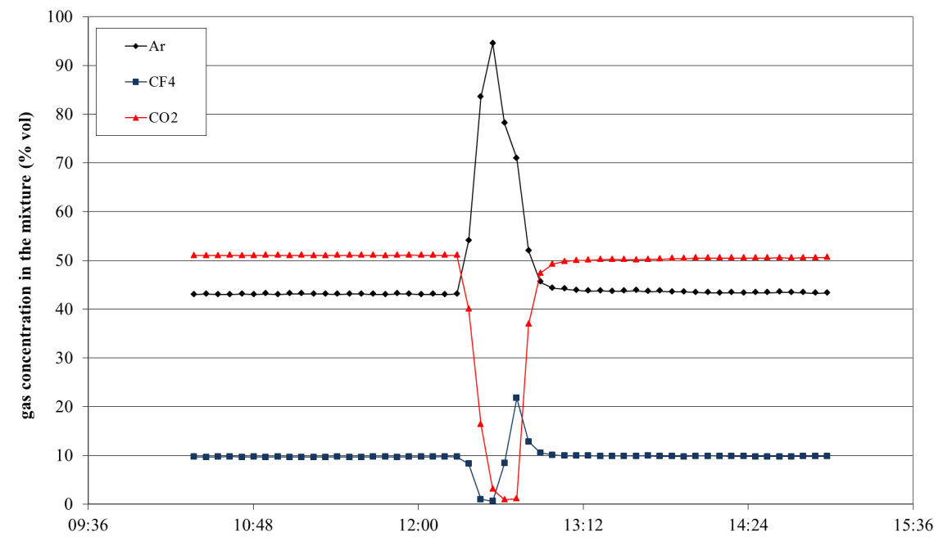
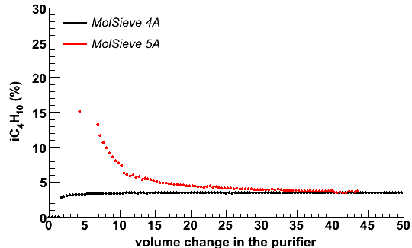
Purifier module
A cleaning agent is typically absorbing not only impurities
It can absorb different gas in different quantity
→ The gas mixture is destabilized at the beginning of each purifier cycle
CO2 absorption in Ni/Al2O3 catalyst
R134a absorption in MS5A even bringing to a flammable mixture

Slide 35
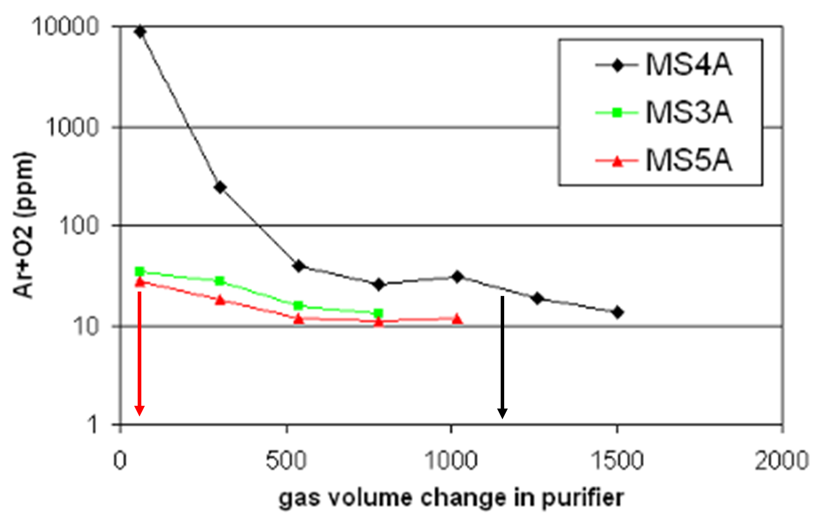
Purifier module
If other gases are used for the regeneration process, they can be retained in the cleaning agent and released at later time polluting the detector gas mixture.
The example below shows how Argon is released from different molecular sieves during flushing with detector mixture:
MS4A retains a factor 100 more Argon than MS3A and 5A

Slide 36
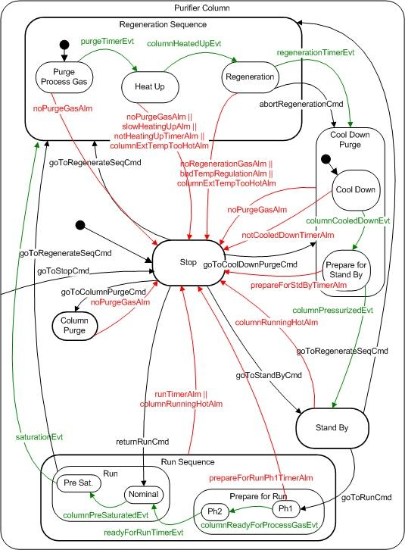
Purifier module
The grafcet on the right illustrates the different phases of column in the purifier module, with related alarm conditions
The regeneration phase of a purifier is passing through different steps:
Purge of process gas (i.e. the detector gas mixture)
Heat up (between 180 C for molecular sieves up to 250 C for metallic catalysts)
Regeneration under vacuum or with flushing of an inert gas for molecular sieves or flushing with Hydrogen for metallic catalysts
The preparation for the run phase of a purifier is passing through different steps:
The stand-by gas (used to avoid air intake) is evacuated
The purifier cartridge pressure is slowly raised from vacuum to the loop pressure by means of a mixture injection at low flow (low enough that it is not depressurizing significantly the high-pressure buffer of the gas system)
The purifier cartridge is flushed for a the time needed to have at the output the same mixture concentrations as at the input

Slide 37
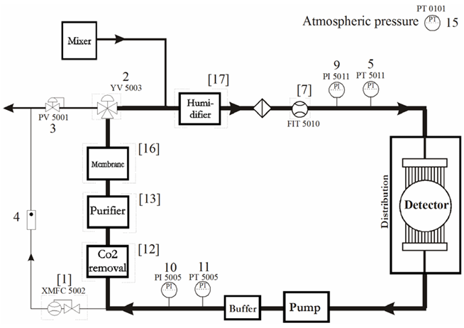
Exhaust module
The exhaust module is:
Ensuring the balance between mixture injected by the mixer module and mixture flow exhausted
Measuring the circulation flow
Controlling the pressure of the high-pressure buffer to compensate for atmospheric pressure changes

Slide 38
Exhaust module
The control of the high-pressure buffer pressure aims in minimizing the gas usage by compensating for atmospheric pressure changes using the gas stored in the high-pressure buffer.
It is particularly important when:
A very expensive gas is used
The mixer injection is negligible (recirculation fraction close to 100%)
During the year, the atmospheric pressure is changing in a relatively large range:
During a storm, the atmospheric pressure can change by several mbar
For a detector of 100 m3, 1 mbar represents 100 litres
1) The MFCs in the mixer may not have a large enough flow capacity to cope with the exceptionally high demand
High-pressure buffer

Slide 39
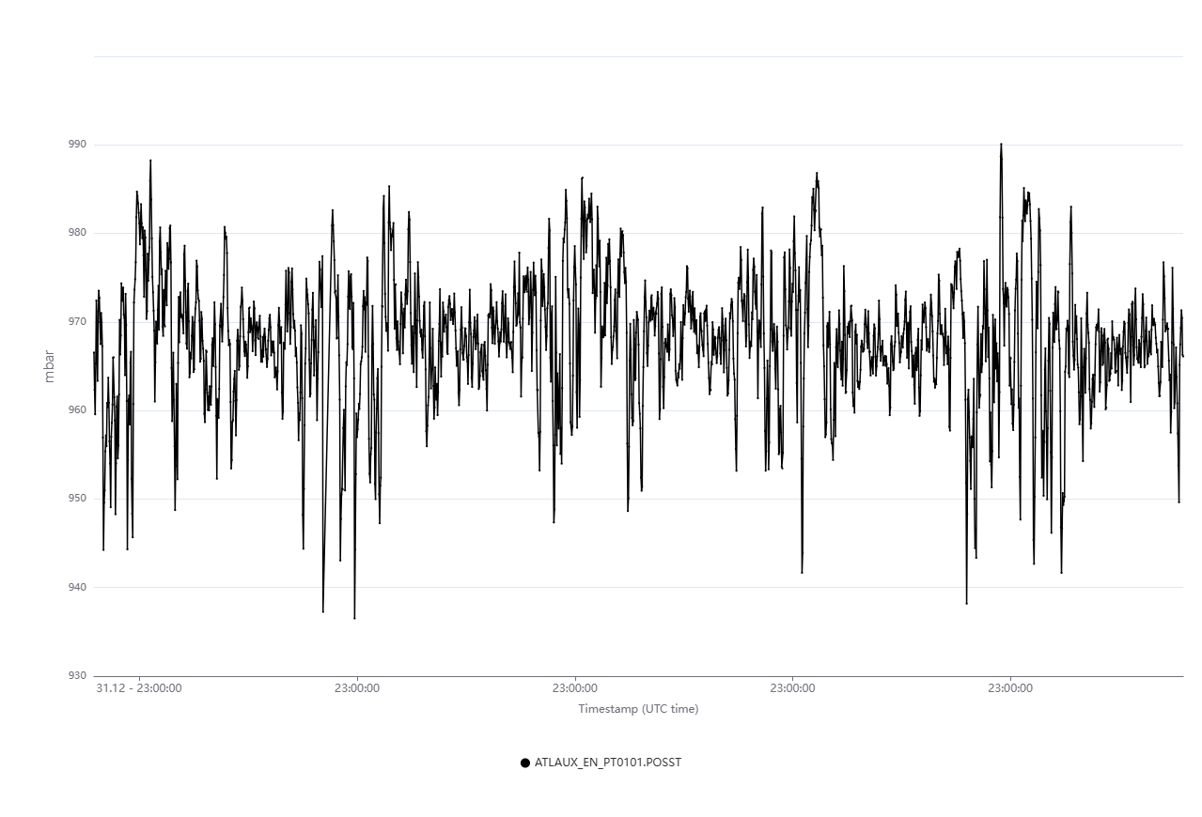
Exhaust module
During the year, the atmospheric pressure is changing in a relatively large range:
from 935 mbar up to 990 mbar (if we take CERN)
For a detector of 100 m3, working at constant relative pressure this implies:
When Patm decreases → the detector release 100 l of mixture per each 1 mbar of decrease
If the detector is using Xenon → 100 l = 2100 CHF
A decrease from 990 mbar to 935 mbar would release 5.5 m3 and it would cost 120 kCHF
The high-pressure buffer is the place where this volume is stored, avoiding gas loss and reducing operational cost
The exhaust module is controlling the high-pressure buffer setpoint

Slide 40
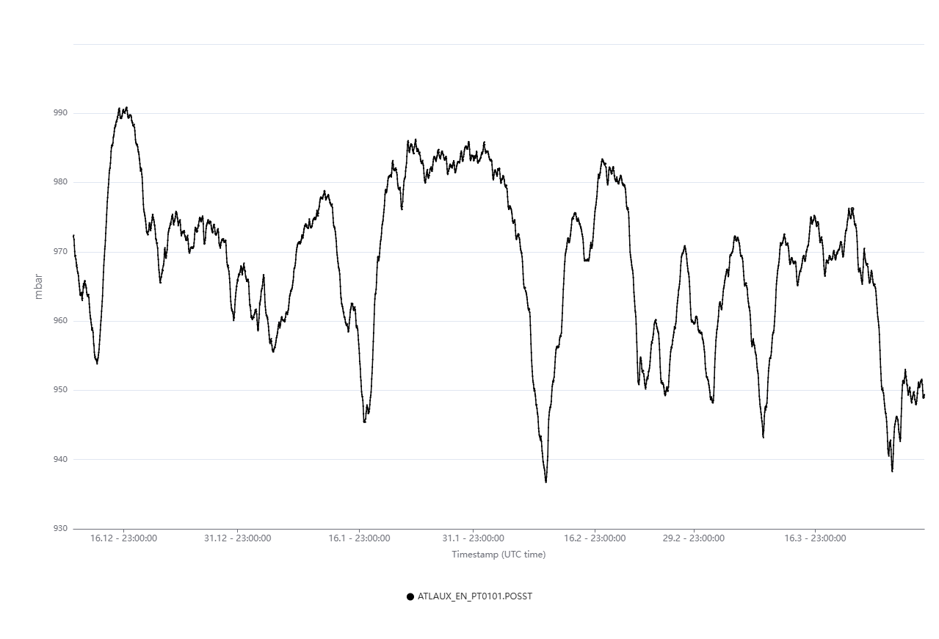
Exhaust module
During/after a storm, the atmospheric pressure can increase by several mbar
If we consider a change of + 1 mbar/h
For a detector of 100 m3, a flow of 100l/h is needed to maintain constant the relative pressure
The MFCs in the mixer may not have a large enough flow capacity to cope with the exceptionally high demand since they are tuned for order of l/h injection (in a system which recirculate basically 100% of the mixture)
The high-pressure buffer is the place from where this gas volume is taken
The exhaust module is controlling the high-pressure buffer setpoint
+10 mbar/10 h
→ + 1 mbar/h

Slide 41
Gas analysis module
Used to analyze the gas mixture
Two types: gas source selected by means of standard valves or n-way valves
  Several sample chains may be organized in several physical location.
  Each sample chain completely independent
basically everywhere
The module operated in automatic mode:
  sample the gas streams or the reference gases selected by experts.
  experts can trigger sampling of selected sources.
  length of the sampling lines taken in considerations to define flushing delays.
Alarm and data exchange with detector DCS
Used for safety (flammability level)
Gas chromatographs connected for more specific analysis

Slide 42
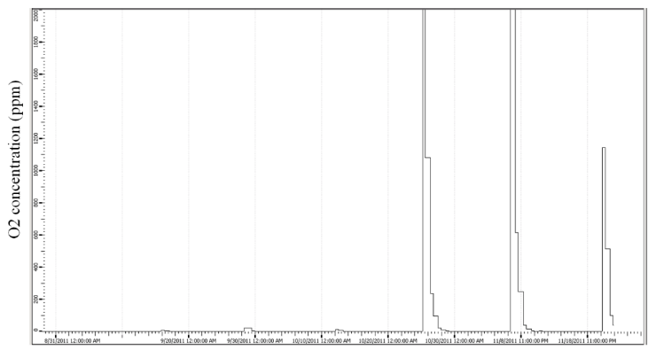
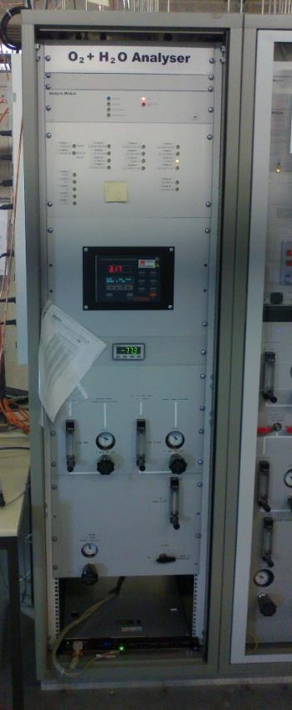
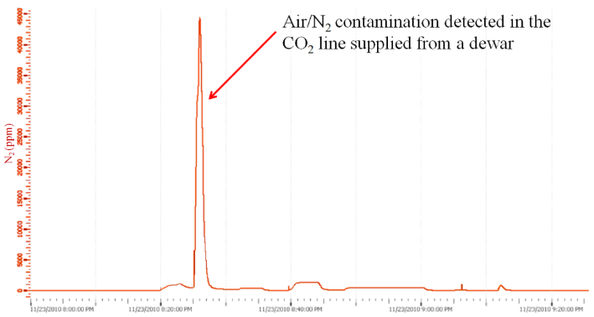
Gas analysis module
Fully automated O2 + H2O analysis module
O₂ in C₂H₂F₄ supply:
usually below 50 ppm
Sometime contamination up to thousand ppm.

Slide 43
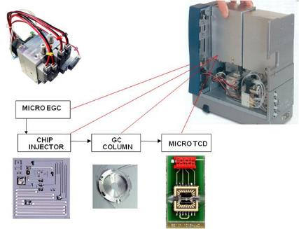


Gas analysis module
Gas chromatographs are used to monitor:
  Stability of mixture composition
  Presence of more complex impurities
CMS and LHCb equipped with GC connected to the selection manifold of the standard analysis rack.
Others GC are directly operated by users
SF6 in RPC system
CO2 in DT system
Other monitoring system based on detector are under development

Slide 44



Gas recuperation systems: separation techniques
Gas recuperation systems: developments for specific mixtures
MEMBRANE SEPARATION
PRESSURE & THERMAL SWING ADSORPTION (PSA & TSA)
DISTILLATION
ABSORPTION
DESORPTION
CMS CSC CF₄
LHCb RICH2 CF₄
Old LHCb RICH1 C₄F₁₀
CMS RPC R134a
CMS RPC SF₆
Old LHCb RICH1 C₄F₁₀
New LHCb RICH1 C₄F₁₀
CMS CSC CF₄
LHCb RICH2 CF₄
Notes:
Aggiungere absorber

Slide 45


Gas Recuperation: the CF4 case
CMS-CSC CF₄ recuperation plant
From Run1 to Run2
up to 44% GHG reduction
Problem:
Too high N₂ concentration for gas recirculation due to diffusion leak from detector components
Technical challenge:
First plant built for CF₄ warm adsorption
A completely non-standard system
R&D started in 2009, Operation from 2012. Several technical and resource problems → Average efficiency 60-70%
More selective sieves or cryogenic separation considered in case of further upgrades

Slide 46



Gas Recuperation: the R134a case
2018: Prototype0 tested in ATLAS-RPC (100 nl/h)
encouraging results, air/N2 and iC4H10/SF6 removed
2019: Prototype0 moved to CMS
2020: test restarted at CMS with CMS-RPC
R134a/iC4H10 form an azeotrope
simple separation thanks to difference in boiling points is not possible
2022: Good R134a quality, ~80% recuperation efficiency (limit due to azeotrope)
2023: installation of new Prototype1 for continuous operation
R134a, iC₄H₁₀, SF₆, …
Starting point mixture
95% R134a - 5% iC4H10
input
Vapour composition curve
Cold separation
R134a/iC4H10 remaining mixture is totally liquefied and it is sent to buffer at 5 °C:
azeotropic mixture is slowly heats up
liquid is enriched of pure R134a
vapour of azeotrope which escapes from exhaust
RPC
chiller
compressor
GC/MS
IR
liquid composition curve
GC

Slide 47

Gas Recuperation: the R134a case
View of R134a recuperation plant installed at CMS
Controls module
Chillers (-40 C & +10 C)
analysis modules
(gas chromatograph
and mass-spectrometer)
two cold trap separation modules
compressor
Storage and re-use

Slide 48
Gas Recuperation: costs vs benefits
Costs/benefits – CF4 and R134a examples:
CF4 recuperation for CMS-CSC
10% CF4 in gas mixture ~ 70 l/h ~ 2200 kg/year ~ 100 kCHF/year (at current price)
With 65% or recuperation efficiency
→ 1400 kg/year CF4 saved ~ -60 kCHF/year ~ -10500 tCO2e/year
R134a recuperation for CMS-RPC
95.2% R134a in gas mixture ~ 700 l/h ~ 12t/year ~ 130 kCHF/year (at current price)
With 80% or recuperation efficiency
→ 12 t/year R134a saved ~ -130 kCHF/year ~ -18000 tCO2e/year
allowing to maintain constant operational cost and GHG emissions despite the increase in fresh flow required to cope with the increase of luminosity
In detector operation is less subject to market crisis affecting price and availability.
Indeed, the availability of recuperated gases can mitigate difficult situations when there is a shortage of fresh gas.
In 2022 when there was a major disruption of CF4 availability in Europe: the CMS-CSC detectors could be operated and therefore participate to the CMS data taking only thanks to the usage of recuperated CF4.

Slide 49


Failure Mode, Effects and Criticality Analysis - FMECA
System decomposition: the systems are divided into the functional modules; for each of them, the components listed in the P&iD are considered for the analysis as Lowest Replaceable Units (LRU)
Operational phase: normal run
Failure mode and cause identification: the input information were retrieved from eLOGs analysis
Failure effects classification: evaluation of local effects, effects on the module and on the system
Criticality analysis: assignment of risk indexes
  Frequency of occurrence (from eLOGs)
  Severity of effects
Building of risk matrixes

Slide 50



Failure Mode, Effects and Criticality Analysis - FMECA
639 components analysed and 1436 failure modes found
The resulting risk matrix for a Gas System is the following:
SEVERAL IMPROVEMENT ACTIONS IDENTIFIED

Slide 51



Gas Systems for LHC experiments: few numbers
M&O in few numbers:
~100 intervention during oncall service
800 checks/interventions recorded (M&O, oncall, projects, …)
Consolidation/upgrades
M&O elogs
Gas Systems efficiency
(external problems excluded)
~ 1 h downtime/year/system
On-call elogs

Slide 52
Summary
Gas systems at CERN
30 gas systems (about 300 racks) delivering the required mixture to the particle detectors of all LHC experiments (and one delivering H₂ to LINAC4 and many others for non-LHC experiments).
Designed and built according to functional modules:
  Simplified maintenance and operation activities for the team
  Fully automated systems with remote control/monitoring
  few examples briefly presented
Gas systems have demonstrated an impressive reliability level:
  On average about 1 h downtime/year (excluded external causes, i.e. power-cuts, …)
Maintenance and consolidation are fundamental to ensure stability and reliability at long term
F-gas policy
CERN F-gas policy is in line with “F-gas regulations” which aim to limit the GHG usage
Decreasing the consumption makes detector operation less subject to crisis affecting price and availability
Horizon 2025: -28% and Horizon 2030: -50%
Detector design
It is fundamental to look not only at detector performance but also at the infrastructure

