Slide 1
Impact on luminosity of
Turn-around time,
Run time etc.
R. Garoby Joint HL-LHC/LIU brainstorming
24/06/2011

Slide 2
Definitions (reminder…)
Data taking
T_{ta}
T_{run}
Case of no Levelling
Luminosity evolution
Average luminosity
Optimum T_{run}
Cf. F. Zimmermann – Chamonix 2011

Slide 3
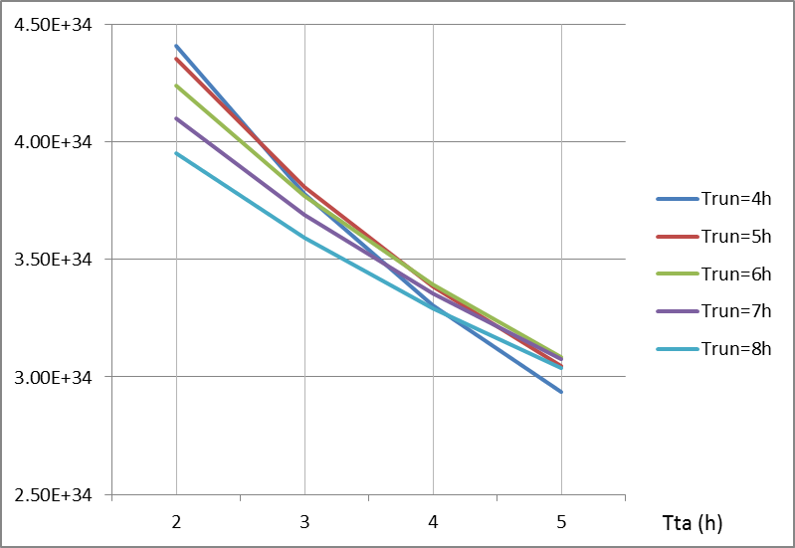
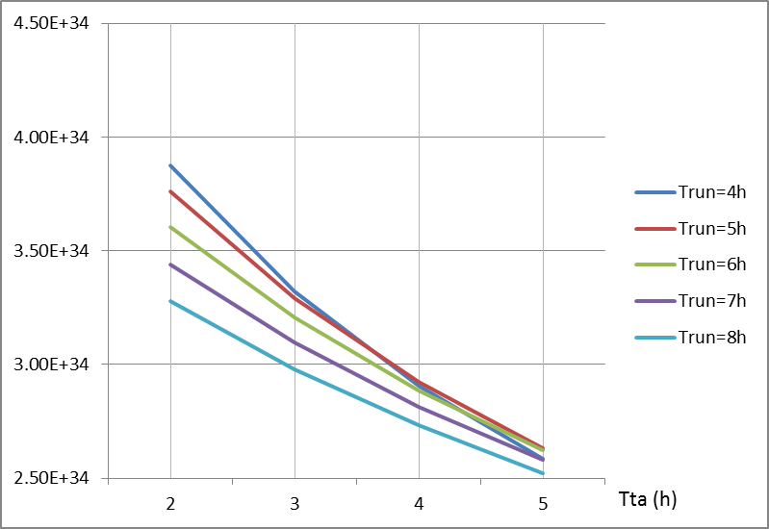
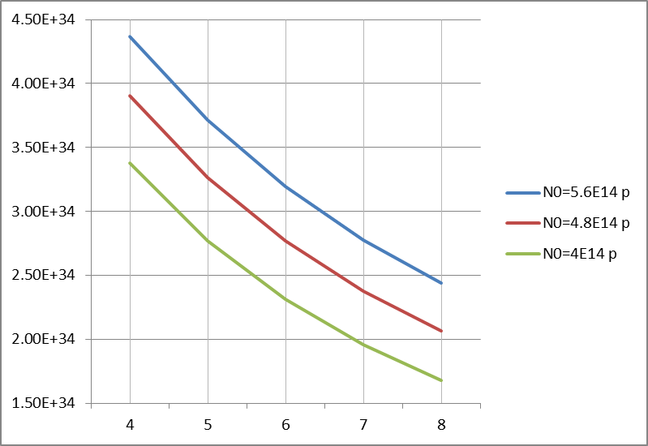

Average Luminosity § Luminosity at end of coast
Initial Luminosity (L₀): 10³⁵ cm⁻²s⁻¹
N₀=5.6 10¹⁴ p
(2 10¹¹ p/b @25 ns)
N₀=4 10¹⁴ p
(1.4 10¹¹ p/b @25 ns)
Average Luminosity
Observations:
- T_{ta} is the main factor for a high average luminosity
- Case 1: if T_{ta} has to be in the range 4-5 h, T_{run} has
small impact
  a low T_{run} can be used
  small dynamic range in L: need for levelling?
- Case 2: if T_{ta} can be made small (2-3 h), T_{run} shall
  preferably be small
  small dynamic range in L: need for levelling?
Luminosity at end of coast

Slide 4
Conclusions
Working on the reduction of T_{ta} will be highly rewarding (2-3 h ?)
T_{run} does not need to be very long (4-5 h is fine)
The dynamic range in luminosity will not exceed a factor of 3: does it justify levelling?
A small T_{run} (4 h) is compatible with a moderate intensity (4 10¹⁴ p)…

