Slide 1
bunch spacing, pile up and all that
Frank Zimmermann
HL-LHC/LIU brainstorming
Jiva Hill, 24 June 2011

Slide 2
no beam-beam limit
limit on total beam current in LHC [& SPS] due to several systems (RF, dump, vacuum, collimator robustness, machine protection, RP, …) at ultimate value
single bunches > 3e11 ppb with 2.5 μm emittance
have been accelerated in the SPS
we can get a factor 2 higher peak luminosity with 50 ns spacing at the same current
in addition we may get smaller emittance at 50 ns
→ additional gain in peak luminosity?
pile up replaces beam-beam as HL-LHC constraint
- do we understand it?
- trade off between integrated luminosity & pile up?
leveling works!

Slide 3
example HL-LHC parameters
parameter | symbol | nom. | nom.* | 25 ns, crab, lrc | 50 ns, crab, lrc
protons per bunch | N_{b} [10¹¹] | 1.15 | 1.7 | 1.7 | 3.4
bunch spacing | Δt [ns] | 25 | 50 | 25 | 50
beam current | I [A] | 0.58 | 0.43 | 0.86 | 0.86
rms bunch length | σ_{z} [cm] | 7.55 | 7.55 | 7.55 | 7.55
beta* at IP1&5 | β∗ [m] | 0.55 | 0.55 | 0.15 | 0.15
full crossing angle | θ_{c} [μrad] | 285 | 285 | 425 | 425
normalized mittance | γε [μm] | 3.75 | 3.75 | 2.8 | 2.8
Piwinski parameter | φ=θ_{c}σ_{z}/(2*σ_{x}*) | 0.65 | 0.65 | 2.13 | 2.13
tune shift | ΔQ_{tot} | 0.009 | 0.0136 | 0.006-0.011 | 0.012-0.015
potential pk luminosity | L [10³⁴ cm⁻²s⁻¹] | 1 | 1.1 | 9.6 | 19.3
actual (leveled) pk luminosity | L_{lev} [10³⁴ cm⁻²s⁻¹] | 1 | 1.1 | 5 | 5 (2.5)
events per #ing |  | 19 | 40 | 95 | 190 (95)
effective lifetime | τ_{eff} [h] | 44.9 | 30 | 13.3 | 13.3 (26.6)
level time / run time | t_{level,run} [h] | 15.2 | 12.2 | 3.7 / 8.6 | 6.5 / 10.1 (16.4)
e-c heat SEY=1.2 | P [W/m] | 0.2 | 0.1 | 0.4 | 0.3
SR+IC heat 4.6-20 K | P_{SR+IC} [W/m] | 0.32 | 0.30 | 0.58 | 0.91
IBS ε rise time (z, x) | τ_{IBS,z/x} [h] | 58, 104 | 39, 70 | 71, 60 | 36, 30
annual luminosity | L_{int}[fb⁻¹] | 57 | 58 | 259 | 317 (204)

Slide 4
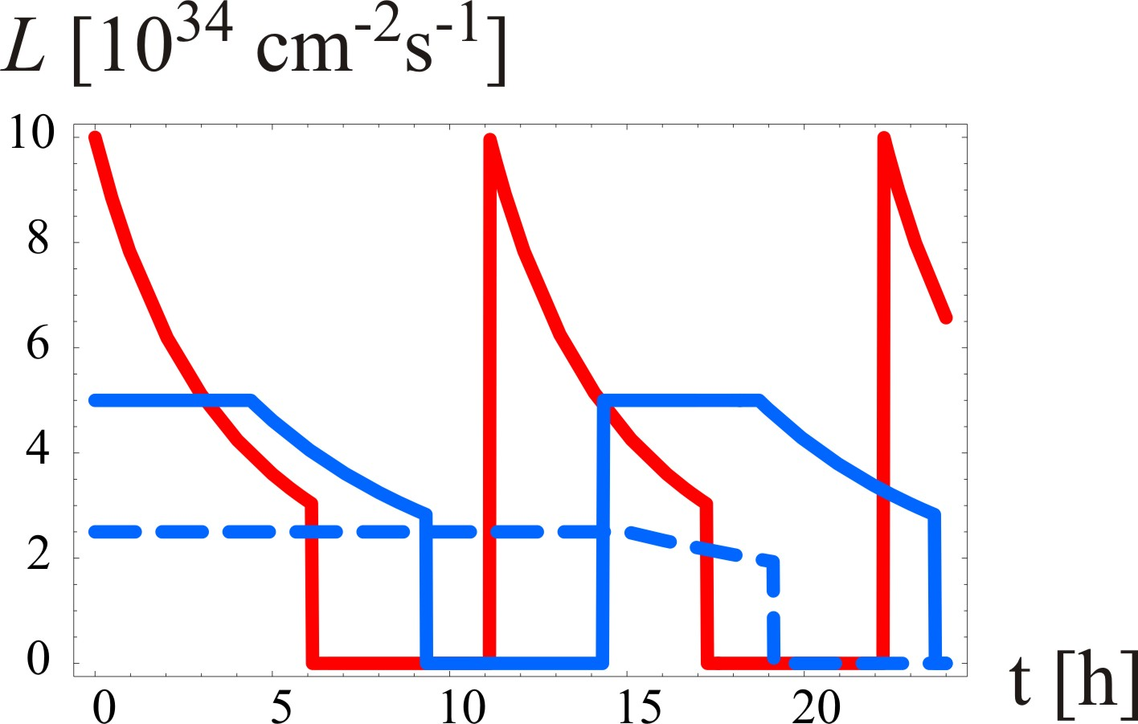
luminosity leveling at the HL-LHC
w/o leveling
virtual peak
luminosity
leveling at
5x10³⁴cm⁻²s⁻¹
k=2, τ_{eff}=15 h, T_{ta}=5 h
leveling at
2.5x10³⁴cm⁻²s⁻¹
k=4, τ_{eff}=30 h, T_{ta}=5 h

Slide 5
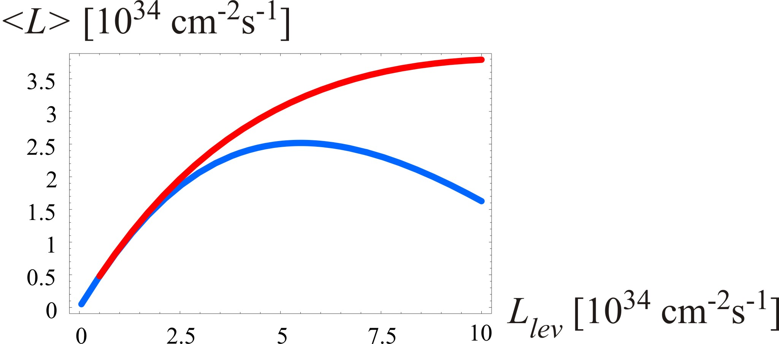
trade off: integrated lumi ↔ pile up
50 ns
pile up 190
50 ns
pile up 285
25 ns
pile up 95
50 ns
pile up 95
25 ns
pile up 47
roughly for 2 times more integrated luminosity 4 times the pile up

Slide 6
25 ns or 50 ns?
e-cloud is not the only argument
50 ns beam gives much higher peak luminosity
and has larger reach for integrated luminosity
pile up can be controlled by leveling
what is the pile up limit (physics dependent?),
and do we calculate the pile up correctly?

Slide 7
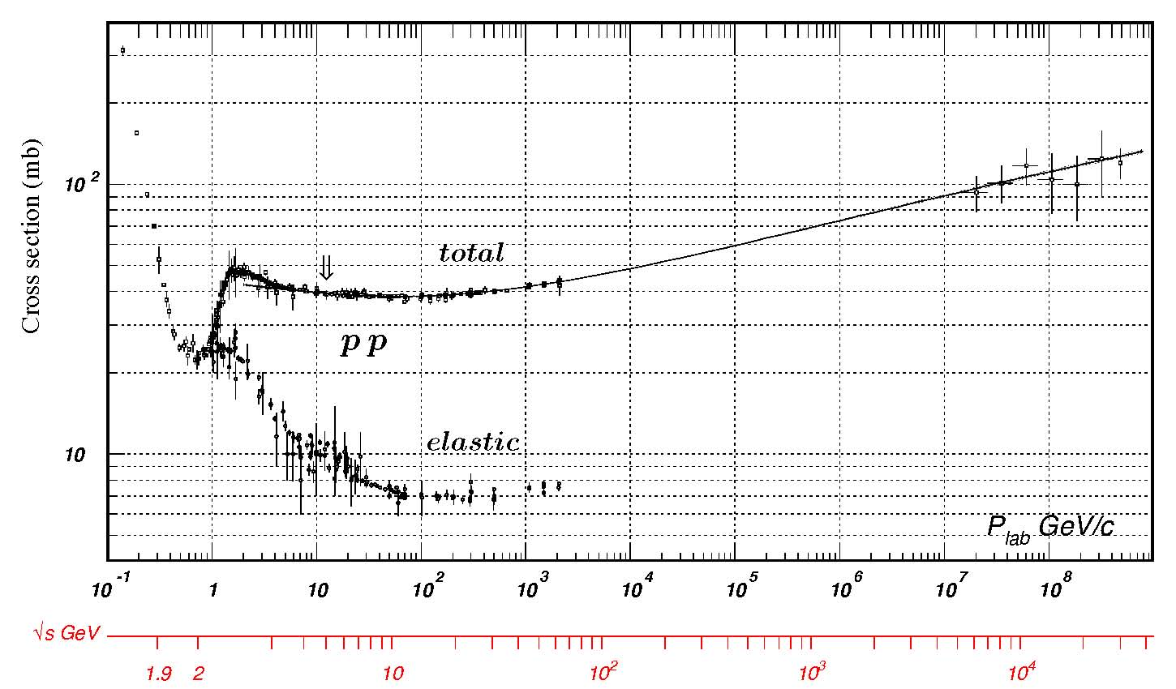
pile up
Peak Stable Luminosity (ATLAS) | 1.26x10³³ | Fill 1815 | 11/05/29, 06:41
Max. Peak Events / Bunch Crossing (ATLAS) | 14.01 | Fill 1732 | 11/04/23, 05:47
Max. Average Events / Bunch Crossing over the fill (ATLAS) | 8.93 | Fill 1644 | 11/03/22, 02:20
nominal Pile Up LHC Design Report = 19.0
at L=10³⁴ cm⁻²s⁻¹ with 2808 bunches
scaling to actual conditions:
present pile up should be
< 19.0 (2808/1092) 0.126
~ 6 ??
_{tot}∼
100 mbarn
~ 10⁻²⁵ cm²
from
cosmic rays
_{inelastic}∼
60 mbarn~
6x10⁻²⁶ cm²
LHC

Slide 8
appendix

Slide 9
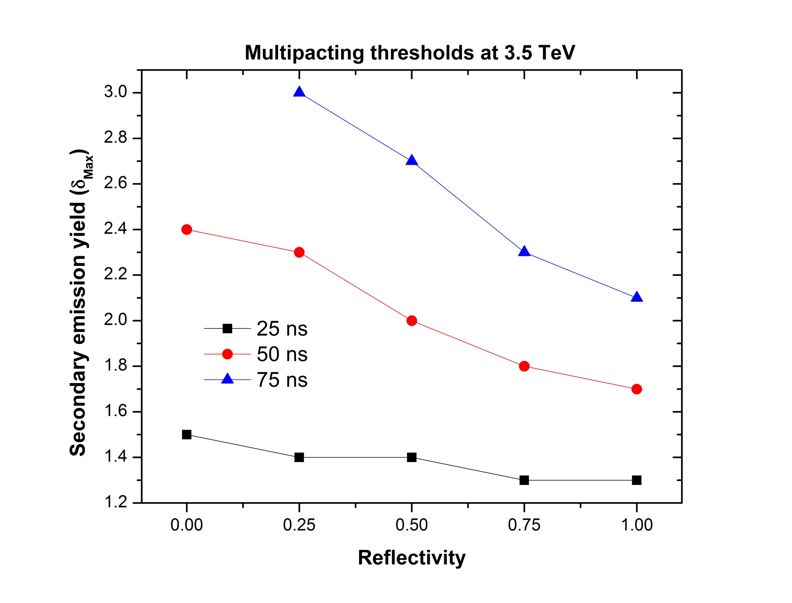
electron cloud build up at 3.5 TeV
H. Maury
machine study in 2011
now
“scrubbing” ?!
of low-energy e-

Slide 10
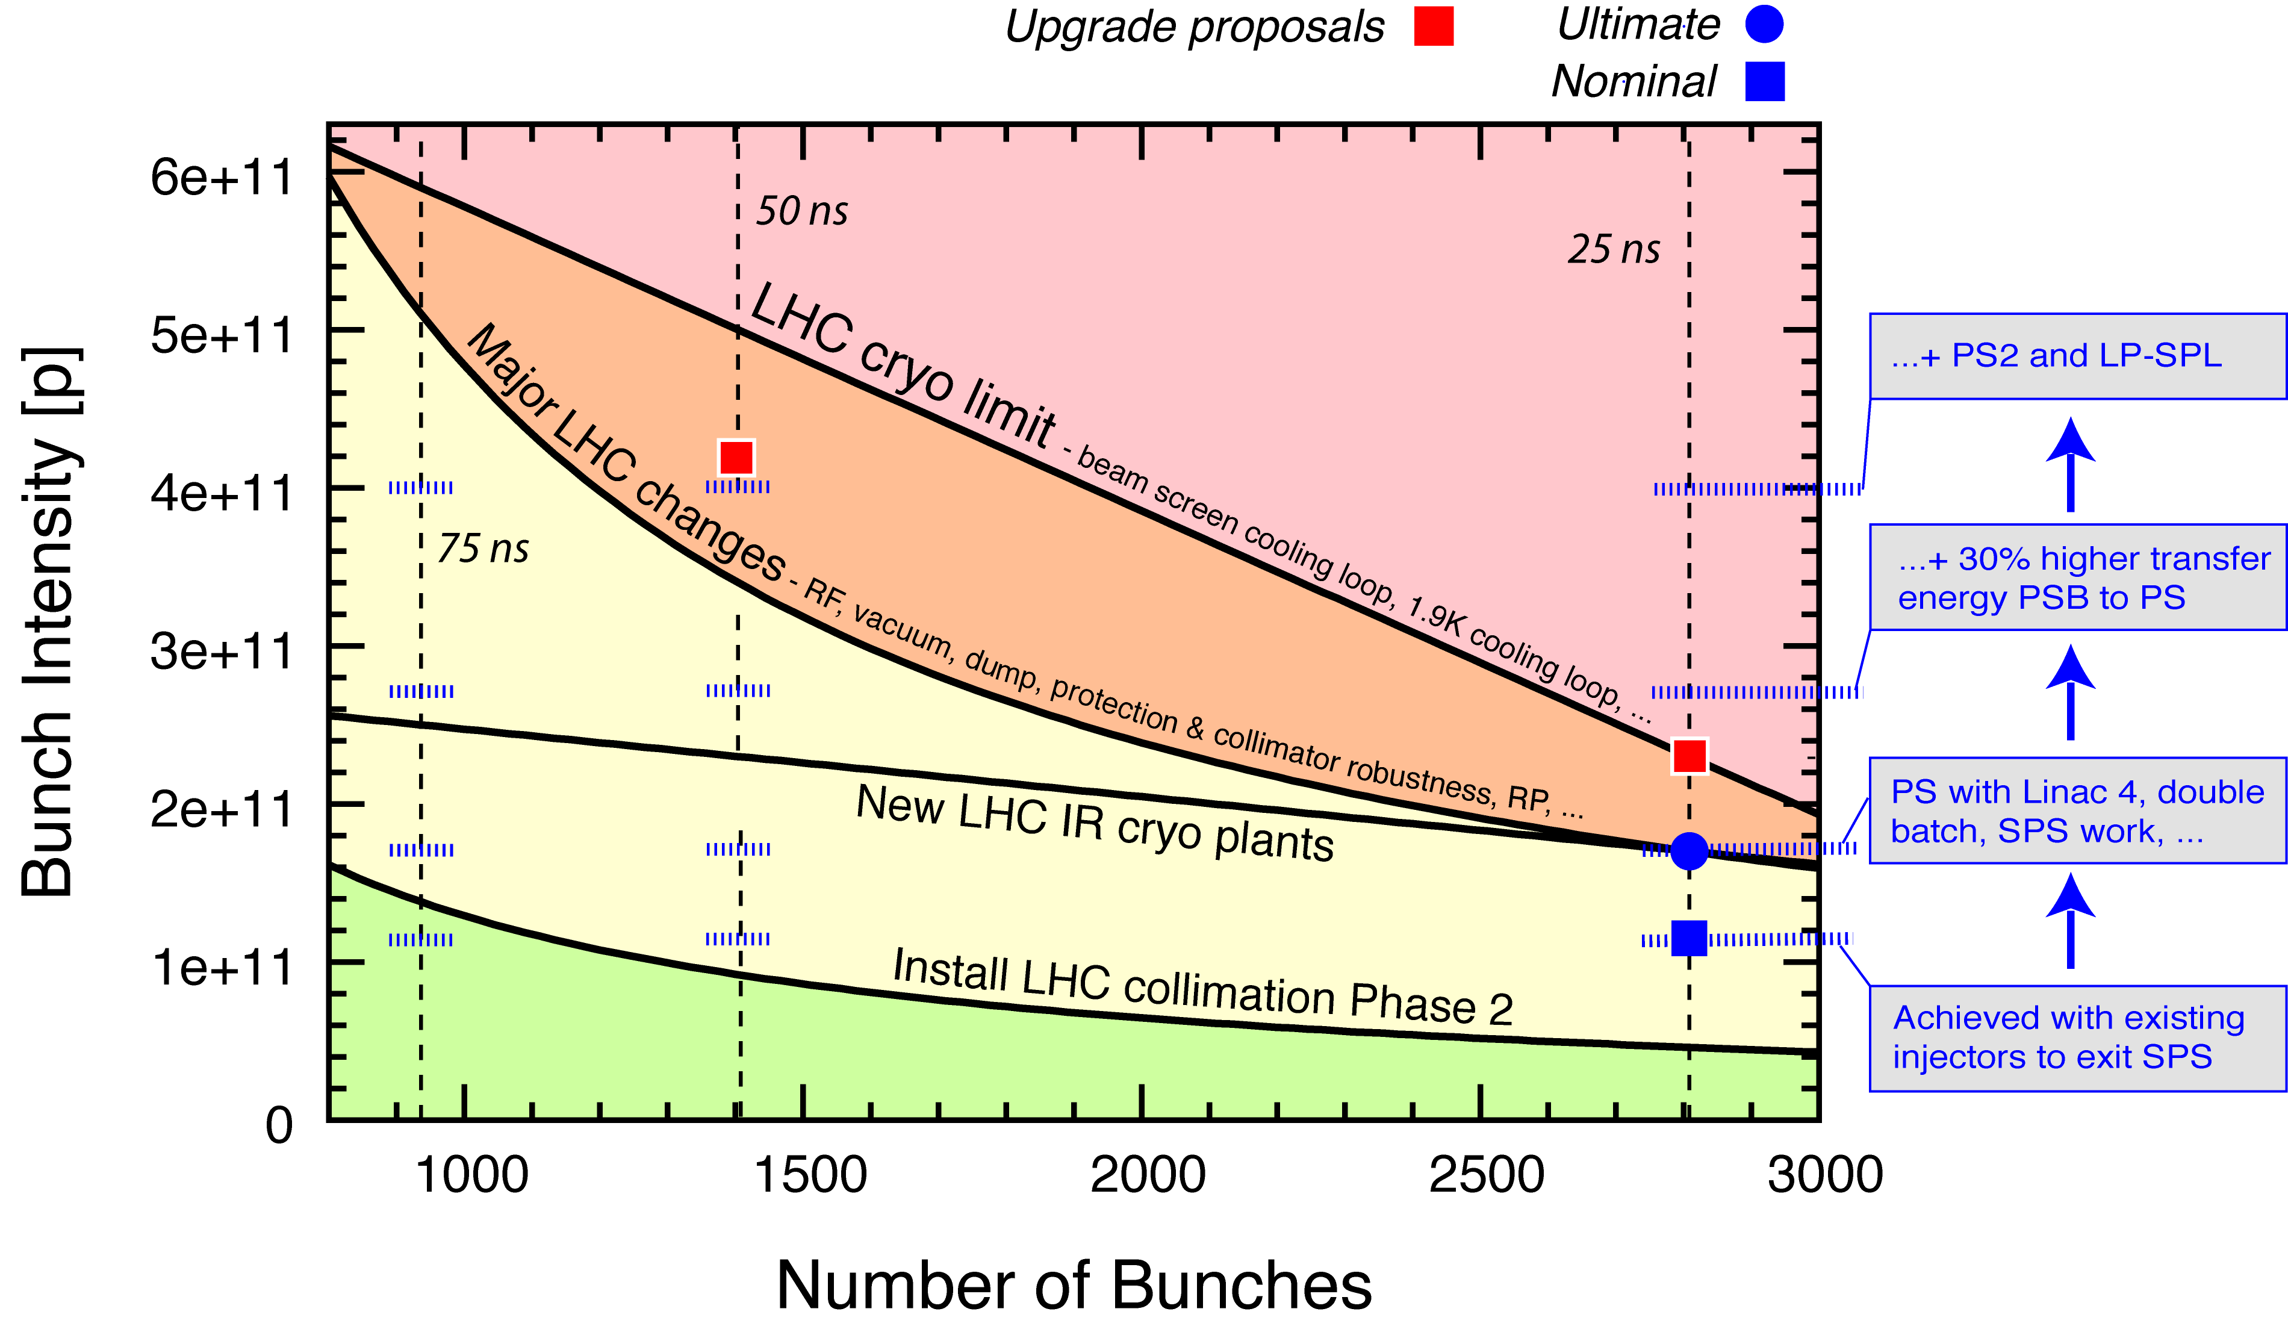
LHC Intensity Limits (7 TeV)
R. Assman @ Chamonix 2010
Chamonix 2011
R. Assmann
Ideal scenario: no imperfections included!
Note: Some assumptions and conditions apply…

