Slide 1
A few considerations
    Peak Lumi limitation → IT aperture
    PAC-MAN
    Bunch length

Slide 2
Peak luminosity limitations
(based on the parameters “HL-LHC kickoff+”)
    → Peak lumi larger than 5E34 (from OB’s talk)
Parameter | nominal | 25ns | 50ns
N | 1.15E+11 | 2.0E+11 | 3.3E+11
n_{b} | 2808 | 2808 | 1404
beam current [A] | 0.58 | 1.02 | 0.84
beam separation [σ] | 10 | 10 | 10
β* [m] | 0.55 | 0.15 | 0.15
ε_{n} [μm] | 3.75 | 2.5 | 3.0
ε_{L} [eVs] | 2.51 | 2.5 | 2.5
Piwinski parameter | 0.68 | 2.5 | 2.5
geom. reduction | 0.83 | 0.37 | 0.37
beam-beam / IP | 3.10E-03 | 3.9E-03 | 5.0E-03
Peak Luminosity | 1 10³⁴ | 7.4 10³⁴ | 8.4 10³⁴
    What to do at the beginning of the coast?
    Anti-crabing (!), parallel sep. (LR!!) or more X-angle (demand on the IT/D1/Q4/D2 aperture, especially for 50 ns with bigger peak lumi and bigger emittance!!!)

Slide 3
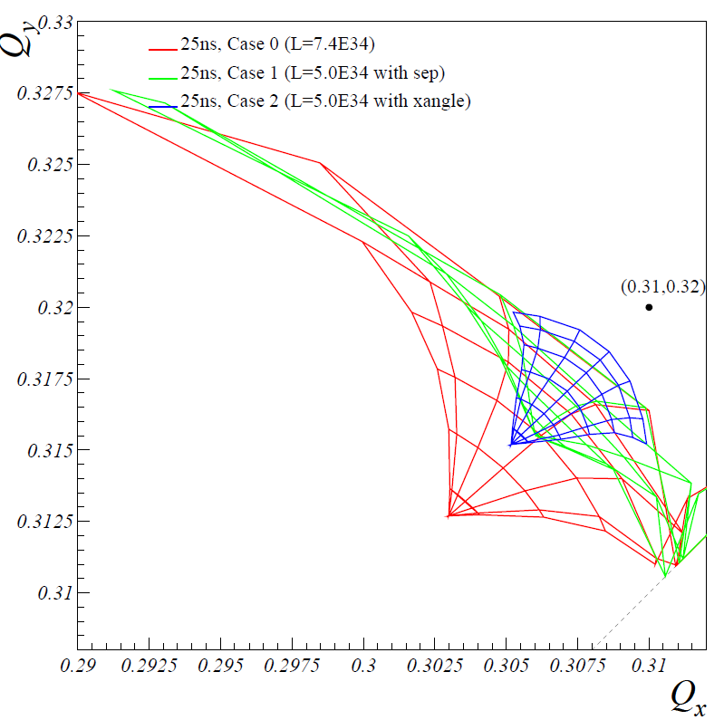
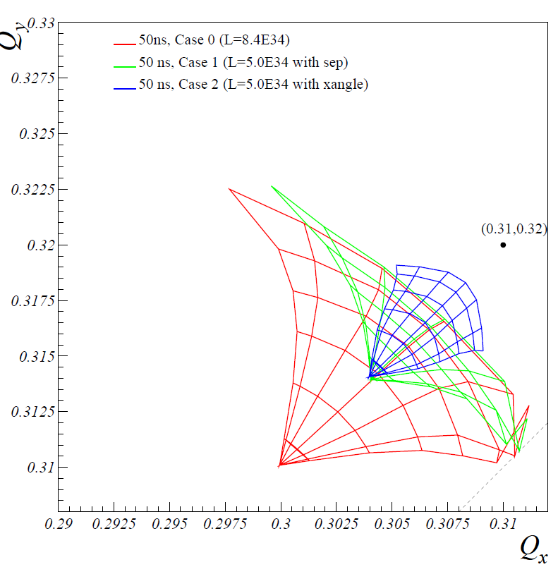
Assuming 2 IR’s and 21 LR’s per IP side (Phase I, could be up to 24 for the HL-LHC)
25 ns
50 ns
Crossing angle seems to be the best (only?) way: 15.5/17.7sigma needed for 25/50ns.
→ Even larger Piwinsky angle up to 4.5 for 50 ns!
For 50 ns (also with larger emittance) the IT aperture will be substantially larger

Slide 4
Pacman bunches
    Sooner or later there will be more PAC MAN than nominal bunches because the IT is longer, e.g. for 25 ns:
      Nominal LHC: 30 pacman per batch with 15 LR’s per IP side.
      Phase I : 42 pacman per batch with 21 LR’s per IP side.
      HL-LHC : up to 48 pacman against 24 nominal
    Eliminating the nominal bunches with 25 ns micro-batches of
    24 bunches will also
    1) Eliminate the Pacman effect itself,
    2) Halve the number of LR’s (as for 50 ns)
    3) With more bunches than for 50 ns (~1800)
    Possible SPS filling scheme micro-batches (courtesy of G. Rumolo)
    Can the bunch charge be the same as the one offered for 50 ns (2.5E11) with e.g. 2.5 mum emittance?
840 slots
83 slots ≈ 2μs
9 x (24b + 24e + 24b + 24e) @25ns

Slide 5
The “taboo” of the bunch length
    What’s about halving the bunch length?
    5 cm compatible with 16 MV and 1eVs injected emittance, but Landau cavity needed!
    4 cm would require “only” doubling the existing RF, which looks reasonable compared to 40MV crab-cavity per beam!
    A new parameter world can be opened for such a bunch length, which is also much less demanding in Piwinsky angle and beta* aspect ratio (flat optics) without crab.

