Slide 1
Estimated beam characteristics
from the upgraded injectors
R. Garoby for the LIU Project Team
Brainstorming - 24/06/2011

Slide 2
Planned actions
Status of investigations
Estimated beam characteristics
Planning
Summary

Slide 3
Principles of action
To increase performance
Brightness ä
Increase injection energy in the PSB from 50 to 160 MeV, Linac4 (160 MeV H⁻) to replace Linac2 (50 MeV H⁺)
Increase injection energy in the PS from 1.4 to 2 GeV, increasing the field in the PSB magnets, replacing power supply and changing transfer equipment
Upgrade the PSB , PS and SPS to make them capable to accelerate and manipulate a higher brightness beam (feedbacks, cures against electron clouds, hardware modifications to reduce impedance…)
To increase reliability and lifetime (until ~2030!)
(tightly linked with consolidation)
Upgrade/replace ageing equipment (power supplies, magnets, RF…)
Procure spares
Improve radioprotection measures (shielding, ventilation…)

Slide 4
Planned actions
Status of investigations
Estimated beam characteristics
Planning
Summary

Slide 5
Present focus: debugging of transverse emittance measurement – Emittance evolution from PSB to SPS
A. Guerrero
§ H. Bartosik
Emittance preservation (?) between
PS @ 26 GeV and SPS flat bottom
Emittance preservation (?) between
PSB and SPS flat bottom

Slide 6
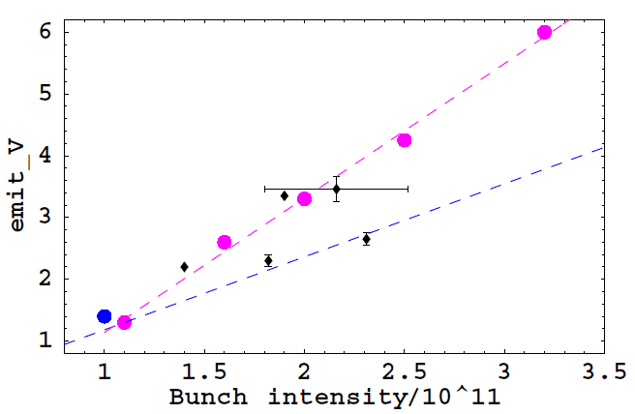
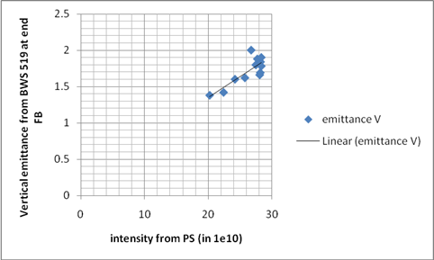
Puzzle: SPS performance in 2011 wrt 2010?
H. Bartosik
No dedicated measurements of emittance as function of intensity in 2010
    In 2010, emittance blow-up in PS was necessary in order to reduce blow-up in the SPS nominal optics
    In low γ_{t} optics, no blow-up in PS was necessary
Dedicated measurements in 2011
    2010 results for low γ_{t} optics confirmed (or outreached)
    No additional blow-up in PS needed for nominal optics – in general beam is more stable
    First measurement of emittance for high intensity in nominal optics shows promising results
    What is different in 2011? Why is beam is so much more stable?
Emittances measured 2010,
intensity corrected for losses
Nominal SPS optics, end of flat bottom (26 GeV/c)
B. Salvant, 26.5.2011
E. Shaposhnikova, Chamonix 2011
450 GeV/c
low γ_{t}

Slide 7
Planned actions
Status of investigations
Estimated beam characteristics
Planning
Summary

Slide 8
Caveat…
Beam parameters are given at injection in LHC: beam loss and blow-up inside the LHC are not accounted for.
All necessary improvements are implemented in the injectors (Linac4, PSB to PS transfer at 2 GeV, coupled bunch instabilities suppressed, e-cloud suppressed, hardware upgraded…)
Estimated beam degradation in the accelerator chain (based on observations in 2010):
  PS: 5 % beam loss, 5 % transverse blow-up
  SPS: 10 % beam loss, 5 % transverse blow-up.
RF gymnastics being kept, imperfections are unchanged:
  +-10 % fluctuation of all bunch parameters within a given PS bunch train.
  Traces of ghost/satellite bunches.

Slide 9
Beam parameters: Comments
Baseline
(estimated limit of SPS)
Constant longitudinal density
(Longitudinal instabilities)
+ Constant total beam current
(RF power)
Beam
Parameters
at 7 TeV
H/V transverse emittances [mm.mrad]
Constant transverse density
(Space charge)
Stretched
(estimated limit of SPS injectors)
Bunch intensity within constant longitudinal emittance [x10¹¹ p/b]

Slide 10
Beam parameters at LHC injection [50 ns]
Nominal performance
Baseline
(estimated limit of SPS)
Stretched:
(estimated limit of SPS injectors)
Beam
Parameters
at 7 TeV
H/V transverse emittances [mm.mrad]
< ½ longit. emittance wrt 25 ns during acceleration in the PS
=> Less Landau damping + e-clouds effects ?
?
?
Bunch intensity within constant longitudinal emittance [x10¹¹ p/b]

Slide 11
Beam parameters at LHC injection [50 ns]
Nominal performance
Baseline
(estimated limit of SPS)
Q2/2011
Stretched:
(estimated limit of SPS injectors)
Beam
Parameters
at 7 TeV
MD: double PSB batch
H/V transverse emittances [mm.mrad]
MD: single bunch with low γ_{t}
?
?
Bunch intensity within constant longitudinal emittance [x10¹¹ p/b]

Slide 12
Beam parameters at LHC injection [25 ns]
Nominal performance
Baseline
(estimated limit of SPS)
Stretched:
(estimated limit of SPS injectors)
Beam
Parameters
at 7 TeV
H/V transverse emittances [mm.mrad]
?
?
Bunch intensity within constant longitudinal emittance [x10¹¹ p/b]

Slide 13
Beam parameters at LHC injection [25 ns]
Nominal performance
Baseline
(estimated limit of SPS)
Stretched:
(estimated limit of SPS injectors)
MD: double PSB batch
Beam
Parameters
at 7 TeV
H/V transverse emittances [mm.mrad]
MD: single bunch with low γ_{t}
?
?
Bunch intensity within constant longitudinal emittance [x10¹¹ p/b]

Slide 14
Planned actions
Status of investigations
Estimated beam characteristics
Planning
Summary

Slide 15
Overall LIU Planning
 | Linac4 | PS injector, PS and SPS | Beam characteristics at LHC injection
2011 - 2012 | Continuation of construction… | Beam studies § simulations Investigation of RCS option Hardware prototyping Design § construction of some equipment TDR | 25 ns, 1.2 10¹¹p/b, ~2.5 mm.mrad 50 ns, 1.7 10¹¹p/b, ∼2.2 mm.mrad 75 ns, 1.2 10¹¹ p/b, ≤ 2 mm.mrad
2013 – 2014 (Long Shutdown 1) | Linac4 beam commissioning Connection to PSB ? | PSB modification (H⁻ injection) ? PSB beam commissioning ? Modifications and installation of prototypes in PS and SPS
2015 - 2017 | Progressive increase of Linac4 beam current | If Linac4 connected: progressive increase of PSB brightness Some improvement of PS beam (Injection still at 1.4 GeV) Equipment design § construction for PS injector, PS and SPS Beam studies | Limited gain at LHC injection (pending PSB (or RCS), PS and SPS hardware upgrades)
2018 (Long Shutdown 2) |  | Extensive installations in PS injector, PS and SPS Beam commissioning
2019 –2021 |  |  | After ~1 year of operation: beam characteristics for HL-LHC…

Slide 16
Planned actions
Status of investigations
Estimated beam characteristics
Planning
Summary

Slide 17
Summary
MDs during 2011-2012 are essential to refine the knowledge and understanding of the injectors and to check the potential of upgrades.
Preliminary requirement/First goal: getting confidence in beam instrumentation => Extensive debugging: progressing well, but time –consuming...
Recent observations in 2011 tend to demonstrate that the accelerators perform better than in the previous years. Not fully understood.
Need to interact with HL-LHC for selecting reachable beam parameters. Main purpose of the present meeting!
Irrelevant to the decision to connect Linac4 to the PSB during LS1 and to the choice between PSB/RCS, the beam characteristics specified for LIU will be met some time after the end of LS2 (~2020).

Slide 18
THANK YOU
FOR YOUR ATTENTION!

Slide 19
Reference

Slide 20
Why is today’s beam better than nominal?
Simple! No more blow-up along the accelerators cascade…
PSB:
  Improved (achromatic) optics in the Linac2 to PSB transfer line since 2005 [http://khanke.home.cern.ch/khanke/papers/2006/ab_note_2006_001.pdf]
PS:
  Injection trajectories
  Working point along the whole cycle
  Transition
PS to SPS:
  Transverse matching with better optics in TT2-TT10
  WARNING: NO MARGIN LEFT!

Slide 21
Spare slides

Slide 22
Planned actions
Status of investigations
Estimated beam characteristics
Planning
Summary

Slide 23
Linac4: Commissioning schedule
M. Vretenar
Start of beam commissioning (3MeV): May 2013
End of beam commissioning (160 MeV): April 2014
(version November 2010)
5 commissioning stages:
3 MeV
10 MeV
50 MeV
100 MeV
160 MeV
In 2013/14 (15 months), 6.5 months of beam commissioning, 3 months of HW tests, 5.5 months of installation

Slide 24
PS injector - option 1: PSB Upgrade
K. Hanke
+ Consolidation (Dipoles Power Supply, RF, Cooling § Ventilation) >20 MCHF

Slide 25
PS injector - option 2: RCS
Tentative RCS parameters
=> Same beam characteristics than PSB @ 2GeV
=> Shorter PS § SPS injection flat bottoms
Energy range | 160 MeV to 2 GeV
Circumference | (200x 4/21) π m ≈ 119.68 m
Repetition rate | ~10 Hz
RF voltage | 60 kV
Harmonics | h = 1 + 2 (in option: 4)
Frequency range | 1.3 MHz (h=1 at injection) to 9.5 MHz (h=4 at ejection)
Beam parameters for LHC (for lower emittances scale down intensity accordingly) | Intensity: up to 12×2.7 10¹¹ protons/cycle (3.25 10¹² p/p) Transv. emittance: ε*_{rms} ≈ 2.5 μm Long. emittance: ε_{l} < 12×0.27 eVs (determined by acceptance for most cases)
Lattice | 3-fold symmetry 21 cells, 5 cells/arc, 2 cells/straight section
Tunes | 3.5 < Q_{H,V} < 4.5
Length of straight section (4x) | 2 x 2.35 m
Relativistic gamma at transition | ~4
Maximum magnetic field | < 1.3 T
K. Hanke
Benefits:
Competitive cost wrt PSB consolidation and upgrade (? Study in progress…)
Reliability (new hardware / modern design)
Commissioning decoupled from physics operation

Slide 26
PS Upgrades
+ Consolidation (Cooling § Ventilation, cables replacement…) ~43 MCHF

Slide 27
SPS Upgrades
+ Consolidation ~ ? MCHF

Slide 28
Planned actions
Status of investigations
Estimated beam characteristics
Planning
Summary

Slide 29
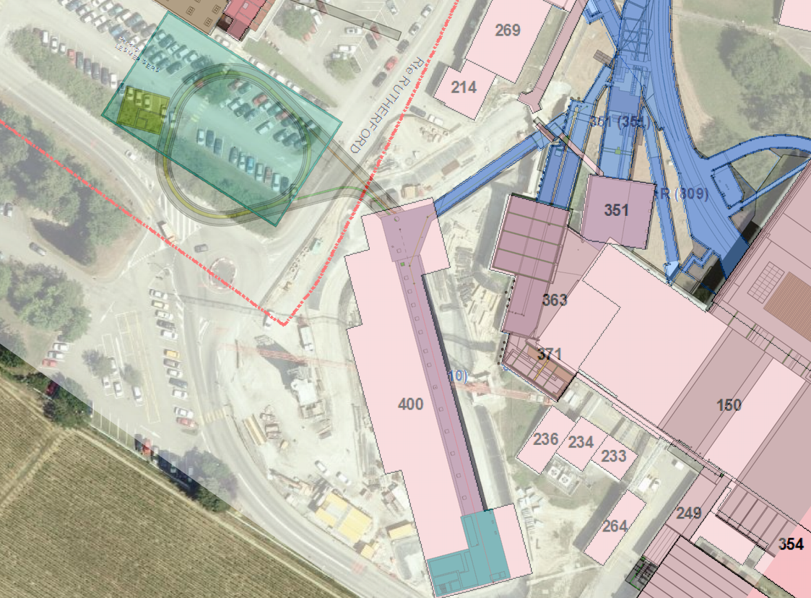
PS injector: RCS feasibility study
Beam characteristics:
for all PS users: equivalent to PSB at 2 GeV
for ISOLDE: ~ 7 10¹³ p/s @ 2 GeV (today: ~ 10¹³ p/s @ 1.4 GeV)
Feasibility report with
cost estimate: end of July

Slide 30
Principle of Working Point Scans
E. Benedetto
GOAL: Identify dangerous resonance lines in tune diagram
Loss measurement for different WPs:
  Low intensity beam (not SC-dominated) → 130 x 10¹⁰ protons
  Large emittance (to fill the chamber & provoke immediate losses)
  Long flat bottom @ 1.4 GeV
  Tune program:
    Scan between (0.1 - 0.4)
    Vertical tune constant
    Sweep of the horizontal tune
  Slope in the intensity signal indicates importance of the crossed resonance line

Slide 31
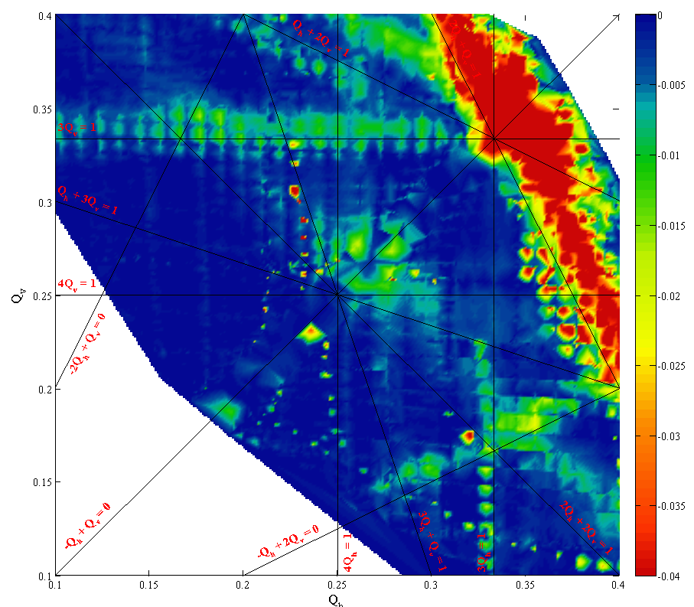
PS Transverse: Tune Scans
2 GeV
E. Benedetto
  w/o PFW : no surprises
  with PFW ongoing

Slide 32
PS Longitudinal: Batch Compression (1/2)
MD tests – H. Damerau, S. Hancock – May 2011

Slide 33
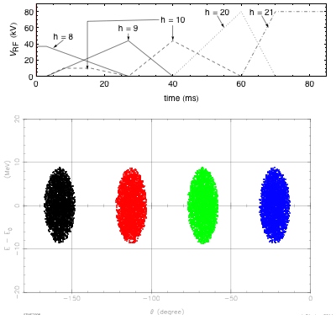
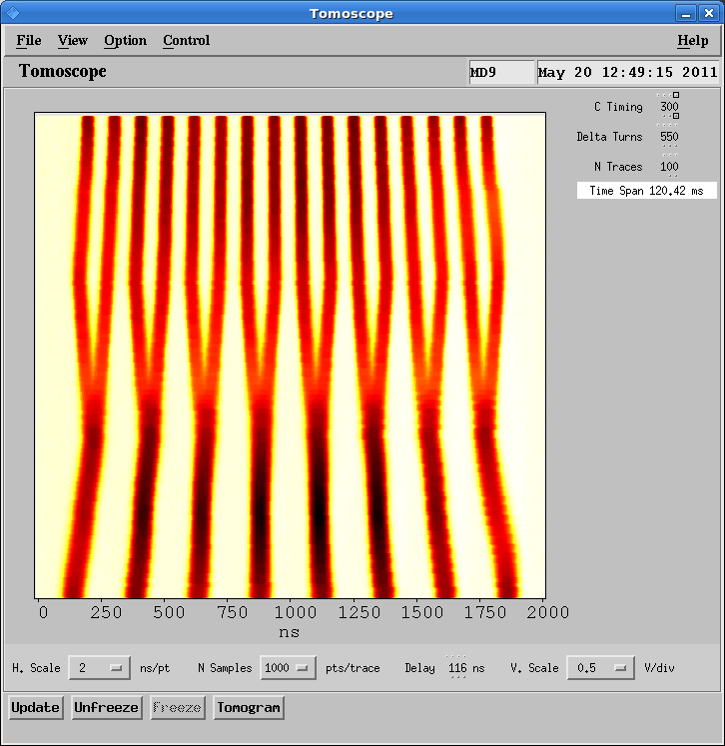
PS Longitudinal: Batch Compression (2/2)
Simulation (C. Carli)
MD result at 2 GeV (H. Damerau, S. Hancock)
Pure h = 21
Pure h = 9
  RF gymnastics OK up to intermediate energy
  Significant effort required to reach 26 GeV and make beam available for the SPS (RF preparation § beam adjustment) => Need for precise measurement of transverse emittances before continuing

Slide 34
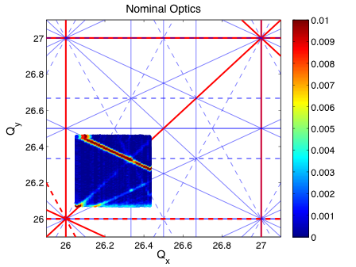
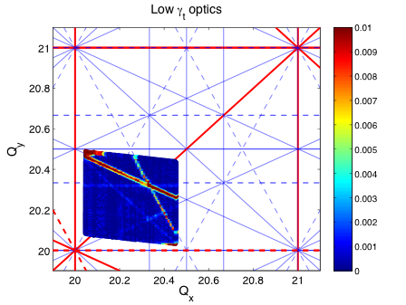
SPS Transverse: Tune Scans
H. Bartosik
Identified resonances in the low γ_{t} optics
      normal sextupole resonance Qx+2Qy is the strongest
      skew sextupole resonance 2Qx+Qy quite strong !!??
      normal sextupole Qx-2Qy, skew sextupole resonance at 3Qy and 2Qx+2Qy fourth order resonances visible
Identified resonances in the nominal optics
      normal sextupole resonance Qx+2Qy is the strongest
      Coupling resonance (diagonal, either Qx-Qy or some higher order of this), Qx-2Qy normal sextupole
      skew sextupole resonance 2Qx+Qy weak compared to Q20 case
      It seems that the stop-band width of the vertical integer is stronger than in Q20 optics
Notes:
TMCI threshold can be increased by increasing chromaticity or longitudinal emittance

Slide 35
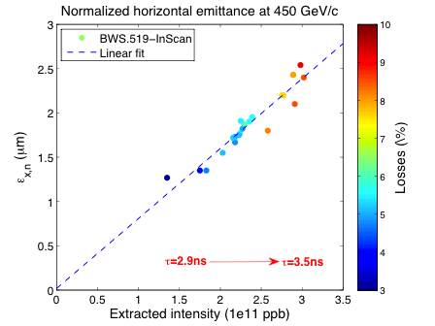

SPS Transverse: Single Bunch Emittances
H. Bartosik
Measurement of single bunch emittances
      In scan with “reference” wire scanner BWS.519 at flat top
      Long cycle (~10s injection plateau, ~10s acceleration)
      Losses along the cycle extracted from DC-BCT measurement
PS bunch length increasing with intensity
      Τ=2.9ns @ 1.5e11 p/b, Τ=3.5ns @ 3e11 p/b
      Emittances in PSB: ~ 1μm < 1.5e11p / ~ 1.1μm @ 2e11p / ~ 1.3μm @ 3e11p (Well adjusted beam in the PSB!)

Slide 36
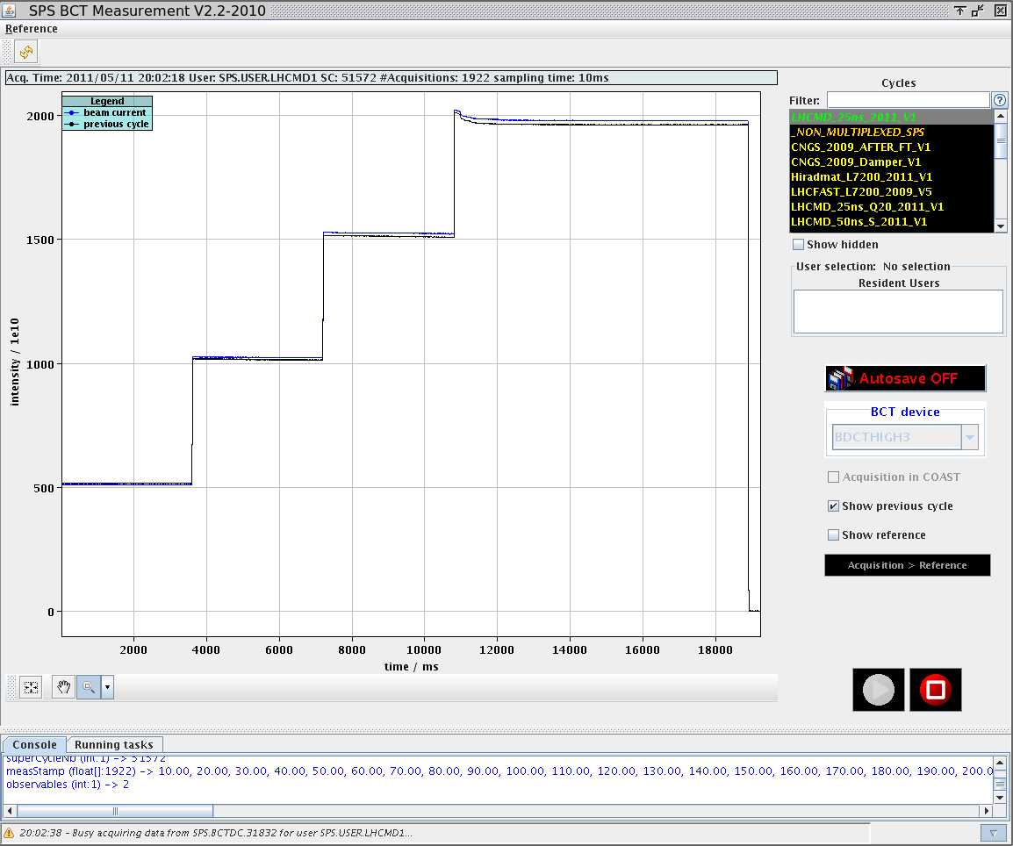
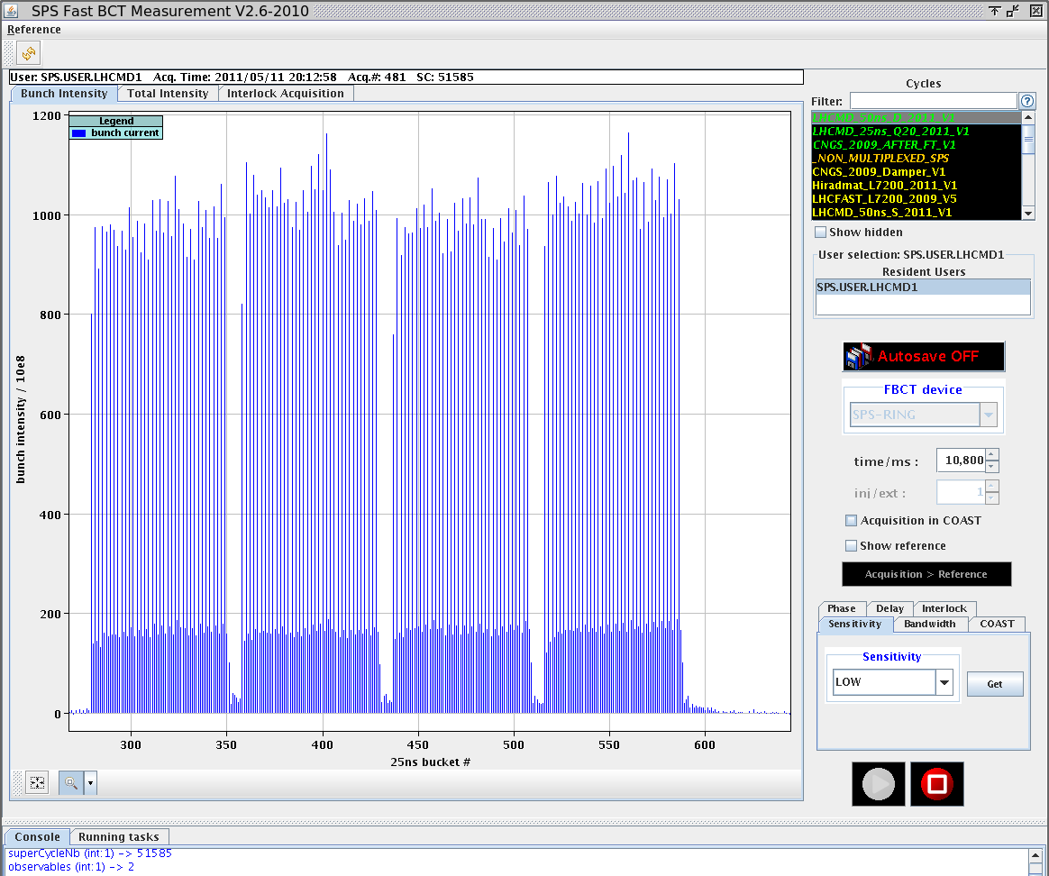
SPS: 50ns bunch train – Double PSB batch
  Intensity 1.65 10¹¹ p/b
    Up to 4 batches injected
    Very low losses along the cycle (reproducible 3%)
    Eh=2.0 μm and Ev=1.9 μm at flat top (sum 3.9)
Measured on 1st batch – to be confirmed

Slide 37
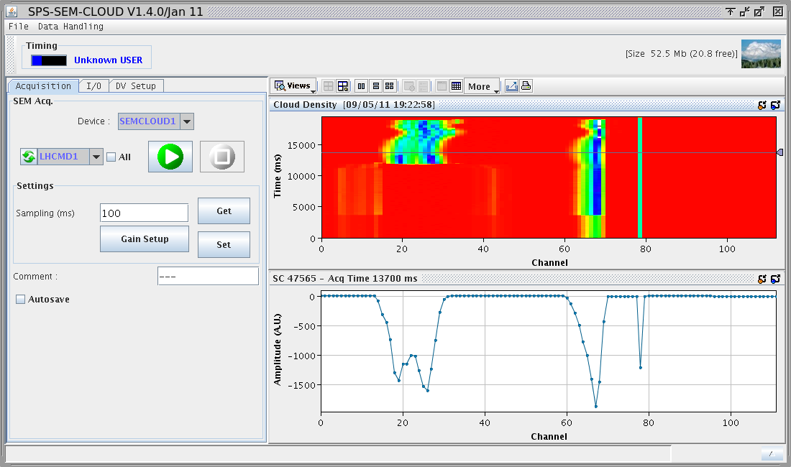
SPS: e-cloud with 25 ns bunch train
M. Taborelli
  Electron cloud measured at all the liners
    Signal already visible with 1 batch on both stainless steel liners
    No signal visible on the a-C coating liner
    Half signal clearly visible on the half coated chamber
    Effect of the clearing electrode checked scanning points on a grid of voltage vs. magnetic field values
Clearing electrode: it was switched off in the middle of cycle
Half-coated liner, only stripe on StSt visible

Slide 38
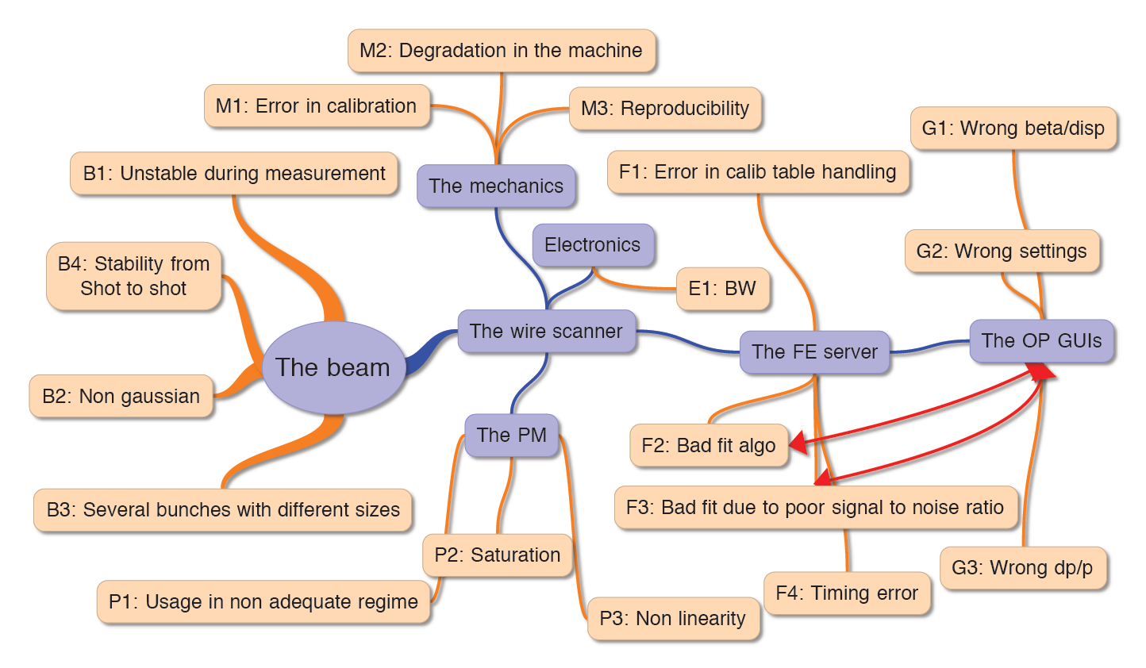
Present focus: debugging of transverse emittance measurement – Error source inventory
J.J. Gras

Slide 39
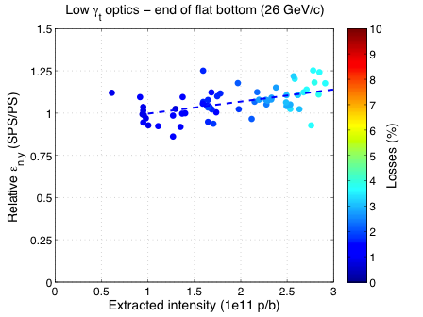
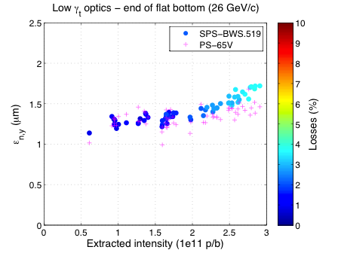
Emittance blow-up in SPS with low γ_{t}
H. Bartosik
MD4 beam in PSB with 1.1 turns injected (slightly smaller transverse emittances)
Simultaneous measurements of vertical emittance in PS and SPS
  At extraction (just before bunch rotation) in PS using PS-65.V
  At end of flat bottom using SPS-BWS.519
  Here RF-voltage of 5.75 MV in SPS
If calibration of wire scanners between machine is believed → emittance blow-up for intensities above 1.5e11 p/b with peak values of 25% at 3e11 p/b
Notes:
TMCI threshold can be increased by increasing chromaticity or longitudinal emittance

Slide 40
Planned actions
Status of investigations
Estimated beam characteristics
Planning
Summary

Slide 41
Linac4 connection to the PSB
High interest of connecting Linac4 to the PSB during LS1:
  Staged upgrade spread between LS1 and LS2 (shorter LS2 ?)
  Timely termination of the Linac4 project
Reasonable scenario (with 20 months LHC shutdown) if LHC stops in May 2013
  Possibility to run the injectors until the end of 2013
  No beam for physics before early 2015
Scenario based on LHC stop at end 2012 is more risky / not recommended: when physics resumes after 20 months interruption, users will expect similar performance § reliability than before the shutdown…
M. Vretenar

Slide 42
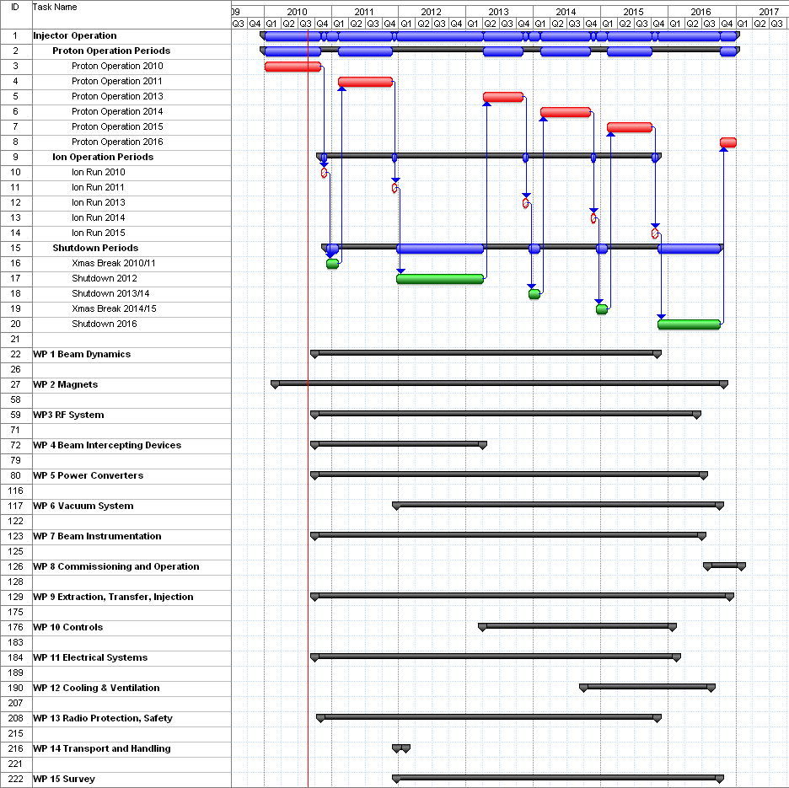
PSB Upgrades

Slide 43
PS Upgrades
Injection, magnets,
power converters…
RF
S. Gilardoni
Priority | Item | When
[1] | New coupled-bunch FB | 2012
2 | Dedicated kicker cavity | 2015-2020
10 MHz
[1] | 1-turn delay FB | 2011
1 | Renovate FB amplifiers | 2011-2015 (?)
1 | Slow phase loops around each cavity | 2013-2014
2 | New power amplifier (1 tube/gap) | 2014-2018 (?)
20 MHz
1 | 1-turn delay FB | 2012
2 | Slow phase loops around each cavity | 2012
40 MHz
[1] | Automatic tuning system | 2011
1 | 1-turn delay FB | 2012
2 | New feedback amplifier in grooves | 2014
2 | Slow phase loops around each cavity | 2012
3 | Study more voltage per cavity | 2013
3 | New power supplies | 2014-
80 MHz
1 | 1-turn delay FB | 2012
1 | Automatic tuning system - PLC, prot./ions switching | 2011-2012
2 | Slow phase loops around each cavity | 2012
2 | New feedback amplifier in grooves | 2014
2 | Fast ferrite tuner | 2016
3 | Study more voltage per cavity | 2013
3 | New power supplies | 2014-
3 | Extra 80 MHz cavity | ???
System | Elements
Injection elements | Injection septum Injection bumpers Eventual extra kicker
Low energy correctors | 100 horizontal correctors 30 vertical correctors
Low energy skew quadrupoles | 45 magnets
Low energy quadrupoles | 40 magnets
Transverse damper | Power part of existing system
e-cloud attenuation system | Chamber coating or electrode Installation
Instrumentation | BWS, BCT, Orbit system, profile monitors.
Improved shielding on top of route Goward and on top of SMH16 | Shielding elements

Slide 44
SPS Upgrades (1/2)
B. Goddard

Slide 45
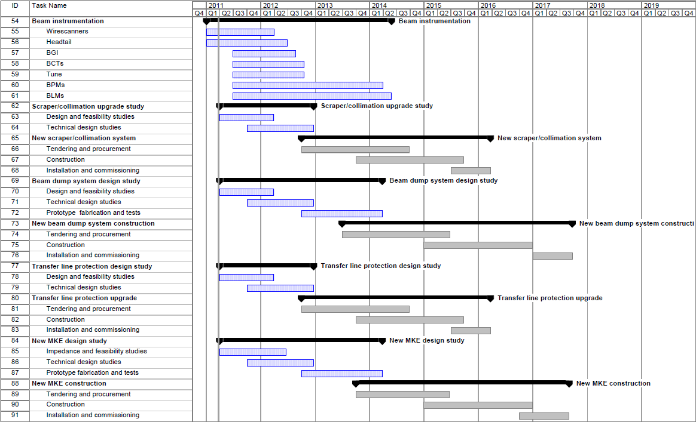
SPS Upgrades (2/2)
Outline LIU-SPS planning - provisional
B. Goddard

