Slide 1
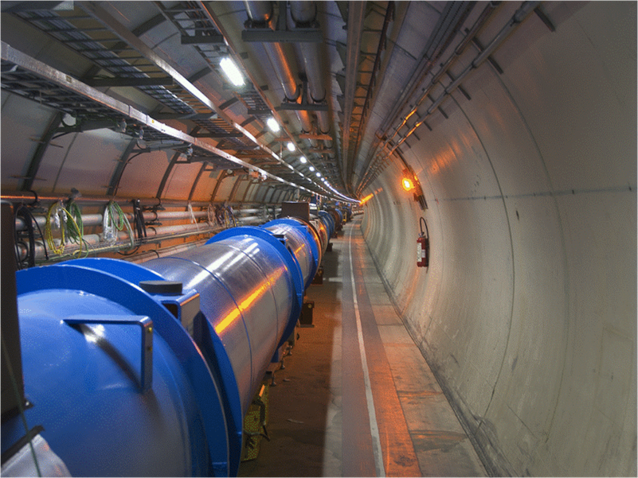
Beam characteristics at collision energy for the main HL-LHC scenarios: Fundamental motivation for the proposed beam parameters
O. Brüning BE-ABP

Slide 2
HL-LHC Performance Goals
Leveled peak luminosity: L = 5 10³⁴ cm⁻² sec⁻¹
Virtual peak luminosity: L ≥ 10 10³⁴ cm⁻² sec⁻¹
Integrated luminosity: 200 fb⁻¹ to 300 fb⁻¹ per year
(I assume 250 fb⁻¹ per year in the following)
Total integrated luminosity: ca. 3000 fb⁻¹
LIU-HL-LHC Brainstorming meeting, CERN, 24 June 2011
Oliver Brüning BE-ABP
2

Slide 3
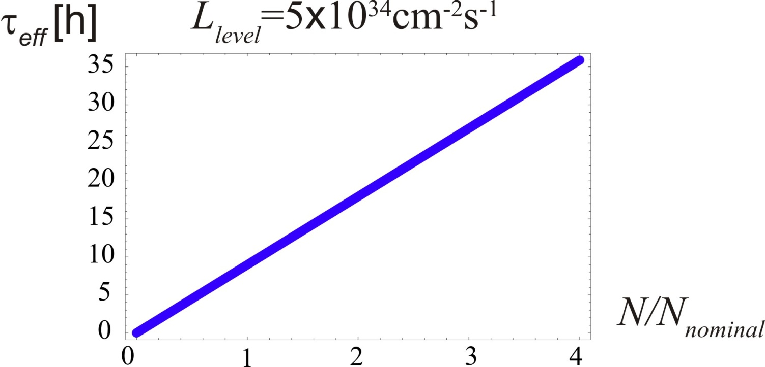
Upgrade Considerations: Beam Lifetime
F. Zimmermann, Chamonix 2011
For given luminosity τ_{eff} scales with total beam current
N(t) = (1-t/τ_{eff}) N_{tot}
(σ=100 mbarn)
argument for HL-LHC scenarios with maximum beam current
τ_{eff} = 13.9 hours for 5 10¹⁴ p/beam
LIU-HL-LHC Brainstorming meeting, CERN, 24 June 2011
Oliver Brüning BE-ABP
3

Slide 4
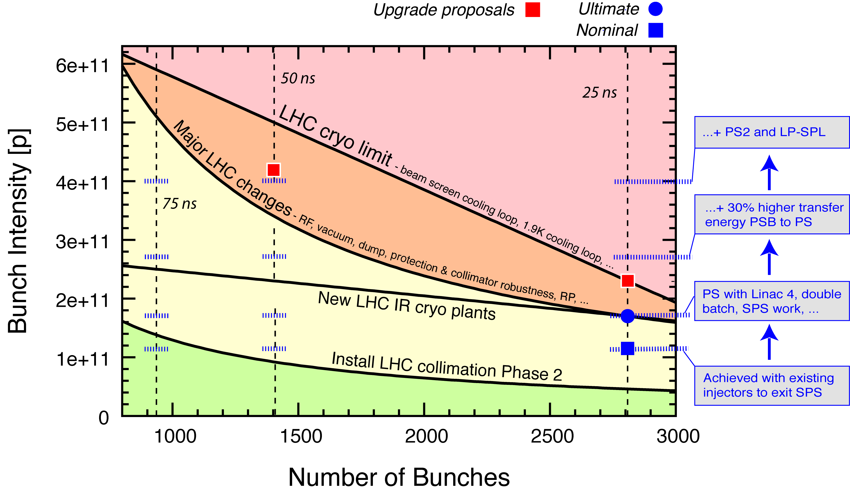
Summary of LHC Intensity Limits (7 TeV)
R. Assman @ Chamonix 2010
Chamonix 2011
R. Assmann
Lower Maximum Intensity of 5 10¹⁴ p/beam
Upper Maximum Intensity of 6.5 10¹⁴ p/beam (TMCI limit for 50ns?)
(Beam Current Limit of ca. 1 A / beam!)
Ideal scenario: no imperfections included!
Note: Some assumptions and conditions apply…
LIU-HL-LHC Brainstorming meeting, CERN, 24 June 2011
Oliver Brüning BE-ABP
4

Slide 5
Upgrade Considerations: Beam Lifetime
Run length assuming leveled luminosity:
virtual luminosity of k * 5 10³⁴ cm⁻² sec⁻¹ ➔ T_{level} = (1-1/√k) * τ_{eff}
Assuming: 1.8 10¹¹ ppb @ 25ns & 3.5 10¹¹ ppb @ 50ns (➔ ≈ 5 10¹⁴ p/beam)
➔ τ_{eff} = 13.9 hours for 5 10¹⁴ p/beam:
# k = 2: ➔ T_{level} = 4.1 h
# k = 3: ➔ T_{level} = 5.9 h
# k = 4: ➔ T_{level} = 7.0 h
LIU-HL-LHC Brainstorming meeting, CERN, 24 June 2011
Oliver Brüning BE-ABP
5

Slide 6
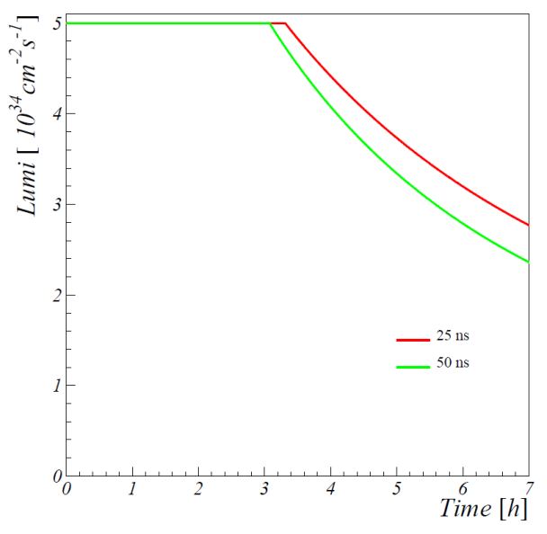
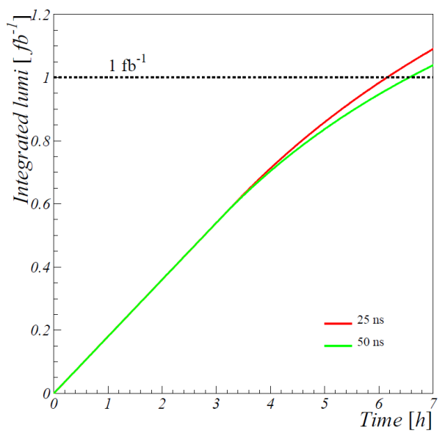
Upgrade Considerations: Integrated Luminosity
Integrated luminosity: run with luminosity decay
[Stephane Fartoukh]
assuming no emittance growth over the fill ➔ the emittance growth due to IBS and beam-beam is compensated by radiation damping
L_{int} = ca 0.4 fb⁻¹ over 3 h for a luminosity decay to 2.5 10³⁴ cm⁻² s⁻¹
LIU-HL-LHC Brainstorming meeting, CERN, 24 June 2011
Oliver Brüning BE-ABP
6

Slide 7
Upgrade Considerations: Integrated Luminosity
Integrated luminosity: leveling to constant luminosity
L_{int} = L_{level} * T_{level}
    integrated luminosity directly proportional to total current
L_{int} = 0.4 + 0.73 fb⁻¹ per fill for N_{tot} = 5 10¹⁴ ppb and k = 2
L_{int} = 0.4 + 1.25 fb⁻¹ per fill for N_{tot} = 5 10¹⁴ ppb and k = 4
(σ=100 mbarn)
LIU-HL-LHC Brainstorming meeting, CERN, 24 June 2011
Oliver Brüning BE-ABP
7

Slide 8
Upgrade Considerations: Integrated Luminosity
Phase | Days | Comment
Commissioning | 21
Scrubbing run | 10
5 MDs | 22 | 4.5 days per slot
6 Technical stops | 30 | 5 days (4 days TS plus 1 day recovery with beam)
Special requests | 10 | TOTEM/ALPHA Intermediate energy run Luminosity scans
Intensity ramp up | ~39
Total high intensity | ~130
Ion setup | 4
Ion physics | 24
TOTAL | 290
requires between 150 and 220 fills per year to reach 250 fb⁻¹ per year!
Can hope for ca. 150 days / year
for HL-LHC operation
implies 1 to 1.5 fills per day for previous scenario
M. Lamont March 2011

Slide 9
Upgrade Considerations: Integrated Luminosity
Machine Efficiency:
average Turnaround time of ca. 5 hours
minimum fill-to-fill time = 3h + leveling time + turnaround time
Efficiency = number of fills per day * fill-to-fill time / 24 h
  allows comparison with LHC operation: Efficiency = L_{oper} / L_{theor}
Example 1: k = 4 ➔ 1 fill per day with run length of 10h:
    fill-to-fill time = 3h + 7h + 5h = 15h
    Efficiency = 1 * 15 / 24 = 63%
Example 2: k = 2 ➔ 1.5 fills per day with run length of 7h:
    fill-to-fill time = 3h + 4h + 5h= 12h
    Efficiency = 1.5 * 12 / 24 = 75%
5 10¹⁴ p/beam
5 10¹⁴ p/beam
LIU-HL-LHC Brainstorming meeting, CERN, 24 June 2011
Oliver Brüning BE-ABP
9

Slide 10
Upgrade Considerations: Integrated Luminosity
HL-LHC running scenarios:
Assume average run length is reduced to premature end of fills
➔ assume on average 25% shorter than ideal fill length
                average fill time of 5h to 7.5h
  1.33 * 1 fills per day for k = 4
  Efficiency = 1.33 * 1 * (0.75* [3h+7h]+5h) / 24 = 70% (63%)
  1.33 * 1.5 fills per day for k = 2
  Efficiency = 1.33 * 1.5 * (0.75* [3h+4h]+5h) / 24 = 85% (75%)
5 10¹⁴ p/beam
LIU-HL-LHC Brainstorming meeting, CERN, 24 June 2011
Oliver Brüning BE-ABP
10

Slide 11
Upgrade Considerations: Machine Efficiency
LHC Operation: theoretical maximum integrated luminosity
average Turnaround time of ca. 5 hours @ 3.5 TeV (2.5 h minimum)
Peak luminosity: 1.1 10³³ cm⁻² sec⁻¹
Luminosity lifetime: ca. 20h (35h) exponential ([1+t/tau]⁻²) decay
Can’t be explained by burn off (ca. 30h from DR restgas and IBS)!
optimum fill length of ca. 14h with rather broad peak
minimum fill-to-fill length: 2.5h + 14h = 16.5h
integrated luminosity / fill: ca. 40 pb⁻¹ (40 pb⁻¹) (fill 1883) (44 pb⁻¹)
integrated luminosity / day: ca. 58 pb⁻¹ (58 pb⁻¹) (65 pb⁻¹)
integrated luminosity / week: 405 pb⁻¹ (405 pb⁻¹) (450 pb⁻¹)
LIU-HL-LHC Brainstorming meeting, CERN, 24 June 2011
Oliver Brüning BE-ABP
11

Slide 12
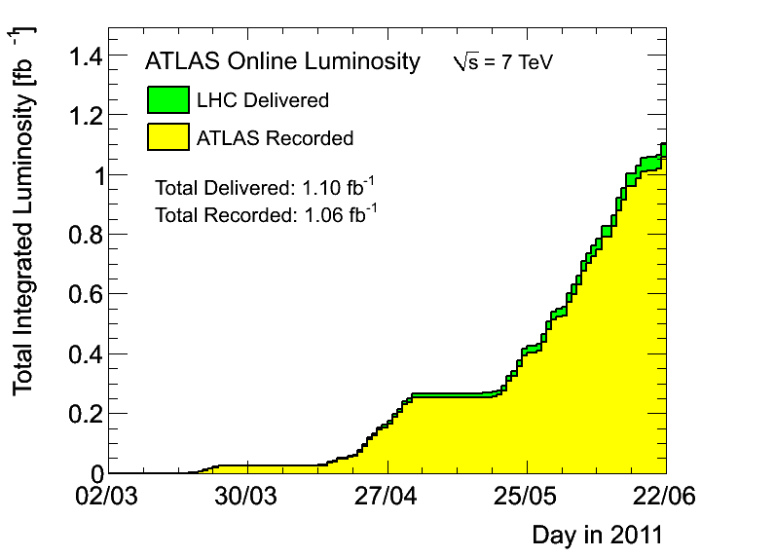
Upgrade Considerations: Integrated Luminosity
LHC
Operation:
650 pb⁻¹
in
last 4 weeks
800 pb⁻¹
in
last 5 weeks
obtained integrated luminosity per week over last month: ca. 163 pb⁻¹
  LHC Efficiency: ca. 163 / 405 ➔ 40%
LIU-HL-LHC Brainstorming meeting, CERN, 24 June 2011
Oliver Brüning BE-ABP
12

Slide 13
Upgrade Considerations: Integrated Luminosity
HL-LHC running scenarios: 6 10¹⁴ p/beam; ‘k’ = 5
➔ τ_{eff} = 16.7 hours for 6 10¹⁴ p/beam:
  fill length of 3 + 9.2 hours for k = 5
  average Turnaround time of ca. 5 hours
      total fill time of 17.2 hours with L_{int} = 1.7 + 0.4 fb⁻¹ per fill
  0.8 fills per day (only leveled run without decay)
      requires ca. 57% efficiency of the machine!
LIU-HL-LHC Brainstorming meeting, CERN, 24 June 2011
Oliver Brüning BE-ABP
13

Slide 14
Upgrade Considerations: Integrated Luminosity
HL-LHC running scenarios:
  fill length of 6.3 h and 8.7 h for 4 10¹⁴ p/beam and ‘k’ = 2 ⬅➔ 4
  Turnaround time of ca. 5 hours
                total fill time of ca. 11.3 and 13.7 hours
  1.7 fills per day (k = 2; virtual luminosity of 10³⁵ cm⁻² sec⁻¹)
  requires 81% machine efficiency!
  1.2 fills per day (k = 4; virtual luminosity of 2 10³⁵ cm⁻² sec⁻¹)
  requires 70% machine efficiency!
What virtual performance levels (‘k’) are within reach for
4 10¹⁴ p/beam, 5 10¹⁴ p/beam and 6 10¹⁴ p/beam?
LIU-HL-LHC Brainstorming meeting, CERN, 24 June 2011
Oliver Brüning BE-ABP
14

Slide 15
Upgrade Considerations: Minimum β* values:
Limitations for β* at 7 TeV: Aperture & Chromatic aberrations
HL LHC Upgrade: New scheme (ATS) for optics
-β* of 0.15m accessible for round beams @ 7 TeV
➔ implies β-functions of > 20km inside triplet magnets!
➔ limit of Field Quality and aperture
-β* of 0.3m / 0.075m accessible for flat beams @ 7 TeV
S. Fartoukh
Aperture at 7 TeV::
interaction with WP3 of the HL-LHC
current aperture goals are consistent with β* of 0.15m and
10 σ separation
LIU-HL-LHC Brainstorming meeting, CERN, 24 June 2011
Oliver Brüning BE-ABP
15

Slide 16
Upgrade Considerations: Maximum Bunch Intensity:
Bunch Intensity:
Collective effects (e.g. single bunch TMCI) ➔ ca. 3.5 10¹¹ ppb
e-cloud effect ➔ depends on bunch spacing
➔ 2.2 10¹¹ ppb at 25ns requires: δ_{sec} < 1.3 and
IR cryo upgrade
➔ TMCI intensity limit for 50ns compatible with: δ_{sec} > 1.7 and
IR cryo upgrade
LIU-HL-LHC Brainstorming meeting, CERN, 24 June 2011
Oliver Brüning BE-ABP
16

Slide 17
Upgrade Considerations: Maximum Brightness
Beam-Beam: limits maximum beam by brightness
  ΔQ = 0.02 – 0.03 seems feasible based on 2010 experience
  maximum acceptable PA? ➔ Θ > 2? (sync-betatron resonances)
  Three experiments with head on collisions: ➔ ξ = 7.7 10⁻³
  assuming the same geometric reduction factor for ξ as for L (0.35 with alternating crossing) and assuming negligible contribution from long range:
        ε_{n} ≥ 2 μm for N_{bunch} = 3.5 10¹¹ (50ns bunch spacing)
        ε_{n} ≥ 1 μm for N_{bunch} = 2.2 10¹¹ (25ns bunch spacing)
LHCC meeting, CERN, 14 June 2011
Oliver Brüning BE-ABP
17

Slide 18
HL-LHC Performance Estimates
nominal bunch length and minimum β*: ‘HL-LHC Kickoff+’
minimum β*
5.6 10¹⁴ and 4.6 10¹⁴
p/beam
Parameter | nominal | 25ns | 50ns
N | 1.15E+11 | 2.0E+11 | 3.3E+11
n_{b} | 2808 | 2808 | 1404
beam current [A] | 0.58 | 1.02 | 0.84
x-ing angle [μrad] | 300 | 475 | 520
beam separation [σ] | 10 | 10 | 10
β* [m] | 0.55 | 0.15 | 0.15
ε_{n} [μm] | 3.75 | 2.5 | 3.0
ε_{L} [eVs] | 2.51 | 2.5 | 2.5
energy spread | 1.00E-04 | 1.00E-04 | 1.00E-04
bunch length [m] | 7.50E-02 | 7.50E-02 | 7.50E-02
IBS horizontal [h] | 80 -> 106 | 25 | 17
IBS longitudinal [h] | 61 -> 60 | 21 | 16
Piwinski parameter | 0.68 | 2.5 | 2.5
geom. reduction | 0.83 | 0.37 | 0.37
beam-beam / IP | 3.10E-03 | 3.9E-03 | 5.0E-03
Peak Luminosity | 1 10³⁴ | 7.4 10³⁴ | 8.4 10³⁴
sufficient room for leveling
(with Crab Cavities)
Virtual luminosity (25ns) of
L = 7.4 / 0.37 10³⁴ cm⁻² s⁻¹
= 20 10³⁴ cm⁻² s⁻¹ (‘k’ = 4)
Virtual luminosity (25ns) of
L = 8.4 / 0.37 10³⁴ cm⁻² s⁻¹
= 22.7 10³⁴ cm⁻² s⁻¹ (‘k’ = 4.5)
OK for HL goals (‘k’ = 4)
(Even better if emittances can be further reduced:
still a factor 1.2 to 2.5
wrt beam-beam limit)
(Leveled to 5 10³⁴ cm⁻² s⁻¹)
Events / crossing | 19 | 141 | 257 | 95 | 190
LIU-HL-LHC Brainstorming meeting, CERN, 24 June 2011
Oliver Brüning BE-ABP
18
Notes:
50ns beam option provides HL-LHC performance levels at ultimate total beam currents; only the ‘large beta*’ option reaches beam-beam limit; IBS growth rates are a concern!; low beta option has 50% higher performance potential

Slide 19
Upgrade Considerations: Integrated Luminosity
HL-LHC 25ns goal: 5.6 10¹⁴ p/beam k = 4
  τ_{eff} = 15.6 h and leveling time: 7.8 h
  Turnaround time: 7.8h + 3h + 5h = 15.8h ➔ 1.5 fills /day
  L_{int} / fill = 1.4 fb⁻¹ + 0.4 fb⁻¹
  60% efficiency on 150 days ➔ 250 fb⁻¹
HL-LHC 50ns goal: 4.6 10¹⁴ p/beam k = 4.5
  τ_{eff} = 12.8 h and leveling time: 6.8 h
  Turnaround time: 6.8h + 3h + 5h = 14.8h ➔ 1.7 fills /day
  L_{int} / fill = 1.22 fb⁻¹ + 0.4 fb⁻¹
  60% efficiency on 150 days ➔ 250 fb⁻¹
LIU-HL-LHC Brainstorming meeting, CERN, 24 June 2011
Oliver Brüning BE-ABP
19

Slide 20
HL-LHC Performance Estimates
nominal bunch length and LIU estimates for injector complex:
minimum β*
Parameter | nominal | 25ns | 50ns
N | 1.15E+11 | 1.7E+11 | 2.5E+11
n_{b} | 2808 | 2808 | 1404
beam current [A] | 0.58 | 0.86 | 0.64
x-ing angle [μrad] | 300 | 480 | 430
beam separation [σ] | 10 | 10 | 10
β* [m] | 0.55 | 0.15 | 0.15
ε_{n} [μm] | 3.75 | 2.5 | 2.0
ε_{L} [eVs] | 2.51 | 2.5 | 2.5
energy spread | 1.00E-04 | 1.00E-04 | 1.00E-04
bunch length [m] | 7.50E-02 | 7.50E-02 | 7.50E-02
IBS horizontal [h] | 80 -> 106 | 25 | 10
IBS longitudinal [h] | 61 -> 60 | 21 | 13
Piwinski parameter | 0.68 | 2.56 | 2.56
geom. reduction | 0.83 | 0.37 | 0.36
beam-beam / IP | 3.10E-03 | 3.0E-03 | 5.6E-03
Peak Luminosity | 1 10³⁴ | 5.3 10³⁴ | 7.2 10³⁴
4.8 10¹⁴ and 3.5 10¹⁴
p/beam
intensity and leveling room
marginal
Virtual luminosity of
L = 5.3 / 0.36 10³⁴ cm⁻² s⁻¹
= 14 10³⁴ cm⁻² s⁻¹ (‘k’ = 2.8)
L = 7.2 / 0.36 10³⁴ cm⁻² s⁻¹
= 20 10³⁴ cm⁻² s⁻¹ (‘k’ = 4)
IBS growth rates need to be re-evaluated for ATS optics!
25ns slightly short of HL goals (k < 4)
50ns requires > 80% machine efficiency
Events / crossing | 19 | 101 | 274 | 95 | 190
LIU-HL-LHC Brainstorming meeting, CERN, 24 June 2011
Oliver Brüning BE-ABP
20
Notes:
50ns beam option provides HL-LHC performance levels at ultimate total beam currents; only the ‘large beta*’ option reaches beam-beam limit; IBS growth rates are a concern!; low beta option has 50% higher performance potential

Slide 21
Upgrade Considerations: Integrated Luminosity
LIU 25ns goal: 25ns; 4.8 10¹⁴ p/beam k = 2.8
  τ_{eff} = 13.3 h and leveling time: 5.4 h
  Turnaround time: 5.4h + 3h + 5h = 13.4h ➔ 1.8 fills /day
  L_{int} / fill = 1 fb⁻¹ + 0.4 fb⁻¹
  60% efficiency on 150 days ➔ 225 fb⁻¹
LIU 50ns goal: 3.5 10¹⁴ p/beam k = 4
  τ_{eff} = 9.7 h and leveling time: 4.9 h
  Turnaround time: 4.9h + 3h + 5h = 12.9h ➔ 1.9 fills /day
  L_{int} / fill = 0.9 fb⁻¹ + 0.4 fb⁻¹
  60% efficiency on 150 days ➔ 115 fb⁻¹
LIU-HL-LHC Brainstorming meeting, CERN, 24 June 2011
Oliver Brüning BE-ABP
21

Slide 22
Personal Summary:
CRAB cavities are a vital ingredient for HL-LHC. Without them we
will fall short of 250 pb⁻¹ goal (k ≥ 4). CC are the best tool for compensating
geometric reduction factor (LRBB wires perhaps partially) (flat beams [SF])
Given equal bunch parameters, 25ns case is clearly better than 50ns
(assuming there is no electron cloud limit for 25ns!)
If LHC is limited by total beam current, 50ns offers larger
performance reach (higher virtual luminosity for equal lifetime)
Revised beam-beam limits (0.02 to 0.03) opens door for high brightness
operation scenarios
50ns schemes benefit from double batch injection ➔ higher brightness
Rather then lowering the bar for project goals, I would stick to challenging
(ideal) goals [while underlining that there is a risk associated to it
(like CC & Nb₃Sn for HL)] and to pursue novel schemes (e.g. feedback
systems etc.)
LIU-HL-LHC Brainstorming meeting, CERN, 24 June 2011
Oliver Brüning BE-ABP
22

Slide 23
Questions for discussion:
What is the smallest emittance LIU can generate for 50ns with 3.3 10¹¹ppb?
What is the highest intensity LIU can offer for 50ns with ε_{n} = 3 μm?
How confident are we that electron cloud effects will not limit 25ns
operation?
What is the emittance and intensity reach for 25ns operation?
Other (than e-cloud and TMCI) intensity limitations in the LHC (e.g. RF)?
Confidence that Nb3Sn magnet technology will be available for HL-LHC?
How confident are we that Crab cavities will be available for HL-LHC?
➔ flat beam option as alternative operation scenario (SF) (β > 40km)
How confident are we that we can reach a better efficiency for HL-LHC than for current operation (➔ see my spare transparencies)?
LIU-HL-LHC Brainstorming meeting, CERN, 24 June 2011
Oliver Brüning BE-ABP
23

Slide 24
Spare Transparencies

Slide 25
Potential limitations: minimum β* values:
Challenges – Unknowns for operation with small β*:
long range b-b & operation with LPA (synchro-β resonances)
  all can be alleviated by increasing β* ➔ smaller PA
Field Quality in triplet magnets:
  all can be alleviated by increasing β* ➔ smaller peak β
  keep β* of 0.2m and 0.5m as backup values for HL-LHC
  (but with reduced performance reach)
LIU-HL-LHC Brainstorming meeting, CERN, 24 June 2011
Oliver Brüning BE-ABP
25

Slide 26
Potential limitations: high brightness operation:
Challenges – Unknowns for operation with small β*:
IBS growth rates:
  Need to be re-evaluated for ATS scheme
  (which should help)
  Can be alleviated by larger bunch length ➔ larger PA
minimum Turnaround time:
  assumed here for HL: 2 * Turnaround time @ 3.5 TeV
  (ramp & squeeze time)
  Can be longer for small β*: larger than 2 ration (1.5 / 0.15)
  and ATS scheme, small current in matching section quads
LIU-HL-LHC Brainstorming meeting, CERN, 24 June 2011
Oliver Brüning BE-ABP
26

Slide 27
Potential limitations: General worries
How confident are we that average fill times are longer than 7h?
RF trips
QPS and PC trips
beam abort due to R2E
UFO rate
Last 30 fills had less then 4 operator initiated EOFs (2-1-1)!!!!!!
How confident are we that we can overcome e-cloud for 25ns?
HL-LHC goals require above ultimate intensities with sub-nominal ε_{n}
  requires SEY of less than 1.3!
  keep 50ns option alive!
  apart from pile-up, 50ns has a high performance potential!
LIU-HL-LHC Brainstorming meeting, CERN, 24 June 2011
Oliver Brüning BE-ABP
27

Slide 28
Potential limitations: high brightness operation:
No Leveling:
ca. 0.6 fb⁻¹ in 7 hours for start luminosity of 5 10³⁴ cm⁻² s⁻¹:
  12 hour minimum fill-to-fill time for 5 h turnaround time
  need 2.8 fills per day
  1.7 fb⁻¹ per day
  250 fb⁻¹ in 150 days
  requires 100% efficiency to reach HL goals!
LIU-HL-LHC Brainstorming meeting, CERN, 24 June 2011
Oliver Brüning BE-ABP
28

Slide 29

cooling & e- heat for 25 ns spacing
L. Tavian,
2005
H. Maury Cuna,
2009
nominal
“ultimate”
spare
cooling
capacity
at zero
luminosity
(=total-SR
-impedance)
LIU-HL-LHC Brainstorming meeting; 24th June
e-cloud
heat
load for
SEY=1.3
spare cooling capacity
for 0.55 m β*
Oliver Brüning BE-ABP
going above N_{b}=1.7x10¹¹ & ultimate luminosity requires
dedicated IR cryo plants; limit then becomes N_{b}~2.3x10¹¹

Slide 30
cooling & e- heat for 50 ns spacing
L. Tavian,
2005
H. Maury Cuna,
2009
“LPA”
spare
cooling
capacity
at zero
luminosity
(=total-SR
-impedance)
(longer flat bunches)
spare cooling capacity
for 0.25 m β*
LIU-HL-LHC Brainstorming meeting; 24th June
e-cloud
heat
load for
SEY=1.5!
Oliver Brüning BE-ABP
going above N_{b}=2.3x10¹¹ & ultimate luminosity requires
dedicated IR cryo plants; limit then becomes N_{b}~5.0x10¹¹

Slide 31
HL-LHC Performance Estimates
nominal bunch length and minimum β*: 6 10¹⁴ p/beam
minimum β*
Parameter | nominal | 25ns | 50ns
N | 1.15E+11 | 2.1E+11 | 4.3E+11
n_{b} | 2808 | 2808 | 1404
beam current [A] | 0.58 | 1.1 | 1.1
x-ing angle [μrad] | 300 | 475
beam separation [σ] | 10 | 10
β* [m] | 0.55 | 0.15
ε_{n} [μm] | 3.75 | 2.5
ε_{L} [eVs] | 2.51 | 2.5
energy spread | 1.00E-04 | 1.00E-04
bunch length [m] | 7.50E-02 | 7.50E-02
IBS horizontal [h] | 80 -> 106 | 25
IBS longitudinal [h] | 61 -> 60 | 21
Piwinski parameter | 0.68 | 2.6
geom. reduction | 0.83 | 0.37
beam-beam / IP | 3.10E-03 | 3.7E-03
Peak Luminosity | 1 10³⁴ | 8.1 10³⁴
25ns is OK for HL goals (‘k’ = 4)
50ns above TMCI stability threshold
Sufficient room for
leveling (with Crab Cavities)
Virtual luminosity of
L = 8.1 / 0.37 10³⁴ cm⁻² s⁻¹
= 22 10³⁴ cm⁻² s⁻¹ (‘k’ = 4.4)
(Leveled to 5 10³⁴ cm⁻² s⁻¹)
Events / crossing | 19 | 154 |  | 95 | 190
LIU-HL-LHC Brainstorming meeting, CERN, 24 June 2011
Oliver Brüning BE-ABP
31
Notes:
50ns beam option provides HL-LHC performance levels at ultimate total beam currents; only the ‘large beta*’ option reaches beam-beam limit; IBS growth rates are a concern!; low beta option has 50% higher performance potential

Slide 32
HL-LHC Performance Estimates
nominal bunch length and minimum β*: 4 10¹⁴ p/beam
minimum β*
Parameter | nominal | 25ns | 50ns
N | 1.15E+11 | 1.4E+11 | 2.8E+11
n_{b} | 2808 | 2808 | 1404
beam current [A] | 0.58 | 0.71 | 0.71
x-ing angle [μrad] | 300 | 430 | 520
beam separation [σ] | 10 | 10 | 10
β* [m] | 0.55 | 0.15 | 0.15
ε_{n} [μm] | 3.75 | 2.0 | 3.0
ε_{L} [eVs] | 2.51 | 2.5 | 2.5
energy spread | 1.00E-04 | 1.00E-04 | 1.00E-04
bunch length [m] | 7.50E-02 | 7.50E-02 | 7.50E-02
IBS horizontal [h] | 80 -> 106 | 23 | 25
IBS longitudinal [h] | 61 -> 60 | 18 | 21
Piwinski parameter | 0.68 | 2.5 | 2.5
geom. reduction | 0.83 | 0.37 | 0.37
beam-beam / IP | 3.10E-03 | 3.1E-03 | 4.2E-03
Peak Luminosity | 1 10³⁴ | 4.5 10³⁴ | 6.0 10³⁴
Not enough room for
leveling (with Crab Cavities)
Virtual luminosity (25ns) of
L = 4.5 / 0.37 10³⁴ cm⁻² s⁻¹
= 12 10³⁴ cm⁻² s⁻¹ (‘k’ = 2.4)
Virtual luminosity (50ns) of
L = 6 / 0.37 10³⁴ cm⁻² s⁻¹
= 16 10³⁴ cm⁻² s⁻¹ (‘k’ = 3.2)
Short of HL goals (‘k’ = 4) even if
CRAB cavities are a viable option
(Leveled to 5 10³⁴ cm⁻² s⁻¹)
Events / crossing | 19 | 86 | 228 | 95 | 190
LIU-HL-LHC Brainstorming meeting, CERN, 24 June 2011
Oliver Brüning BE-ABP
32
Notes:
50ns beam option provides HL-LHC performance levels at ultimate total beam currents; only the ‘large beta*’ option reaches beam-beam limit; IBS growth rates are a concern!; low beta option has 50% higher performance potential

Slide 33
Performance optimization for the LHC
Luminosity (round beams):
1) maximize bunch brightness [N_{b}/ε_{n}]
beam-beam limit and injector complex performance
2) minimize beam size (constant beam power)
3) maximize beam current (beam power limit)
4) compensate for ‘R’
Event pileup & e-cloud
LIU-HL-LHC Brainstorming meeting, CERN, 24 June 2011
Oliver Brüning BE-ABP
33

Slide 34
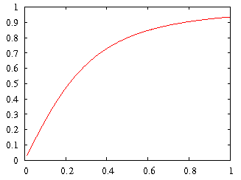
LHC Challenges: R
geometric luminosity
reduction factor:
Piwinski angle
effective cross section
large crossing angle:
➔ reduction of long range beam-beam interactions
➔ reduction of head-on beam-beam parameter
➔ reduction of the mechanical aperture
➔ synchro-betatron resonances
➔ reduction of instantaneous luminosity
➔ inefficient use of beam current
➔ option for L leveling!
LIU-HL-LHC Brainstorming meeting, CERN, 24 June 2011
Oliver Brüning 34

Slide 35
HL-LHC Performance Goals
Operation at performance limit
choose parameters that allow higher than design performance
leveling mechanisms for controlling performance during run
Preferred leveling mechanism: Crab Cavities
Reservations: technology & MP & field quality
➔ Supplementary tools for leveling:
# crossing angle and Long-range and
beam-beam wire compensators
# transverse offsets at IP
# dynamic β* squeeze
LIU-HL-LHC Brainstorming meeting, CERN, 24 June 2011
Oliver Brüning BE-ABP
35

Slide 36
Physics operations
ca. 65% efficiency
5 10¹⁴ p/beam and ‘k’ = 4
is probably OK
~30%
Stable beams!
W. Venturini @ Evian 2011
LIU-HL-LHC Brainstorming meeting, CERN, 24 June 2011

Slide 37
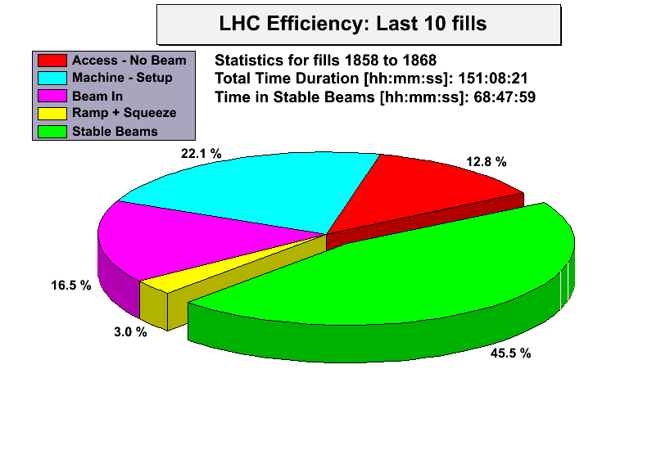
Efficiency (up to end of fill 1868)
ca. 65% efficiency
5 10¹⁴ p/beam and ‘k’ = 4
is probably OK
G. Arduini @ LMC 96, 2011
LIU-HL-LHC Brainstorming meeting, CERN, 24 June 2011
37

Slide 38
Ultimate LHC parameters:
Ultimate LHC: 25ns; 4.8 10¹⁴ p/beam; ε_{n} = 3.75μm
  τ_{lumi} = 12 h and ideal run length : 7 h
  Turnaround time: 7h + 5h = 12h ➔ 2 fills /day
  L_{int} / fill = 0.42 fb⁻¹
  60% efficiency on 150 days ➔ 80 fb⁻¹
LIU goal: 50ns; 3.5 10¹⁴ p/beam k = 4 with 50% efficiency
  τ_{eff} = 9.7 h and leveling time: 4.9 h
  Turnaround time: 4.9h + 3h + 5h = 12.9h ➔ 1.9 fills /day
  L_{int} / fill = 0.9 fb⁻¹ + 0.4 fb⁻¹
  60% efficiency on 150 days ➔ 115 fb⁻¹
LIU-HL-LHC Brainstorming meeting, CERN, 24 June 2011
Oliver Brüning BE-ABP
38

