Slide 1
Public Events Committee Meeting
12 March 2024
Indico

Slide 2
Agenda
New member of the PEv Committee
  Welcome Andreas Juttner (TH)
Recruitment of Public Events Curator [Update]
ToR of the committee [Update]
CERN70 Season [Update]
Status of 2024/25 season [Discussion]
Proposals for evaluation, for 2024/25 [Discussion]
Theme for 2024/25 [Suggestions]

Slide 3
Members and Mandate
Mandate – work in progress
To be picked up by Public Events Curator
1. Purpose
The purpose of the Public Events Committee is to ensure the quality and diversity of the public events programme in terms of format, content, gender and language of the presenter, target audience, etc. Using their professional network, members are invited to suggest content for the chosen themes.
2. Responsibility
The committee is responsible for reviewing proposals received from internal and external sources once feasibility has been established by the Public Events team.
Current members:
Ana Godinho (IR-ECO)
Frederick Bordry (former Director for ATS)
Manuella Cirilli (IPT-KT)
Melania Coletta (HR-D&I)
Tim Smith (IT-CEO)
Pascale Goy (C&SF)
Loraine Massarotti (SG-VI)
François Briard (SG-VI)
Andreas Juttner (TH)
Will join:
Public Events Curator (IR-ECO)*
Physicist (EP / Experiments)
* Convener of the Committee

Slide 4
A reminder of the strategy for Public Events Programming
At CERN – in Globe or SGW
Thematic Events (including Recurrent Events)
Events for the general public (e.g. talks, performances, Sparks!...)
Goal is to have a season of events running from Sept to June
Off-Theme Events
(including Recurrent Events)
Public Events Committee

Slide 5
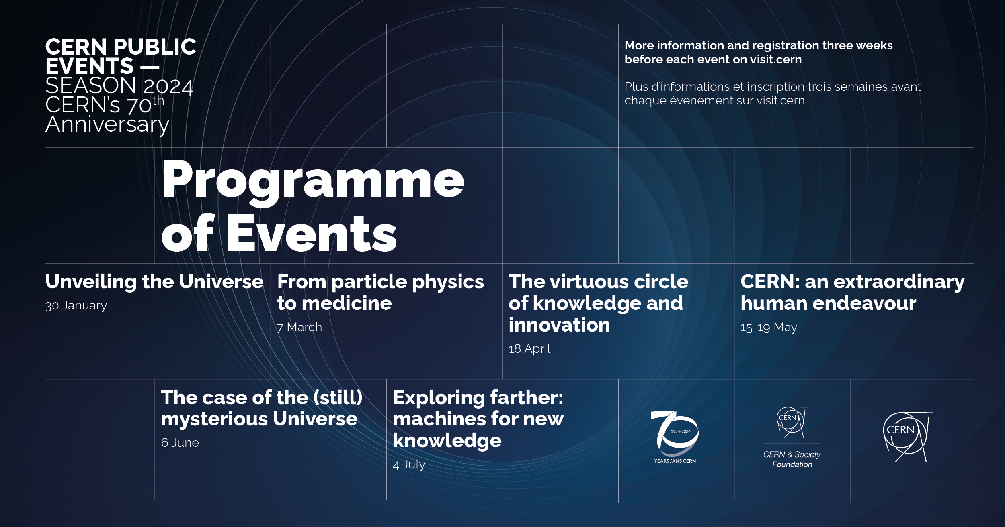
2024 Season – CERN70 (from Jan – Jul 2024)
Unveiling the Universe
Part 1 – Arts and science summit (6.2K views)
Part 2 – 70 years of discoveries at CERN (36K views)
From particle physics to medicine
- Recording (4.3K views)
  Off-theme: Progrès de l’étude de faisabilité du FCC (24 April)

Slide 6
Status of the 2024/25 season

Slide 7
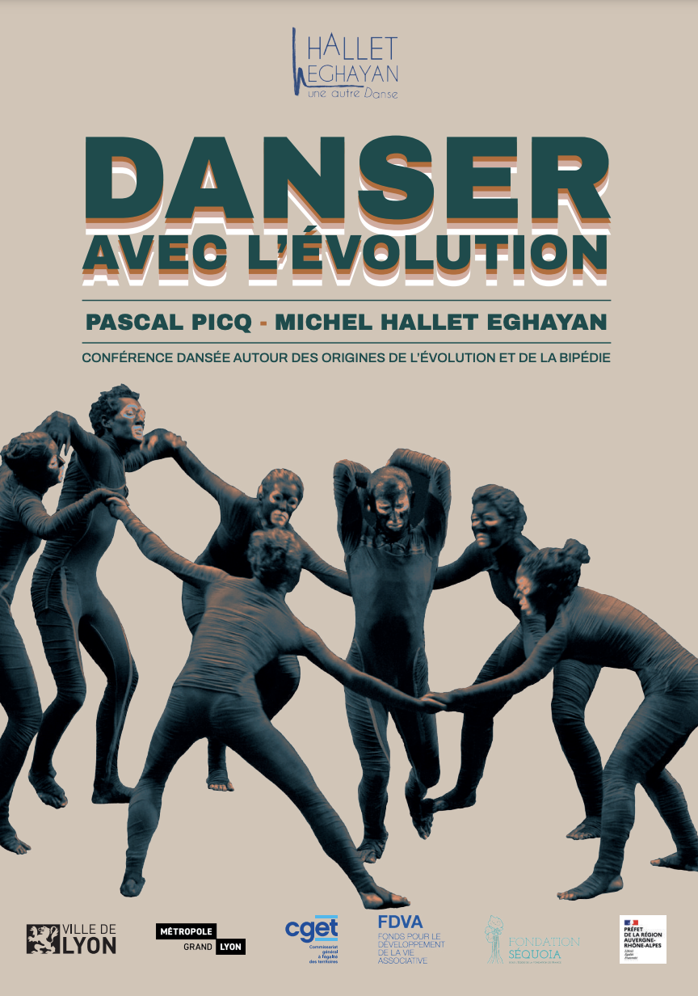
Danser avec l’evolution [In prep]
Hallet Eghayan and Pascal Picq
Theme: Evolution of bipedalism
Comms Hook: Link to the SGW exhibition Back to the Big Bang
Performance starts with 2-3min video about history of the Universe with images provided by CERN (awaiting synopsis)
Could include conversation between Pascal Picq and CERN physicist
Format: Dance and talk/discussion
Duration: 60 min
Audience: General public / Gender: all / Language: FR
Description: CONFÉRENCE DANSÉE AUTOUR DES ORIGINES DE L’ÉVOLUTION ET DE LA BIPÉDIE with anthropologist PASCAL PICQ and choreographer MICHEL HALLET EGHAYAN.
Full description here.
Costs: 7 KEUR (1 performance); 10KEUR (2 performances) + travel and accommodation
Date: 12 / 19 November 2024

Slide 8
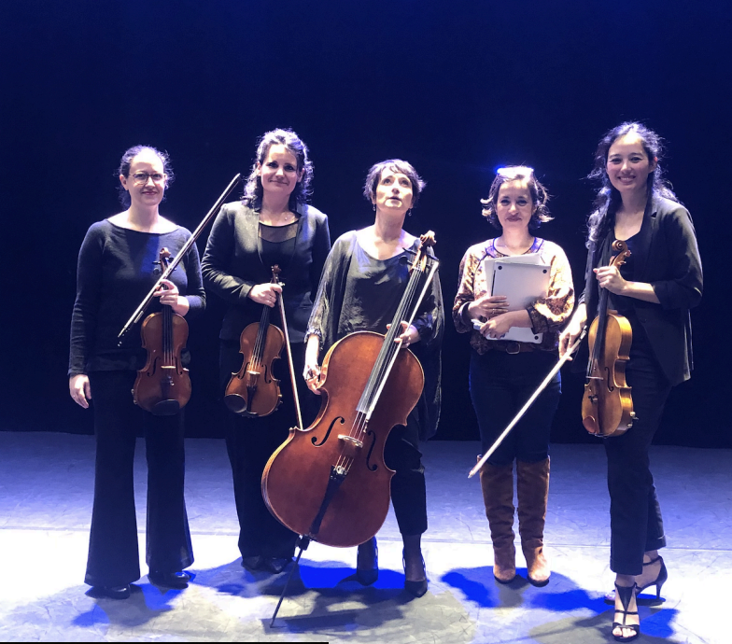
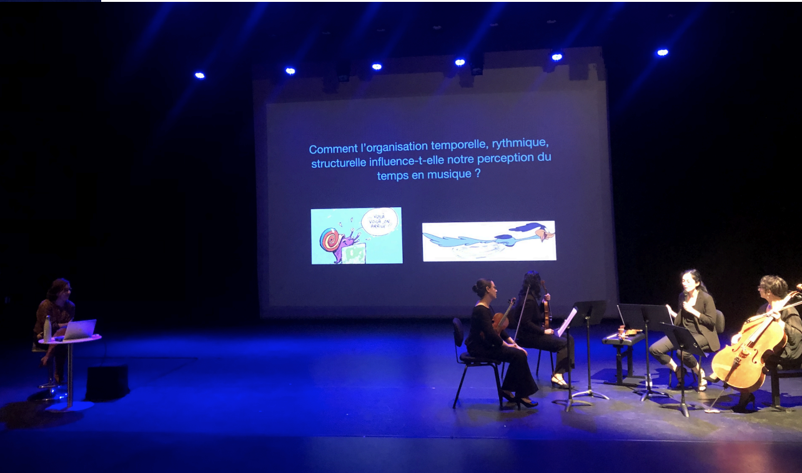
De Temps en temps [In prep]
Theme: Time (in physics and in music)
Proposed by: Yasmine Sara Amhis (LHCb)
Format: Talk + performance
Duration: 60 min
Audience: General public / Gender: F / Language: FR
Description:
Une création artistique et scientifique qui explore le rapport au temps ainsi la perception du temps en physique et en musique. Le temps étant un élément central de ces deux disciplines, en plus d’explications présentées par l’altiste du quatuor, un support musical est employé par le quatuor pour illustrer des concepts comme le rubato, le rythme, le musique répétitive etc. En ce qui concerne la physique, on évoque la notion de temps absolu, de temps relatif et ce en passant par des exemples de la physique fondamentale comme la mécanique classique et la relativité restreinte. Ici ce sont des transparents projetés qui servent de support en plus des explications.
Full description here.
Costs: 4 KEUR (waiting for new cost estimate)
Dates: Feb 2025 (exact date to be defined)

Slide 9
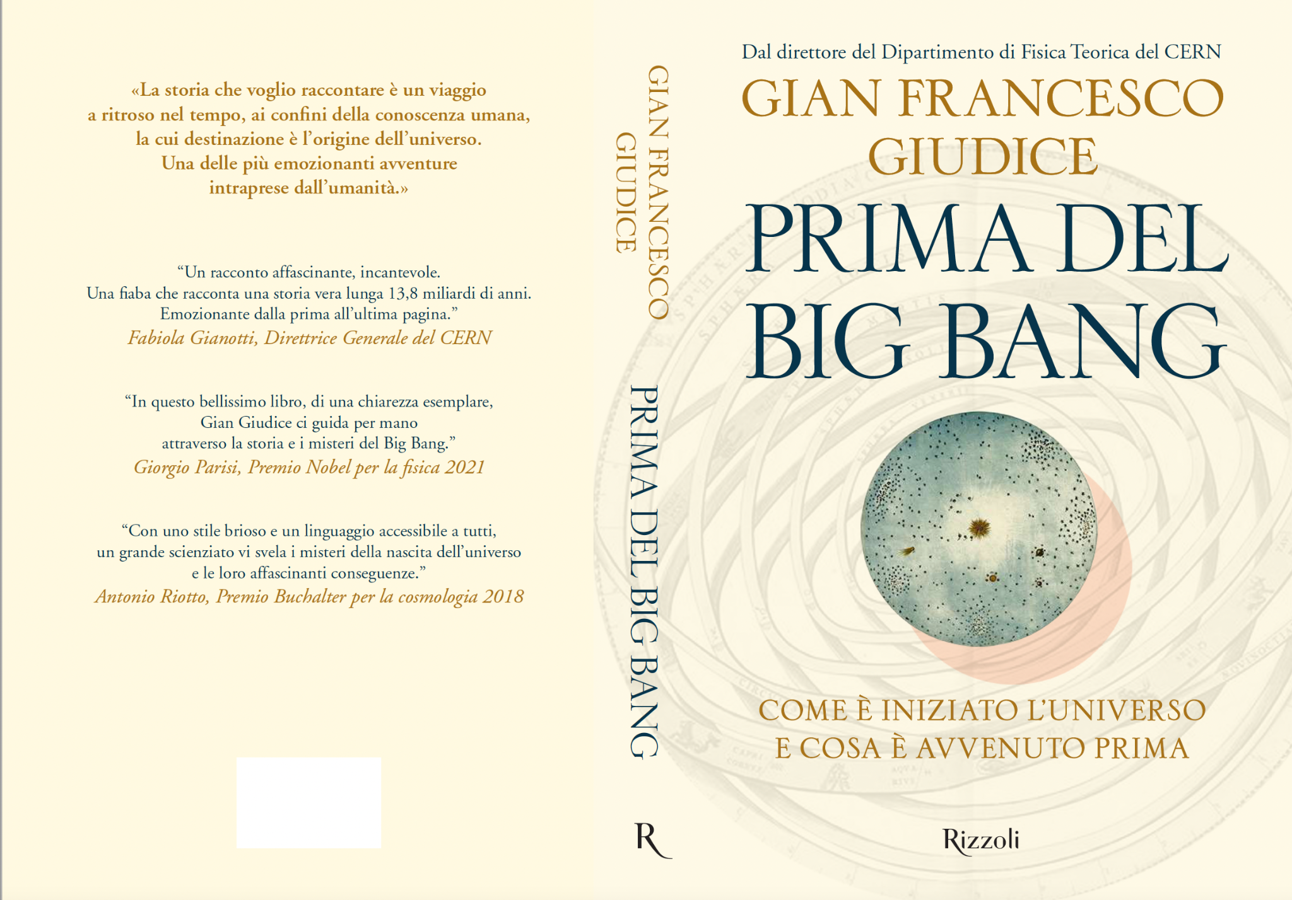
The Mysteries of the Universe [In discussion]
Gian Giudice et al
Theme: The Big Bang
Proposed by: Gian Giudice
Format: Talk
Duration: 75 min
Audience: General public / Language: IT / Gender: M
Description:
“The mysteries of the Universe”, with three talks (15-20 min each): Chiara Caprini - gravitational waves
Alba Grassi - the mathematical universe
Gian Guidice – the Big Bang,
followed by a discussion based on questions from the public, with a moderator
Cost: none
Date: To be determined: some time in 2025

Slide 10
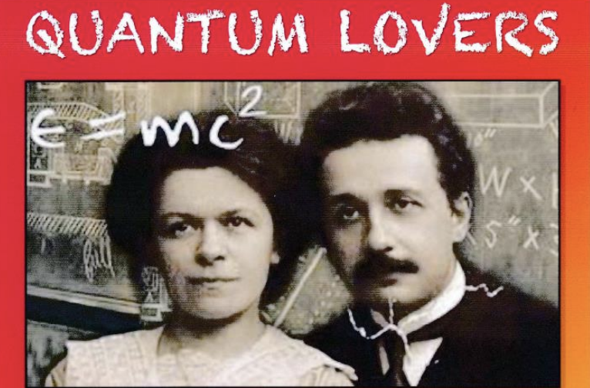
Quantum Lovers [In discussion]
Hasan Padamsee
Theme: relationship between Einstein and first wife, Mileva Maric
Proposed by: James Gillies
Format: Musical
Duration: xx / Audience: General public / Gender: All / Language: EN
Description: in two acts by Hasan Padamsee (Cornell University), performed by GAOS (Geneva Amateur Operatic Society). Inspired by Einstein in Love by Dennis Overbye, NY Times Writer, Einstein in Berlin by Thomas Levenson. QUANTUM LOVERS is about the turbulent love affair and tragic break-up between Albert Einstein and his first wife, Mileva Maric, a bittersweet tale that took place in the tumultuous times of World War I
Costs: To be received
Date: October 2025 (TBC)
Committee recommendation: Committee approved JG going to talk to GAOS informally. James to talk to GAOS informally
Notes:
Committee approves James going to talk to GAOS informally

Slide 11
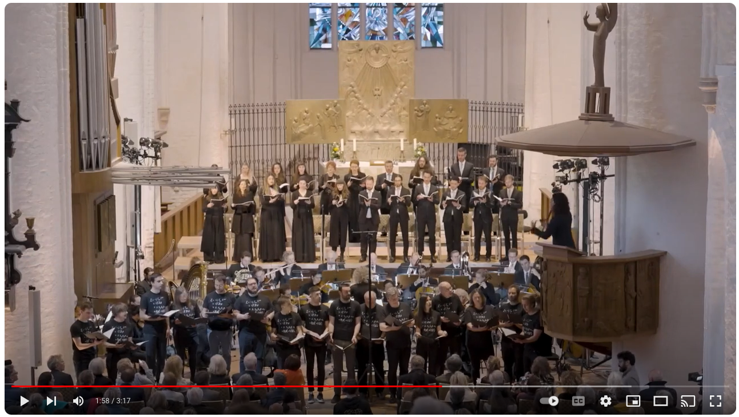
Creation [Waiting for information]
Gloria Bruni
Theme: The Big Bang
Proposed by: Barbara Warmbein (supported by James Gillies)
Format: Opera
Duration: xx / Audience: General public / Gender: All / Language: DE?
Description: The work was inspired by conversations between the composer and scientists at DESY (German National Centre for Nuclear and Particle Physics).
“Fragments of Creation” is Gloria Bruni’s musical contribution to humanity’s search for answers to questions about the origin of the universe, life and humanity, and shares a concern for the future of our planet as a place worth living.
Costs: Waiting for information
Date: Early 2025 - To be discussed
https://www.youtube.com/watch?v=C7PLZKE22Ww&t=5s

Slide 12
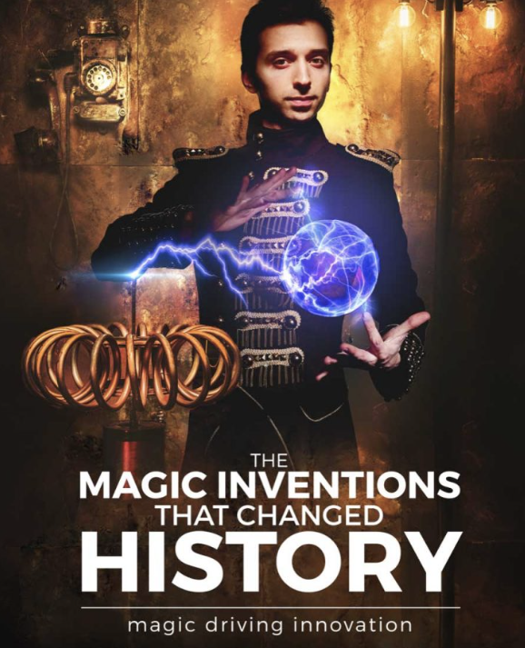
The magic inventions that changed history [Needs follow-up]
Magic and Science Academy (Cambridge)
Theme: scientific discoveries
Proposed by: Francois Briard
Format: Magic show / Duration:
Audience: General public / Gender: M / Language: EN
Description: From mechanical tools to chemical reactions and from electrical devices to flying and disappearing objects! Embark on an enchanting journey exploring the spell binding inventions that changed history and transformed life, as if by magic! While the purpose of magistery was always to produce mystery and awe, some of the most history changing tools, devices and practices were invented by magical scientists that kept them secret to captivate their audiences! And as expectations and capabilities were evolving, they kept innovating, producing technologies that at the time seemed as if they were magical! https://www.magicacademy.co.uk/shows
https://cernbox.cern.ch/s/1p6QYT3WuJqurAD
Costs: 3700 EUR/show (10 KEUR for pack of 3 shows)
Dates: June 2025?
Status: Decide go/no-go in light of cost. If go, find a date
Notes:
Anja has been in touch with them and would be interested in bringing this, along with TSP, etc
JG reminds us this used to happen from within CERN, going to local schools

Slide 13
The universe in a grain of sand [Part of Cineglobe 2024]
Mark Levinson
Theme: Understanding of nature; Art-science
Proposed by: Claudia
Format: Movie
Duration: 60min / Audience: General public / Gender: All / Language: EN
Description: A meditation on the way both scientists and artists make sense of the world, using their understanding of nature to develop new tools, techniques and processes to explore the deepest mysteries of the universe". The film will be released in 2024.
Costs: NA
Date: May 2024

Slide 14
Summary of 2024/25 Season
Recurrent
October 2024
Q1 2025
Confirmed (from past meetings)
February 2025
Approved but date TBC
2025
Partage ta Science
Arts & Science Summit
May 2025
CineGlobe
January 2025
Dark Matter Day
Sparks! – Future Quantum
De temps en temp
November 2024
Danser avec l’évolution
Early 2025
October 2025
The magic inventions that changed history
Creation
The mysteries of the Universe, Gian Giudice
Quantum Lovers
November 2024
Codez la science

Slide 15
New proposals

Slide 16
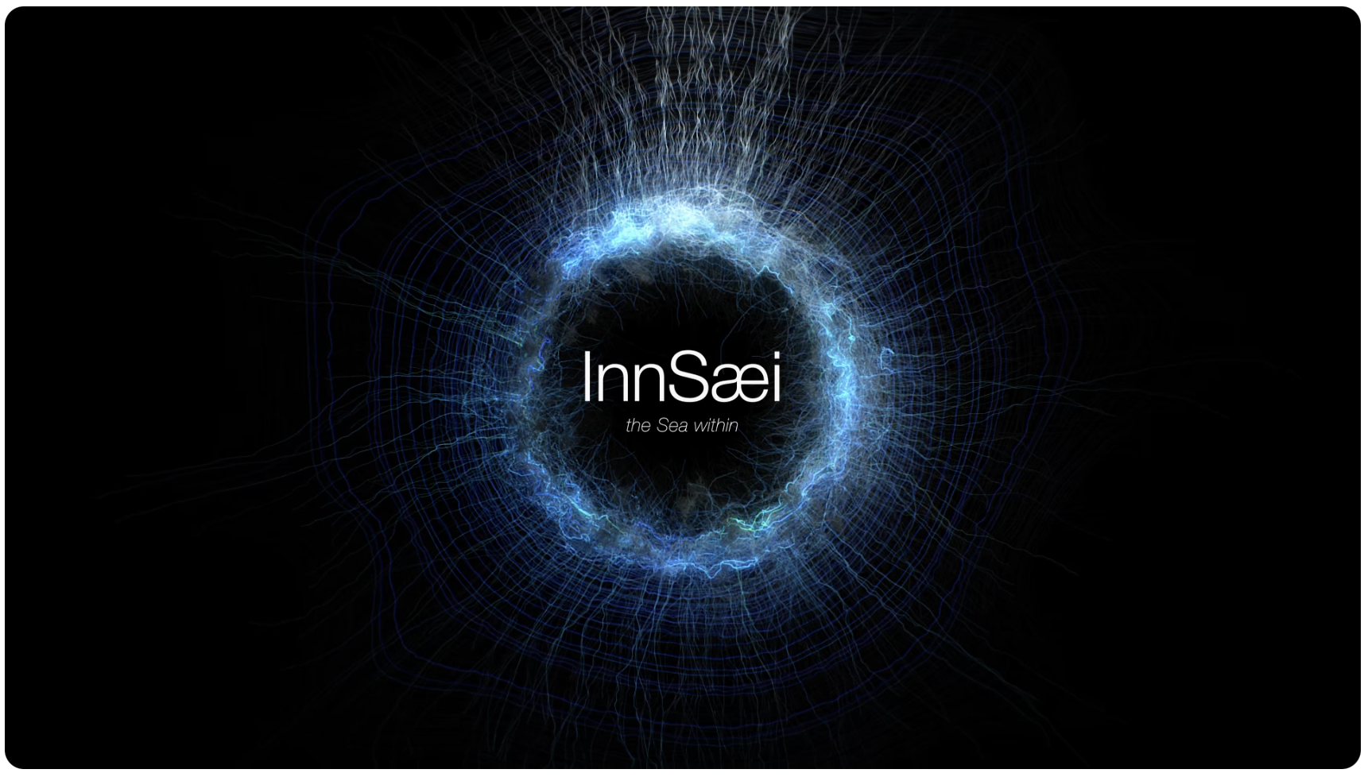
InnSæi – the Sea Within
Hrund Gunsteinsdottir
Theme: The inner workings of intuition, creativity and innovation
Proposed by: Louise Carvalho
Format: Film screening + Discussion
Duration: 90min / Audience: General public / Gender: All /
Language: EN
Description: The evening starts with a screening of the documentary film InnSæi – the Sea Within, released worldwide on Netflix in 2017, Icelandic for intuition and the home of our greatest human potential for scientific discoveries, innovations and flourishing futures.
Followed by a Q&A with the co/collaborator of the film and now author of her new book on InnSaei intuition. Discussion with some pre/selected audience members of various ages on intuition as well as its role in science, research and education
https://www.youtube.com/watch?v=leFCIThHaOs
https://hrundgunnsteinsdottir.com/
Costs: Travel and accommodation
Date: As of April 2024

Slide 17
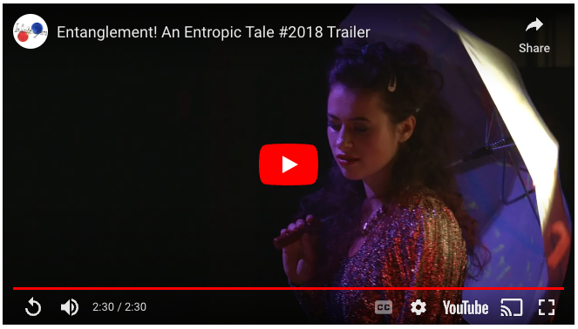
Entanglement! An entropic tale
Infinite opera
Theme: Contemporary physics: GW, Parallel Universes, Black Holes, Hawking radiation
Proposed by: Cockcroft Institute physicist on behalf of Infinite Opera - an experimental opera creation company based in Birmingham.
Format: Opera
Duration: xx / Audience: General public / Gender: All / Language: EN
Description: Deeply connected, Electron and Positron long to touch but doing so would mean their annihilation. Guided by the nihilistic and reckless Entropy, their search for identity and meaning leads to black holes, parallel universes, encounters with the laws of physics – and ultimately the end of the universe as we know it.
https://infiniteopera.com/works/entanglement-an-entropic-tale/
Based on current concepts from particle physics, Entanglement! An Entropic Tale is a cosmic exploration of life and death, creation and destruction, and the importance of living life in the present.
Costs: To be received
Date: To be discussed

Slide 18
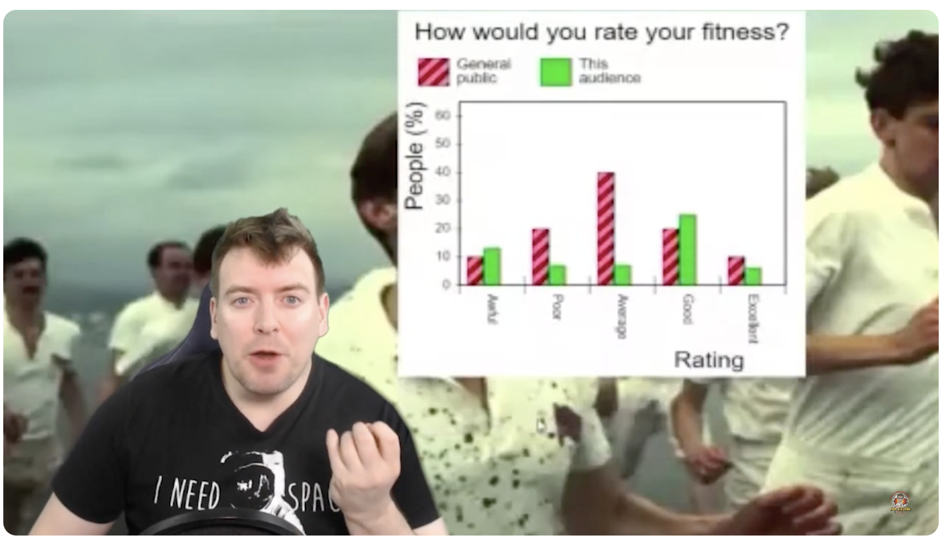
Hunting the Higgs
Sam Gregson aka Bad Boy of Science
Theme: Discovery of the Higgs boson
Proposed by: Sam Gregson (former ATLAS physicist) and
ATLAS Outreach group
Format: Interactive masterclass + comedy + music
Duration: 90min / Audience: General public / Gender: All /
Language: EN
Description: A fast-paced, gamified and massively interactive particle physics masterclass. Audiences undertake all of the steps of the scientific method to discover the Higgs Boson for themselves. If they perform well enough during each step, they have a chance to make an historic scientific discovery as a group!
https://www.youtube.com/watch?v=VeAlQvMAYtE
Full proposal here.
Costs: <5000 GBP
Date: To be discussed
Notes:
From edcuation team: The games seem fun and engaging, but with little educational value. Can be a fun interactive activity for (mixed) audiences, I don’t think it fits our usual science show format.

Slide 19
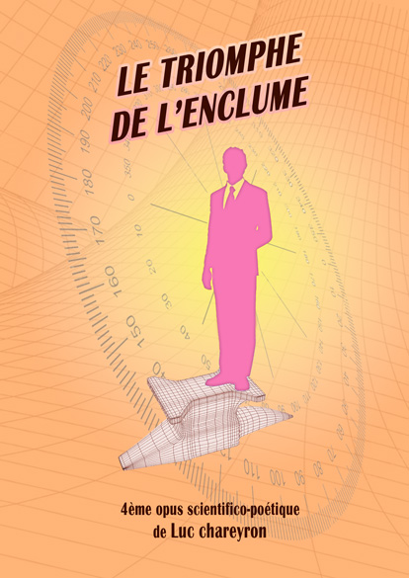
Le triomphe de l'enclume
Luc Chareyron
Theme: Gravity
Proposed by: Luc Chareyron. Has performed twice at Globe. Supported by François:
Format: Poetic opus (reading)
Duration: XXmin / Audience: General public / Gender: All /
Language: FR
Description: proposition "scientifico-poétique" sur la gravité. Un texte que je lis en public à chaque fois que l'occasion se présente et avec lequel je continue d'élaborer une forme destinée au spectacle vivant.
https://www.lucchareyron.com/
Costs: To be discussed
Date: To be discussed

Slide 20

Theme for the 2024/25 season – Ideas?
https://quantum2025.org/

