Slide 1
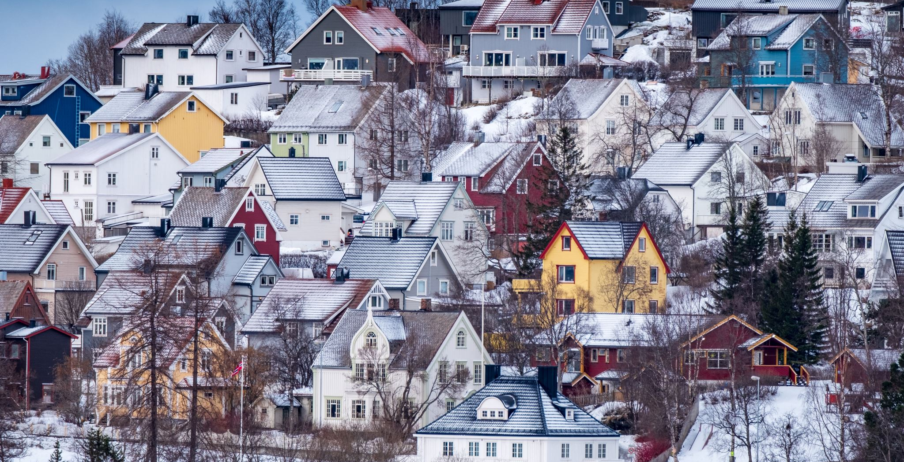
Good and bad news from the Finnish EDI landscape in physics
Katja Lauri, Eija Tuominen, Hanna Vehkamäki
University of Helsinki

Slide 2


OUTLine
Finnish Women
Finnish Women in Physics
Another EDI Issue: Language
Actions in Finnish Universities
https://blog.hip.fi/fighting-the-equality-paradox-in-finnish-science/
By the Finnish NORNDiP Advisory Board Members:
Katja Lauri is research director @ Institute for Atmospheric and Earth System Research
Eija Tuominen is research team leader @ VTT
Hanna Vehkamäki is professor in computational aerosol physics and vice dean of equality

Slide 3
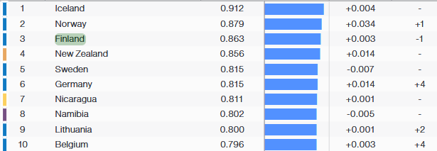
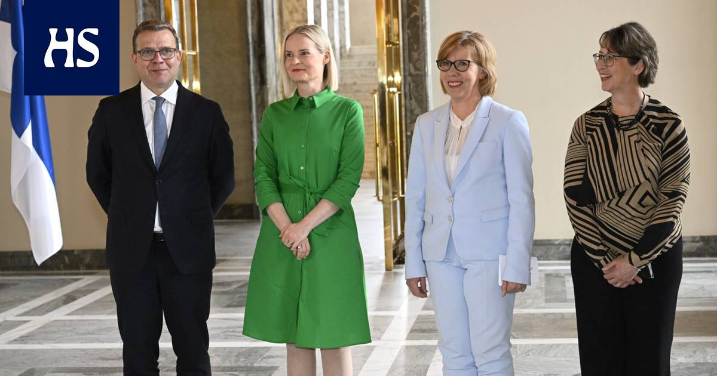
Finnish Women ARE comparatively equal
Finland is #3 in the global equality index (used to be #2).
E.g., three out of four political parties forming the Finnish Government are led by a woman.
From left:
Prime Minister Petteri Orpo,
Minister of Finance Riikka Purra,
Minister of Education Anna-Maja Henriksson,
Minister of Forestry and Agriculture Sari Essayah
https://www.is.fi/politiikka/art-2000006628100.html
https://www3.weforum.org/docs/WEF_GGGR_2023.pdf

Slide 4
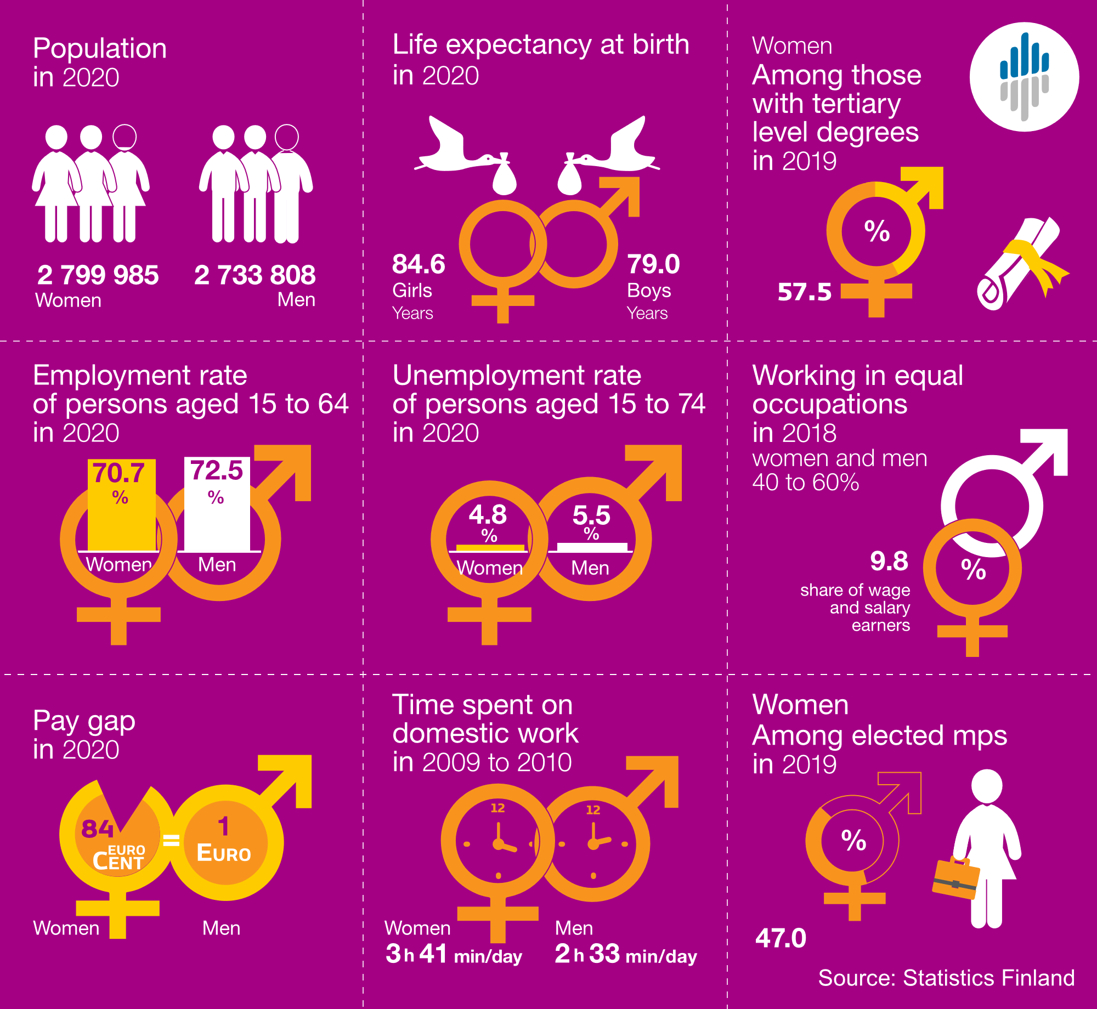
ARE Finnish Women equal?
Finnish women in working life:
Education: women prevail
Employment: ~same level
Salary: woman’s euro is 84 cents
NOTE: Finnish working life is extremely divided between women’s jobs and men's jobs
Source: Statistics Finland, Gender Equality in Finland 2021
08/05/2024
4

Slide 5
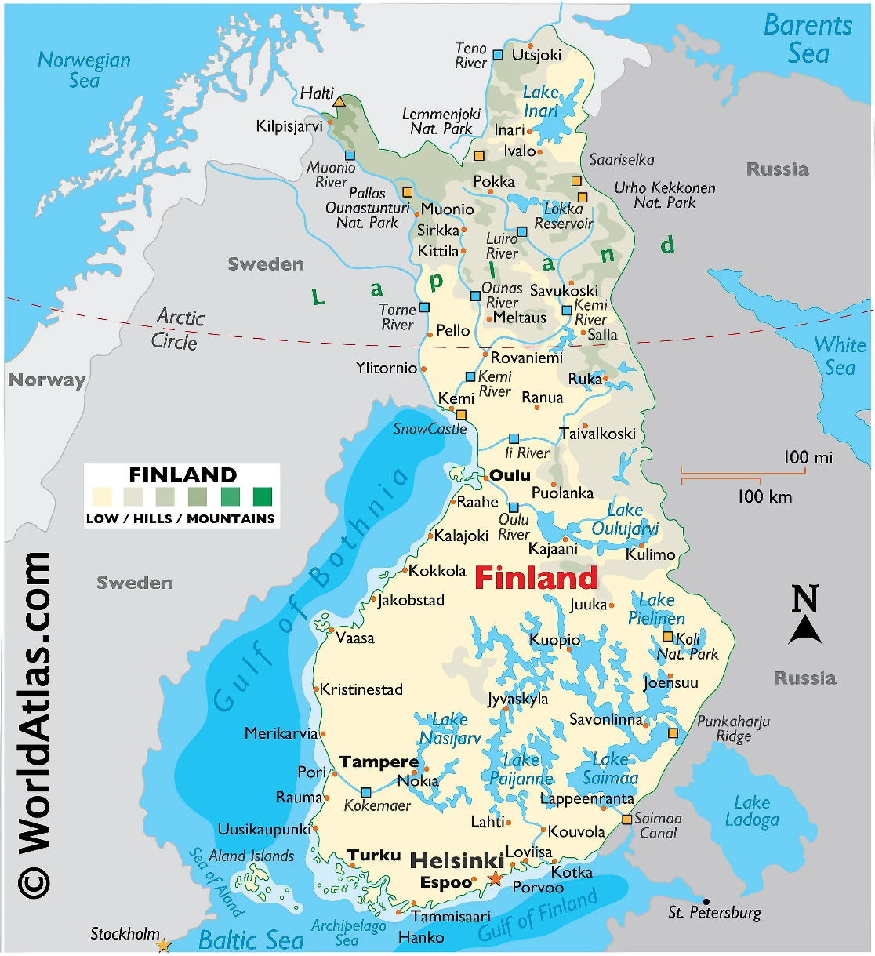
WOMEN IN PHYSICS in Finnish universities
Cities with universities with Physics Depts.
Data is important!
Data women in physics in Finnish universities is often or difficult to find – but the situation is slowly improving. (”The director did not answer my emails and HR did not dare to share the data.”)
Luckily, many colleagues are actively working for diversity in physics in their universities.
Special thanks to Bernadette Gehl-Väisänen (Aalto), Anu Kankainen (Jyväskylä), Laura Karppinen (Helsinki), Panja Luukka (Lappeenranta-Lahti), Miikka Dal Maso (Tampere), Assa Sasikala Devi and Taina Cooke (Oulu), Milica Todorovic (Turku) and Cristina Florea (UEF).
06/05/2024
5

Slide 6
Women in physics in Finnish Universities
UNIVERSITY | FEMALE FULL PROFESSORS
Lappeenranta-Lahti University of Technology | 1/4 | 25% →
University of Helsinki | 9/43 | 21% ↑
University of Eastern Finland / Kuopio | 2/13 | 15% →
University of Oulu | 1/10 | 10% ↓
Aalto University | 4/23 | 17% →
University of Turku | 1/8 | 13% ↑
University of Jyväskylä | 1/17 | 6% ↓
Tampere University | 2/14 | 14% →
Åbo Akademi | 0/1 | 0% →
University of Eastern Finland / Joensuu | 1/15 | 7% →
FPS Board:
Members: 5/12 female ↑
Chair Mr. Daniel Price / Helsinki
Vice-chair Mr. Juha Muhonen / Jyväskylä
FPS WG Diversity in Physics Finland
(e.g., gender session in FPS annual meeting)
Chairs Ms. Tuuli Miinalainen and
Mr. Ondřej Krejčí
~90 members in the mailing list
https://blogs.helsinki.fi/diversityinphysics/
08/05/2024
6

Slide 7
GENDER “TWEEZERS” in physics In selected Finnish universities
For reference:
Barthelemy, R.S. and Knaub, A.V., 2020. Gendered motivations and aspirations of university physics students in Finland. Physical Review Physics Education Research, 16(1), p.010133:
“Despite all of the positive aspects in Finland for women and for science education, our results suggest that Finnish female university students still face challenges that male students do not face.”
08/05/2024
7

Slide 8
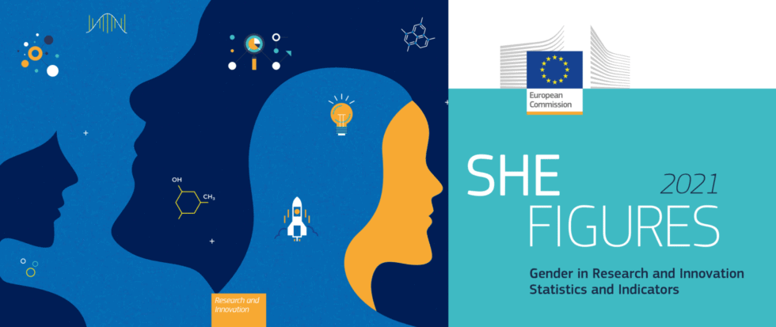
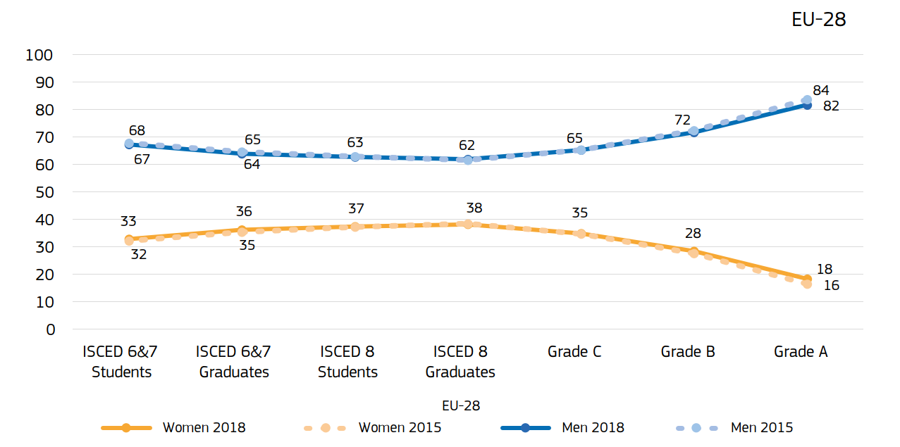
GENDER “TWEEZERS” in
STEM IN EuropE
EU She Figures 2021: Gender in STEM
Factors influencing women’s career:
Hiring: job advertisements, bias in recommendation letters, bias in recruitment
Working conditions: less resources, less mentoring, lower salary, part time jobs
Career progression: promotion, evaluation
Grants: women’s chances to receive grants are lower
Source: https://www.leru.org/publications/implicit-bias-in-academia-a-challenge-to-the-meritocratic-principle-and-to-womens-careers-and-what-to-do-about-it (2018)
https://op.europa.eu/en/publication-detail/-/publication/67d5a207-4da1-11ec-91ac-01aa75ed71a1
08/05/2024
8

Slide 9
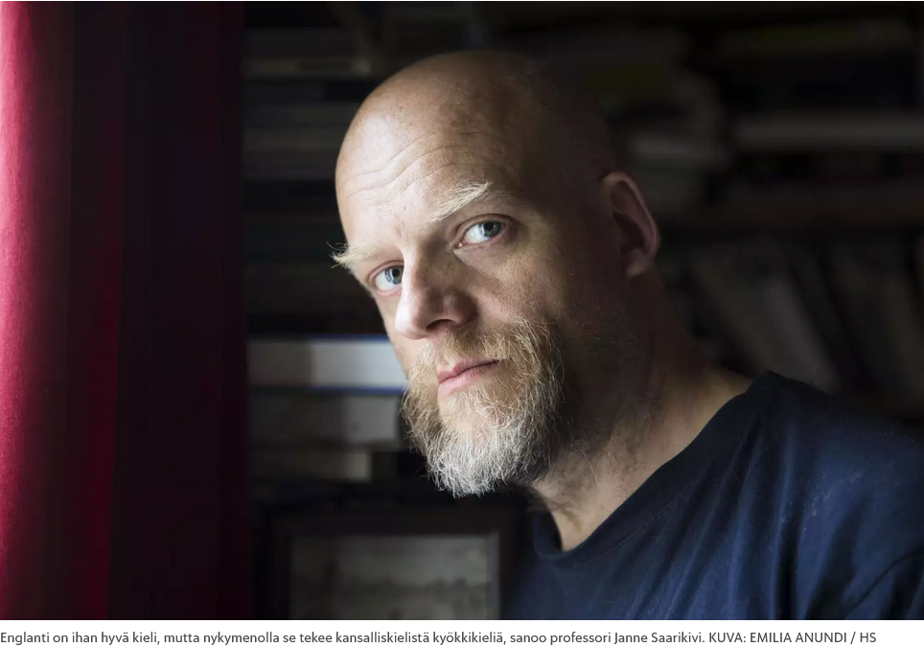
Internationalisation of Finnish universities
Increase in number of foreign students and staff at universities
  Example from Physics: in LUT, 62% of staff in Physics is international
Almost 90% of dissertations and 40% of master's theses are written in English.
A student survey expressed dissatisfaction with the current state. 38% of Finnish-speaking and 74% of Swedish-speaking respondents want more courses in their mother tongue.
There is a need to increase Finnish language teaching and multilingualism. Otherwise, the marginalization of national languages in education and elsewhere in society is imminent.

Slide 10
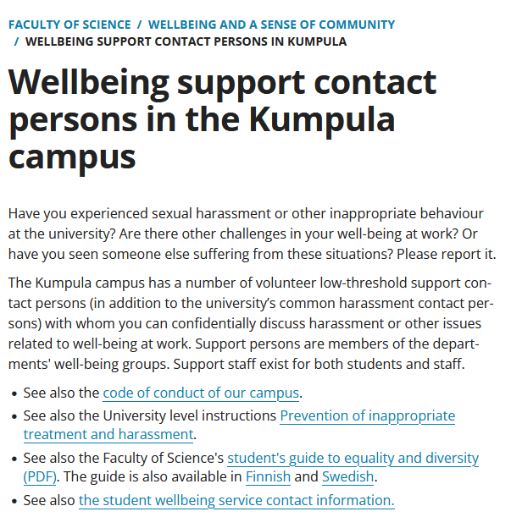
UH Faculty of Science:
Departments’ work well-being groups
Each department has its own wellbeing group (CHEM, CS, GEO, INAR, MATHSTAT, PHY & HIP). These groups form Kumpula joint well-being network led by Vice-Dean Hanna Vehkamäki.
A strong focus in the well-being work is on equal rights and opportunities.
Departmental work well being groups are systematically involved in the analysis of the work well being survey results from 2023
Collaboration with student association harassment contact persons initiated
Nov 2022: all the current Well-being groups’ low threshold contact person ‘been trained’

Slide 11
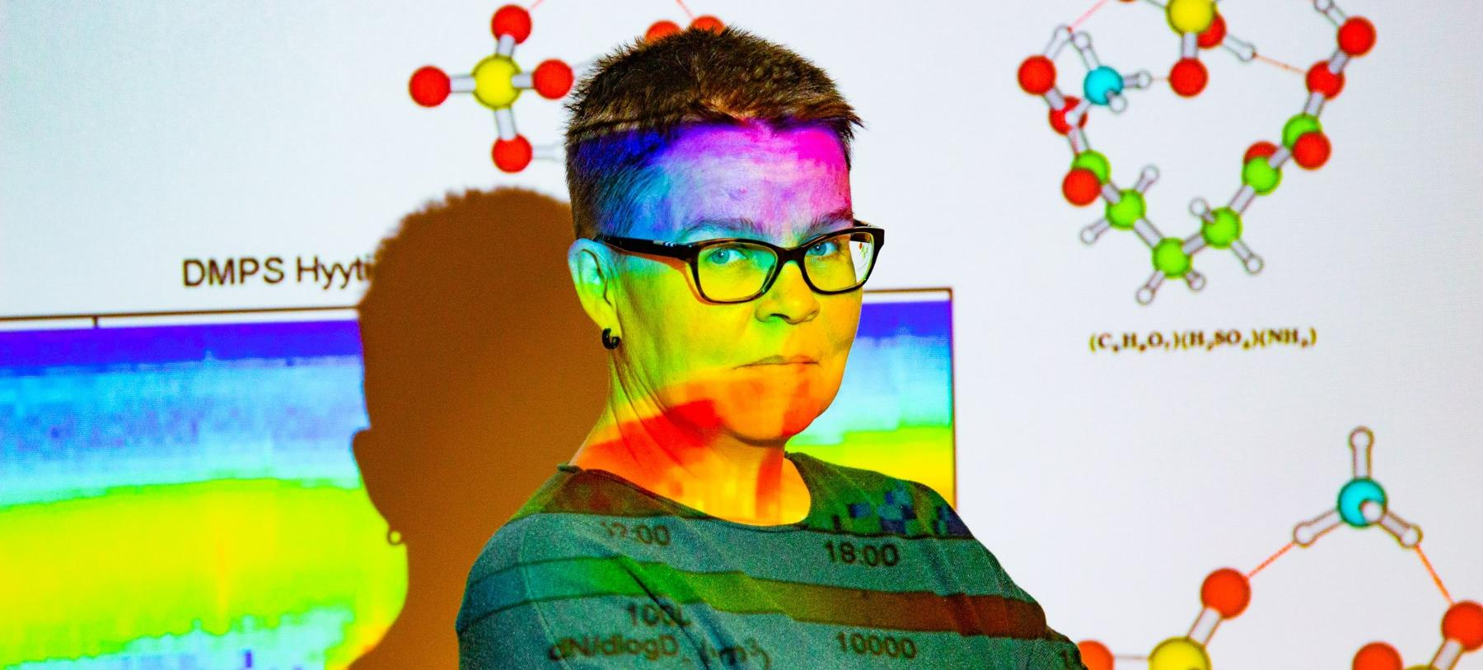
RECENT DIVERSITY& WORK WELL-BEING ACTIVITIES IN THE UH FACULTY OF SCIENCE
Every toilet has a Safer space contact person info sheet
Unisex signs to all individual toilets in the campus (multitoilets in lobbies stay gender specific)
Up-to-date faculty staff & degree gender data now on the faculty web page
  https://www.helsinki.fi/fi/matemaattis-luonnontieteellinen-tiedekunta/tiedekunta/tiedekunta-numeroina
Faculty student guide available since beginning of autumn term 2022
‘In Kumpula we manage, or do we’ - mental health event 10.10.2022 and minority stress and being an ally event 23.1.2024
Kumpula LGBTQ+ STEM day webinar 18.11.2021
  https://blogs.helsinki.fi/kumpula-lgbtq/events/lgbtq-stem-day-webinar-18-11-2021/
Vice-dean’s diversity blog in Flamma (also in HELWOR blog for general public)
  https://blogs.helsinki.fi/tutkijanaiset/
Renewal of the faculty instructions for filling professor and lecturer positions finalized

Slide 12
Other matters in progress
Gathering information on employees’ packing density across faculty
Introduction of faculty travel support for work well-being and diversity related –conferences& presentations
Piloting a survey on distribution of academic household work → poster in NORNDiP
Summer worker orientation discussed and underlined in the supervisor’s network
Intranet link list for information that had proven to be difficult to find
Discussion started on developing a moodle-based safety training
  general house security (how to act in cases of fire, accidents etc)
  general laboratory safety (physics, chemistry)
  recycling etc
  psychological safety ( combating harassment, bullying, discrimination etc)

Slide 13
To wrap up the bad and the good news
Bad news:
  The EDI (equality, diversity and inclusion) work is not getting easier in the polarizing environment
  The gender tweezers do not seem to be improving in physics units in Finnish universities
Good news:
  Finland remains high in international gender equality indexes
  FPS positive about equality, diversity and inclusion actions, FinDiP working group
  We start to have more active local action groups at physics depts. in universities
The unknown news:
  Something will be done about the language environment in Finnish universities, but it remains to be seen if the change will be positive or negative in terms of EDI

Slide 15
Abstract of the Minedu report
The number of foreign students and staff at universities has increased. In particular, there has been an increase in English-language master's programs. Even in programs declared to be in Finnish, there is a lot of teaching in English. Almost 90% of dissertations and 40% of master's theses are written in English. For one third of students, the educational path in the national language is interrupted between the bachelor's and master's degrees. At Aalto University, teaching in English extends widely to bachelor's studies. Decisions by law enforcement authorities regarding the right to study in the national languages have not changed the situation. A student survey expressed dissatisfaction with the current state. 38% of Finnish-speaking and 74% of Swedish-speaking respondents want more courses in their mother tongue. If possible, over 80% would prefer to have the course in their mother tongue. The recommendations of the study include clear guidelines on the right to study in Finnish and Swedish. It proposes a language proficiency requirement and arrangements for teachers recruited from abroad, rewards for research conducted in the national languages, and recording the number of students trained in Finnish-language programs in the universities' performance agreements. With the increasing number of international students at universities, there is a need to increase Finnish language teaching and multilingualism. Otherwise, the marginalization of national languages in education and elsewhere in society is imminent.

Slide 16

EXAMPLE: Activities increasing diversity @ UH Science
Active discussion
  Talks and presentations in meetings, colloquia, and lectures
  Training events, e.g., about implicit bias and sexual harassment
Work well-being
  Well-being groups, low-threshold contact points, Code of Conduct, tips for a more inclusive workplace
Networking, mentoring, role models
  Avoiding being “the only woman in the room”, avoiding “all-male-panels”
Work life balance
  Understanding family responsibilities, also in job announcements
Continuous collection of data
  Where we are and where we want to be
06/05/2024
16

Slide 17

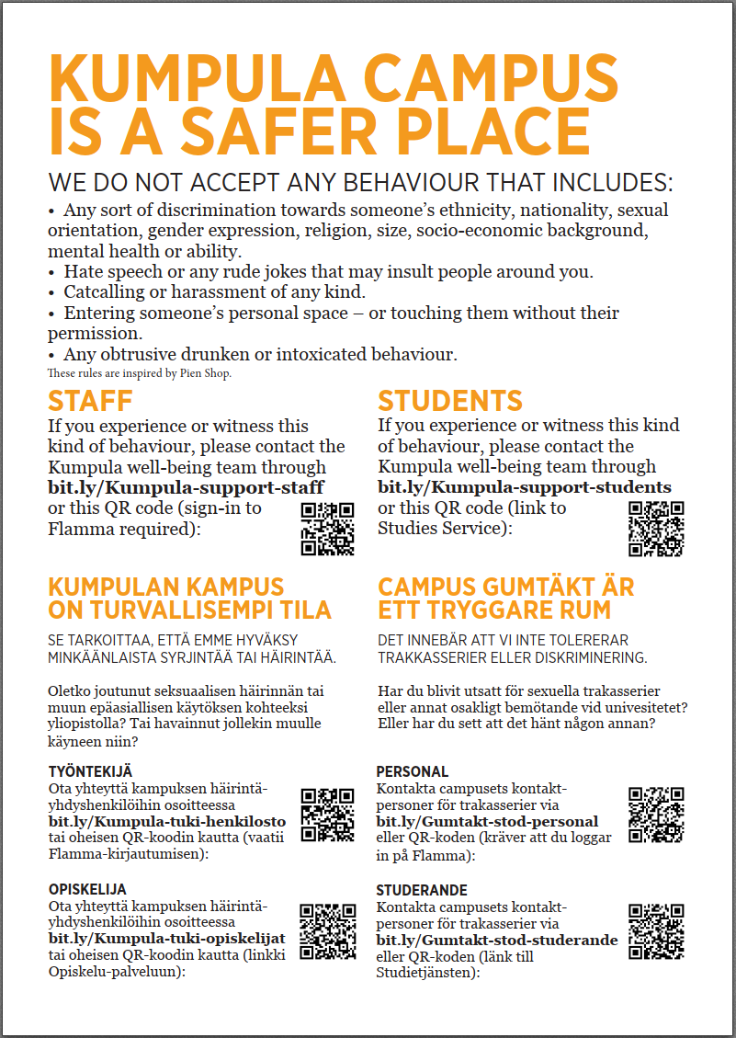
EXAMPLE:
TOILET NOTES @ UH SCIENCE
Helsinki Association of Women Researchers conducted a survey on sexual harassment (2018): the importance of low threshold contact was obvious (https://blogs.helsinki.fi/tutkijanaiset/2019/01/17/how-to-erase-sexual-harassment-feedback-from-finnish-academia/).
Every toilet in Kumpula Campus has a note with contact information.
An upset person can look for more information in a quiet place.
06/05/2024
17

Slide 18

Why diversity matters?
Diverse teams make better science
  Diverse teams bring in diverse experiences, practices, perspectives, values, and motivations
  Diversity increases the quality of the process and effectiveness of scientific inquiry.
  (Reference: abundancy of scientific studies.)
Everyone has right to equal opportunities
https://greatergood.berkeley.edu/article/item/how_diversity_makes_us_smarter
06/05/2024
18

Slide 19
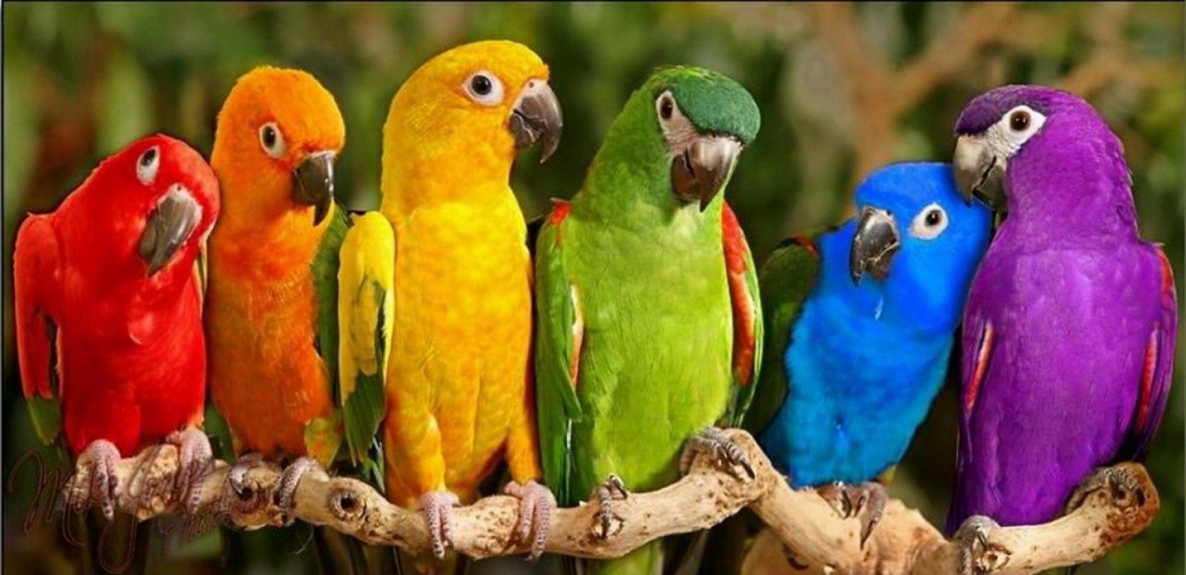
Summary
Diversity makes better science!
Increasing diversity needs actions!
Actions make difference!
06/05/2024
19

Slide 20
BACK UP SLIDES
20

Slide 21
REFERENCES
Astegiano, J., Sebastián-González, E., & Castanho, C. D. T. (2019). Unravelling the gender productivity gap in science: a meta-analytical review. Royal Society open science, 6(6), 181566.
EU She Figures (2018). https://ec.europa.eu/info/publications/she-figures-2018_en, accessed 29.7.2020.
Gvozdanović, J., & Maes, K. (2018). Implicit bias in academia: A challenge to the meritocratic principle and to women‘s careers - And what to do about it. Technical Report 23. Advice paper.
Holman, Luke, Devi Stuart-Fox, and Cindy E. Hauser (2018). The gender gap in science: How long until women are equally represented? PLoS biology 16.4 (2018): e2004956.
Hunt, Vivian, Dennis Layton, and Sara Prince (2015). Diversity matters. McKinsey & Company 1.1: 15-29.
Medin, Douglas L., and Carol D. Lee (2012). Diversity makes better science. APS Observer 25.5.
Nielsen, Mathias Wullum, et al. (2017). Opinion: Gender diversity leads to better science. Proceedings of the National Academy of Sciences 114.8: 1740-1742.
Nielsen, Mathias Wullum, Carter Walter Bloch, and Londa Schiebinger (2018). Making gender diversity work for scientific discovery and innovation. Nature human behavior 2.10: 726-734.
Quimby, Julie L., and Angela M. De Santis (2006). The influence of role models on women's career choices." The Career Development Quarterly 54.4: 297-306.
Schiebinger et al. (2017). Gender diversity leads to better science, Proc. Nat. Acad. Sci., 114(8), 1740.
Stoet, Gijsbert, and David C. Geary (2018). The gender-equality paradox in science, technology, engineering, and mathematics education. Psychological science 29.4: 581-593.
Ward, Kelly, and Lisa Wolf-Wendel (2004). Academic motherhood: Managing complex roles in research universities. The Review of Higher Education 27.2: 233-257.
21

Slide 22
GENDER “TWEEZERS” in physics In selected Finnish universities 2023
For reference:
Barthelemy, R.S. and Knaub, A.V., 2020. Gendered motivations and aspirations of university physics students in Finland. Physical Review Physics Education Research, 16(1), p.010133:
“Despite all of the positive aspects in Finland for women and for science education, our results suggest that Finnish female university students still face challenges that male students do not face.”
08/05/2024
22

Slide 23
GENDER “TWEEZERS” in physics In selected Finnish universities 2022
For reference:
Barthelemy, R.S. and Knaub, A.V., 2020. Gendered motivations and aspirations of university physics students in Finland. Physical Review Physics Education Research, 16(1), p.010133:
“Despite all of the positive aspects in Finland for women and for science education, our results suggest that Finnish female university students still face challenges that male students do not face.”
06/05/2024
23

Slide 24
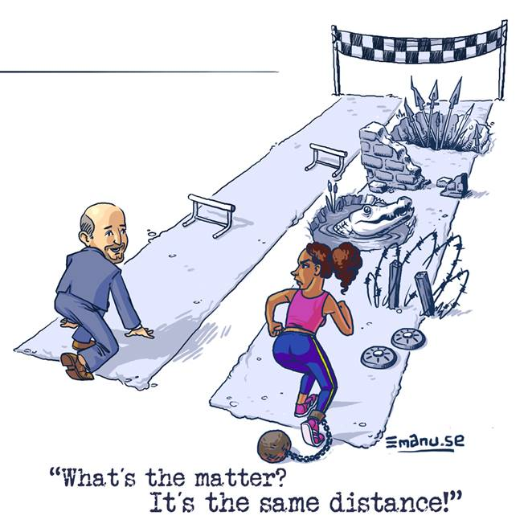
(Women in Technology (WIT) matters) <wit-matters@cern.ch>
24

