Slide 1
Is academic housework a way to establish yourself in academia?
Thamar M. Heijstra
8th of May 2024
Sixth Conference of Nordic Network for Diversity in Physics
School of Social sciences

Slide 2
Academic housework
All the important but time consuming service work activities that receive little recognition within the current academic system.
  Carried out more often by women than men
  For example: Giving back to the community, various teaching and research related activities, administrative work and gender equality initiatives

Slide 3
The academic system
Academic values of excellence and meritocracy
Academia as a business
  New Public Management practises
  Efficiency and performance measurements
  Tenure track positions are scarce, more academics on short-term contracts
Gendered academia
  Male orientated work environment
  Teaching responsibilities are gendered
    The caring female teacher vs the male scientist

Slide 4
Male-orientated work environment
It becomes quite clear you know, the culture of academia, this male culture. There were these colleagues of mine. They were hired at the same time as me..and one of them immediately starts with this: „I was writing an article this weekend and just pulled an all-nighter“. And I am just like, wait a minute, are we 18? What kind of bullshit is this? As if this was something positive. I knew he just had a baby. I mean what kind of life is this? You know bragging about it, but this is part of the culture.
(Staub & Heijstra, 2021)

Slide 5
Symbolic capital (Bourdieu)
Honour and prestige, non-material possessions
  Academic capital: the power to control academic resources
  Scientific capital: prestige based on scholarly publications
  Intellectual capital: the ability to influence public opinion
Cultural, economic and social capital can be transformed into symbolic capital as long as it it ‘perceived and recognized’ as legitimate. (Skeggs 1997,8)

Slide 6
Academic capital
Financial resources but also time
Not everyone’s time is valued equally
  Women’s time is other’s time
  “Unfortunately I had the reputation of being a good lecturer”
  Academics in subordinate positions
    Highest burnout rates among postdocs and PhD students

Slide 7
Acceptance of academic housework as natural chores
Everything that can be seen as natural chores that come with the profession such as attaining departmental meetings, and other meetings, the organization of courses, the reviewing of articles and books, and the writing of recommendation letters, are part of either the teaching or research responsibilities that academic employees have, and therefore they will not be measured according to an hourly rate (University board, 16 June 2011).
Women in STEM, and other fields of academia where there are few women, tend to have more administrative work put on their shoulders than men:
I feel that it’s quite big a section, there are all sorts of small tasks that you’re sort of expected to do. I get lots of emails that say ‘you need to be here because this is about this particular issue in the faculty, or in the university, and you should be here, cause this is something you should have an opinion about. And you should have read this before you show up and things like that. And then there are all of these jobs that nobody sees but that you are expected to do, that are time consuming without reflecting themselves directly in some kind of compensation.

Slide 8
Acceptance of the situation
Attracted by the system, blinded by the symbolic capital
Improvement from even more precarious situations as being on student loans/research funds
The assumption that this is a temporary situation
A promise that it is all worth it
Belief in meritocracy and personal ability/responsibility
A male full professor in STEM explains:
You have to want it enough [a permanent position]. Because that love for academia gives you the freedom and opportunity to decide what you do with that part of your working hours. A superior cannot come and tell you what to do like in other institutions.

Slide 9
At the end of the day…
Academics with well-established symbolic capital outsource time-consuming and under- valued tasks while they also feel less obliged to take on such chores.
Newcomers do not have that opportunity as much because of lack of resources and the work that goes into enhancing their academic, scientific and intellectual capital, while trying to maximise their chances to gain goodwill, recognition and respect.

Slide 10
Still, what we know from an analysis on hiring practises:
In STEM:
  A lot of emphasis on excellence
  Foreign experience from prestigious universities
  Publications is what is the most important
  Teaching is a plus but not a main criteria
  Administrative experience not a main criteria in actual practises

Slide 11
The precarious precondition for change (Hark 2016)
In order to change the system one must become part of the system, work the cracks (Collins, 2000) and play by the rules of the game (Morley, 2013).

Slide 12
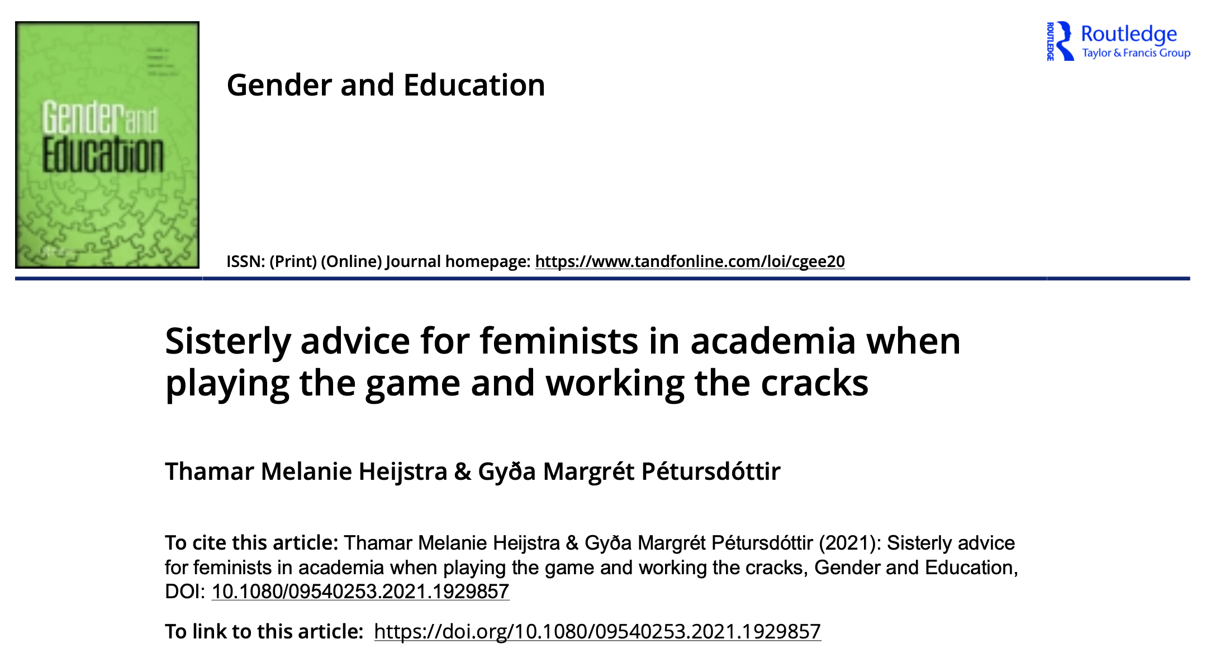
So we asked:
How do you stay afloat in the neoliberal academy? (while rocking the gendered institution with feminist scholarship?)
12 academic women
  Homogeneous and privileged
  In the twilights of their careers

Slide 13
Their advice could be summarized as
Belief in yourself
Establish yourself
Like/Love what you do
Invest in women’s solidarity
Endure and persevere
Focus on your feminist goals
...And remember that there is a world outside of academia

Slide 14
1. Believe in yourself and your work
You cannot satisfy everyone. It is not possible. We would go up in smoke in no time if we were trying to do that. We just have to believe in ourselves, our subject matter, and what we are doing. I think that is the main thing. If we try to take all responsibility and satisfy everyone, we become so torn down that we aren’t of any use…to anyone.

Slide 15
2. Establish yourself
Obtain a full professor position because then you are in the position to do things. Draw boundaries when it comes to all the extra work. You just have to think, “Okay this is really important, but there is only so much that I can do.”

Slide 16
3. Enjoy what you are doing
Try to do things you find rewarding. Don’t just do what you need to do. Go your own way and try to be creative and enjoy what you are doing. I really like most of the things that I have done, and I am also really proud of the things that I have done.

Slide 17
4. Invest in women’s solidarity
Pep each other up and say... “You are cool, and you are smart. This is stunning science. Amazing, well done, you.” All those things that men, in their own homosociality, are constantly doing. Keep up your self-confidence and support each other.

Slide 18
5. Endure and persevere
Realise that adversity, frustration and disappointment are always going to be part of this.
Some things go slow, other things go fast.
I have learnt to become a bit more humble... All I wanted was revolution! [bangs her fist on the table] and change the world... But I have come to understand that that is not the way it works... I have changed a lot personally.
Don‘t loose your courage.

Slide 19
6. Focus on your feminist goals
There are always these fish swimming around somewhere, male fish that decide and control. You know, “I am here. Be aware. Us, the boys, do it like this...” When there is the opportunity try and shake things up.

Slide 20
7. Don’t let the university swallow you, bones and all
I would probably say that you would have to prioritise your health above anything else.
Just bite the bullet and continue to be stubborn even if it is dreadful and boring - but don‘t believe that there is not another life outside university.

Slide 21
A new view
I don´t participate in this workaholic culture of our foremothers. And this is maybe something that is changing with the younger people. And we talk about this, the girlfriends, we´re not going to become like – you know. Some others that we have worked with are just always at work. So, this might be changing, hopefully. Or maybe we´re just lazy and all the others just work and work… at least this is something I have not learned from other feminist scholars that there is a world outside of academia (laughs heartily).

Slide 22
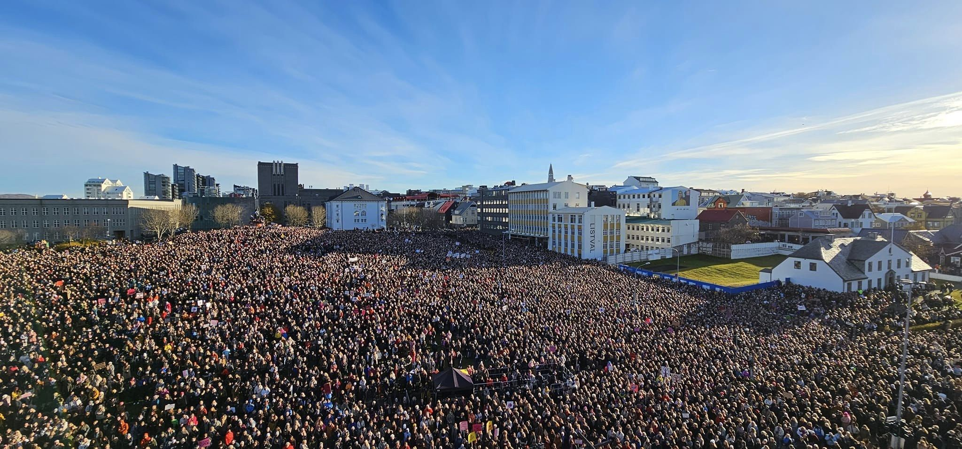
Conclusion
  Academic housework in itself is not particularly useful for academic career making but it can create goodwill and signal a “proper” academic work ethic
  B-E-L-I-E-F quite a neoliberal approach still
  Within the new generation of academics, some are, unlike their role models unwilling to play the academic game in the same way.

