Slide 1
Brief report on IMC24 from all moderation centers

Slide 2


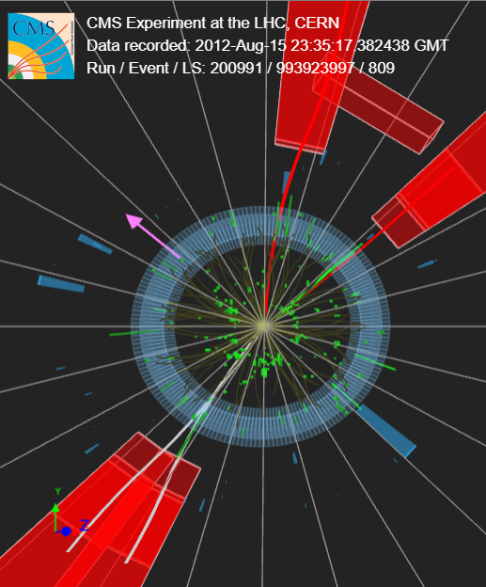
What’s New
CMS Improvements and Innovations
  Improved iSpy-webgl - easier to pick tracks, radial lines to help with + and -, better look
  More 4-lepton events (almost double)
  Tested Google Sheet alternative to CIMA
Videoconferences
  Mini-virtual-visits
New(ish) Measurements
  NOvA → normalized
  Belle II → parallel with Jake Bennett, et al

Slide 3
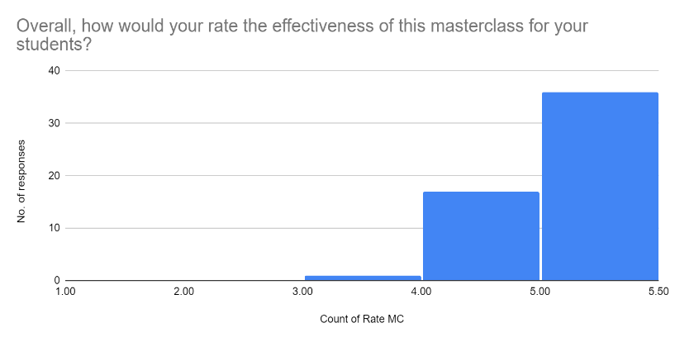
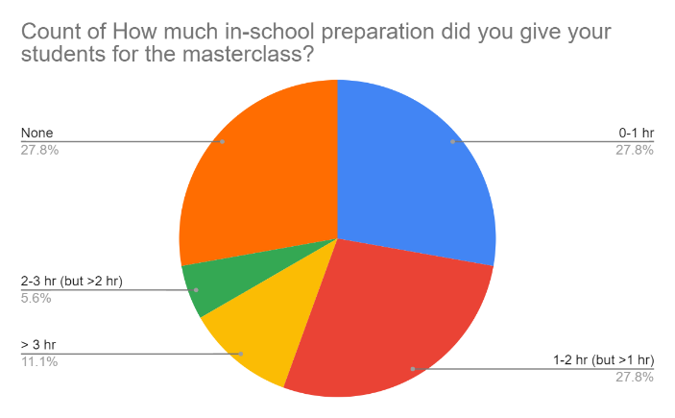
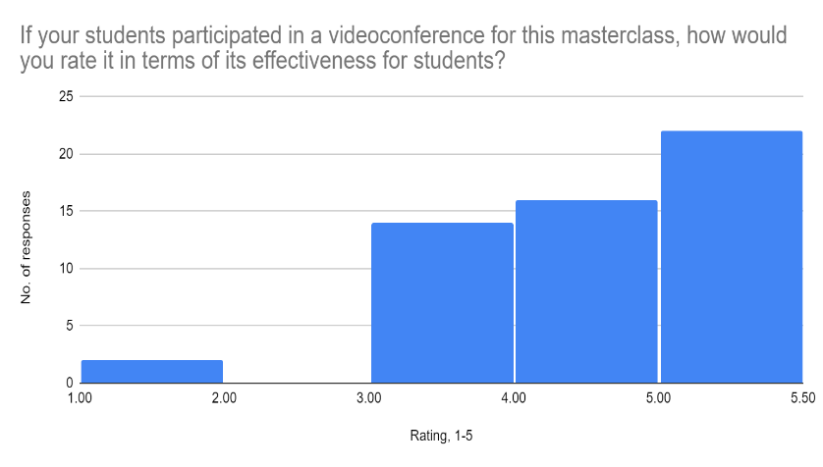
What Now?
Feedback from tutors and teachers
New and improved CIMA?
More data?
Moving toward DUNE…

Slide 4
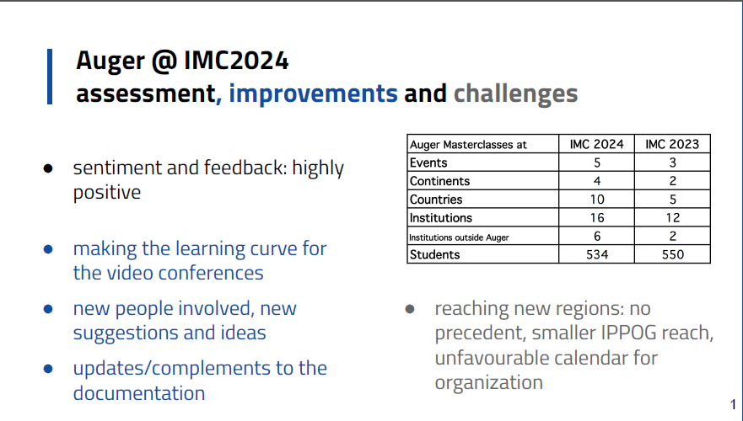

Slide 5
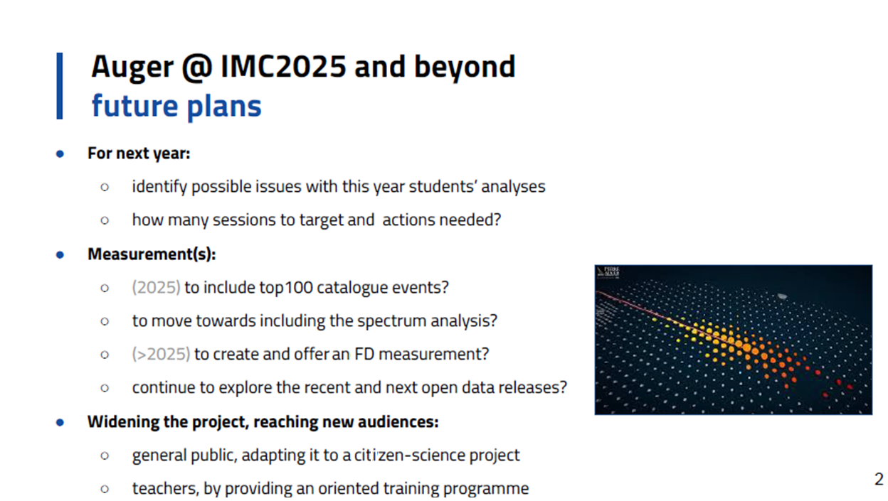

Slide 6
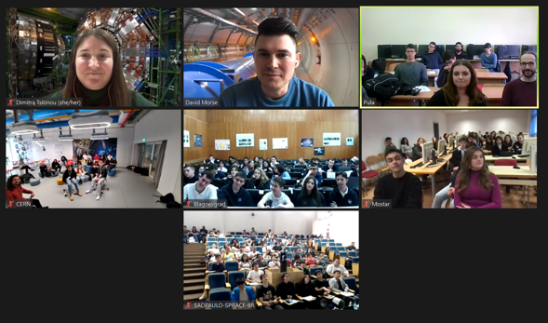
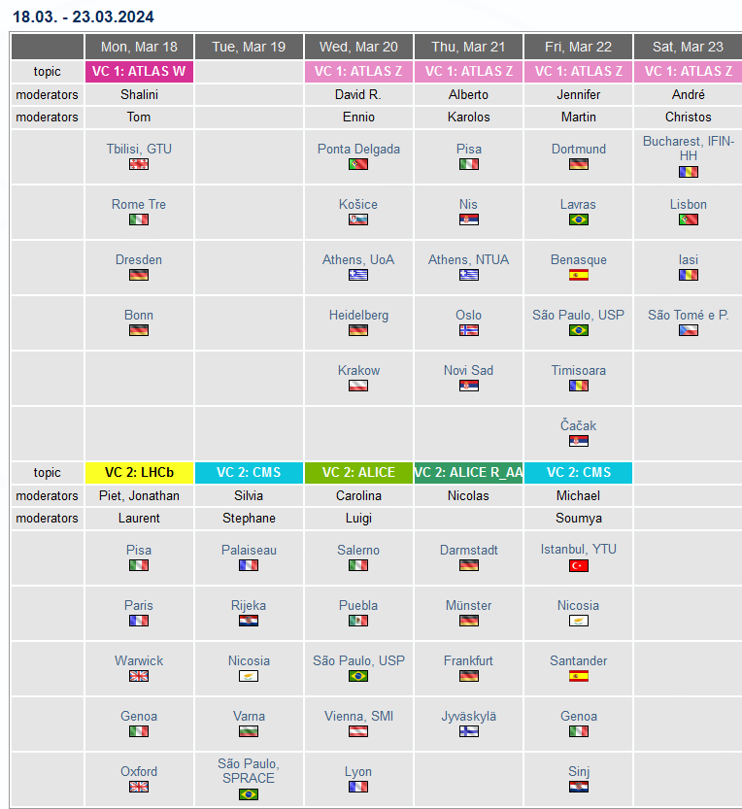
IMC24: CERN program
ATLAS Z path: new OPloT website
CMS: see slide from Ken
All other measurements: stable
233 Masterclasses in 7 weeks
62 videoconferences
Few no-shows
Special time slot for Kenya (+ Israel)
Training for moderators on Feb 12, followed by a sandwich lunch
64 moderators (shortage on ALICE side, theorists helped out)
1 room at CERN (4/S-20), decorated with tunnel roll-ups
Notes:
CMS on 11.3. , moderators Dimitra Tsionou and David Morse

Slide 7
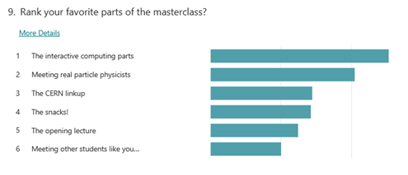
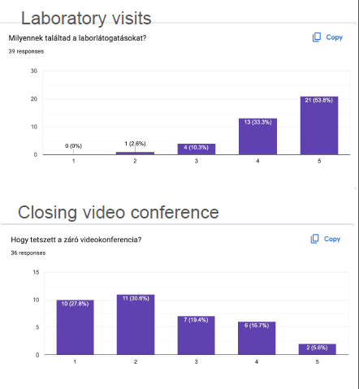
Future plans for CERN based program
Feedback in general good
Few reports of issues with videoconference
Quality management video conference
  Preparation/selection of moderators
  Make training even more better (use recorded sessions)
  New platform for quiz. Difficulty: finding (+ paying) a suitable model
  Invite more persons to working group (from institutes that sent poor feedback)
Revise registration process
  Receive confirmation, view other registrations
  Earlier time slots for countries in eastern time zones
Update repository of certificates etc.
  updated logos, accessible gifs

Slide 8
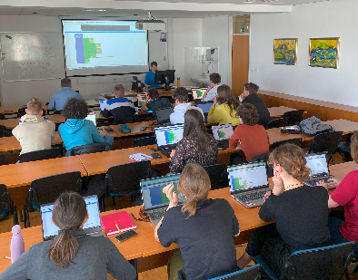

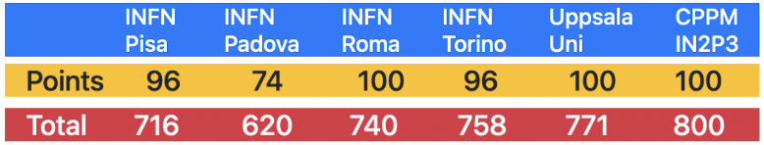
BELLE II IMC in 2024
R. Pestotnik: Belle II IMC SG@ IPPOG, Apr. 22, 2024
Total ~630 participants –58% more than in 2023
9 events announced through IMC and Belle II collaboration channels
New participants from Armenia, Japan & India
  Events: EU x4, US x2, JP x1, IN x2
  2 Indian events will be held in May and in July
Feb.1: Instructor Tutorial @Belle II General Meeting
Feb. 28: Question time
Recorded instructions
Video conference
  live connection to Belle II Control room
  Quiz: Belle II app and voting system – allows group ranking.
Date | Institutes | Region | Participants
Mar. 5 | 2 | EU | 44
Mar. 13 | 3 | EU | 85
Mar. 26 | 6 | EU | 301
Feb. 23 | 1 | EU | 40
Mar. 30 | 2 | JP | 30
Mar. 5 | 2 | US | ~130
Mar.. 21 | Quarknet | US | ?
May | 2 | IN | Exp. 40-60
July | 2 | IN | Exp. 40-60

Slide 9
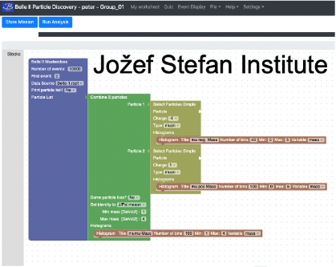
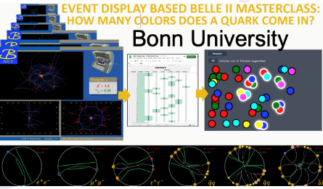
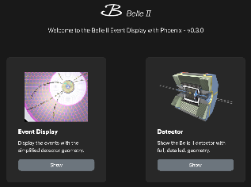
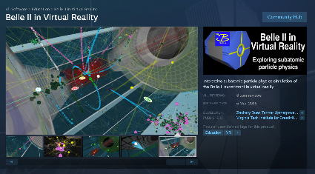
Belle II – 2024 exercises
R. Pestotnik: Belle II IMC SG@ IPPOG, Apr. 22, 2024
Two exercises – Free choice of the participating institution:
Spectroscopy – enriched data samples -10 Mevents – at 8 sites
  https://belle2.ijs.si/masterclass/ - runs on the server + client browser
  → improved advanced mode for Uni Students with additional likelihood cuts
Measure quark colors - at 8 sites
  https://belle2.ijs.si/public/home/quark-colors/
  similar to LHC experiments : limited set of events
Support materials:
  New Event display: https://display.belle2.org/
  Virtual reality https://store.steampowered.com/app/810020/Belle_II_in_Virtual_Reality/
Blockly javascript interface + server
→ mixed video conferences:
Students presented different exercises to each other
Plans: Increase participation and organize IMC in new regions (CN)

Slide 10
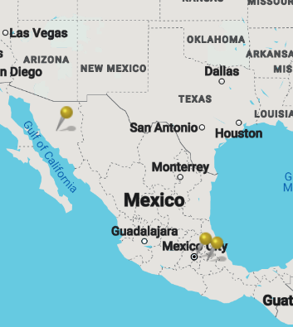
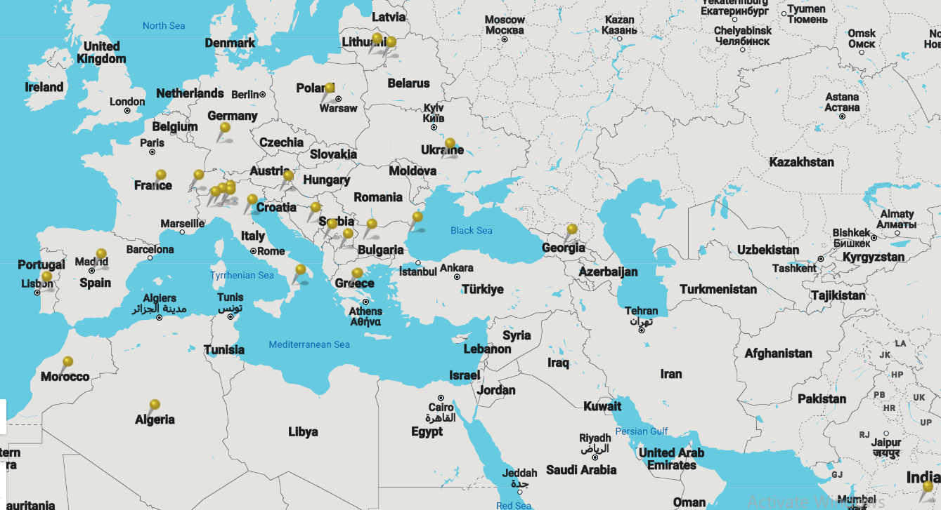
PTMC 2024: more than 1500 students participated from 22 countries and 47 institutes during 8 sessions
Including 11 Feb and 8 March women days
Some institutes had 2 sessions
due to high demand.
Online and hybrid sessions too.
At least 8 of the core team tutors follow MSc or PhD in related field.

Slide 11
