Slide 1
Fast losses in IR7: new layout configuration
B.Salvachua (SY-BI-BL)
Inputs from E.Effinger, A.Lechner, S.Morales, C.Zamantzas
23 Feb 2024 - BLM Thresholds Working Group - BLMTWG

Slide 2
Introduction
During 2023 proton run, losses in IR7 during injection were dumping the beam with 236b injection trains and only in Beam 1.
These are fast losses in RS01 (40us) reaching the BLM maximum electronics limit of 23 Gy/s at the primary horizontal and skew collimators.
See follow-up at:
  JAPW 2023:
    Session 2 (5th Dec 2023): https://indico.cern.ch/event/1337597/sessions/515527/#20231205
    Session 5 (6th Dec 2023): https://indico.cern.ch/event/1337597/sessions/515567/#20231206
  BLMTWG (27th Nov 2023): https://indico.cern.ch/event/1350470/
  LBOC (20th Jun 2023): https://indico.cern.ch/event/1291758/
  MPP (15th Dec 2024): https://indico.cern.ch/event/1356938/

Slide 3
How many protons impact the primary collimator?
Estimation of protons at 450 GeV impacting the primary collimators during saturation by calibrating another BLM downstream that does not saturate.
S.Morales
RS01 6.8e8 p in 40 us or 8e-4% train
For the injections that made it:
RS09: 4e10 p in 1.3 s or 0.1% train
0.1% of train
RS12: 8e11 p in 83 s or 2% train
Equivalent of 50 Joules in 40us
Saturation level of the TCP.C

Slide 4
How many protons impact the primary collimator?
This estimate of saturation around a pilot is confirmed by a test on 23 June.

Slide 5
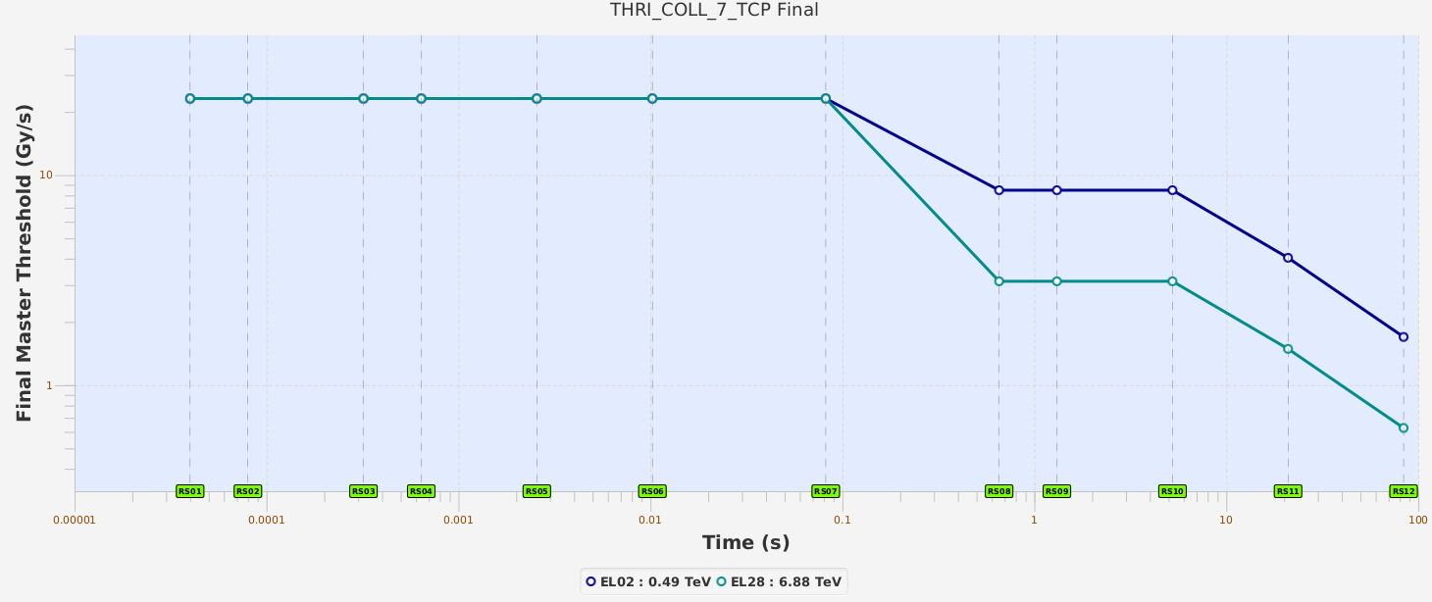
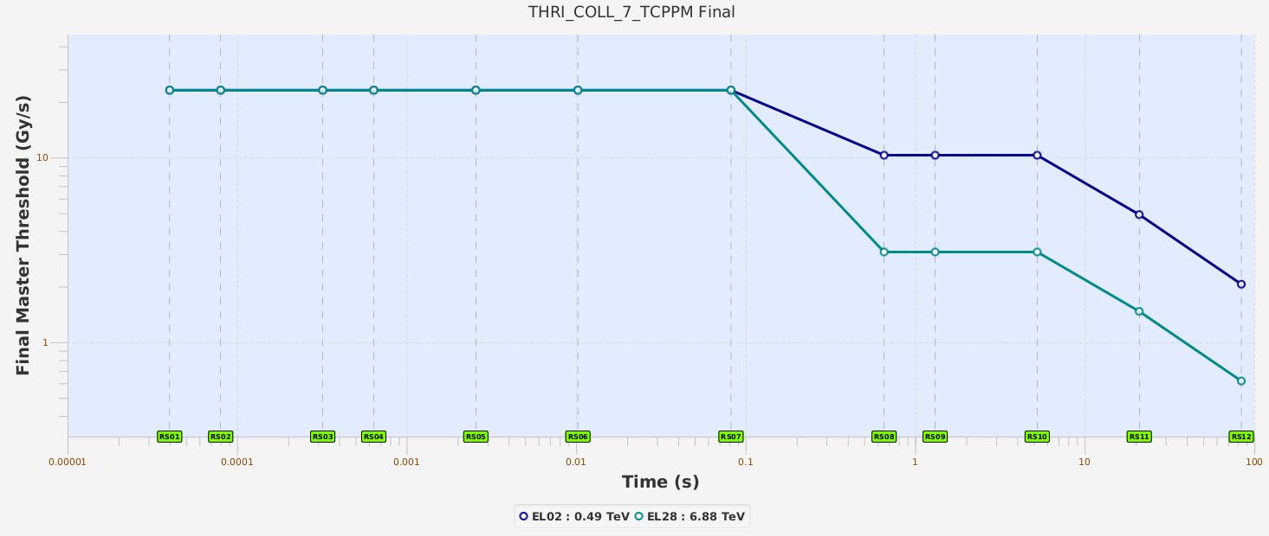
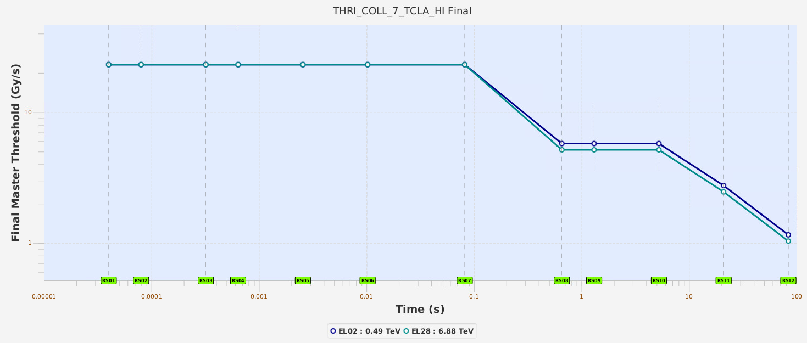
BLM Thresholds for collimators
The saturation of short running sums in several locations affects all energies (not only injection). All other collimation families are also affected but these families more heavily.
TCP.C Horizontal
TCP.D Vertical
TCP.B Skew
Tolerate higher beam power for shorter period - different regime
125 kJ
Steady state losses set to 500kW
Curves are based on measured data and simulations. They correspond to the expected signal for the different beam losses.
2+2 TCLA.A and B of the other beam

Slide 6
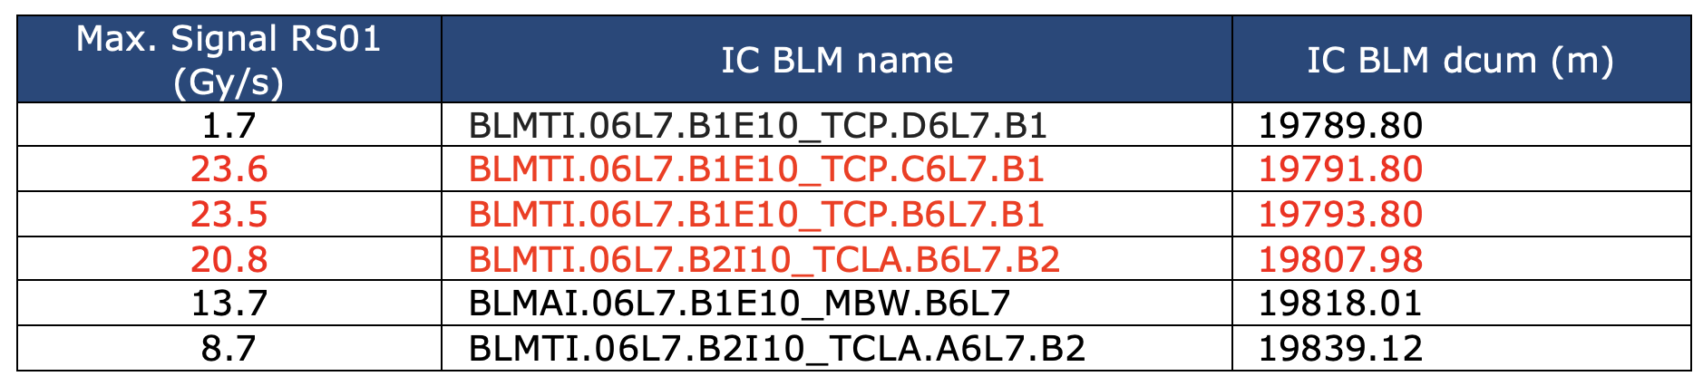
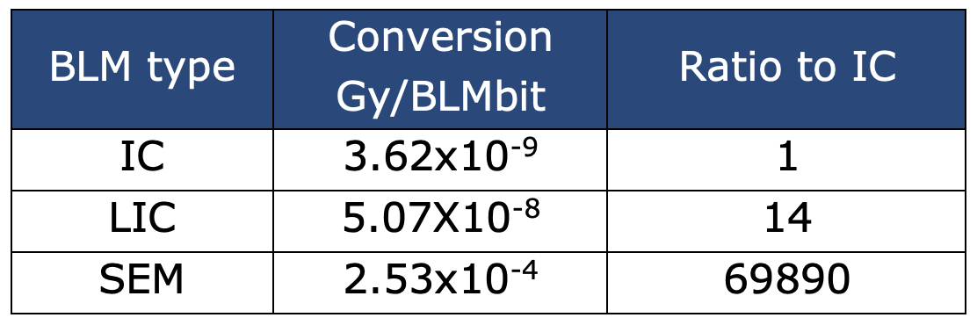
BLM signals during injection
These are the measured BLM signals during one of the injections with high losses in IR7.
The affected BLMs corresponds to the monitors in the previous families.
In order to study what would be the strategy for LS3, we have proposed:
    The installation of transversally displaced Ionization Chambers (IC) in order to reduce its response and eventually move the interlock functionality to these new IC.
    The replacement of SEM detectors by Little Ionization Chambers (LIC) in the 6L7 area.
The SEM provide a response that is too low, while for the LIC the response is expected to be 14 times lower.
To be mentioned, that we need a response of about 100 times lower at the TCPs in order to completely avoid saturation.

Slide 7
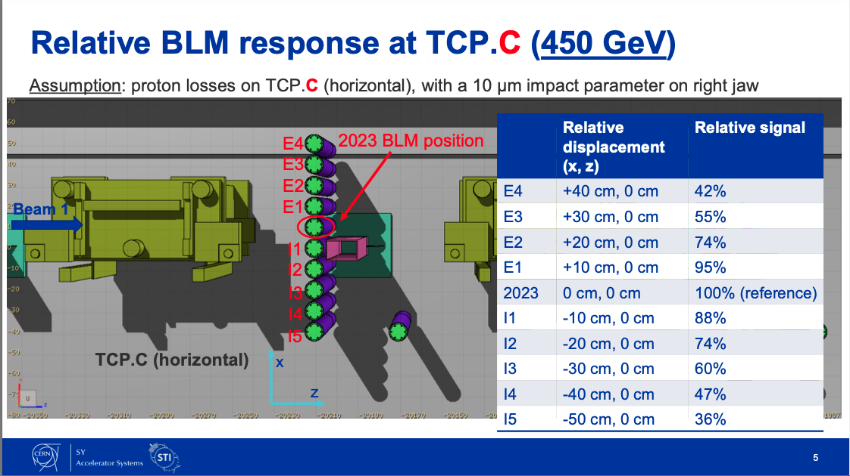
Can we reduce the BLM response?
A.Lechner provided the Fluka expected change of BLM response as function of transversal displacement.
More details: https://indico.cern.ch/event/1371132/
Considering integration constrains the BLM could only be installed around positon I3 for
TCP.C6L7.B1 and TCP.B6L7.B1
But other proposal was put forward.

Slide 8
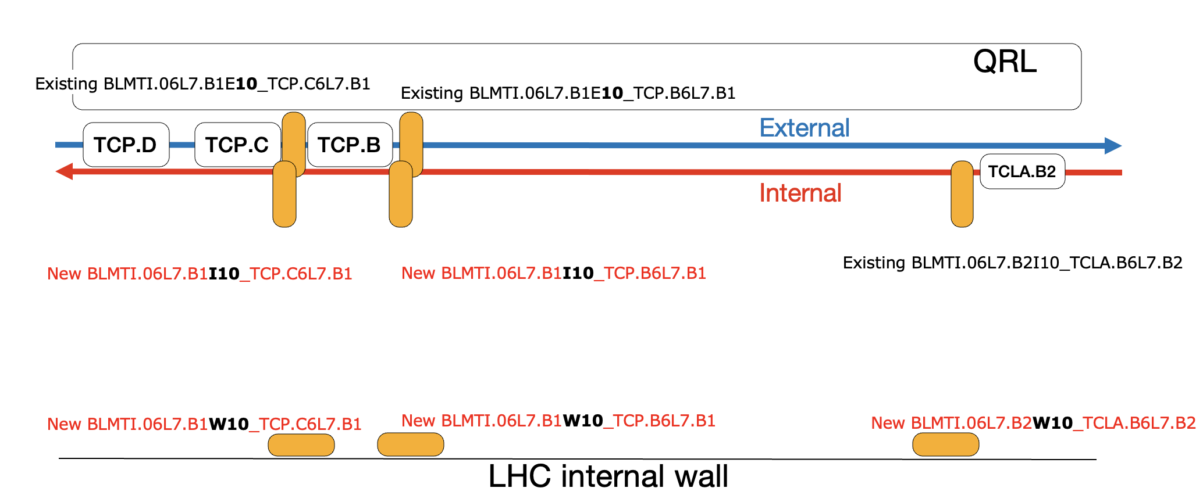
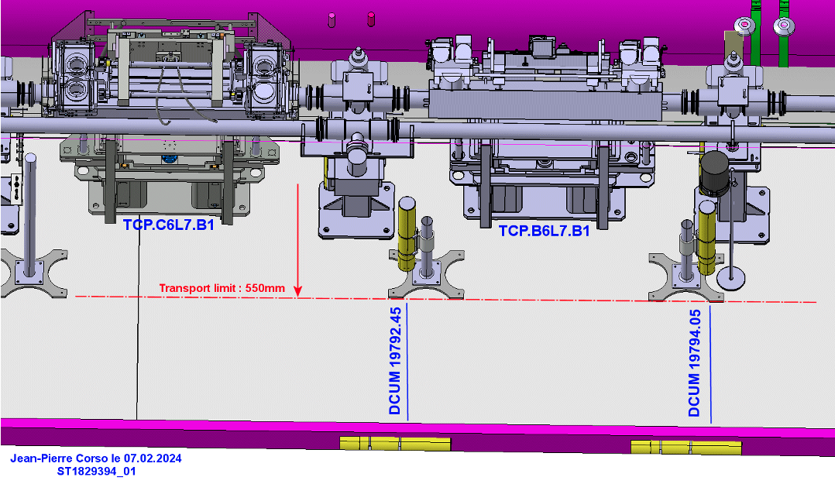
New IC BLM installation in 6L7
We have proceed with the installation over EYETS and the ECR under approval:
LHC-BLM-EC-0019, Addition of BLM detectors and replacement of several SEM by LIC
2 IC BLM in position about I3 for the TCP.C and TCP.B —> 60% response expected
3 IC BLM installed in the tunnel passage WALL, about 2 m transversal displacement from the beam pipe for TCP.C, TCP.B and TCLA.B
10 LIC BLM replacing 10 SEM BLM, at the same location

Slide 9
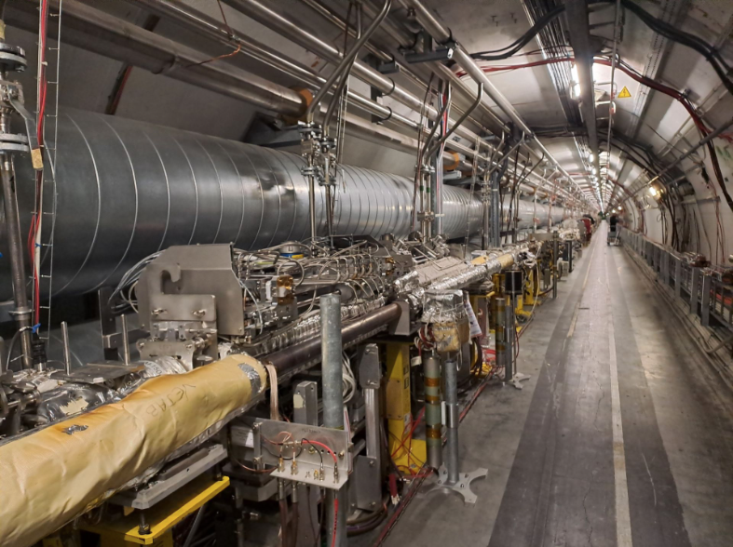
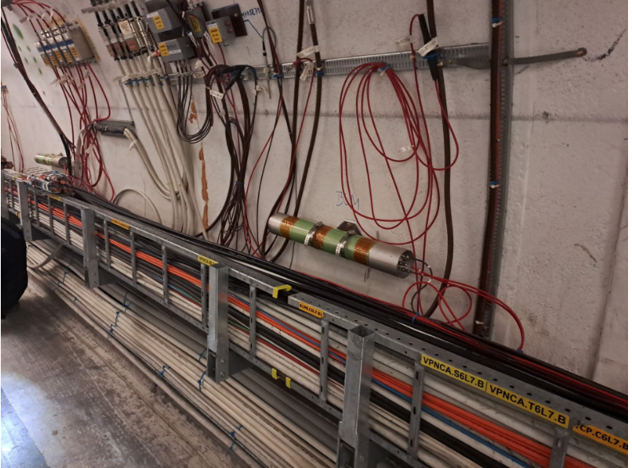
Installation pictures

Slide 10
Thresholds strategy
BLM name 2023 | Family 2023 (B1+B2) | Additional BLM 2024 for same protected element
BLMTI.06L7.B1E10_TCP.D6L7.B1 (external beam line) | THRI_COLL_7_TCPPM
BLMTI.06L7.B1E10_TCP.C6L7.B1 (external beam line) | THRI_COLL_7_TCPPM | BLMTI.06L7.B1I10_TCP.C6L7.B1 (internal beam line) BLMTI.06L7.B1W10_TCP.C6L7.B1 (internal wall) | THRI_COLL_7_TCPPM_’suffix’
BLMTI.06L7.B1E10_TCP.B6L7.B1 (external beam line) | THRI_COLL_7_TCP | BLMTI.06L7.B1I10_TCP.B6L7.B1 (internal beam line) BLMTI.06L7.B1W10_TCP.B6L7.B1 (internal wall) | THRI_COLL_7_TCP_’suffix’
BLMTI.06L7.B2I10_TCLA.B6L7.B2 (internal beam line) | THRI_COLL_7_TCLA_HI | BLMTI.06L7.B2W10_TCLA.B6L7.B2 (internal wall) | THRI_COLL_7_TCLA_HI_’suffix’
New families based on the old families with additional:
SCALE_CORRECTION or new response.
Flags for start-up for new IC:
CABLE_CONNECTED = True
BIS_CONNECTED = False —> The interlock functionality will be set after beam confirmation and agreement of the new RESPONSE FACTORS
MASKABLE = True

Slide 11
Summary
Saturation of BLMs in the primary collimators could be a limitation for 2024 run.
This affects Injection Losses but also the Quench Test/
New BLM installation over EYETS to study the options:
  Adding 2 IC at a displaced position (35cm), expecting signal reduction by 60 %
  Adding 3 IC at displaced position (2m), expecting larger signal reduction. Response to be studied.
  Replacing 10 SEM by LICs in 6L7. The response and signal stability to be studied. A Technical Student will do this analysis starting in June 2024.
  For the moment the interlock is still based in standard IC monitors.
B. Salvachua - MPP 15/12/2023
B. Salvachua - BLMTWG 23/02/2024

Slide 12
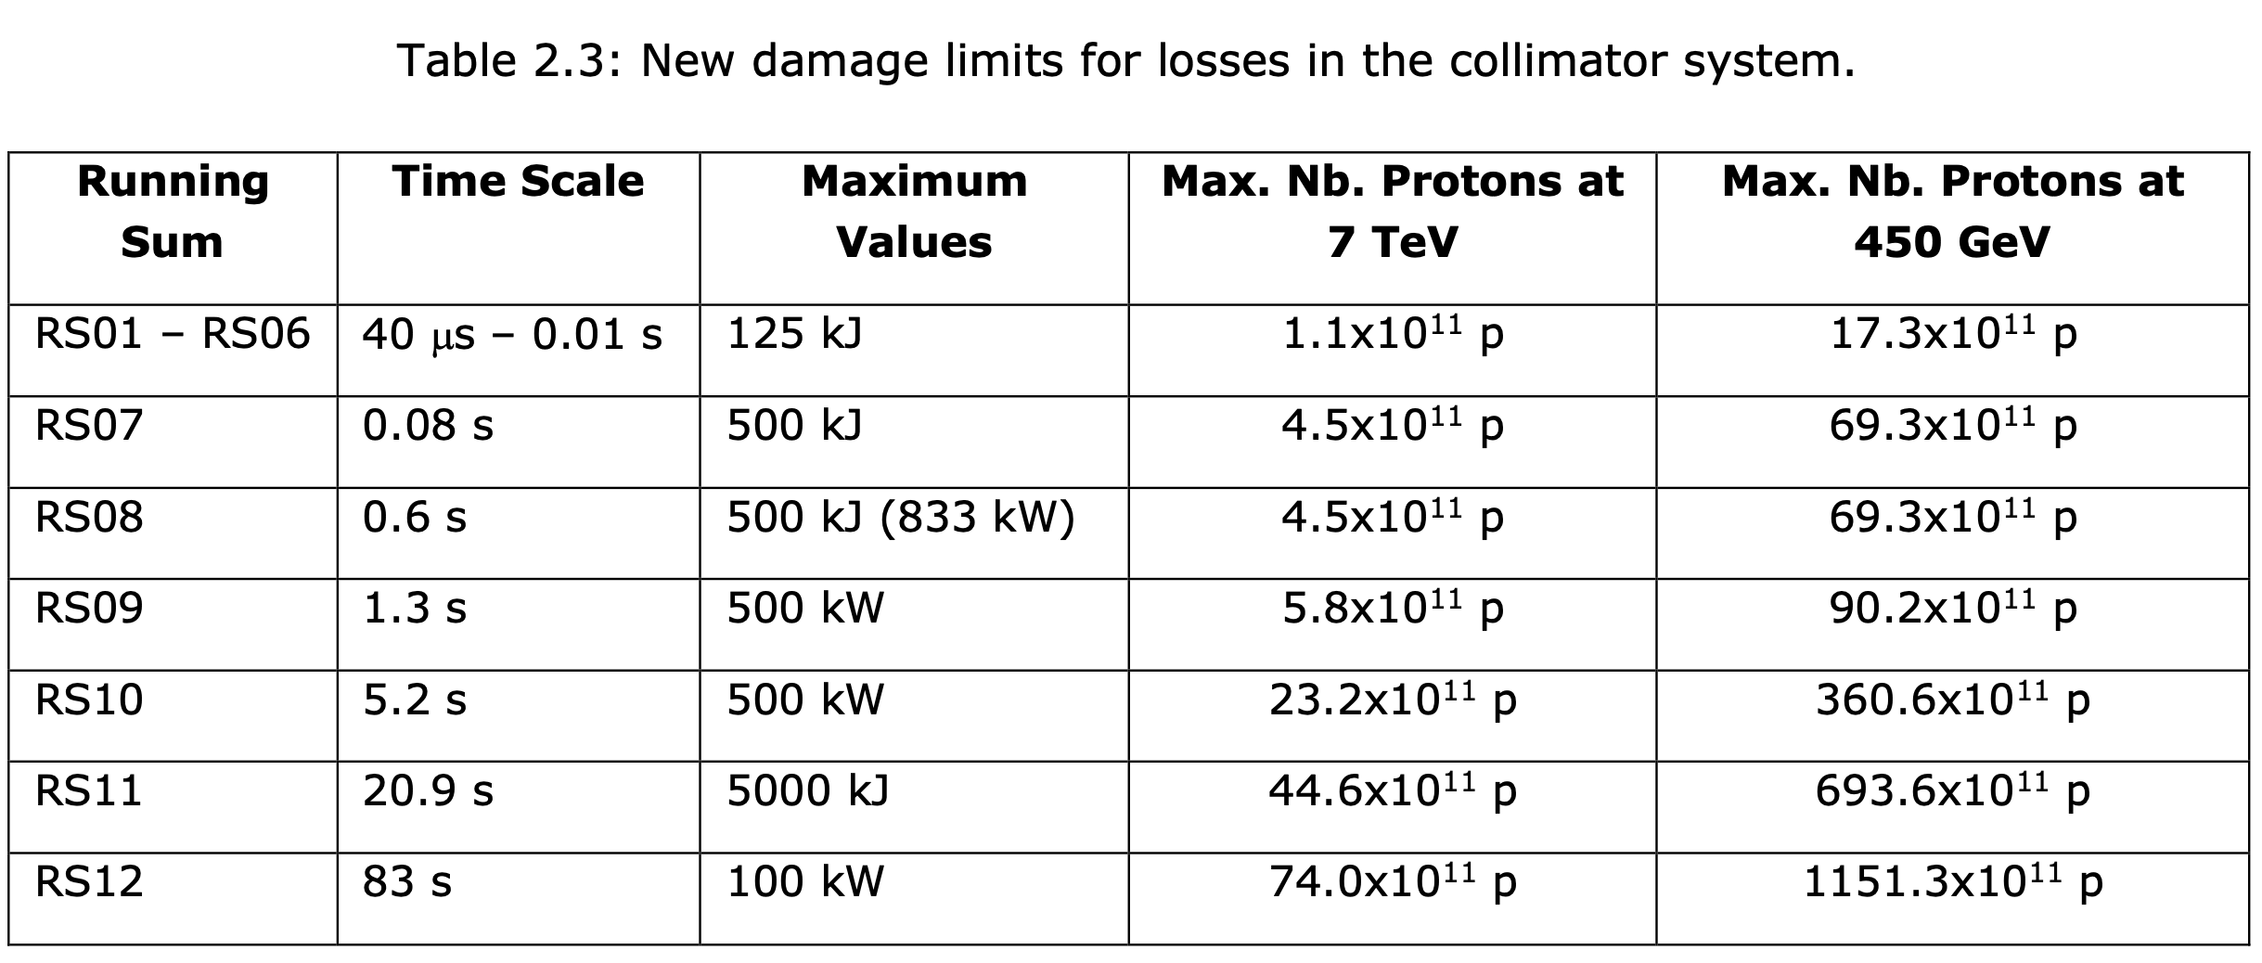

Slide 13
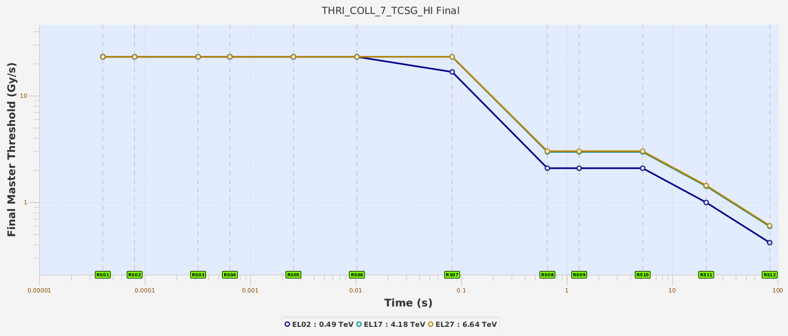
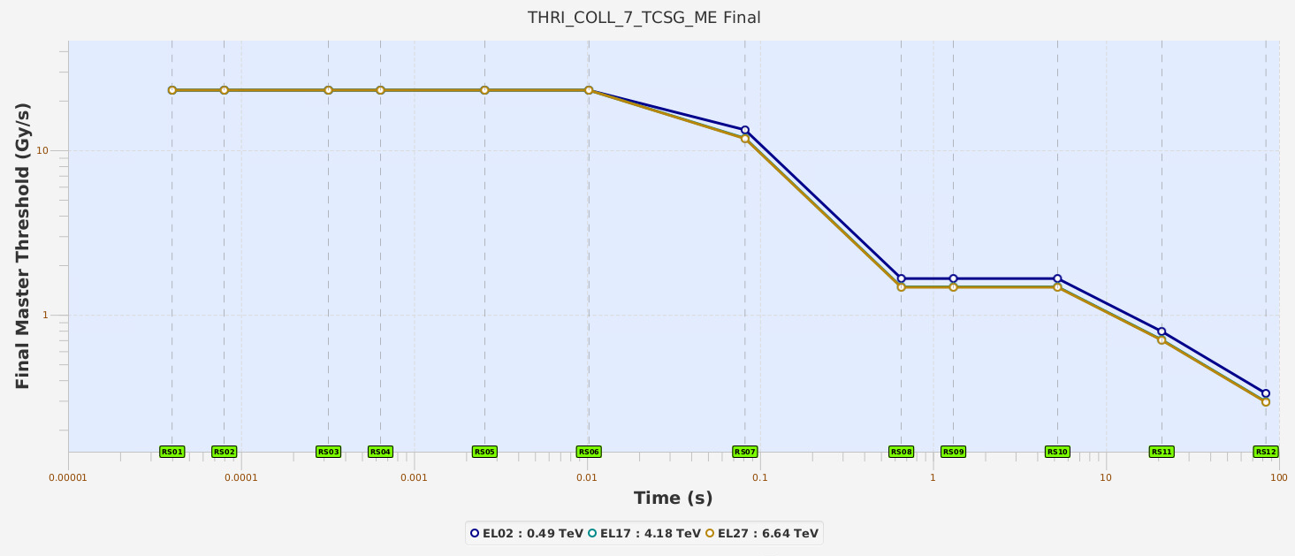
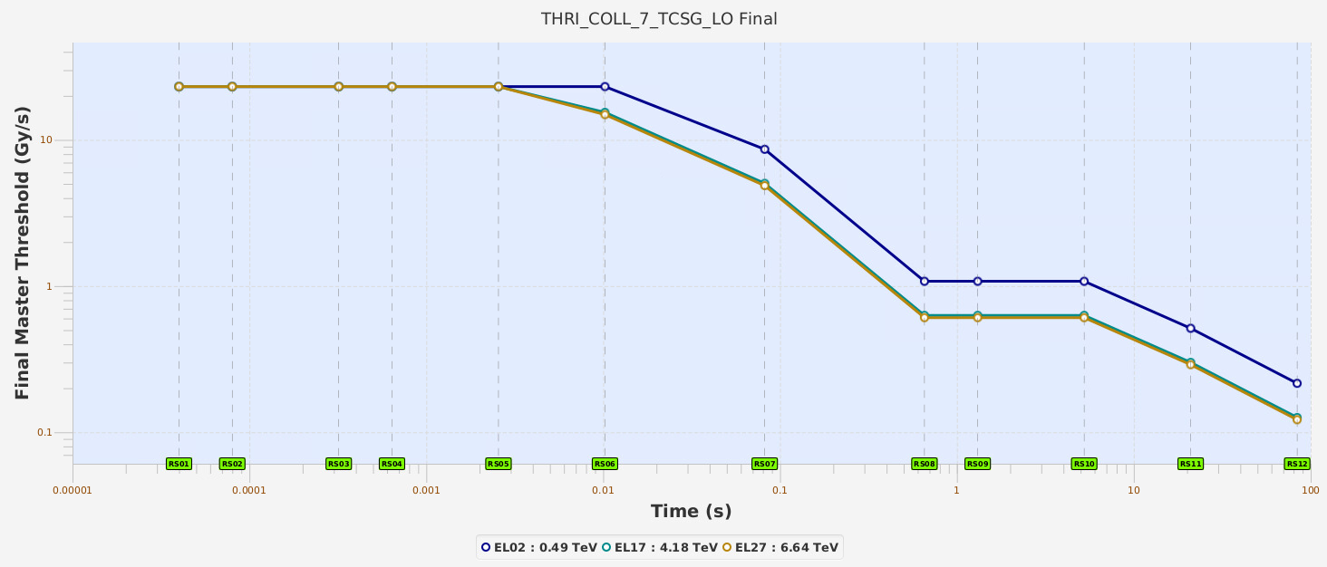
Other collimation families
2 TCSG.A6
8 BLM TCSG
11 BLM TCSG

