Slide 1
Installation of new monitors in IR6
23/02/2024
Sara Morales on behalf of the SY-BI-BL section
98th BLMTWG

Slide 2
Motivation for the installation of new monitors in IR6
Installation of a short LESS treated vacuum chamber (only Beam 1, Beam 2 cleaned Cu tube for reference) in IR6 to mitigate electron cloud formation
  Will it generate more UFOs?
    Risk of premature beam dumps and magnet quenches
  In case it happens, proposal to add more beam loss monitors to be able to identify where the UFO is originated
Described on ECR LHC-VC-EC-0003

Slide 3
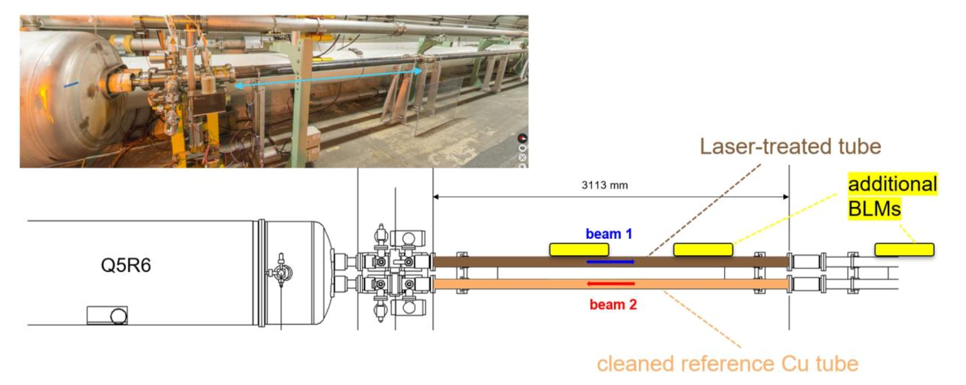
Motivation for the installation of new monitors in IR6
Installation of a dBLM as well!
Figure 8 from the ECR

Slide 4
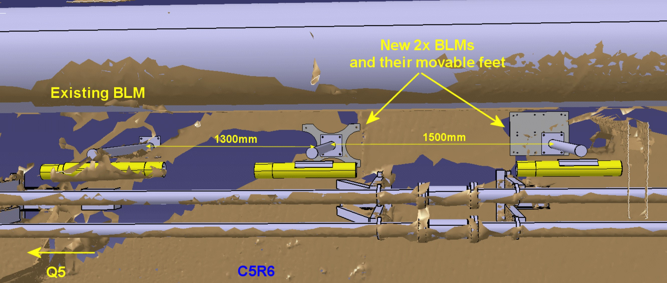
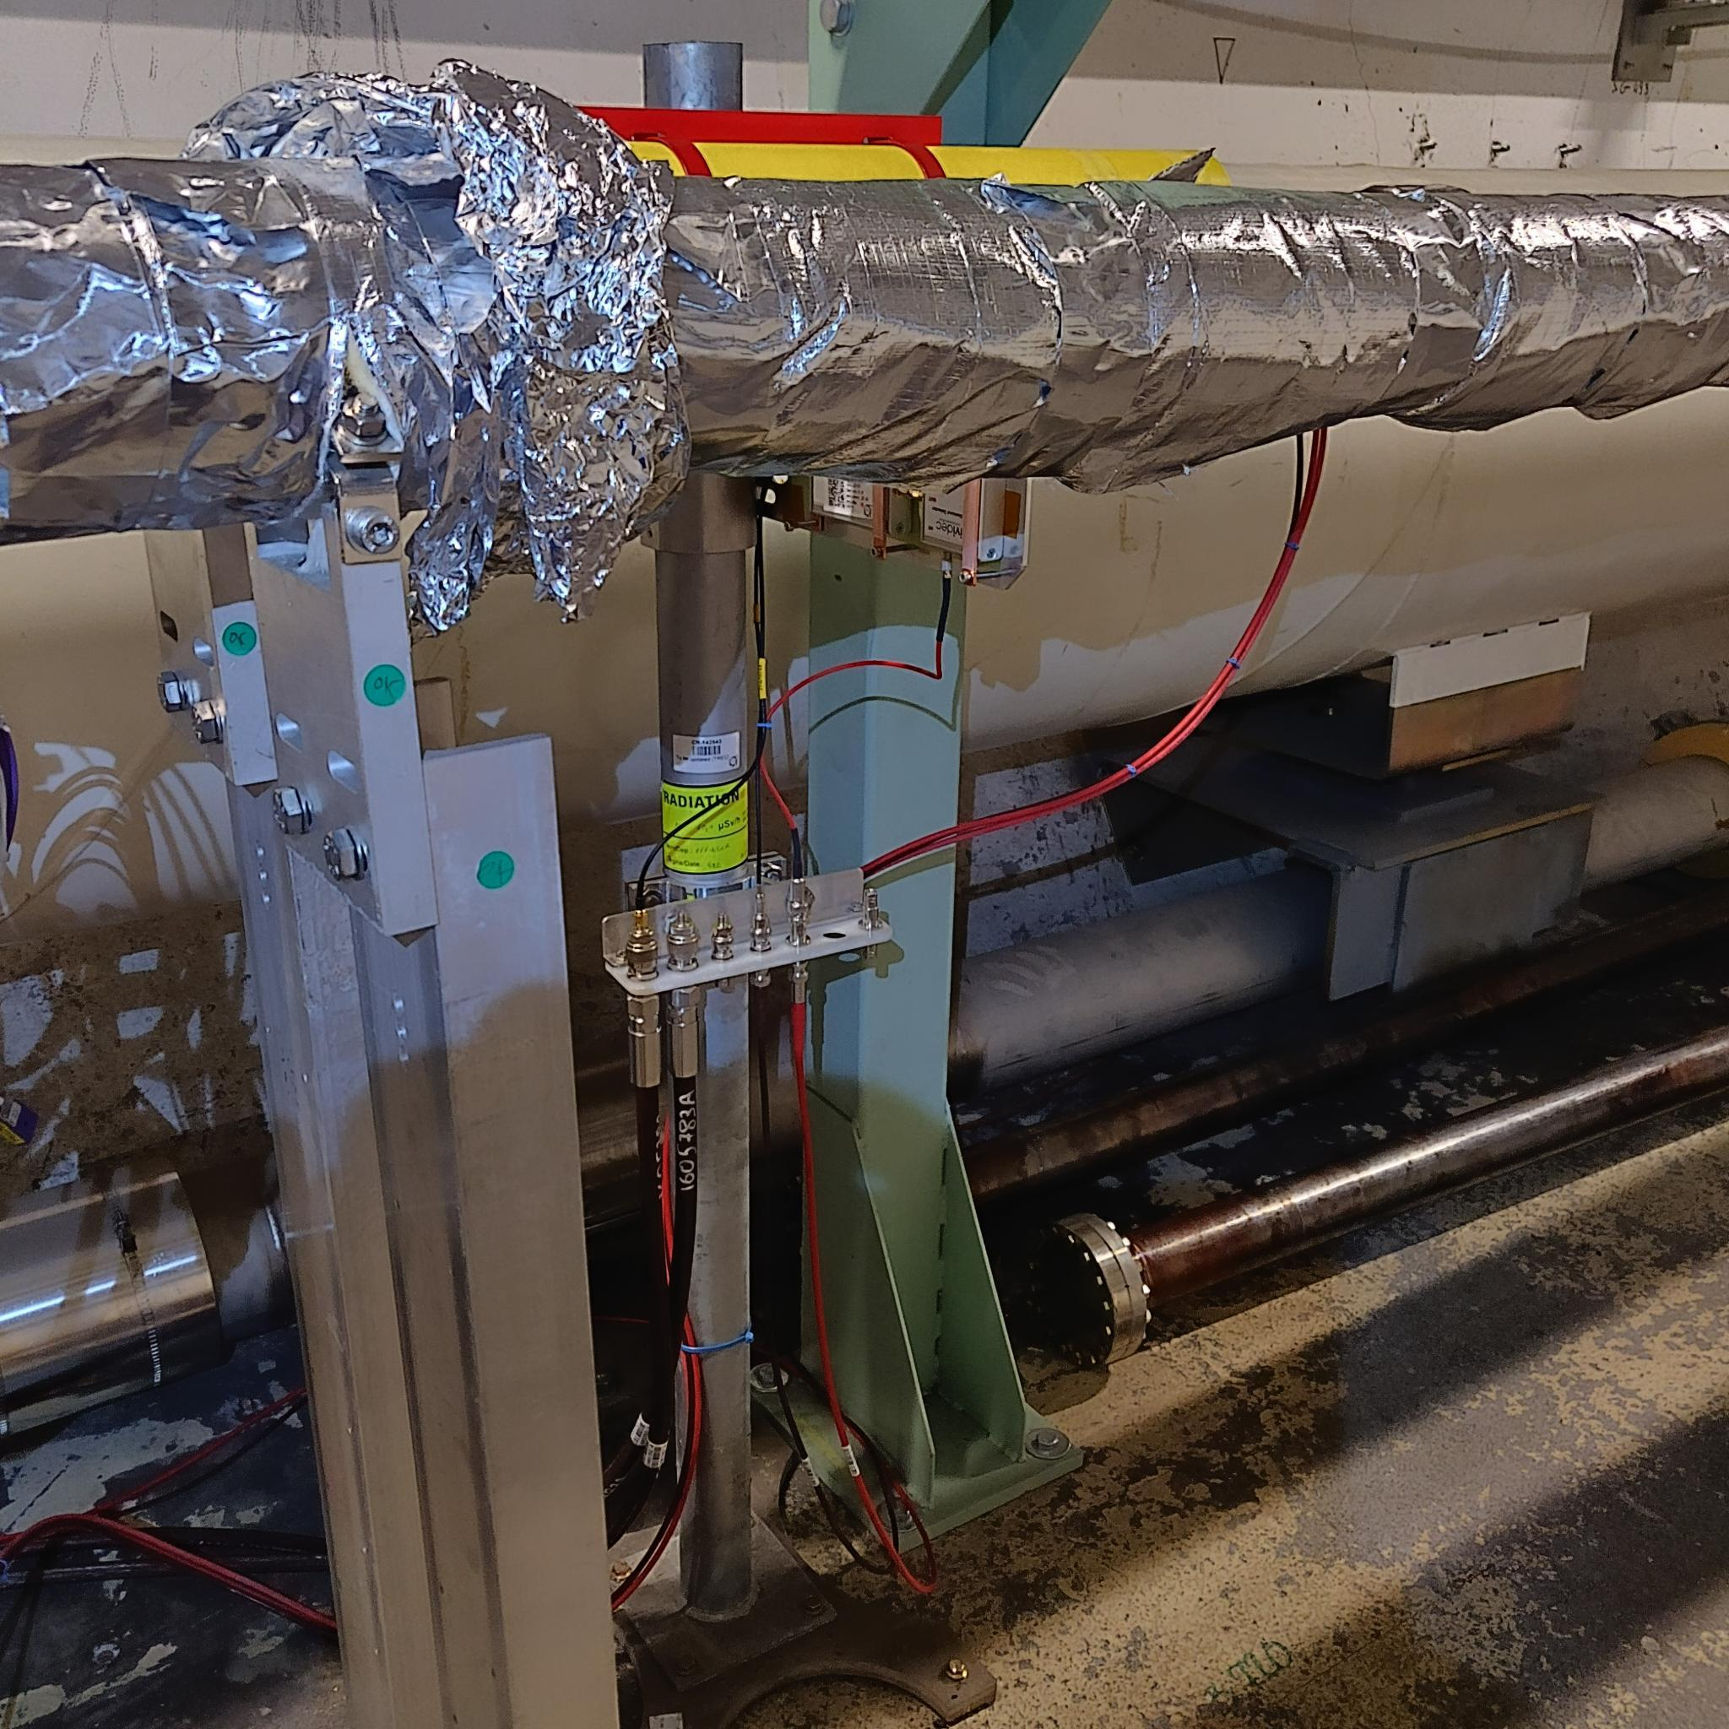
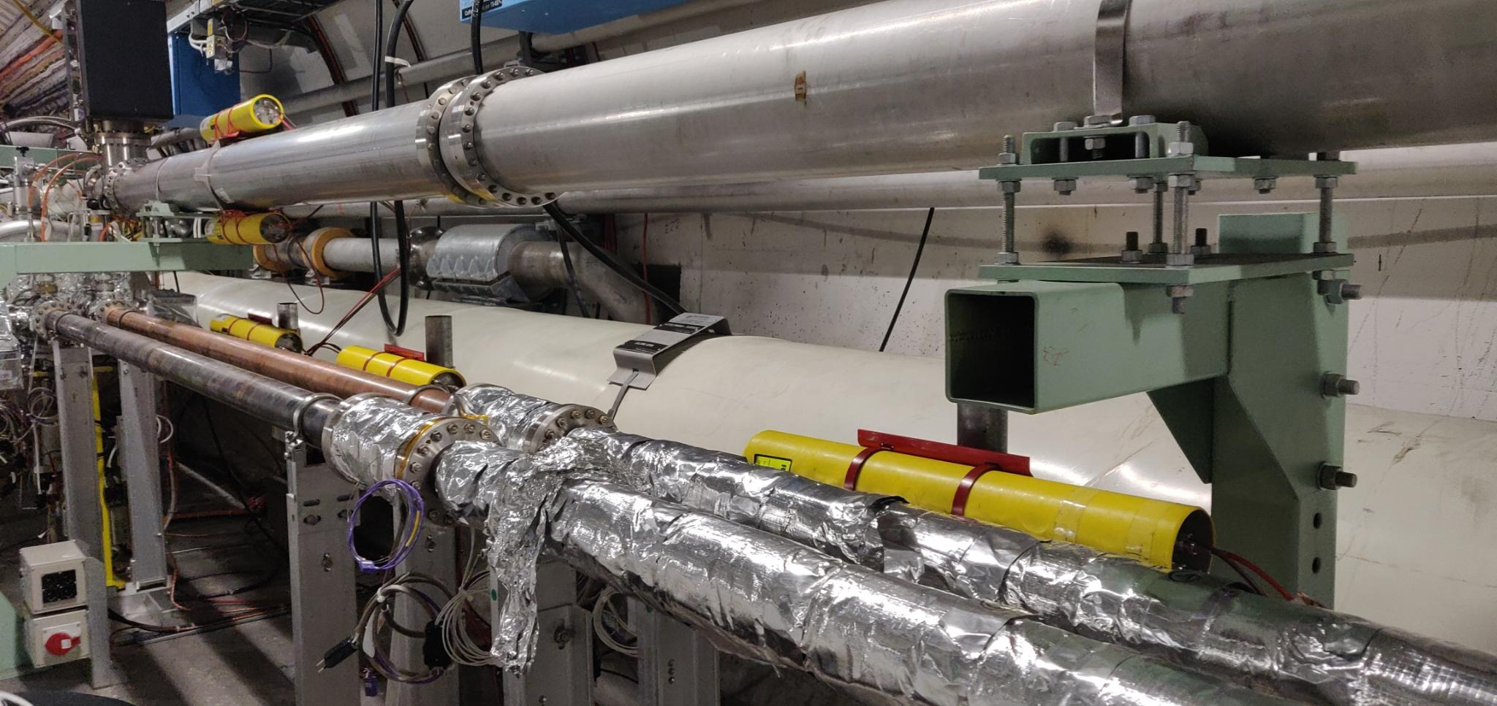
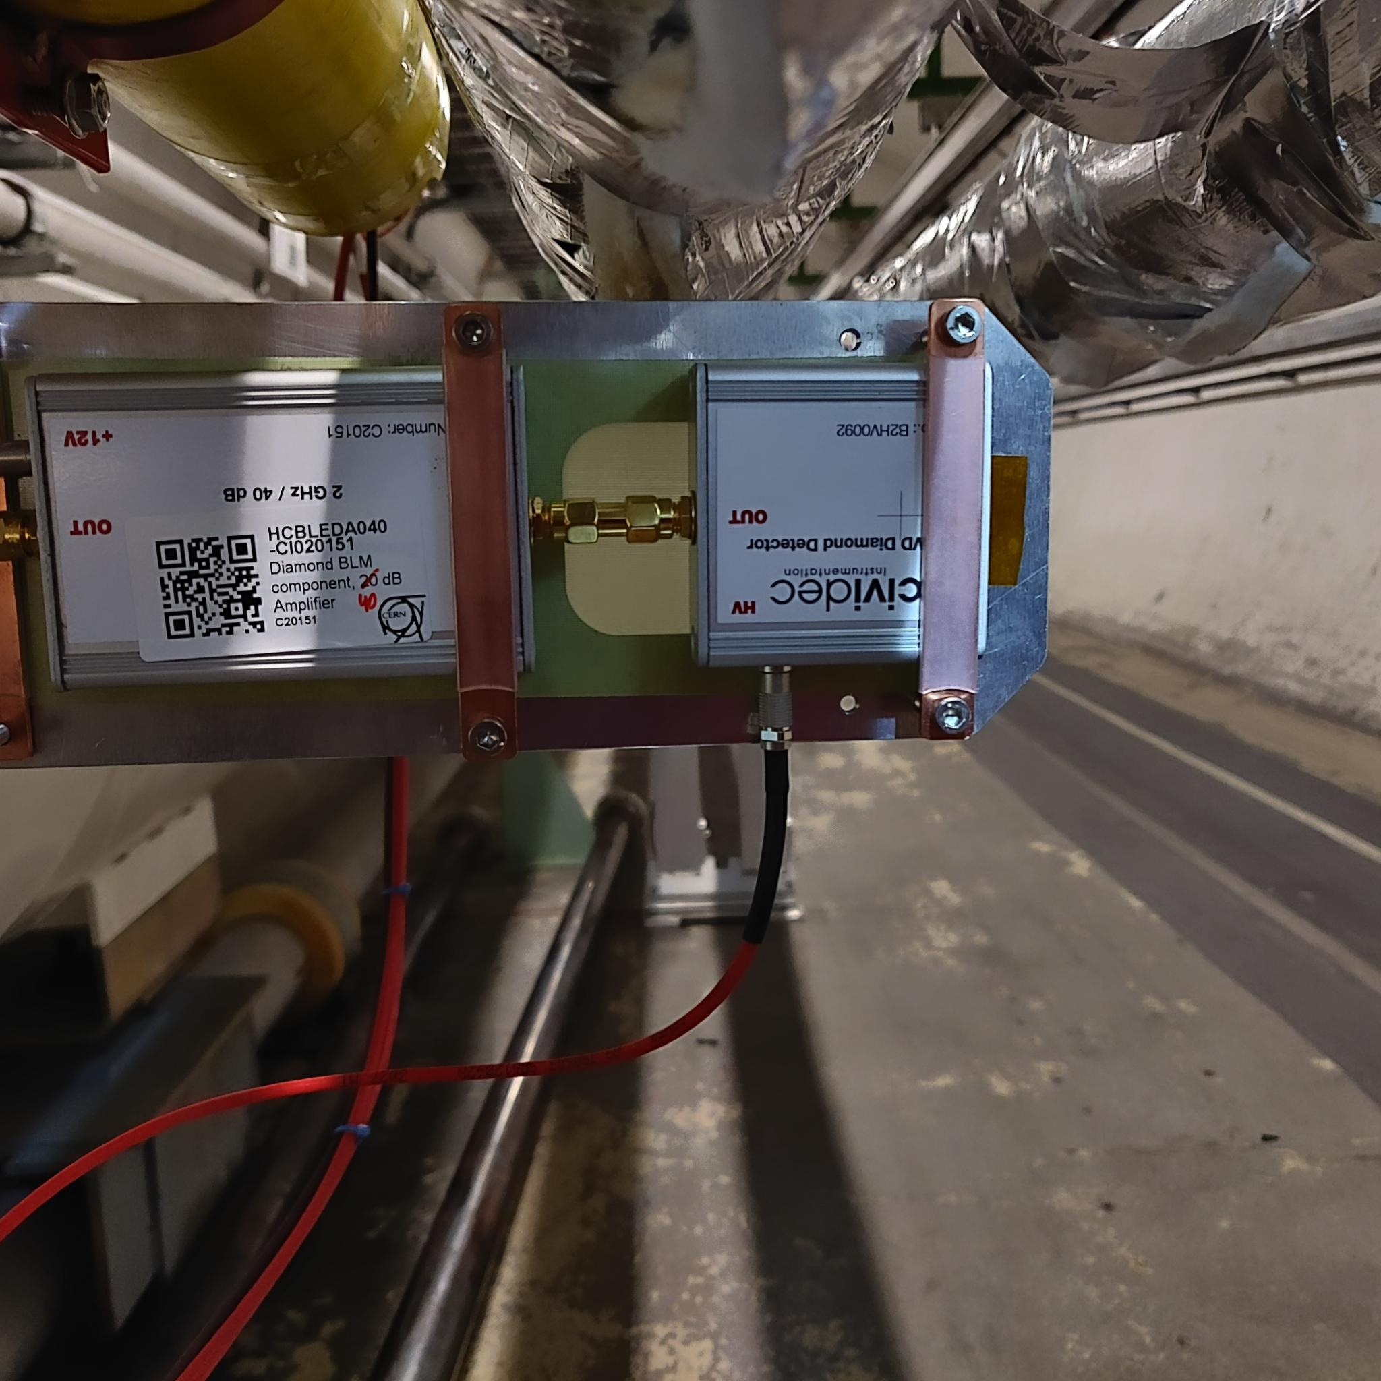
Installation of new monitors in IR6
Courtesy of JP Corso
dBLM installed
New monitors
Pictures courtesy of A. Lernevall and E.Calvo

Slide 5
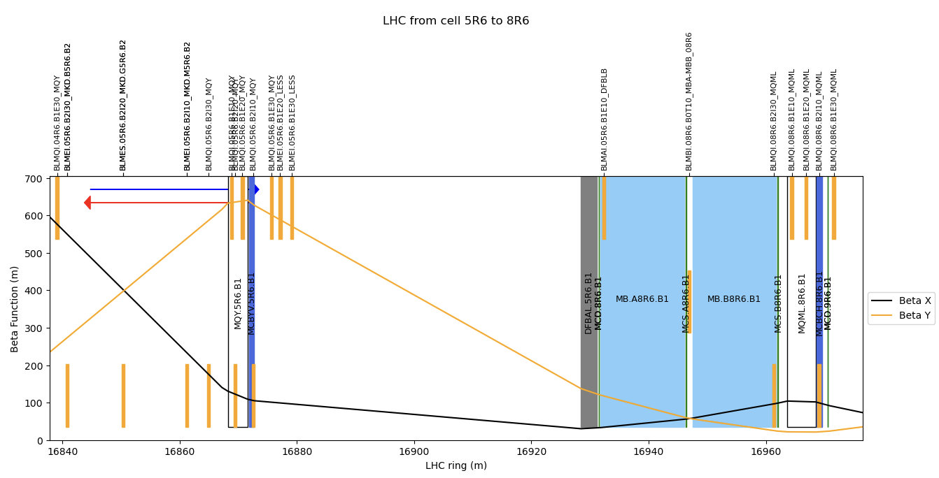
Installation of new monitors in IR6
Courtesy of B.Salvachua

Slide 6
Installation of new monitors in IR6 – Flags on LSA
BLM name | DCUM [m] | Family | Connected | BIS | Maskable
BLMEI.05R6.B1E20_LESS | 16876.85 | THRI_DRIFT | Yes | No | Yes
BLMEI.05R6.B1E30_LESS | 16878.85 | THRI_DRIFT | Yes | No | Yes
BLMED.05R6.B1E30_LESS | 16878.85 | - | - | - | -
I -> Ionization chamber
D -> Diamond BLM

