Slide 1
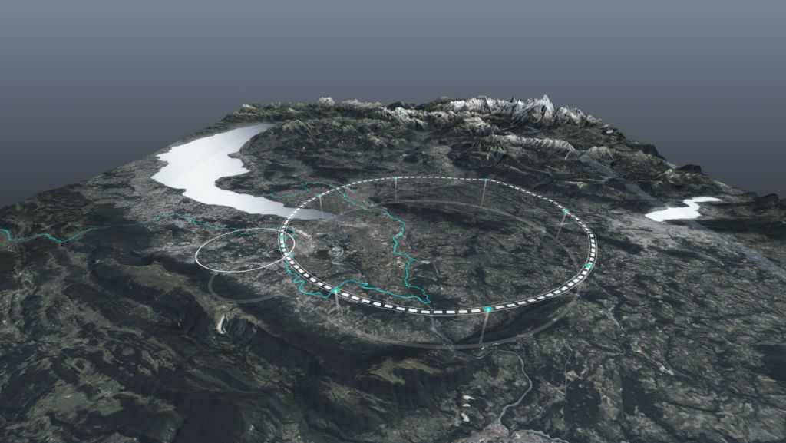









The Path Towards the
Future Circular Collider at CERN
Emmanuel Tsesmelis (CERN)
Head of Associate Member State and Non-Member State Relations
Convenor of FCC Global Collaboration Working Group
Talk-for-Guides: FCC Communication towards Visitors
11 March 2024
http://cern.ch/fcc
Work supported by the European Commission under the HORIZON 2020 projects EuroCirCol, grant agreement 654305; EASITrain, grant agreement no. 764879; iFAST, grant agreement 101004730, FCCIS, grant agreement 951754; E-JADE, contract no. 645479; EAJADE, contract number 101086276; and by the Swiss CHART program
photo: J. Wenninger

Slide 2
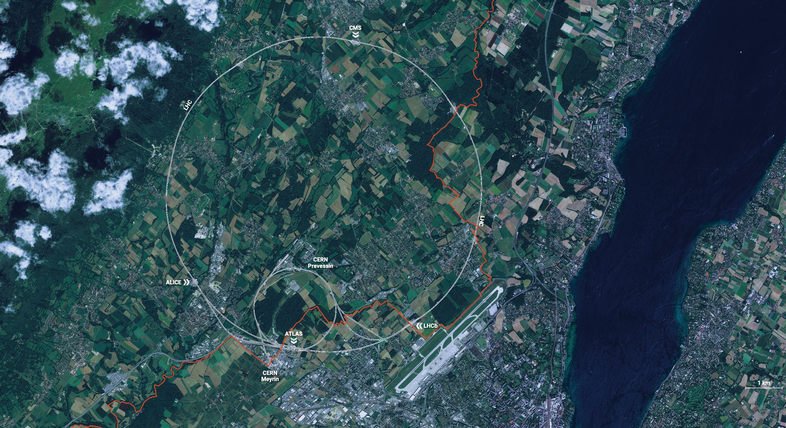
CERN is the world’s biggest laboratory
for particle physics.
Our goal is to understand the most fundamental particles and laws
of the universe.

Slide 3
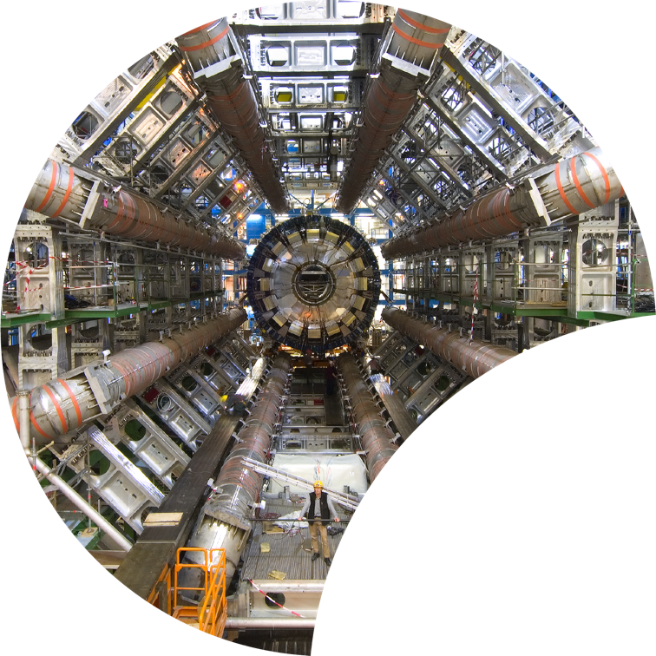
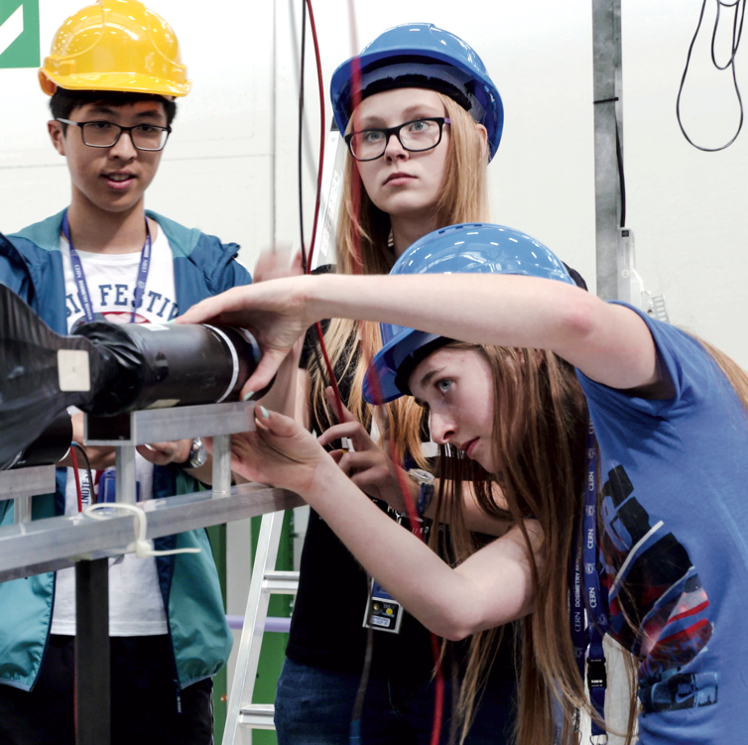

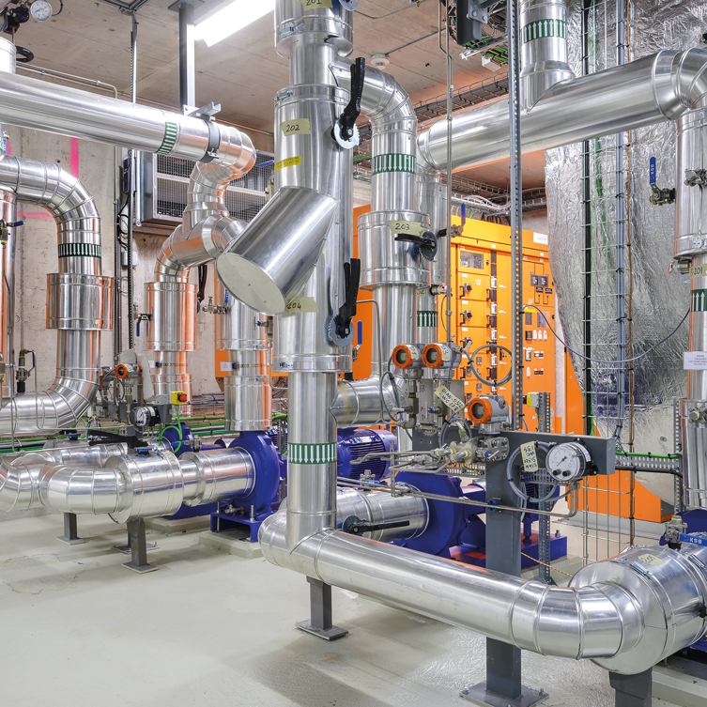

Four pillars underpin CERN’s mission
RESEARCH
EDUCATION
& TRAINING
COLLABORATION
TECHNOLOGY
& INNOVATION

Slide 4
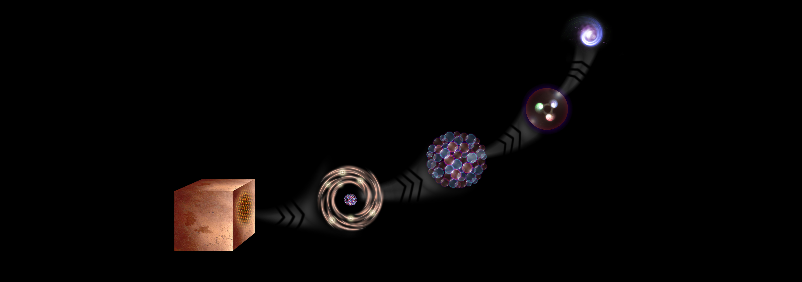
What is the universe made of?
We study the elementary building blocks of matter
and the forces that control their behaviour
Quark
<10⁻¹⁸ m
Proton
~10⁻¹⁵ m
Nucleus
~10⁻¹⁴ m
Electron
Matter
0,1 m
Atom
~10⁻¹⁰ m

Slide 5
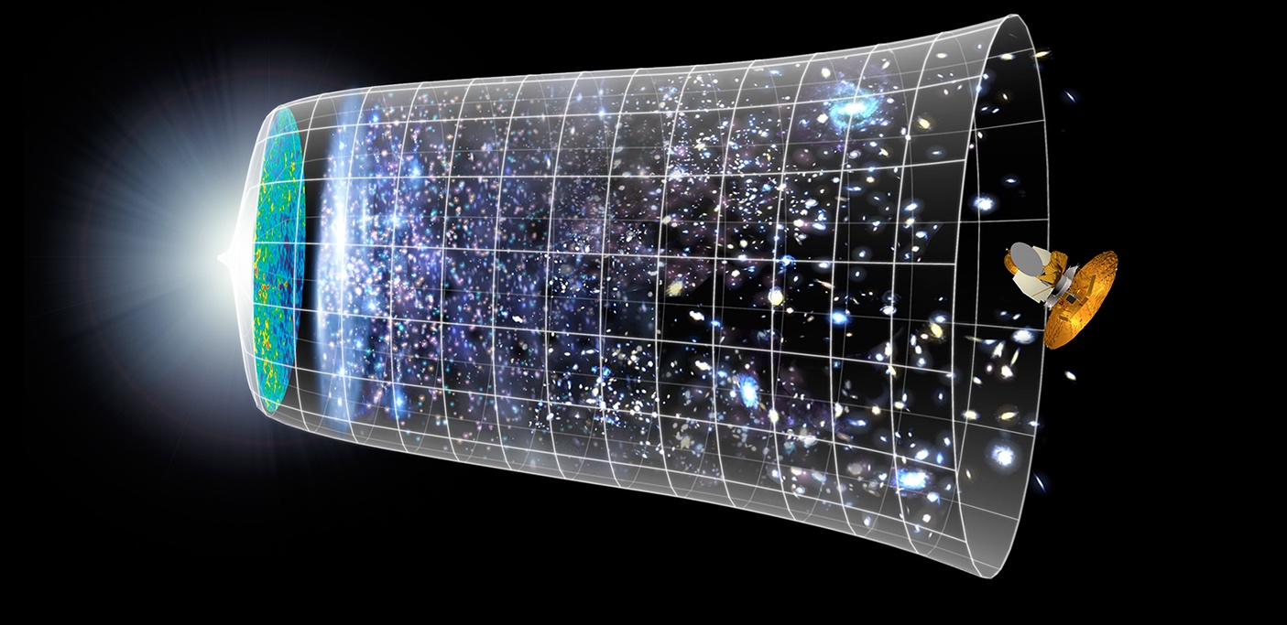

How did the universe begin?
Big Bang
We reproduce the conditions a fraction of
a second after the Big Bang, to gain insight into the structure and evolution
of the universe.
Telescopes
Accelerators
380 000 years
13.8 Billion Years
Today
10²⁸ cm
Synergies with fields of astronomy,
astrophysics and cosmology

Slide 6
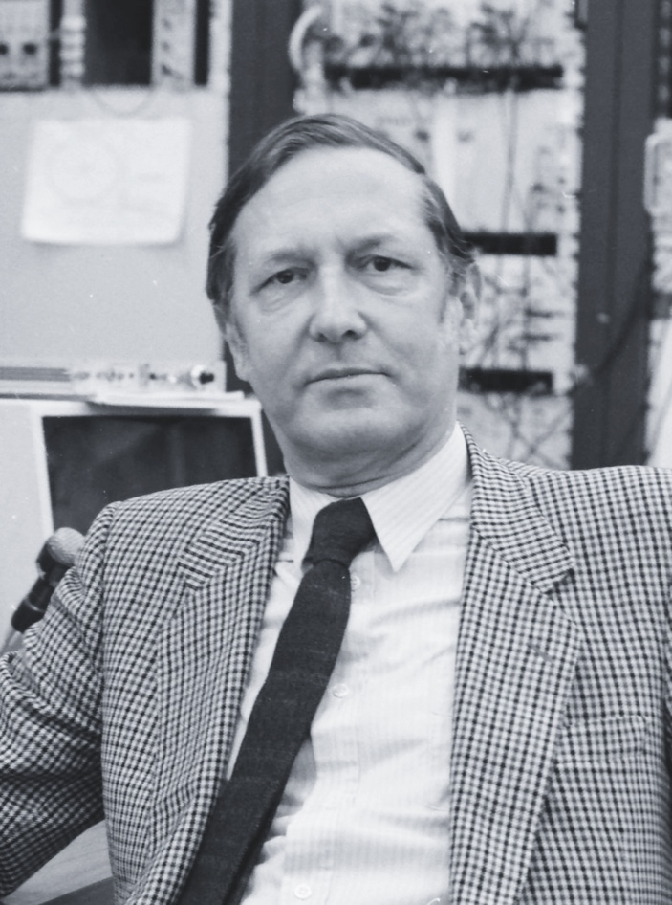
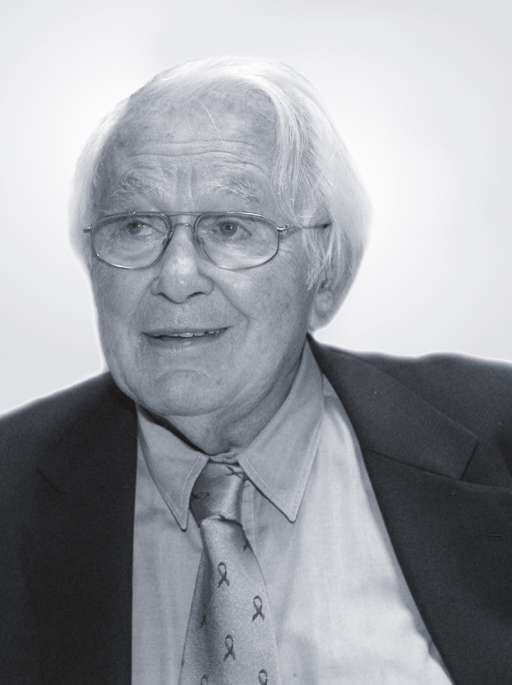
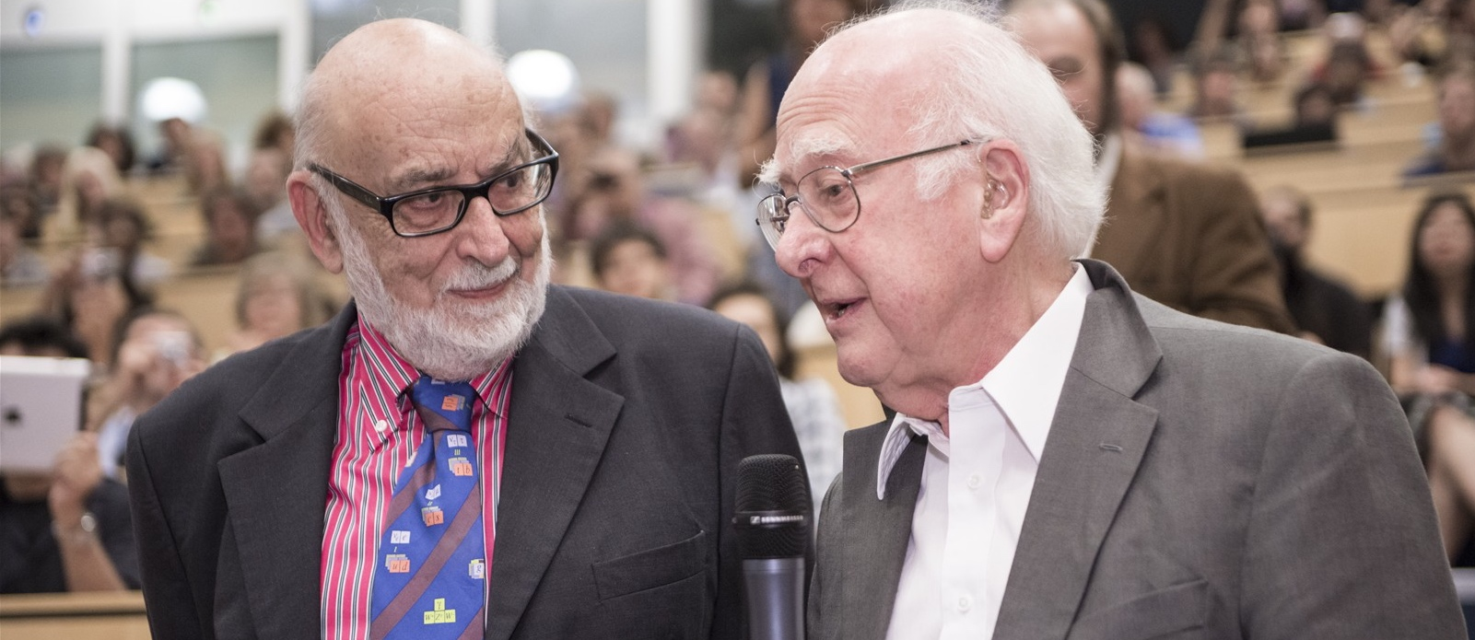
At CERN we help to answer these questions
The Higgs boson was discovered in 2012; without it fundamental particles would be massless
and atoms could not form.
Carlo Rubbia
Simon Van der Meer
Georges Charpak
Several CERN scientists have received
Nobel Prizes for key discoveries
in particle physics.
François Englert and Peter Higgs. With Robert Brout, they proposed the mechanism in 1964.

Slide 7
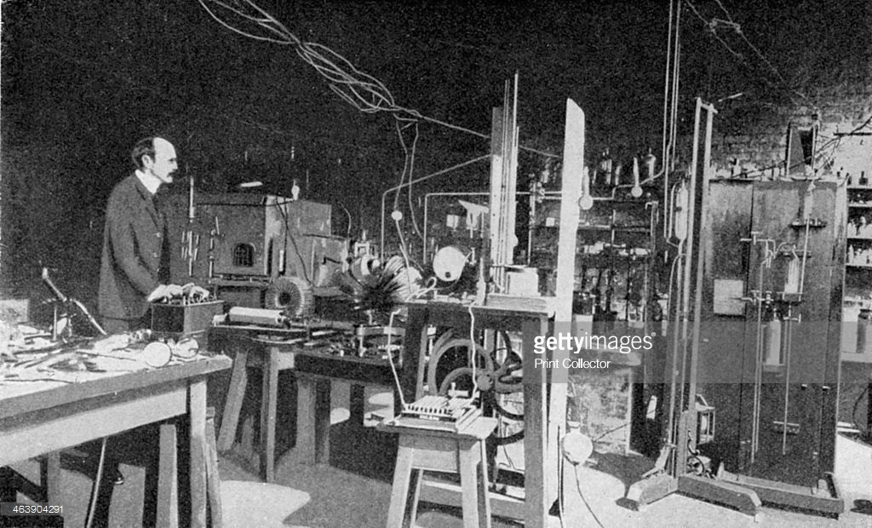
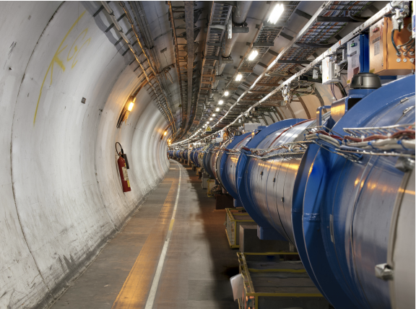
Accelerator Development
Characterised by rapid progress for over a century.
  From cathode-ray tubes to the LHC.
  From the discovery of the electron to the discovery of the Higgs boson.
Advances in accelerators require corresponding advances in accelerator technologies
  Magnets, vacuum systems, RF systems, diagnostics,...
Timelines becoming long, requiring:
  Long-term planning.
  Long-term resources.
  Global collaboration.

Slide 8
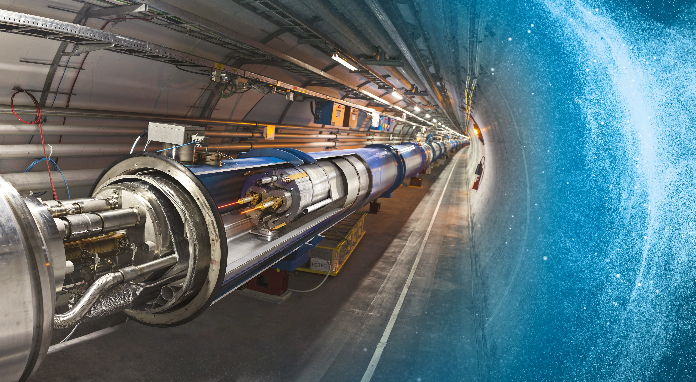
Large Hadron Collider (LHC)
27 km in circumference
About 100 m underground
Superconductivity is the enabling technology for magnets and RF cavities.

Slide 9
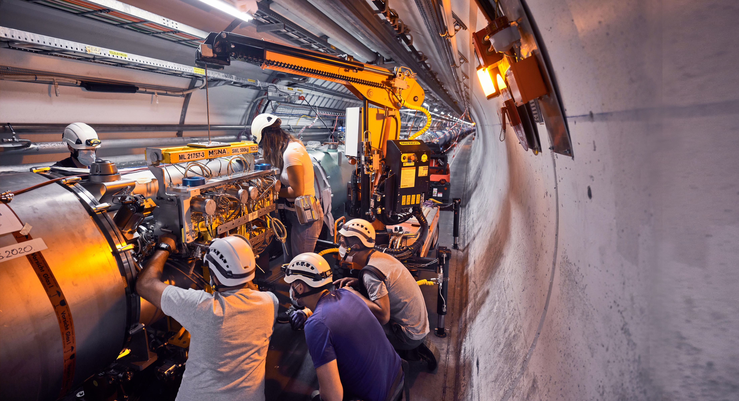
Upgrade to the
High-Luminosity LHC is under way
The HL-LHC will use new technologies to provide
10 times more collisions
than the LHC.
It will give access to rare phenomena, improved precision and discovery potential.
It will start operating in 2029 and run until 2040.
The LHC / HL-LHC will make
significant progress but new
collider needed to advance
research in totally new areas.

Slide 10
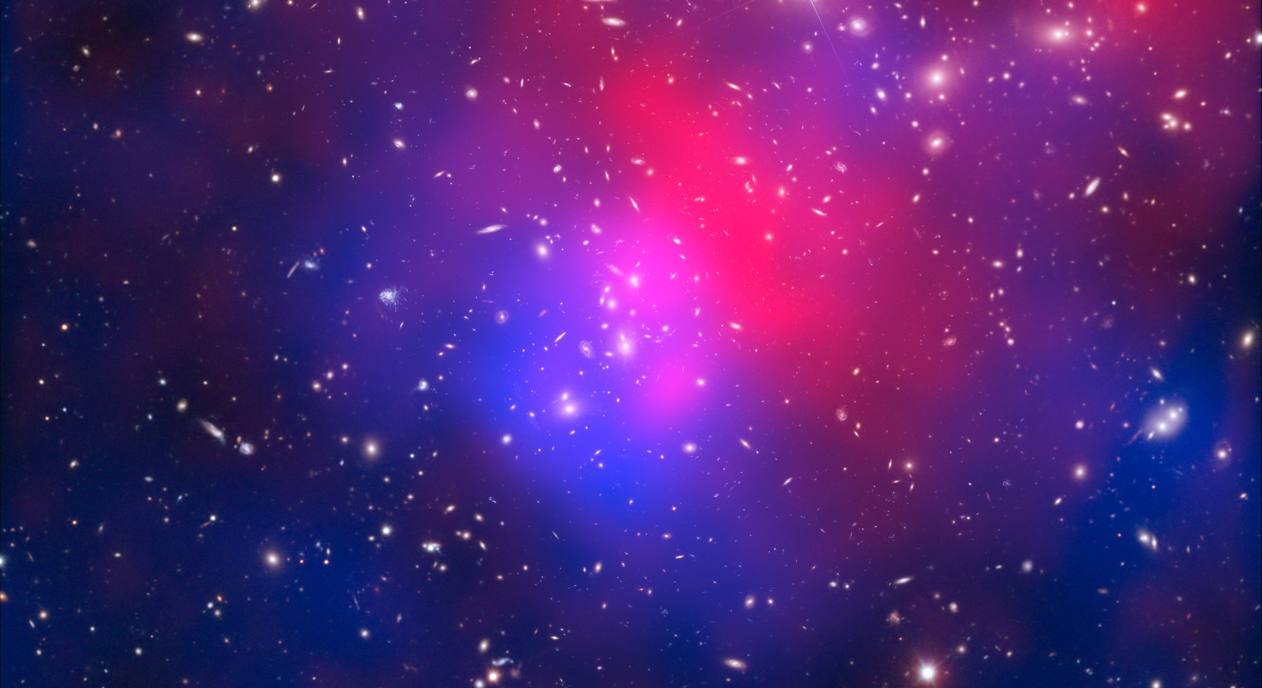
There are many unanswered questions in fundamental physics
Including
What is the unknown 95% of the mass
and energy
of the universe?
Is there only one Higgs boson, and does it behave exactly as expected?
Why is the universe made only of matter, with hardly any antimatter?
Why is gravity so weak compared to the other forces?

Slide 11
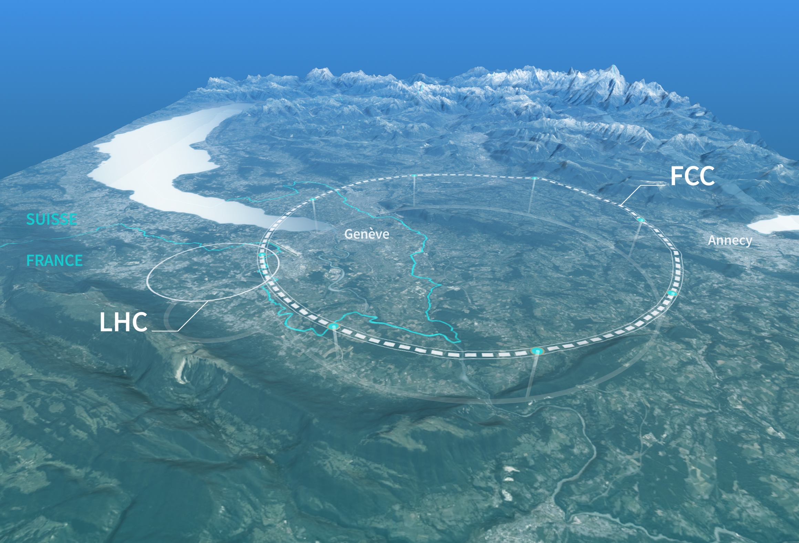
Preparing CERN’s Future
Driven by the 2020 Update of the European Strategy for Particle Physics
Technical and financial feasibility study of a Future Circular Collider (FCC).
Accelerator R&D to develop technologies for FCC and for alternative options.
Detector and computing R&D.
Maintain and expand a compelling scientific diversity programme.
Continue to support other projects around
the world.

Slide 12
CERN Research Infrastructure
LHC
PS Complex
SPS
FCC
photo: J. Wenninger

Slide 13

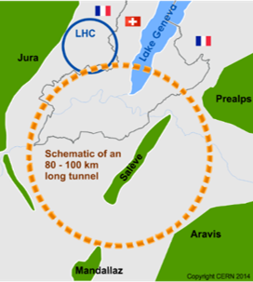
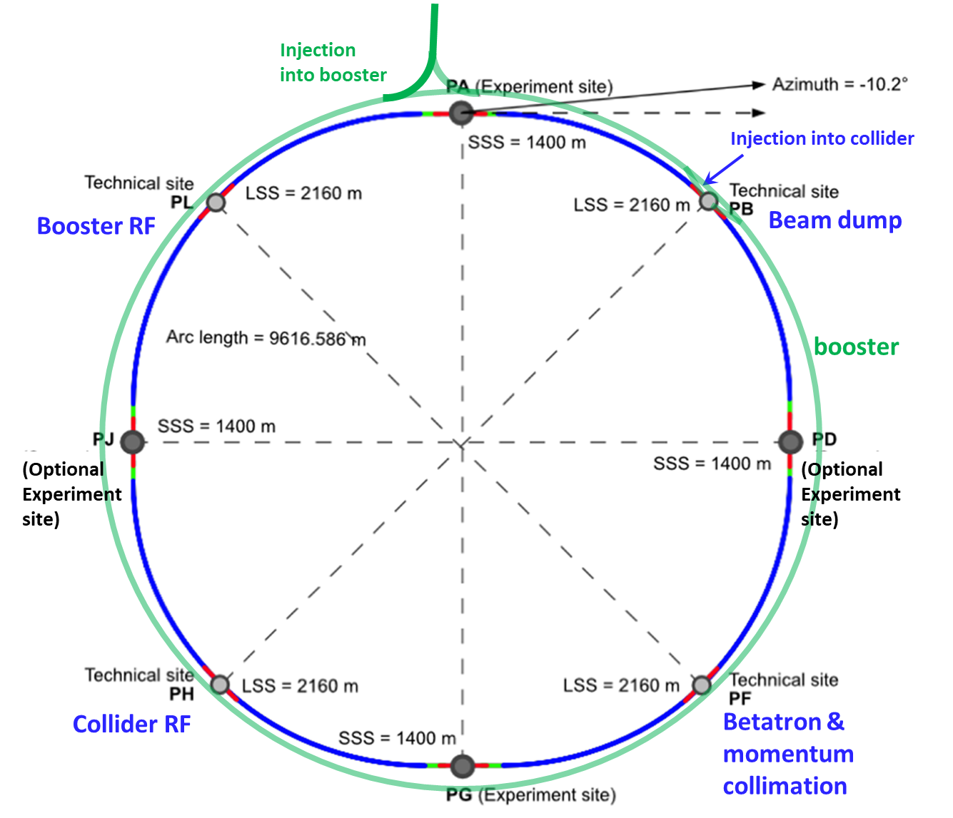
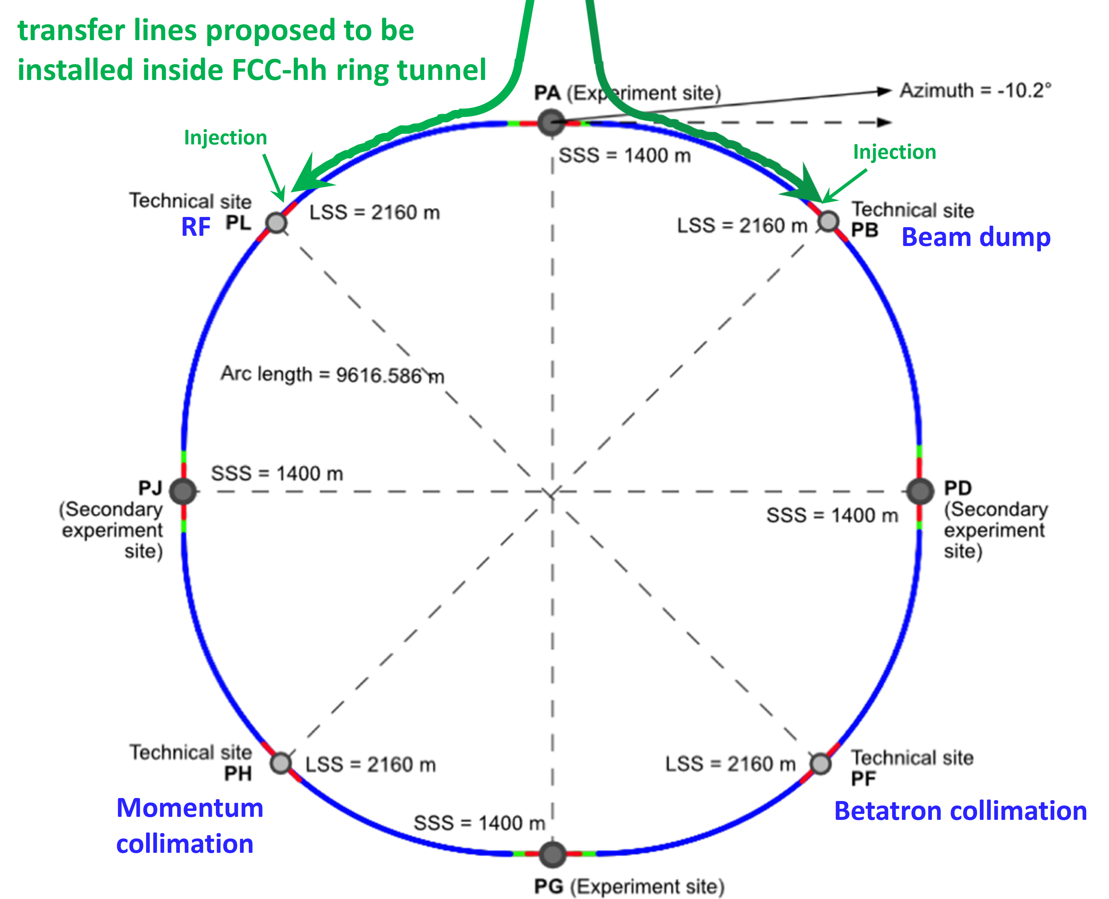
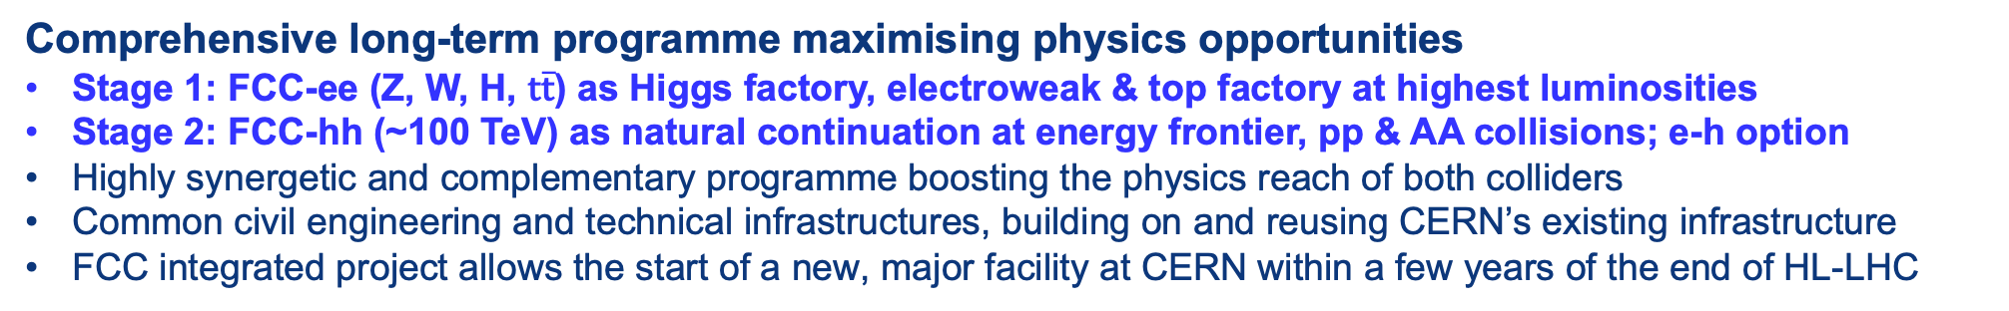
FCC Integrated Programme
Comprehensive long-term programme maximising physics opportunities
Stage 1: FCC-ee (Z, W, H, $\text{t}\overline{\text{t}}$) as Higgs factory, electroweak & top factory at highest luminosities
Stage 2: FCC-hh (~100 TeV) as natural continuation at energy frontier, pp & AA collisions; e-h option
Highly synergetic and complementary programme boosting the physics reach of both colliders
Common civil engineering and technical infrastructures, building on and reusing CERN’s existing infrastructure
FCC integrated project allows the start of a new, major facility at CERN within a few years of the end of HL-LHC
FCC-ee
FCC-hh

Slide 14
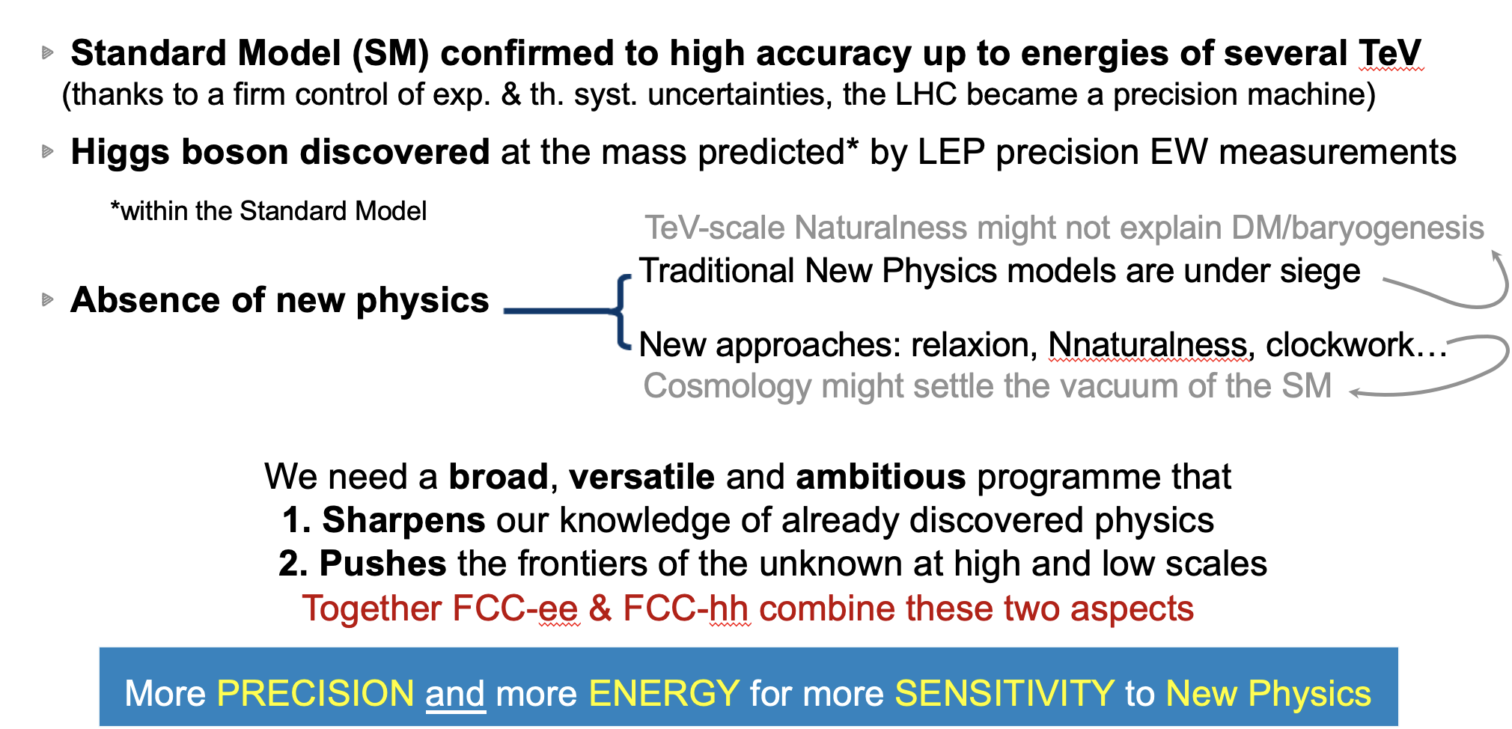
The LHC Legacy (so far)
C. Grojean

Slide 15
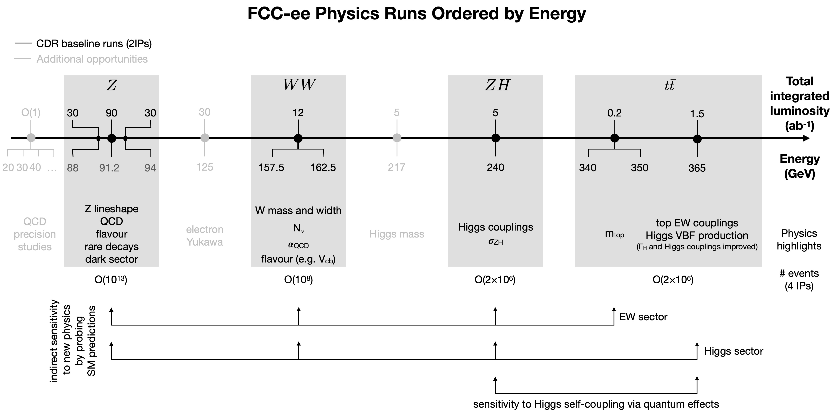
FCC-ee Collider Programme
Opportunities beyond the baseline plan (√s below Z, 125GeV, 217GeV; larger integrated lumi…)
Opportunities to exploit FCC facility differently (to be studied more carefully):
  using the electrons from the injectors for beam-dump experiments,
  extracting electron beams from the booster,
  reusing the synchrotron radiation photons.
C. Grojean

Slide 16
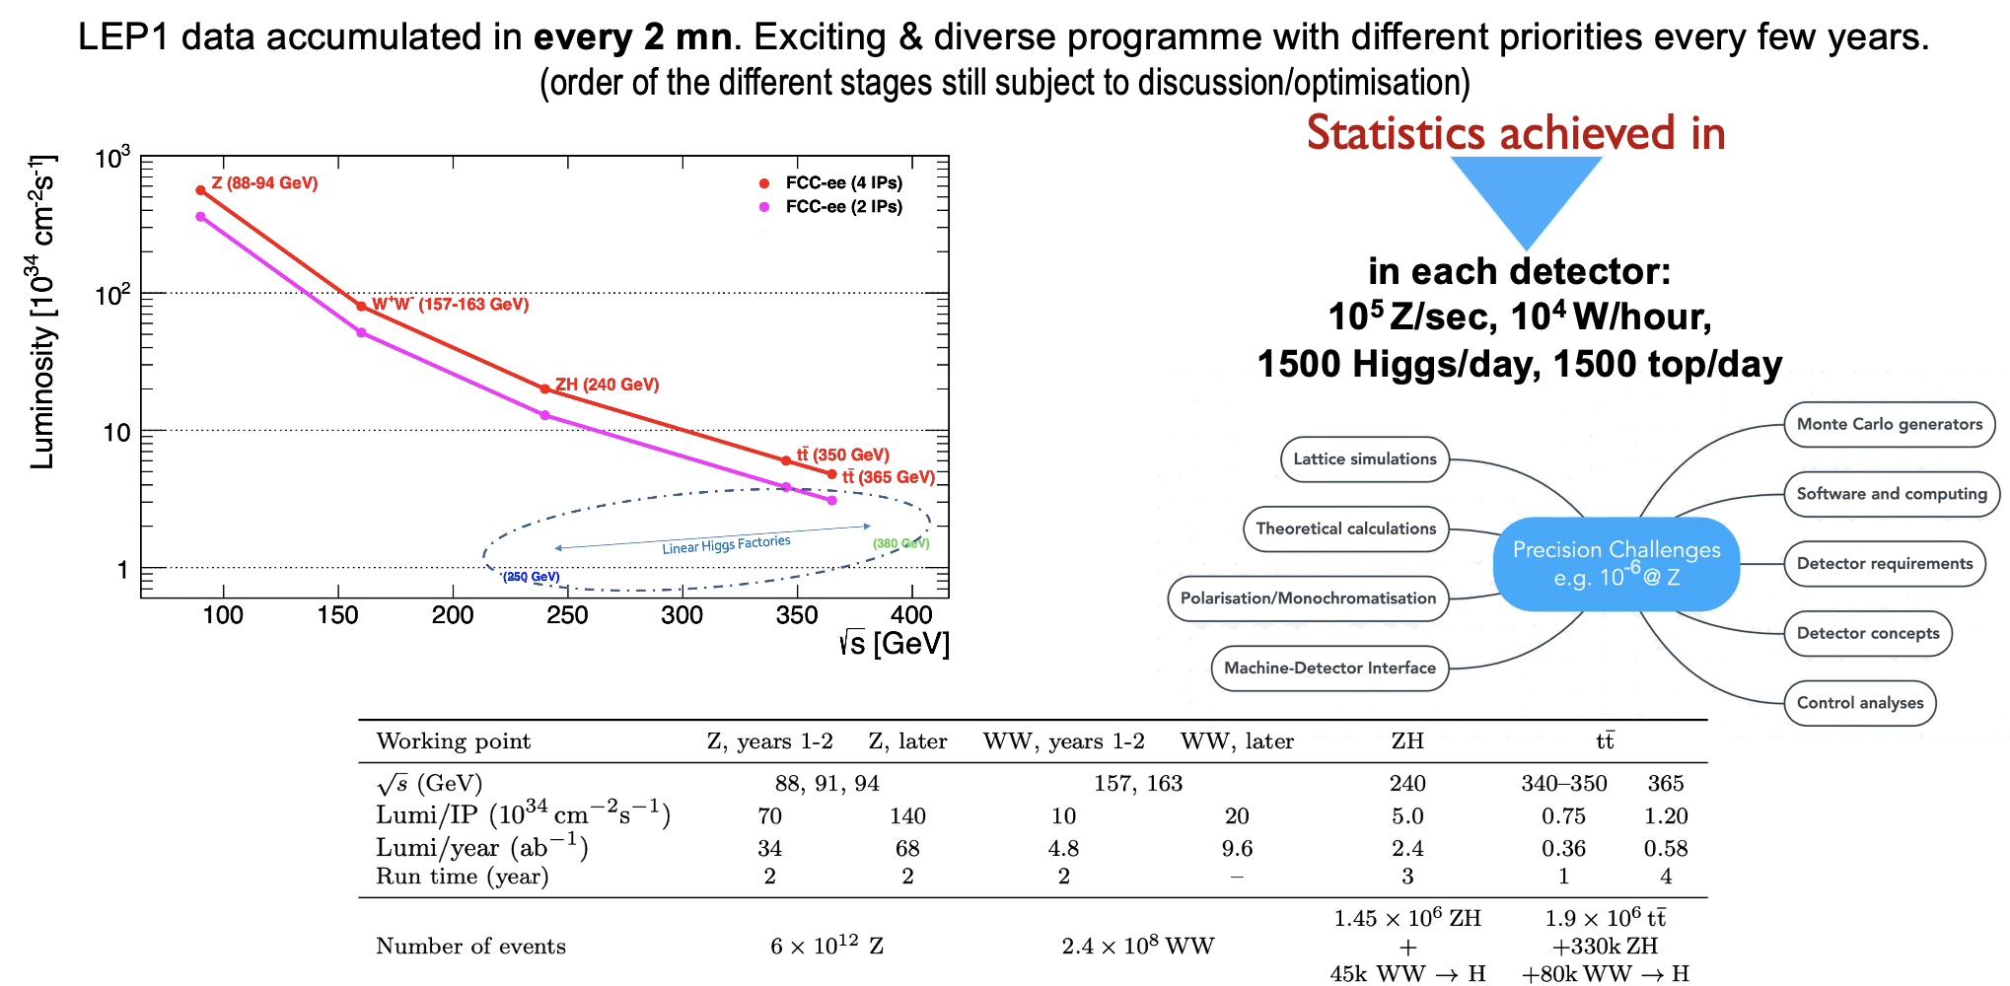
FCC-ee Run Plan
C. Grojean

Slide 17
FCC-ee Explore and Discover
EXPLORE INDIRECTLY the 10 -100 TeV energy scale with precision measurements
  From the correlated properties of the Z , b, c, 𝜏, W, Higgs, and top particles
    Up to 20-50-fold improved precision on ALL electroweak observables (EWPO)
→ mZ , mW , mtop , ΓZ , sin² 𝜃w^{eff}, Rb , 𝛼QED(mZ), 𝛼s(mZ mW mt), top EW couplings …
    Up to 10 × more precise and model-independent Higgs couplings (width, mass) measurements
→ Access the Higgs potential and infer the vacuum structure of the Universe
→ Reveals the dynamics of the EW phase transition and infer the fate of the EW vacuum
DISCOVER that the Standard Model does not fit
  New Physics! → Pattern of deviations may point to the source.
DISCOVER a violation of flavour conservation / universality
  Z→𝜏𝜇 in 5x10¹² Z decays; 𝜏→𝜇𝜈/e𝜈 in 2×10¹¹ 𝜏 decays; B⁰→K*⁰𝜏⁺𝜏⁻ or BS→𝜏⁺𝜏⁻ in 10¹² bb evts
DISCOVER dark matter, e.g., as invisible decays of Higgs or Z
DISCOVER DIRECTLY elusive (aka feebly-coupled) particles
  in the 5-100 GeV mass range, such as right-handed neutrinos, dark photons, light Higgs-like scalars, dilaton, ALPs, relaxions…
C. Grojean

Slide 18
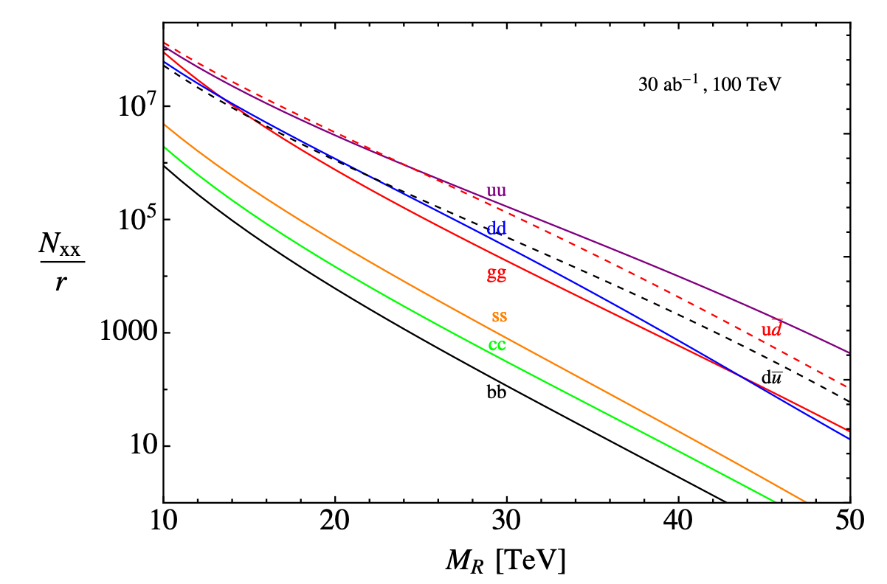
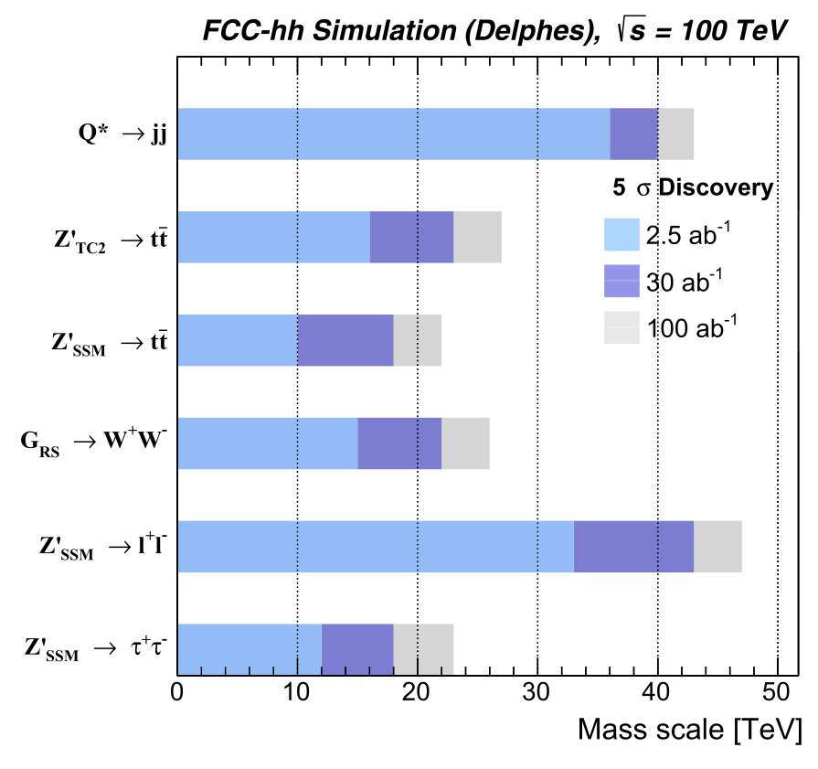
FCC-hh Particle Resonance Production
Number of Resonances Produced FCC-hh Mass Reach
Plot from mid-term report
Plot from FCC CDR
FCC-hh effectively collides 196 different initial states, perfect exploratory machine
C. Grojean

Slide 19
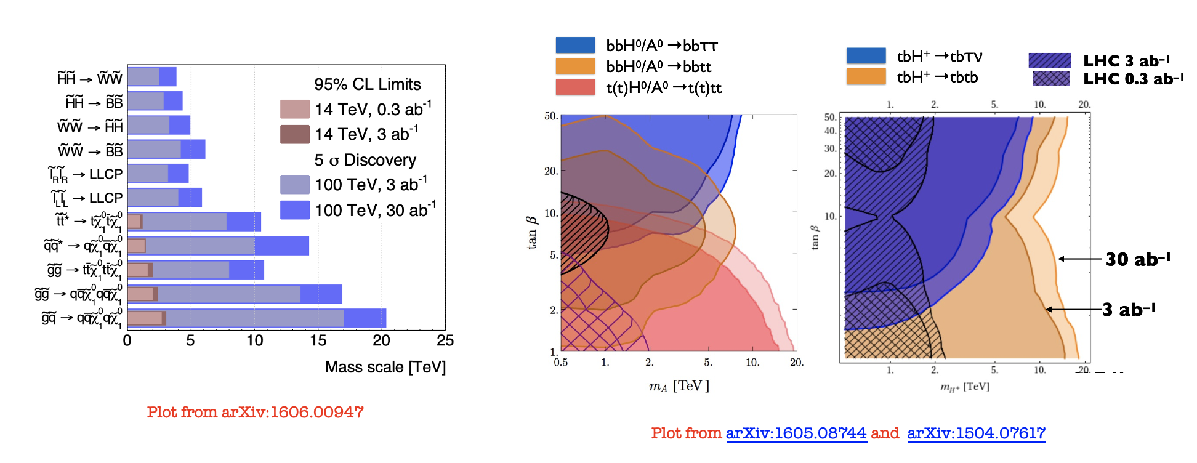
FCC-hh Beyond the Standard Model - SUSY
C. Grojean

Slide 20
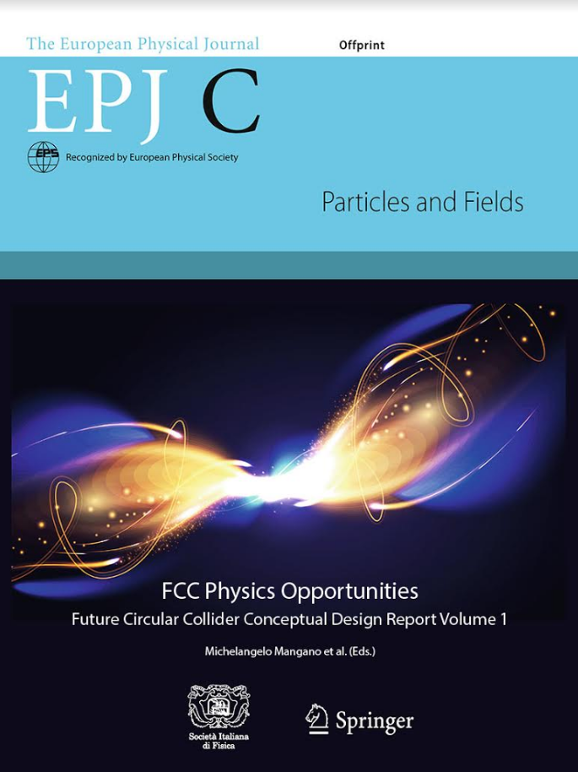
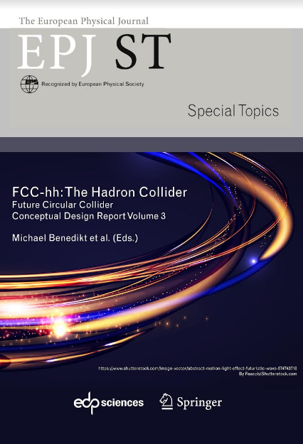
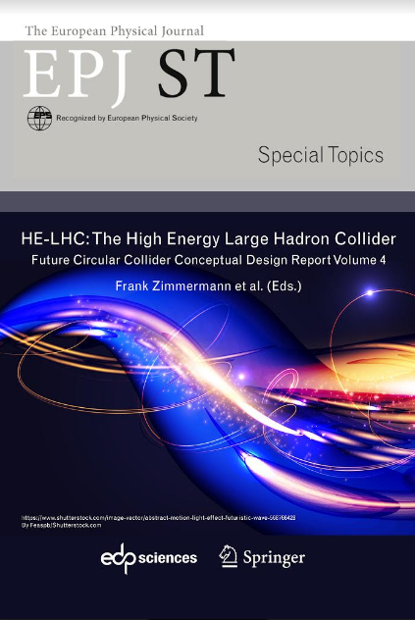
European Strategy for Particle Physics – The Roadmap
2013 Update of European Strategy for Particle Physics:
“CERN should undertake design studies for accelerator projects in a global context, with emphasis on proton-proton and electron-positron high-energy frontier machines.”
→ FCC Conceptual Design Reports (2018/19)
2020 Update of European Strategy for Particle Physics:
“Europe, together with its international partners, should investigate technical and financial feasibility of a future hadron collider at CERN with a centre-of-mass energy of at least 100 TeV and with an electron-positron Higgs and electroweak factory as a possible first stage.”
  Vol 1 Physics, Vol 2 FCC-ee, Vol 3 FCC-hh, Vol 4 HE-LHC
  CDRs published in European Physical Journal C (Vol 1) and ST (Vol 2 – 4)
  EPJ C 79, 6 (2019) 474 , EPJ ST 228, 2 (2019) 261-623 , EPJ ST 228, 4 (2019) 755-1107 , EPJ ST 228, 5 (2019) 1109-1382

Slide 21


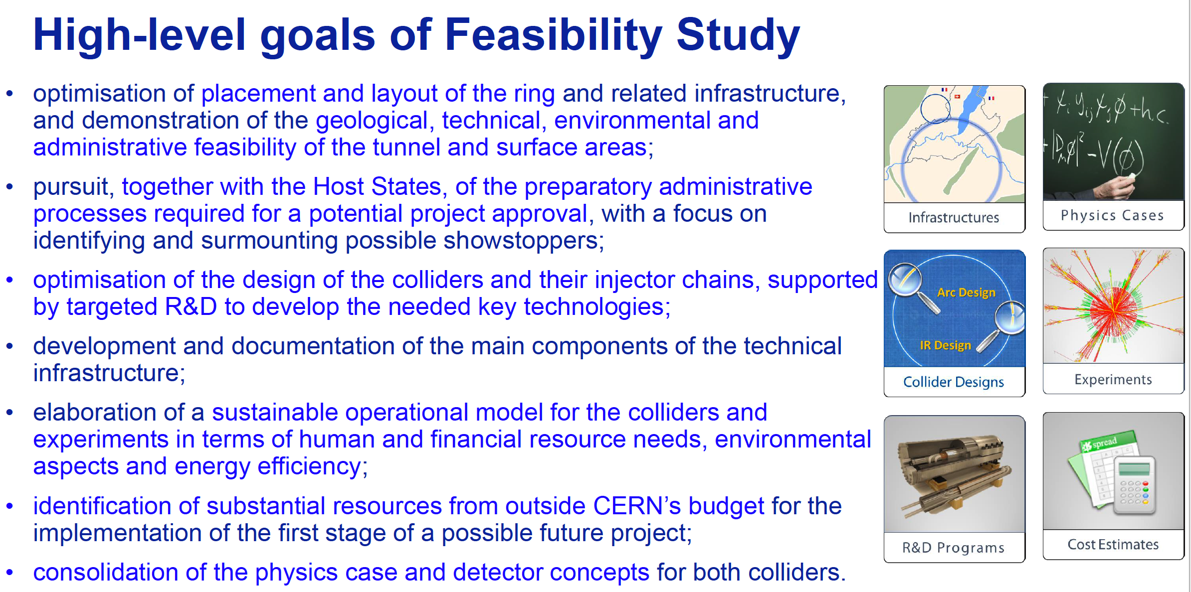
High-level Goals of Feasibility Study
Increasing international collaboration as a prerequisite for success:
links with science, research & development and high-tech industry will be essential to further advance and prepare the implementation of FCC

Slide 22
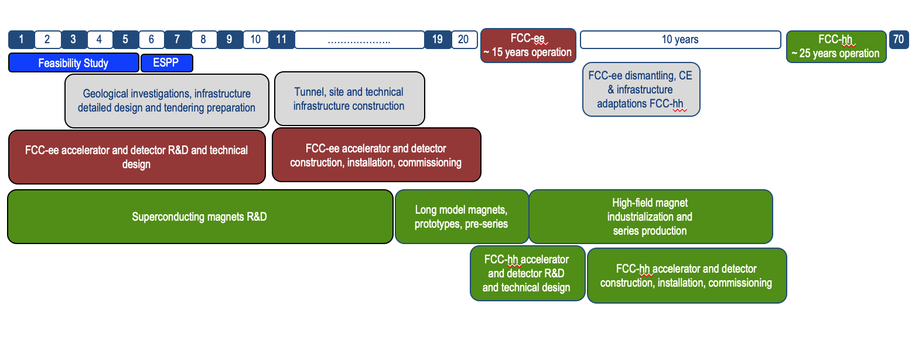
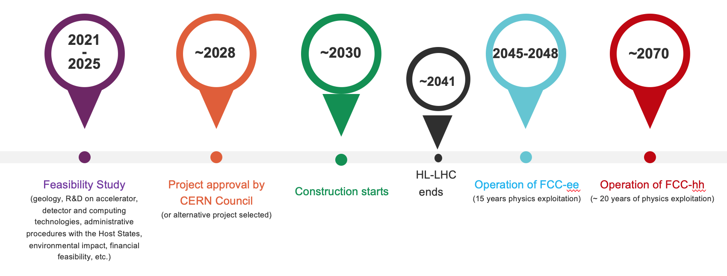
FCC Integrated Programme - Timeline
Note: FCC Conceptual Design Study
started in 2014 leading to CDR
in 2018
FCC construction can proceed in
parallel with HL-LHC operation.
“Realistic” schedule taking into account:
past experience in building colliders at CERN
approval timeline: ESPP, Council decision
that HL-LHC will run until 2041
Can be accelerated if more resources available
2033
2048
2074

Slide 23
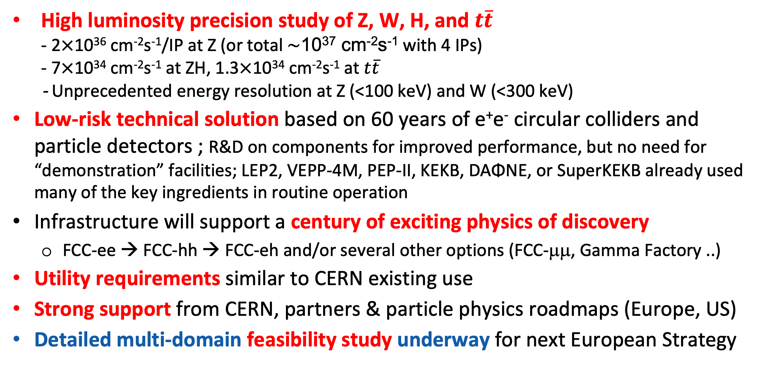
FCC-ee in a Nutshell
High luminosity precision study of Z, W, H, and $t\overline{t}$
- 2$×$10³⁶ cm⁻²s⁻¹/IP at Z (or total $\sim$10³⁷ cm⁻²s⁻¹ with 4 IPs)
- 7$×$10³⁴ cm⁻²s⁻¹ at ZH, 1.3$×$10³⁴ cm⁻²s⁻¹ at $t\overline{t}$
- Unprecedented energy resolution at Z (<100 keV) and W (<300 keV)
Low-risk technical solution based on 60 years of e⁺e⁻ circular colliders and particle detectors ; R&D on components for improved performance, but no need for “demonstration” facilities; LEP2, VEPP-4M, PEP-II, KEKB, DAΦNE, or SuperKEKB already used many of the key ingredients in routine operation
Infrastructure will support a century of exciting physics of discovery
  FCC-ee → FCC-hh → FCC-eh and/or several other options (FCC-μμ, Gamma Factory ..)
Utility requirements similar to CERN existing use
Strong support from CERN, partners & particle physics roadmaps (Europe, US)
Detailed multi-domain feasibility study underway for next European Strategy

Slide 24
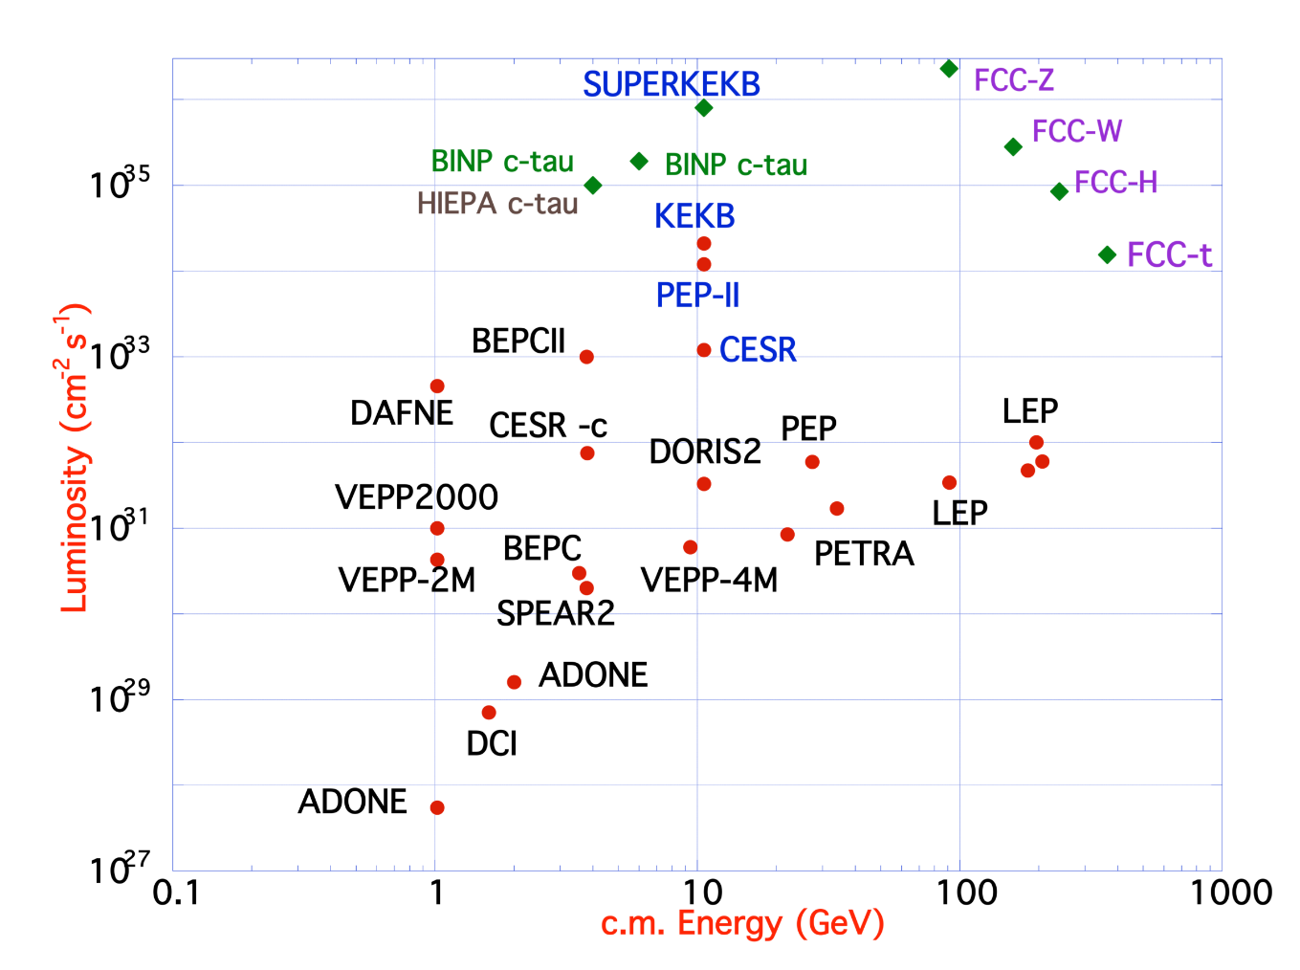
FCC-ee Design Concept
Based on lessons and techniques from past colliders (last 40 years)
B-factories: KEKB & PEP-II:
double-ring lepton colliders,
high beam currents,
top-up injection
DAFNE: crab waist, double ring
S-KEKB: low β_{y}*, crab waist
LEP: high energy, SR effects
VEPP-4M, LEP: precision E calibration
KEKB: e⁺ source
HERA, LEP, RHIC: spin gymnastics
Marica Biagini
Marica Biagini
combining successful ingredients of several recent colliders → highest luminosities & energies

Slide 25
FCC-ee: Main Machine Parameters
Parameter | Z | WW | H (ZH) | ttbar
beam energy [GeV] | 45.6 | 80 | 120 | 182.5
beam current [mA] | 1270 | 137 | 26.7 | 4.9
number bunches/beam | 11200 | 1780 | 440 | 60
bunch intensity [10¹¹] | 2.14 | 1.45 | 1.15 | 1.55
SR energy loss / turn [GeV] | 0.0394 | 0.374 | 1.89 | 10.4
total RF voltage 400/800 MHz [GV] | 0.120/0 | 1.0/0 | 2.1/0 | 2.1/9.4
long. damping time [turns] | 1158 | 215 | 64 | 18
horizontal beta* [m] | 0.11 | 0.2 | 0.24 | 1.0
vertical beta* [mm] | 0.7 | 1.0 | 1.0 | 1.6
horizontal geometric emittance [nm] | 0.71 | 2.17 | 0.71 | 1.59
vertical geom. emittance [pm] | 1.9 | 2.2 | 1.4 | 1.6
horizontal rms IP spot size [μm] | 9 | 21 | 13 | 40
vertical rms IP spot size [nm] | 36 | 47 | 40 | 51
beam-beam parameter ξ_{x} / ξ_{y} | 0.002/0.0973 | 0.013/0.128 | 0.010/0.088 | 0.073/0.134
rms bunch length with SR / BS [mm] | 5.6 / 15.5 | 3.5 / 5.4 | 3.4 / 4.7 | 1.8 / 2.2
luminosity per IP [10³⁴ cm⁻²s⁻¹] | 140 | 20 | 5.0 | 1.25
total integrated luminosity / IP / year [ab⁻¹/yr] | 17 | 2.4 | 0.6 | 0.15
beam lifetime rad Bhabha + BS [min] | 15 | 12 | 12 | 11
Design and parameters
dominated by the
choice to allow for
50 MW synchrotron
radiation per beam.
4 years
5 x 10¹² Z
LEP x 10⁵
2 years
> 10⁸ WW
LEP x 10⁴
3 years
2 x 10⁶ H
5 years
2 x 10⁶ tt pairs
Up to x2000 improvement on all EW observables
Up to x10 improvement on Higgs coupling (model-indep.) measurements over HL-LHC
x10 Belle II statistics for b, c, τ
indirect discovery potential up to ~ 70 TeV
direct discovery potential for feebly-interacting particles over 5-100 GeV mass range
Up to 4 interaction points → robustness,
statistics, possibility of specialised detectors
to maximise physics output
F. Gianotti

Slide 26

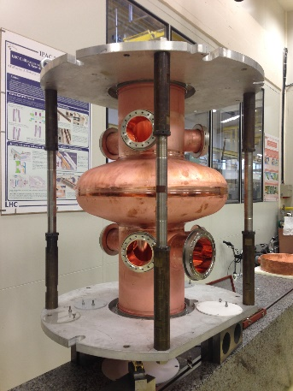
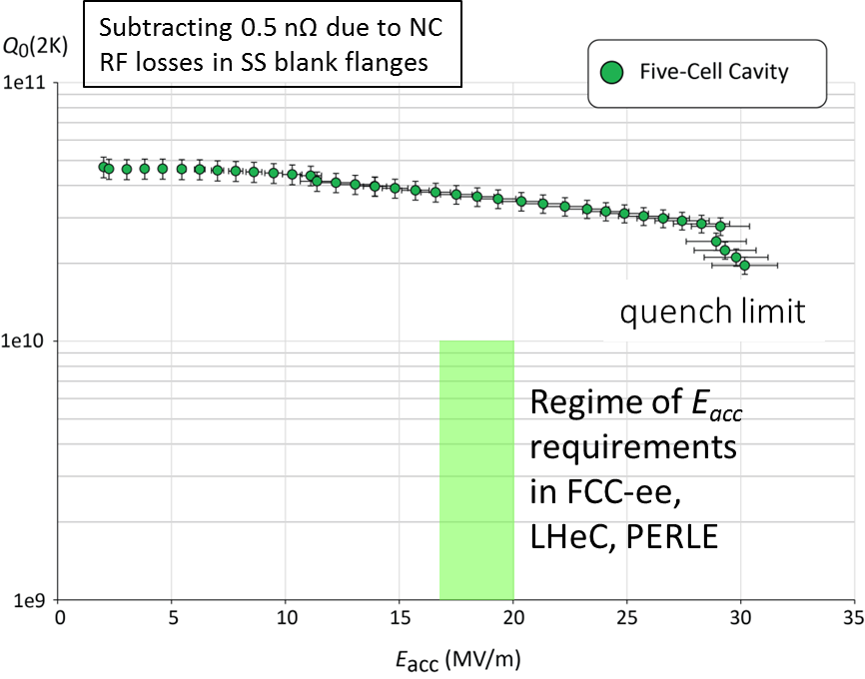
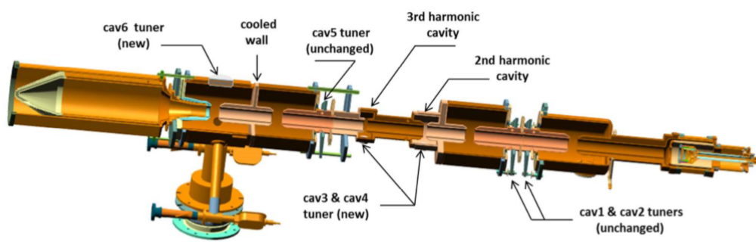
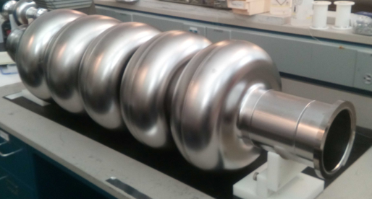
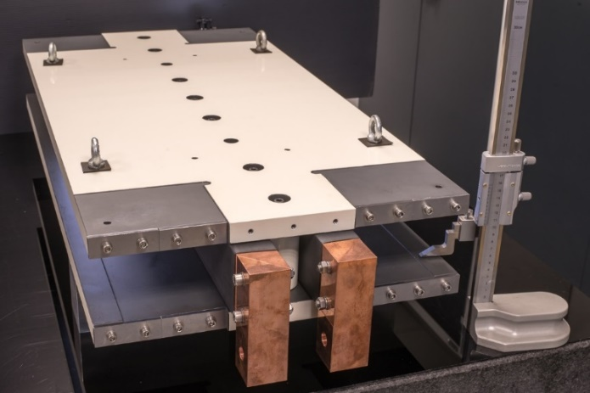
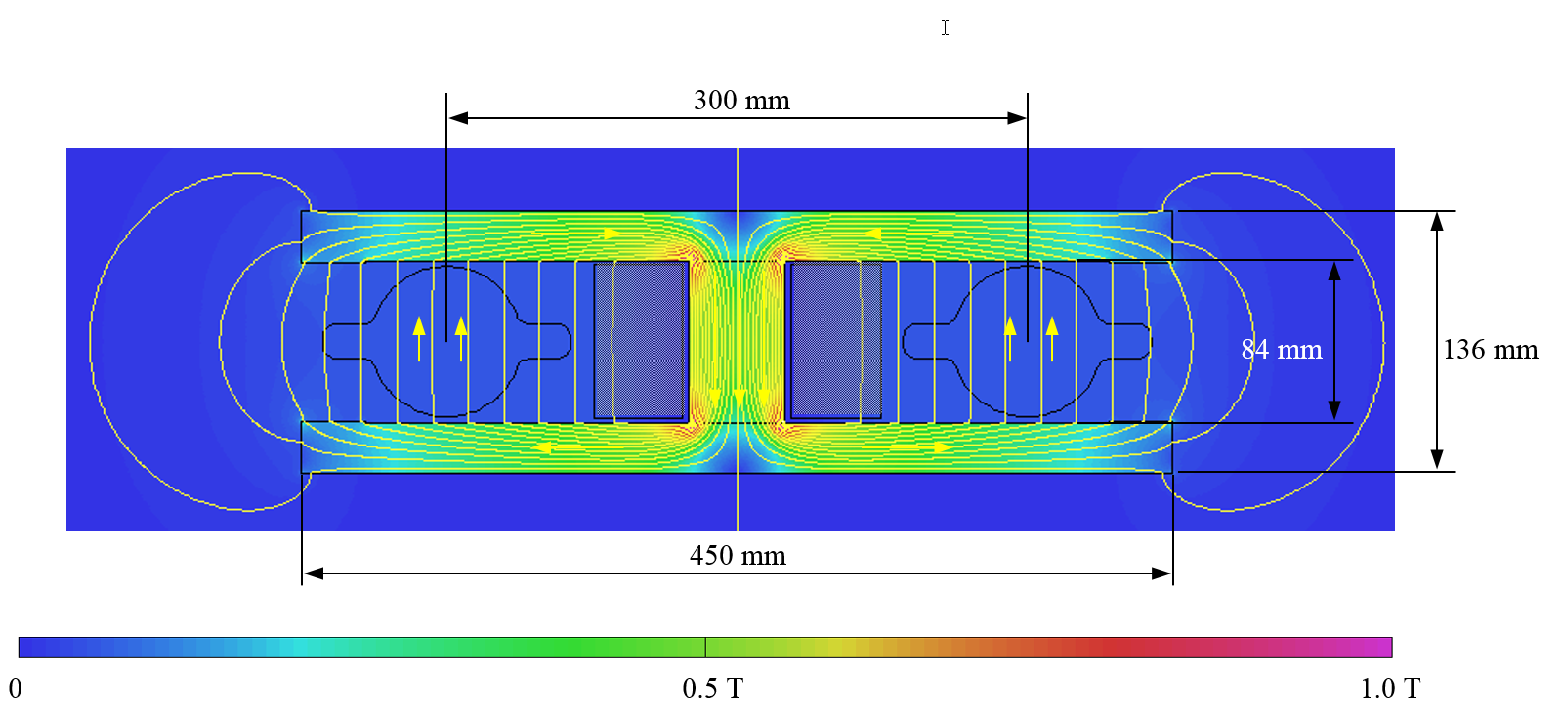

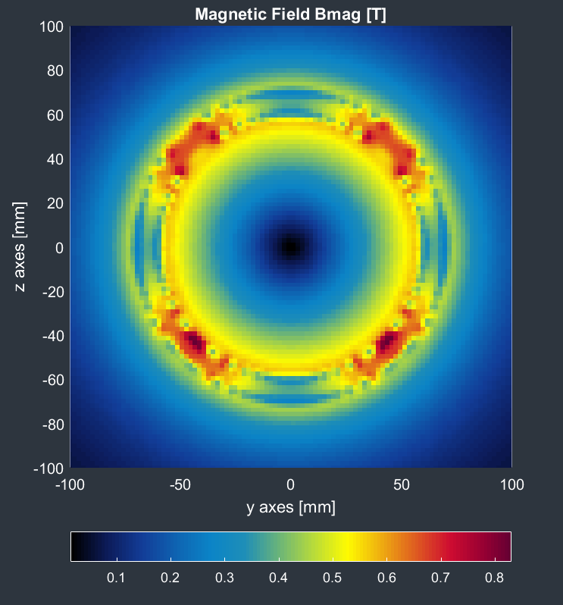
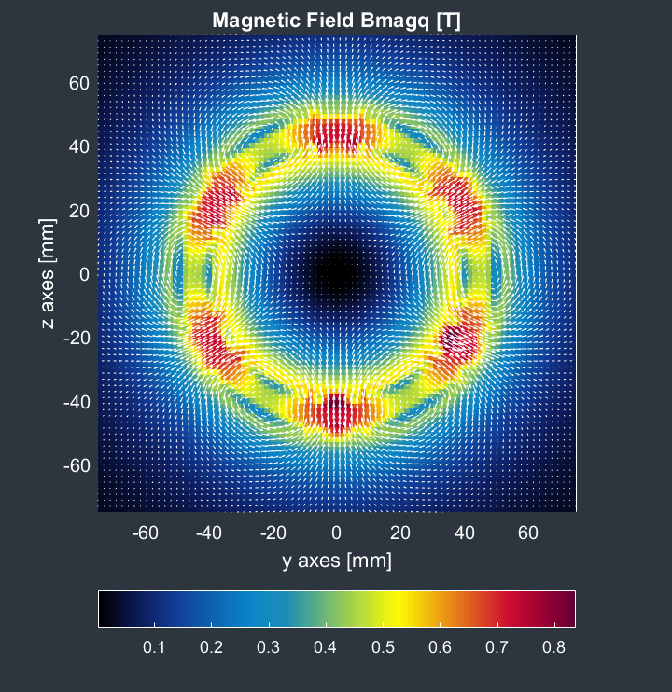
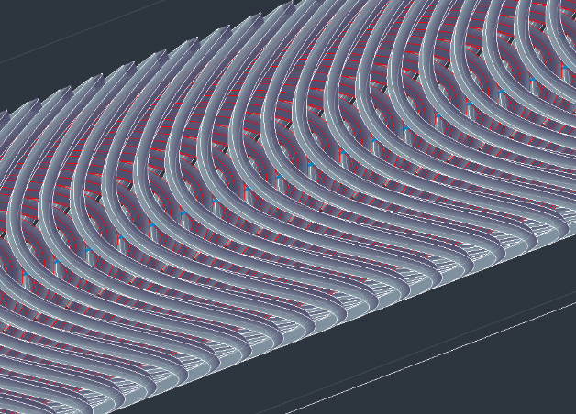

FCC-ee Accelerator R&D Examples
Efficient RF power sources
(400 & 800 MHz)
Efficient SC cavities
I. Syratchev
400 MHz 1-,2- & 4-cell Nb/Cu , 4.5 K
F. Marhauser
800 MHz 5-cell Nb
prototype / JLAB, 2 K
FPC & HOM coupler, cryomodule, thin-film coatings…
Energy efficient twin aperture arc dipoles
Under study: CCT HTS quad’s & sext’s for arcs
A. Milanese
M. Koratzinos

Slide 27
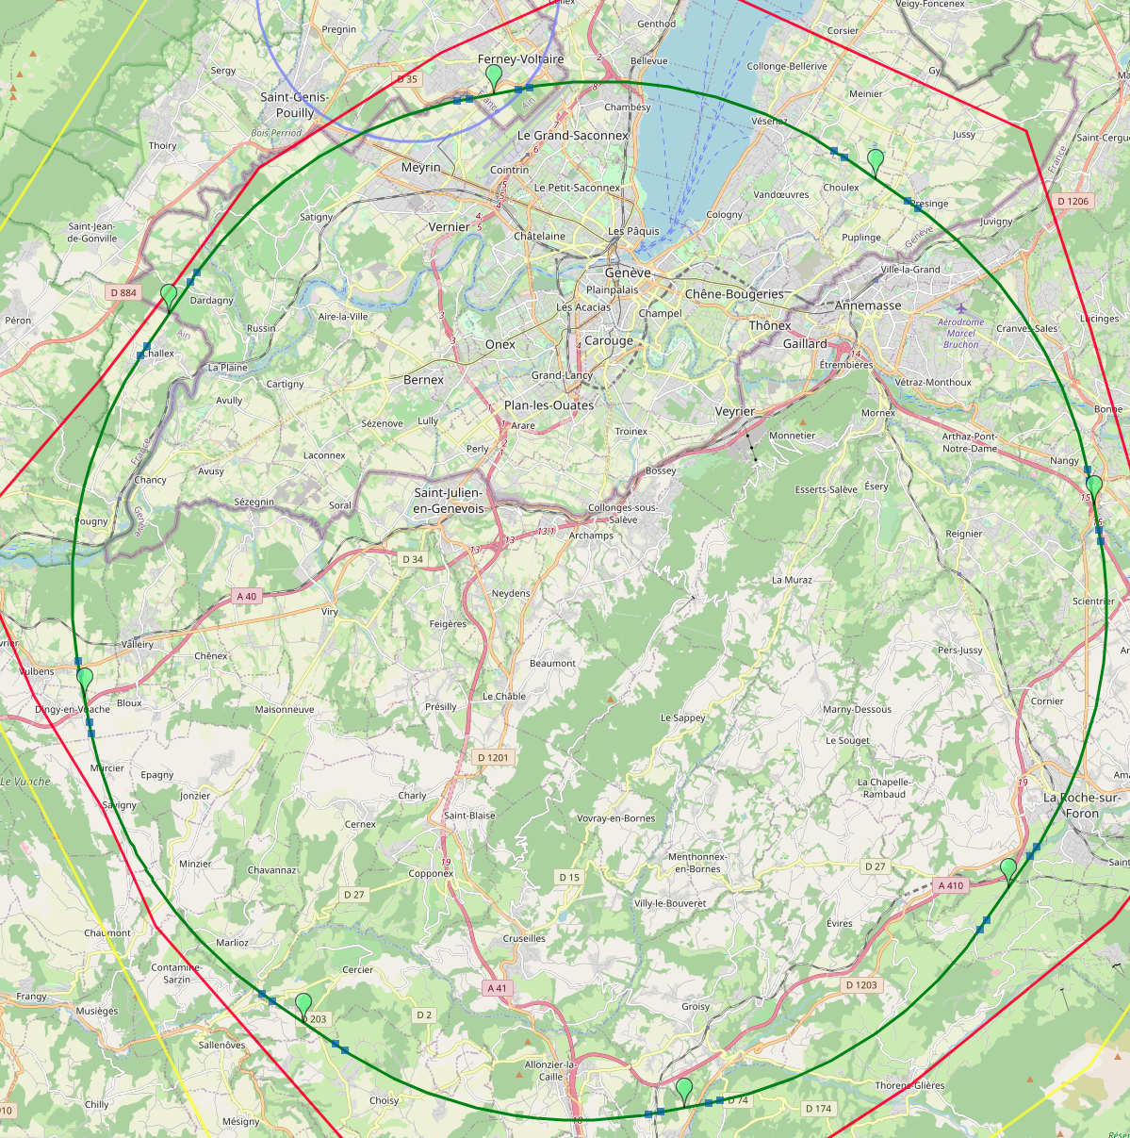
Optimised Placement and Lay-out for Feasibility Study
V. Mertens,
J. Gutleber
Layout chosen out of ~ 100 initial variants, based on geology and
surface constraints (land availability, access to roads, etc.), environment, (protected zones), infrastructure (water, electricity, transport), machine performance etc.
“Avoid-reduce-compensate” principle of EU and French regulations
PA: Experiment
PB: technical
PL: technical
Overall lowest-risk baseline: 90.7 km ring, 8 surface points,
Whole project now adapted to this placement
Number of surface sites | 8
Surface requirements | ~40 ha
LSS@IP (PA, PD, PG, PJ) | 1400 m
LSS@TECH (PB, PF, PH, PL) | 2032 m
Arc length | 9.6 km
Sum of arc lengths | 76.9 m
Total length | 90.7 km
PD: experiment
PJ: experiment
PF: technical
PH: technical
27
PG: experiment

Slide 28
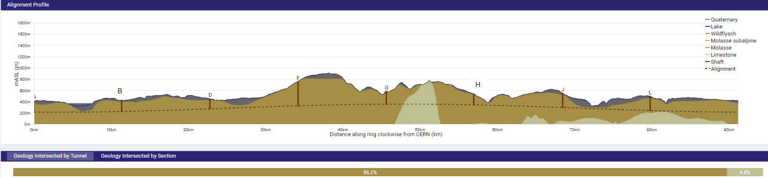
FCC Tunnel Implementation
Tunnel implementation summary
91 km circumference
95% in molasse geology for minimising tunnel construction risks
Site investigations in zones where tunnel is close to geological interfaces: moraines-molasse-limestone

Slide 29
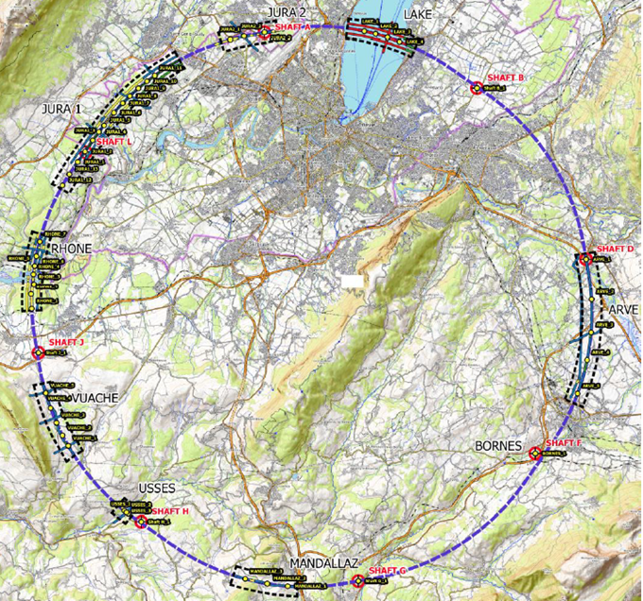
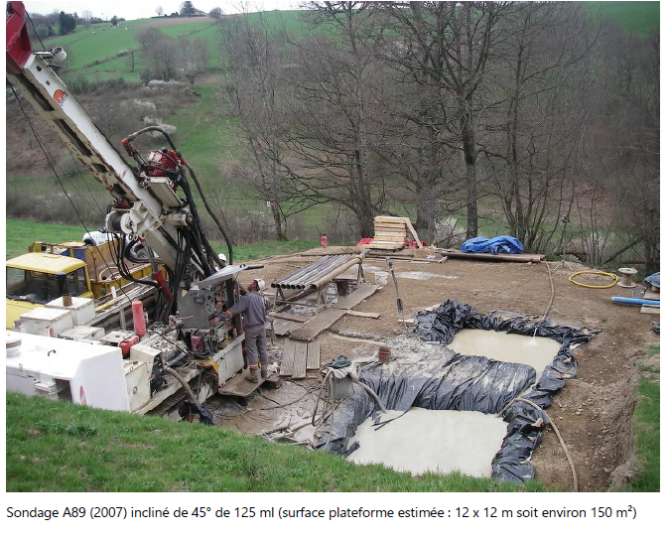
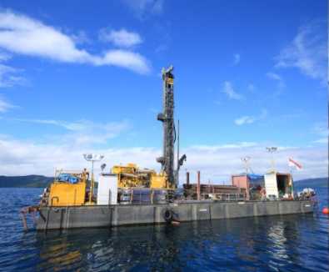
Status of Site Investigations
Site investigations in areas with uncertain geological conditions:
  Optimisation of localisation of drilling locations ongoing with site visits since end 2022.
  Alignment with FR and CH on the process for obtaining autorisation procedures. Ongoing for start of drillings in Q2/2024.
Contracts Status:
  Contract for engineering services and role of Engineer during works, active since July 2022
  Site investigations tendering ongoing towards contract placement in December 2023 and mobilization from January 2024.
Drilling works on the lake

Slide 30
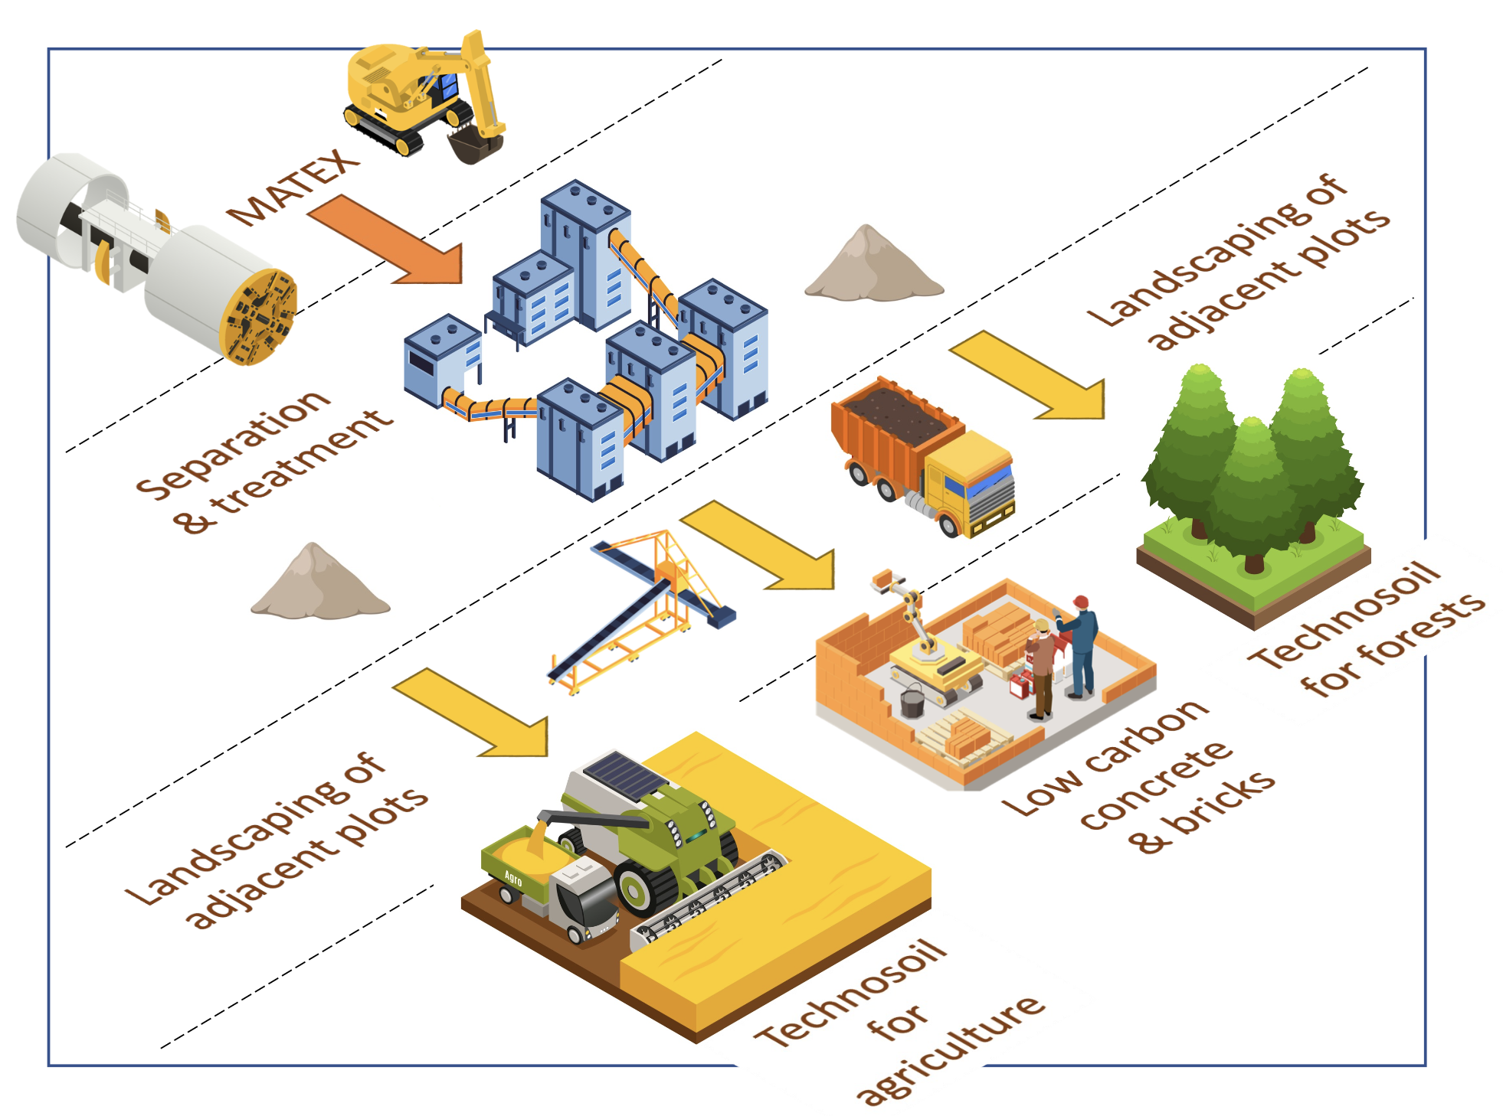
An innovative local approach for excavated materials
Excavation Material Management
T. Watson
Excavated material from FCC subsurface infrastructures: 6.5 Mm³ in situ, 8.4 Mm³ excavated (bulk factor 1.3)
2021-2022: International competition “ Mining the Future”, launched with the support of the EU Horizon 2020 grant agreement 951754, to find innovative and realistic ideas for the reuse of Molasse (96% of excavated materials)
2023: Definition of the “OpenSky Laboratory” project:
  Objective: Develop and test an innovative process to transform sterile “molasse” into fertile soil for agricultural use and afforestation.
  Duration: 4 years (2024-2027)

Slide 31
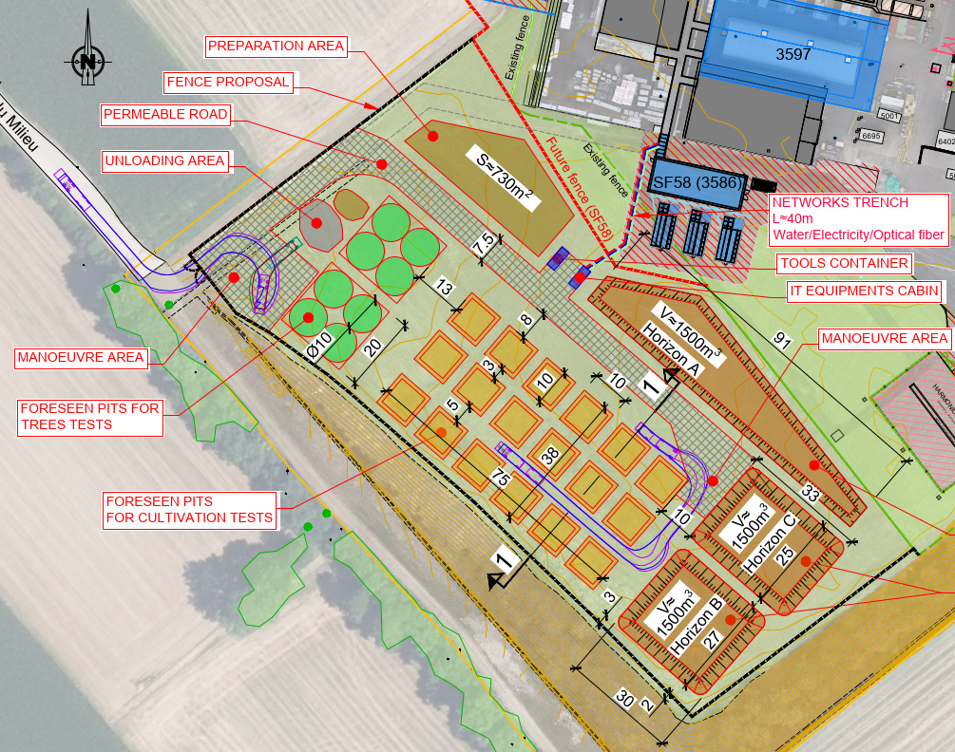
OpenSky Laboratory: Demonstrate Molasse Reuse Cases
GOAL: demonstrate the feasibility to transform Molasse (excavated material) into fertile soil.
Project launched in January 2024
5500 m² near LHC P5 in Cessy, France.
Trial with 5 000 t of excavated local molasse
Layout :
cells for agriculture trials (10*10 m)
cells for forestry trials (20*20 m)
Different types of plants selected in function of regional specificities and possible soil reuse cases
Project phases:
1) Initial laboratory analysis to identify the most suitable mix of molasse and amendments.
2) Field tests in a controlled environment (monitoring of the field conditions)

Slide 32





FCC-hh: Highest Collision Energies
Order of magnitude performance increase in both energy & luminosity
100 TeV collision energy (vs 14 TeV for LHC)
20 ab⁻¹ per experiment collected over 25 years of operation (vs 3 ab⁻¹ for LHC)
Similar performance increase as from Tevatron to LHC
Key technology: high-field magnets
from
LHC technology
8.3 T NbTi dipole
via
HL-LHC technology
12 T Nb₃Sn quadrupole
FNAL dipole demonstrator
14.5 T Nb₃Sn

Slide 33
FCC-hh – Main Machine Parameters
parameter | FCC-hh | HL-LHC | LHC
collision energy cms [TeV] | 81 - 115 | 14 | 14
dipole field [T] | 14 - 20 | 8.33 | 8.33
circumference [km] | 90.7 | 26.7 | 26.7
arc length [km] | 76.9 | 22.5
beam current [A] | 0.5 | 1.1 | 0.58
bunch intensity [10¹¹] | 1 | 2.2 | 1.15
bunch spacing [ns] | 25 | 25 | 25
synchr. rad. power / ring [kW] | 1020 - 4250 | 7.3 | 3.6
SR power / length [W/m/ap.] | 13 - 54 | 0.33 | 0.17
long. emit. damping time [h] | 0.77 – 0.26 | 12.9 | 12.9
peak luminosity [10³⁴ cm⁻²s⁻¹] | ~30 | 5 (lev.) | 1
events/bunch crossing | ~1000 | 132 | 27
stored energy/beam [GJ] | 6.1 - 8.9 | 0.7 | 0.36
Integrated luminosity/main IP [fb⁻¹] | 20000 | 3000 | 300
With FCC-hh after FCC-ee: significantly
more time for high-field magnet R&D
aiming at highest possible energies
Formidable challenges:
high-field superconducting magnets: 14 - 20 T
power load in arcs from synchrotron radiation: 4 MW → cryogenics, vacuum
stored beam energy: ~ 9 GJ → machine protection
pile-up in the detectors: ~1000 events/xing
energy consumption: 4 TWh/year → R&D on cryo, HTS, beam current, …
Formidable physics reach, including:
Direct discovery potential up to ~ 40 TeV
Measurement of Higgs self to ~ 5% and ttH to ~ 1%
High-precision and model-indep (with FCC-ee input)
measurements of rare Higgs decays (𝛄𝛄, Z𝛄, µµ)
Final word about WIMP dark matter
F. Gianotti

Slide 34




High-field Magnets for FCC-hh: Nb₃Sn & HTS R&D
PSI Nb3Sn CCT «CD1» main test carried out in 2022/23
Rough estimates
Bottom line: HTS technology must catch up over the
coming 10 years
in TRL to LTS
B. Auchmann
It trained A LOT. It reached 100% of maximum field at 4.5 K. No conductor degradation occurred from handling, assembly, powering, or thermal cycling.
Stress-management works, CD1 is a robust magnet.
B. Auchmann
HTS Innovation Funnel for HFM
Next: FCC-hh SM-CC Demonstrator
Goal: demonstrate robust & cost-efficient Nb3Sn technology for next European Strategy update.
Novel concept: Stress-managed and asymmetric common coils.
Stainless steel shell
Iron yoke
Coil collar
Former
Non-magnetic poles
Nb₃Sn conductor
B₀ target of 14 T, at T_{op}: 4.2 K
Eng margin of 10%
B₀ short sample @ 1.9 K: 16 T
D. Araujo

Slide 35


Regular Arc Tunnel Cross-section & Element Integration
FCC-ee
FCC-hh
Cable trays:
Fibre optic
LV distribution
Control cables
Booster ring
Collider ring
DC cable trays
HV cable
Main ring below of booster ring
Main ring and booster ring 1.03 m apart
Collider Center
Collider Center

Slide 36

Detectors Under Study for FCC-ee
Increasing international collaboration as a prerequisite for success:
links with science, research & development and high-tech industry will be essential to further advance and prepare the implementation of FCC
and Time Projection Chamber (TPC) of ILD

Slide 37


Energy and Carbon Footprint
Our first responsibility (as particle physicists) is to do the maximum of science
  With the minimal energy consumption and the minimal environmental impact for our planet
    Should become one of our top-level decision criteria for design, choice and optimization of a collider
All Higgs factories have a “similar” physics outcome
  Natural question: what is their energy consumpti0n or carbon footprint for the same physics outcome?
    Circular colliders have a much larger instantaneous luminosity and operate several detectors
    FCC-ee is at CERN, where electricity is already almost carbon-free (and will be even more so in 2048)
arXiv:2208.10466
Energy consumption / Higgs with 2IP
Circular ~ Linear / 5
Carbon footprint / Higgs with 2IP
FCC-ee ~ CLIC / 5 ~ ILC / 50
(independently of the location
or the starting time of the collider)
(if operating today)

Slide 38
FCC Feasibility Study – Mid-term Review
First part of FCC Feasibility Study completed successfully with the Mid-term Review
20 – 22 November 2023: SPC and FC review meetings on mid-term review
2 February 2024: CERN Council meeting on mid-term review
Focus 2021 - 2023:
Identify best placement & layout and adapting entire project to new placement.
This provided the input for the mid-term review documentation and cost estimate update.
Fruitful collaboration between scientific & technical actors, in close cooperation with the CERN Host State services, at departmental/cantonal and local level. Direct exchange in place with communes concerned by surface sites. Environmental studies ongoing.
Focus 2024 - 2025:
Subsurface investigations, further optimisation of implementation, surface sites, synergies, etc.
Full design iteration in view of technical and cost optimisation of entire project.
Cost containment and reduction of cost uncertainties, development of risk register.
Further development of an affordable funding model and related governance implications (with Council).
Environmental impact (civil engineering, excavated materials, sustainability); geological investigations
Completion of the FCC Feasibility Study in 2025.

Slide 39
FCC Preliminary Budget
The total estimated cost for FCC-ee with 4 experimental points that could run across 4 different energy stages (from 90 to 360 GeV) is 15 BCHF over several decades and across CERN’s Member States, Associate Member States as well as international partners (non-Member States / Observer States).
These facilities are planned to be used initially for FCC-ee and take into account any specific requirements for a future FCC-hh machine.
Large parts will return via procurement to industries of participating countries.
Current uncertainties will be reduced further by the completion of the FCC Feasibility Study in 2025.

Slide 40
FCC Governance
The path to the governance structure required for the FCC project and operation phases is both exciting and challenging.
Requires the long-term engagement and support of participants from CERN’s Member, Associate Member & non-Member States.
As the project evolves further, it is crucial to refine and adapt the collaboration model to ensure the efficient allocation of resources and sustained momentum.
The collaborative spirit that defines the FCC promises to shape the future of particle physics.
First discussions on the governance considerations for the FCC project are taking place in the CERN Council.

Slide 41

FCC Feasibility Study Organisational Structure
FCC Organisational Structure
  Ownership of the Feasibility Study by the Council.
  Effective and timely supervision.
  Integration of scientific and technical advice.
  Participation of stakeholders that can potentially make significant financial and technical contributions to a possible future project.
  Execution of Feasibility Study.
FCC Feasibility Study is organised as an international collaboration.
The FCC Feasibility Study and a possible future project will profit from CERN’s decades-long experience with successful large international accelerator projects, e.g., the LHC and HL-LHC, and the associated global experiments, such as ATLAS and CMS.

Slide 42

Status of FCC Global Collaboration
The CERN Council reviewed the work undertaken in a fruitful meeting on 2 February 2024.
It congratulated and thanked all the teams involved in the study for the excellent and significant work done so far and for the impressive progress, and looks forward to receiving the final report in 2025.
150
Institutes
32
Companies
34
Countries
EC
H2020
FCC Feasibility Study: Aim is to increase further the collaboration, on all aspects,
in particular, on Accelerator and Particle/Experiments/Detectors (PED).

Slide 43

FCC Week 2023 London, UK
473 participants
362 in person and 111 remote
FCC Week 2024
San Francisco, USA
10-14 June 2024
Courtesy P. Charitos

Slide 44
FCC Summary & Outlook
We now know much about the Universe, using increasingly larger and more complex machines. There remain many very interesting and unanswered questions in particle physics to be solved.
CERN is the right place for the next large accelerator.
The first stage of FCC could be approved within a few years after the next European Strategy Update, if the latter is supportive. Following approval by the CERN Council, tunnel construction could then start in the early 2030s and FCC-ee physics programme could begin in the second half of the 2040s, a few years after completion of the HL-LHC physics runs, expected by around 2040.
Long-term goal: world-leading HEP infrastructure for 21st century to push particle-physics precision and energy frontiers far beyond present limits.
We are counting on the scientists and engineers of the future to make the project a success for the exploration of the fundamental laws and building blocks of the Universe.

Slide 45

Video - Designing the Future Circular Collider (FCC)

