Slide 1
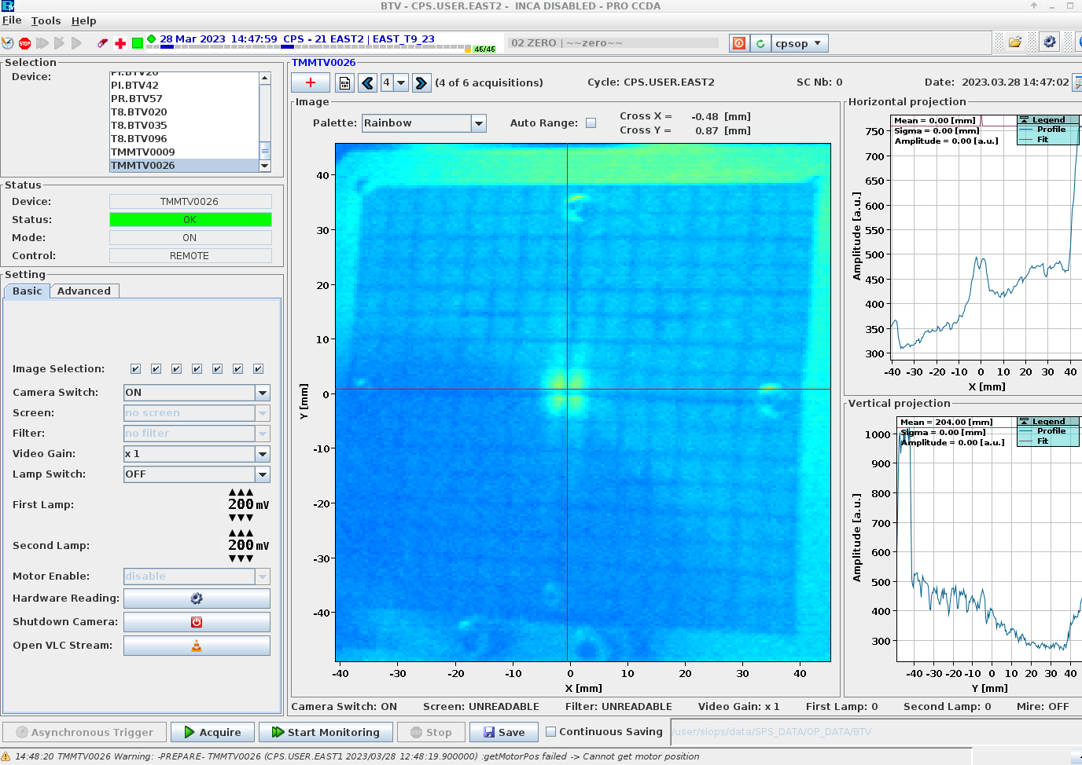
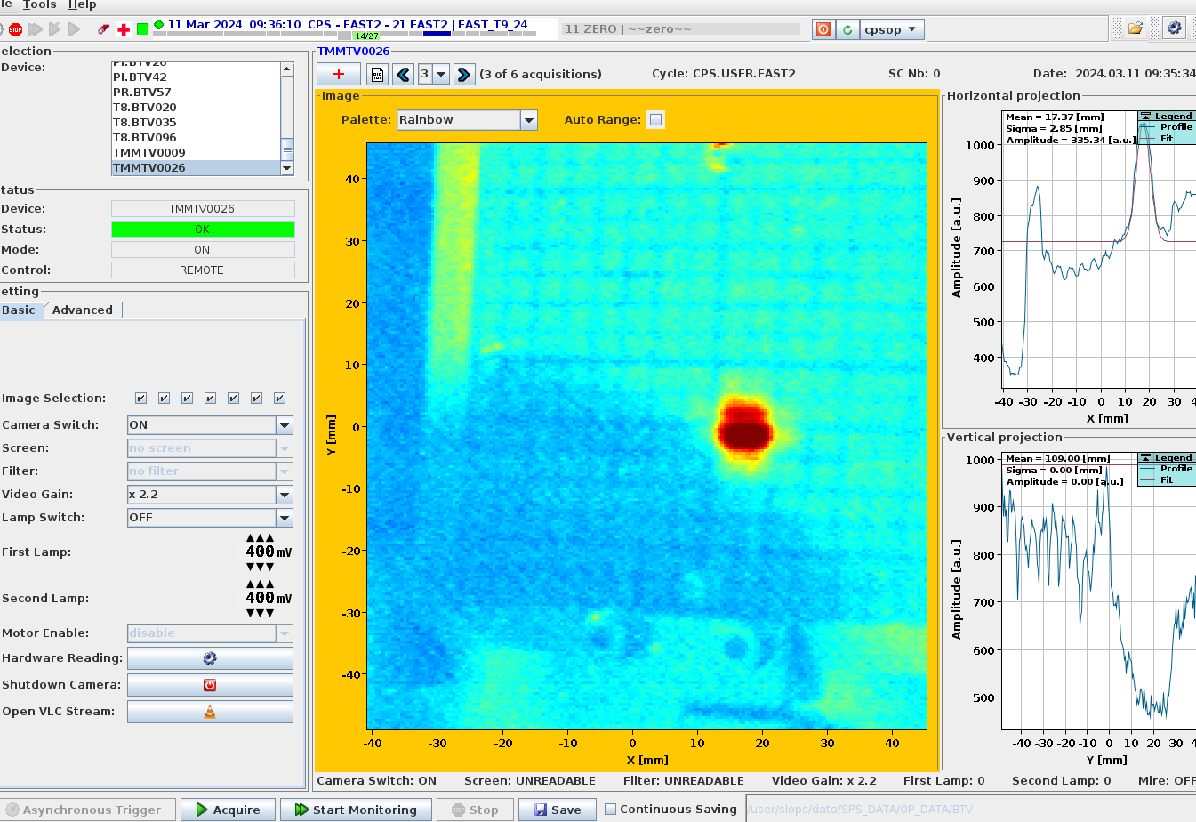
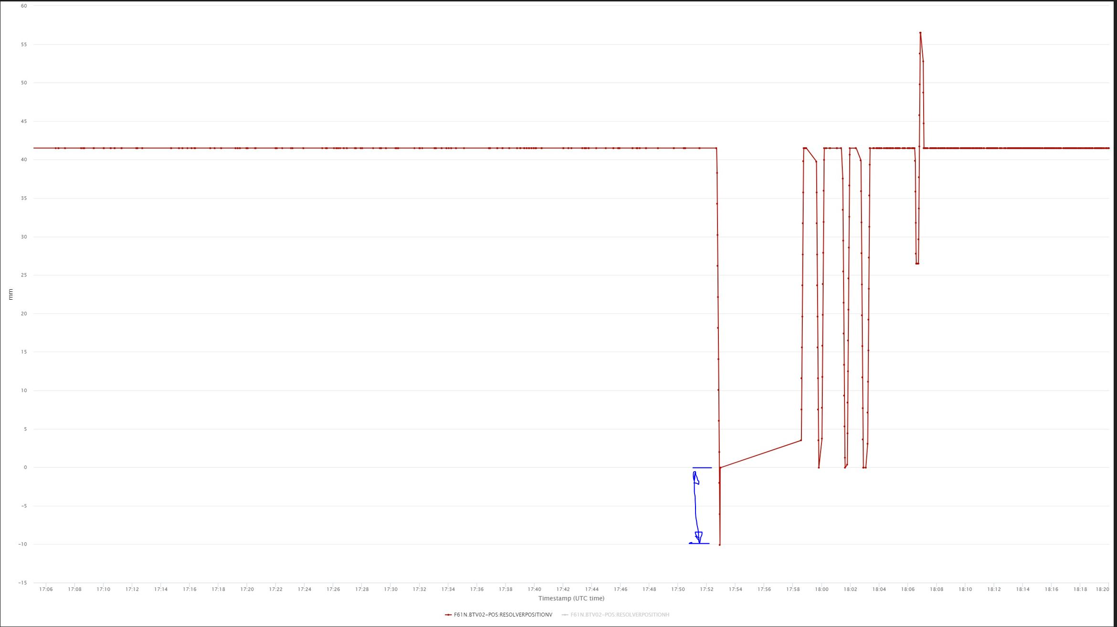
F62.TMMTV026 position
BI confirmed the camera can move left/right → This did not explain the vertical offset observed.
STI confirmed IST was done and checked.
To check the position and be sure of the alignment survey was performed.
+11 mm vertical offset found by BE-GM, consistent with what was observed in the VLC app.
Horizontally the alignment was good.
BE-CEM piquet performed an origin check on Monday 18:30 and found the 11 mm offset and the origin was corrected.
No horizontal movement done.
Last year’s situation
Starting configuration checked on Monday 11th March’2024

Slide 2
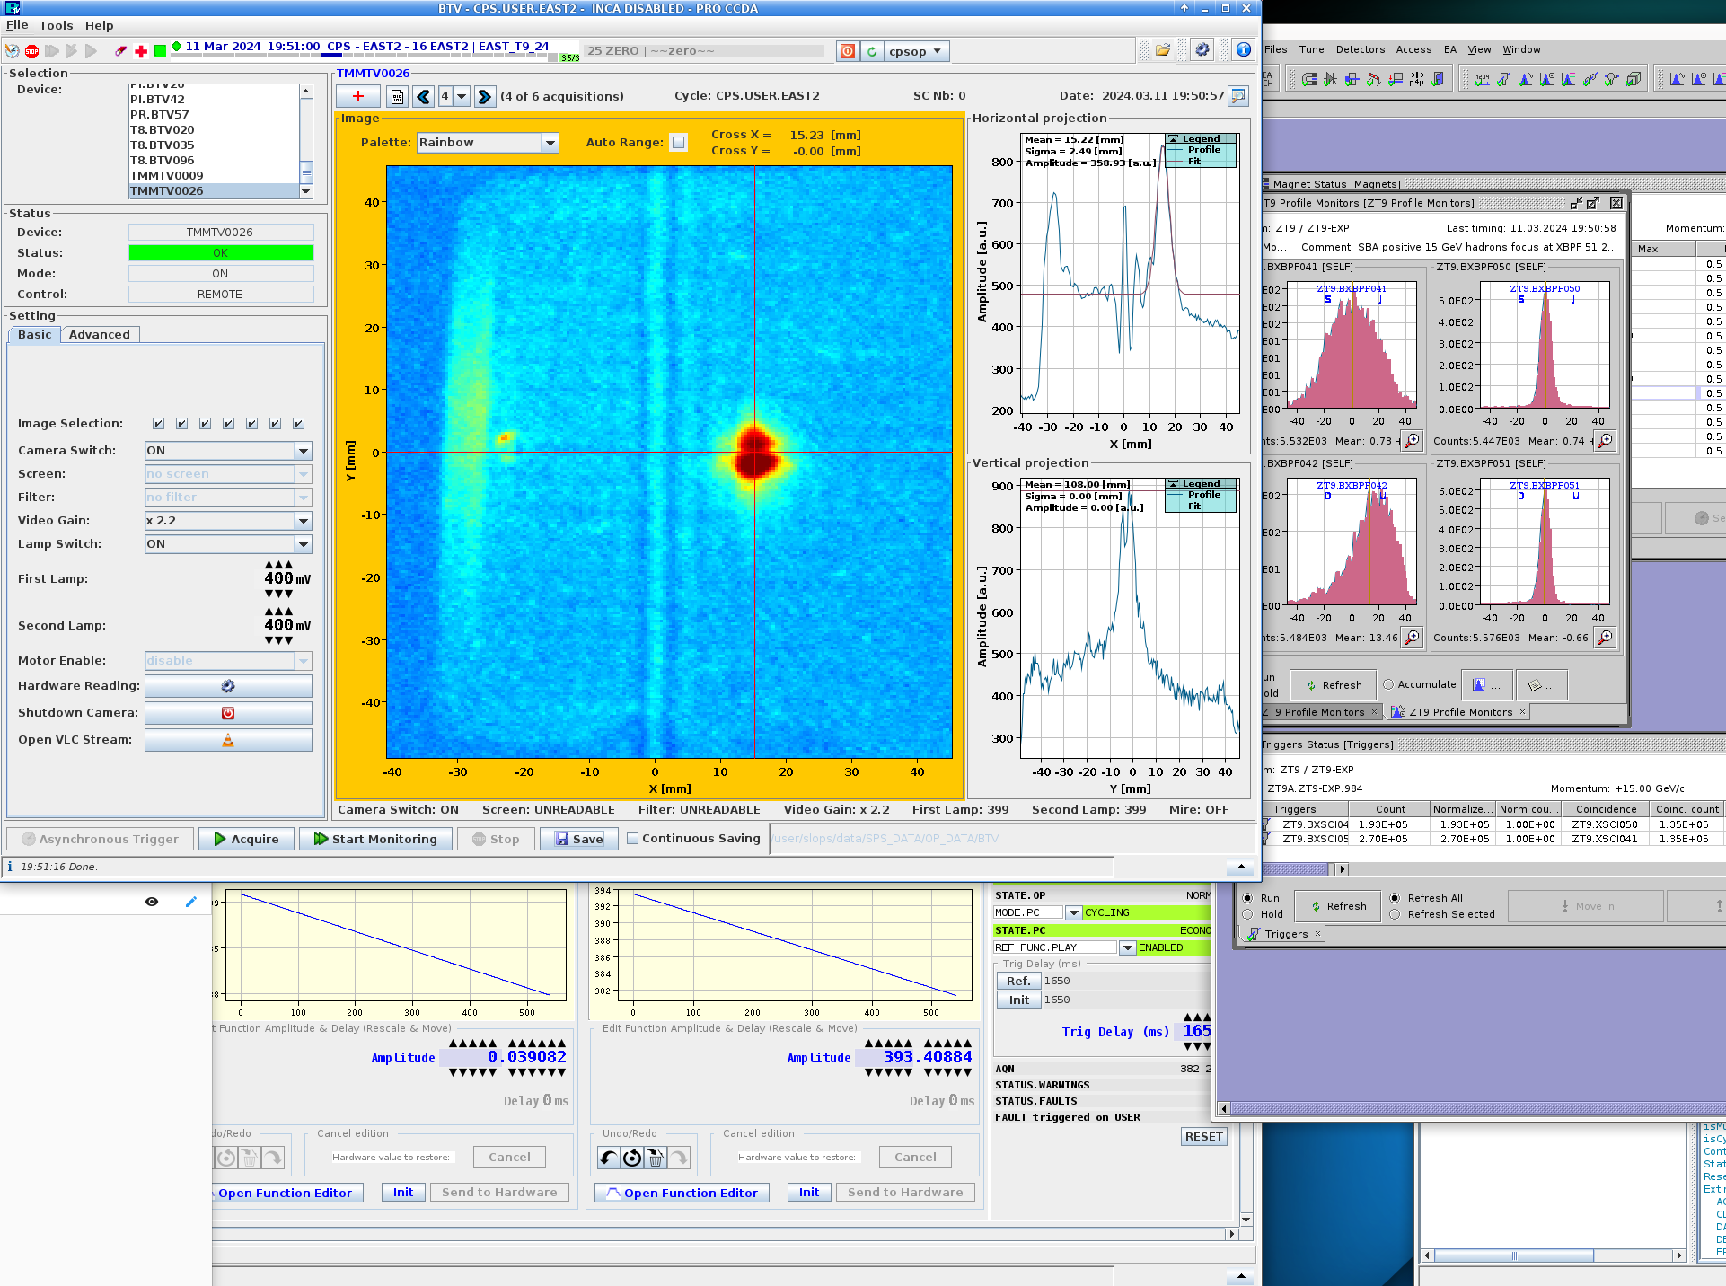
F62.TMMTV026 position
After the origin check the vertical offset is gone.
Horizontally it looks offset by about +1.5 cm.
Checked with beam that this is indeed the good target position (beam hitting the target).
To be checked with BI that the calibration be updated so the BTV is centred on the screen.
Realignment or alignment check not done again after the switch adjustment as the position of the target can be relatively confirmed with the checks and measurement, the working point is found, thus the extra dosage from a intervention can be avoided.
During the YETS a measurement of the alignment to be planned to have the updated reference.
Current situation

