Slide 1
Beginning of appointment - Intro
Jacopo Fanini
08.04.2024

Slide 2
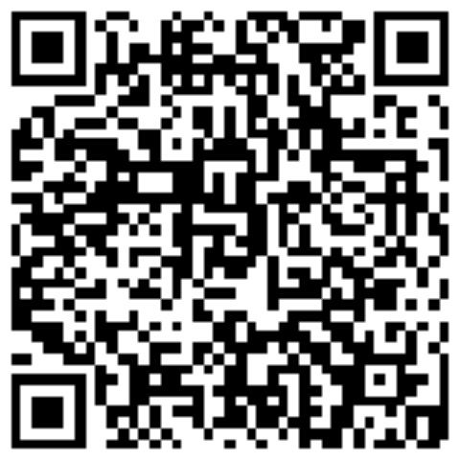


Who am I?
Born and raised in a small village in Italy, near Verona
Curious, purposeful, overly perfectionist
2019-2022: Bachelor’s degree in Physics @ UniPd
Thesis @ AGATA Collaboration, INFN-LNL
Science Communicator @ Sperimentando
2022-202?: Master’s degree in Nuclear Engineering @ PoliMi
Spare time: running, hiking, reading, socialising, ...

Slide 3

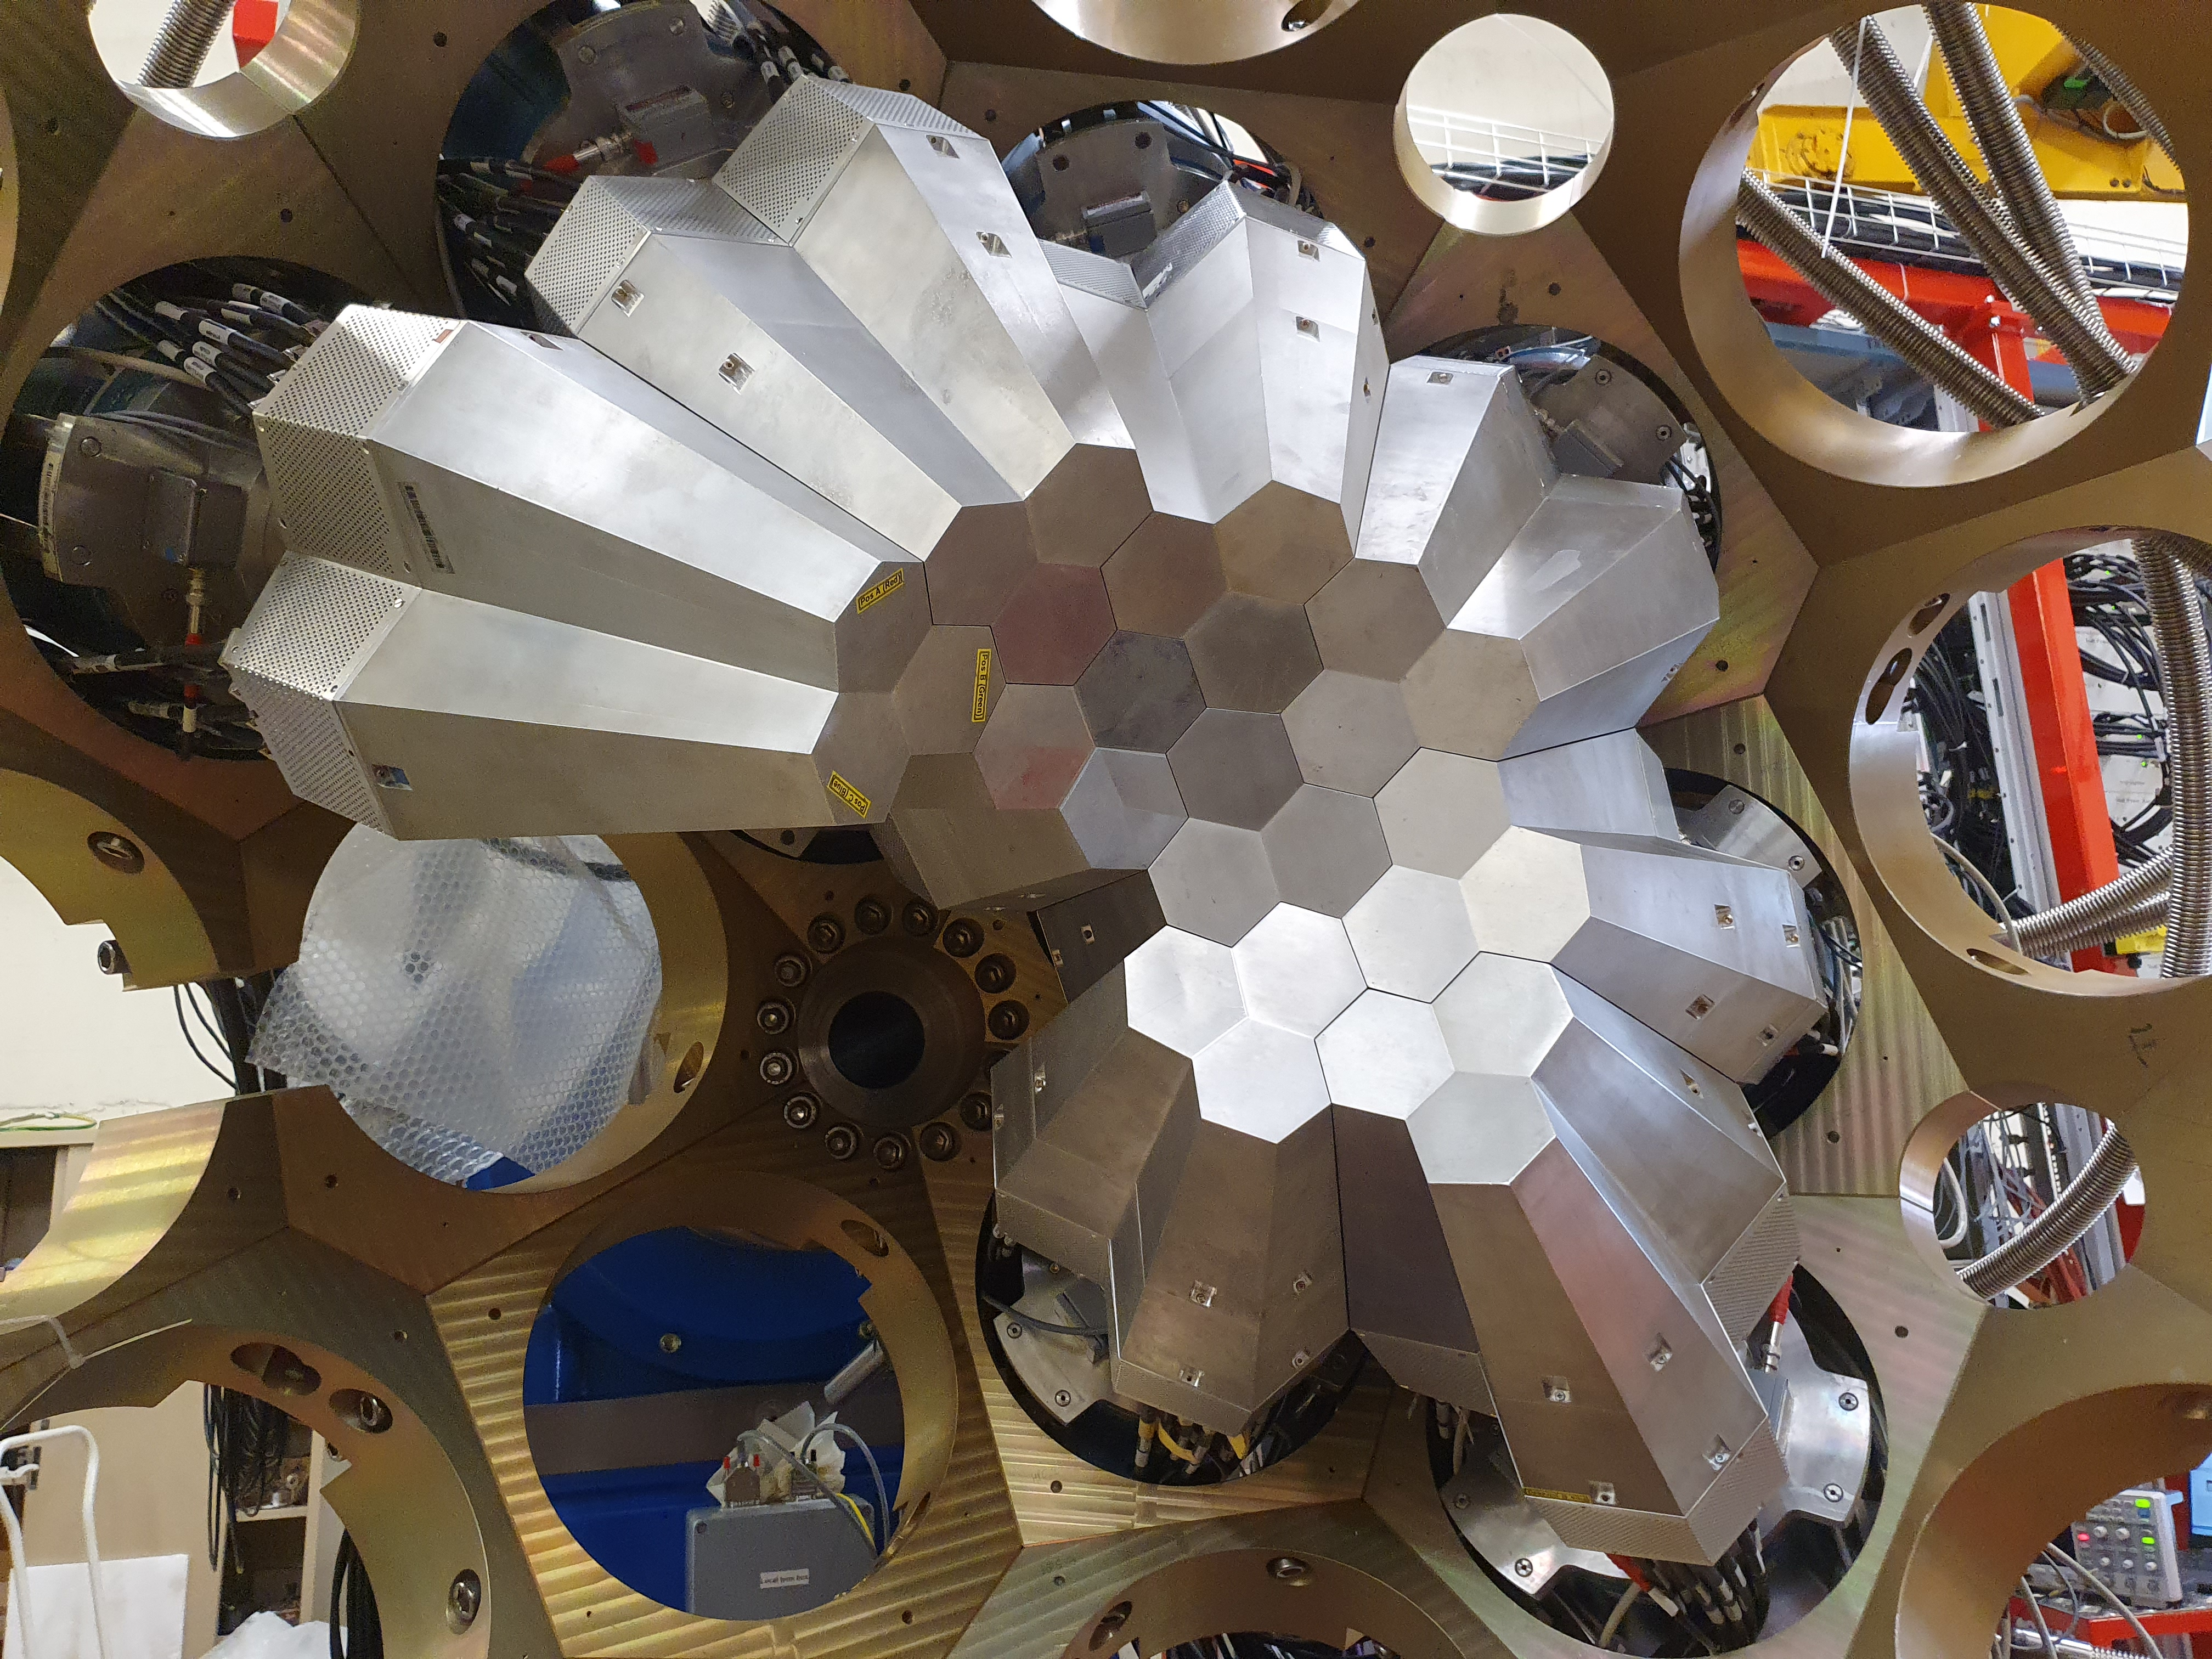

What did I do?
Thesis @ AGATA Collaboration, INFN-LNL
Characterization of a new digital acquisition chain for ancillary detectors
Spectroscopy analysis for detector commissioning
Science Communicator @ Sperimentando
Explained physics and science to laymen and children
Designed experiments and posters

Slide 4





What am I going to do?
Technical student (12 months) supervised by Gerardo
Learn many new things
Import ALEPH data at LEP in Key4Hep under FCC
ALEPH data re-analysis
Master’s thesis
…
?

Slide 5
Thank you!
See you @ office
corridor
Zoom
Mattermost
R1-R2
Geneva
conference
…
Jacopo Fanini (2 R-020)
jacopo.fanini@cern.ch

