Slide 1
Spokesperson election
Presentation of the 4 candidates
We will be recording the presentation for those unable to attend the meeting, so they can view it later.
The vote (by the institutes representatives) will start after the meeting and close at noon CET, February 28th (48h).
If a candidate has obtained more than 50% of the vote, (s)he is elected. If not, the two most voted candidates will go for a second round.
Spokesperson chair election result by the 1st of March.
I propose to have two volunteers to supervise the election.

Slide 2
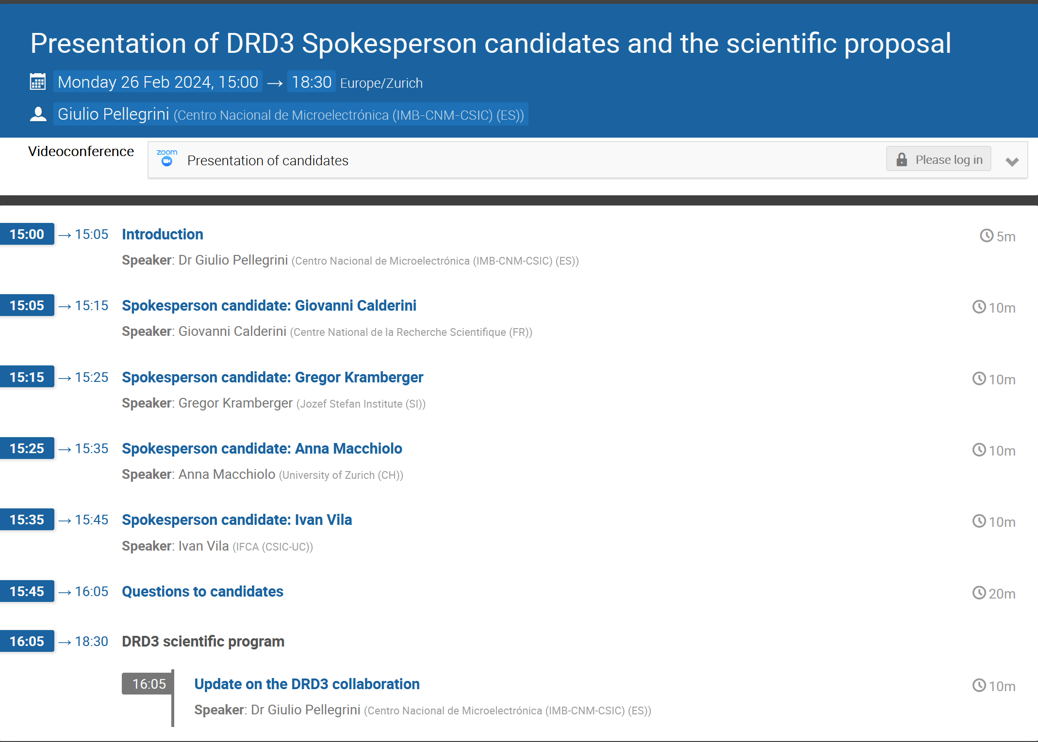
Agenda

Slide 3
DRDC conditional approval of DRD3
The DRD3 has been conditionally approved:
The Research Board preliminarily approved DRD3 so that work towards establishing the collaboration can progress, on condition that the new collaboration structure be established in a timely fashion following the guidelines provided by the DRDC, and the new management appointed.
Approval of DRD3 will be reviewed at the next Research Board meeting in March 2024, on the basis of an updated proposal.

Slide 4
DRD3 timeline
Following the DRDC suggestions, we have now an accelerated schedule
Request of nomination for the CB chair | 15/12/2023
Select 4-5 candidates for the CB chair |  | 6/1/2024
Call for Spokesperson
First online workshop, only for the CB |  |  | 22/1/2024
Election of the CB chair |  |  |  | 29/1/2024
Workshop online (Election of the Spokesperson +summary) |  |  |  |  | 26/02/2024
Election of the Spokesperson |  |  |  |  |  | 01/03/2024
2nd meeting of the DRDC (final approval) |  |  |  |  |  |  | 04/03/2024
First in person workshop at CERN |  |  |  |  |  |  |  | 17/06/24

Slide 5
The next steps
March 4th meeting with the DRDC
Selection of the WP and WG responsible.
Start the preparation of the “MoU”
More details in my talk after the presentation of the candidates

