Slide 1


A Vision for DRD3's Future
Collaboration Board DRD3 meeting
February 26th, 2024
Iván Vila Álvarez
Instituto de Física de Cantabria (CSIC-UC)

Slide 2
Outline
Who?
  My short CV
Why?
  My DRD3 related Highlights
How?
  Proposal for implementing the DRD3 collaboration

Slide 3
My professional leifmotif in a nutshell: a three-prong approach
Enjoying the present:
Hadron Collider experiments
Preparing for the future:
Enabling technologies for future experiments
[2006-] Instrumentation R&D for frontier physics: experiments (HL-LHC & ILD) at EUDET, AIDA, AIDAInnova EU projects; DEPFET & RD50 collaborations:
[1995-99, 2005-] Large Hadron Collider at CERN:
Returning to the society:
Technology transfer
Bidirectional relationship between scientific projects and industrial innovation.
Bottom-up: Taking technologies from industrial innovation agents for science.
Top-down: Through the industrial application of technologies and results arising from science.
Success cases:
CMS Muon system (PhD)
[1999-2005] Tevatron at Fermilab:
CMS HL upgrade of Inner Tracker (Tenured)
CDF Time-of-flight detector (Postdoc)
B physics (Postdoc)
Sensors for 4D-tracking of charged particles (LGAD, ILGAD, TI-LGAD)
Sensors for extreme radiation (3D pixels, SiC)
Innovative techniques:
Management of used nuclear fuel (FOS).
muonic tomography (LGAD).
new techniques for characterizing semiconductor devices.(TPA-TCT)
CMS run1 - Electroweak sector physics (Tenured)
Fiber Optic Sensors
TPA-TCT testing method
DRD3

Slide 4
Some Coordination and leadership activities
Member of the Steering Board for the tracker upgrade, Tracker Institutional Board, and Finance Board of CMS (2007-)
IFCA Team Leader for the RD50 collaboration at CERN (2010-)
Chairman of the FP7 AIDA collaboration (2011-2015)
Principal Investigator Spanish Network of Future Linear Accelerators (2016-2017)
Technical Coordinator of the Silicon Tracking System for the International Large Detector collaboration (2016-)
Working Group Coordinator on hybrid pixels AIDA-2020 (2016-2020)
International Advisory Board Member of VERTEX workshops (2017-)
Head of the HEP group at IFCA (2019-)
Principal Investigator in Cantabria for the Spanish R&D Complementary Plan for Astrophysics and Particle Physics (2022-)

Slide 5
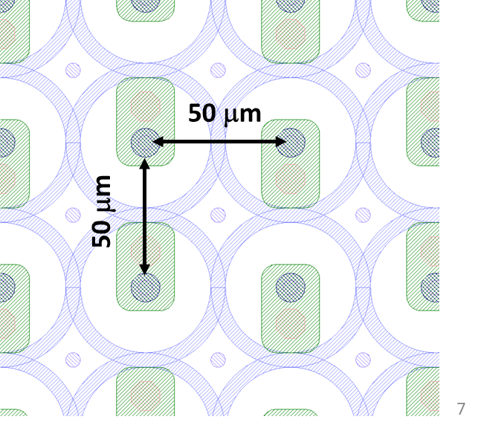
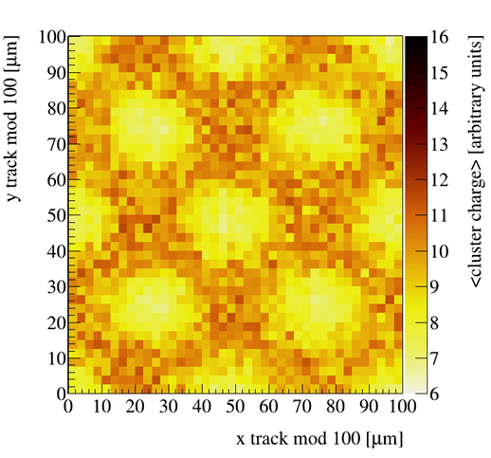
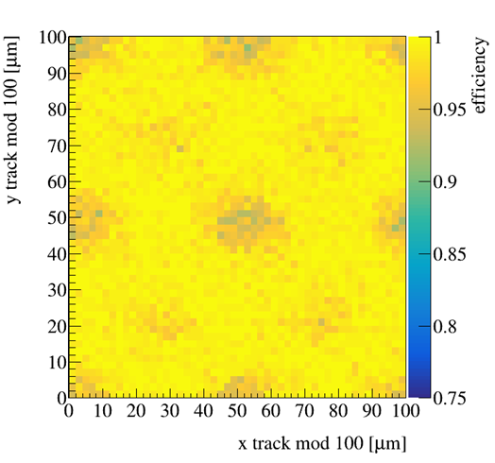



DRD3 related highlights: Radiation tolerance – 3D sensors [2008- ]
First radiation tolerance study inside CMS of double-sided 3D pixel sensors including biasing grid, with PSI46 ROC (100x150 μm²) up to 5e15 n_{eq}/cm²
First assessment of small-cell (50x50 μm²) double-side 3D pixels (R4Sens ROC) up to 5e15 n_{eq}/cm²
R&D for the innermost layer of the High-luminosity upgrade of the CMS Inner Tracker (small cell Single-Sided 3D, RD53A & CROCs). Selected as baseline technology.

Slide 6
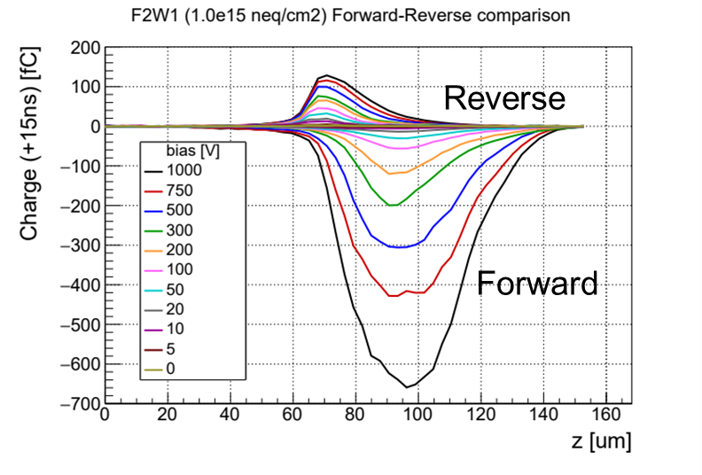
DRD3 related highlights: Radiation tolerance – SiC sensors [2022- ]
SiC remerged as a promising candidate as hard-rad radiation sensor (industrial driven)
Radiation tolerance study of p-in-n SiC diodes (epitaxial 50um thick).
First characterization of SiC devices with TPA-TCT method
First observation of strong signal recovery in forward-biased irradiated diodes

Slide 7
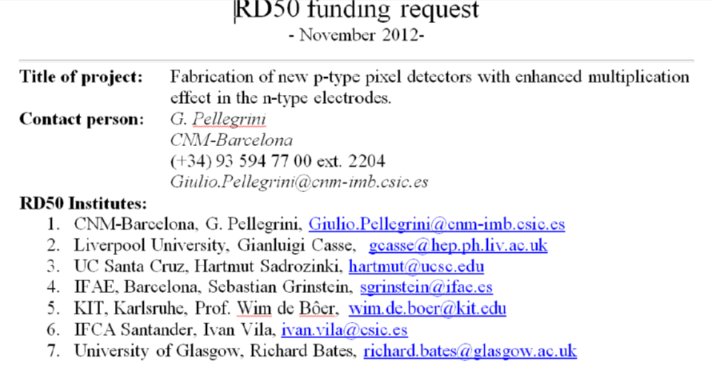
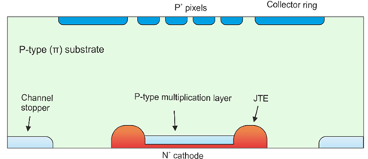
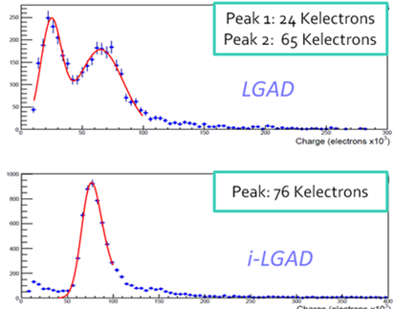
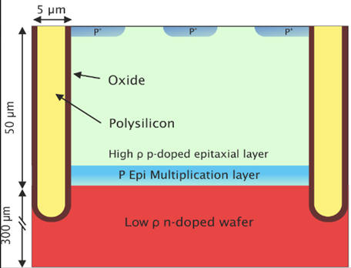

DRD3 related highlights: Timing and 4D tracking – LGADs [2012 -
Pioneer in the introduction of LGAD technologies for HL-LHC:
  large SNR (decoupled from the material thickness) for O(10ps) MIP time stamping for disentangling between the different interaction vertices.
  LGAD is the baseline technology of the endcap MIP timing detector for the HL upgrade of Atlas and CMS experiments
  Radiation tolerance study completed up the CMS requirements 1e15 n_{eq}/cm²
Can the LGAD enable the 4D tracking paradigm?
  Need to achieve a 100% fill factor.
  O(10um) spatial resolution with fine electrode segmentation or AC coupling
Proponente of ILGAD, p-in-p LGAD architecture as a 4D tracking enabling technology. Contributing to other alternatives too: TI-LGAD, AC-LGADs.

Slide 8
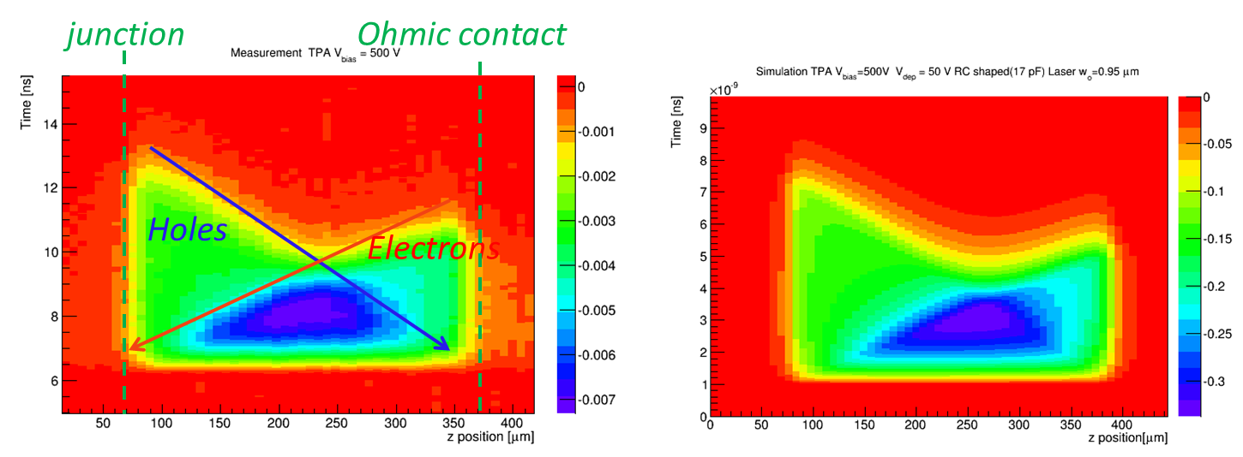
DRD3 related highlights: characterization methods - TPA-TCT
Co-Inventor of the TPA-TCT characterization method based on the non-linear optics and femtosecond lasers.
TPA-TCT a true 3D high-resolution mapping tools of the semiconductor response and electric fields.
Measurement
Simulation

Slide 9
DRD3 collaboration structure implementation
A Very large and diverse collaboration requires:
  A well defined governance.
  A true bottom up approach (Goberning Board rol is critical)
Management Team:
  Spokesperson and two deputies.
  Chairperson and deputy.
  Administration manager.
WG conveners:
  Up to three conveners per Working Group (two preferred)
Steering committee:
  Management team + Working group coveners

Slide 10
DRD3 collaboration structure implementation (2)
Deputy spokespersons:
  Nominated by the Spokesperson.
  Approved by the Goberning Board (GB).
Designation of Working Group conveners (after DRDC approval of the collaboration):
  Step 1: Institutions subscribe to one or more Working Groups (WGs).
  Step 2: Request to nominate candidates to the WG institutions.
  Step 3: Short-list of nominees (ordered according to support, no more than five).
  Step 4: Dedicated Zoom meeting to present the candidates.
  Step 5: Online vote of institutional representatives (allow for a least one day of reflection)
  Step 6: Endorsed by the GB.

Slide 11
DRD3 collaboration structure implementation (2)
Deputy spokespersons:
  Nominated by the Spokesperson.
  Approved by the Goberning Board (GB).
Designation of Working Group conveners (after DRDC approval of the collaboration):
  Step 1: Institutions subscribe to one or more Working Groups (WGs).
  Step 2: Request to nominate candidates to the WG institutions.
  Step 3: Short-list of nominees (ordered according to support, no more than five).
  Step 4: Dedicated Zoom meeting to present the candidates.
  Step 5: Online vote of institutional representatives (allow for a least one day of reflection)
  Step 6: Endorsed by the GB.

Slide 12
DRD3 collaboration structure implementation (3)
Work Packages:
  Recall that these are time-limited goal-oriented strategic projects with defined milestones and deliverables and resource commitments (MoU annexes).
  WP are the core instrument to achieve the R&D Roadmap goals.
  The number of WP is expected to vary during the DRD3 lifespan.
The detailed implementation of the WP will depend on the decision of the contributing institutions, to decide on:
  Contact(s) persons
  Allowed type of commitments: monetary, person power, in-kind.
For the four initial WP, the corresponding WG conveners should call for a meeting on how to carry out the WP organization.
New WP should be approved by the management team and endorsed by the GB.

Slide 13
THANK YOU FOR YOU ATTENTION!

