Slide 1

Some ideas for the communication strategy of TIARA
Prof. Toms Torims (RTU)
26th TIARA Collaboration Council meeting
05.03.2024 at CERN

Slide 2

@TIARA 24th meeting
TIARA needs to take actions regarding the update of its web site. It is important for our visibility.
But, more generally, the real need in this moment is to analyze the dispersion of information about accelerator activities among the different websites of collaborations and projects (AMICI, Accelerating News, the project websites ...)
We need to analyze this situation to come to a conclusion on the real needs and take actions. Help is needed for such work.
The work requested goes beyond the scope of simply websites; it is about the complete communication strategy of TIARA.
Once analyzed the situation, it is likely that professional support will be needed, requesting the allocation of funds from TIARA.

Slide 3

@TIARA 24th meeting
Actions agreed
support on initiating the analysis of the communication strategy
TT to work out the situation in terms of communication, in particular, the information on the web sites of the accelerator community and report in the next TCC meeting

Slide 4

Who we are?
Where are we?
Group of institution representatives (Community? Stakeholders?) who are willing to support Particle Accelerator projects and collaboration
In the same time each TIARA partner have very strong own interests
Everyone is interested in EU projects and EU money
Do we try to control or coordinate accelerator community EU proposals?
TIARA clearly needs to reinvent itself...

Slide 5
How we would like to position TIARA?
Strong impact? – i.e. powerful
Good representation? – i.e. everyone /or almost/ is onboard
One voice vis-a-vis EU and community at large? – i.e. strong and clear mandate from the community
Regular dialogue with EC? – i.e. DG RTD accepts TIARA as a representative of the particle accelerator stakeholders
Efficient and transparent coordination among partners? – i.e. everyone is informed and engaged
Successful projects? – i.e. projects supported /proposed/ by TIARA are good and successful ones
Aligning strategic interest of EU and Particle Accelerator Community? – i.e. vin-vin approach

Slide 6

We are not making currently such a nice impression on the public domain ...

Slide 7
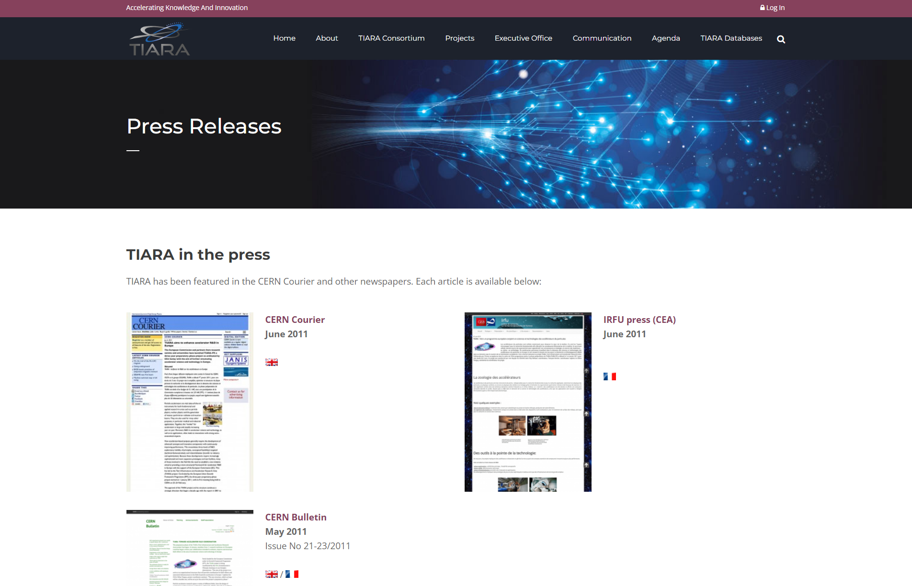
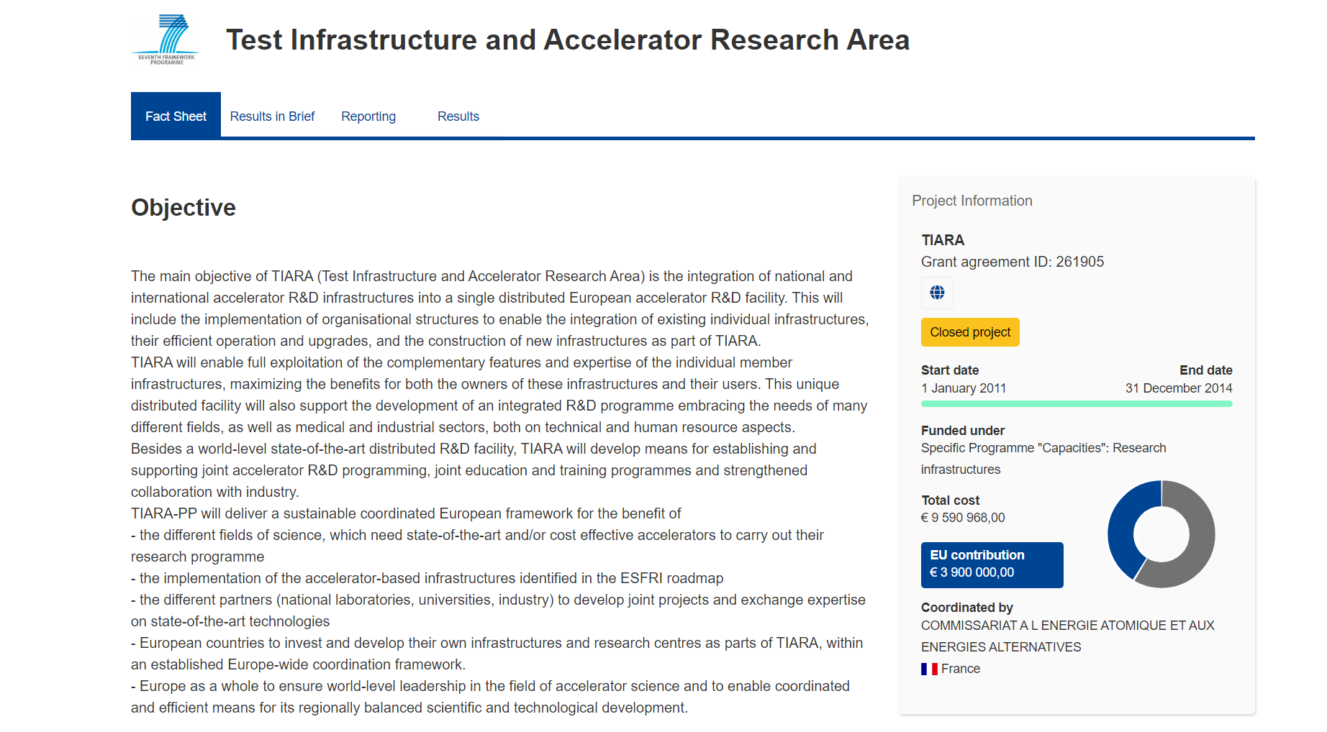
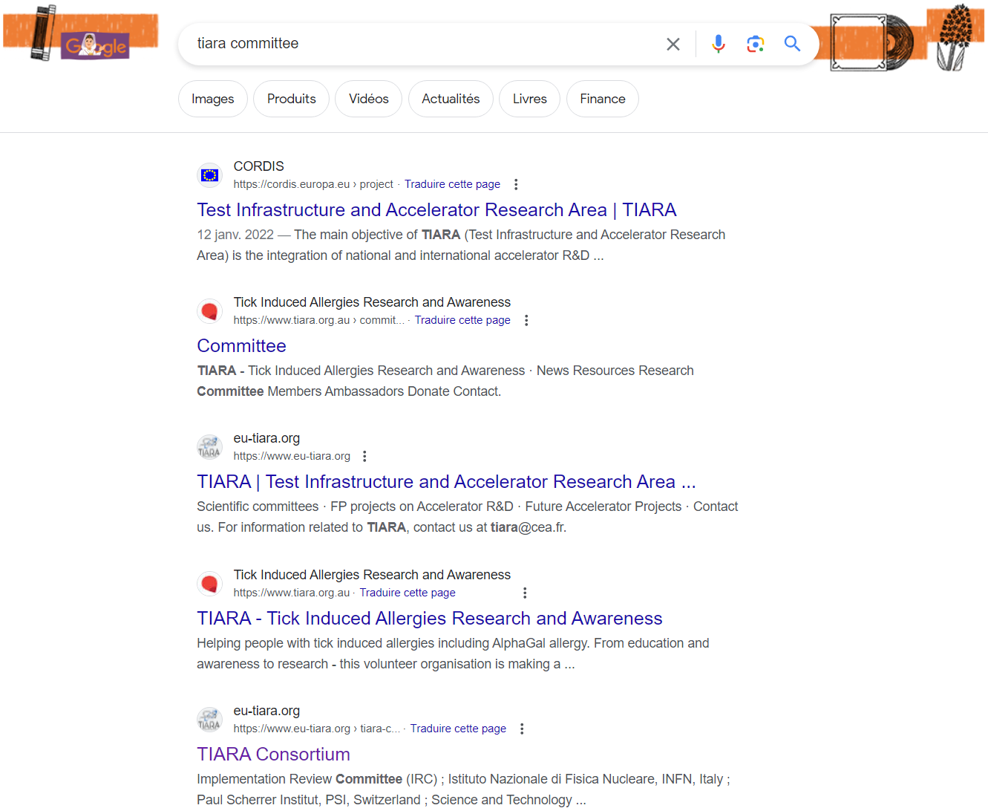
Search for TIARA

Slide 8
Web sites (illustrative only)
Accelerating news – the one and only who can really claim that is somehow representing the particle accelerator community
Project web sites:
I.FAST – up and running, yet mostly relevant to the project itself, with on exception Challenge-Based Innovation
ATTRACT – ecosystem approach – simple and effective
AMICI – outdated – it was actual while AMICI EU project was running
+ number of others: obsolate and on-going
None of these project sites refers to TIARA

Slide 9
TIARA members Web sites

Slide 10
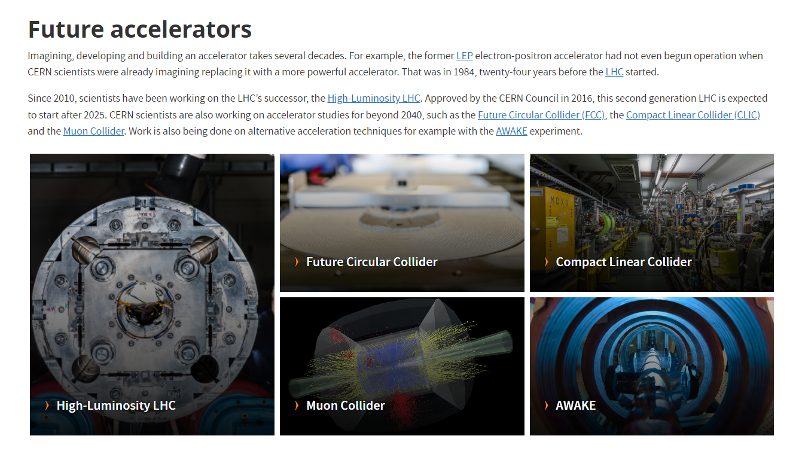
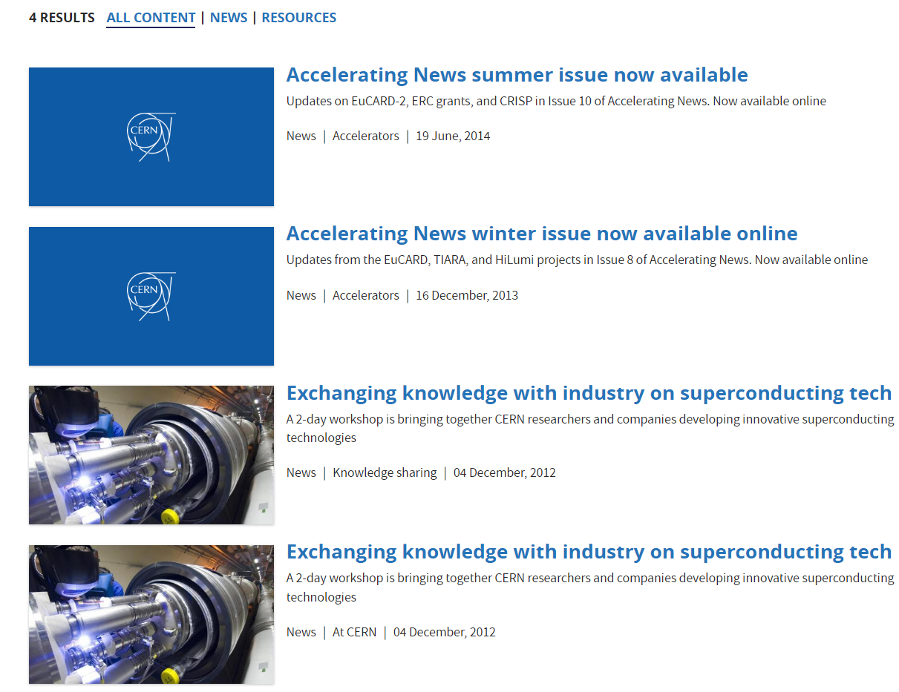
Search for TIARA
CERN Accelerators

Slide 11
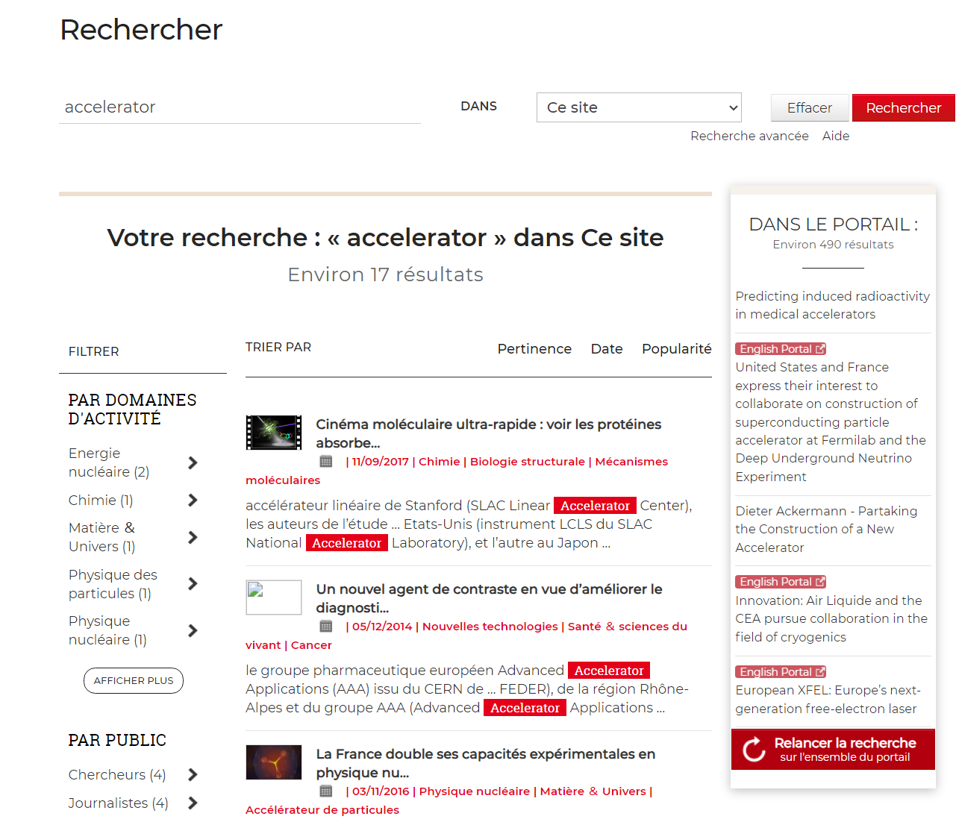
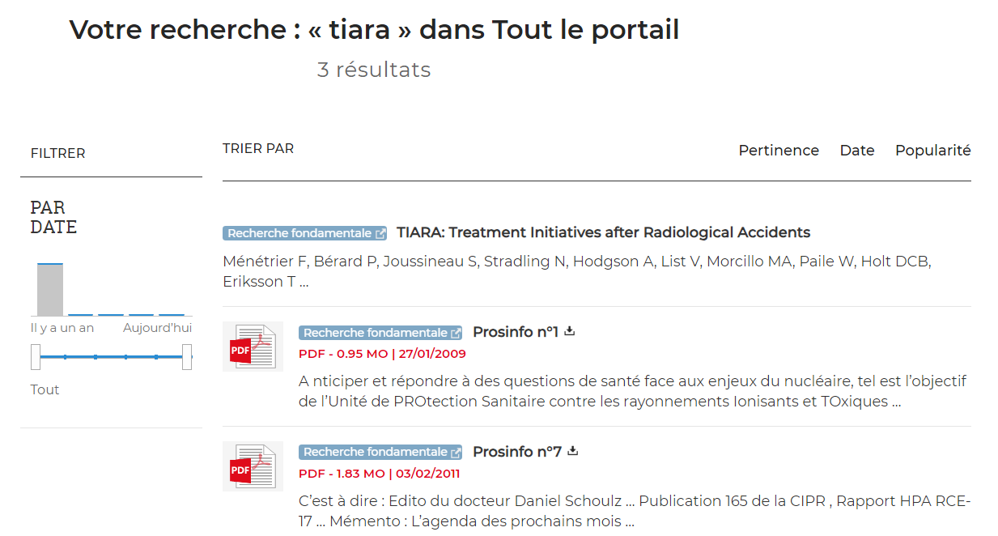
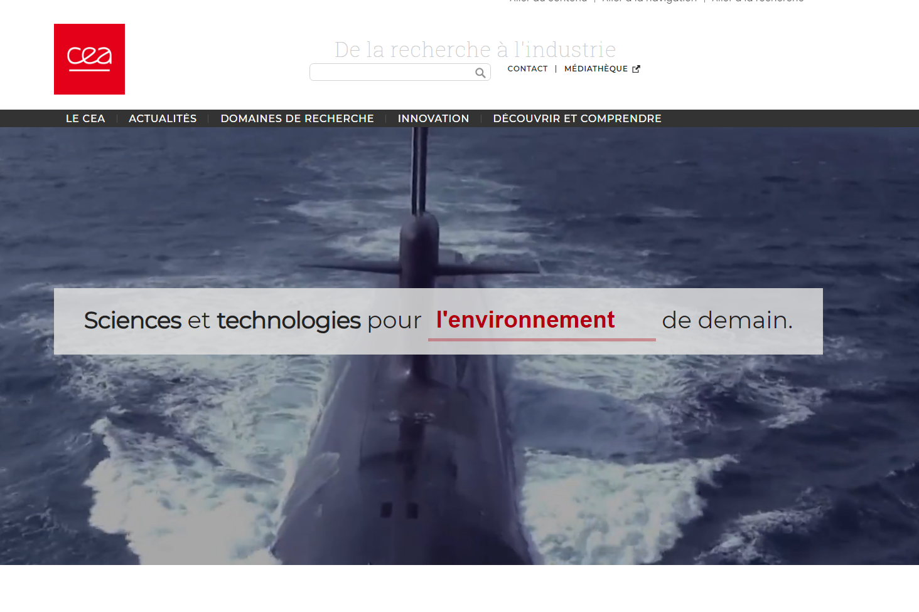
CEA

Slide 12
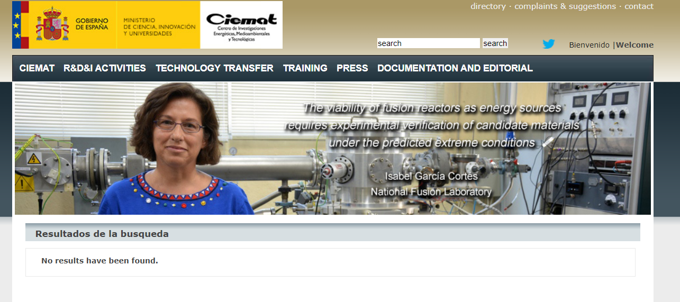
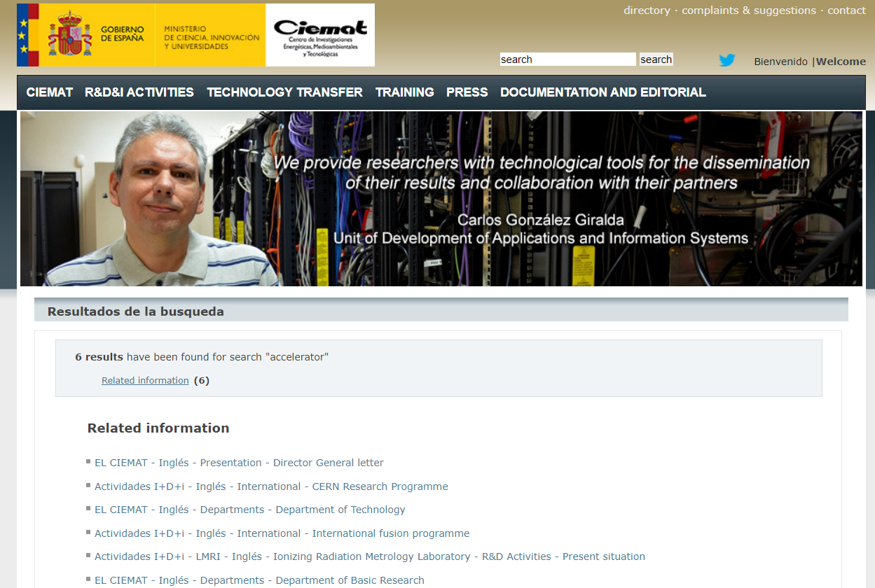
CIEMAT

Slide 13
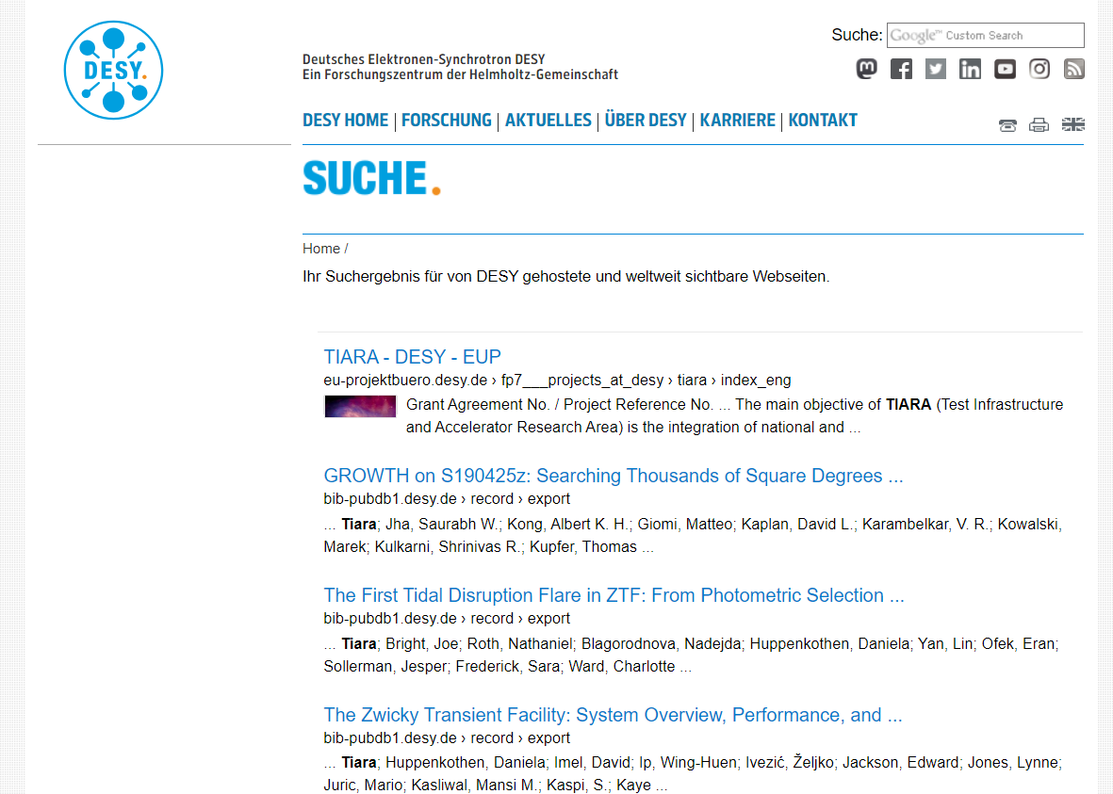
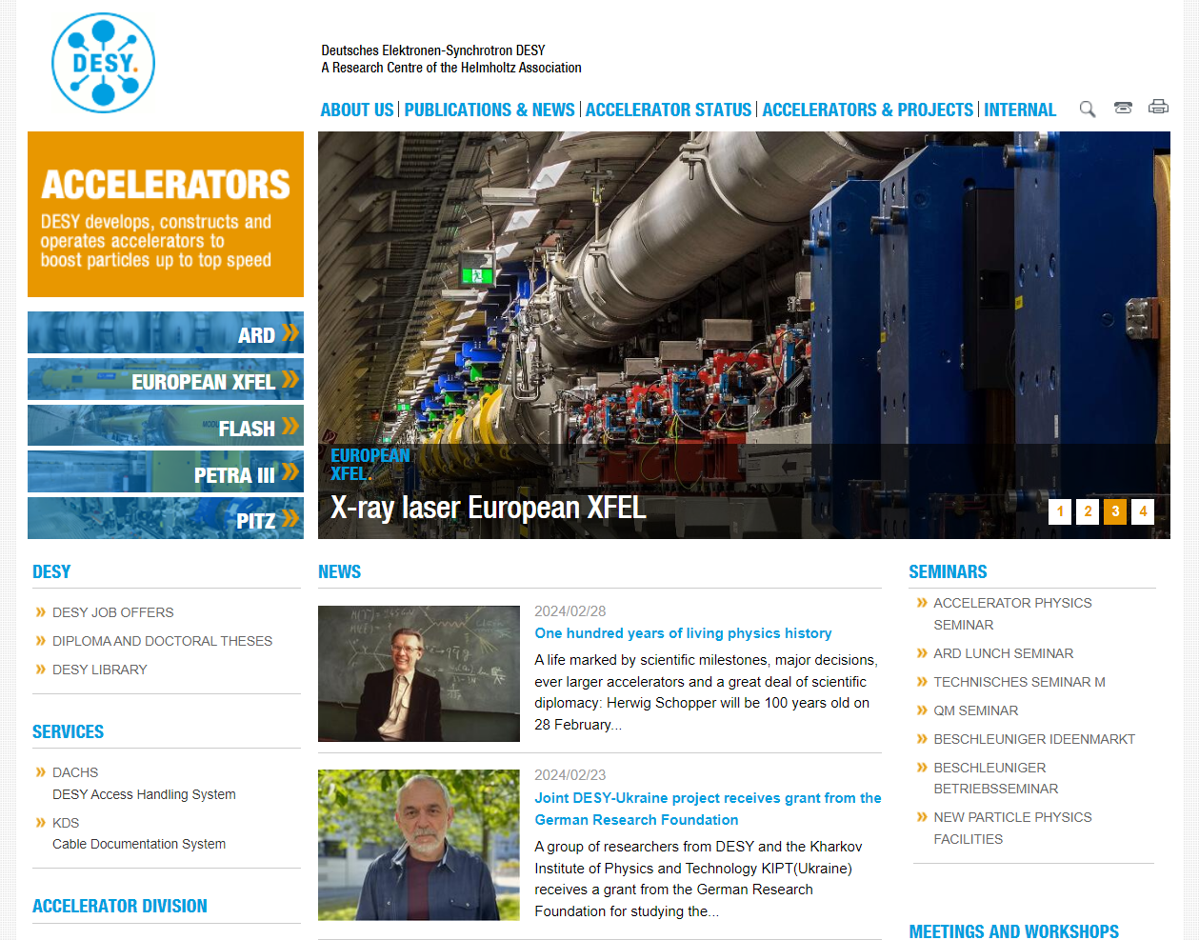
DESY

Slide 14
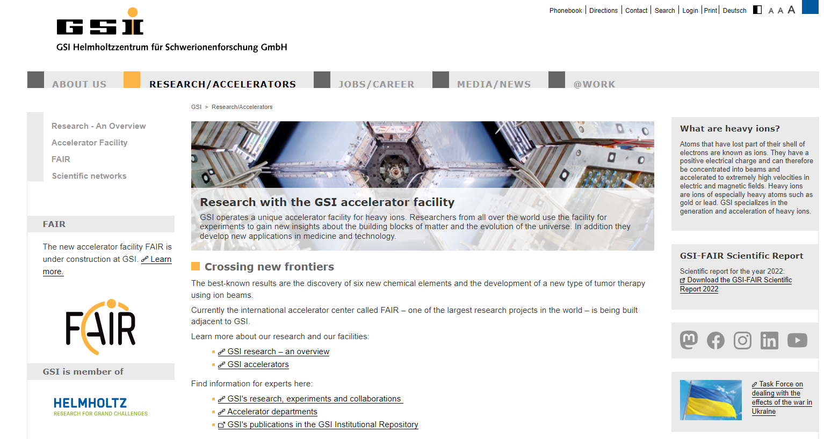
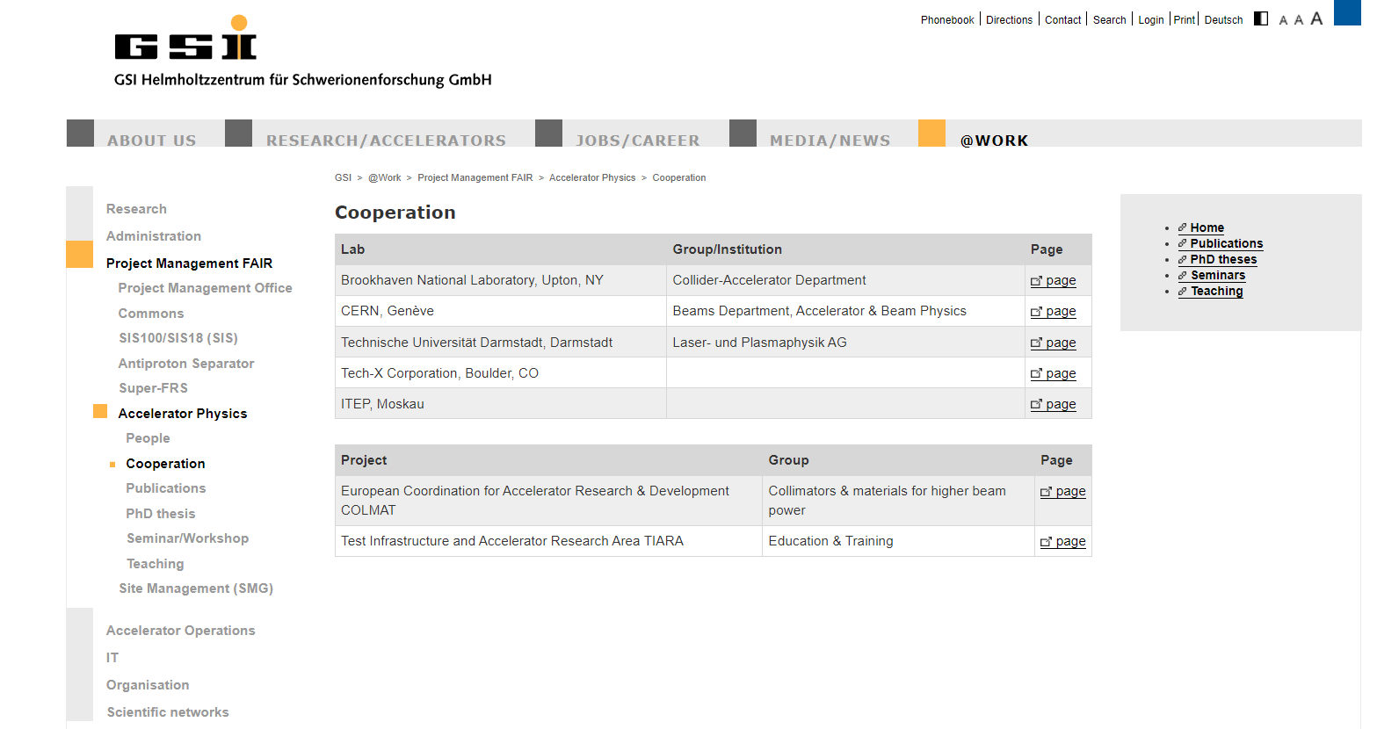
GSI

Slide 15
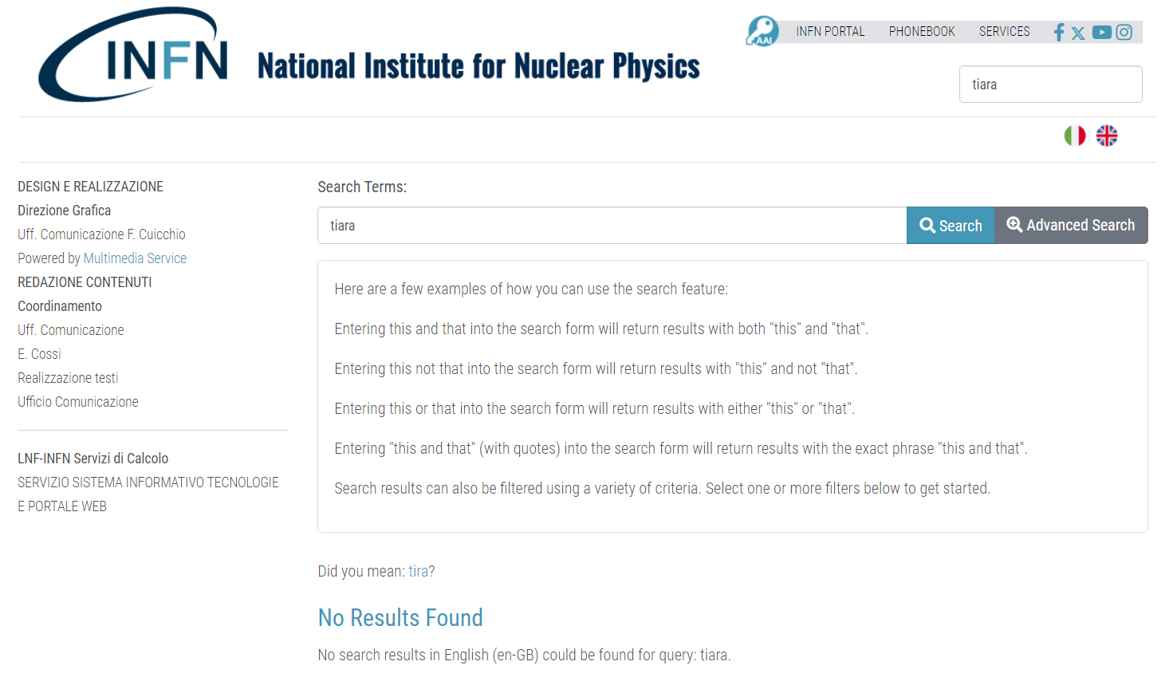
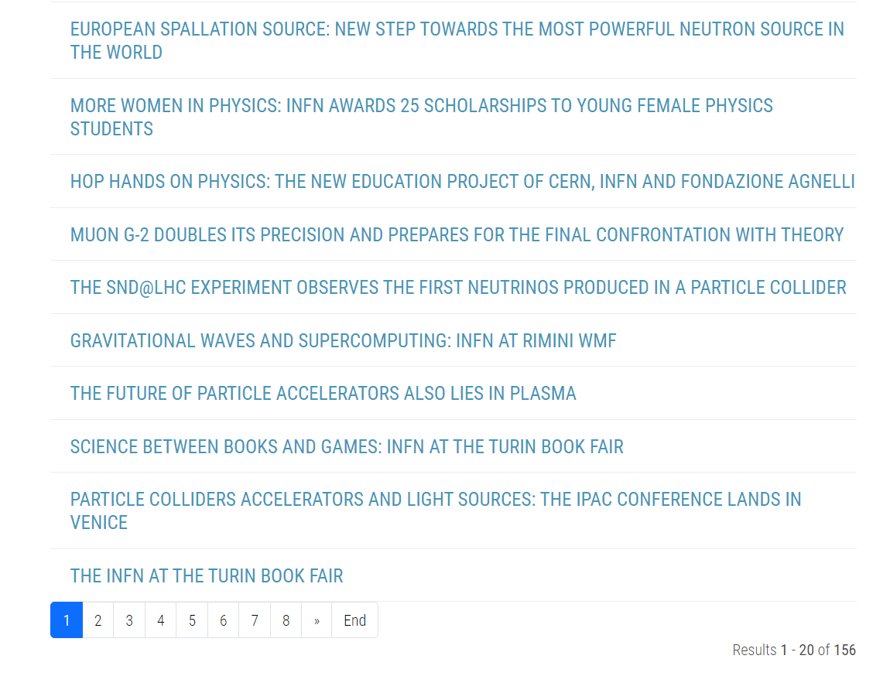
INFN

Slide 16
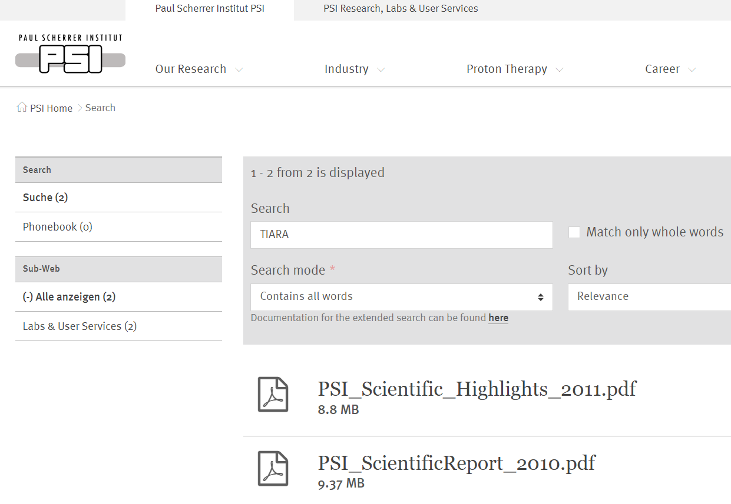
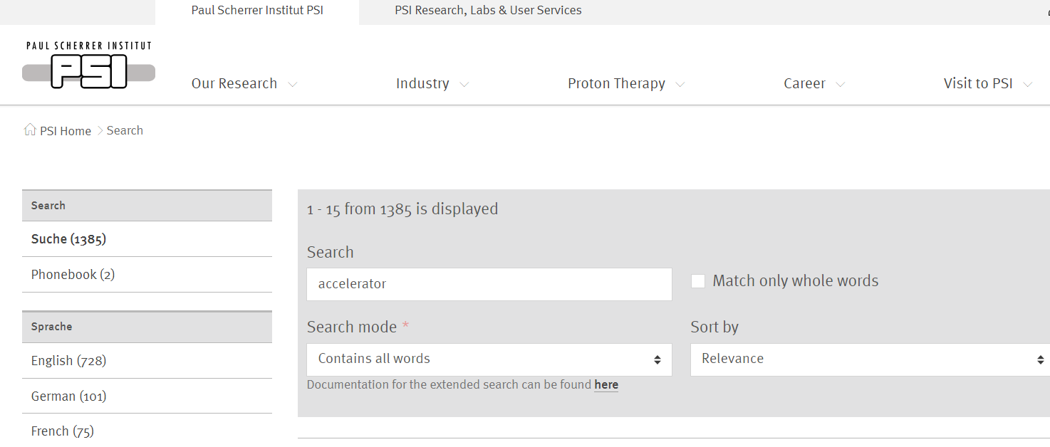
PSI

Slide 17
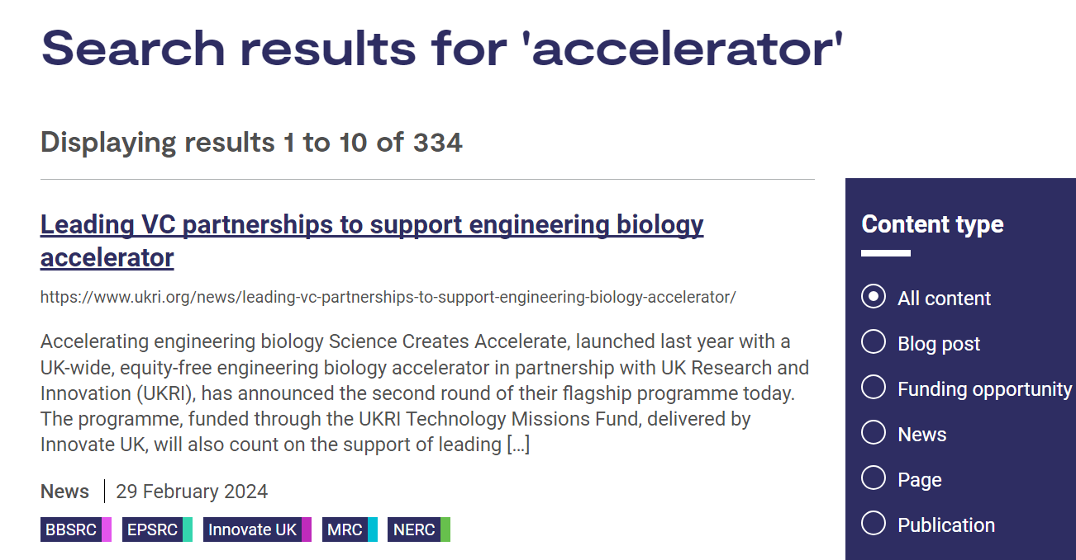
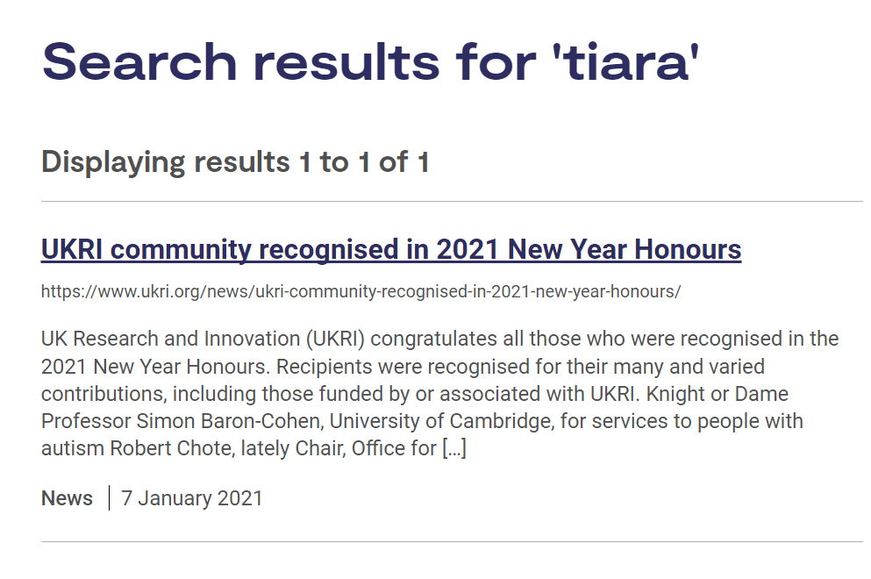
STFC

Slide 18
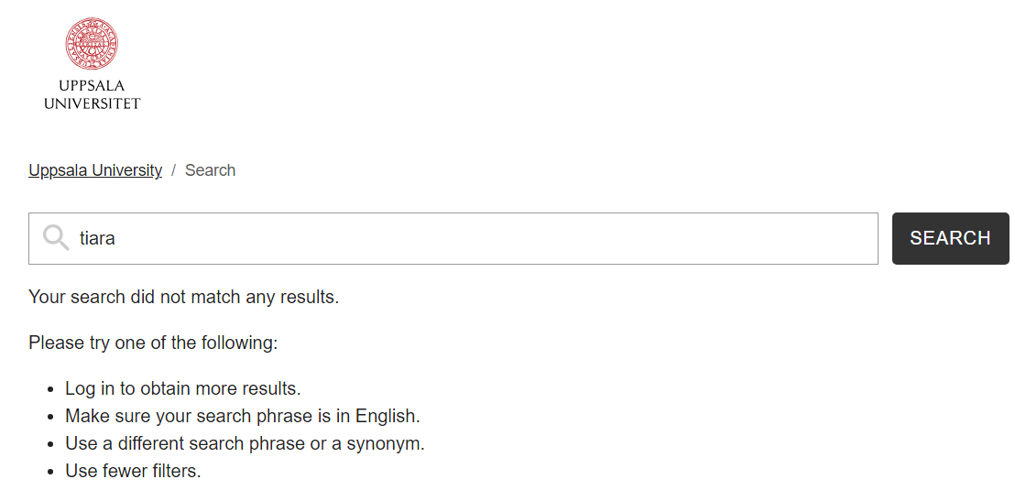
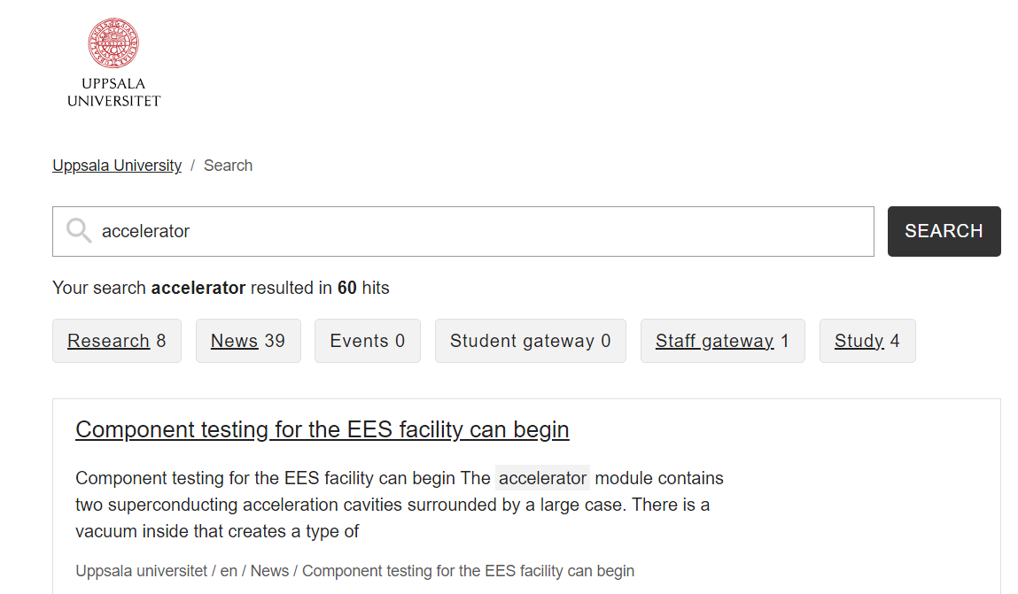
UPPSALA UNIVERSITET

Slide 19
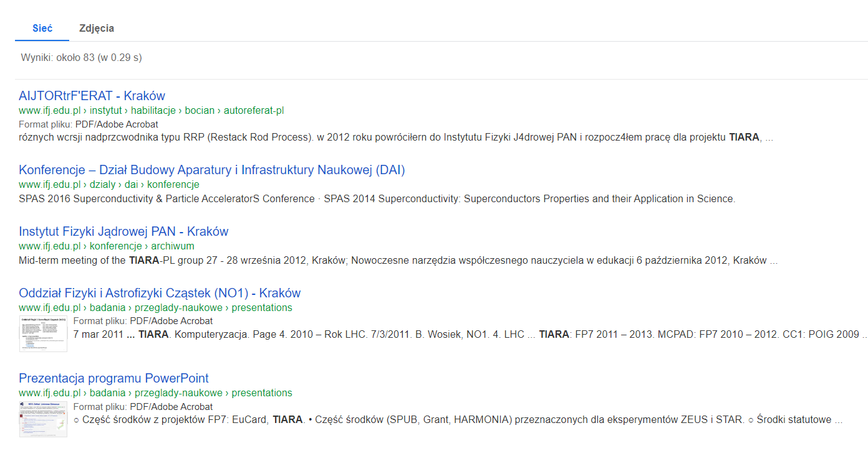
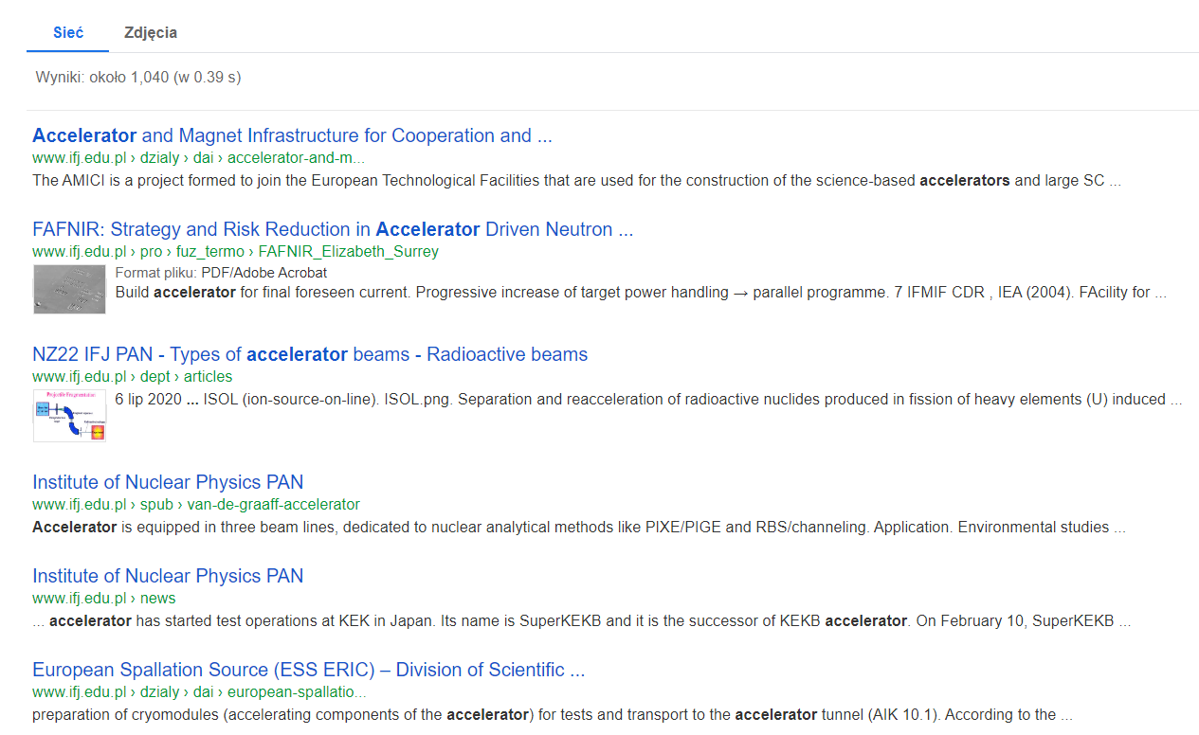
lFJ PAN

Slide 20
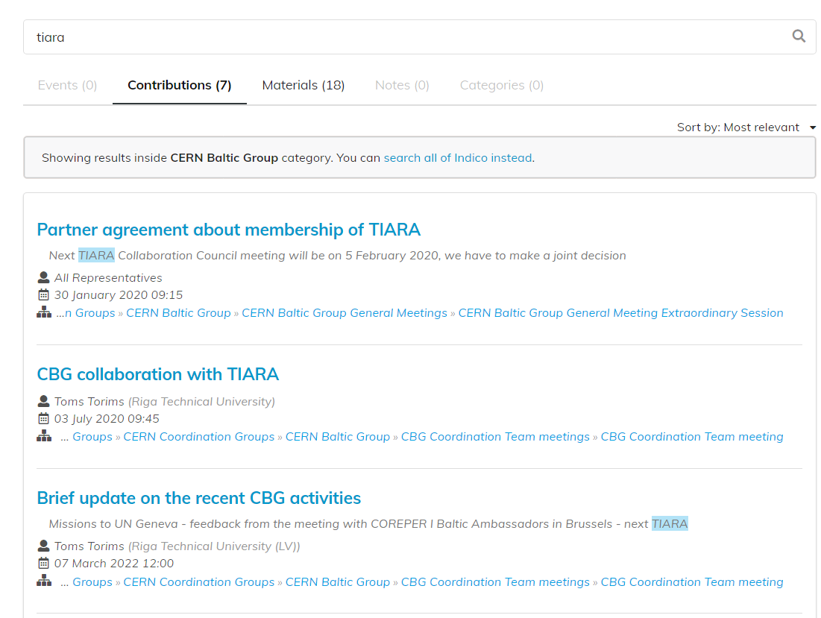
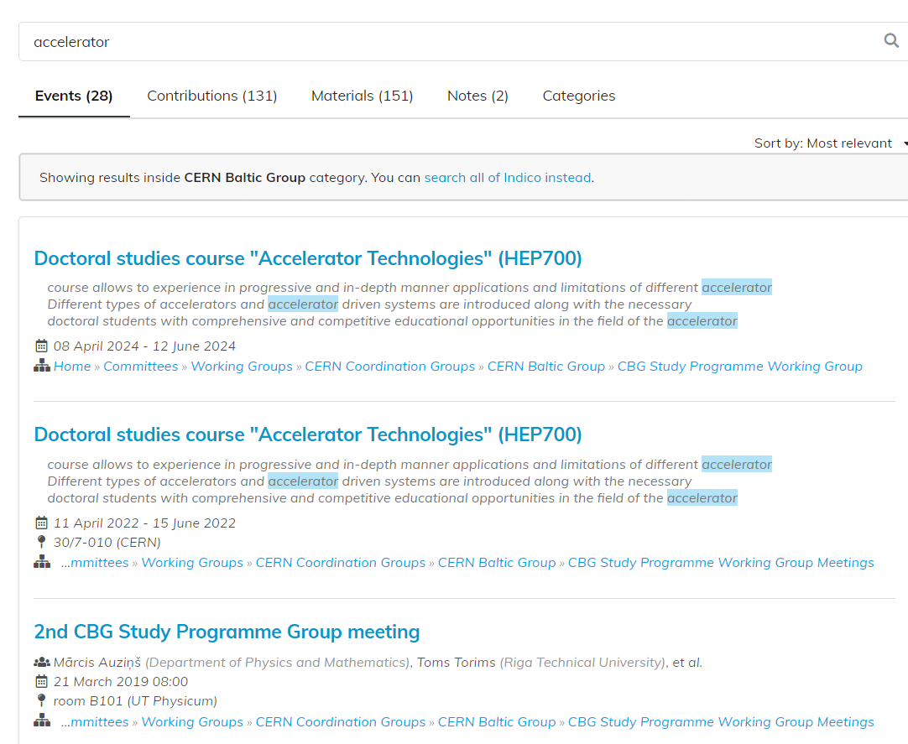
CERN Baltic Group

Slide 21
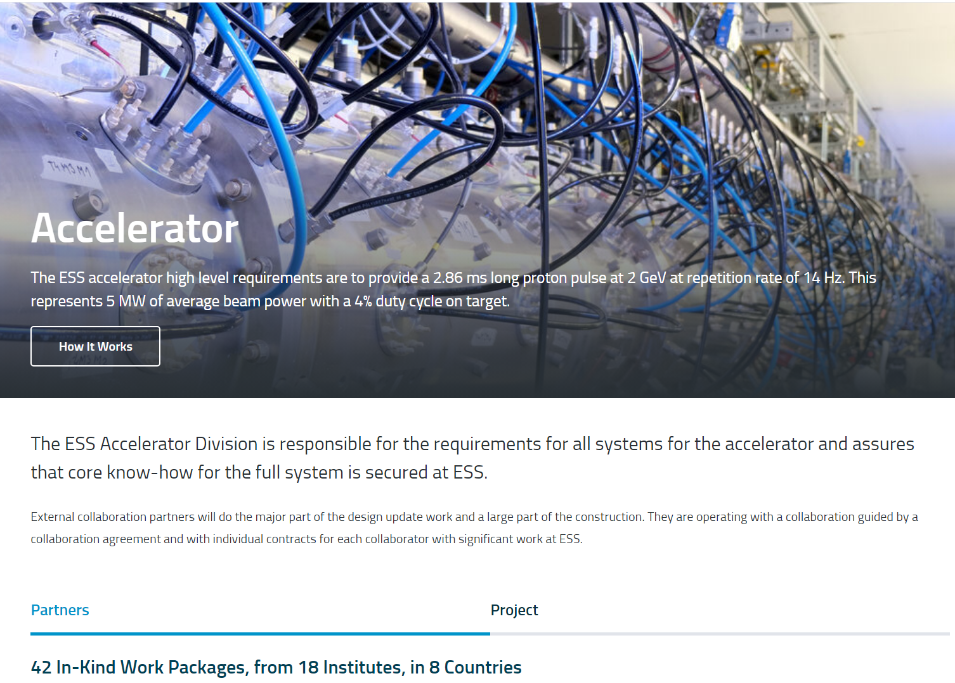
ESS

Slide 22
TIARA MoU
the purpose ... of the "Test lnfrastructure and Accelerator Research Area (TIARA)", a Consortium of European Research lnstitutions operating significant R&D Infrastructures in the European Particle Accelerator Research Area...designated as the "Consortium" to create:
a dedicated structure to exchange expertise
to facilitate and support the setting-up of joint R&D programmes
education and training activities in the field of Accelerator Science and Technology in Europe

Slide 23
Hints for TIARA communication strategy
mission?
vision?
moto or slogan?
internal communivation and external communication
overall goal of the ComStrat? What we would like to achieve?
target audiences?
communication narative?
positioning?
messaages?
communication channels, activities and tools ... etc

