Slide 1


Recuperation systems for fluorinated gas at the CERN LHC Experiments
Maria Cristina Arena
EP-DT-FS gas team and University of Pavia
EP-DT seminar, 28/02/2024

Slide 2
Outline
Introduction
  LHC gaseous detectors
  Focus on GHGs at CERN
  CERN strategies for reducing fluorinated gas emissions
  Separation techniques
Recovery systems:
  CMS CSC CF₄
  LHCb RICH2 CF₄
  LHCb RICH1 C₄F₁₀
  CMS RPC R134a
Conclusions

Slide 3
INTRODUCTION

Slide 4
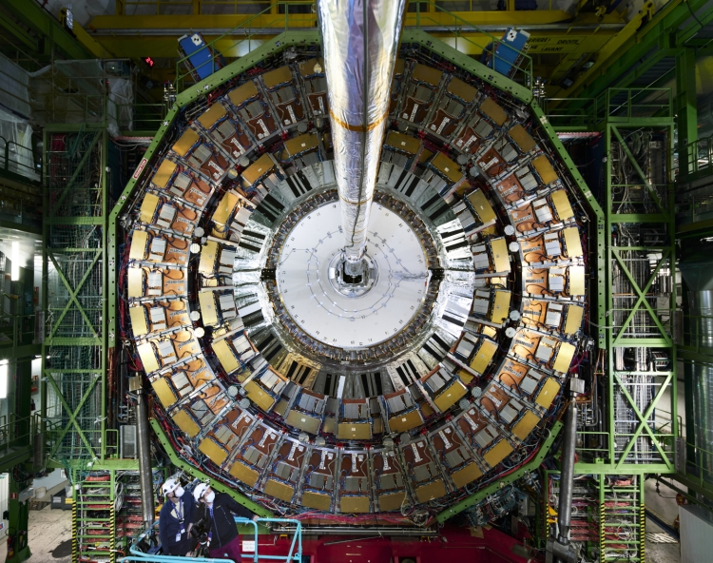
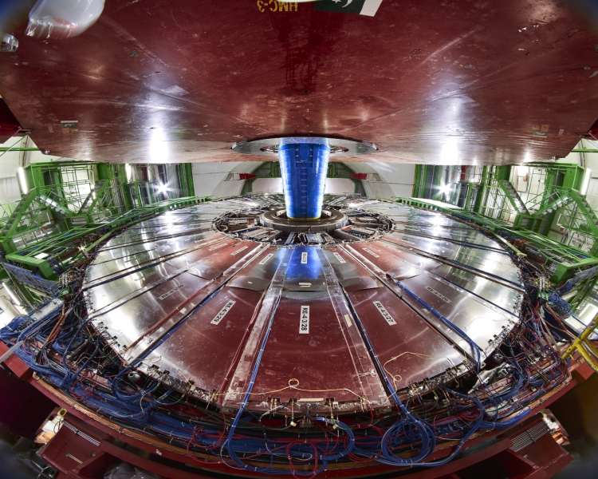
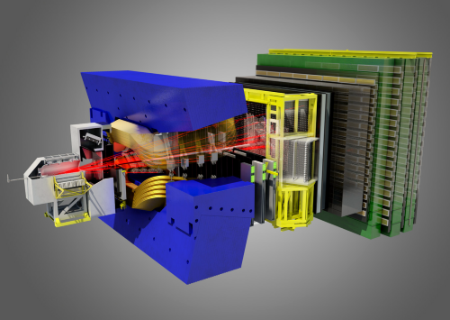
LHC gaseous detectors
Gaseous detectors are installed in all of the four main LHC Experiments and in many not-LHC facilities
Among gaseous detectors, there are:
Muon systems (located in the outermost region, covering large surface areas)
Trackers (located closer to the interaction point, usually operated in high-rate environments)
Particle identification systems (used to identify charged particle momenta)
They are used for:
Triggering (e.g., Resistive Plate Chambers, Cathode Strip Chambers, Drift Tubes)
Tracking (e.g., CSC, DT)
Particle identification (e.g., RICH)
CMS CSC
CMS RPC
RICH1
LHCb
RICH2

Slide 5
LHC gas mixtures
Depending on the purpose and the geometry of the detectors, different gas mixtures are required
Some detectors work with a single pure gas:
  C₄F₁₀
  RICH1
Other detectors need mixtures with 2 up to 4 components
CO₂/Ar-CO₂/Ar/ CF₄ – CO₂/ CF₄
  CSC
  MWPC
  RICH2
  GEM
  DT
  C₂H₂F₄/iC₄H₁₀/SF₆
  RPC
  MID
  TOF
Some of these gases are GREENHOUSE GASES (GHG)
Notes:
Fare schema invece di lista → gas freccia e detector (esempio)

Slide 6
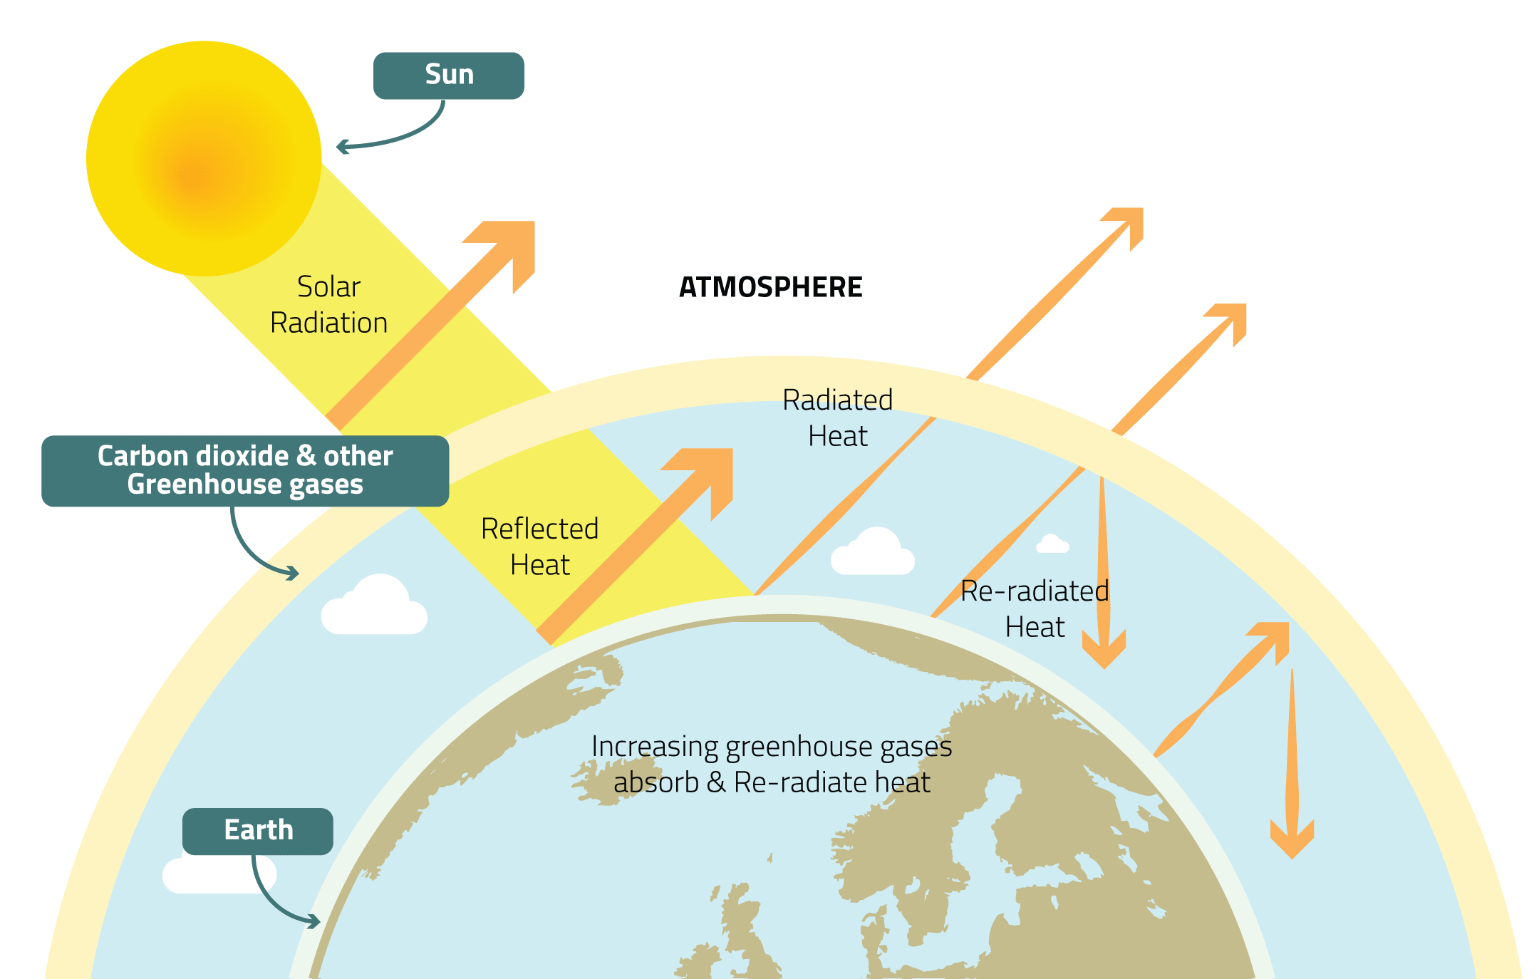
Global Warming Potential (GWP) and GHG emissions at LHC
Greenhouse Gases (also known as GHGs) are gases in the earth’s atmosphere that trap heat.
Global warming potential (GWP) is an index to measure of how much infrared thermal radiation a GHG would absorb over a given time. It is expressed as a multiple of the radiation that would be absorbed by the same mass of added carbon dioxide, which is taken as a reference gas.
Gas | Atmospheric lifetime | GWP_{100 years}
CO₂ | 50-200 years | 1
R-134a | 14 years | 1430
CF₄ | 50,000 years | 7390
C₄F₁₀ | 2600 years | 9200
SF₆ | 3200 years | 22800

Slide 7
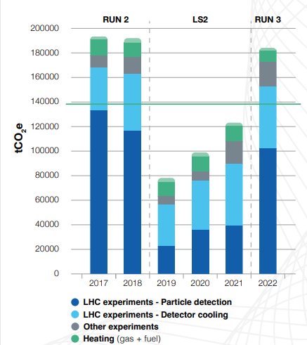
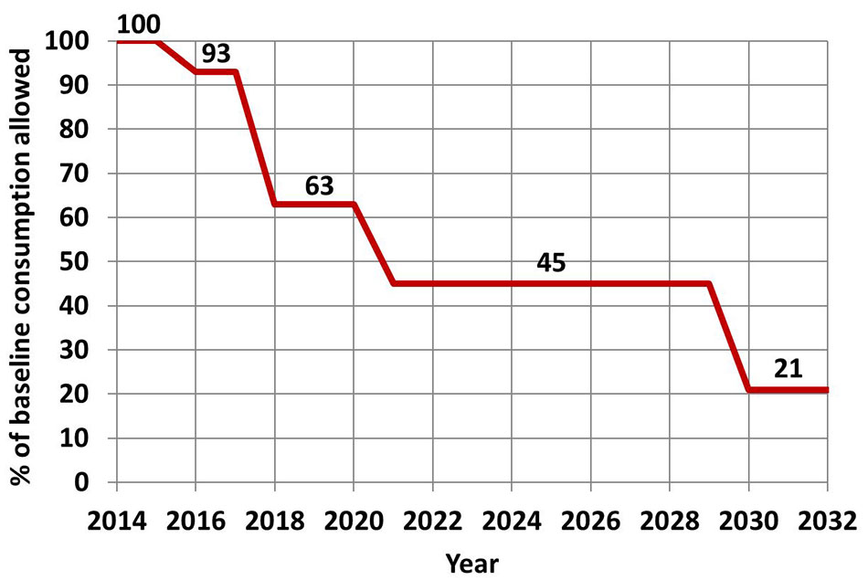
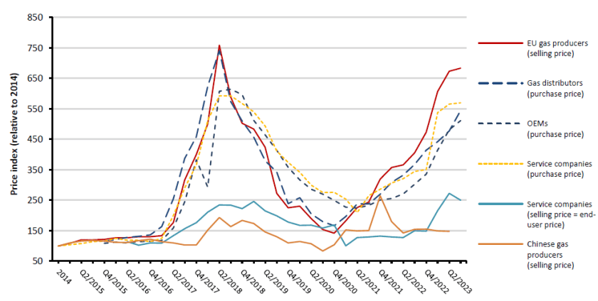
GHGs consumption and cost at CERN
https://doi.org/10.25325/CERN-Environment-2023-003
CERN scope 1 emissions for 2017-2022
The use of gas mixtures containing fluorinated compounds account for about 78% of the Organization’s direct emissions
CERN’s objective is to reduce its GHGs emissions by 28% by the end of Run 3 (baseline 2018)
Thanks to the strategies adopted for reducing the emissions, the intense campaign performed during LS2 to repair leaks, especially in CMS and ATLAS, R&D activity (Gas recirculation, Gas recuperation and new more eco friendly mixtures), for the first months of Run 3 the emissions due to particle detectors decreased respect to Run 2
% GHG consumption reduction respect to 2009-2019 consumption (EU ETS)
Since 2014 new EU legislation →
Since 2021 the GHG consumption allowed is 45% respect to the average 2009-2012 consumption
F- gases banned if more eco friendly alternatives are available
New strategies for controlling and preventing emissions
Average R134a price variation in EU (from 2014)

Slide 8
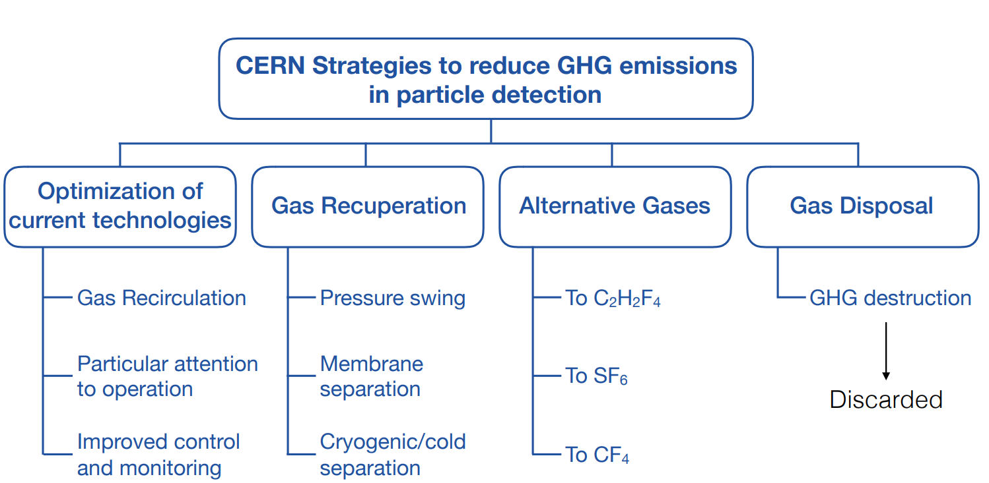
CERN strategies for reducing emissions of GHGs
In collaboration with Experiments and the CERN Environmental Protection Steering board

Slide 9
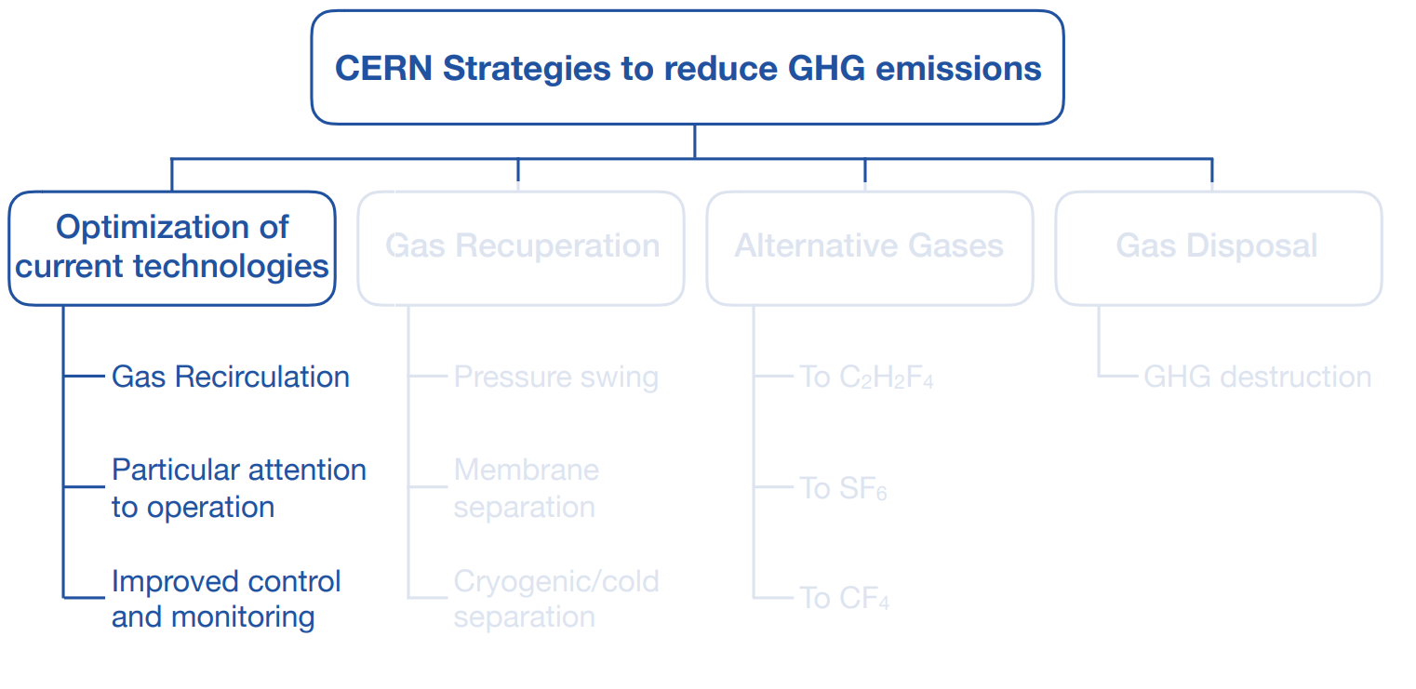
CERN strategies for reducing emissions of GHGs

Slide 10
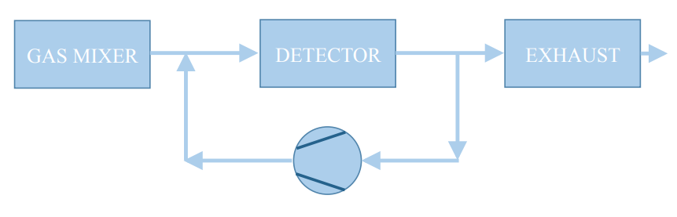
Gas Recirculation
PROS
  Reduction of gas consumption
CONS
  Lot of parameters need to be controlled, as flow, pressure, etc.
  Accumulation of impurities such as fluorides (if fluorinated compounds are present in the gas mixture), oxygen and nitrogen
  Additional modules to the gas system in order to purify the gas mixture

Slide 11
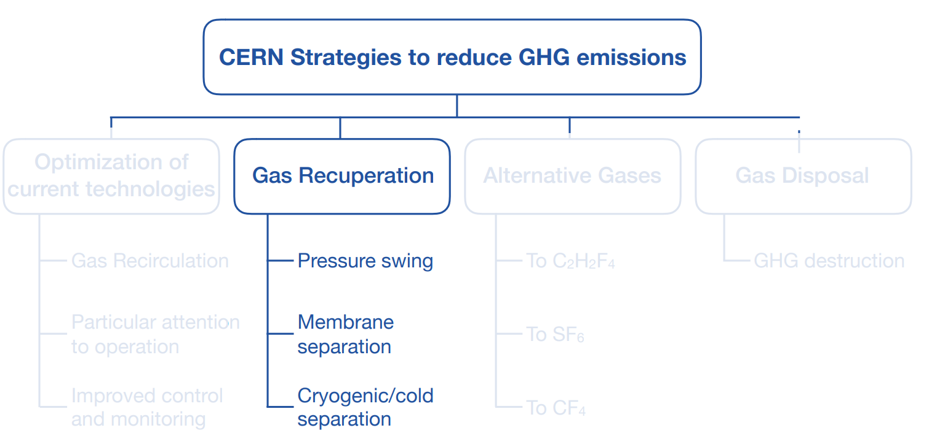
CERN strategies for reducing emissions of GHGs

Slide 12
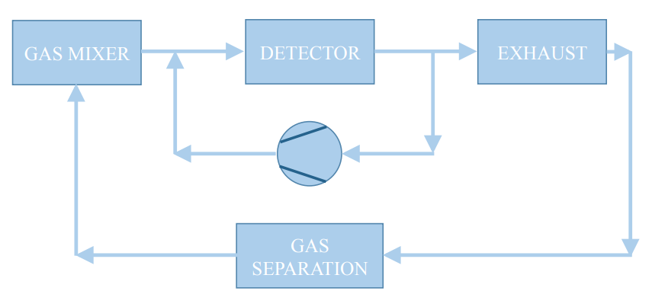
Gas Recuperation
Some detectors cannot work with a 100% recirculated flow, usually for air accumulation in the gas mixture
Most of the systems work with a recirculation fraction of 90% (detector requirements) → 10% sent to the atmosphere
In some cases, this gas is sent to recovery plants where the GHG is separated from the other components, stored and then re-injected in the mixer through a dedicated line
PROS
  Further reduction of gas consumption
CONS
  Higher complexity
  R&D activities to design custom made systems, maintain and improve the efficiency
  Gas analysis to monitor the quality of recuperated gas
Notes:
Togliere testo

Slide 13
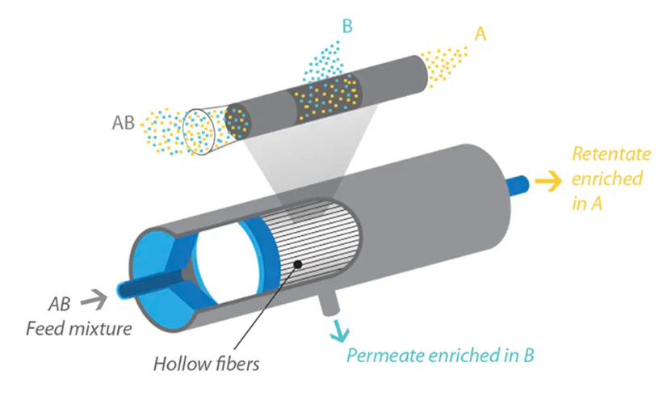
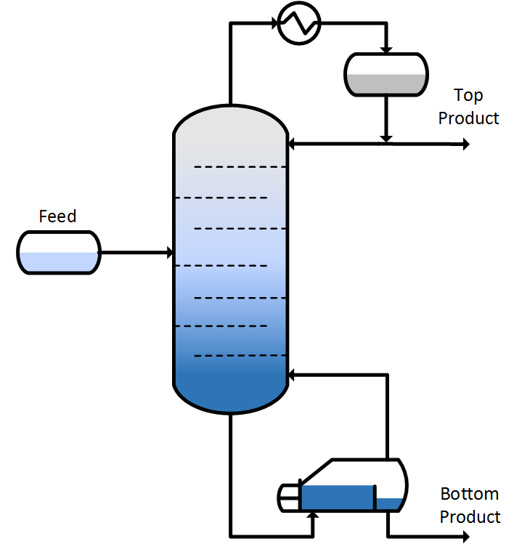
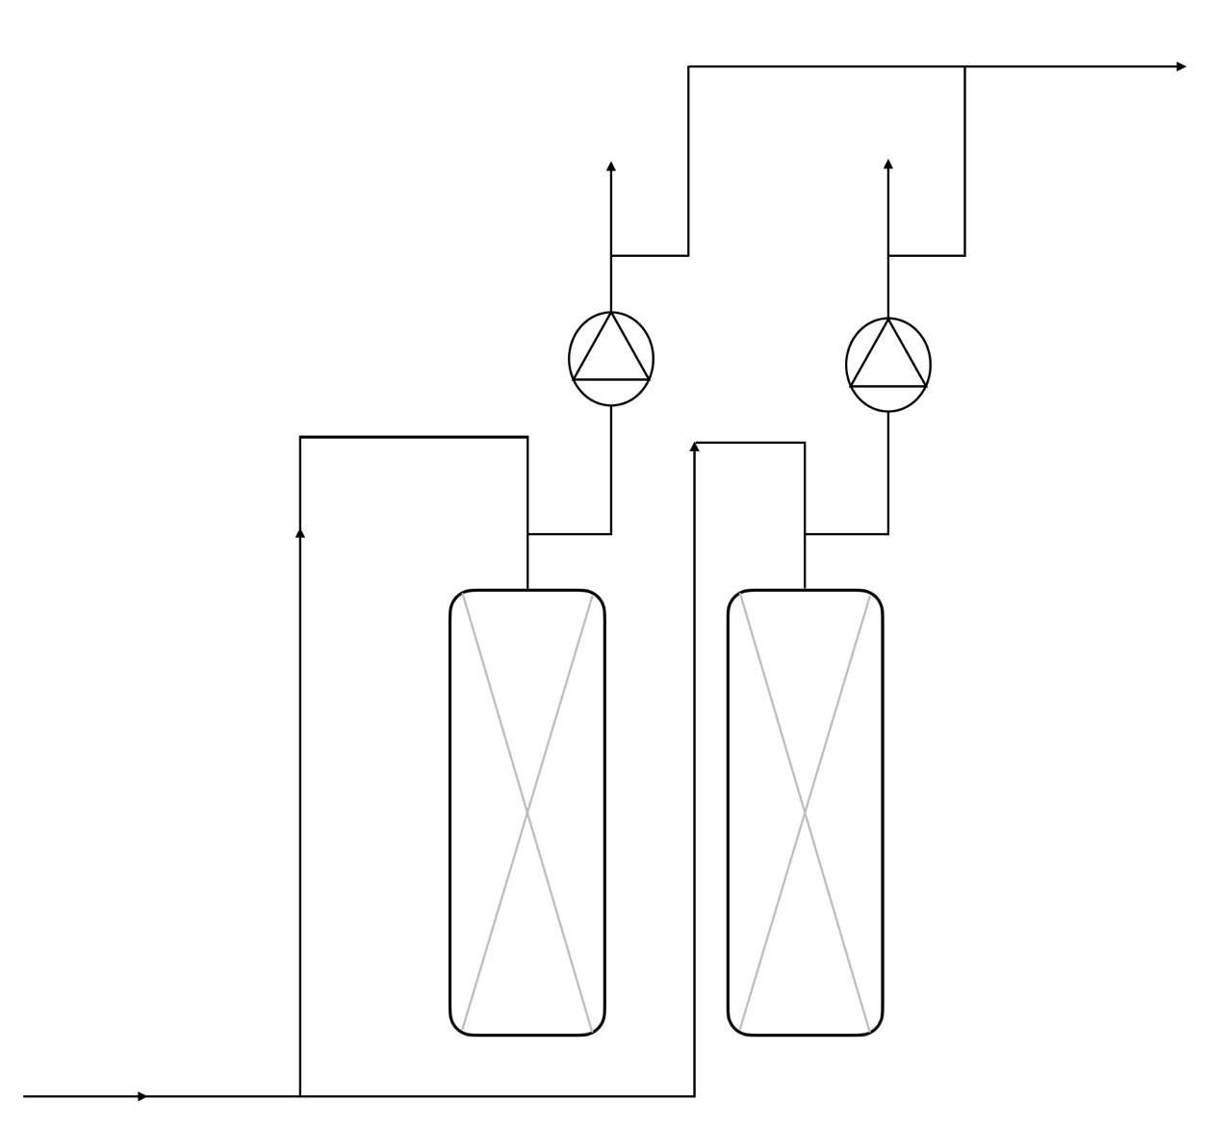
Gas separation techniques
PRESSURE & THERMAL SWING ADSORPTION (PSA & TSA)
MEMBRANE SEPARATION
DISTILLATION
ABSORPTION
DESORPTION
CMS CSC CF₄
LHCb RICH2 CF₄
CMS RPC R134a
CMS RPC SF₆
Old LHCb RICH1 C₄F₁₀
New LHCb RICH1 C₄F₁₀
CMS CSC CF₄
LHCb RICH2 CF₄
Old LHCb RICH1 C₄F₁₀
Notes:
Aggiungere absorber

Slide 14
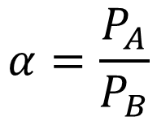
Gas separation techniques
Membrane separation
Separation process is driven by →
  Partial pressure gradient
  Nature of membrane (chemical structure)
  Permeability (P) → capability of a membrane to permeate gas molecules
  Solubility (S) →thermodynamic parameter given the amount of penetrant absorbed by membrane
  Diffusivity (D) → dependent on geometry of penetrant: if molecular size increases the coefficient decreases
Transport of gas is described by the solution-diffusion mechanism → difference in thermodynamic activities existing across the membrane and interacting forces working between membrane material and permeating molecules
$$P=Diffusivity \left(D\right) ×Solubility (S)$$
$$α=\frac{P_{A}}{P_{B}}$$
Permeability A
selectivity
Permeability B
Ability of a membrane to separate two molecules
Notes:
Aggiungere absorber

Slide 15
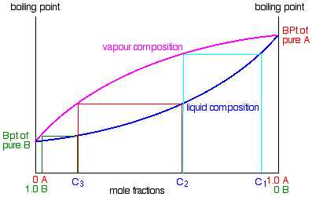
Gas separation techniques
Distillation
Purification method to separate 2 or more compounds based on differences in boiling points or volatility
The composition of vapor phase depend on the initial one of the liquid phase →
lighter (lower-boiling) component tend to concentrate in vapor phase
heavier (higher-boiling) component tend toward the liquid phase
Simple distillation → Can be used when the components have widely different boiling points (>100˚C)
Typical liquid-vapor plot
Fractional distillation → Subsequent vaporization-condensation event (called a "theoretical plate"), and each event enriches the distillate in the lower boiling component. Specific packed columns are used for this purpose
Schematic view of a distillation column
Notes:
Aggiungere absorber

Slide 16
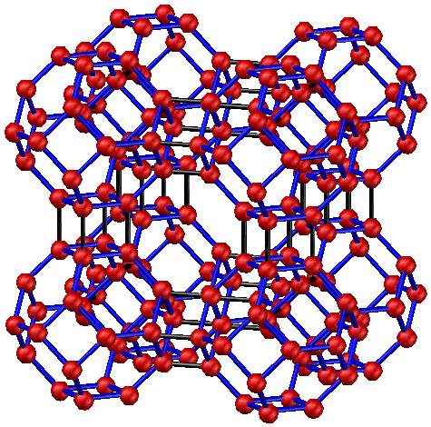
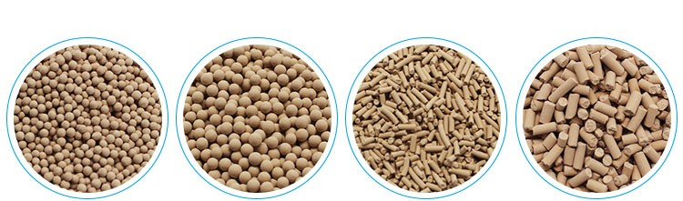
Gas separation techniques
Thermal Swing Adsorption & Pressure Swing Adsorption
MS 3A
MS 4A
MS 5A
MS 13X
Crystalline metal aluminosilicates having a three-dimensional interconnecting network of silica and alumina tetrahedra
Structure model of 4Å molecular sieve
THERMAL SWING ADSORPTION (TSA) → After the contaminants have been absorbed, the sieve bed is heated, usually using a clean hot stream of pure gas, to regenerate the MS for reuse. Then it is cooled down to restart the process. Temperature regeneration is the most effective one.
PRESSURE SWING ADSORPTION (PSA) → gas feed stream fed to the sieve beds at high pressure and then the sieve bed pressure is reduced to regenerate the MS and remove adsorbent contaminants. Vacuum regeneration has the advantage of not overheating the material, avoiding break down processes.
ABSORPTION
DESORPTION
Schematic view of an absorber module of gas system
Notes:
Aggiungere absorber

Slide 17
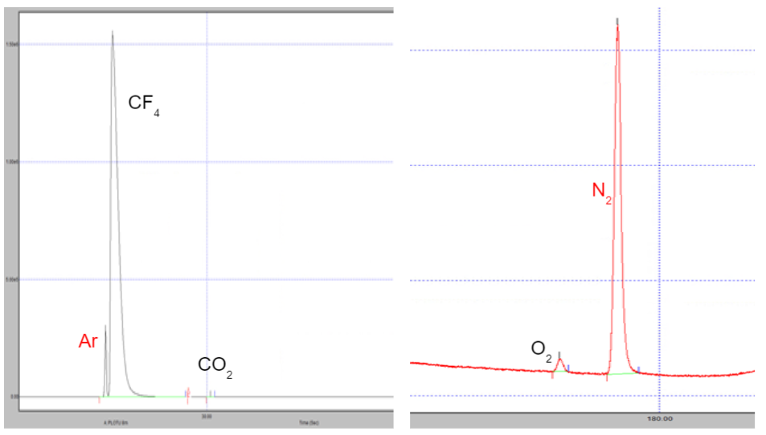
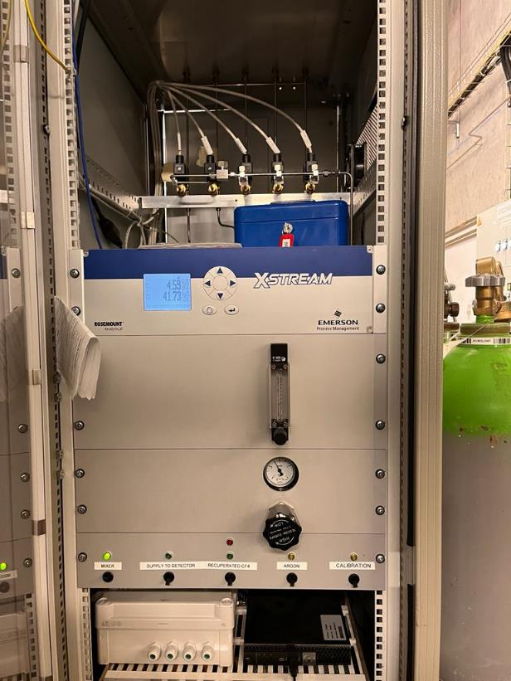
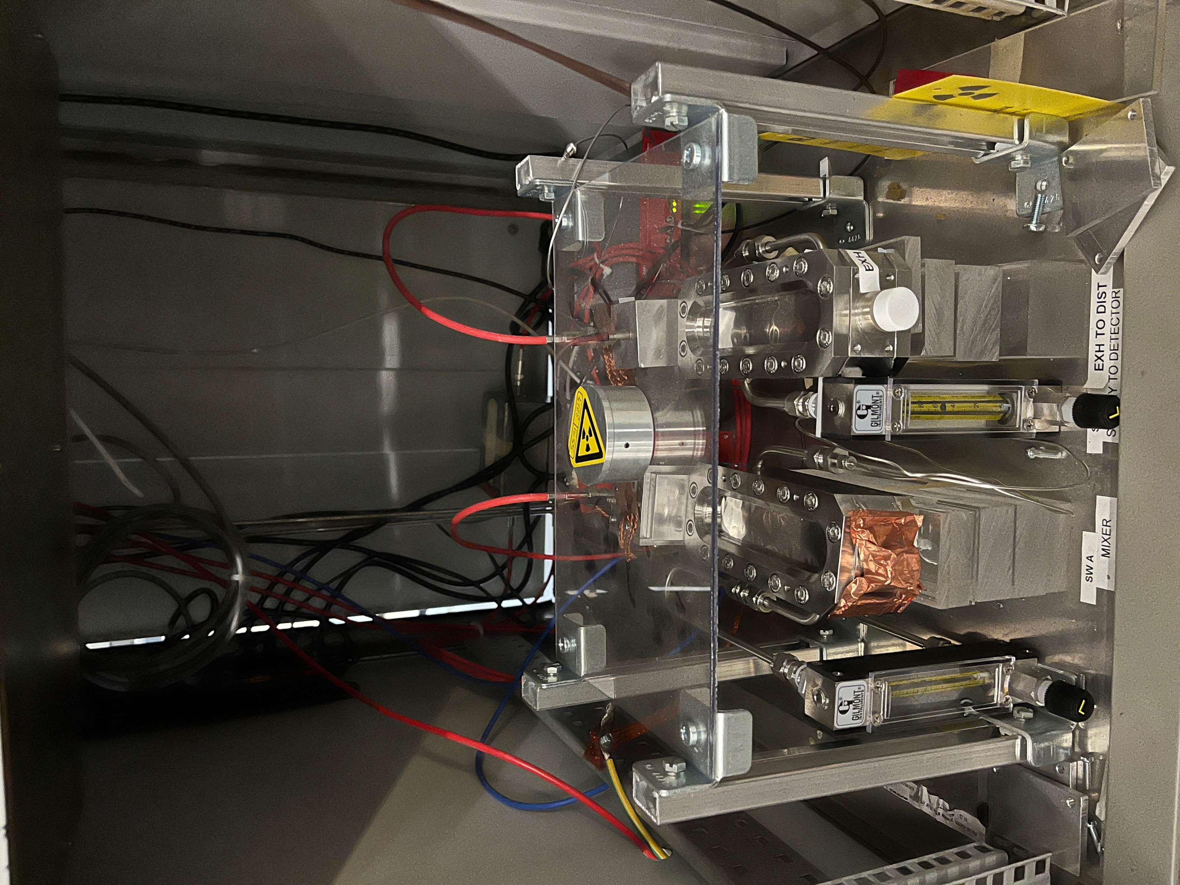
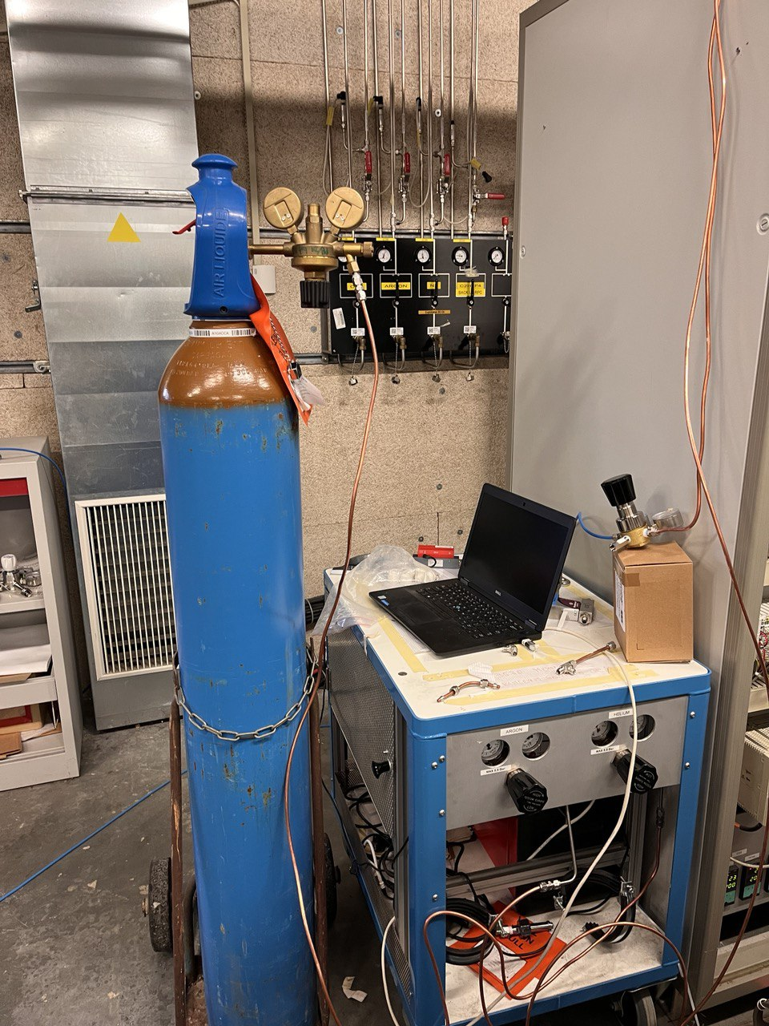
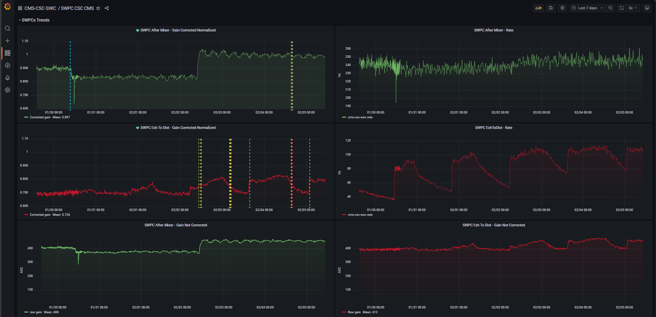
Monitoring of gas quality
Gas recirculation and gas recuperation systems imply the need to monitor both the quality of the recuperated gas and the gas circulating in the loop
uGC analysis
IR analysis
Detector based analysis
Notes:
Aggiungere absorber

Slide 18
CMS CSC CF₄ Recovery system

Slide 19
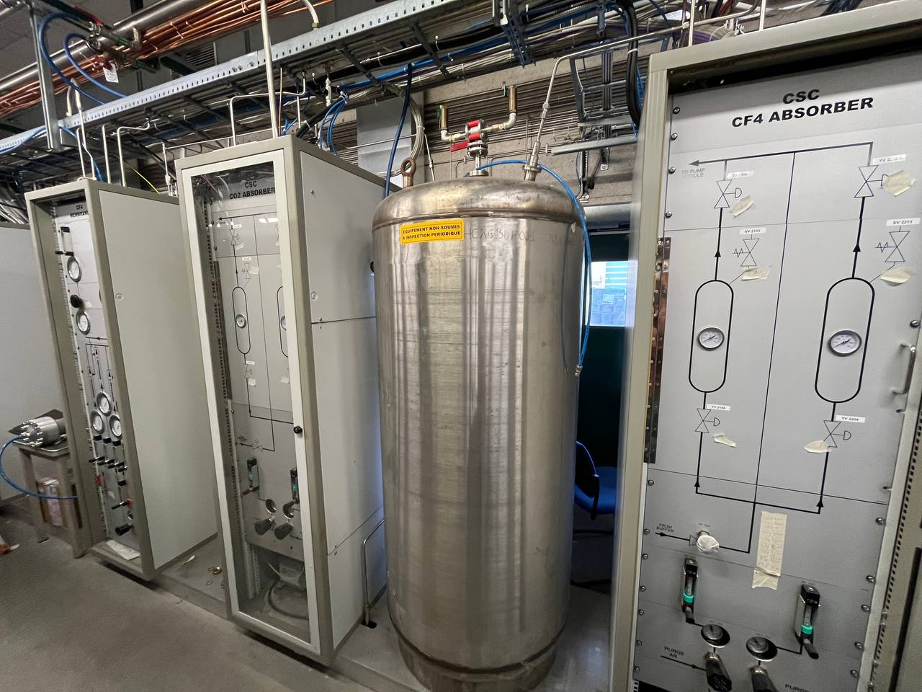
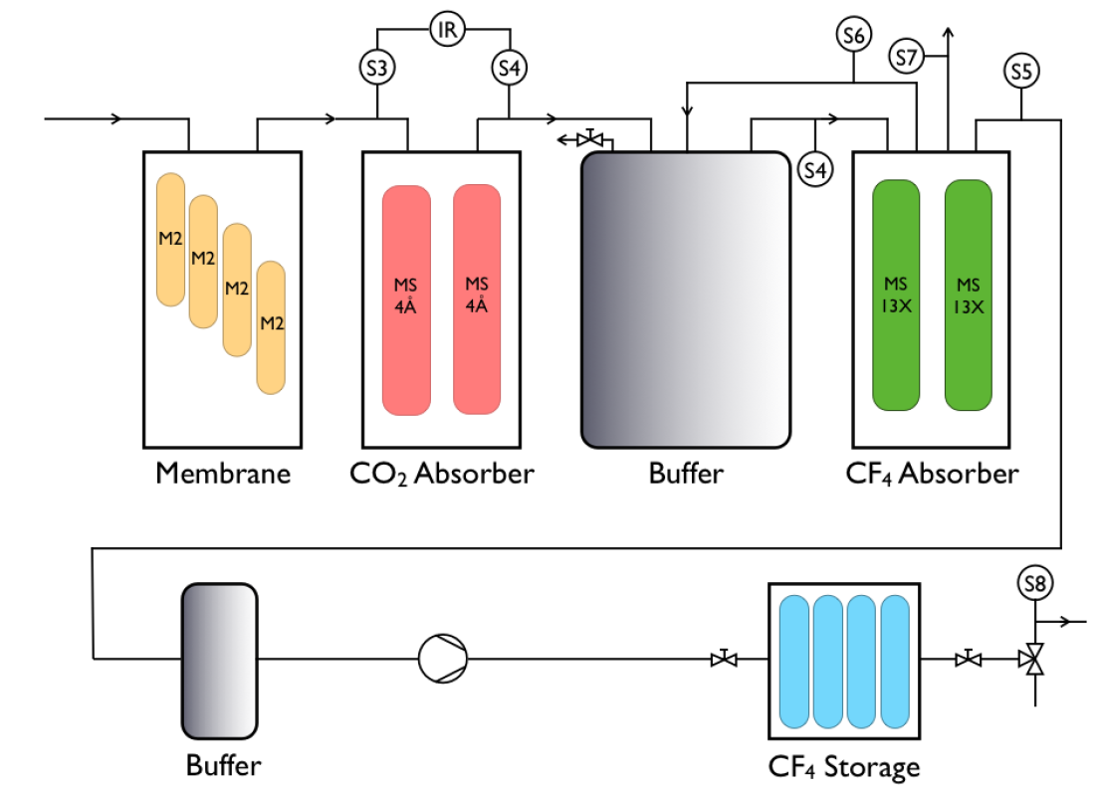
CF₄ recovery plant
Overview
First plant for CF₄ warm adsorption,
non-standard gas system
Gas mixture to separate
Ar/CO₂/CF₄ : 40/55/5 or 40/50/10
Full software control on plant parameters
Modules:
  Input to plant
  Membrane separation module
  CO₂ adsorption module
  CF₄ adsorption module
  CF₄ compression module
  CF₄ injection module
  Infrared analysis module
  SWPC monitoring module
Plant operational since 2012,
a lot of tuning and upgrades realized

Slide 20
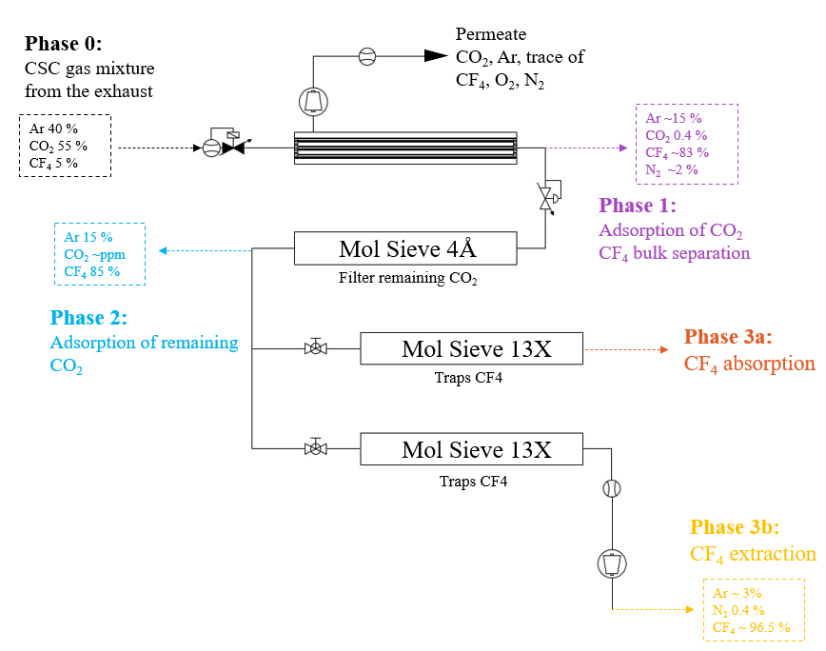
CF₄ recovery plant
Recuperation process
Phase 0 → CSC gas mixture is injected in the first module of the recovery system from the Exhaust module
Phase 1 → the gas passes through the membrane module optimized for the CO₂ separation; CF₄ is recovered at the retentate side with 15% of Ar, 0.4% of CO₂ and 2% of N₂
Phase 2 → All the remained CO₂ is absorbed in the MS 4Å
Phase 3 → CF₄ is absorbed in the MS 13X, N₂ and Ar are vented and the CF₄ is then recovered through pressure swing adsorption
Phase 4 (3b) → CF₄ is extracted and stored in the battery, ready to be reinjected in the mixer
Main contaminants: O₂ and N₂
Ar ~ 10%
CF4 ~ 89.6%
N2 ~ 0.4%

Slide 21
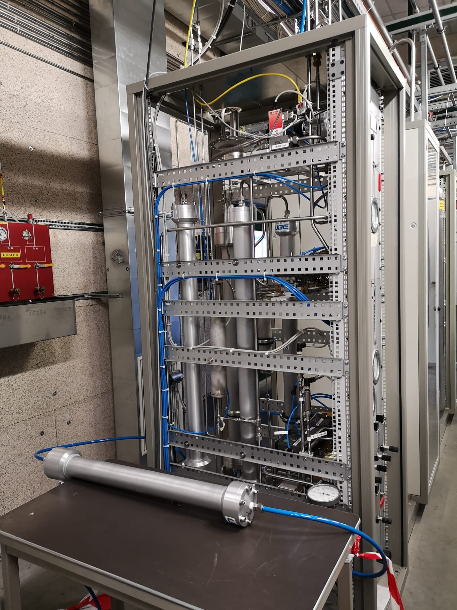
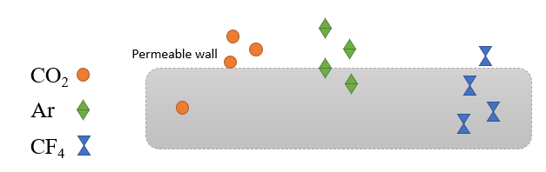

CF₄ recovery plant
R&D Membrane module
 | Model | Working flow | Specifications
Membrane 1 | CO-C10 | Up to 300 l/h | High thickness and density gradient
Membrane 2 | CO-C10A | Up to 300 l/h | High thickness and density gradient
Membrane 3 | CO-C10A | Up to 300 l/h | High thickness and density gradient
Membrane 4 | CO-410A | More than 600 l/h | High thickness and density gradient
Memb. Highly sensitive | CO-C07FS | Up to 300 l/h | Reduced thickness and density gradient
Feed
Retentate (positive pressure)
$ε$= $\frac{{\text{Φ}CF}_{4 retentate side }}{\text{Φ}{CF}_{4 feed}}$
Permeate (negative pressure)

Slide 22
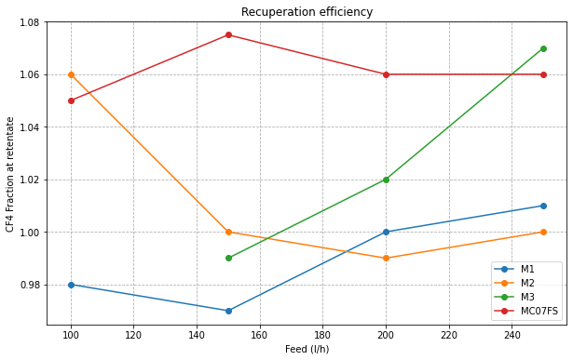
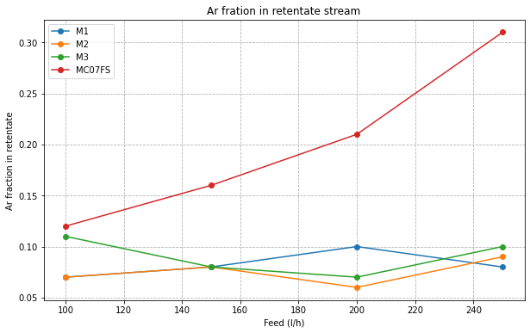
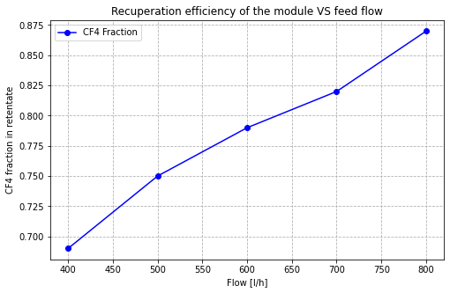
CF₄ recovery plant
R&D Membrane module - Results
Ar fraction in retentate stream is a contamination of our recuperate gas → C07FS not good for our purpose
Increasing the feed flow, the recuperation efficiency increases for all the membranes tested
The general efficiency of membrane module increase with the feed flow → smoothing and stabilization of CSC exhaust flow
Notes:
Sistemare asse y

Slide 23
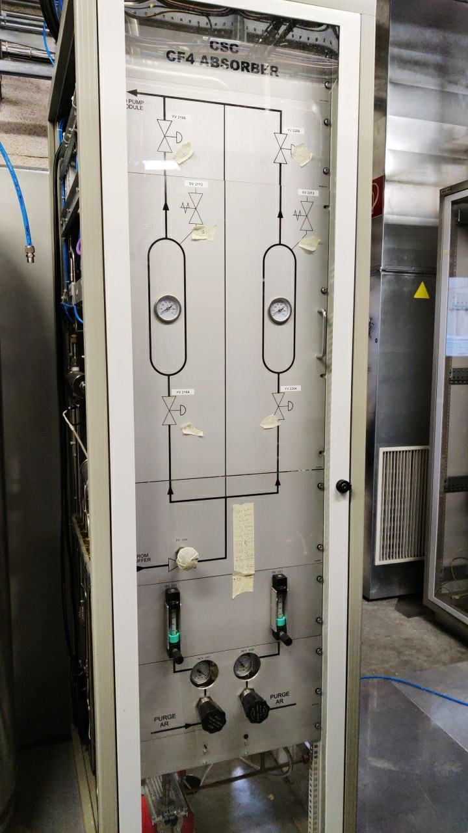
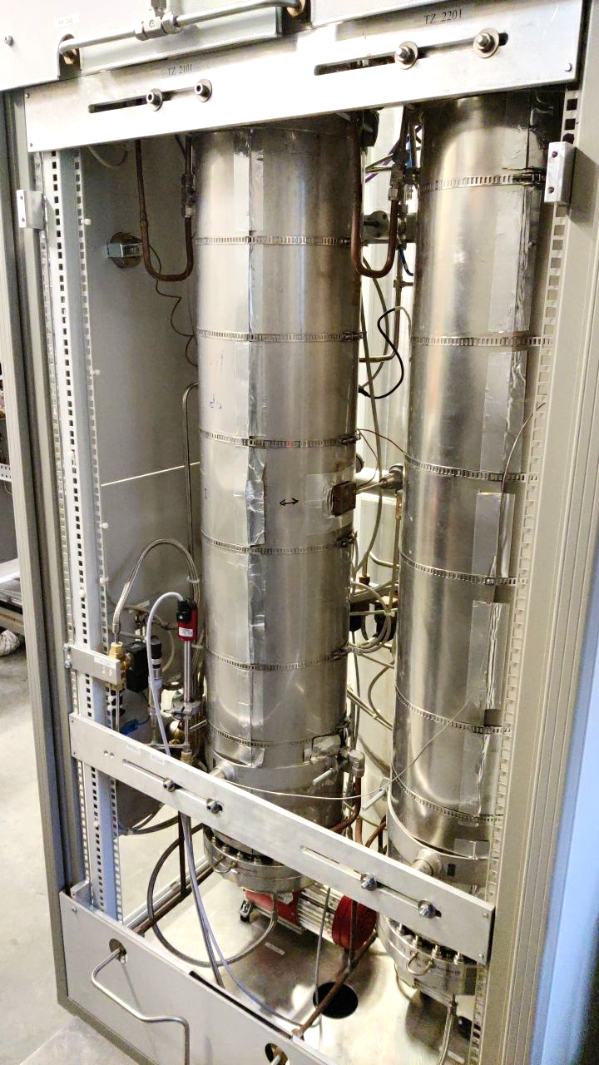
CF₄ recovery plant
R&D CF4 13X Absorber Module
Last separation module of CF₄ recovery system
Molecular sieve 13X
Working principle: Pressure swing adsorption
4 steps at 4 different pressure values:
  Column filling (from -0.9 barg to -0.050 barg)
  Separation phase
  Venting of components not absorbed by MS (from-0,050 barg to -0.450barg)
  Emptying of column (from -0.45barg to -0.9 barg)

Slide 24
CF₄ recovery plant
R&D CF₄ 13X absorber module - Results
Many tests performed to find out the best pressure value to start the CF₄ recovery
Tradeoff between quality of recuperated CF₄ and total recuperation efficiency
ANALYSIS CF₄ ABSORBER
CF₄ RECUPERATION EFFICIENCY
Before optimization
Ar 17.14%
CF₄ 80.95%
O₂ 460 ppm
N₂ 37625 ppm
After optimization
Ar 1.78%
CF₄ 97.16%
O₂ 173 ppm
N₂ 2646 ppm
Before optimization
45%
After optimization
66%

Slide 25
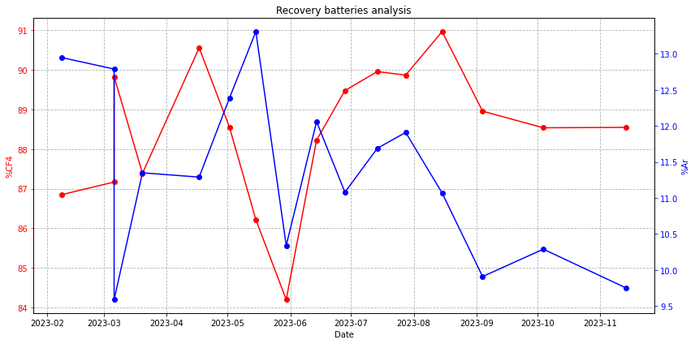
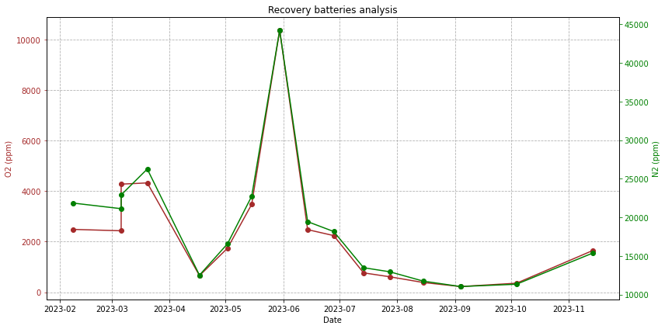
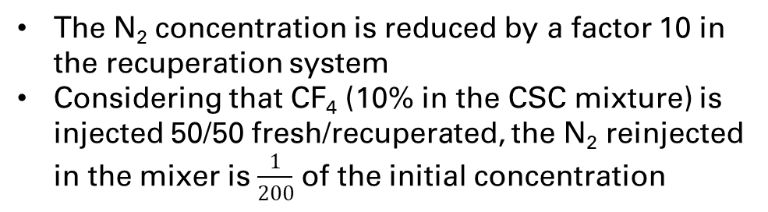
CF₄ recovery plant
Recuperation batteries
Problem with pump module
Problem with pump module
2023-2024 average
composition of the battery
Ar 11%
CF₄ 88%
N₂ 1.9%
O₂ 0.2%
The N₂ concentration is reduced by a factor 10 in the recuperation system
Considering that CF₄ (10% in the CSC mixture) is injected 50/50 fresh/recuperated, the N₂ reinjected in the mixer is $\frac{1}{200}$ of the initial concentration

Slide 26
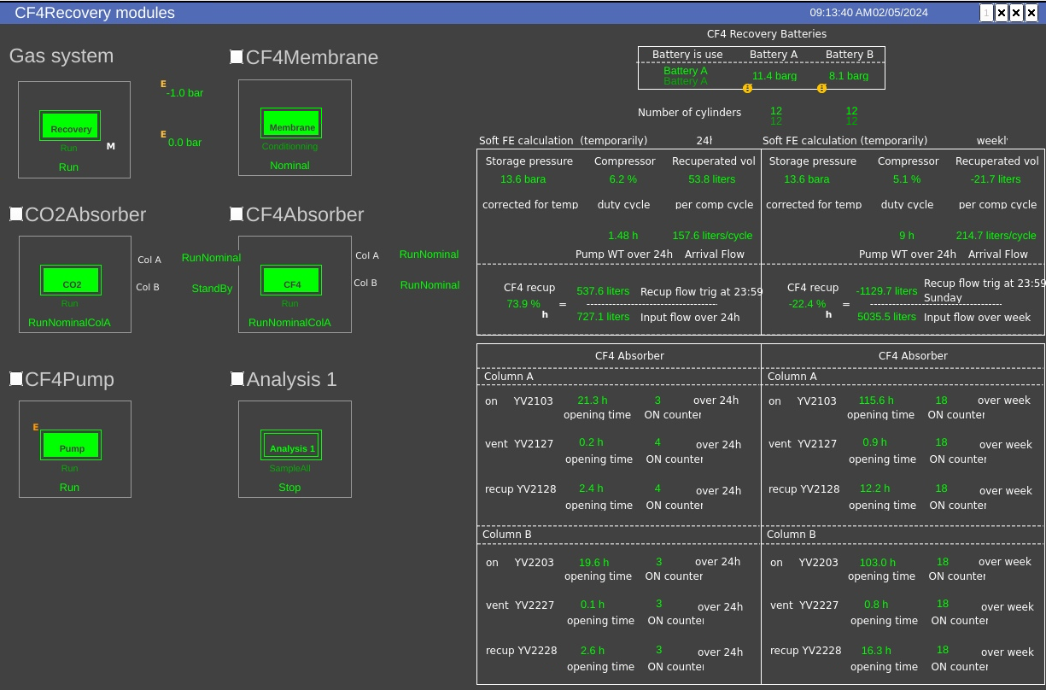
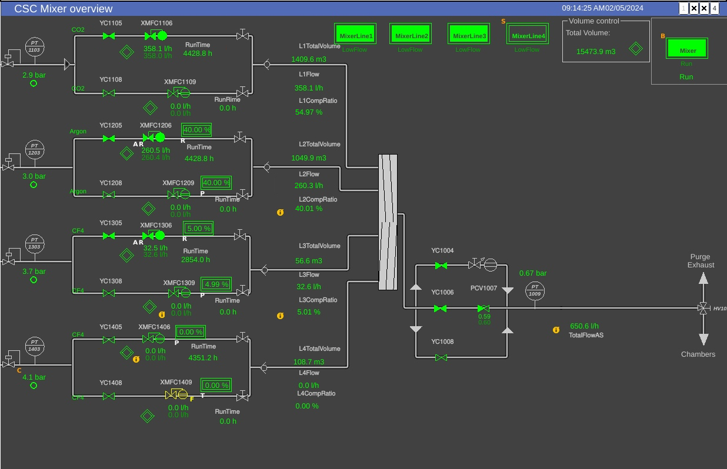
CF₄ recovery plant
Software
Dedicated mixer line for CF₄ recuperated

Slide 27
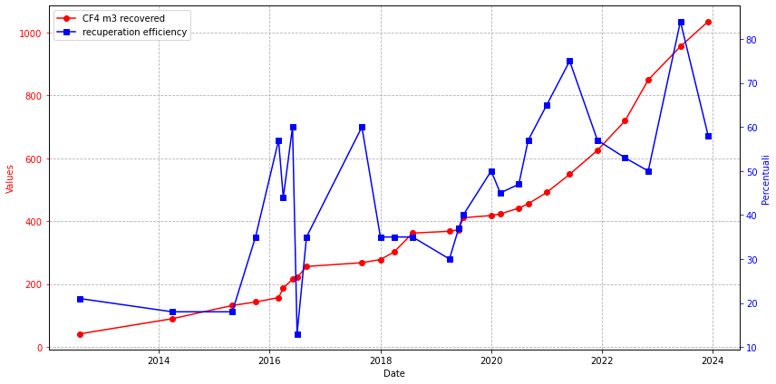
CF₄ recovery plant
Recuperation summary
Efficiency mean value: 70% in the period January-November 2023, (higher than 2021 and 2022, 65% and 51% respectively)
In 2023, out of 358 m³ of CF₄ injected into the mixer, 242 m³ were recovered CF₄ (70%)
2023 → 300m³ and 60kCHF saved
2012 → 42m³
The CF₄ recuperation system is also important to overcome possible CF₄ shortage → in 2023 no fresh CF₄, without CSC no CMS data taking!

Slide 28
LHCb rich2 cf₄ recovery system

Slide 29










LHCb CF₄ recovery plant
Overview
Recovery system used when the detector is filled or emptied
LS2 → detector filled with 100% CO₂
Run 3 → 92/8 CF₄/CO₂
4 volumes of gas needed to have the correct gas mixture in the RICH2, lot of GHG exhausted
Full software control on plant parameters
Modules:
  Input to plant
  Membranes
  Compressor module
  Storage battery
The recovery system is not projected to work in continous since a control of paramaters is needed
Plant Input
Membrane 1
To Purifier/Storage
Pump 1
Membrane 2
Exh
GC
Pump 2
ExhGC

Slide 30
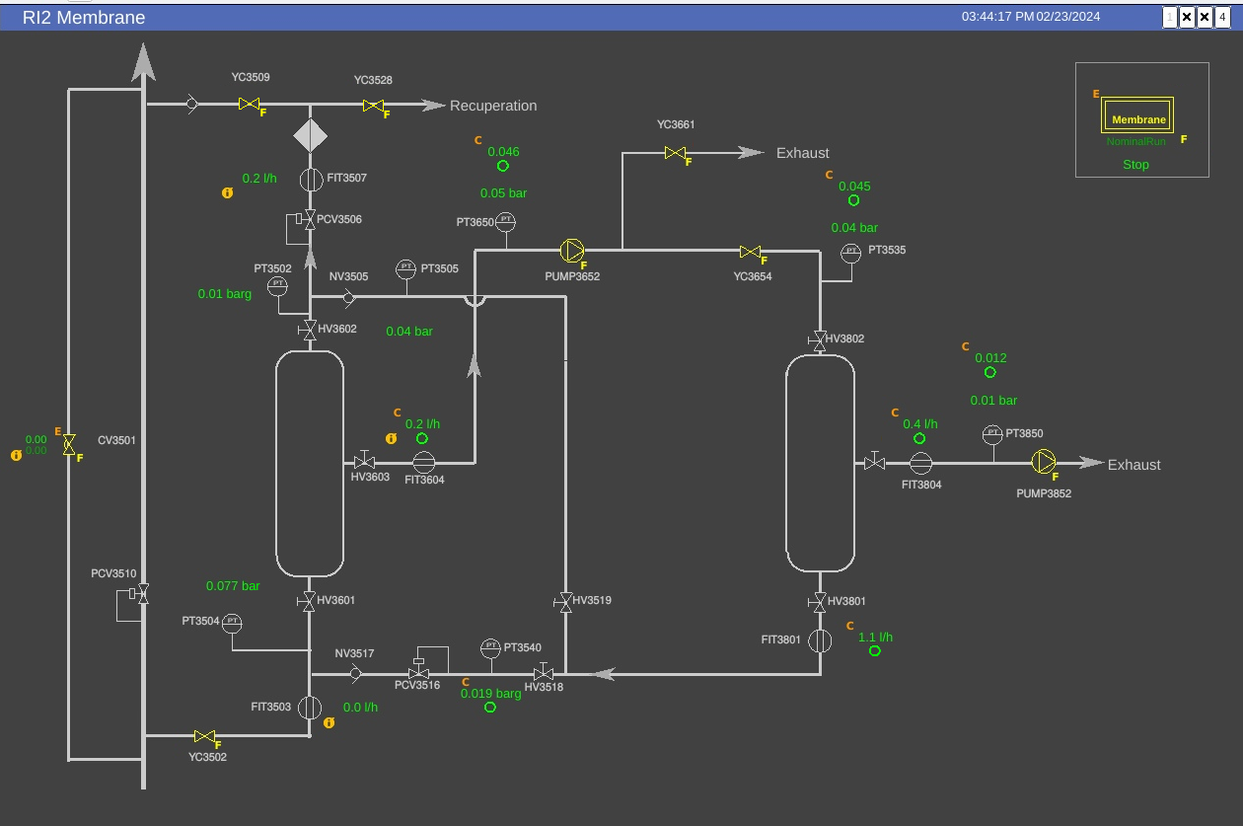
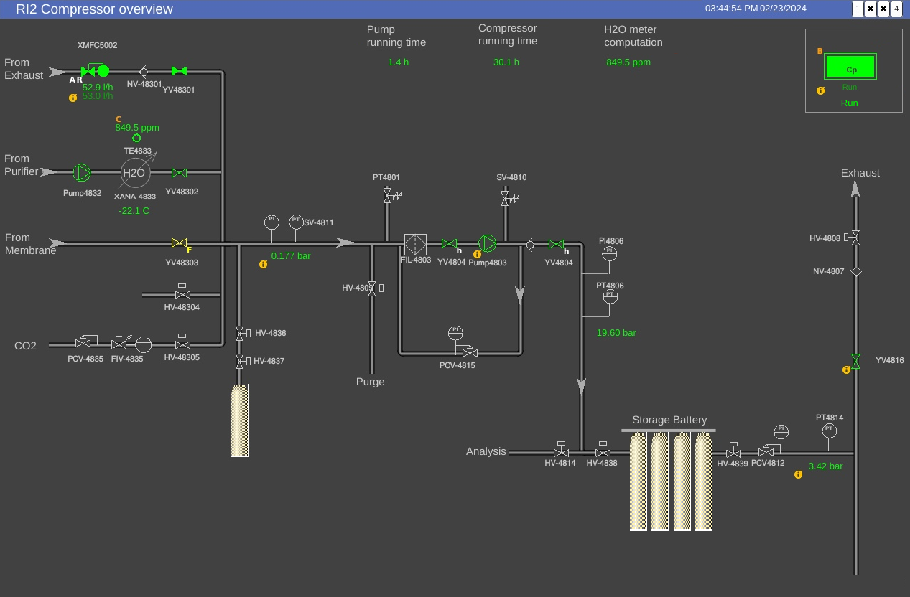
LHCb CF₄ recovery plant
Software

Slide 31
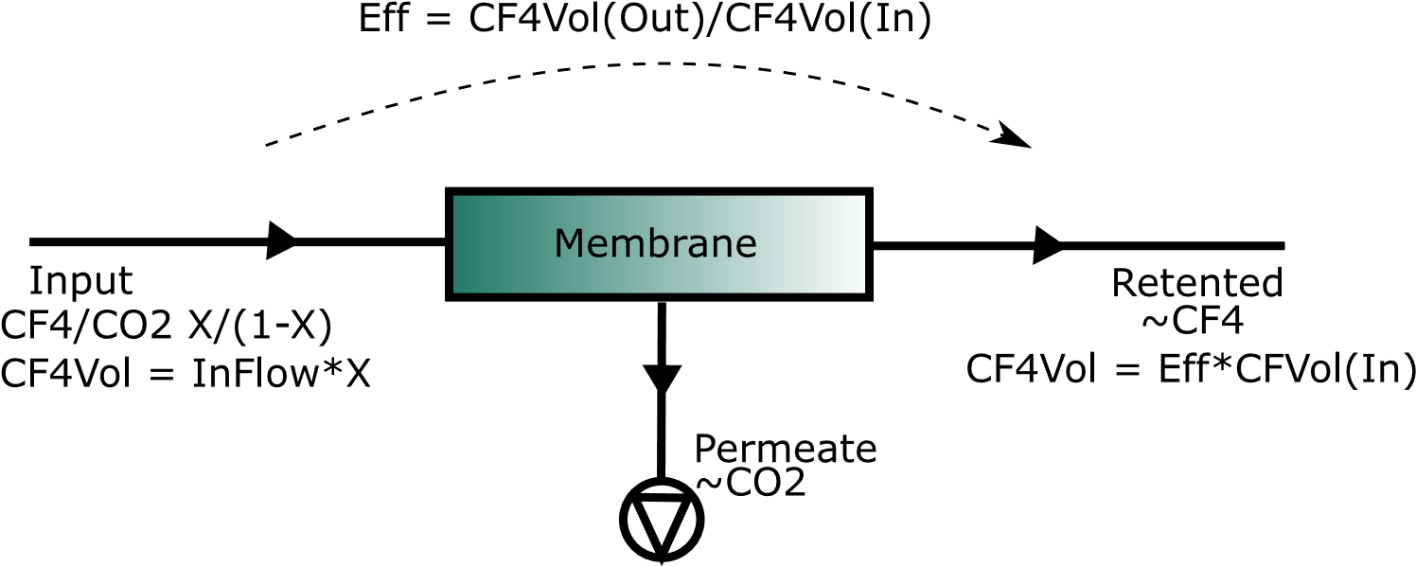
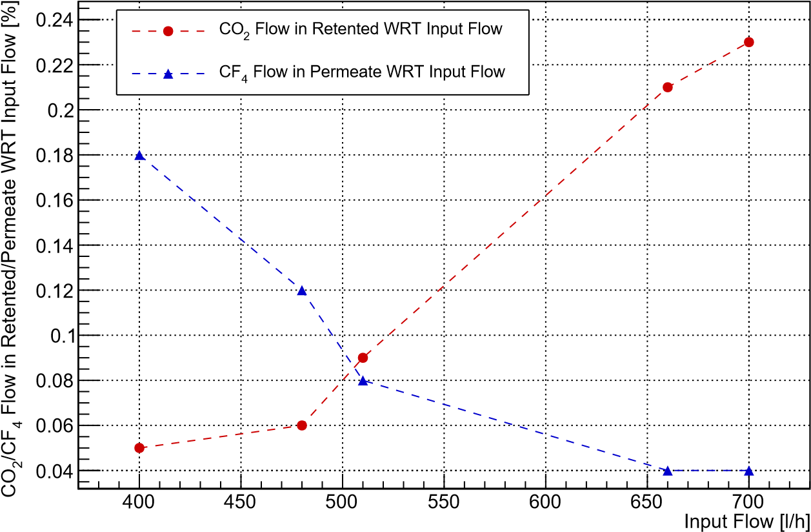
LHCb CF₄ recovery plant
Recuperation setup
Single membrane
Plant Input
Membrane 1
To Purifier/Storage
Pump 1
Double membrane
Membrane 2
Plant Input
To Purifier/Storage
Exh
GC
Membrane 1
Pump 2
Pump 1
Membrane Performance
ExhGC
Membrane 2
Exh
GC
Double membrane with reinjection
Pump 2
Plant Input
Membrane 1
To Purifier/Storage
ExhGC
Pump 1
Membrane 2
Exh
GC
Pump 2
ExhGC

Slide 32
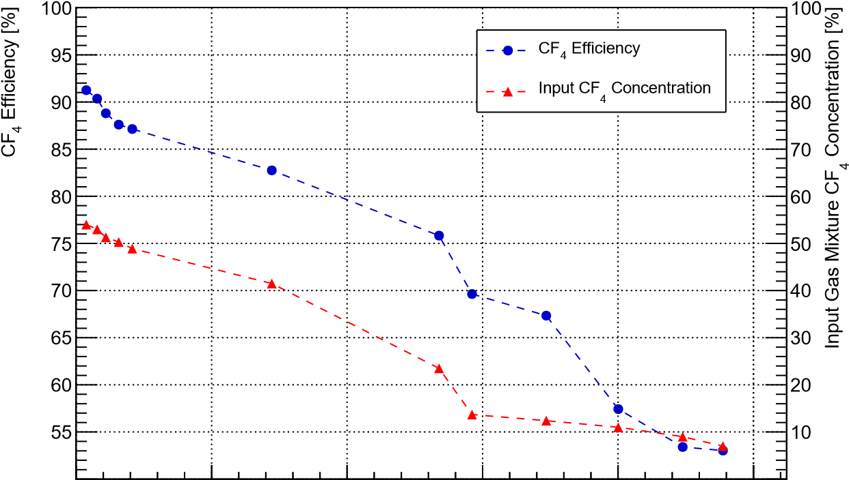
LHCb CF₄ recovery plant
Recuperation process – Emptying
Recuperation started with a composition of 60/40 CF₄/CO₂
Recuperated CF₄ volume
CF₄ Membrane Efficiency
3
]
Volume [m
Membrane Output
30
Storage Battery
4
CF
25
20
15
10
Significant drop in the recuperation efficiency due to CF₄ concentration at the input lower than 20%
5
0
0
100
200
300
400
500
#Hours of Recovery Plant Operation
28.5m³ of recuperated CF₄ at the end of operation
Recuperation efficiency of 65% (lot of CF₄ when gas system turned off before the LS2 due to changing in atmospheric pressure)

Slide 33
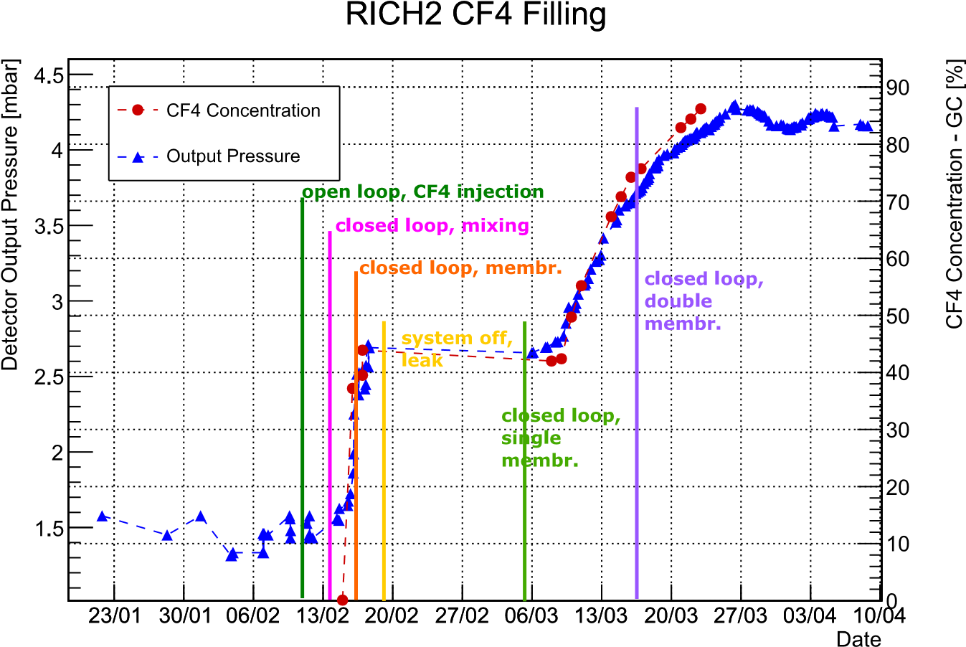






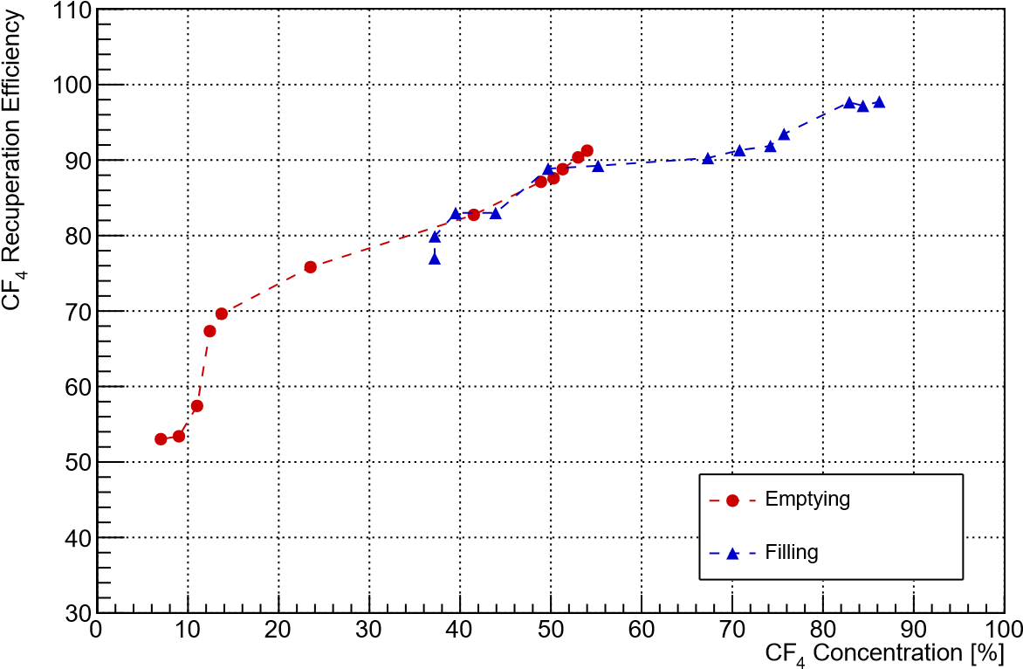


LHCb CF₄ recovery plant
Recuperation process – Filling
PROCESS STARTED IN OPEN MODE
PHASE 1
Exhaust from the top part → almost only CO₂ exhausted
Injection on the bottom part of the detector
RECUPERATION MODE
PHASE 2
CF₄ from retentate side sent back to the loop
Permeate stream exhausted
Increase of CF₄ concentration at the input of the membrane module → Increase of recuperation efficiency
Phase 2 started with 37% of CF₄ in the loop
Single membrane configuration until 70% of CF₄ present in the loop, then double membrane configuration to recover the huge volume of CF₄ in the permeate stream

Slide 34
LHCb rich1 c₄f₁₀ recovery system

Slide 35
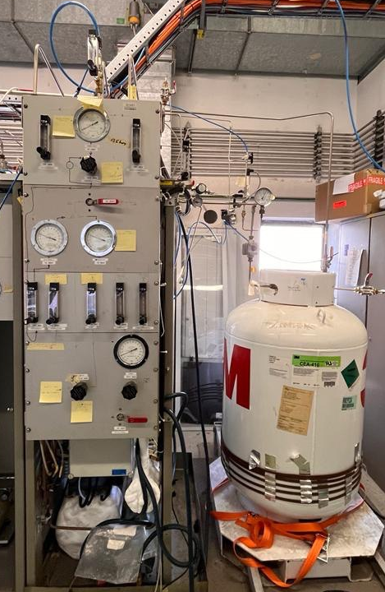
C₄F₁₀ recovery plant
Overview
Recovery system used for detector filling, emptying or cleaning
Old recuperation system used for DELPHI
→ New recuperation system installation by end of 2024
LS2/EYETS → detector filled with 100% CO₂
Run → 100% C₄F₁₀
2 volumes of gas needed to have the correct gas in the RICH1, lot of GHG exhausted
Some parameters can be controlled by software but lot of manual control needed → operator must be there during operation
Modules:
  Input to plant
  Cold box
  Bottle for recovery and injection
Recuperation is critical due to C₄F₁₀ shortage

Slide 36
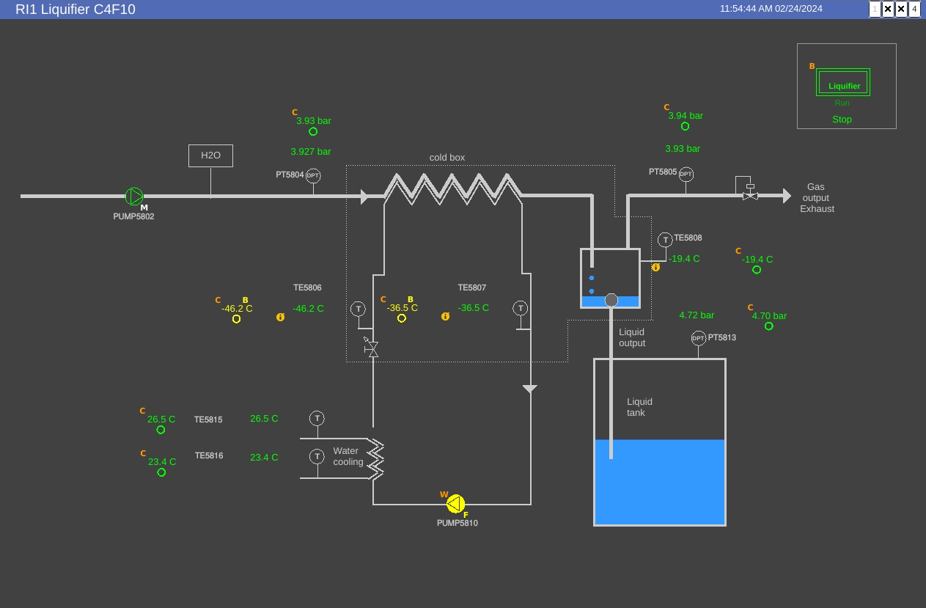
C₄F₁₀ recovery plant
Software

Slide 37
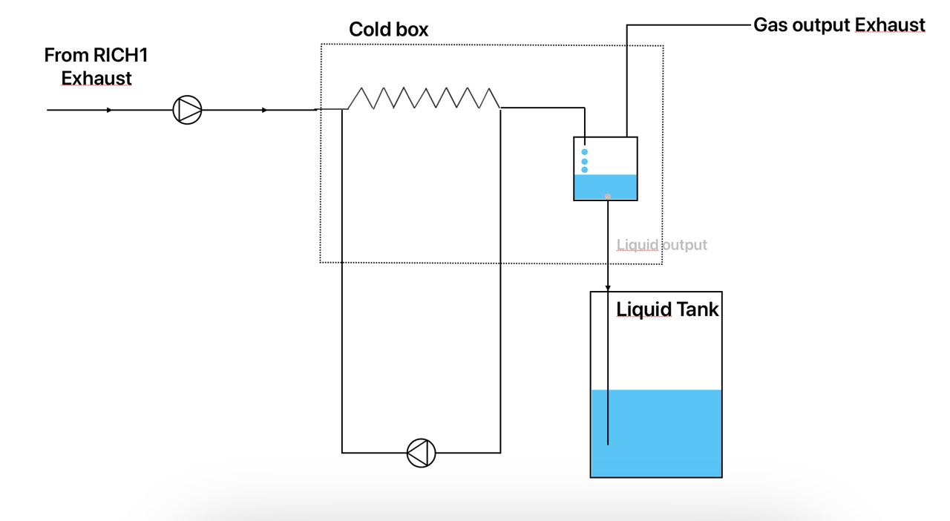

C₄F₁₀ recovery plant
Recuperation setup
Recuperation started with 30% of C₄F₁₀ at the Exhaust
Gas mixture sent to liquifier (-15°C) → C₄F₁₀ liquified, air and CO₂ exhausted to air
Pressure in liquifier set by pressure in the bottle → it must be higher to let the liquid go inside
Due to high pressure (3-5 barg) some CO₂ is solubilized in C₄F₁₀ and then recoverd in the bottle → contamination
Different composition of gas and liquid phase in the bottle

Slide 38


LHCb C₄F₁₀ recovery plant
Recuperation summary
Since Run 3, recuperation procedure done 5 times → 80% of efficiency
The nagative value is due to the fact that the pump is located in the surface gas room while the detector is 100m underground.
The pressure changes based on the ratio between the two gases
Some C₄F₁₀ lost to the exhaust of liquifier due to a lack of software control on the recovery system

Slide 39


C₄F₁₀ recovery plant
New recovery systems
Double Stage Equilibrium
(conservative approach since ~equal to present system)
Distillation Columns
(better performance expected, but more difficult to tune)

Slide 40
CMS rPC R134a recovery system

Slide 41

RPC R134a RECUPERATION
Plant Overview
New system installed in April 2023 and commissioning in May 2023
Goal: to recover the R134a from the mixture R134a/SF₆/iC₄H₁₀ 95.2/0.3/4.5
Problem: R134a forms an azeotrope with iC₄H₁₀
2 racks for the separation columns, 4 columns
The system was designed to work both in series and in parallel
The plant was designed following the tests done with prototype between 2020 and 2022
SEPARATION MODULES
COMPRESSOR
ELECTRICAL RACK
CHILLER

Slide 42


RPC R134a RECUPERATION
Software
Dedicated mixer line for R134a recuperated

Slide 43

RPC R134a RECUPERATION
Separation process
Azeotrope → mixture that exhibits the same concentration in the vapor phase and the liquid phase. This contrasts with ideal solutions with one component typically more volatile than the other
Slow heating of liquified azeotrope (blue curve) allows to enrich the liquid of R134a and the vapor phase of iC₄H₁₀
Thermodynamic simulation done by M. Bruno (PoliTO)

Slide 44

RPC R134a RECUPERATION
Plant Overview
Optimal conditions:
  Filling rate → 200 l/h up to 600 l/h
  Chiller Temp. → -36.2°C
  Top buffer P → 10 mbar (C1&C2), 35 mbar (C3)
  Bottom buffer T → 20°C
  Emptying rate → 600 l/h (air)
FLAMMABLE EXHAUST
Heat exchangers
Top Buffers
Bottom Buffers
Compressor module
80% of Recuperation Efficiency

Slide 45



RPC R134a RECUPERATION
Tests results
Lot of parameters tested for both single columns and entire system
Increasing the feed, more gas is lost at the exhaust due to lower heat exchange
For the same reason, it increases decreasing chiller T
Increasing chiller T, more azeotrope is exhausted and the quality of R134a increases

Slide 46



RPC R134a RECUPERATION
Tests results
When the pressure in the top buffer increases, also the recuperation efficiency increases because less gas is sent to the exhaust line and more is recuperated
The effect is having more iC₄H₁₀ in the recuperated R134a → lower quality
Tradeoff between the two parameters

Slide 47



RPC R134a RECUPERATION
Recuperated R134a Quality
More than 70 tests were performed to find the best parameters for the plant
If we inject 50/50 R134a fresh/recuperated, with a flow of 700 l/h, we will inject:
500 ppm iC₄H₁₀

Slide 48

RPC R134a RECUPERATION
New SF₆ recuperation plant
Studies on SF₆ solubility in R134a ongoing
SF6: 0,126
iC4H10 : 0,22
R134a: 0,62
N2: 0,04
SF6 : 0,591
iC4H10 : 1,27 E-10
R134A : 0,00022
N2: 0,408
Two distillation columns for reasonable reflux ratio (from 140 to 20/20)
output mixture composition:
59% SF₆ , 40% N₂, 1% freon + residue of isobutane
→ Easier to separate in the second stage with a membrane or a MS that are more selective for SF₆ → test ongoing
SF6: 0,013
iC4H10 : 0,7934
R134A : 0,19
N2 : 0,0036
SF6: 0,075
iC4H10 : 0,240
R134a: 0,684
N2: 1,23 E-13
SF6: 0,00189
R134a: 0,85
iC4H10: 0,148
N2: 8,32-09

Slide 49
Conclusions
Common effort for reduction emissions → Gas system Team, Experiments and the CERN Environmental Protection Steering board
Fluorinated gases are responsible for more than 80% of CERN GHG emissions → strategies for reducing them is fundamental
In 2023, 560m³ of GHG were recuperated → 10000 tCO2 → -8% CERN emissions
4 operational recovery systems (2 CMS and 2 LHCb) and a new recovery systems by the end of 2024
New qualified operators for R&D and M&O of recovery systems→ engineers, chemists
Use of recuperation system implies more control on gas quality → daily gas chromatograph analyses and online monitoring systems (e.g., SWPC and IR)
Intense R&D activity to design new custom made recovery systems, improve the recuperation efficiency and the quality of recuperated gases
Recovery systems allowed to overcome critical situations when the new/fresh gas was not available

Slide 50
Thanks for your kind attention

