Slide 1
Synchrotron Radiation in the FCC-ee arcs – update to latest accelerator design
B. Humann, A. Lechner
With many thanks to J. Bauche, L. van Freeden, R. Kersevan, M. Hofer, M. Ady, F. Valchkova-Georgieva
28.02.2024

Slide 2
Aim of updated studies
Studies presented until end of 2023 date back to input from 2020, which is not really representative anymore
Implemented (not so) recent changes:
  Beam separation: 30cm to 35cm
  Vacuum chamber diameter: 70mm to 60mm → compromise for less volume and acceptable performance
  New absorber design (thanks to R. Kersevan)
  More recent optics file:
    Dipole lengths: 19m, 21m, 22m (which can consist of several dipoles connected to each other) → sustainable to work with three different dipole lengths?
    Often only 15cm between the magnets (magnetic length!) → sufficient space between the components when return coils added?
Goal: perform simulations for all operation modes and develop the necessary for shielding.
  Today: Radiation load for ttbar (182.5GeV, 5mA) and Higgs (120GeV, 26.7mA). Baseline absorbers and conceptual shielding design

Slide 3
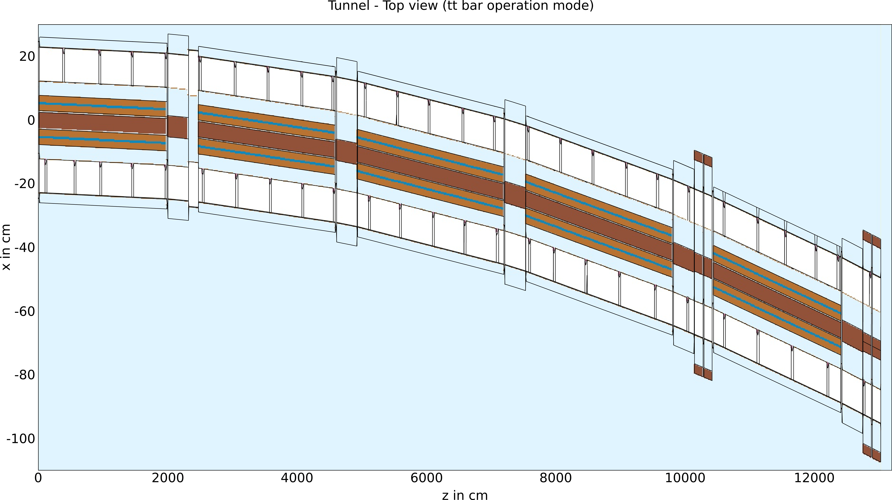
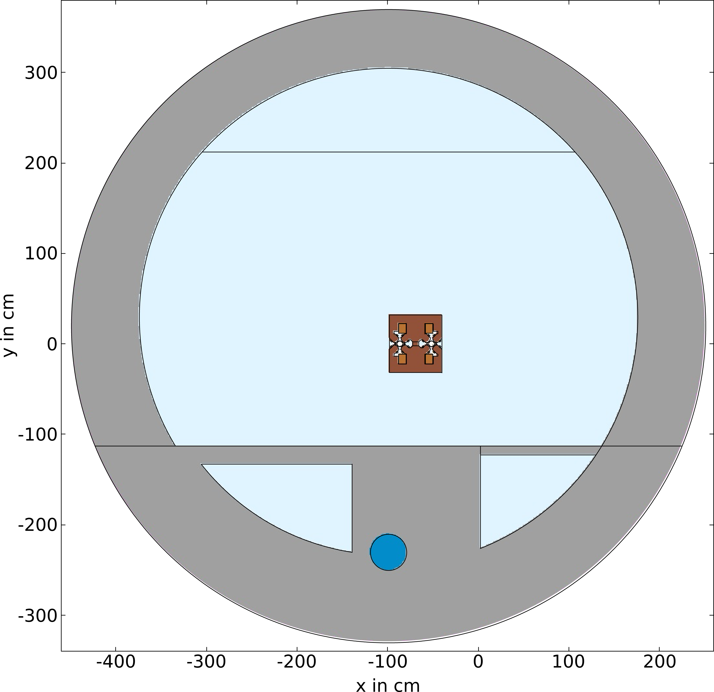
Geometry layout
Tunnel – cross section
130m long half cell
Reinjection of particles at the beginning of the cell as soon as they touch the final plane
No detailed design with cable trays, extraction pipes, etc.
No alcoves yet
Thanks to F. Valchkova for the tunnel layout

Slide 4
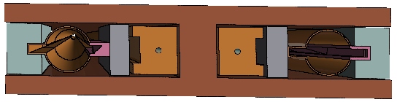
Geometry layout - dipoles
Dipole
5 dipoles in half cell
Iron yoke, copper busbars with water cooling
Two different absorber schemes tested:
Only absorbers (pink)
Absorbers plus tungsten shielding on the external side and lead on the internal side
Thanks to J. Bauche and L.v. Freeden for the magnet design

Slide 5
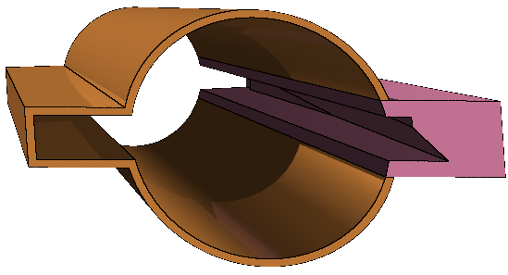
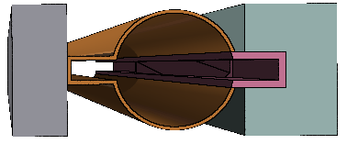
Geometry layout – absorbers
Absorber (ABS)
Approximation of complex geometry
Weight close to the weight of the actual absorber prototypes (1kg)
CuCrZr, 30cm length
60cm length for conceptual shielding
52 ABS¹⁾ for both beams
ABS
Using tungsten and lead for the additional shielding to optimize the cost of the system.
On the external side, where the tunnel environment needs to be protected, tungsten is used due to its better absorption properties.
On the internal side a block of lead is used, as it provides good absorption properties for the busbar protection but is less expensive.
Conceptual shielding
Absorber
ABS + concept. shield
Lead
Tungsten
1) In this geometry there are only 50 ABS, as the last two would have been placed in an MS with too much space constraints
13.3kg
33.5kg

Slide 6
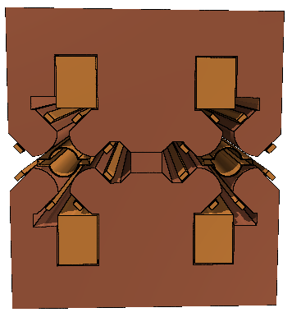
Geometry layout – quadrupoles
Quadrupole
Implemented without return coils
Drift spaces between MQ and MB sometimes only 15cm
One MQ has ABS placed in it
5 MQs in half cell

Slide 7
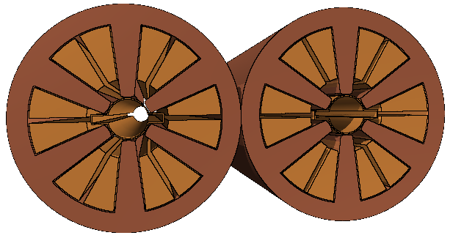
Geometry layout – sextupoles
Sextupole
2x2 MS in the half cell
1.3m length

Slide 8
Absorbed power per half cell for the baseline layout – Higgs vs ttbar
Total power of half cell: 164kW (~100kW of SR for full ring)
By design, the total power distribution is comparable for both operation modes, but the power sharing is different.
Power deposition on the absorbers:
  Higgs: 75% of total power
  ttbar: 71% of total power
  Absorbers are more efficient for Higgs
The impact on the tunnel environment should be studied closely, as 5% (Higgs) and 7% (ttbar) of the total power are deposited there.
The absorbed power on the vacuum chambers is significant. It should be understood, if such values are sustainable
 | Higgs | ttbar
MBs (w/o VC) | 27.1kW | 28.8kW
MB VC | 3.4kW | 4kW
MQs (w/o VC) | 1.5kW | 1.7kW
MQ VC | 0.4kW | 0.4kW
MSs (w/o VC) | 0.01kW | 0.04kW
MS VC | 0.003kW | 0.02kW
ABS (w/o VC) | 118.3kW | 112.8kW
ABS VC | 4.8kW | 4.4kW
Tunnel (Air, Concrete) | 8.7kW | 12.3kW
TOTAL | 164.2kW | 164.4kW
Additional shielding: tungsten block on the external beam absorbs up to 0.7kW, for the other blocks the absorbed power goes up to 0.3kW.

Slide 9
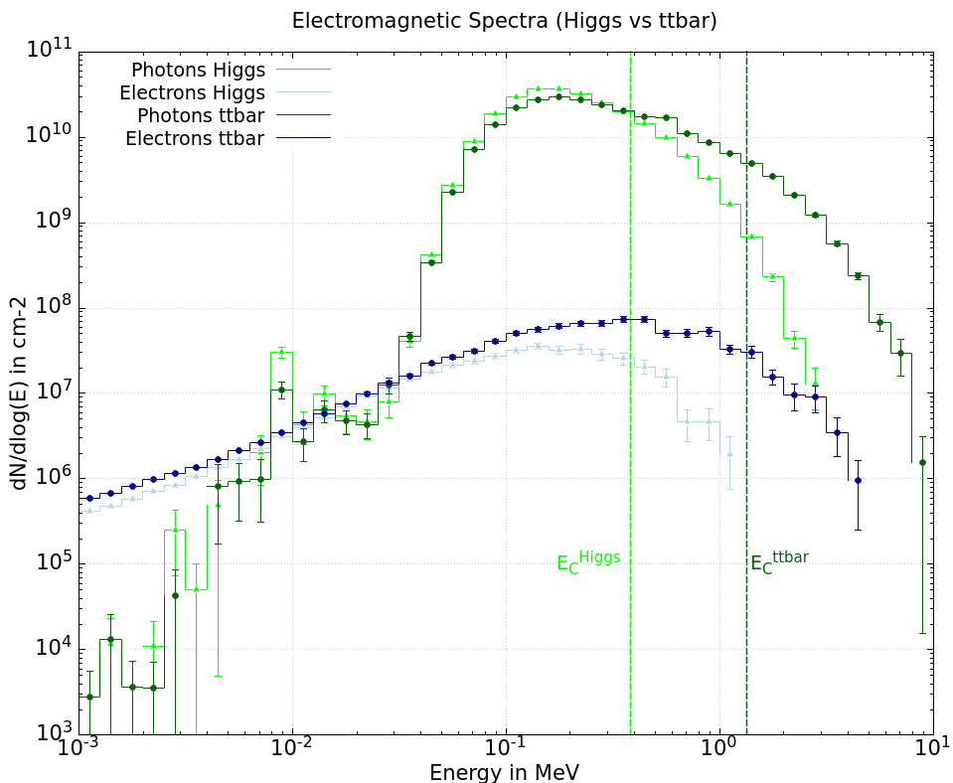
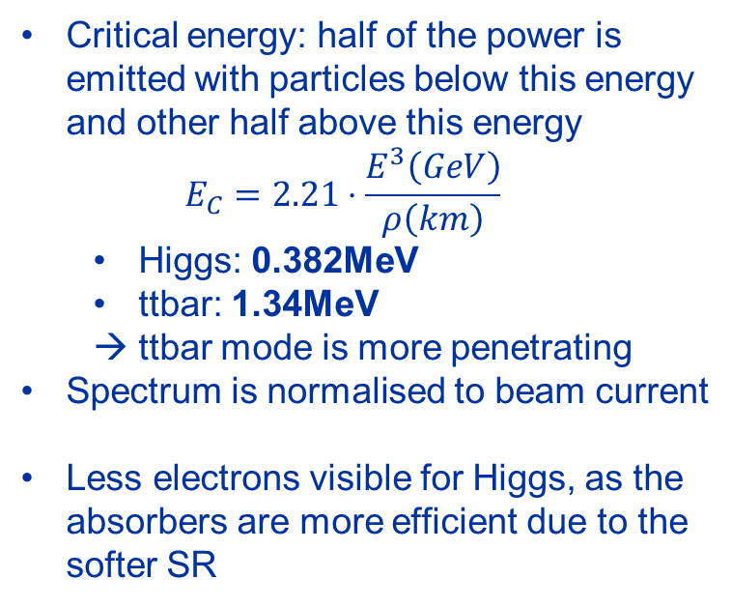
Electron and photon spectrum in the tunnel
Critical energy: half of the power is emitted with particles below this energy and other half above this energy
  Higgs: 0.382MeV
  ttbar: 1.34MeV
  ttbar mode is more penetrating
Spectrum is normalised to beam current
Less electrons visible for Higgs, as the absorbers are more efficient due to the softer SR

Slide 10
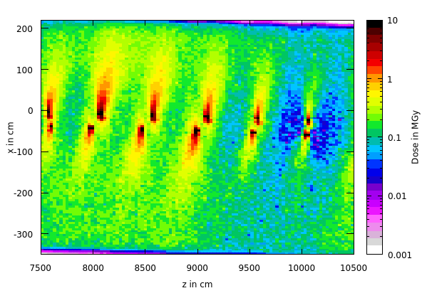
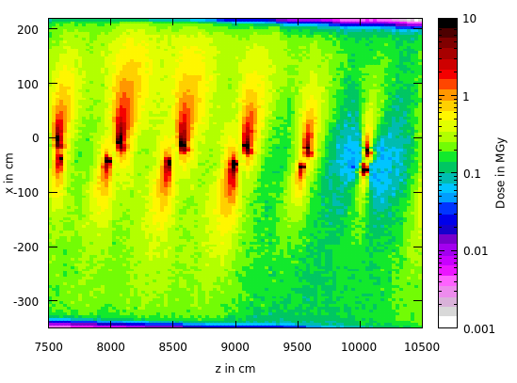
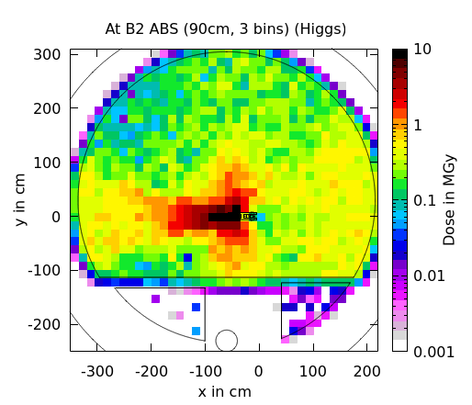
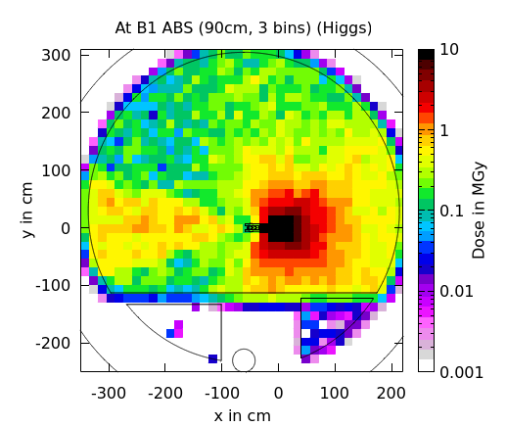
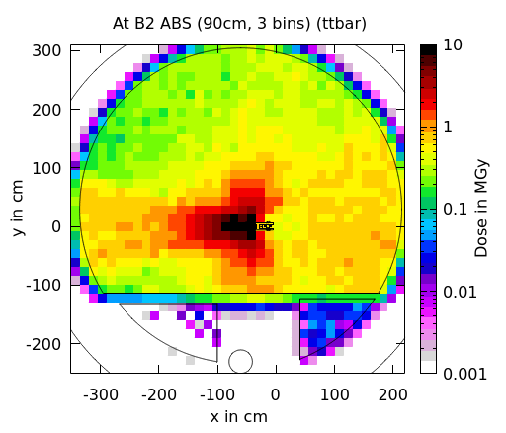
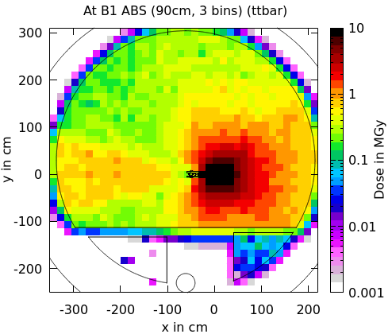
Dose levels in the tunnel w/o add. shield.
Higgs
ttbar
Hot-spots due to ABS in the longitudinal position of the absorbers themselves.
Higgs to ttbar: up to a factor of three difference → Higgs contribution is significant
The dose levels are given for 10⁷s of operation

Slide 11
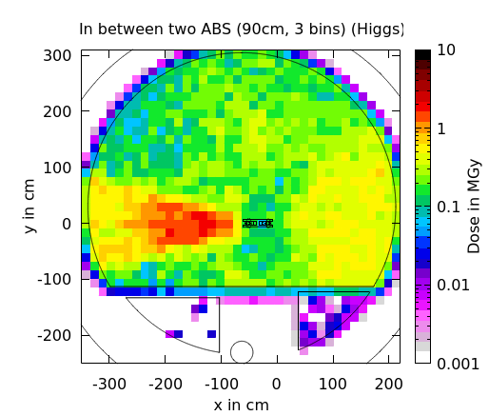
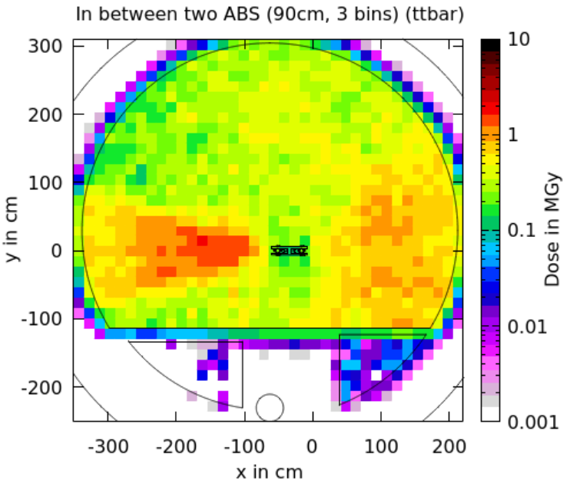
Dose levels in the tunnel w/o add. shield.
Higgs
ttbar
Areas of lower dose due to MQs and MS that provide a better shielding due to their geometry
Dose levels in between the absorbers unacceptably high. Needs significant reduction of dose levels.
→ i.e.: Cables can withstand up to 300kGy, but we obtain up to 600kGy/year in the places where cables should go
Like ttbar operation, substantial shielding is also required for the Higgs mode.
The dose levels are given for 10⁷s of operation

Slide 12
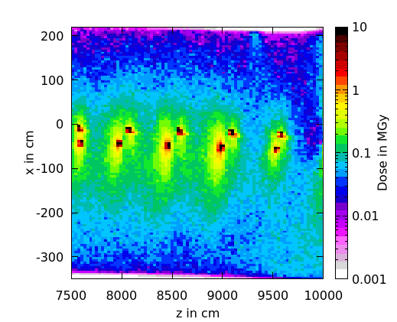
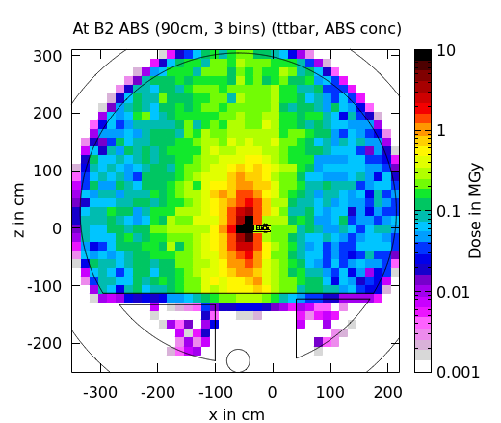
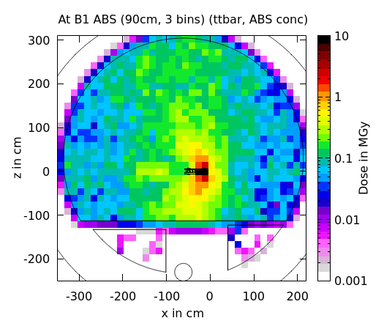
Dose levels with added concept. shield.
Conc. shield ttbar
ttbar
Significant dose reduction due to shielding around absorbers.
The additional shielding works well in the horizontal plane, but more shielding would be required vertically.
The dose levels are given for 10⁷s of operation

Slide 13
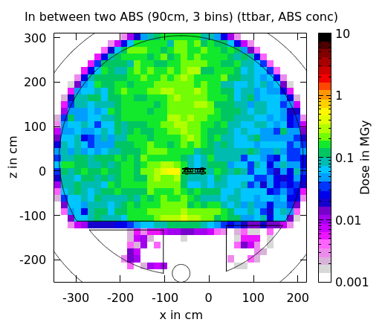
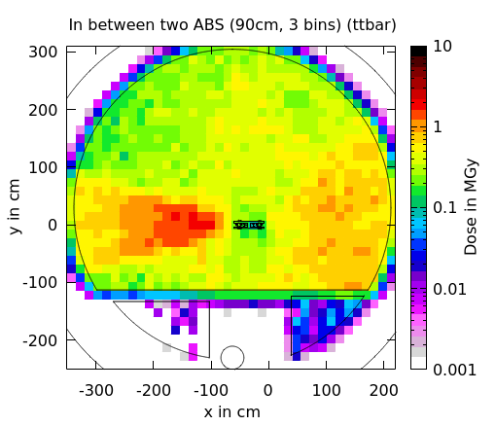
Dose levels with added concept. shield.
Conc. shield ttbar
ttbar
The conceptual shielding leads to a significant reduction in the dose levels.
Still, a more efficient shielding is needed to achieve sustainable dose levels for operating the machine several years.
The dose levels are given for 10⁷s of operation

Slide 14
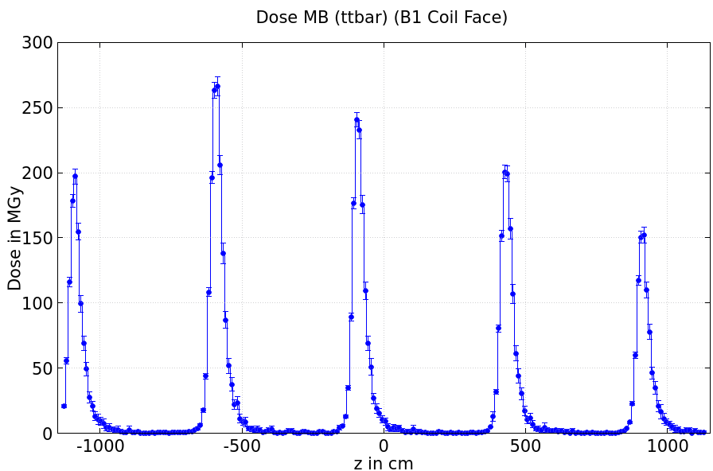
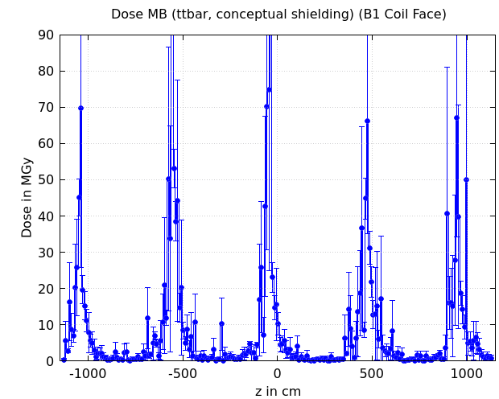
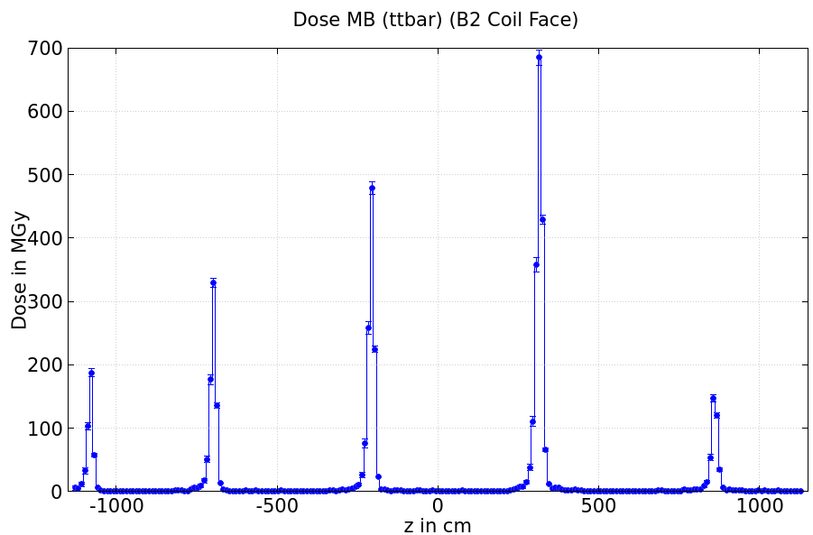
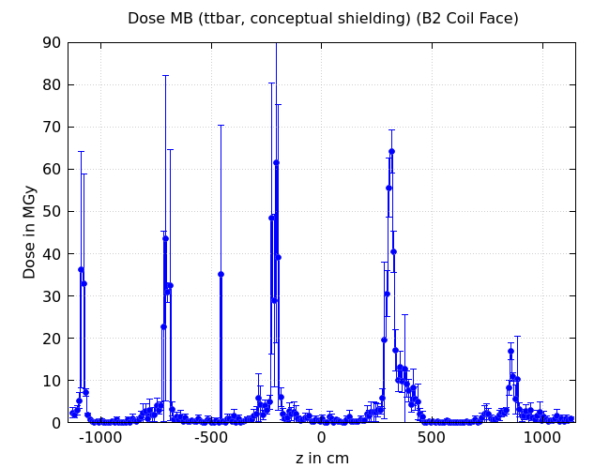
Dose on the MB busbars – ttbar
Int
Ext
External
Coils protectable with a block of lead?
External
Dose is reduced by a few factors but not enough to use organic insulation material.
Due to space constraints, it is difficult to use more material between the vacuum chamber and the busbars.
Absorber
Conceptual shield.
Internal
Internal
The results for the conceptual shielding do not provide a definitive number yet, as the statistical error is still too large! It still allows for a first estimate.
The dose levels are given for 10⁷s of operation

Slide 15
Conclusion
Using the basic absorber layout, the observed dose levels in the tunnel and on the dipole busbars are too high to withstand operation of several years. This is valid for the ttbar mode as well as for the Higgs operation mode.
A conceptual additional shielding has been tested leading to a significant reduction in the dose levels. However, a more refined shielding concept needs to be developed to fulfill all the requirements acceptable dose levels for systems in the tunnel.
Need to study the possible integration of the shielding with TE/MSC and TE/VSC (including the need of extra supports, active cooling, access to the vacuum chamber for NEG coating and bake out etc.)

