Slide 1
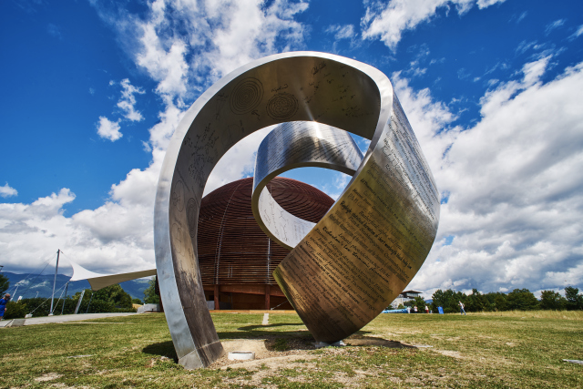
Tackling the Computing Challenges @ CERN
CERN OpenLab Summer Student lecture
2th July 2024
Alessandro Di Girolamo - CERN IT

Slide 2

… a brief “random walk” through CERN

Slide 3
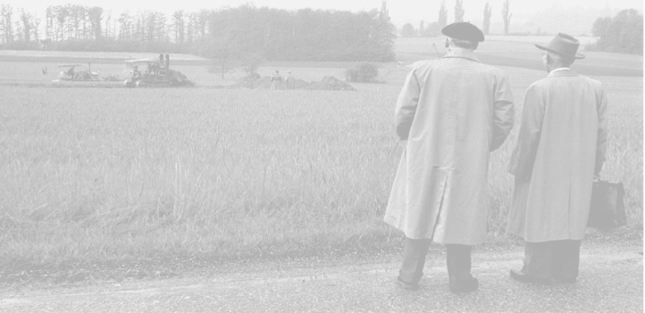

What does CERN stand for?
Conseil
Européen pour la
Recherche
Nucléaire

Slide 4



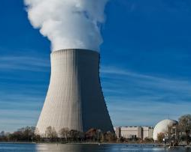
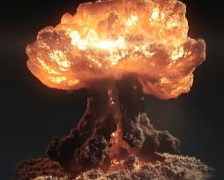
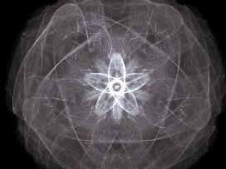
Nuclear?
European laboratory for particle physics
Notes:
(you can question the audience for each image: do we produce electricity? do we produce bombs? Etc.)
The word «Nuclear» should not be misunderstood:
- CERN does not produce electricity (but consumes a lot)
- CERN does not produce military applications out of nuclear power (forbidden by CERN convention, and, anyway, all research results are made publicly available and there are scientists from many countries in each experiment… therefore no risk that exclusive military applications are developed).
- CERN studies the structure of matter. In the 50’s, the nucleus is the main object of study about matter. The word «Nuclear» comes from that.
Nowadays CERN is studying the components of the components of the nucleus. Therefore CERN can use (after being allowed by the Council) an alternative «branding» which is more accurate and less open to interpretation: « European laboratory for particle physics »

Slide 5
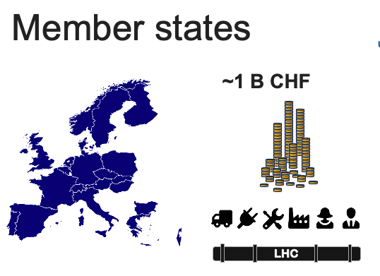
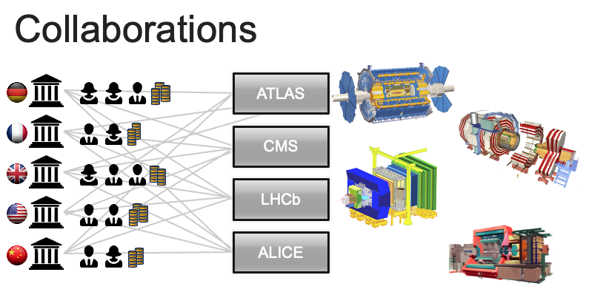
CERN
Who is it?
The Council
  Member states
The Collaborations
  experiments

Slide 6



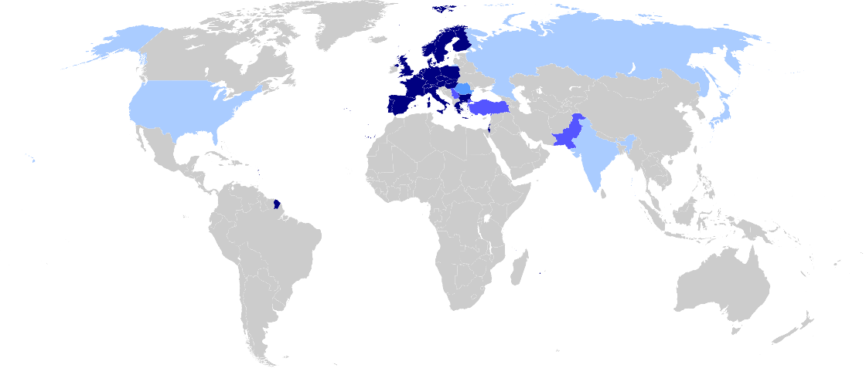
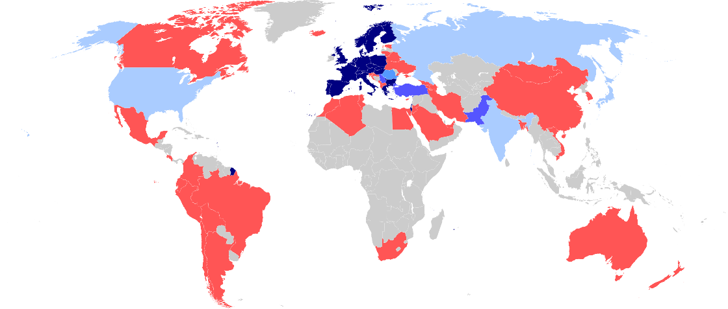

CERN: a worldwide collaboration
23 members
+ Associates
+ Observers
Cooperation agreements
Scientific contacts
Notes:
Even though the «E» in CERN stands for European, CERN became a WORLD actor in the particle physics community.
In fact, half of the world particle physicists ARE connected with CERN at some point. No other scientific domain has reached this level of integration.

Slide 7










How many persons?
15000+!
2500 staff
600 fellows & apprentices
500 students
10000+ users
2000 external companies
Notes:
CERN employs «only» 2500 persons. In which there are «only» 70 research physicists (you can ask the audience if they can guess this).
As Fellows and Apprentices are here for a first employement experiences.
The number of students can vary from 300 to 600 depending of the time of the year. It’s mostly university students.
The core population of CERN is made of about 11’000 «users», called like that because they are here to «use» CERN’s facilities.
They are NOT employed by CERN and come in the frame of the collaborations.
They are not all the time at CERN. Some spend 5% of their time at CERN (a few days a year), some spend 100% of their time. It really depends on their function in the collaboration, on the need for them to be on site, or, on the other hand, the possibility for them to work remotely.
Given the size for CERN’s population, many services are externalized (mail, transport, restaurants, etc) to firms.

Slide 8
Our Mission
The CERN Mission
perform world-class research in fundamental physics.
provide a unique range of particle accelerator facilities that enable research at the forefront of human knowledge, in an environmentally responsible and sustainable way.
unite people from all over the world to push the frontiers of science and technology, for the benefit of all.
train new generations of physicists, engineers and technicians, and engage all citizens in research and in the values of science

Slide 9

CERN
How does it work ?
Notes:
Now we have many questions to answer. But how are we going to proceed?

Slide 10

Accelerating and colliding
Notes:
Most of CERN’s experiments are made of collisions. We take 2 objects and smash them together at very high speed.
Let’s take 2 apples. What happens if we smash them together?
At very low speed, not much. They will stop each other. That’s a «Level 1» collision.
At higher speed, they will damage each other, change direction, slow down. That’s a «Level 2» collision.
At very high speed (imagine we use apple cannons), they will explode. That’s a «Level 3» collision.
We have all experienced such collisions: with cars, bikes, ourselves (not «Level 3» hopefully).
At CERN we want to produce «Level 4» Collisions… This level is so high in energy, that out of the collisions will come… pears, bananas, strawberries, kiwis and… of course apples. Sound strange?

Slide 11
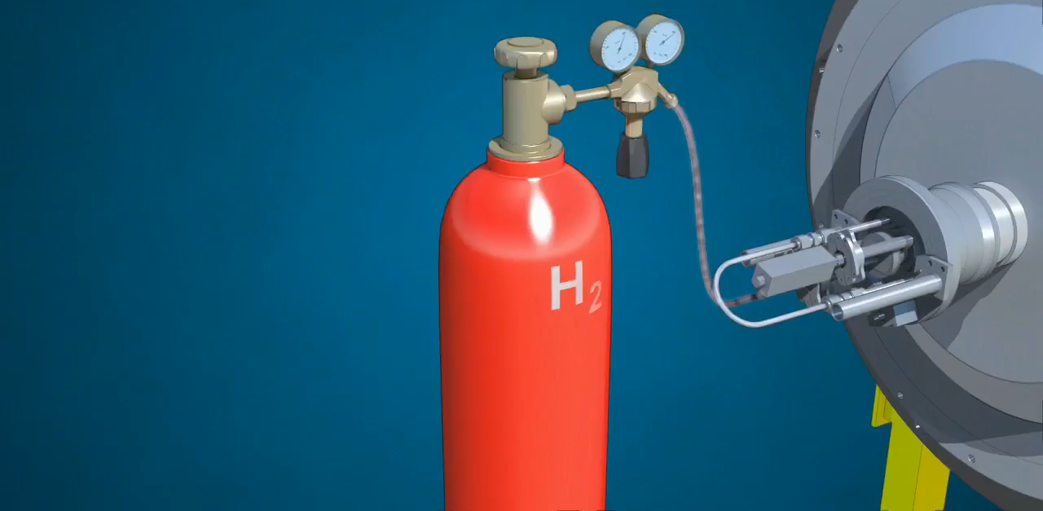
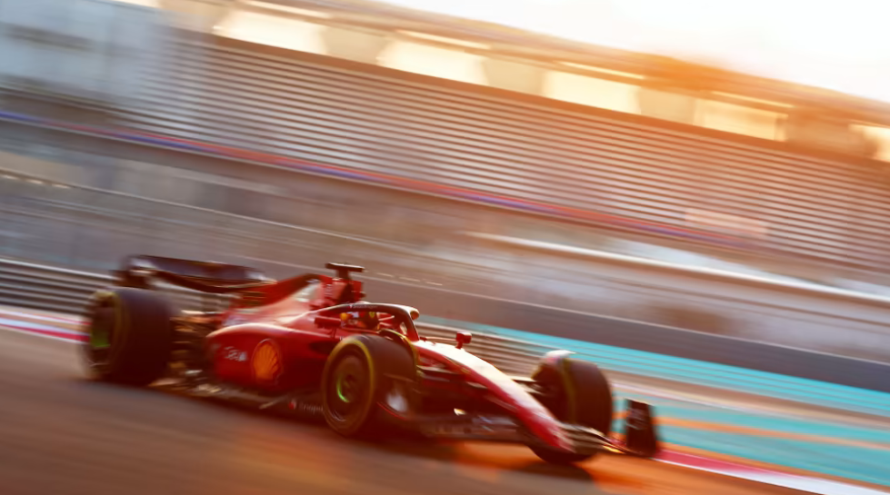
Accelerator
chain
Notes:
But how do we produce protons and grant them the energy of a flying mosquito?
First we start with a bottle of hydrogen gas.
Hydrogen is quite close to what we want. It’s made of protons. With one electron orbitting around.
We send hydrogen gas through an electric field. Proton which has a positive charge goes through. Electron whic has negative charges bounces back and it removed. We are then left only with protons.
They are sent through the LINAC (LINear Accelerator) which uses alternating electric fields to either attract or push the protons. It is so efficient that after only 45m they have been accelerated to a 1/3 of the speed of light, that is 100’000 km per second. Needless to say that continuing in straight lines will be impractical.
We then send the protons to the Booster which will prepare bunches of protons in 4 superposed rings.
They are then sent in the PS (Proton Synchrotron). This machine is 600m circumference, was built in 1959 and is still in use! In 1.2 seconds it accelerate protons to 99% of the speed of light. Very efficient. But cannot go faster. We then need to transfer protons to the «2nd gear of our accelerator complex».
The SPS (Super Proton Synchrotron) build in 1976 and of 7km curcumference. In 3 seconds, it accelerate particle to 99.9% of the speed of light. Once again cannot go faster.
Then half of the particles are sent clockwise and half anti-clockwise into the LHC (Large Hadron Collider). This machine is the largest machine on Earth: 27 km circumference. It will take about 20 minutes to reach our maximum velocity: 99.9999991% of the speed of light which correspond to 7 TeV energy.

Slide 12

Incredible levels of energy
7+7 TeV
100’000’000’000’000’000’000’000
u
u
d
Notes:
Each proton we accelerate at CERN will eventually reach an energy of 7 TeV (Tera electron-Volt).
Does that sound familiar to you? Can explain what level of energy it represents in everyday life? (ask the audience)
This is the incredible energy of a… flying mosquito!
OK… For you and me of course this is insignificant. But remember that we grant this energy to ONE proton.
A normally well-fed mosquito is made of about 10^23 protons! It’s like we are trasnsferring the energy of ALL these protons to ONE if them.
So, at the proton level, this is very very energetic. Remember, it’s the amount of energy proportional to the size of the accelerated object which counts!

Slide 13
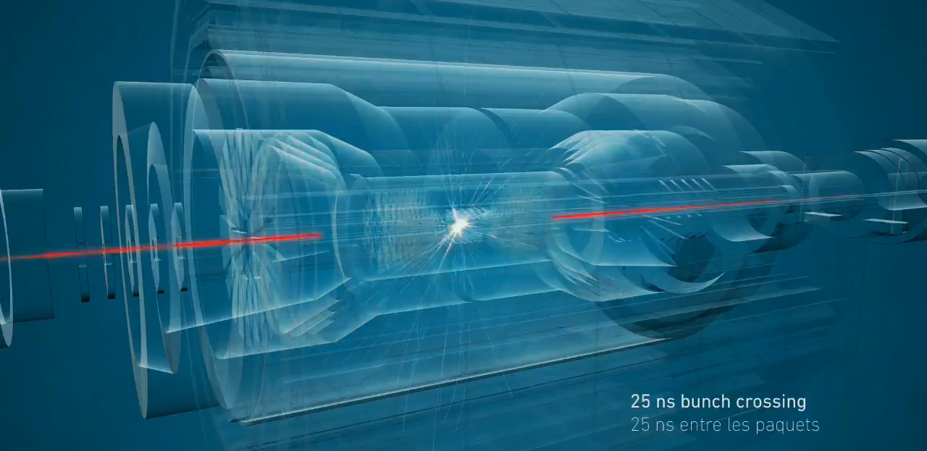
Millions of collisions per second
Notes:
The 2 beams are circulating in separate pipes and in 4 places we cross the 2 pipes over so that collision occur there and only there.
We have built particle detectors which will observe and record the traces of new particles created in the collision.
There are so many protons and they go so fast that around 600 million collisions will occur every SECOND in each of the 4 detectors.
These detectors are a bit like huge digital cameras of about 100 Megapixel resolution. Guess the size of the SD card to store the LHC’s pictures?

Slide 14
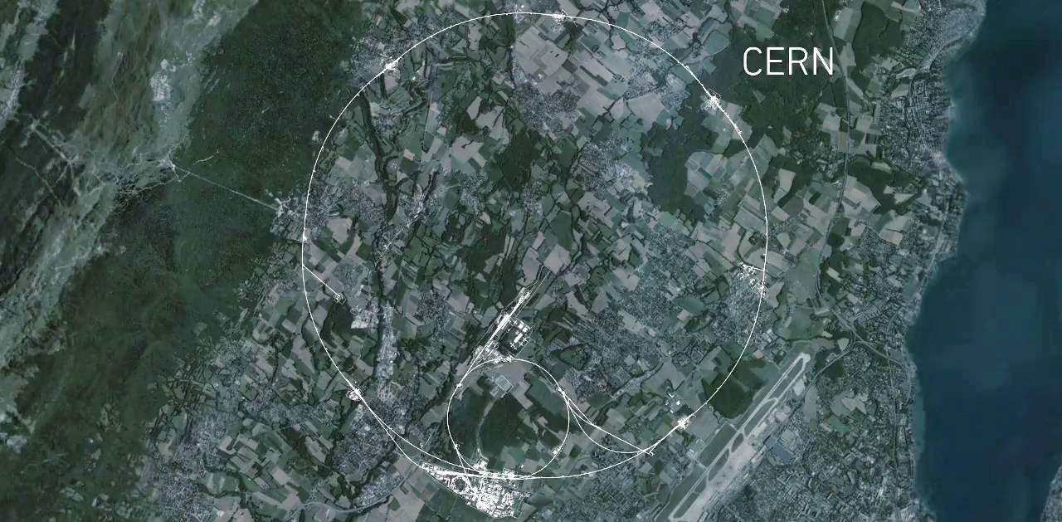
CMS
Largest
accelerator machine
on earth: LargeHadronCollider
ALICE
ATLAS
LHCb
Notes:
This is a map of the complex of main accelerators of CERN.
The dotted line is the French-Swiss border.
The 2 main CERN sites are Meyrin and Prévessin (as big, but not as built nor populated)
The PS is the tiny 600m ring on the Meyrin site, the SPS goes accross the border and the LHC takes all the space between Geneva airport and the Jura (dark green on the left).
The 4 red dots represent where the 4 detectors are located.

Slide 15
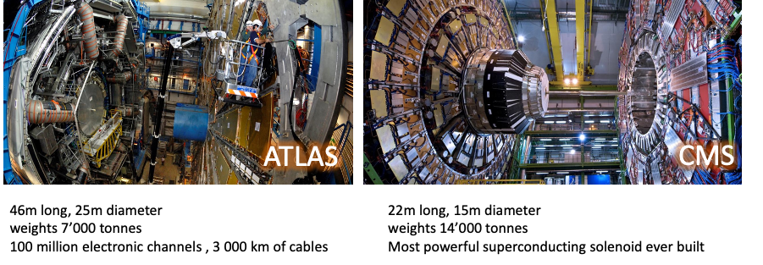
ATLAS and CMS
Two general-purpose detectors cross-confirm discoveries, such as the Higgs boson.

Slide 16
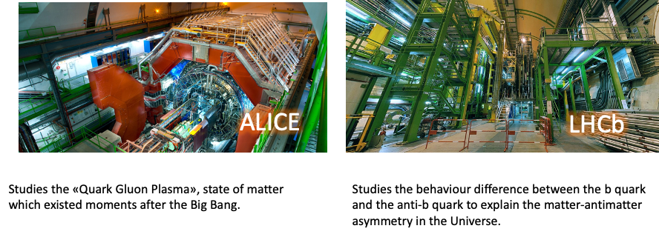
ALICE and LHCb
ALICE and LHCb experiments have detectors specialised on studying specific phenomena.

Slide 17
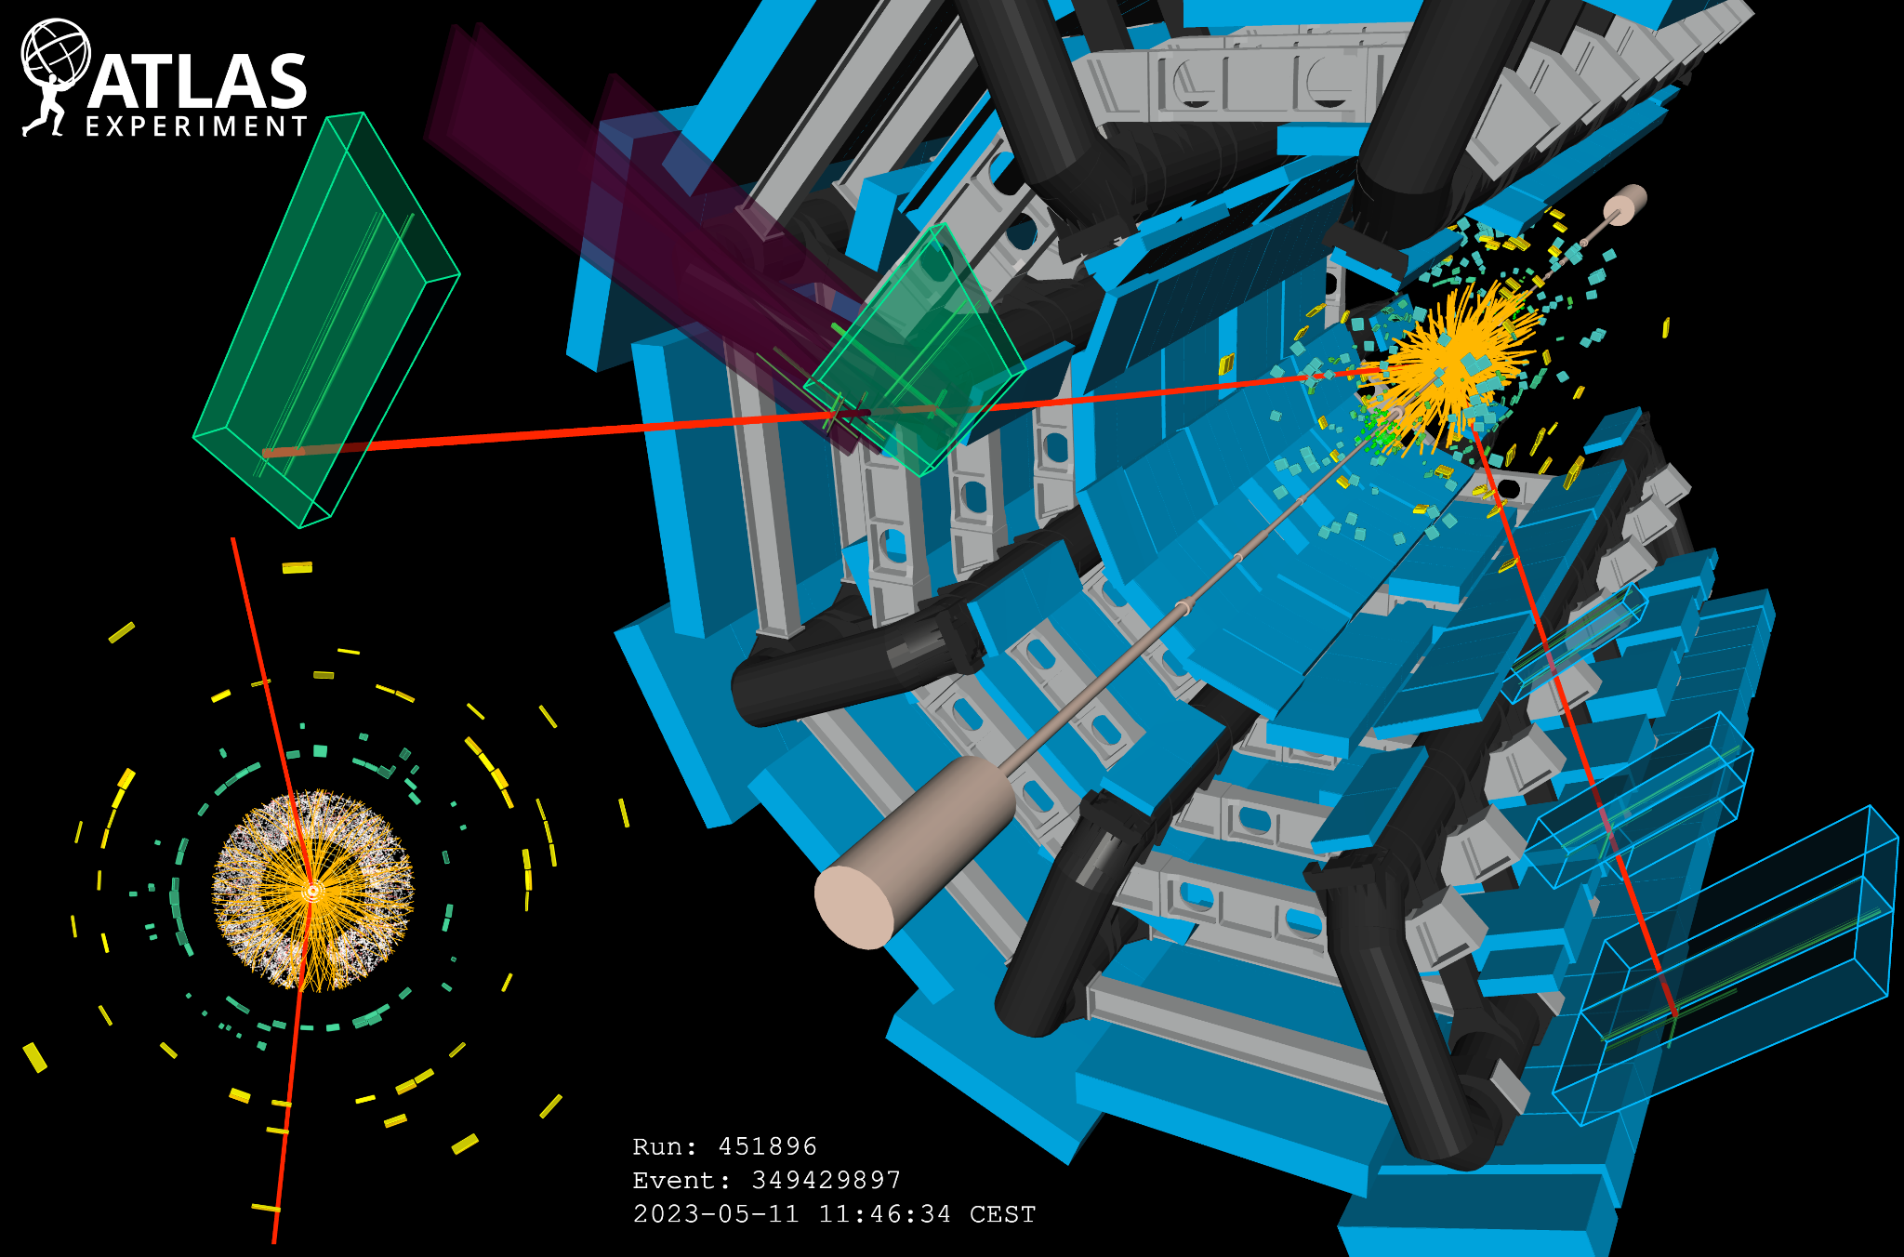
Millions of collisions per seconds generate particles that decay in complex ways – into even more particles
Notes:
An event display of a collision event (Run 451896, Event 349429897) recorded in ATLAS on 11 May 2023, when stable beams of 2400 bunches of protons at the energy of 6.8 TeV per beam were delivered to ATLAS for the first time in 2023 by the LHC. The figure on the right shows a cut-out view of the ATLAS detector; starting from the center of the detector, the image shows the reconstructed tracks of charged particles (orange lines), the energy deposits in the LAr (squares in different hues of green) and Tile (yellow/orange squares) calorimeters, as well as the reconstructed muon tracks (red lines) and their associated hits (green lines) inside the MDT and TGC chambers (green/blue and purple boxes, respectively). The bottom view on the left shows a zoomed-in projection of the same event on the transversal plane, with a focus on the inner detectors; starting from the center, the image shows the hits in the Pixel (white dots), SCT (yellow strips), and TRT (white/red dots) detectors, the reconstructed tracks of charged particles (orange lines), the reconstructed muon tracks (red lines), as well as the energy deposits in the barrel electromagnetic region of the LAr calorimeter (green squares) and in the Tile hadronic calorimeter (yellow/orange squares).

Slide 18
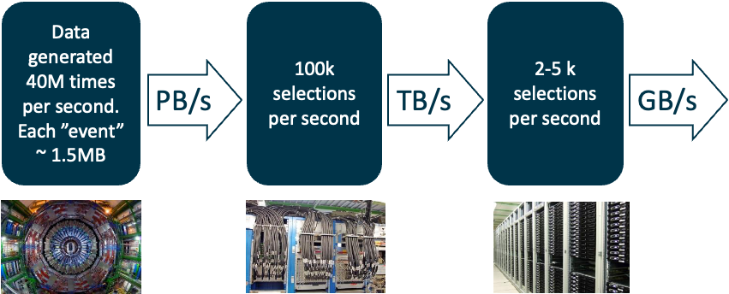
Data filtering (Trigger)
PetaBytes of data per second:
The “trigger” is filtering data in real time, selecting potentially interesting events

Slide 19
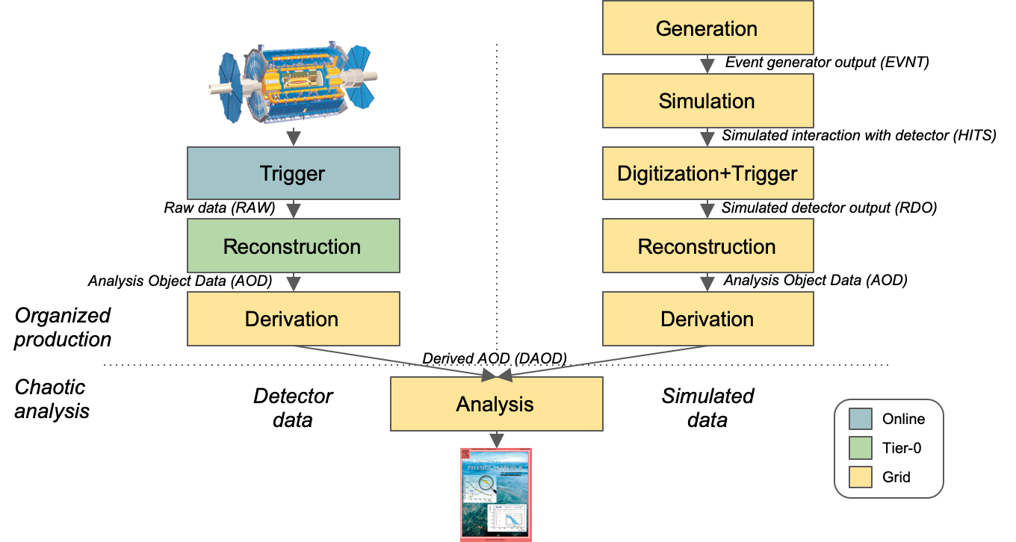
From Data to Paper(s): data processing chain
Notes:
Thks Fernando!

Slide 20

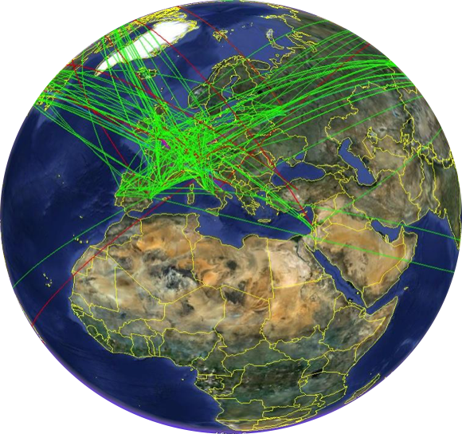
The Worldwide LHC Computing Grid - WLCG
International collaboration to distribute and analyse LHC data
Integrates computing centres worldwide that provide computing and storage resource
into a single infrastructure accessible by all LHC physicists
Global network connectivity
  Tier-0 (at CERN): Large resource, recording and
  custodial archival of collision data, prompt reconstruction
  Tier-1s: Memory and CPU intensive tasks second
  tape copy of detector data, occasional Tier-0 overspilling
  Tier-2s: Processing centres, nowadays many are
  similar to the Tier-1s
Around 1.5 million CPU cores fully occupied 24/7
Around 1.5 EB data (~600 PB on disk and >800 PB on tape)
More than 100 PB moved every month, accessed by 10k users

Slide 21
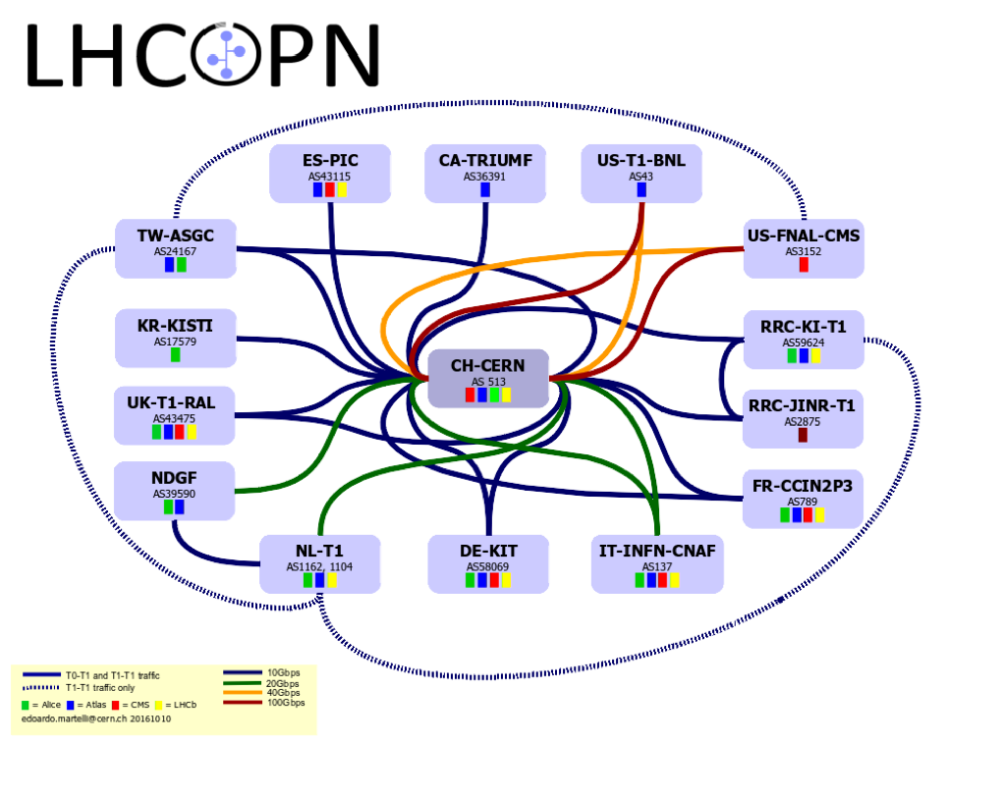
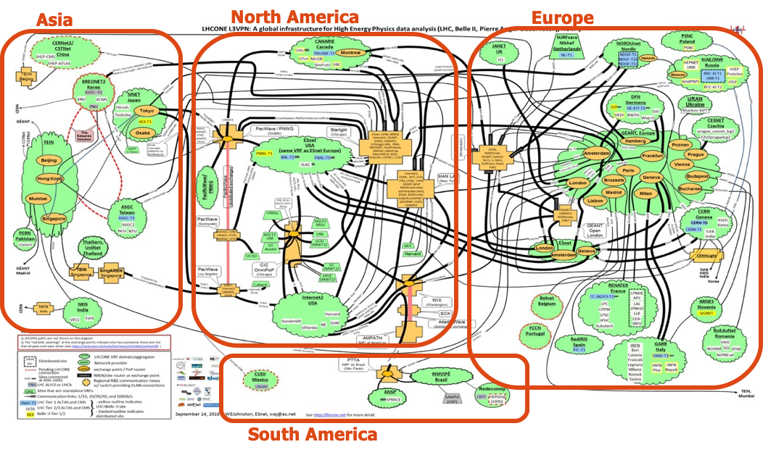
Worldwide Networking
WLCG relies on powerful network infrastructure which connects the whole Grid
LHCOne: overlay network
  Enable NREN to manage general public network for HEP scientific computing
LHCOPN: LHC Optical Private Network
  For Tier0 ↔ Tier1s traffic,
  managed by Tier0 and Tier1s

Slide 22
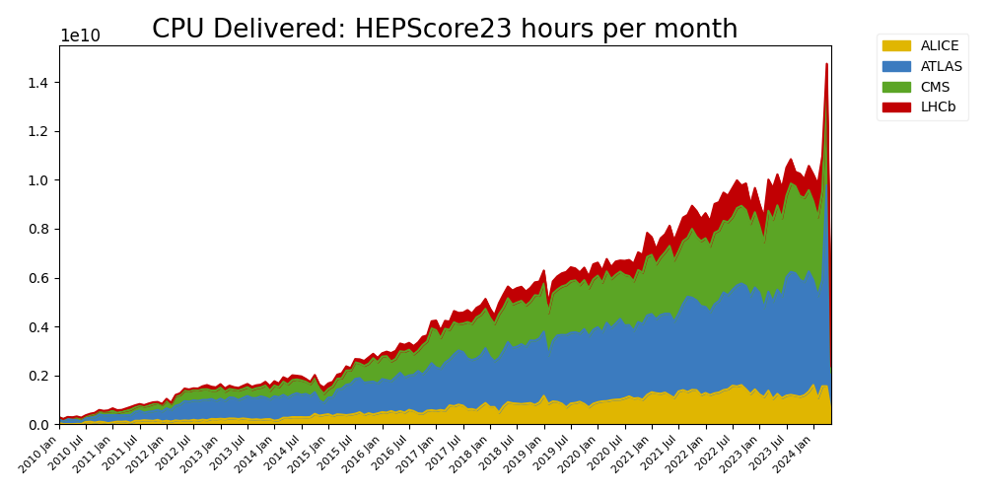
WLCG resources: compute
Notes:
Robust resource growth of resources:
Average +20% CPU and disk yearly growth
Consistent with a ‘flat budget’ funding for computing centres, the de-facto adopted model across all Funding Agencies for the past 10 years

Slide 23
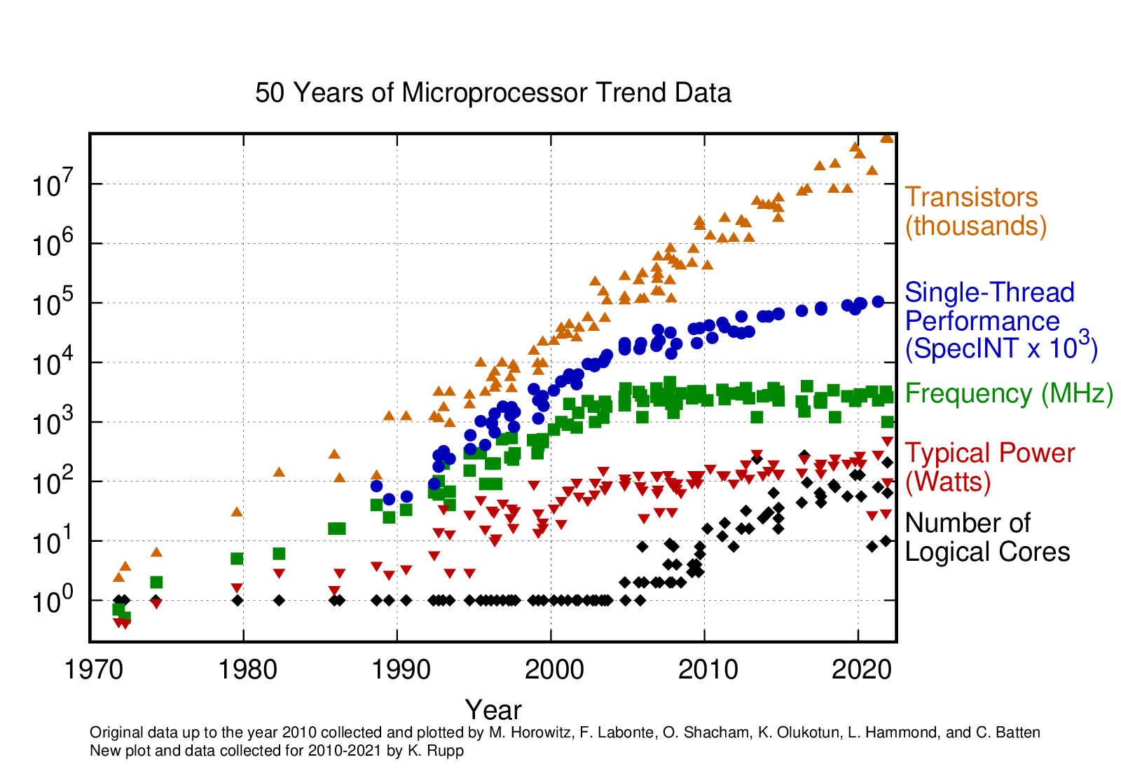
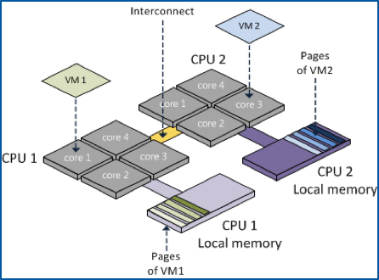
Hardware evolution
A challenge not only for the HEP computing:
  Transistors go into many cores, co-processors, vector units...
  Clock speed stalled since ~2005
    Single core performance is essentially also stalled
  Mobile devices and data centres are the key volume markets
  Memory consumption is a huge driver now
  Memory access and I/O paths also become problematic
Modernizing code will play a vital role for the upgrades of experiments and LHC
Increase software performance by adopting modern coding techniques and tools
Fully exploit the features offered by modern HW architectures
  Many-cores GPU platforms, acceleration co-processors and innovative hybrid combinations of CPUs and FPGAs
Getting performant software requires significant investment in programming skills
  Also, it does not happen overnight...

Slide 24
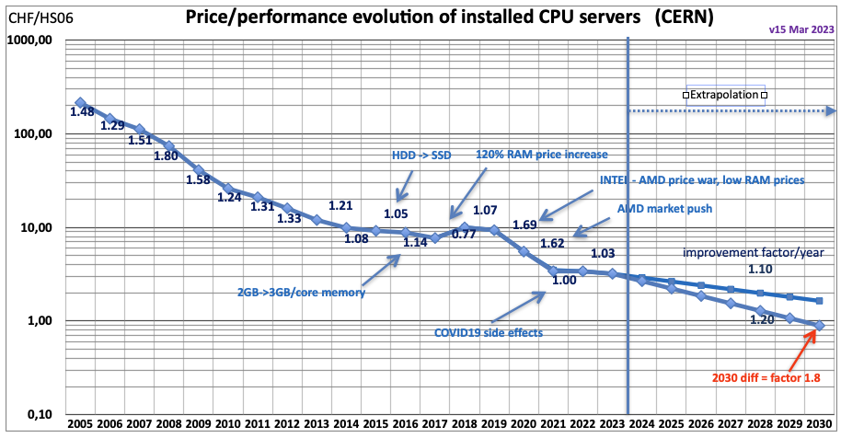
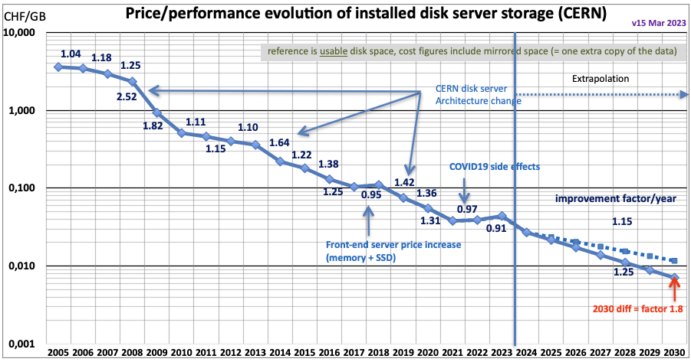
Hardware cost evolution
Hardware cost is more and more dominated by market trends rather than technology
  science has no influence on these markets!
For the budget we have been assuming +20%/year in storage and CPU capacity, but we have to deal with large fluctuations and a “flat” budget constraint

Slide 25

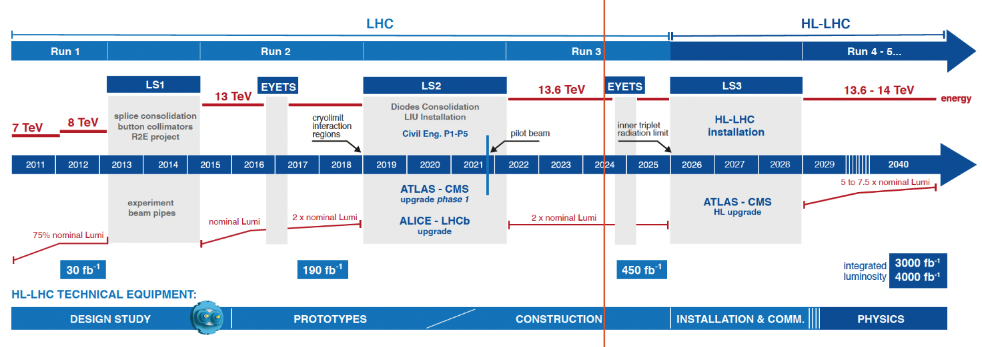
HL-LHC plans
Expected to be operational from 2029
  Objective is to increase the integrated luminosity by a factor of 10
ATLAS and CMS will face several challenges wrt Run3 (now): ~3x instantaneous luminosity, 3-4x pileup (mu ~60 -> 200)
Notes:
Link to the image??
https://hilumilhc.web.cern.ch/content/hl-lhc-project

Slide 26
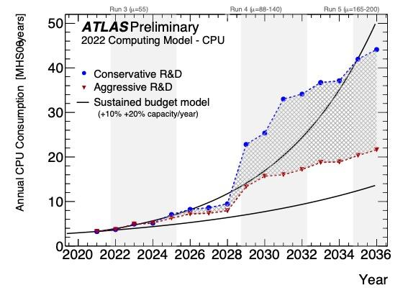
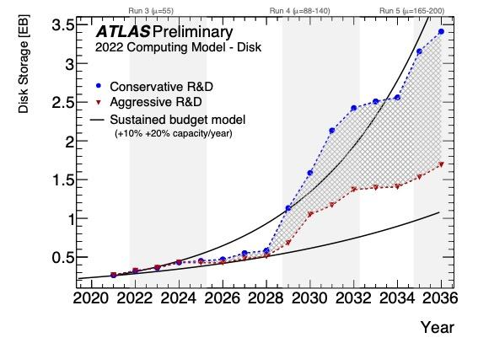
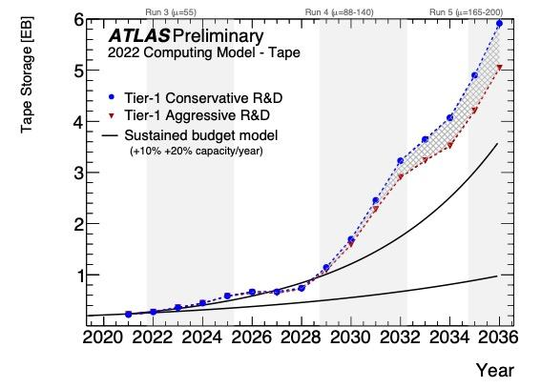
HL-LHC Software and Computing Challenges
Computing Resource Estimates show need for major R&D (or budgetary) effort to achieve HL-LHC physics potential.
  We have defined Conservative R&D and Aggressive R&D scenarios
    Conservative should be achieved with today’s effort and people
    Aggressive requires more people, more R&D projects bringing resource savings
  The black lines indicate the “flat budget” of 10% (lower line) and 20% (upper line).
Investing in brainpower is paramount!
Notes:
projected evolution of disk (top) and tape (bottom) usage from 2020 until 2036, under the conservative (blue) and aggressive (red) R&D scenarios. The grey hatched shading between the red and blue lines illustrates the range of resources consumption if the aggressive scenario is only partially achieved. The black lines indicate the impact of sustained year-on-year budget increases, and improvements in new hardware, that together amount to a capacity increase of 10% (lower line) and 20% (upper line). The vertical shaded bands indicate periods during which ATLAS will be taking data.

Slide 27

Tackling the HL-LHC Computing Challenges
Compute..
  Optimize the usage of al the available resources, including new HW technologies and facilities
  Make physics choices that save computation without sacrificing the physics reach
Storage
  Optimize data format
  Evolve the computing models to make use of different (cheaper) storage technologies
Sustainability
  Environmental sustainability (Use - not waste!)
  New technologies!
  Boomers, GenX/Y/Z: we are all different, different times different challenges!

Slide 28

Time to act: NOW
Experiments defined their roadmaps toward HL-LHC:
ATLAS S&C HL-LHC Roadmap ; CMS Phase 2 Computing Model
Based on the HL-LHC schedule, it is clear that R&D projects need to start now
  from R&D to demonstrators, with measurable impact
  We see already lot of engagement!
Integration and validation will require lot of time
  Late arriving R&D is risky

Slide 29
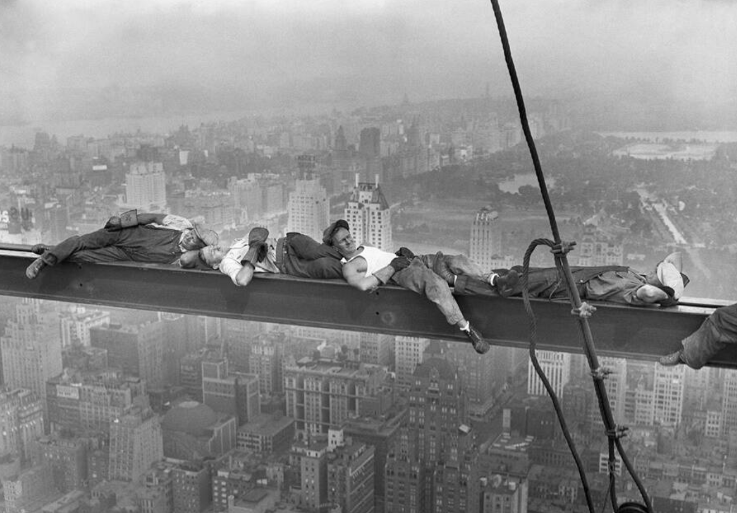
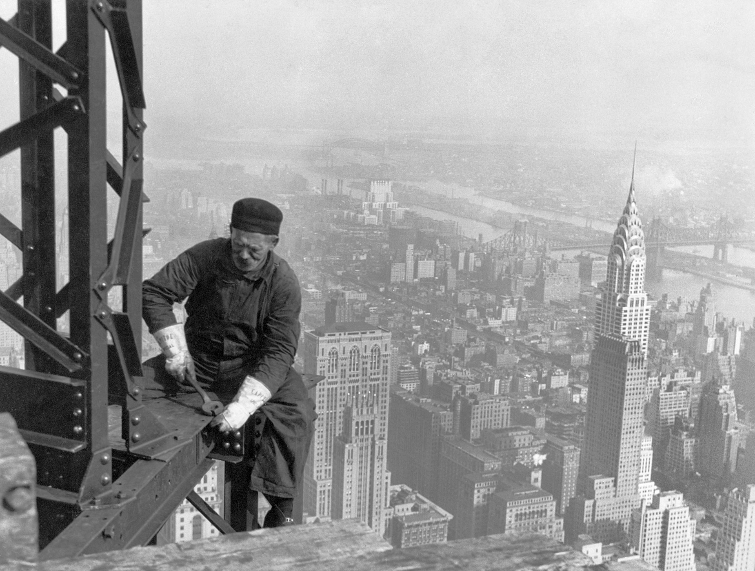
Some caveats: lots of “business as usual”
We have to keep on running the experiments while we are planning for major upgrades
  “we are building a new ATLAS while we are running ATLAS” (Karl Jakobs, ex ATLAS spokesperson)
  Failing is not an option
Lot of efforts that need to go into non-R&D work (or at the boundaries)
  Maintaining our current software
  Updates to the distributed computing infrastructure
  Upgrade geometry, digitization, re-tuning simulation…
  SW performance improvements
R&D projects are on top of this:
  balance (between R&D and “business as usual”) is key
  We need a strong focus on “impact”

Slide 30
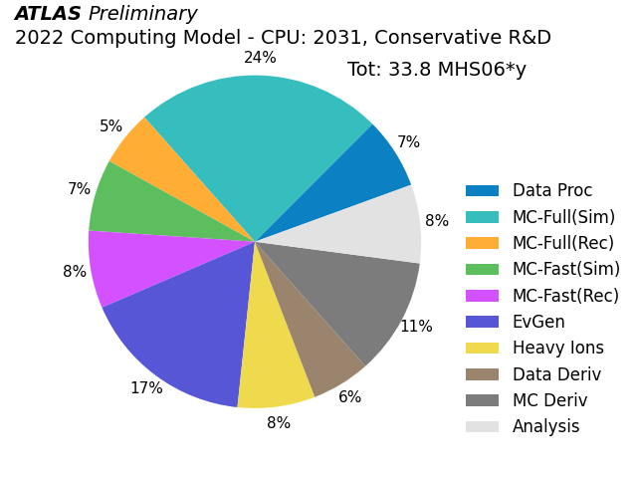
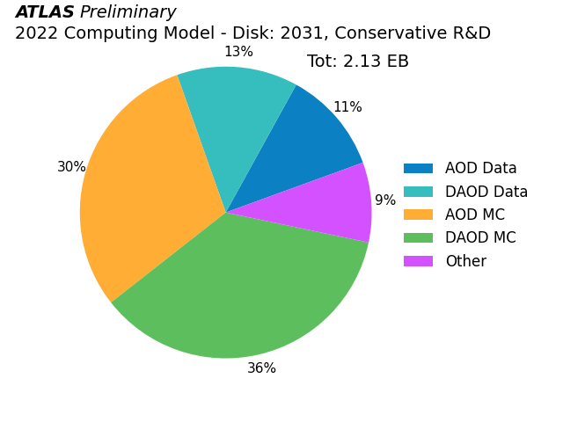
HL-LHC - Resource Estimates for 2031
There is no “silver bullet”:
  it’s not that we do have 1 (one) single problem and if we solve that “we are done”.
we need to work on each and every part of our system
The opportunities are “everywhere”: we need to work hard to scavenge a few % here and there
  An “evergreen” motivational speech, Any Given Sunday : true we do not play *against* anyone, but we still want to bring out the best from ourselves - while having fun!

Slide 31
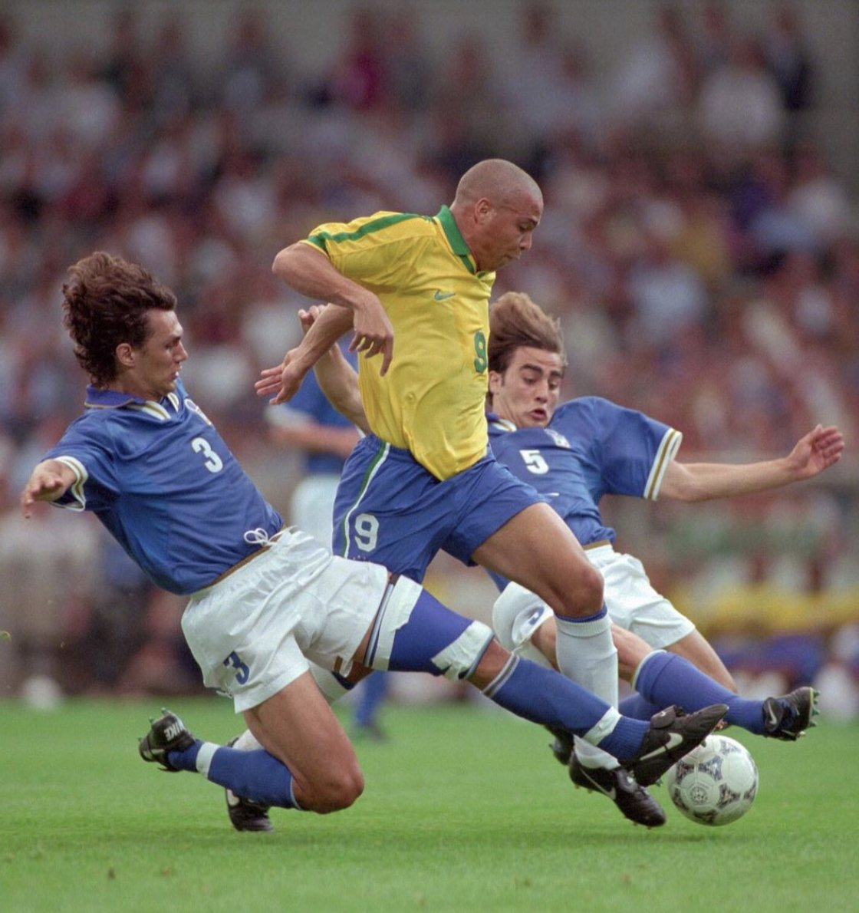
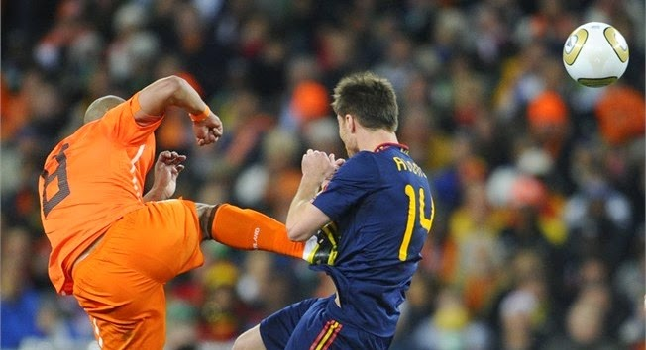

Tackling the challenges
There is nothing bad in being “two” in tackling difficult challenges!
  Important we work together and we organize ourselves
  We don’t compete
There are no shortcuts and not so many “low hanging fruits”
  It requires disciplines from all of us
  Others might suffer from our “being late”
Expectations management is paramount
  We do not dictate! We do bring people onboard, we (try to) motivate them (and people motivate us!)
  Crucial to clearly define our commitments taking into account all the “other” stuff we have to do
  It is critical that we are able to estimate by when “that something” will be done.

Slide 32
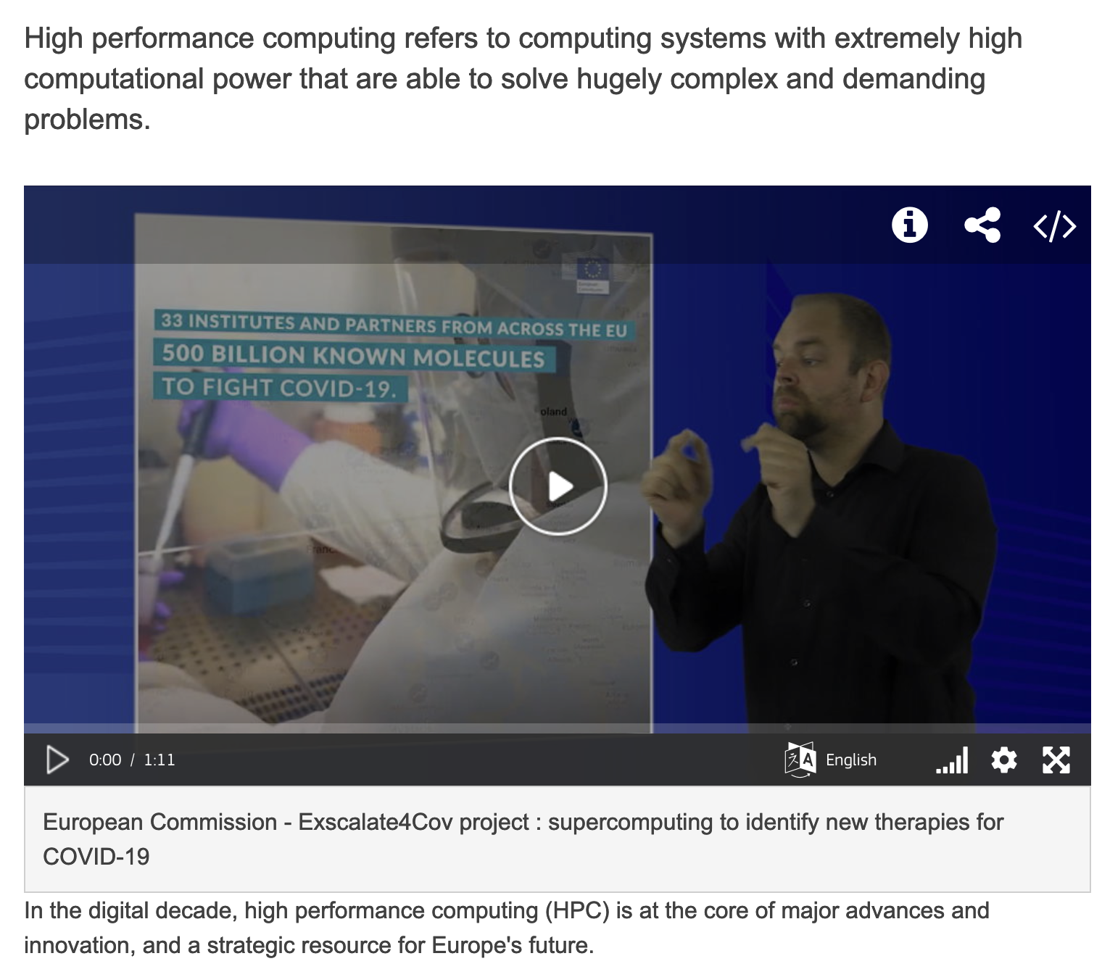
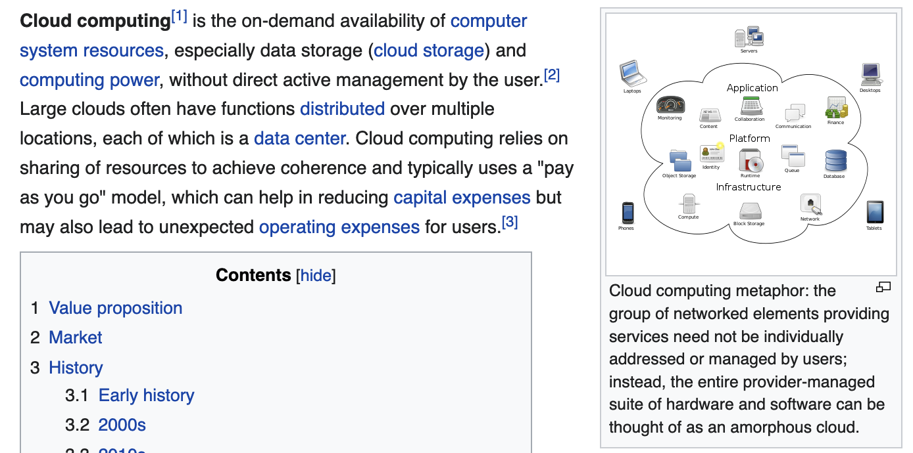
Tackling the challenges: infrastructure evolution
HPC and Clouds (and Industrial partners)
  More and more often we are seeing them discussed together
  Not really much overlap, except that they “both” are not standard Grid sites.
They really deserve two different “set of slides” → next

Slide 33
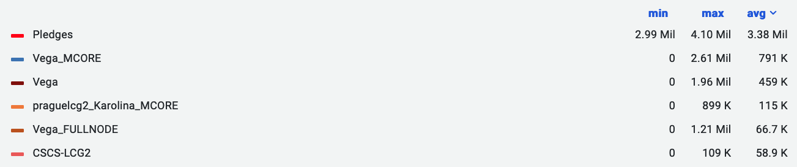
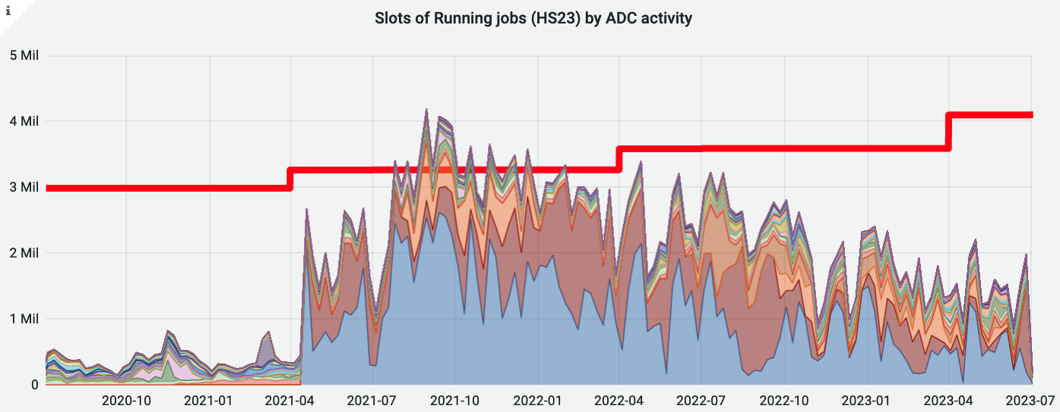
HPC and ATLAS - last 3 years - HPC only
A few HPCs make a big difference
  But still it’s important to highlight that many HPCs are integrated!
  Looking forward to Leonardo(n4) and Perlmutter(n8)
Notes:
https://monit-grafana.cern.ch/d/000000696/job-accounting-historical-data?from=1609459200000&orgId=17&to=now&var-bin=1d&var-cloud=All&var-computingsite=All&var-container_name=All&var-cores=All&var-country=All&var-error_category=All&var-es_division_factor=24&var-eventservice=All&var-federation=All&var-groupby=resource_type&var-groups=All&var-gshare=All&var-inputdatatypes=All&var-inputprojects=All&var-job_resource_type=All&var-jobstatus=All&var-jobtype=All&var-nucleus=All&var-outputproject=All&var-pledges=CPU&var-processingtype=All&var-prodsourcelabel=All&var-resources=GRID&var-resources=cloud&var-resources=hpc&var-resourcesreporting=All&var-site=All&var-tier=All&viewPanel=159

Slide 34
A strategy towards opportunistic HPC
Investment in proportion to opportunity
  At the moment, e.g., we see ARM as a higher priority than Power
  Not trying to get in on every machine!!
    We don’t need to – getting the easy/with internal good support ones gives ample CPU.
  All the “easy” HPCs transparently integrated, running all workflows, are much welcome!
We have a good (and growing) toolkit for edge services
  With several available solutions, one is likely to fit a new machine
Work towards several big HPCs is ongoing
  E.g. Perlmutter, Fugaku(2)/CSCS, Toubkal …
The details can make the difference:
  HPC are not easy, need expertise on I/O, shared file systems, scheduling, AAI…
Without forgetting:
  The risk that the opportunistic CPU resources will disappear at any time is very real
  The main physics program of the experiment should be supported through pledged resources
  A constant yearly increment for both CPU and Disk is reasonable to minimize the risks that, if these resources disappear, the computing centers providing pledged resources won’t be able to provide what is needed

Slide 35
R&D Projects with Industry
The experiments and the labs are engaging with industrial partners on R&D projects, e.g.:
  SEAL, a decentralized cloud storage start-up
  Google Cloud and Amazon Web Services
Opportunities to evaluate technologies and to define a resilient long term strategy
  Use of cloud compute for all workflows, and a comparison to traditional resources of the total cost of ownership (TCO)
    Google already used for interactive analysis
  Evaluation of test technologies (e.g. TPU, ARM) using cloud resources without requiring large-scale purchases
    AWS extensively used in setup and validation of ARM Athena nightlies builds
  Evaluation of remote cold storage as a complement / supplement to tape systems
These projects also present great connections with strong partners
  Amazon and Google are major players that many groups already collaborate with
  Being able to speak the same language and learn how they operate is invaluable

Slide 36
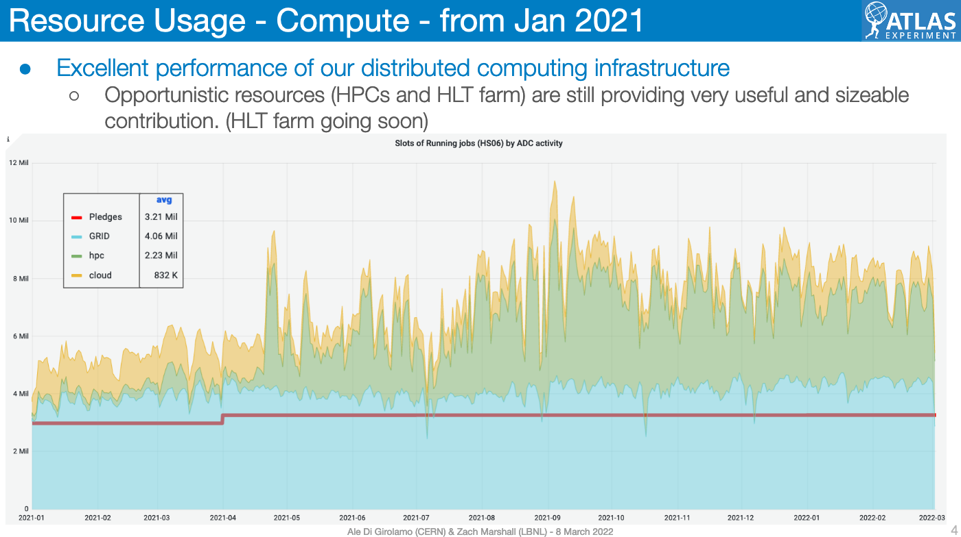
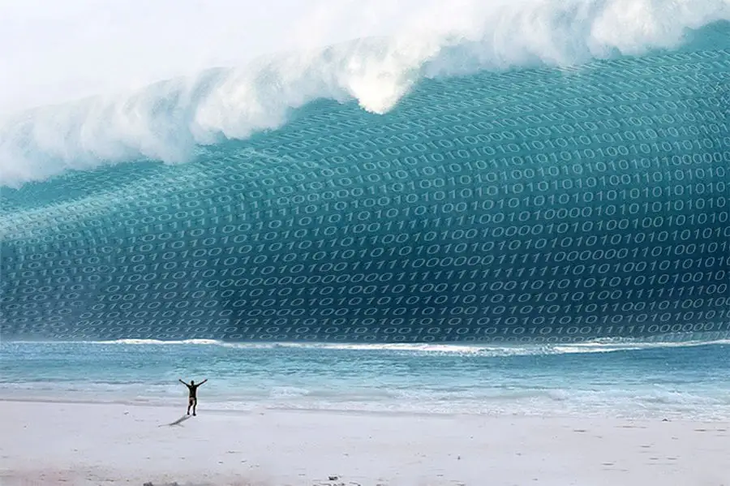
Opportunistic CPU but NO opportunistic Disk
Resources extremely useful for the physics community
  We have developed a detailed programme for secondary MC simulation samples
  E.g.: large number of diphoton background events simulated → significant reduction of spurious signal systematic uncertainty → enabled a low diphoton-mass analysis; V+jets w both new Sherpa and MadGraph → primary setup for upcoming V+jets modelling pub, used in Z+jets measurements paper
Still, they produce a huge challenge for our storage: we need to store all these data!

Slide 37
Storage challenges
Our data sample is going to be 10x bigger!
  today trigger rate is ~4kHz, will be 10kHz in HL-LHC,
  RAW size from 1.5MB/event to ~4MB in HL-LHC
  MC simulated events from 30B/year to 150B/year
We are working on several R&D (and lots of “business as usual”) to make sure we make the best use of our Disk and Tape:
New analysis models: smaller data types
Data Carousel: trading Tape (cheaper, but slower) for Disk
Constant review of the content and the objects stored in each datatypes

Slide 38
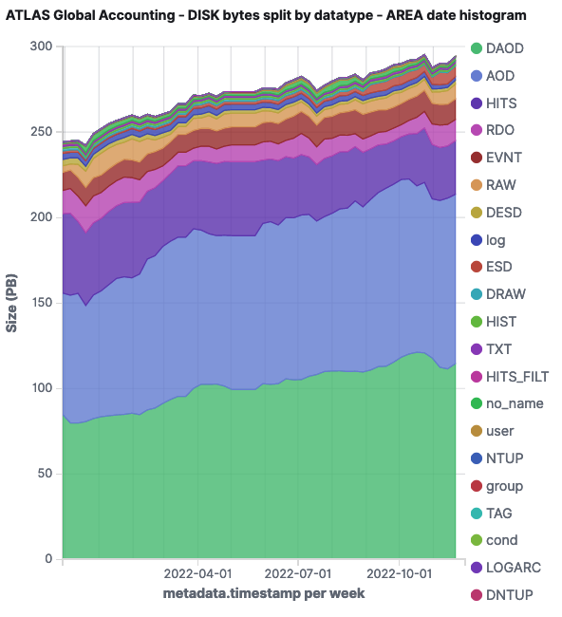


Storage challenges: more
Lot of analytics:
  Too much, never enough - and always complicated to keep all the chain working! - help welcome!
  understand what we use, how often, how many replicas …
Some more blue-sky R&D are fascinating, e.g.:
fastchain: trading CPU for Disk
  A fast end-2-end simulation, we could choose to save less (or zero) intermediate data - potentially important impact on disk and tape savings
More aggressive deletion - and recreation on demand
  Again trading CPU for Disk, one of the complexity is on the timely reproduction (with proper metadata)
Data Scientists:

Slide 39
Tackling challenges: considerations
HPCs are very useful to mitigate the risk of being short in CPU resource
  With some caveats - as we discussed
Clouds and in general project with industry help us in improving our frameworks, make it more sustainable and “community standard”
  Some interesting “opportunistic storage” R&D
  And TCO evaluation is important
Many more R&D to mitigate the HL-LHC not-enough-CPU risks:
  We are following with great interest the Geant4 collaboration (+Adept and Celeritas) and Event Generator groups’ R&D efforts
Many R&D to mitigate the storage challenges’ risks:
  Our systems are complex: need lots of brains and analytics expertise to take the right informed decisions
Note that not all our R&D will reduce our resource consumption!
  We want to do *great* physics, some of the R&D will help us on this too
  And some others will push us to rewrite our (reco and tracking) code, to be able to be accelerators (e.g. GPU) friendly
    → independently on the usage or not of accelerators, we will for sure gain having better written code: sustainability and capability to engage more people

Slide 40
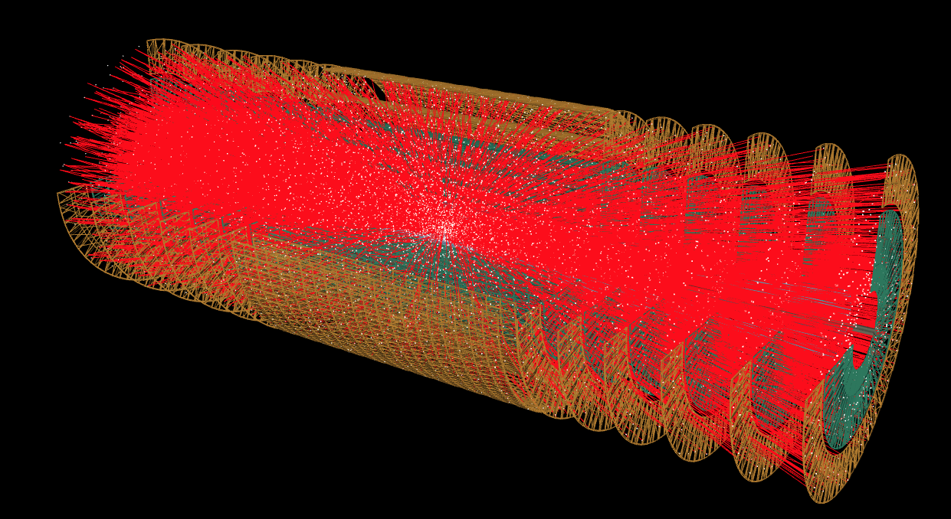
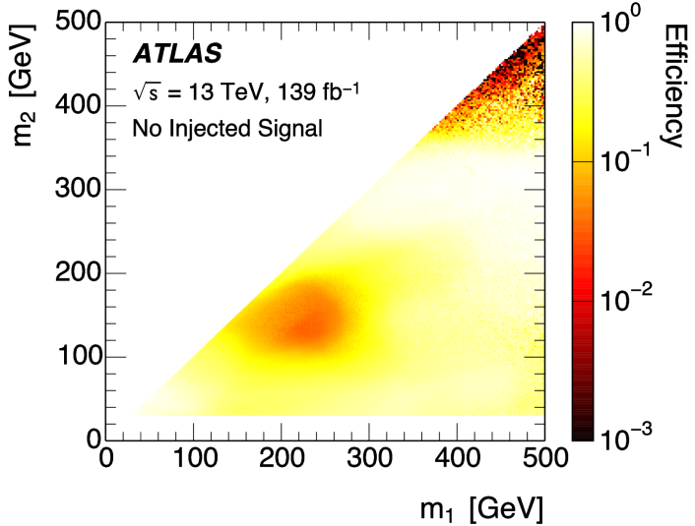
ML, AI, and more
Machine Learning (and AI) is pervasive in the experiments
  For trigger, reconstruction (e.g. pixel clusters, electrons and hadrons), analysis (e.g. signal/background discrimination), fast detector simulation (e.g. generative networks for calorimeter simulation)
  Not only inside the experiments, but also work in collaboration with external machine learning experts (e.g. TrackML challenge, Higgs ML challenge)
AI for computing
Quantum Computing and Algorithms
Notes:
..
For trigger, reconstruction (e.g. pixel clusters, electrons and hadrons), analysis (e.g. signal/background discrimination), fast detector simulation (e.g. generative networks for calorimeter simulation)

Slide 41
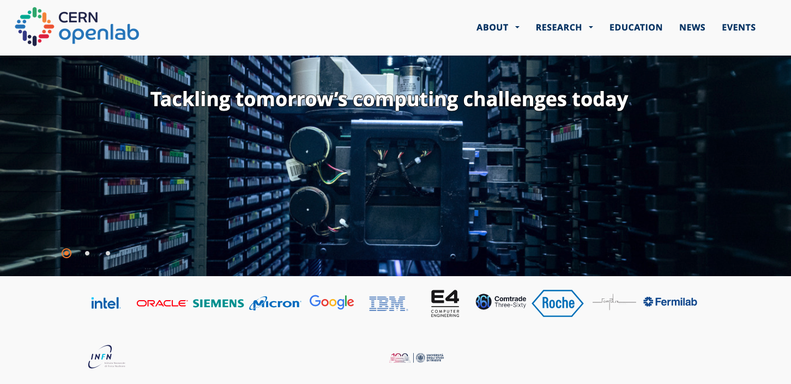
CERN OpenLab

Slide 42

.… The Role of Computing in Society
… in the scientific community actually… but also in the society at large.
What do YOU think?
What’s YOUR forecast?
https://www.menti.com/al99q1kj4iqi or
https://www.menti.com/ 3302 3009

Slide 43
The road ahead: “Welcome”!
Exciting Challenges:
  The experiments at CERN are facing interesting, difficult, but solvable software and computing challenges for the HL-LHC.
Critical Need for Talents:
  One of the biggest challenges not mentioned here is engaging, supporting and retaining skilled developers – YOU!!
Unified Goals:
  Focusing our efforts on common shared objectives is paramount.
Impactful Collaboration:
  The way in which we work can make the difference between success and failure!
Time to act is now!
  Ad Augusta per angusta!
We are part of a team. We are all unique. We can make a difference.

Slide 44
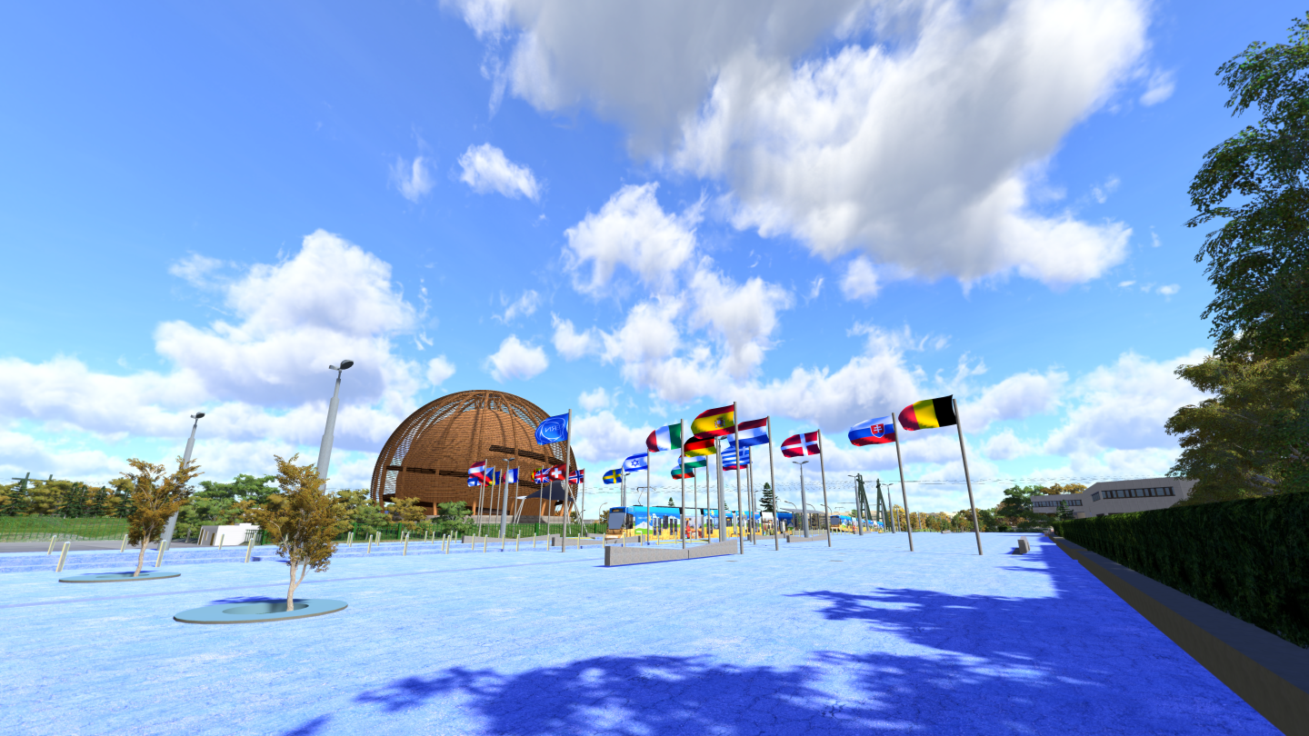
…
Thank you
….
….
  ...
….
… a special thanks for the many very useful discussions and providing material for this talk, to: Antonella Del Rosso, Zach Marshall, David South, Concezio Bozzi, Stefano Piano, Fernando Barreiro Megino, Maria Girone and many more!

Slide 45
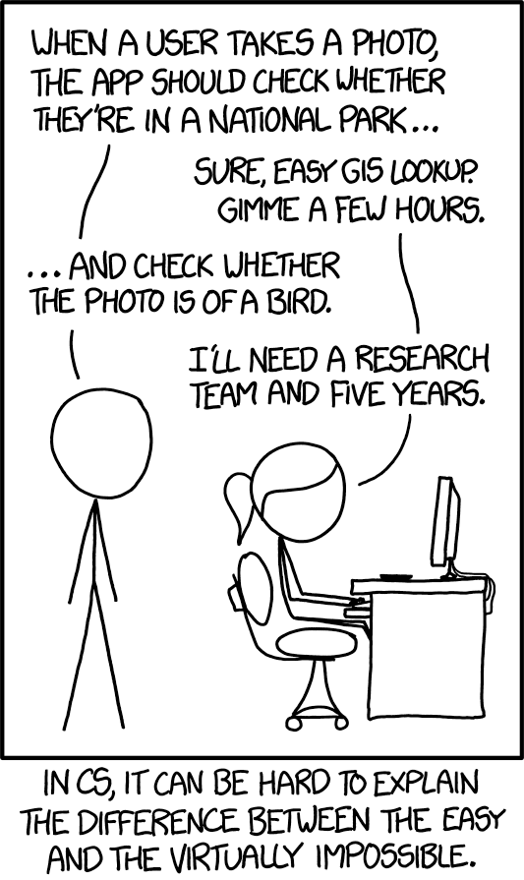
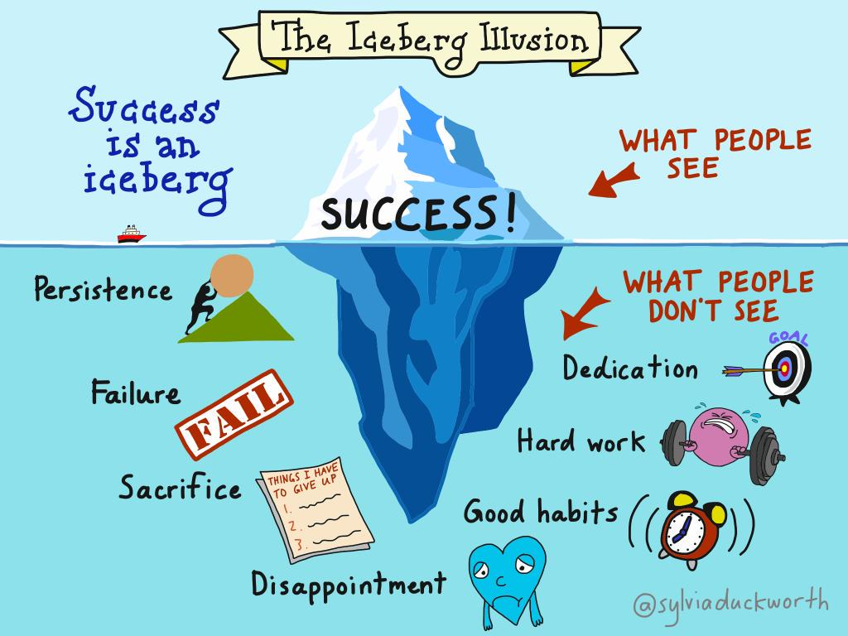


Slide 46
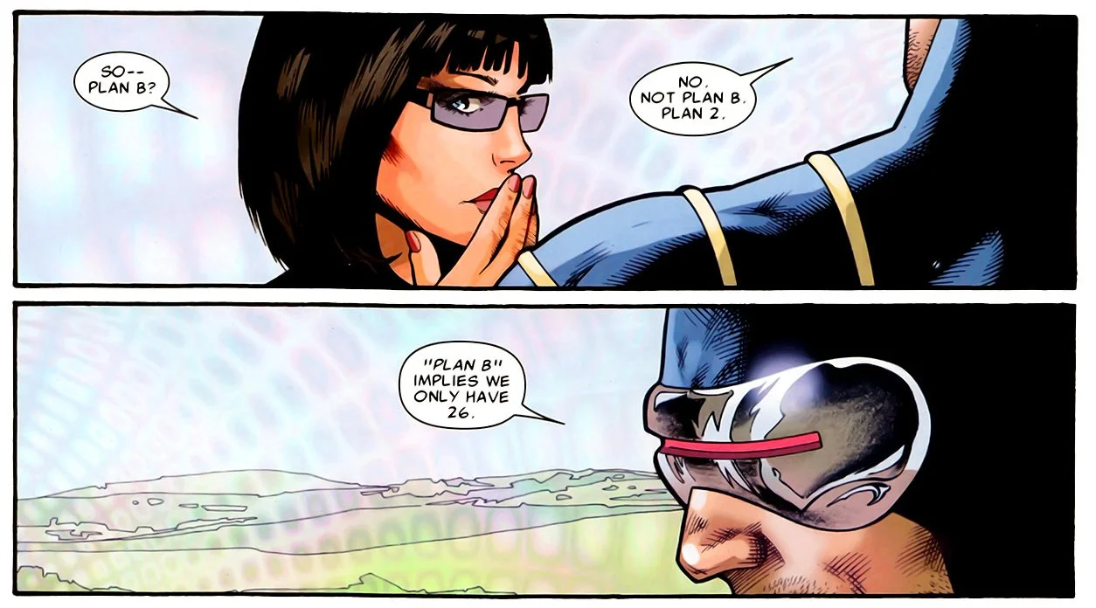
Plan B

Slide 47
NOT to be uploaded

Slide 48
Material
Material
Other slides 20221201 ATLAS in HL-LHC, 20230227ATLAS S&C HL-LHC Roadmap OAB, 2019 ATLAS CECP
https://agenda.infn.it/event/34738/timetable/ JENA workshop June 2023
CHEP May 2023 (Simone Campana, Charles Legget, much more)
ICHEP 2022 (Bologna) Stefano Piano, w many links (GPU in Alice 2021, LHCb tracking w GPU
ECFA 2021 SimoneC
LHCOPN 13 Jan2020 Ian Bird - WLCG Challenges and Collaborations
ESPP 2019 (SimoneC)
Maria Girone: summer students lectures (didn’t find the link)

Slide 49

Worldwide LHC
Computing Grid (WLCG)
44m
Notes:
All these detectors will generate loads of data… about 1 PB (petabyte = million of gigabyte per… SECOND!)
Impossible to store so much data. Anyway not needed.
The event the experiments are trying to create and observe are very rare.
That’s why we make so many collisions but we keep only the interesting ones.
Therefore next to each detector is a «trigger», a kind of filter made of various layers (first electronic, then computers) which will select and keep only 1 collision out of a million average.
In the end will still generate dozens of Petabytes of data each year. We need about 200’000 computer CPUs to analyze this data.
As CERN has only about 100’000 CPUS we share the date over more than 100 computer centre over the planet (usually located in the physics institutes participating to the LHC collaboration). This is the Computing Grid, a gigantic planetary computer and hard drive!

Slide 50
CERN
So what ?
Notes:
That «how» we make research at CERN.
You may now wonder if this is useful for you in your everyday life?
The answer is simply… probably not.
As explained earlier, fundamental research is not made for practical applications. It is there
But…
To make its fundamental research, CERN had to organize the largest scientific collaborative project, build the largest machine on Earth, build the coldest place in the galaxy, make the highest vacuum, build the largest and heaviest experiments, build the largest computing grid…
All these technological challenges ended up in new technologies which can find application on a much shorter scale…
Let’s review some of them

Slide 51


World Wide Web
Notes:
How do you share data and documentation amongst 10’000 physicists?
The internet was invented in the 70’s but was really not user friendly.
One man proposed a system to unify it in1989. He is Tim Berners-Lee and was working at CERN.
Like any technology developed by CERN, it was freely given to the World in 1993. Which made the Web a planetary star!

Slide 52

Medical applications
Notes:
If you have brain tumor, you may try to use chimiotherapy to cure it. But the cure goes all over your body and damage healthy organs.
You may use radiotherapy, but this will certainly damage healthy tissues around the tumor (image on the right).
Or you can use proton therapy using acceleration techniques directly derived from CERN’s technology. Proton therapy will damage more precisely leaving healthy tissued untouched (image on the left).

Slide 53

Safety
Notes:
You can use a particle detector to see what’s inside a suitcase in car in a truck without unloading it…
That’s particularly handy for customs, airports, harbours etc.

Slide 54


Humanitarian
Notes:
CERN hosts UNOSAT, a UN agency specialized in the analysis of satellite images, especially comparing them before and after a natural disaster or a war.
This shows pictures taken before and after the earthquake in Nepal in 2015. With the power of Computing Grid, very precise comparison can be processed in minutes to count the number of houses, roads, infrastructure touched and give valuable information in short time to emergency response teams.

Slide 55

Some links…
Information : www.cern.ch
CERN TV : youtube.com/cern
Recruitment : www.cern.ch/jobs
Notes:
We have invented the web, so please use it! ;-)

Slide 56



In a nutshell…
Fundamental research
Largest international scientific collaboration
Technology transfer in benefit of society
Notes:
In a nutshell:
CERN is a organization devoted to fundamental research
It hosts the largest international scientific collaborations
By facing technological challenges, CERN develops technologies which are useful for society.
(the picture show solar panels on top of Geneva airport, using the LHC vacuum technology to make them more efficient)

Slide 57

« Magic is not happening at CERN,
magic is being explained
at CERN. »
Notes:
Thank you for your attention!

Slide 59

BackUp

Slide 60










Like a small town
Mail, Stores…
Library
Hotels
Kindergarten
Clubs, Associations
Bank, Post Office,
Travel Agent
Medical Service
Fire Brigade
Tramway, bus, bikes
Restaurants
Notes:
CERN has 2 main sites. The most populated one is Meryrin, straddling accross the French-Swiss border (unique in the World).
CERN’s territory, even though by Switzerland and France is under the control of the Organization. This means local French and Swiss authorities do not have access to it unless agreed by CERN’s Director General.
CERN is like a small town with various services you can find in a town. And also with the problems of a small town: mobility, parking, ageing of some buildings etc
There is even a demonym for the people working at CERN: «les Cernoises et les Cernois».

Slide 61

Fundamental research
Notes:
CERN’s goal is FUNDEMENTAL research, not APPLIED research.
CERN is not to improve the way electricity is produced or rockets are launched.
CERN is to help answering questions and for a better understanding of the Universe.

Slide 62


Answering questions…
Antimatter ?
Notes:
Theorists believe that at the moment of the Big Bang, a theory telling that all universe is an expansion of a tiny space of pure energy which was transformed into matter, as many particles than antiparticles were created. It is also believed that the first instants of the universe was a gigantic anihilation of partcles and their counter anti-particles which were just created. But it seems that out of 1 billion particle-antiparticle anihilation, 1 particle survived… And that what makes the current Universe… apparently made only of matter. Why matter has won over antimatter? Are we sure there is no antimatter left from the Big Bang?
CERN is looking at that question with various experiments amongst which:
AD (Antimatter Decelerator) creates anti atoms and slows them down to eventually trap them (the image here is the one from Angels and Demons movie, our trap is bigger, sexiers and consumes much more energy)
AMS is an experiment on the International Space Station which looks for traces of primordial antimatter from space. It needs to be there outside of the Earth’s atmosphere where many particle collisions occur and produce briefly anti-particles. The AMS Control Centre is located at CERN and receives signals from the experiment.

Slide 63


Answering questions…
Higgs ?
Notes:
CERN also helped proving certain theories like the existence of the «Higgs Boson».
This particle is responsible for giving its mass to all other particles. It is very important in the standard model.
It was predicted in 1964 by 2 Belgian physicists (François Englert and Robert Brout), then by the Scottish physicist (Peter Higgs) and others later.
If took 48 years to have the experiments (ATLAS and CMS) which proved its existence. The discovery was announced at CERN on 4th July 2012.
This discovery led François Englert and Peter Higgs (only surviving of the 3)to be rewarded by a Nobel Prize in 2013.

Slide 64

Answering questions…
Dark matter ?
Notes:
But we have many more questions unanswered.
For example when we look at galaxies far away, and at their rotation speed, the estimated mass of the visible matter (stars, planets, clouds of gas etc) is not sufficient to «keep it together». At the speed it rotates, this galaxy should split away.
And the worrying thing is that is seems we are missing 95% of the needed mass…
What is 95% of the universe’s mass made of? Dark matter? Dark energy? There are many theories again (Supersymetry amongst others). CERN may help finding out more about it.

Slide 65

Collaborate
Notes:
In order to face all these questions and challenges, scientists need huge, complex and costly instruments.
Therefore international collaboration is the only way to answer these questions. CERN accounts for half of the world particle physicists.

Slide 66

Collaborate
Notes:
In order to face all these questions and challenges, scientists need huge, complex and costly instruments.
Therefore international collaboration is the only way to answer these questions. CERN accounts for half of the world particle physicists.

Slide 67

Collaborate
Notes:
In order to face all these questions and challenges, scientists need huge, complex and costly instruments.
Therefore international collaboration is the only way to answer these questions. CERN accounts for half of the world particle physicists.

Slide 68

Educate
Notes:
A last goal of CERN is to educate: students of course by welcoming them at CERN for internships, but also the general public, by making its discoveries available and understandable. CERN is visited each year by 100’000 visitors on guided tours. And many more visit CERN’s permanent exhibitions. This presentation is part of CERN’s educational effort.

Slide 69

The
coldest
temperature
in the world (and not only!)
Notes:
That’s why we need to cool down the cables to the lowest temperature possible.
We have to reach -271°C (or 1.9° kelvin, which is 1.9° above the absolute zero).
At that temperature, the cables made of Niobium Titanium (NbTi) are «superconducting», it means they don’t heat up anymore as they have no electric resistance.
LHC is colder than the vast majority of the Universe whose average temperature is 2.725° kelvin (if you look for a «cool» place to work, CERN is a good one)
This is possible thanks to cryogenic facilities using 120 tonnes or 700’000 litres of Helium!

Slide 70

The most
powerful
magnets
Notes:
The LHC is built underground, mainly for financial reasons (would have cost too much to buy all the land and would have been impractical anyway).
It also provide natural shielding of radiations for the population but also shielding from cosmic rays to the 4 detectors.
The LCH is mainly hosted in a 3m diameter tunnel containing mostly superconducting magnets and some accelerating devices.
You can see on the picture that the 2 counter-rotating beams are hosted in different pipes, making collisions impossible there.

Slide 71

The highest vacuum
Notes:
These 2 pipes need to be as empty as possible (otherwise protons would hit air molecules all the time).
Thanks to turbo-molecular pumps and other technologies, we reach a vacuum of 10^-13 atmosphere in the centre of the pipes: this is 10 times emptiers than on the surface of the Moon or as empty as in the solar system.
The magnetic field which curves the beam, is provided by the coils surrounding the pipes. As each beam holds as much energy as in a high-speed train, the magnets must deliver a tremendous magnetic field of 9 T (tesla). This equates to 200’000 times the magnetic field of Earth (ca 45 micro tesla)
For that, each of the small electric cableyou see around the vacuum pipes (1mm by 10mm section) a current of 11’000 amperes (in comparison in your home there is a current of about 20 amperes in the wires).

Slide 72

HUGE high-precision detectors
30m
44m
Notes:
Now that we have accelerated the particles, let’s collide them!
This is possible only in the 4 points where we cross-over the beams.
The collision point is tinier than a needle head.
Here is the ATLAS detector, the largest of the 4 LHC detectors. Look at the small persons next to it.
It is 50 long, 25m diameter and weights 7’000 tonnes, the same as the Eiffel Tower.
The collision of protons will create new particles in all directions. That’s why the detector often have this cylindrical shape.

Slide 73

ATLAS
Notes:
Here is a real picture of ATLAS.
Noticed the man at the bottom?
ATLAS is a multi-purpose experiment looking for the Higgs Boson (which it has found in 2012), dark matter candidates etc.
It gathers 3000 physicists from 174 universities and institutes in 38 countries.

Slide 74

Tackling the HL-LHC Computing Challenges
James Catmore
Adapt to latest trends, more heterogeneity
Reduce the disk footprint
Use what we have more efficiently

Slide 75


