Slide 1
SRF activities at CERN
Eurisol-NET (ENSAR/NA03) WG
CERN June 27-28 2011
M. Pasini, CERN BE/RF and K.U.L.

Slide 2
Contents
SRF CERN infrastructures
Nb/Cu experience
Bulk Nb cavities
HIE-ISOLDE QW Resonators
Status and summary

Slide 3
SRF infrastructures
HPWR, LPWR, EP, CP available on site with particle counting meter
15 m long clean room class 100 are available, there is a plan to go to class 10 (sLHC-Project-Note-0026)
5 vertical cryostat are available (4 bath cryostat and 1 vacuum cryostat) and 2 horizontal bunkers
RF infrastructure available for tests from 100 MHz up to 1.3 GHz
Cryogenics at 1.9K and 4.5K (new optimized cryo distribution line will be available next year)

Slide 4
On going activites
SPL study
  Cavity development
  Cavity diagnostics: OSD, Thermometry
Basic SRF research
  Quadrupolar resonators
Cavity production and testing
  LHC spare cavities
  HIE-ISOLDE QWRs
New projects
  Crab cavities?

Slide 5
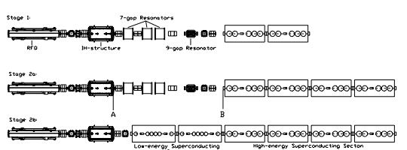
HIE-ISOLDE project
3 stages installation
1.2 MeV/u
3
MeV/u
5.5 MeV/u
8
MeV/u
10 MeV/u

Slide 6
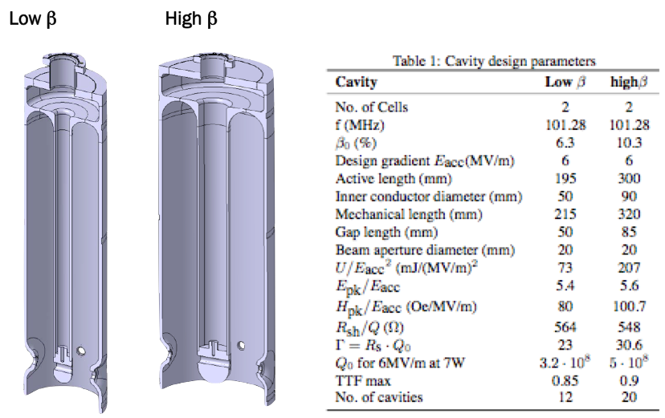
QWR cavities

Slide 7
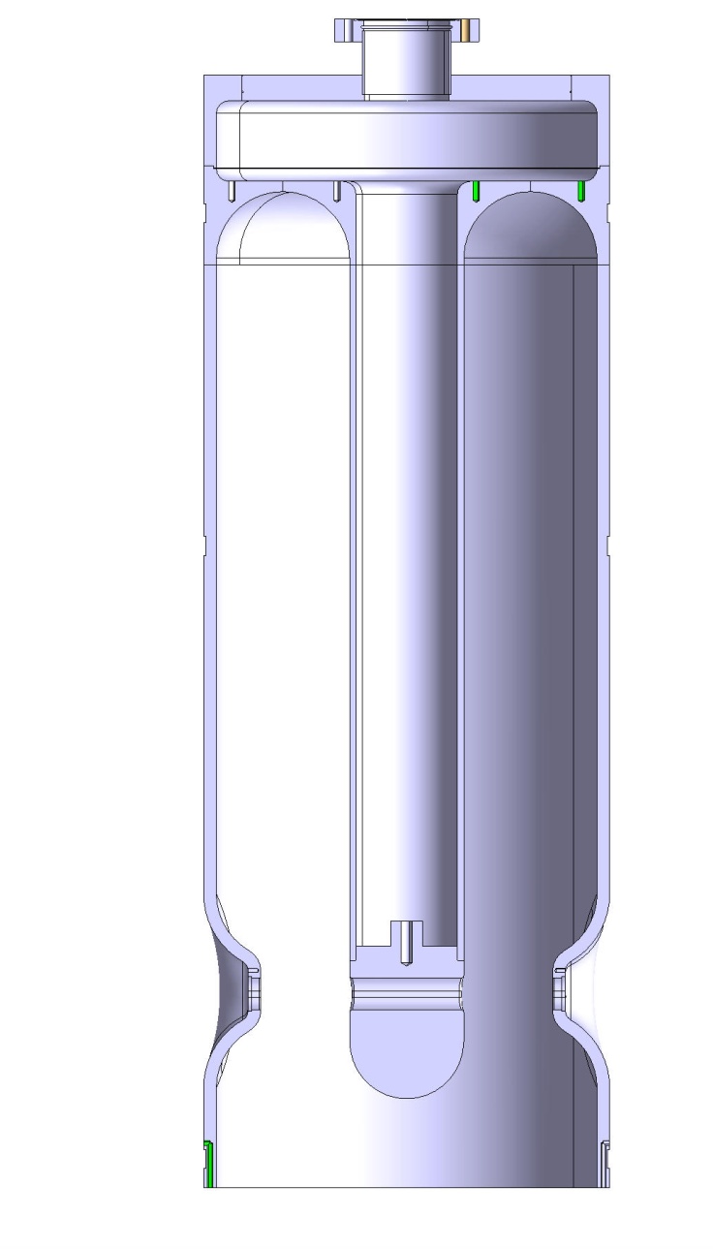
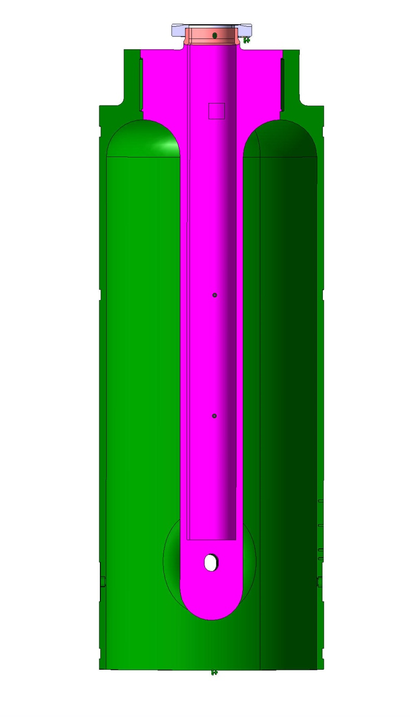
New mechanical design
Cavity prototype
Pre-series

Slide 8
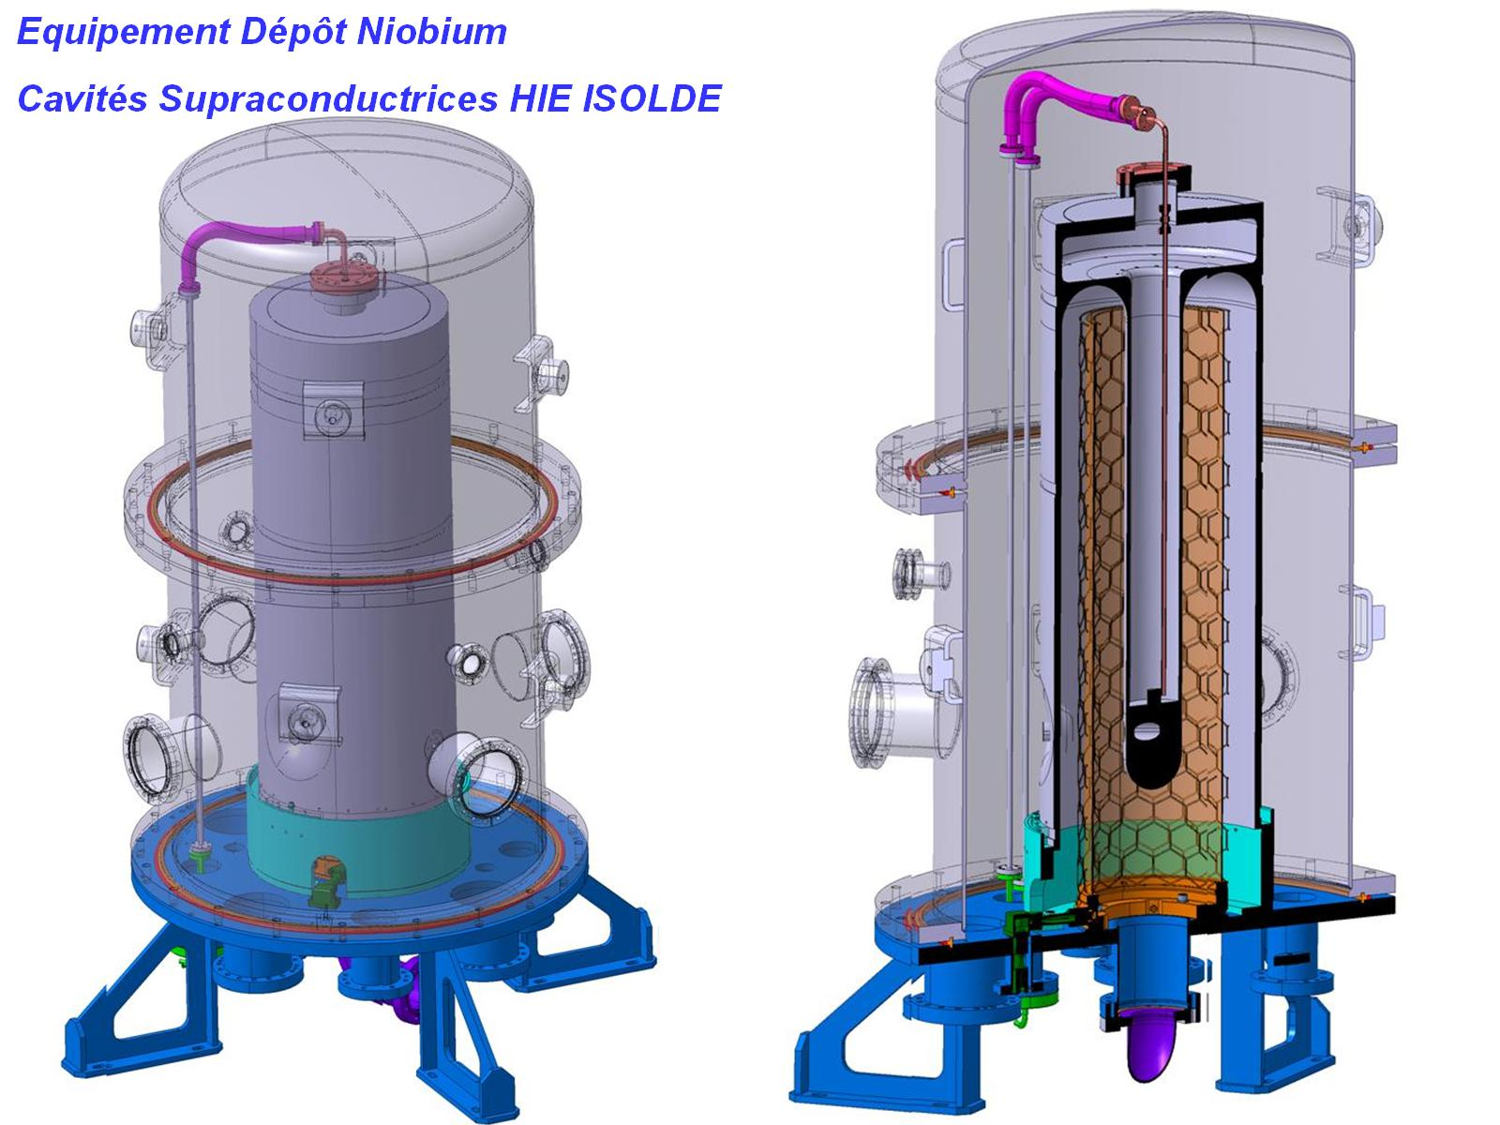
Nb Sputtering

Slide 9
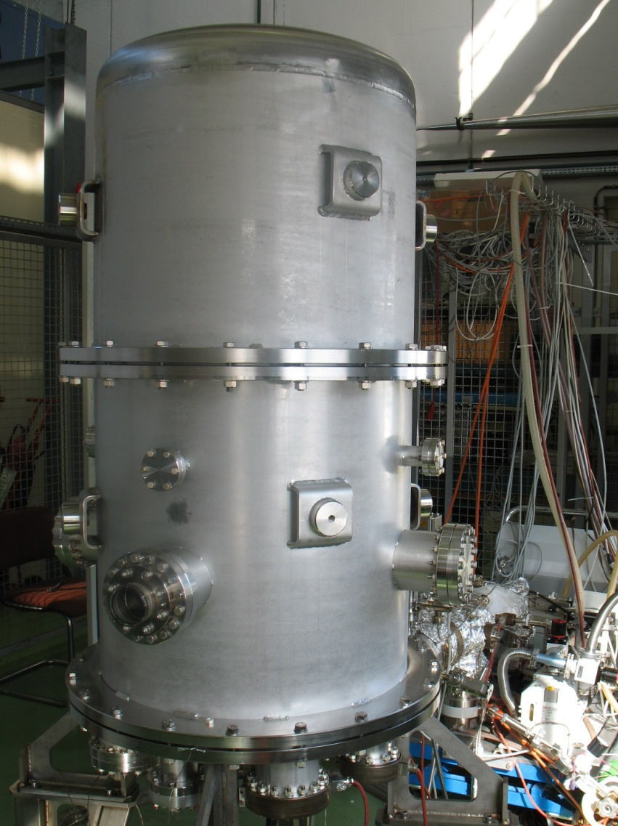
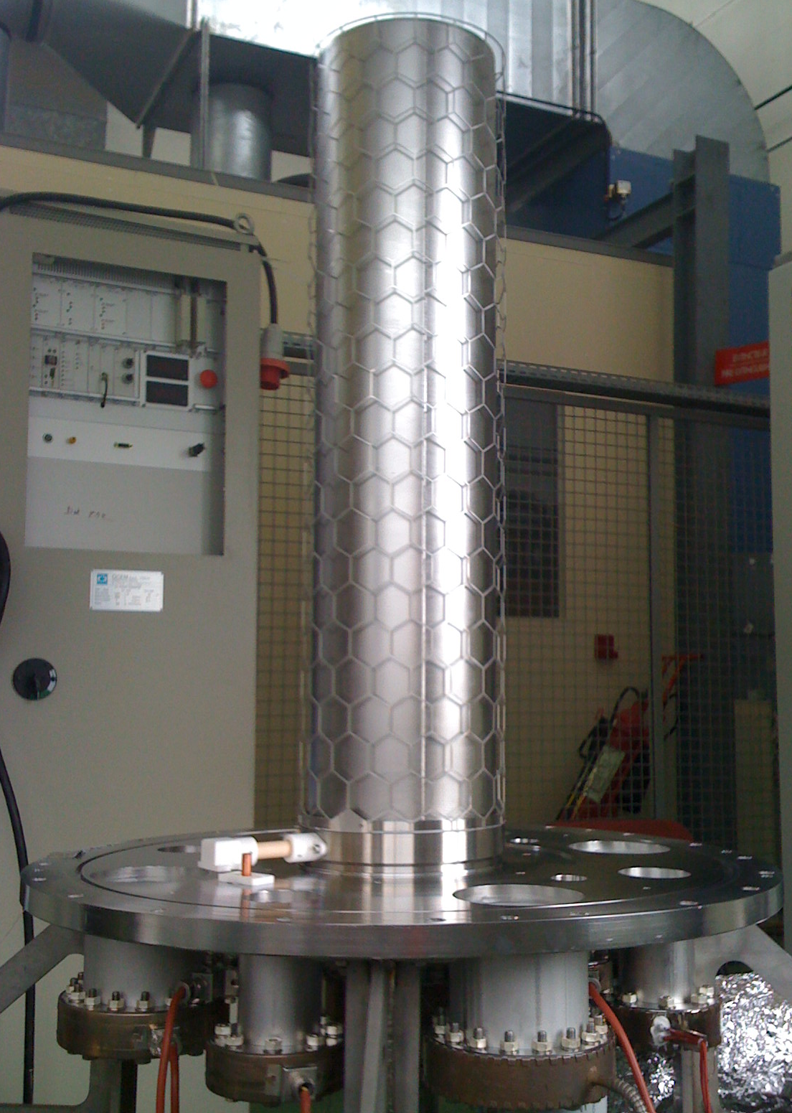
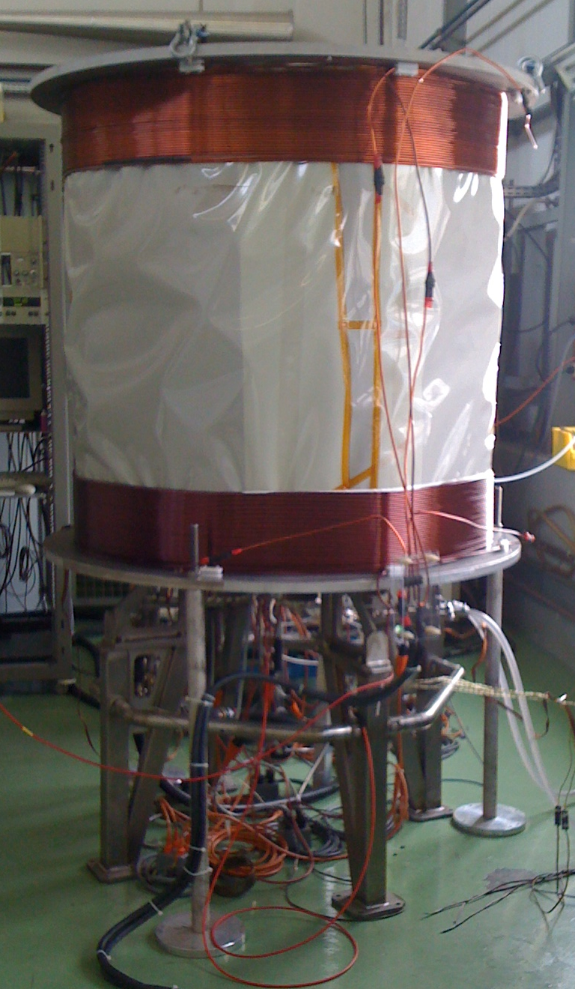
Bias and Magnetron sputtering
Bias Diode Sputtering
Magnetron Sputtering

Slide 10
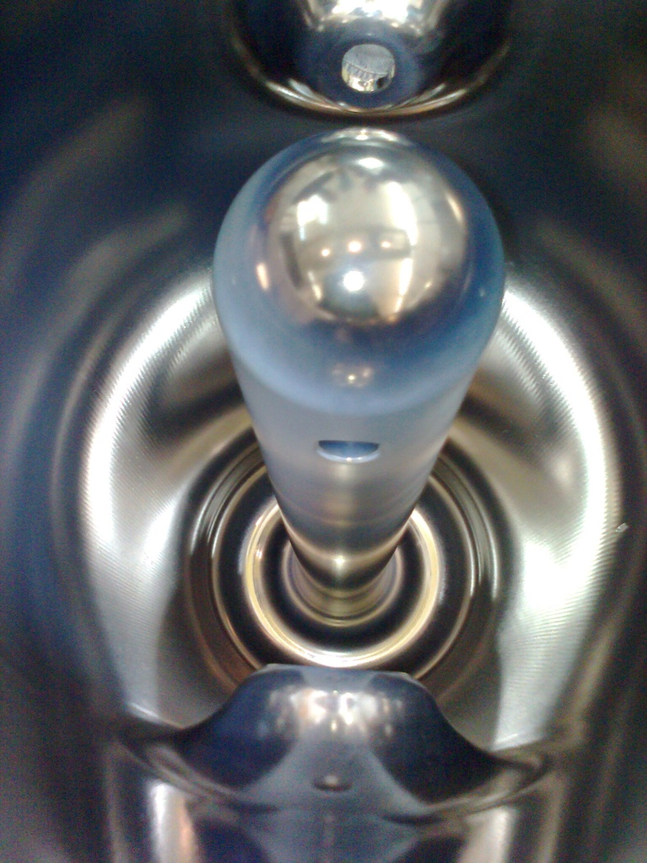
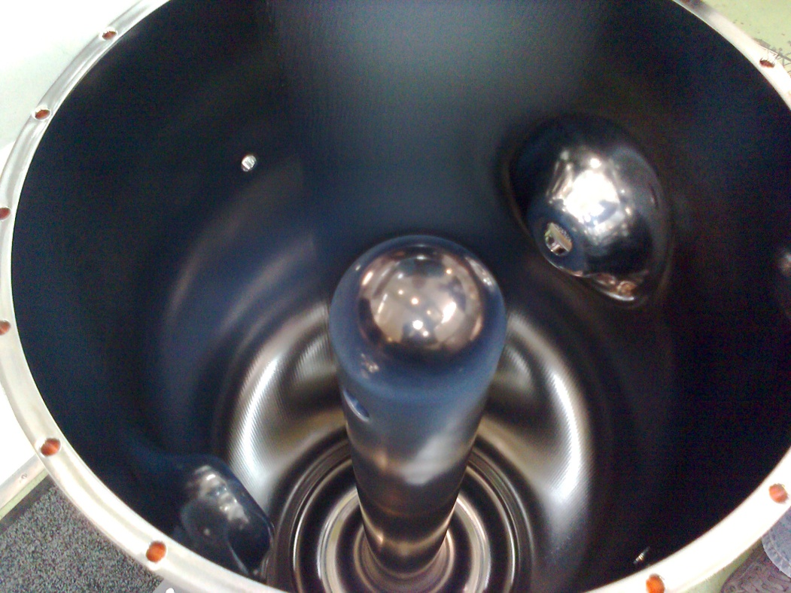
Prototype cavity

Slide 11
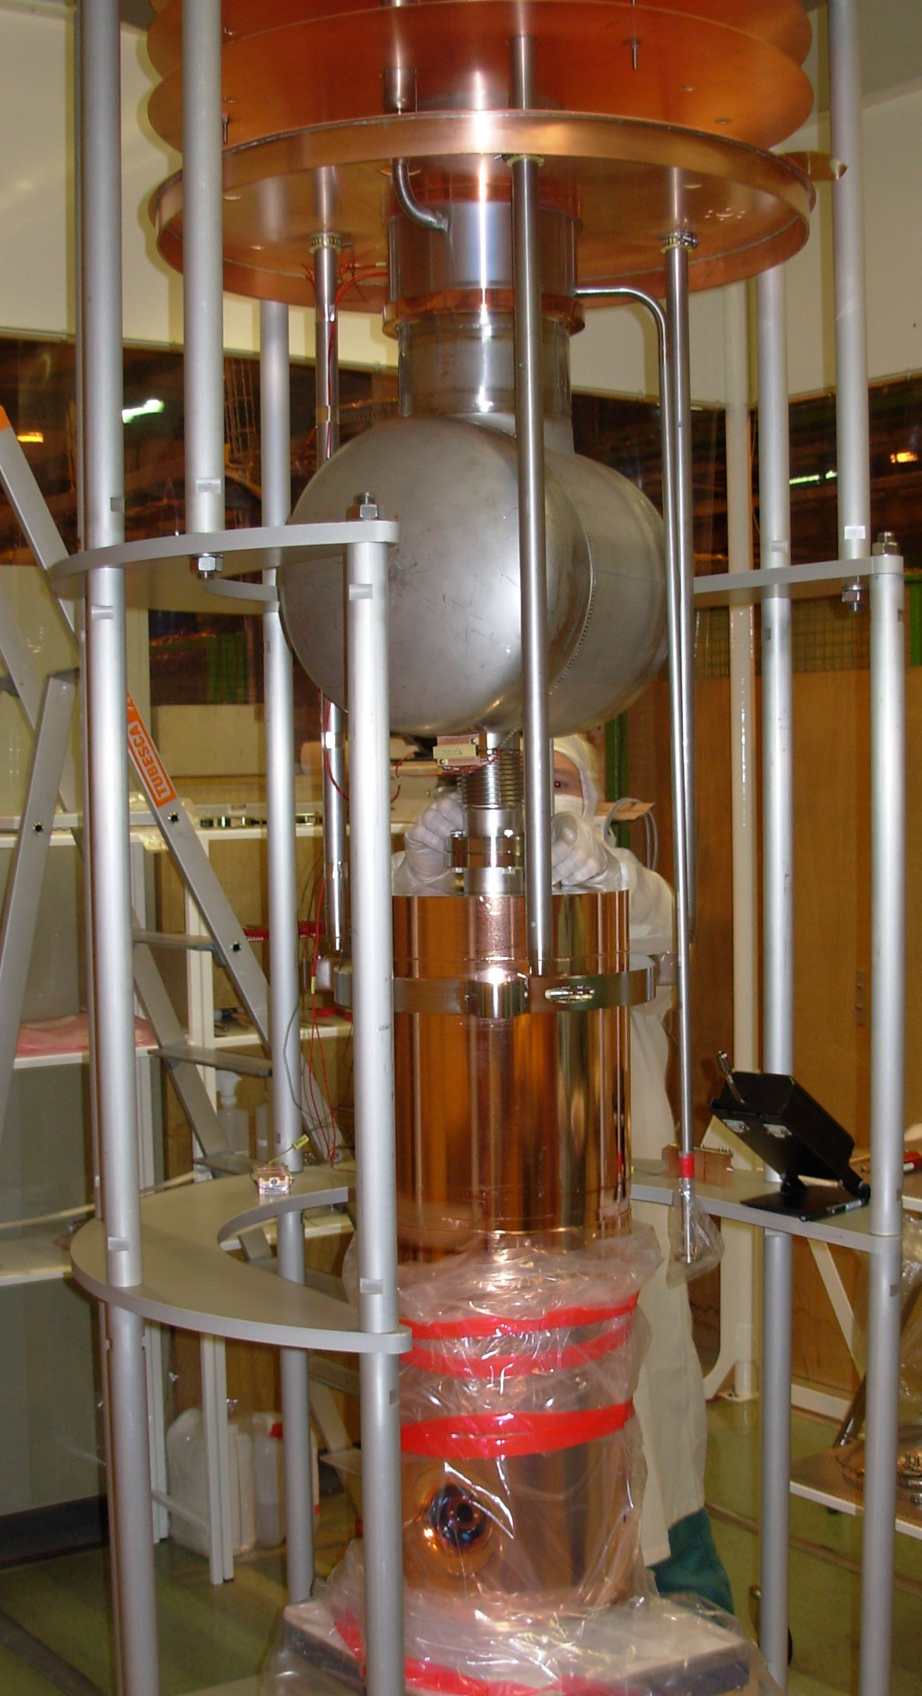
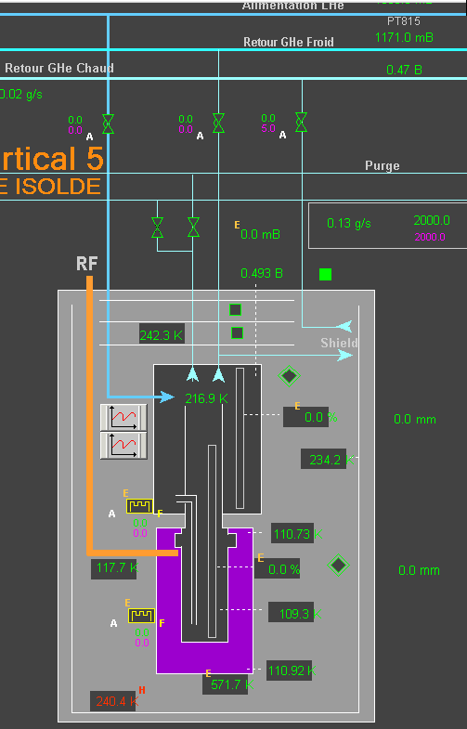
Test Cryostat

Slide 12
Test results

Slide 13
Summary
2 prototypes cavities are ready to be measured (Bias and Magnetron)
All the infrastructure is in place to continue the development on the sputtering technique
Unfortunately we had a problem (cold leak) with the test cryostat which cost us nearly 4 months of time. We have made a repair and we are getting ready to eventually replace it with a second one.

