Slide 1

Status of R&D on ion source at
IRENA plasma ion source for SPIRAL2 project
RILIS in collaboration with ISOLDE-CERN
submitted NUPNET proposal: EURIMIS project
C. Lau et al., EURISOL-NET, CERN 27-28 June 2011

Slide 2

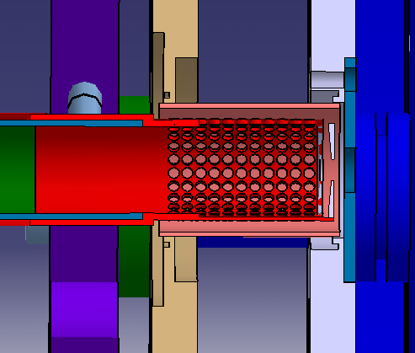
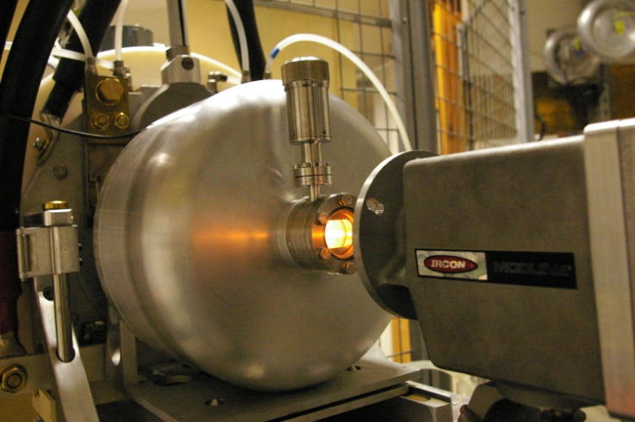
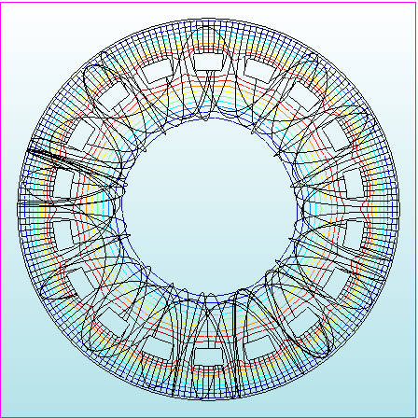
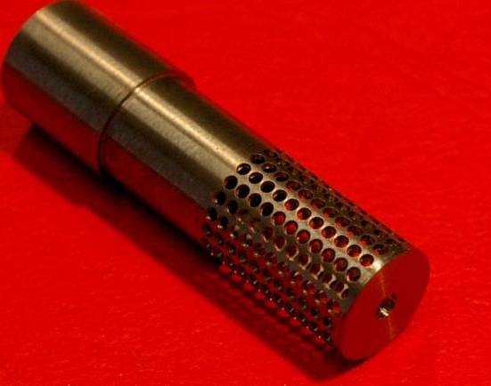
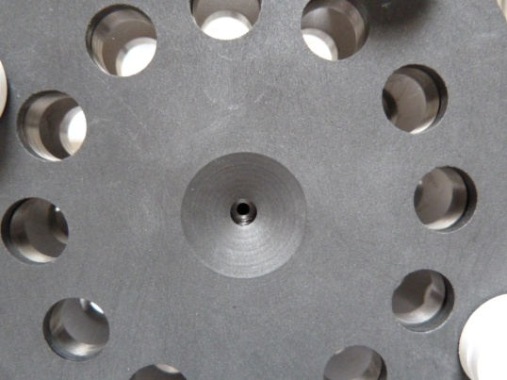
IRENA plasma ion source for SPIRAL2
IRENA (Ionization by Radial Electron Neat Adaptation) prototype based on EBGP (Nitschke, LBL 1985).

Slide 3
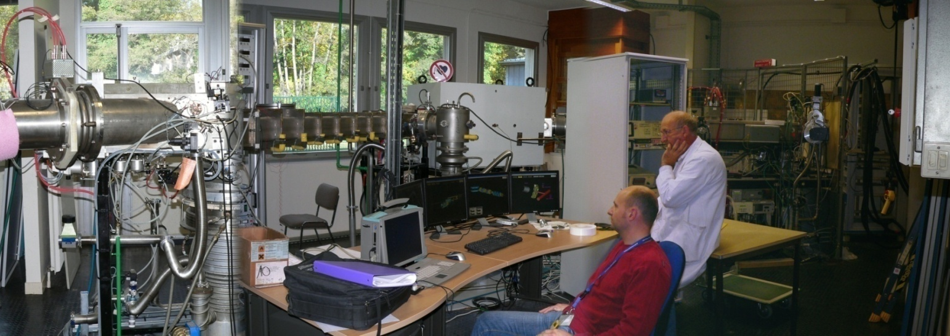
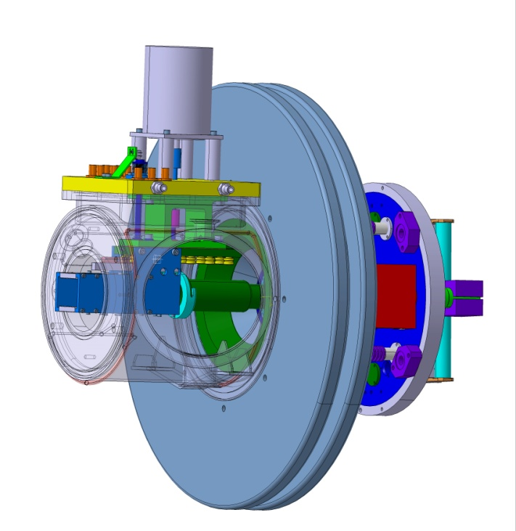
Tests of the IRENA plasma ion source
Ion source prototypes tested at ALTO off-line isotope separator.
Important high voltage issues since the out-gassing of a BeO target.
Cannot operate over 20 kV even after many repairs .
Design of a new extraction electrode
  translation + electrostatic
  very limited vacuum chamber
  fast confinement of the UC_{X} target.

Slide 4
IRENA: Latest results (tests still in progress)
Arc discharge |  | I_{Ar}
U [V] | I [A] | [nA]
256 | 0,32 | 80
403 | 0,66 | 253
Vacuum: 8 10⁻⁶ mbar , U_{HT} = 20 kV
Total extracted current comparable to std FEBIAD
Leaks suspected in the calibrated gas circuit for Ar
Effective ionization efficiency should be better than
obtained from current measurements (≥ a few %).
Further planned developments
Design of IRENA for tests at ALTO and validation.
In parallel design for integration to SPIRAL2 plug (starting phase)
Development of rare earth beams using fluoration process (SF₆ or CF₄),
in collaboration with Argentina

Slide 5
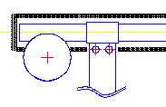
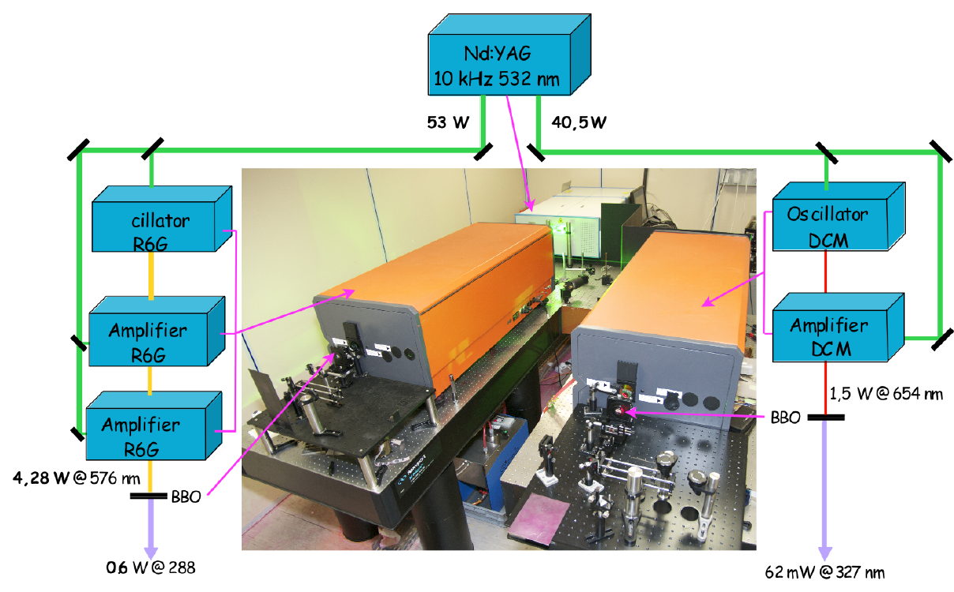
RILIS ion source
Collaboration with ISOLDE-CERN (V.Fedosseev et al.)
to start the exploitation of RILIS at ALTO
1st Ionization schemes planned:
Ga 287 nm, 532 nm (ε ≤ 21%),
Cu 327 nm, 287 nm (ε ≤ 7%),
Sn 286, 410 (ε ≤ 9%)
Edgewave
Power: 100 W; pulse: 9 ns
Laser beams

Slide 6
EURIMIS (EURISOL Multi-megawatt Ion Sources)
Partners | Requested budget | Responsable Labo
CERN | 0 k€ | B. Marsh
IFJ (Poland) | 25 k€ | R. Misiak
IPNO | 210 k€ | C. Lau
LNL-INFN | 60 k€ | A. Andrighetto
SLCJ (Poland) | 25 k€ | J. Choinski
Work Package
Project coordination
WP1: IRENA device for the RILIS
WP2: Beam extraction
WP3: Physicochemical alteration
WP4: Material for selective regulation

