Slide 1
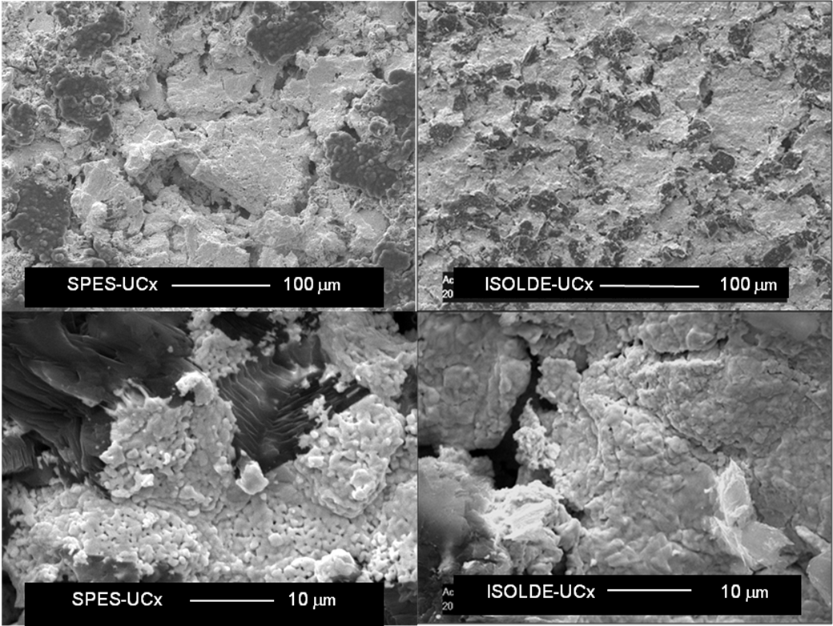
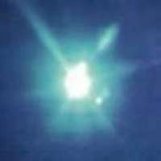
Uranium Carbide Material Developments
at CERN-ISOLDE
Alexander Gottberg

Slide 2
Actinide Targets Online
Actinide targets in 2010 (2009)
244 shifts out of 350 → 72% (282 → over 60% of total)
12 new and 2 old units (12 new)
Numbers from M. Kowalska

Slide 3
Actinide Targets Online
Actinide targets in 2010 (2009)
244 shifts out of 350 → 72% (282 → over 60% of total)
12 new and 2 old units (12 new)
Numbers from M. Kowalska

Slide 4
Material Production
      UO₂ + 6C → UC₂ + 2C + 2CO_{(g)}
Production Process:
Blending UO₂ and carbon powder
Cold pressing into pills
Carbothermal reduction of UO₂
conventional UC pills used at ISOLDE,
3.5g/cm³, grain size 3 μm to 50 μm, high porosity

Slide 5
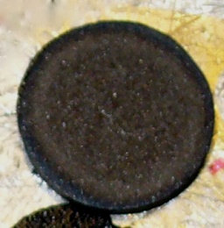
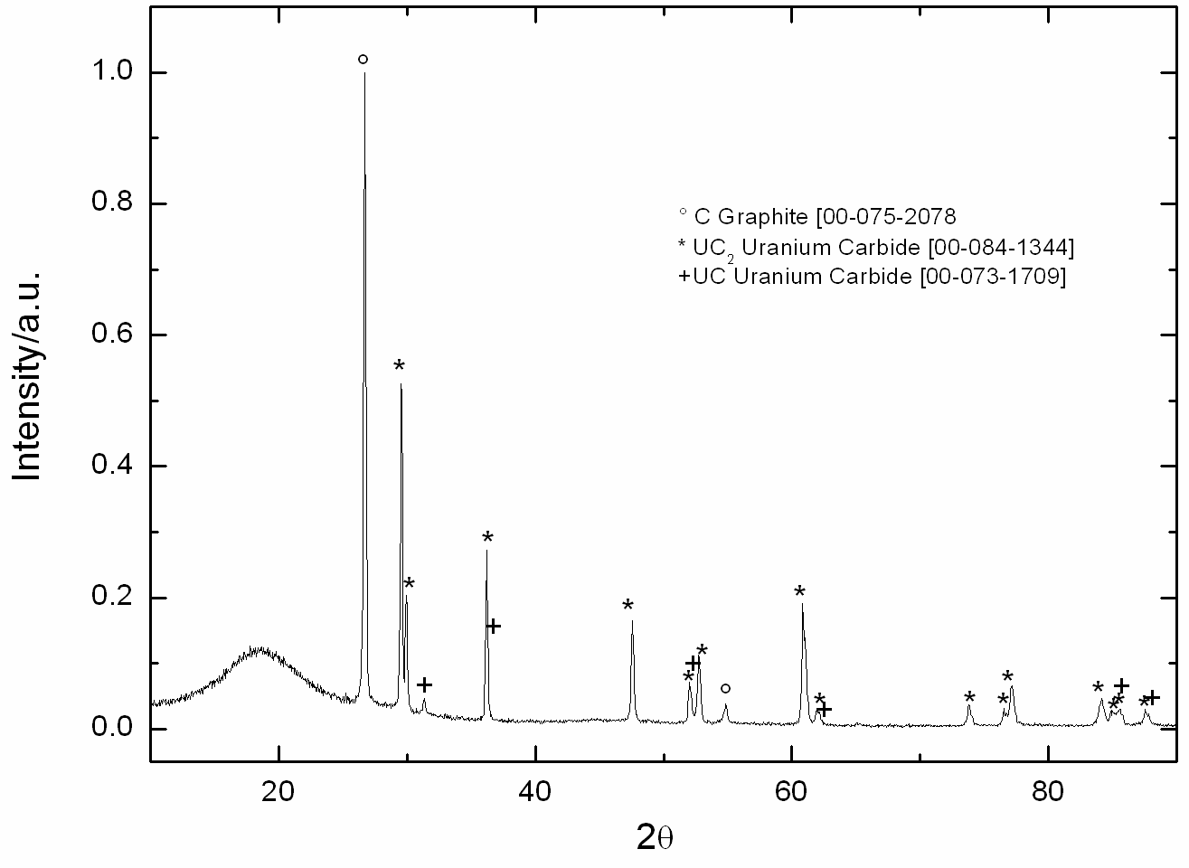
Current UC_{x} at ISOLDE
ρ_{bulk}= 3.5 g/cm³
L. Biasetto et al.

Slide 6





ActiLab in FP7-ENSAR

Slide 7
ActiLab in FP7-ENSAR
Task 1: Synthesis of new actinide targets (CERN, INFN, IPNO)
Subtask 1: Sol-gel synthesis in complex fluids
Subtask 2: Nanostructures
Task 2: Characterization of actinide targets (CERN, INFN)
Subtask 1: Microstructure, porosity, specific surface, crystalline phase
Subtask 2: Emissivity, thermal conductivity at high temperature
Task 3: Actinide targets properties after irradiation (CERN, PSI)
Subtask 1: Post-irradiation examination of target prototypes
Task 4: Online tests of actinide targets (CERN, GANIL, IPNO)
Subtask 1: Impact of pulse time structure on release and ageing properties
Subtask 2: Analysis of the results-effusion and diffusion phenomena

Slide 8
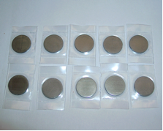
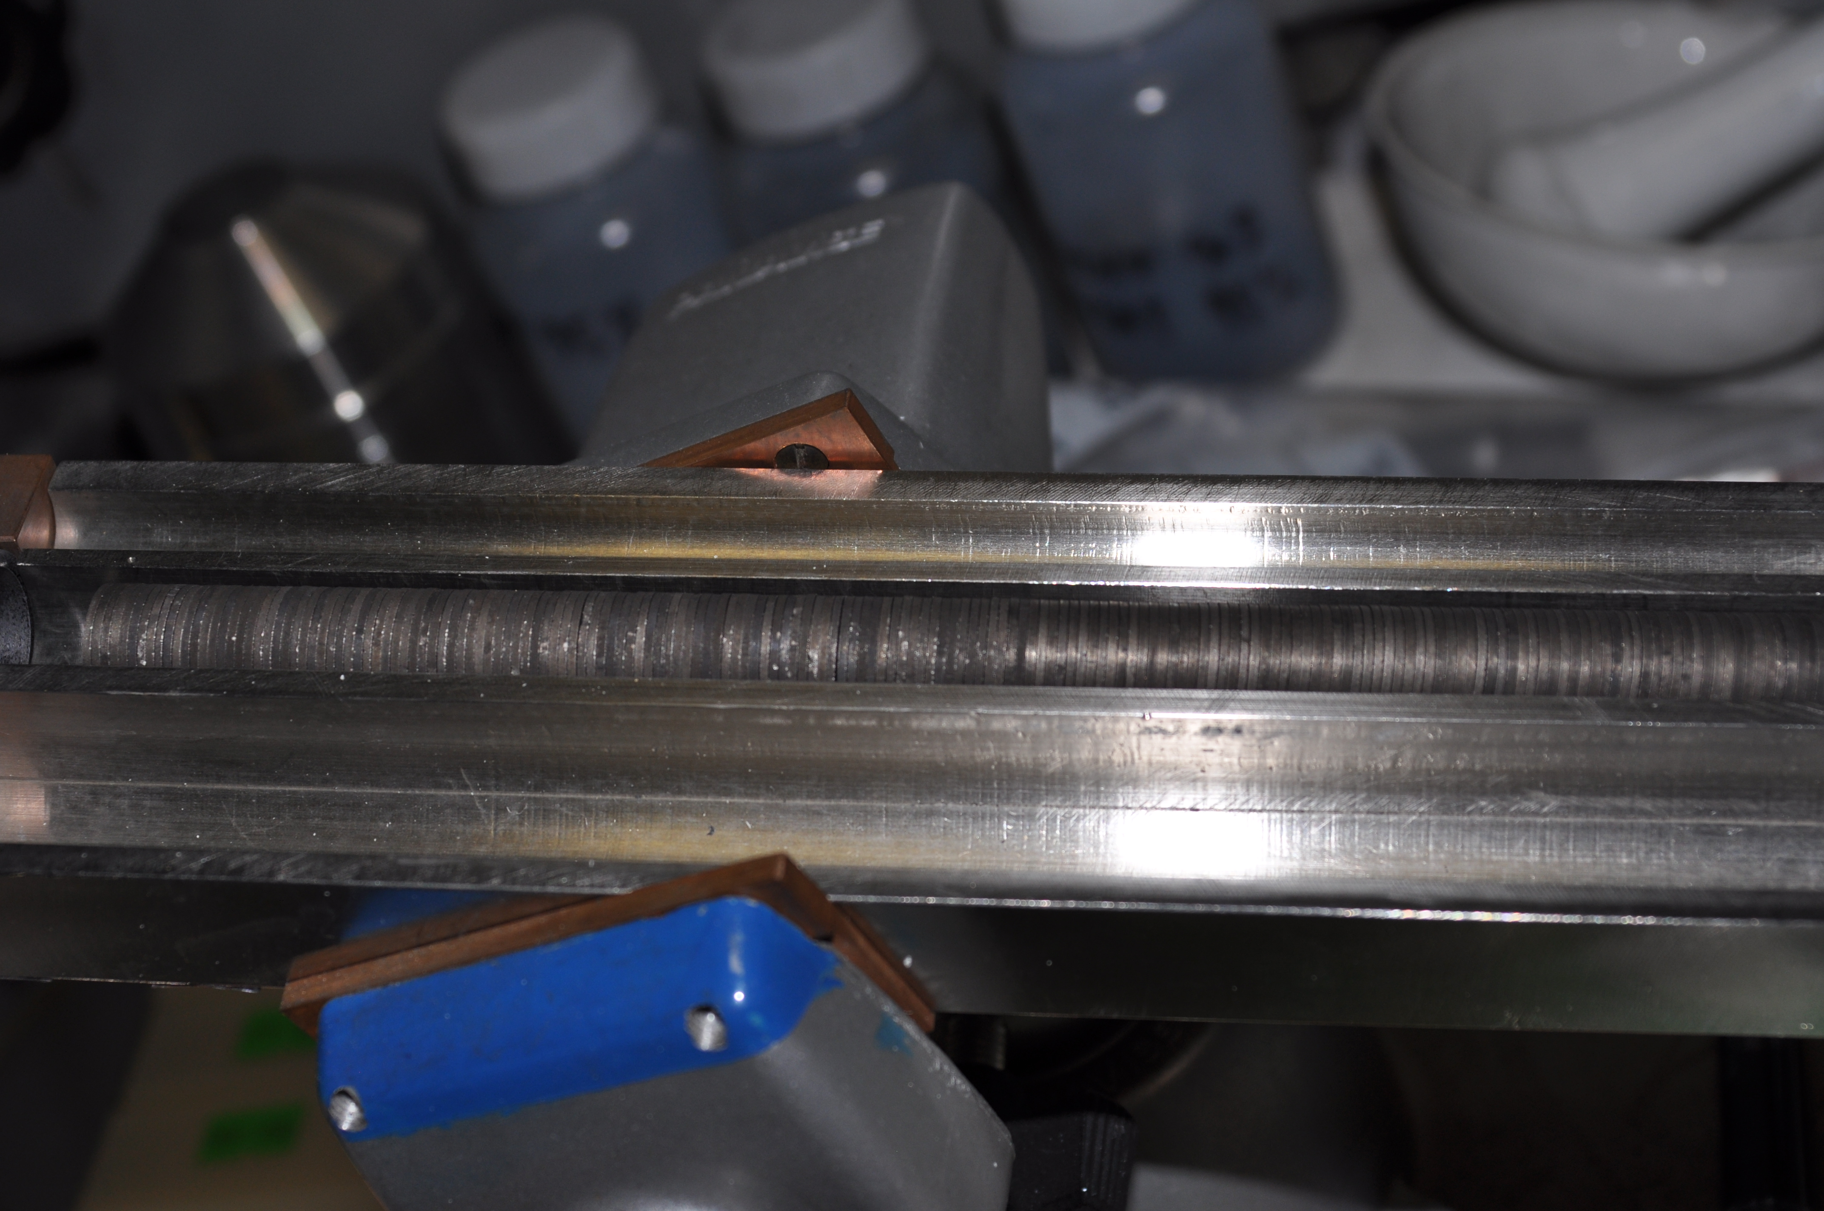
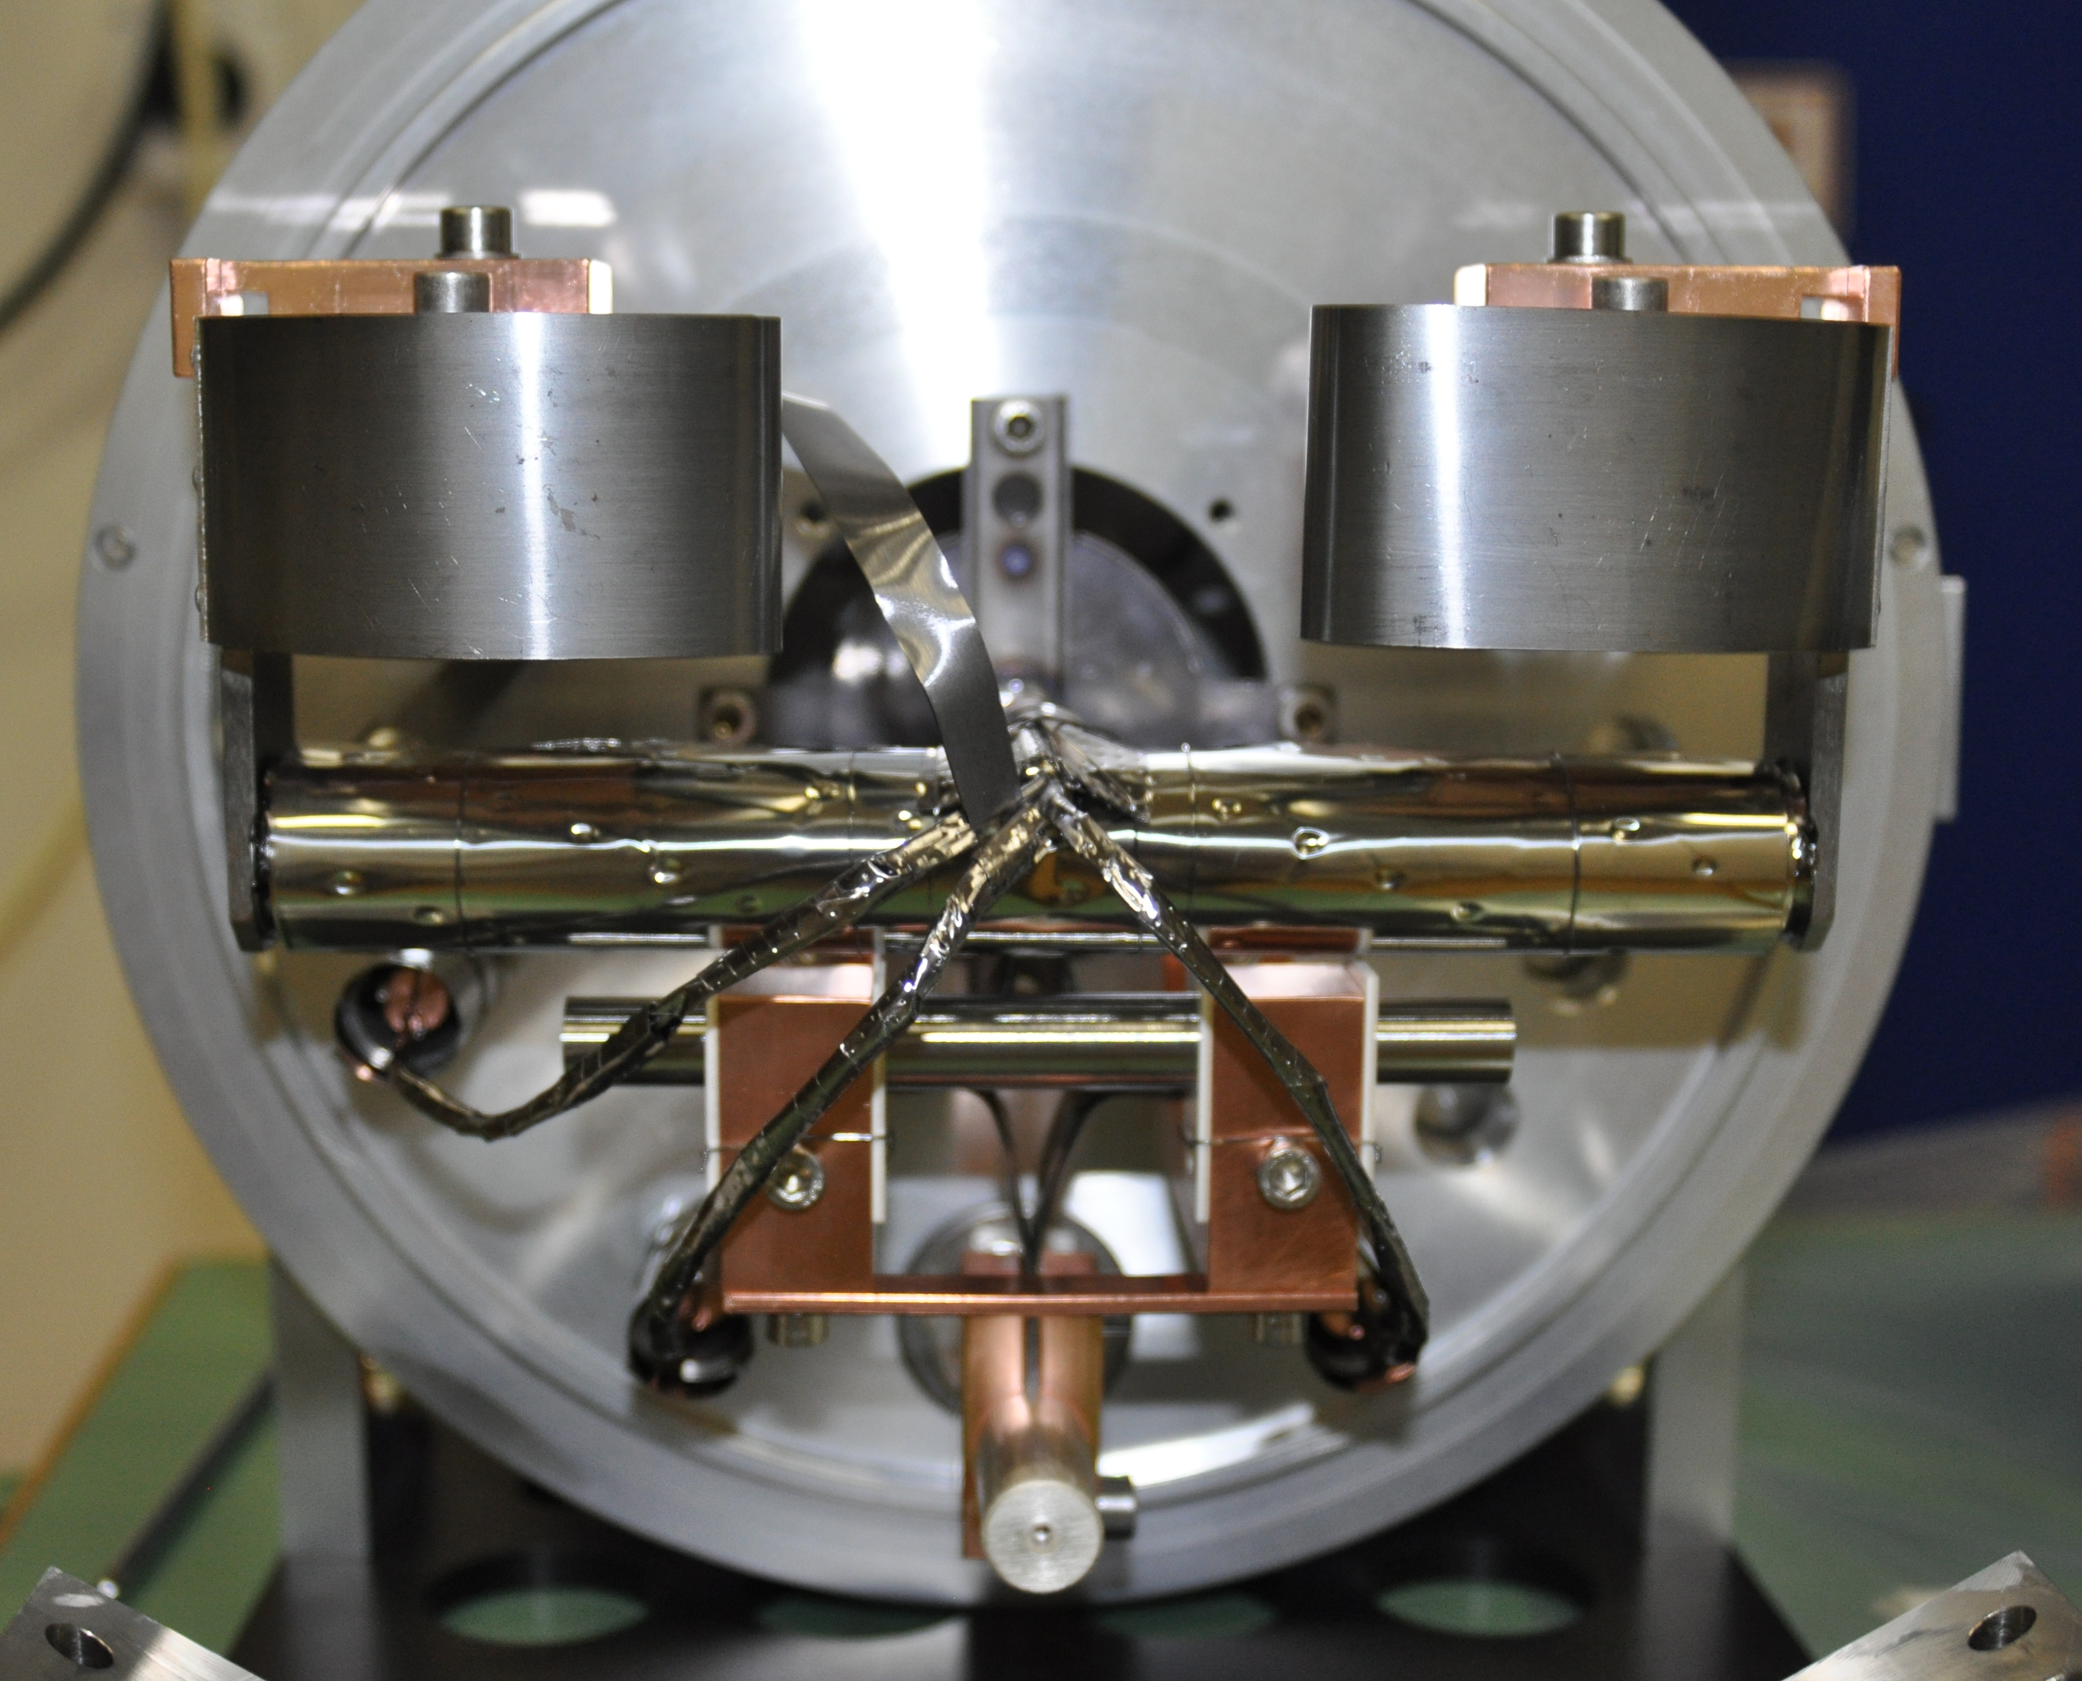
High Density UC Target at CERN
Importation from Russia of HD-UC pellets to CERN & online tests in Nov. 2010:
Set 1: 100 pills
UC (²³⁵U:0.38%), 13.2mm diam., 1mm thick, 12.3g/cm³,
avg. grain 10 μm , UC₂<4%
Set 2: 300 pills
UC (²³⁵U:0.38%), 13.2mm diam., 1mm thick, 12.7g/cm³,
avg. grain 6 μm , UC₂<4%

Slide 9
Yields from HD UC
[1] V. N. Panteleev, et al.,
Eur. Phys. J. A 42,
495-501 (2009)
Comparable absolute yields (Gatchina 91g/cm², conventional ISOLDE ≈45g/cm²)
HD absolute yields @ ISOLDE (241g/cm²) x2 to x10 lower than from conventional UC targets

Slide 10
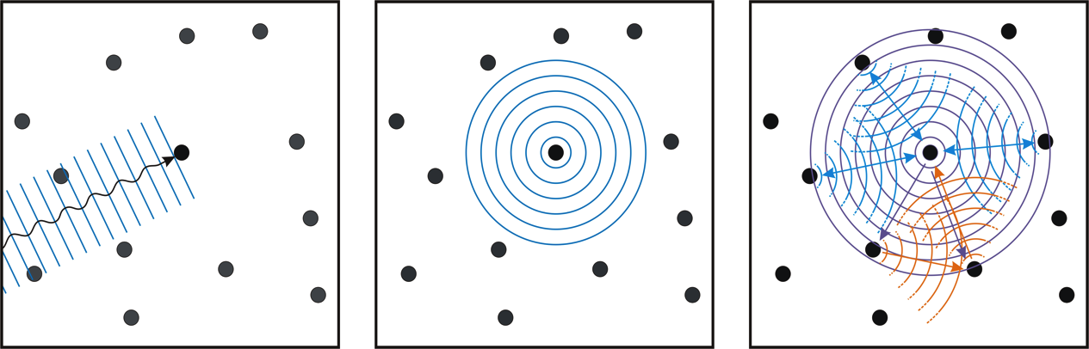
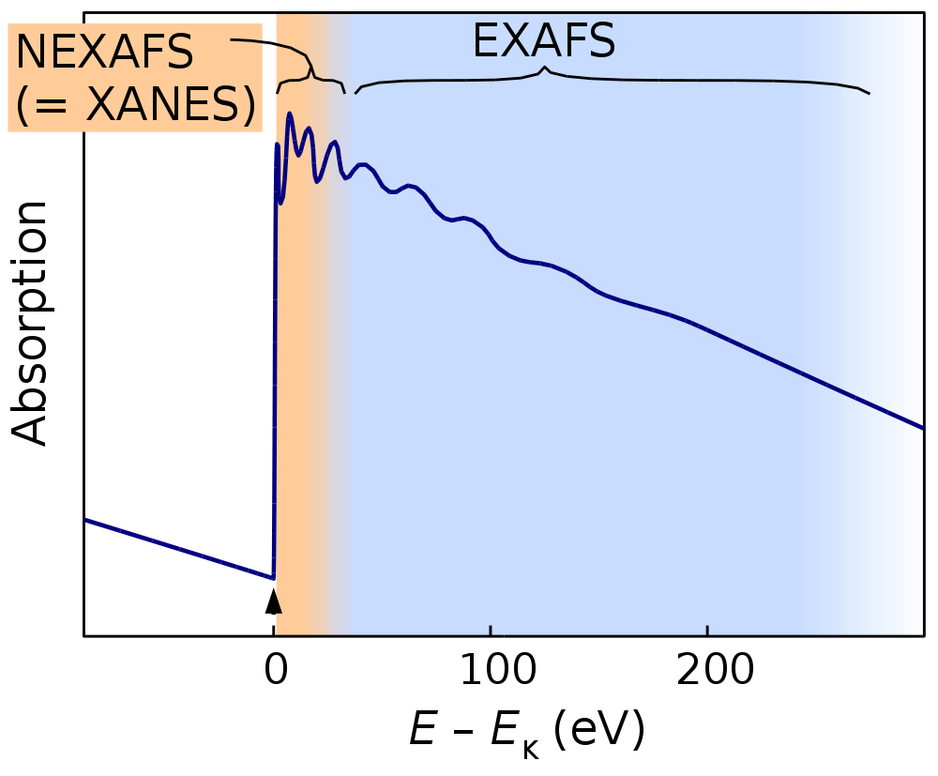
Micro Spot Material Mapping at SLS
Beamline X05LA @ SLS, PSI offers: hν= 5 – 20 keV, ΔE/E=2•10⁻⁴, 1 x 1 µm²
XRD
XFS
X-ray absorption fine structure (XAFS, NEXAFS, EXAFS)

Slide 11
Micro Spot Material Mapping at SLS
Beamline X05LA @ SLS, PSI offers: hν= 5 – 20 keV, ΔE/E=2•10⁻⁴, 1 x 1 µm²
XRD
XFS
X-ray absorption fine structure (XAFS, NEXAFS, EXAFS)
Fluorescence
EXAFS
Results from first X-ray absorption experiments on UC

Slide 12
Team and Collaboration
Team:
Richard Catherall
Thierry Stora
Tim Giles
Pekka Suominen
João Pedro Ramos
Christoph Seiffert
Bernard Crepieux
Gunvor Koldste
Marc Guichard
Thanks to:
Daniel Grolimund (PSI)
Claude Degueldre (PSI)
Ines Günther-Leopold (PSI)
Daniel Stracener (ORNL)
Vladimir Panteleev (PNPI)
Stefano Sgobba (EN-MME)
Yorick Blumenfeld
Magdalena Kowalska

Slide 13
Some first results
Follow up:
Simulation tests
Advance sample preparation
Using post-irradiated UC_{x} pellets
Beamtime and Actinet request for 2012

Slide 14
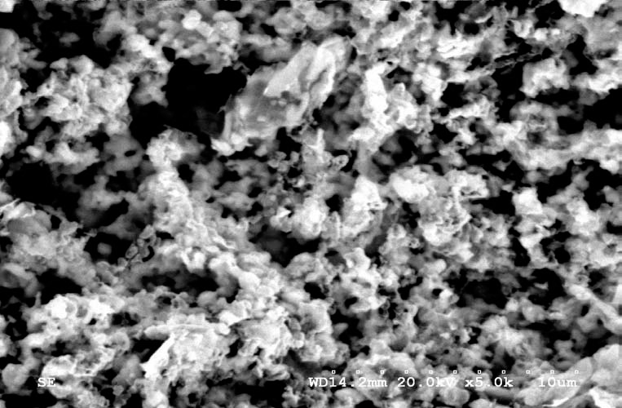
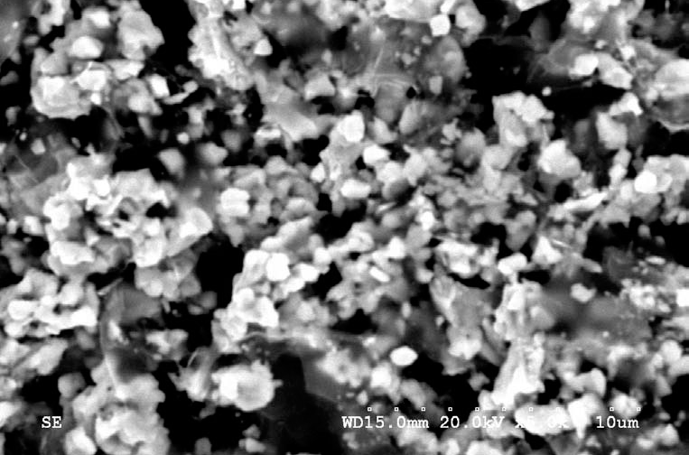
Some first results
Peter Kunz: First UC_{x} Target Run at TRIUMF
UC_{2+x}
sintered UC_{x}/C on exfoilated graphite
target thickness 15g/cm²
I_{Proton} = 2μA (license limit)
T_{Target}= 1950˚C
Close to ISOLDE process:
Carbothermal reduction of UO₂
Fabrication of target disks (under inert gas atmosphere)
Conditioning / Sintering of target material
10μm
UC_{x} after carbonization procedure
(step 1)
Sintered UC_{x} on targe disc
(step 3)

Slide 15
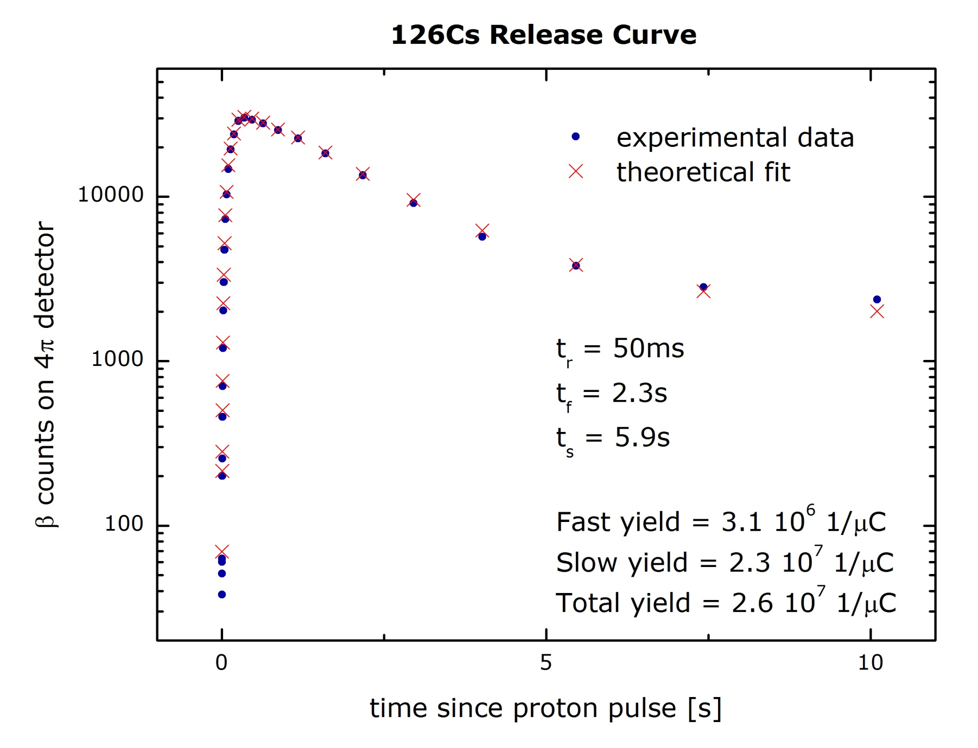
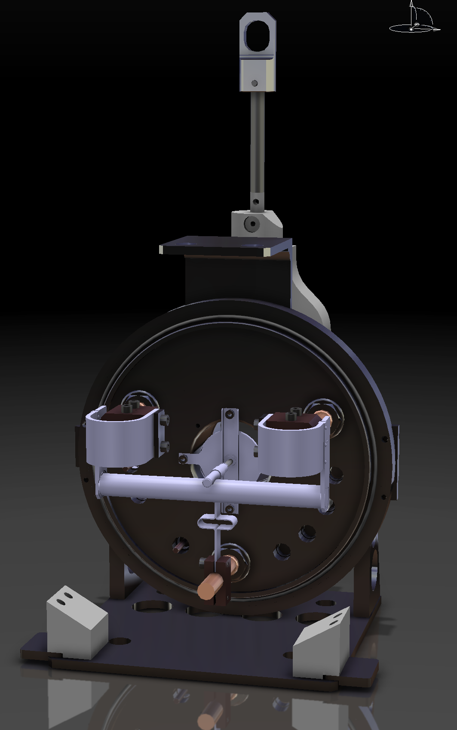
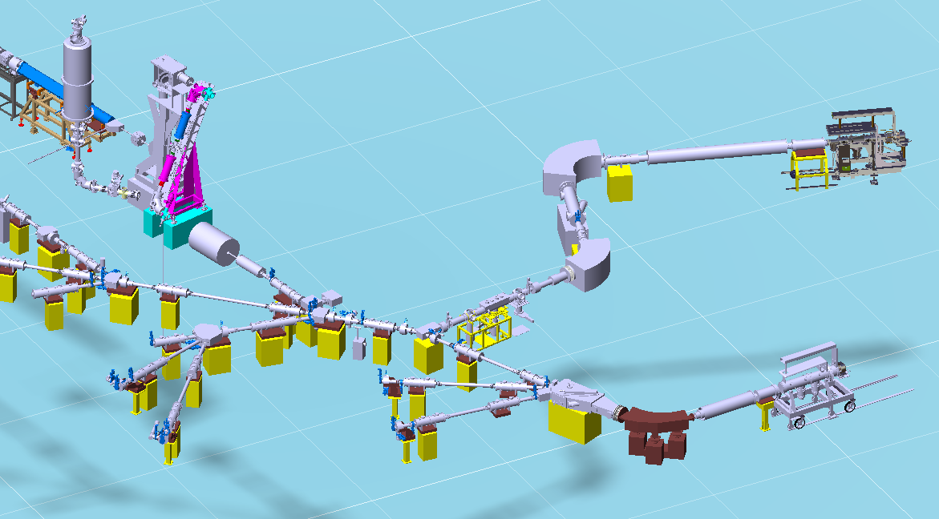
Yields from HD UC

